Slide 1
Beam Profile Monitors for Electron Beams in PAL-XFEL
June 12, 2023
Changbum Kim
On behalf of PAL-XFEL
Pohang Accelerator Laboratory

Slide 2
Contents
PAL-XFEL
Transverse Profile Monitors
  Screen Monitor
  Wire Scanner
Lattice Matching

Slide 3
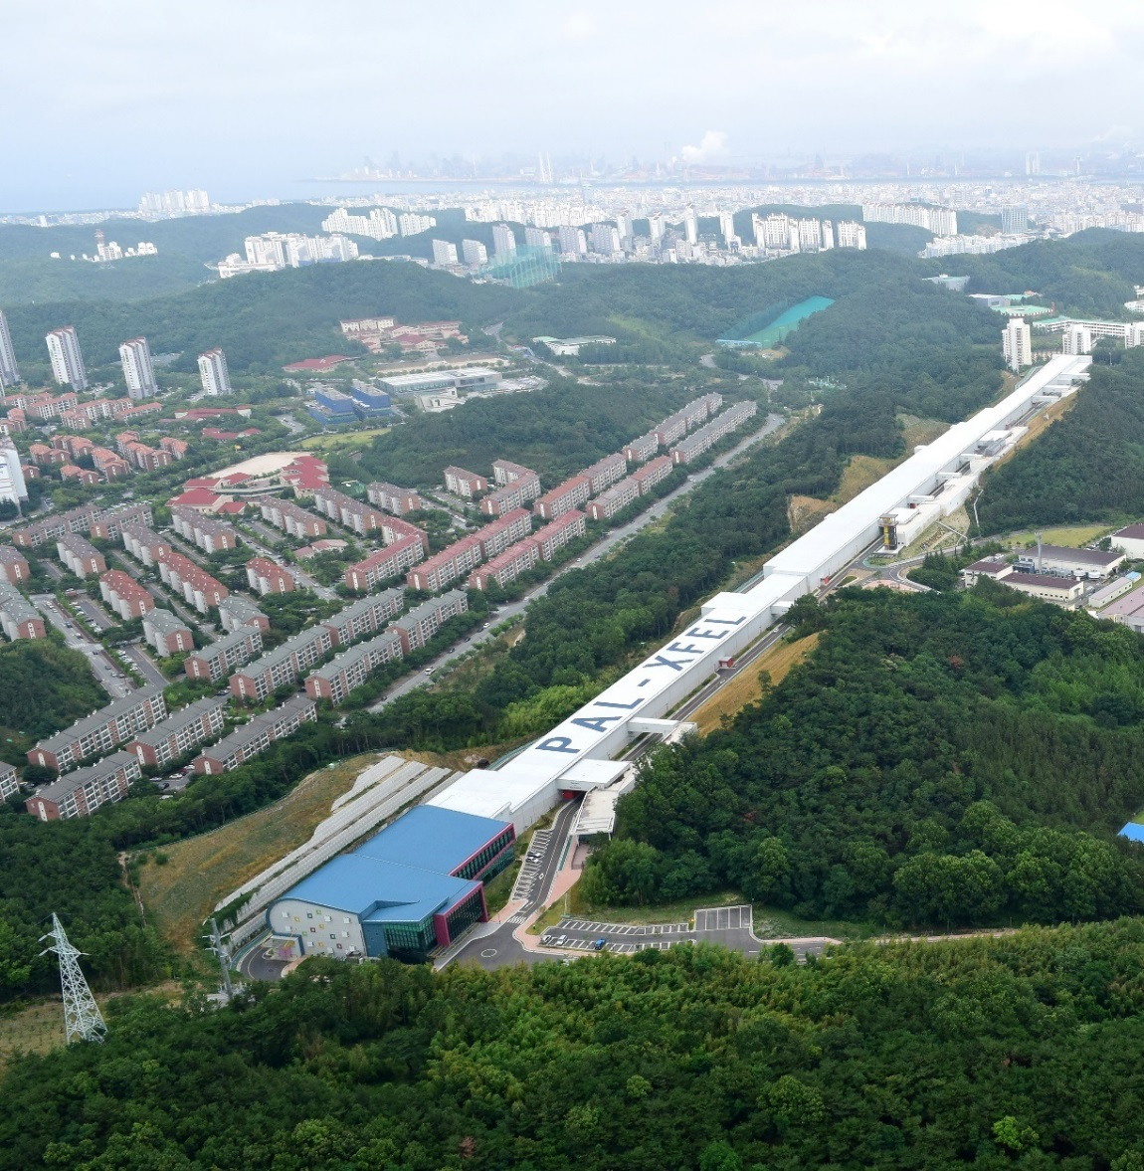
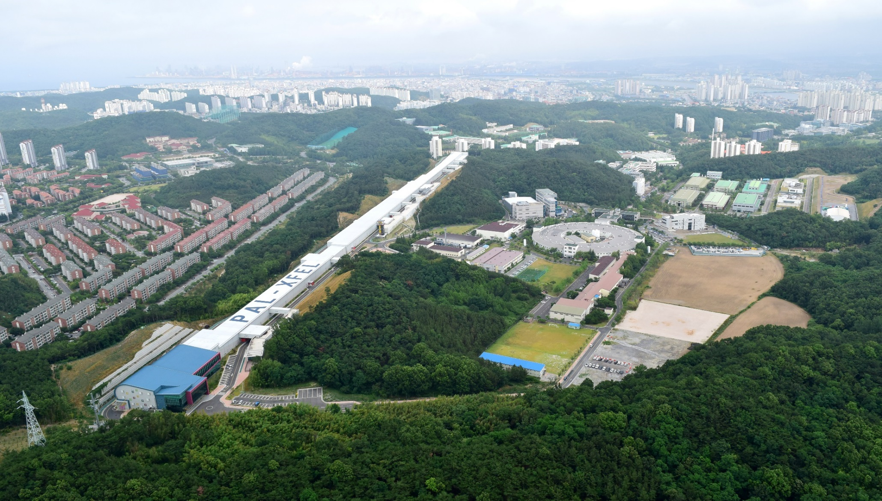


PAL-XFEL
Apr. 2011: PAL-XFEL project started
Apr. 2016: Commissioning started
Jun. 2017: User-service started
- 120 days for user (95% of availability)
Achieved in 2018
- 140 days for user (95% of availability)
Achieved in 2019
- 160 days for user (96.8% of availability)
Achieved in 2020
- 170 days for user (96.9% of availability)
Achieved in 2021
- 180 days for user (96.9% of availability)

Slide 4
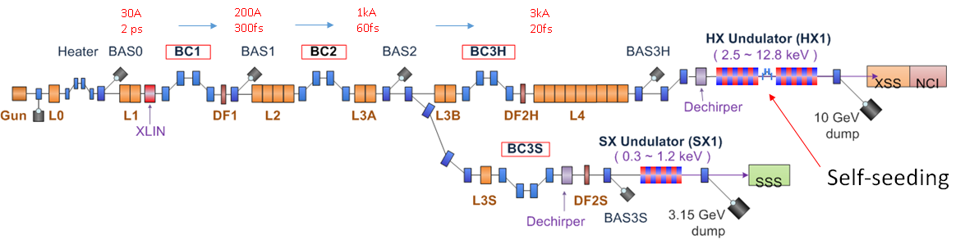
Layout & Parameters of PAL-XFEL
  Main parameters
  e⁻ Energy 11 GeV
  e⁻ Bunch charge 20-200 pC
  Slice emittance < 0.4 mm mrad
  Repetition rate 60 Hz
  Bunch length 5 fs – 50 fs
  Peak current 3 kA
  SX line switching Kicker Magnet
Undulator Line | HX | SX
Photon energy [keV] | 2.0 ~ 15.0 | 0.25 ~ 1.25
Beam Energy [GeV] | 4 ~ 11 | 3.0
Wavelength Tuning | Energy | Gap
Undulator Type | Planar | Planar
Undulator Period / Gap [mm] | 26 / 8.3 | 35 / 9.0

Slide 5
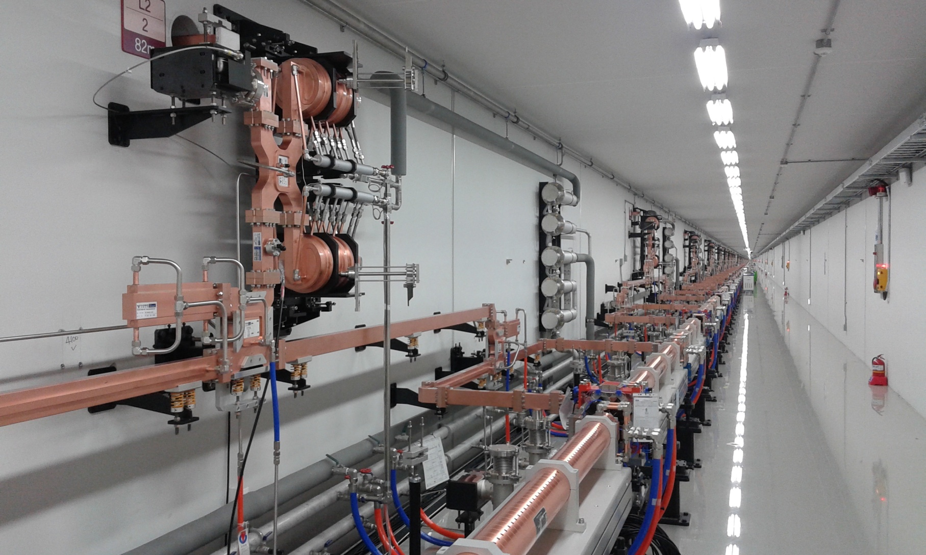
Linear Accelerator Tunnel
Parameter | Unit | Value
Energy | GeV | 11
Charge | pC | 200
No. of SLED |  | 42
No. of Acc. Column |  | 173

Slide 6
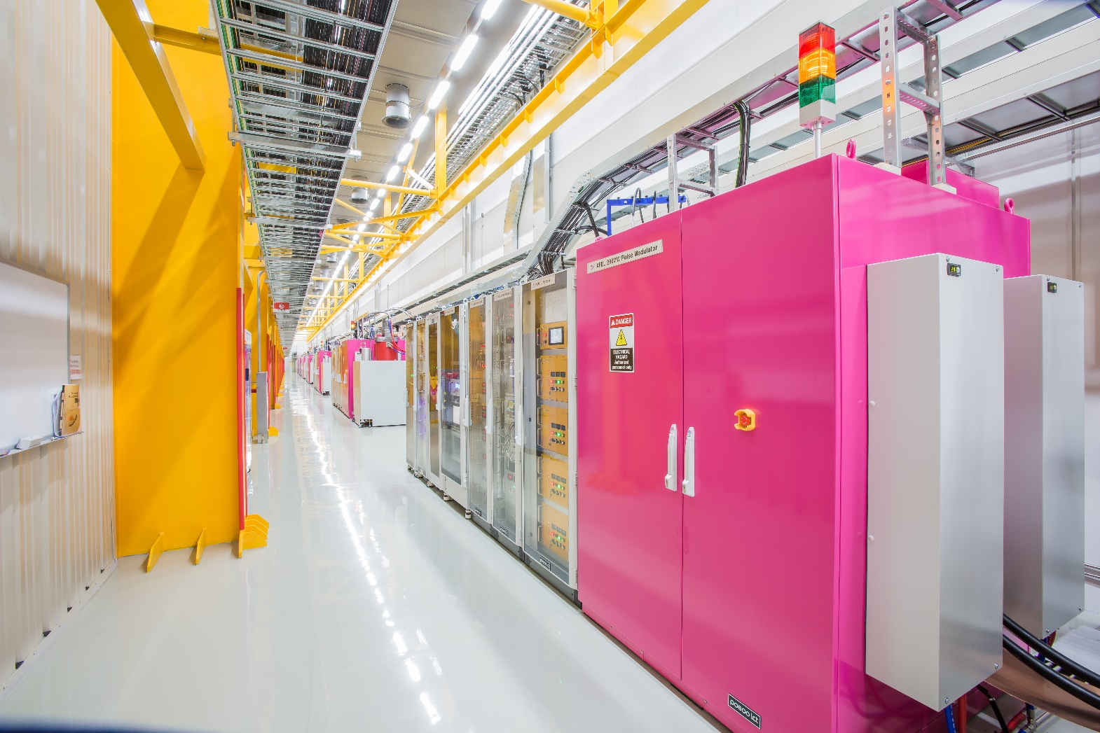
Klystron & Modulator Gallery
Parameter | Unit | Value
RF frequency | MHz | 2856
No. of Klystron & Modulator |  | 51
Max. repetition rate | Hz | 60
RF pulse width | μs | 4

Slide 7
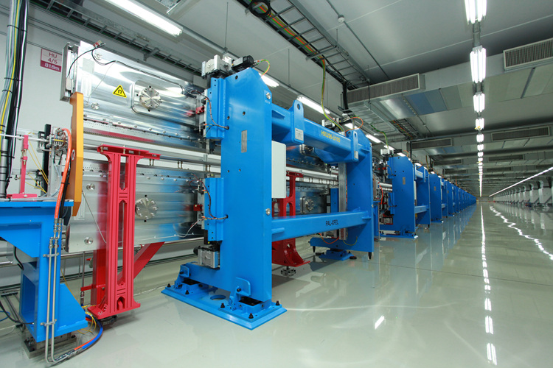
Undulators
Parameter | Unit | Value
No. of Undulator |  | 21
Length | m | 5
Magnet Period | mm | 26.0
Minimum Gap | mm | 8.3
Wavelength | nm | 0.1
Magnetic field | Tesla | 0.8124
K |  | 1.9727

Slide 8
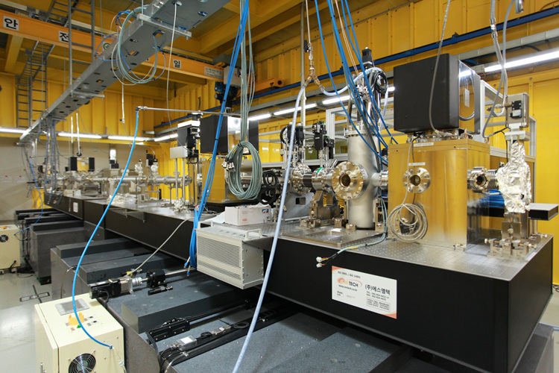
Beamline
Experimental Station: Hard X-ray Pump & Probe, Coherent X-ray Imaging, Soft X-ray Pump & Probe

Slide 9
Diagnostics for PAL-XFEL
Parameter | Instruments | Number | Resolution
Beam Position & Beam Energy | Stripline BPM | 160 | < 5 um
 | Cavity BPM | 49 | < 1 um
Beam Size | Screen Monitor | 54 | < 10 um
 | Wire Scanner | 9 | < 10 um
Bunch Length | Coherent Radiation Monitor | 4 | -
 | Transverse Deflecting Cavity | 3 | < 10 fs
Beam Charge | Turbo ICT | 10 | < 1 pC
Beam Arrival Time | Beam Arrival Time Monitor | 10 | < 30 fs
Beam Loss | Beam Loss Monitor | 26 | -

Slide 10
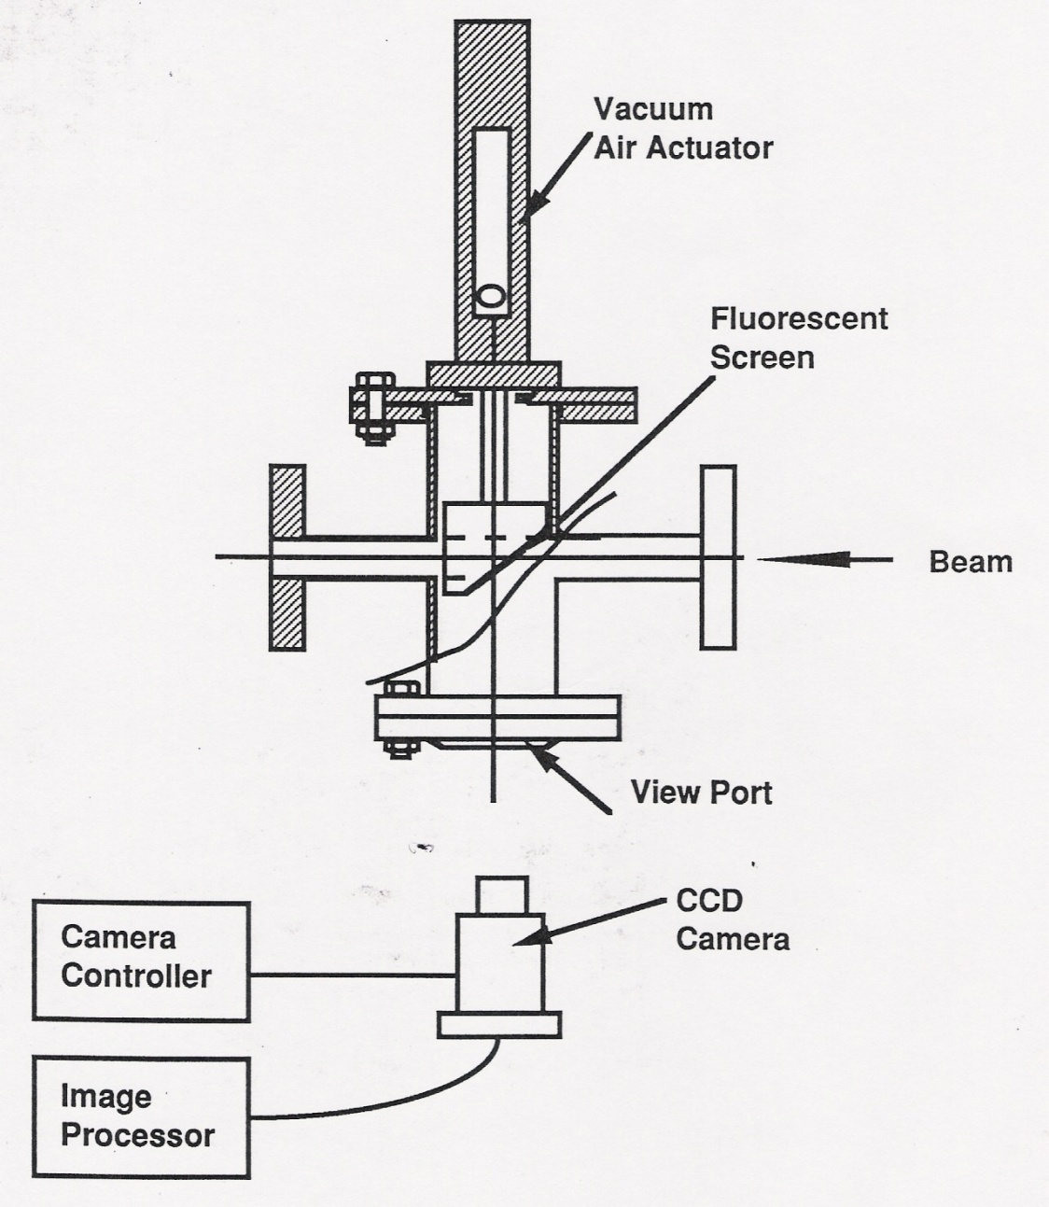
Screen Monitor
Generally destructive to the beam (energy absorbed, scattering of particles as they pass through screen)
Camera shutter should be synchronised to beam arrival for best results
Full 2D transverse profile in one shot
Actuator required to remove screen from beam path

Slide 11
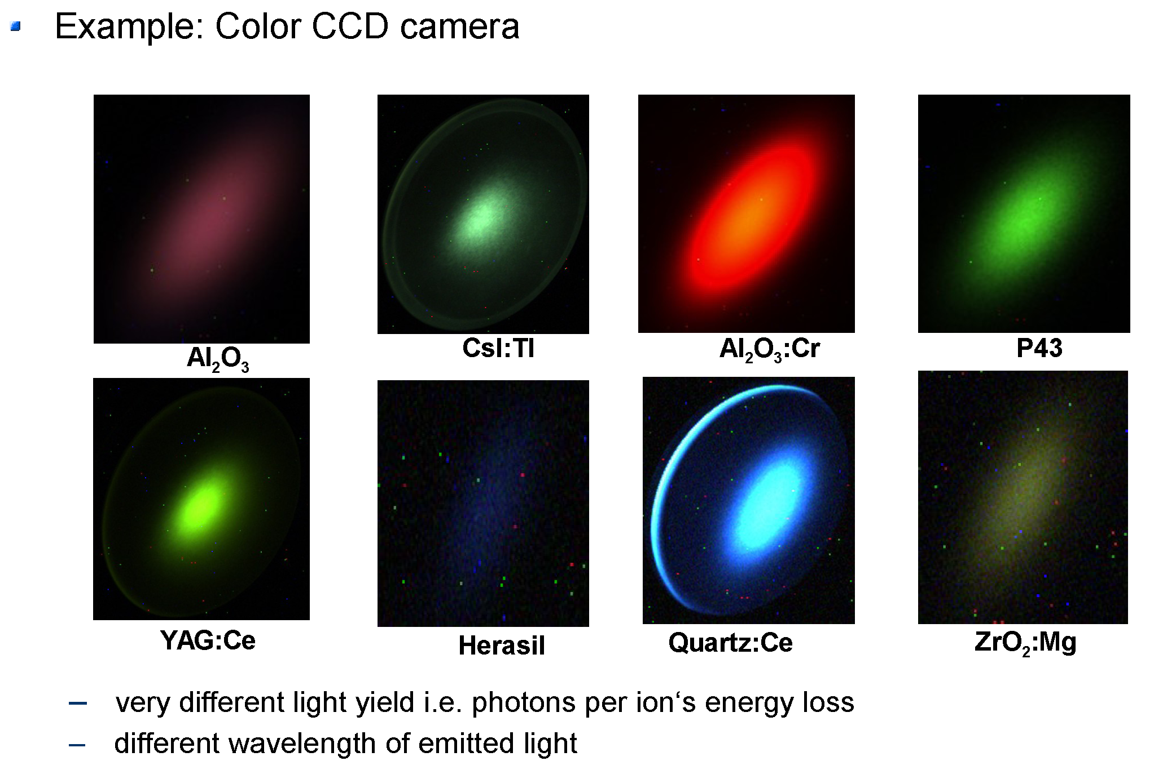
Various Targets

Slide 12
Phosphor Screens
High conversion efficiency (300-400 photons from one 10 keV electron on a 5 μm thick layer)
Relatively long fluorescence decay time (up to many ms)
Opaque, thus typically used as thin layer of small grains (down to 1 μm) deposited on a substrate
Resolution is about twice phosphor layer thickness
Layers are mechanically fragile and can be damaged by high intensity beam
Proxitronic data sheet

Slide 13
Scintillator Screens
Optical transparency at wavelengths of their own specific emission energy
Resolution is comparable to screen thickness
Short fluorescence decay times (< 1 μs)
Some have high mechanical strength, so thin (> 50 μm), freestanding screens are feasible
Desirable:
  High density, more energy absorbed for same thickness
  High conversion efficiency, more photons per energy absorbed
 | YAG:Ce | LuAG:Ce | YAP:Ce | BGO
Density [g/cm³] | 4.57 | 6.73 | 5.37 | 7.13
Hardness [Mho] | 8.5 | 8.5 | 8.6 | 5
Chemical formula | Y₃Al₅O₁₂ | Lu₃Al₅O₁₂ | YAlO₃ | Bi₄(GeO₄)₃
Wavelength of max. emission [nm] | 550 | 535 | 370 | 480
Decay constant [ns] | 70 | 70 | 25 | 300
Photon yield at 300 K [10³ Ph/MeV] | 35 | 20 | 25 | 8-10

Slide 14
Optical Transition Radiation (OTR) Target
Transition Radiation is created when relativistic charged particle cross a dielectric boundary
Typically, metal targets are used, as metals have large negative dielectric constant at optical frequencies
A part of the emitted photons (OTR) is in the visible and can be used to image the particle distribution
Forward OTR is emitted in a cone around the particle trajectory
Backward OTR is emitted in a cone around the ‘reflected’ particle trajectory
Forward OTR
Backward OTR

Slide 15
Properties of OTR
Intensity scales with:
Maximum at 1/γ
Number of (visible) photons per particle:
Practically: 1-3% of particle number

Slide 16
Advantages & Disadvantages of OTR
Advantages
  Like a phosphor screen, but without resolution limits (resolution possible down to optical wavelength)
  No saturation, linear intensity to destruction threshold (>10¹² e⁻/mm²)
Disadvantages
  Few photons per electron, which are emitted into a large angle at low particle energies
  Practically only feasible for strongly relativistic particles (γ>100)

Slide 17
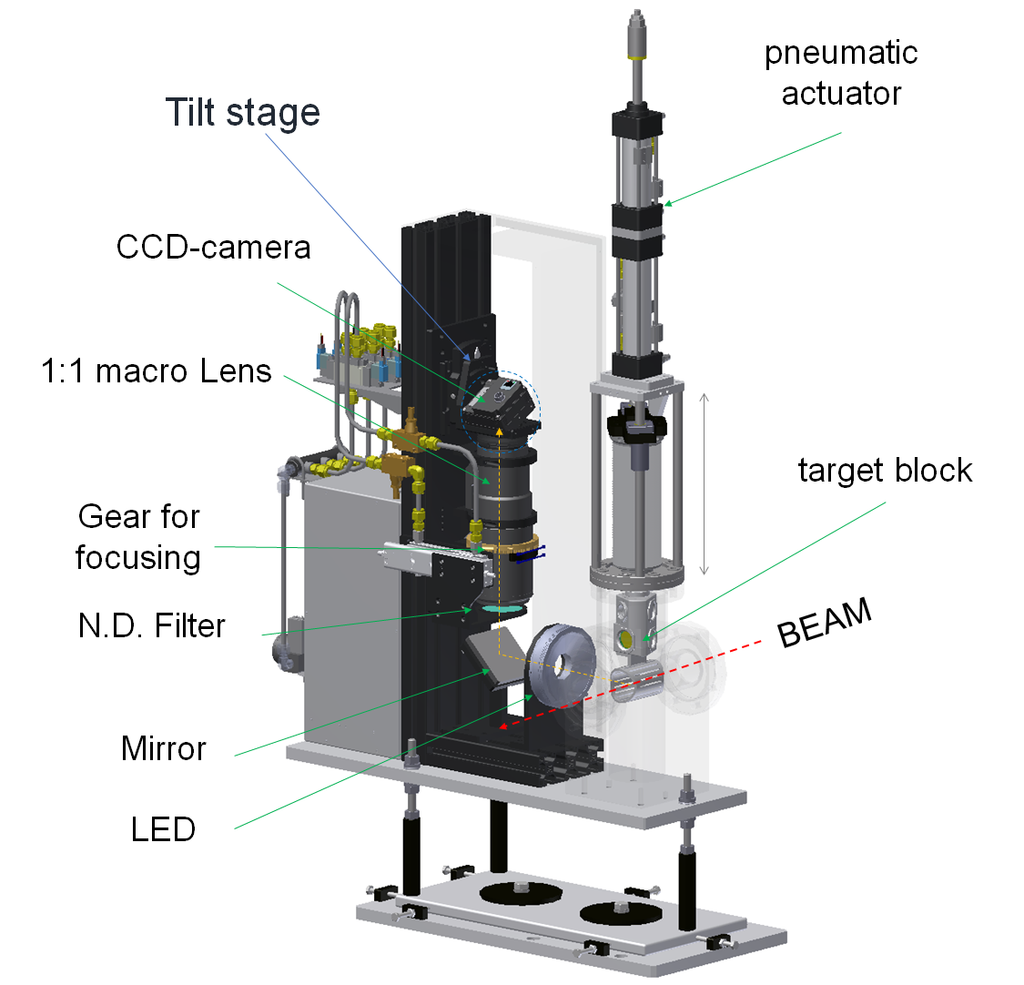
Screen Monitor for PAL-XFEL
  3-position pneumatic actuator
  RF shield for reducing the wake field
  Scintillator (YAG:Ce)
  OTR Target (Al-foil)
  LED backlight lamp
  Neutral density filter
  DSLR lens
  DC motor for remote focusing
  GigE camera
  Tilt stage for Scheimflug’s geometry

Slide 18
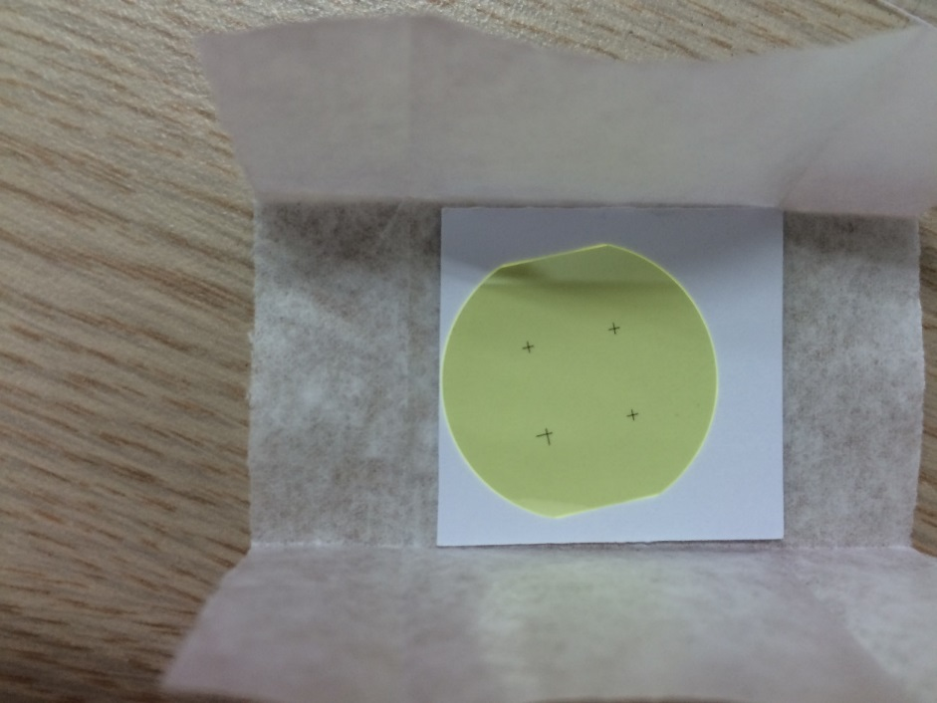
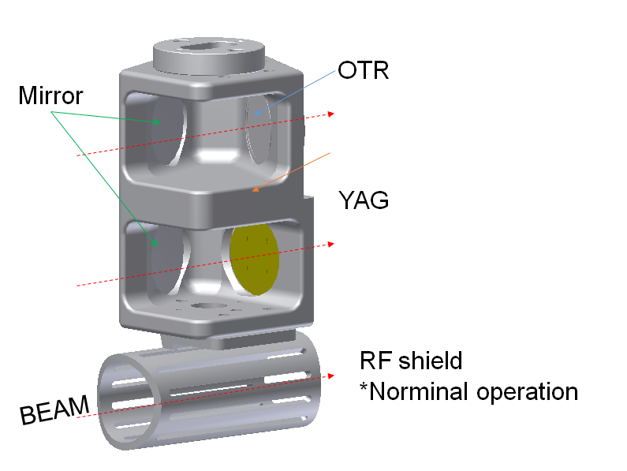
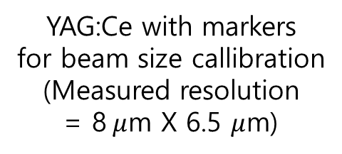
Target Holder
YAG:Ce with markers
for beam size callibration
(Measured resolution
= 8$μ$m X 6.5 $μ$m)

Slide 19
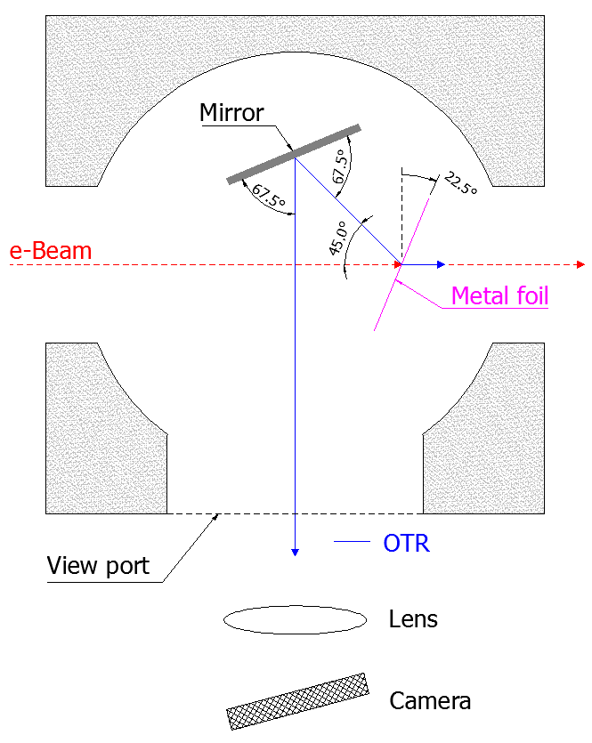
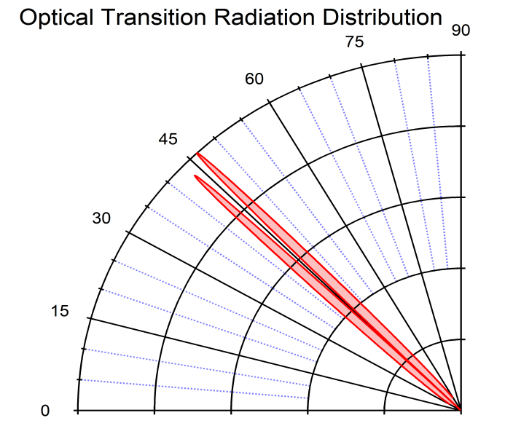
OTR Target
  OTR imaging with Al foil
  - thickness : 1 μm
  Target rotation: 22.5 °

Slide 20
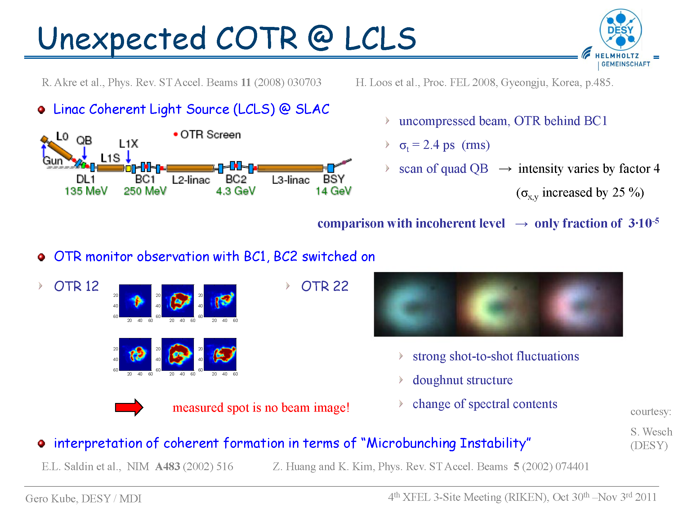

Slide 21
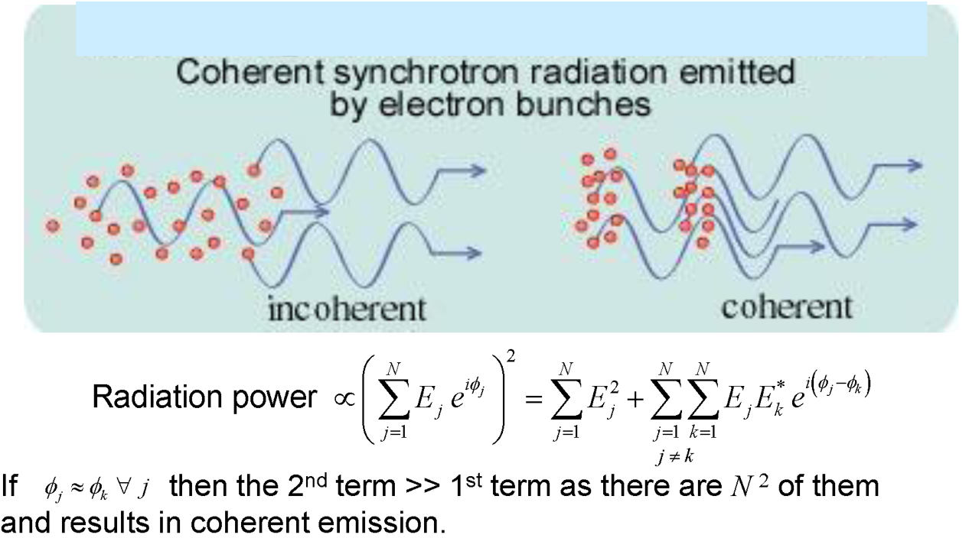
Radiation Power of Incoherent and Coherent Radiation

Slide 22
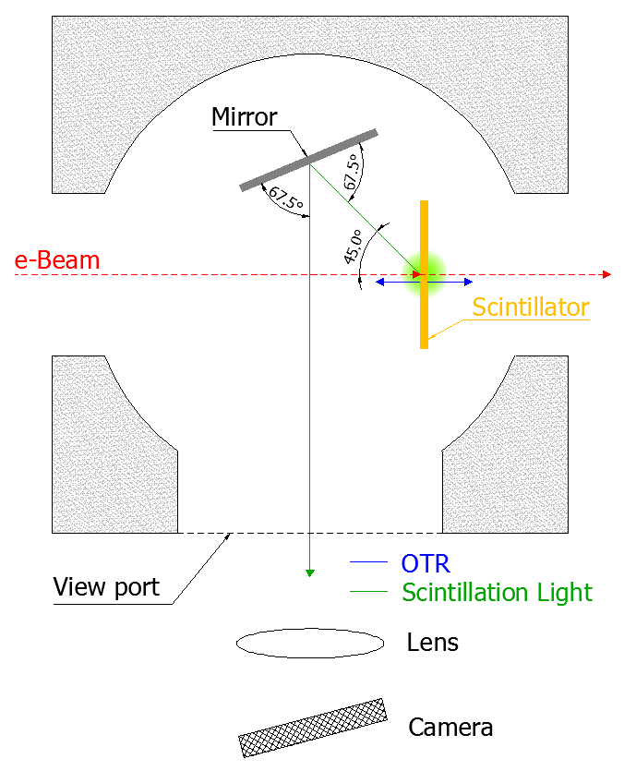
Scintillator Target
  YAG:Ce scintillator
  - Thickness : 100 or 30 μm
  Observation geometry of 45° with respect to the beam axis
  ⇒ Minimized holder size
  ⇒ Big error from target thickness

Slide 23
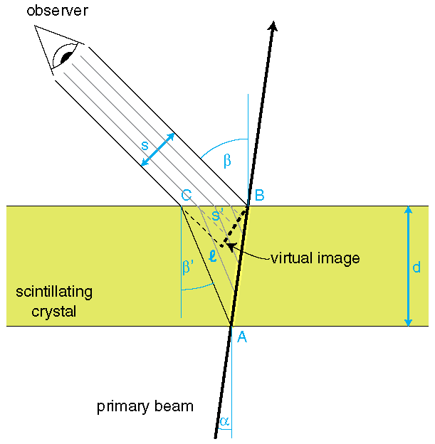
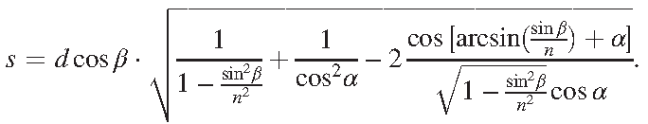
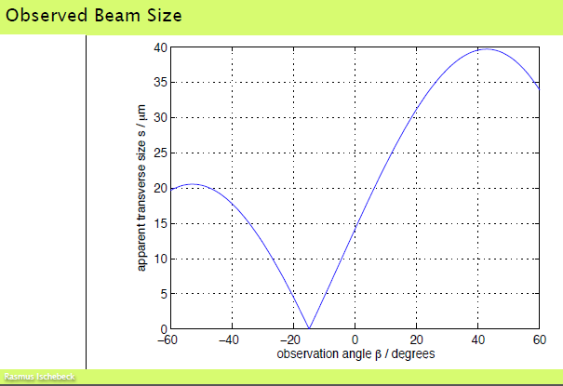
Beam Size with Observation Angle
Observation of light from a scintillating crystal
with an arbitrary observation angle β
R. Ichebeck at al., Phys. Rev. ST Accel. Beams 18, 082802 (2015)

Slide 24
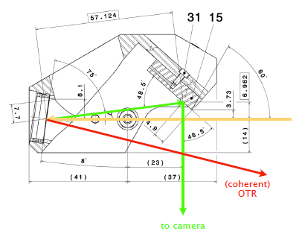
SwissFEL Screen Monitor
R. Ichebeck at al., Phys. Rev. ST Accel. Beams 18, 082802 (2015)

Slide 25
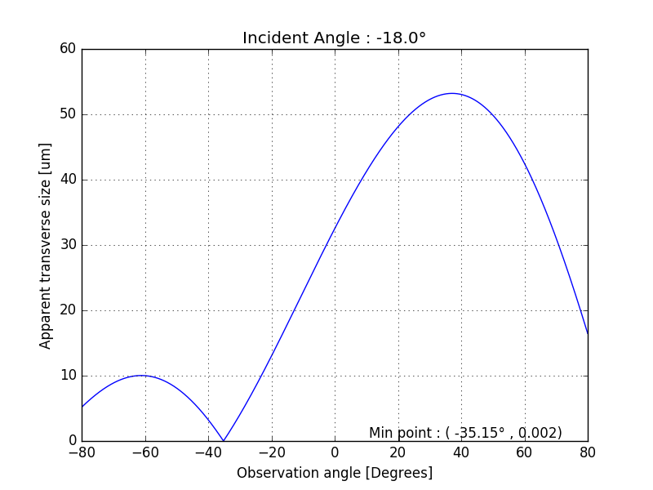
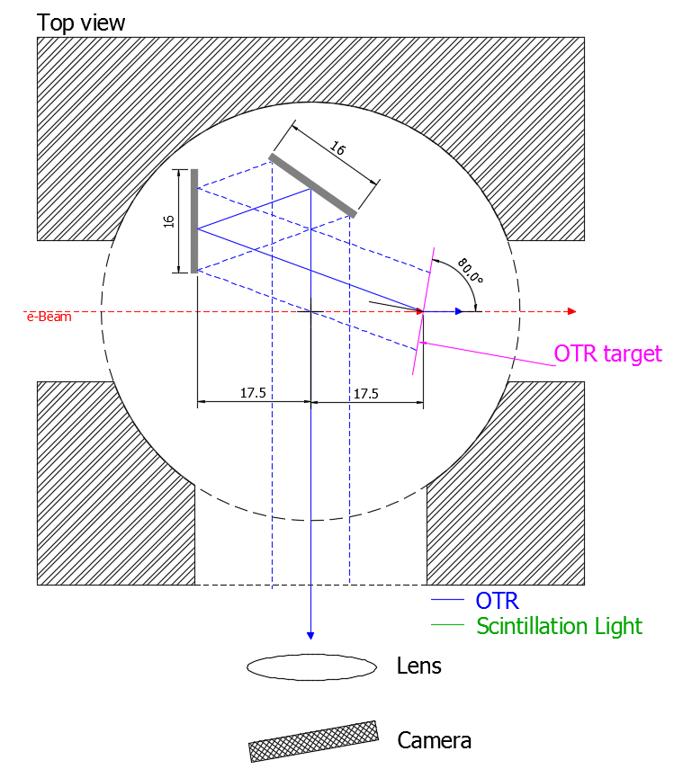
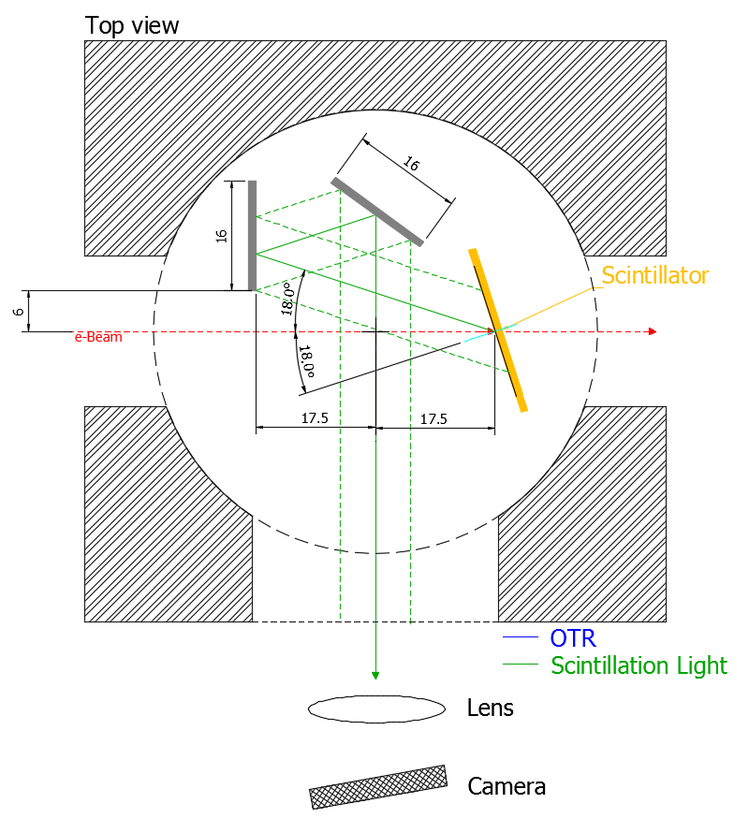
Geometry of New Target Holder
Incident Angle (α) : -18°
Observation Angle (β) : -36°
OTR Target
YAG Target

Slide 26
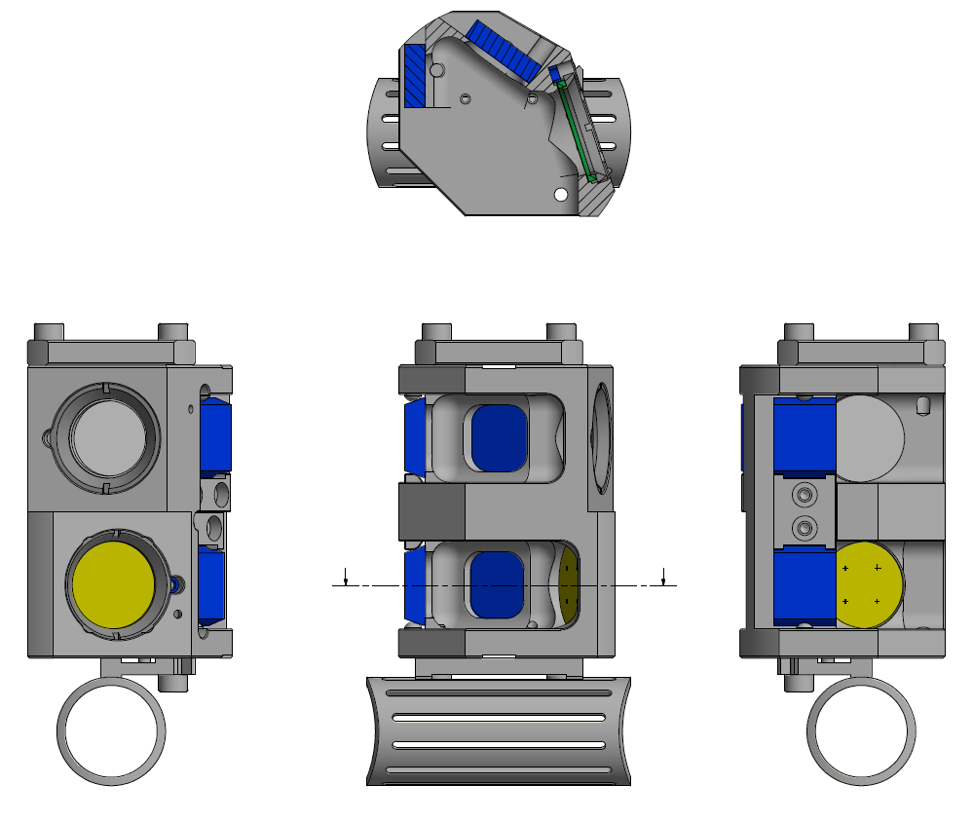
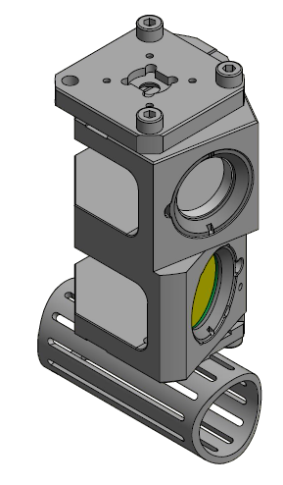
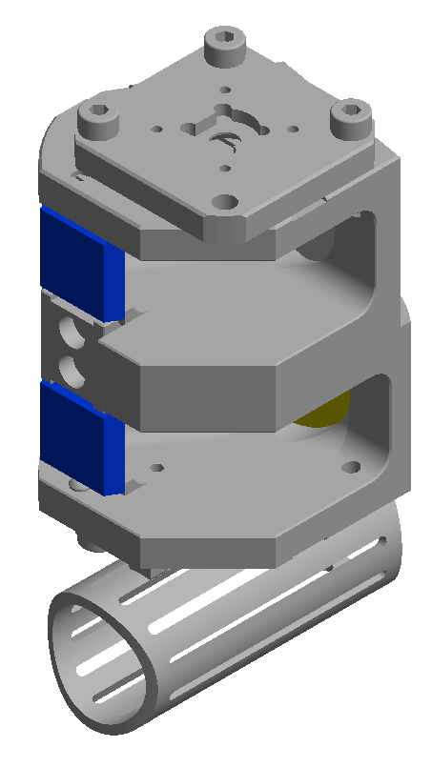
3D Design of New Target Holder

Slide 27
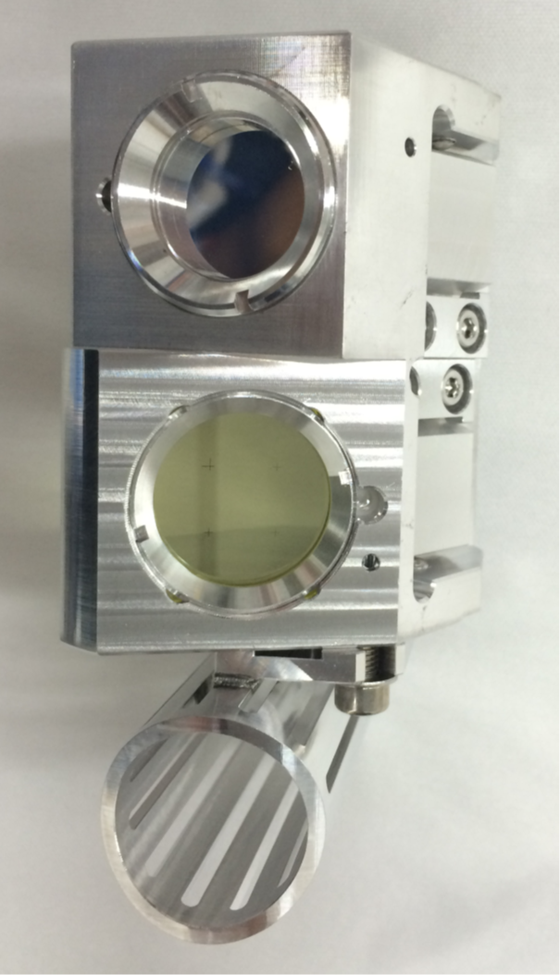
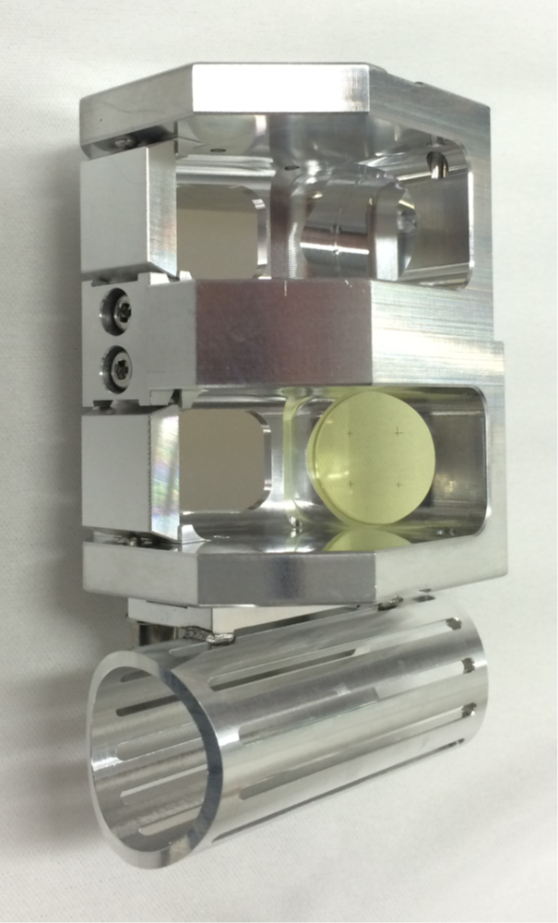
Pictures of New Target Holder

Slide 28
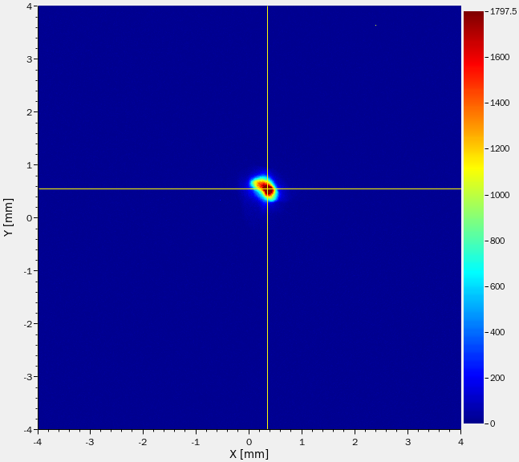
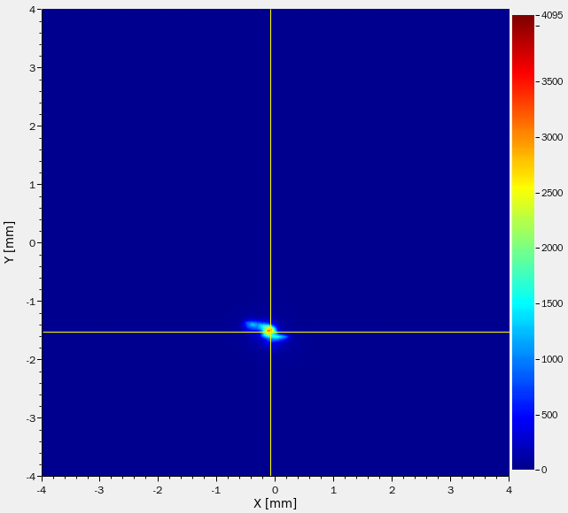
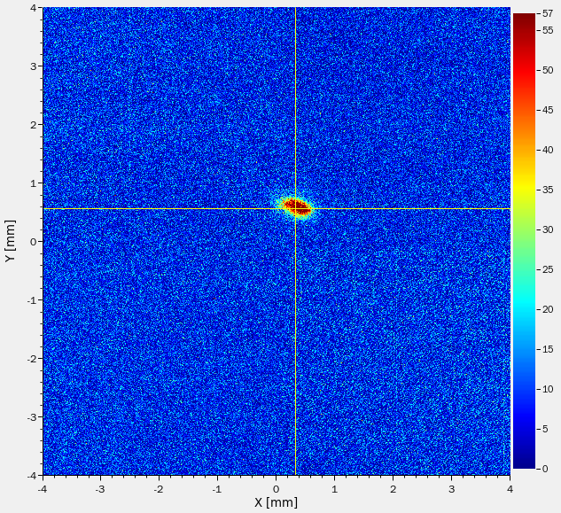
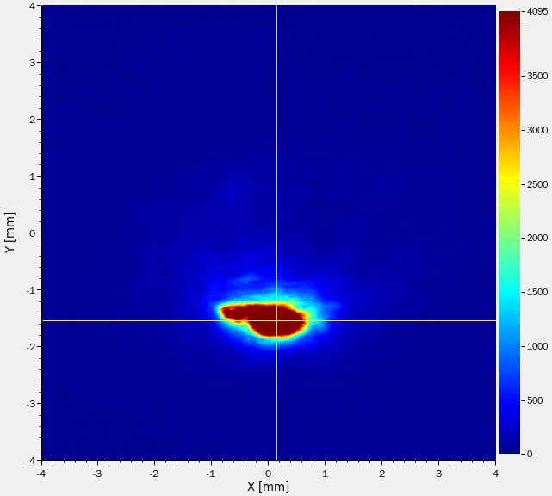
Measurement Results of Screen Monitor
BC Off
BC On
YAG:Ce
OTR

Slide 29
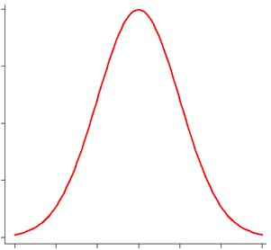
Working Principle of Wire Scanner
Intensity
Radiation
detector
Position
1D Profile is measured either as intensity of radiation (Bremsstrahlung) or as secondary emitted electron current over position of wire
Resolution down to wire diameter (5-6 μm)
Instead of movement, many wires can be used in a ‘harp’

Slide 30
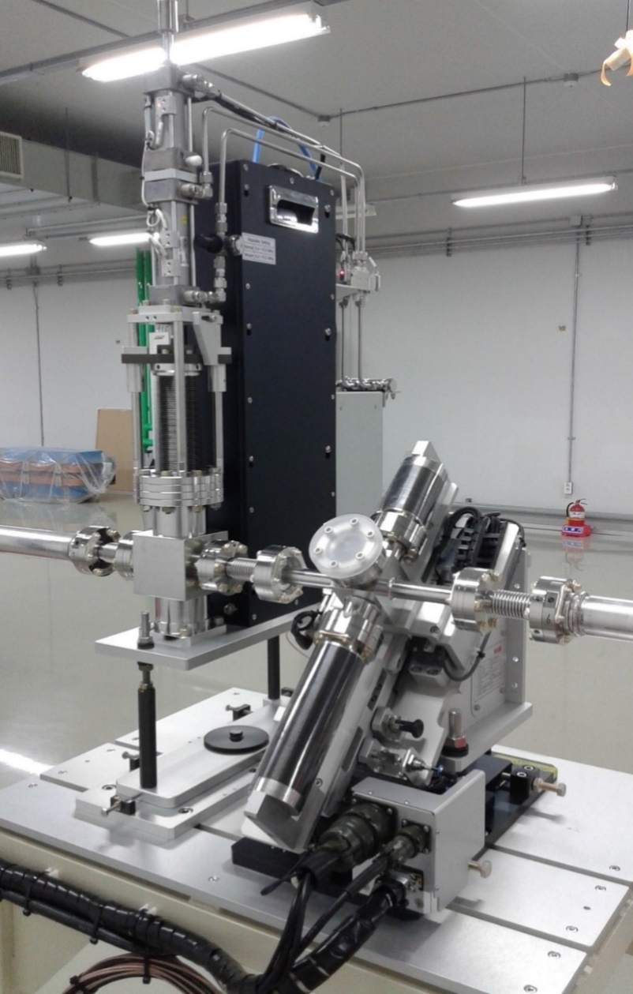
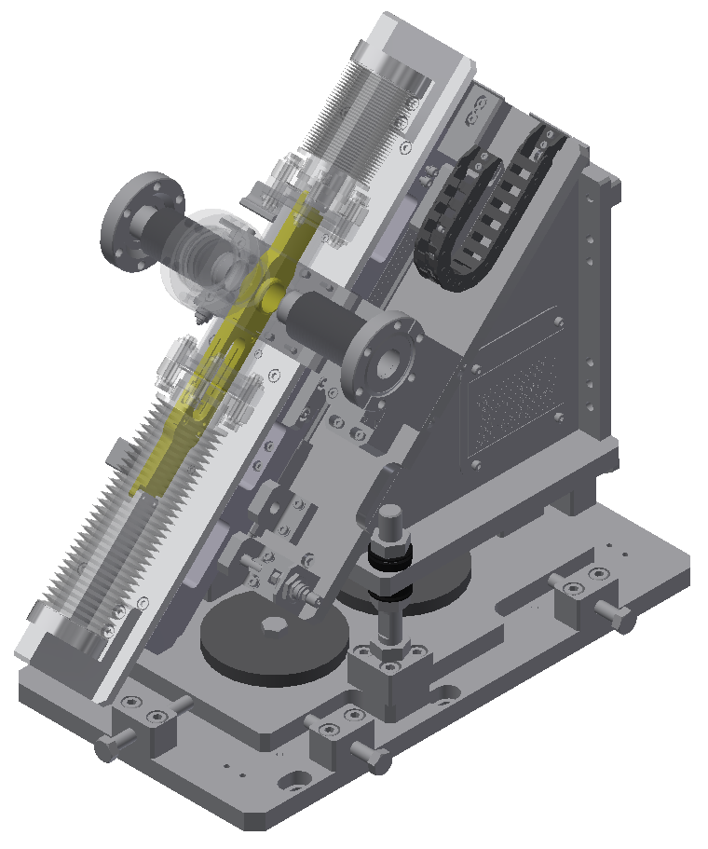
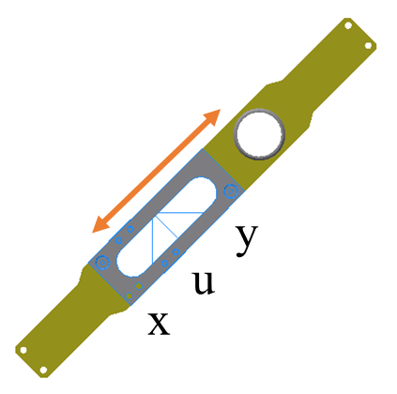
Wire Scanner of PAL-XFEL
Wire material
  Tungsten (18 μm)
  Carbon (34 μm)
motion
e-beam
RF shield
Three wires and a RF shield tube to minimize wakefield effect
The stage mounted on 45° motion stage with linear motor
Ironless linear motor to minimize the magnetic field at the beam position
Screen monitor and wire scanner

Slide 31
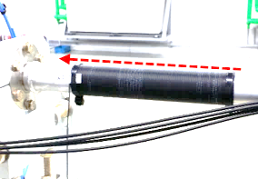
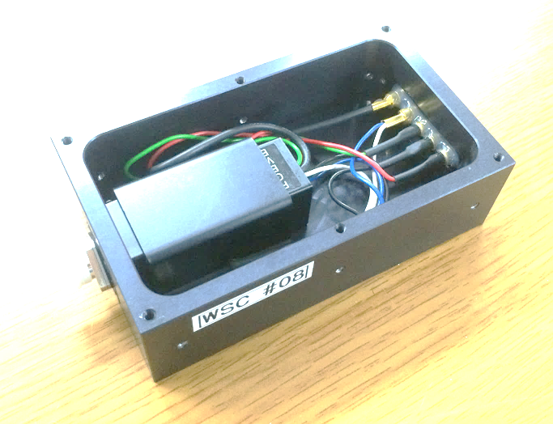
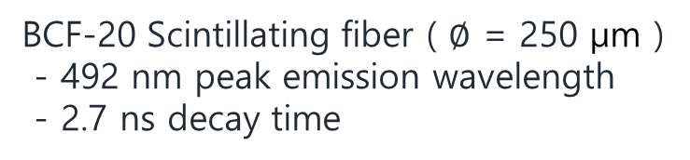
Beam Loss Monitor for Linac
e-beam path
BCF-20 Scintillating fiber ( $∅$ = 250 μm )
- 492 nm peak emission wavelength
- 2.7 ns decay time
Hamamatsu H10722-110
- 230 ~ 700 nm spectral response
Optical fiber is wound on the vacuum chamber for Cherenkov radiation
Optical fiber is shielded from external light and connected directly to the PMT head

Slide 32
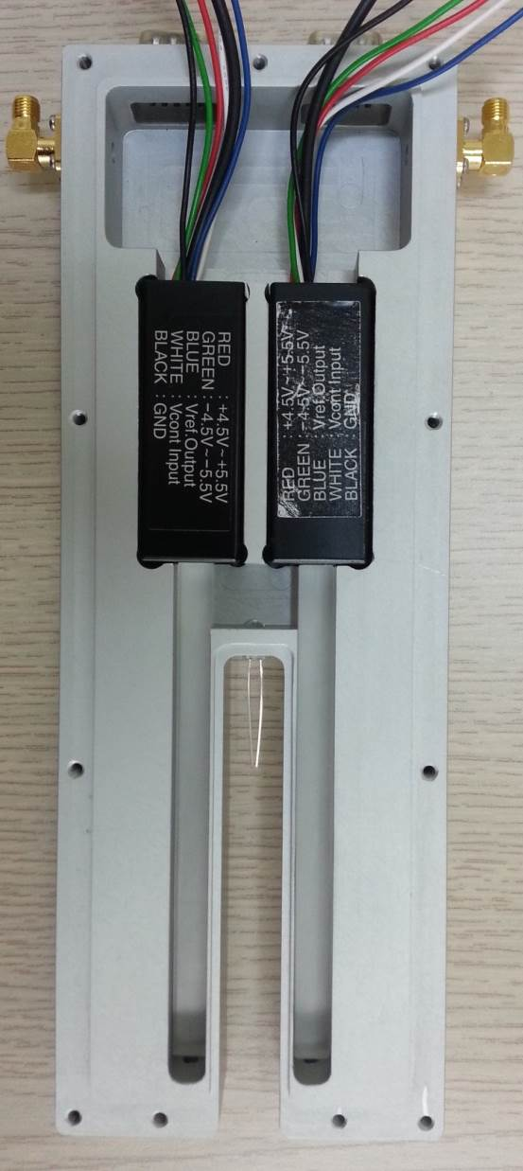
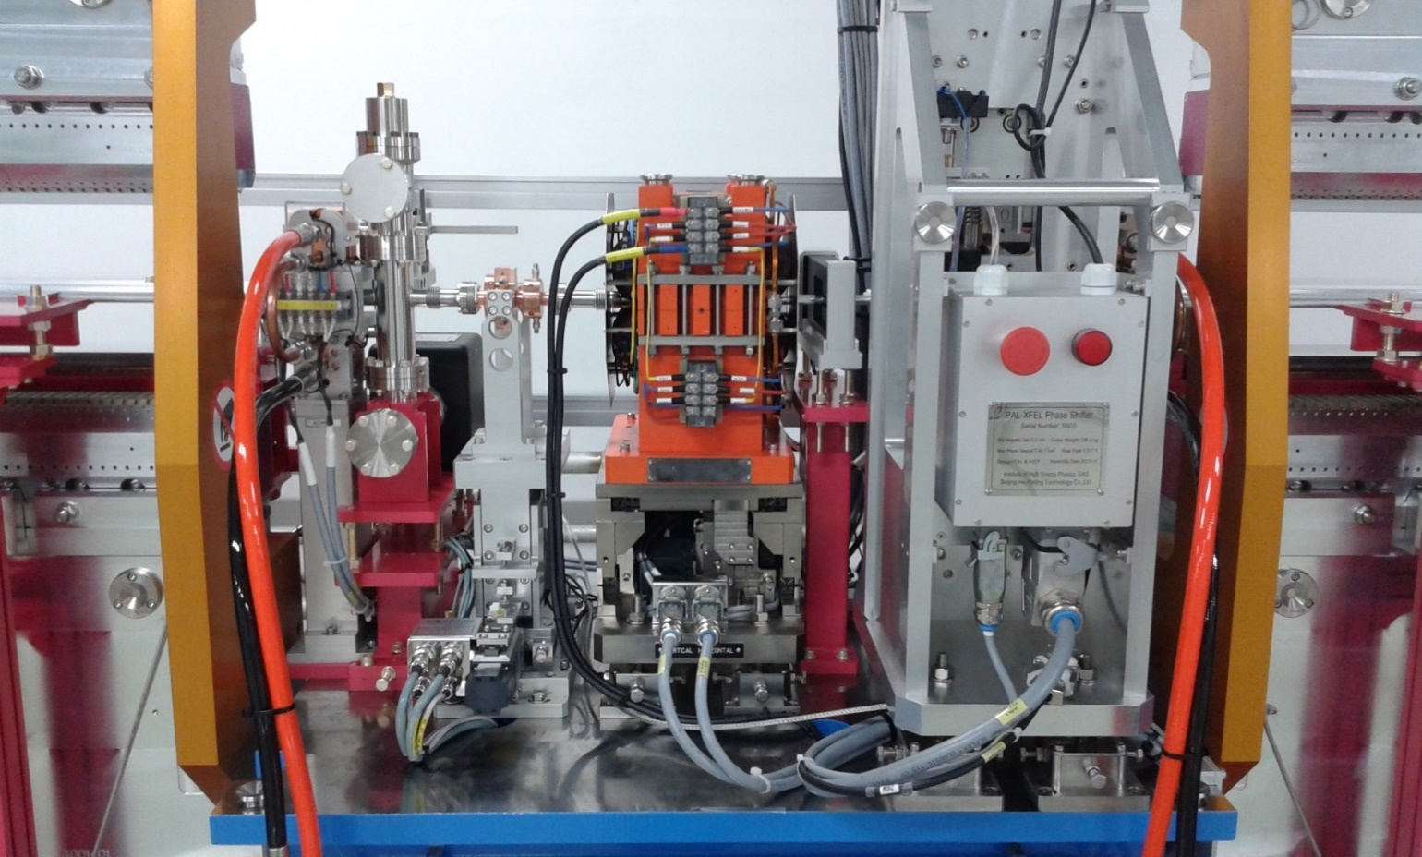
Beam Loss Monitor for Undulator
Beam loss monitor
PMT
module
LED
(for heartbeat)
PMMA rod
(for radiator)

Slide 33
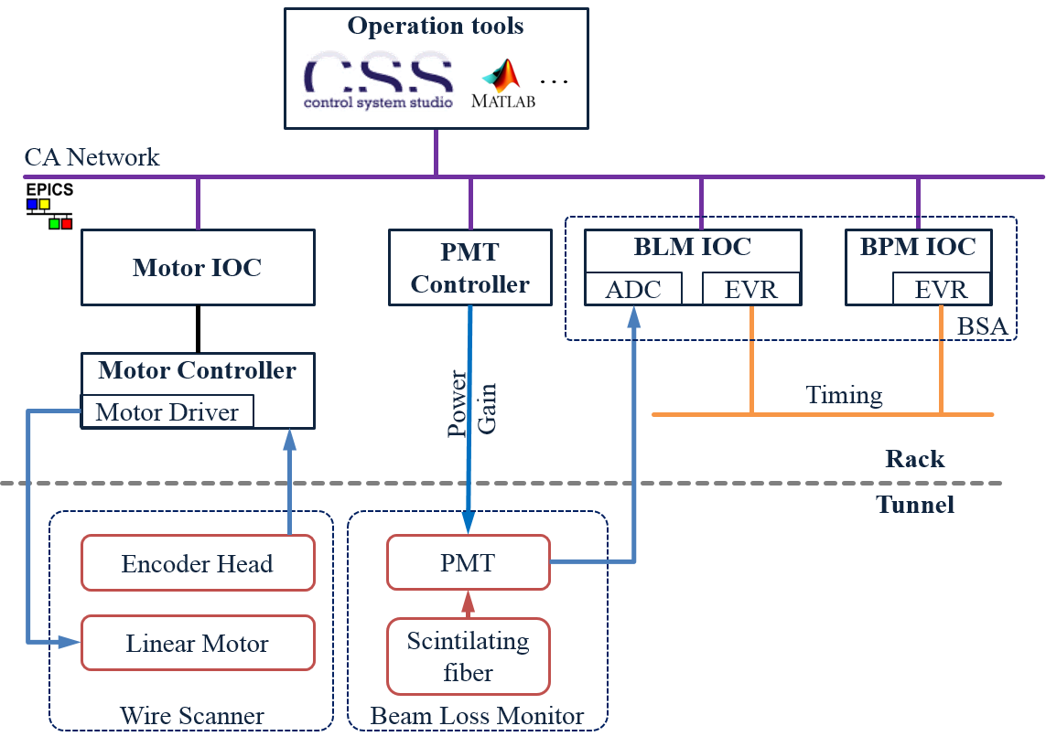
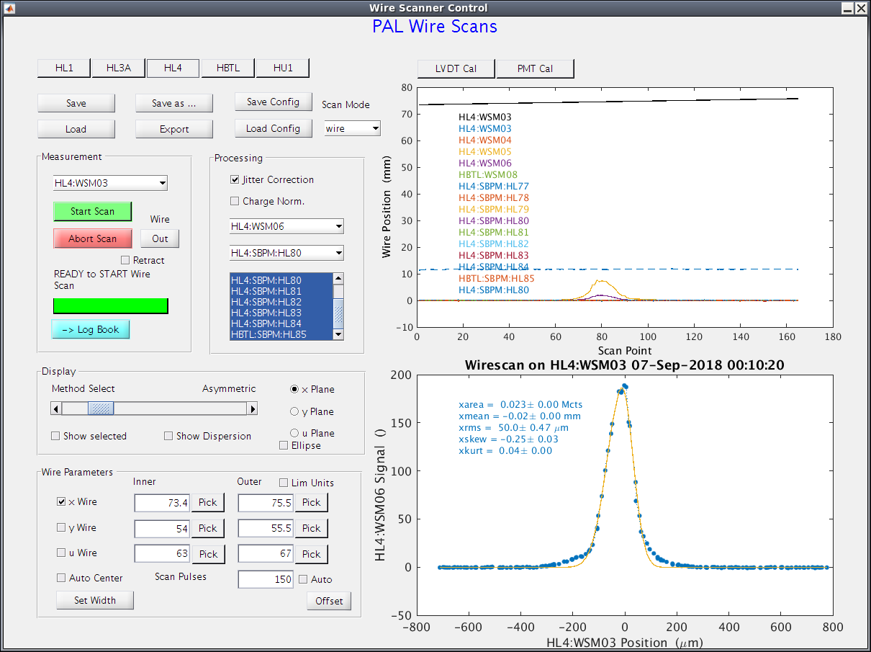
Control Layout & Measurement GUI
Wire Scanner GUI

Slide 34
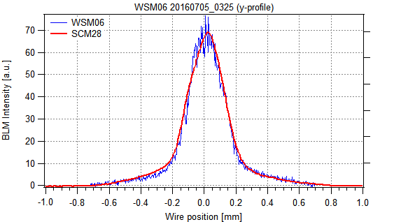
Correction of Beam Position Jitter
PMT
#1
PMT
#2
PMT
#3
Wire
Scanner
BPM
ADC
BPM
ADC
BPM
ADC
PMT
ADC
BPM
ADC
PMT
ADC
BPM
ADC
PMT
ADC
Beam Synchronous Acquisition
Wire position correction
Wire position
BPM reading
Beam jitter
correction
Lattice
Comparison between Wire Scanner & Screen Monitor

Slide 35
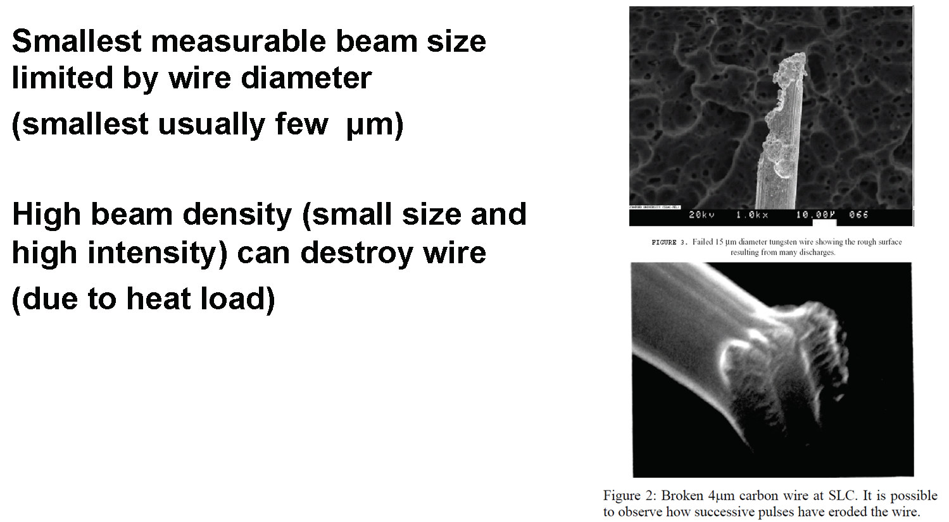
Limitations of Wire Scanners

Slide 36
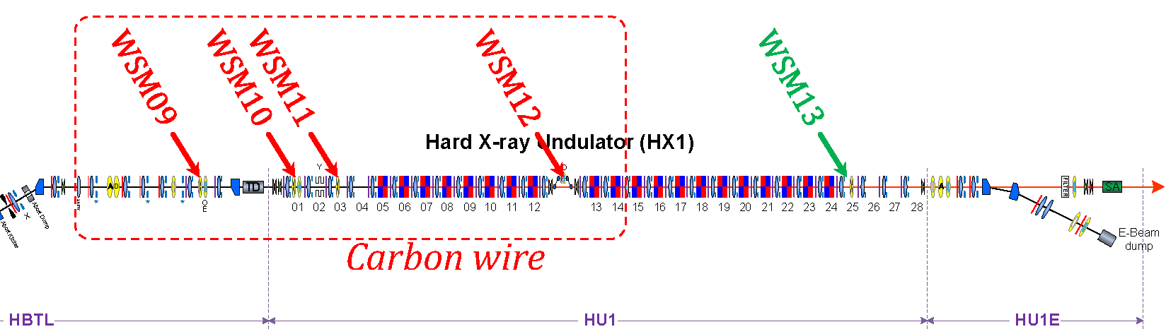
Lattice Matching with Wire Scanners

Slide 37
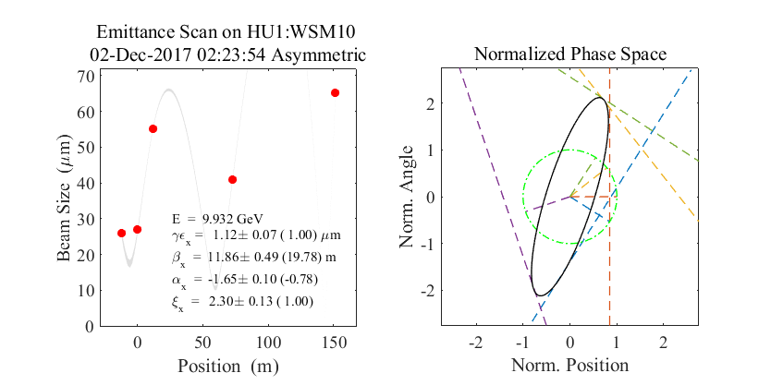
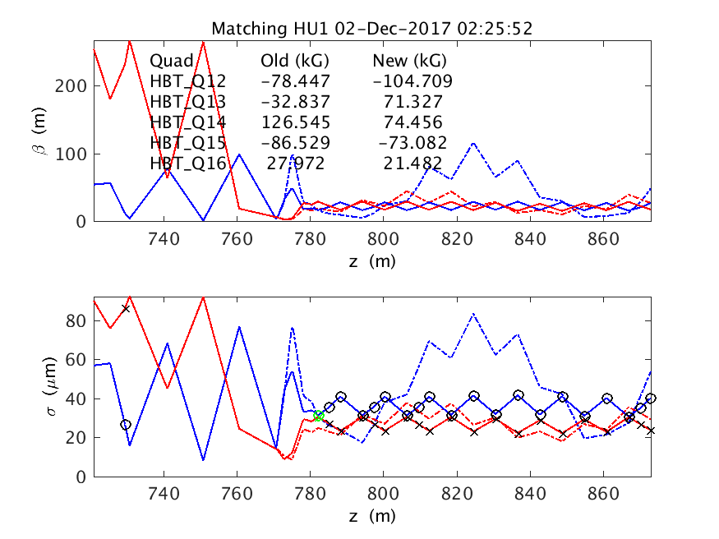
Before Lattice Matching in Undulator

Slide 38


After Lattice Matching in Undulator

Slide 39

Thanks to:
All Members in PAL-XFEL and Domestic/International Collaborations
Thank you for your attention!

