Slide 1
Photon diagnostics @ FLASH
WP13 EuPRAXIA electron and photon diagnostics workshop
Stefan Düsterer for the FLASH team
13.06.2023

Slide 2
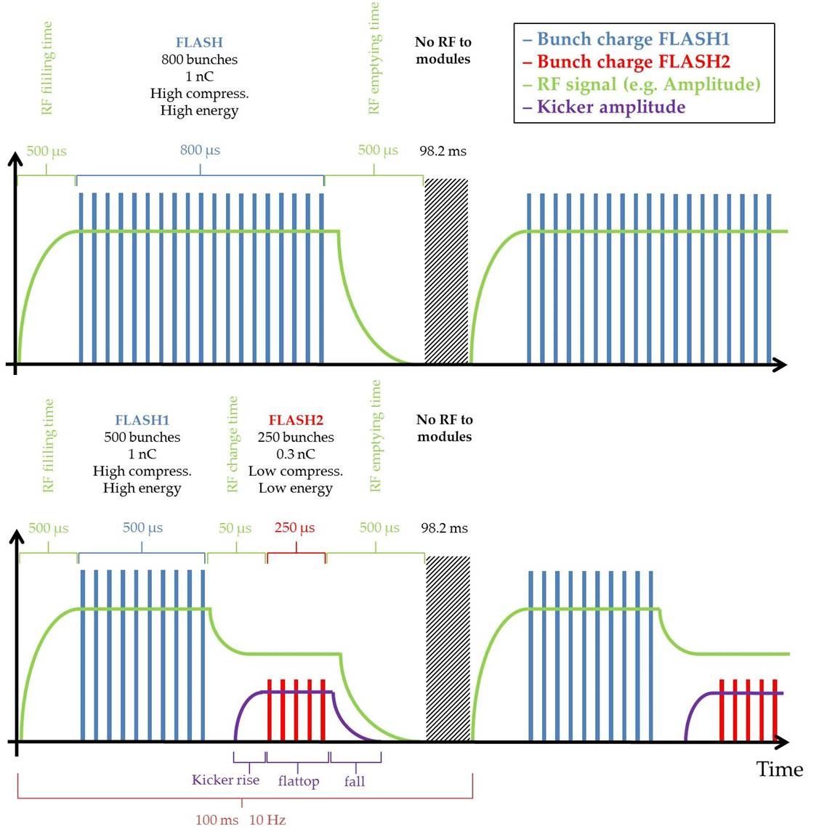
FLASH Photon beam parameters
Photon beam Parameters | FLASH1 | FLASH2
Photon energy fundamental (eV) | 24 – 290 eV | 14 – 300 eV
Wavelength fundamental (nm) | 4.2 – 51 nm | 4 – 90 nm
Photon pulse duration (FWHM) | <30-200 fs | <30-200 fs
Single photon pulse energy (average) | 1 – 500 μJ | 1 – 1000 μJ
Spectral width (FWHM) | 0.7 – 2 % | 0.5 – 2 %
Pulses per second** | 10 - 5000 | 10 - 5000
**shared between FLASH1 and FLASH2

Slide 3
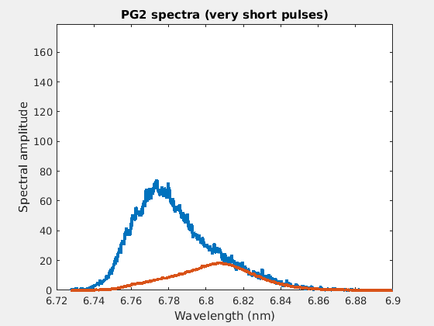
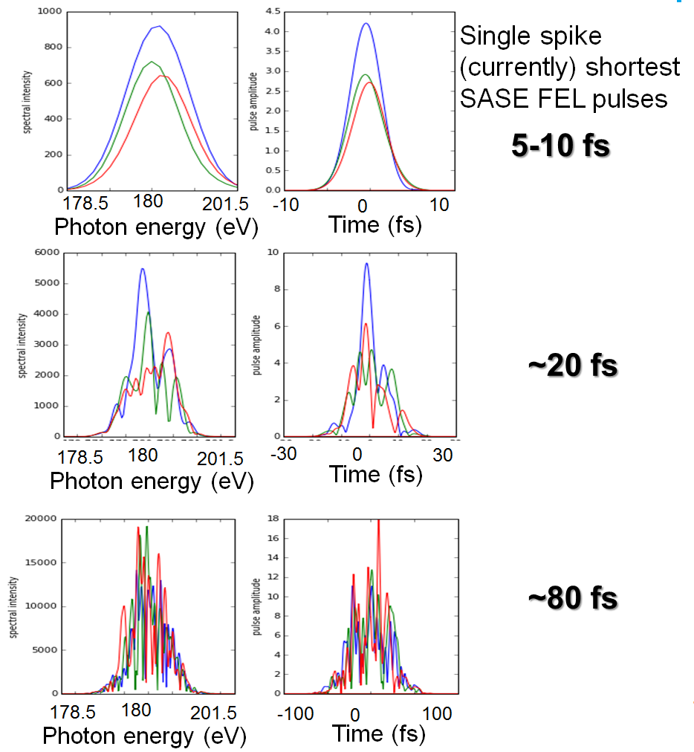
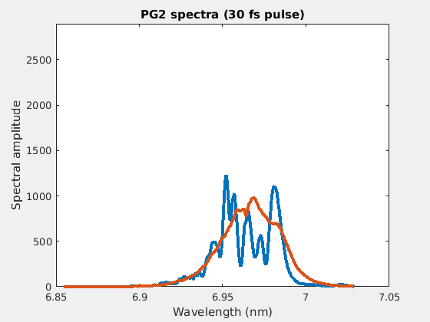
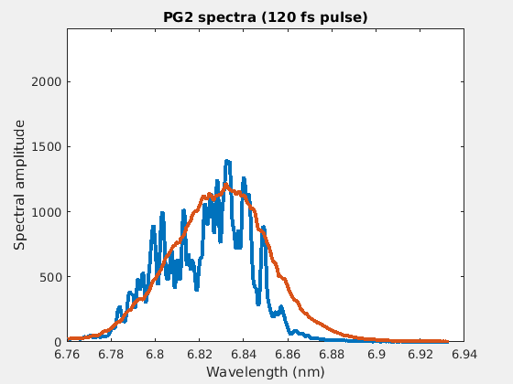
SASE pulses (Self-Amplified Spontaneous Emission )
Spectral measurements
Simulation
~30 fs
178
180
182
Photon energy (eV)

Slide 4
Diagnostic tools for FELs.
What kind of diagnostic tools do users need to make efficient use of FELs?
  focus size
  beam position
  pulse energy
  spectral distribution
  temporal radiation pulse properties
  coherence
  polarization
Due to the SASE specific shot-to-shot fluctuation the users need most this information for every single pulse => online, non-destructive

Slide 5
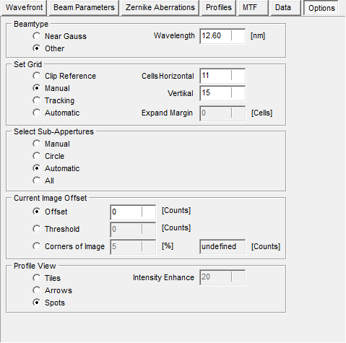
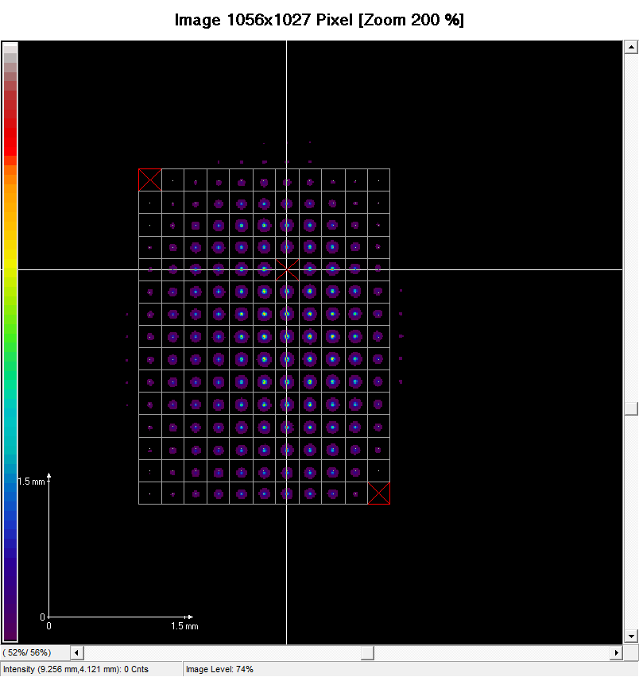
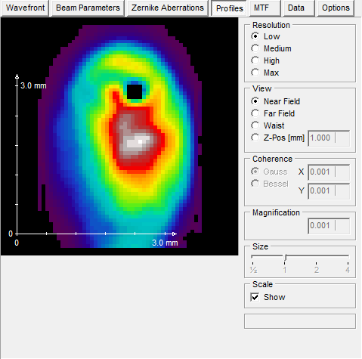
Focus size and position
Wave front sensors
B. Keitel et al . J. Synchrotron Rad. 23, 43-49 (2016);

Slide 6
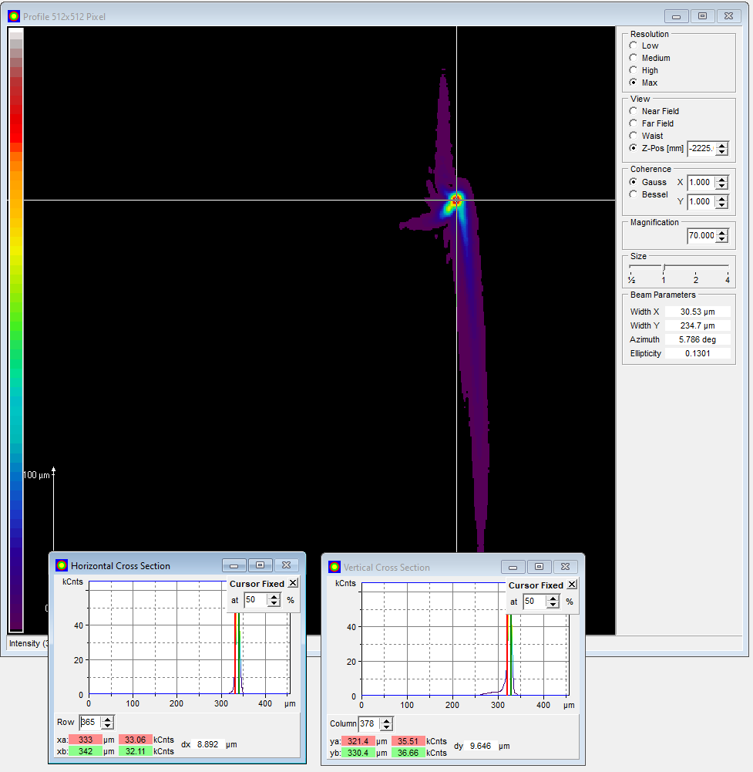
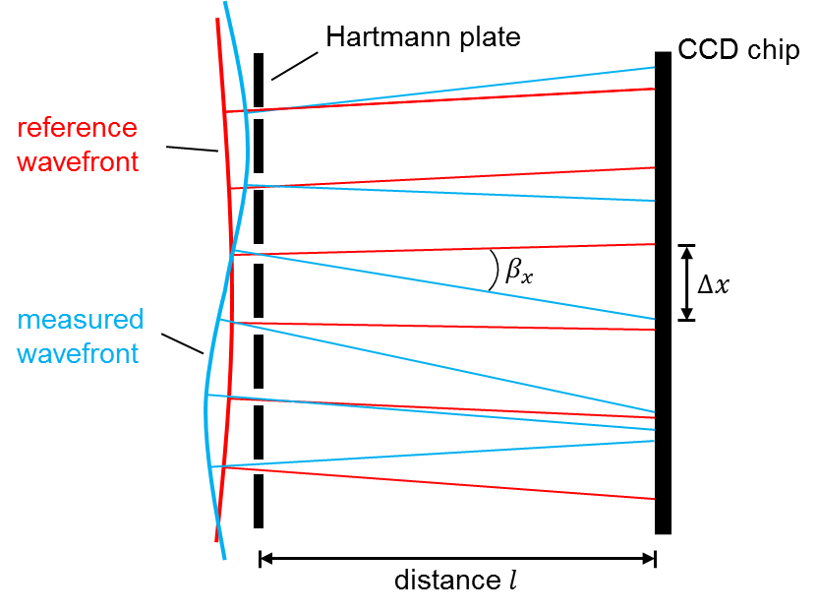
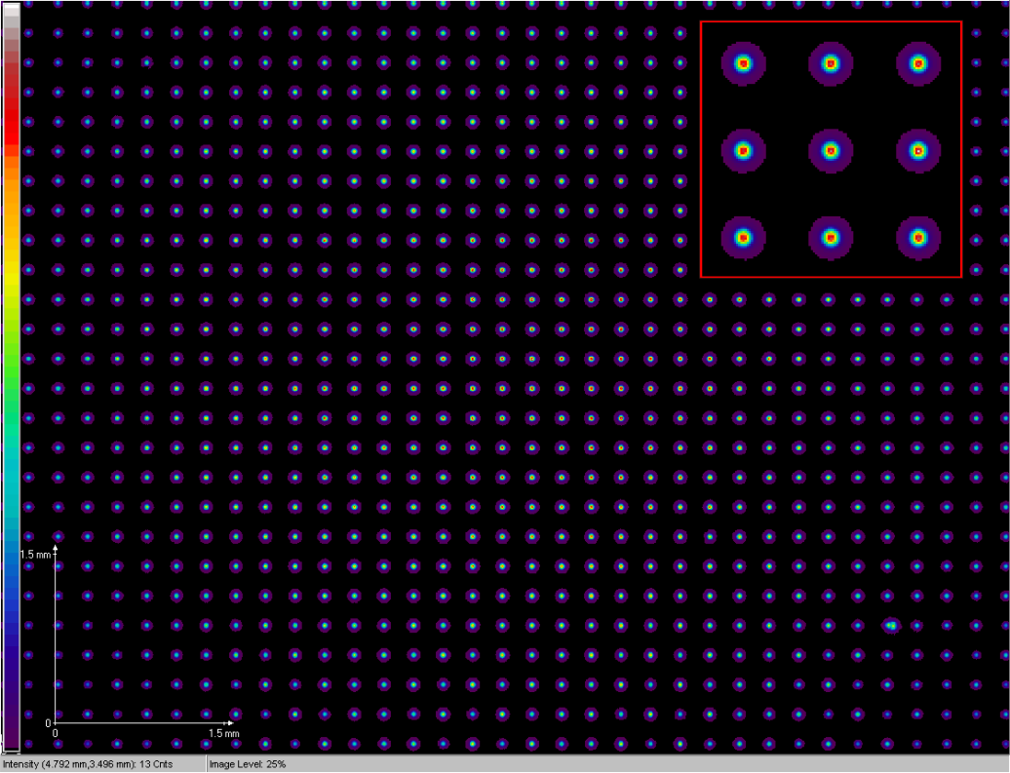
Wavefront sensors (WFS) at FLASH
Operation principle
The actual beam is compared to a reference wave (spherical wave).
Intensity and phase information in single shot measurements:
Amplitude of each spot → local intensity
Position of each spot → local slope, wavefront phase
Software MrBeam (by IFNANO) allows evaluation of
Intensity profile / beam size
Waist position and size
Wavefront and Zernike aberrations
Beam divergence
Beam quality product M²
Pointing stability
Back propagation of intensity profiles for any position in the beam
Back propagation of partial coherent beam using Gaussian or Besselian coherence functions is available
Reference spot pattern
Alignment pinhole
Courtesy B. Keitel
Notes:
The wavefront of a beam is defined as a surface perpendicular to its local direction of propagation, it carries detailed information about beam aberrations, including intrinsic ones as well as those introduced by optical elements along the beam path.
A Hartmann wavefront sensor consists of a pinhole array and a CCD camera in a certain distance.
The incident wavefront illuminates the pinhole array. Each pinhole focuses the local wavefront onto the CCD. Without aberration, the CCD signal would be a perfect array of regular spots (red). If the wavefront is distorted, each spot moves away from its ideal position (blue).
By measuring for each spot the displacement (Δx) from the ideal reference spot position, the entire incident wavefront can be reconstructed (deviation proportional to the local slope). The angle ß_{x} approximates the wavefront gradient.
In a calibration measurement the ideal spot positions were defined. A good calibration is valid for the whole range of operation, and can be used for years.
A benefit of the Hartmann wavefront sensor is that it provides both intensity and phase information about the beam in a single shot measurement. The measurements of these two parameters is independent: the local intensity is given by the amplitude of each spot. The local slopes and wavefront phase is given by the position of the spots.
Software MrBeam (from LLG) allows evaluation of: Intensity profile / beam size, Pointing stability , Wavefront w_pv, w_rms, Zernike coefficients
waist position and size, beam divergence, beam quality product M²
Since the wavefront sensor records both intensity and phase, it allows also the prediction of intensity distributions for any position in the beam course by numerical propagation. The software MrBeam features Fresnel-Kirchhoff propagation.

Slide 7
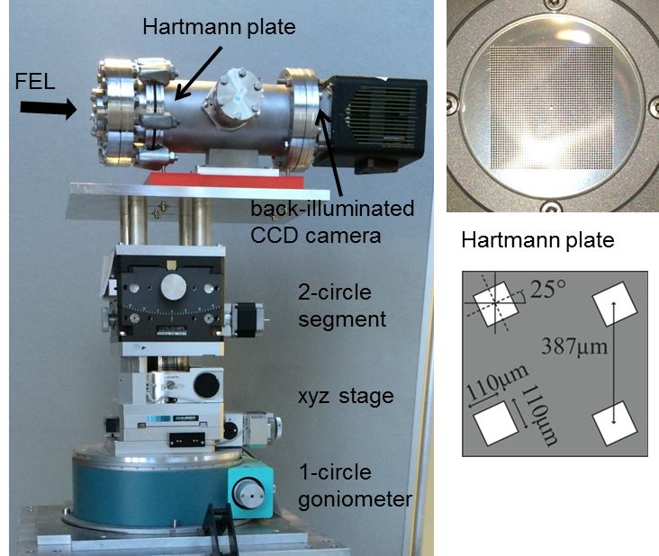
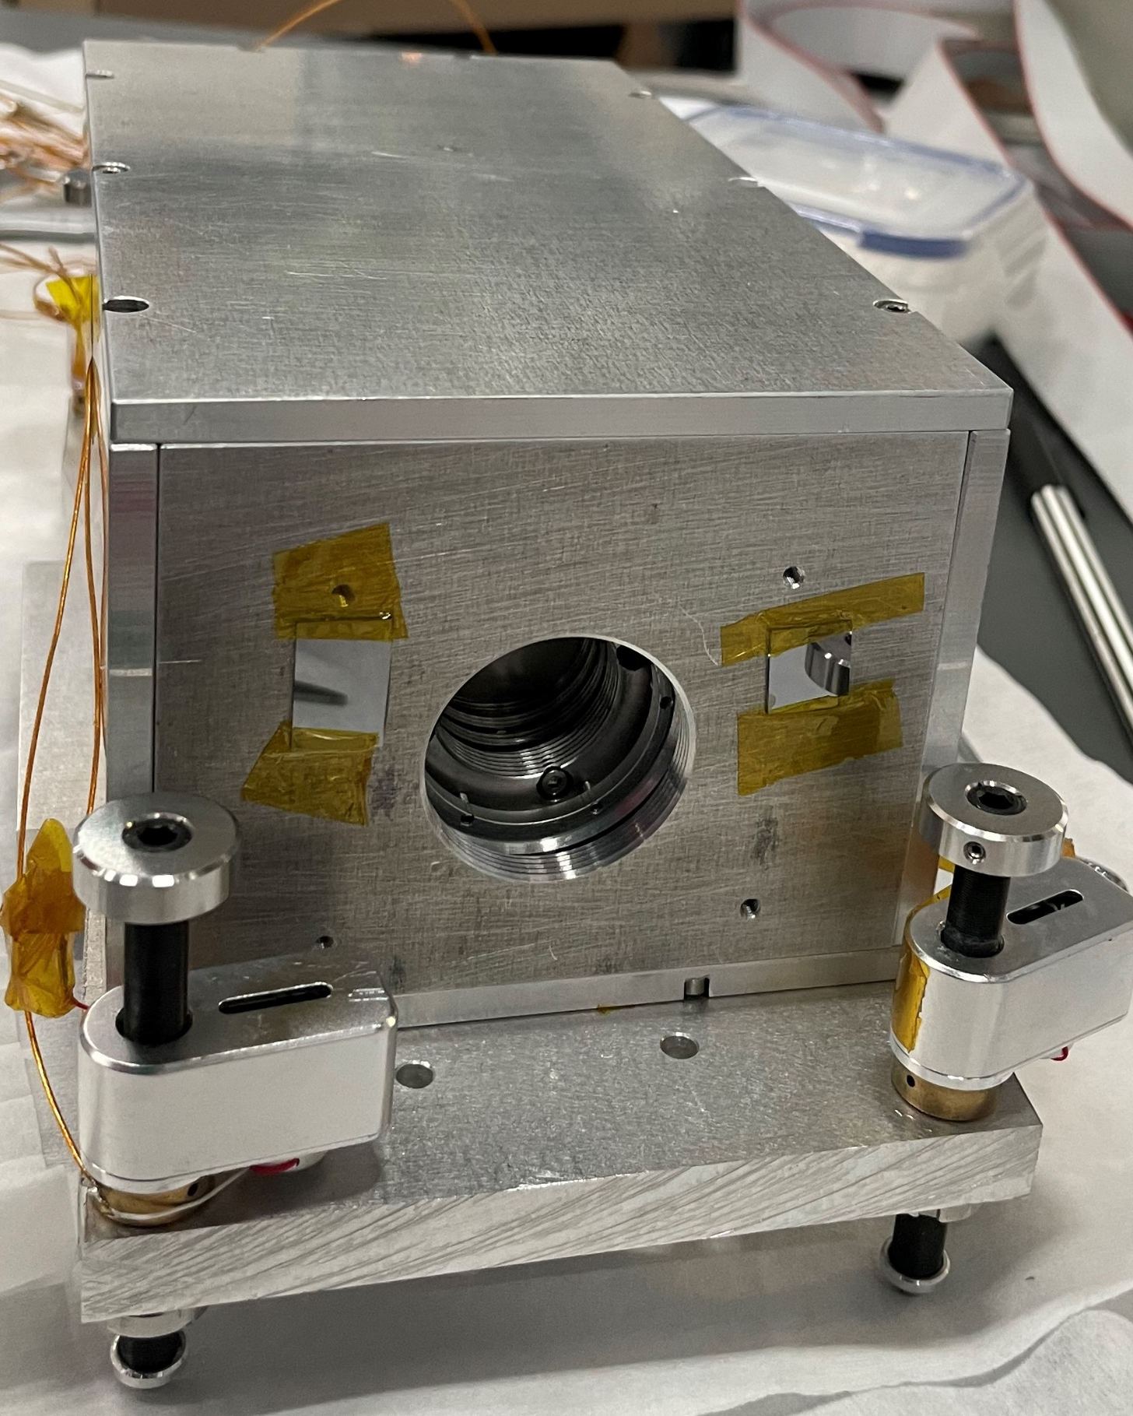



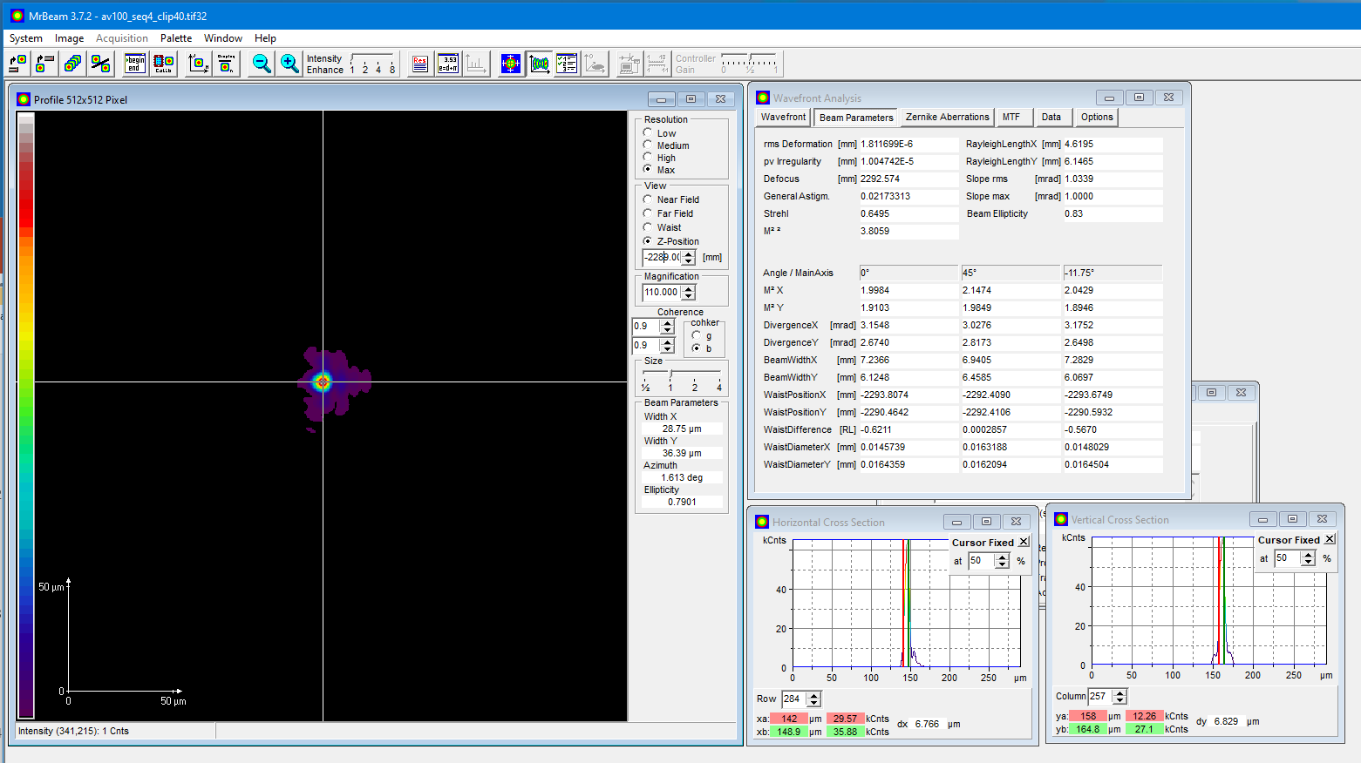
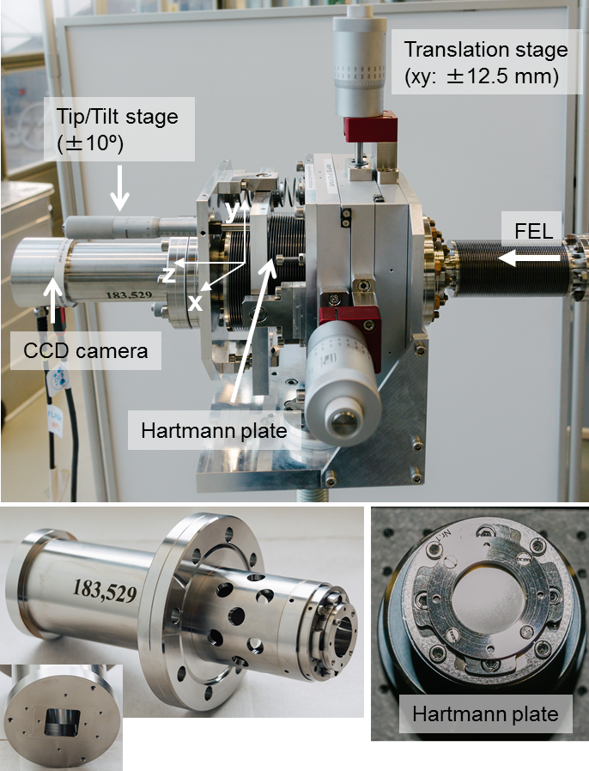
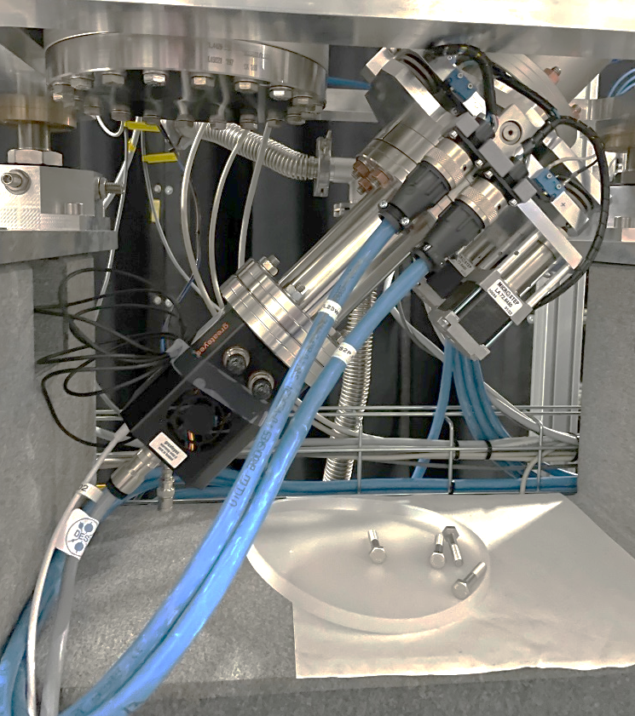
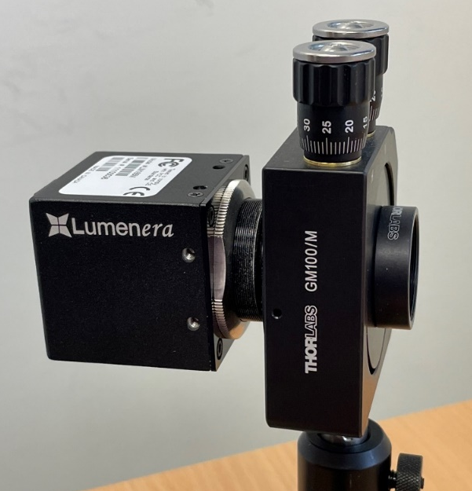
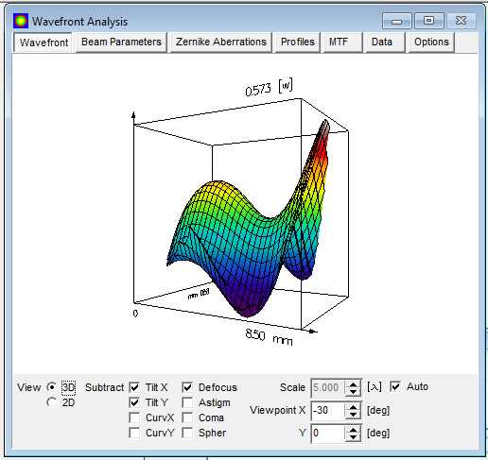
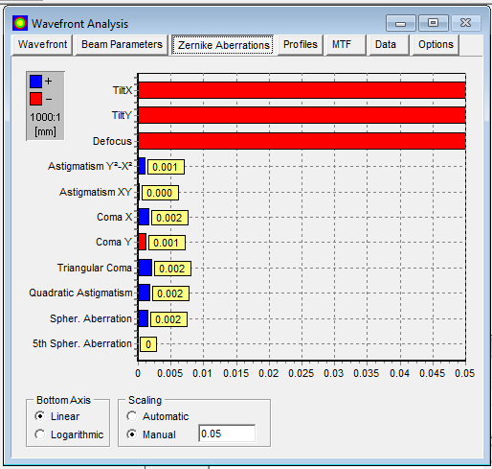
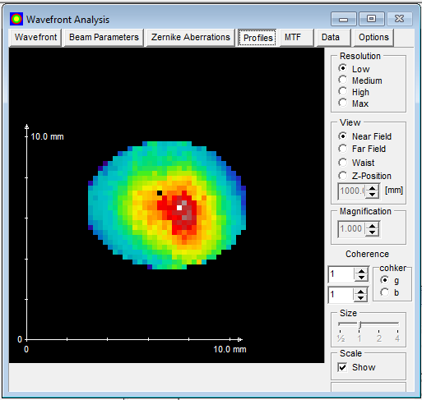
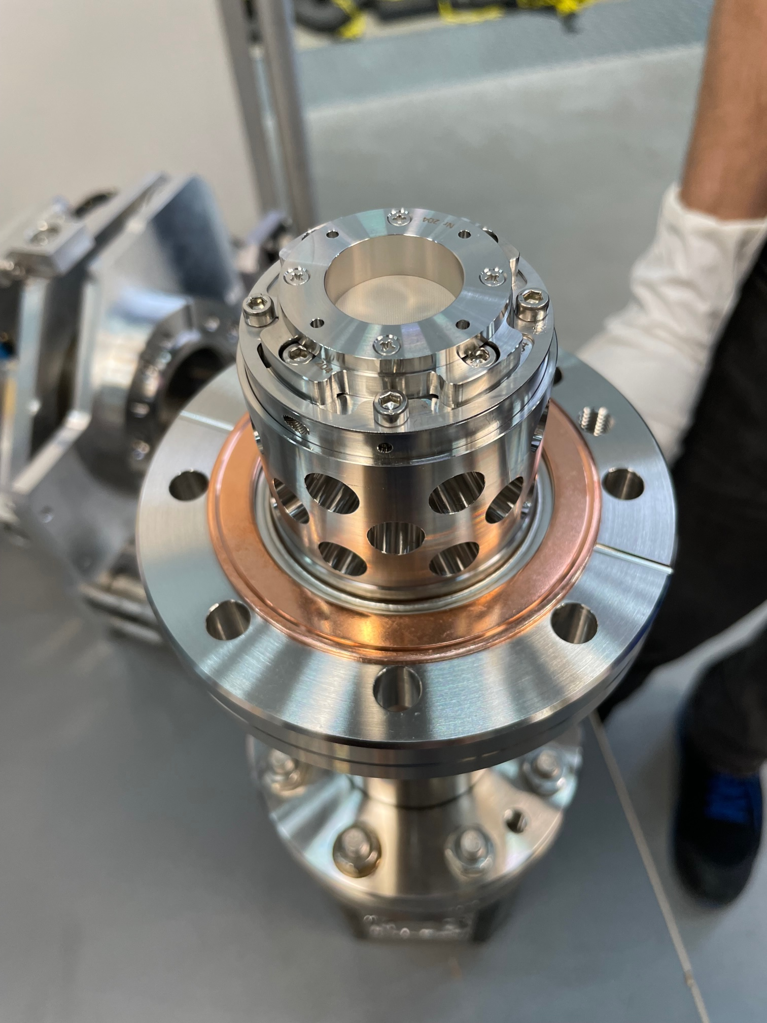
Wavefront sensors (WFS) at FLASH
Continuous collaboration with industry since 2005
(France)
Since 2005 first WFS for the XUV wavelength range (8 - 40 nm) in
operation at FLASH
Since 2019 in-vacuum WFS with high NA for highly divergent XUV beams
First WFS at FLASH, still in operation
Fully in-vacuum WFS
(Göttingen) together with (Spin-off company)
In 2006 start of development for compact XUV (4 – 30 nm) WFS
Compact integrated system
since 2023
Compact portable system
since 2015
WFS for visible (350 – 1100 nm)
Courtesy B. Keitel

Slide 8
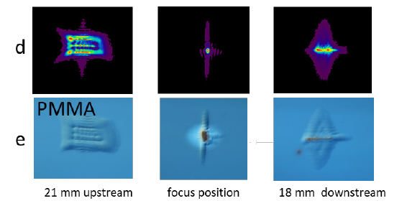
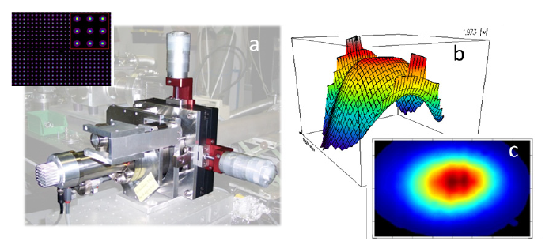
Wavefront sensor benchmarking
Compare to imprints
Courtesy B. Keitel

Slide 9
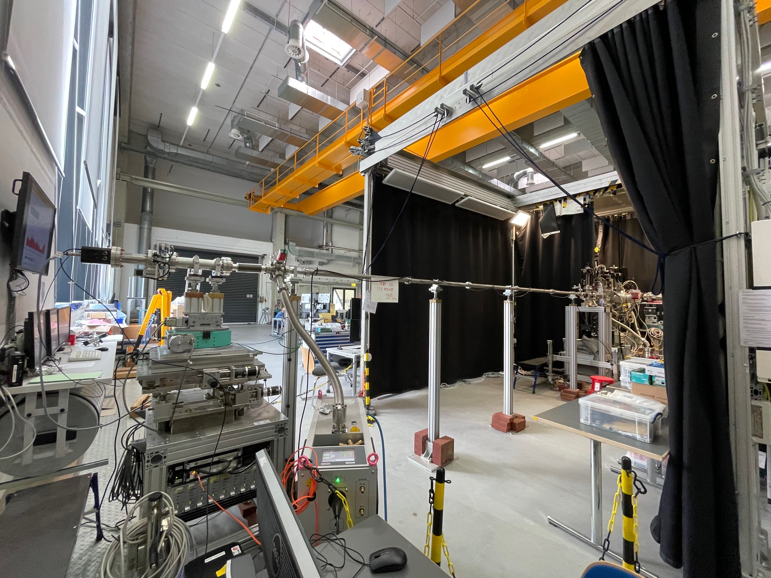
Wave front sensors need space …

Slide 10

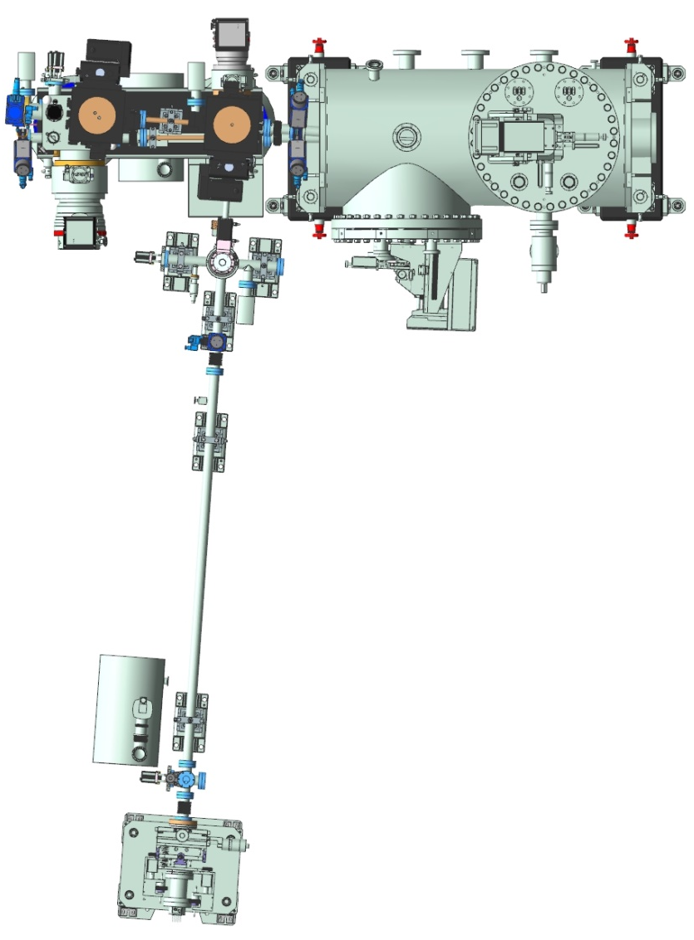
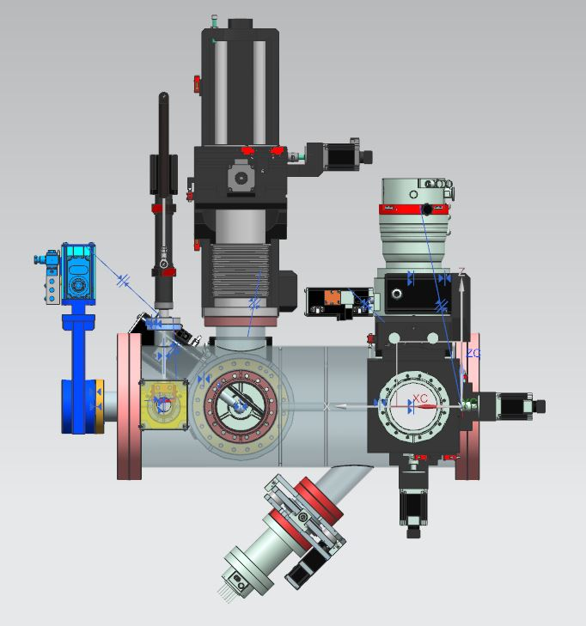
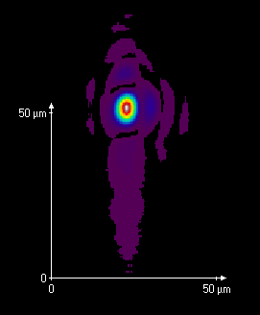

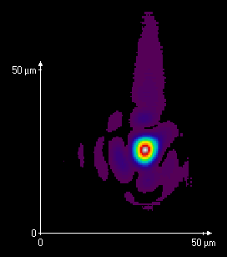
Permanent wave front sensing setup incorporated at beamline FL23 and FL24 at FLASH2
differential pumping unit
WFS straight on
KB optics
FEL
differential pumping unit
two mirrors at 22.5° reflect beam sideways
KB optics
to user experiment
FEL
Focus spot size: 4.7 x 6.4 µm² fwhm
Focal length: 1763 mm
WFS before focus position
side arm WFS
one mirrors at 22.5° reflects FEL down
Focus spot size: 5.4 x 6.1 µm² fwhm
Focal length: 1768mm
Successful first proof-of-principle demonstrator:
WFS in the side arm for alignment of KB optics without disturbing users
two mirrors at 22.5°
limited wavelength range (8 nm up to 40 nm)
focus positions between 1.5 m and 3.5 m can be measured
conform results in the side arm and straight direction
New design:
need to incorporate WFS into every beamline using bendable KB optics
WFS be located 45° beneath the differential pumping unit
one mirror under 22.5° increases intensity
WFS is located before focus position to avoid a large arm
Courtesy B. Keitel

Slide 11
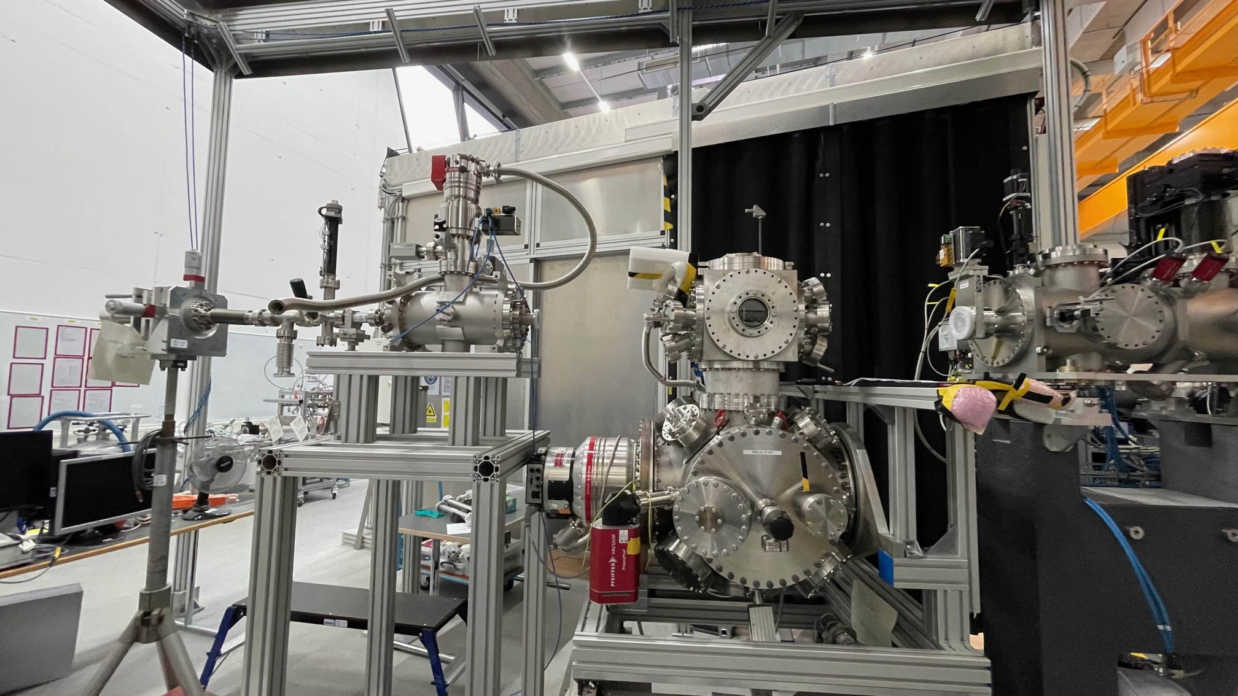
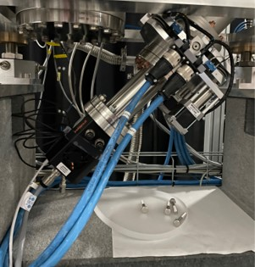
Compact WFS
Integrated in the focussing chamber
Courtesy B. Keitel

Slide 12
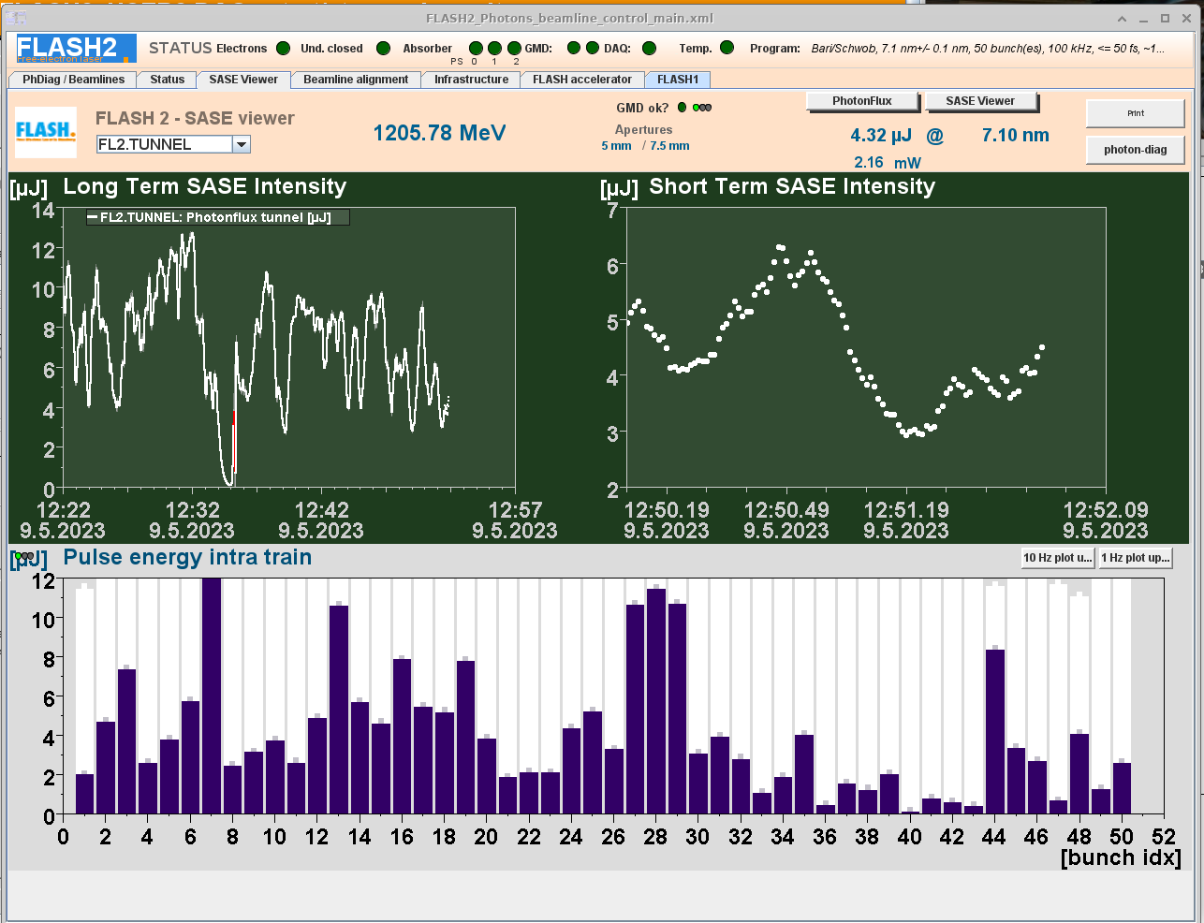
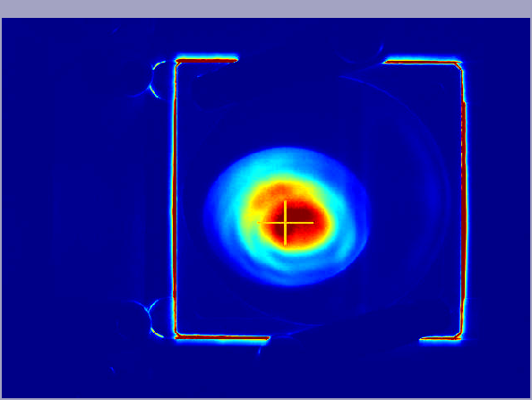
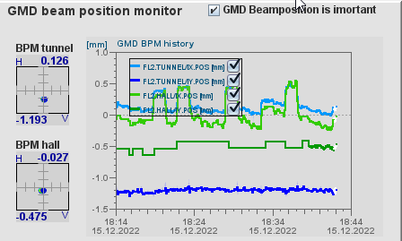
Beam position and pulse energy
Screens and “GMD”

Slide 13
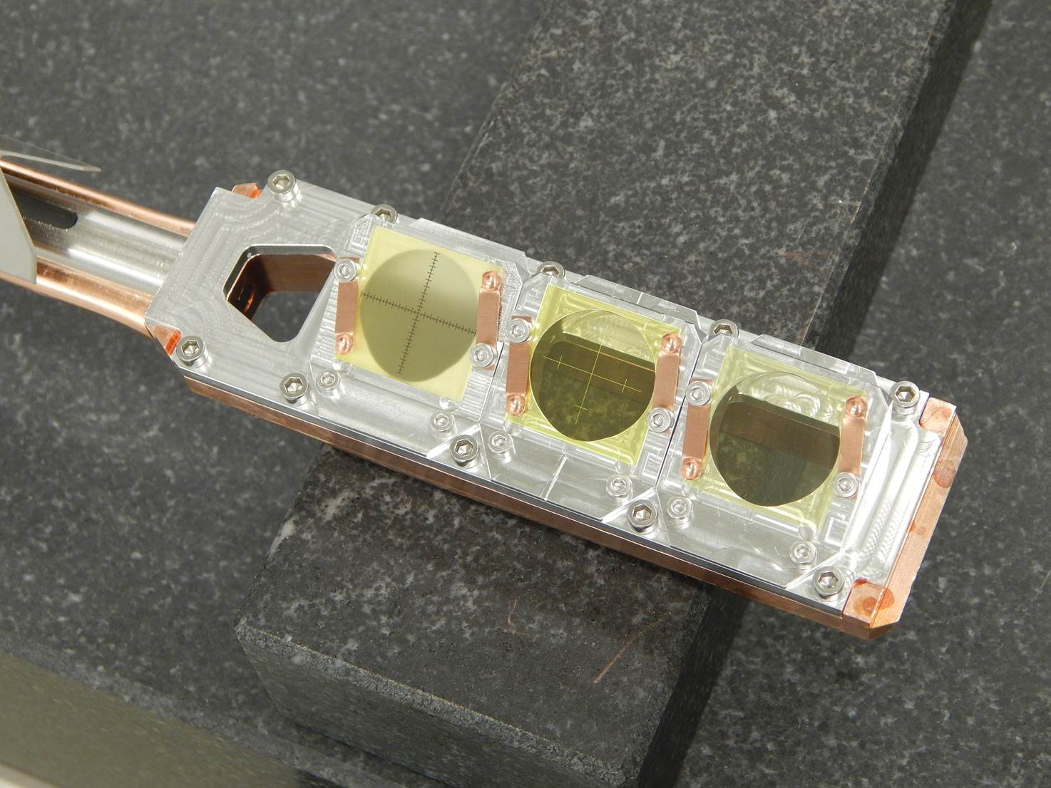
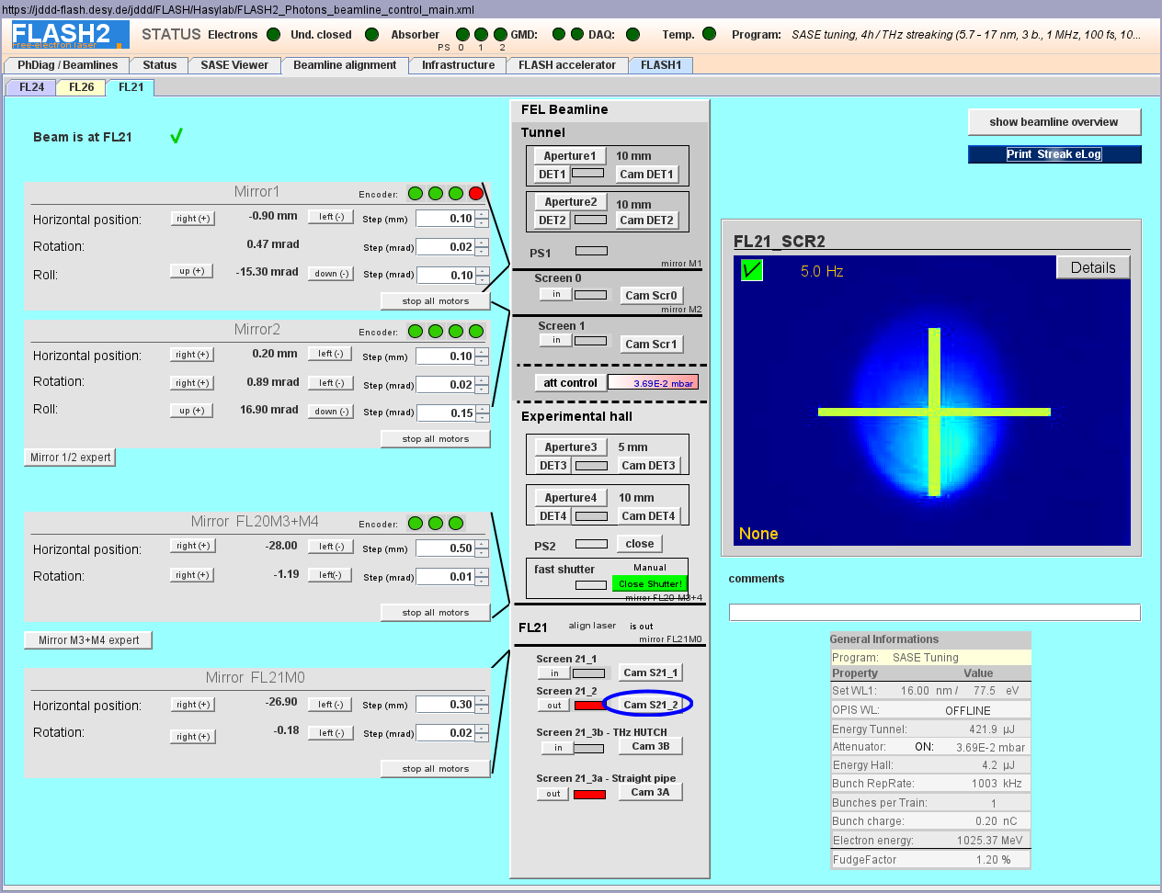
Beam position / shape
Important for machine setup and beamline alignment
Ce:YAG crystals (no powder due to aging)
motorized and pneumatic
mounted at 30 deg
Diamond are more robust screens for small, intense spots

Slide 14
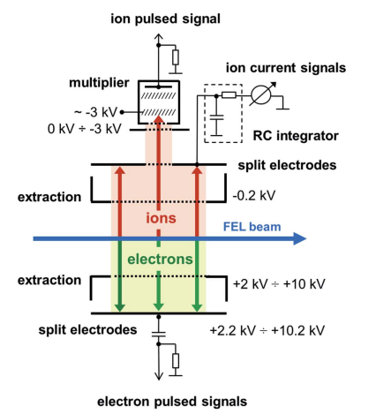
Pulse energy
Gas monitor detector (GMD)
A. A. Sorokin et al, J. Synchrotron Rad. 26, 1092-1100 (2019);

Slide 15
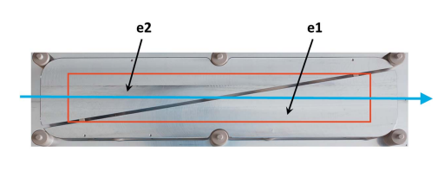
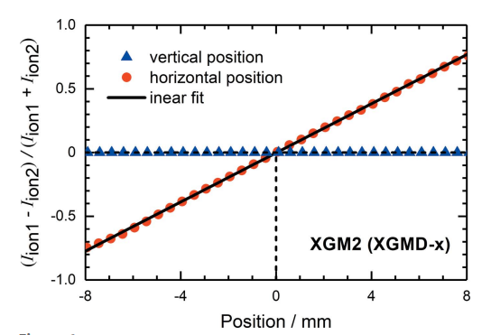
Pulse energy
Split electrodes … allows to measure the beam position
Gas monitor detector (GMD)
A. A. Sorokin et al, J. Synchrotron Rad. 26, 1092-1100 (2019);

Slide 16
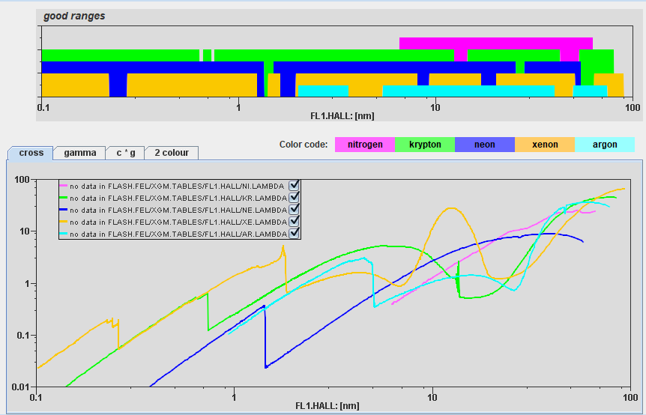
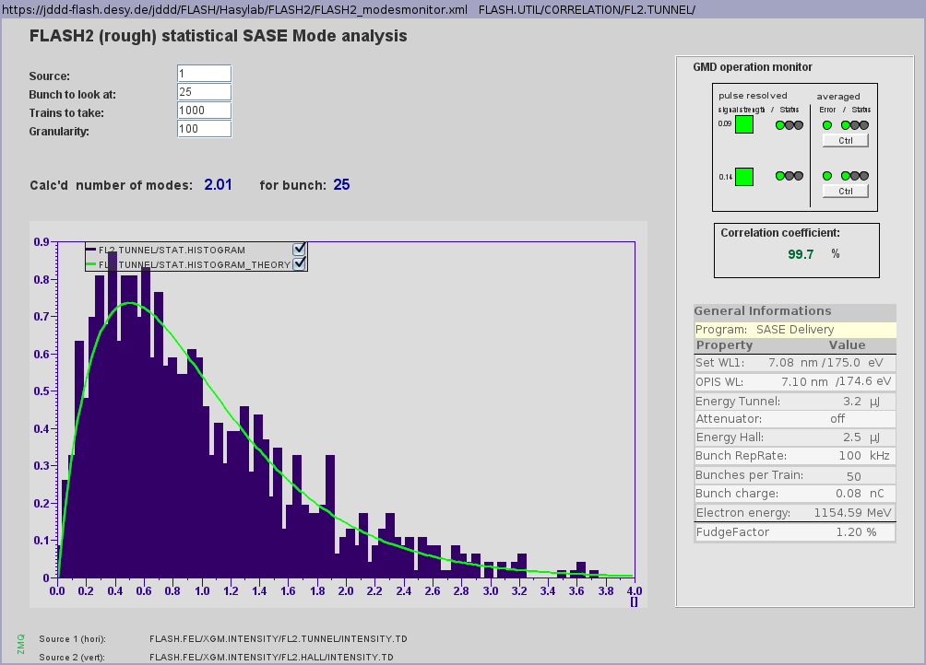
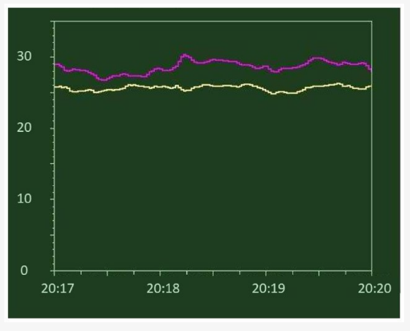
GMD in action
Statistical pulse energy analysis -> number of SASE modes
10 nm
7 nm
Two color operation
E. Schneidmiller, Appl. Sci. 13, 67 (2023)

Slide 17
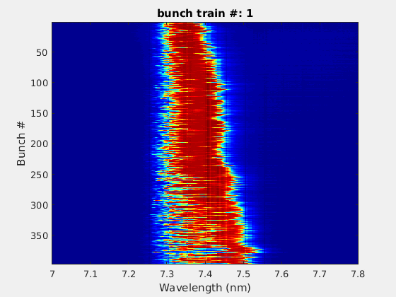
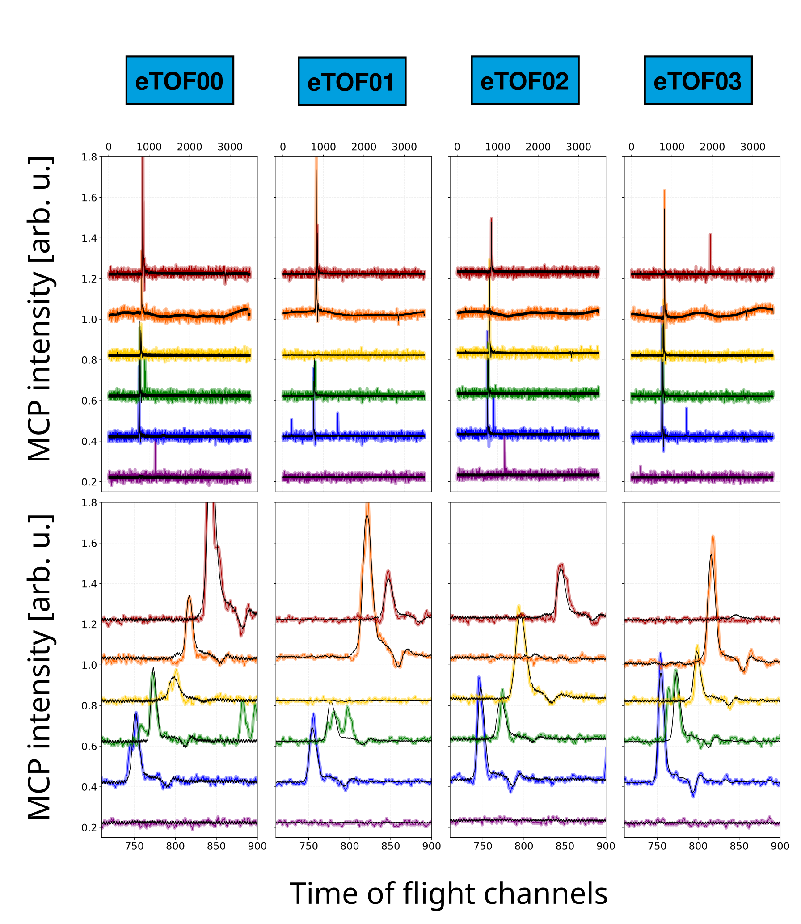
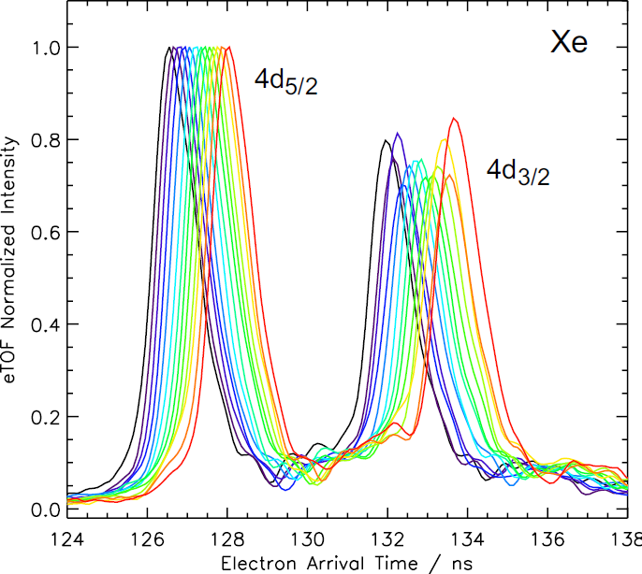
Spectrum
Photo ionization and MHz line camera
Tuning

Slide 18
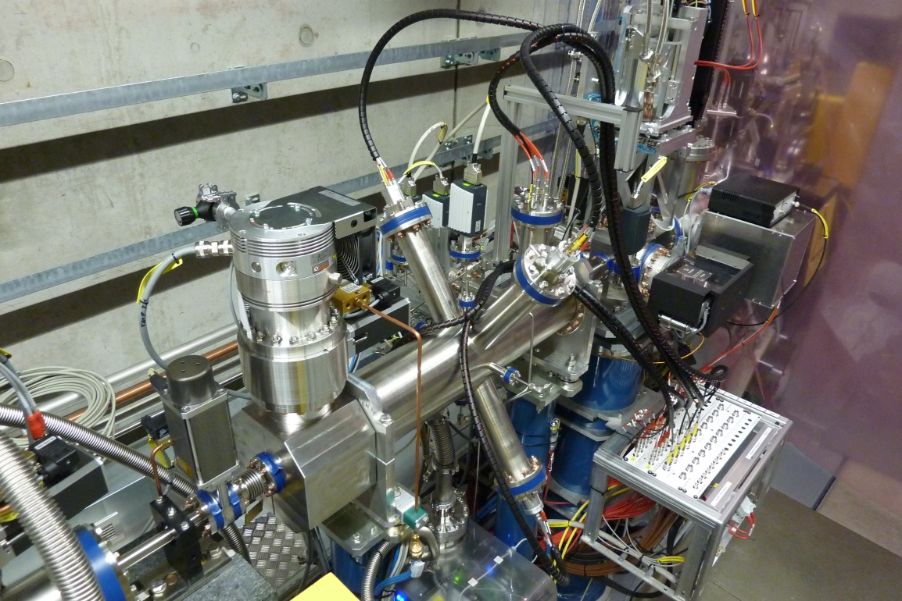
Online Photoionization Spectrometer (OPIS) @ FLASH2.
Measure the wavelength with photo electron spectroscopy
MCP signal intensity
photoelectron line
No optical elements which can be damaged or degrade
Basically 100% transmission
Self-calibration capability using Auger electrons
Low signal level to avoid space charge
prompt
signal
M. Braune, et al , J. Synchrotron Rad. 25, 3-15 (2018);
ADC trace
time-of-flight
time
steps of Δhν=0.05 eV
Courtesy M. Braune

Slide 19
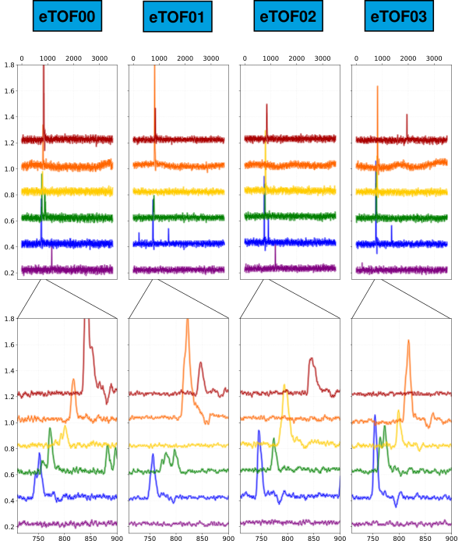
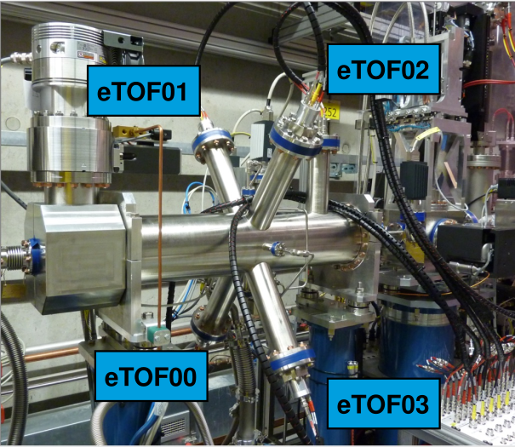
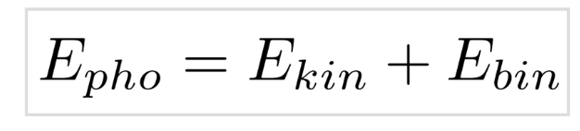
OPIS: Raw data
MCP intensity [arb. u.]
Time of flight channels
Notes:
- example raw data
Each color
- these 4 electron time of flight spectrometers.
- On the bottom we have a zoom in.
-Our main interest is the position of this photoelectron line, this is Neon 2p in this case.
- position of this line changes because we had varied the undulator settings
random hits, missing signal, baseline disturbance in some traces

Slide 20

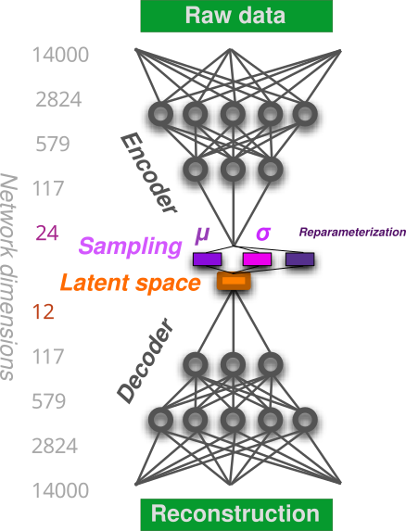


OPIS: Reconstruction
G.Hartmann, et al Sci. Rep. 12, 20783 (2022);
Reconstructed Data
Notes:
So we trained a network with this data,
network compresses it to a bottleneck of only 12 nodes.
And here in black we see the reconstruction.
Where the photoelectron peak is,
and baseline disturbance is reconstructed,
Noise level is reduced
And random Hits are discarded

Slide 21
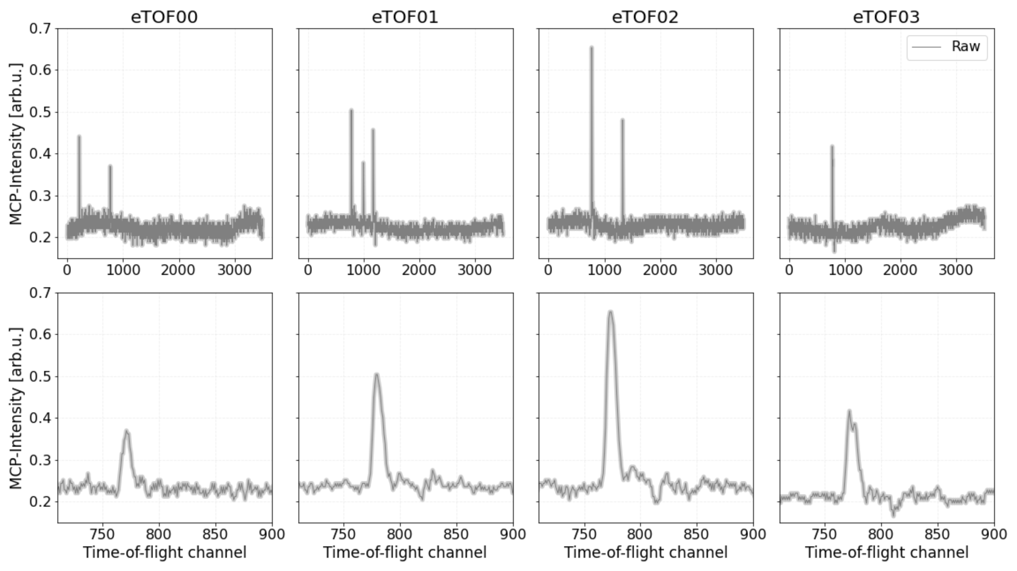
OPIS: Data cleaning
G.Hartmann, et al Sci. Rep. 12, 20783 (2022);
Stefan Düsterer | 13.6.2023 | EuPRAXIA workshop
21
Notes:
we can also use the network for data cleaning.
Here you can see some sinle shot raw data

Slide 22

OPIS: Data cleaning
G.Hartmann, et al Sci. Rep. 12, 20783 (2022);
Stefan Düsterer | 13.6.2023 | EuPRAXIA workshop
Notes:
As we have seen before, the reconstruction in black removes the random hits also the noise level is reduced

Slide 23


OPIS: Latent space
Stefan Düsterer | 13.6.2023 | EuPRAXIA workshop
23
Notes:
Other values that are stored inside the latent space include the Intensity of the Photoelectron peak,
The Baseline disturbance, the Interleaving issue and the Beampointing
Which is very remarkable, considering that we feed in the raw data from this opis device.

Slide 24

OPIS: Obtain central wavelength
Stefan Düsterer | 13.6.2023 | EuPRAXIA workshop
G.Hartmann, et al Sci. Rep. 12, 20783 (2022);
Notes:
- look at the latent space of 33 M. single shots
- 2D histogam all values of z0 and z1, that build a circle.
- phase of this circle to obtain the central wavelength.
- position of the Neon 2p peak plotted over the wavelenth settings of the undulator.
- red calibrated, purple the results from the network
- SASE setup, so the true central wavelength fluctuates around the one that is set by the undulator.
- 98% of the data could be evalueted, which is all data except the shots where is no signal in all 4 e-tofs.

Slide 25



VLS-Spectrometer with MHz line camera
KALYPSO:
  256 pixels, 50 µm pitch
  14 bit ADC, 2.7 Mfps
  Developed within ARD Matter & Technology between KIT, DESY and HZDR
  Low-latency continuous read-out with up to 2.7 MHz rep rate => cw and feedback capability
  Under development version 3:
  up to 1024 pix, up to 5 MHz, better signal-to-noise
Tuning
0th order
to BL1-3
6nm
KALYPSO
60nm
FINISHED
1st order
VLS grating
G. Brenner et al.,
Nucl. Instr. and Meth A 635, 99–103 (2011).
C. Gerth, et al. J. Synchrotron Rad. 26, 1514 - 1522 (2019);
Stefan Düsterer | 13.6.2023 | EuPRAXIA workshop
Notes:
Photon electrion spectroscopy
Quality → to setup the machine
Fluctuation →
Photon diagnostic for users .. → monitor

Slide 26





Temporal properties
Pulse duration and arrival time

Slide 27






THz streaking principle
A noble gas target is photoionized by the FEL pulse.
Gas needle
Photoelectron
spectrum
Streaking trace
Photoelectrons interact with the THz field which will accelerate or decelerate the photoelectrons.
FEL pulse
Gas atoms
Photoelectrons
Electron time‐of‐flight (eTOF) spectrometer detects the ejected photoelectrons
THz field
FEL pulse
eTOF
U. Frühling et al. Nat. Photonics 3, 523 (2009)
I. Grguraš et al. Nat. Photonics 6, 852 (2012)
Notes:
Linearly polarized THz field
Temporal information of the FEL pulse will be mapped with the THz vector potential into the kinetic energy distribution that we measure with eTOF
The technique is non-invasive

Slide 28


THz Streaking - observables
What can we learn from the signal?
Single shot XUV arrival time
Single shot XUV pulse duration

Slide 29
THz streaking at FLASH
Summary of the last years
Short and long pulses
          R.Ivanov at al., Journal of Physics B, 53 (2020)
Correlation to other pulse parameters
        I.Bermudez at al., Optics Express 29, 10491-10508 (2021)
Pulse duration along the gain curve
M. Bidhendi, Appl. Sci. 12, 7048 (2022)
Ap. Sci. 12, 7048 (2022)
Arrival time studies
R.Ivanov at al., J. Synchrotron Rad., 25 (2018)
R.Ivanov et al, Opt. Express 31, 19146 (2023)
“parasitic measurement” option
R.Ivanov et al, Opt. Express 31, 19146 (2023)
2 color operation
E. Schneidmiller, Appl. Sci. 13, 67 (2023)
Pulse duration of FEL harmonics
Comparison to electron diagnostic (TDS)

Slide 30

Testing “parasitic” measurements
Use only a small fraction of the FEL beam

Slide 31


Comparison TDS vs THz streaking
Use electron diagnostics to measure XUV pulse duration / shape
No lasing
C. Behrens at al, Nature Communications 5, 3762 (2014)
lasing
Electron Energy
Time

Slide 32



Comparison TDS vs THz streaking
Recent data … work in progress …
Thanks to Ch. Behrens and G. Goetzke

Slide 33
Summary
SASE FEL needs pulse resolved diagnostics !
Focal spot size / position
Energy, pointing
Spectrum
Pulse duration (~ 30 fs to ~ 300 fs)
Next steps
  More automated analysis ( AI …)
  More non-invasive and “little-invasive” diagnostics
  Measure very short pulses (0.5-20 fs) -> angular streaking
  After 2025 … FLASH1 -> SEEDED HIGH REPRATE FEL

Slide 34




Thanks to
Acknowledgments
M. Bidhendi, R. Ivanov, I. Bermudez, M. Yurkov, E. Schneidmiller, G. Brenner, J. Roensch-Schulenburg , M. Kuhlmann, U. Frühling, M. K. Czwalinna, M. Brachmanski, S. Kreis, J. Müller, S. Schulz, A-L Calendron, M. Degenhardt, B. Keitel, K. Tiedtke, M. Braune, G. Goetzke, Ch. Behrens …
J. Liu
N. Kabachnik
A. Kasansky
G. Hartmann,
P. Feuer-Forson
F. Kaertner, M. Pergament,
M. Kellert, S. Reuter

Slide 35

Thanks
for your
attention

Slide 37

Arrival time measurements
Precision for pump-probe
Correlation width = 12 fs rms !
BAM
R.Ivanov et al, Opt. Express 31, 19146 (2023)

Slide 38


Two-color operation @ FLASH2
2 pulses with 2 colors from the same electron bunch
Undulator
λ1 = 15 nm (83 eV)
λ2 = 19 nm (66 eV)
By E. Schneidmiller
Short WL = 15 nm (82 eV); ~ 70 fs (FWHM)
Long WL = 20 nm (62 eV). ~ 90 fs (FWHM)
E. Schneidmiller et al., Appl. Sci. 13, 67 (2023)

Slide 39



Two-color operation @ FLASH2
Arrival time fluctuations
Relative arrival time
Longer wavelength pulses arrive on average ~ 15 fs later

Slide 40
Evolution of pulse energy and pulse duration
M. Bidhendi et al. Appl. Sci. 12, 7048 (2022)
Notes:
the number of undulators was scaled to the undulator coordinate z such that the onset of measurable SASE (>0.5 µJ) coincided with the z range in which the energy gain became visible in the simulated energy gain curve (z/zsat∼0.7)

Slide 41

Error sources @ different pulse duration ranges
a) Fluctuating SASE XUV spectrum
Measured XUV spectrum
$τ_{xuv}=\sqrt{\frac{{σ^{2}}_{streak}−{σ^{2}}_{reference}}{s^{2}}}$
Streaking speed: s~ 0.1 eV/fs
$τ_{FEL}$< 30 fs (FWHM)
30 fs < $τ_{FEL}$< 200 fs (FWHM)
$τ_{FEL}$> 200 fs (FWHM)

Slide 42



Special operation modes
Double pulse in deep saturation regime
Energy [eV]
Shot number
135 fs
-200 fs
0 fs
200 fs
Time [fs]
Notes:
Although we give a number for the pulse duration, we can see the pulse shape and
For instance, sometimes we see wiggles in the pulse shape that we can also see in Polarix.
- Double peak is generated at deep saturation.

Slide 43

THz generation
Schematic layout of the THz‐streaking setup.
It consists of two parts:
the THz production via tilted pulse‐front in a LiNbO3 crystal using an IR laser (1030 nm)
and the UHV chamber located above the optical table, where the FEL and THz beams are collinearly overlapped and focused into the interaction region
I. Bermudez, PhD thesis (2022).

Slide 44


Further detectors
HAMP, XGMD, Round-Robin GMD
KALYPSO
Parameters for current version 2.1
  256 pixels, 50 µm pitch
  14 bit ADC, 2.7 Mfps
Parameters for prototype version 2.5
  1024 pixels, 25 µm pitch
  14 bit ADC, 2.2 Mfps
Other DESY groups:
Polarimeter („CookieBox“), P04 @PETRA III
16-eTOF spectrometer instrument for monitoring the polarization
by measuring the photoelectron angular distribution
Percival (“Pixelated Energy Resolving CMOS Imager,
Versatile and Large”)
back-thinned to access its primary energy range of 250eV to 1keV,
the roughly 10x10cm2, 3520 x 3710 pixel monolithic sensor
up to 120Hz
KALYPSO
Percival
(courtesy C. Wunderer)
| FLASH2020+ | Hamburg | Kai Tiedtke | 22.01.2019 |

Slide 45




Alignment pinhole
Wavefront sensors (WFS) at FLASH
How a wavefront sensor works
Wave front reconstruction:
The displacement of the spot centroid (x_{c},y_{c})_{ij} with respect to a known reference position (x_{r},y_{r})_{ij} is a measure for the spatial average of the Poynting vector S. (β_{x,y})_{ij} approximates the wavefront gradient.
$$β$$
The wavefront is reconstructed by a modal approach, via a least squares fit with a polynomial basis P_{k}. Zernike polynomials are well suited for the reconstruction at FLASH due to the circular beam shape and good representation of typical focusing mirror aberrations.
$$f$$
Courtesy of Pascal Mercère,SOLEIL
Numerical propagation:
Since the sensor records both intensity and phase, it allows also the prediction of intensity distributions for any position in the beam course by numerical propagation. The IFNANO software MrBeam features Fresnel-Kirchhoff propagation:

