Slide 1
Notes:
Slide 1: Company Logo Full Page
Before you start editing the slides of your talk change to the Master Slide view:
Microsoft Office :Menu: View > Slide Master;
Macintosh – View > Master > Slide Master
Edit the following items:
On the Slide Master (first master slide) – lower area
a) On the left Delete the text and write the title of the event/Conference, Location
b) On the right delete the text and write the name and surname of the speaker and the date (day, month , year)
Close Master View

Slide 2


Soft X-rays Photon Diagnostics:
the FERMI experience
Marco Zangrando
on behalf of the PADReS and FERMI Teams
WP13 EuPRAXIA – Photon Diagnostics

Slide 3
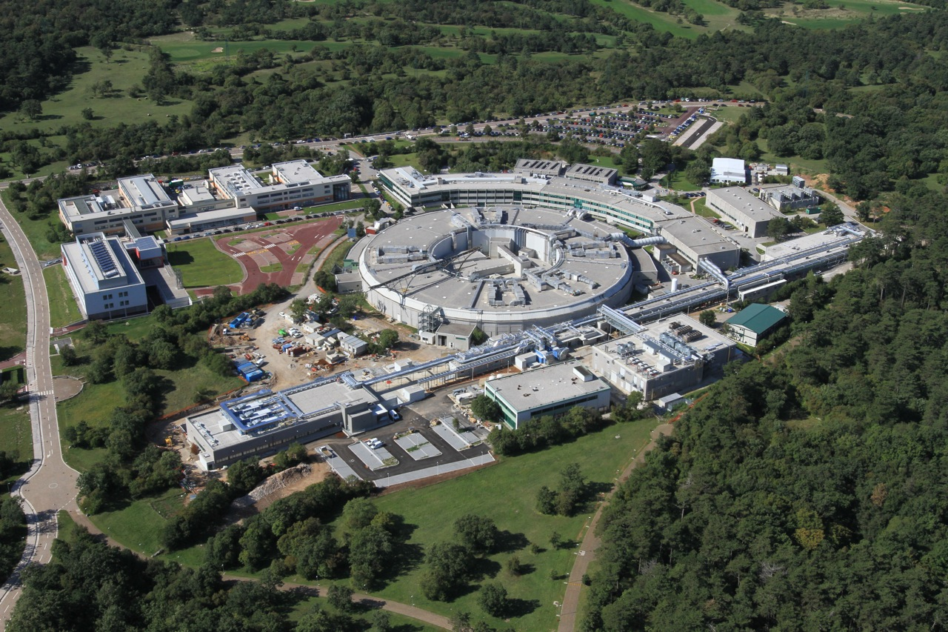
ELETTRA SINCROTRONE TRIESTE
The lightsources
ELETTRA Synchrotron Light Source:
up to 2.4 GeV – TOP-UP mode
In operation since 1993
FERMI FEL-1 & FEL-2 Free Electron Laser
100nm to 4 nm
In Operation since 2012
∼ 200 m
Linac Tunnel +
Injector Extension
∼ 100 m
Undulator Hall
∼ 50 m
Experim. Hall

Slide 4
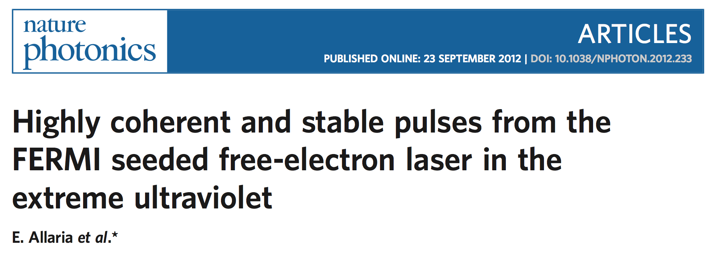
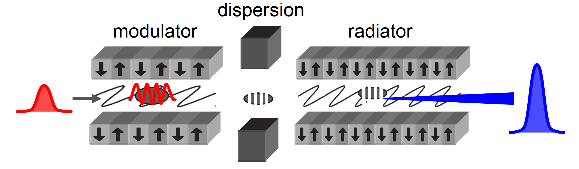
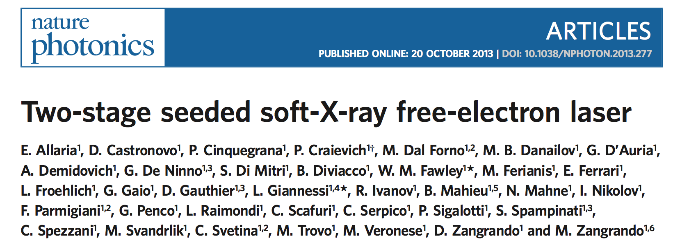
FERMI: HIGH GAIN HARMONIC GENERATION
FEL-1 and FEL-2
FEL-1 : Single stage HGHG
* Apple II type helical undulators (variable gap)
Seed Laser:
THG (~260nm)
OPA (230-260nm or 296-360nm)
Mod.
High gain radiator tuned at n^{th} harmonic
Dispersion
Spectral range: 20 – 100 nm
FEL-2 : Double stage HGHG with fresh bunch injection technique
1st mod.
1st rad.
2nd mod.
DS1
DL
DS2
2nd rad.
Spectral range: 4 - 20 nm

Slide 5
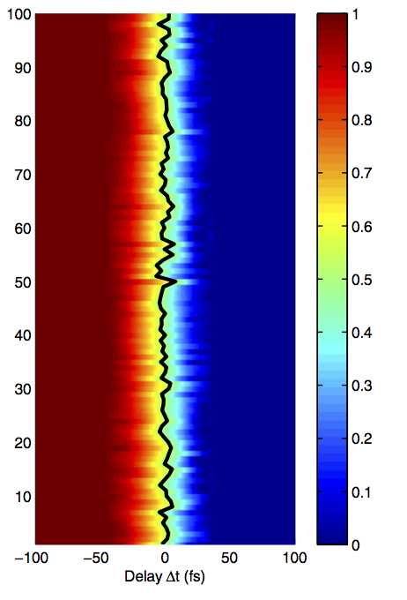
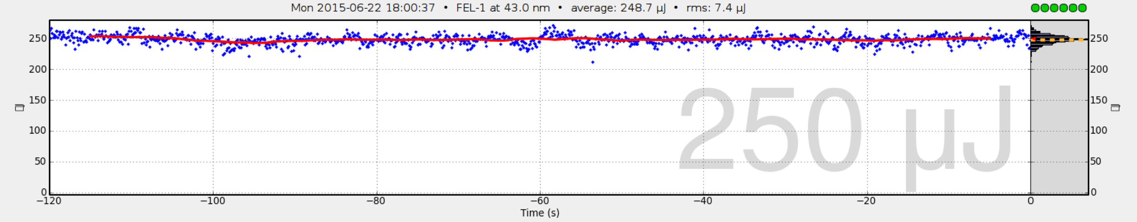
FERMI: HIGH GAIN HARMONIC GENERATION
Routine performance
High Gain Harmonic Generation free electron laser
Covering the 100 – 4 nm range with two FEL lines (single and double “fresh bunch scheme” cascades)
Pulse energy: 10 – 100s µJ | Pulse length: 20 – 100 fs
Full polarization control
High coherence (temporal and spatial)
Down to 2∙10⁻⁴ rms linewidth
Central λ stability down to 10⁻⁵ rms
FEL temporal jitter: (relative to the Seed): 2.2 fs
P. Finetti et al. Phys. Rev. X 7, 021043 (2017)
Several unique properties, stability (time, energy, photons): laser like photon statistics
Not standard, Typical 10-15% rms on FEL-1 ∼ 2-3 ⨯ on FEL-2
FEL-1 saturated @43 nm
3% rms

Slide 6
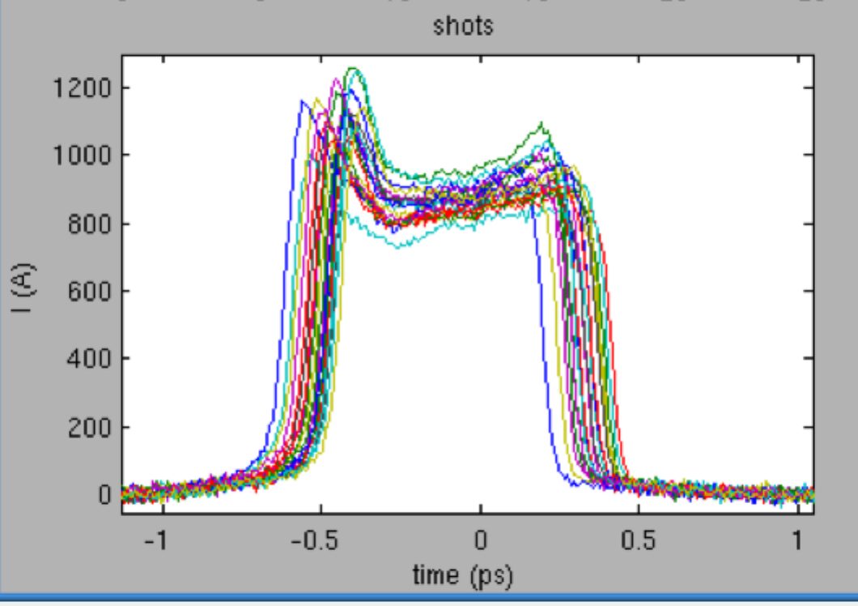
FERMI: HIGH GAIN HARMONIC GENERATION
Versatility → Exotic modes
Multiple pulses can be generated by double pulse seeding in different ways, depending on the requirements on the output radiation. Temporal separation between 25-300 and 700-800 fs. Shorter separations are accessible via FEL pulse splitting*. Larger separations require the split & delay line.
* Pulse Splitting by using a powerful chirped Seed Laser
PRL 110, 064801 (2013)
Spectral separation 0.4-0.7%
Allaria et al., Nat. Comm., 2013
time
gain
bandwidth
spectrum
RAD2 gain
bandwidth
Spectral separation 2-3%
or much larger if the two radiators are tuned at different harmonics
Ferrari et al., Nat. Comm, 2016
spectrum
MOD gain
bandwidth
time
RAD1 gain
bandwidth
spectrum
Two (almost) temporally superimposed pulses at harmonic wavelengths of the seed. The two pulses are correlated in phase and the phase can be controlled with the phase shifter.
K. Prince et al. Nat. Phot. 10, 176 (2016)
MOD gain
bandwidth
time
spectrum

Slide 7
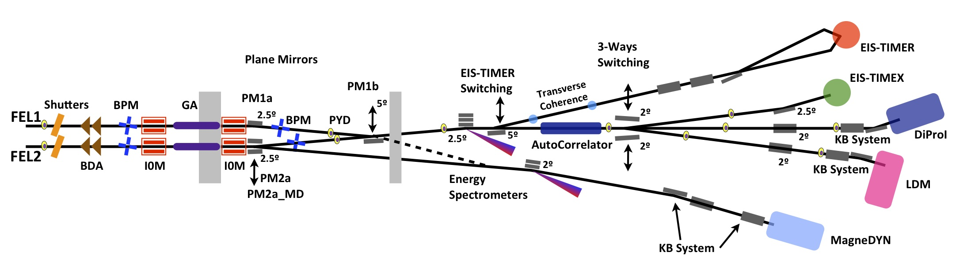
FERMI PHOTON TRANSPORT AND DIAGNOSTICS
Photon Analysis Delivery and REduction System
2 Photon diagnostics sections + manipulation capabilities
5 FEL-served endstations

Slide 8
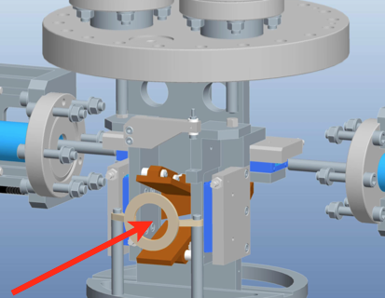
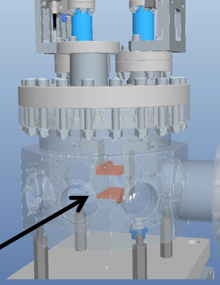
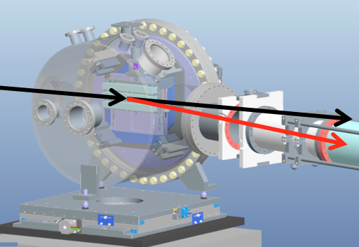
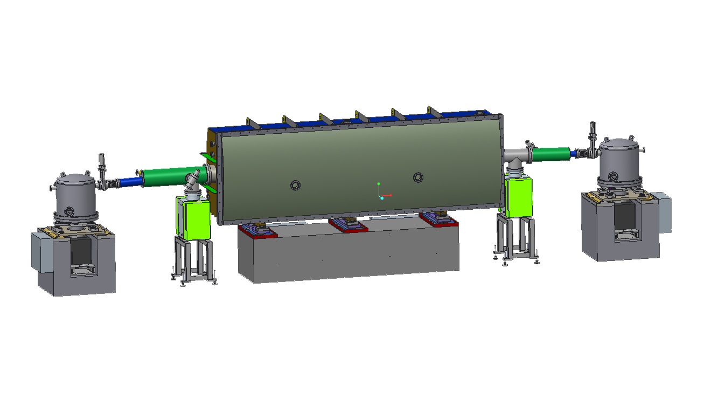
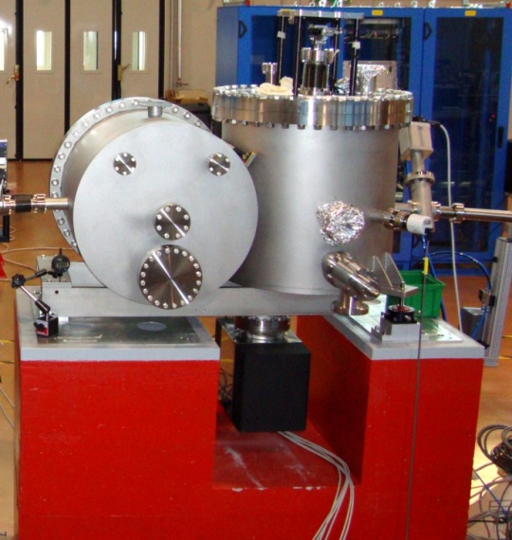
FERMI PHOTON TRANSPORT AND DIAGNOSTICS
The most peculiar elements
Most of the machine activities devoted to fine tuning and to reach the ultimate performance rely on the photon diagnostics available along PADReS:
  Intensity monitors
  Beam position monitors
  Energy spectrometers (PRESTO/TARDI)
  while
All of the experimental activities carried out in the endstations rely, besides the photon diagnostics, on the photon transport/manipulation system
  Gas absorber
  Split and delay line (AC/DC)
  Focusing systems (KAOS and elliptical mirror)

Slide 9
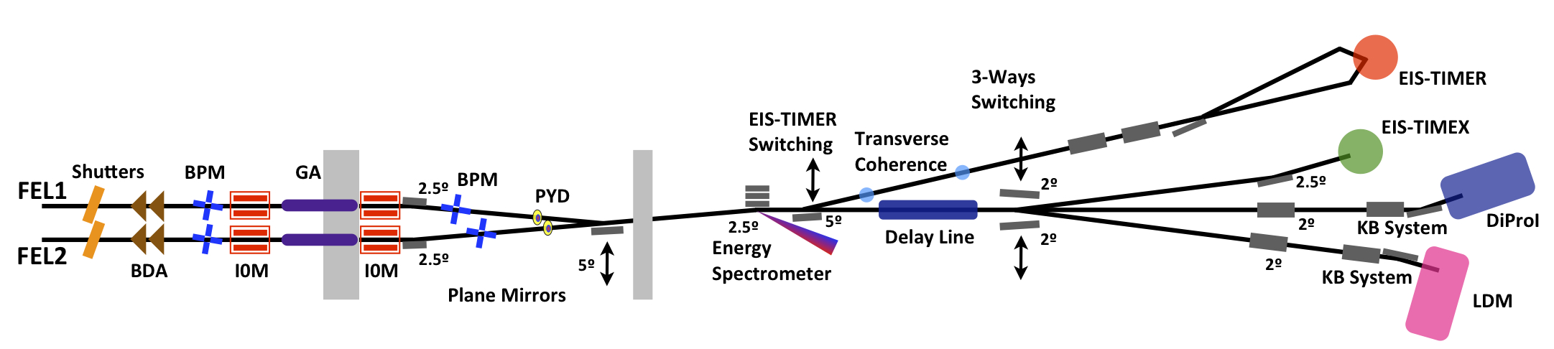
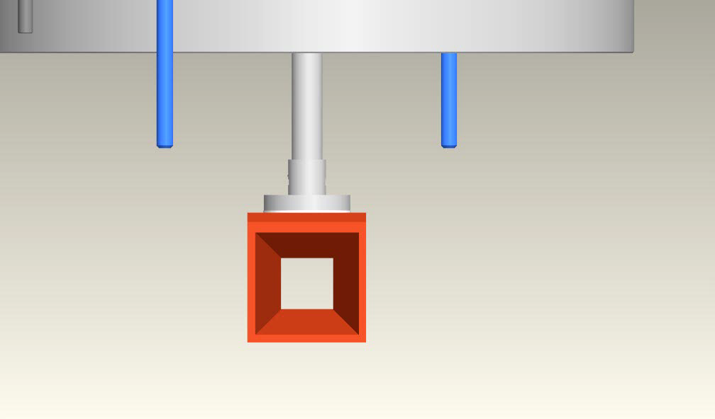
TRANSVERSE DISTRIBUTION
Beam Defining Apertures and Beam Position Monitors
Beam defining apertures:
33 (25) meters from FEL1 (FEL2)
Used to eliminate the non-TEM₀₀ modes
Beam position monitors:
Used to monitor the photon beam angular displacement online and shot-to-shot (knife-edge scans possible)

Slide 10
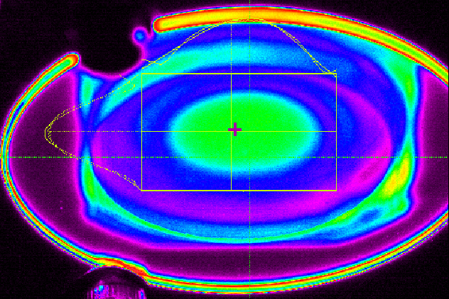
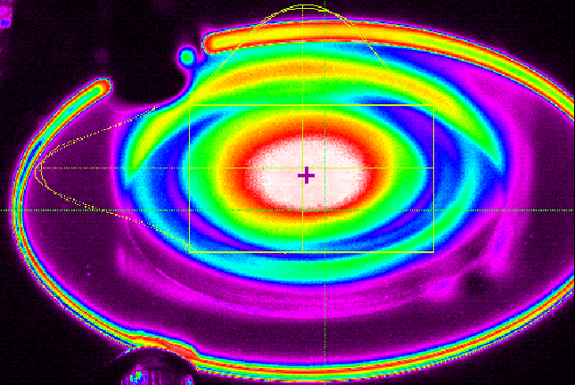
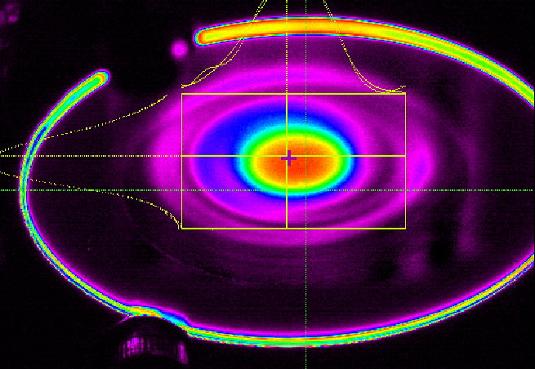
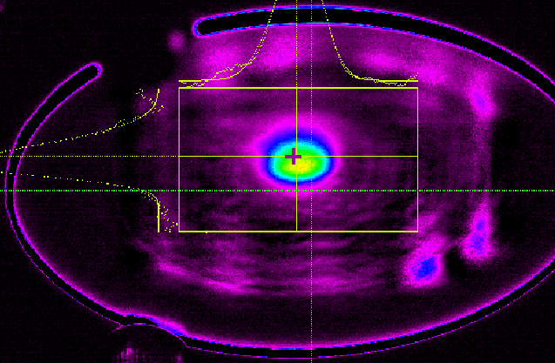
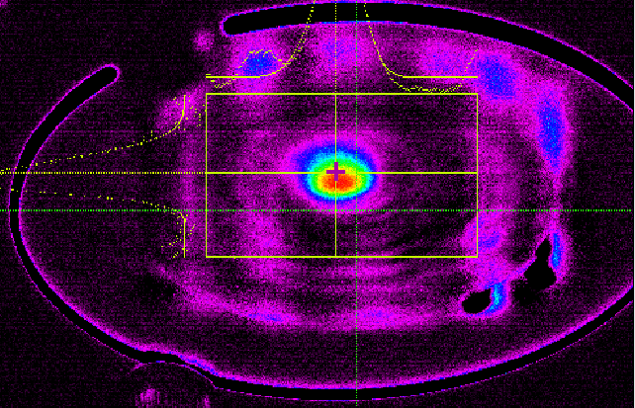
TRANSVERSE DISTRIBUTION
YAG screens
Ce:YAG screens:
Along the whole system (ideally one for each optical element)
FERMI experience:
BDAs and BPMs play an important role in cutting unwanted off-axis emission from undulators and monitoring possible instabilities in the photon beam pointing

Slide 11
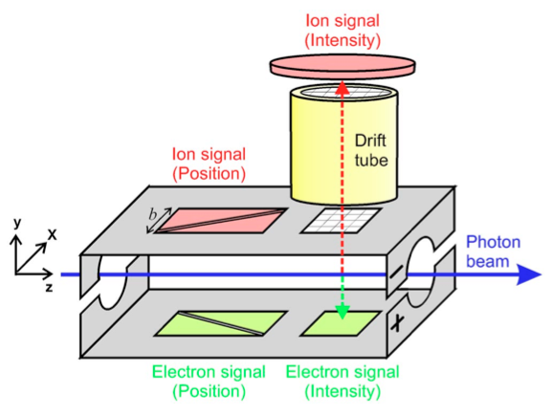
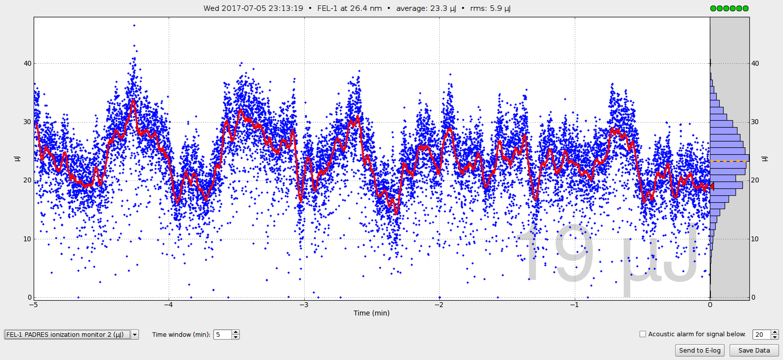
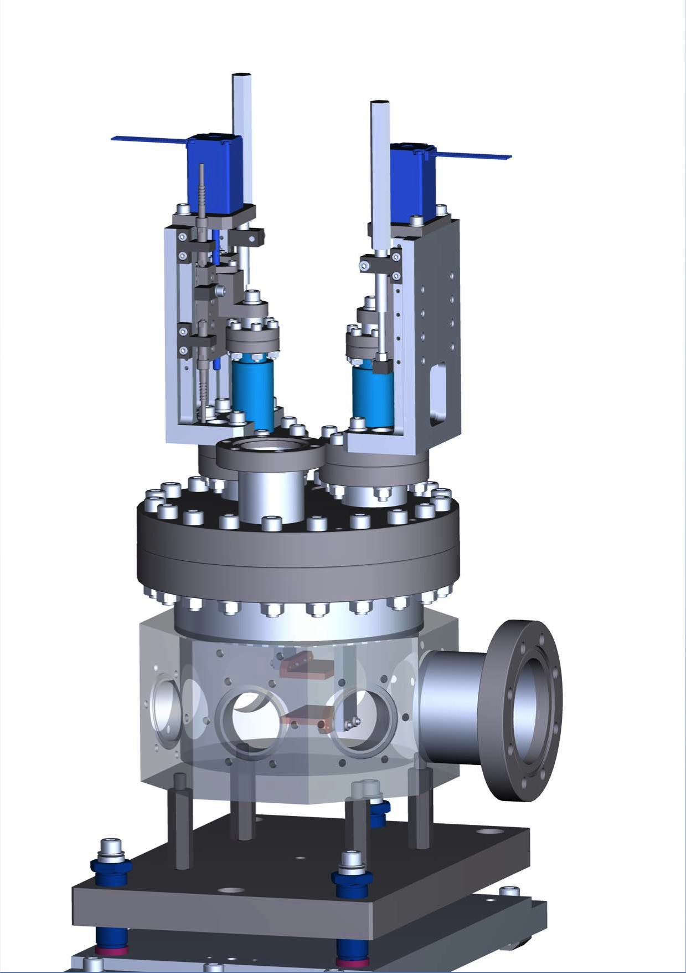
INTENSITY
Gas-based monitors
Intensity monitors:
Measures the number of photons of each pulse
(~3% precision, 1% reproducibility)
Online and shot-to-shot
Transparent
Nparticle = Nphoton⋅σ(hν)⋅z⋅η⋅n
Nparticle = number of detected particles
Nphoton = number of photons
σ = photoionization cross section
z = detector acceptance length
η = ion detection efficiency
n = atomic gas density (p and T required)
p = 3 ∙ 10⁻⁵ mbar
Saturated @43 nm
Not standard, typical 10-15% rms
FERMI experience:
I0Ms should be diversified (gas-based, grating-based, mirror photo-current, operating on residual vacuum) and distributed along the transport (especially before the endstations)
3% rms

Slide 12
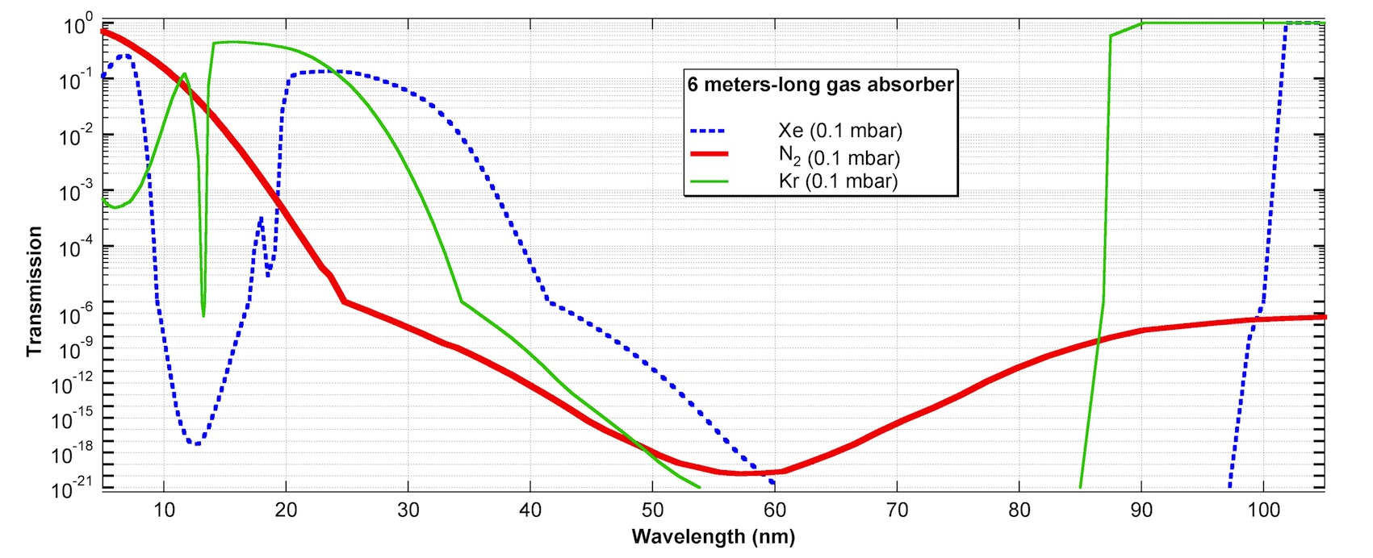
INTENSITY
Gas-based absorbers
Gas absorber:
Need to align the beam without destroying the sample + intensity-dependent studies
Max attenuation at all λ: 10⁻⁴
Preservation of coherence, spectrum, statistics, etc.
FERMI experience:
The gas absorber should be also able to implement different gases in order to meet, if possible, the users’ needs (e.g., cutting higher orders and/or multi-cascade FEL photons)

Slide 13
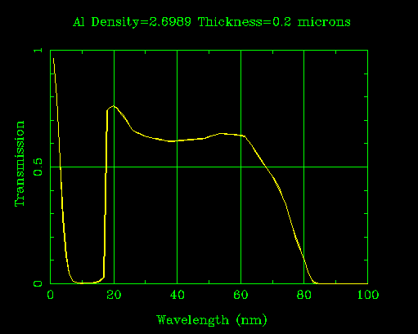
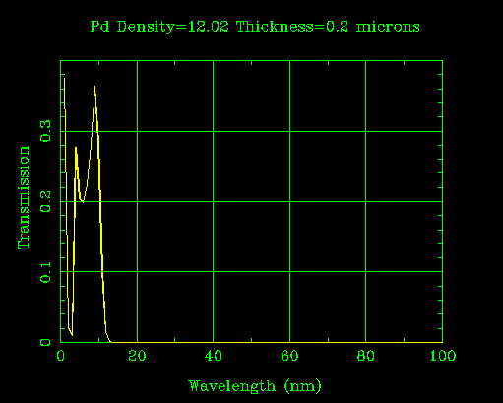
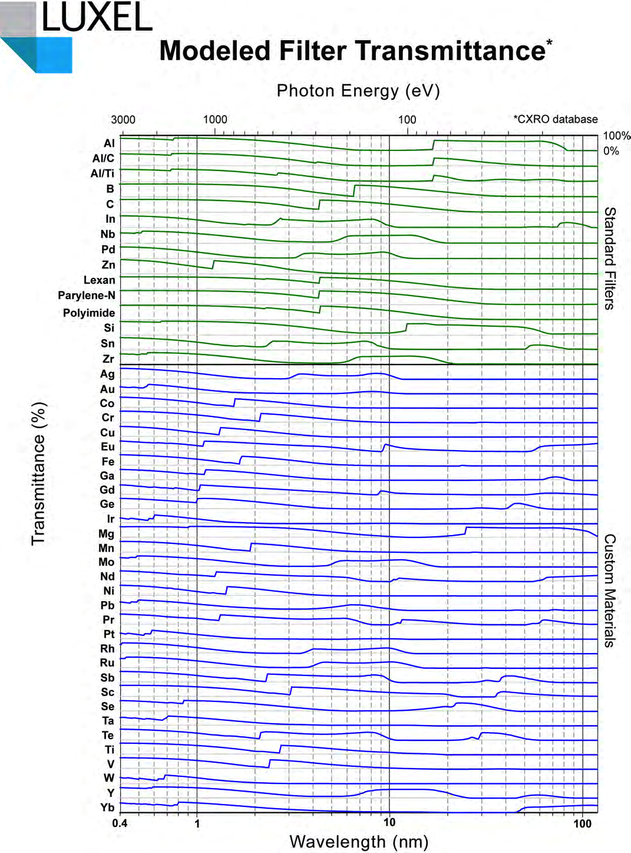
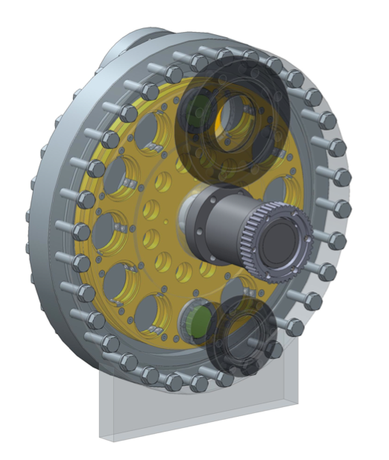
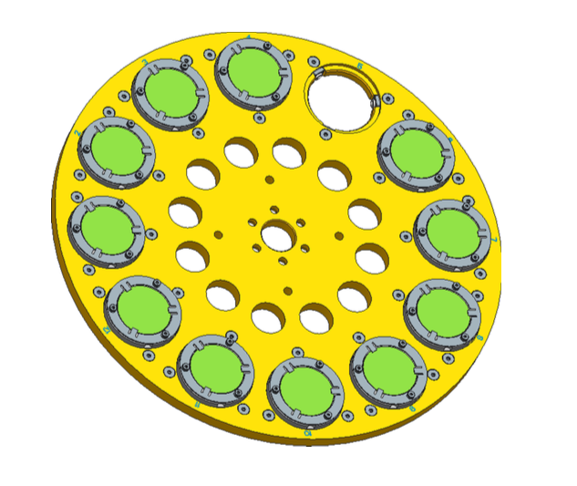
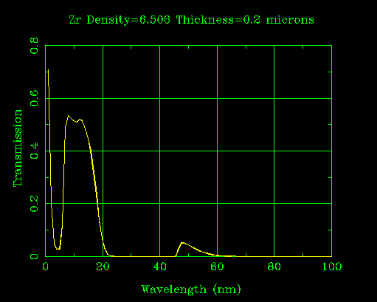
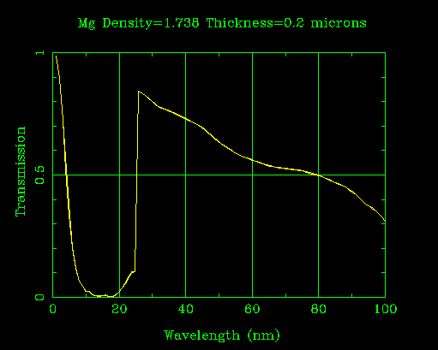
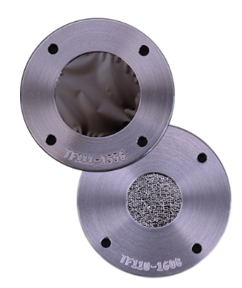
INTENSITY FILTERING
Solid state filters
Filtering stations:
Need to cut unwanted radiation (seed laser, higher harmonics, other types of photons) + reduce the overall intensity + preserve wavefront
Solid state filters (foils) of variable thickness (50nm → >1000nm), with no sustaining mesh, and variable diameters (up to 15mm)

Slide 14
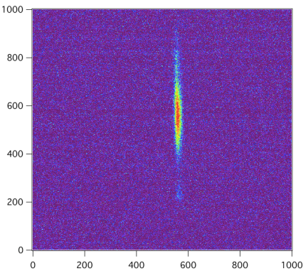
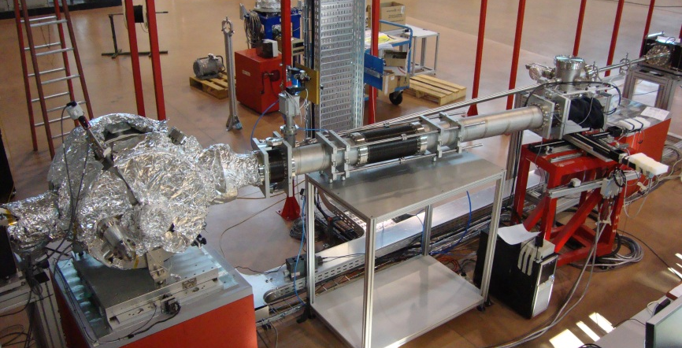
ENERGY SPECTROMETERS
PRESTO and TARDI
Spectrometers (PRESTO and TARDI)
Online (non invasive)
Shot-to-Shot
~97% of FEL → beamlines
1% of FEL → YAG + triggered CCD
Resolving Power ~15000 @32.5nm (2.5meV)
Available information: λ, BW, spectral content
250mm
60 mm

Slide 15
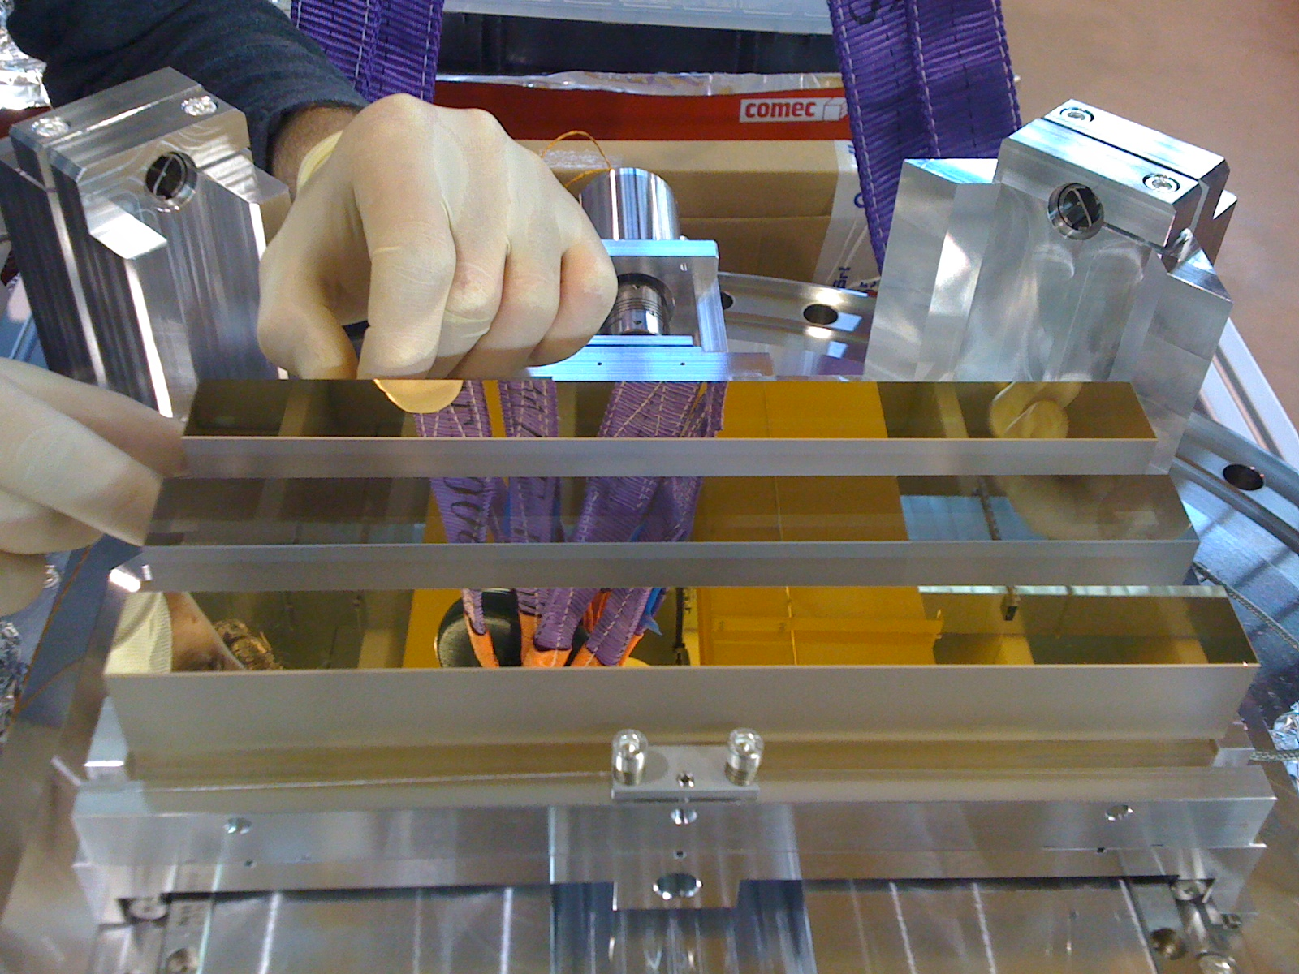
PRESTO:Pulse Resolved Energy Spectrometer, Transparent and Online
Diffraction gratings
The target is to guarantee single-shot acquisitions over the entire (standard) wavelength range of FERMI: 100 – 4nm
3 gratings:
Low Energy (LE)
High Energy (HE)
Super High Energy (SHE)
Since 2011 – 100-24nm
Since 2012 – 27-6.7nm
60 mm
60 mm
Since 2015 – 13-3.2nm
G1-LE
25mm
80 mm
G2-HE
(I.Cudin)
FERMI experience:
The energy spectrometers should operate in single-shot mode (→ efficient gratings and detectors) and should be able to operate in two/multi color acquisition mode to measure fundamental/higher harmonics, 2-color double pulses, and FEL double-stage photons
G3-SHE
250 mm

Slide 16
PRESTO/TARDI spectrometers
Parameters and Efficiencies
 | LE | HE | SHE
λ (nm) – m=1 | 100-24.8 | 27.6-6.7 | 12.7-3.1
D₀ (l mm⁻¹) | 500 | 1800 | 3750
D₁ (l mm⁻²) | 0.35 | 1.26 | 2.68
D₂ (l mm⁻³) | 1.7 × 10⁻⁴ | 6.3 × 10⁻⁴ | 1.4 × 10⁻³
Groove profile | Laminar | Laminar | Laminar
Groove height (nm) | 12 | 4 | 9
Groove ratio (w/d) | 0.6 | 0.6 | 0.65
Coating | Carbon | Gold | Nickel
 | LE | HE
λ (nm) – m=1 | 13.5-60.5 | 2.1-9.6
D₀ (l mm⁻¹) | 600 | 3750
D₁ (l mm⁻²) | 4.2 × 10⁻¹ | 2.6
D₂ (l mm⁻³) | 2.10 ×10⁻⁴ | 1.30 ×10⁻³
Groove profile | Laminar | Laminar
Groove height (nm) | 10 | 4.8
Groove ratio (w/d) | 0.7 | 0.64
Coating | Carbon | Gold
The target was to cover the entire FERMI range in first order of diffraction

Slide 17
PRESTO/TARDI spectrometers
Resolving Powers
Resolving power to be scaled depending on the detection system
PRESTO and TARDI currently use Ce:YAGs in vacuum coupled to a visible light CCD camera → Res.Power ~ 20.000

Slide 18
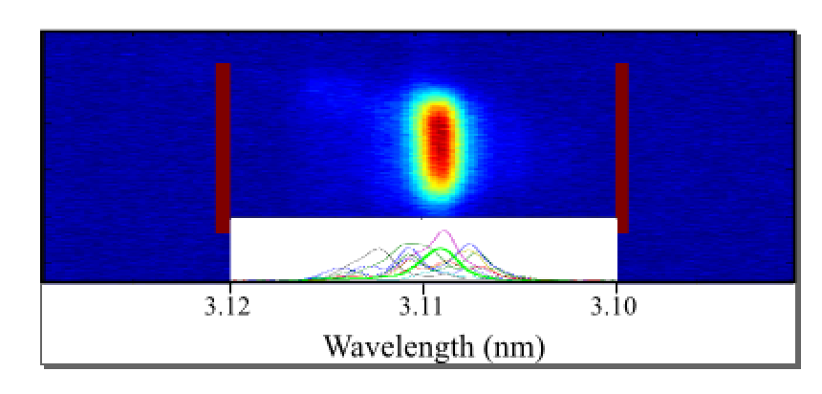
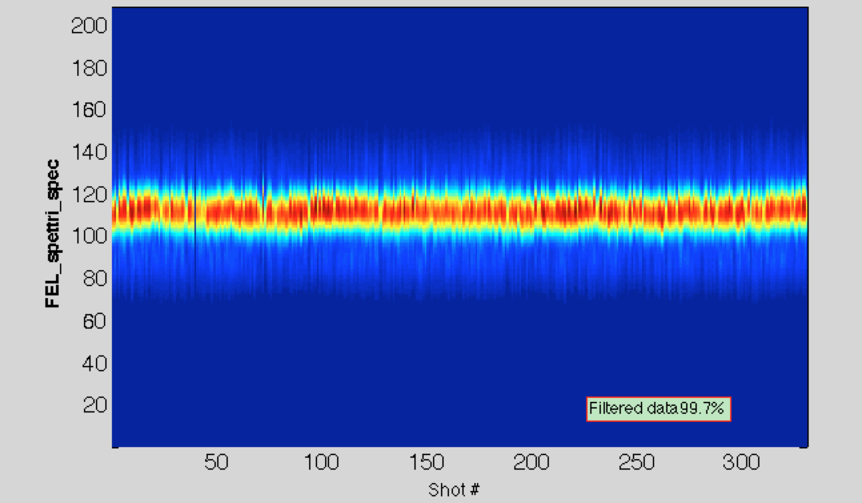
ENERGY SPECTROMETERS
Typical spectra
Single shot spectra measured down to 4 nm (3.1nm with PRESTO and 2.1nm with TARDI)
43.7 nm
23.8 nm
4.4 nm
4.0 nm
3.1 nm
Gaussian with both wavelength and bandwidth stability.

Slide 19
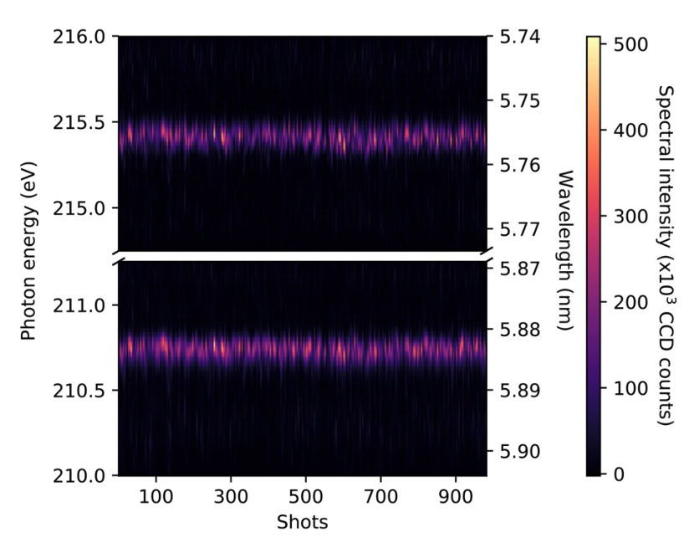
FERMI: EEHG TESTS
Two color mode
Courtesy E. Allaria – P. Rebernik

Slide 20
FEL UNDULATOR LINE ALIGNMENT
Spontaneous emission on PRESTO CCD
Electron trajectory should be straight;
Resonance condition to the FEL wavelength should be met in each undulator
Undulator need to be aligned to the electron beam axis
In case of seeded FEL such as FERMI it is also required that:
the seed laser is aligned to the same electron beam axis.
The spontaneous emission appears in a typical C-shape (as show in Fig. 2) corresponding to a vertical cut of the undulator emission cone integrated over the beam defining aperture (BDA). This shape reflects the quadratic relationship between wavelength and angle of deviation from the axis contained in the resonant condition equation for the emission from an undulator. The minimum of the parabola identifies the emission axis. In order to improve the accuracy, we set the BDA to a very small horizontal opening.
Courtesy E. Allaria – C. Spezzani
Notes:
The spontaneous emission appears in a typical C-shape (as show in Fig. 2) corresponding to a vertical cut of the undulator emission cone integrated over the beam defining aperture (BDA). This shape reflects the quadratic relation- ship between wavelength and angle of deviation from the axis contained in the resonant condition equation for the emission from an undulator. The minimum of the parabola identifies the emission axis. In order to improve the accu- racy, we set the BDA to a very small horizontal opening.

Slide 21
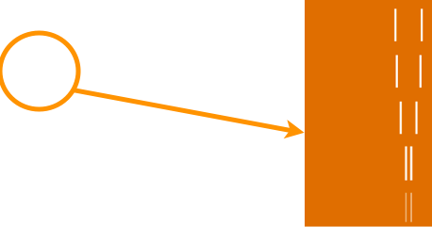
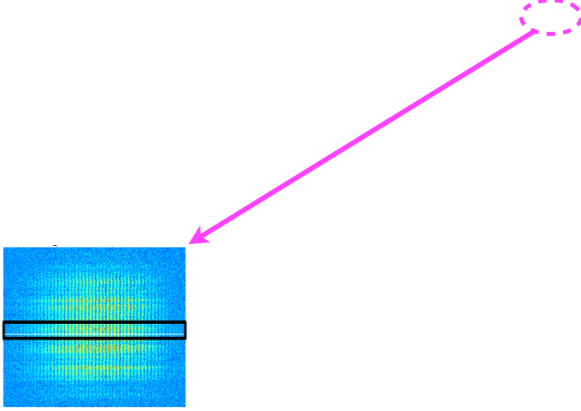
TRANVERSE COHERENCE
Direct beam

Slide 22
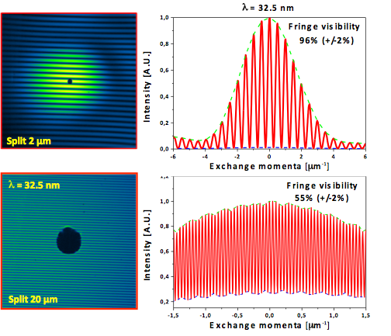
TRANVERSE COHERENCE
Focused beam
Measurements of the transverse coherence using a mask with pairs of pinholes or slits on it (sample prepared by M. Barthelmess) – beamline DiProI

Slide 23
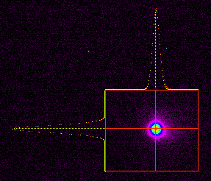
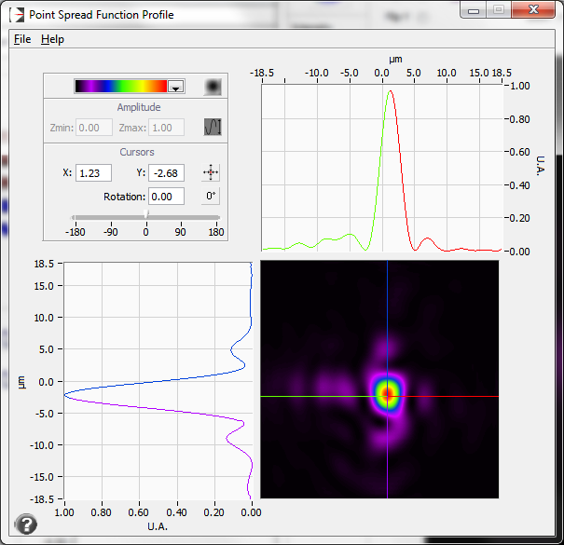
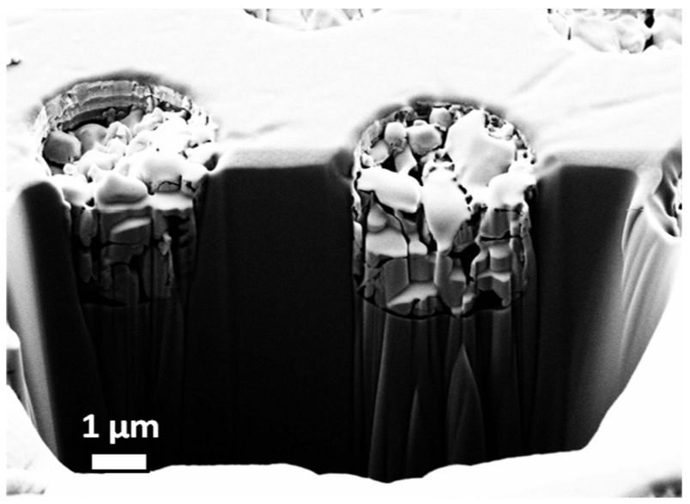
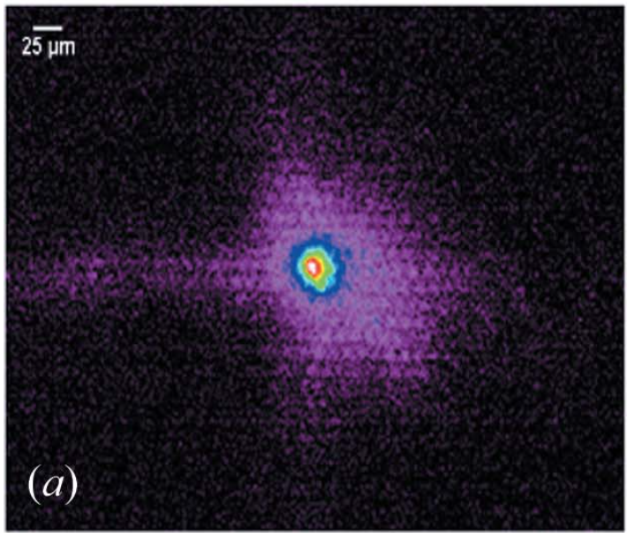
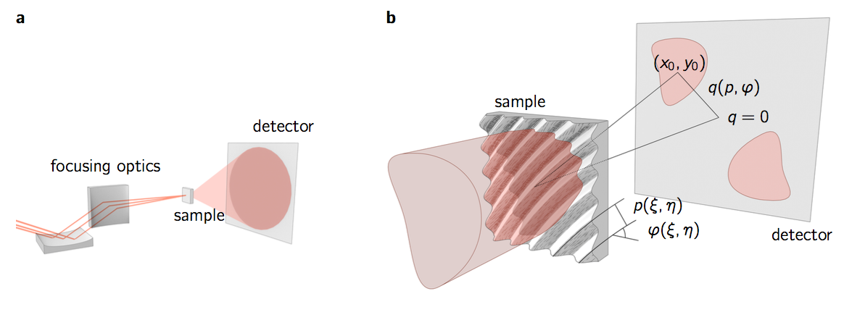
SPOT SIZE DETERMINATION
Different techniques
Scintillator-based (e.g. Ce:YAG)
Invasive
May suffer from saturation effects
Scintillator gets damaged in focus
No single-shot information (generally)
Quick and cheap
PMMA and Si indentation
Invasive
Single shot information
Deadly time-consuming (not fit for beamtimes)
Wavefront sensor
Almost non invasive (intensity issues)
Single shot information
Online
Quantitative information about focusing
Other techniques
Pixelated P array
(ref. A. Matruglio et al., J. Synchrotron Rad. (2016). 23, 29-34)
VLS grating based spot reconstruction
(ref. M.Schneider, et al., Nat. Comm. 9 (2018) 214)
…

Slide 24
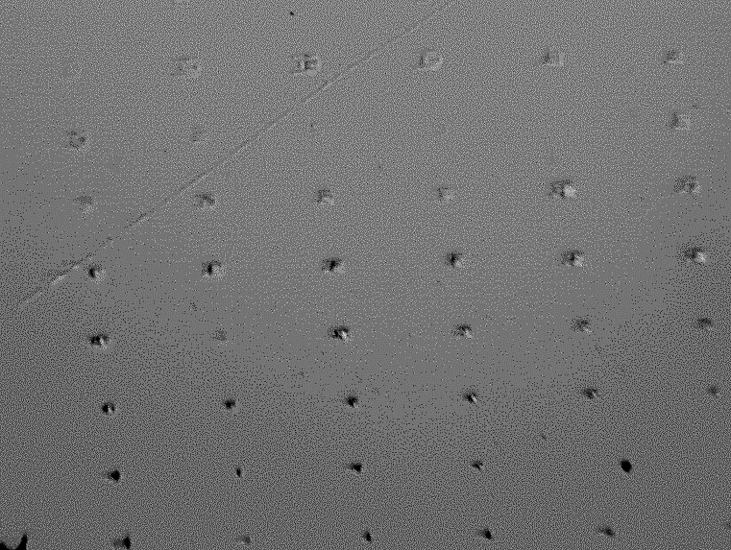
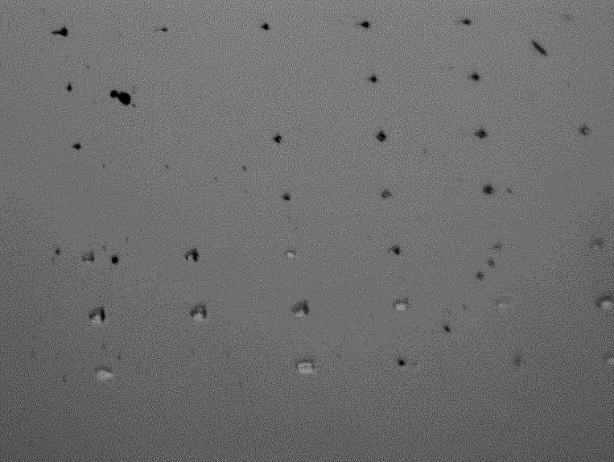
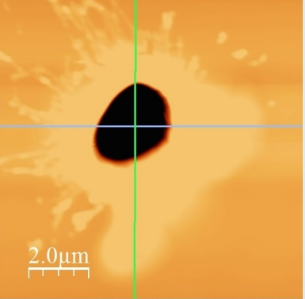
SPOT SIZE DETERMINATION
YAG vs. PMMA indentation
Step = 1mm
defocus
Best spot
Focal spot of the ellipsoidal mirror (10x10µm² FWHM)

Slide 25
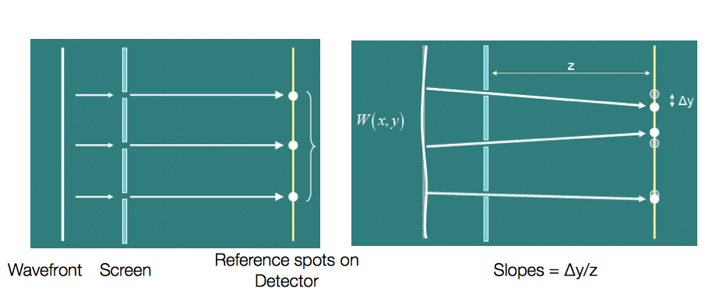










SPOT SIZE DETERMINATION
Wavefront Sensor
SPECS
72 x 72 grid (13 x 13) mm²
Pitch=180µm, Pinhole diameter: 60µm
Wavelength range: 4-40nm
Accuracy ~λ/10
Squared pinholes !
Displacements
Phase Gradient
Wavefront reconstruction
Wavefront
Residual
Back-propagation
Spot at focus
Modal decomposition
(Zernike)
Focal lengthts

Slide 26







SPOT SIZE DETERMINATION
WFS-based optimization
λ = 32 nm
Evidence of:
RMS = 0.720 Lambda
Strehl ratio = 0.216
astigmatism at 0º 0.80 Lambda
coma at 90º 0.25 Lambda

Slide 27



SPOT SIZE DETERMINATION
WFS-based optimization
λ = 32 nm
Zernike coefficients under 0.05λ
RMS = 0.051 Lambda
Strehl ratio = 0.903
FERMI experience:
The focusing optimization and consequent spot size characterization is fundamental for experiments and must be pursued by means of non-invasive and online diagnostics → the wavefront sensor is the best, so far.
In order to fulfill user diverse and often exotic requests, the active optics systems (like KAOS, for instance) seem to represent the best solution.

Slide 28
KAOS – KIRKPATRICK-BAEZ ACTIVE OPTICS SYSTEM
WFS vs. PMMA indentations
Aberration-free
Aberrated (on purpose)
Notes:
In particular, our results prove that in the aberration-free state both reconstruction methods give consistent qualitative results. This conclusion is not only true at the focal plane but for at least few mm along the beam propagation axis.
In both cases (imprints and WFS) at the edges of the focal region both reconstruction methods return qualitatively different results. These largely appear at ≈ ± 5 mm and, in first approximation, can be explained in terms of WFS resolution and a non-planar wavefront.

Slide 29



KAOS – KIRKPATRICK-BAEZ ACTIVE OPTICS SYSTEM
Versatility
KAOS
The Kirkpatrick-Baez Active Optical System
Focusing
plane bendable
mirror
blade
pusher
motors
anti-twist
blade
Shaping
$λ$: $1 nm −100 nm$
Max Power: $∼90×$
Min. R: $∼60 m$
Residual: not super low, but a
good compromise
Collimation

Slide 30






POLARIZATION
A universal diagnostic?
A single shot polarimeter based on angle resolving electron spectrometer (J.Viefhaus’ group at DESY and then R.Coffee at LCLS)
Theory predicts specific electron distributions over the 16 detectors depending on the used gas and FEL polarization.
E. Allaria et al. Phys. Rev. X 4, 041040 (2014)
Axis of Linear Polarization (°)
20h56_helium_lin_cross_32nm7
Bunch ID

Slide 31





PULSE LENGTH
Cross correlation techniques
Two cross-correlation methods have been implemented and used for measuring the FEL pulse length.
Solid state cross correlation:
*
temporally & spatially encode FEL on the surface of a Si₃N₄ target probed with an ultrashort laser pulse
In both cases FEL pulse length has been studied as a function of seed laser parameters and FEL wavelength.
* In collaboration with F. Tavella team
** In collaboration with C. Callegari and LDM team
Cross correlation measurement probing the intensity of sidebands in electron spectra
**
P. Finetti et al. Phys. Rev. X 7, 021043 (2017)
Expected FEL pulse shortening at higher harmonics (shorter wavelength) has been confirmed by measurements.
Notes:
In a superradiant pulse, slippage of radiation over the electron current is dominant.
The pulse finds new fresh electrons during its evolution: equivalent to the “fresh bunch technique”
Multi-stage harmonic cascade permits to get saturation at each step: phase mismatching of electrons in the tail leads to shorten the FEL pulse
Single-stage 400nm→200nm successfully tested at SPARC
Au@2º → 0.61 → 4 X Au → 0.14
Au@3º → 0.45 → 4 X Au → 0.04
Ni@2º → 0.83 → 4 X Ni → 0.47
Ni@3º → 0.71 → 4 X Ni → 0.25

Slide 32






PHOTON ANALYSIS DELIVERY AND REDUCTIONS SYSTEM
Members and collaborations
Current PADReS:
M. Zangrando, A. Simoncig, M. Manfredda,
R. Gobessi, S. Gerusina, C. Fava
Beamlines:
L. Foglia (TIMEX/TIMER)
F. Capotondi, E. Pedersoli, M. Pancaldi (DiProI)
IT:
A. Abrami, & ITC
Machine Physics :
E. Allaria, G. De Ninno, L. Giannessi & FERMI team
Former PADReS:
N. Mahne (CNR-IOM), L. Raimondi (Elettra), C. Svetina (IMDEA), D. Cocco
G. Dovillaire
D. Cocco
B. Rösner,
et al.
A. Hafner
E. Ploenjes
K.Tiedke, et al.
L. Rebuffi
G.De Ninno
(CENILS)

Slide 33
Notes:
Last Slide 1: Thanks to the audience

Slide 34
Notes:
Last Slide 2: Aerial Photo of Elettra

