Slide 1
Requirements specific for EuPRAXIA
From CDR to TDR
A. Cianchi (Tor Vergata University of Rome and INFN)
On behalf of EuPRAXIA WP13 diagnostics group

Slide 2
Outline
EuPRAXIA CDR as a starting point
  Diagnostics for PWFA
  Diagnostics for LWFA
Open problems
The case of EuPRAXIA@SPARC_LAB

Slide 3

CDR Electron Diagnostics
Contributions from:
  CEA
  CNRS
  Cockroft
  DESY
  ELI-Beamlines
  INFN
Cost estimation
Starting point
Edited by A. Cianchi and N. Delerue

Slide 4
The principal challenges
A plasma accelerator sets new and interesting challenges for every device, including diagnostic tools.
The EuPRAXIA machine will produce electron beams with high brightness, accelerated by one or several plasma-accelerator stages. The inherent instability of plasma acceleration, observed in experiments in the past, lends itself to single-shot measurements.
Additionally, diagnostics must measure beam transverse dimensions of the order of µm (RMS) and bunch lengths of the order of a few fs (FWHM), ideally with single-shot devices. This is not trivial and exceeds, in certain cases, the state of the art.
Different schemes can be foreseen to inject electron beams into the plasma booster stage, some including an RF accelerator.
However, even the performance of this RF-based machine will be far from conventional, as the high accelerating gradient, the need to operate at very high frequencies (in the X-band range), requests to control the beam trajectory position / transverse size at the µm level and bunch lengths at the fs level set a very high standard for the diagnostics, even if multi-shot measurements were foreseen.
Finally, in a compact machine, all the components must be compact as well to avoid wasting space and increasing the overall machine length.

Slide 5
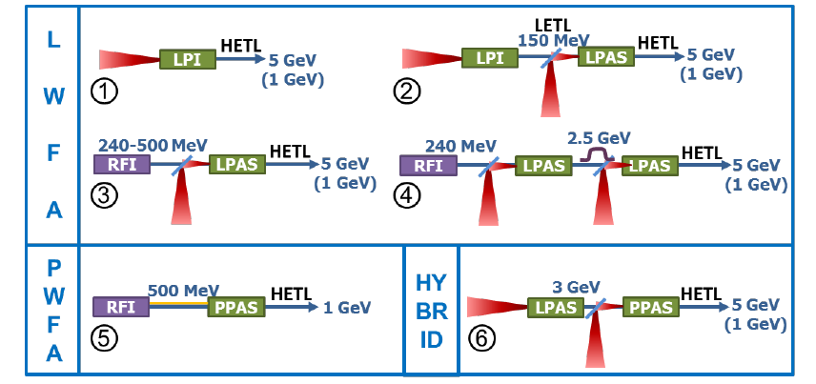
Different scenarios
Scheme 1 is a laser-driven plasma injector (LPI) where the electron beam is generated and also accelerated up to 5 GeV in a single plasma stage.
Scheme 2 is a staged setup where the electron beam is generated in a laser-driven plasma injector (LPI), then transported and injected into a laser-driven plasma-accelerator stage (LPAS), where its energy is boosted up to 5 GeV.
Scheme 3 is a staged setup where the electron beam is generated in an RF photo-injector a pre-accelerated in an RF linac (RFI), then transported and injected into a laser-driven plasma accelerator stage (LPAS) where its energy is boosted up to 5 GeV.
Scheme 4 is a staged setup where the electron beam is generated in an RF photo-injector and pre-accelerated in an RF linac (RFI), then transported and injected into two consecutive laser-driven plasma-accelerator stages (LPAS); in each stage the beam experiences an energy gain of approximately 2.5 GeV, while propagation through a magnetic chicane in the transport between the LPAS induces an energy dechirping process.
Scheme 5 is a staged setup where two electron beams – a driver and a witness – are generated in an RF photo-injector and pre-accelerated in an RF linac (RFI), then transported and injected into a beam-driven plasma-accelerator stage (PPAS), where the energy of the witness beam is boosted up to 5 GeV.
Scheme 6 is a staged hybrid accelerator setup where a laser-driven plasma injector (LPAS) generates an electron beam that is in turn used as the beam driver in a second beam-driven plasma injector (PPAS); in the latter a higher-quality electron beam is generated and accelerated up to 5 GeV.

Slide 6

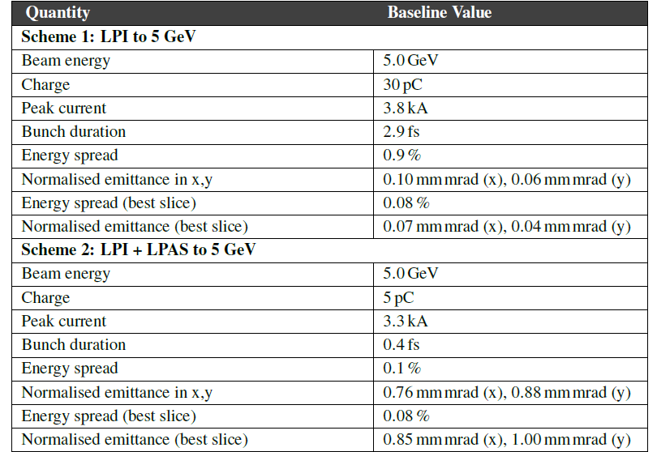
Tables

Slide 7

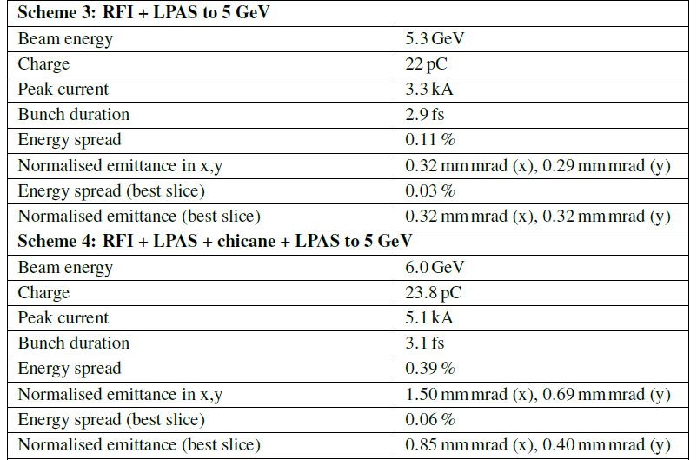
Tables

Slide 8
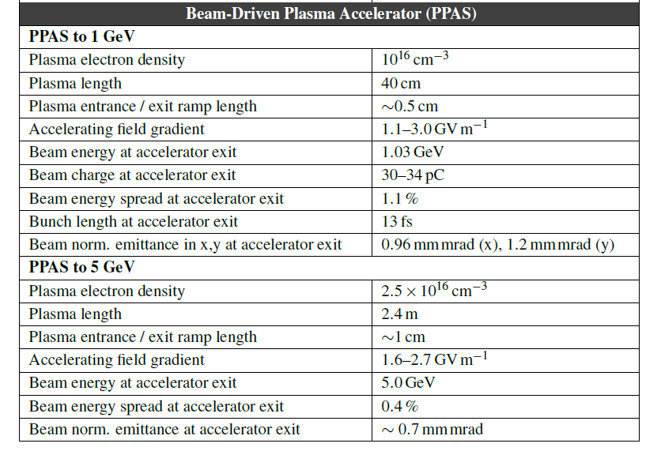
Critical points for PWFA
 | Driver | Witness | Unit
Charge | 200 | 30 | pC
Beam size (rms) | 6 | 2 | μm
Bunch length (rms) | 60 | 4 | μm
Energy | 530-650 | 530-650 | MeV
Norm. Trans. emittance | 3-4 | 0.7 | mm-mrad
Beam size at the plasma entrance in the order of μm!
Low charge (about 30 pC)
Bunch length in the order of few fs
Presence of the light after the plasma
Strong defocusing soon after the plasma
Instabilities?
Mostly of the very remarkable results obtained in the last years are still proof-of-principle. There are very few cases where other groups used same solutions

Slide 9
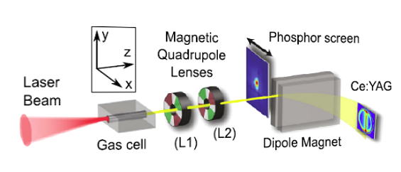
Transverse emittance single shot
One of the few examples of a diagnostics used in many groups
However, the strength of the system is in the energy spread.
If this value will be down to few zero point something percent is the system still useful?
Weingartner, Raphael, et al., Physical Review Special Topics Accelerators and Beams 15.11 (2012): 111302
Barber, S. K., et al., Physical Review Letters 119.10 (2017): 104801.
F Li et al 2018 Plasma Phys. Control. Fusion 60 014029
F. Li et al, Plasma Physics and Controlled Fusion 60, 044007 (2018 )

Slide 10
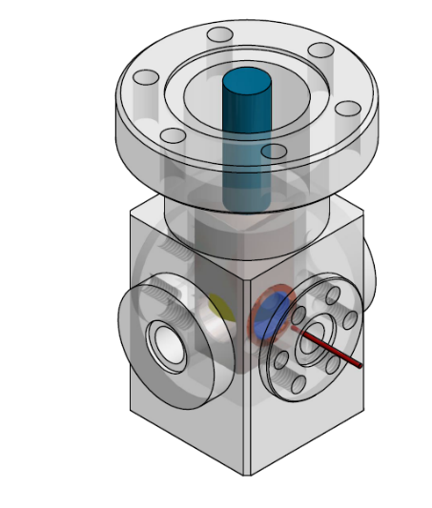

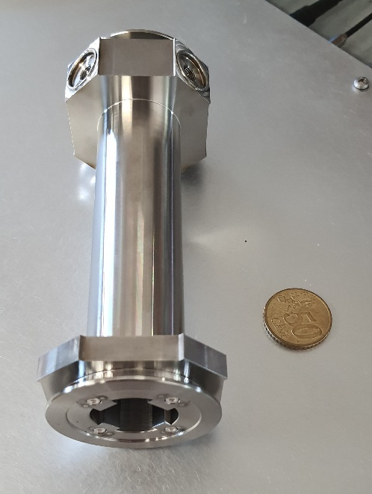
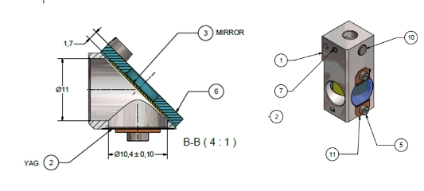
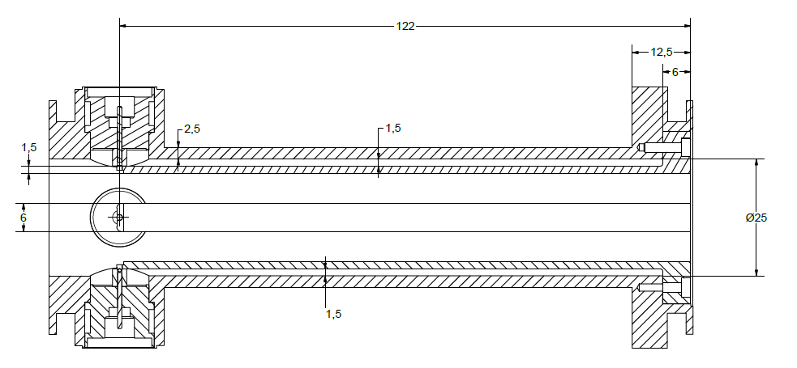
Make compact devices
Compact view screen prototype
Compact stripline BPM prototype
80 mm
Courtesy A. Stella
Courtesy V. Lollo

Slide 11
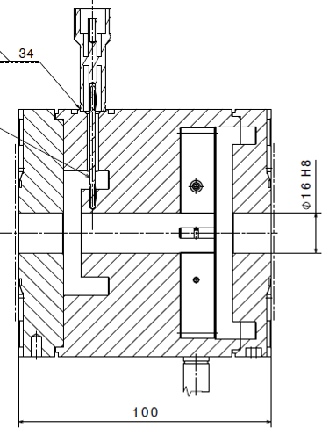
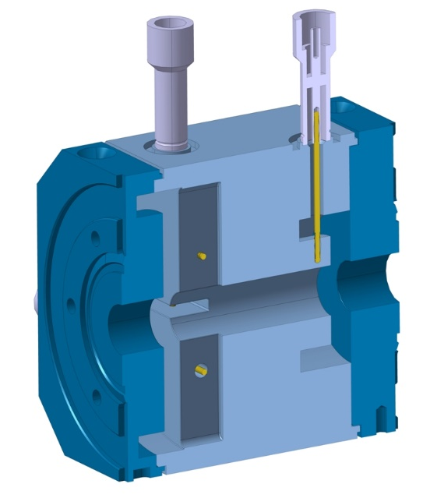
Charge and trajectory
Bergoz Turbo- ICT (down to 50 fC, up to 300 pC) for the charge
Stripline BPM or button BPM for S band linac
Cavity BPM (likely C or X band) for the rest of the machine
16 mm
100 mm
PSI cavity BPM, frequency 3.2844GHz
Notes:
PSI just an example will not fit, NLC BPM should be ok

Slide 12
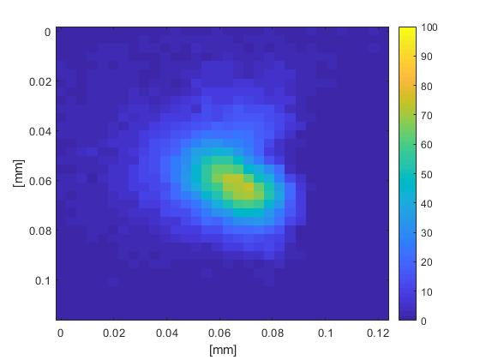
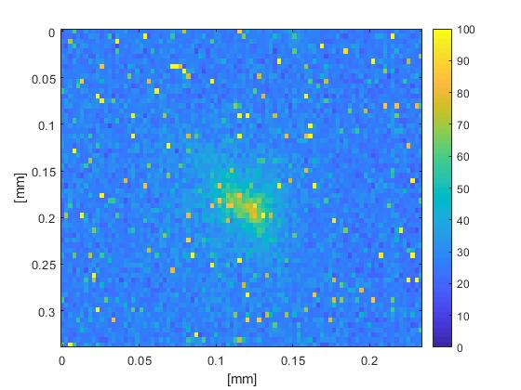
Not Twins but brothers
In a PWFA accelerator we cannot measure witness just switching off driver because during the path they cross each other and so the witness size is strongly affected
First, we take an image of both driver and the witness at the injection point.
The laser comb technique allows easily block the witness beam, thus we can take a shot of the driver alone.
The image of the driver alone is then subtracted as a background from the image of the both driver and witness, thus leaving only the image of the witness.
The resulted image can be used to extract the size of the witness.
It is a multishot measurement
The witness, after subtraction of the driver
11.9×13.8 μm
Witness alone, driver is absent completely
41.8×66.4 μm

Slide 13
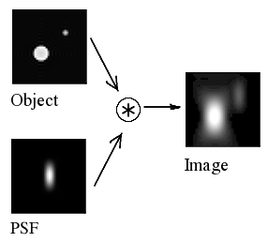
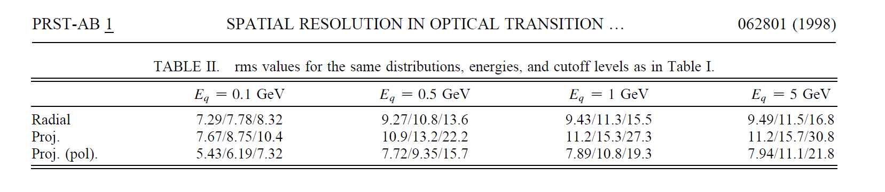
OTR PSF
We need to measure beam size in the order of μm rms
At low beam size the OTR PSF (Point Spread Function) starts to give a contribution
About 4 μm
Castellano, M., and V. A. Verzilov. "Spatial resolution in optical transition radiation beam diagnostics." Physical Review Special Topics-Accelerators and Beams 1.6 (1998): 062801.

Slide 14
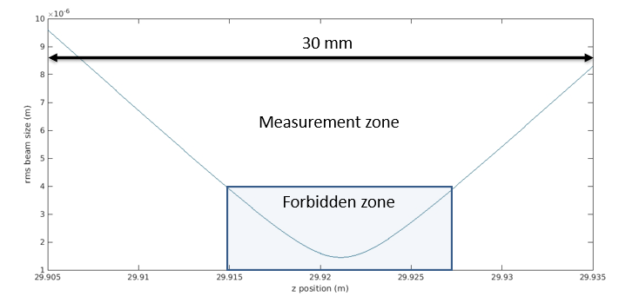
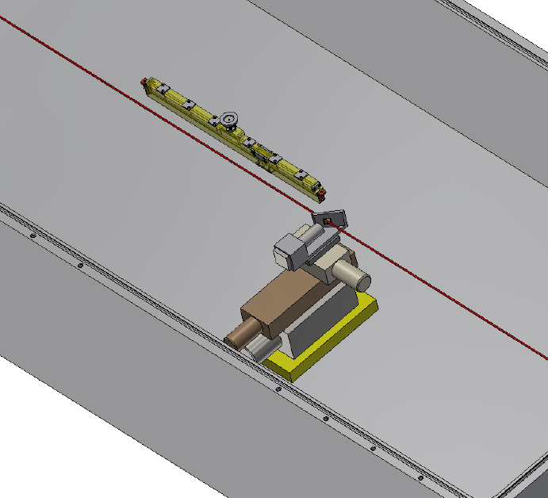
Beam size measurement @plasma
Microemittancemeter, a device that can measure the beam size in a range of few cm and reconstruct the beam size with the envelope.
capillar
With 5% error in the beam size in the measurement zone (10 points every side) the error in the minimum is around 20%
With 10% error is about 33%
It gives also an emittance measurement about with the same error
screen

Slide 15
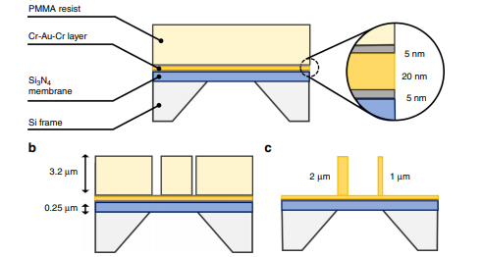
Self-standing wire scanners
Free standing gold wire
Sub-um resolution
1-D measurement
Not single shot
Proved up to 200 pC
Maybe problem of space occupancy downstream the plasma capillary
It is a possible solution if others will be not available
Borrelli, Simona, et al. "Generation and measurement of sub-micrometer relativistic electron beams." Communications Physics 1.1 (2018): 1-8.

Slide 16
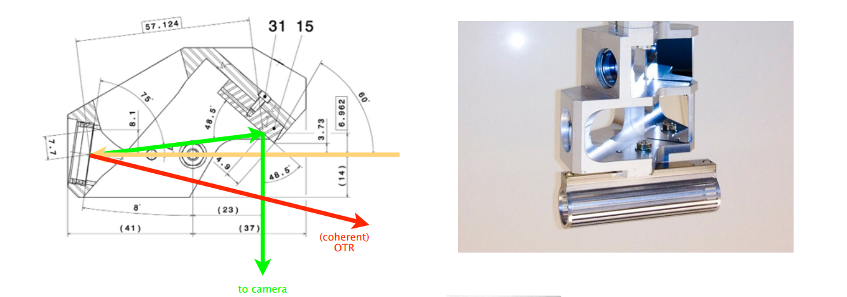
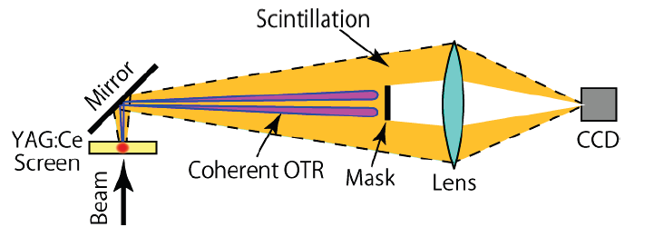
COTR problem
  With high current and some dispersive elements, microbunching can appear
  COTR is fatal in the beam size measurement
  YAG:CE or similar with Scheimpflug optics
  System not very compact
  If we use only OTR for low beam size the solution is not trivial
PSI
Sacla
Ischebeck, Rasmus, et al. "Transverse profile imager for ultrabright electron beams." Physical Review Special Topics-Accelerators and Beams 18.8 (2015): 082802.
S. Matsubara et al., Improvement of screen monitor with suppression of coherent-OTR effect for SACLA, IBIC 2012 -

Slide 17
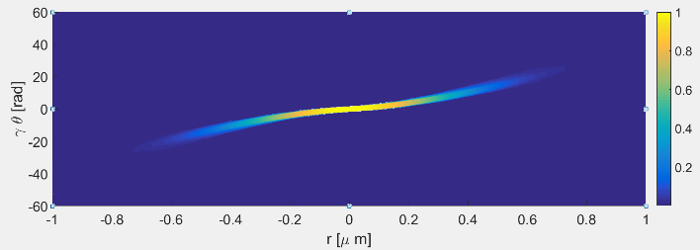
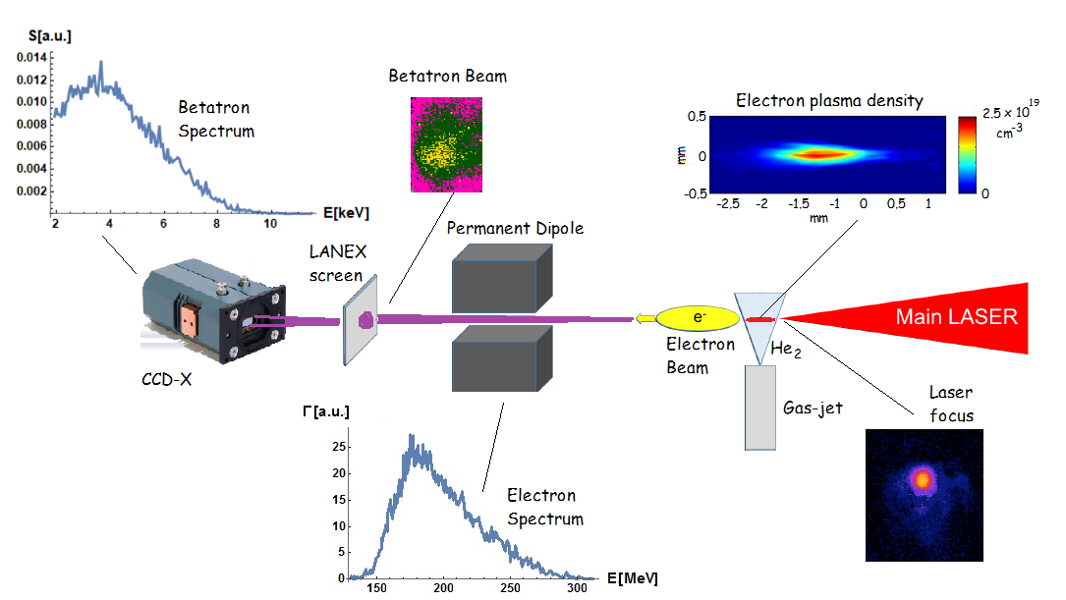
Emittance with betatron
First measurement of the emittance including the correlation term
The beam profile is retrieved not simply the average dimensions
An expression is given for the correlation function between the betatron oscillation amplitude and the divergence of the single accelerated electrons, i.e. the angle with respect the acceleration axis, in order to obtain the distribution of the electron divergences.
In a PWFA machine this system measures only the driver and not the witness
It could be excellent for schemes 3-4
1 J
30 fs (FWHM)
10 μm diameter focus,
a0 ∼ 4.4
n_{e}=(8±1)10¹⁸ cm⁻³
Curcio, A., et al. "Trace-space reconstruction of low-emittance electron beams through betatron radiation in laser-plasma accelerators." Physical Review Accelerators and Beams 20.1 (2017): 012801.

Slide 18
Longitudinal diagnostics
X-band TDS (limited to few fs)
EOS (Electro Optical Sampling used also with time of arrival monitor), limited to about 40-50 fs
Coherent radiation spectrum (hopefully single shot, some developed, other in progress): not limited in principle
More to come: ??
  TDP (Transverse Deflecting Plasma) limited to hundreds of as

Slide 19
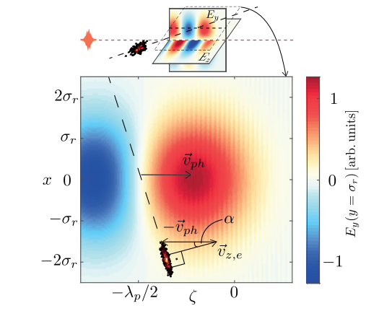
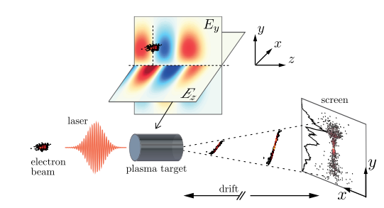
Plasma deflector?
Very compact, mm size
It needs to be proved
Dornmair, Irene, et al. "Plasma-driven ultrashort bunch diagnostics." Physical Review Accelerators and Beams 19.6 (2016): 062801.
Notes:
Offset pari a sr in collinear geometry, non collinear helps in placing mirror to extract laser

Slide 20
Some important points
Two sets of diagnostics beamlines, one for commissioning phase and one for normal operation
Capture the beam as soon as possible after plasma, diagnostics less important than beam optics.
Use also Betatron radiation from plasma
Basic layout must be done for all the possibilities, plasma injector, RF injector, laser driven, beam driven
Quite compact design and reasonably integrated in the beam optics
Reasonable multi-shot solutions exist already, but single shot will be much more interesting
  R&D needed
Today not yet a solution for slice energy spread even in a conventional accelerator
Driver removal still an open point, we would like to have the beam particles after this stage.

Slide 21
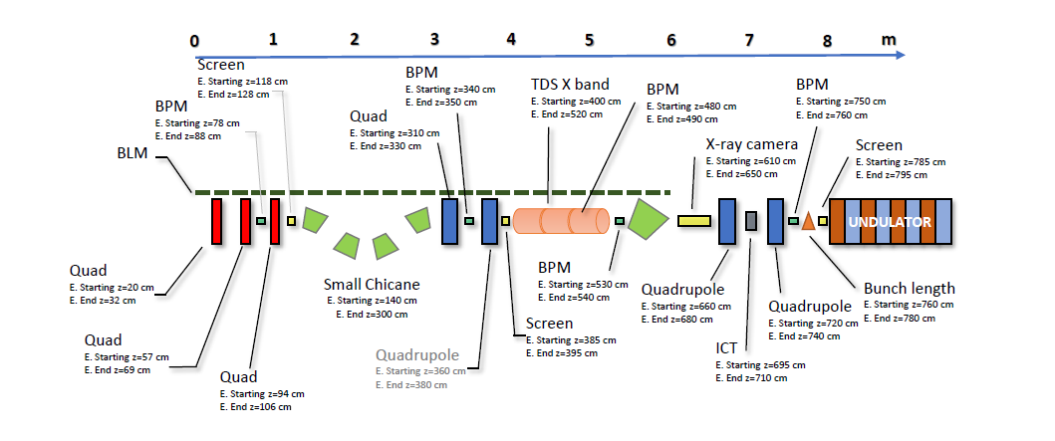
Integration example
Integration of some diagnostics after a plasma booster in a PWFA machine

Slide 22
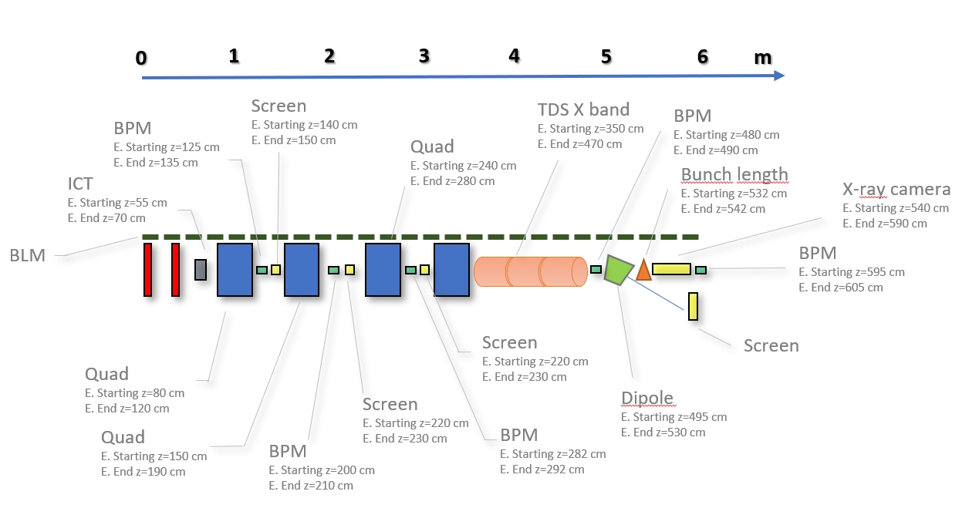
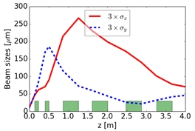
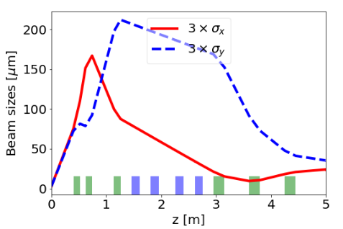
LPAS

Slide 23
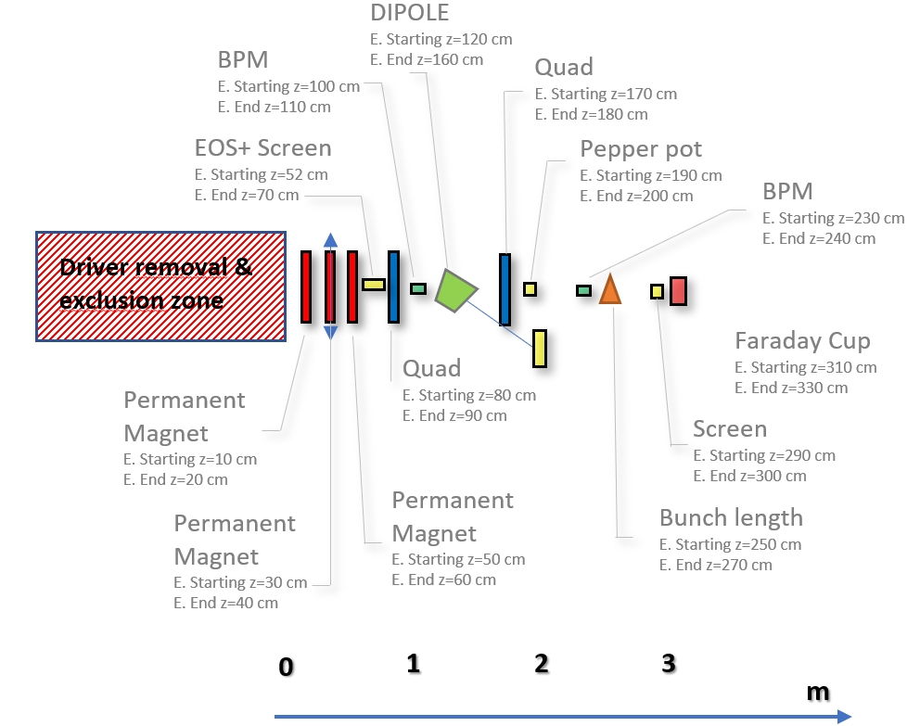
LPI Commissioning beamline

Slide 24
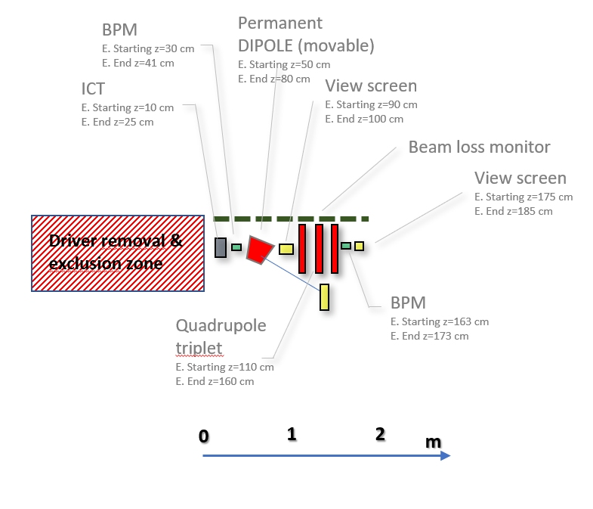
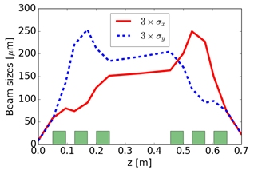
LPI Normal operations

Slide 25

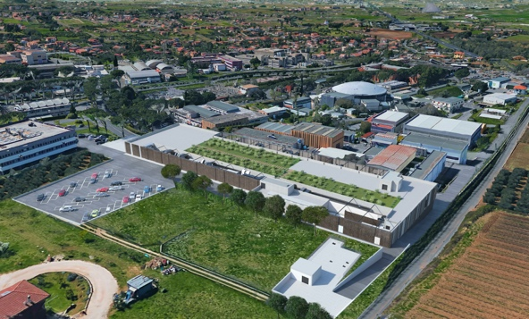

Headquarter and Site 1: EuPRAXIA@SPARC_LAB
Frascati`s future facility
> 130 M€ invest funding
Beam-driven plasma accelerator
Europe`s most compact and most southern FEL
The world`s most compact RF accelerator (X band with CERN)
http://www.lnf.infn.it/sis/preprint/pdf/getfile.php?filename=INFN-18-03-LNF.pdf

Slide 26
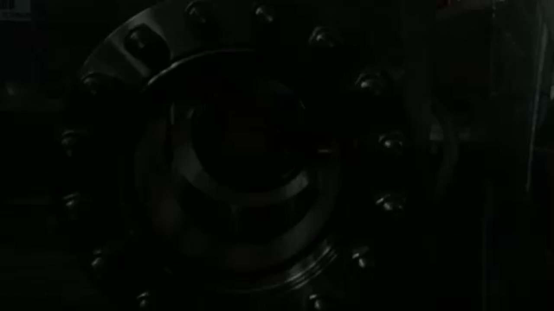
EuPRAXIA@SPARC_LAB
Undulators
1 GeV LINAC
Plasma module
RF power modules
FEL user area @3nm
Secondary
Sources
Beam user areas
0.5 PW Laser

Slide 27
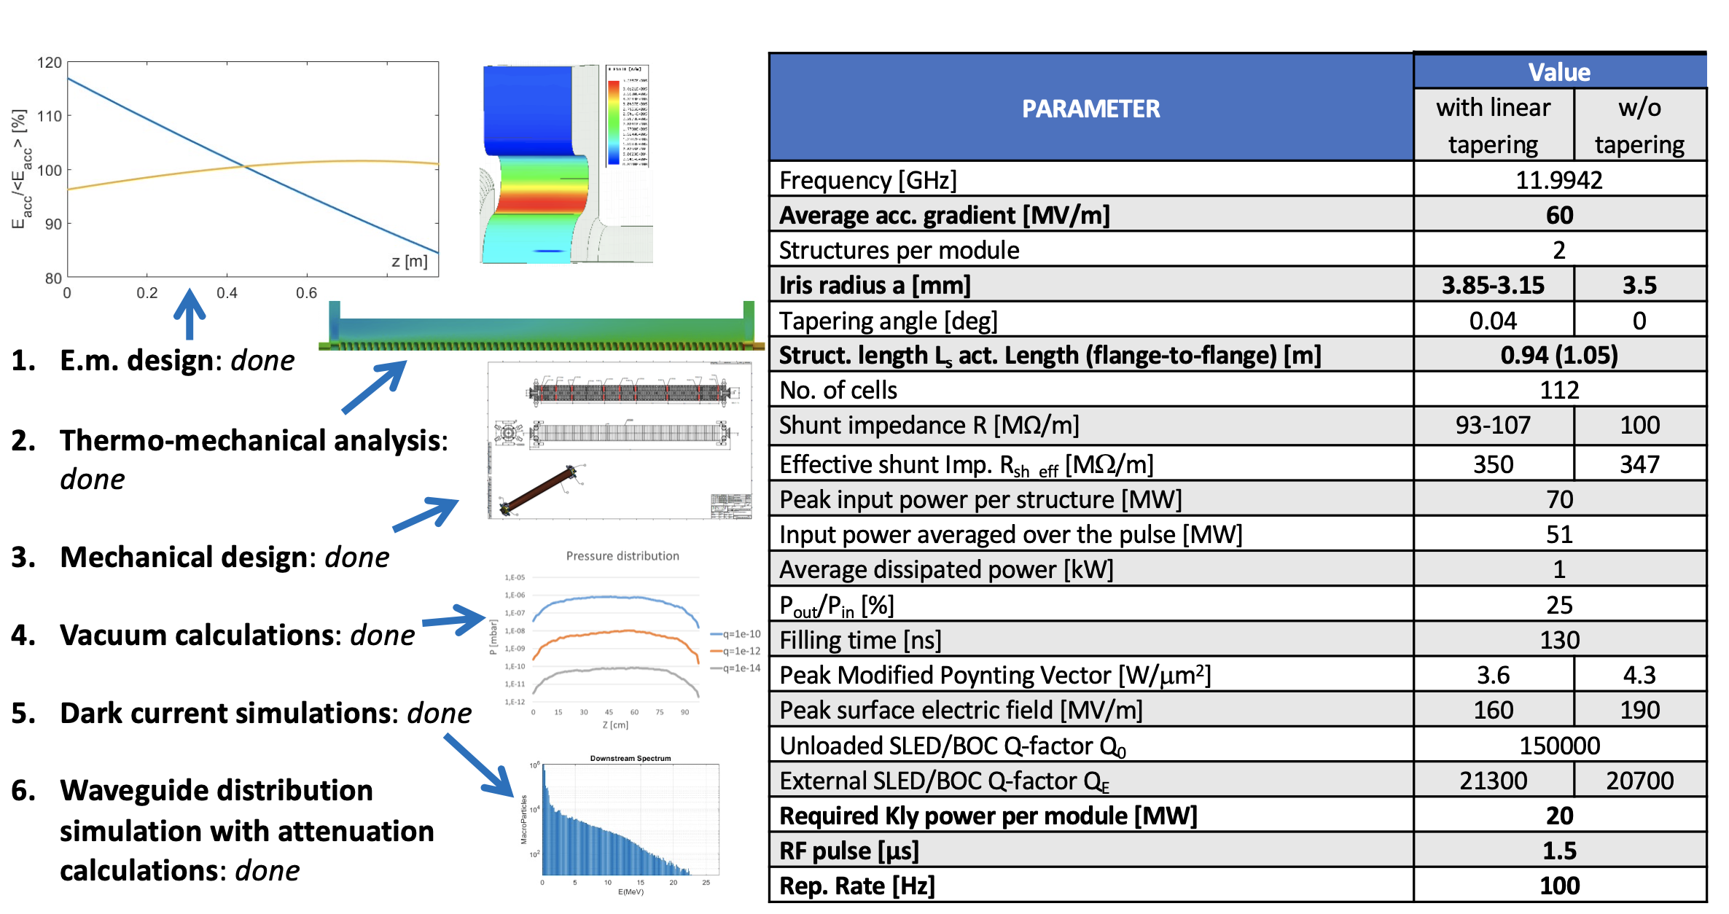
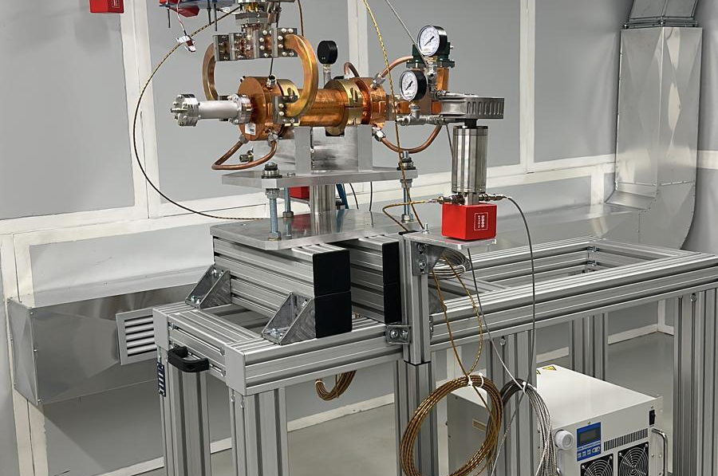
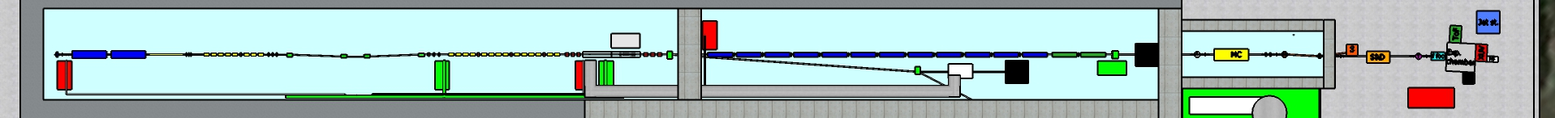
World`s Most Compact RF Linac: X Band
Courtesy D. Alesini
55 m

Slide 28
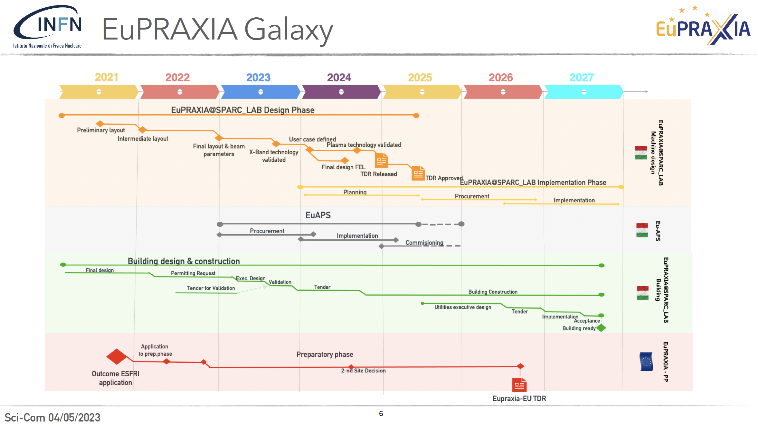
Framework
Courtesy of A. Falone

Slide 29
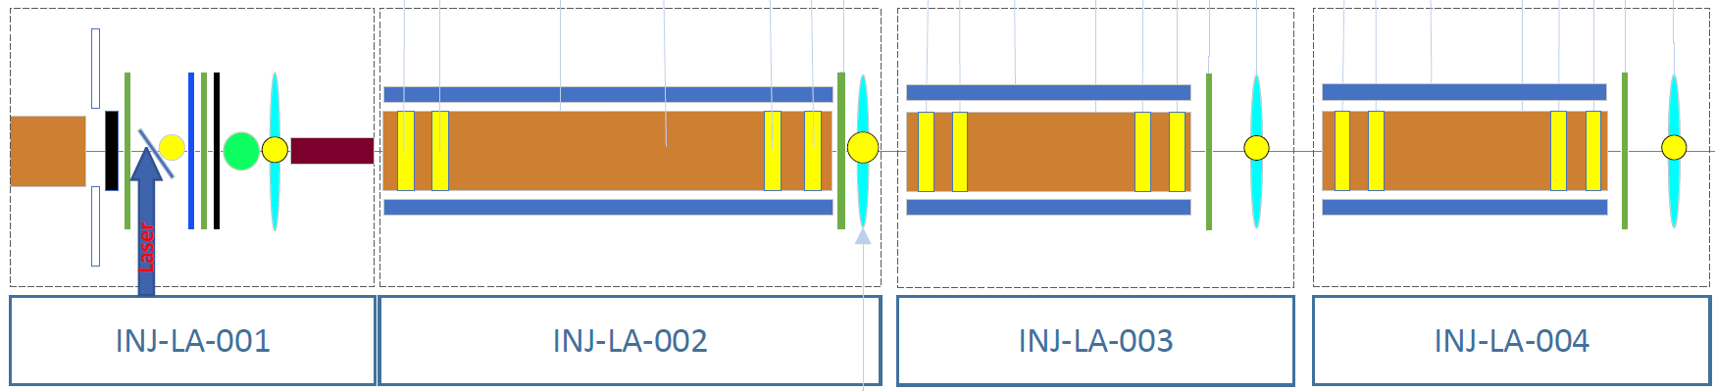
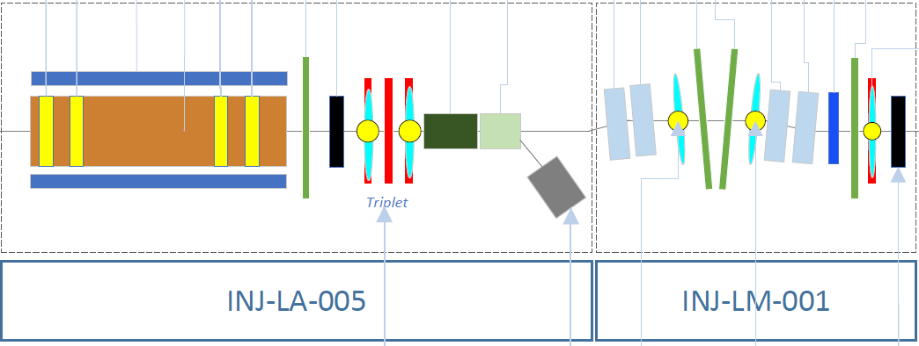
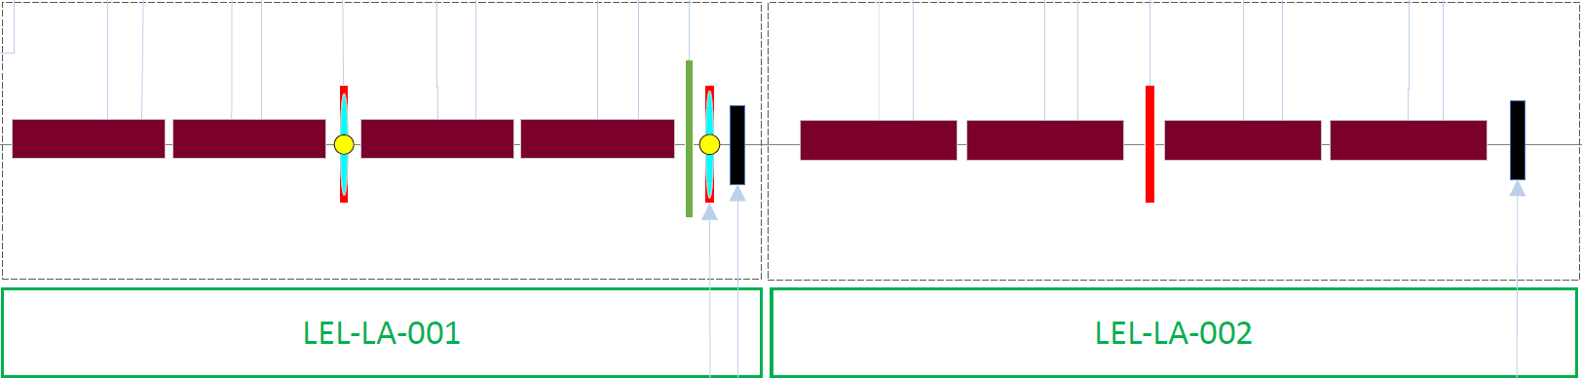
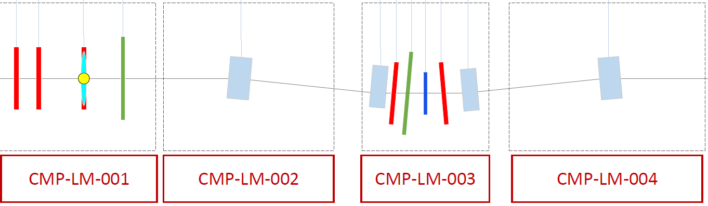
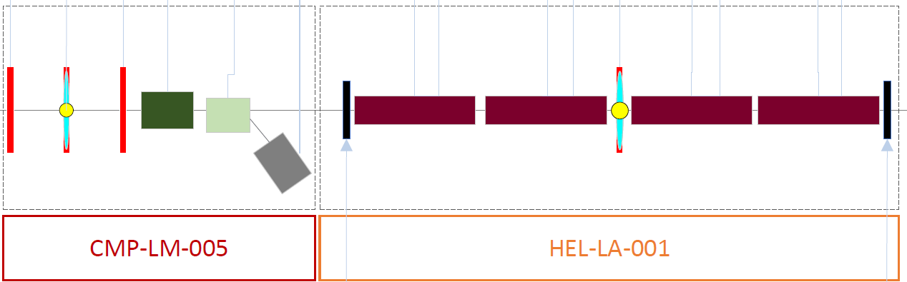
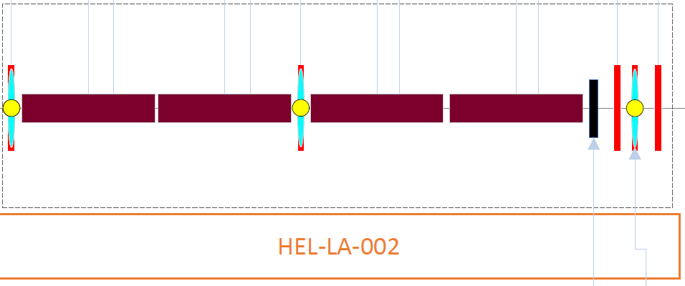
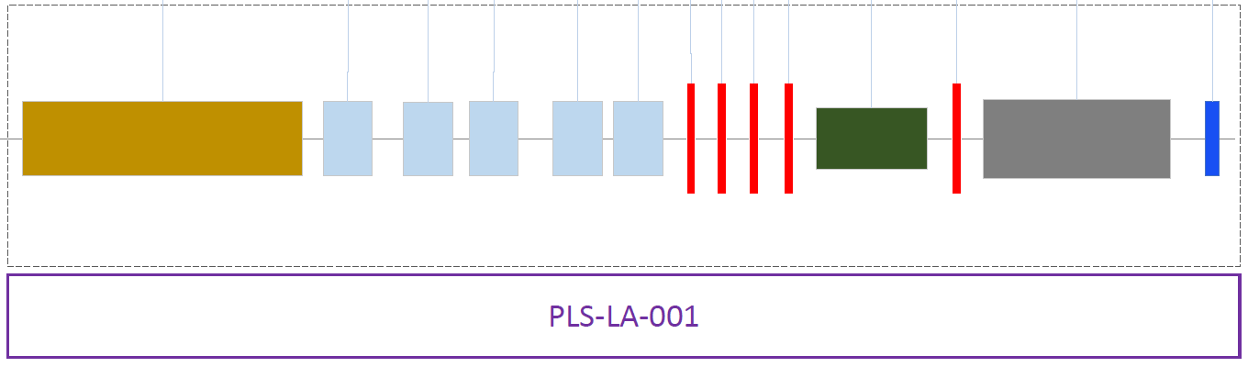
Schematic Layout

Slide 30
Conclusions
There is a lot to do for a plasma accelerator
Compactness, single shot, reliability, are the most important parameters especially in a commissioning phase
There are some state-of-art solutions that can be implemented
Some R&D is needed
Hopefully this workshop will help to find solutions.

