Slide 1
Overview of X-Ray Diagnostics for LCLS
Stefan Moeller for LCLS
June 13, 2023
EuPRAXIA Workshop 2023,
Lausanne, Switzerland

Slide 2
Content
LCLS Overview
      LCLS-II Facility and beam parameters
      LCLS-HE future upgrade
LCLS II Photon Diagnostics Overview
      SXU (soft) beam line
      HXU (hard) beam line
Technical details of some diagnostic components
Summary and Outlook

Slide 3
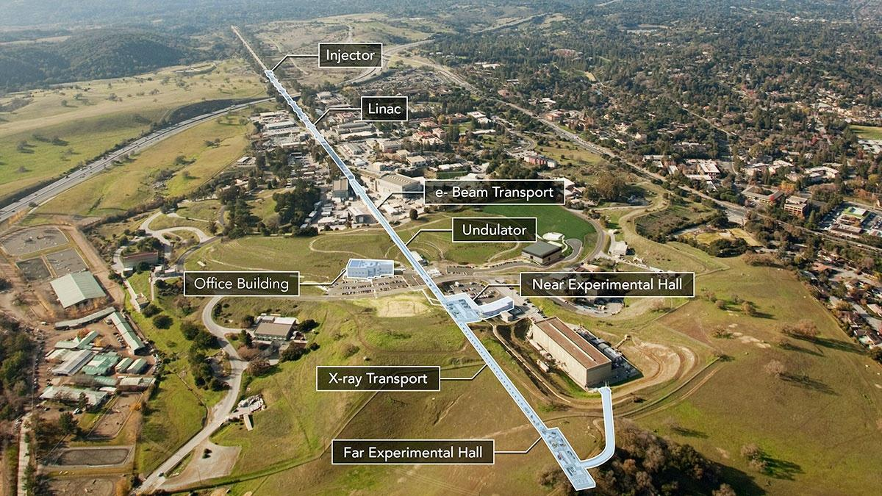
LCLS LINAC Coherent Light Source at SLAC
LCLS II
(First Light 2023)
(at 1km point)
LCLS I
(First Light April 2009)
New SCRF linac and injector in 1st km of SLAC linac tunnel
(1km)
(340m)
(130m)
Electron Beam Dump EBD (~20m)
Front End Enclosure FEE
(~30m)
(200m)

Slide 4
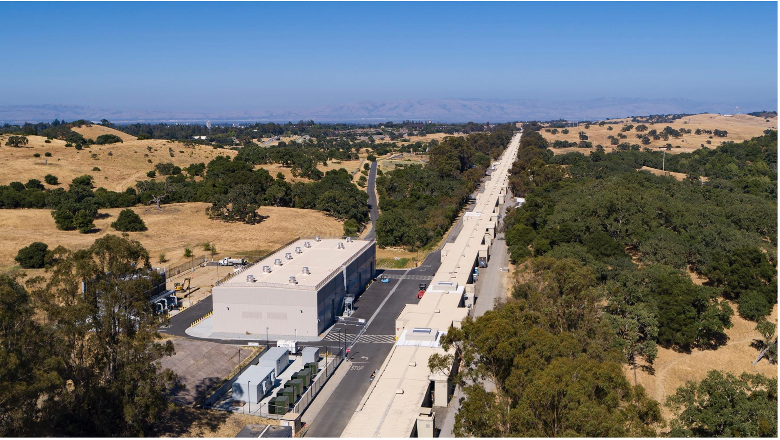
View from the LCLS II injector and Cryoplant

Slide 5
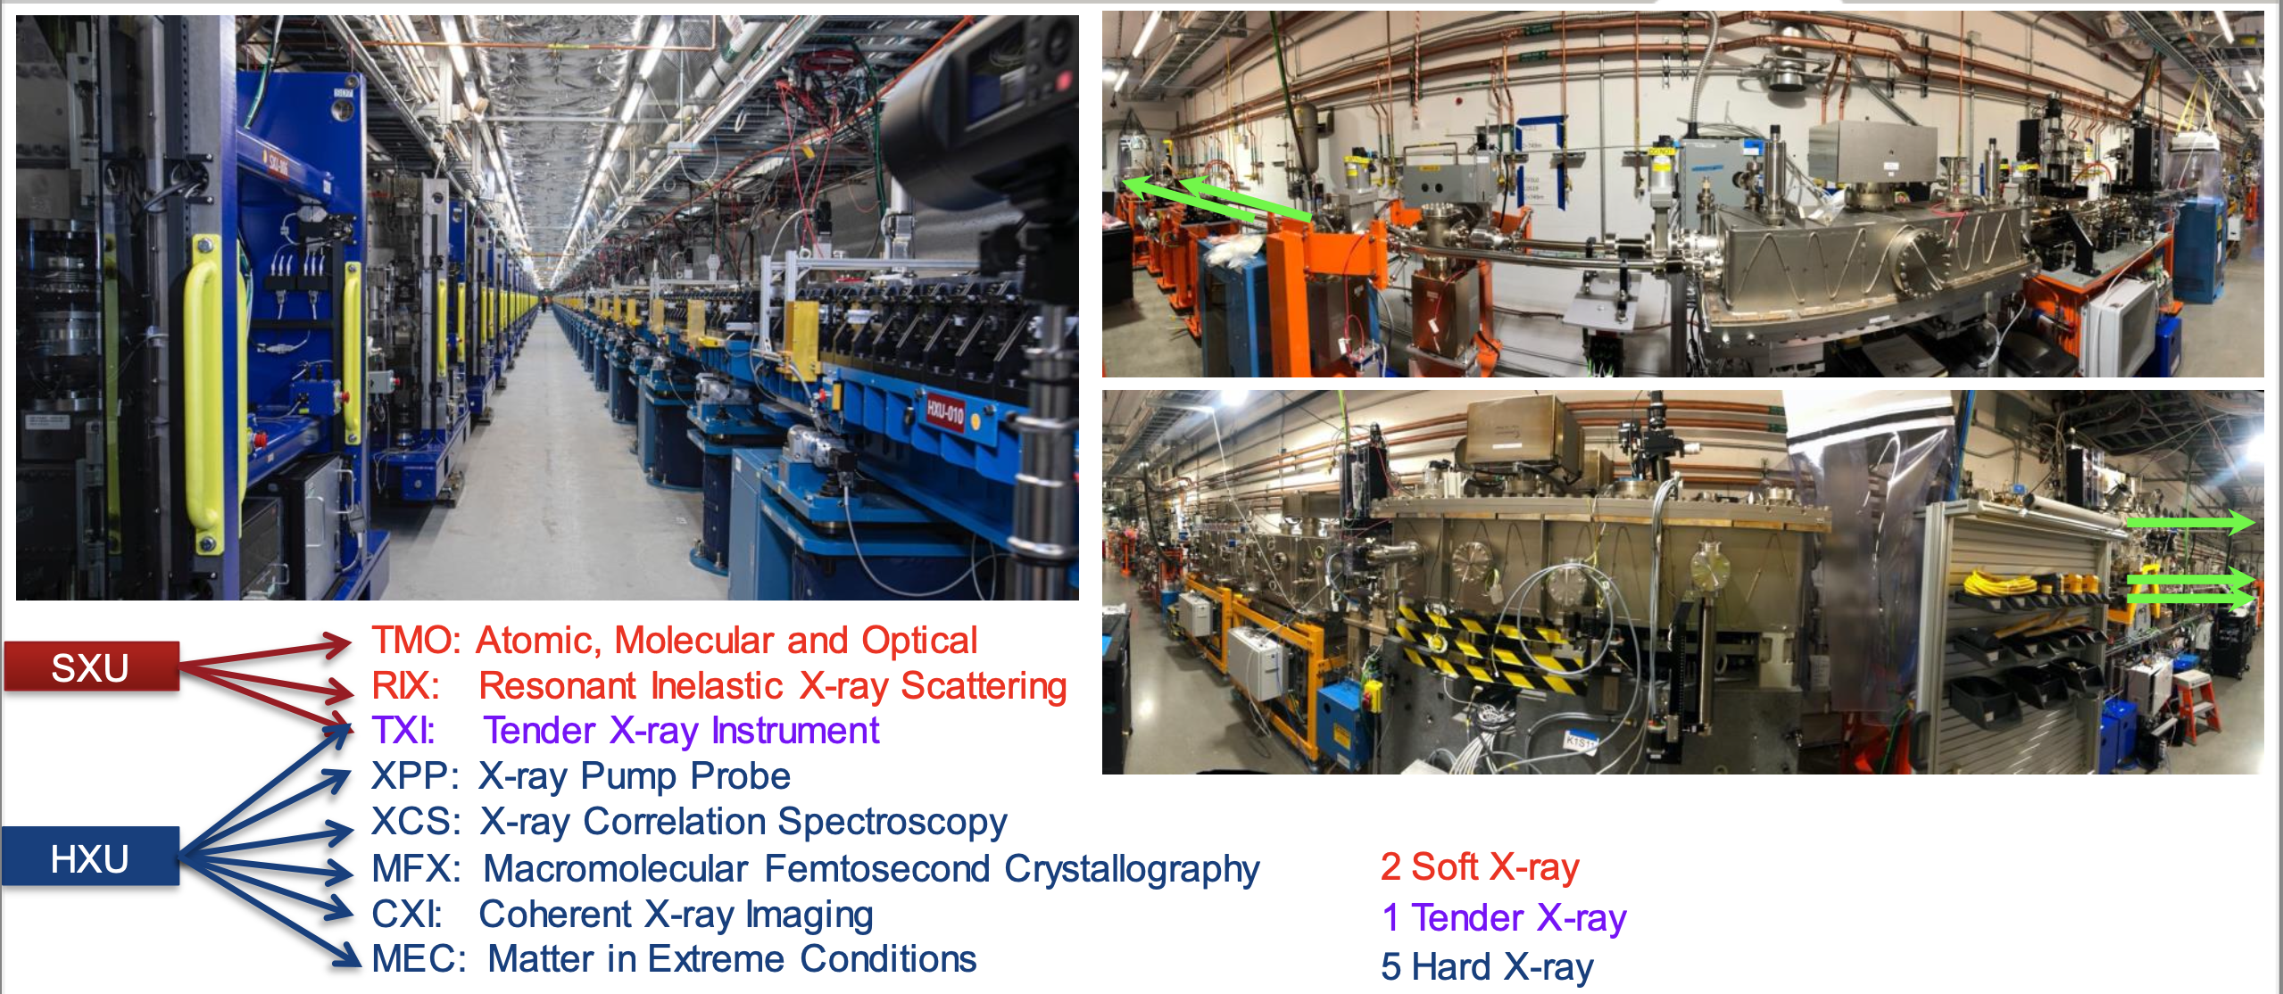
Hard and Soft x-ray FELs can be switched through either undulator and optically distributed to the LCLS instruments

Slide 6
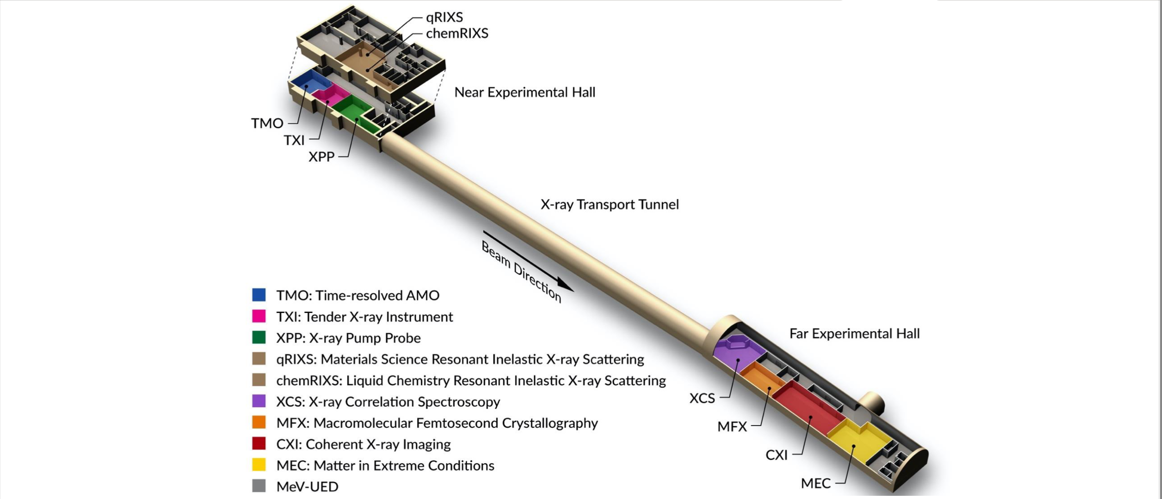
Current LCLS Experimental lay out

Slide 7

LCLS-II Key Performance Parameters (in progress)
Threshold and Objective
Performance Measure | Threshold (5 kW beam) | Objective (120 kW beam) | Measurements
Variable gap undulators | 2 (soft and hard x‑ray) | 2 (soft and hard x‑ray)
Superconducting linac-based FEL system
Superconducting linac electron beam energy | 3.5 GeV | ≥ 4 GeV | Spectrometer bend (magnet strength, screen)
Electron bunch repetition rate | 93 kHz | 929 kHz | BPM’s, laser rate
Superconducting linac charge per bunch | 0.02 nC | 0.1 nC | Toroid, Faraday cup
Photon beam energy range | 250–3,800 eV | 200–5,000 eV | Absorption edges, spectrometer
High repetition rate capable end stations | ≥ 1 | ≥ 2 | N/A
FEL photon quantity (10⁻³ BW) per bunch | 5x10⁸ (10x spontaneous) @2,500 eV | > 10¹¹ @ 3,800 eV | Gas energy monitor, GMD, Spectrometer
Normal conducting linac-based system
Normal conducting linac electron beam energy | 13.6 GeV | 15 GeV | Spectrometer bend (magnet strength, screen)
Electron bunch repetition rate | 120 Hz | 120 Hz | BPM’s, laser rate
Normal conducting linac charge per bunch | 0.1 nC | 0.25 nC | Toroid, Faraday cup
Photon beam energy range | 1–15 keV | 1–25k eV | Absorption edges, spectrometer
Low repetition rate capable end stations | ≥ 2 | ≥ 3 | N/A
FEL photon quantity (10⁻³ BWª) per bunch | 10¹⁰ (lasing @ 15 keV) | > 10¹² @ 15 keV | Gas energy monitor, GMD, Spectrometer

Slide 8
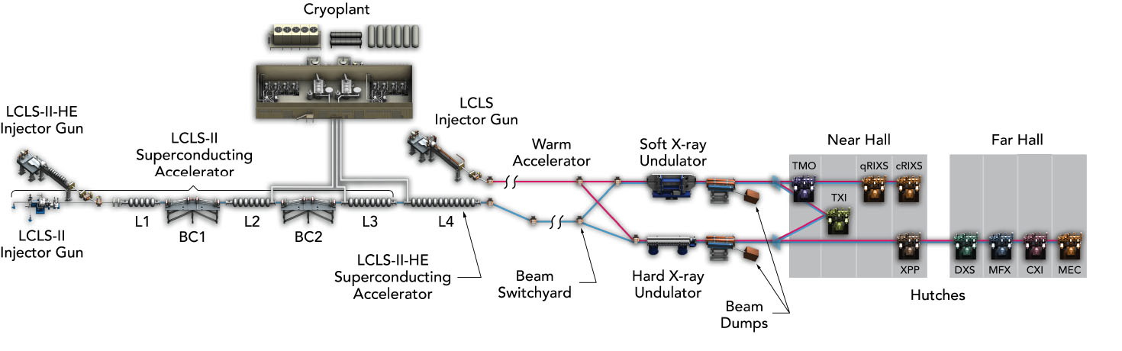
LCLS-II-HE Future Upgrade
Add 23 additional cryomodules (L4 linac) to double the LCLS-II accelerator energy: 4 GeV to 8 GeV
Install new cryogenic distribution box and transfer line between the cryoplant and the new L4 linac
New long period soft X-ray undulator
Upgrade the LCLS hard X-ray instruments for MHz beam and data rates
Design low-emittance injector and SRF gun for extended hard X-ray performance

Slide 9
LCLS-II-HE Energy Range

Slide 10
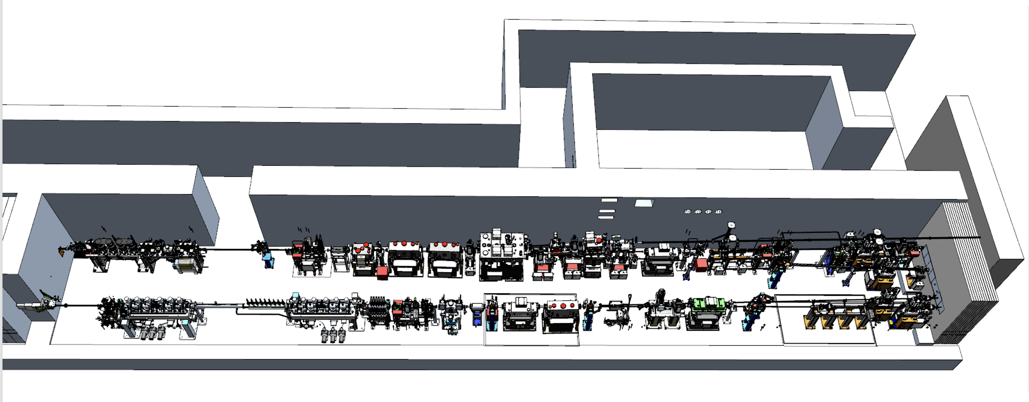
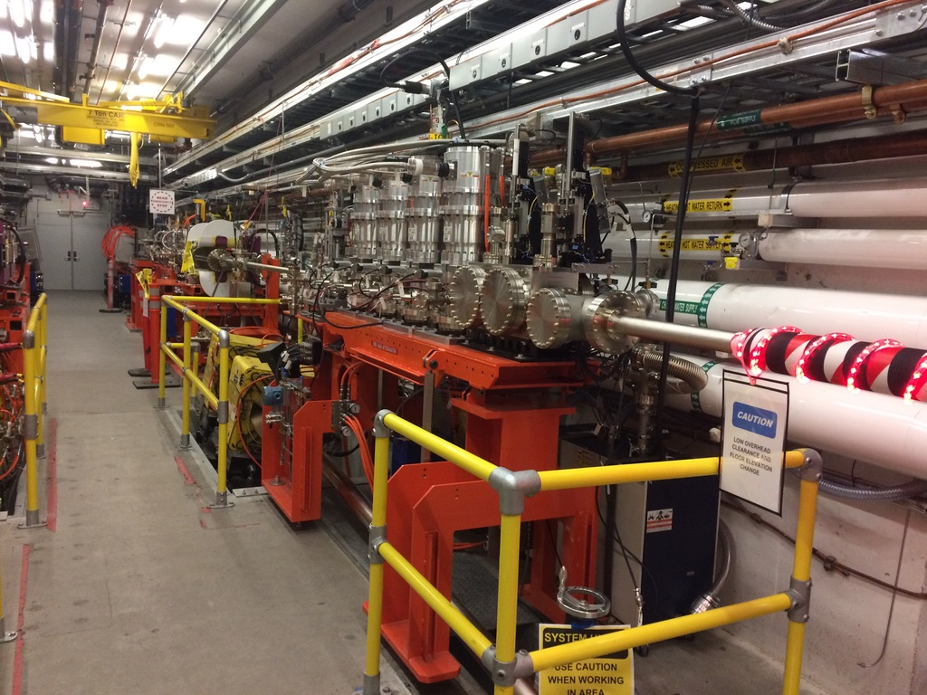
LCLS Photon Diagnostics Overview
Diagnostics in areas:
Undulator
EBD
FEE
Instrument hutches
XRT (between NEH and FEH)

Slide 11
LCLS Diagnostics Overview: HXR and SXR
Accelerator:
XTCAV
Eloss scan
…
HXR:
RTDS- multi-use chamber
Imagers
GEMs- Gas Energy Monitors
Solid Attenuator
Wave Front Sensor WFS
Power Meters
K-mono spectrometer
XTES spectrometer (XRT)
Instr. Diagnostics:
SXR:
RTDS
Imagers
X/GMD- Gas Energy Monitor
Gas Attenuator
WFS
Power Meters
Instr. Diagnostics:
Mono/spectrometer @ ChemR
Solid Attenuator
Zone plate spectrometer @TMO
Multi TOF spectrometer Cookiebox TMO
FIMs-Fluorescence Intensity Monitor
(on KB optics)
IPM Intensity Monitor
…

Slide 12
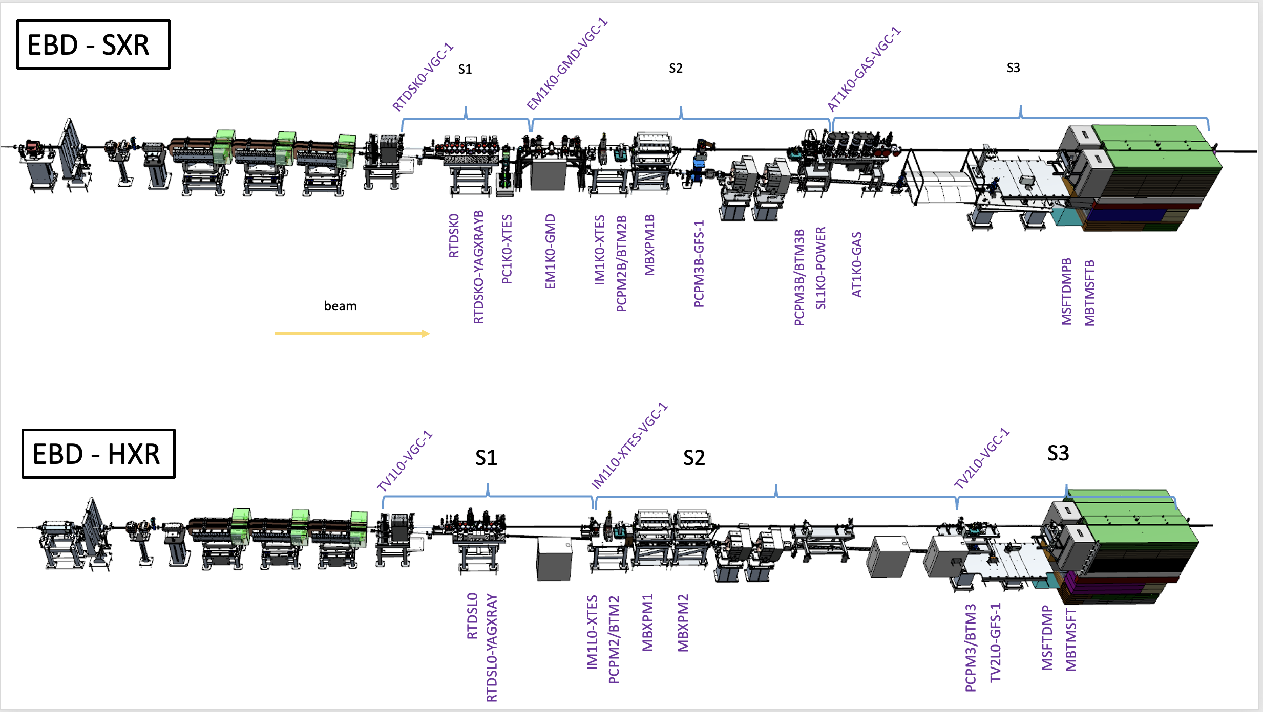
Electron Beam Dump (EBD) – Component Layout
RTDS
GMD
Imager
Gas Attenuator 1/2
XTCAV
ELoss
RTDS
Imager

Slide 13
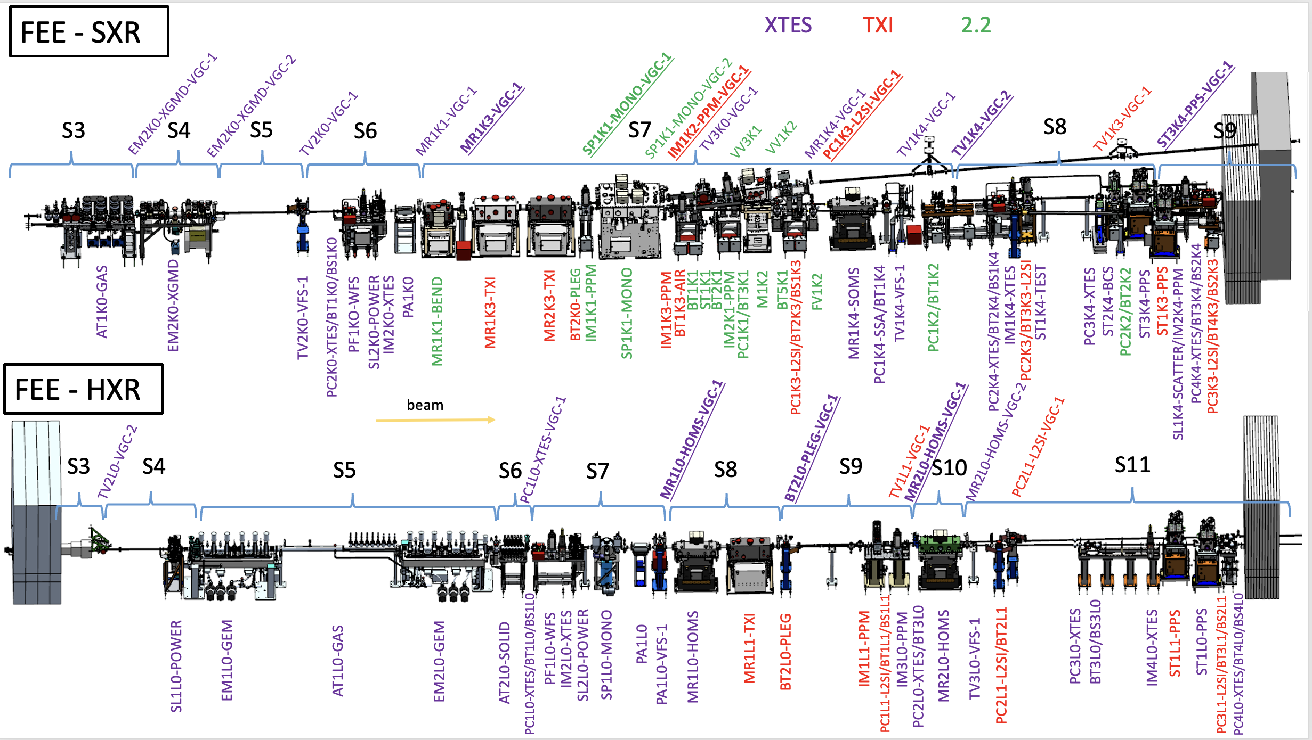
Front End Enclosure (FEE) – Component Layout
WFS
Imager +PM
S-Att
Imager +PM
XGMD
Imager2
Mirrors
Mono
Gas Att
K-Mono
GEM1
GEM2
S-Att
WFS+Imager
Mirrors
IM+PM
Imager

Slide 14
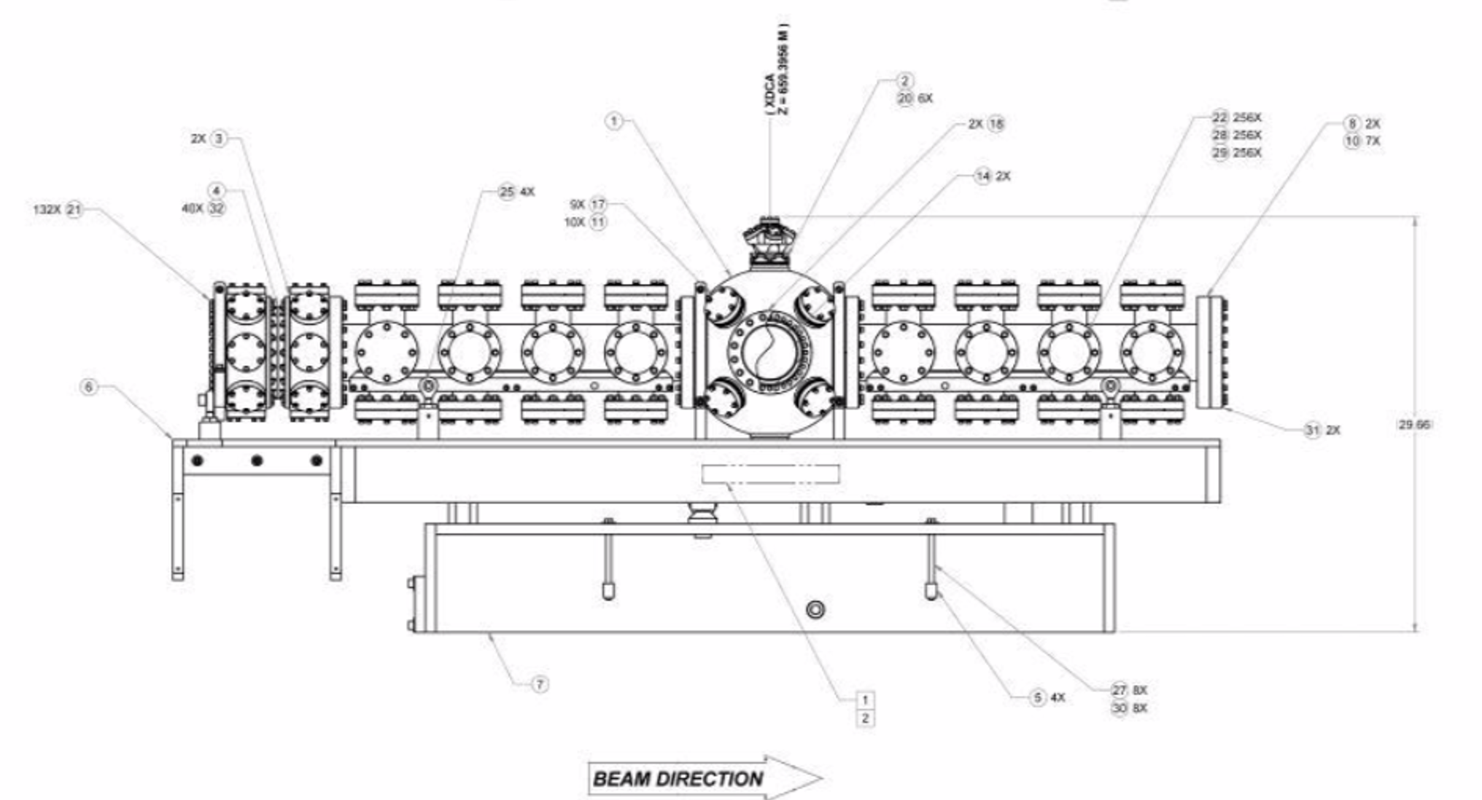
HXR/SXR: RTDS in EBD
Rapid Transfer Diagnostics Station:
Most upstream multipurpose Chamber:
-filters (OTR), slits
-energy foils/attenuator
-power meter
-diodes for 2 pulse detection
-damage studies for RP
-etc.
-”unfriendly” environment
-basic controls interface
-”1st day diagnostics”: filter, YAG,
powermeter

Slide 15
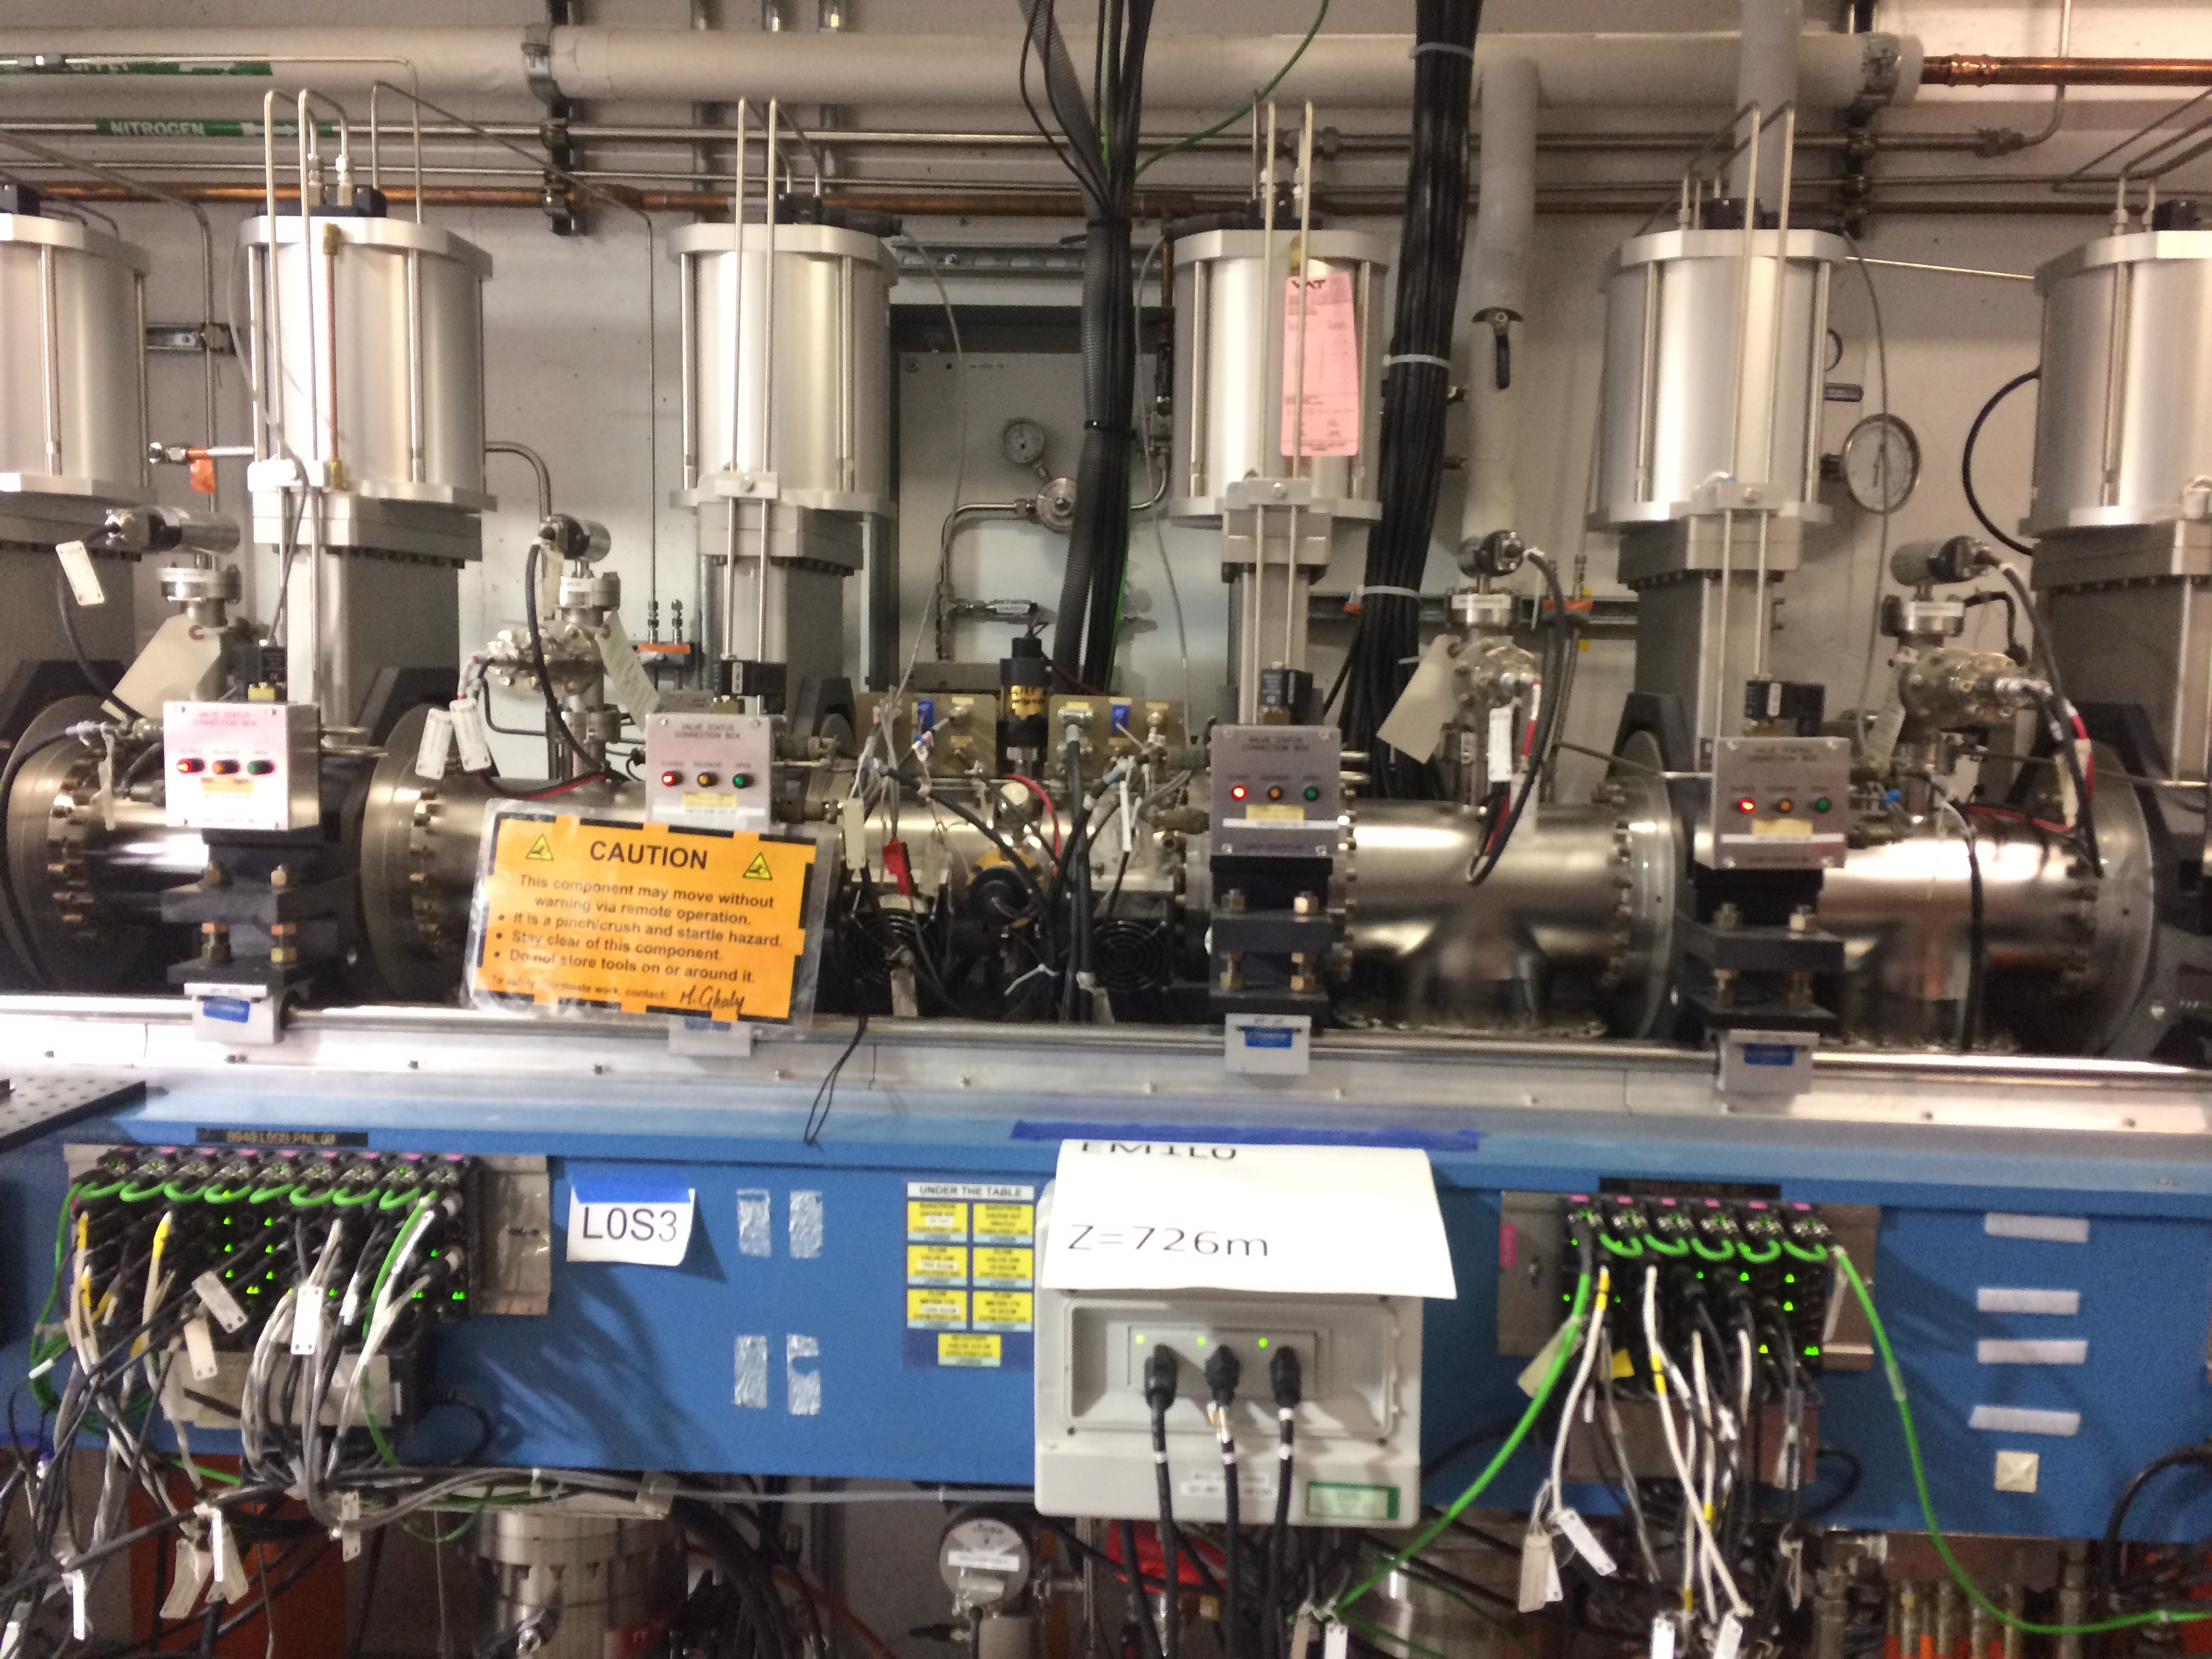
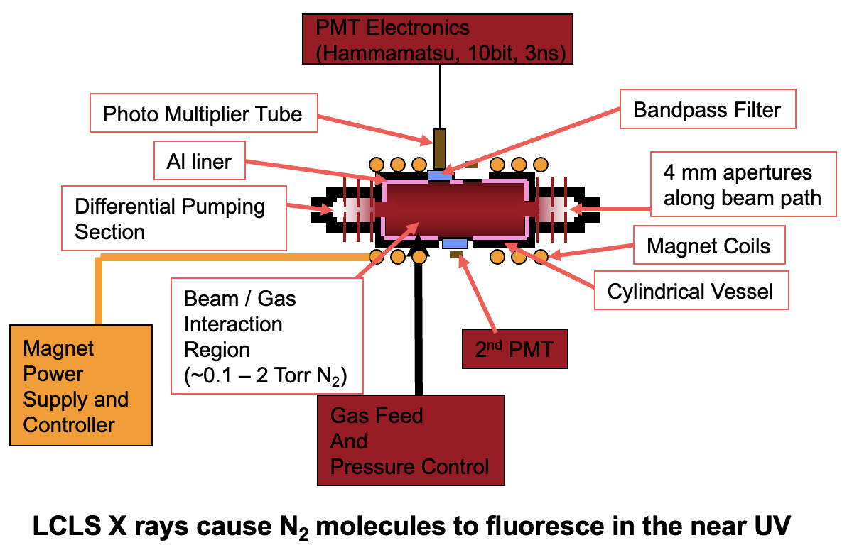
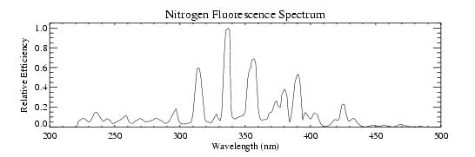
HXR Gas Energy Monitors (GEM) 2x in the FEE integrated in Gas Attenuator (old)
A.N. Brunner
Cornell University (1967).
Near UV N2 Fluorescence
Relative FEL intensity
Specs: 0.05-2.0mJ, <10uJ
~450-25,000keV
Absolute calibration via Electron Loss Method
Hau-Riege,S. et al., Phys. Rev. Lett. 105 043003 (2010)
15

Slide 16
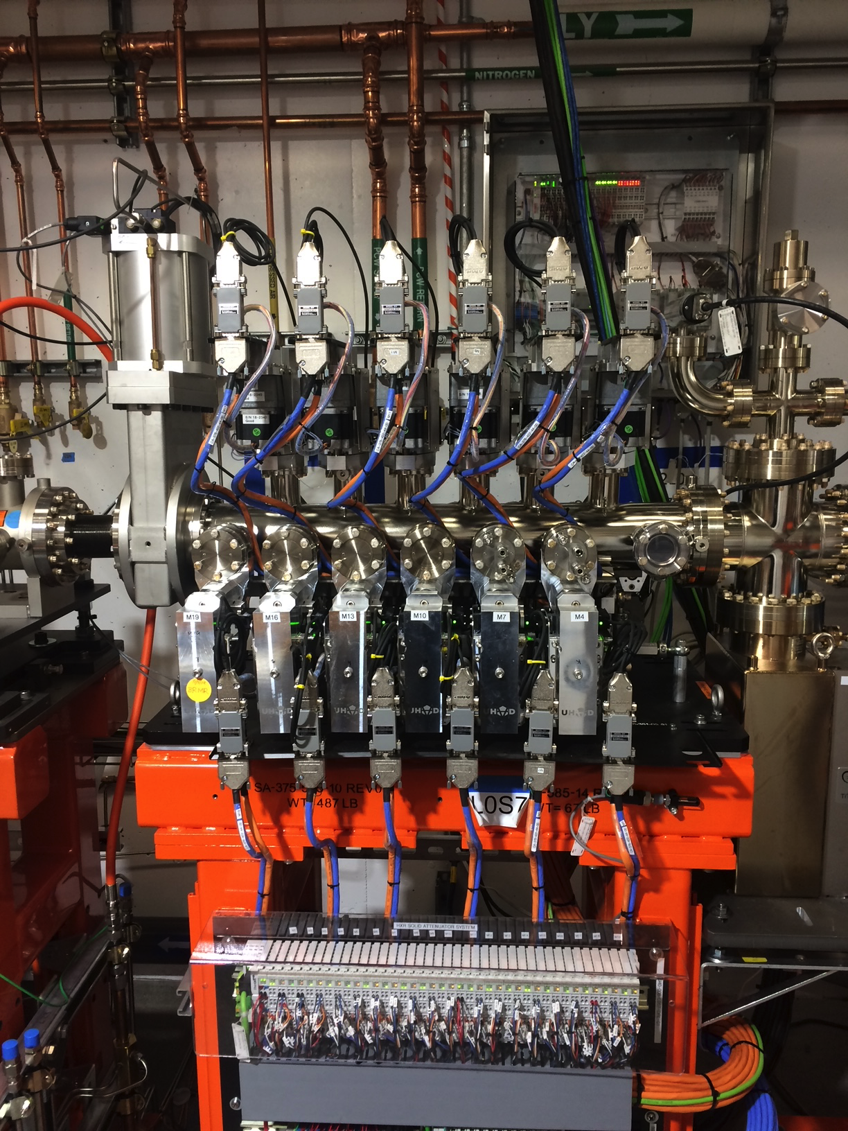
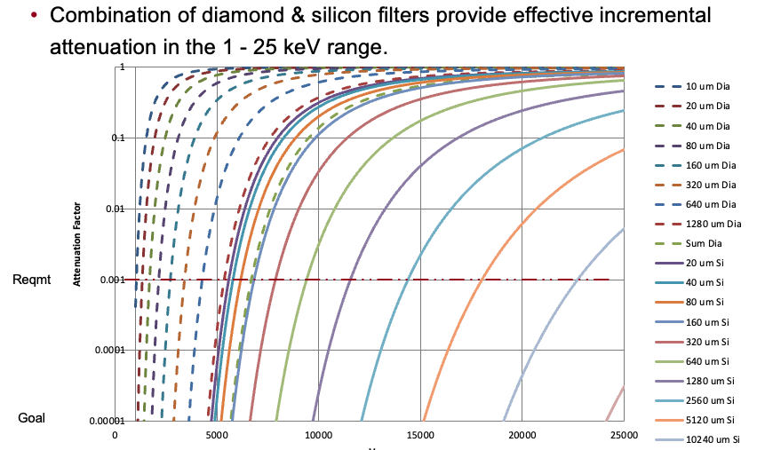
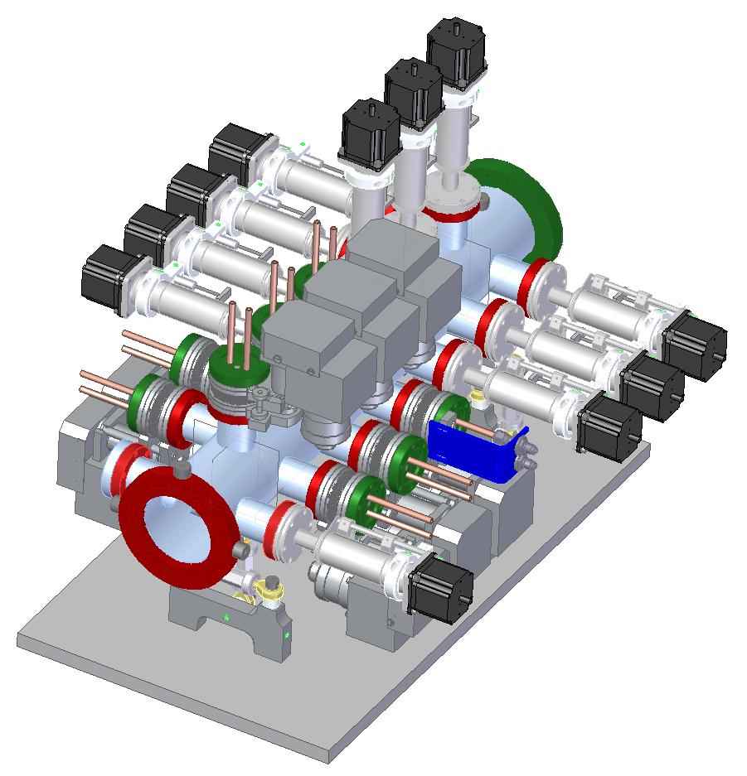
HXR Solid Attenuator
  Includes:
  8 Water cooled Diamond filter/actuator assemblies
  10 Passively cooled Silicon filter/actuator assemblies
  Filters (Diamond upstream and Silicon downstream)
  Filter viewing system. (camera/lens not yet included)
  Withstand the maximum peak single shot damage
  Withstand the thermal loading of the average power of 200 W in the SC mode (SC Linac may exceed 200W output),
  Withstand the thermal loading of the average power of 1.2 W in the Cu mode (Cu Linac may exceed 1.2 output).
LCLS-II project, M. Campell FDR (2016)

Slide 17
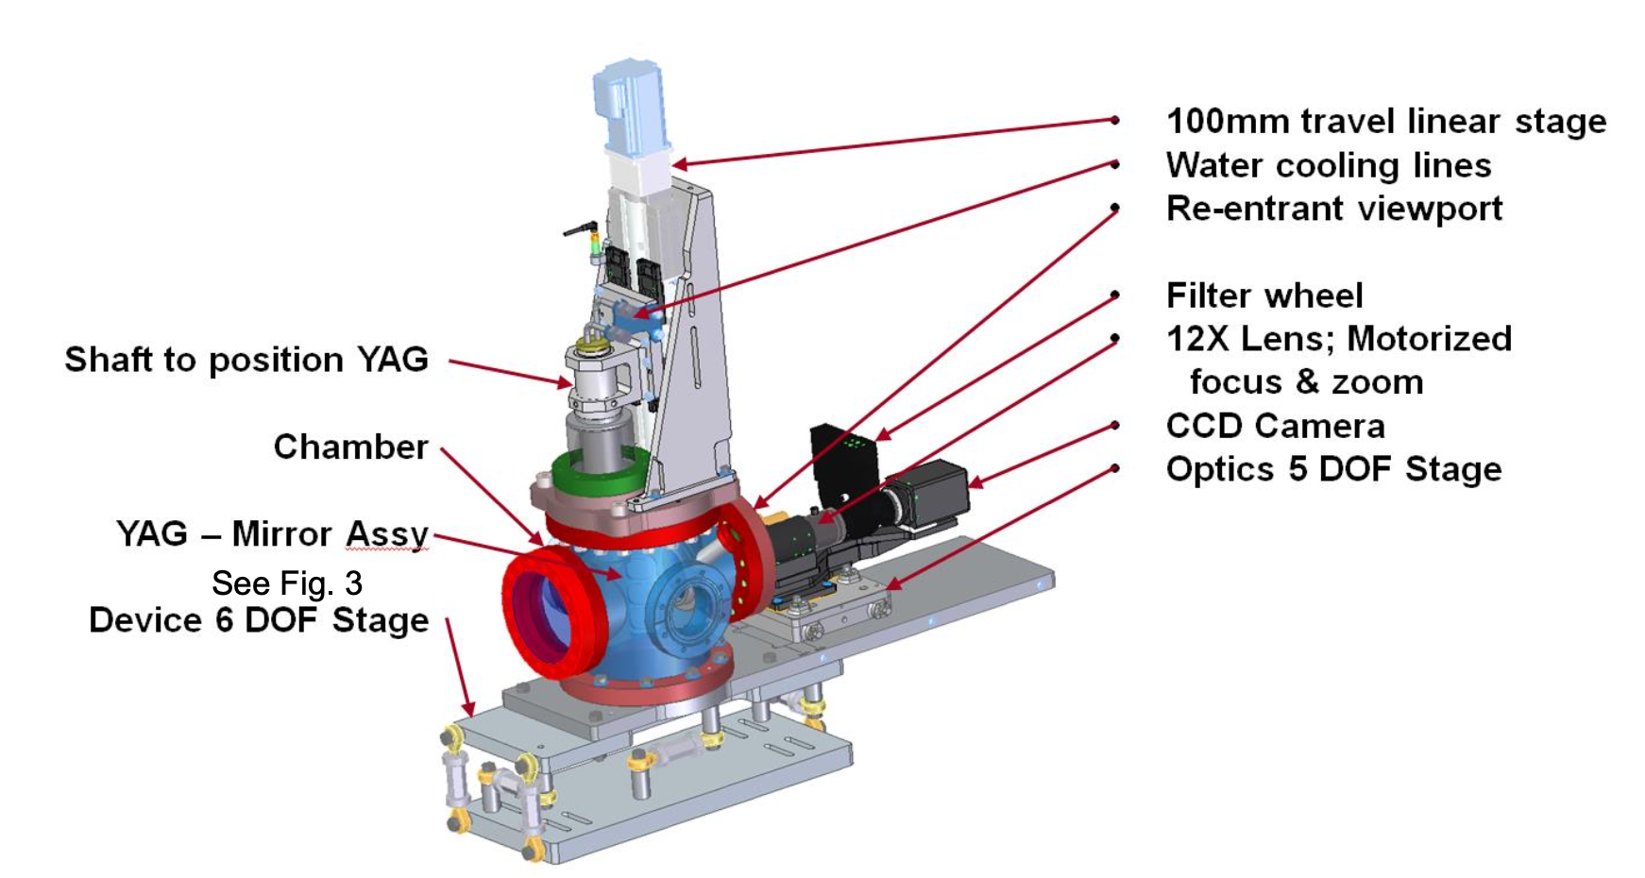
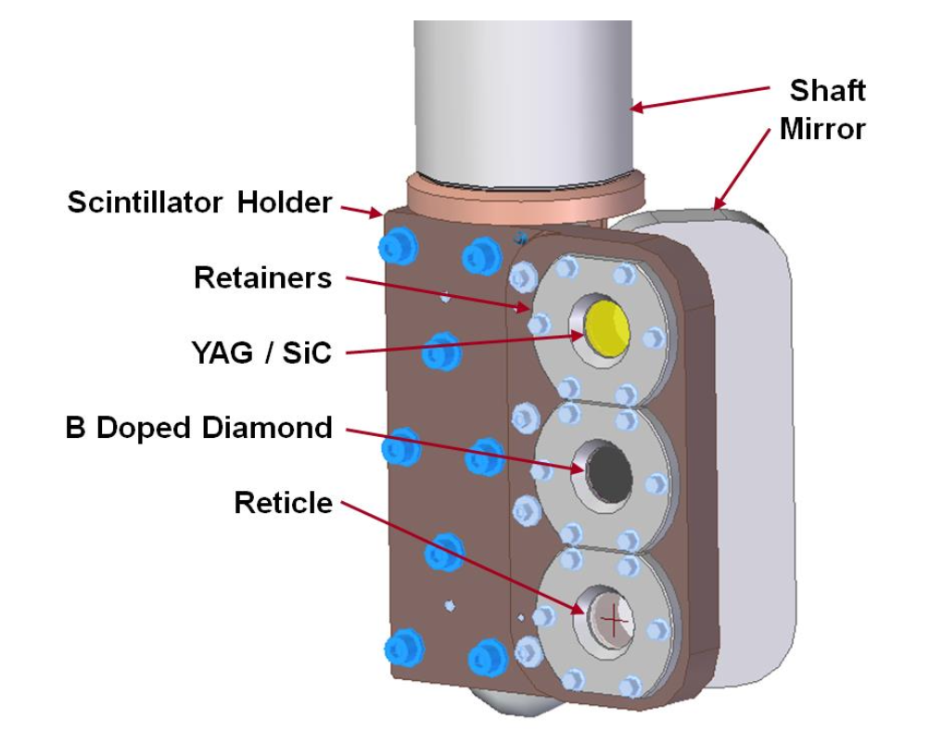
Imager both HXR and SXR (SC and Cu)
Beam Profile, alignment, beam quality
0.2-1.3keV SXU/1-5keV HXU, 20W 1MHz
1-25keV CU-HXU, 120Hz
Res. 4.4um SXR, 3.34um HXR
Variable FOV dep. on pos. 0.6-27mm range
120Hz, or burst mode for >Hz
YAG, CVD diamond
Opal camera,
3rd position compatible with
powermeter mounting
Y. Feng et al., L2SI Project (2010)

Slide 18
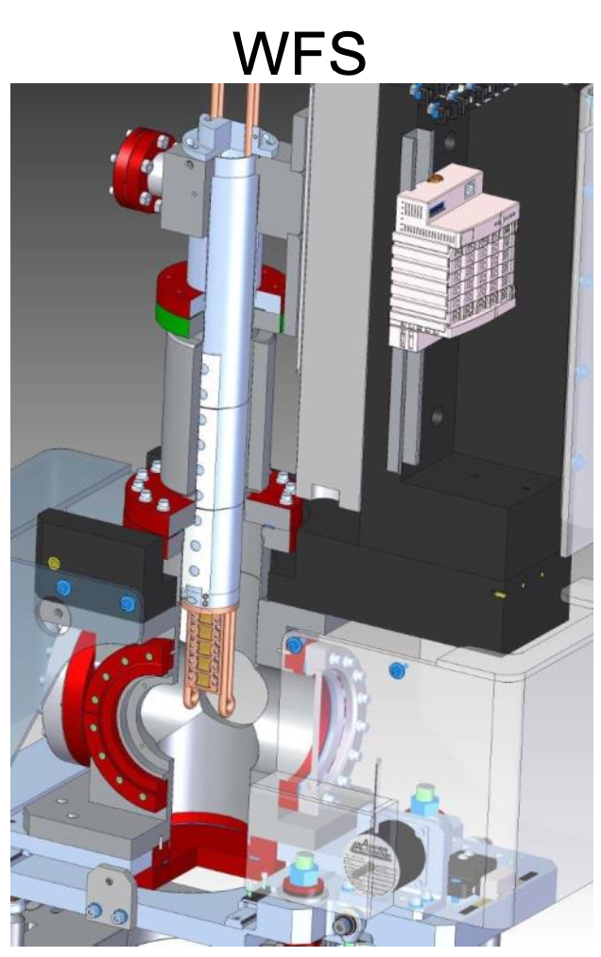
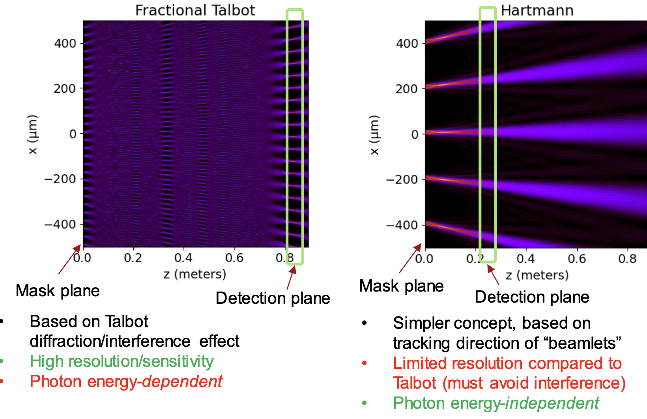
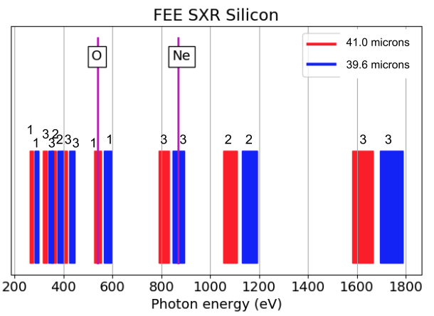
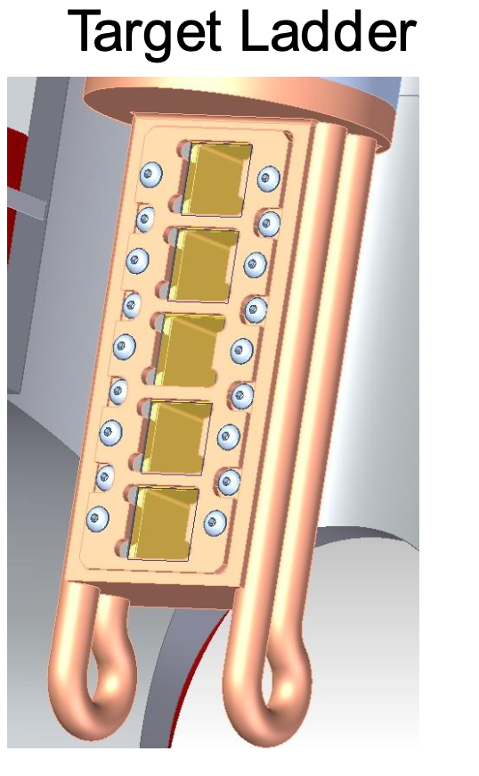
Wavefront Sensor (WFS)- fractional Talbot
Focus size, ~ location, ~ quality, mirror alignment and characterization, phase correction for CRLs
WFSensor is paired with downstream imager
Pixel size res. 1-12.5um (IM2K0) is calibrated by reticle of imager
Up to 5 masks (pinhole arrays)
-Si 2W, Diamond 20W
WFS mount has z travel to reach Talbot planes
Talbot based WFSensing is very sensitive,
and flexible for soft and hard x-rays!
Shows good agreement with (lengthy)
imprint studies!
M. Seaberg et al., J. Synchrotron Rad. (2019). 26(4), 1115–1126
(compares 3 WFS methods successfully. (Photon Diag 2017))

Slide 19
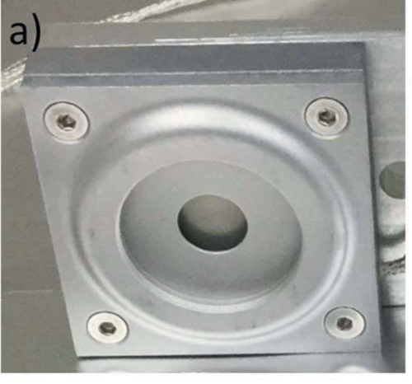
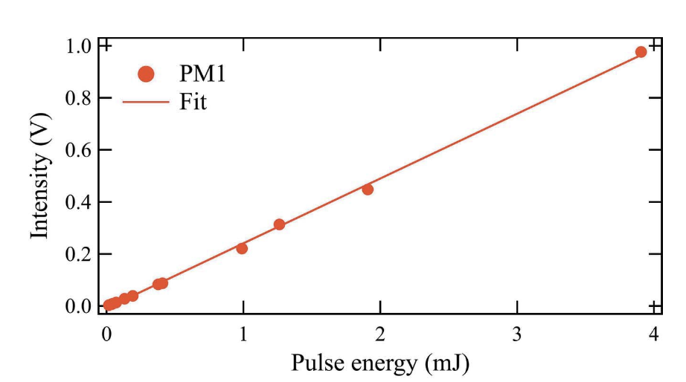
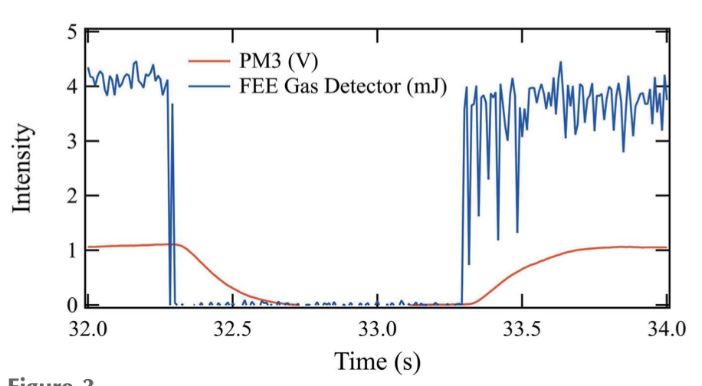
Powermeter
Commercial laser power meter for compact ,absolute, intercepting measurement,
Integrated into imager mounting
Pyroelectric, thermopile method
Gentec-EO model UP10P-2S-5-TE-DO power meter, Al absorber
Response time ~0.2sec 1/e, sensitivity ~10uJ, linear dynamic range 2 orders, abs. with 6%.,
photon energy independent as losses due to fluorescence and photo electron yield is low.
P. Heimann et al., J. Synchrotron Rad. (2018). 25, 72–76

Slide 20
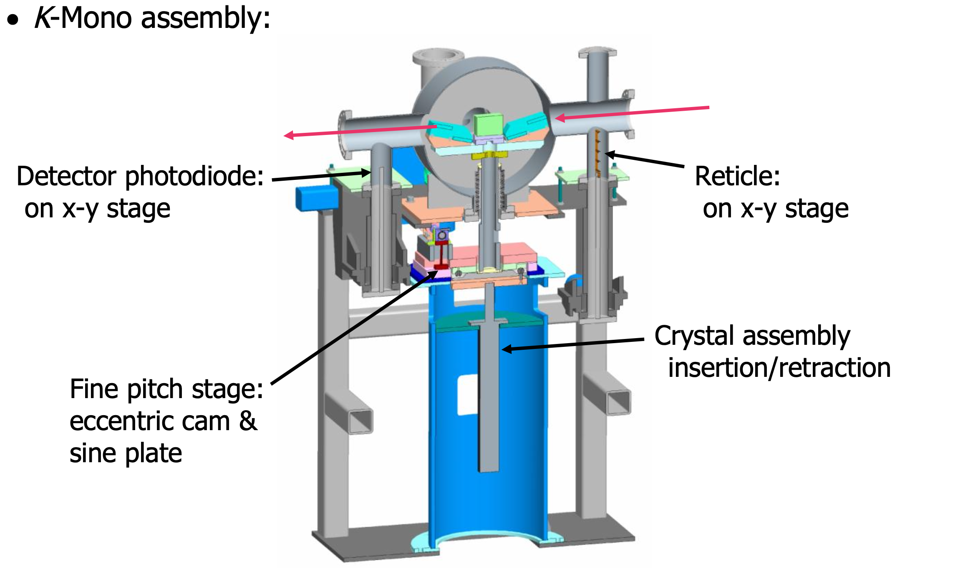
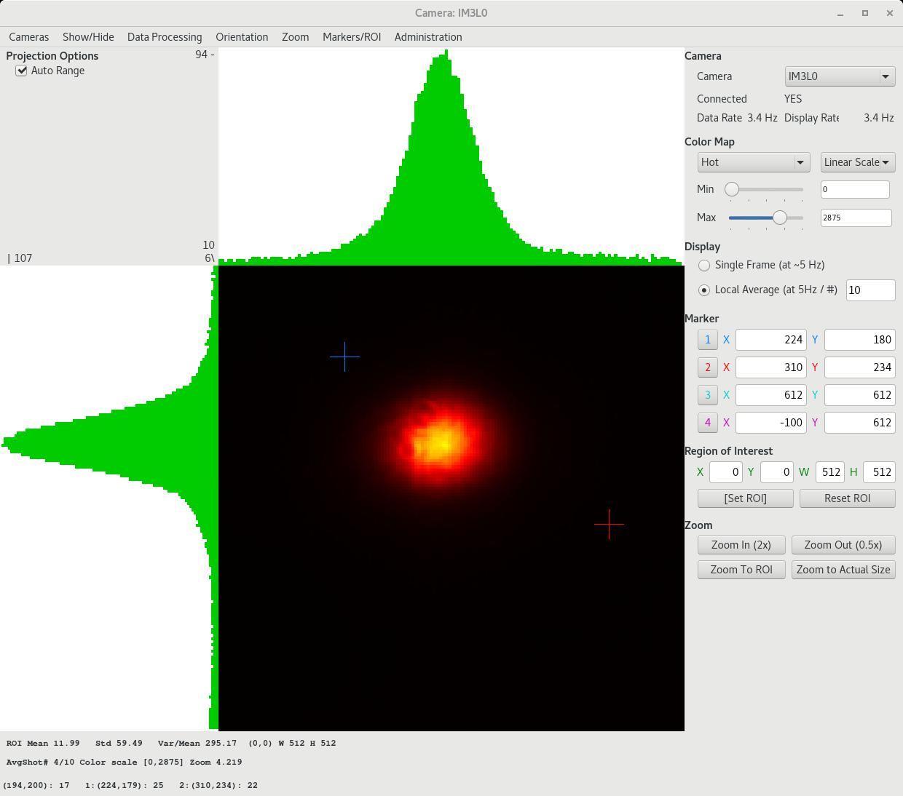
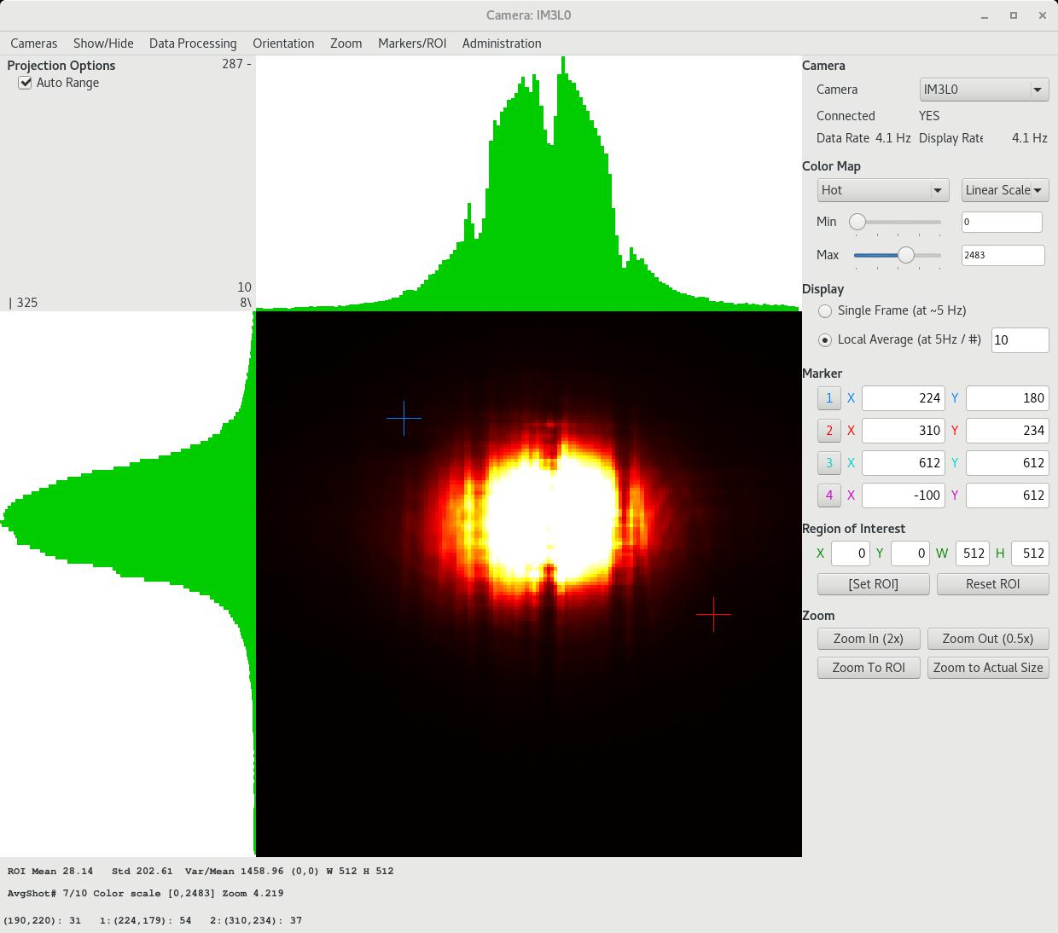
K-Mono (HXR FEE, original LCLS device)
P. Stefan et al., LCLS Commissioning Report 2009
Originally intended for in-situ magnetic k alignment of undulator segments with beam (MMF back up plan)
Narrow bandwidth, photon-energy filter
2 channel cut Si (111) 4 bounce monochromator
Central pass energy 8172+/-75eV, Res. 0.2eV
Downstream Imager (IM3K0) for transmitted beam
MFX occasionally uses k-mono
Upgrade plan in the future
8.2keV without and with k-mono)

Slide 21
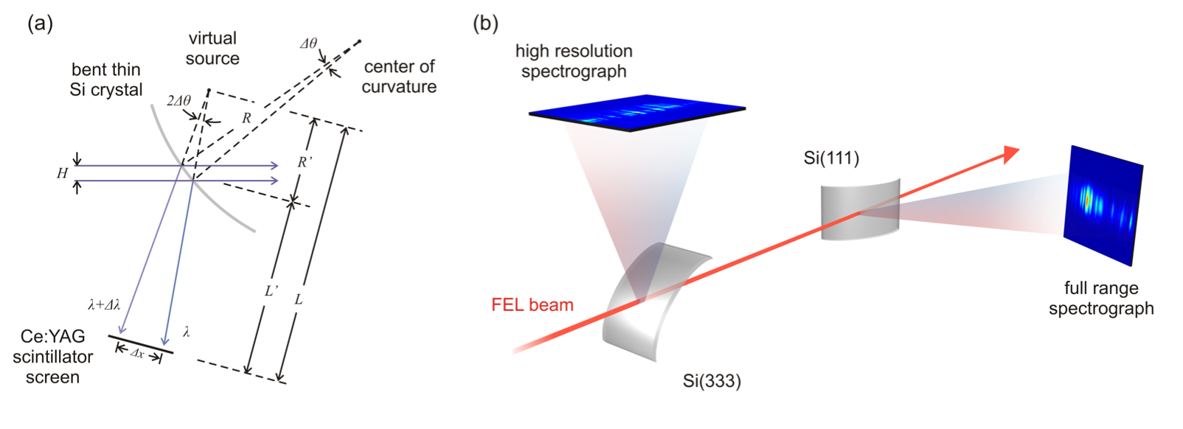
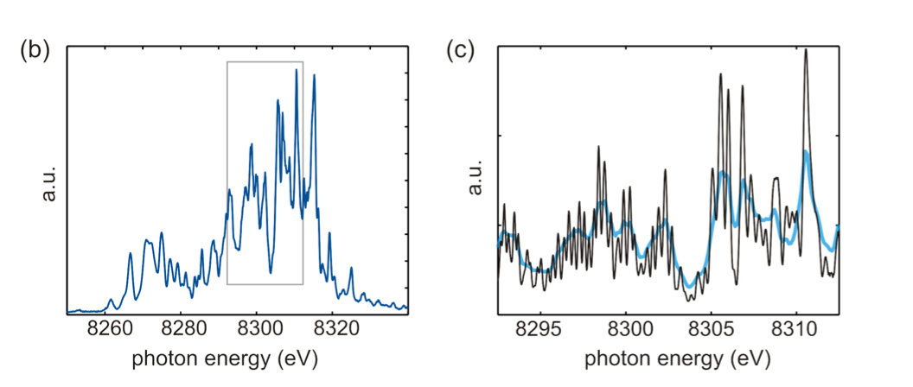
XRT Spectrometer (HXR transmissive single shot)
cylindrically bent 10um Si crystal (5x15mm, R<100m)
Resolution for SASE spikes, full FEL Bandwidth
Inline spectral diagnostic, >80% transmission
Spectrum at 8.3keV Si(111)
Resolution 0.5 resp. 0.2eV Si(333)
Bent Crystal dispersion Geometry
Set up for tandem measurement
D. Zhu et al., J of Phys Conf Series 425 (2013) 052033

Slide 22
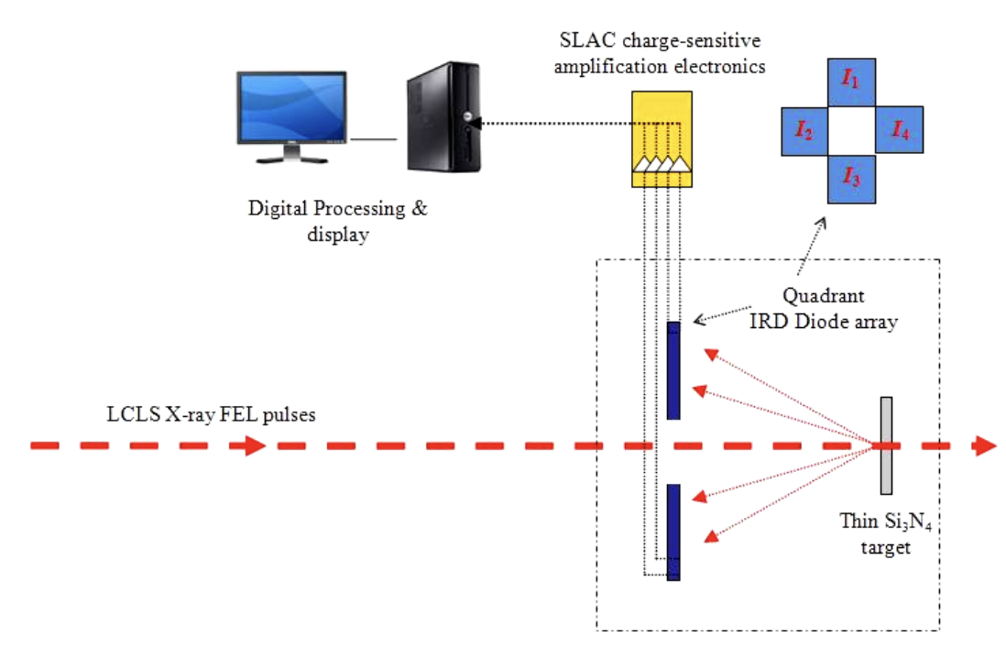
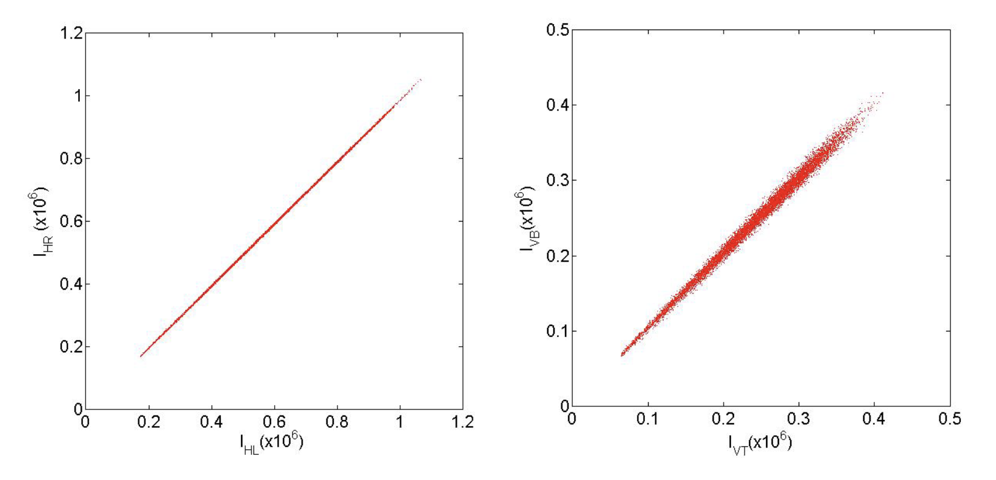
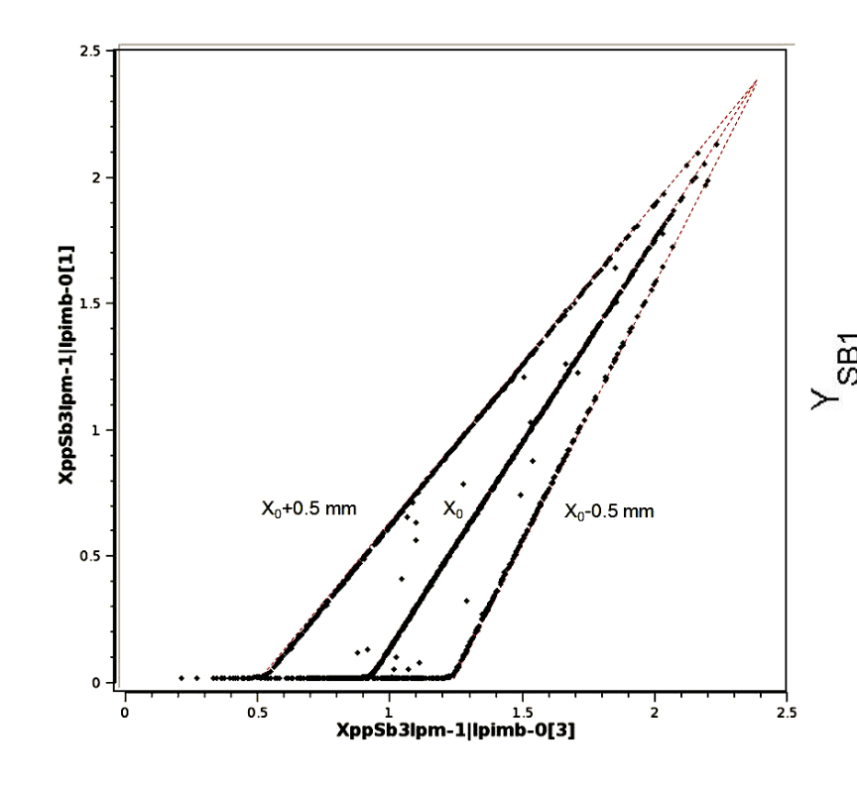
IPM hard x-ray single-shot Intensity-Position Monitor
IPM detects back-scattered X-rays from thin, partially transmissive silicon nitride or diamond foils
Wavefront preserving
Highly transmissive
Free standing foils, density uniformity; ~0.5um thick
(0.1-1.0% relative precision)
Position sensitivity 2-3um
Intensity correlations (vertical and horizontal)
(Feng et al., Proc. of SPIE Vol 8140 (2011)).
Position measurement

Slide 23
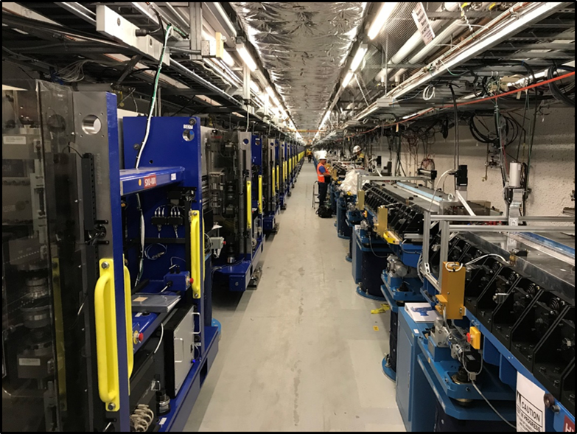
Moving over to the SXR beam line
SXR beamline in EBD
SXU
HXU

Slide 24
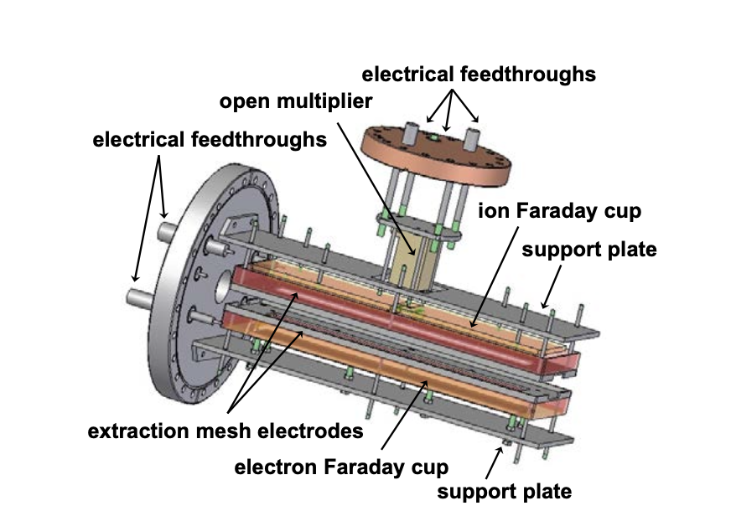
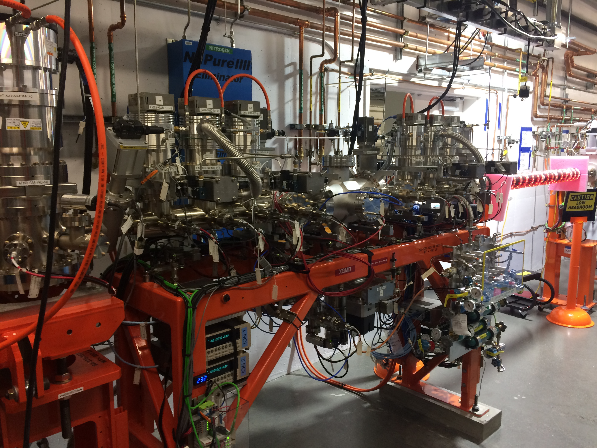
Gas Monitor Detector: GMD (in EBD) and XGMD (FEE)
Tiedtke et al., Opt. Express 22, 21214-21226 (2014)
Developed by DESY and PTB
Atomic ionization of rare gases
at low pressures (1E-5 to E-7Torr)
-transmissive,
-large dynamic range and linear
Charge detection of photo ions
and photo electrons
by Faraday cups provides:
Absolute pulse energy [mJ]
Average ion current is cross calibrated
at metrology lab (PTB)
Open ion multiplier provides:
  Charge states
  Spectral purity
  Mean charge
XGMD (incl beam position

Slide 25
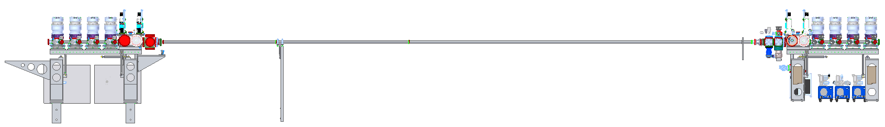
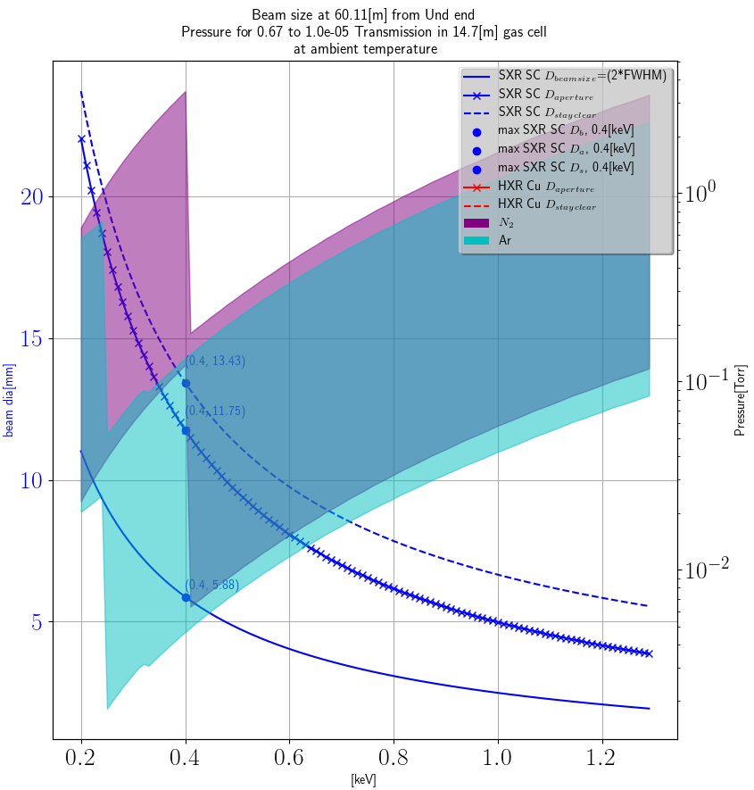
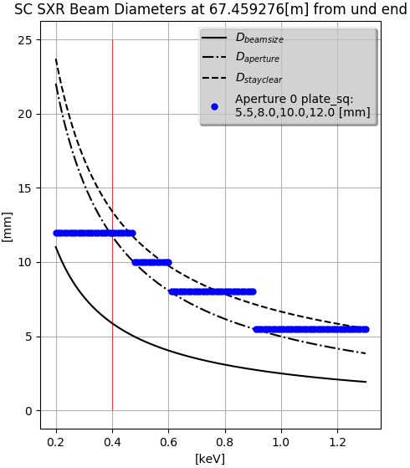
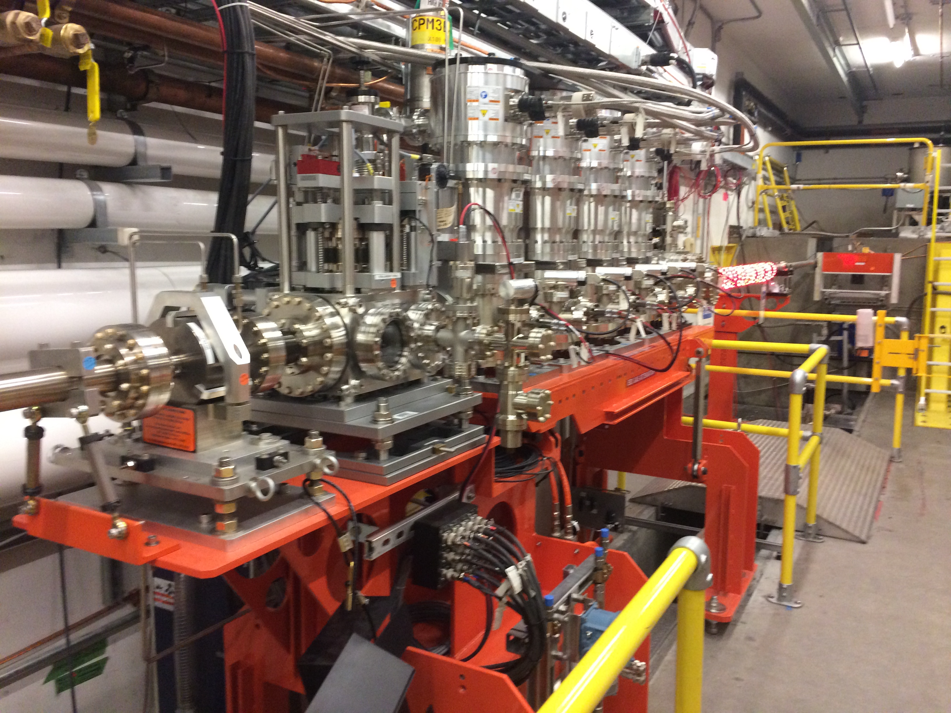
SXR - Gas Attenuator
Schaefer, D. et al., LCLS-II FDR (2017)
  14.7[m] gas cell filled with Argon or Nitrogen gas spanning EBD and FEE
  Variable apertures on each side to exploit the reduction in beam size with increasing energy: 13, 10, 8 and 5.5 mm
    Inner gas tubes ID 15mm
EBD
FEE

Slide 26
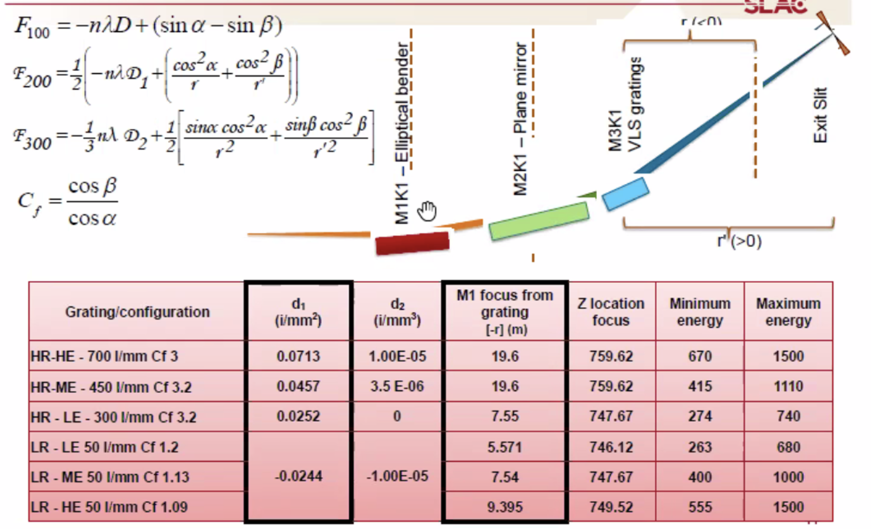
Monochromator @2.2
Requirements:
250-1600eV
Resolving power 2,000 Low and 50,000 high
D. Cocco et al.

Slide 27
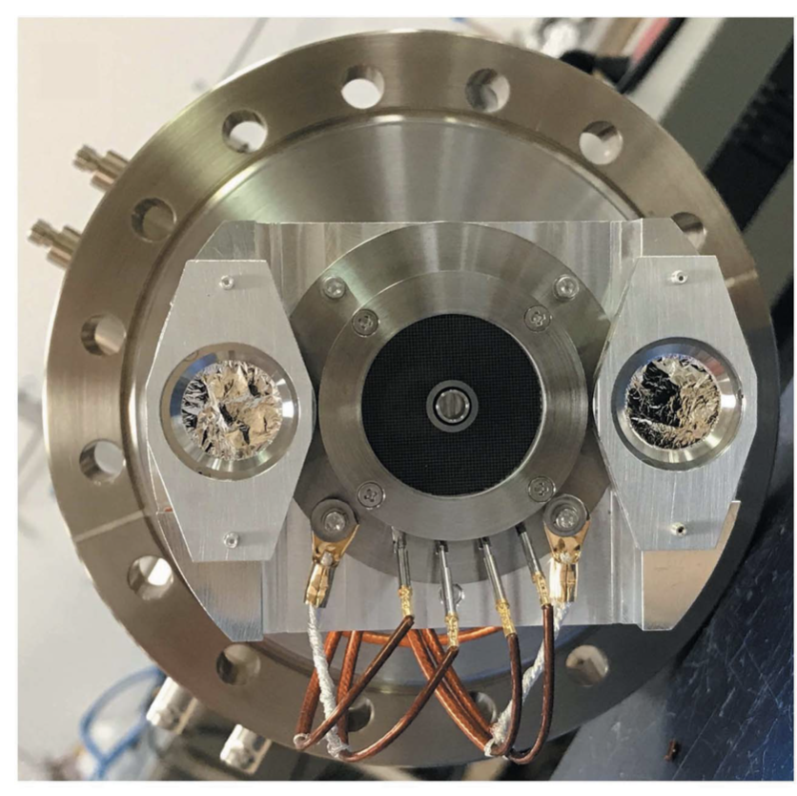
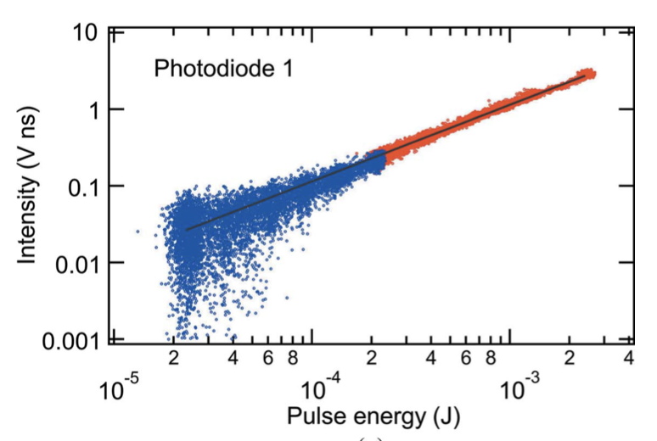
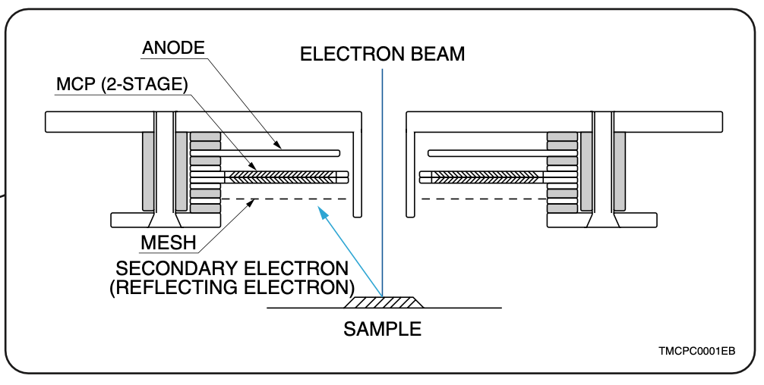
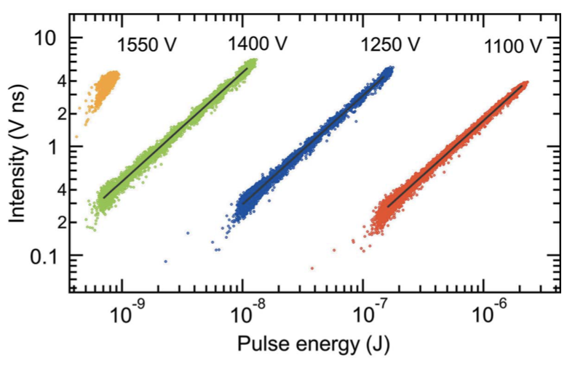
FIMs Fluorescence Intensity Monitors
Fluorescence detectors (MCP, diodes) facing the KB mirrors in the instrument beamlines (non–invasive, occupies no space along x-ray transport )
Pulse by pulse normalization for LCLS-II experiments
High vacuum compatible!
MCP (Hamamatsu F2223-21SH): wide range responsivity;
2 Diodes (Optodiode AXUV63HS-1): provides beam position
28ns FWHM, 24ns for MCP
Requirement: Signal to noise ratio 100:1; large dyn. range
250-5000eV, 0.2uJ-12mJ, 0.93MHz
2ns rise time, 100nm Al foil against electrons
MCP 1480eV, positive bias, 0.7nJ-2uJ
Neg bias: 30nJ-230uJ not shown
Noise 2-5%
Diode 1540eV
P. Heimann et al., J. Synchr. Rad. (2019) 26, 358-362

Slide 28
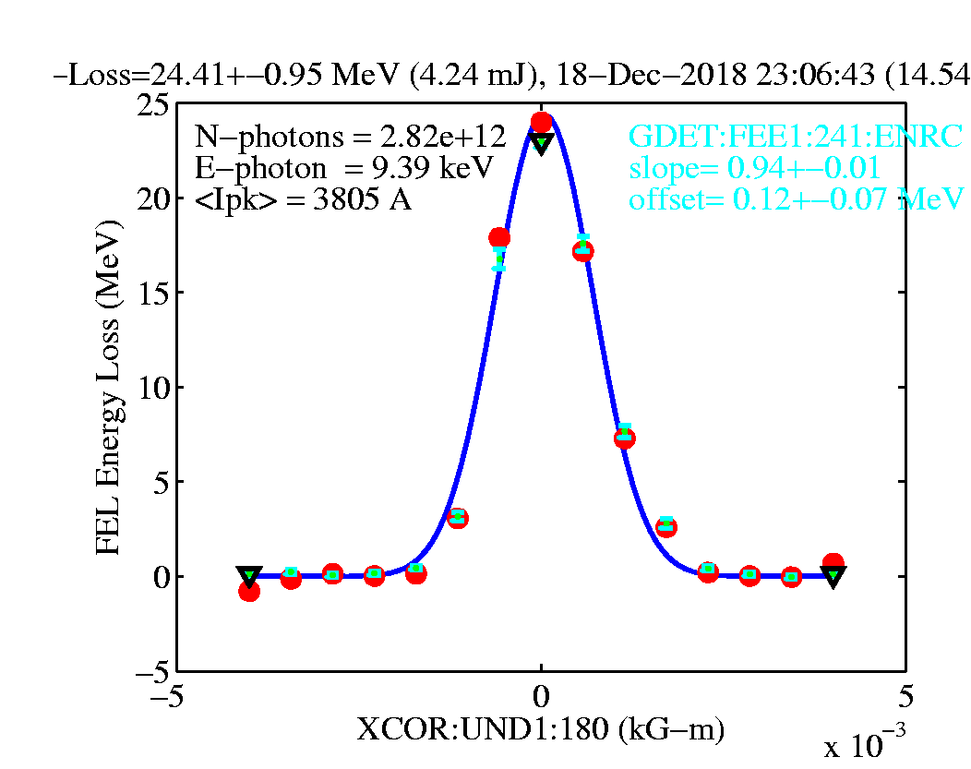
Energy Loss Scan Method
e⁻
+E_{jitter}
Undulator
FEL Photons
LTU DL2
+E_{jitter}
Without lasing:
e⁻
  Measure the electron energy before (LTU) and after undulator (Dump), once without lasing and once with lasing.
  The energy loss of the electrons is the energy gain of the photons.
E-Loss
With lasing:
e⁻
Dump
E-Loss=24.41±0.95 MeV (4.24 mJ), 18-Dec-2018 23:06:43 (14.54 GeV)
Decker F.J et al., priv. comm. 2018

Slide 29
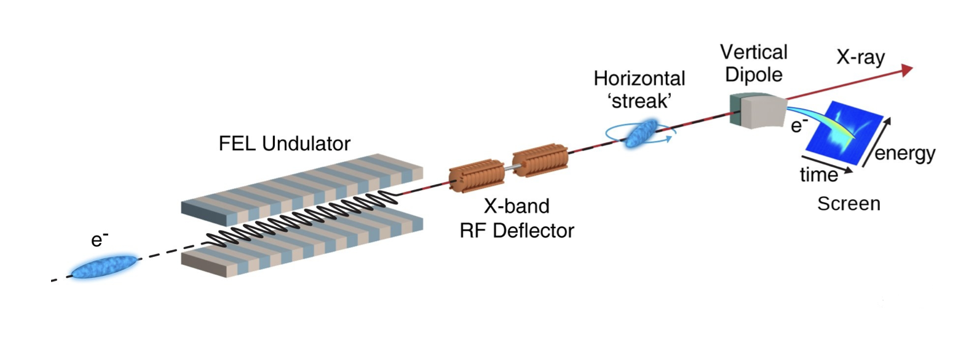
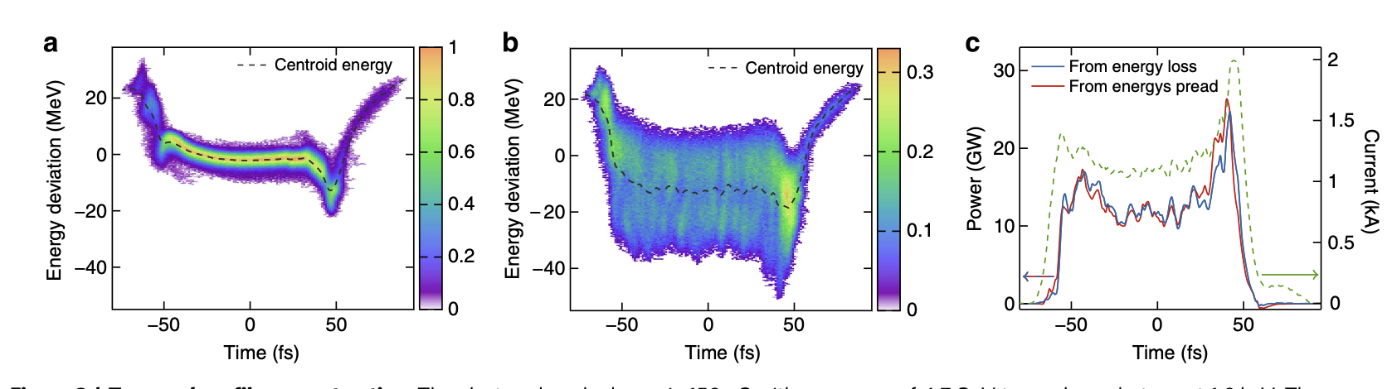
XTCAV (X-band Transverse deflecting CAVity)
Single shot electron bunch (x-ray) temporal and energy characterization
1-3fs rms
Lasing evolution
Large dynamic range
Non invasive
No lasing
with lasing
Y. Ding et al., Phys Rev STAB 14, 120701 (2011)
C. Behrens et al., Nat. Com. 5:3762 (2014)

Slide 30
Summary
LCLS-II x-ray diagnostics has been upgraded for the high rep-rate commissioning and operation of LCLS-II
Proven LCLS-I diagnostics is operating for the Cu 120Hz and R&D is ongoing for LCLS-II HE
--
Accelerator/Electron Diag. vs. x-ray diagnostics vs Instr. Diag.
Diagnostics devices vs. method development
Diagnostics development has traditionally been a highly collaborative field with active exchanges among various FEL facilities.

Slide 31
Thanks to my colleagues:
SLAC TID Directorate
Marcio Paduan Donadio
Dawood
Thi Le
LCLS:
Marc Campell
Nolan Brown
Don Schaefer
Margaret Ghaly
Vincent Esposito
Yiping Feng
Michael Browne
Tyler Johnson
Federica Murgia
Silke Nelson
Phil Hemann
W. Schlotter
Matt Seaberg
Mike Estrada
Georgi Dakovski
Mason Landrum
Diling Zu
May Ling Ng
Sanghoon Song
Technical staff
Accelerator Directorate:
H.D Nuhn
Alberto Lutman
Tim Maxwell
W. Colocho
F.-J Decker
Tonee Smith
Patrick Krejcik
Yuantao Ding
Zhirong Huang
Jacek Krzywinski
Clive Field
ACR Operators
LCLS-II and HE:
Eliazar Ortiz
Michael Rowen
Armin Busse
Xavi Permanyer
…and many more
External Labs
Kai Tiedtke, Fini Jastrow, Svea Kreis, M. Ilchen, Andrey Sorokin (DESY)
Mathias Richter (PTB)
Uwe Arp (NIST)
Stefan Hau-Riege (LLNL)
Michael Holmes (LBNL)
Harald Sinn, Jan Gruenert, Maurizio Vannoni (European XFEL)
Daniele Cocco, David Fritz
31

Slide 32
Thank You!
32

