Slide 1
Time resolved diagnostics: TDS, TDC, TCAV…
Paolo Craievich :: RF section :: Paul Scherrer Institut
WP13 EuPRAXIA electron and photon diagnostics, EPFL, 12.06.2023

Slide 2
Outline
Motivations for high-resolution time-resolved diagnostic
TDS as diagnostic tools
Novel Concept with Variable Polarization – The PolariX TDS
  Results obtained at DESY
Overview of the LPS measurements in SwissFEL
  C-band TDS system
Post-undulator PolariX TDS for ATHOS
    Specifications and commissioning
    Results
Summary and conclusion

Slide 3
Motivations for high-resolution time-resolved diagnostics
Ongoing Tendency of Getting Shorter and shorter Electron Bunches
FEL science (user): novel coherent diffractive imaging techniques and timing of ultrafast process require shorter (sub-fs/as) FEL X-ray pulses, i.e., observation of atomic and molecular process occurring at attosecond timescale
  Femtosecond-level temporal resolution are required for optimisation of these ultra-short bunches
  Single-shot characterization of the longitudinal phase space of the beam allows for single-shot reconstruction of the X-rays pulses as well
Novel high-gradient acceleration techniques: Laser Wakefield Plasma Acceleration – LWFA, Beam Driven Plasma Acceleration –PWFA, THz driven Acceleration, Dielectric Laser Driven Acceleration - DLA) are characterized by short period of accelerating field and therefore naturally produce or accelerate fs long beams
  The focusing gradients inherent to these novel high-gradient accelerator concepts require high-quality, axially-symmetric beams
  Longitudinal characterization of the driver and witness electron beams is essential for characterizing and optimizing the acceleration channel

Slide 4
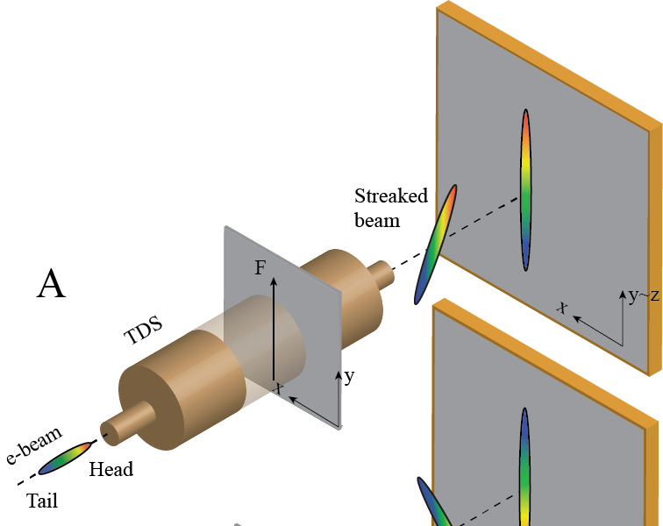
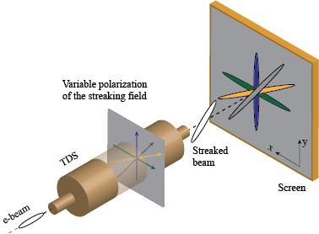
Transverse Deflecting Structures – What’s next?
TDS are RF-based devices used for the manipulation and/or the diagnostics of charged particle beams to retrieve longitudinal/temporal proprieties
Conventional TDS: streaking in a fixed polarization (i. e. vertical or horizontal)
POLARIzable X-band Transverse Deflection Structure – POLARIX TDS
horizontal dimension (x) vs z/t
Streaking force oscillating in vertical direction
The longitudinal distribution of the e-bunch is mapped into the transverse one thanks to the time dependent transversely deflecting field
Diagnose multidimensional phase space of electron bunches to investigage complex beam dynamics (e.g. collective effects, beam correlations, slice emittance..)

Slide 5
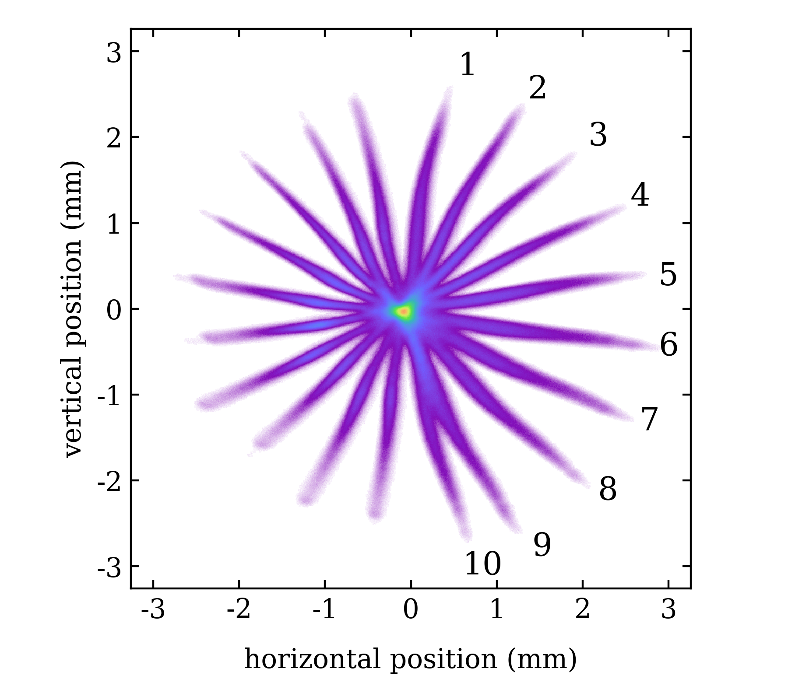
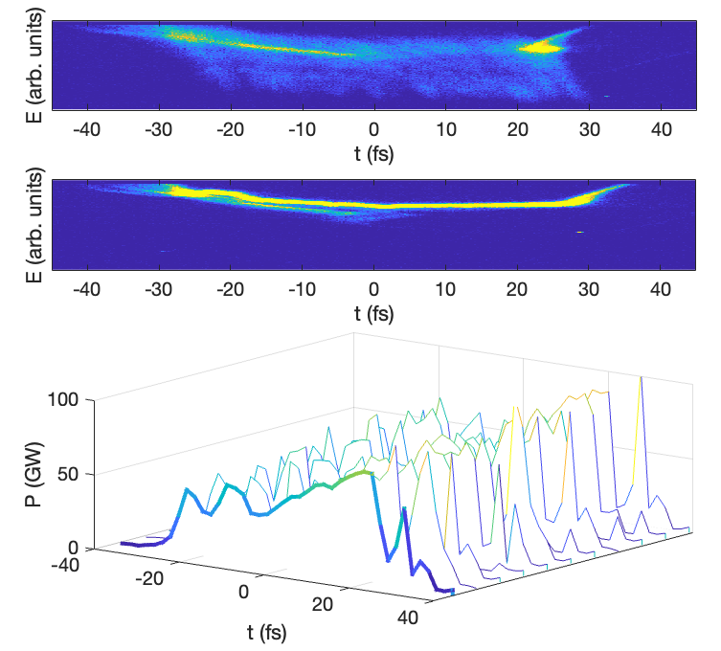
TDS as diagnostic tools – capabilities
Bunch length measurement and longitudinal charge profile measurement (1D)
Combined with dipole → longitudinal phase space measurement
Combined with quadrupole scan or multi-screen lattice → slice emittance measurement on the plane perpendicular to the streaking direction, slice transverse phase space reconstruction - slice emittance on different transverse planes
Measure of the FEL-induced lasing effects imprinted on the electron beam longitudinal phase space: first reference C. Behrens et al., Nat. Comm. 5, 3762 (2014)
5D/6D phase-space characterization becomes possible by different streaking planes and using tomographic methods
Reconstruction of the 3D charge density
Example from SwissFEL/Athos
B. Marchetti et al., Sci. Rep., 2021

Slide 6
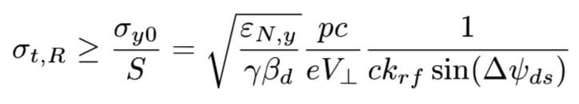



TDS as a diagnostic tool – time resolution
Longitudinal resolution is limited by the vertical beam size and the streak parameter S:
Given by the project
Electron bunch:
beam energy
normalized emittance ε_{N,y} (screen resolution!!)
Optics:
phase advance,
beta function at TDS, β_{d}
Optic design of the diagnostic beam line
High-beta function at TDS
$$sin⁡\left(Δψ_{ds}\right)$$
$sin⁡\left(Δψ_{ds}\right)$ ~ 1
RF structure:
wave number k_{rf} = w_{rf}/c
Integrated deflecting voltage
X-band frequency allows having higher resolution due a smaller wave number than S-band (x4) and C-band (x2) frequencies
Shorter structure with large kick, i.e., K = 4 and 11
for C-band and X-band structures
$$V_{⊥}=K∙L∙\sqrt{P_{RF}}$$
MV∕(m∙√MW)

Slide 7
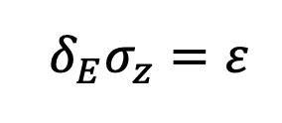
TDS as a diagnostic tool – some remarks
General measurement concept
Profile monitor
Spectrometer dipole (vertical)
X-band TDC
TDS system needs space for the installation of all components!
Quad to get dispersion
Quads to match beta functions in the TDS
Quads to measure the beam
Profile monitor
Energy resolution
Off-axis particles are also accelerated V_{z}(y) = k*y*V₀
This results in a relation of time and energy resolution:
More info:
E. Prat et al. PR AB 23, 090701 (2020)
(C. Behrens and C. Gerth, DIPAC09)
Non linearities in RF fields
To first order the streaking field is independent from transverse offset, BUT this depending on the beam size and iris diameter. In additon there are RF input/output couplers that can give non linearities in the RF field.
TDS system used at lower energy MUST HAVE very low residual non linearities in order to:
perform high precison mesurements
emittance preservation at phase space manipulations
avoid optics matching issue even without RF TDS

Slide 8
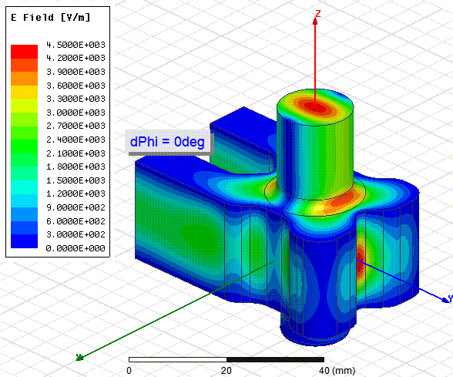
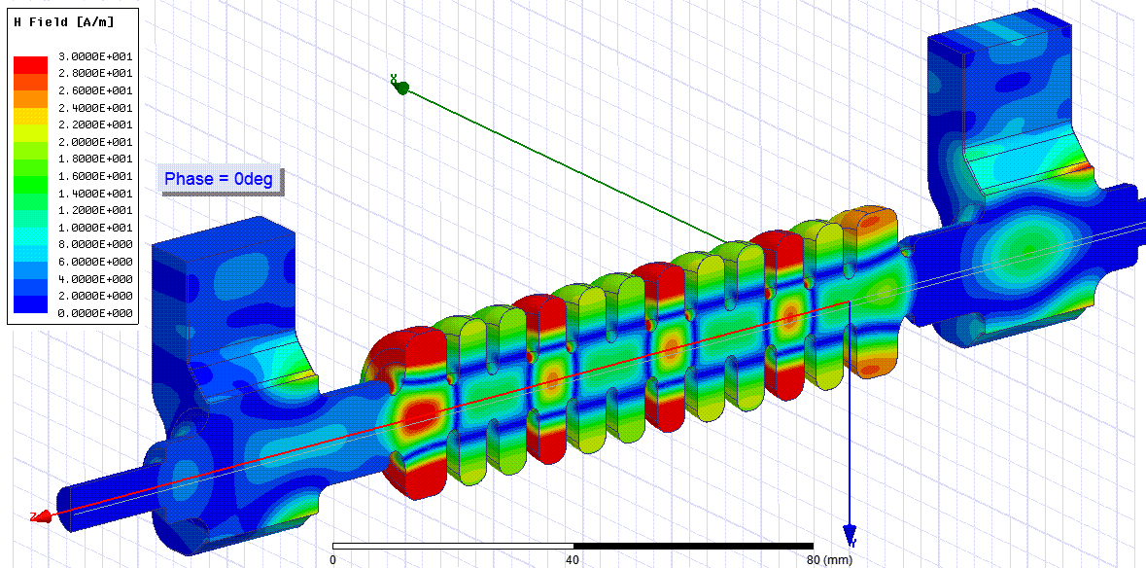
Novel Concept with Variable Polarization – X band
Variable polarization circular TE11 mode launcher: E-rotator
Phase difference between port 1 and port 2:
0 degree -> vertical polarization
180 degree -> horizontal polarization
References:
Grudiev, CLIC-Note-1067, 2016
P. Craievich et al., Phys. Rev. Accel. Beams, 2020
B. Marchetti et al., Sci. Rep., 2021

Slide 9


DESY-CERN-PSI Collaboration
History of the Collaboration, including the main Milestones of the Project
The RF design of the TDS has been done at CERN (with support from PSI)
Common Mechanical Design of the structure fulfilling the requirements of the different experiments.
The mechanical design of the prototype has been done at PSI. The prototype as well as the series structures has been/ will be manufactured using the PSI tuning free assembly procedure.
CERN performed the high-power test of the prototype.
DESY installed the prototype structure and appropriate RF-source in the FLASHForward beamline for first test of the structure with electron-beam → this lead to first measurements in September 2019!
2x TDSs installed in FLASH II and in operation
2x TDS installed in SINBAD-ARES (DESY) – they will start the RF conditioning soon
2x TDSs installed in SwissFEL Athos

Slide 10
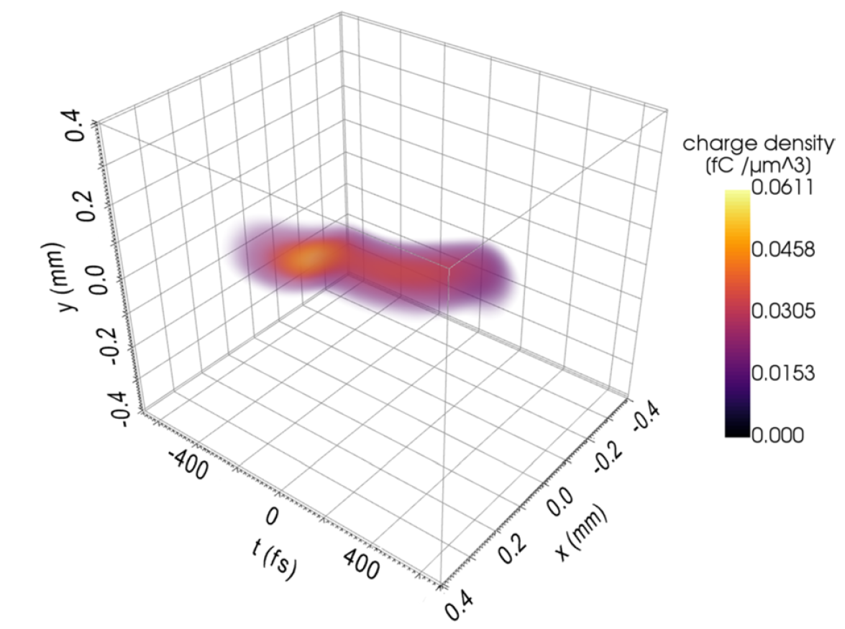
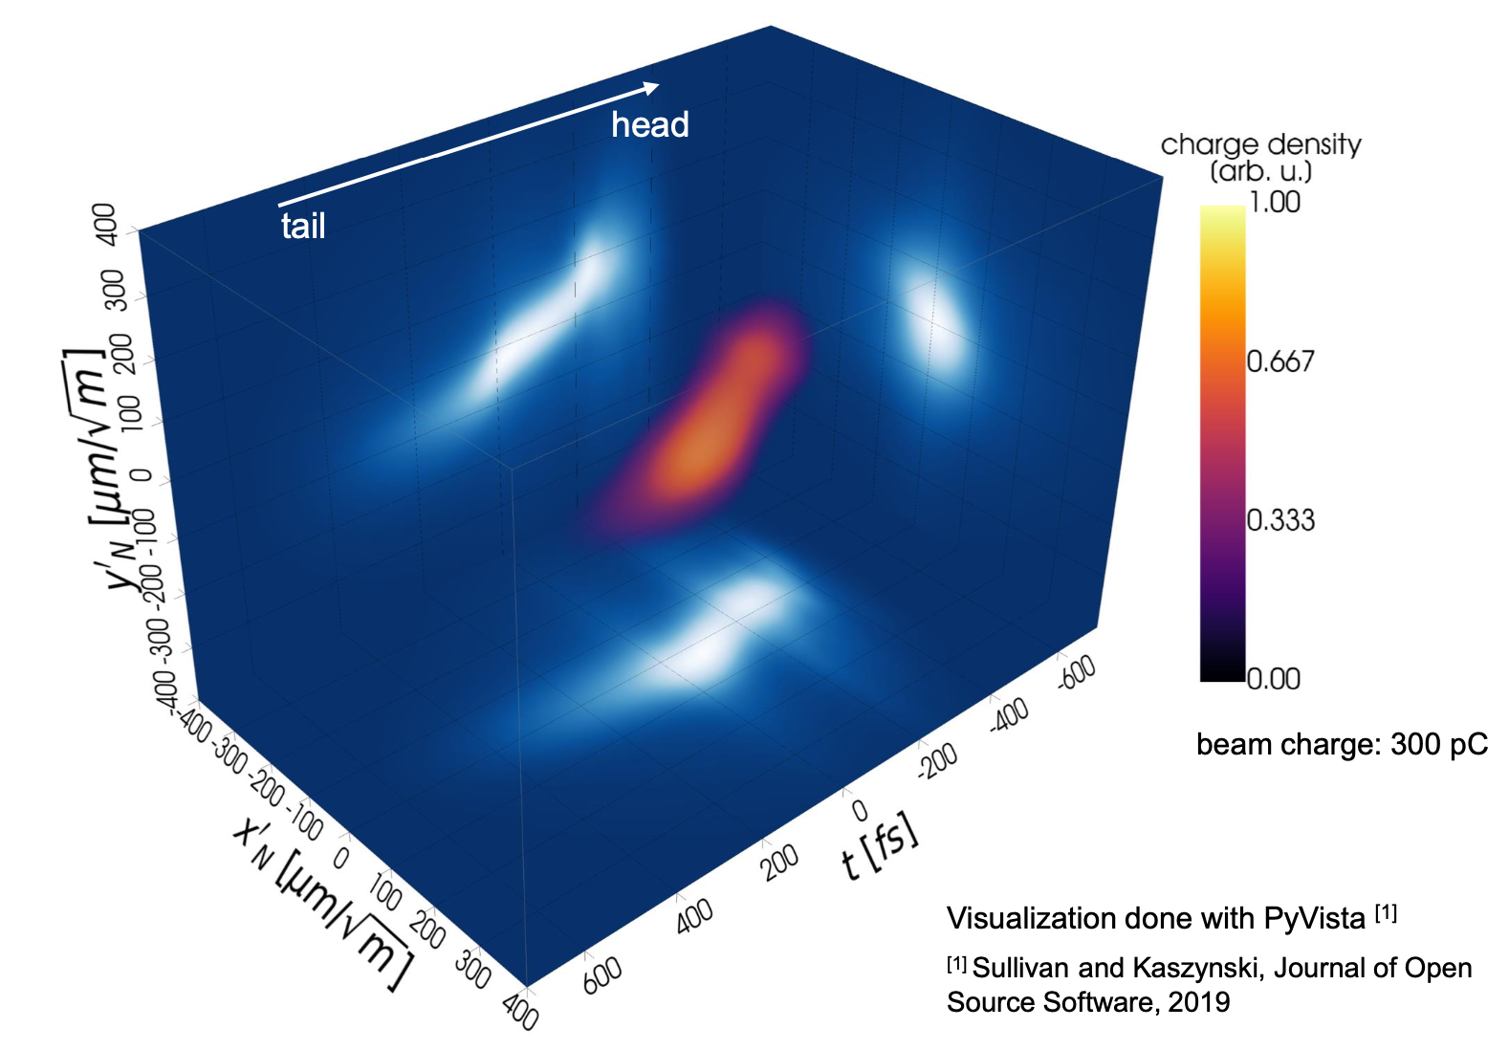

Variable streaking angle enables new tomographic methods
To obtain the full 5-dimensional (x, x’, y, y’, t) phase space of bunches
Experimental reconstruction of 3D charge density ^{[1, 2]} at FLASHForward:
Successful reconstruction of the 5D phase-space distribution
3D visualization of the (x’_{N}, y’_{N}, t) phase space
Visualization done with PyVista ^{[5]}
5D tomography:
Quadrupole-based transverse phase-space tomography + streaking along various angles with PolariX TDS.
Excellent performance shown in simulations ^{[3, 4]}.
Experimentally demonstrated
(Sonja Jaster-Merz, IPAC’23, WEODB2)
^{[1]} D. Marx et al., Journal of Physics: Conference Series, vol. 874, 2017,
^{[2]} B. Marchetti et al., Sci. Rep., 2021 ,
^{[3]} S. Jaster-Merz et al., JACoW IPAC2022 MOPOPT021, 2022 ,
^{[4]} S. Jaster-Merz et al., JACoW LINAC2022 MOPORI10, 2022,
^{[5]} Sullivan and Kaszynski, Journal of Open Source Software, 2019
Slide courtesy of S. Jaster-Merz

Slide 11
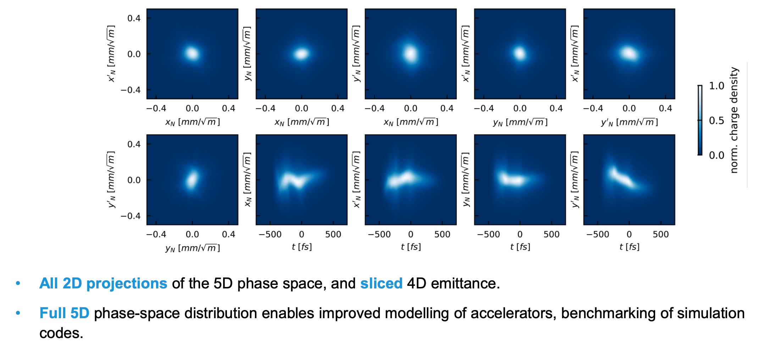
Reconstructed 5D phase space enables new insights
5D phase-space reconstruction of an electron beam - WEODB2 | Sonja Jaster-Merz, IPAC’23

Slide 12
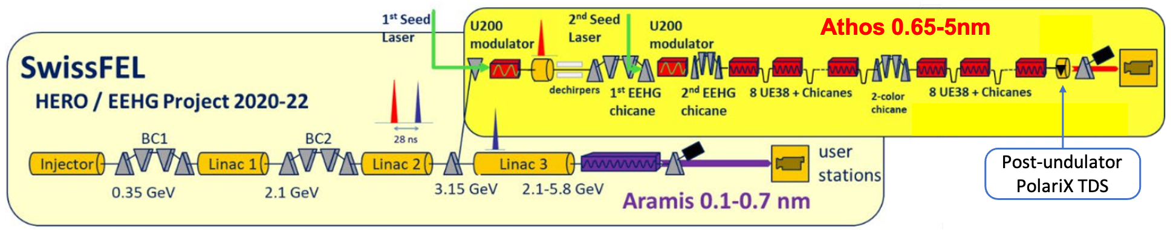
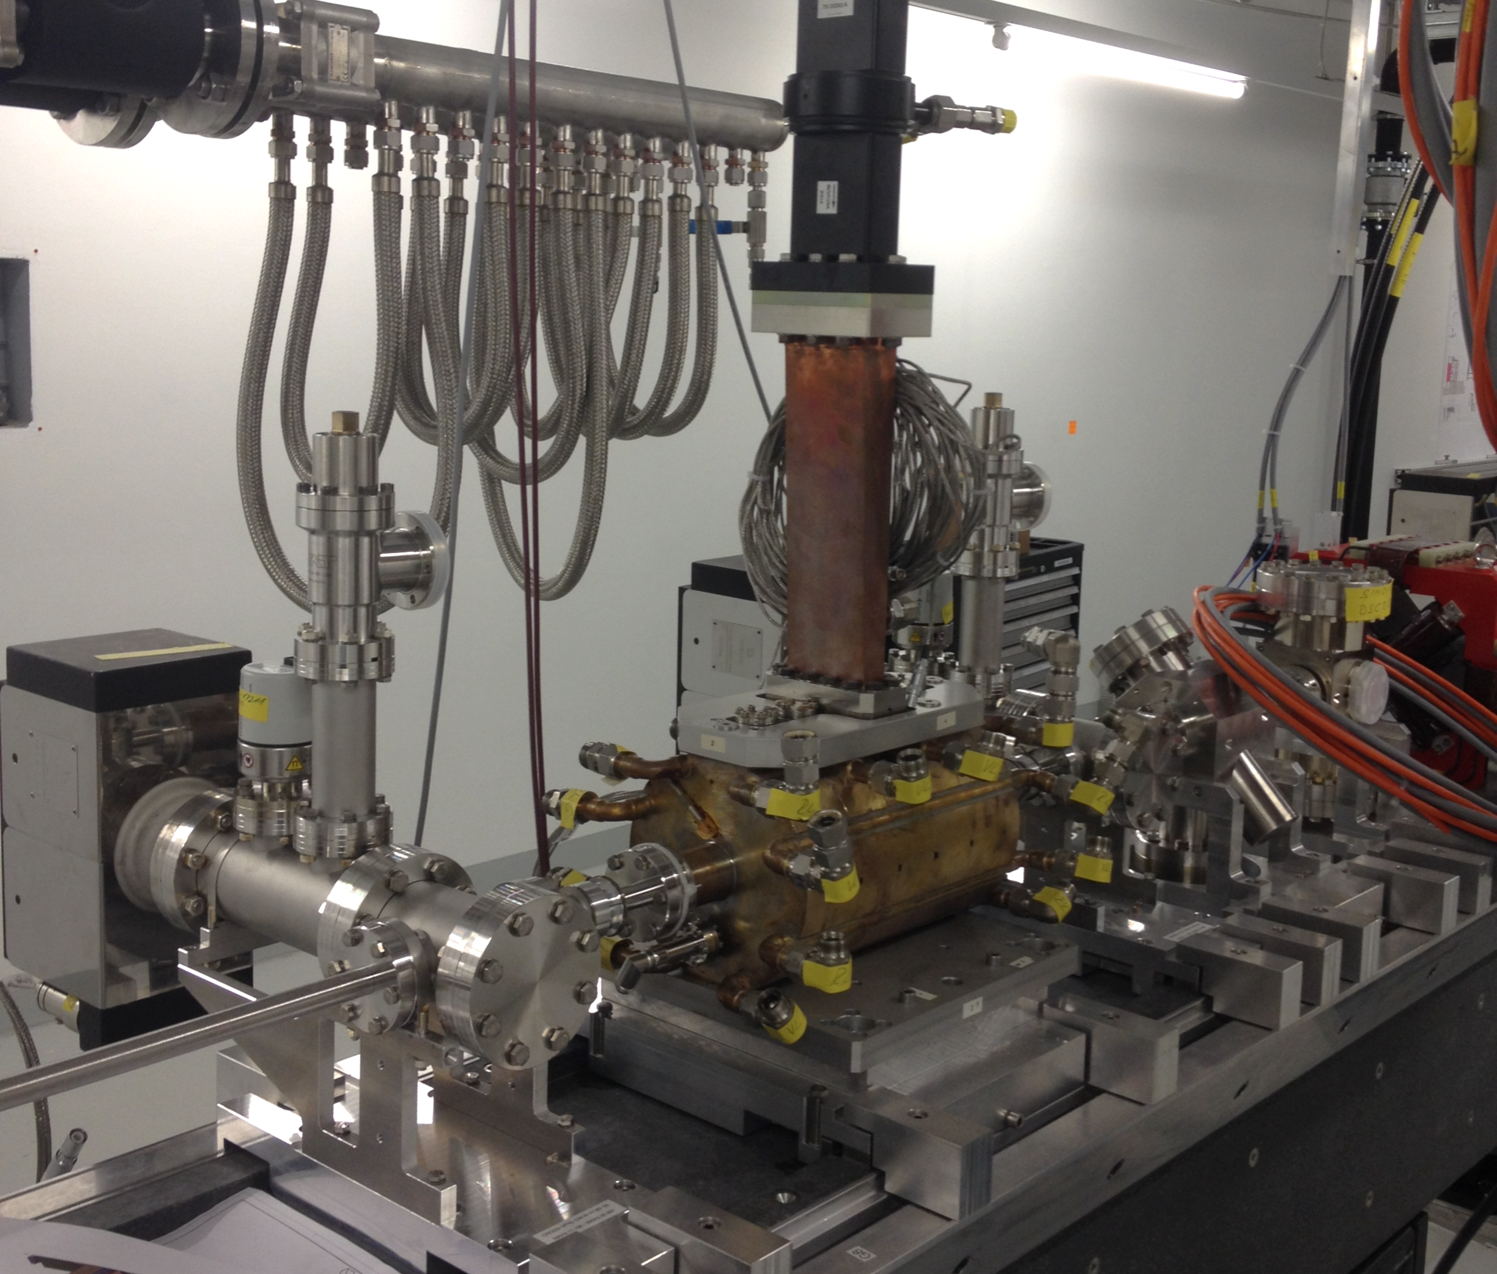
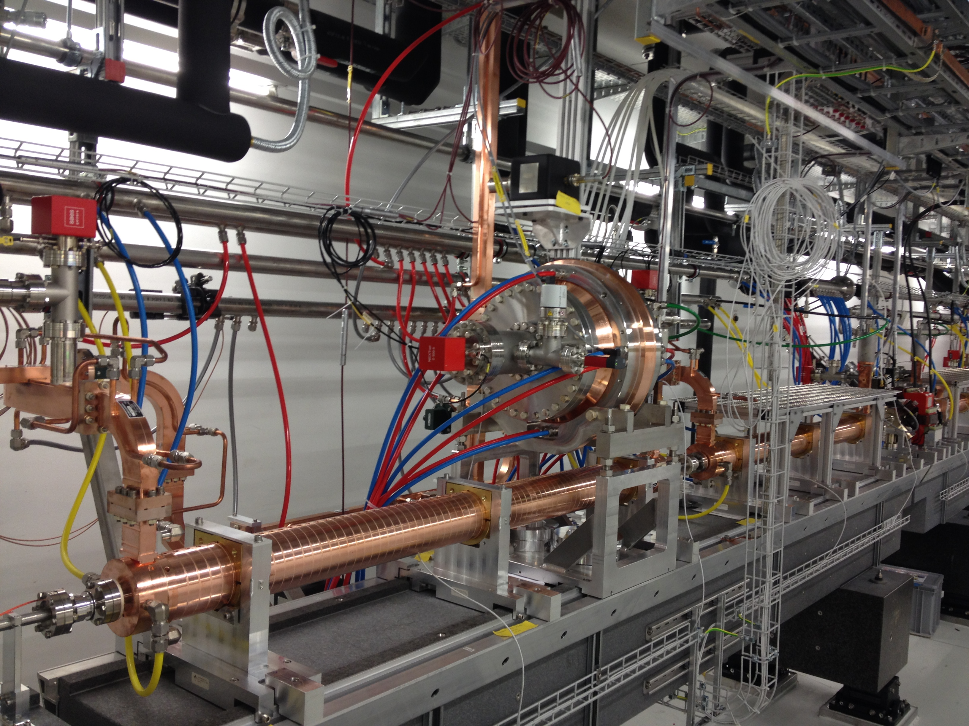
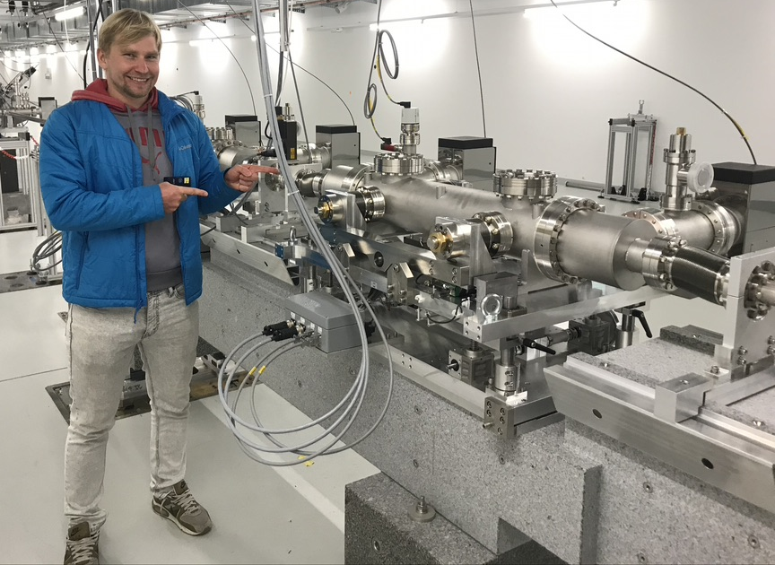
Overview of the LPS measurements in SwissFEL
Post-undulator passive streaking
PolariX-TDS system
S-band TDS (5-cell SPARC/FERMI type)
Post-undulator passive streaking
C-band TDS
Max integrated Deflecting voltage 5 MV, beam energy 300 MeV, Resolution ~10 fs

Slide 13
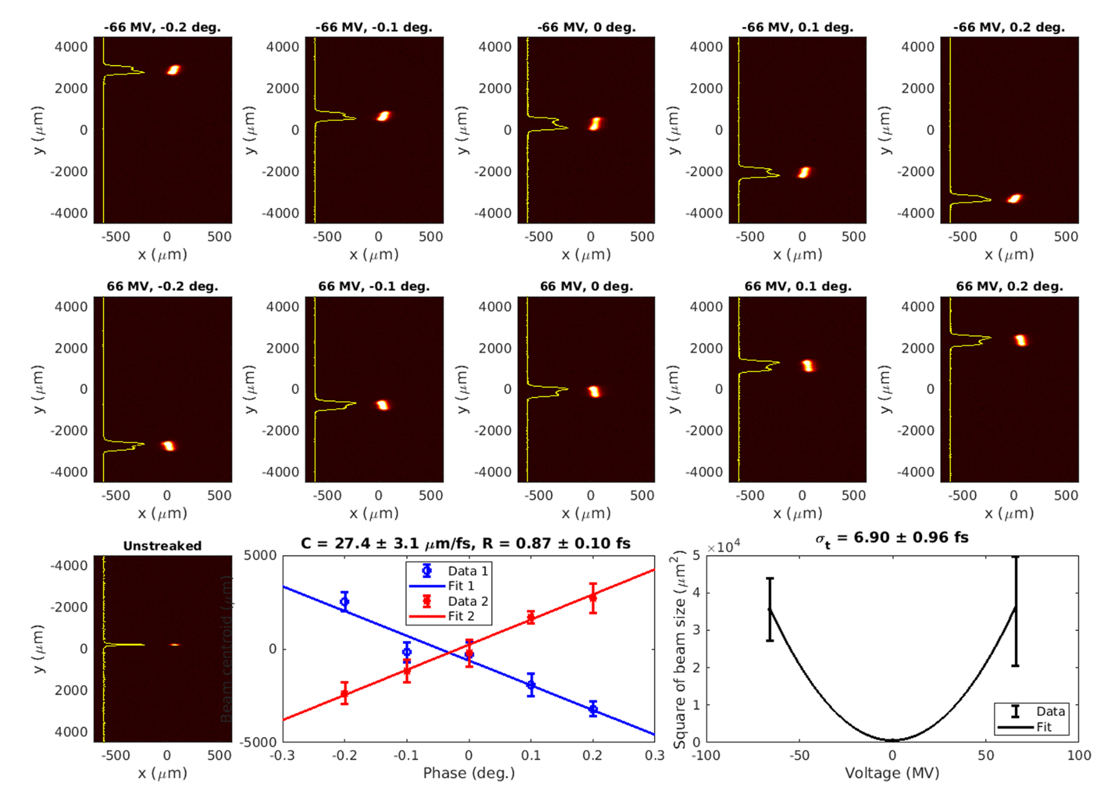
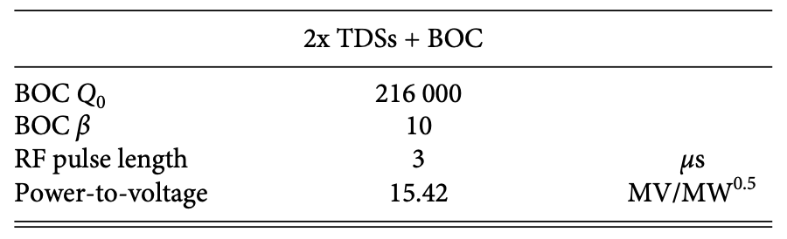
C-band TDS system
Temporal resolution 0.87 ± 0.10 fs (bunch length 6.90 fs)
with ε=76 nm, E=5.2GeV, β=60m, V =66MV
RF system
~5 m
E. Prat, A. Malyzhenkov and P. Craievich, Rev. Sci. Instrum. 94, 043103 (2023)

Slide 14
ATHOS: the Soft X-rays beamline in SwissFEL
Relevant hardware:
8x2 undulator APPLE-X modules: variable field, variable polarization, Transverse-Gradient Undulator (TGU)
Inter-undulator Chicanes for High power and Improved Coherence (CHIC): R56 + delay
2-color chicane
2 x (laser + modulator + chicane)
Temporal diagnostics :
  Post-undulator X-Band RF system (PolariX-TDS)
  Post-undulator passive streaker
For SASE process:
  Reduction of the saturation length, variable polarization, higher peak power and shorter pulse durations with increasing longitudinal coherence and bandwidth: High-Brightness SASE (HB SASE), large bandwidth. Fresh-slice multi-stage amplification
  Widely tunable two-color pulses
With optical lasers for external seeding:
  Production of trains of attosecond pulses with the Enhanced SASE (ESASE) mechanism
  Phase-locked pulses
  Echo-Enabled Harmonic Generation (EEHG)

Slide 15
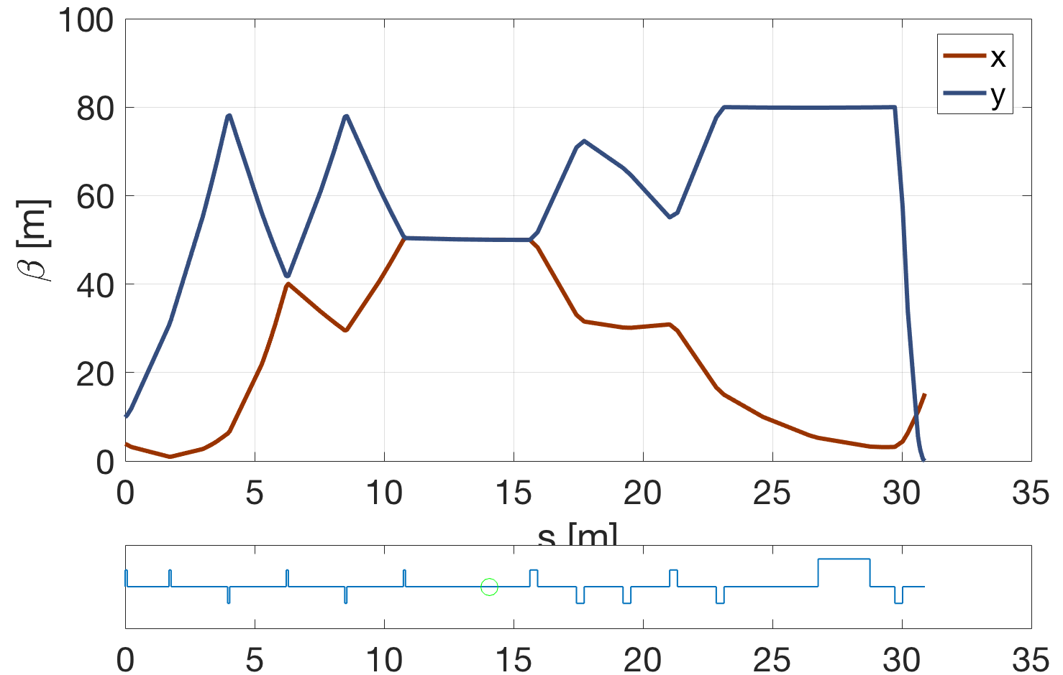
PolariX TDS diagnostic beamline @3GeV
Quads to match the β functiion in the TDSs
Quads to measure the beam at the screen
β_{x} = β_{y} = 50 m → optics for both polarizations
Beam measurements:
Projected and slice emittance on different planes
Electron pulse length and charge density profile (sub-fs resolution)
Energy spread induced by FEL process (photon pulse length)
Plot by E. Prat

Slide 16
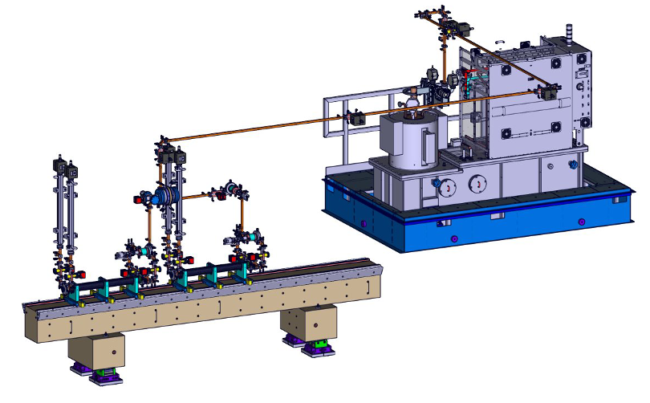
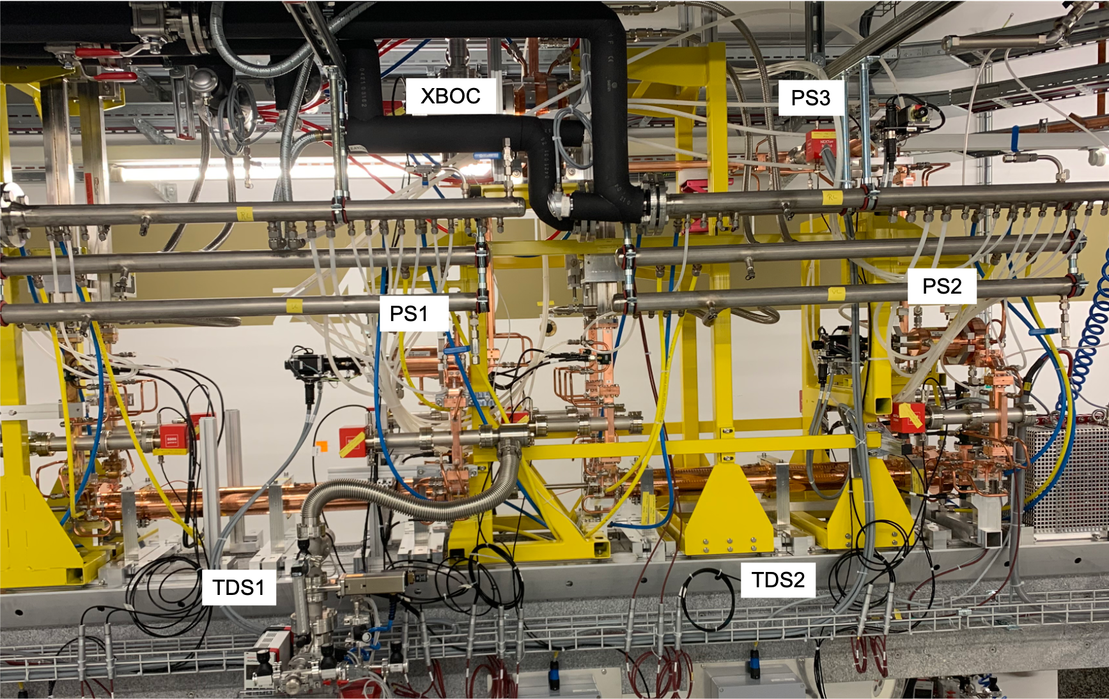
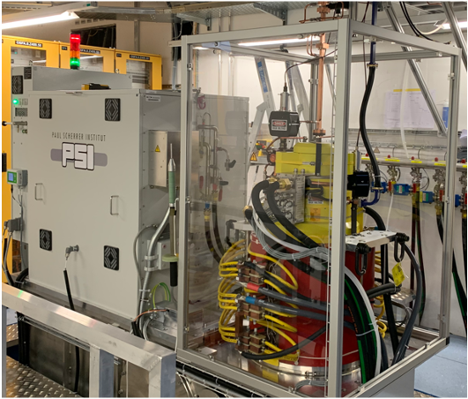
X-band TDS and RF components
3 Phase shifter (PSI)
XBOC (PSI)
RF loads
All waveguide RF components including the XBOC and phase shifters were designed and built at PSI, Klystron: CPI VKK-8311 50 MW X-band
PSI HV modulator: develop and built in-house (400 kV, 3 ms)
After about three weeks of integrated conditioning time, a peak power from the klystron of 30 MW with a total RF pulse length of 1 𝜇𝑠 was achieved, now we can run the station with 35 MW with 1.2 us → deflecting voltage higher than 90 MV (specification was higher than 60 MV)

Slide 17
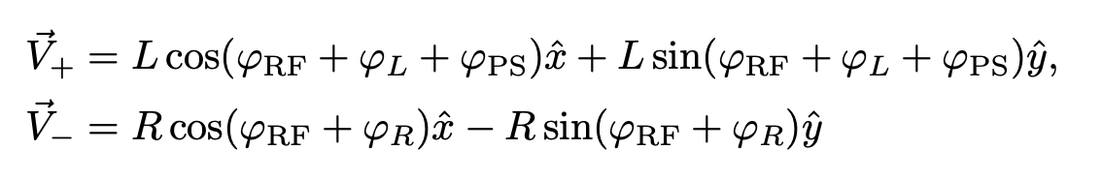
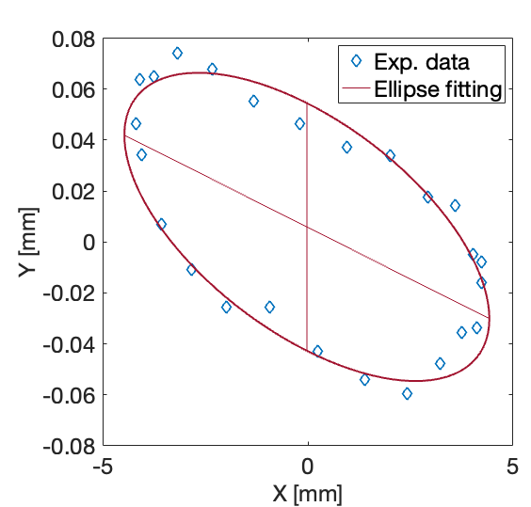
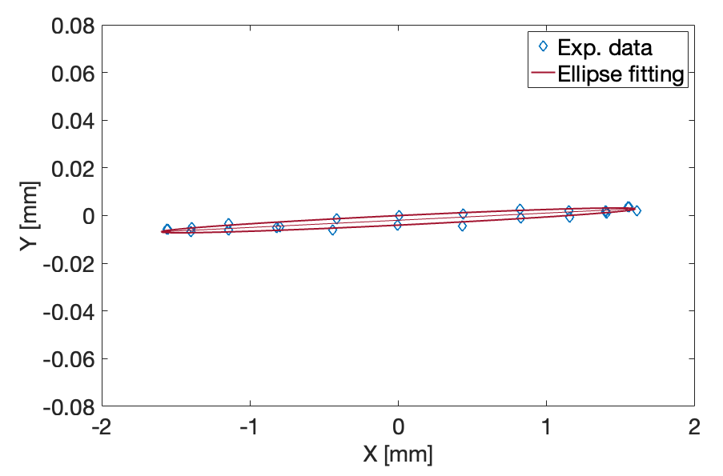
RF setup and commissioning with beam
Deflecting field is the sum of two rotating modes, one clockwise and the other counter clockwise
Wrong setting of the PSs and/or the amplitudes are unbalanced then the superposition of the two rotating modes results in an elliptically polarized mode, whose effect is to provide a kick in the plane orthogonal to the streaking plane (we will call this effect a residual kick).
F. Marcellini et al.

Slide 18
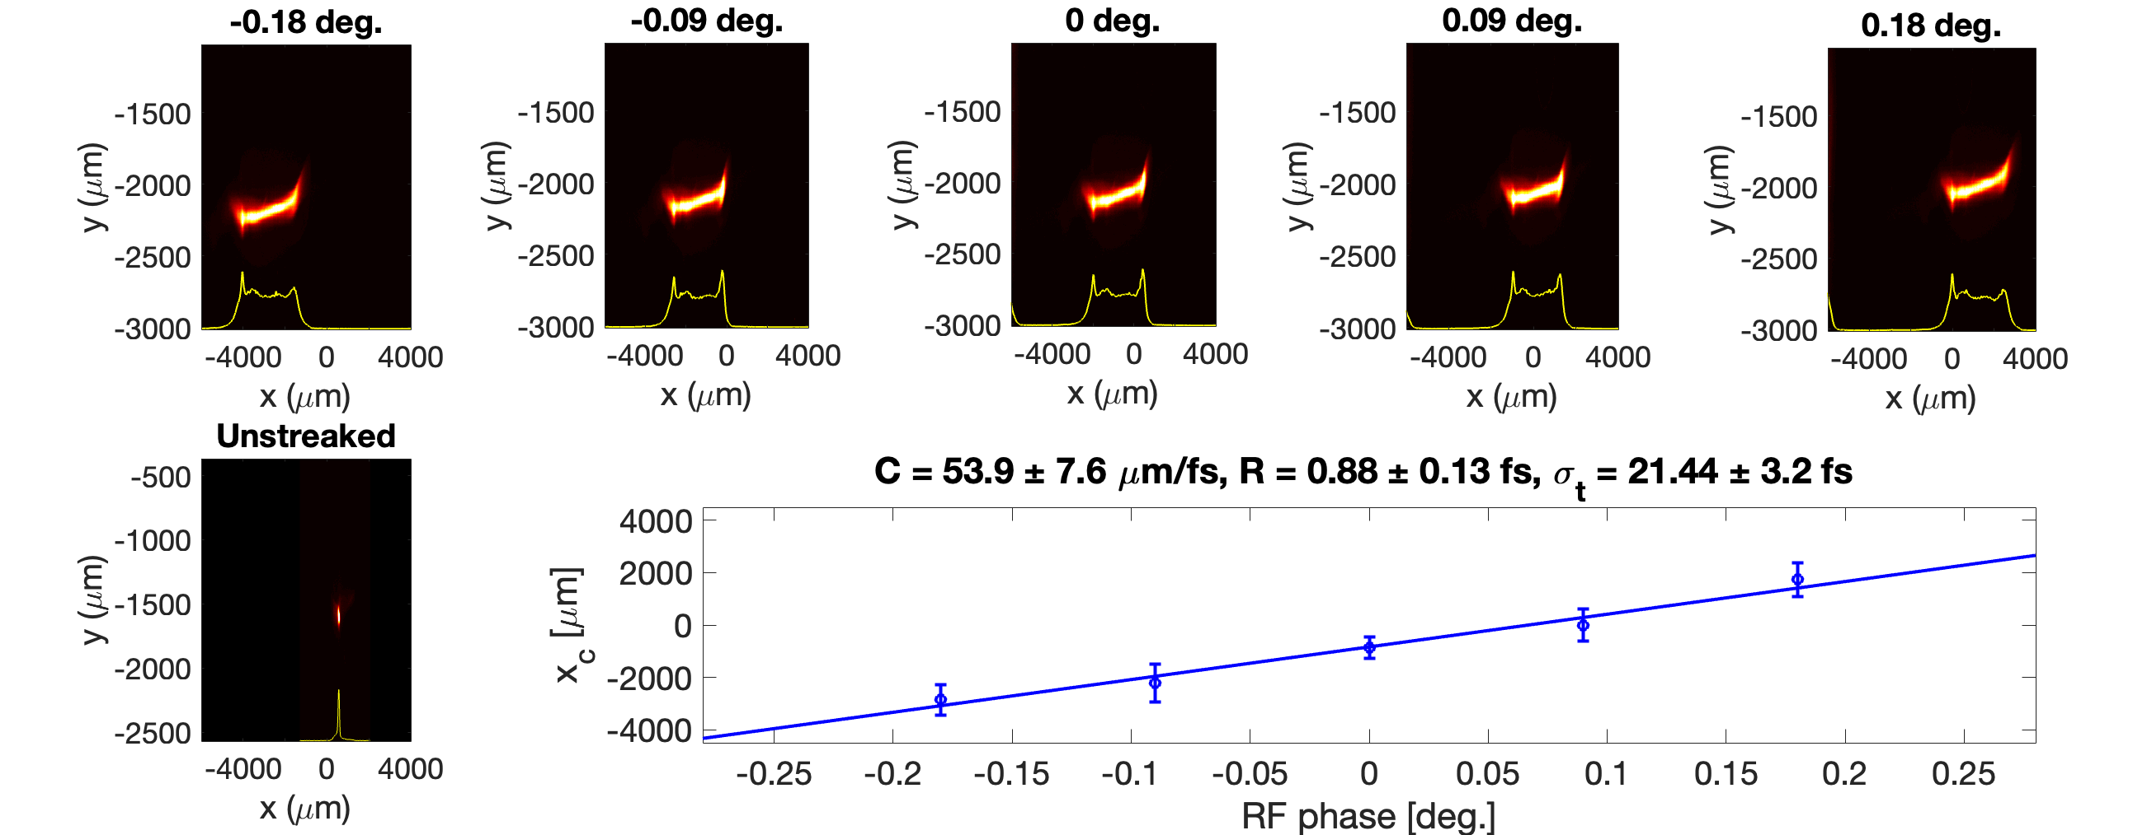
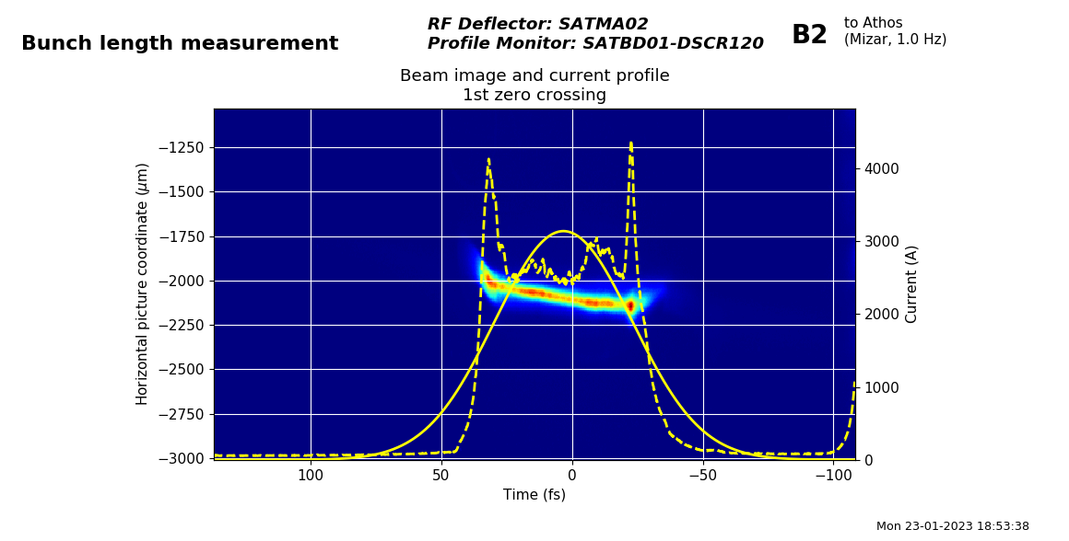
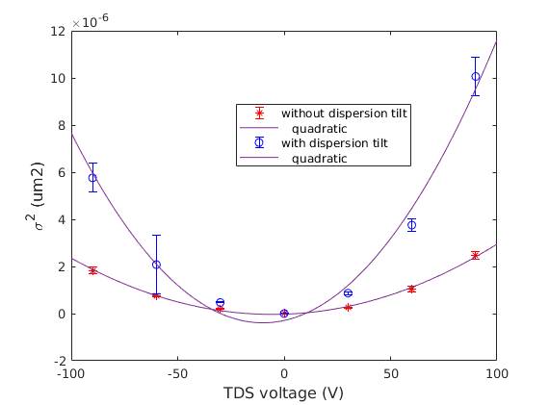
Calibration, resolution and bunch length
The absolute calibration factor C between the transverse coordinate on a screen and the time coordinates within the electron bunch is obtained by measuring the dependence of the transverse position of the centroid of the streaked beam on the RF phase
Time coordinates are obtained by dividing the transverse coordinates on the screen by the calibration
Bunch length is simply obtained as the streaked beam size divided by the calibration factor C
Resolution R= s₀/C
σ₀ = 47.7 ± 0.6 μm
Deflecting voltage 85 MV, s₀ = 47.7 ± 0.6 μm
Preliminary resolution studies of X-band TDS combined with dispersive tilt
TDS adds up to the incoming tilt so that the final streaking becomes larger.
Assuming that the calibration factor does not change with respect to the standard case without initial beam tilt

Slide 19
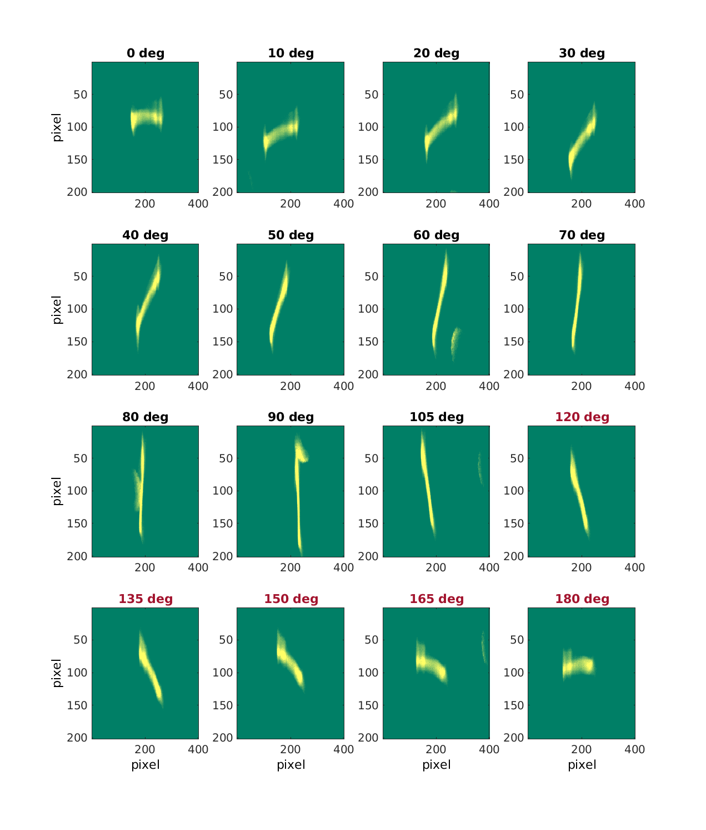
Variable polarization – first measurements
Bunch centroid on a BPM after TDSs as a function of the global RF phase. Polarisation variation of 5 deg.
Right plots: Images on screen before dipole as a function of polarization angle. Dark polarization angles: 85 MW, red polarization angles: 72.8 MV.

Slide 20
RF setup and commissioning with beam
RF Phase and beam arrival time jitter can be limiting factors in achieving higher resolution
Correlations between streaked beam centroid measured on the BPMs after the TDSs and RF phase (left), beam arrival time (middle) and mean energy (right) in BC2
Calibrated time jitter on the screen ~10 fs
Beam loading amplitude and phase
The beam-loading phase of TDS2 fluctuates more than twice in magnitude compared to TDS1 → this could be caused by an initial angle when the beam enters in TDS2 (due to an angle in the beam orbit itself), or by transverse wakefield effects in TDS1.
Use a proper signal (beam loading) to be used for RF feedbacks could improve the RF phase jitter
TDS 1
TDS 2
Plots by Z. Geng

Slide 21
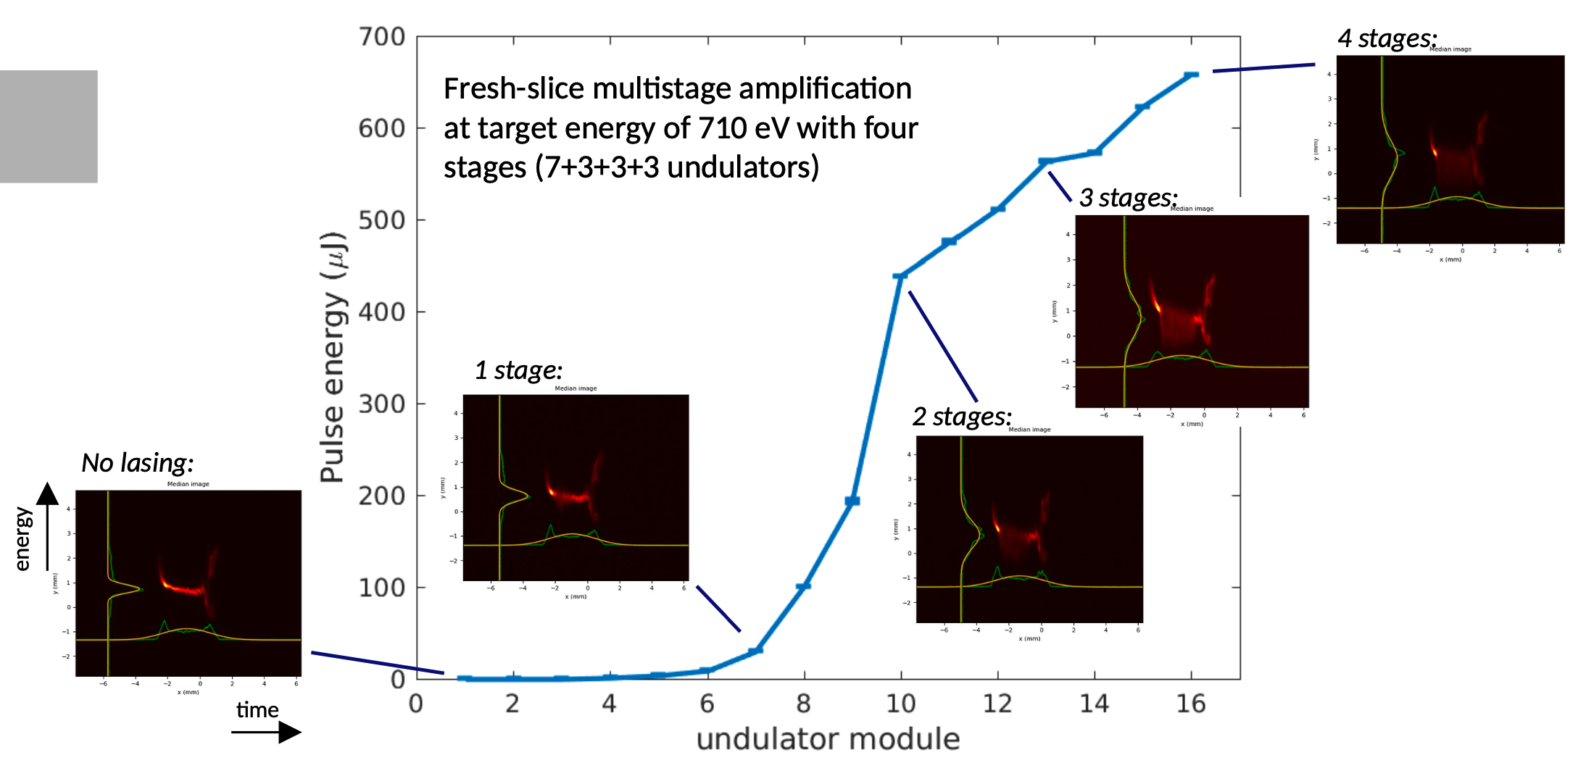
Example of Athos setup (beam dump screen)
Fresh-slice multistage amplification at target energy of 710 eV with four stages (7+3+3+3 undulators)
E. Prat, G. Wang,
T. Weilbach, Ch. Kittel

Slide 22
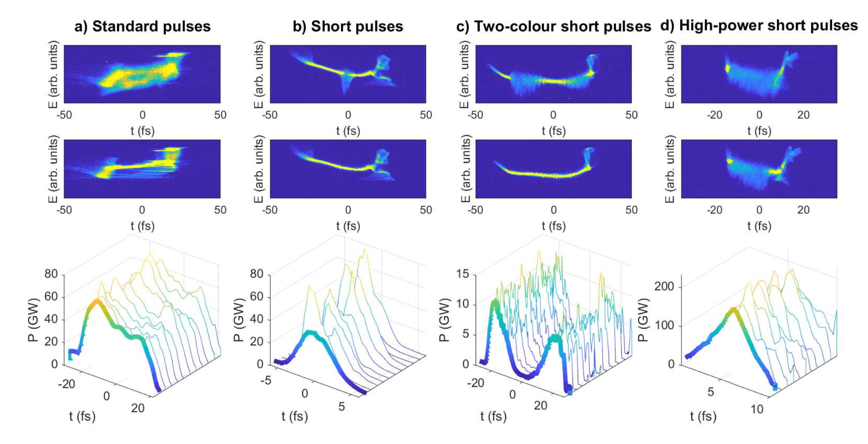
Setup of the FEL modes (beam dump screen)
E. Prat et al., An X-ray free-electron laser with a highly configurable undulator and integrated chicanes for tailored pulse properties, submitted, 2023

Slide 23
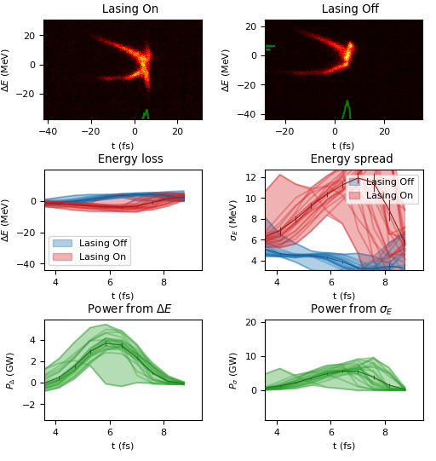
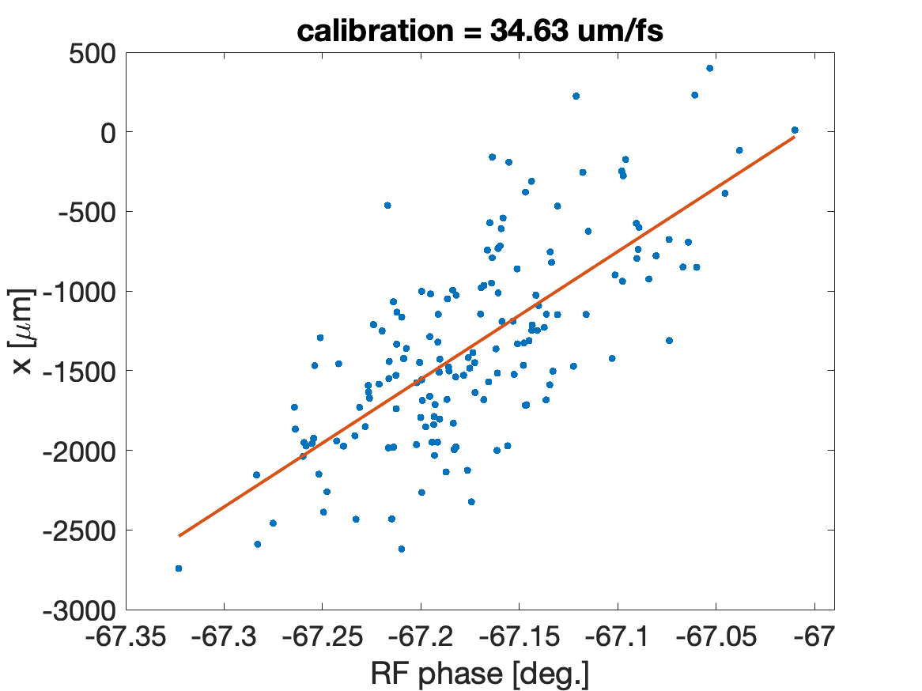
Short pulse mode (10 pC) – and higher jitter
For some modes of operation, a jitter on the images was observed at the screen, which made the calibration of the TDS system difficult
  In order to perform the time calibration and bunch length measurement in the presence of jitter, we may exploit the jitter itself.
  the calibration coefficient can be estimated with reasonable accuracy by means of a linear regression between the values of the beam centroid at the screen and the RF phase jitter values.
Plots by E. Prat

Slide 24
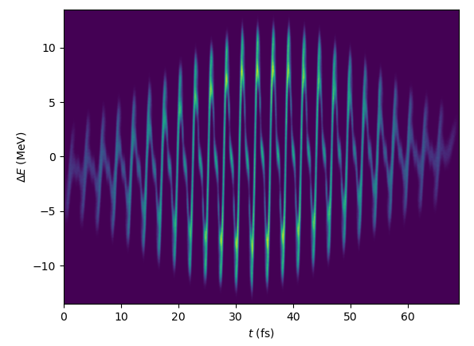
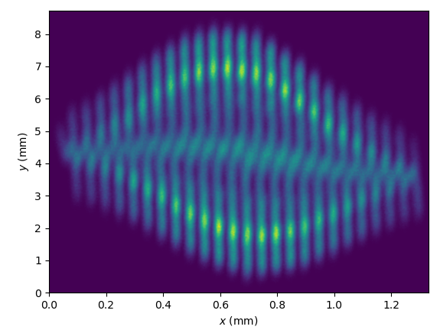
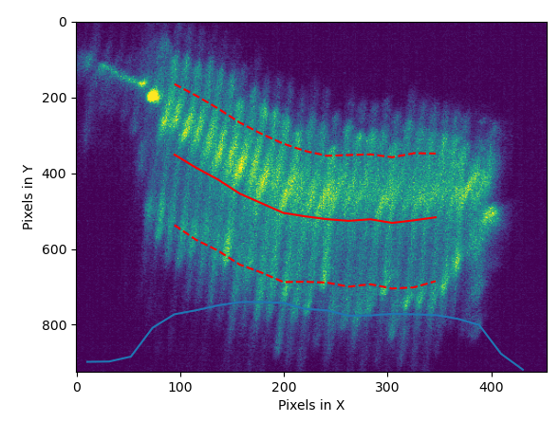
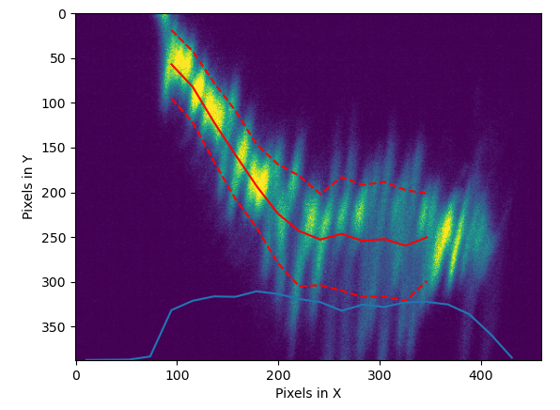
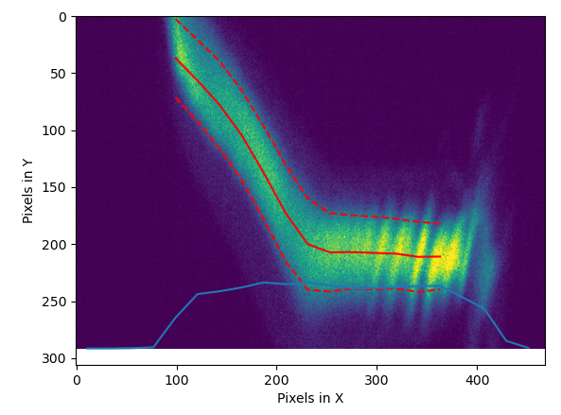
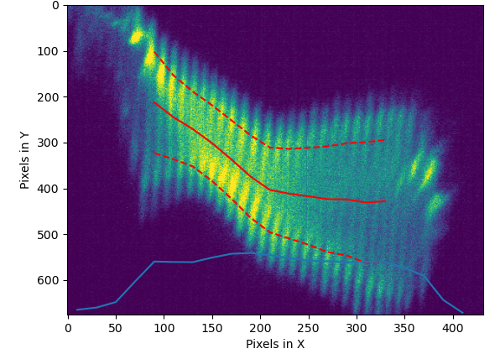
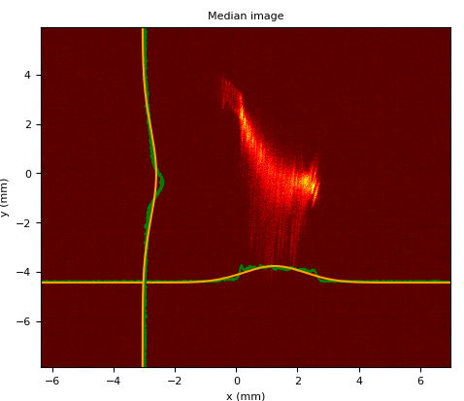
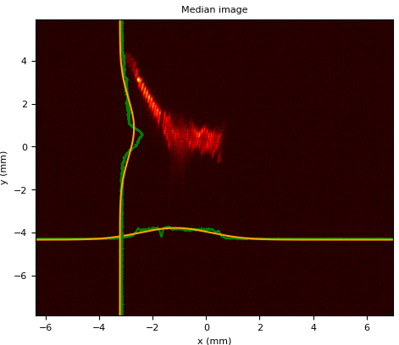
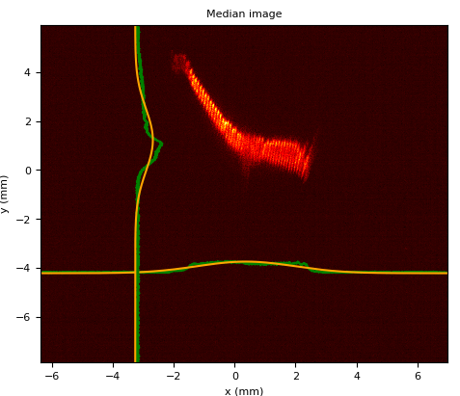
Seeding at SwissFEL
ESASE: the periodicity of the modulation is 800 nm, corresponding to 2.66 fs. It shows that we have a resolution well be 1 fs
Sim.
Sim. + TDS
LH off
LH on
LH on
HERO on
Effect of the laser Heater used to damp microbunching instability in ESASE
Controlling the Pulse Length with Tilts
Long. Phase Space small Tilt
Long. Phase Space large Tilt
Long. Phase Space no Tilt
Courtesy of S. Reiche

Slide 25
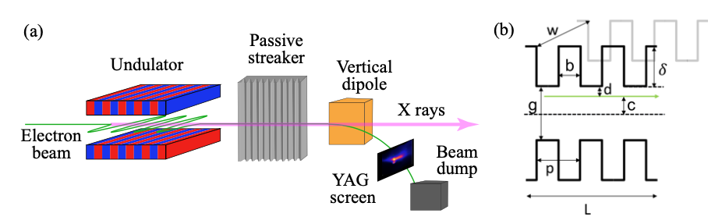
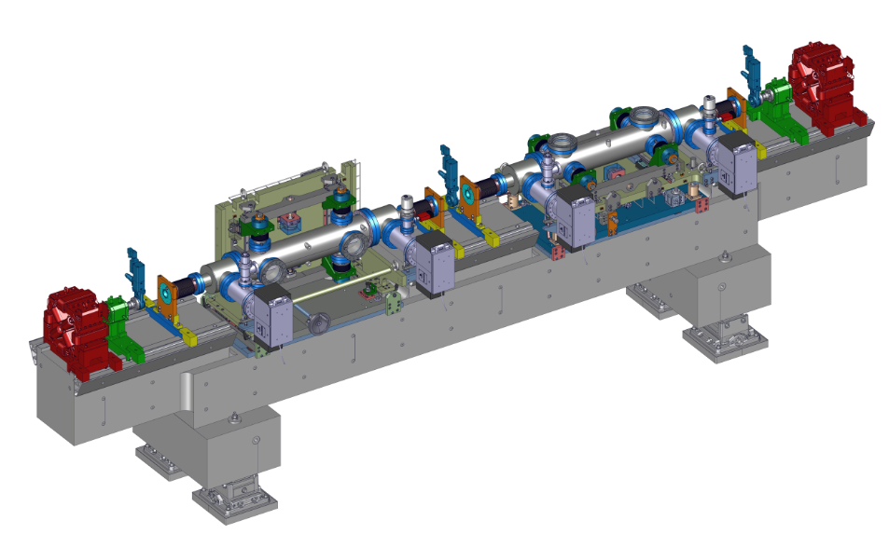
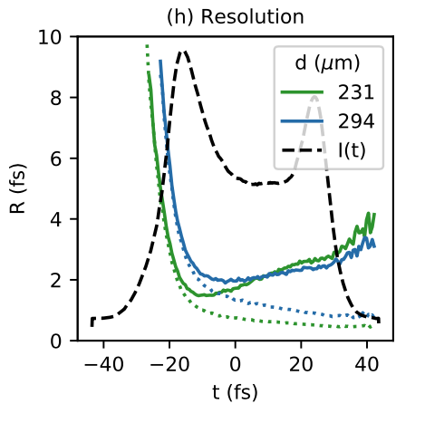
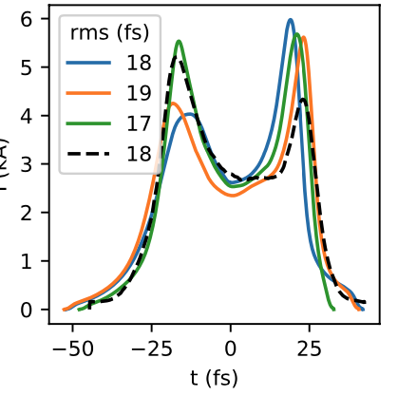
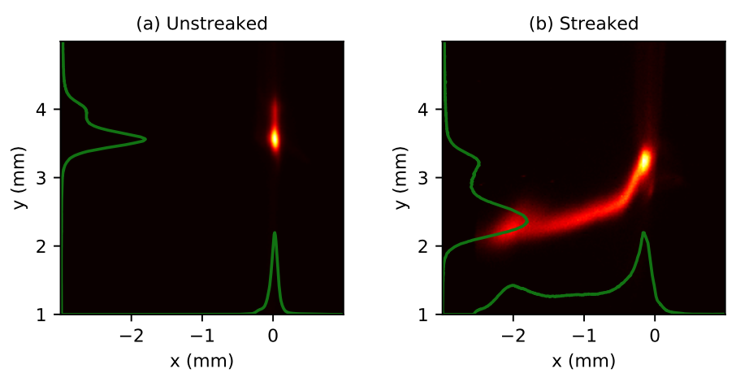
Post-undulator passive streaking (Aramis)
more information: P. Dijkstal et al., PRR 2, 042018(R), 2020)
An electron beam traveling off-axis through such a device excites transverse wakefields, resulting in a time-dependent kick that streaks the electron beam.

Slide 26
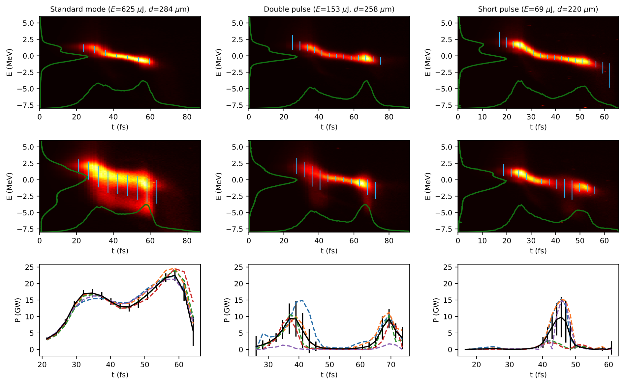
Post-undulator passive streaking – LPS
more information: P. Dijkstal et al., PRR 2, 042018(R), 2020)
Diagnostics of variable lasing modes at SwissFEL

Slide 27
Conclusion and outlook
Conclusion
    TDS-based diagnostics systems are essential tools for the commissioning and optimisation of linac-based FELs (temporal resolution below 1 fs with C-band and X-band RF systems)
    They are also key devices for diagnosing the beam in new acceleration techniques (before and after acceleration). Here the sub-fs resolution is even more important!
Outlook
      PolariX TDS: Try pushing the time resolution below 0.5 fs (in different streaking plane)
      Repetition rate up to 10 Hz, future operation up to 100 Hz (provide shot-to-shot photon pulse length to users)
      Slide emittance measurements in different deflecting planes
      Implement the measurement for a full 5-dimensional phase space
      Systematic comparison between the passive streaker and TDS

Slide 28
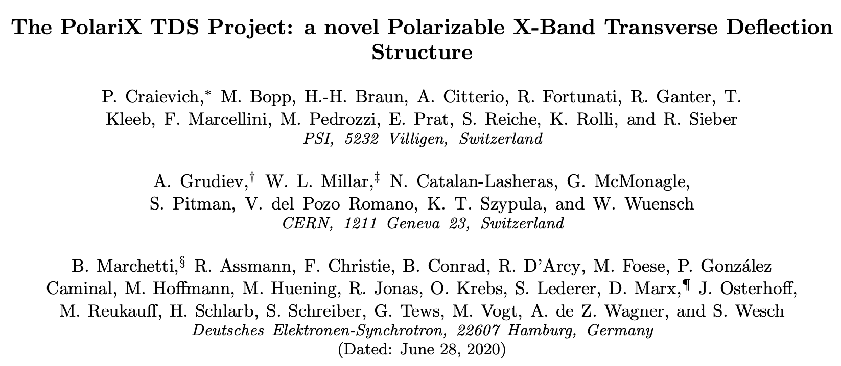

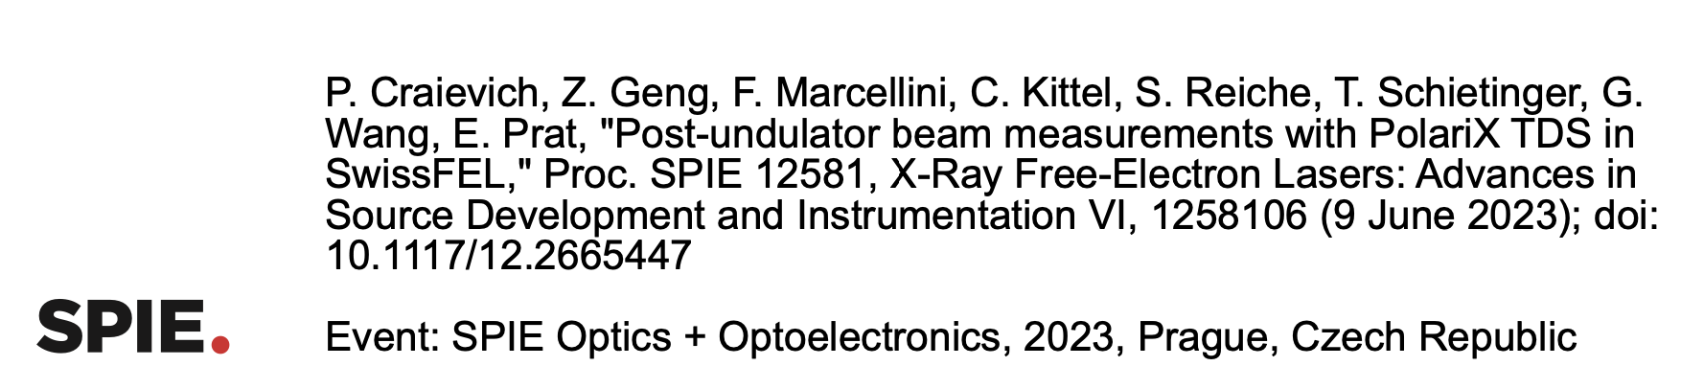

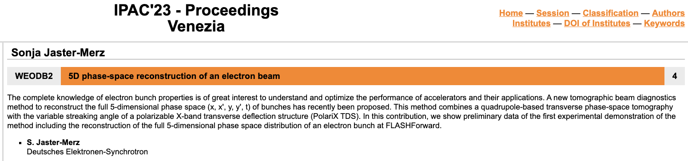
Wir schaffen Wissen – heute für morgen
Credits
To prepare my slides, I have especially used material from: E. Prat, F. Marcellini, S. Reiche, P. Dijkstal
Thanks to my colleagues at PSI involved in the design, development and commissioning of the TDS systems
Thanks also go to our colleagues at CERN and DESY involved in this collaboration for the useful discussions. Especially S. Jaster-Merz (DESY) for the slides related to activities at DESY
Some more details for the PolariX TDS:
https://doi.org/10.1117/12.2665447
https://doi.org/10.1103/PhysRevAccelBeams.23.112001
https://doi.org/10.1038/s41598-021-82687-2

