Slide 1
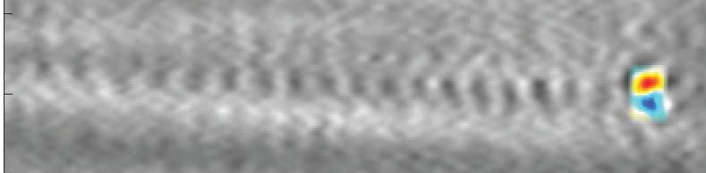

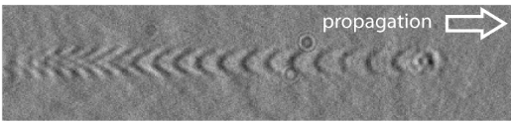
Diagnostics for Laser-Wakefield Accelerators
Malte C. Kaluza
Institute of Optics and Quantum Electronics, FSU Jena, Germany
Helmholtz-Institute Jena

Slide 2
Motivation and Outline
(One of the) Central goal(s) of EuPRAXIA:
  Realize a free-electron laser based on electron pulses from a LWFA
What are the requirements to reach this goal?
  Provide a stable/reliable/controllable GeV-class LWFA-driven electron source
How does a LWFA work?
Which e-beam parameters are essential?
  How are they correlated with accelerator structure (plasma wakefield)?
  How can they be measured?
Beyond existing (and possible) diagnostics:
  machine-learning algorithms, Bayesian optimization models
Summary and outlook

Slide 3
Motivation and Outline
(One of the) Central goal(s) of EuPRAXIA:
  Realize a free-electron laser based on electron pulses from a LWFA
What are the requirements to reach this goal?
  Provide a stable/reliable/controllable GeV-class LWFA-driven electron source
How does a LWFA work?
Which e-beam parameters are essential?
  How are they correlated with accelerator structure (plasma wakefield)?
  How can they be measured?
Beyond existing (and possible) diagnostics:
  machine-learning algorithms, Bayesian optimization models
Summary and outlook

Slide 4
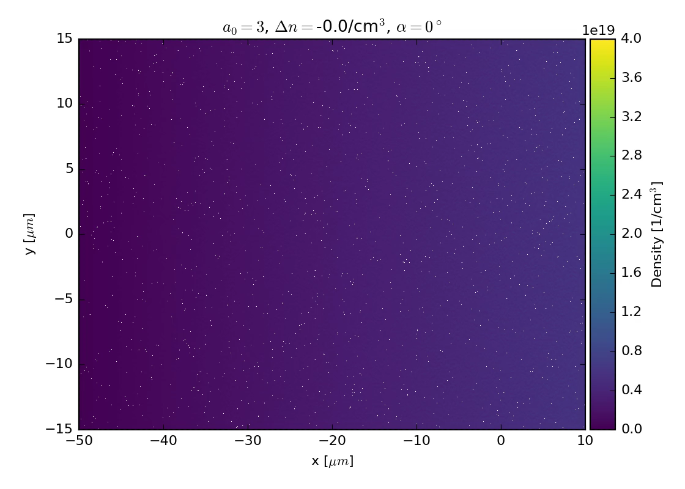
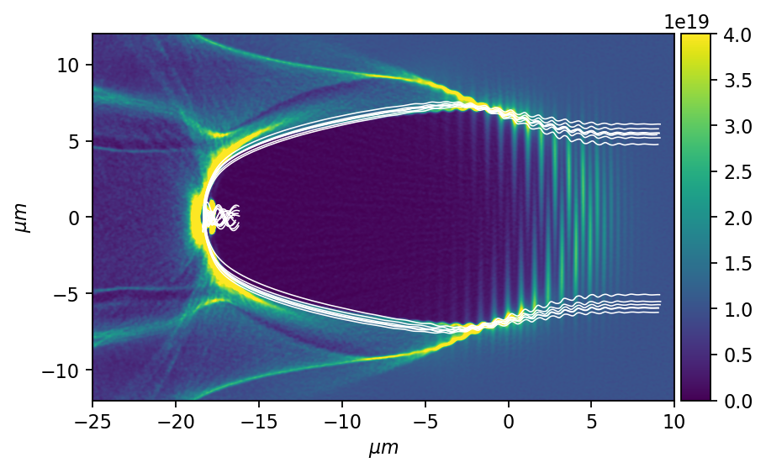
Laser Wakefield Acceleration of Electrons: Principle
Acceleration of electrons in a (laser-driven) plasma wave
A. Pukhov et al., APB 74, 355 (2002)
Injection of background electrons into accelerating phase of the plasma wave

Slide 5
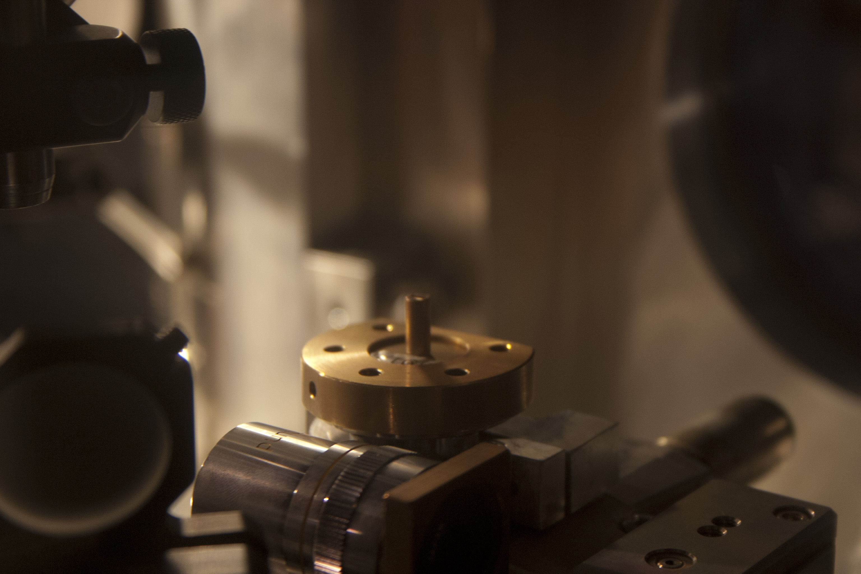
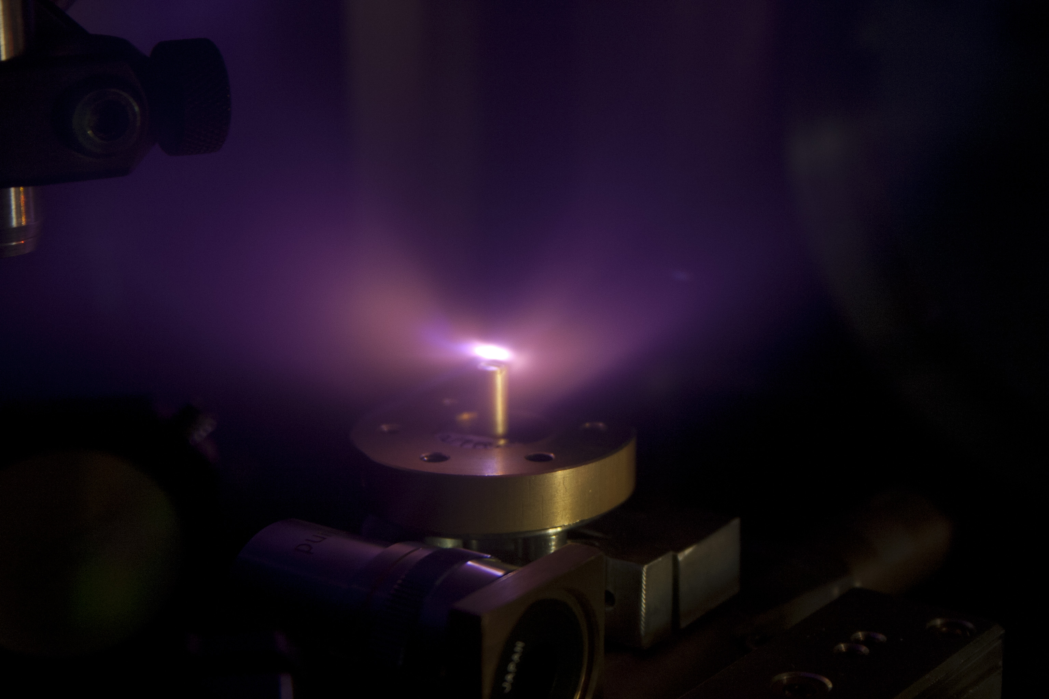
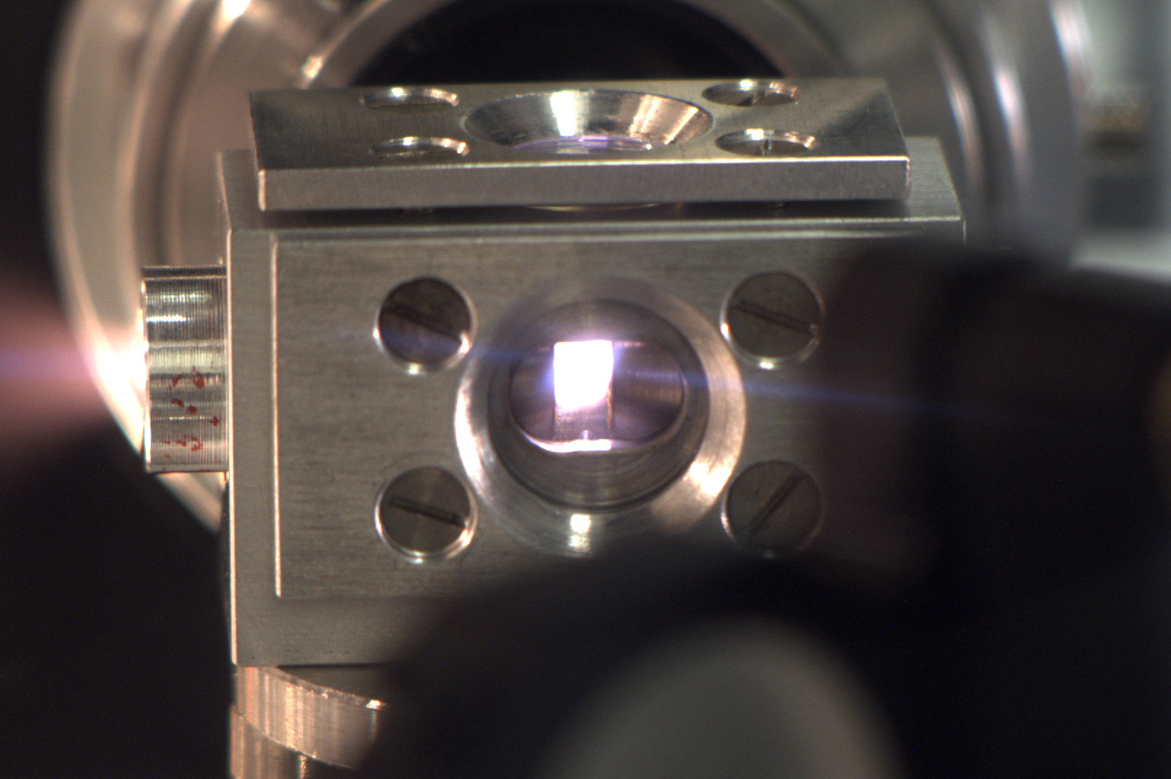
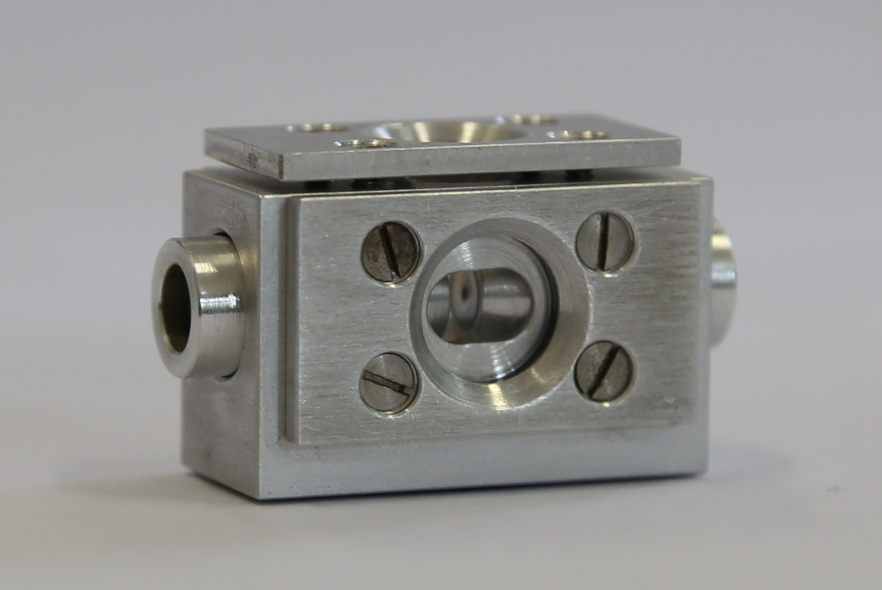
Laser Wakefield Acceleration of Electrons @ JETI: Setup
Setup of a LWFA experiment @ JETI:
Few-cycle probe
M. Schwab, MCK et al., APL 103, 191118 (2013)
D. Adolph, MCK et al., APL 110, 081105 (2017)
I. Tamer, MCK et al., Opt. Expr. 28, 19034 (2020)
Target
Lanex
Magnet
Gas-Jet
Camera
B. Landgraf, MCK et al.,
RSI 82, 083106 (2011)
A. Adelmann, MCK et al.,
Appl. Sci. 8, 443 (2018)
M. Schnell, MCK et al., PRL 108, 075001 (2012)
S. Kuschel, MCK et al., PRL 121, 154801 (2018)
Gas-Cell

Slide 6
Motivation and Outline
(One of the) Central goal(s) of EuPRAXIA:
  Realize a free-electron laser based on electron pulses from a LWFA
What are the requirements to reach this goal?
  Provide a stable/reliable/controllable GeV-class LWFA-driven electron source
How does a LWFA work?
Which e-beam parameters are essential?
  How are they correlated with accelerator structure (plasma wakefield)?
  How can they be measured?
Beyond existing (and possible) diagnostics:
  machine-learning algorithms, Bayesian optimization models
Summary and outlook
energy spectrum:
  energy of (mono-energetic?) peak
  background?
charge
pulse duration
source size
divergence
pointing (stability)
…

Slide 7
Motivation and Outline
(One of the) Central goal(s) of EuPRAXIA:
  Realize a free-electron laser based on electron pulses from a LWFA
What are the requirements to reach this goal?
  Provide a stable/reliable/controllable GeV-class LWFA-driven electron source
How does a LWFA work?
Which e-beam parameters are essential?
  How are they correlated with accelerator structure (plasma wakefield)?
  How can they be measured?
Beyond existing (and possible) diagnostics:
  machine-learning algorithms, Bayesian optimization models
Summary and outlook
High-resolution images of plasma wave:
  Formation and evolution of e-bunch
  -> e-pulse duration in the plasma
Visualize evolution of accelerator structure (plasma wave)
  visualize point of injection of e-bunch
  -> acceleration length -> peak energy
Detection of betatron radiation
-> source size of electron pulse
Measure intensity evolution of driving main pulse via RECR
  Indirect measurement of acceleration fields
  -> peak energy of e-bunch
Visualize transverse scattering of laser pulse
-> spatio-temporal couplings in main pulse
-> e-beam direction/steering

Slide 8
Motivation and Outline
(One of the) Central goal(s) of EuPRAXIA:
  Realize a free-electron laser based on electron pulses from a LWFA
What are the requirements to reach this goal?
  Provide a stable/reliable/controllable GeV-class LWFA-driven electron source
How does a LWFA work?
Which e-beam parameters are essential?
  How are they correlated with accelerator structure (plasma wakefield)?
  How can they be measured?
Beyond existing (and possible) diagnostics:
  machine-learning algorithms, Bayesian optimization models
Summary and outlook
High-resolution images of plasma wave:
  Formation and evolution of e-bunch
  -> e-pulse duration in the plasma
Visualize evolution of accelerator structure (plasma wave)
  visualize point of injection of e-bunch
  -> acceleration length -> peak energy
Detection of betatron radiation
-> source size of electron pulse
Measure intensity evolution of driving main pulse via RECR
  Indirect measurement of acceleration fields
  -> peak energy of e-bunch
Visualize transverse scattering of laser pulse
-> spatio-temporal couplings in main pulse
-> e-beam direction/steering

Slide 9
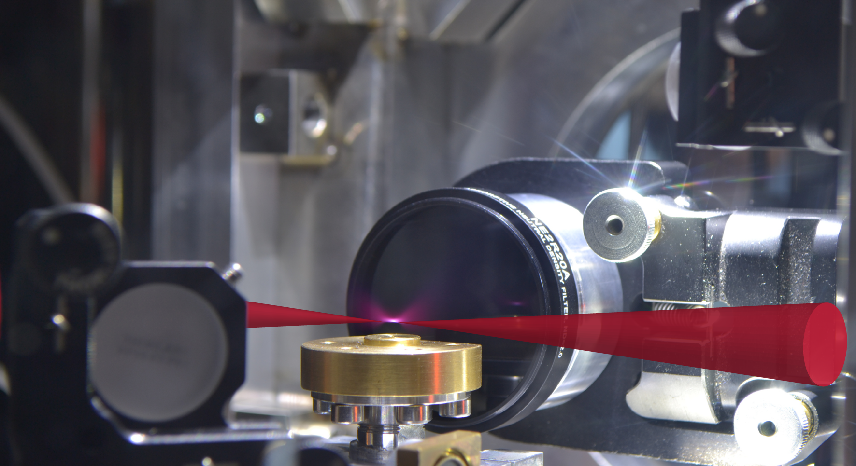
Laser Wakefield Acceleration of Electrons: Optical probing
transverse optical probing
main pulse
electrons
X-rays,…
gas-jet

Slide 10
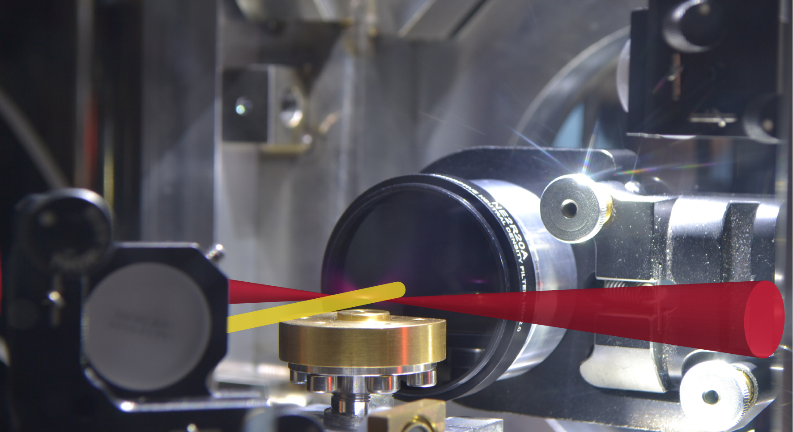
Laser Wakefield Acceleration of Electrons: Optical probing
transverse optical probing
main pulse
imaging lens
electrons
X-rays,…
probe pulse
gas-jet

Slide 11
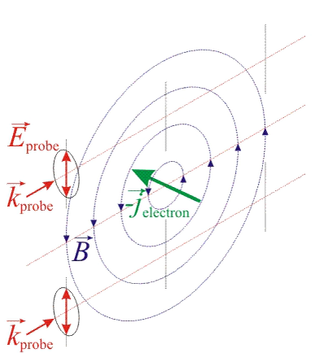
Laser Wakefield Acceleration of Electrons: Optical probing
Transverse probing of B-fields in under dense plasma
with linearly polarized probe pulse:
when ⇒ different η for circularly polarized probe-components (“Faraday-effect”)
⇒ Rotation of probe polarization:
⇒ measure φ_{rot} to deduce B-field distribution!
J. A. Stamper et al., PRL (1975)

Slide 12
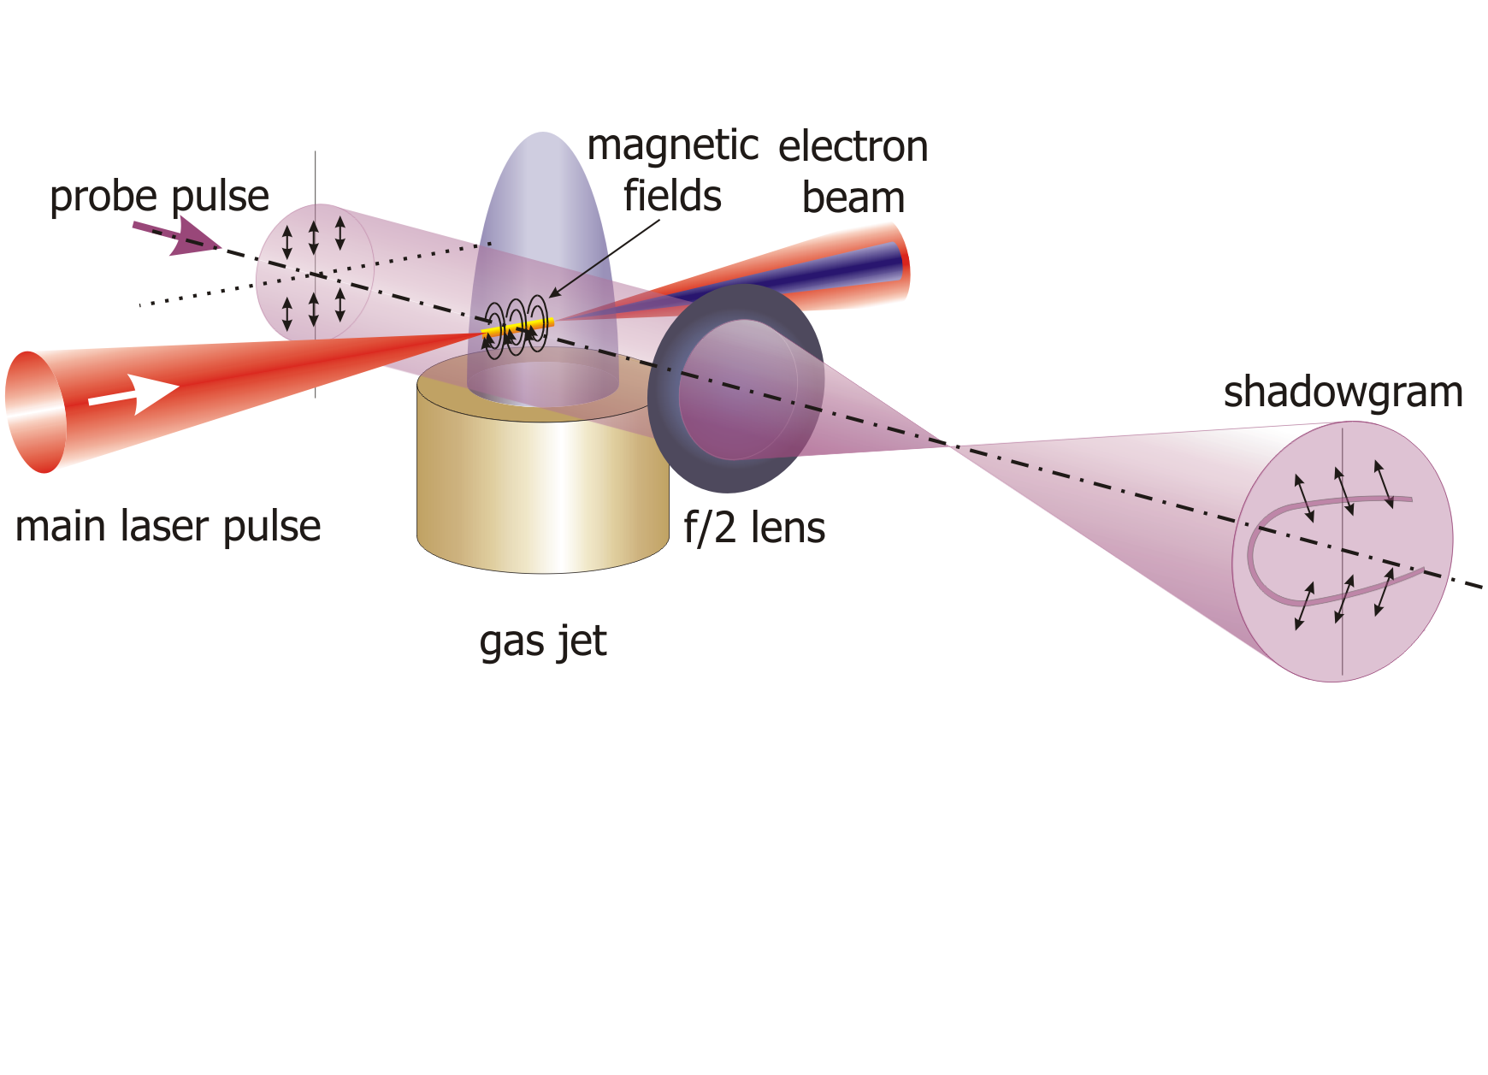
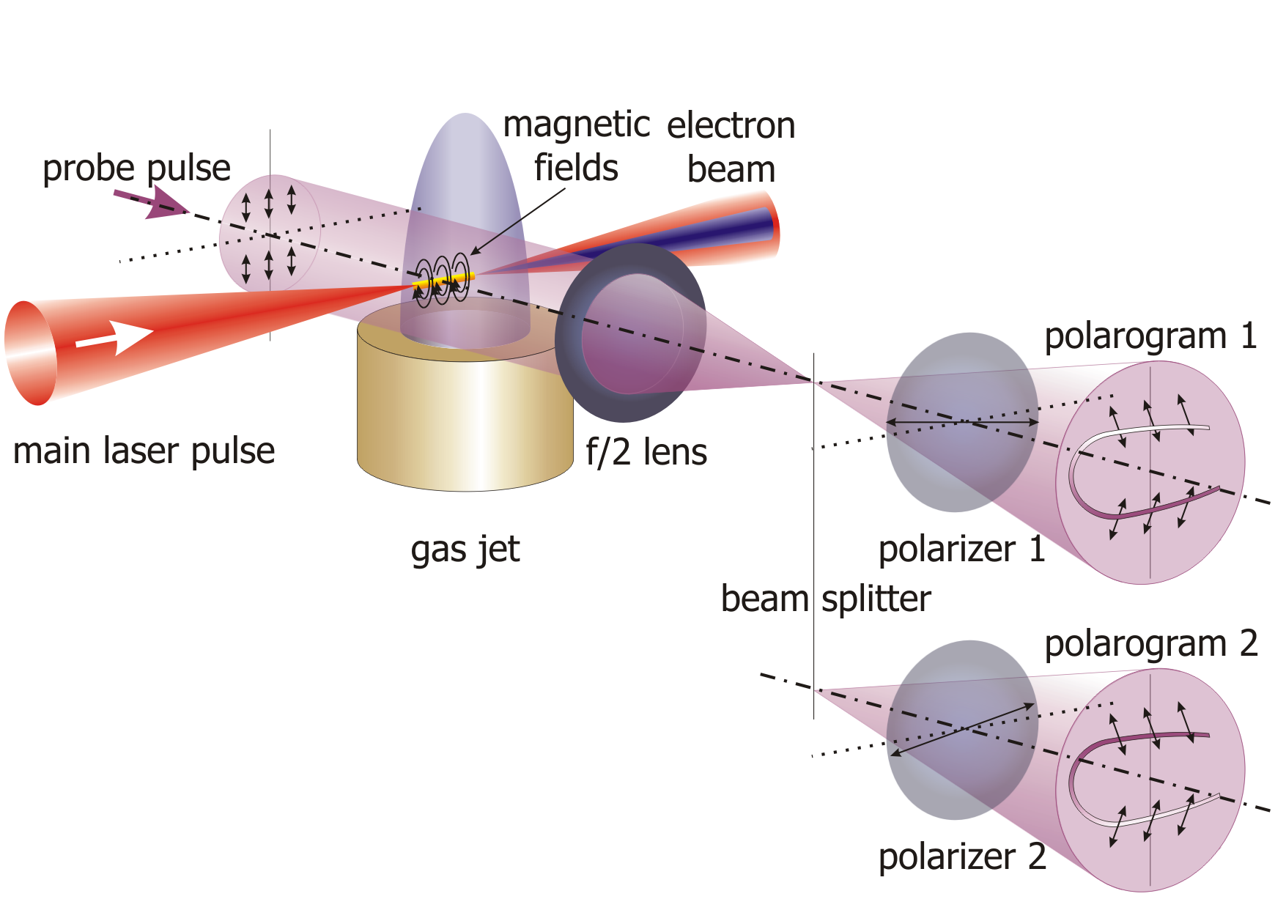
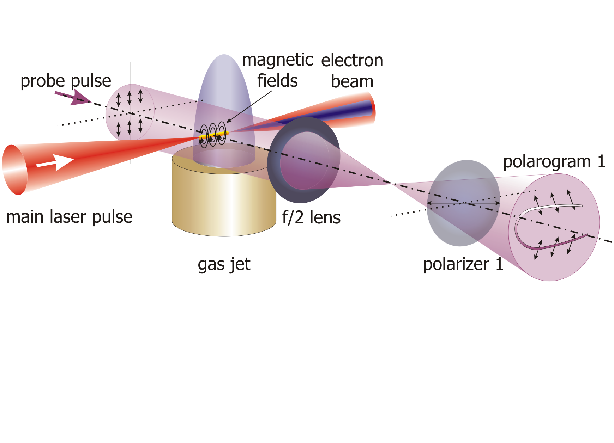
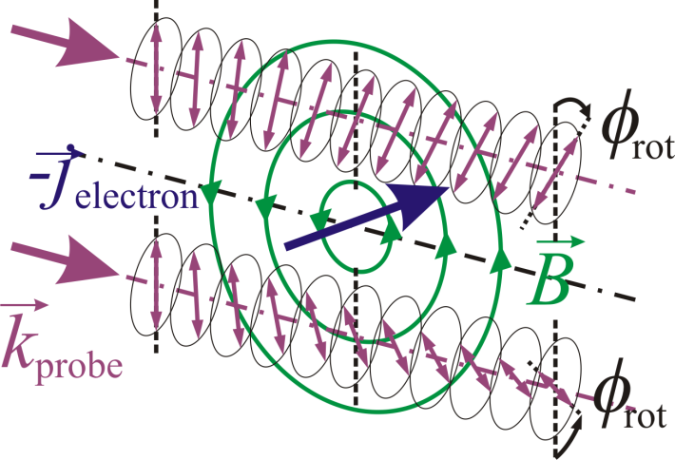
Laser Wakefield Acceleration of Electrons: Optical probing
MCK et al., PRL 105 115002 (2010)

Slide 13
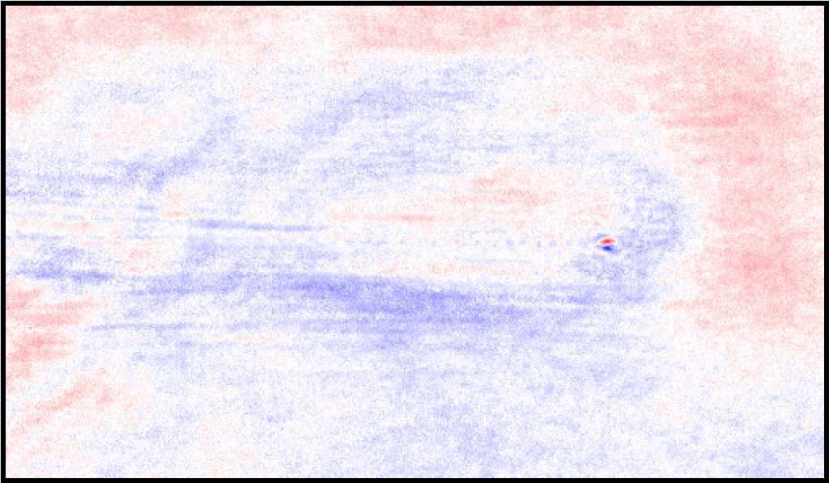
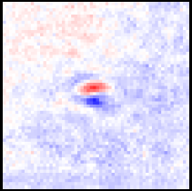
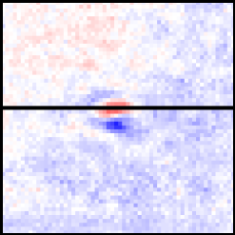
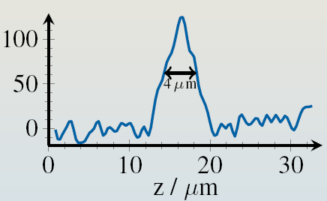
Laser Wakefield Acceleration of Electrons: Optical probing
first experiment @ LWS10 (MPQ Garching):
5-fs main- and probe pulses
polarogram 1
polarogram 2
Electron bunch length: Δz = 4 µm
τ_{FWHM}= (6±2) fs, τ_{RMS}= (2.5±0.9) fs
A. Buck, MCK et al., Nature Physics 7, 543 (2011)

Slide 14
Motivation and Outline
(One of the) Central goal(s) of EuPRAXIA:
  Realize a free-electron laser based on electron pulses from a LWFA
What are the requirements to reach this goal?
  Provide a stable/reliable/controllable GeV-class LWFA-driven electron source
How does a LWFA work?
Which e-beam parameters are essential?
  How are they correlated with accelerator structure (plasma wakefield)?
  How can they be measured?
Beyond existing (and possible) diagnostics:
  machine-learning algorithms, Bayesian optimization models
Summary and outlook
High-resolution images of plasma wave:
  Formation and evolution of e-bunch
  -> e-pulse duration in the plasma
Visualize evolution of accelerator structure (plasma wave)
  visualize point of injection of e-bunch
  -> acceleration length -> peak energy
Detection of betatron radiation
-> source size of electron pulse
Measure intensity evolution of driving main pulse via RECR
  Indirect measurement of acceleration fields
  -> peak energy of e-bunch
Visualize transverse scattering of laser pulse
-> spatio-temporal couplings in main pulse
-> e-beam direction/steering

Slide 15
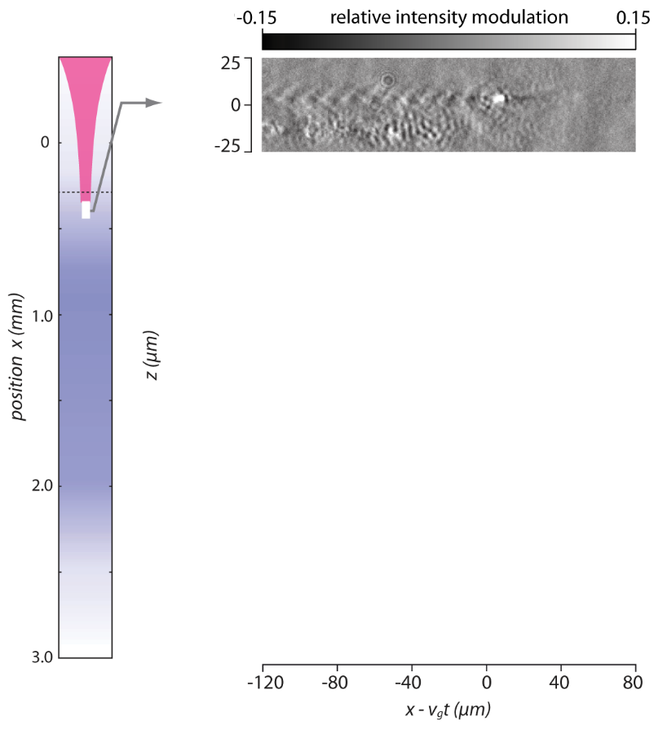
Laser Wakefield Acceleration of Electrons @ JETI: Optical probing
A. Sävert, MCK et al. Phys. Rev. Lett. 115, 055002 (2015)

Slide 16
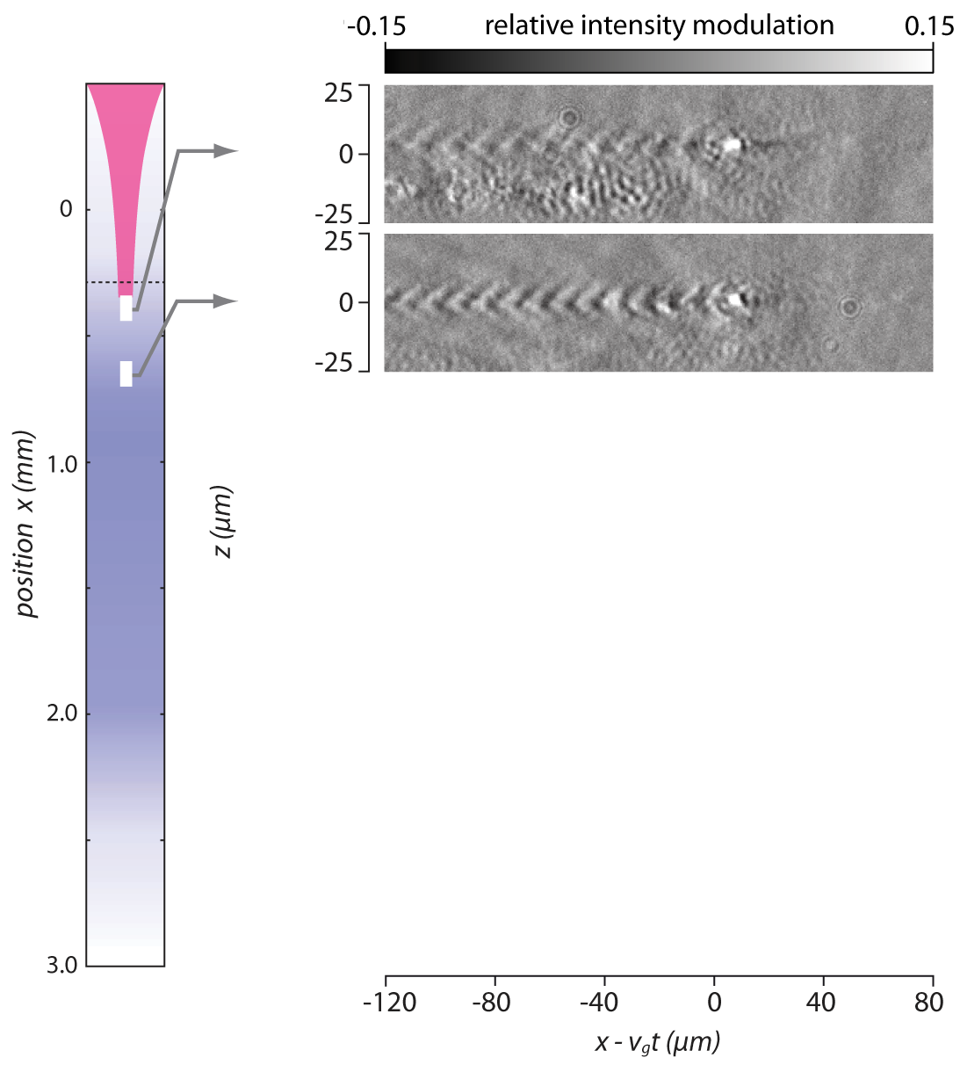
Laser Wakefield Acceleration of Electrons @ JETI: Optical probing
Self focussing
A. Sävert, MCK et al. Phys. Rev. Lett. 115, 055002 (2015)

Slide 17
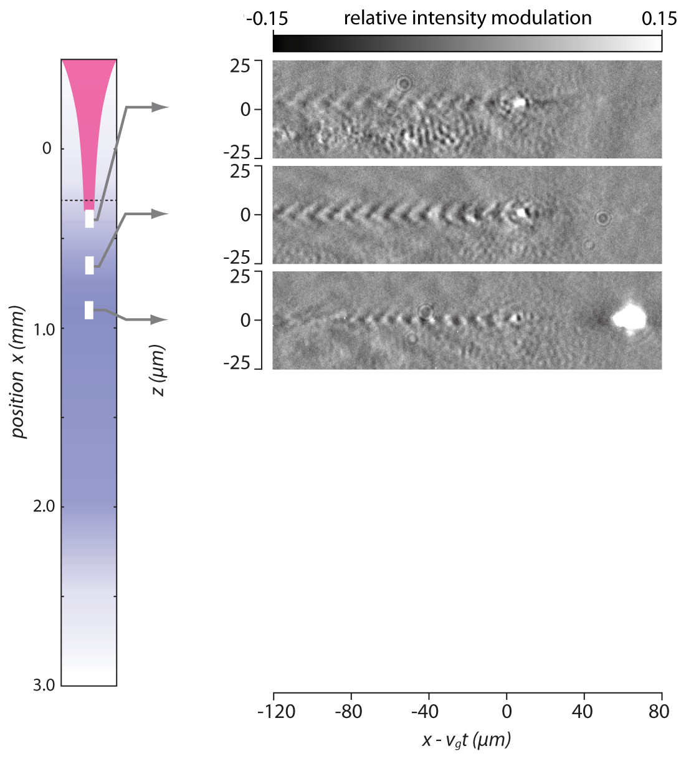
Laser Wakefield Acceleration of Electrons @ JETI: Optical probing
Self focussing
Injection
A. Sävert, MCK et al. Phys. Rev. Lett. 115, 055002 (2015)

Slide 18
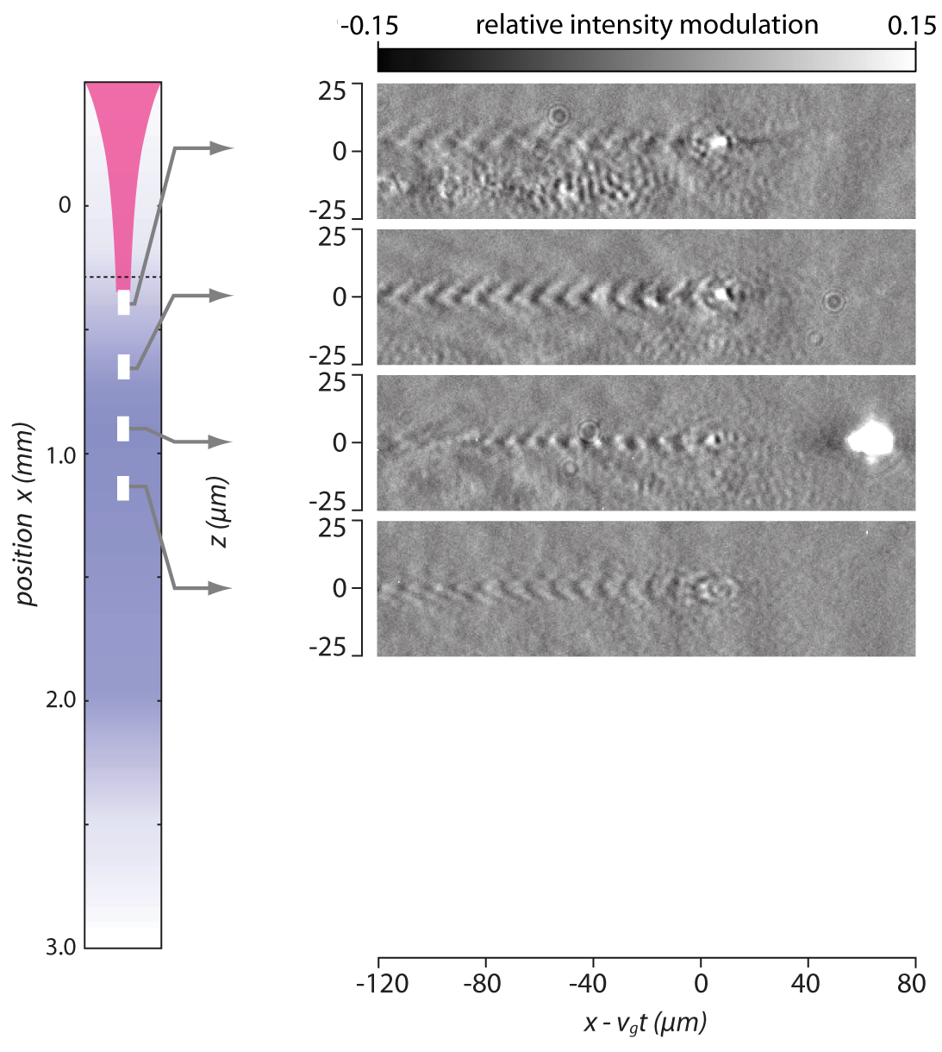
Laser Wakefield Acceleration of Electrons @ JETI: Optical probing
Self focussing
Injection
A. Sävert, MCK et al. Phys. Rev. Lett. 115, 055002 (2015)

Slide 19
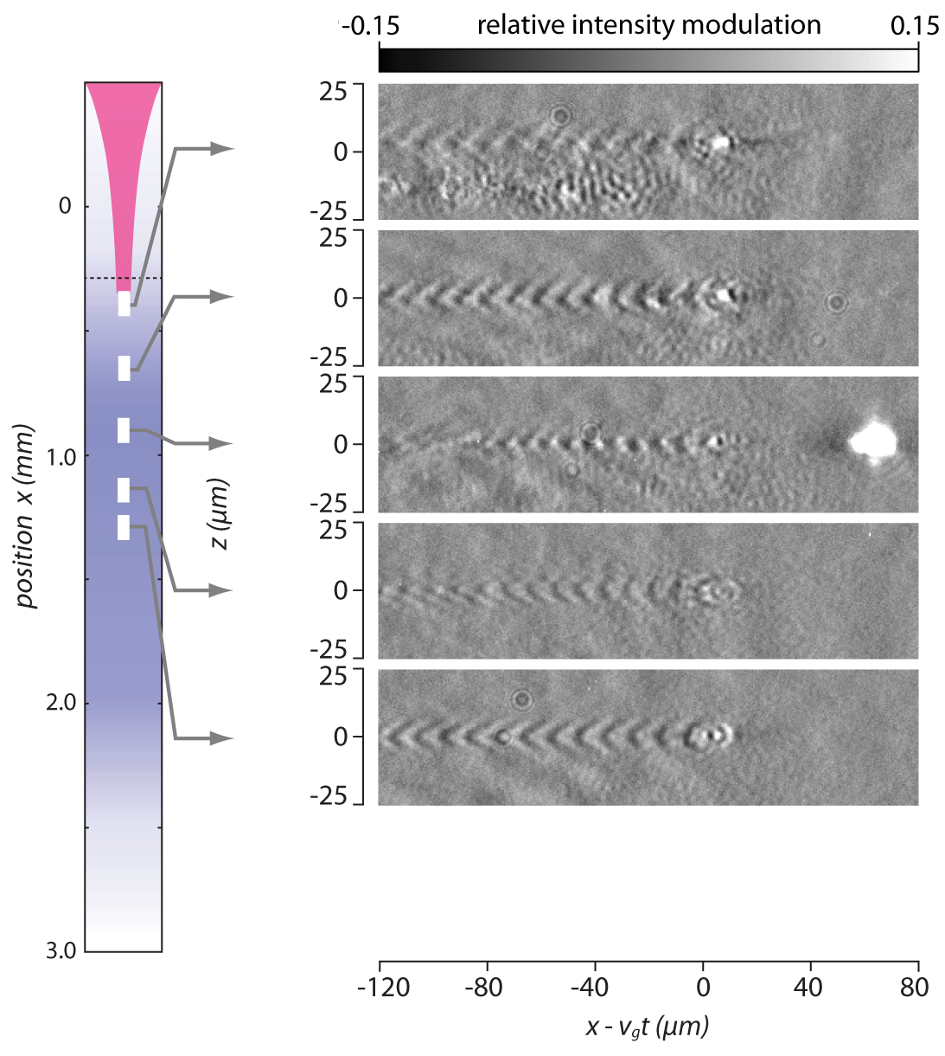
Laser Wakefield Acceleration of Electrons @ JETI: Optical probing
Self focussing
Injection
Acceleration
A. Sävert, MCK et al. Phys. Rev. Lett. 115, 055002 (2015)

Slide 20
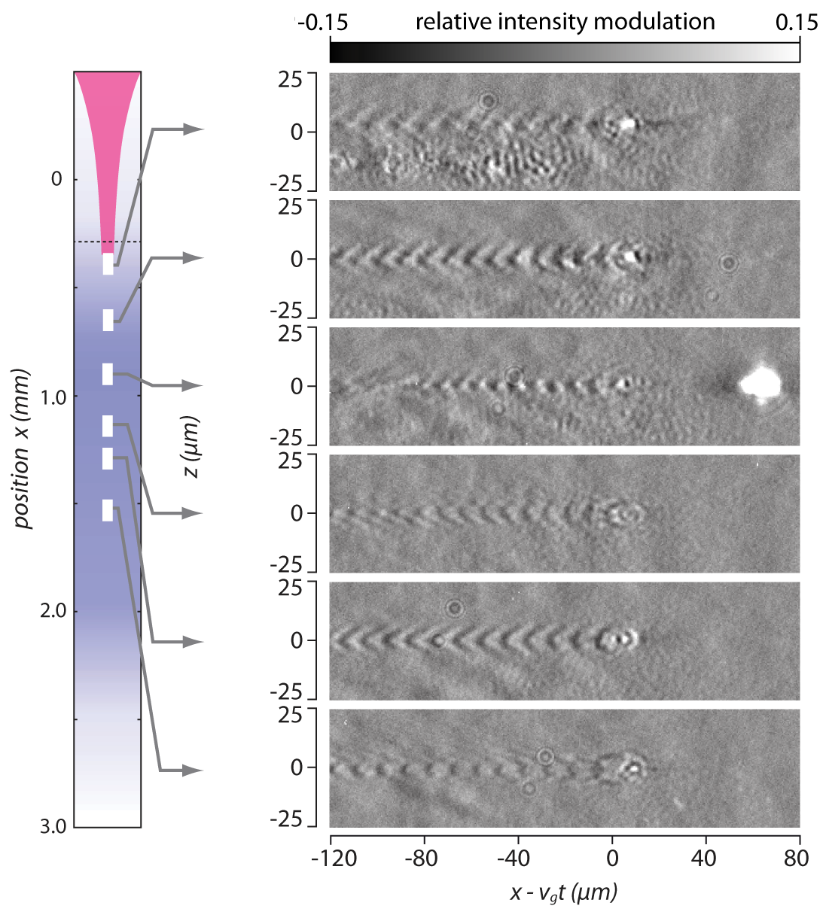
Laser Wakefield Acceleration of Electrons @ JETI: Optical probing
Self focussing
Injection
Acceleration
A. Sävert, MCK et al. Phys. Rev. Lett. 115, 055002 (2015)

Slide 21

Laser Wakefield Acceleration of Electrons @ JETI: Optical probing
Self focussing
Injection
Acceleration
A. Sävert, MCK et al. Phys. Rev. Lett. 115, 055002 (2015)

Slide 22
Motivation and Outline
(One of the) Central goal(s) of EuPRAXIA:
  Realize a free-electron laser based on electron pulses from a LWFA
What are the requirements to reach this goal?
  Provide a stable/reliable/controllable GeV-class LWFA-driven electron source
How does a LWFA work?
Which e-beam parameters are essential?
  How are they correlated with accelerator structure (plasma wakefield)?
  How can they be measured?
Beyond existing (and possible) diagnostics:
  machine-learning algorithms, Bayesian optimization models
Summary and outlook
High-resolution images of plasma wave:
  Formation and evolution of e-bunch
  -> e-pulse duration in the plasma
Visualize evolution of accelerator structure (plasma wave)
  visualize point of injection of e-bunch
  -> acceleration length -> peak energy
Detection of betatron radiation
-> source size of electron pulse
Measure intensity evolution of driving main pulse via RECR
  Indirect measurement of acceleration fields
  -> peak energy of e-bunch
Visualize transverse scattering of laser pulse
-> spatio-temporal couplings in main pulse
-> e-beam direction/steering

Slide 23
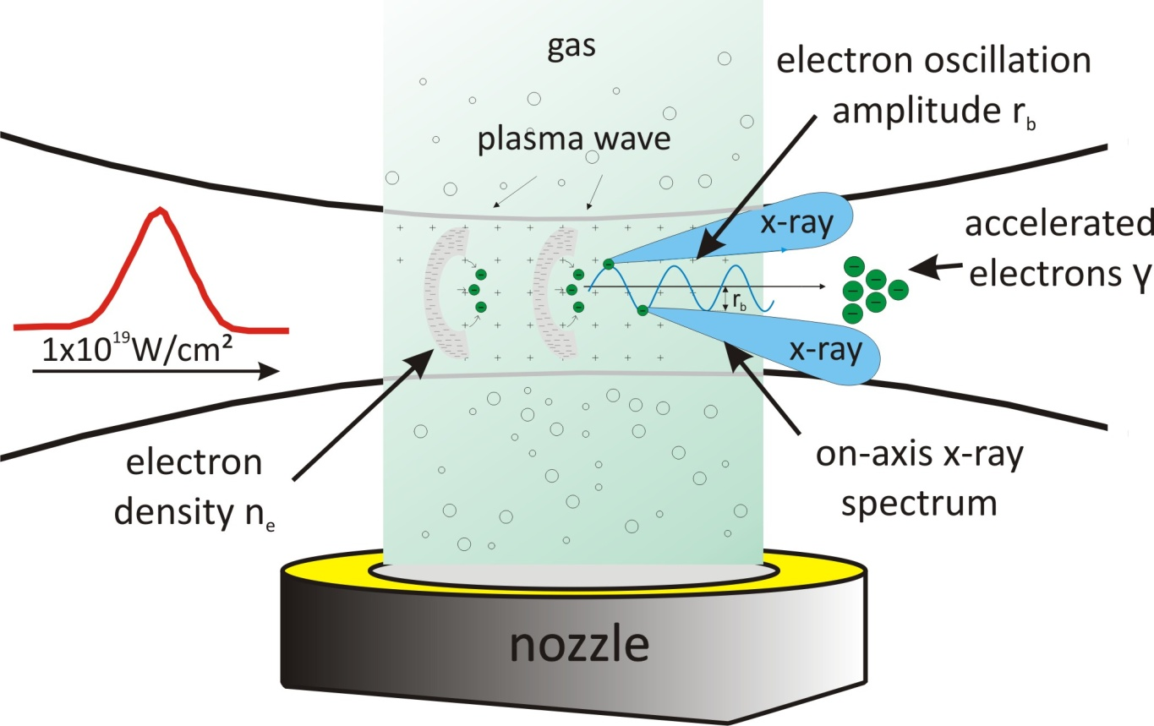

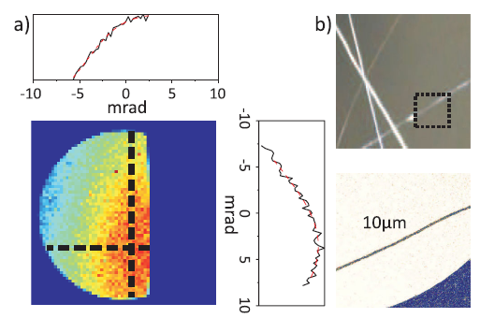
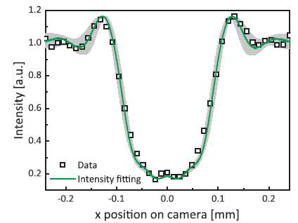
Laser Wakefield Acceleration of Electrons: Betatron Radiation
Acceleration of electrons in plasma wave
M. Schnell, MCK et al.
Phys. Rev. Lett. 108, 075001 (2012)
Fresnel-diffraction pattern at wire edges: r_{x-ray} = (1.8 ± 0.3) µm
electron source size: r_{electron bunch} = (1.6 ± 0.3) µm

Slide 24
Motivation and Outline
(One of the) Central goal(s) of EuPRAXIA:
  Realize a free-electron laser based on electron pulses from a LWFA
What are the requirements to reach this goal?
  Provide a stable/reliable/controllable GeV-class LWFA-driven electron source
How does a LWFA work?
Which e-beam parameters are essential?
  How are they correlated with accelerator structure (plasma wakefield)?
  How can they be measured?
Beyond existing (and possible) diagnostics:
  machine-learning algorithms, Bayesian optimization models
Summary and outlook
High-resolution images of plasma wave:
  Formation and evolution of e-bunch
  -> e-pulse duration in the plasma
Visualize evolution of accelerator structure (plasma wave)
  visualize point of injection of e-bunch
  -> acceleration length -> peak energy
Detection of betatron radiation
-> source size of electron pulse
Measure intensity evolution of driving main pulse via RECR
  Indirect measurement of acceleration fields
  -> peak energy of e-bunch
Visualize transverse scattering of laser pulse
-> spatio-temporal couplings in main pulse
-> e-beam direction/steering

Slide 25
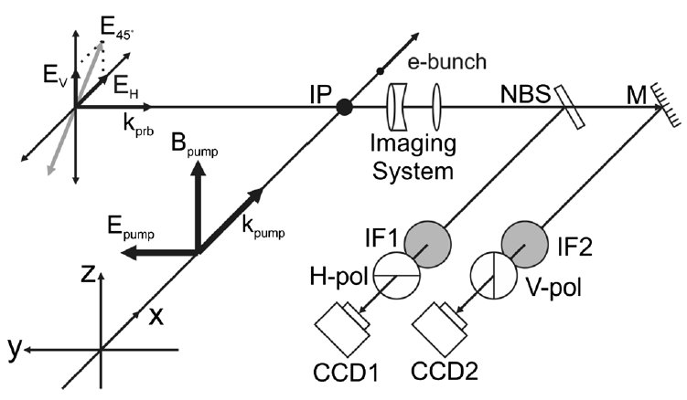
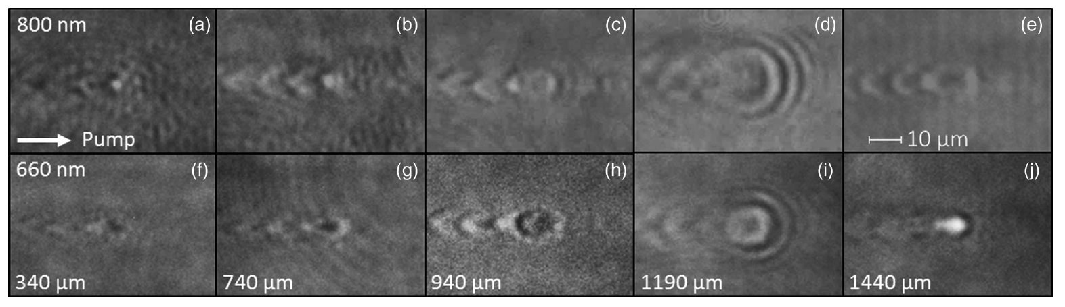
Laser Wakefield Acceleration of Electrons @ JETI: Optical probing
Non-invasive diagnostic of intensity evolution during interaction based on relativistic electron cyclotron resonance
Probe wave length and main-pulse intensity dependent probe-pulse absorption!
Signature of intensity evolution of main pulse during its passage through the plasma!
M. B. Schwab, MCK et al. Phys. Rev. AB 23, 032801 (2020)

Slide 26
Motivation and Outline
(One of the) Central goal(s) of EuPRAXIA:
  Realize a free-electron laser based on electron pulses from a LWFA
What are the requirements to reach this goal?
  Provide a stable/reliable/controllable GeV-class LWFA-driven electron source
How does a LWFA work?
Which e-beam parameters are essential?
  How are they correlated with accelerator structure (plasma wakefield)?
  How can they be measured?
Beyond existing (and possible) diagnostics:
  machine-learning algorithms, Bayesian optimization models
Summary and outlook
High-resolution images of plasma wave:
  Formation and evolution of e-bunch
  -> e-pulse duration in the plasma
Visualize evolution of accelerator structure (plasma wave)
  visualize point of injection of e-bunch
  -> acceleration length -> peak energy
Detection of betatron radiation
-> source size of electron pulse
Measure intensity evolution of driving main pulse via RECR
  Indirect measurement of acceleration fields
  -> peak energy of e-bunch
Visualize transverse scattering of laser pulse
-> spatio-temporal couplings in main pulse
-> e-beam direction/steering

Slide 27
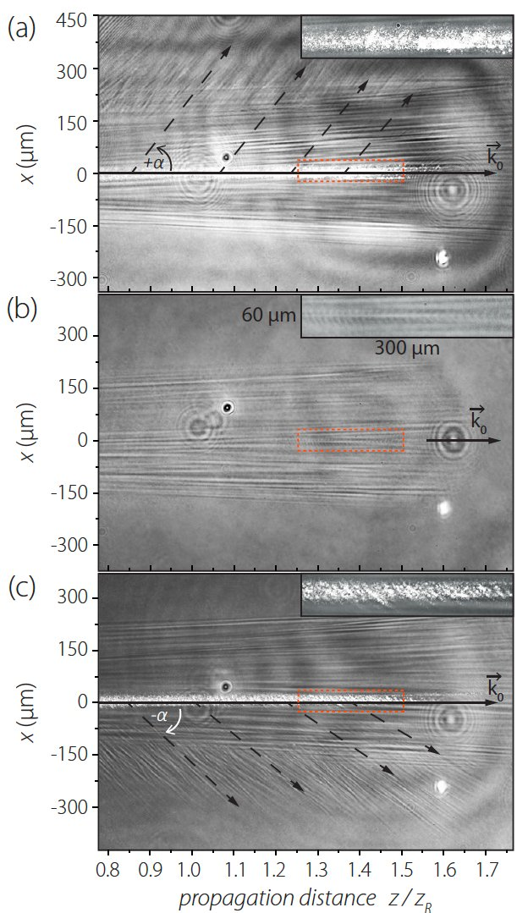
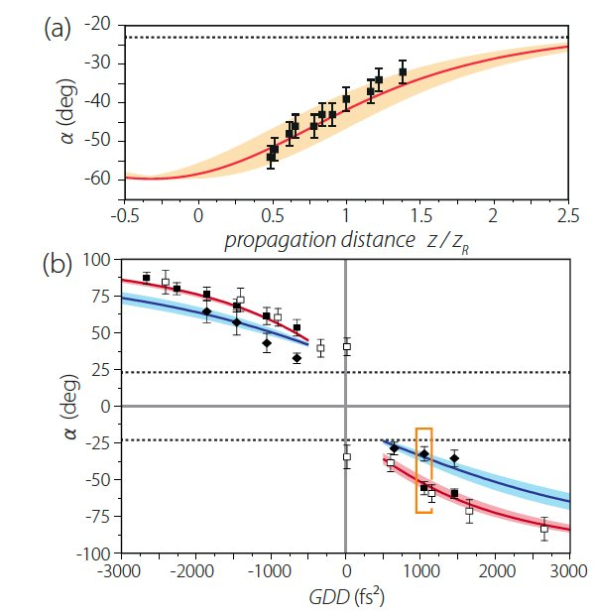
Laser Wakefield Acceleration of Electrons @ JETI: Optical probing
Observation of Stimulated Raman Sidescattering, diagnostic for spatio-temporal couplings of main pulse (PFT) and electron beam steering
C. Zepter, MCK et al. Phys. Rev. Research 5, L012023 (2023)

Slide 28
Motivation and Outline
(One of the) Central goal(s) of EuPRAXIA:
  Realize a free-electron laser based on electron pulses from a LWFA
What are the requirements to reach this goal?
  Provide a stable/reliable/controllable GeV-class LWFA-driven electron source
How does a LWFA work?
Which e-beam parameters are essential?
  How are they correlated with accelerator structure (plasma wakefield)?
  How can they be measured?
Beyond existing (and possible) diagnostics:
  machine-learning algorithms, Bayesian optimization models
Summary and outlook
When electron pulse cannot be measured non-invasively
  Deduce/estimate e-beam parameters from other parameters (which can be measured non-invasively)
  Possible, when exact correlations between parameters are known (not yet!)
  Use machine-learning algorithms + Bayesian optimization models to find such correlations

Slide 29
Motivation and Outline
(One of the) Central goal(s) of EuPRAXIA:
  Realize a free-electron laser based on electron pulses from a LWFA
What are the requirements to reach this goal?
  Provide a stable/reliable/controllable GeV-class LWFA-driven electron source
How does a LWFA work?
Which e-beam parameters are essential?
  How are they correlated with accelerator structure (plasma wakefield)?
  How can they be measured?
Beyond existing (and possible) diagnostics:
  machine-learning algorithms, Bayesian optimization models
Summary and outlook

Slide 30
Summary and Outlook
LWFA-based FEL as one of the central goals of EuPRAXIA seems within reach
essential for its optimization:
  high-resolution diagnostics for
    driving laser,
    plasma/accelerator structure,
    particle pulses,
  find correlations between different parameters also using machine-learning methods
Feedback loops for stabilization of laser and particle pulses.
Thank you for your attention!

Slide 31
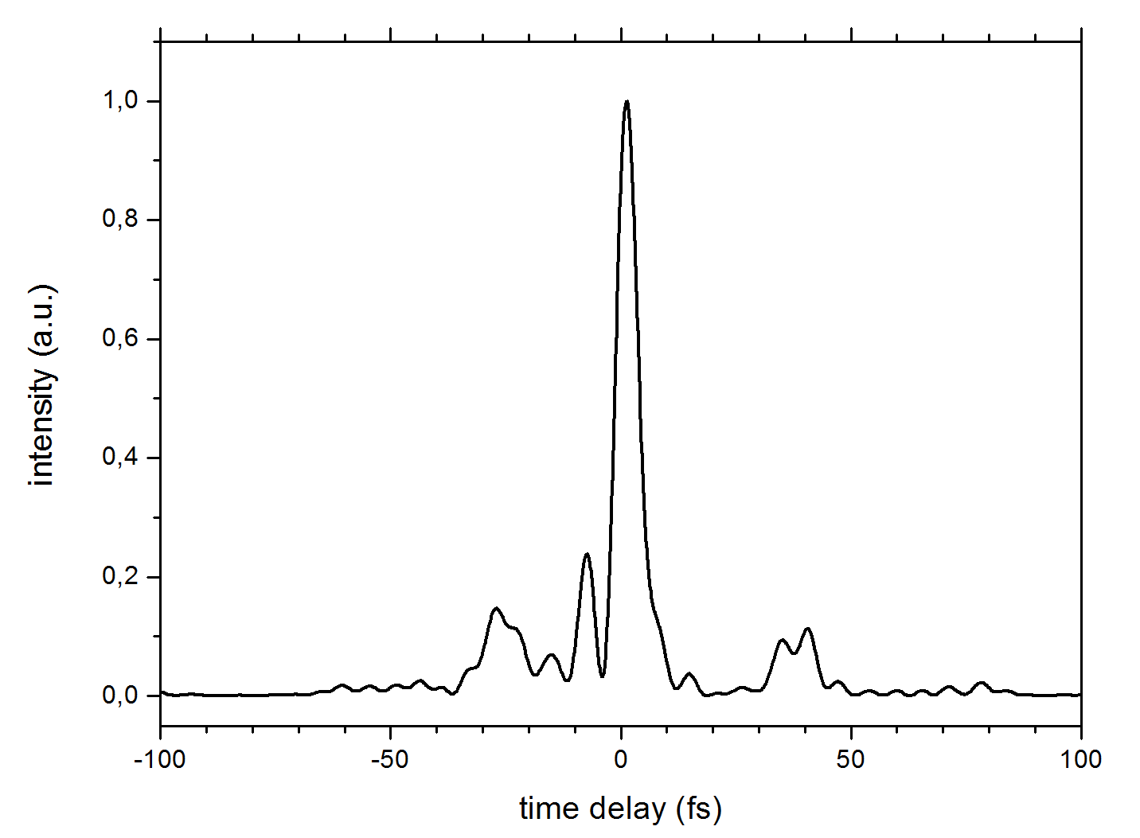
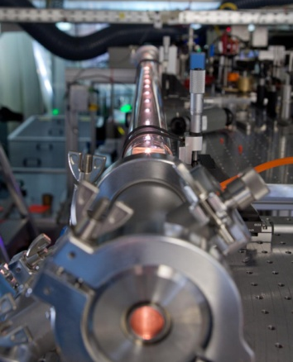
Laser Wakefield Acceleration of Electrons @ JETI: Optical probing
Generation of few-cycle probe pulses @ JETI via frequency broadening
τ_{probe} = 5.9 fs
JETI input pulses: 32 fs, ~1 mJ
(5.9±0.4) fs @ 300 µJ, (2.8±0.4) fs @ 200 µJ
shadowgraphy, Faraday-rotation, interferometry, … possible
JETI input pulses: 32 fs, ~1 mJ
(5.9±0.4) fs @ 300 µJ
M. Schwab, MCK et al., Applied Physics Letters 103, 191118 (2013)
D. Adolph, MCK et al., Applied Physics Letters 110, 081105 (2017)

Slide 32
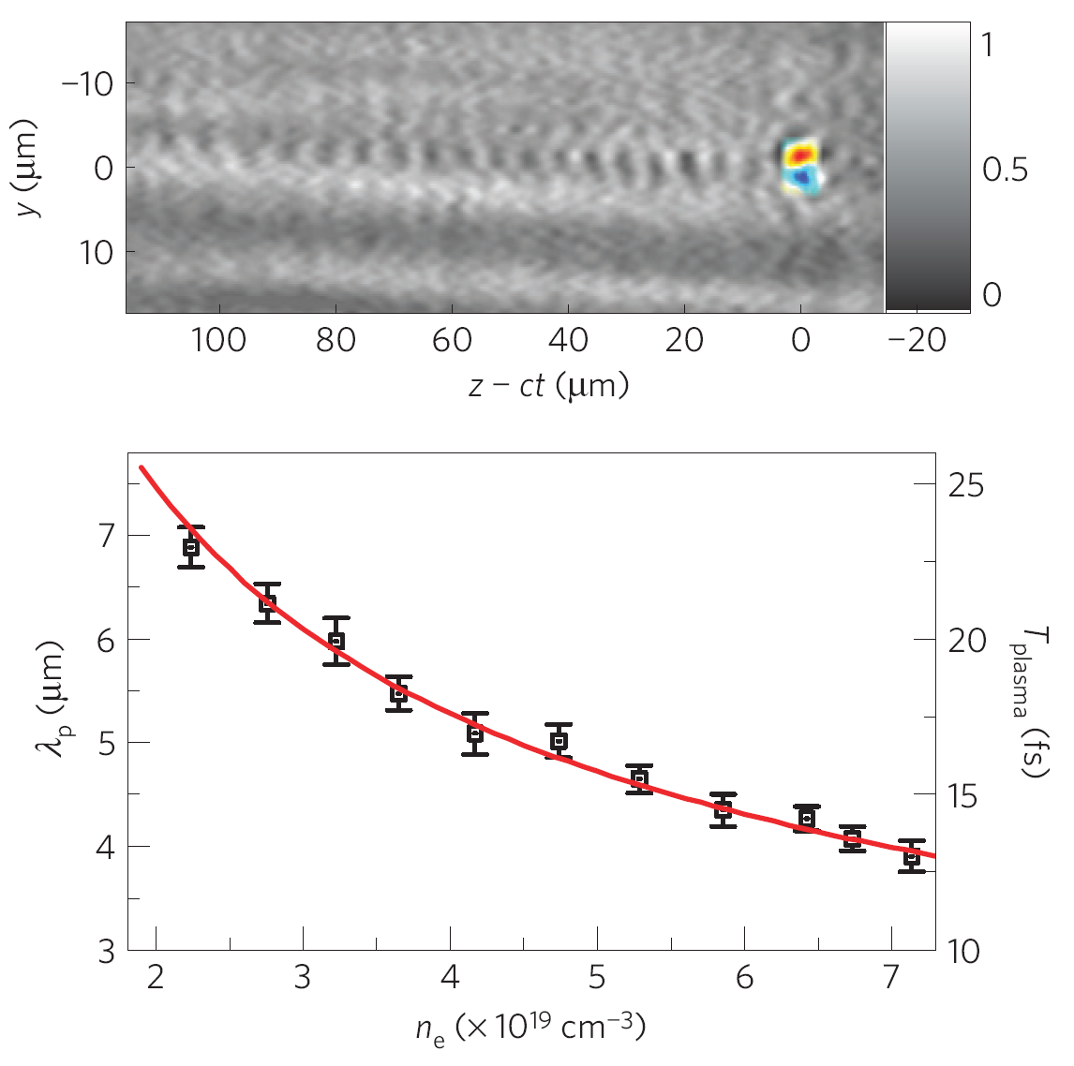
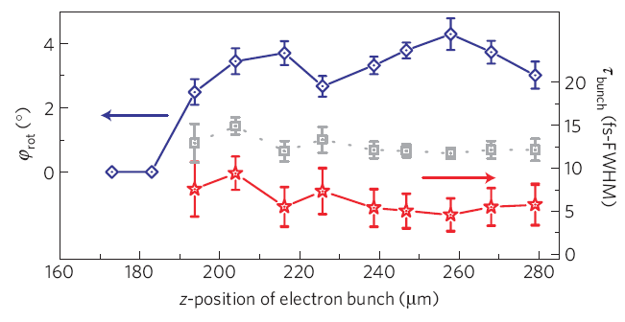
Laser Wakefield Acceleration of Electrons: Optical probing
Polarimetry:
Visualization of e-bunches via B-fields
Variation of delay between pump and probe pulse:
⇒ Evolution of e-pulse generation!
First online observation of e-bunch generation!
A. Buck, MCK et al., Nature Physics 7, 543 (2011)

Slide 33
Laser Wakefield Acceleration of Electrons: Optical probing
Polarimetry:
Visualization of e-bunches via B-fields
Variation of delay between pump and probe pulse:
⇒ Evolution of e-pulse generation!
Shadowgraphy:
Visualization of the plasma wave
First online observation of e-bunch generation!
A. Buck, MCK et al., Nature Physics 7, 543 (2011)

Slide 34
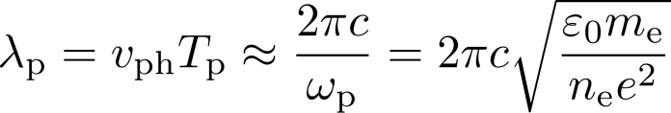
Laser Wakefield Acceleration of Electrons: Optical probing
Shadowgraphy:
Visualization of the plasma wave
Variation of plasma density ⇒ change of plasma wave length
A. Buck, MCK et al., Nature Physics 7, 543 (2011)

Slide 35
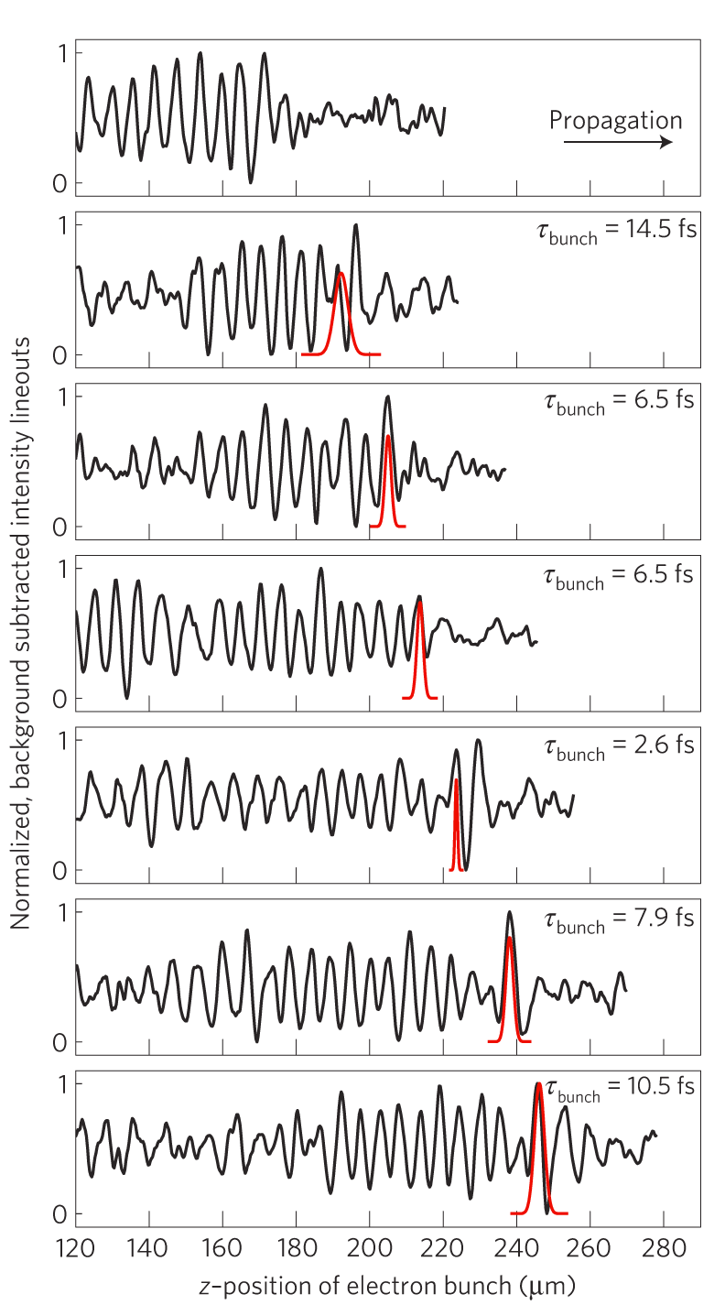
Laser Wakefield Acceleration of Electrons: Optical probing
Polarimetry + Shadowgraphy:
Measurement of e-bunch position
within the plasma wave:
e-pulse is indeed accelerated within the 1st wave period!
A. Buck, MCK et al., Nature Physics 7, 543 (2011)

Slide 36
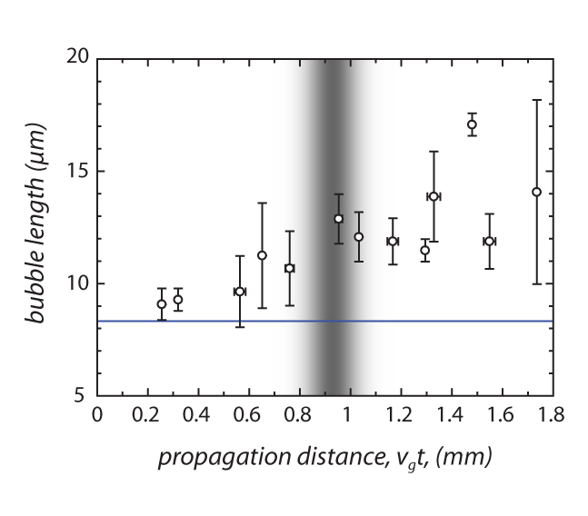




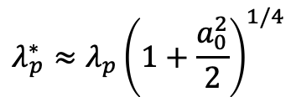
Laser Wakefield Acceleration of Electrons @ JETI: Optical probing
„well behaved“
wavebreaking radiation
„beam loading“ dominated
„single bubble“ regime
λ_{p} @ n_{e}=1.6x10¹⁹ cm⁻³
„multi bubble“ regime
Elongation of 1st plasma wave period
starts before injection of electrons.
no „beam loading“ but
main pulse amplification.
$$λ_{p}^{∗}≈λ_{p}{\left(1+\frac{a_{0}^{2}}{2}\right)}^{1/4}$$
A. Sävert, MCK et al. Phys. Rev. Lett. 115, 055002 (2015)

Slide 37
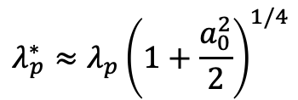
Laser Wakefield Acceleration of Electrons @ JETI: Optical probing
„well behaved“
wavebreaking radiation
„beam loading“ dominated
„single bubble“ regime
λ_{p} @ n_{e}=1.6x10¹⁹ cm⁻³
„multi bubble“ regime
Elongation of 1st plasma wave period
starts before injection of electrons.
no „beam loading“ but
main pulse amplification.
$$λ_{p}^{∗}≈λ_{p}{\left(1+\frac{a_{0}^{2}}{2}\right)}^{1/4}$$
A. Sävert, MCK et al. Phys. Rev. Lett. 115, 055002 (2015)

