Slide 1
Requirements on electron beam instrumentation for beam dynamics and operation of a free-electron laser
Eduard Prat :: SwissFEL Beam Dynamics :: Paul Scherrer Institut
WP13 EuPRAXIA electron and photon diagnostics
EPFL, Lausanne, 12 June 2023

Slide 2
Contents
Electron beam requirements for X-ray FELs
Electron beam instrumentation requirements
Emittance and time-resolved measurements
Some important resolutions, implication to optics and transverse profile monitor (PM) resolution
FEL properties from electron beam properties
Summary and conclusion

Slide 3
Contents
Electron beam requirements for X-ray FELs
Electron beam instrumentation requirements
Emittance and time-resolved measurements
Some important resolutions, implication to optics and transverse profile monitor (PM) resolution
FEL properties from electron beam properties
Summary and conclusion

Slide 4
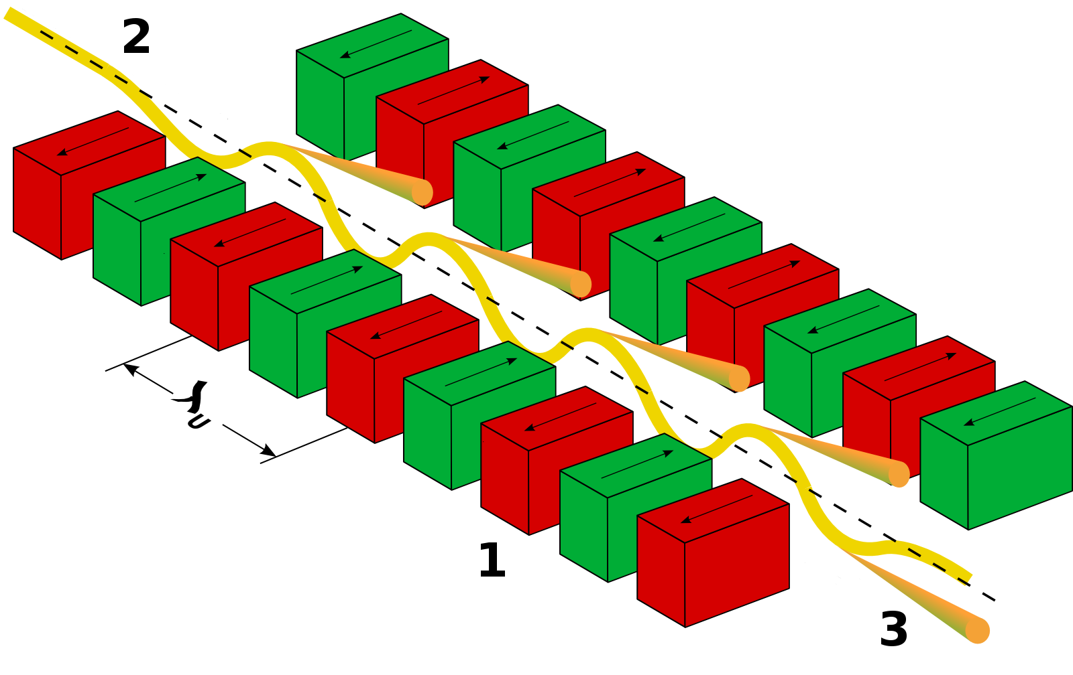
Electron beam energy
The electron beam energy needs to be at the GeV level for X-rays

Slide 5
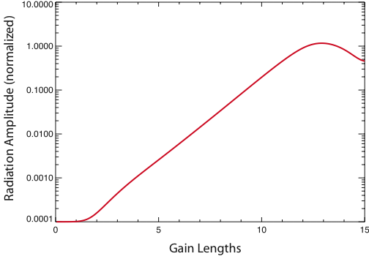
Peak current and beam sizes
Pierce parameter
Gain length
Efficiency
A better FEL performance, i.e. higher powers and shorter gain lengths, are obtained for larger ρ parameters. We want:
  Large peak currents (from 1 to several kA)
  Small transverse beam sizes (10s of μm)
  (Larger undulator fields K, but require higher electron beam energies for the same wavelength)
FEL saturation
FEL energy (arb. units)
Undulator length (gain lengths)

Slide 6
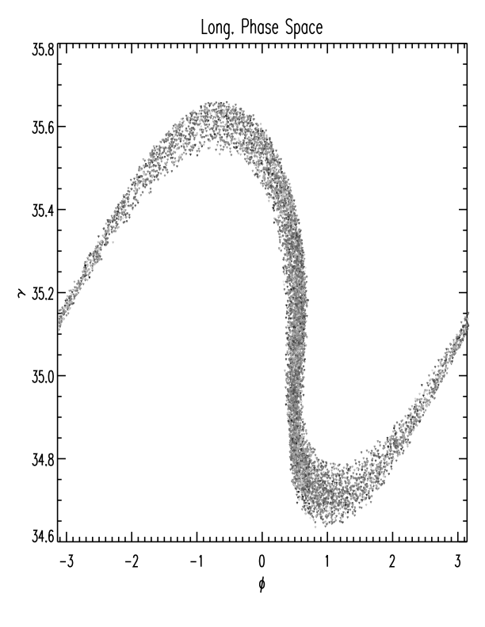
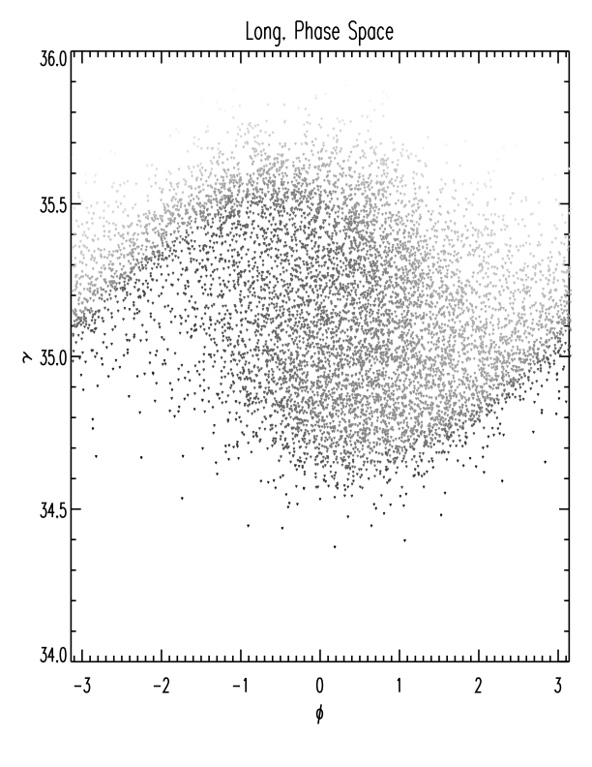

Energy spread
Only electrons within the FEL bandwidth can contribute to FEL gain.
The FEL bandwidth is approximately equal to the ρ parameter
Consequently, the relative energy spread needs to be smaller than ρ
Small spread
Large spread
Strong Bunching
Weak Bunching
Energy spread constraint:
$$\frac{σ_{E}}{E}<ρ$$
For X-rays: relative energy spread needs to be smaller than 10⁻³ – 10⁻⁴
Besides this limit: lower energy spreads are desired → better FEL performance and shorter pulses
Standard FEL injectors have relative energy spreads of ~1e-5 (energy spread resolution should be better than that)

Slide 7
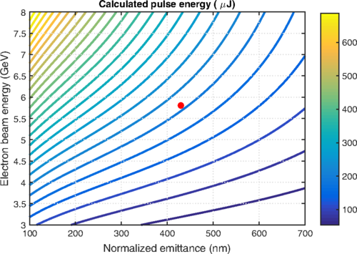
Emittance
Transversely coherent FEL radiation is generated when
If the normalized emittance is reduced:
  The final beam energy can be decreased →more compact and cheaper accelerator
  Higher radiation power and shorter undulator line for a given beam energy
Calculations for SwissFEL at 0.1 nm
FEL injectors produce normalized emittances down to several tens of nanometers – resolutions of ~10 nm required
Notes:
7

Slide 8
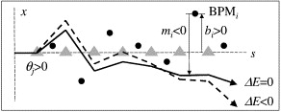
Transverse overlap
FEL performance strongly depends on a good transverse overlap between electrons and photons. Therefore we need to control:
Trajectory: with beam-based alignment (sub µm control required)
Beam size: with optics matching
Notes:
8

Slide 9
Time-resolved properties
FEL process occurs within a small fraction of the bunch length and properties can vary along the longitudinal beam position → need for time-resolved measurements and optimization
  Slice current
  Slice emittance
  Slice optics
  Slice trajectory
FEL pulse duration is mostly defined by the electron beam pulse duration which is able to lase (proper current, emittance, trajectory, etc.). The lower limit is the FEL slippage (100’s of as for X-rays).
Standard pulse duration is of few tens of fs. Short pulses below 1 fs have been achieved in X-rays in different ways
→ need to measure time-resolved properties with at least few fs resolution, ideally with sub-fs resolution
Notes:
9

Slide 10
High and stable FEL performance
Scientific users require extremely stable FEL radiation output in terms of:
  pulse energy (~% level)
  arrival time (~10 fs)
  wavelength (~0.1%)
  pointing (~10% of beam size).
Several feedbacks are used for that:
  Charge feedback (gun laser)
  Trajectory feedbacks along the machine
  Compression (current) feedbacks after each bunch compressor
  Arrival time feedbacks
  Electron beam energy feedbacks
Example: shot to shot FEL spots at SwissFEL. Intensity stability of few %, pointing stability around 10% of the rms beam size

Slide 11
Contents
Electron beam requirements for X-ray FELs
Electron beam instrumentation requirements
Emittance and time-resolved measurements
Some important resolutions, implication to optics and transverse profile monitor (PM) resolution
FEL properties from electron beam properties
Summary and conclusion

Slide 12
Properties to be measured
In FEL facilities, electron beam diagnostics are required to characterize, optimize, and stabilize the electron beam for best FEL performance
We need to diagnose:
  How many electrons we have: charge
  First-order moments: transverse trajectory, energy and arrival time
  Second-order moments: transverse beam sizes and divergences, energy spread, pulse duration, optics and emittances
  The above as a function of time: current, transverse tilts, energy chirp, slice optics and emittance, slice energy spread
  Moreover: radiation loss monitors to protect people and machine (not consider after in this talk)

Slide 13
Other aspects
Repetition rate and invasiveness
Here we limit ourselves to ~100 Hz facilities (as EuPRAXIA will be)
Some properties need to be stabilized in feedbacks and therefore must be measured in full rep rate and non-invasively; e.g. trajectories, compression signals, etc.
Some other properties do not require to be measured in full rep rate and can be measured invasively; e.g. the emittance (but would be nice to!)
Absolute and relative measurements
Some devices give absolute measurements, some others only relative but can be calibrated.
Example: rf streaking measurements (absolute, invasive) and compression monitors (relative, non-invasive).

Slide 14
Overview of required diagnostics
 | Range | FB | State-of-the-art devices
Charge | ~1 pC - ~1 nC | Yes | ICT or BPM (rel.)
Trajectory | <1 µm to few mm | Yes | BPMs
Energy | ~1 MeV to ~10 GeV | Yes | Dipole + BPM
Arrival time | ~1 fs to ~10 ps | Yes | WCM or BAM
Beam size | Few µm to few mm | No | Screen or WS
Energy spread | 1e-5 – few per cent | No | Dipole + Screen or WS
Pulse duration | < 1 fs – ~100 fs | Yes | Compression monitors (rel.) or TDS
Emittance | ~10 nm to few µm (norm.) | No | Screen or WS
Time-resolved properties | ~1 fs in time, the rest as for projected | No | Streaker + screen

Slide 15
Contents
Electron beam requirements for X-ray FELs
Electron beam instrumentation requirements
Emittance and time-resolved measurements
Some important resolutions, implication to optics and transverse profile monitor (PM) resolution
FEL properties from electron beam properties
Summary and conclusion

Slide 16
Optics-based emittance measurements
The 2D (4D) transverse beam matrix is obtained measuring the beam sizes (and <xy>) for different phase advances between reconstruction point s₀ and measurement point s.
What we can measure at s
2D
What we want to reconstruct at s₀
4D
Intrinsic emittances ε₁, ε₂ are derived from 2D and coupling terms [K. Kubo, ATF Report 99-02 (1999)]
At least 3 (4) transformations are needed for 2D (4D) parameters, but more measurements improve the robustness of the reconstruction
The best 2D reconstruction is when the phase-advance is covered regularly between 0 and π
Notes:
16

Slide 17
Measurement optics: FODO vs quad scans
Measurement point
Reconstruction point
Quadrupole magnet
FODO Quadrupole scan
Multiple-position/fixed-optics Fixed-position/multiple-optics
Parasitic measurements No parasitic measurements
More equipment Less equipment
Dedicated long lattices More compact
Not-flexible optics Flexible optics
Non-flexible measurement location Flexible measurement location
Less sensitive to PM errors More sensitive to PM errors
Typically worse resolution Better resolution
Larger phase-advance steps Smaller phase-advance steps
Quadrupole scans are preferred since they are more flexible, require less components, are more compact and can have better resolutions
(My) best approach:
For commissioning or machine setup: use quadrupole scans at several locations in the machine
For routine operation: FODO measurements. Don’t allocate dedicated lattices but use what is already there (e.g. long linac sections) → more compact accelerator
Notes:
17

Slide 18
Time-resolved measurements
The beam is deflected in one direction as a function of time and the slice
parameters in the other direction are reconstructed using 2D profile monitors.
Profile
monitors
Deflector
Quadrupole magnets
Profile monitor
In straight section: measurement of transverse slice beam properties
In dispersive location: longitudinal phase-space measurement
Quadrupole magnets
Used to optimize measurement resolution (emittance, time, energy)
Quadrupole scan done for emittance measurements
Fixed optics for longitudinal phase-space measurements
Notes:
18

Slide 19
Time-resolved measurements
Image analysis. The beam is split into slices. Per each slice the beam size and centroid are obtained (e.g. doing Gaussian fits).
Emittance/mismatch determination. From the beam sizes per each optics the emittance and optics are obtained per each slice
Beam tilt determination. From the slice trajectory at each optics, the tilt in offset (<xs>) and angle (<x’s>) are obtained
Energy spread: obtained from beam size at dispersive location
Notes:
19

Slide 20
Streaking methods
Streaking can be done with different methods:
Transverse deflecting RF structure (TDS) – more standard method
Introducing dispersion to an energy chirped beam
Transverse wakefields
Shared problem: streaking is invasive (unless used after the undulator)
Shared advantage: streaking can be used to shape the FEL beam (short pulses)
 | TDS | Dispersion | Wakefields
Demonstrated res. | < 1 fs (*) | ~1 fs (**) | ~1 fs (***)
Pros | Easy reconstruction | Zero cost | Self synchronized, moderate cost
Cons | High cost, arrival time sensitivity | No absolute measurement. Linear streaking only if linear energy chirp. | Nonlinear streaking, difficult reconstruction
(*) [C. Behrens et al, Nat. Comm. 5, 3762 (2014)]
(**) [E. Prat et al, PRR 4, L022025, 2022]
(***) [P. Dijkstal et al, PRR 4, 013017 (2022)]
The methods can be combined for enhanced resolution!

Slide 21
Contents
Electron beam requirements for X-ray FELs
Electron beam instrumentation requirements
Emittance and time-resolved measurements
Some important resolutions, implication to optics and transverse profile monitor (PM) resolution
FEL properties from electron beam properties
Summary and conclusion

Slide 22
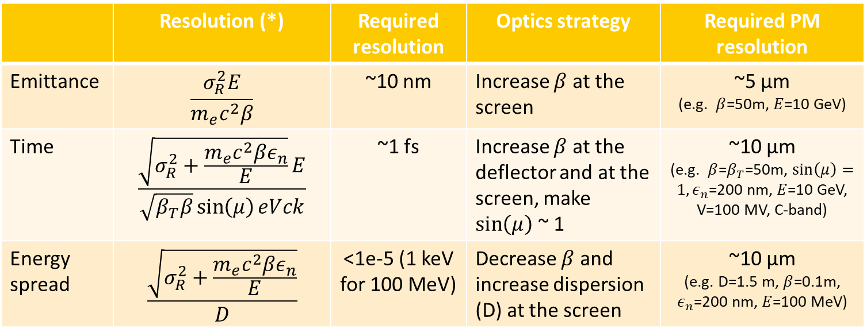
Some important resolutions
 | Resolution (*) | Required resolution | Optics strategy | Required PM resolution
Emittance | $$\frac{σ_{R}^{2}E}{m_{e}c^{2}β}$$ | ~10 nm | Increase $β$ at the screen | ~5 µm (e.g. $β$=50m, $E$=10 GeV)
Time | $$\frac{\sqrt{σ_{R}^{2}+\frac{m_{e}c^{2}βε_{n}}{E}}E}{\sqrt{β_{T}β}\sin\left(μ\right)eVck}$$ | ~1 fs | Increase $β$ at the deflector and at the screen, make $\sin\left(μ\right)$ ~ 1 | ~10 µm (e.g. $β$=$β_{T}$=50m, $\sin\left(μ\right)=1, ε_{n}$=200 nm, $E$=10 GeV, V=100 MV, C-band)
Energy spread | $$\frac{\sqrt{σ_{R}^{2}+\frac{m_{e}c^{2}βε_{n}}{E}}}{D}$$ | <1e-5 (1 keV for 100 MeV) | Decrease $β$ and increase dispersion (D) at the screen | ~10 µm (e.g. D=1.5 m, $β$=0.1m, $ε_{n}$=200 nm, $E$=100 MeV)
Optics should be optimized for each particular resolution
For all cases, improve the screen resolution helps
Most critical case is emittance resolution (we can increase streaking for time resolution, and dispersion for energy spread resolution) →
→ around 5 µm required for 10 nm resolution
(*)This standard resolution can be overcome by measuring the properties for different parameters (e.g. energy)
Notes:
22

Slide 23
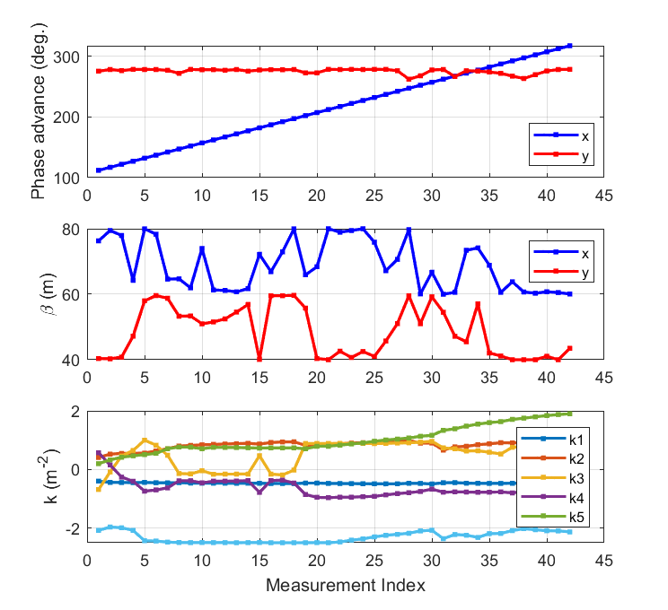
Optimized multiple-quadrupole scan for slice emittance measurements
Example for SwissFEL
Phase-advances
Beta at the TDS in the streaking plane is 60 m (for good time resolution)
Six quadrupoles between TDS and PM are used to:
Optimize emittance resolution:
  Scan regularly phase advance in measurement plane
  Large beta at the screen in the measurement plane
Optimize time resolution:
  sinµ~1
  Large beta at the PM in the streaking plane
Betas at the PM
k-values
Notes:
23

Slide 24
Some words on profile monitors
The devices commonly used to measure the transverse beam parameters in FEL facilities are OTR screens, scintillator screens (e. g. YAG), and wire-scanners.
WS have the best resolution, but 2D information is missing – and they are slow.
Scintillators are better than OTRs, a MO is required for few-µm resolution
 | Scintillator screens | OTR screens | Wire-scanners (WS)
Demonstrated resolution | 15 µm w/o MO (*) 5 µm with MO (**) | (As good as scintillators) | 0.5 µm (***)
2D information (slice, coupling, tilts) | Yes | Yes | No
Charge sensitivity | Very good | Poor | Very good
Measurement time | Fast | Fast | Slow
Interference with operation | Yes | Yes | Less
Issues | Saturation effects | COTR | Multi shot measurement (jitter correction required)
MO = microscope objective.
(*) [R. Ischebeck et al, PRSTAB 18, 082802 (2015)] Scintillator thickness was 100 µm
(**) [J. Maxson et al, PRL 118, 154802 (2017)] Scintillator thickness was 20 µm
(***) [S. Borrelli et al, CP 1, 52 (2018)] Use of sub-µm metallic stripes on a membrane using lithography, standard WS have a resolution of 1.25 µm
Notes:
24

Slide 25
Contents
Electron beam requirements for X-ray FELs
Electron beam instrumentation requirements
Emittance and time-resolved measurements
Some important resolutions, implication to optics and transverse profile monitor (PM) resolution
FEL properties from electron beam properties
Summary and conclusion

Slide 26
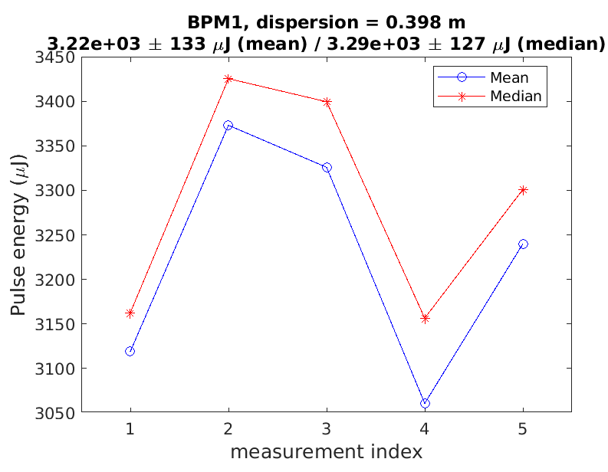
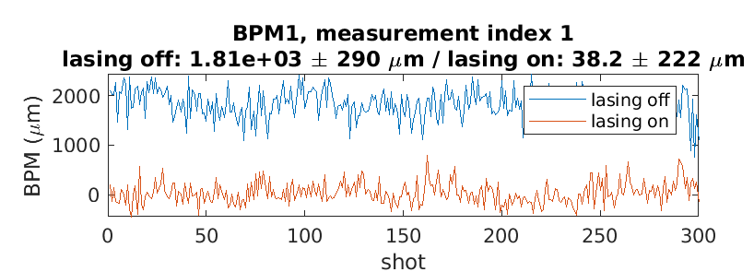
FEL properties from electron beam properties
FEL process reduces the energy and increases the energy spread of the electrons
Comparing the energy loss and energy spread increase of the electrons between lasing-on and lasing-off conditions is useful to diagnose the FEL pulse energy and the FEL power profile.
FEL pulse energy: we just need a BPM in a dispersive section. Useful to calibrate photon gas detector
Notes:
26

Slide 27
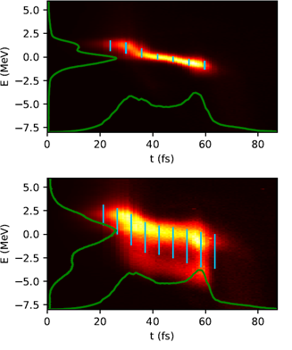
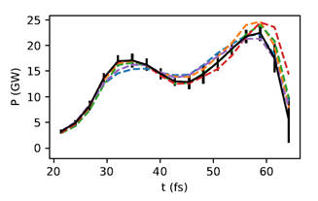
FEL properties from electron beam properties
FEL power profile: we need a TDS and a screen in a dispersive section to measure the longitudinal phase-space (some limitations like slippage effects)
Method originally proposed in [Ding et al, PRSTAB 14 120711 (2011)], first demonstrated in [Behrens et al, Nat. Comm. 5, 3762 (2014)]
lasing off
Example with a passive streaker
[Dijkstal et al, PRR 4, 013017 (2022)]
lasing on
Notes:
27

Slide 28
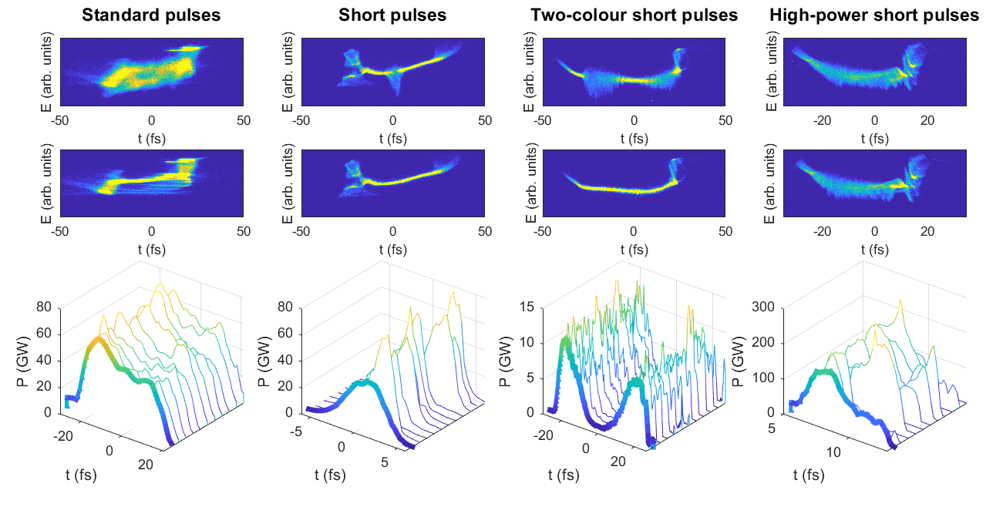
Examples at SwissFEL
900 eV
900 eV
500/760 eV
620 eV
Lasing on
Lasing off
FEL power profiles
Measurement: streaking with X-band + dispersion tilt (short pulse cases)
Power profile from energy spread increase due to lasing
Time resolution better than 1 fs
Notes:
28

Slide 29
Contents
Electron beam requirements for X-ray FELs
Electron beam instrumentation requirements
Emittance and time-resolved measurements
Some important resolutions, implication to optics and transverse profile monitor (PM) resolution
FEL properties from electron beam properties
Summary and conclusion

Slide 30
Summary and conclusion
In X-ray FELs, electron beam diagnostics should measure:
  Trajectory with <1 µm trajectory
  Normalized emittances with ~10 nm resolution
  Energy spreads with < 1e-5 resolution
  Time-resolved properties with < 1 fs resolution
  (Radiation-loss monitors)
Optics should be optimized for best resolutions… but anyway we need PMs with resolutions of 10 µm or better
Energy and longitudinal phase-space measurements of the electron beam should be used to reconstruct FEL pulse energy and power profile.
State-of-the-art diagnostics almost sufficient to cover the requirements. Possible improvements in standard facilities:
  Hardware: screens with few µm resolution, streaking devices with < 1 fs resolution
  Reduce invasiveness of some diagnostics → machine learning?

