Slide 1
EuPRAXIA Electron and Photon Diagnostics
Welcome
Alessandro Cianchi, Rasmus Ischebeck

Slide 2
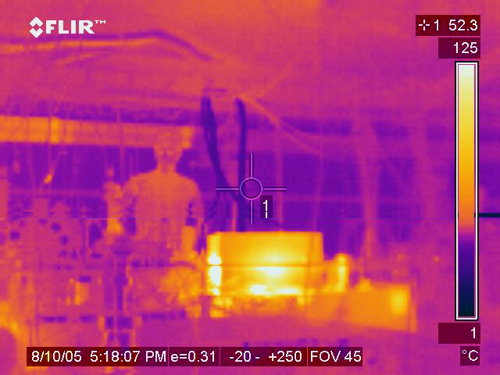
Plasma Wakefield Acceleration
Pieloni, Herr, Ischebeck, Van Riesen-Haupt, Sabato, Yi: Advanced Concepts in Particle Accelerators
Rasmus Ischebeck > Advanced Accelerator Concepts

Slide 3
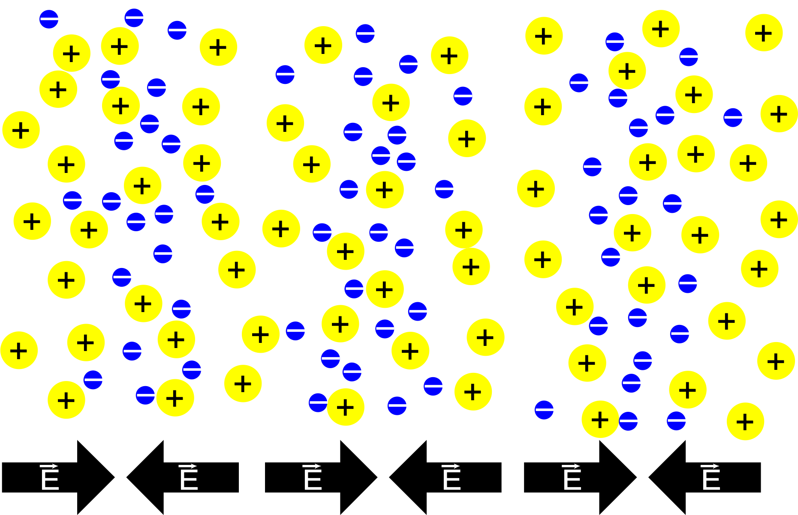
Plasma Wakes - Theory
Unlike electromagnetic waves in vacuum, plasma wakes can have a longitudinal electric field
Tajima & Dawson, PRL, 43, 267(1979)
For a plasma with (initial) density n0
Linear plasma wake has a wavelength:
Limit:
Pieloni, Herr, Ischebeck, Van Riesen-Haupt, Sabato, Yi: Advanced Concepts in Particle Accelerators

Slide 4
Plasma Wakes - Theory
Above this limit: non-linear wakes, “Blow-out regime”
Fields can be calculated only with numerical methods
Typical wavelength: 50 µm
Accelerating fields up to 50 GV/m
Pieloni, Herr, Ischebeck, Van Riesen-Haupt, Sabato, Yi: Advanced Concepts in Particle Accelerators
Miaomiao Zhou

Slide 5
Principle of LWFA
Ischebeck, Pieloni, Herr, Sabato: Advanced Concepts in Particle Accelerators

Slide 6
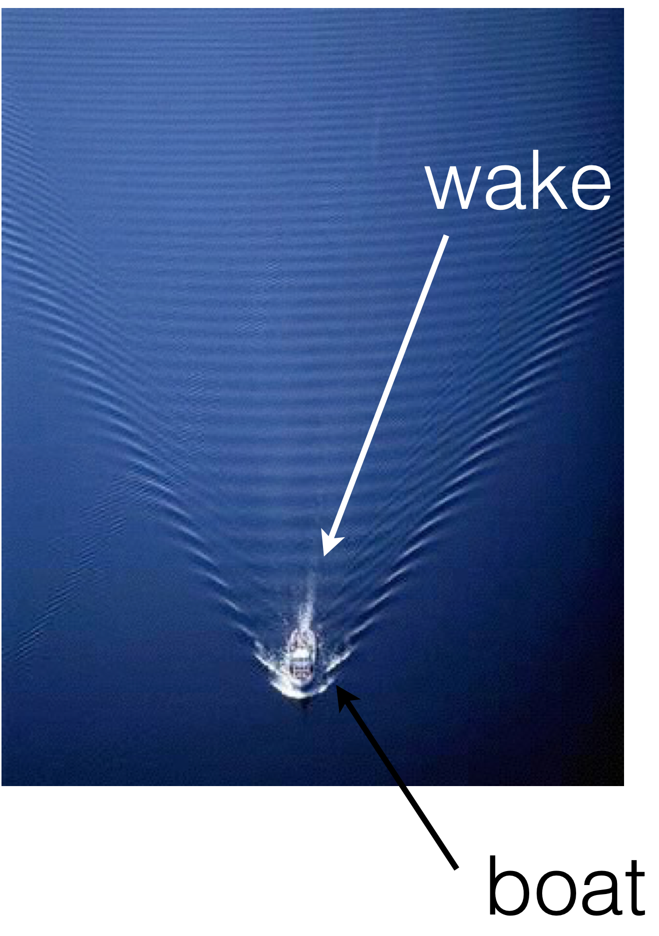
Wakefield Acceleration
Pieloni, Herr, Ischebeck, Van Riesen-Haupt, Sabato, Yi: Advanced Concepts in Particle Accelerators
Stuart Mangles

Slide 7
Pieloni, Herr, Ischebeck, Van Riesen-Haupt, Sabato, Yi: Advanced Concepts in Particle Accelerators
Taylor Ratliff
Notes:
Plasma waves have a longitudinal electric field
Here: plasma generated by an ultrashort laser pulse
Phase velocity is equal to the speed of light
Electrons can be captured in the wave

Slide 8
The Choice of the Driver for Plasma Wakefields
The plasma wakefields can be excited by several means:
Short high power laser pulses
Short electron bunches
Short (and long) proton bunches
Each method has its advantages and disadvantages
EuPRAXIA
Pieloni, Herr, Ischebeck, Van Riesen-Haupt, Sabato, Yi: Advanced Concepts in Particle Accelerators
Ralph Aßmann

Slide 9
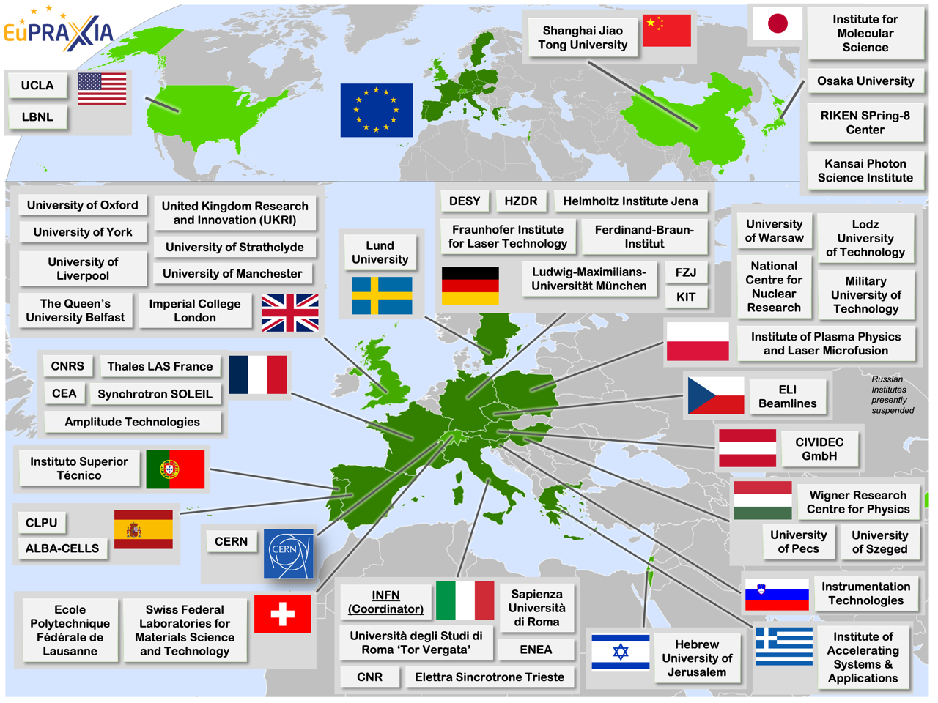
EuPRAXIA
Rasmus Ischebeck

Slide 10
EuPRAXIA Sites
Electron-beam driven plasma wake
Site 1, Frascati
Laser-driven plasma wake
Site 2, to be determined
Rasmus Ischebeck

Slide 11
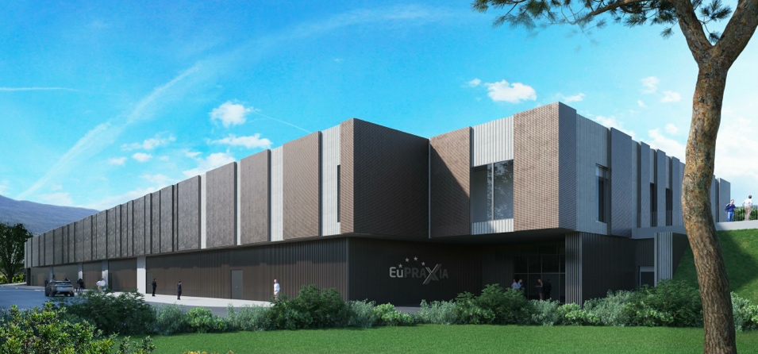
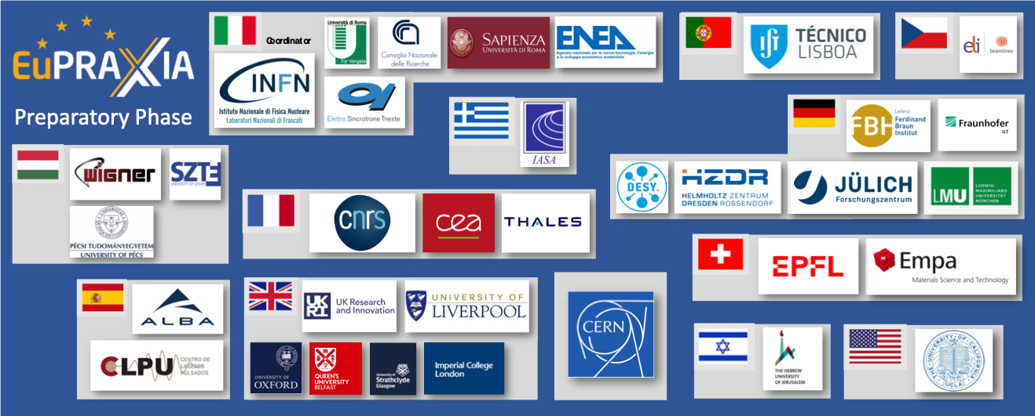
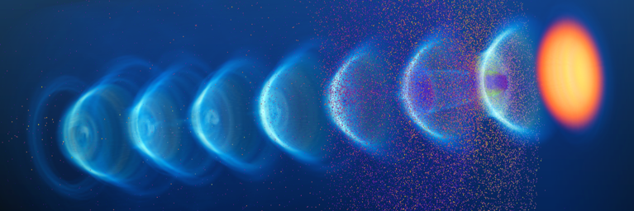
EuPRAXIA-PP (Preparatory Phase) Key Facts
Prepares the implementation of the full RI in Europe
Total project volume (including in-kind): 8.3 M€
EU funding: 2.49 M€ (EU without in-kind)
Outside EU 0.69 M€ (Switzerland) 0.51 M€ (UK)
Work organized in 16 Work Packages
Project dates: 1 Nov 2022 – 31 Oct 2026
Coordinator and location of headquarters: INFN
34 participating organizations from 12 countries
Will establish a “Board of Financial Sponsors“ with representatives of funding agencies.
So far ~ 25% of total M&P funding (569 M€) secured. Site 1 is essentially financed → Massimo.
R. Assmann, M. Ferrario - 5 June 2023

Slide 12
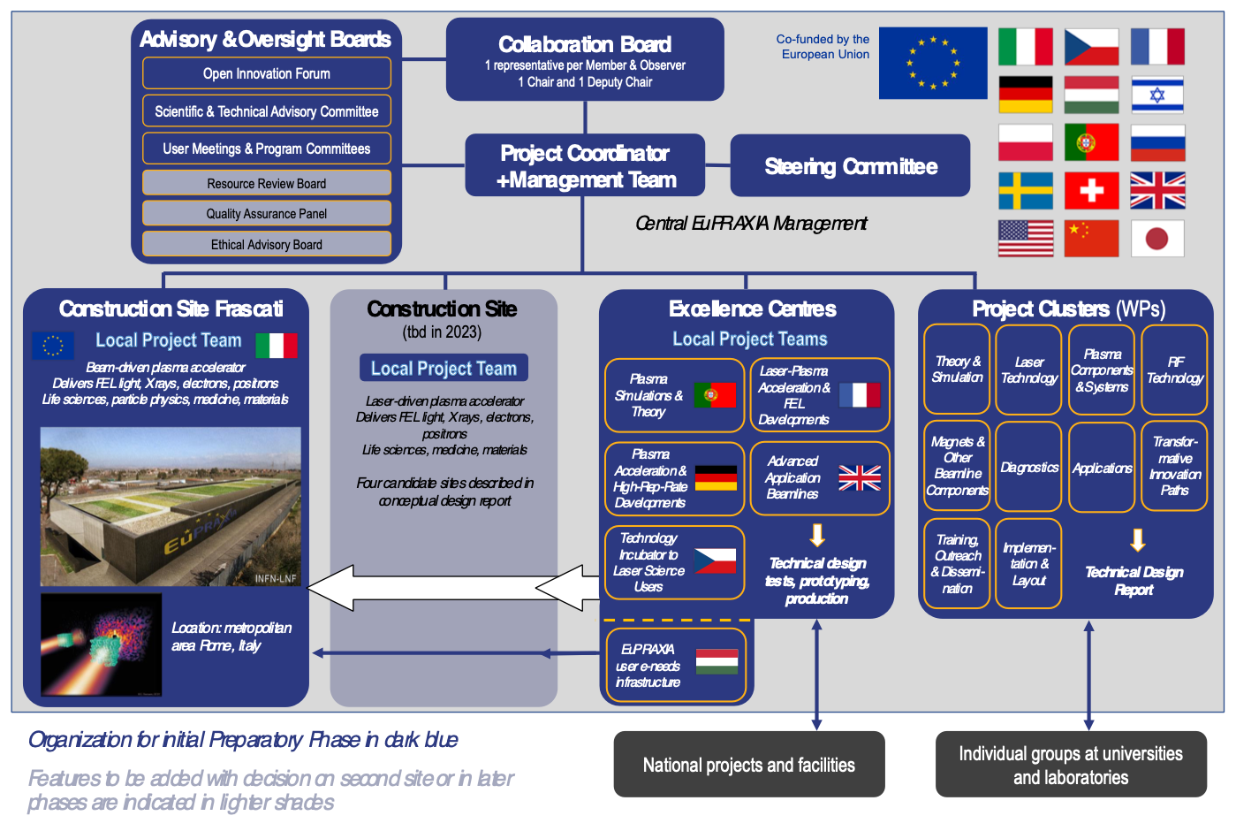
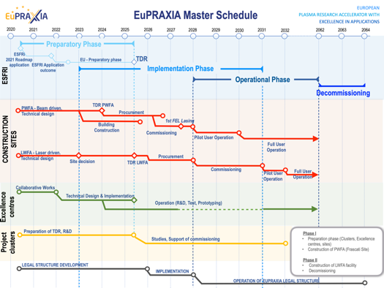
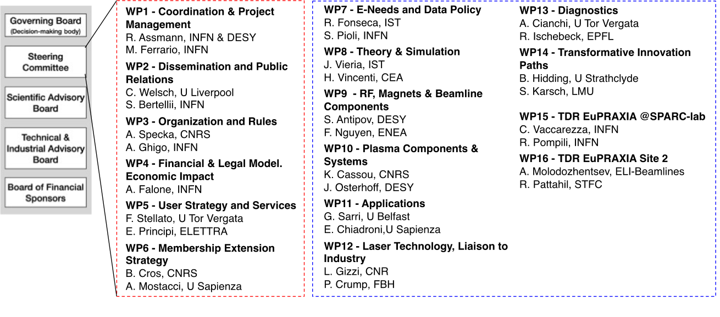
Preparatory Phase Main Goals
Managerial WP`s
Outreach to public, users, EU decision makers and industry
Define legal model (how is EuPRAXIA governed?), financial model, rules, user services and membership extension for full implementation
Works with project bodies and funding agencies → Board of Financial Sponsors
Technical WP‘s (correspond to Project Clusters):
Update of CDR concepts and parameters, towards technical design (full technical design requires more funding)
Specify in detail Excellence Centers and their required funding: TDR related R&D, prototyping, contributions to construction
Help in defining funding applications for various agencies
Output defined in milestones & deliverables with dates
R. Assmann, M. Ferrario - 5 June 2023

Slide 13
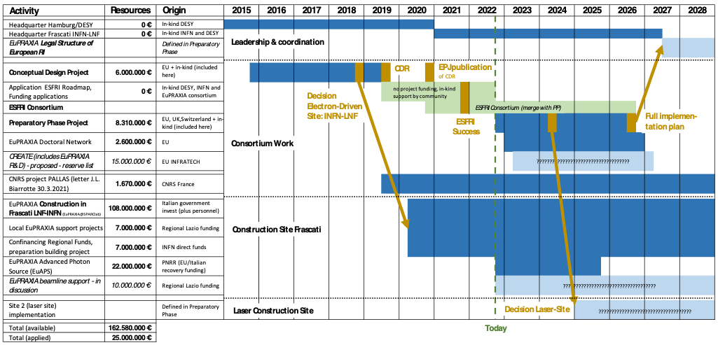
EuPRAXIA Project Overview & Funding Lines
162.6 M€ resources approved, 25 M€ applied for
R. Assmann, M. Ferrario - 5 June 2023

Slide 14
Instrumentation for EuPRAXIA
Rasmus Ischebeck
Midjourney

Slide 15
Electron Beam Instrumentation for EuPRAXIA
Electron beam parameters: requirements defined by FEL process
Emittance
Peak current
Energy spread
As a consequence, beam instrumentation equivalent of that of an RF-driven FEL
But, some caveats…
6D phase space density
Rasmus Ischebeck

Slide 16
Electron Beam Instrumentation for EuPRAXIA
Many other instruments required for safe and reliable operation of the machine:
Particle energy
Bunch charge
Orbit
Losses
Also required:
Controls and automation
Data acquisition
Rasmus Ischebeck

Slide 17
Electron Beam Instrumentation for EuPRAXIA
…some caveats:
Strong laser pulse for laser-driven, or pre-ionized plasma schemes
Requires shielding to not pollute measurements
Bunch length may be very short, no bunch compression required
Still, we will want to measure bunch length
Internal structure of the bunches may be completely different
Instrumentation for phase space profiles
Methods to modify phase space distribution
Rasmus Ischebeck

Slide 18
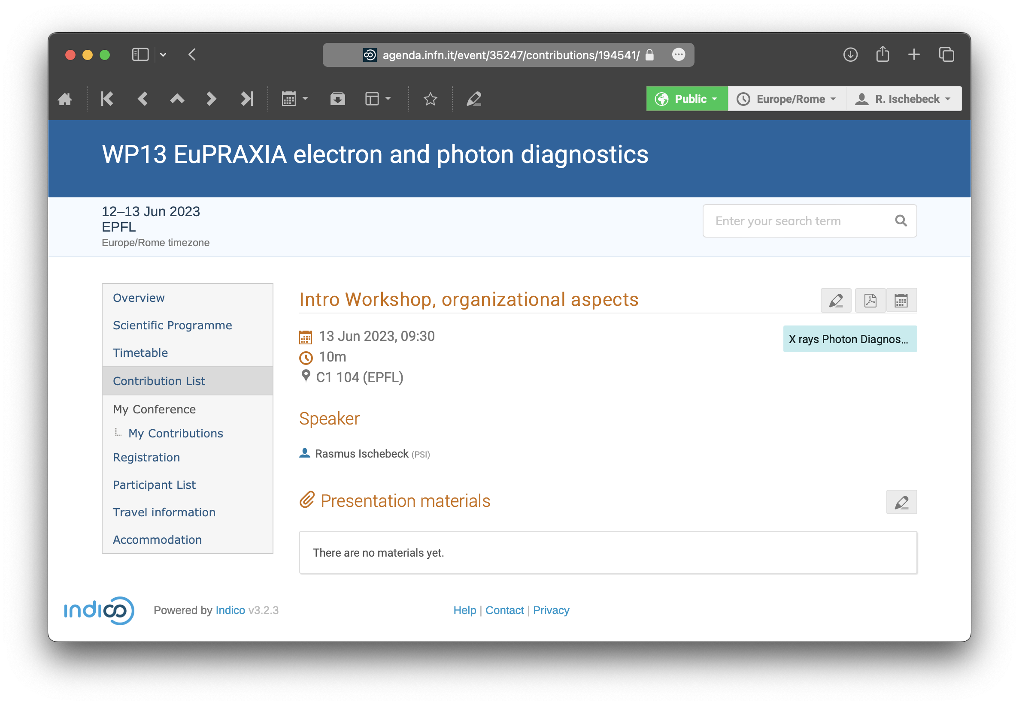
Practical Things
If you have not done so yet, please upload your talk to the Indico page: https://agenda.infn.it/event/35247/contributions/mine
Click on your presentation, then click on the pencil next to “Presentation materials”
Rasmus Ischebeck

Slide 19
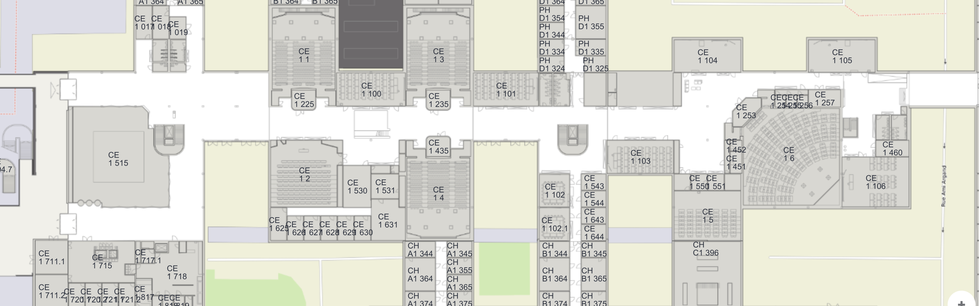
Practical Things
We will have coffee and lunch breaks in the Espace Copernic:
We will take the metro to the conference dinner
Let me know if you need a metro ticket
Rasmus Ischebeck

Slide 20
Thank You for your Attention
Rasmus Ischebeck

