Slide 1
Ceramic beam tube resistive coating R&D
Marina Scialabba
Final Report for CNI-ISSNAF Internship Program 2015
14 April 2016

Slide 2
Introduction:
Ceramic beam tubes are used in kicker magnets throughout the Fermilab accelerator complex.
These tubes require an internal coating that must have a resistance in the k-Ohm range to prevent charge buildup, allow passage for beam image current, and have a negligible effect on magnetic fields and the vacuum system.
Problem to solve: Achieving a suitable coating in a consistent and repeatable manner, which presents the largest technical risk for kicker magnet fabrication.

Slide 3
Specification:
Resistivity from 1 to 10 kOhm/square
Coating must be uniform and non-magnetic
Ultimate vacuum pressure to be 10e⁻⁸ Torr range
Low secondary electron yield (SEY)
Operating temperature from 10 to 100 °C
Lead-free

Slide 4
Background study:
The tube must be long and sufficiently straight so as not limit magnet design, with wall strength capable of withstanding the atmospheric and mechanical forces encountered during construction and operation.
Tube characteristics
99.8% Alumina, Al2O3 strong recrystallized high alumina
Racetrack shape
Inner Dimensions: 1.56” x 3.56” and thin walls about 3/16”
Length approximately 60”

Slide 5
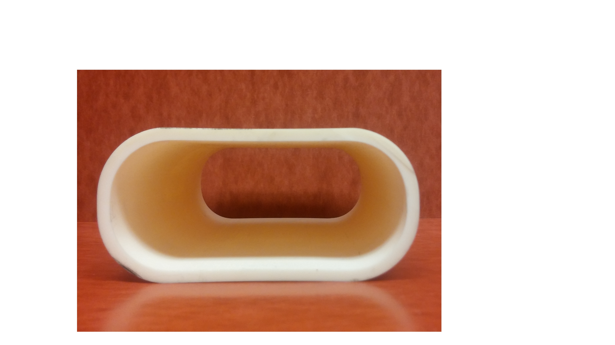
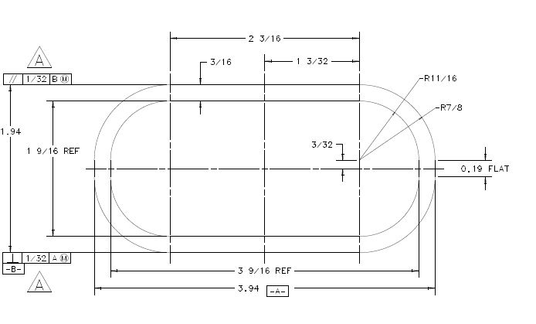
Background study:

Slide 6
Why ceramic beam tubes?
To avoid shielding of a fast changing external magnetic field by metallic chamber walls.
To reduce heating due to eddy currents
(from “ Recent experience in the fabrication and brazing of ceramic beam tubes for kicker magnets at FNAL” – C.R. Ader et al – EPAC2008)
The inner surfaces of the ceramic chambers are coated with a conductive coating to reduce the beam coupling impedance and provide passage for beam image current.

Slide 7
Current method for coating of tube
Graphite mixture
Acheson - Aerodag G
“contains highly refined graphite particles suspended in an isopropyl alcohol with a special thermoplastic resin binder”
Advantages: low material cost, ability to do coating at Fermilab
Disadvantages: process is time-consuming and not repeatable, requires bake for vacuum

Slide 8
ITO – Indium Tin Oxide
Optical coating performed by Clausing Coatings Company
The resistance measured was acceptable
Outgassing rate of specimen after 48 hours was similar to baked stainless steel
Residual Gas Analysis – RGA – scan looked clean
Limited information about SEY, and did not test this yet
Both electrical and vacuum requirements were satisfied by ITO coating (from “Evaluation of Indium Tin Oxide coating on kicker ceramic beam tube” – L. Valerio and C. Jensen – 2015 – FNAL – internal document)

Slide 9
Coating companies

Slide 10
Coating companies:
R2200 lead-free resistor series paste
Wide range of resistance values from 10 Ohm/square to 1 MOhm/square
Nothing about vacuum test
Nothing about SEY properties

Slide 11
Coating companies:
Ti coating
It guarantees uniform coatings
No information about SEY
“ Titanium coating of ceramics for accelerator
applications ” (W. Vollenberg et al – CERN – IPAC 2015)
SEY low compared to alumina and it could be reduced
Depending on the film thickness titanium provides different surface resistances that fulfill requirements of ceramics in particle accelerators

Slide 12
Coating companies:
Nanocomposite coating
- metal particles on insulating matrix that is a mixture
of aluminum oxide and aluminum fluoride
Atomic Layer Deposition process (ALD)
- uniform coatings
Lead free
Acceptable outgassing and low SEY
Possible concerns:
- monolayer thickness
- heat affects resistivity

Slide 13
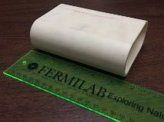
Test steps coating
Clean the tube before coating (internal and external sides)
Coating internal side
Basic resistance measurement
Vacuum test
- calculate outgassing rate
- RGA diagram
Resistance (end to end) measurement applying metallic tapes to the ends of the tube
Calculate resistance Ohm/square
$$Resistance \left(\frac{Ohm}{square}\right)=Resistance \left(end to end\right)∗\frac{Circumference }{Length}$$

Slide 14
Future perspectives
Continue to consider ITO
Determine if Heraeus will be tested
Get samples of Ti and ALD to test. If those tests successful, develop a study about them
Compare
Price
Uniformity of coating
Determination of risks

Slide 15
Thank you for your attention!

