Slide 1
LBNF – Long Baseline Neutrino Facility Department of Particle Physics Division Decay Pipe Concrete Shielding – Placing Sequence
Supervisors: Tracy K Lundin, Thomas J Hamernik
Presenter: Lisa Favilli
2014 CNI-ISSNAF Internship Final Presentation
December, 11th, 2014

Slide 2
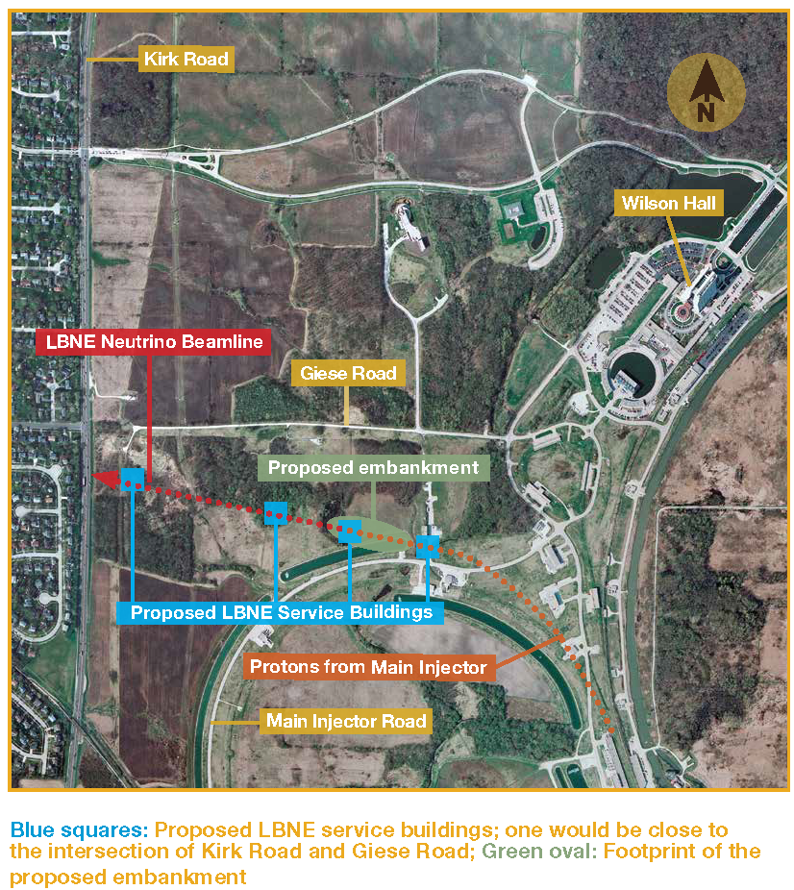
What is the LBNF?
The Long-Baseline Neutrino Facility (LBNF) is designed to send neutrinos straight through the earth from Batavia, Illinois, to Lead, South Dakota. It will include a beamline to create the neutrinos and a near and far detector to detect them for physics studies.
The scientists make the neutrino beam in a three-step process:
Using the Fermilab’s main injector accelerator as a proton source, they extract the proton beam and smash it into a target.
The protons interactions with the protons and neutrons in the target material produce new, short-life particles as pions and kaons.
These particles travel a short distance trough a decay pipe, and as they do, a good fraction of them decays into neutrinos that continue on in the same direction, forming a neutrino beam.

Slide 3
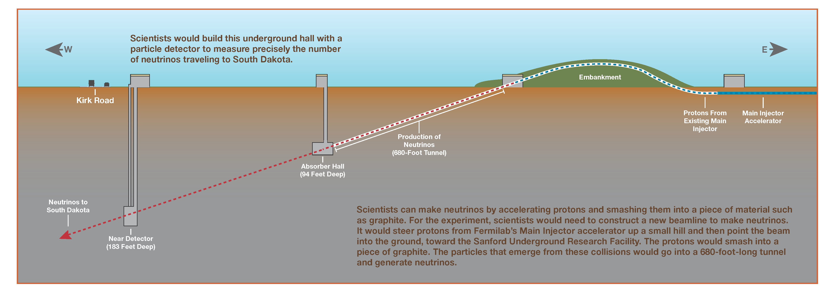
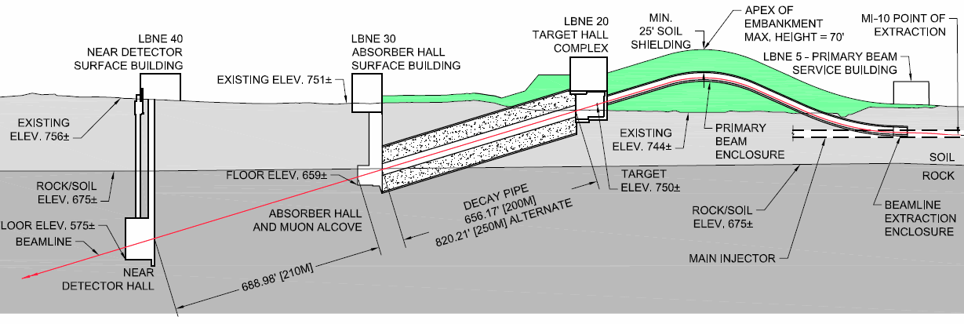
What is the Decay Pipe Shielding?
The decay pipe is the part of the beamline in which
the protons and neutrons decay into neutrinos.
The project would require the construction of three buildings, a 52-foot-high hill made of compacted soil and a 680-foot long tunnel. This tunnel is the Decay Pipe (DP), placed between the Absorber Hall and the Target Hall complex.
This process releases radiation,
which need to be shielded.
The area of concern is the design of a concrete structure
with the role to shield the radiation.

Slide 4
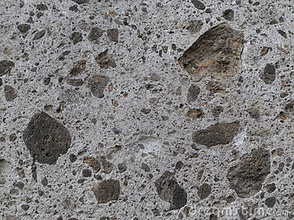
Decay Pipe Concrete Shielding – About material
EFFICIENCY
OF SHIELDING
DENSITY
GEOMETRY
CONCRETE IS A HIGH DENSITY MATERIAL
5.6 m RADIUS
THE DP CONCRETE SHIELDING IS A MASS CONCRETE

Slide 5
Decay Pipe Concrete Shielding – Typical Cross Section
COMPACTED
BACKFILL SOILS
CONCRETE
SHIELDING
SAND LAYER
15.5 m (51 ft)
CENTER OF THE BEAM
DECAY PIPE
IN SITU SOILS
AND ROCK
15.5 m (51 ft)
GEOMEMBRANE
GRAVEL LAYER

Slide 6
Decay Pipe Concrete Shielding – The Goal
NON-HORIZONTAL
PLACING PLAN
RADIATION SHIELDING
DENSITY
GEOMETRY
MASS CONCRETE
HEAT OF HYDRATION
+
LOW EXTERNAL TEMPERATURE
DIFFERENT COOLING BETWEEN INTERIOR AND EXTERNAL SURFACES
VOLUME CHANGES
+
RESTRAINTS
SEGREGATION
+
CRACKS
FAILURE OF THE SHIELDING
GOAL: DEFINE A VIABLE SEQUENCE FOR PLACING THE SHIELDING, TAKING MEASURES TO CONTROL THE HEAT OF HYDRATION AND TO PLACE AT A 10 % SLOPE

Slide 7
Project of the Decay Pipe Concrete Shielding - Summary
GOAL
TO DETERMINE A VIABLE SEQUENCE PLACING THE DECAY PIPE CONCRETE SHIELDING
METHODS
ASSUMPTIONS
INTERCONNECTED ASPECTS
REPORT
HEAT OF HYDRATION CONTROL
ONE CROSS SECTION FOR THE ENTIRE LENGTH
NO RESTRICTIONS ON THE AVAILABILITY OF CONCRETE
DRAWINGS
CRACKING AND TEMPERATURE CONTROL
THE GEOMEMBRANE IS NOT CONSIDERED IN THIS EFFORT
CONCRETE MASS PROPERTIES
THE PLACING PLAN IS A 10% SLOPE
CONCRETE COMPOSITION PROPERTIES
VOLUME CHANGES CONTROL AND JOINTS CONSTRUCTION
TO USE AN ORDINARY PORTLAND CONCRETE
DEFINITION OF THE PHASES OF PLACING
EVALUATION OF AN ALTERNATIVE CONCRETE

Slide 8
Project of the Decay Pipe Concrete Shielding – Report
REPORT: the document that contains suggestions and recommendations regarding materials and phases of construction.
Elements composing
each aspect
PARAMETERS
REQUIREMENTS
Needs of the project
How to reach the
needs of the project.
RECOMMENDATIONS

Slide 9
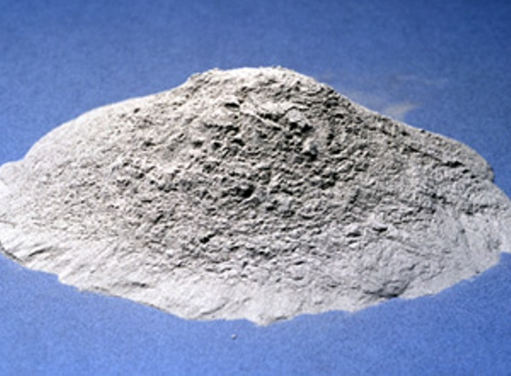
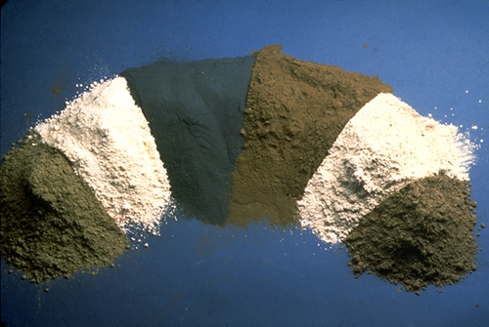
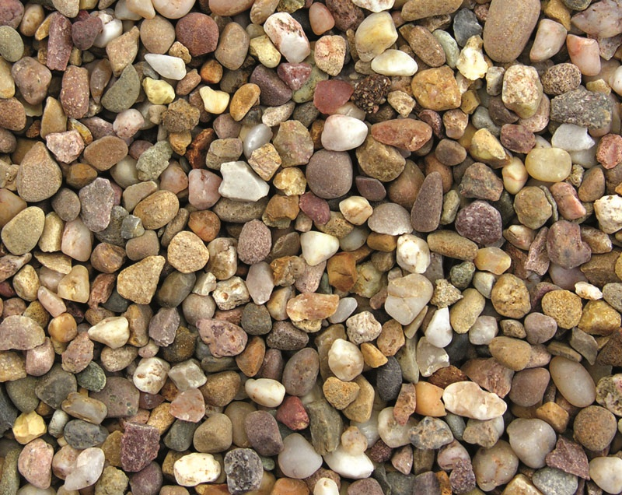
Heat of hydration control
PARAMETERS
REQUIREMENTS
RECOMMENDATIONS
TO HAVE LOW HEAT OF HYDRATION
CEMENT TYPE
LOW HEAT OF HYDRATION
PORTLAND TYPE II
POZZOLAN TYPE
CEMENTITIOUS PROPERTIES
CLASS C
POZZOLAN PERCENT
MEDIUM - HIGH
35 %
CEMENT CONTENT
LOW
240 kg/m³ (405 lb/cy)
NATURAL COARSE VOL.
HIGH
82 %
AGGREGATES TYPE
RECOMMENDED FOR MC
CRUSHED
AGGREGATES SIZE
IMPROVE WORKABILITY
3 in. - 4 in. (80 mm-100 mm)
WATER/CEMENT RATIO
LOW CONTENT
0.20

Slide 10
Cracking and temperature control
PARAMETERS
REQUIREMENTS
RECOMMENDATIONS
TO CONTROL CRACKING AND TEMPERATURE
CEMENTITIOUS MATERIAL CONTROL
CRACK RESISTANCE
HIGH
LAYER NUMBER | DIMENSIONS m (ft) | Q.TY OF CONCRETE m³ (yd³)
1 | 15.5x1.5x20.3 (51x5x67) | 472 (617)
2 | 15.5x1.5x20.3 (51x5x67) | 472 (617)
3 | 15.5x1.5x20.3 (51x5x67) | 472 (617)
4 | 2x6.5x20.3 (6.6x21x67) | 264 (345)
5 | 2x6.5x20.3 (6.6x21x67) | 264 (345)
6 | 2x6.5x20.3 (6.6x21x67) | 264 (345)
7 | 2x6.5x20.3 (6.6x21x67) | 264 (345)
8 | 7.5x6.5x20.3 (25x21x67) | 677 (885)
9 | 15.5x1.5x20.3 (51x5x67) | 472 (617)
10 | 15.5x1.5x20.3 (51x5x67) | 472 (617)
11 | 15.5x1.5x20.3 (51x5x67) | 472 (617)
PRE-COOL INGREDIENTS
CRACKING AND TEMPERATURE
POST-COOL CONCRETE
COOLING OPERATIONS
INSULATE EXT. SURFACES
NO. OF BLOCKS: 10
LENGTH: 20.3 m (67 ft)
PLACING IN BLOCKS
CONSTRUCTION MANAGEMENT
DEGREE OF RESTRAINTS
LOW
STRAIN APPLICATION
SLOW
THIN LAYERS
1.5 – 2 m (5 – 6.6 ft)

Slide 11
Concrete mass properties
PARAMETERS
REQUIREMENTS
RECOMMENDATIONS
TO HAVE SHIELDING EFFICIENCY
MINIMUM VALUE:
2350 kg/m³
TYPE OF CONCRETE
NORMAL DENSITY
NORMAL WEIGHT
LIMESTONE
AGGREGATES PROPERTIES
LOW THERMAL
EXPANSION COEFFICIENT
4.5 X 10⁻⁶ F⁻¹
LOW MODULUS
OF ELASTICITY
14000 MPa (2 X 10⁶ psi)
DIMENSION
RADIUS ENOUGH TO SHIELD
5.6 m

Slide 12
Concrete composition properties
PARAMETERS
REQUIREMENTS
RECOMMENDATIONS
COMPLETION OF THE PREVIOUS RECOMMENDATIONS
COMPRESSIVE STRENGTH
MEDIUM VALUE
1500 psi – 2000 psi
PERMEABILITY
LOW
5 X 10⁻¹⁰ cm/sec
DRYING SHRINKAGE
LOW
4 X 10⁻⁴
SLUMP RANGE
RECOMMENDED FOR MC
1 in. – 2 in.
TEMPERATURE DIFFERENTIAL
LOW RANGE
35 °F

Slide 13
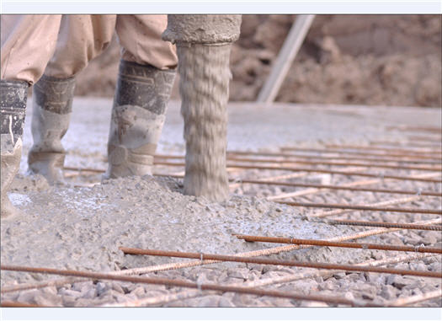
Volume changes control and joints construction
PARAMETERS
REQUIREMENTS
RECOMMENDATIONS
TO PREVENT AND CONTROL CRACKS
VOLUME CHANGES
CONTRACTION JOINTS
VERTICAL BETWEEN BLOCKS
TWO CONTRACTION JOINTS
HORIZONTAL AND
VERTICAL CONSTRUCTION BETWEEN LAYERS
PLACING IN BLOCKS
CONSTRUCTION JOINTS
HORIZONTAL AND VERTICAL “LINES” ARE CONSTRUCTION JOINTS
JOINTS MATERIAL
WITH THE SAME DENSITY OF CONCRETE
SHIELDING EFFICIENCY
DENSITY

Slide 14
Definition of the phases of placing 1/2
PARAMETERS
REQUIREMENTS
RECOMMENDATIONS
TO HAVE BEST PLACING SEQUENCE
1.5 – 2.0 m (5.0 – 6.6 ft)
THICKNESS OF LAYERS
THIN LAYERS
USE 4 in. VIBRATORS
ROUGH BACKGROUND SURFACE
10 % SLOPE
PLACING PLAN
SETBACK OF 1.5 m (5 ft)
LARGE DIMENSIONS
DIVIDE INTO 10 BLOCKS
INSULATE EXTERNAL SURFACES
POST PLACING OPERATIONS
CONTROL
HEAT GENERATION
POST COOL

Slide 15
Defining of the phases of placing 2/2
Operations | Recommendations | Reference item
Pre cooling ingredients
Placing gravel and sand layers
Building concrete rough surface (30 cm) | Clean surface with wet sandblasting | Figure 1
Placing layers 1-2-3 of the first block | Divide the length into 10 blocks Setback toward the successive edges of 1.5 m (5 ft) Clean surface with wet sandblasting before placing the next layer Insulate the external surface of concrete Use vibrators diameter of 4 in. (100 mm) | Figures 1-2
Placing layers 1-2-3 for each block |  | Figure 3
Placing layers 4-5 of the first block |  | Figure 4
Placing layers 4-5 for each block |  | Figure 5
Placing layers 6-7 of the first block |  | Figure 6
Placing layers 6-7 for each block |  | Figure 7
Placing layer 8 of the first block |  | Figure 8
Placing layer 8 for each block |  | Figure 9
Placing layers 9-10-11 of the first block |  | Figure 10
Placing layers 9-10-11 for each block |  | Figure 11
Post cooling with embedded pipes
Insulate external surfaces

Slide 16
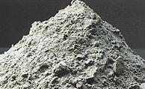
Evaluation of alternative concrete
PARAMETERS
REQUIREMENTS
RECOMMENDATIONS
TO COMPARE POSSIBILITIES
HEAT OF HYDRATION CONTROL
LOWER HEAT OF HYDRATION
TESTS AND
INFORMATION ON:
THERMAL BEHAVIOUR
CRACKING AND TEMPERATURE CONTROL
COOLING OPERATIONS REDUCED/ELIMINATED
CHEMICAL PROPERTIES
PHYSICAL PROPERTIES
LARGER LAYERS AND
FEWER BLOCKS
PLACING PROCEDURE
MECHANICAL PROPERTIES
FEWER JOINTS
THERMAL PROPERTIES
MORE WORKABILITY
RADIOLOGICAL PROPERTIES
PLACING PLAN
LESS SEGREGATION
LEACHING TEST

Slide 17
Summary and Conclusions
DISCUSSED ASPECTS
STATUS
METHODS
HEAT OF HYDRATION CONTROL
REPORT AND DRAWINGS
CRACKING AND TEMPERATURE CONTROL
REPORT AND DRAWINGS
CONCRETE MASS PROPERTIES
REPORT AND DRAWINGS
CONCRETE COMPOSITION PROPERTIES
REPORT AND DRAWINGS
VOLUME CHANGES CONTROL AND JOINTS CONSTRUCTION
REPORT AND DRAWINGS
DEFINITION OF THE PHASES OF PLACING
REPORT AND DRAWINGS
EVALUATION OF AN ALTERNATIVE CONCRETE
TESTS

Slide 18
Sources and References
ACI 116R-00 “Cement and Concrete Terminology”
ACI 207.1R-96 “Mass concrete”
ACI 211.1-91 “Standard practice for Selecting Proportions for Normal, Heavyweight and Mass Concrete”
ACI 214-77 “Recommended practice for Evaluation of Strength Test Results of Concrete”
ACI 224R-90 “Control of Cracking in Concrete Structures”
ACI 224.3R “Joints in concrete construction”
ASTM C150 “Standard specification for Portland Cement”
ASTM C618 – 08 “Standard specification for Coal Fly Ash and Raw or Calcined Natural Pozzolan for Use in Concrete”
ASTM C637 – 09 “Standard specifications for aggregates for radiation – shielding concrete”
Barite Analysis – Thomas Hamernik
Memorandum – Thomas Hamernik

Slide 19
Thank you all
for your attention!

