Slide 1
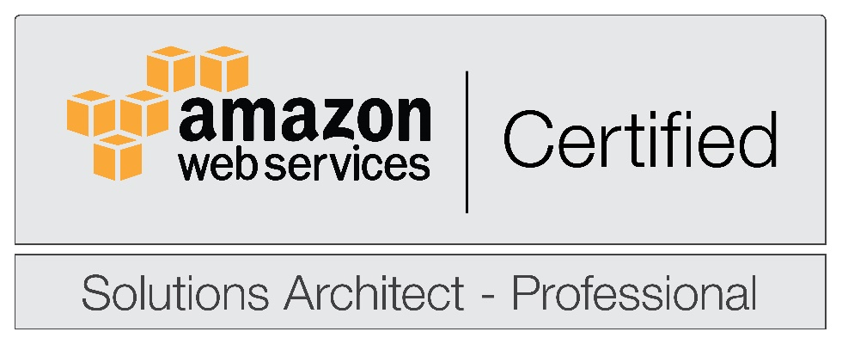
On-demand Computing for Scientific Workflows using Amazon Web Services
Grid and Cloud Services Department, Fermilab
Claudio Pontili
Supervisors:
Gabriele Garzoglio
Steven Timm

Slide 2
Presentation Outline
Introduction: why do we want to use Commercial Cloud?
GlideinWMS: a simple way to access resources
Test: Running up to 1000 simultaneously jobs on Amazon Web Services and FermiCloud
Task A: Moving software and data to Commercial Cloud
Task B: Adding and removing HTCondor to GlideinWMS using AWS
Task C: Hybrid Cloud solution AWS+Fermicloud
Conclusions

Slide 3
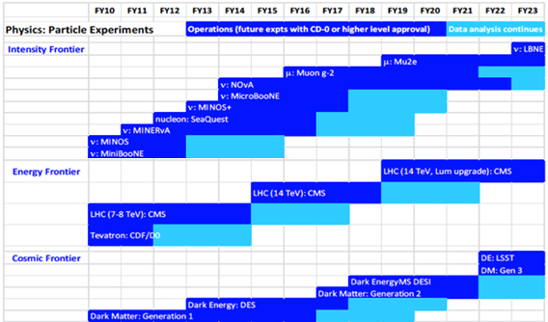
Introduction: Fermilab Experiment Schedule
FY16
Measurements at all frontiers – Electroweak physics, neutrino oscillations, muon g-2, dark energy, dark matter
8 major experiments in 3 frontiers running simultaneously in 2016
Sharing both beam and computing resources
Impressive breadth of experiments at FNAL

Slide 4
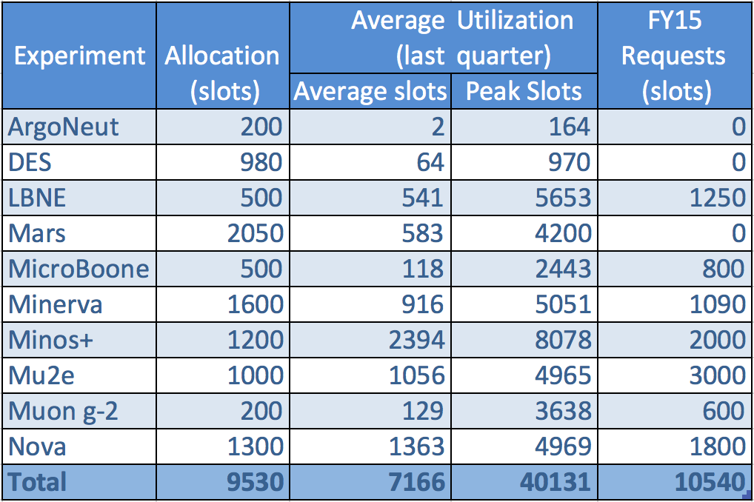
Introduction: Computing requirements for experiments
higher intensity and higher precision measurements are driving request for more computing resources than previous “small” experiments
beam simulations to optimize experiments - make every particle count
detector design studies - cost effectiveness and sensitivity projections
higher bandwidth DAQ and greater detector granularity
event generation and detector response simulation
reconstruction and analysis algorithms
Notes:
Message: the average utilization is within the requested allocation. The peak utilization is 6 times higher. --> we need to learn how to utilize offsite resources.

Slide 5
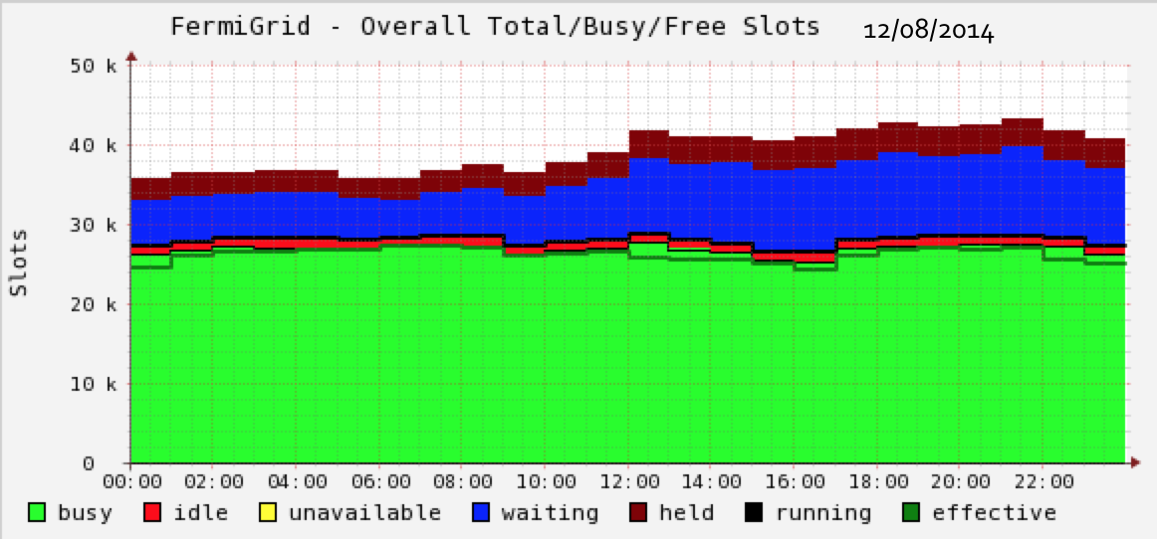
Introduction: Slots Fermilab, OSG, & Clouds
Current full capacity of FermiGrid → ~30k slots
Full capacity of OSG (Open Science Grid) → ~85k slots
Additional OSG opportunistic slots → 15k – 30k
Additional per-pay slots at commercial Clouds
Notes:
Why we say that the current capacity is 30K but the average is just 7k
Resource distribution: Cloud computing is a centralized model whereas grid computing is a decentralized model where the computation could occur over many administrative domains.
Ownership: A grid is a collection of computers which is owned by multiple parties in multiple locations and connected together so that users can share the combined power of resources. Whereas a cloud is a collection of computers usually owned by a single party.

Slide 6
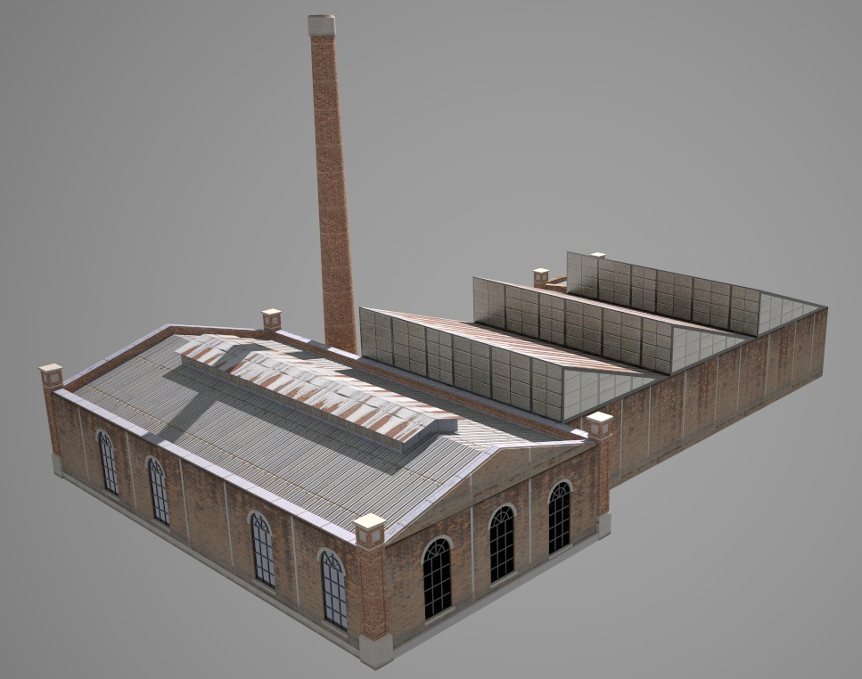

Federation via GlideinWMS – Grid and Cloud Bursting
Unified submit tool for grid and cloud
using HTCondor
Jobsub_submit
Job Queue
FrontEnd
GlideinWMS
Pilot Factory
Users
Jobs
Pilots
FermiGrid
Amazon
AWS
Gcloud
KISTI
Fermi
Cloud
OSG
Notes:
Can I write instead of Job Queue FrontEnd->Condor Queue?
Can I add a reptangle to show the HTCondor boundaries?

Slide 7
Running AWS NovA Jobs as function of time, Oct 23. 2014
3300 jobs
525 m3.large
Total cost $449
Prices are getting down
1 hour
Notes:
Proud for the result, 1 hour to full
Put scales on both axes

Slide 8
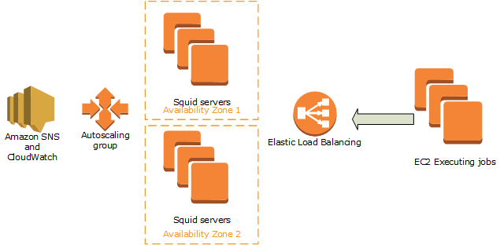
Task A: Moving software and data to commercial cloud using Scalable Squid Servers
Need to transport software and data to the Cloud
Auto-scalable squid servers, deploying and destroying in 30 seconds using CloudFormation script
Notes:
Input data, application data, output data

Slide 9
Task B: Auto-Scaling GlideinWMS adding/removing HTCondor using Amazon Web Services
New resources are made available through the WMS (HTCondor)
The system is designed to scale by adding servers
Problem: the submission system is a stateful service
  Easy to scale up
  Hard to scale down
Solution? Manage lifecycle of each server using AWS Hooks and Standby (released July 30th 2014)
Notes:
A stateless service is one that provides a response after your request, and then requires no further attention.
A stateful service is one where subsequent requests to the service depend on the results of the first request.

Slide 10
Task B: Auto-Scaling HTCondor using AWS - 2
At least 7 different Amazon services
2 different programming languages (Java and bash scripting)
Role based authentication: auto-generating and auto-rotating logins and passwords
Notes:
Starting from the components of the other architecture I added new service to manage HTCondor

Slide 11
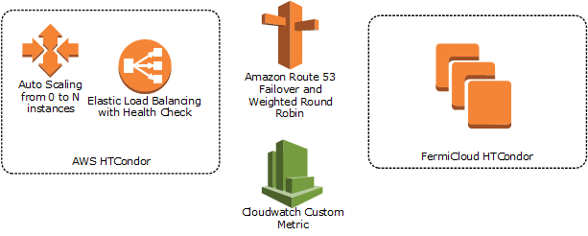
Task C: Hybrid cloud – Fermicloud and Amazon Web Service
No change for the final user, who just wants to deploy a job in the same old way and compute it as fast as possible
Now we can handle spikes of traffic using commercial cloud
We pay AWS only during spikes

Slide 12
Conclusions
Experiments have an increased need for computing resources with an increased diversity of requirements
Managing these needs (especially peak demand) is a major focus
Experiments are being enabled to use a diverse set of resources: Local, Grid, and Cloud
Need to demonstrate sustainability and cost effectiveness of the commercial Cloud solution for physics use cases (e.g. NOvA MonteCarlo)
This work demonstrated the scaling of on-demand services in support of scientific workflows using native Amazon Services

Slide 13
Thank you
Questions?

