Slide 1
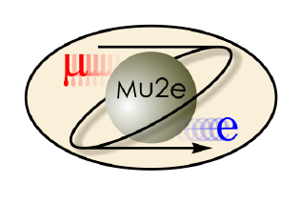
“3D CAD Modeling and Mechanical Integration at the Mu2e Experiment at Fermilab”
Marco Commisso
Supervisors: George Ginther, Simone Donati
Italian Summer Internship, Final Presentation

Slide 2
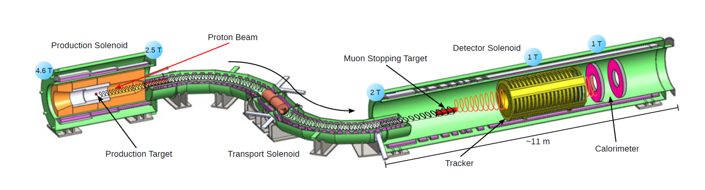
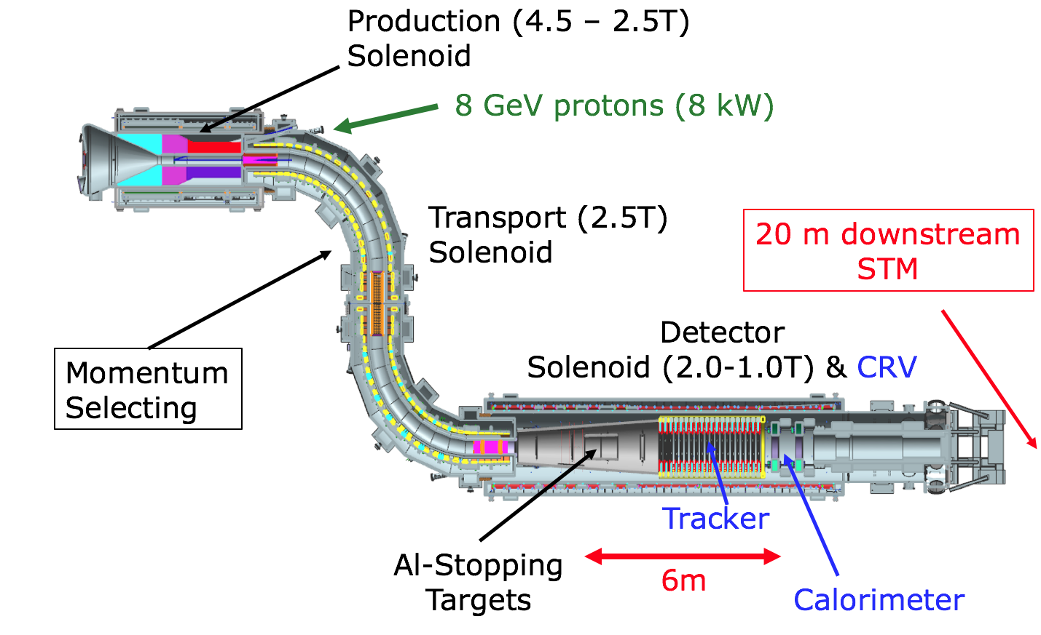
Intro
µ ¯ + Al —› e ¯ + Al
Physics beyond the Standard Model
—› Lepton Flavor Violation
Muon (Neutrino-less) conversion in Electron

Slide 3
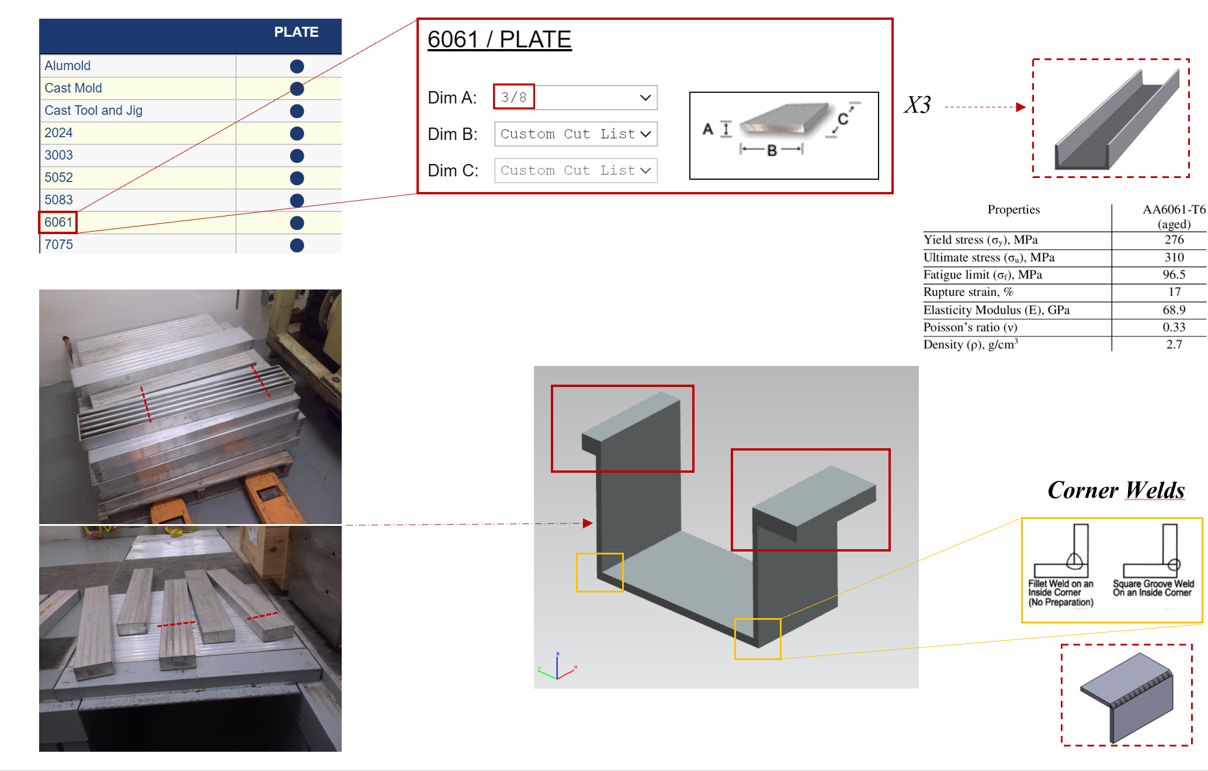
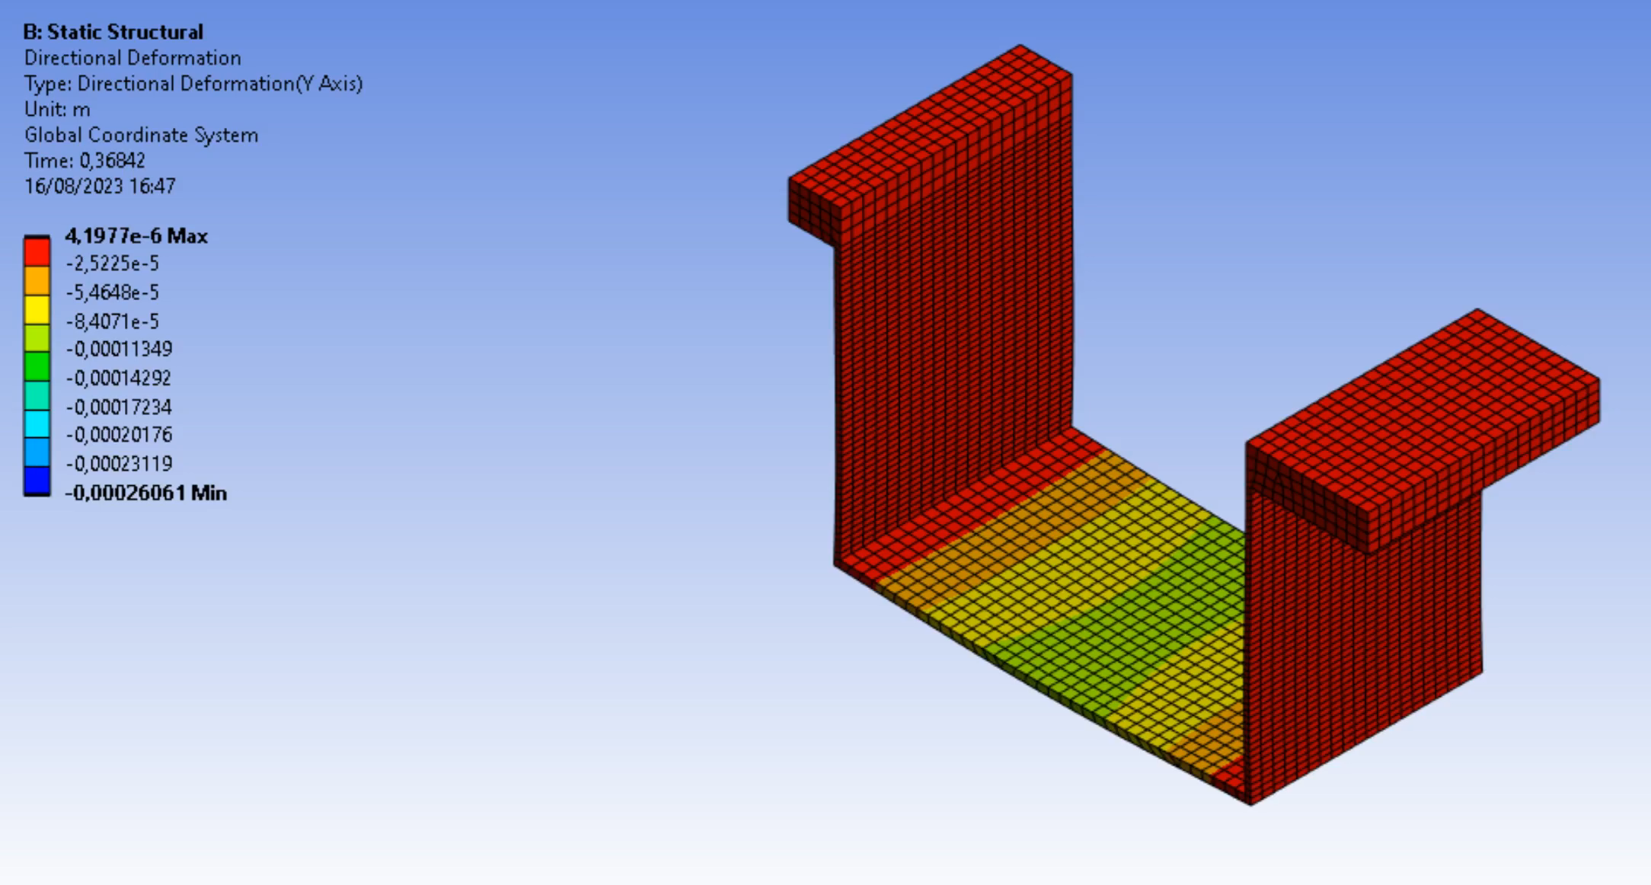
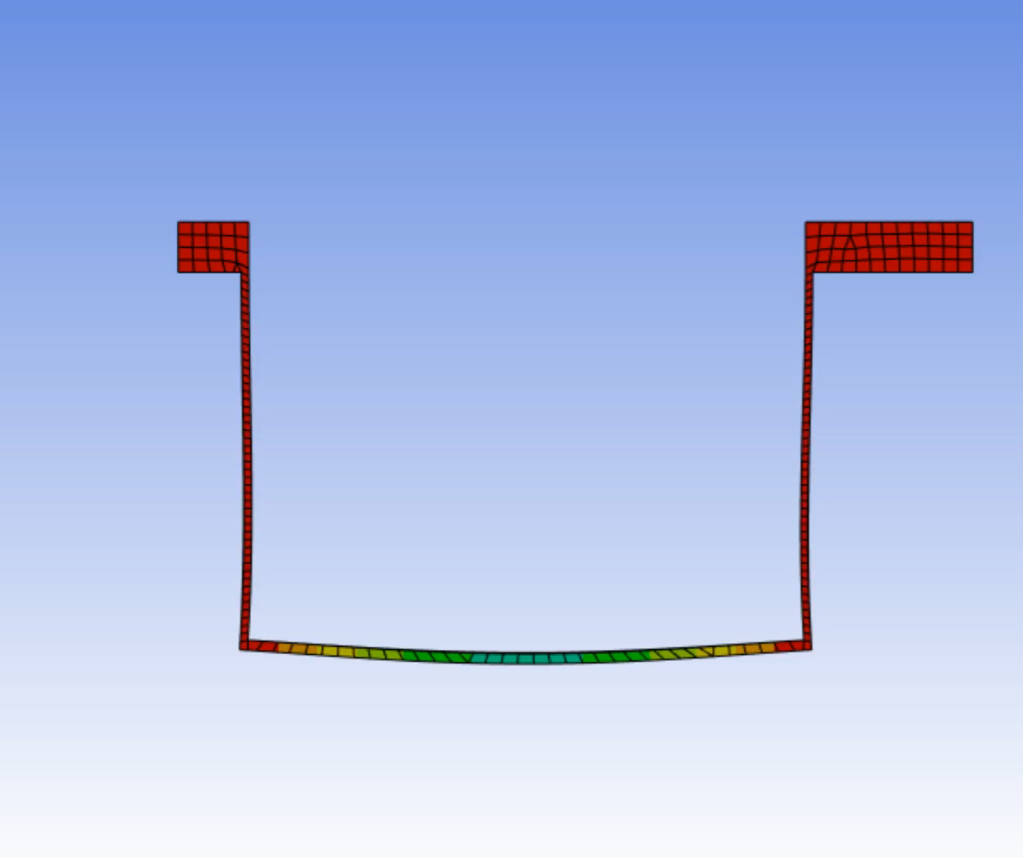
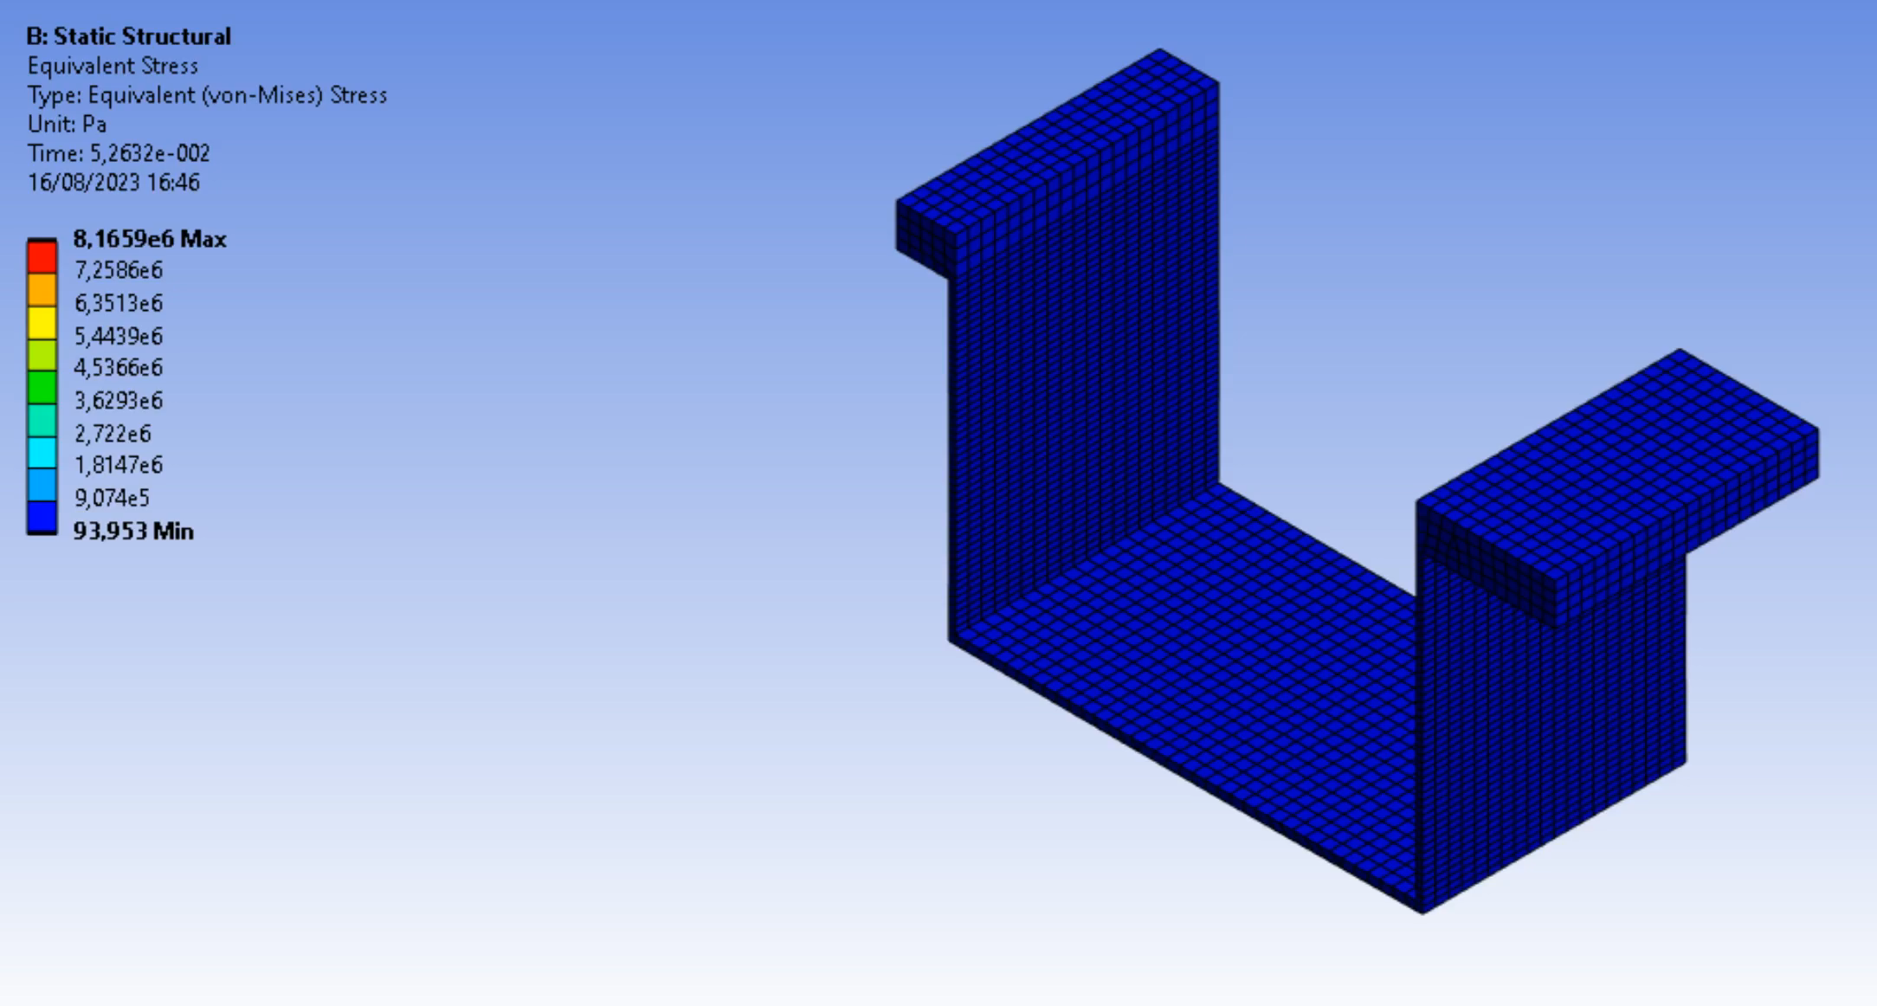
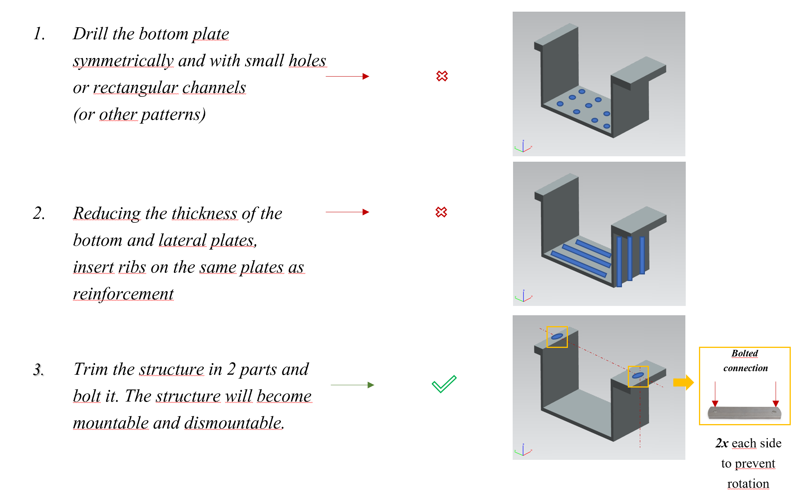
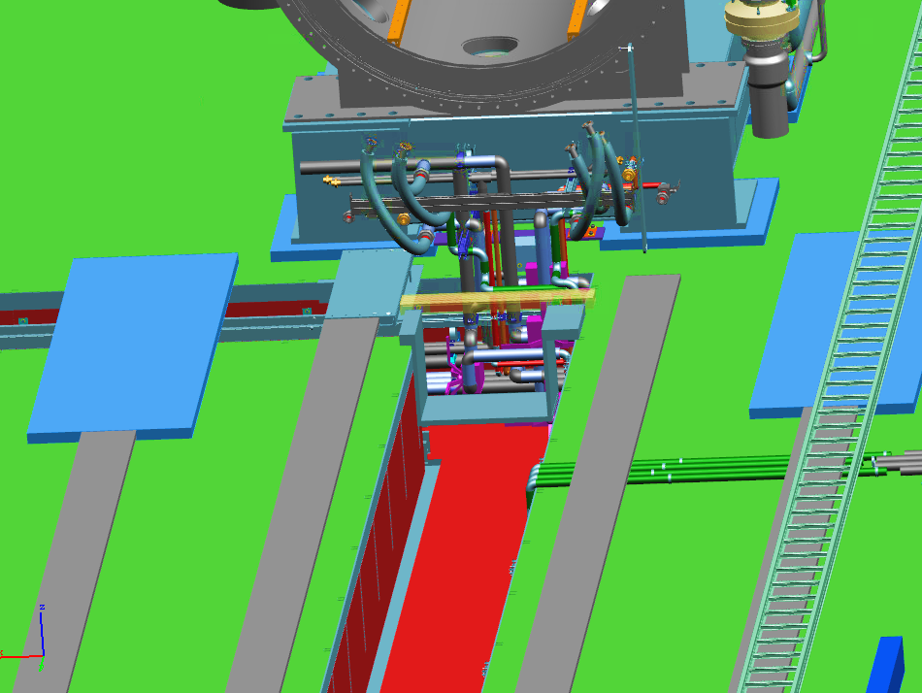
Brief review of the previous episode

Slide 4
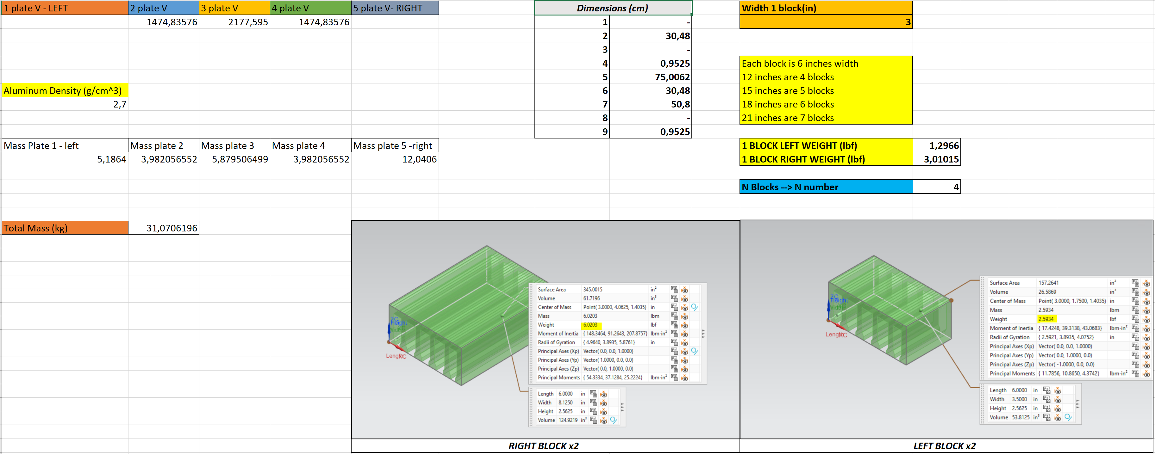
Calculations revealed feasibility in terms of weight

Slide 5
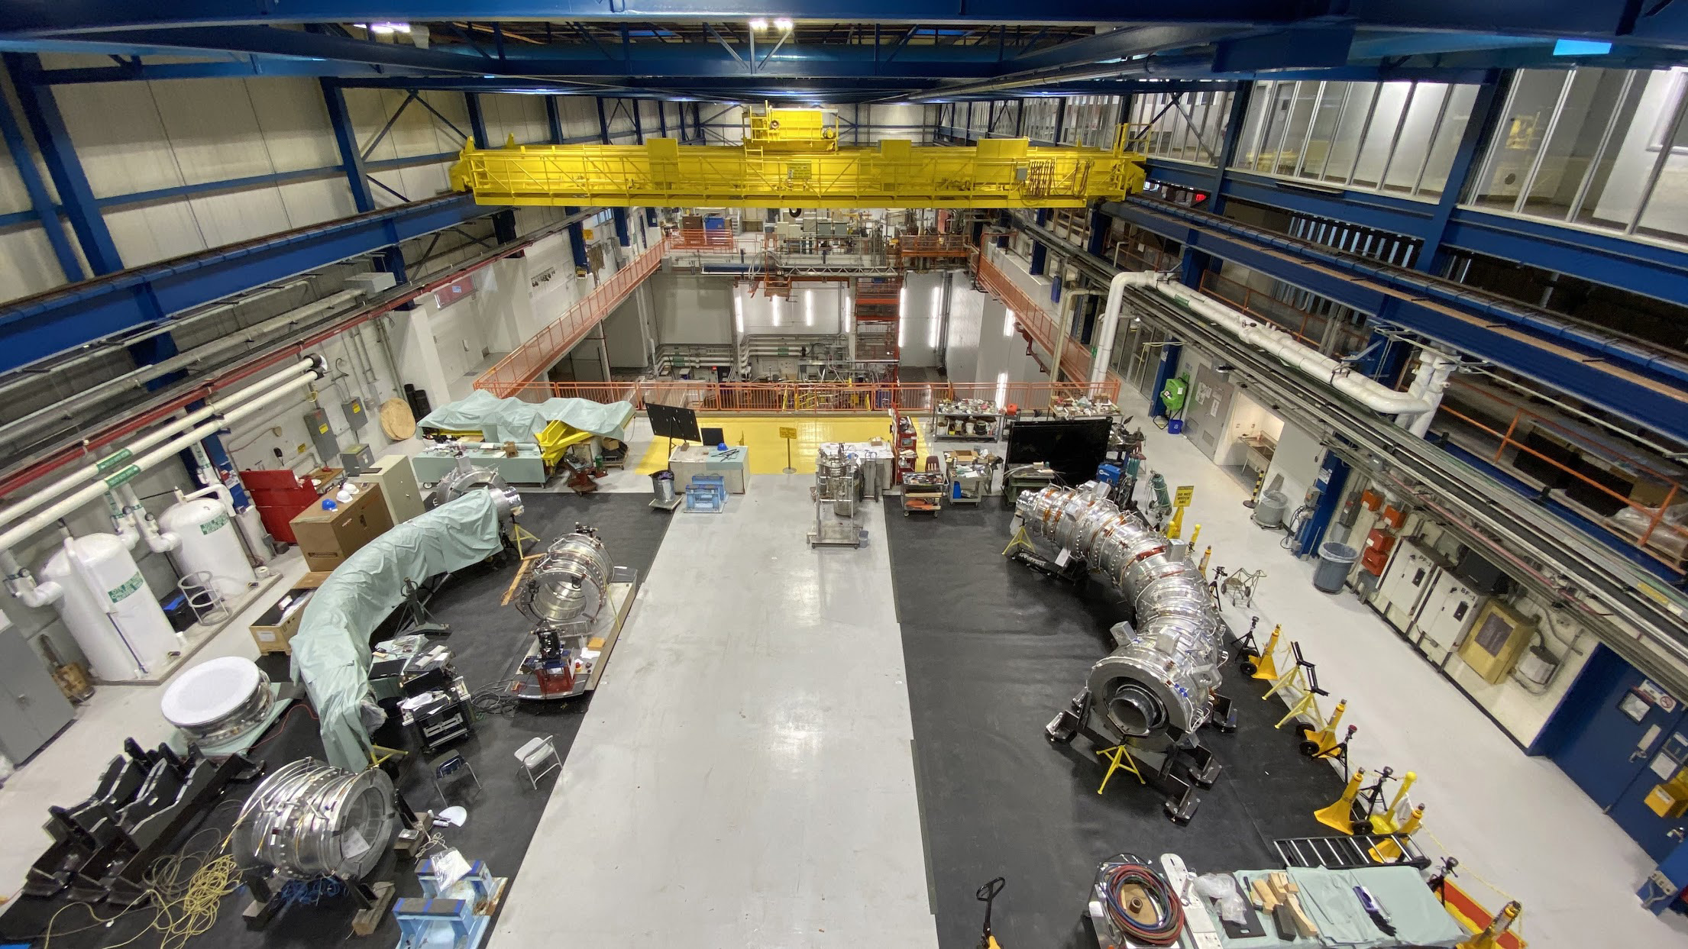
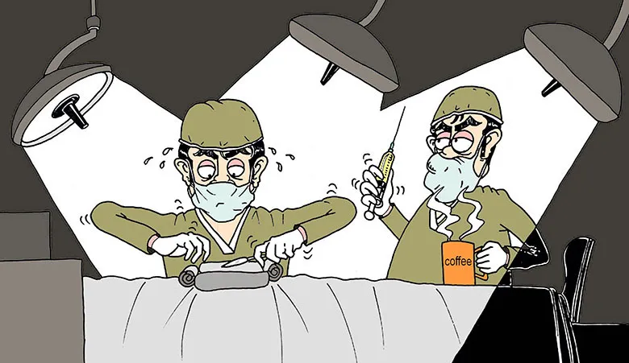

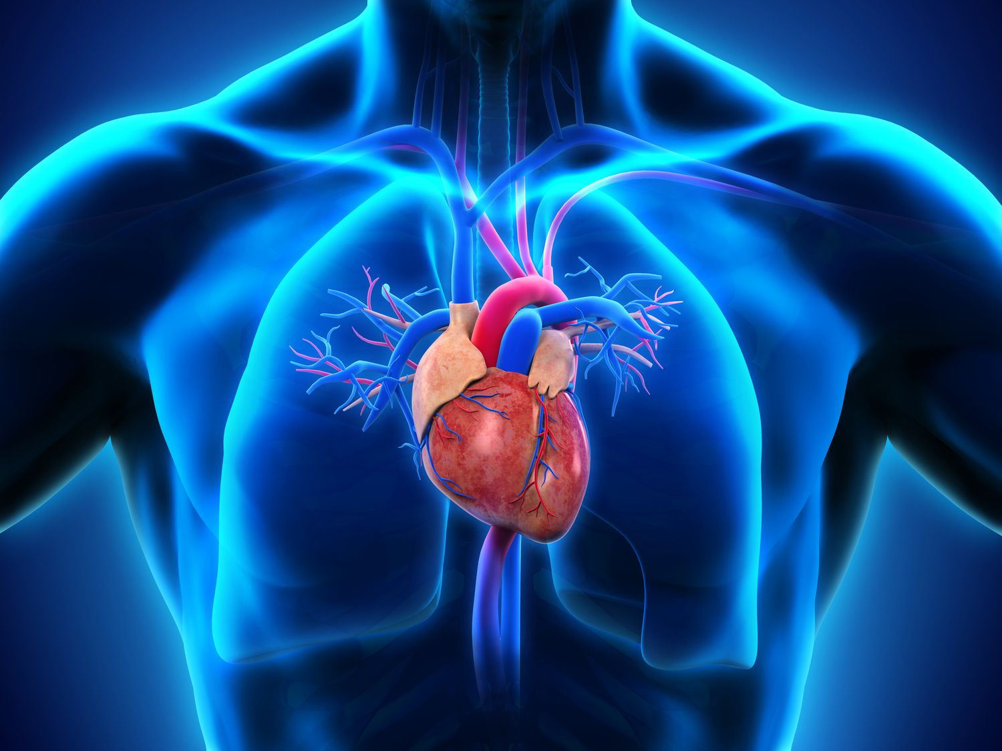


New episode
Surgical 3D-CAD interventions
Heart
Brain
Skin
Detector Train: it is the support structure of the muon beamline and the muon beamline itself. It is the beating heart of the experiment
DS Trench and Cables: it is the brain of the experiment, cables send tons of data to the DAQ system
Shielding: main protection of the experiment. It ensures the isolation of the whole system from external background + internal radioactive environment

Slide 6
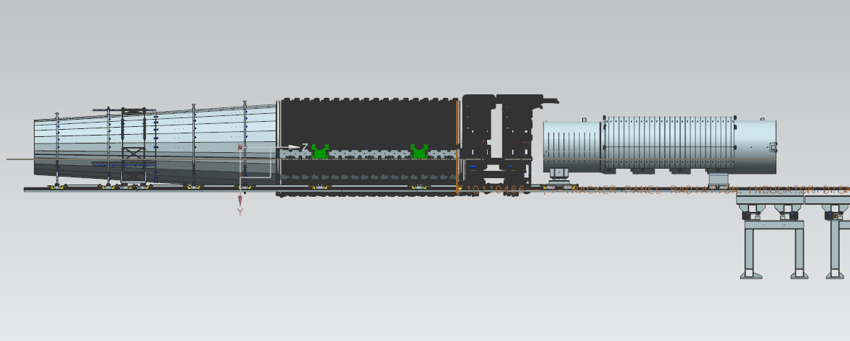
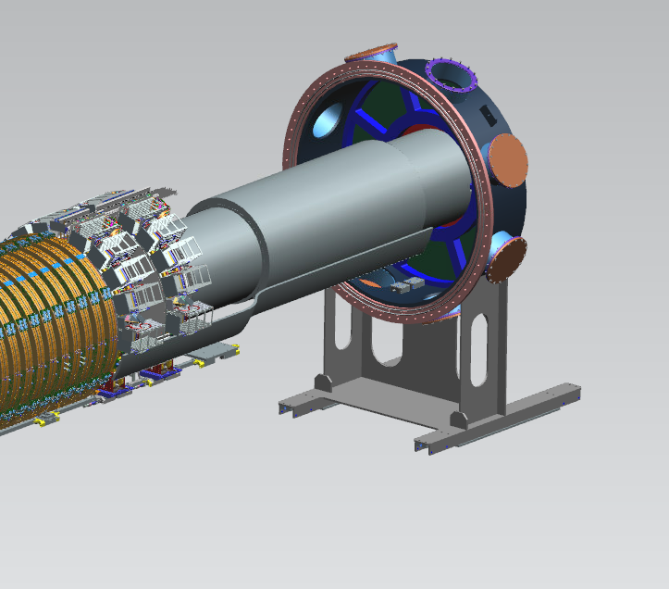
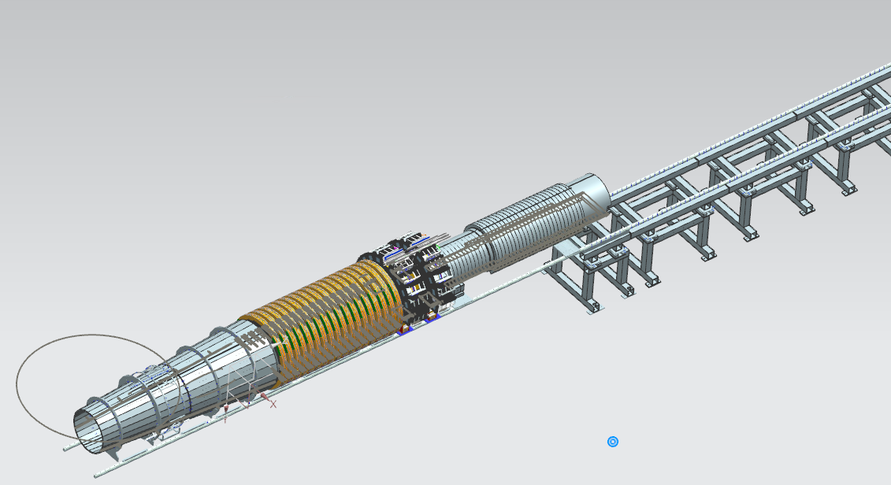
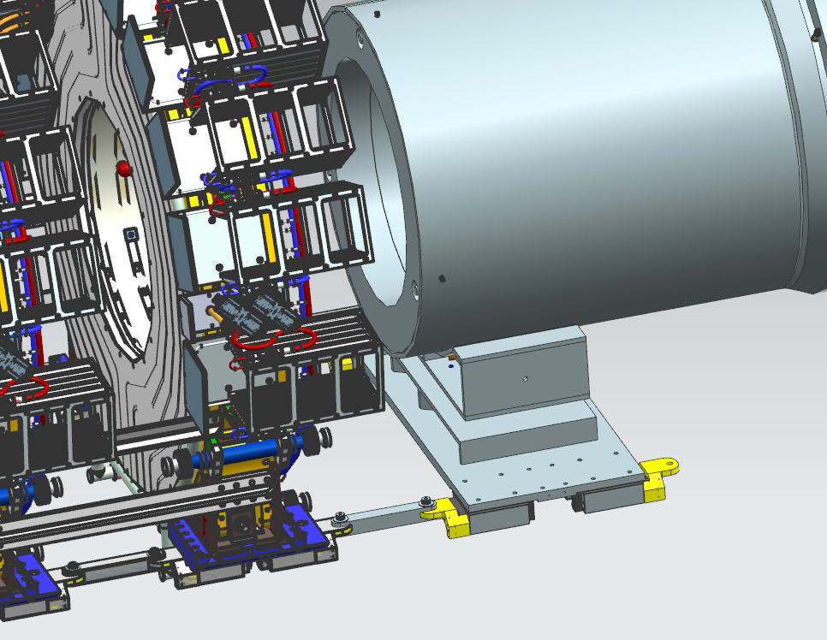
DETECTOR TRAIN IN
EXTRACTED / INSERTED POSITION
Inserted
Extracted
Inserted

Slide 7
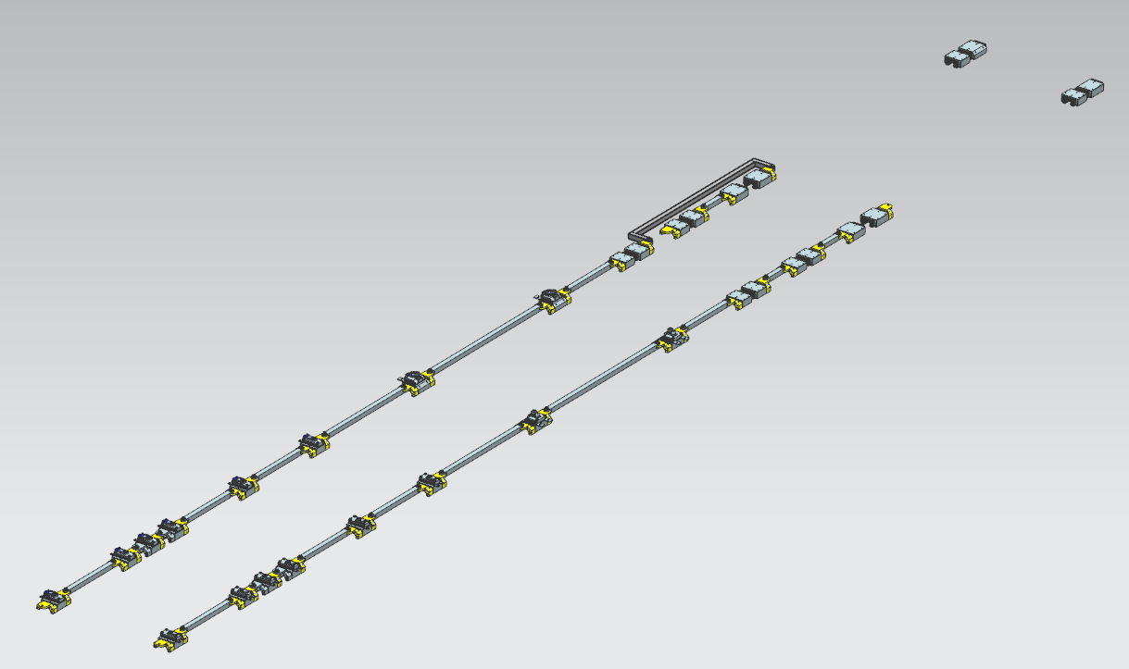
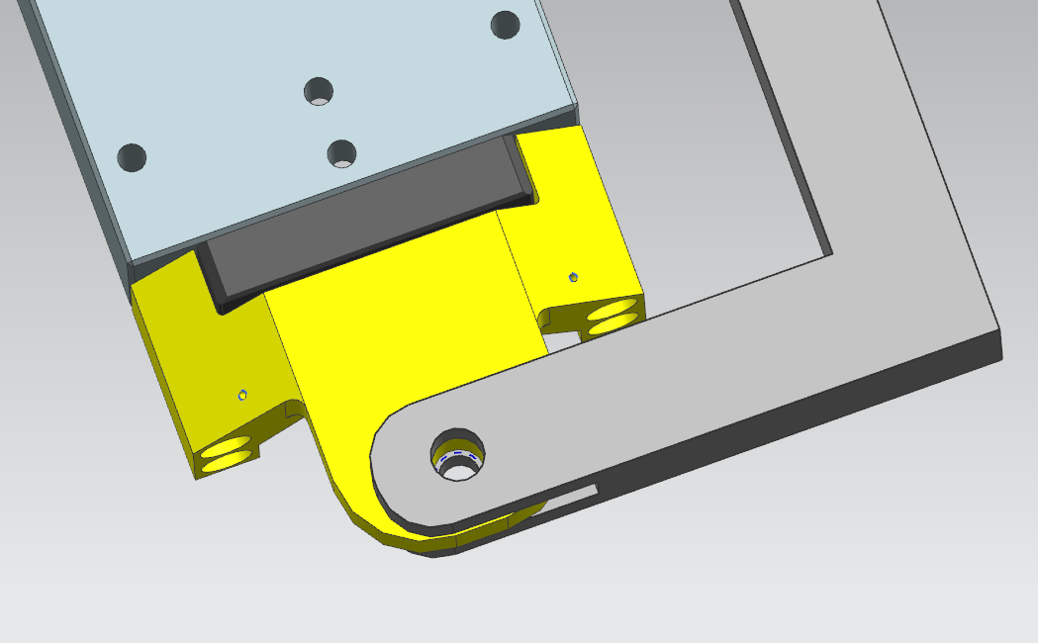
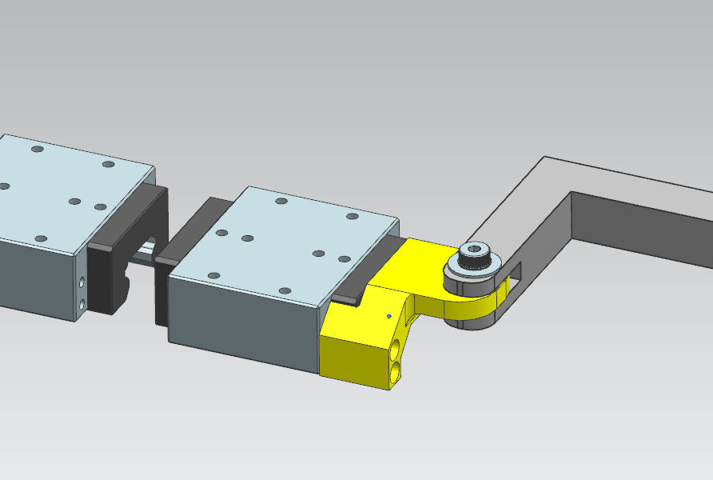
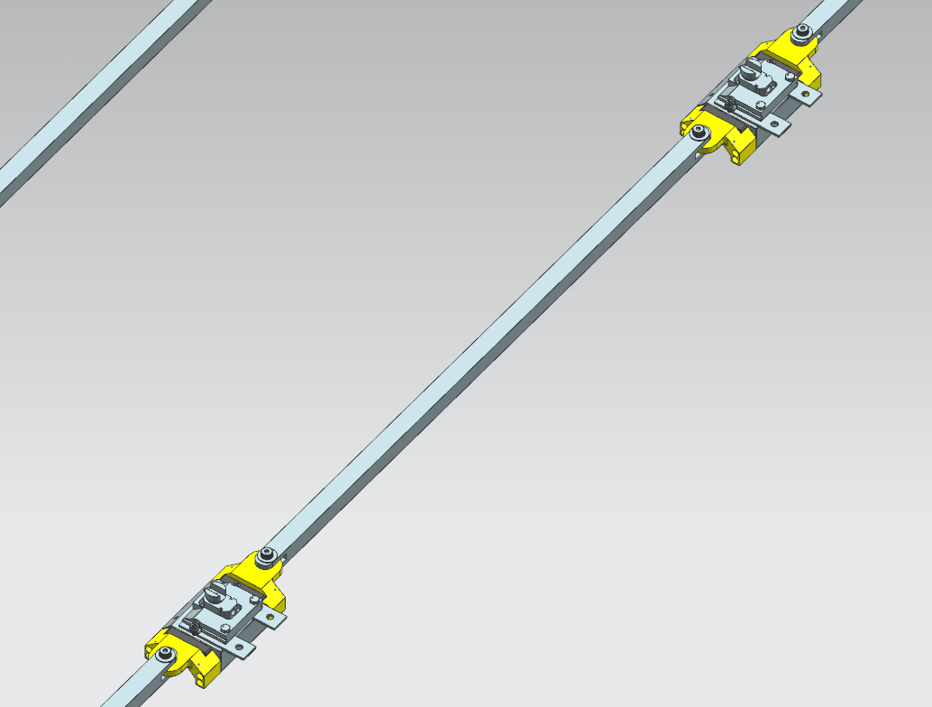
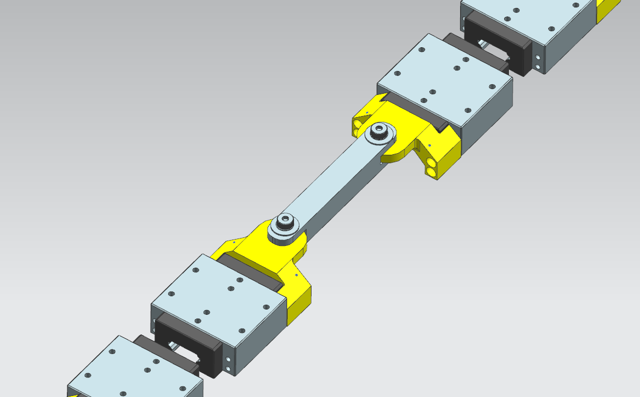
Detector Train in Inserted/Extracted Position → Supports
NORTH RAIL
SOUTH RAIL
Calorimeter bypass bar
Offset bar Tracker
Offset bar MBS to Calorimeter
Notes:
1: verifying the dimensions of the different components of the Coupler Assembly → Bearing blocks dimension and their relative position
2: veryfing the position of the North and South rail in the Mu2e coord. System
3: overlap Temporany Hitch Glides with Extension Mount for coupler (slave)
4: adjust the lenght of the different offset bars in order to have the proper dimension for the sitting of the detector train

Slide 8
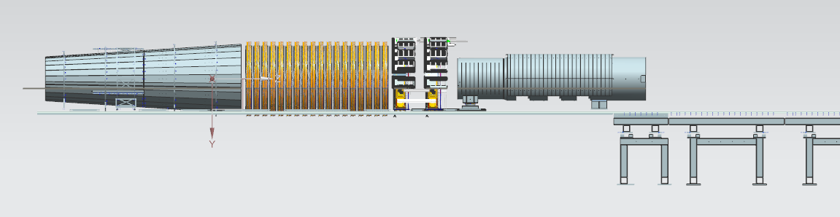
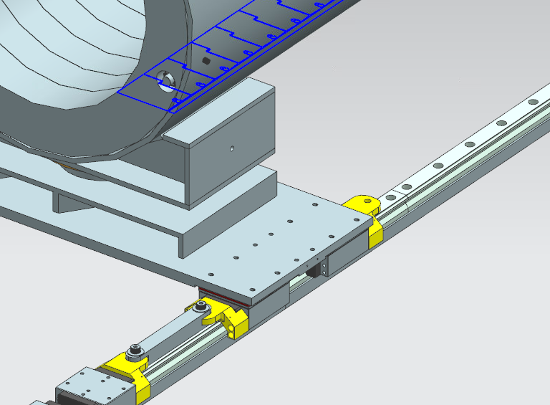
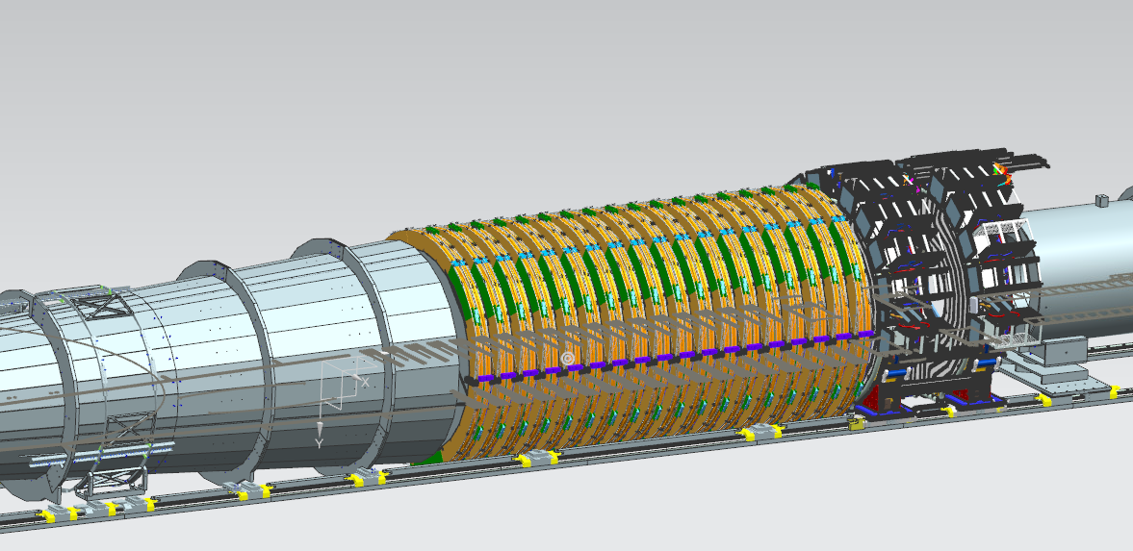
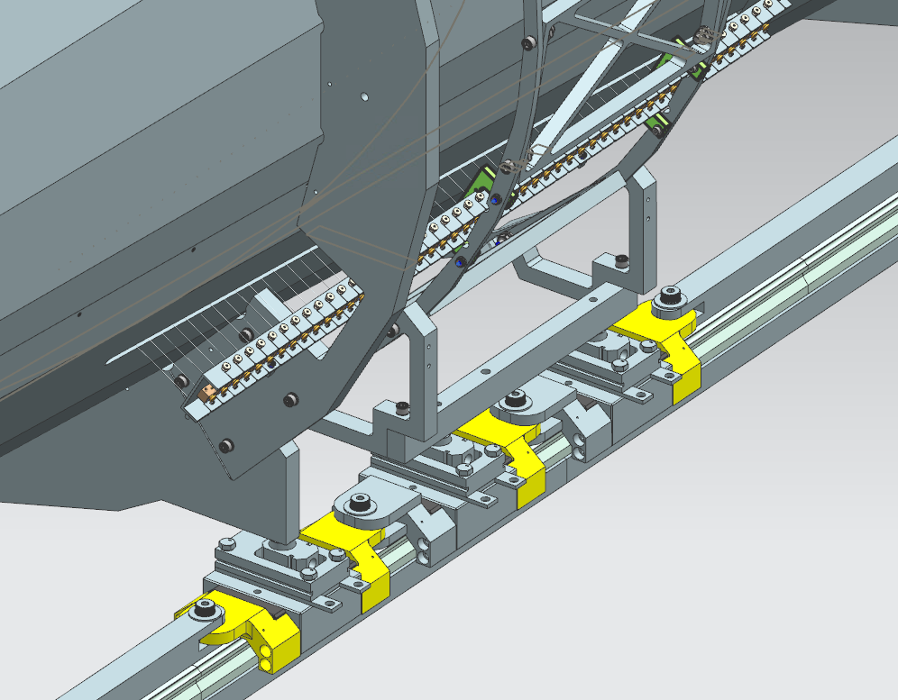
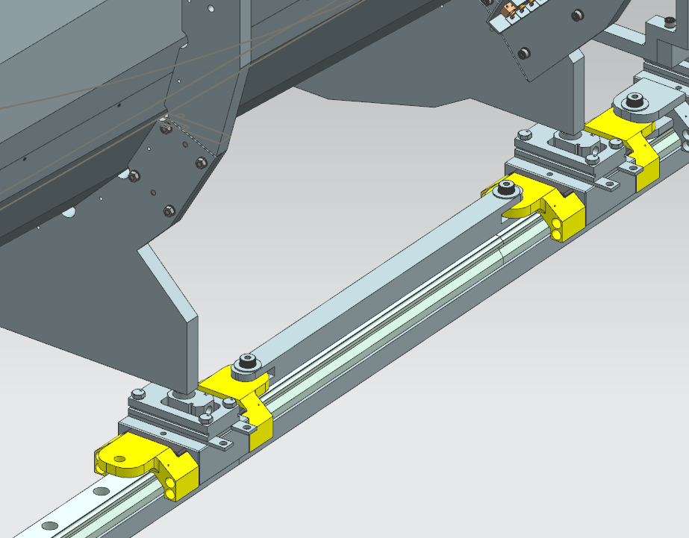
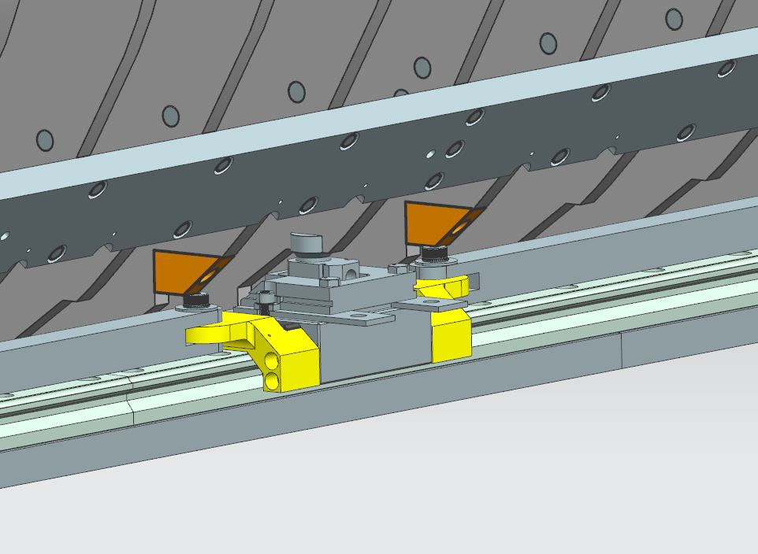
Detector Train in Inserted/Extracted Position → Muon Beamline
Stopping target
OPA
Tracker
Calorimeter
MBS
Notes:
1: Measure the various components position in the X,Y,Z Mu2E coord.reference
2: Measure relative position of these components → for what concern instead the Extracted position we had to find a position for the IFB and then move all the pieces relative to this component, in particular to its flange
3: Connect the components to the coupler assembly using CUP-HOLE connections.
3:

Slide 9
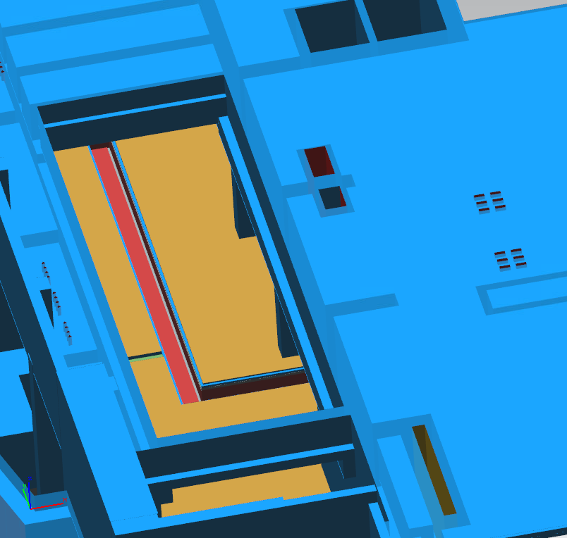
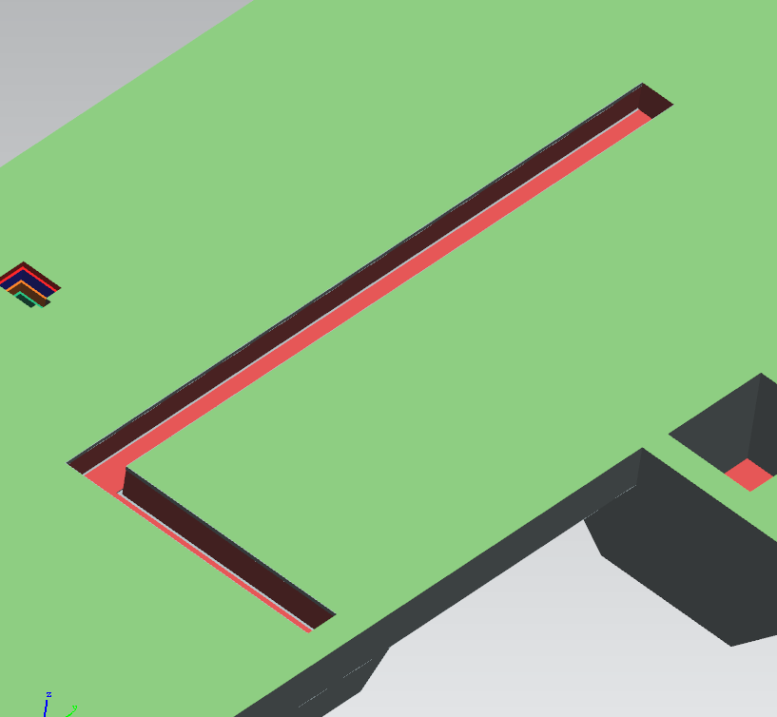
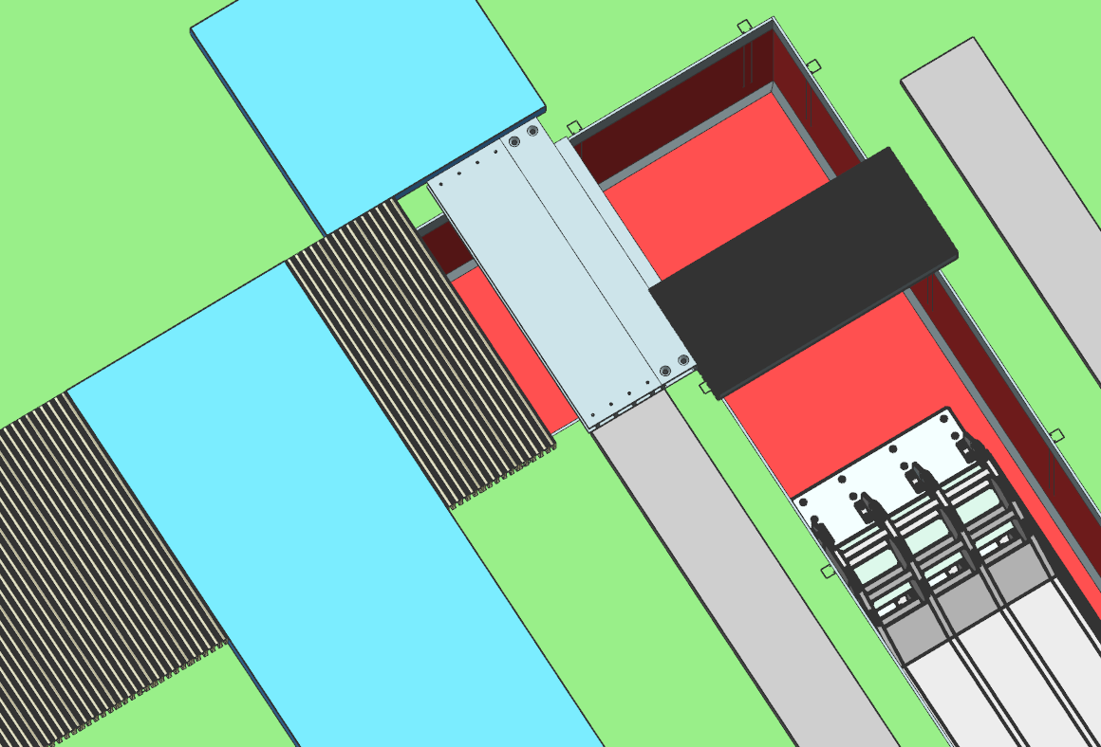
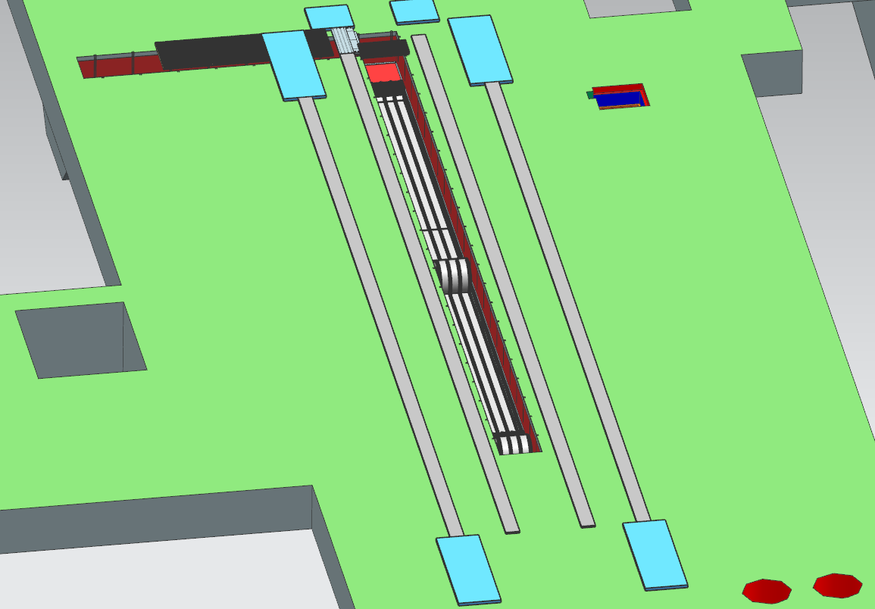
DETECTOR SUPPORT AND INSTALLATION SYSTEM – DS TRENCH
E
N
E
N
S
W
S
W
DS Trench Grating Corner Plate
Grates
W
S
N
E
High capacity trench plate

Slide 10
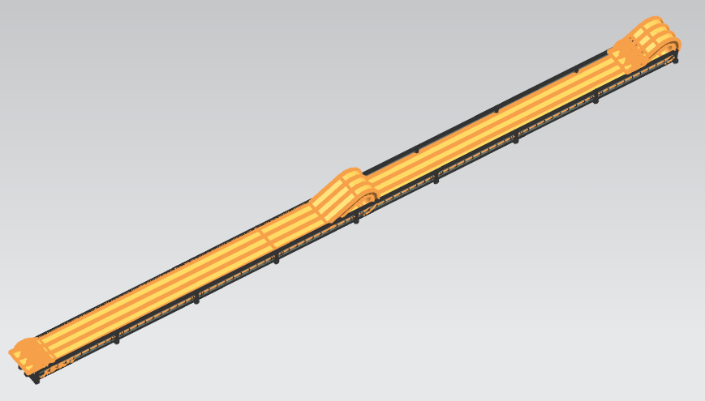
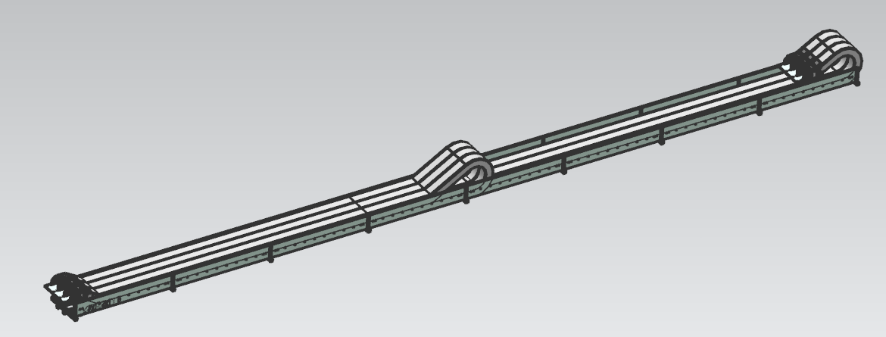
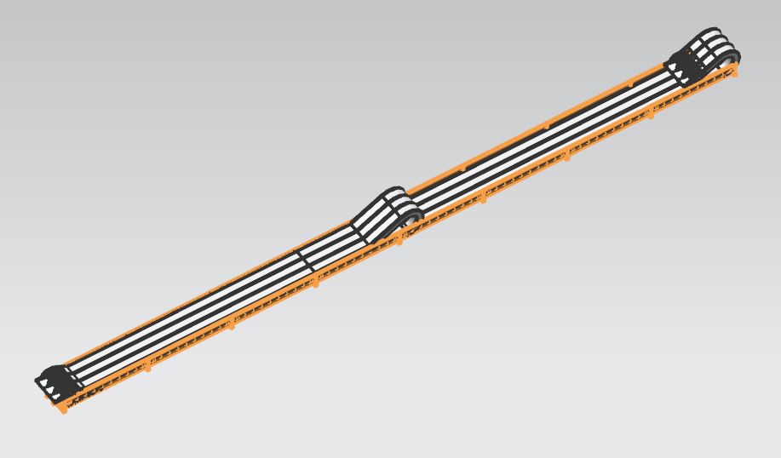
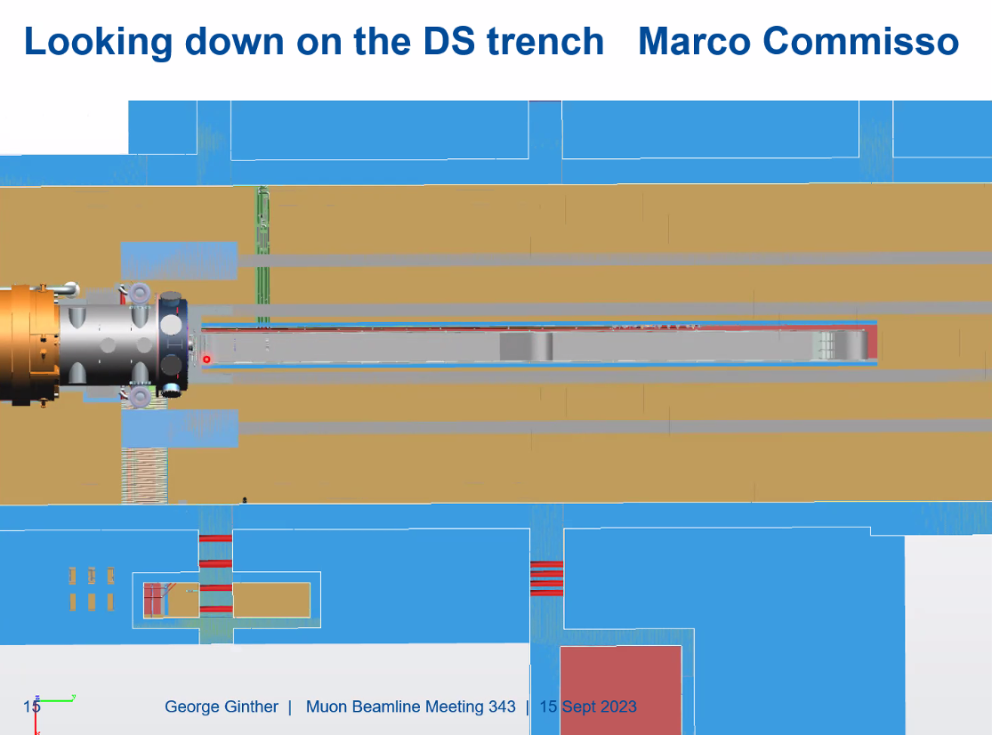
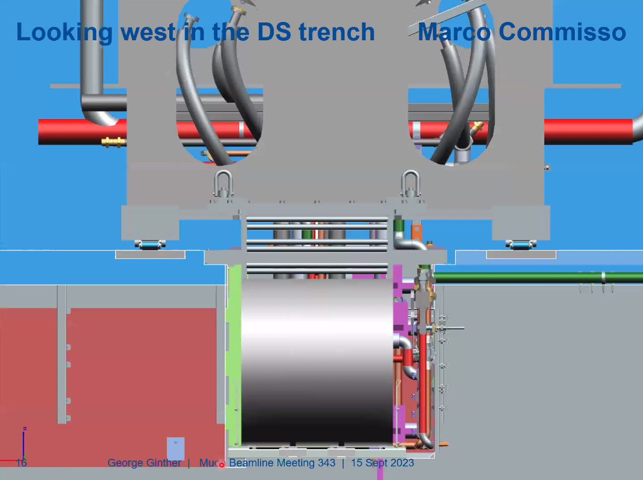
Detector Support and Installation System → DS cable management system
ECHAIN
ECHAIN TROUGH

Slide 11
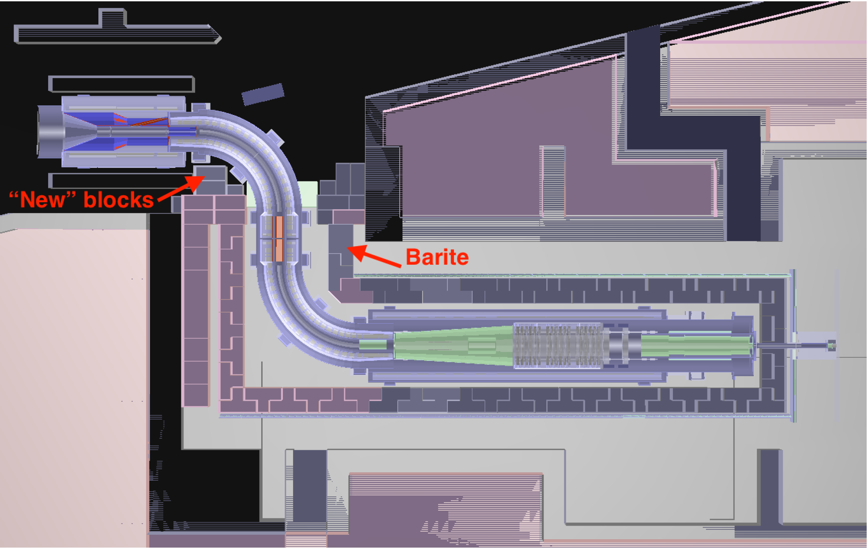
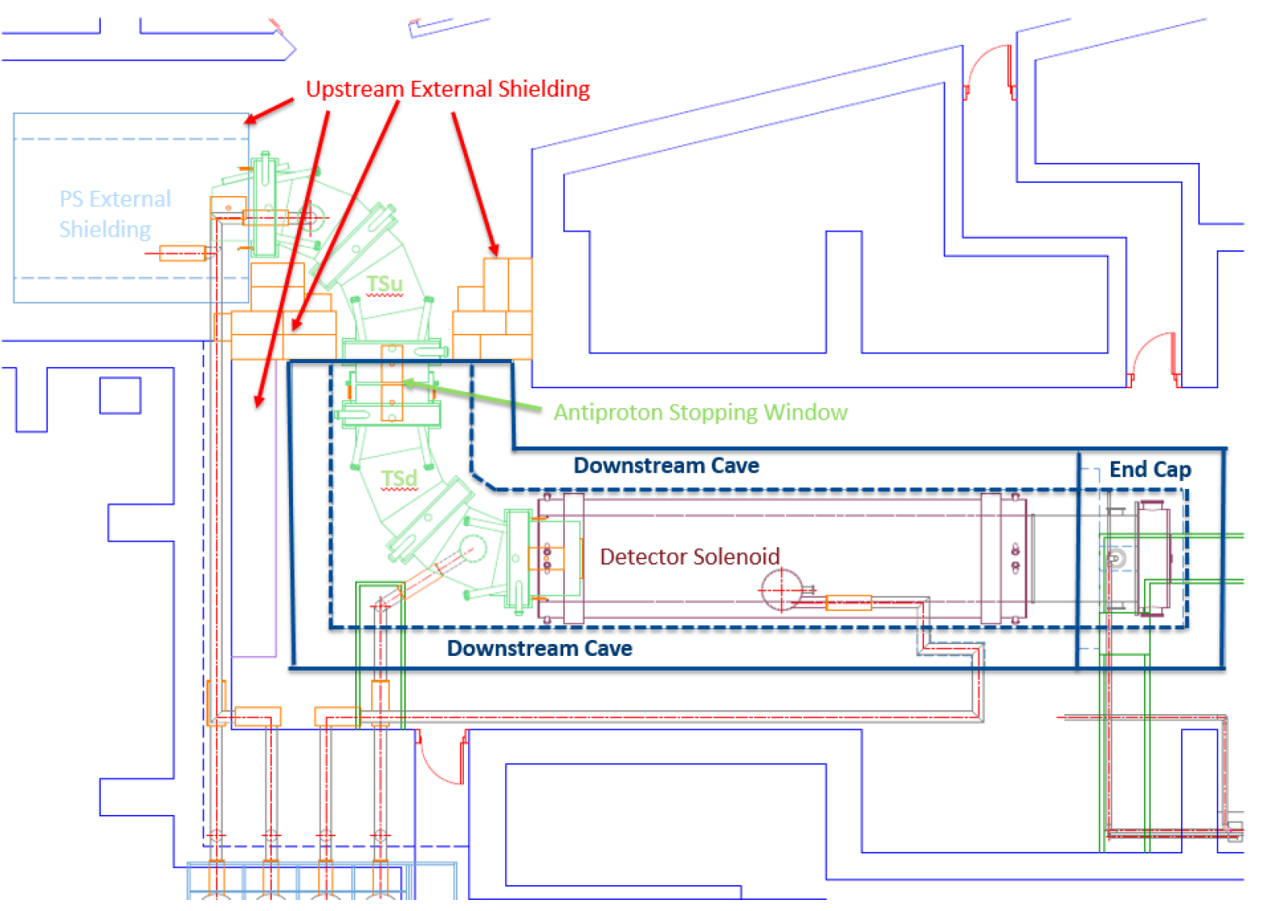
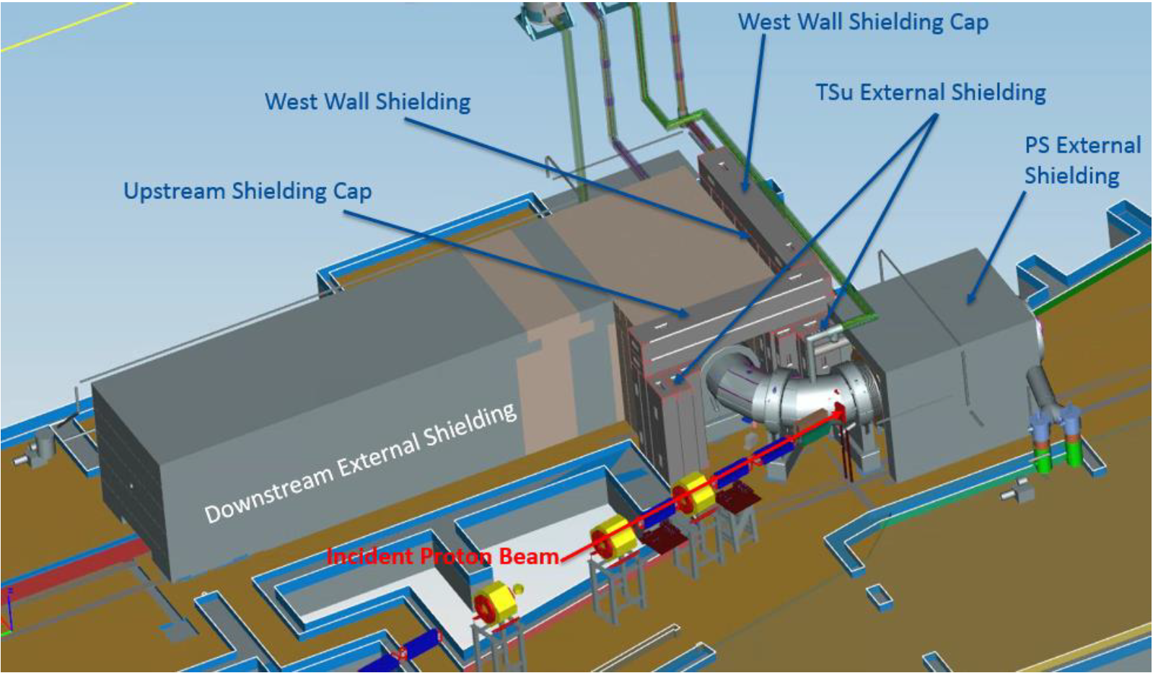
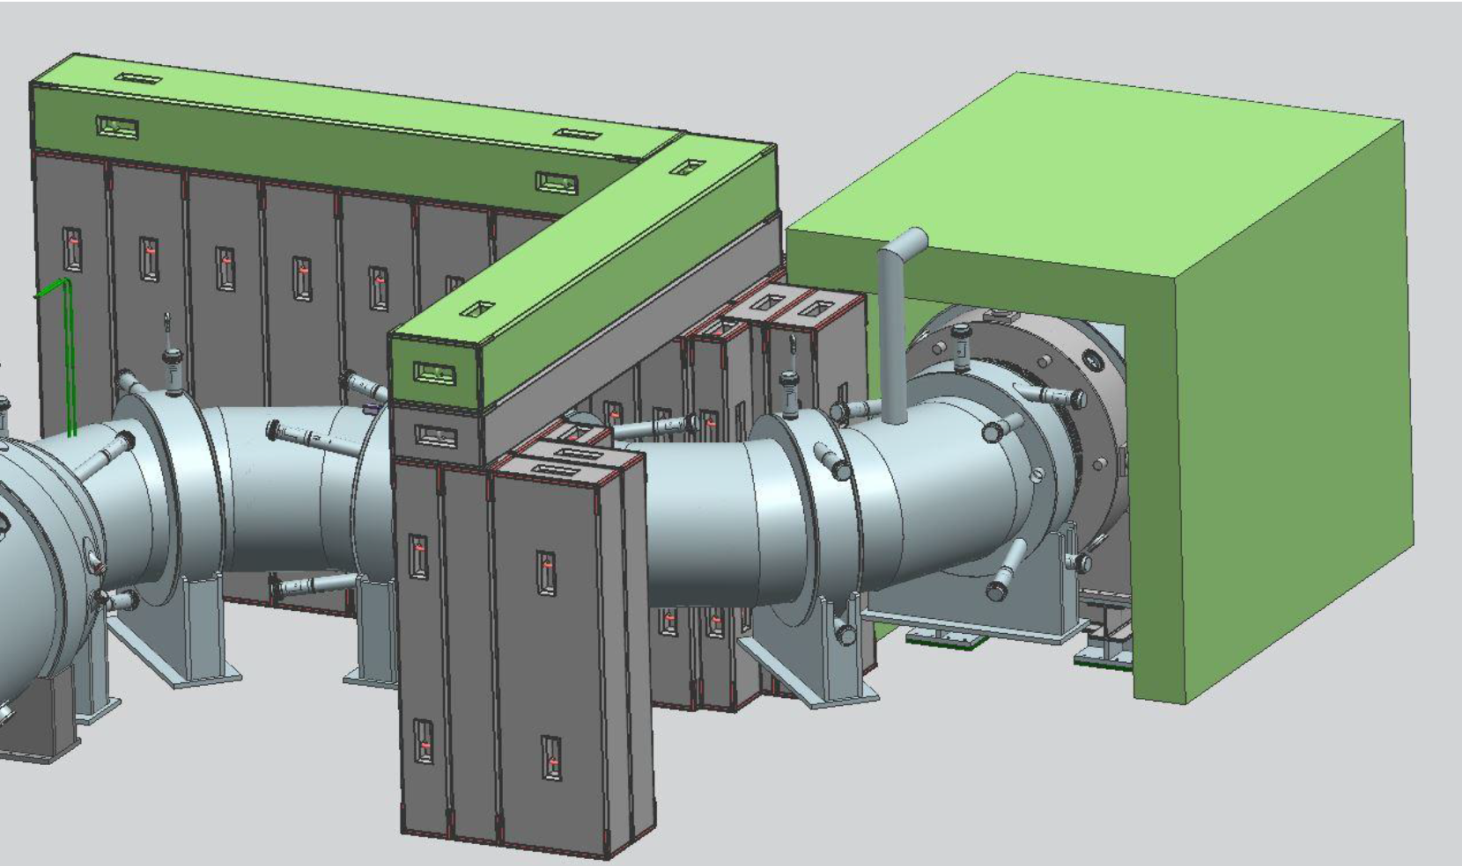
SHIELDING ENVIRONMENT

Slide 12
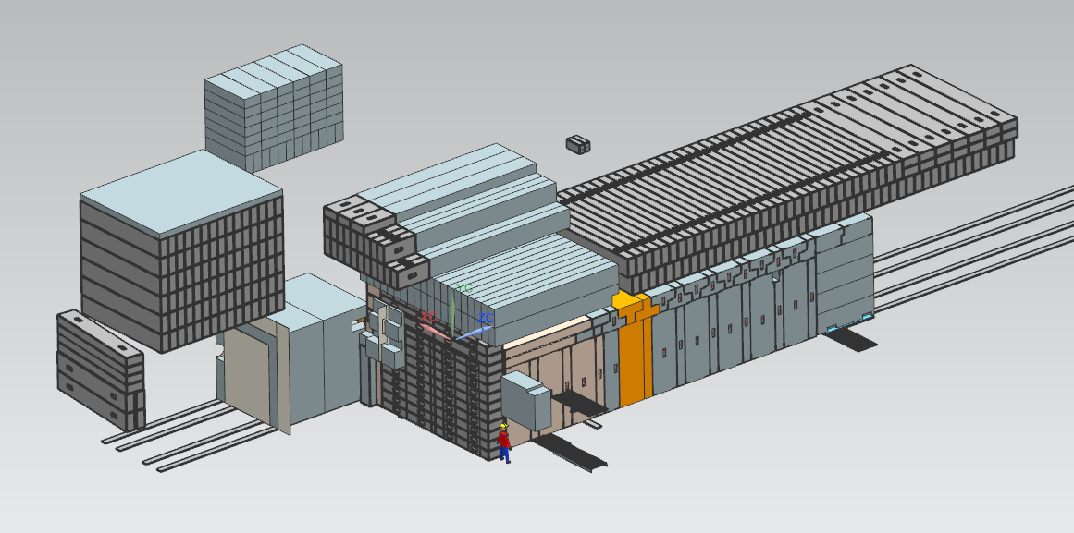
Shielding Assemblies
TS Hatch blocks
+
North west shield block pile
Remote handling hatch blocks
DS Hatch blocks
PS Hatch blocks
Extintion Monitor Hatch blocks
Upstream + downstream shielding blocks

Slide 13
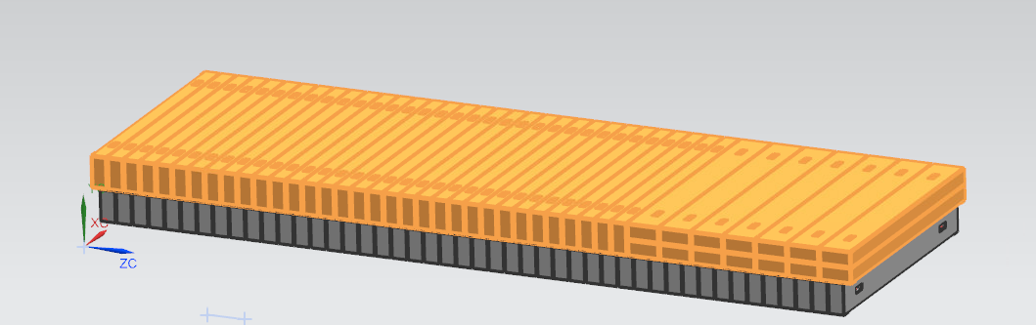
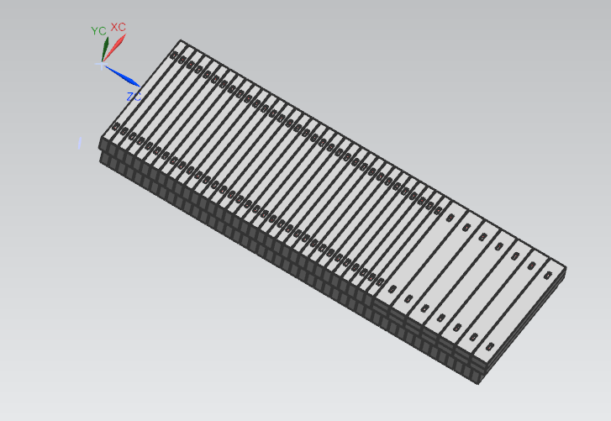
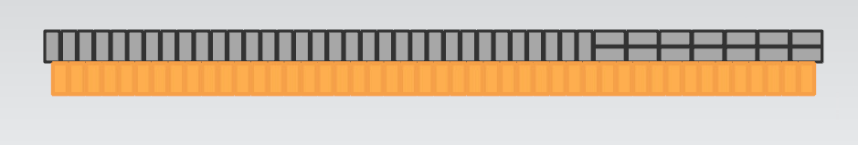
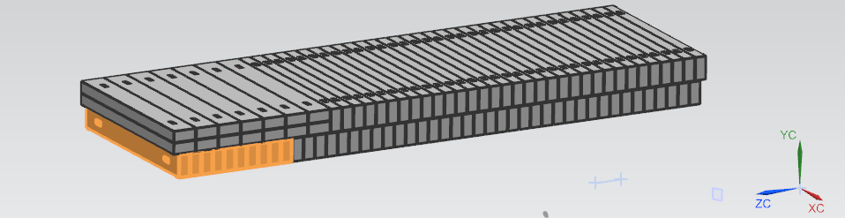
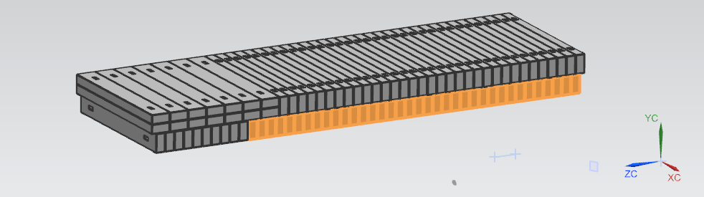

Conventional Construction Assembly
Upper
Lower
DS Hatch Blocks
L-East
Reconfigure
the
DS Hatch Block Shielding Assembly
L-West
Notes:
Using MARS / GEANT4 calculations

Slide 14
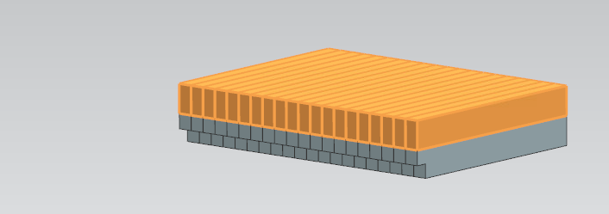
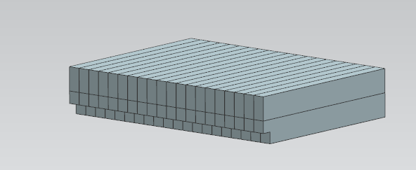
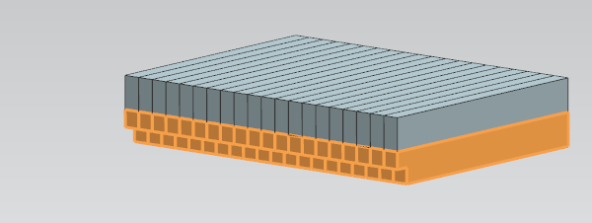
Conventional Construction Assembly
Upper
TS Hatch Blocks
Lower
Reconfigure
the
TS Hatch Block Shielding Assembly

Slide 15





Remote Handling Hatch Blocks-Assembly
-Rotation of 12 bottom shield blocks
-More advantageous Orientation
Extintion Monitor Hatch Blocks-Assembly
-Rotation of 4 upper shield blocks
-IMPROVED
CRACKED
COVERAGE

Slide 16



Downstream External Shield -Assembly
Purpose:
-Reduce the rates of Neutrons and Gammas incident on the CRV counters
-Allow a line of sight to the Muon Stopping Target Monitor (STM) and reduce the neutron and gamma background incident upon the STM.
Constituents:
Reinforced concrete T blocks assembled in 2 independend but matched zones → Downstream cave + End Cup Shielding

Slide 17



Upstream External Shield - Assembly
Purpose:
-Isolates the primary proton beamline from the Detector Solenoid (DS) hall
-Shielding the Cosmic Ray Veto (CRV) from primary target (in PS)

Slide 18



Shield Blocks Alignment Guides
6’’x3’’x3/8’’
3/8
6
3
Not implemented yet

Slide 19



Shield Blocks Alignment Guides
Shield block
Alignment guides

Slide 20
Conclusions
Get access to the 3D Model of the experiment learned how to:
Make measurements
Verifying components positions
Import pieces into the model
Design components
Participate to:
Mechanical Integration Meetings
Muon Beamline Meetings
Few Electrical Integration Meetings

Slide 21

THANKS FOR YOUR ATTENTION!

