Slide 1
Development of a Summing Overlay Module in Pynq environment with RedPitaya
End-Term Presentation
26 Settembre 2024
Fabio A. Ciraci

Slide 2
Table of contents
01
02
03
04
GQuEST
FPGA
What I did until now?
Conclusion
Fabio A. Ciraci

Slide 3
GQuEST
Gravity from the Quantum Entanglement of Space and Time

Slide 4
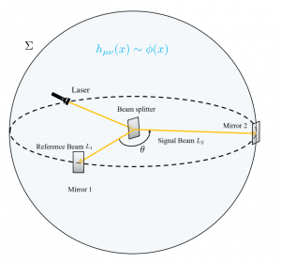
What is it?
The goal is to measure how seemingly empty space affects interfering light
A laser is splitted in two.
The two beams of light shine down two perpendicular arms of equal length towards mirror.
Then the beams bounce back from the mirror, recombine and reflect into ultra sensitive detectors.
Fabio A. Ciraci

Slide 5
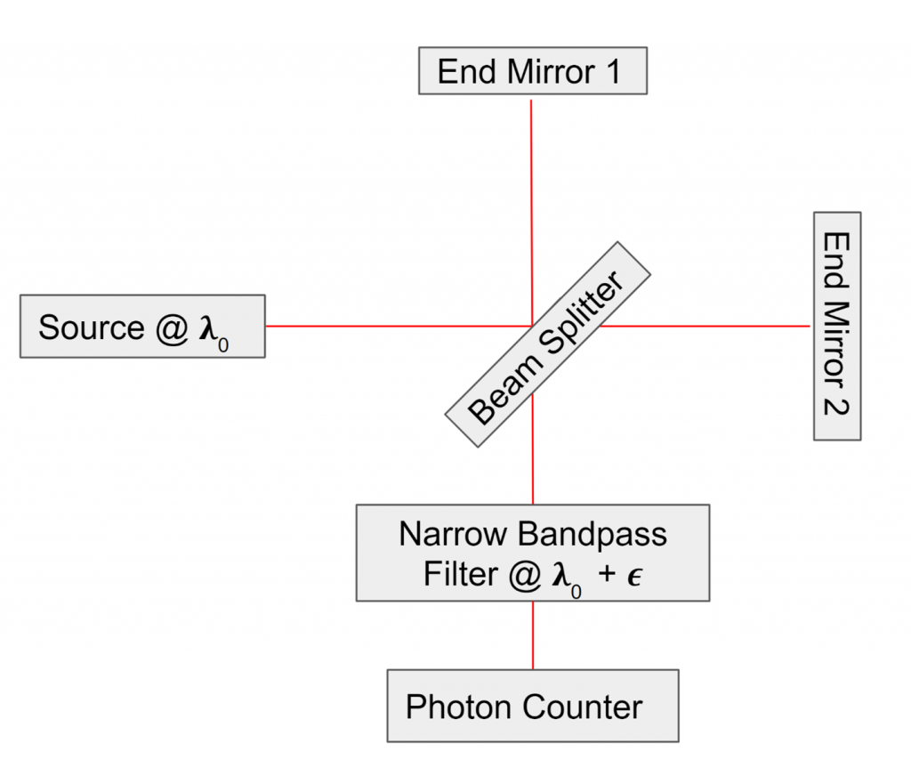
What is it?
Random fluctuations in empty space are called quantum fluctuations and causes slight changes to the beam.
This data can help us understand and investigate theoretical links between gravity and quantum mechanics
Fabio A. Ciraci

Slide 6
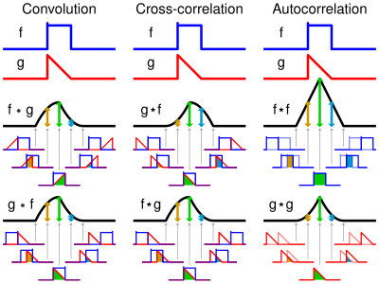
What was my goal?
My goal was to create an overlay module pynq compatible to be runned on the RedPitaya board in order to perform sums between different arrays.
In the context of GQuEST they represent the two signals on which the correlation is performed.
The correlation correspond to the sum of the Fourier Transform of two signals when inversed transform
Fabio A. Ciraci

Slide 7
FPGA
Field Programmable Gate Array

Slide 8
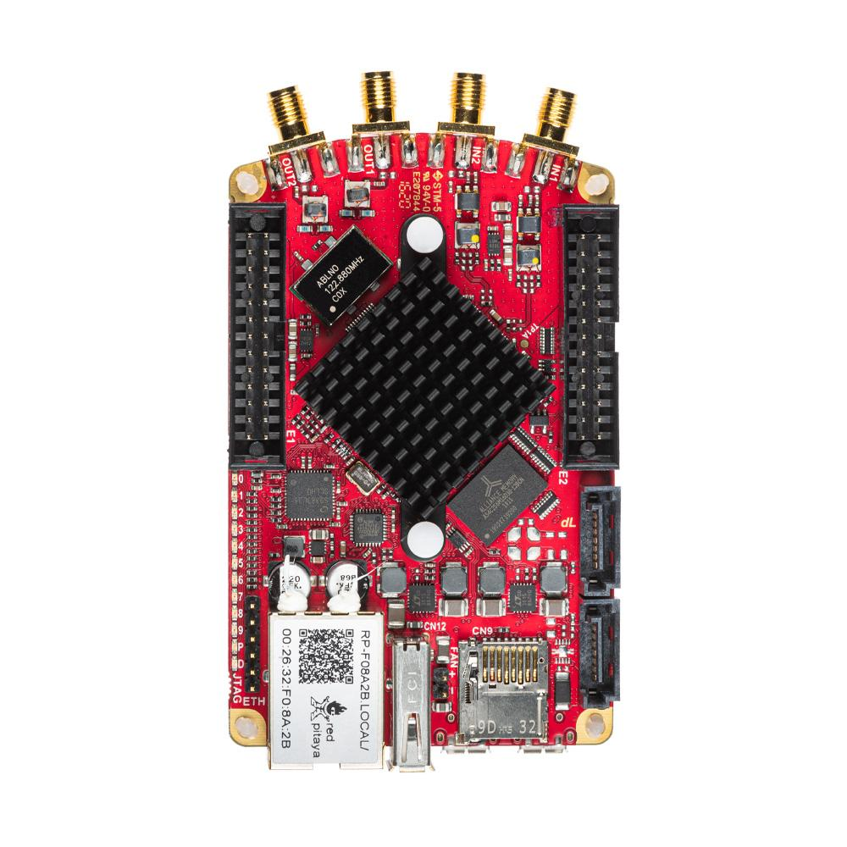
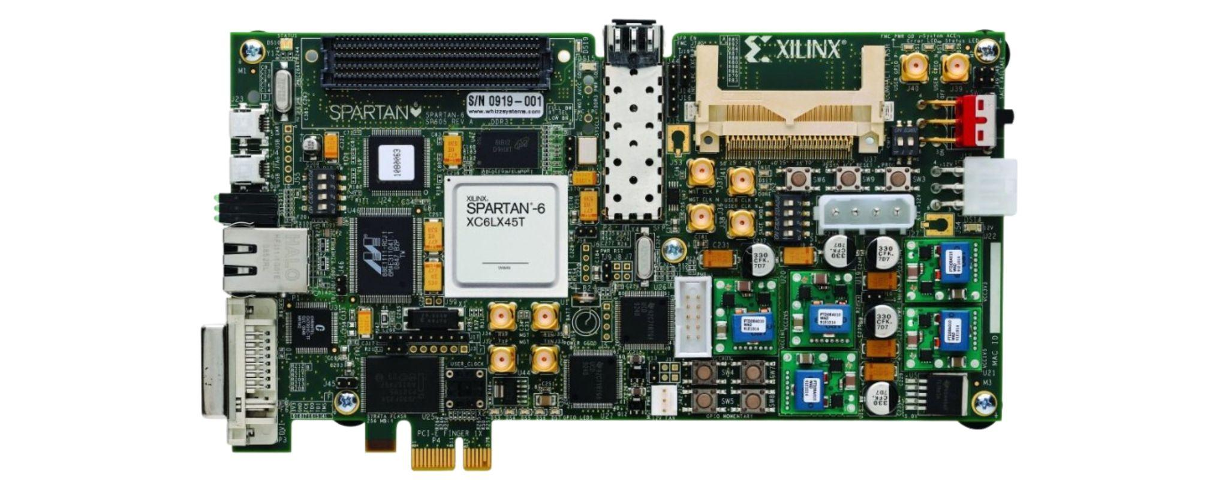
What is it?
Fabio A. Ciraci

Slide 9
in simple words:
A computer where is possible to program the hardware logic using easy-to-use software
Fabio A. Ciraci

Slide 10
What I did

Slide 11
—Brian Kernighan
The first step in learning any programming language is to get a simple program running. Typically, this is a program that prints the message 'Hello, World!' to the terminal screen

Slide 12
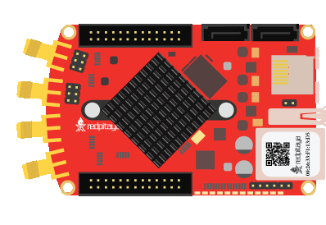
Blinking Led
The FPGA equivalent of “Hello World” is an array of Blinking Led.
Fabio A. Ciraci

Slide 13
-Fabio Ciraci
Once you have an “Hello, World” you only need an “Hello , dlfwdvlbahb”

Slide 14
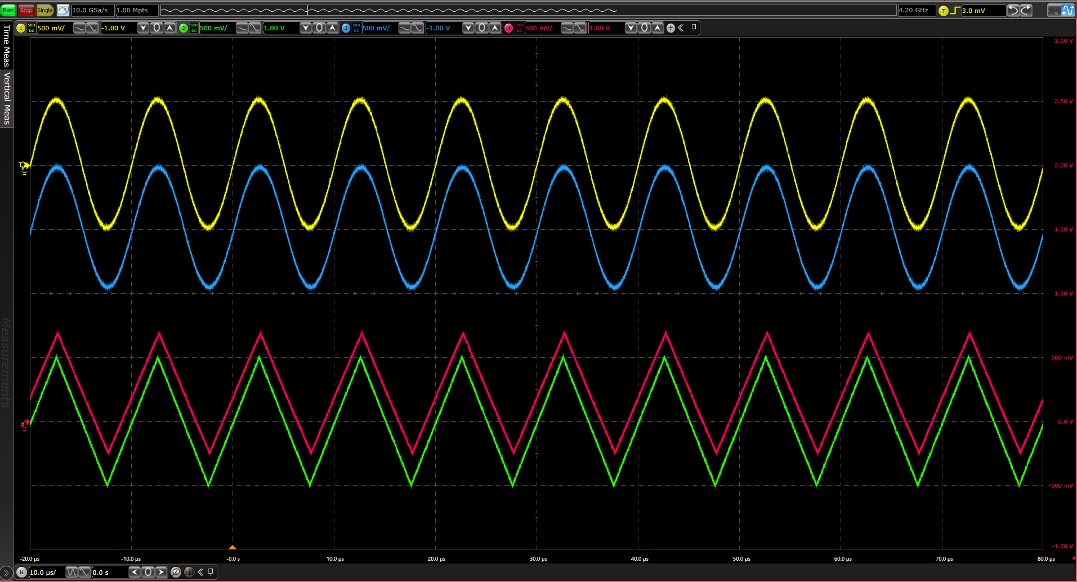
Analog Echo
In the second program I tried to forward the input to the output, that’s the case of the Analog Echo
The yellow and red line are the input, while the blue and greens are the outputs.
Fabio A. Ciraci

Slide 15
Adder
2+2=?
The adder that is needed for the GQuEST experiment need to sum two arrays
The first step to reach the goal was to sum two numbers
Fabio A. Ciraci

Slide 16
-Fabio Ciraci
Summing numbers is not that easy

Slide 17
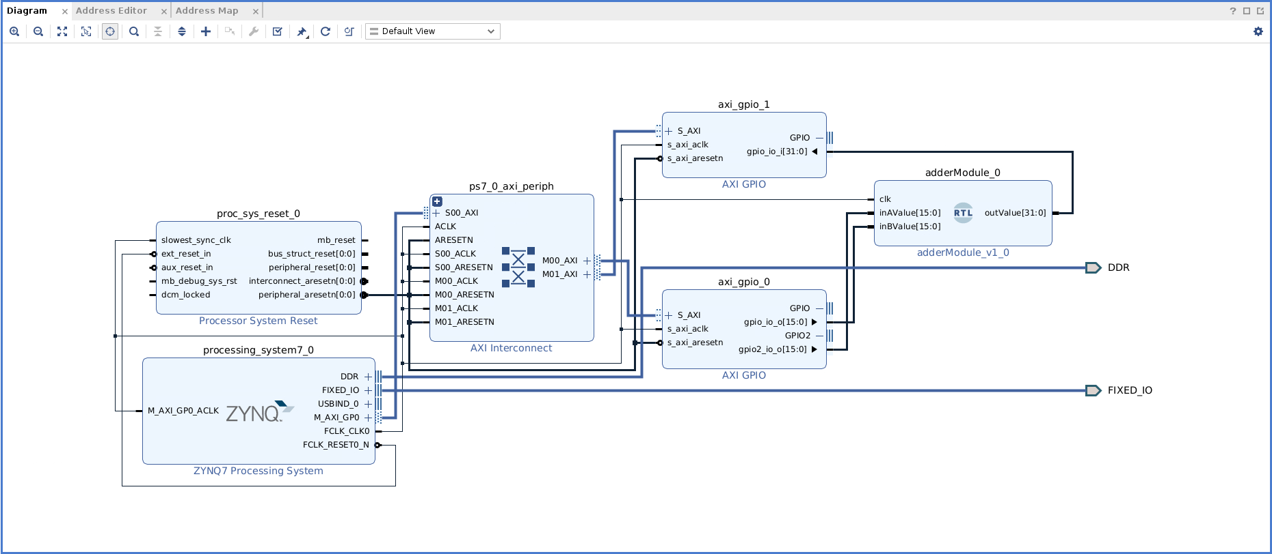
This is my solution
Fabio A. Ciraci

Slide 18
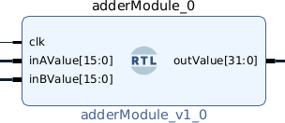
Adder Module
The Adder module is the core module, it takes two inputs along with the clk and the reset and send back to the AXI GPIO module the sum of the two numbers
`timescale 1us/1us
module adderModule (
input clk,
input signed[15:0] inAValue,
input signed[15:0] inBValue,
output reg signed[31:0] outValue
);
always @(posedge clk) begin
outValue <= inAValue + inBValue;
end
endmodule

Slide 19
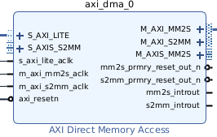
DMA Access
The memory of the PL in the FPGA is not enough to load an array, but the PS has much more.
To exploit it is necessary to use the DMA(Direct Memory Access)
Fabio A. Ciraci

Slide 20
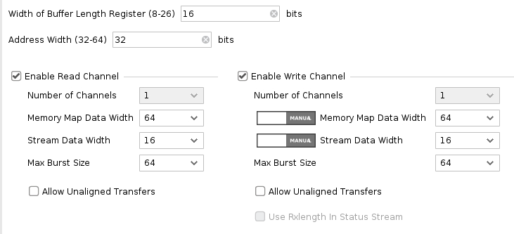
Direct Memory Access
The DMA acts like a portal between the PL and the PS.
It has two channel, one for writing and one for reading
They are both useful because our goal is to send two arrays and load the result from the output.

Slide 21
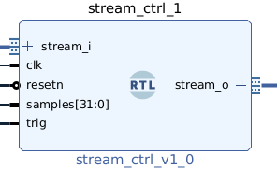
Stream Controller
This block is the Stream Controller.
If the DMA is not loaded the trig is set to 0, when the DMA is loaded into the wire is sended 1.

Slide 22
Stream Controller
entity stream_ctrl is
Generic( DATA_WIDTH : integer := 16);
Port (
clk : in STD_LOGIC;
resetn : in STD_LOGIC;
samples : in STD_LOGIC_VECTOR(31 downto 0);
trig : in STD_LOGIC;
stream_i_tdata : in STD_LOGIC_VECTOR(DATA_WIDTH - 1 downto 0);
stream_i_tvalid : in STD_LOGIC;
stream_i_tready : out STD_LOGIC;
stream_o_tdata: out STD_LOGIC_VECTOR(DATA_WIDTH - 1 downto 0);
stream_o_tvalid : out STD_LOGIC;
stream_o_tlast : out STD_LOGIC;
stream_o_tready : in STD_LOGIC
);
end stream_ctrl;
It is necessary to control the flow of the data coming into the adder module, for this purpose another block is necessary.

Slide 23
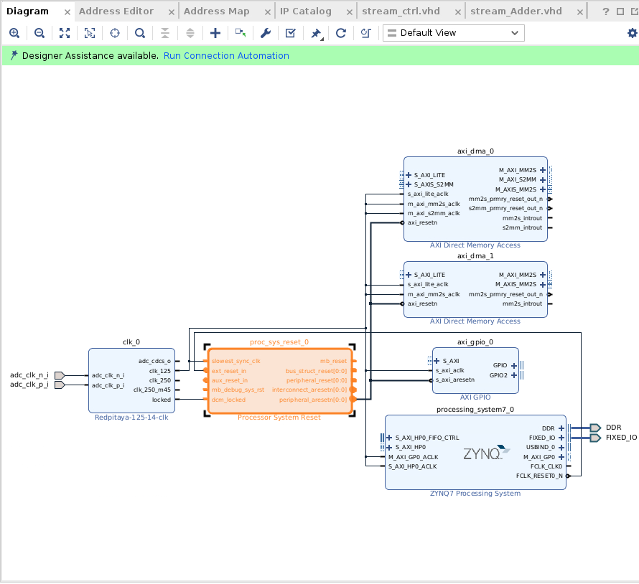
Pre-Design
This is the basic structure without the modules, as you can see to optimize the calculation and the memory only two DMAs are used.

Slide 24
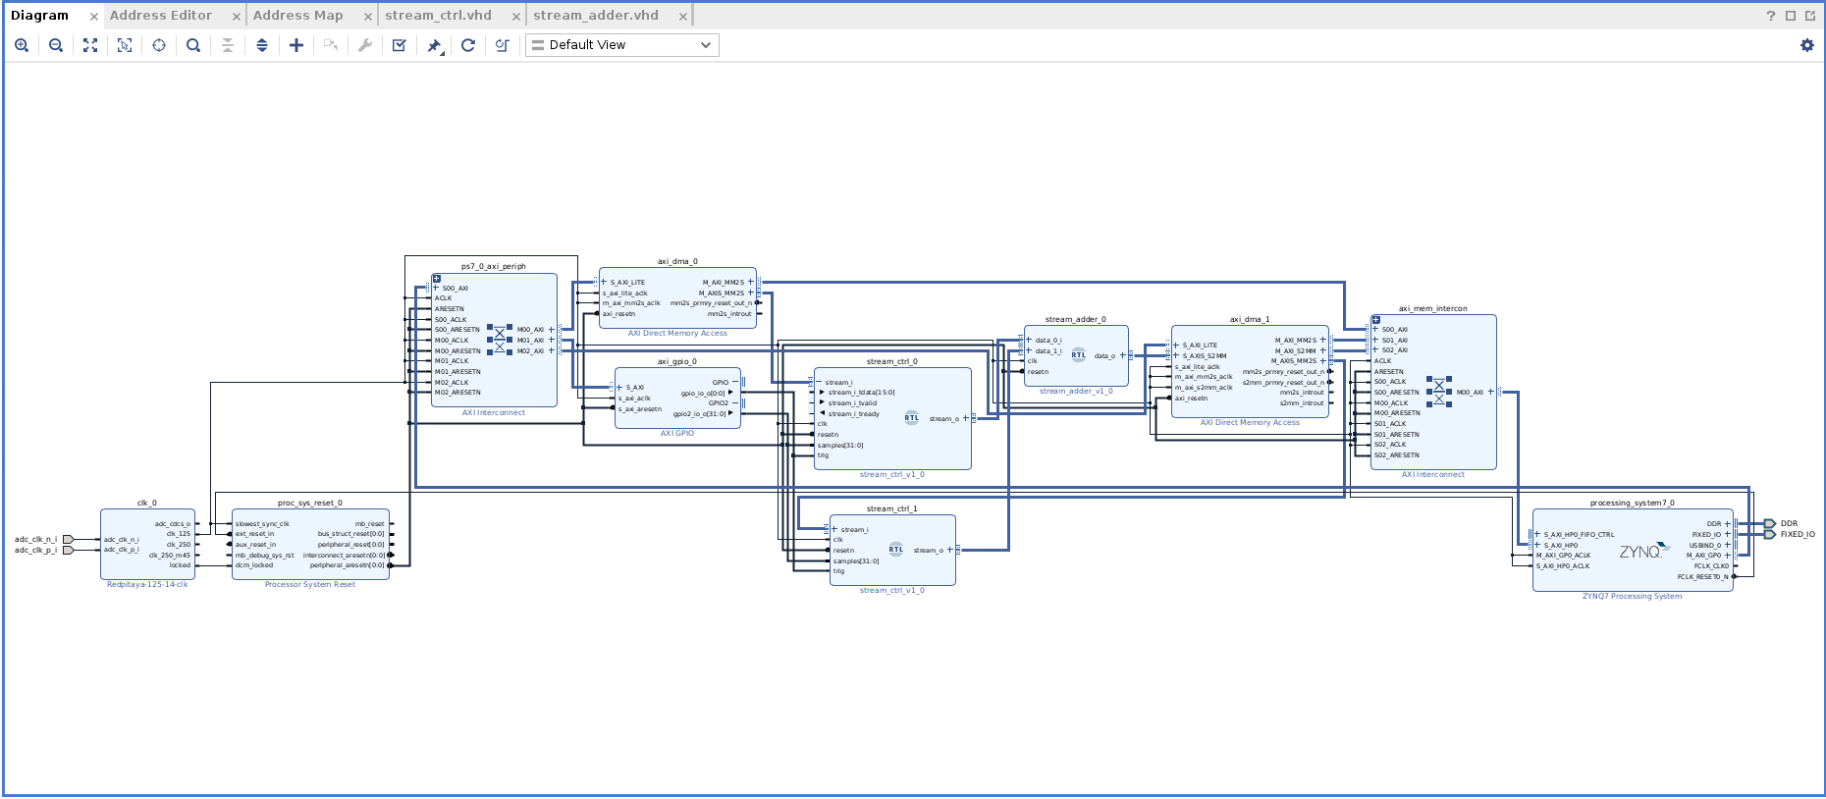
The Final Design

Slide 25
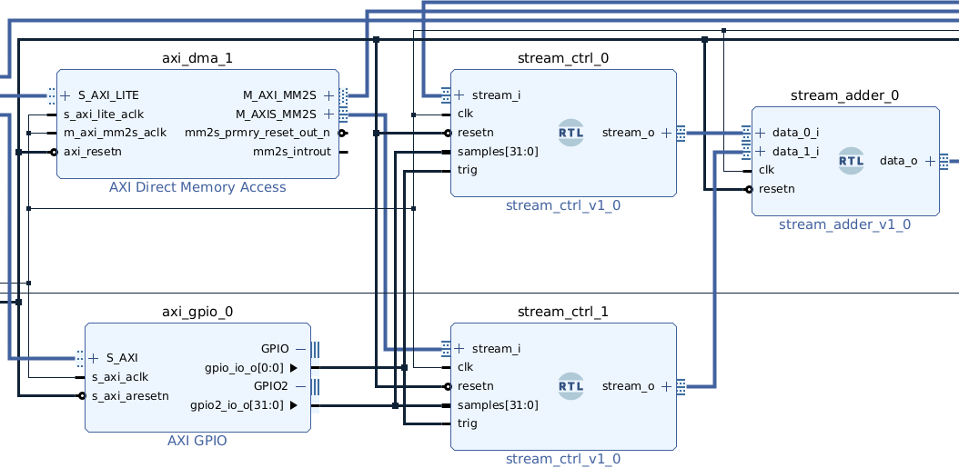
Core Modules
This is the core of the design:
The stream adder, the stream control and the DMA.
The goal is to use as few bits as possible because the RedPitaya has only 512 Mb of memory.

Slide 26
Conclusions

Slide 27
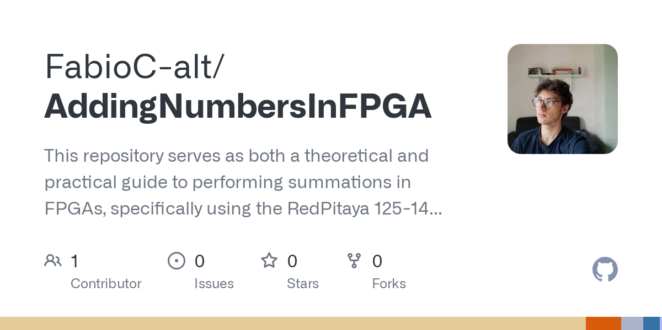
Results
From my experience here I wrote a github repo where is possible to find tutorials to reproduce this example along with more theoretical explanation.

Slide 28
Conclusions
The next steps in the GQuEST project will focus on the development of the correlation function.
I want to thank all the people that shared this adventure with me.
The downside were higher and the high moments skyrocketed with you

Slide 29
Thanks!
Do you have any questions?
fabio.ciraci@studio.unibo.it
The examples and images are both taken from the github repo of dspsandbox: “FPGA notes for scientist”

