Slide 1



Calibration of the Mu2e calorimeter with cosmic ray events
Giacinto Boccia
Italian Summer Students Final Reports
26 September 2024

Slide 2


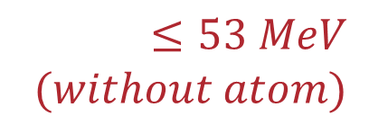



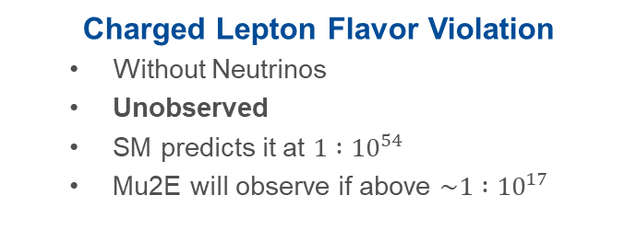





Why Mu2e?
$$ν_{μ}$$
$$e^{−}$$
$$μ^{−}$$
$$e^{−}$$
$$μ^{−}$$
$$104.9 MeV$$
$$≤53 MeV$$
$$(without atom)$$
$$W^{−}$$
$$\overline{ν_{e}}$$
$$Al$$
$$Al$$
Charged Lepton Flavor Violation
  Without Neutrinos
  Unobserved
  SM predicts it at $1 :{10}^{54}$
  Mu2E will observe if above $\sim 1 :{10}^{17}$
Regular Muon Decay
    Produces 2 neutrinos
    Common
    Several possible channels
    Background for Mu2e
Notes:
The experiment needs to produce muons, so it starts from a proton beam on a Tungsten target, which yields pions, said pions decay to muons that are then selected and transported to a stopping target made of Aluminum. Here we need them to stop (forming a muonic atom) as we need to know the exact kinematics of the dacay in order to recognize the flavor violation.
The electron produced then goes trough a tracker (magnetic spectrometer) and ends in the calorimeter.
1.7 us between pulses, combined with the choice of Al as a stopping material (Z determines the life of the muonic atom), allows to define a time window between pulses where muonic atoms are still decaying while other particles (Pions) are less likely to be present.

Slide 3
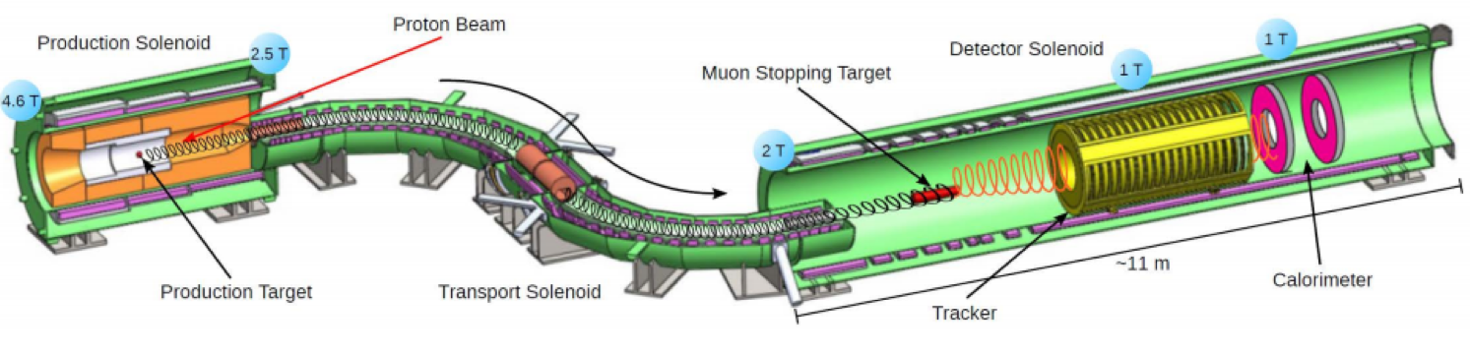







How do we do it?
$$π^{−}$$
$$μ^{−}$$
$$e^{−}$$
$$p$$
$$W$$
$$Al$$
$$\overline{ν_{μ}}$$
Notes:
The experiment needs to produce muons, so it starts from a proton beam on a Tungsten target, which yields pions, said pions decay to muons that are then selected and transported to a stopping target made of Aluminum. Here we need them to stop (forming a muonic atom) as we need to know the exact kinematics of the dacay in order to recognize the flavor violation.
The electron produced then goes trough a tracker (magnetic spectrometer) and ends in the calorimeter.
1.7 us between pulses, combined with the choice of Al as a stopping material (Z determines the life of the muonic atom), allows to define a time window between pulses where muonic atoms are still decaying while other particles (Pions) are less likely to be present.

Slide 4
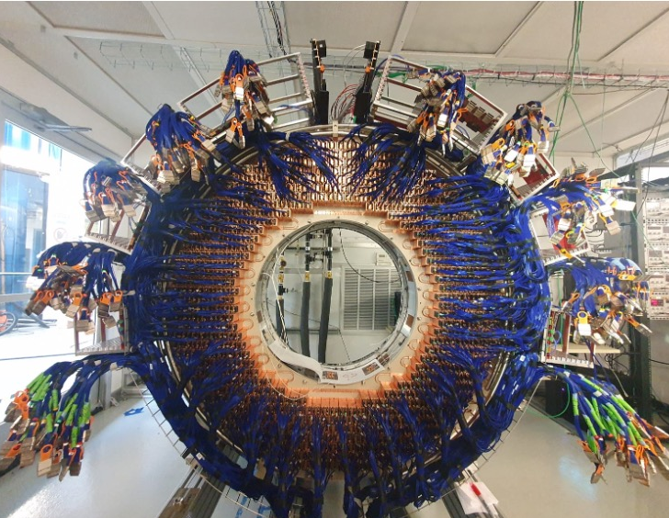
The Calorimeter
Consists of 2 disks, each holding 674 crystals
Each CsI crystal measures 34x34x200 mm³ and is read by two SiPMs with two independent channels
Calibration:
  Activated fluid
  LASER system
  Cosmic rays
Back view of one of the calorimeter disks, electrons will come from the opposite face of the apparatus.
Notes:
Cesium Iodide
Fluorinert

Slide 5
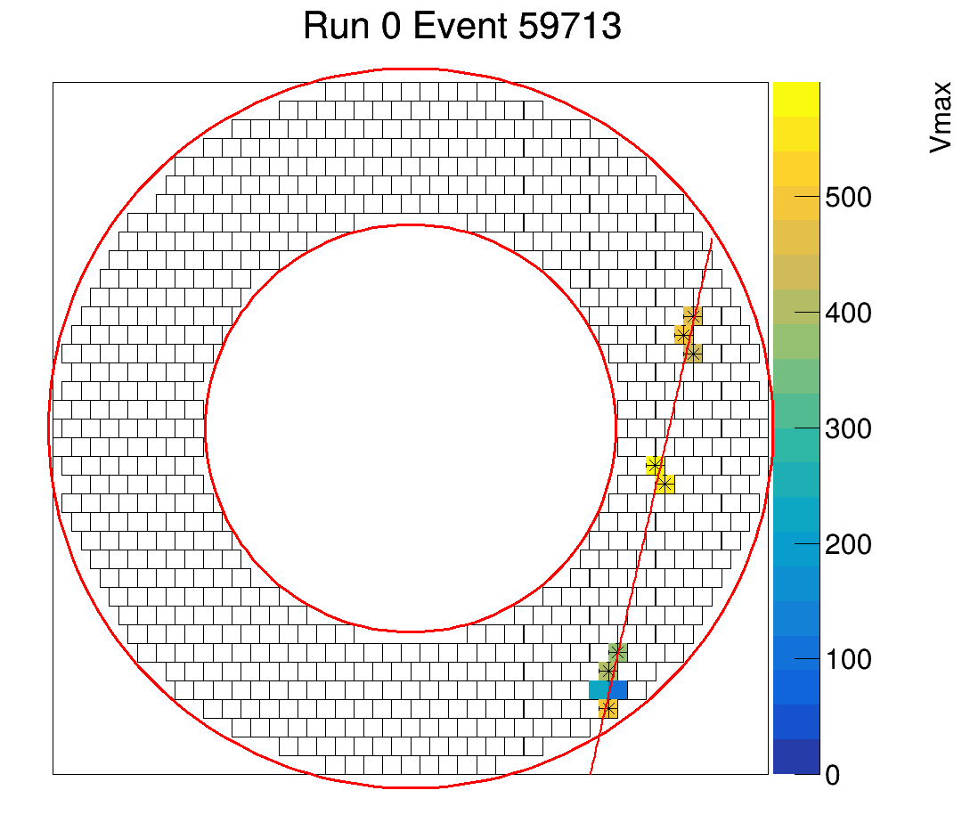
My project I - Event Display
Vertical Slice Test: first real calorimeter cosmic ray events detected by six readout boards
  58/674 crystals read
  Not contiguous
Available plots:
  Signal peak (linked to energy)
  Time differences (between SiPMs)
Linear fits of hits above a threshold
Frontal view of one of the calorimeter disks during a cosmic ray event, crystals are drawn and colored if activated, event fit in red.
Notes:
60 Crystals are already connected

Slide 6
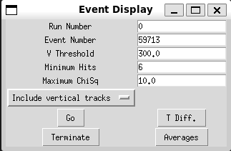
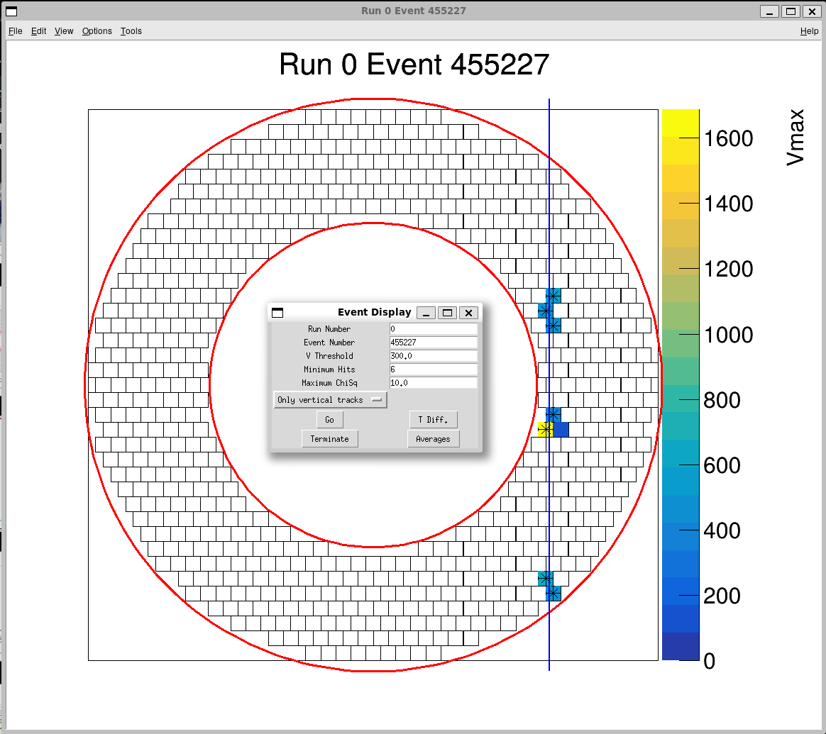
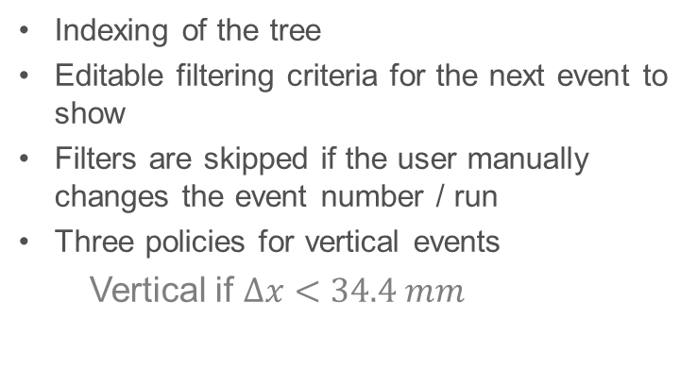
Main control window of the event display program, fields display the current values and can be edited by the user to filter the next event to show
Indexing of the tree
Editable filtering criteria for the next event to show
Filters are skipped if the user manually changes the event number / run
Three policies for vertical events
  Vertical if $Δx<34.4 mm$
Frontal view of one of the calorimeter disks during a vertical cosmic ray event, crystals are drawn and colored if activated, vertical events are not fitted, but a blue vertical line is drawn over the centroid

Slide 7

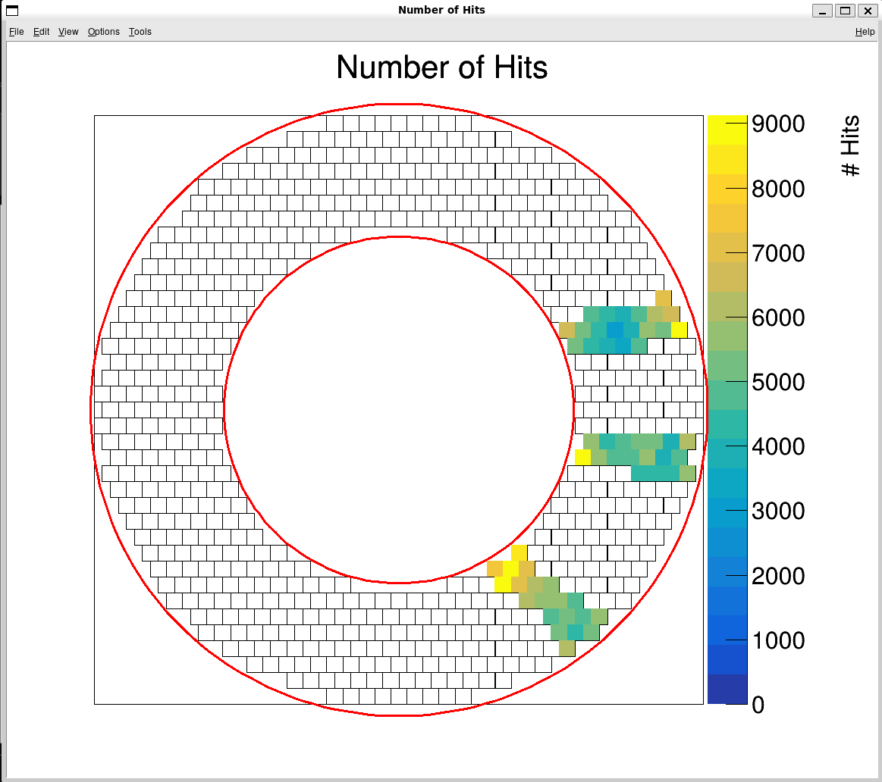
Control panel of the event display program when in “Averages” mode
Loading all the events from the file
For each crystal we can draw:
  Average peak amplitude
  Number of hits
  Average time difference
Frontal view of one of the calorimeter disks, the color of cells represents the total number of hits over the entire reconstructed file

Slide 8
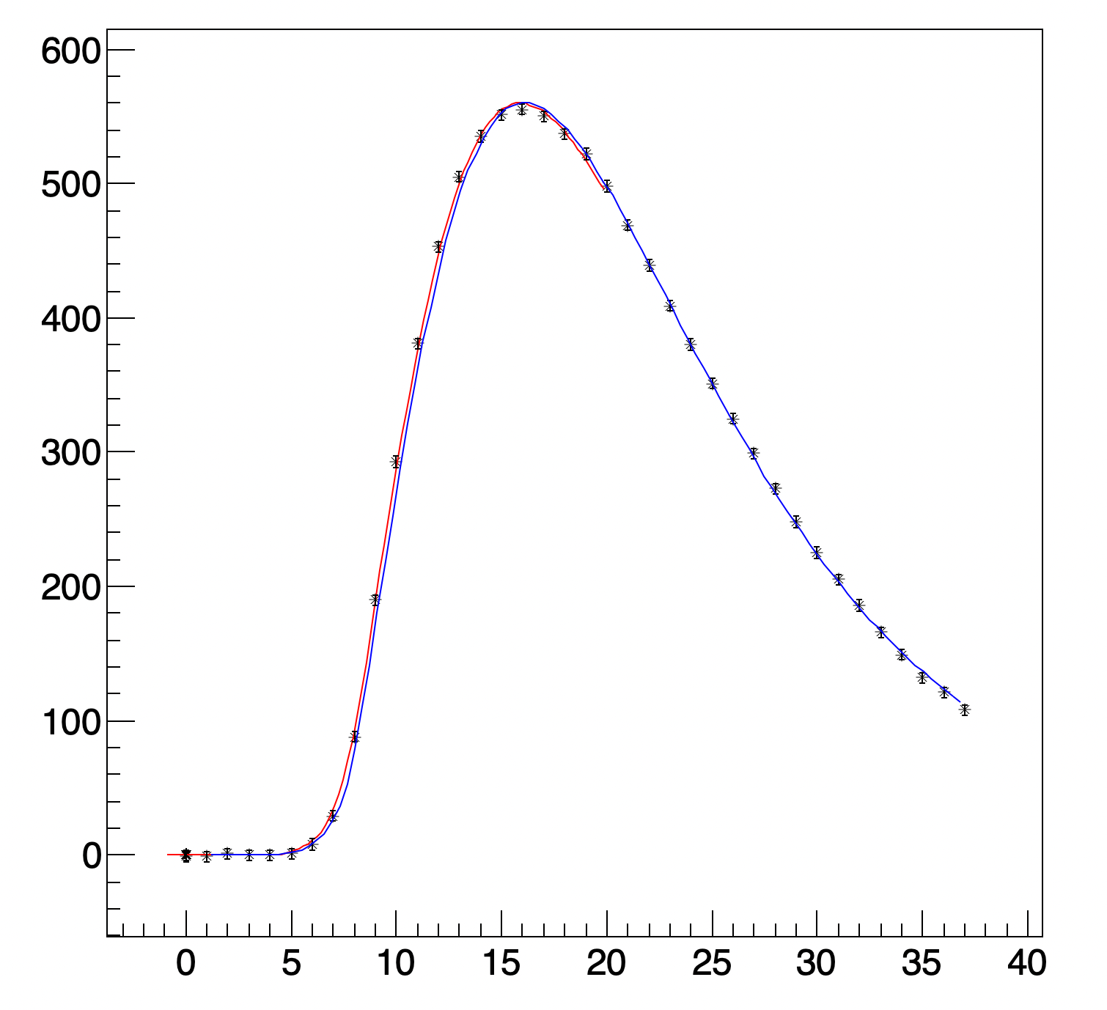
Template fitting window
Each readout channel (SiPM) is sampled every 5 ns
The waveform is fitted to extract the timing of the hit (hit time is defined as when the fitting curve crosses 20 % of the peak)
To extract the best time evaluation, we must optimize the time window where the fit is applied
ADC counts
Template fitting of sampled signal, in red and blue over different time windows.
Clock counts

Slide 9
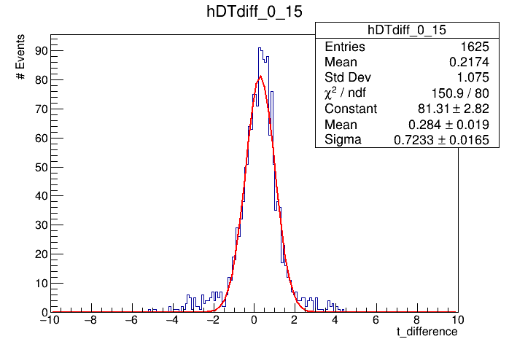
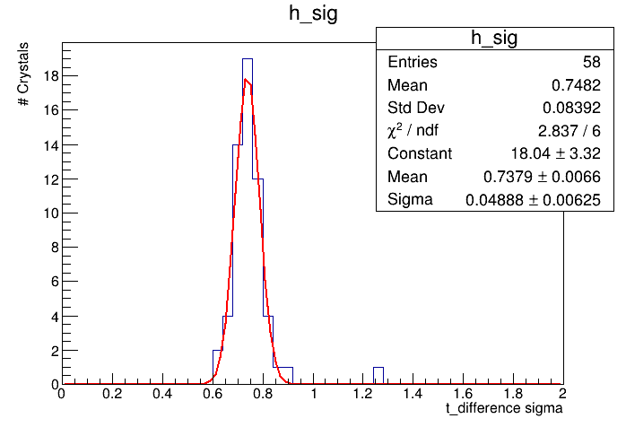
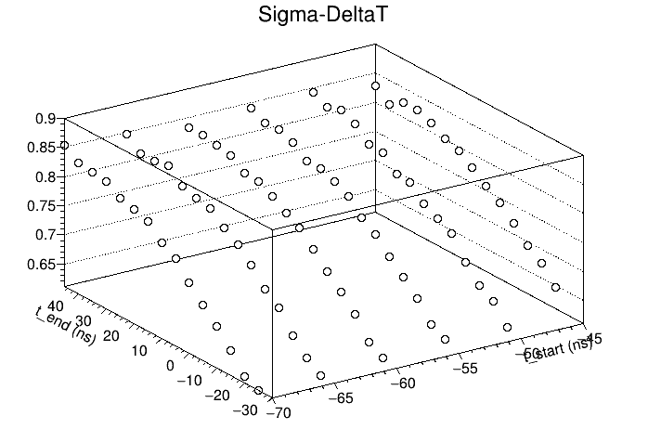
My Project II - Window Sampling
Time response differences between the two SiPMs, over multiple events for the same crystal.
Time response fluctuations, for different crystals over multiple events for the same fitting window.
Mean time response fluctuations, for multiple fitting windows. Start and end values (ns) are relative to the peak.
Optimization of the fitting window to minimize the time resolution of the calorimeter

Slide 10

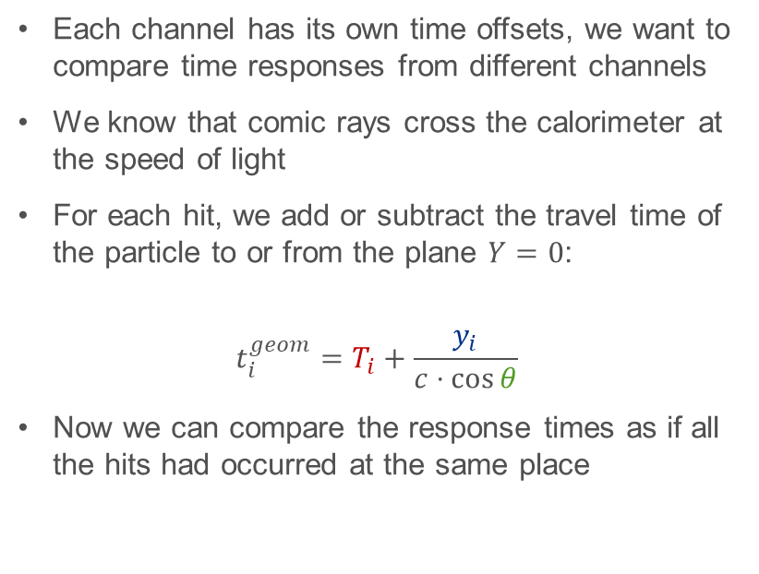


My Project III – Iterative Time Calibration
$$Y$$
Each channel has its own time offsets, we want to compare time responses from different channels
We know that comic rays cross the calorimeter at the speed of light
For each hit, we add or subtract the travel time of the particle to or from the plane $Y=0$:
$$t_{i}^{geom}=T_{i}+\frac{y_{i}}{c⋅\cos{θ}}$$
Now we can compare the response times as if all the hits had occurred at the same place
$$θ$$
$$X$$
Notes:
Each readout channel has its own time response delays, due to the involved electronics, and its response needs to be calibrated to reconstruct the correct

Slide 11
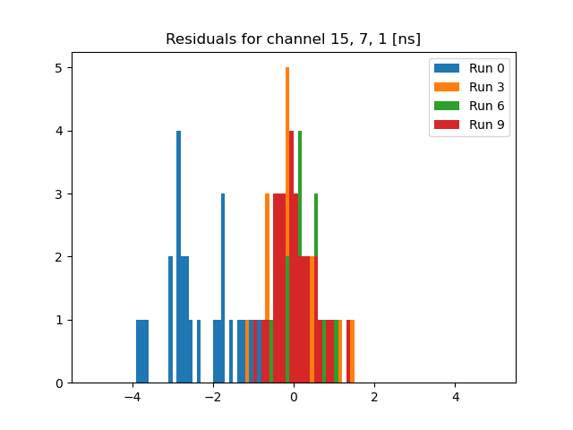

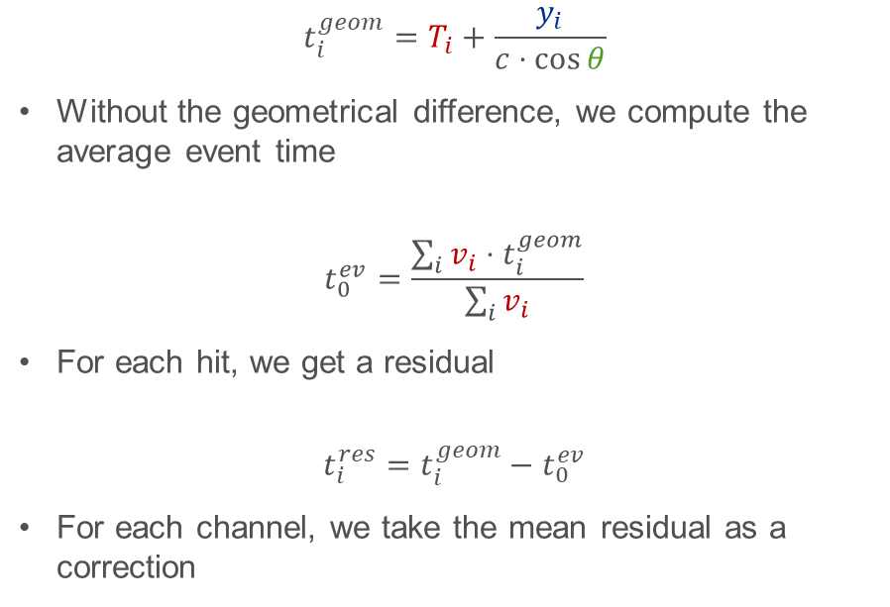
My Project III – Iterative Time Calibration
$$t_{i}^{geom}=T_{i}+\frac{y_{i}}{c⋅\cos{θ}}$$
Without the geometrical difference, we compute the average event time
$$t_{0}^{ev}=\frac{\sum_{i}{v_{i}⋅t_{i}^{geom}}}{\sum_{i}{v_{i}}}$$
For each hit, we get a residual
$$t_{i}^{res}=t_{i}^{geom}−t_{0}^{ev}$$
For each channel, we take the mean residual as a correction
ns
Histogram of the residuals for a single channel, over many events and iterative runs
$$T_{chan}^{corr}$$

Slide 12
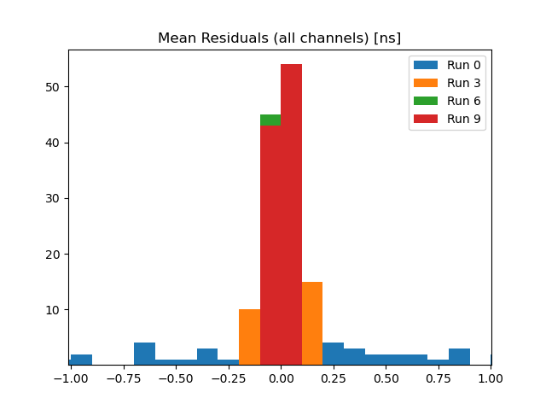
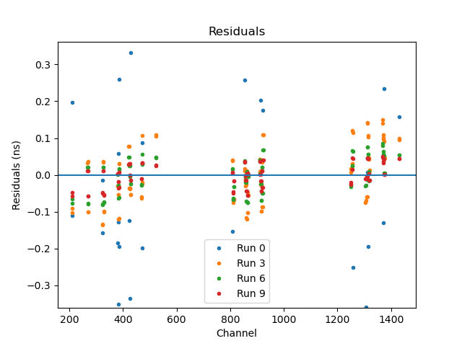
My Project III – Iterative Time Calibration
ns
Distribution of the mean residual for each channel across many events and across the iterations of the calibration
Plot of the mean residual for each channel (only a small part of the calorimeter is instrumented) across many events and across the iterations of the calibration

Slide 13



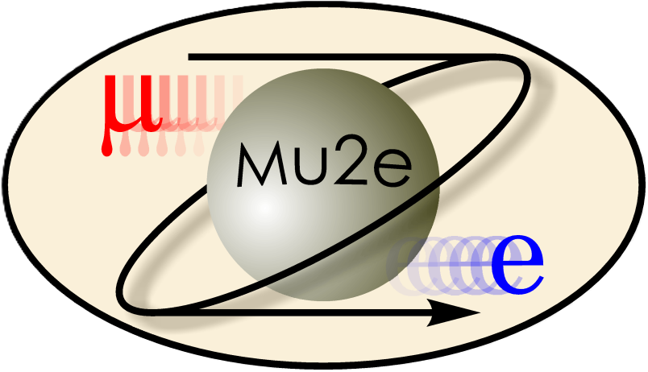
Collaborations / Involved partners

Slide 14








How we plan to continue? – Cosmic Ray Inclination
$$R$$
$$z$$
By evaluating the time difference between hits, we can calculate the angle of the track:
  The flight time between hits is:
  $$Δt=\frac{\sqrt{{\left(R_{1}−R_{2}\right)}^{2}+{\left(z_{1}−z_{2}\right)}^{2}}}{c}$$
  The signal times are:
  $$T_{1}=\frac{L−z_{1}}{c}η$$
  $$T_{2}=\frac{L−z_{2}}{c}η+Δt$$
  $$ΔT=\frac{R_{1}−R_{2}}{c}\left(−η⋅\tan{θ}+\sqrt{1+\tan^{2}{θ}}\right)$$
$$T_{1}$$
$$ΔT$$
$$c⋅Δt$$
$$θ$$
$$T_{2}$$
Notes:
Let’s consider the Z axis. Here I depicted just a few crystals, and I am considering just 2 of the hits from a cosmic ray event.
So, what is the time difference between hits, well, we have the time of flight between them, but then the light from each hit needs to arrive at the readout, right? [ANIMATION]
And then we will get a readout time difference, that we measure, we know the distance on the disk plane, so we should be able to find theta.

Slide 15

How we plan to continue? – Cosmic Ray Inclination
By evaluating the time difference between hits, we can calculate the angle of the track
If the cosmic ray is vertical, it can span the entire z axis
$$z$$

Slide 16
How we plan to continue? – Cosmic Ray Inclination
By evaluating the time difference between hits, we can calculate the angle of the track
If the cosmic ray is vertical, it can span the entire z axis
If the cosmic ray is inclined the span becomes shorter
$$z$$

Slide 17
How we plan to continue? – Cosmic Inclination
By evaluating the time difference between hits, we can calculate the angle of the track
If the cosmic ray is vertical, it can span the entire z axis
If the cosmic ray is inclined the span becomes shorter
Even more inclination and the ray is locked in one position
So, cosmic ray events could be used as a 3D calibration source
$$z$$

Slide 18
How am I doing it? – Event Display
Disk
The program is split in two between the GUI part and the main python library that holds all the classes and some functions to perform the usual operations
While the GUI and the functions that it calls perform all the intended uses of the event display, the object-oriented approach is intended to allow for future extensions of its use
A version showing both disks has been considered
Crystal
Hit
Hit
N
X
Y
T
Q
N
X
Y
T
Q
Event_fit
Linear_fit
__is_vertical

Slide 19
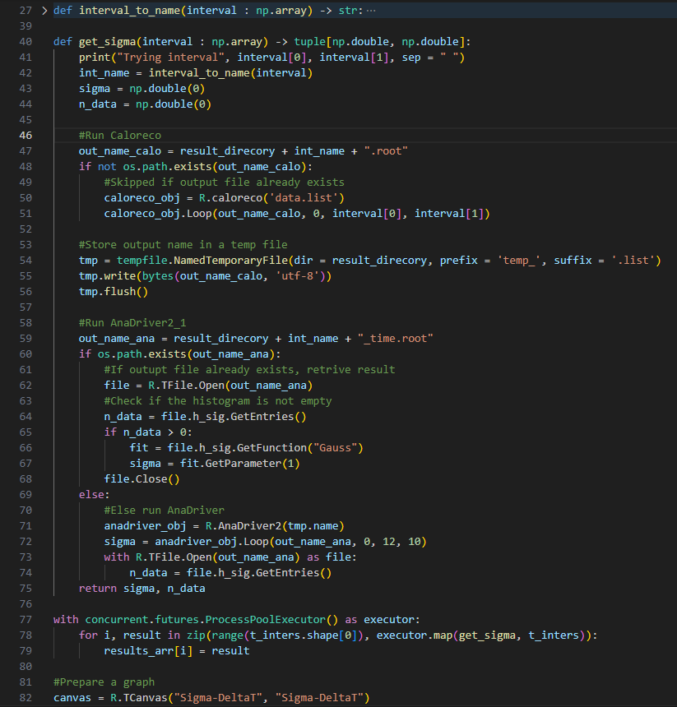
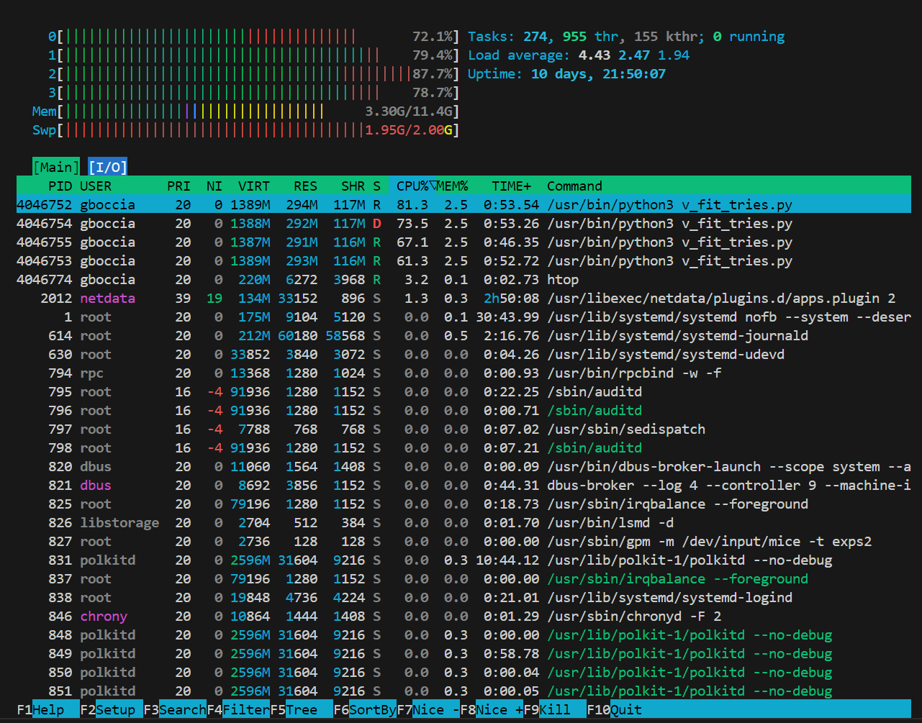
How am I doing it? – Window Sampling
Parallelism over different time windows
Successful use of the Elastic Analysis Facility
On mu2egpvm03 it takes a while…

Slide 20
How am I doing it? – Time Calibration
Tree
Current events amount to:
  About 2 h of data
  About 60 crystals
Expect to have 100 times the hits once completed
Use parallelism (EAF):
  In linear fits
  In computing residuals
Keep graphs optional, do not create a graph each time you need a fit
Linear Fits
Cuts
Residuals
Corrections

