Slide 1
Magnetometer measurement for g-2 experiment
Nicolò Rossolino

Slide 2
Introduction to Muon g-2
$\overset{⃑}{μ}=g\frac{q}{2m}\overset{⃑}{S}$
$a_{μ}=\frac{g−2}{2}$
Dirac equation: $g=2$
BSM:
What we are searching!
QFT:
$\sim {10}^{−3}$ shift

Slide 3
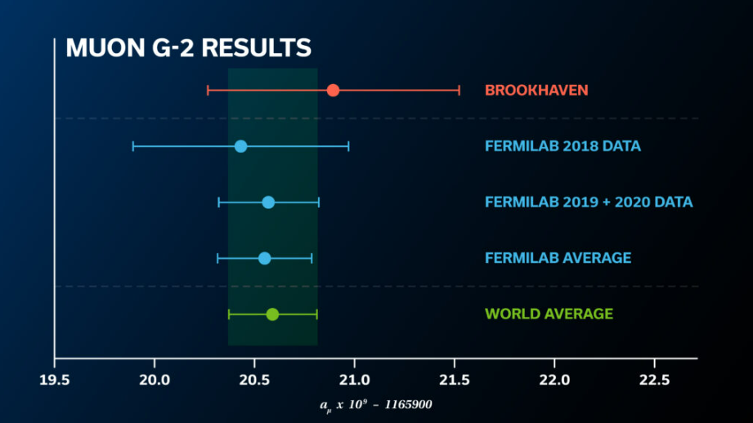
Muon precession
When muons circulate in a magnetic storage region,
There is a precession motion of the particle spin with reference to its momentum due to the magnetic field
$$ω_{a} ≅a_{μ}\frac{qB}{m}$$
The goal of muon g-2 experiment is to measure $a_{μ}$with 140ppb uncertainty

Slide 4
Main Formula
Fundamental factors (uncertainty 25ppb)
$$R_{μ}$$
$ω_{a }$= muon anomalous precession frequency
$ω_{p}(T_{r})$ = magnetic field B in terms of shielded proton precession frequency and weighted by the muon distribution

Slide 5
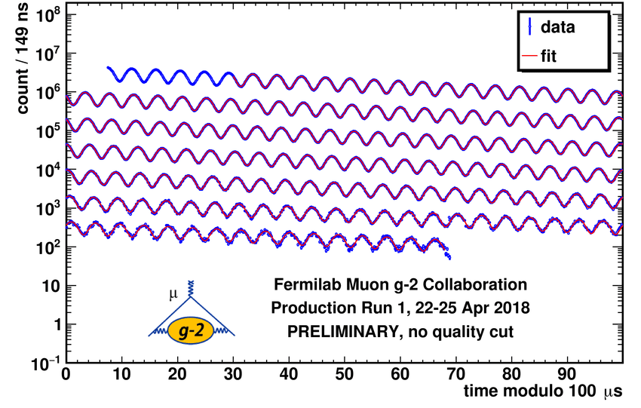
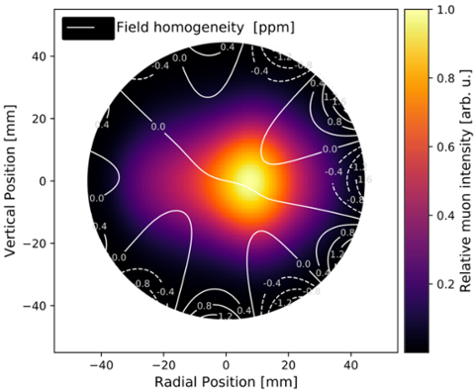
Master formula for analysis
My work focuses on $B_{k }$which is the transient field from eddy currents in kickers and the measurment of the kick pulse

Slide 6
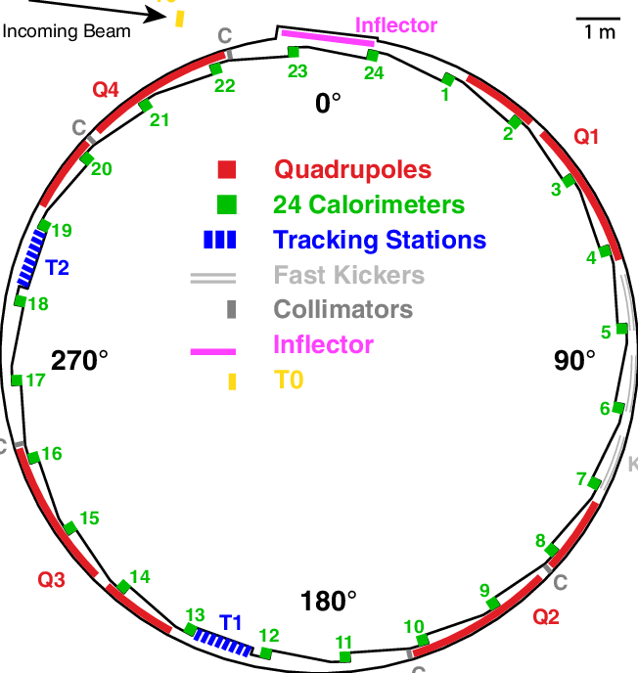
Magnetic Kicker
g-2 uses three magnetic kickers to create a vertical magnetic field to deflect the beam into a centered stable orbit (magic radius)
The kicks are magnetic pulses of about 200 Gauss
The presence of eddy currents causes the kicker transient magnetic field, an effect of about 1-2 mGauss that extends in the measurement time window
We measured the pulse of the kicks and the eddy currents with a magnetometer based on the Farady effect

Slide 7
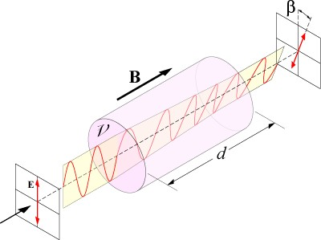
Faraday Rotation
Farady effect is the rotation of the light linear polarization into some particular dielectrict crystals when they are subjected to magnetic field
Farady rotation is used to measure the kicker transient magnetic field, since the variation of the magnetic field is proportional to the rotation of the polarization of a laser beam
β = V∙B∙d
β = V∙B∙d

Slide 8
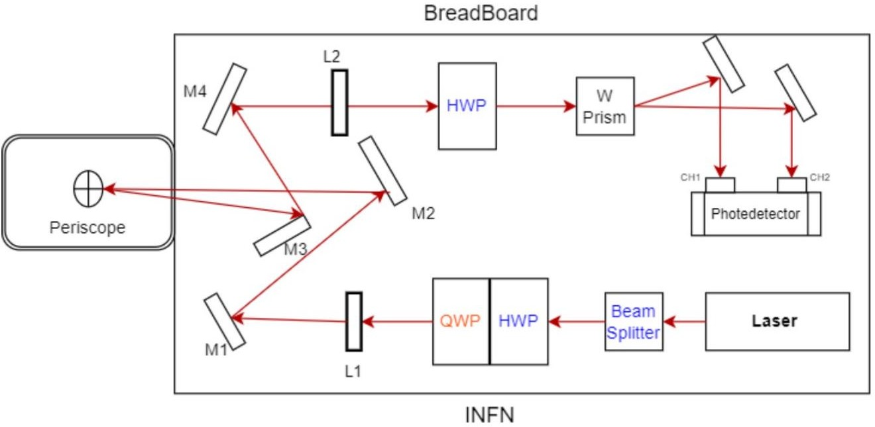
Magnetometer experimental setup
The pirinciple is to study the Faraday rotation sending a laser ray in a TGG Verdet crystal
Wollaston Prism - used to split
used to balance the laser light
before the acquisition
laser light in two beams: horizontally and vertically polarized beam
focusing lenses
collects first beam and second beam and then gives the difference in output intensities
linearly polarized
633 nm red light
composed by two TGG ((Terbium Gallium Garnet) crystals
improves the laser polarization; deflected light used to measure laser stability
Quarter Wave Plate - studies the noise
Half Wave Plate -
dieletric mirrors
maximizes the laser light
4

Slide 9
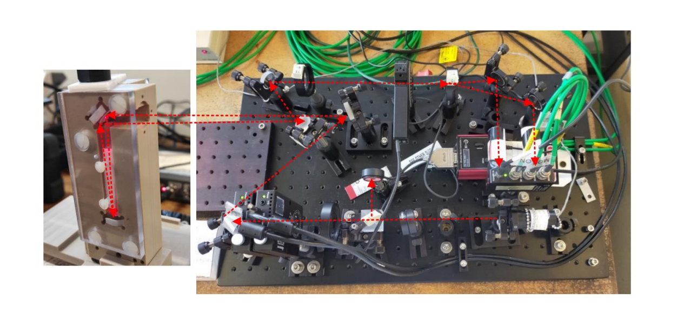
Magnetometer Pictures
Laser beam path on the breadbord and into the periscope

Slide 10
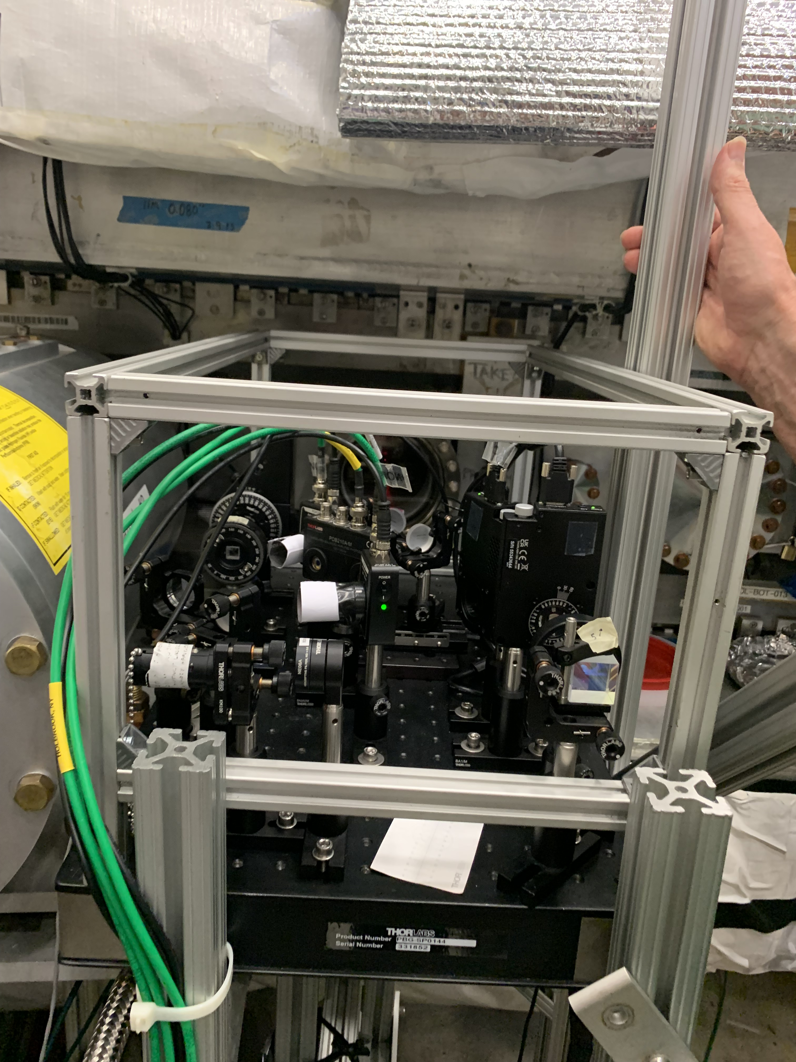
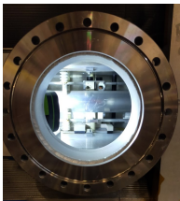
Into the ring
The main goals of my project are:
Install the breadboard inside the ring in the kicker 3 region
Measure the pulse of the main kicks and comparing them with each others
Take measures at two different radial distances
Measure the eddy currents contributions
Add the new pulse measurement in the simulation

Slide 11
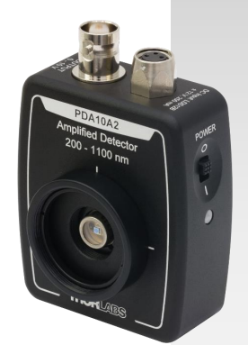
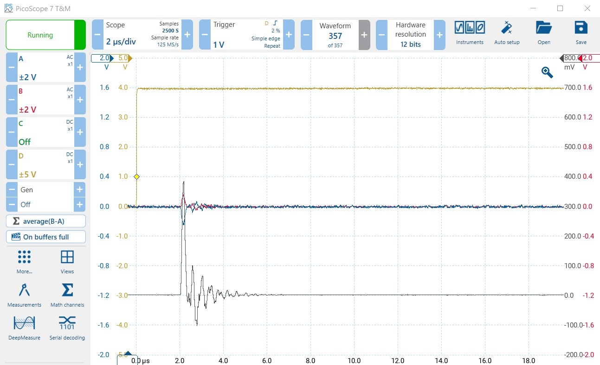
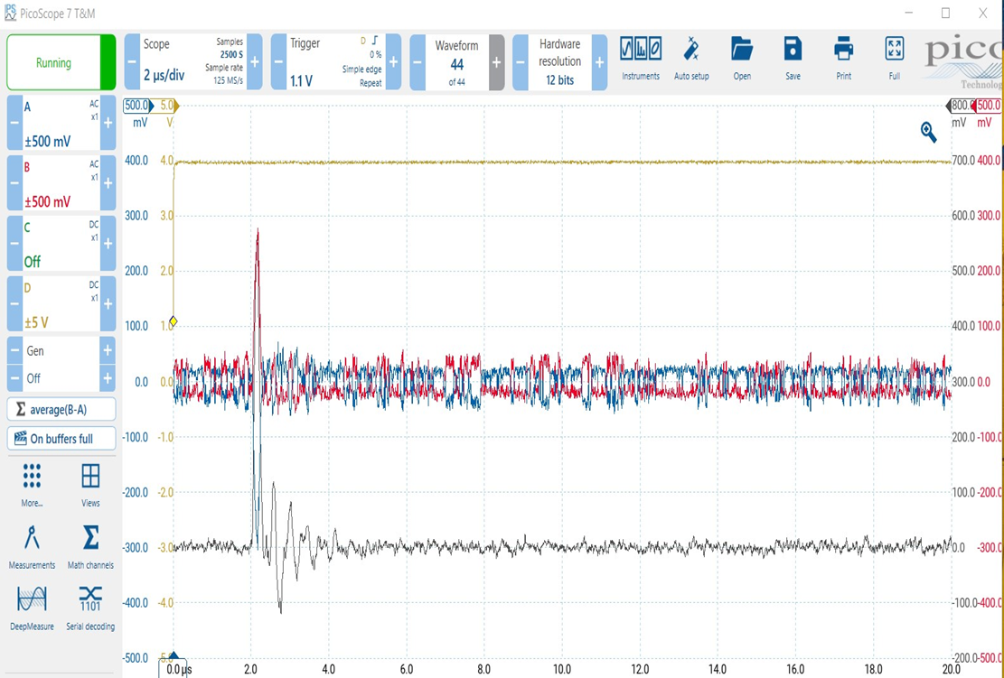
DAQ Setup
Trigger mimics the experiment:
Two groups of bunches each separated by 200ms
Each group with 8 kicks separated by 10ms
Data were recorded in 20us interval and 4ns sampling steps
To acquire the full kick pulse we use a fast diode model PDA10A2

Slide 12
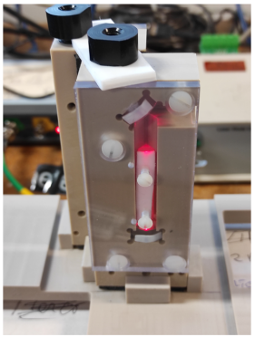
Probing the radial dependence of the kicker pulses
We have the possibility to acquire datas with a different radial distance than the magical one, the second periscope is shifted 1.5 cm radial farther ($R_{1}$) than the central one ($R_{0}$)

Slide 13
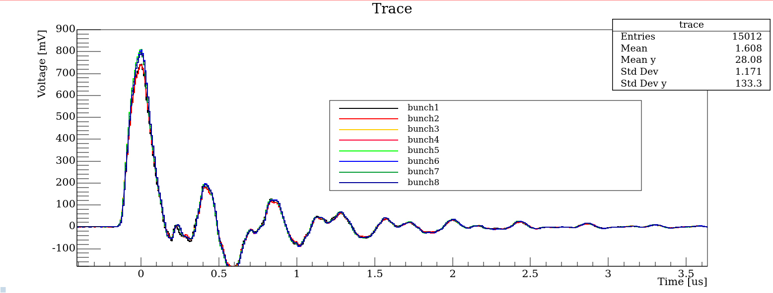
Kicker Pulse R0 Configuration
Preliminary
The strenght of the kick in 1st and 2nd bunch appears to have a lower amplitude than the other ones of a $\sim 10\%$ factor. Still under investigation

Slide 14
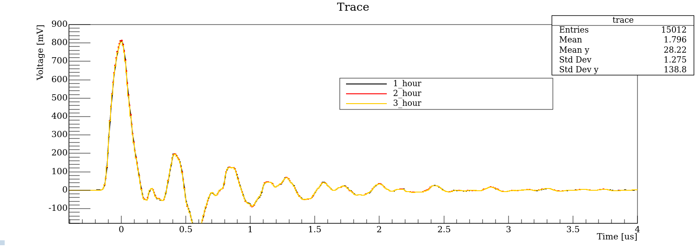
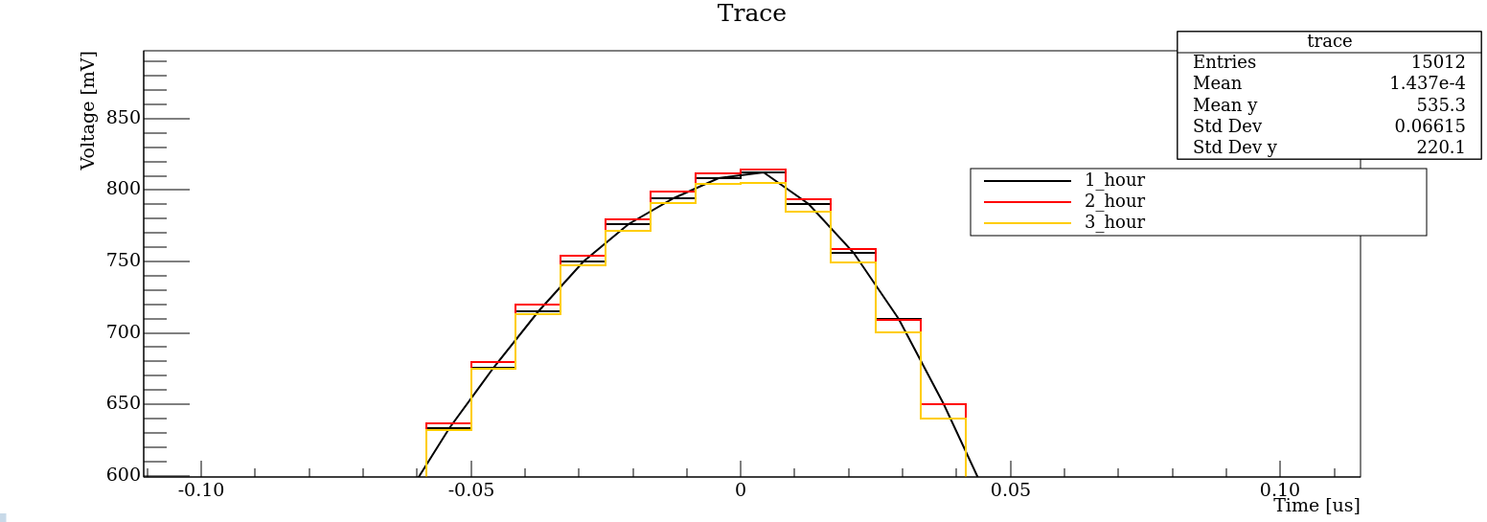
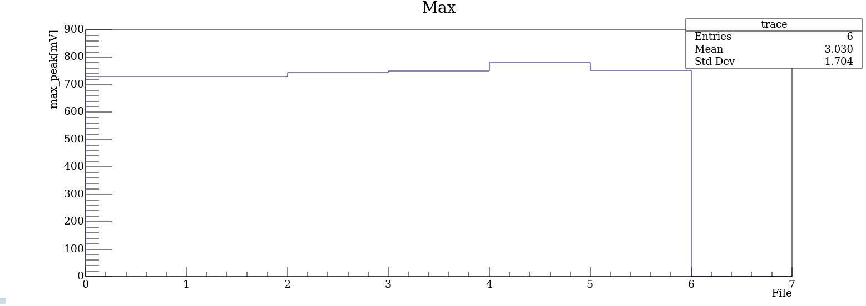
Kicker amplitude differences investigation
The reason for the lower amplitude of the first two kicks is probably the «heating time» of the kicker system.
More statistic would be needed to complete the study

Slide 15
Kicker Pulse R1 Configuration
All the pulses have compatible shape and amplitude

Slide 16
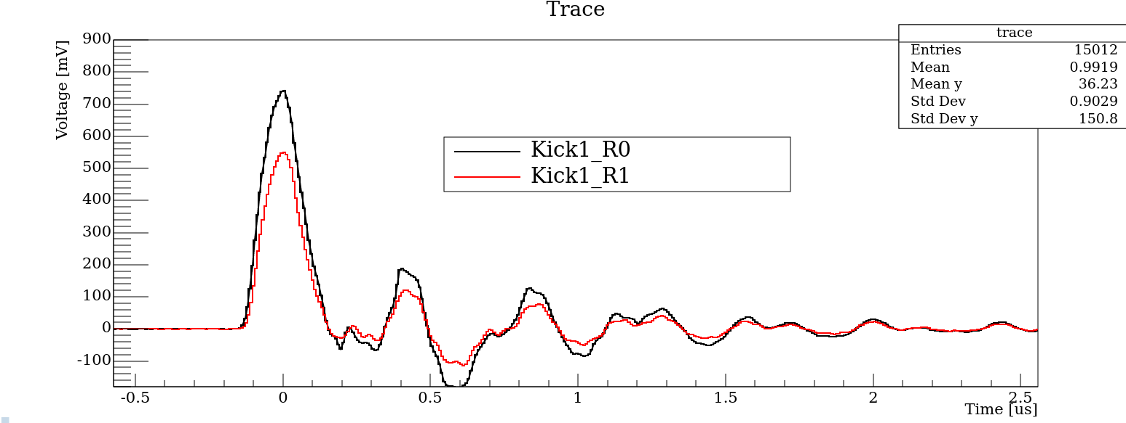
$R_{0}−R_{1}$Comparison
$R_{0}$ 1st kick appears to be lower, as expected, because the radial distance from the periscope is lower in that configuration

Slide 17
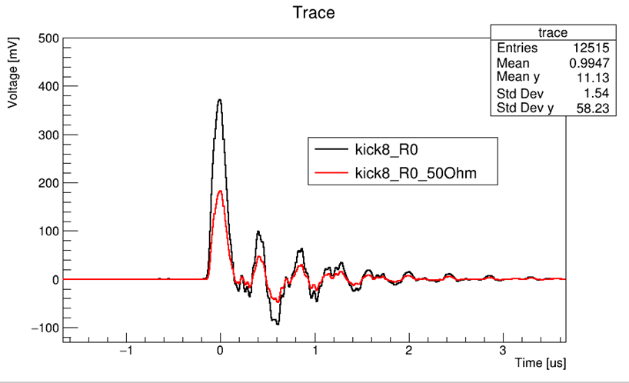
Example of checks performed during the setup
We tested the setup with a 50Ω ending on the cable connected to the oscilloscope to optimize the diode bandwith. From the plot we see as expected that the 50Ω configuration is exactly half than the other one

Slide 18
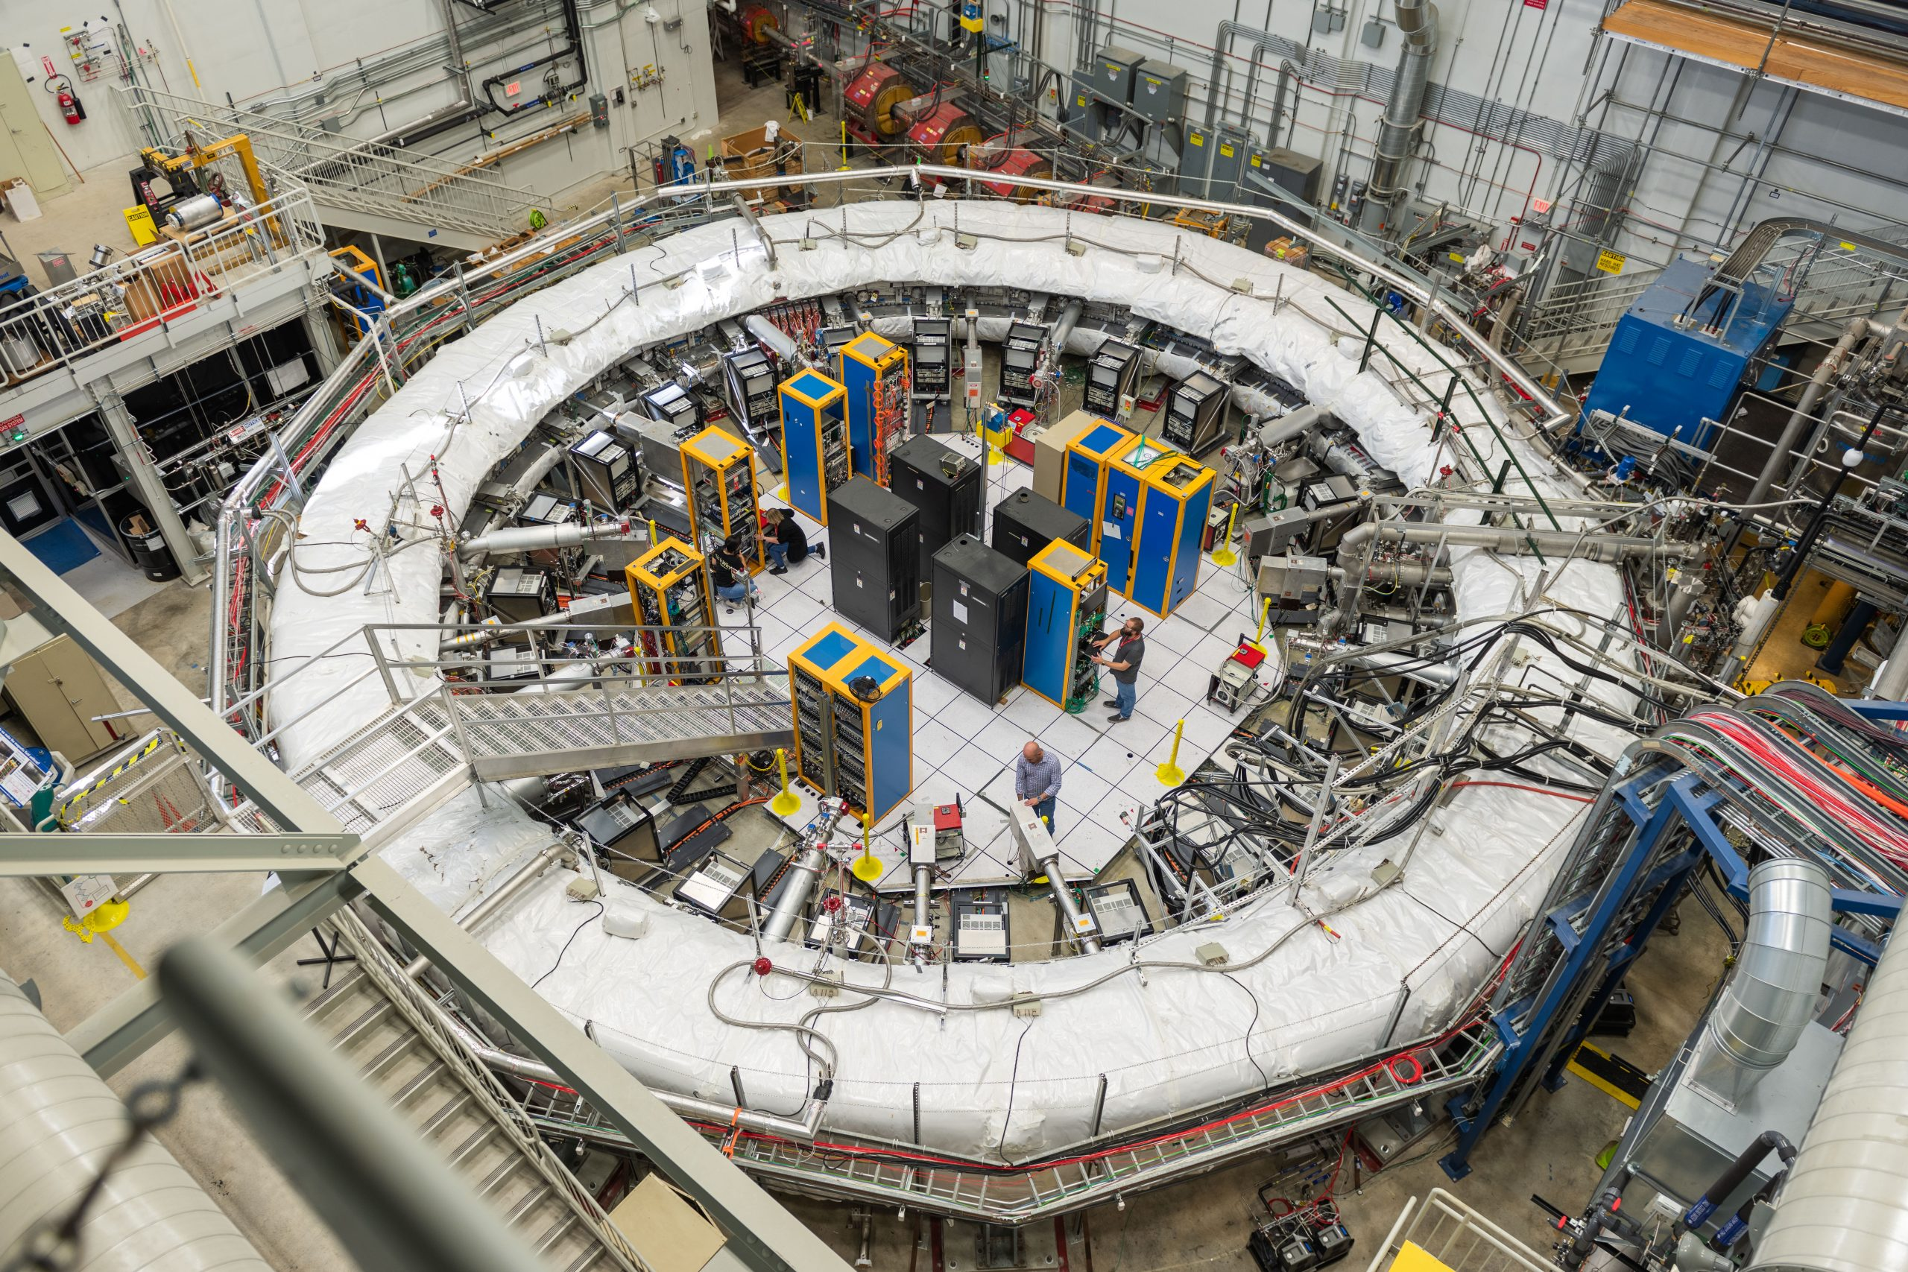
Next analysis goals
Investigate the reason why the amplitude of the kick in bunches 1 and 2 at $R_{0}$ are lower than the others
Add kickers pulse shape in the simulation
See slide 12

Slide 19
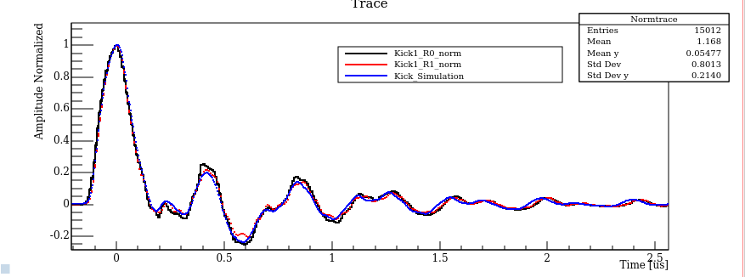
Simulation Kicks Comparison
Both $R_{0}$ and $R_{1}$normalized 1st kick have the same shape with the kick used in simulation. It confirms the pulse we are using in the simulation is corrected

Slide 20
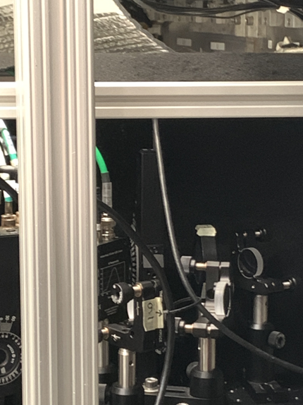
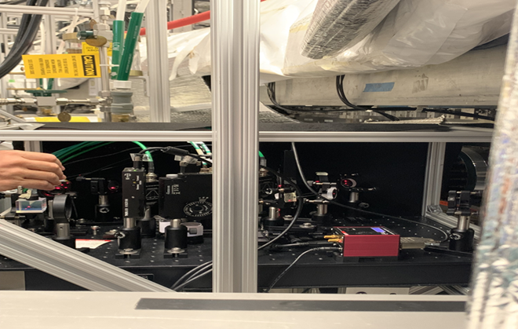
Magnetometer setup for eddy currents effects
Add a lense to focus the laser on the photodetector
Change the photodecter because for this measurement is needed an amplification of the signal
Data were acquired in both configuration $R_{0}$ e $R_{1}$
Each measurement was about 1 day long to minimize the noise

Slide 21
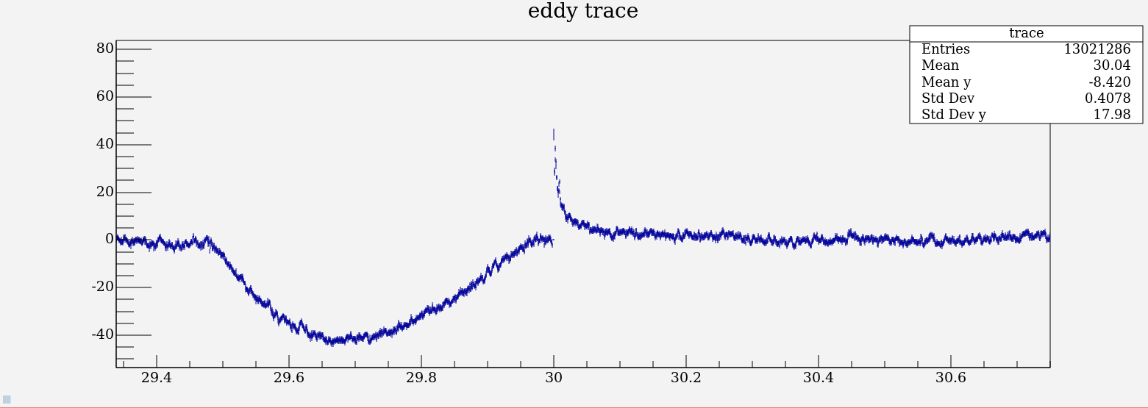
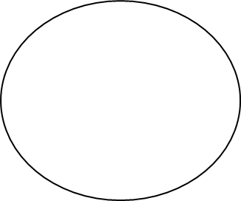
Example of an eddy currents plot
Blumlein (condensator charging for the kick)
Eddy Currents
Analysis done for data taken in $R_{1}$configuration

Slide 22
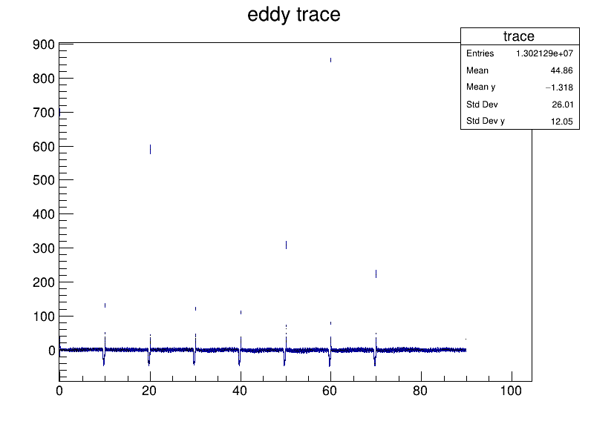
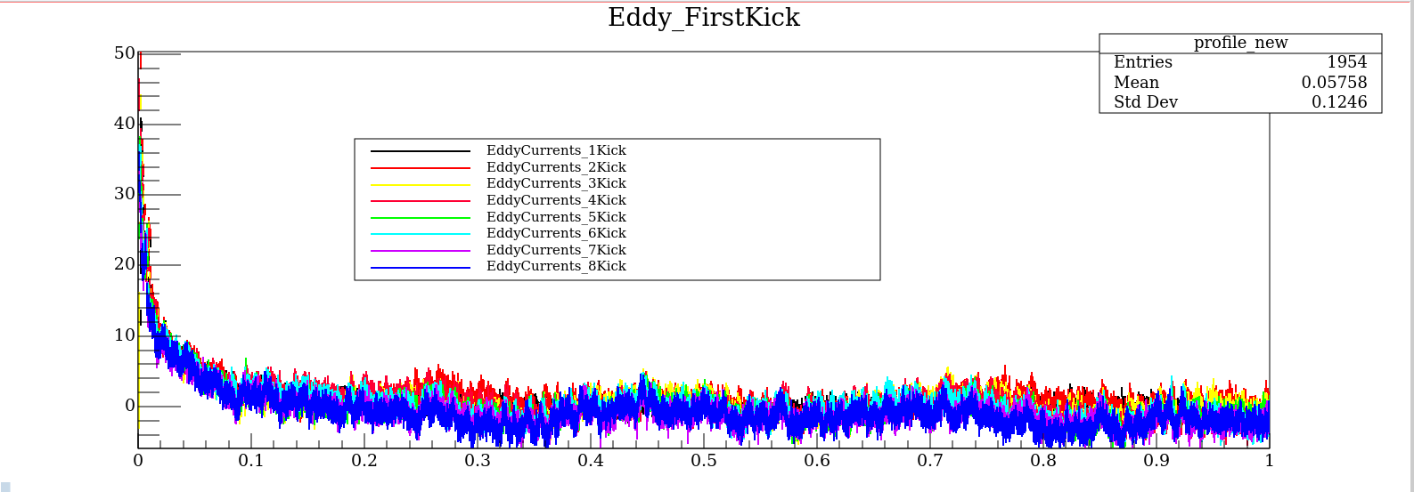
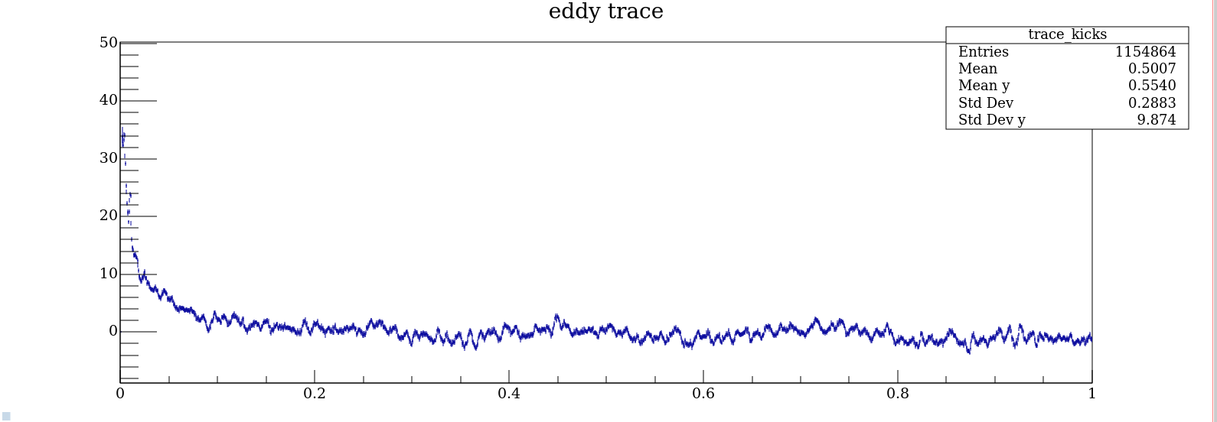
8 kicks plot in (0, 100)ms interval
One kick every 10ms, all signals can be compared so the average has been done. The eddy currents effect could be described by an exponential behavior

Slide 23
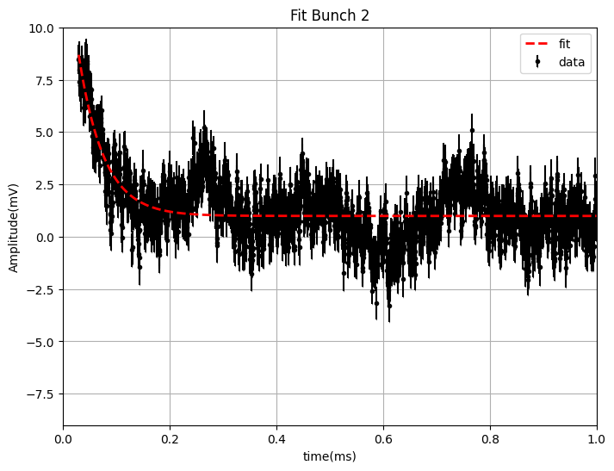
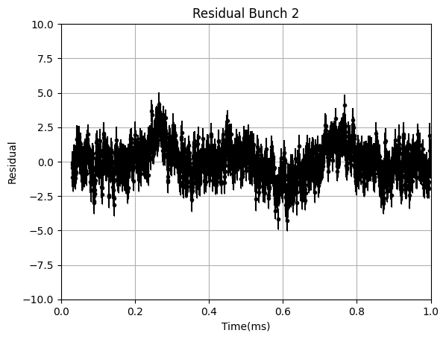
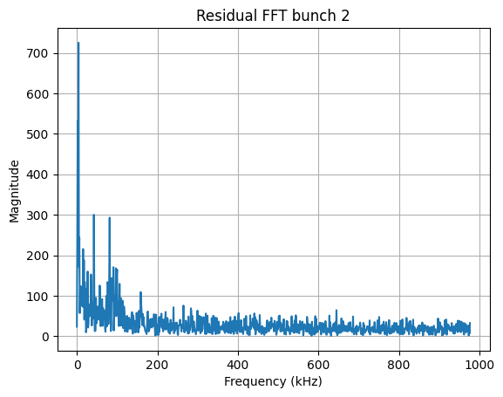
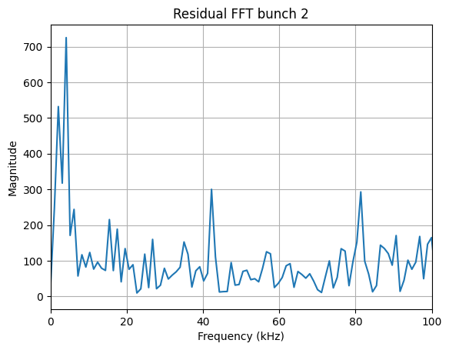
Exponential fit is not enough…
From the residual plot we see an oscillation and from the FFT plot we see at least three oscillations at frequencies of 3.8 KHz, 2.8 KHz and 17KHz probably generated by mechanical and electronical noise

Slide 24
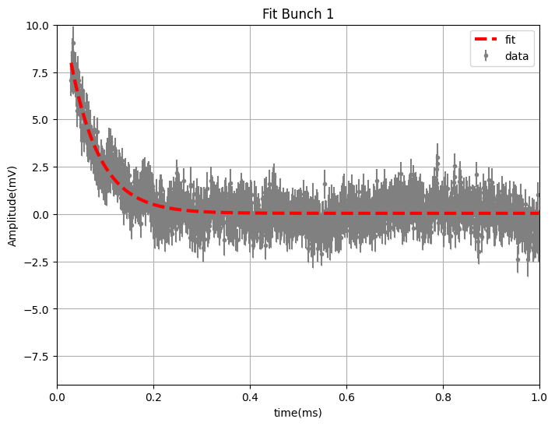
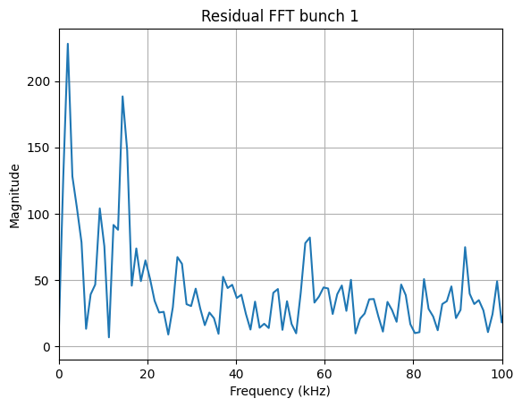
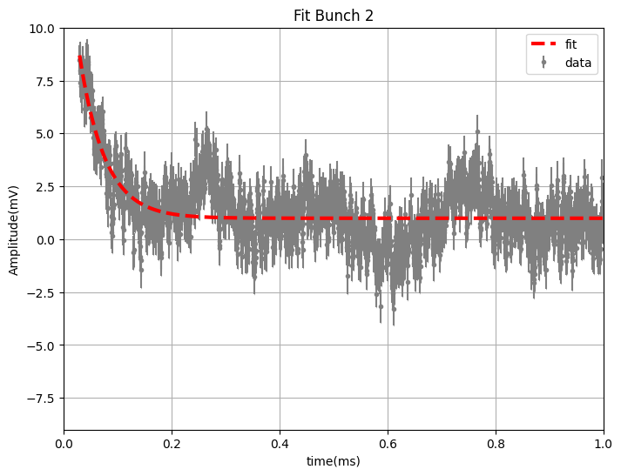
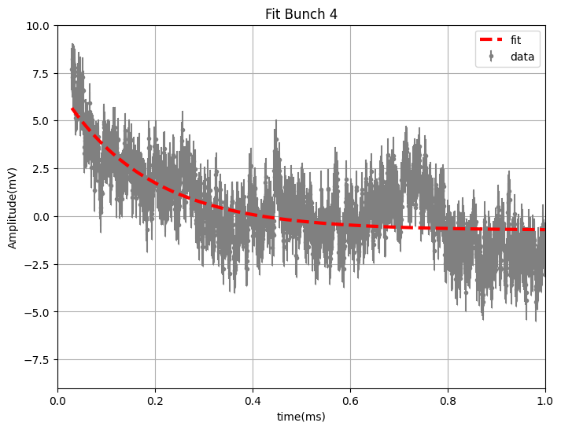
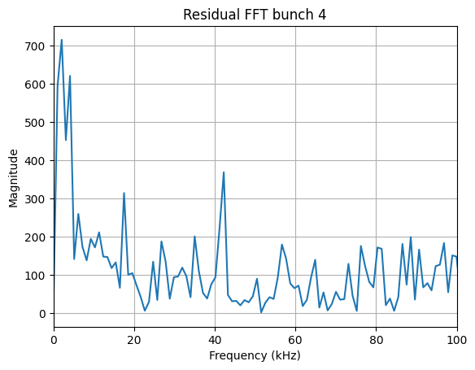
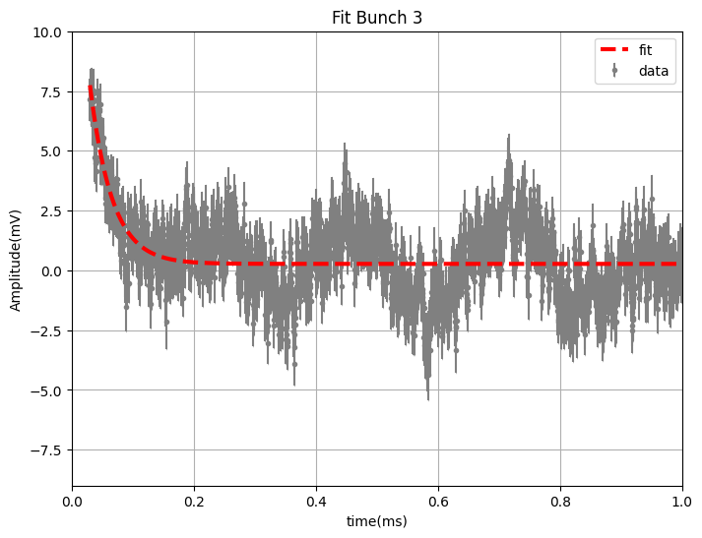
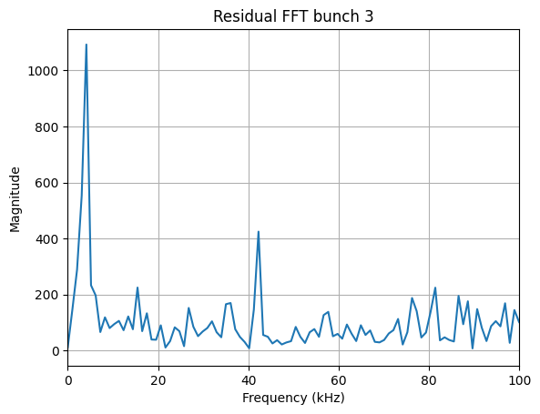
Exponential Fit and FFTs

Slide 25
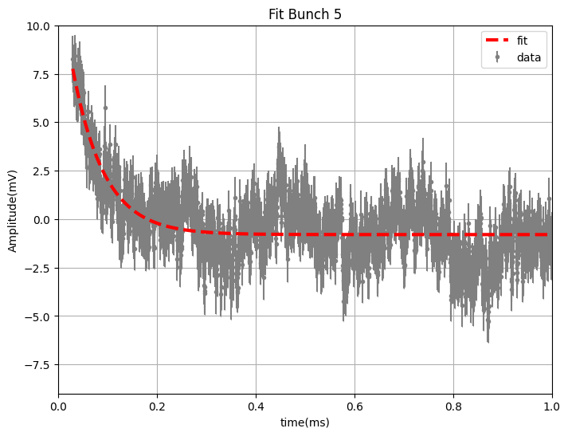
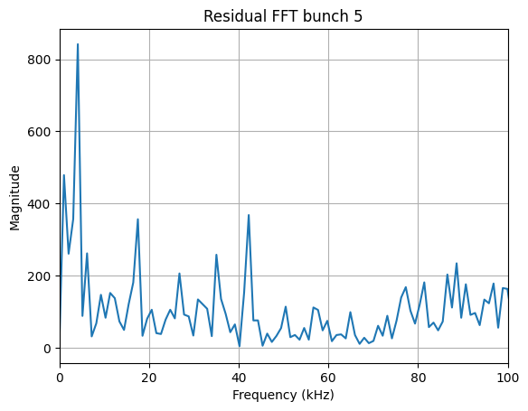
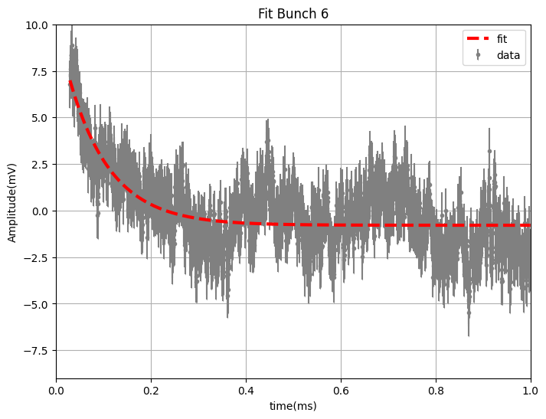
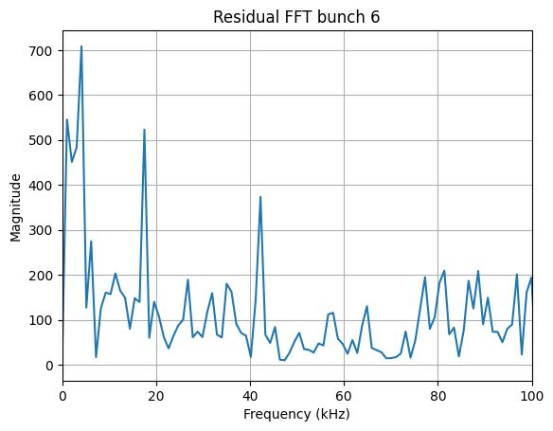
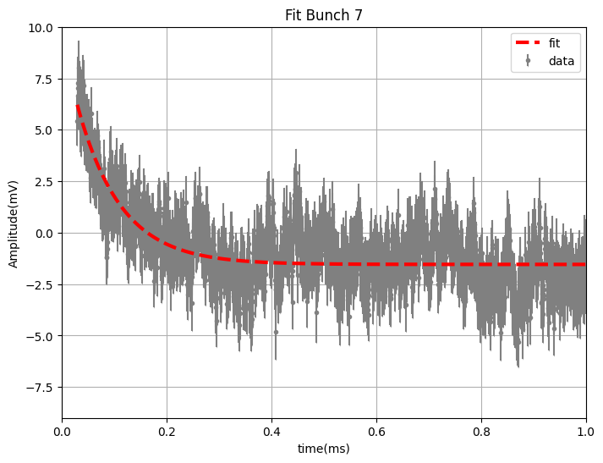
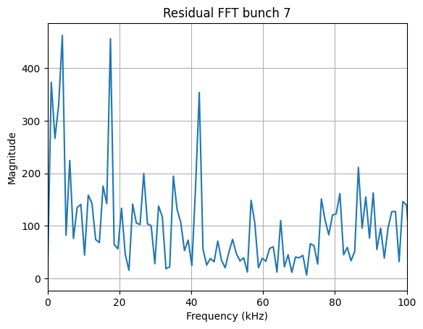
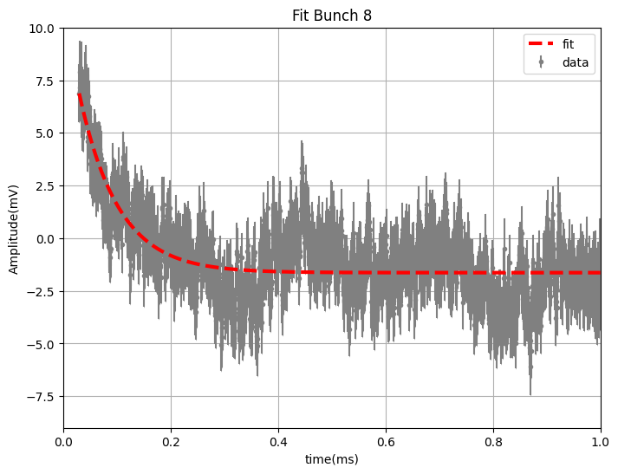
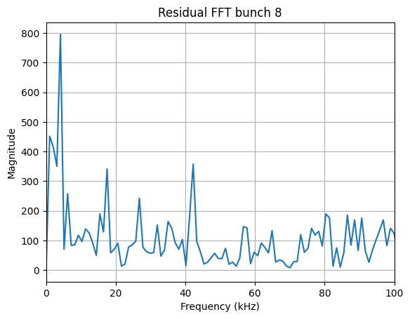
Exponential Fit and FFTs (part2)

Slide 26
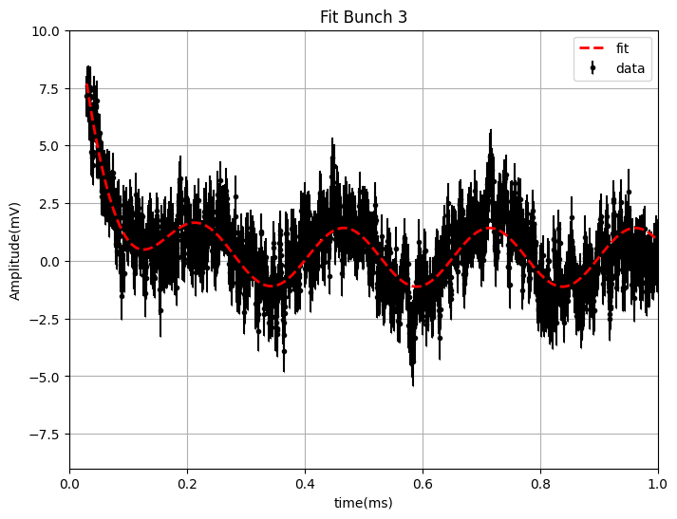
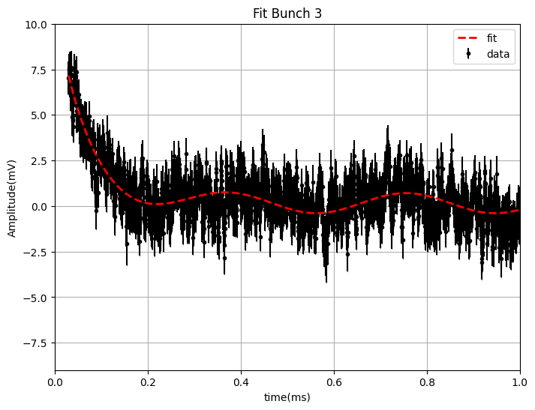
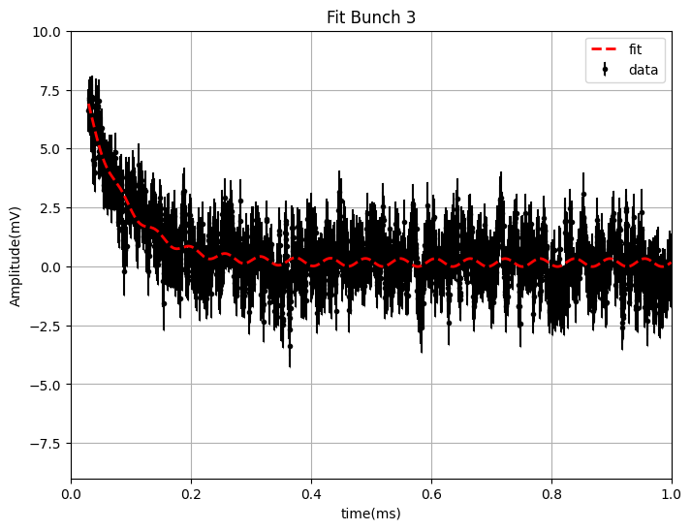
Oscillations in the bunches
w≃$1.9 KHz$: Detector Mechanical Noise, probably generated by the breadboard vibrations since we see it in all the bunches
ω≃$3.8 KHz$: Mechanical Oscillation, probably generated by periscope bridge vibration, caused by the previous kick arriving, since we do not see it in the first kick but in all the other ones
ω≃$17 KHz$: Kicker Field Oscillation, causing changes that needs to be accounted for magnetic field. This frequency has been seen also by the UMass magnetomer team with a fiber magnetometer.

Slide 27
Total Fit on the 8 bunches $(Ae^{\frac{−t}{τ}}+Bsin\left(ωt+φ\right)+Csin\left(ω_{2}t+φ_{2}\right)+Dsin$ $\left(ω_{3}t+φ_{3}\right)+E$

Slide 28
Total Fit (part2)

Slide 29
Fit Results
Kick4 τ and Kick3 τ are much different than the other ones and there seems to be a correlation between τ and A(exponential amplitude) values, the fitting function and the fitting parameters still need to be optimized

Slide 30
Total Fit on the 8 bunches $(Ae^{\frac{−t}{τ}}+Bsin\left(ωt+φ\right)+Csin\left(ω_{2}t+φ_{2}\right)+Dsin$ $\left(ω_{3}t+φ_{3}\right)+E$
From the fit on the mean plot the results obtained are:
$A=\left(15,1±0,2\right)mV$
$τ=(0,0635 ±0,0007)ms$

Slide 31
Total Fit on the 8 bunches $(Ae^{\frac{−t}{τ}}+Bsin\left(ωt+φ\right)+Csin\left(ω_{2}t+φ_{2}\right)+Dsin$ $\left(ω_{3}t+φ_{3}\right)+E$
From the fit on the mean plot the results obtained are:
$A=\left(15,1±0,2\right)mV$
$τ=(0,0635 ±0,0007)ms$
Kick 9 = Average Kick

Slide 32
Next Analysis Steps for the final report
Trying another fit with decaying 17KHz oscillation
Compute the same analysis in $R_{0}$configuration and compare the results

Slide 33
Thanks for the opportunity to be at Fermilab. Thanks to Anna Driutti, Alberto Lusiani, Marco Incagli, Renee Fatemi, the simulation and magnetometer team, Hogan Nguyen and the Ops team in MC1 for all the help given!

