Slide 1
Lost Muons analysis for the Muon g-2 experiment at FermiLab
Francesco Confortini
Supervisors: Brendan Casey, Anna Driutti
28/09/2023

Slide 2
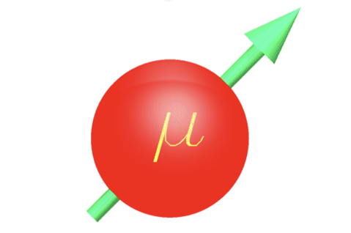
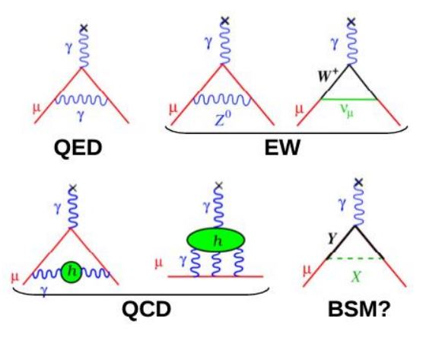
Muon magnetic moment
Muons are point like particles, like electrons, with a magnetic moment of:
$$\vec{μ}=g\frac{q}{2m}\vec{S}$$
Dirac theory predicts that the g-factor of an elementary particle is 2 but higher order corrections shift this value by the muon anomaly defined as
$$a_{μ}=\frac{g−2}{2}≈{10}^{−3}$$
All high order loops contribute to $a_{μ},$ even the ones of particles that we haven’t discovered yet. For that a precise comparison beetwen the theorical value and expermiental measurement is a good test for the Standard Model in Physics.

Slide 3
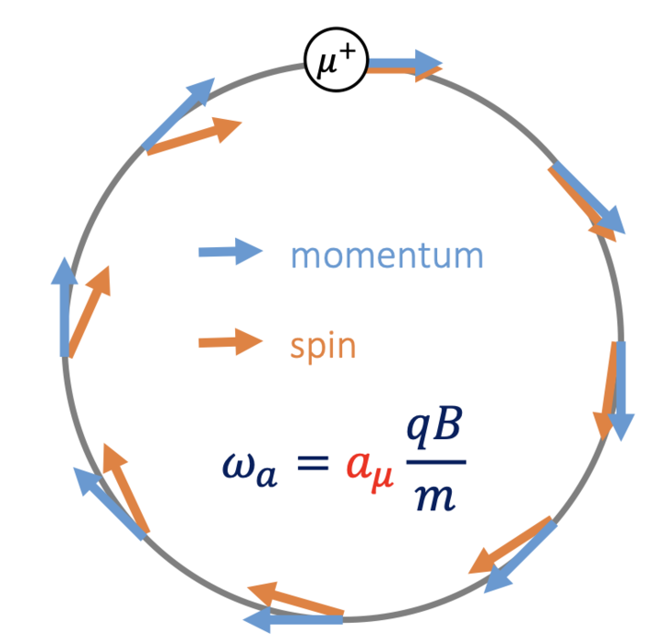
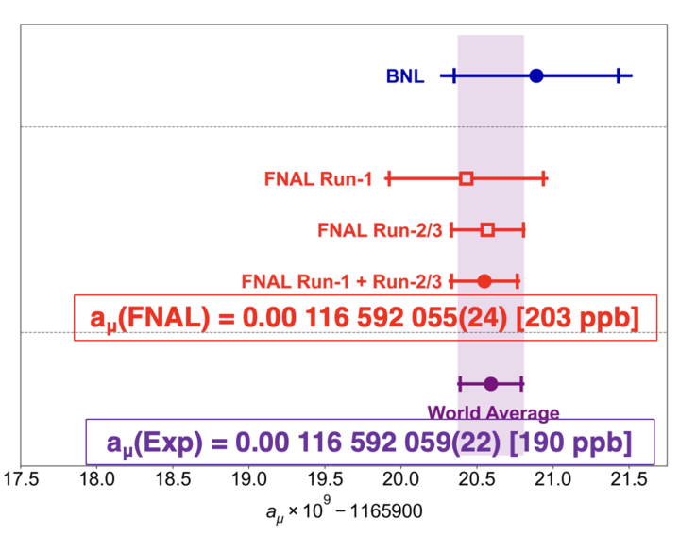
Muon precession
In a magnetic field the muon spin frequency $ω_{s}$ precess at a rate greater than the cyclotron frequency $ω_{c}$
The anomalus precession frequency is given by:
$$\vec{ω_{a}}=\vec{ω_{s}}−\vec{ω_{c}} ≈a_{μ}\frac{e\vec{B}}{m}$$
Hence the ingredients to measure $a_{μ}$ are polarized muons beam stored in a magnetic field and a precise measure of
$ω_{a}$ and B
Goal of the Muon g-2 collaboration is to measure $a_{μ}$ with a 140 ppb uncertainty using this technique
On August 10th the collaboration published its second result based on Run2 and Run3 confirming the previous measurmeant based on Run1 and reaching $≈$ 200ppb unc.

Slide 4
Master formula
$C_{e}:$ eletctric field correction
$C_{p}:$ pitch correction
$C_{pa}:$ phase-acceptance correction
$C_{dd}:$ differential decay
$C_{ml}:$ muon loss correction
$f_{clock}:$ blinded clock
$ω_{a}^{meas}:$ measured precession frequency
$$ω_{a}$$
beam dynamics corrections
$$R_{μ}=\frac{\overbrace{f_{clock}{⋅ω}_{a}^{meas}}(1+\overbrace{C_{e}+C_{p}+C_{ml}+C_{pa}+C_{dd})}}{\underbrace{f_{calib}{⋅ω}_{p}^{′}(x,y,φ)⨂M(x,y,φ)} ∙(1+\underbrace{B_{k}+B_{q})}}$$
$$\tilde{ω_{p}^{′}}(T_{r})$$
Field corrections
$f_{calib}:$ absolute magnetic field calibartion
$ω_{p}^{′}\left(x,y,φ\right):$ field maps
$M\left(x,y,φ\right):$ muon beam distribution
$B_{k}:$ transient field from eddy current in the kicker
$B_{q}:$ transient field from quad vibration

Slide 5
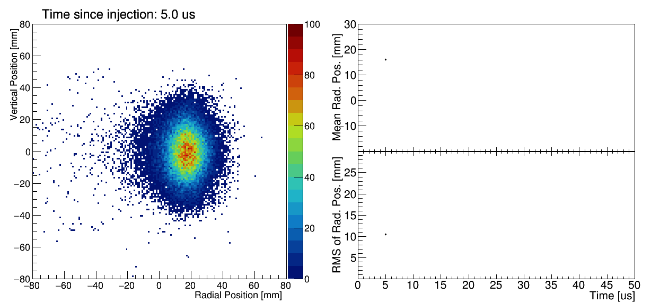
Beam dynamics
If the muons were monoenergetic, and none of momentum is in vertical direction, then that muons will live in the «storange orbit». But the motion and path of the muons in the real beam is changed by several factors
The resulting presence of an electric field and a vertical betatron oscillations neccessitate «beam dynamics» corrections that must be applied to $ω_{a}^{meas}$ in order to obtain $ω_{a}$
$C_{e}:$ eletric field correction
$C_{p}:$ pitch correction
$C_{pa}:$ phase-acceptance correction
$C_{dd}:$ differential decay
$C_{ml}:$ muon loss correction
Beam spot changes during the time from experimental data (from tracker)
Lost muons are the subject of my work

Slide 6
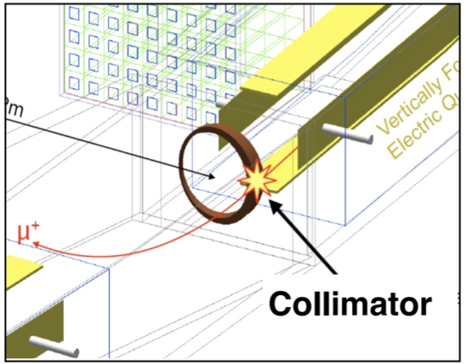
Lost Muons
Lost Muons are muons that during their path into g-2 ring are lost before decaying.
Several driving mechanism can lead to loss muons during the storage but most of them are lost because of their interaction with collimators
This effect can be taken into consideration in the final $ω_{a}$ fit including and additional factors $Λ(t)$
$$Λ(t)$$
$$N\left(t\right)=N_{0}e^{−\frac{t}{τ}}Λ\left(t\right)[1−A\cos\left(ωt+φ\right)]$$
The goal of lost muons analysis is the determination of the lost muons spectrum $L\left(t\right)$ and of its exponetally weighted integral:
$$J\left(t\right)=\int_{0}^{t}{L\left(t^{′}\right)e^{t^{′}/τ} dt^{′}}$$
In general this is obtain using data-driven techniques, my goal is to evalute it with the simulation

Slide 7
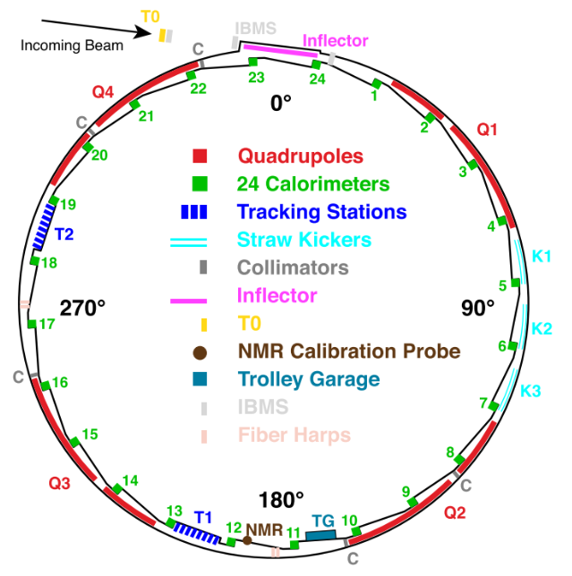
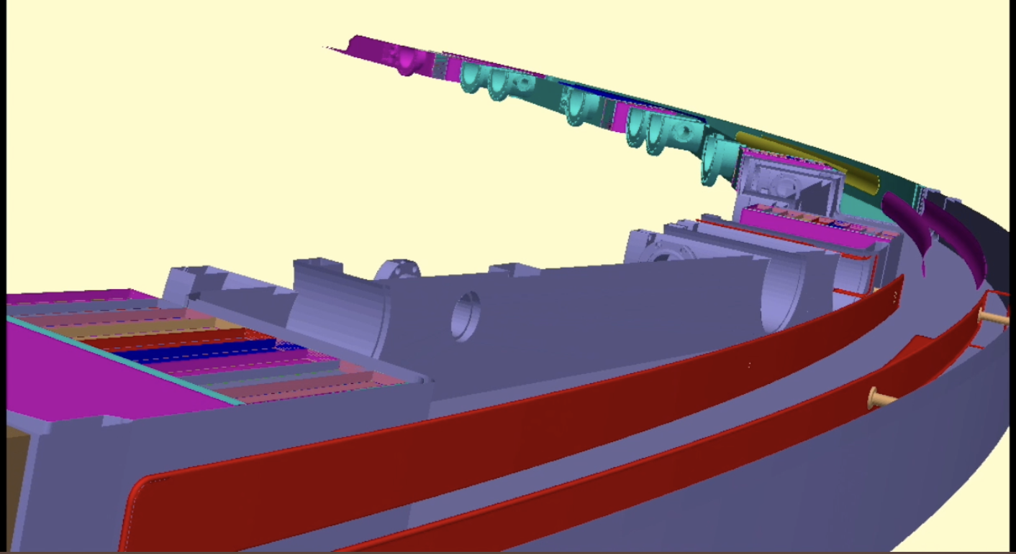
GM2RingSIM
Based on GEANT4 implemented within the ART framerwork
Simulates injection into storange ring and interactions with materials and fields
Some input parameters, e.g. T0 distribution, kicker pulse and fields are taken from data others are tuned comparing with IBMS and tracker data
Include Ghost Detector which are used to track the particle’s position in the ring
Includes several particle guns, in particular the lost muons gun which it is used to produce high statistics simulation samples of lost muons.

Slide 8
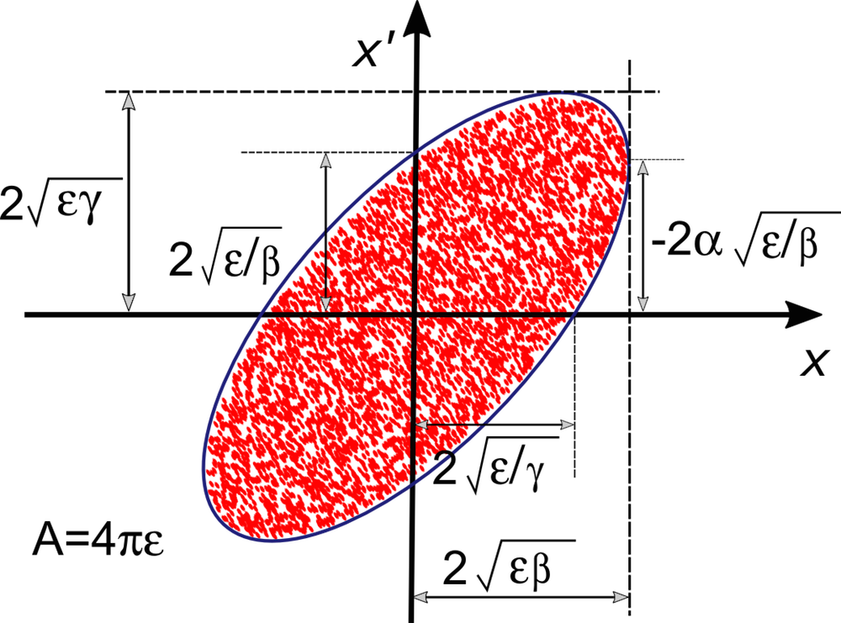
Beam dimension parameters
The initial phase of my work consisted of the extraction of the twiss parameters (characteristic beam parameters)
These parameters influence the ellipcity and focusing of the particle beam
I used a simulated test sample based on Run2 settigs as my starting point
Data: GM2/mc/run2_beamgun_2007
Runs_1666980000
Runs_1667047000
Runs_1667176000
Runs_1667721700

Slide 9
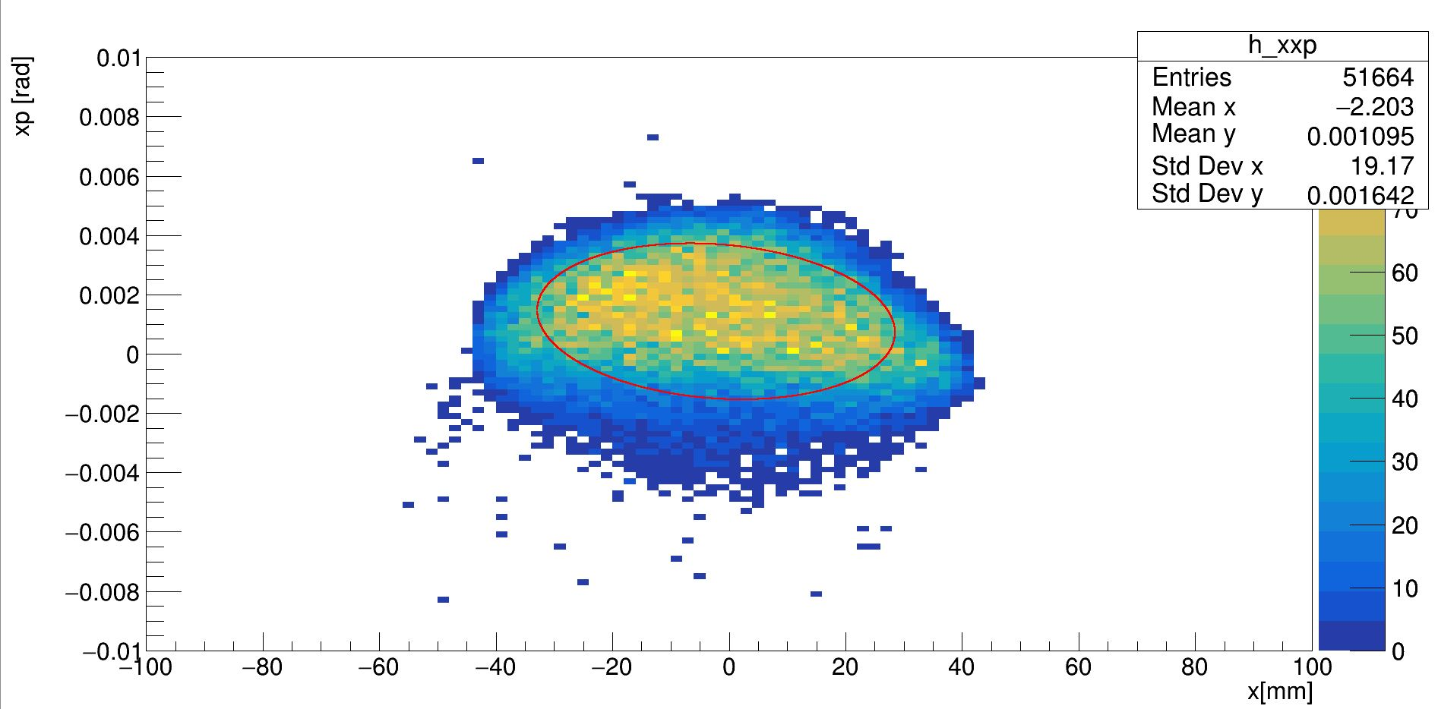
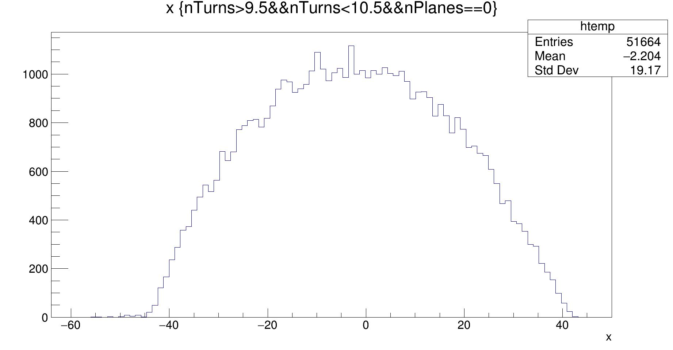
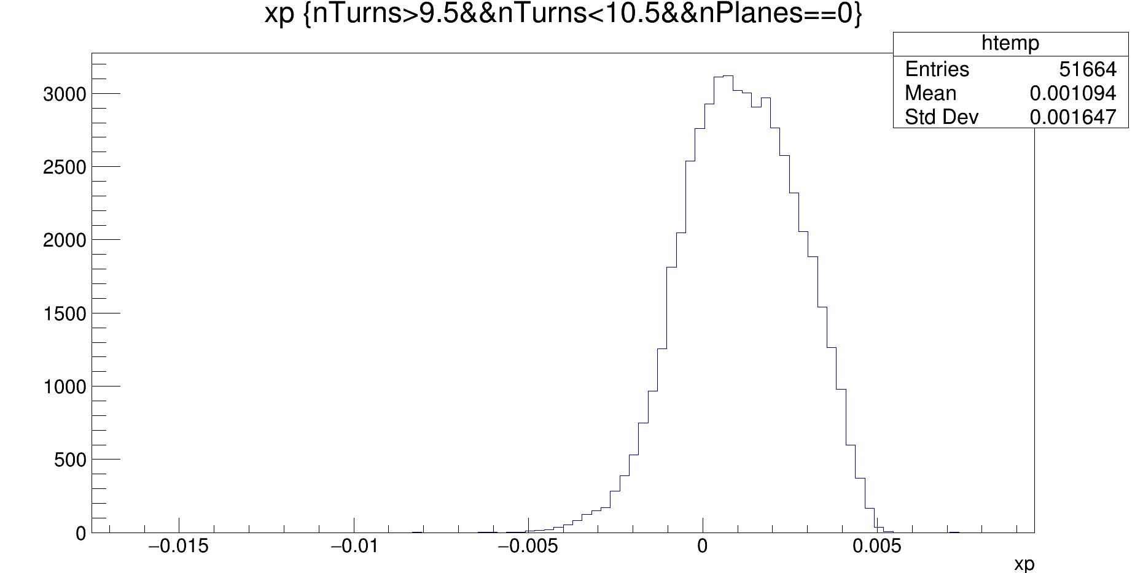
Twiss Parameters according to the G2mSim
This is the distribution in the radial phase space with the ellipse described by the parameters extracted with this equations:
$$β_{x}=\frac{σ_{x}^{2}}{ε_{xRMS}}$$
$$γ_{x}=\frac{σ_{x′}^{2}}{ε_{xRMS}}$$
$$ε_{xRMS}=\sqrt{\left\langle x^{2}\right\rangle \left\langle x^{′2}\right\rangle −{\left\langle x∙x^{′}\right\rangle }^{2}}$$
$$x^{′}=\frac{p_{radial}}{p_{logitudinal}}$$

Slide 10
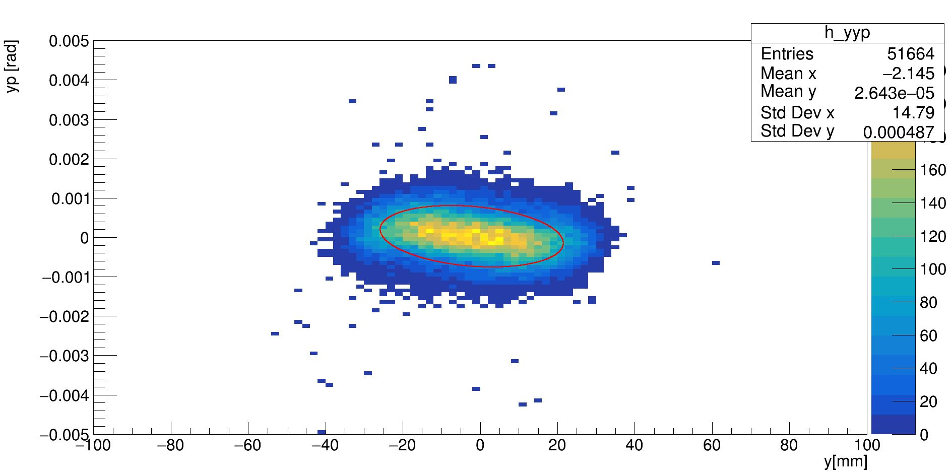
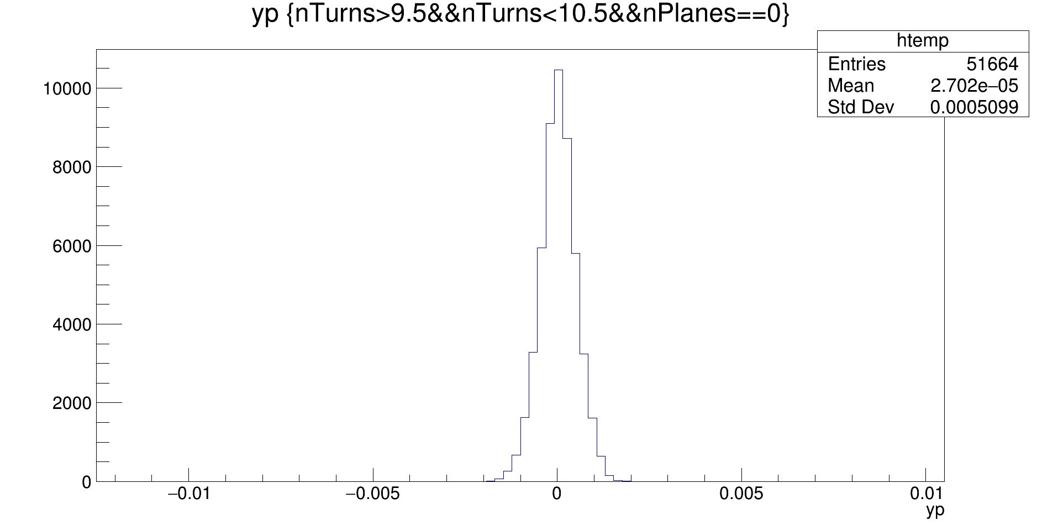
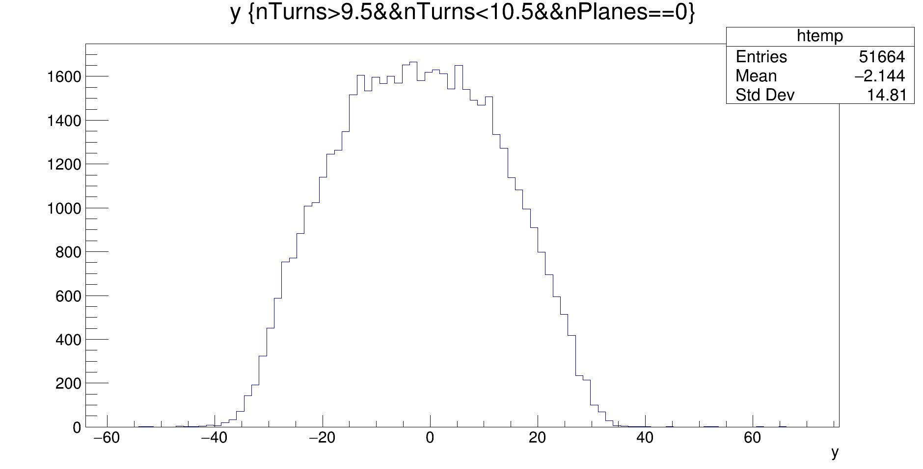
Twiss parameters according the Gm2Sim
This is the distribution in the vertical phase space with the ellipse described by the parameters extracted with this equations:
$$β_{y}=\frac{σ_{y}^{2}}{ε_{yRMS}}$$
$$γ_{y}=\frac{σ_{y′}^{2}}{ε_{yRMs}}$$
$$α_{y}=\sqrt{β_{y}γ_{y}−1}$$
$$ε_{yRMS}=\sqrt{\left\langle y^{2}\right\rangle \left\langle y^{′2}\right\rangle −{\left\langle y∙y^{′}\right\rangle }^{2}}$$
$$y^{′}=\frac{p_{y}}{p_{logitudinal}}$$

Slide 11
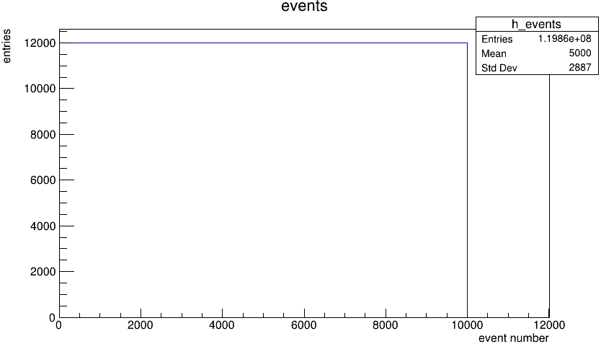
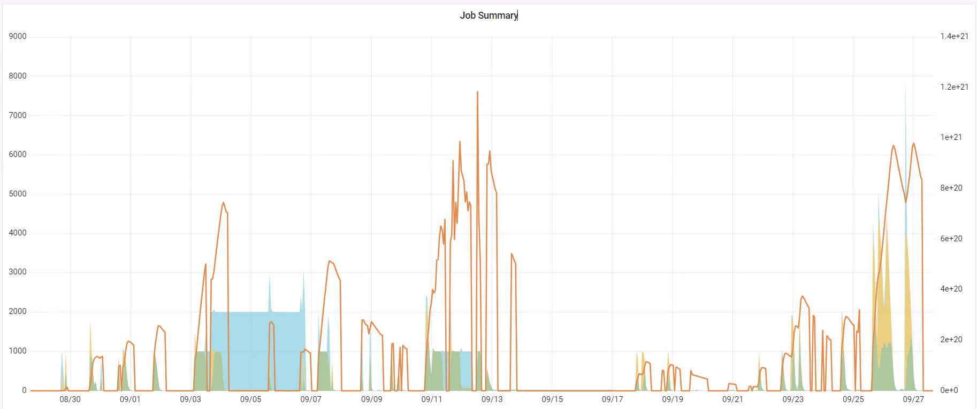
Lost Muons Gun
After the extraction of the parameters I used the Lost Muons Gun to produce a high statistic sample for the analysis.
Requires the twiss parameters as setup
Selects only the muons that have high probability to hit a collimator before decaying (e.g. muons that are not stored)
In the graphs you can see the total number of the events produced using the FermiGrid

Slide 12
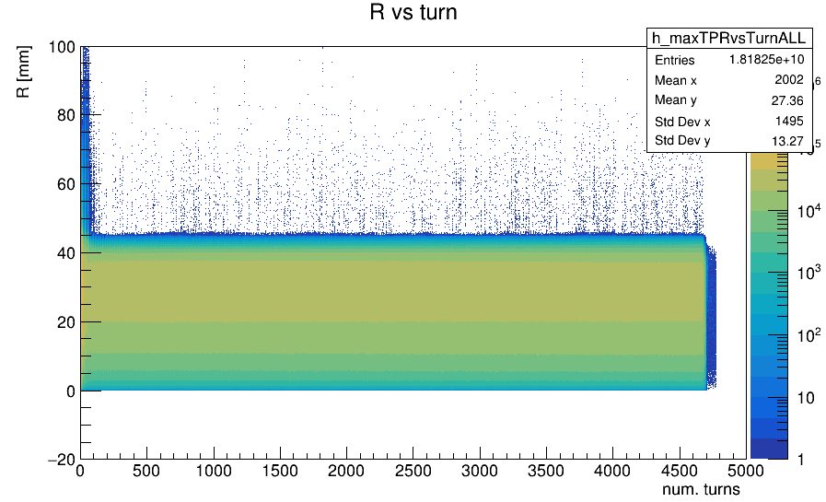
Lost Muons Selection
To identify and select Lost Muons, specific criteria were applied to our simulation samples:
Survivors: surivive at the least 200 turns in the storange ring (they never exceed 40mm radius).
Edge: exceed 40 mm radius during their life in the ring
Edge
Survivors
Note: Collimator inner radius is 40mm, so survivors never hit a collimator while edges might hit a collimator

Slide 13
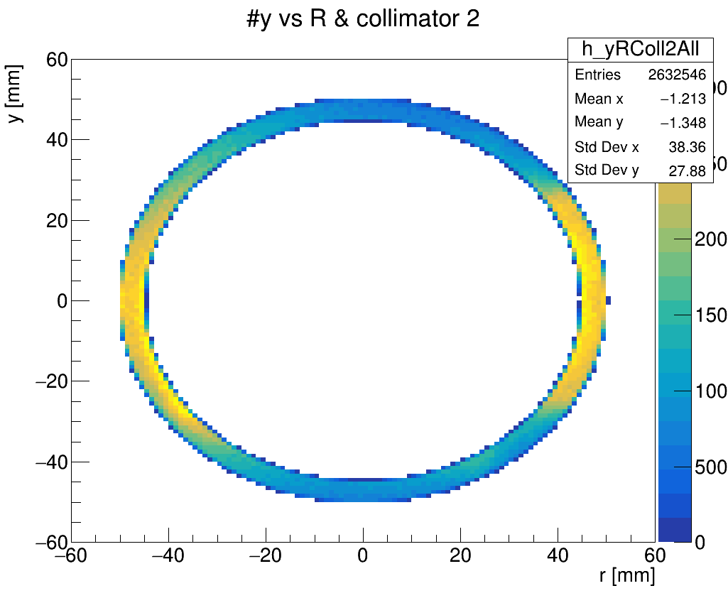
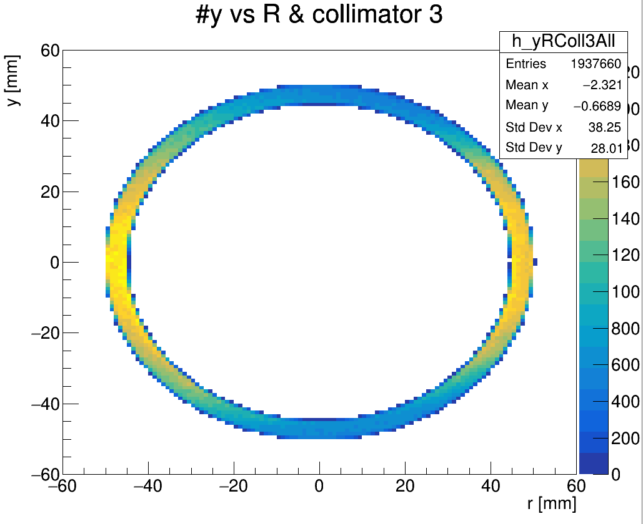
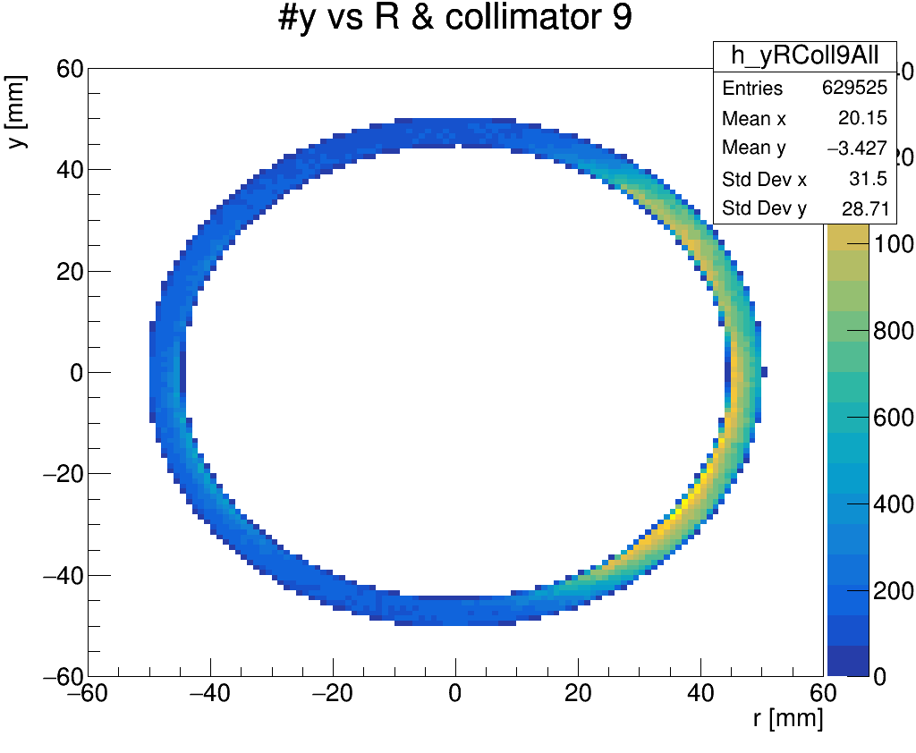
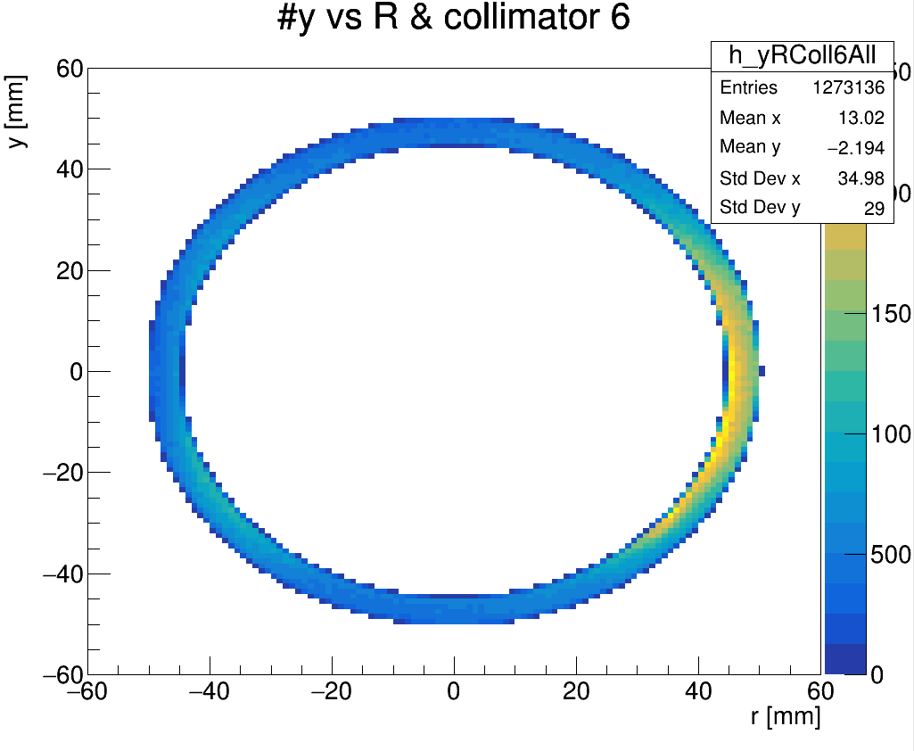
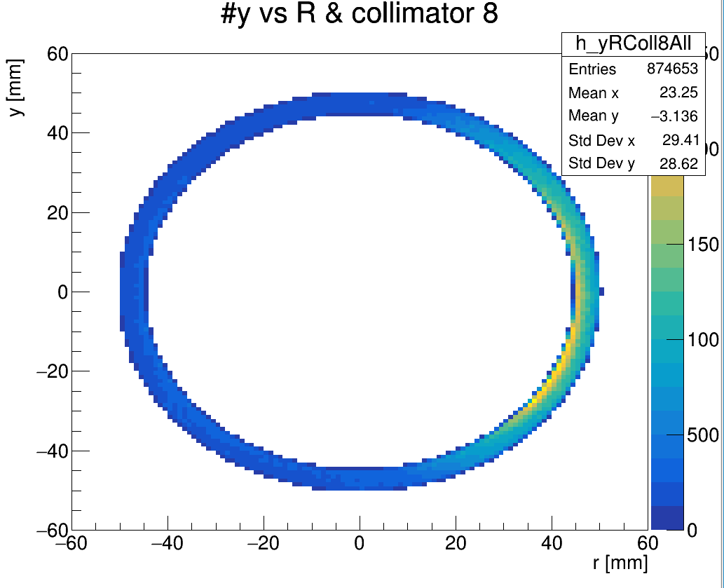
Collimators Hits
Muons position distributions when they hit a collimator

Slide 14
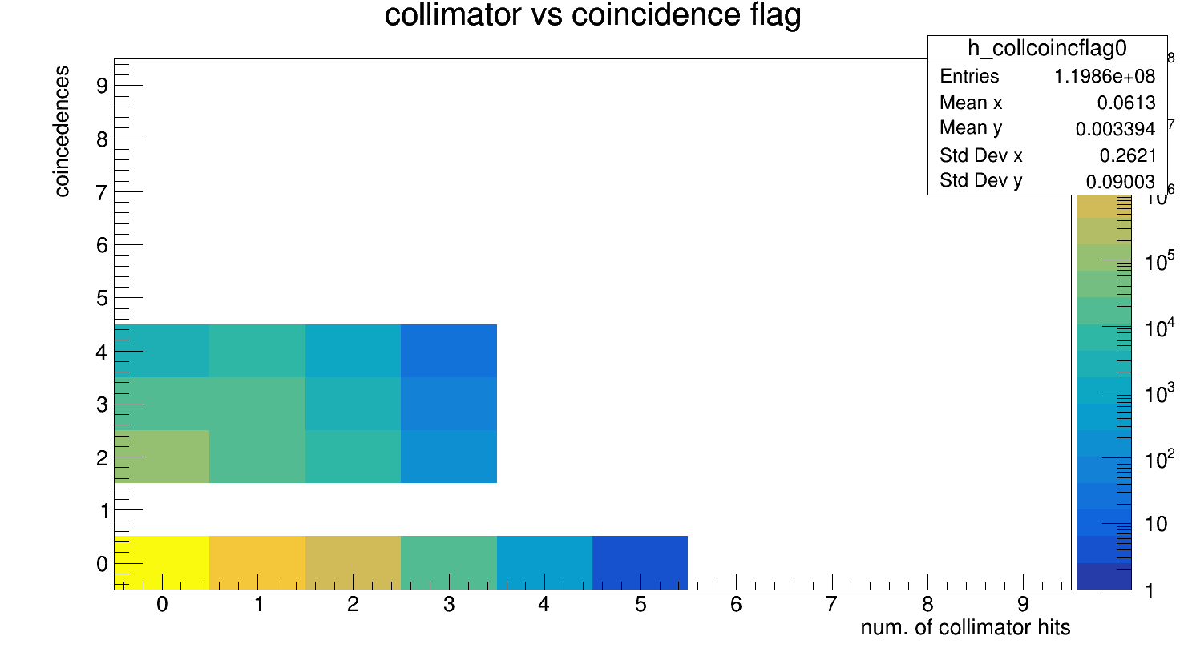
Lost Muons Flag
Number of coincidence vs number of collimators hit
For the analysis of the Lost Muons we are interested to the muons that hit a collimator and make a double or more coincidences with the calorimeters
Doubles,triples and quadruples from the Lost Muons that hit a collimator
In Simulation lost muons are those hit a collimator, but in the real analysis a data-driven model with the triple coincidence with calorimeter is used. Hence, we are interested to compare the two definition of lost muons with the simulation.

Slide 15
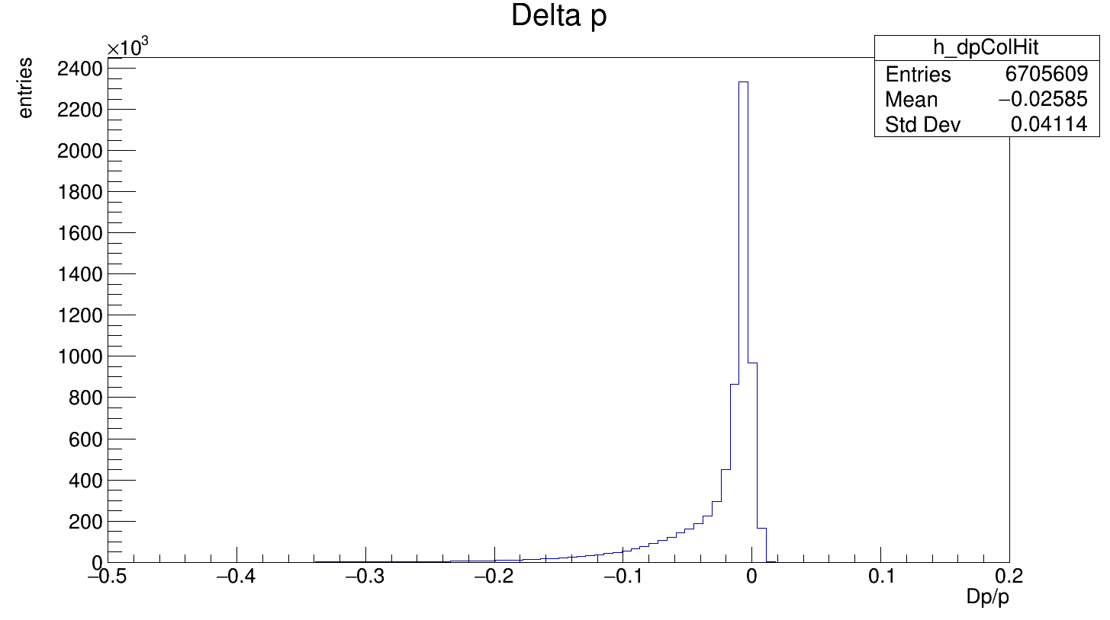
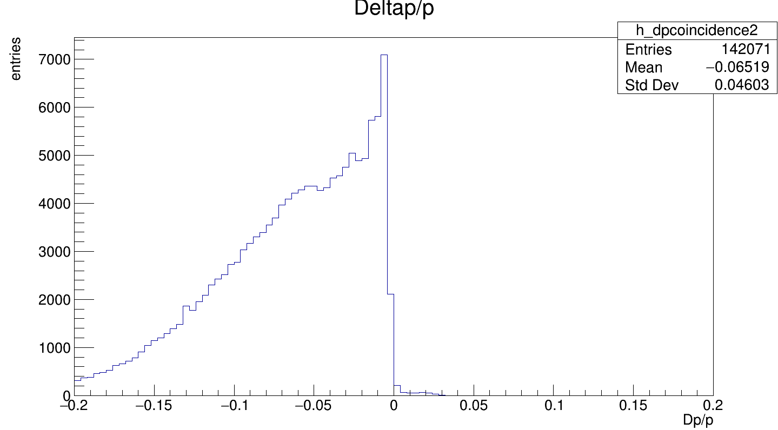
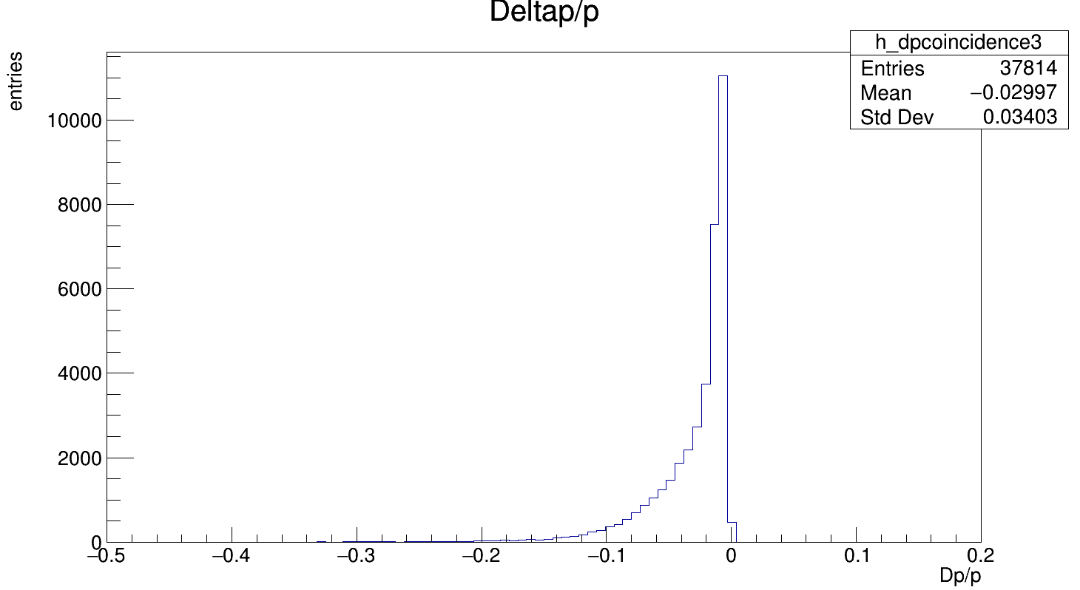
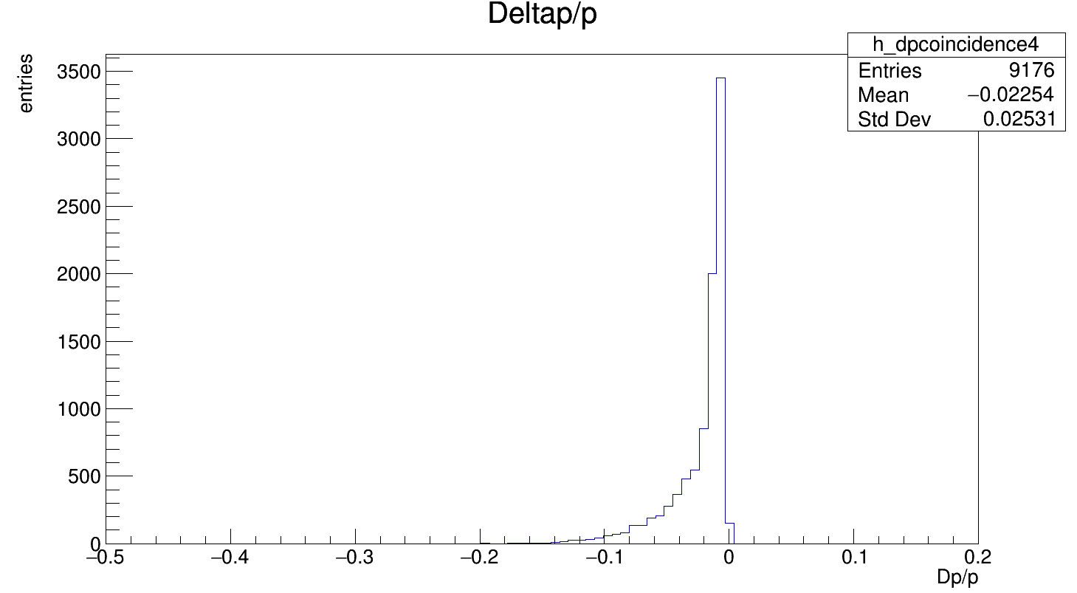
Lost Muons Momentum
I plotted the momentum distributions for the various flags in the analysis
Collimator
Doubles
Triples
Quadruples

Slide 16
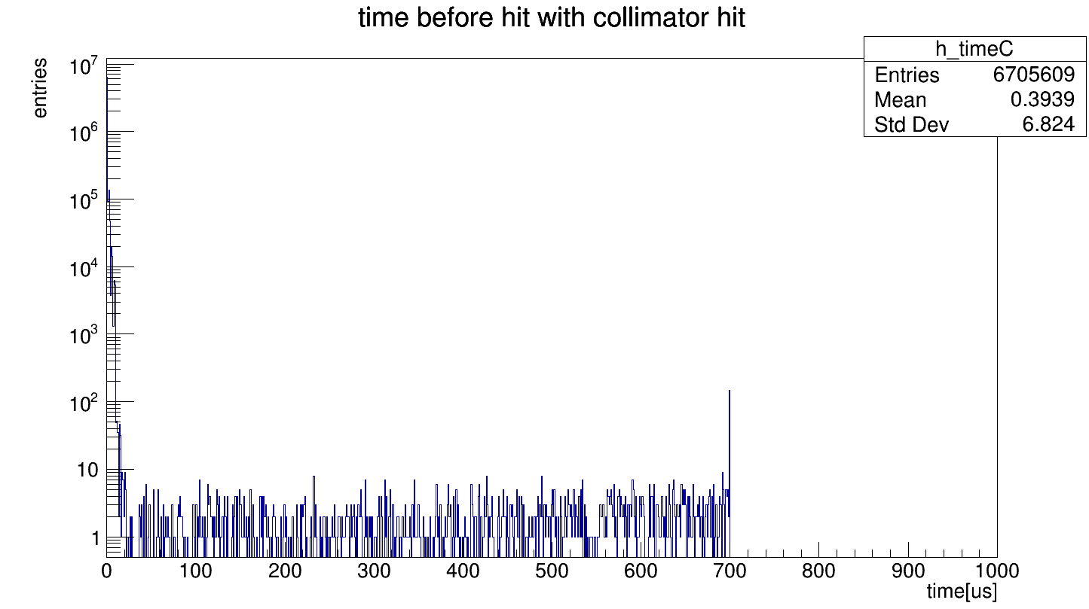
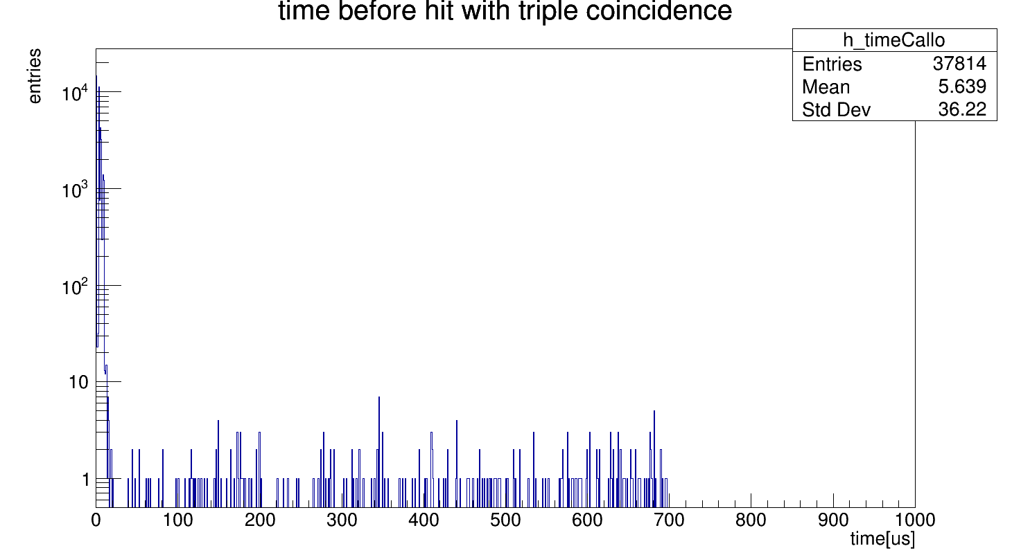
Time Spectrum
Time spectrums are quite similar
Collimator
Triples
but we need to generate more statistics

Slide 17
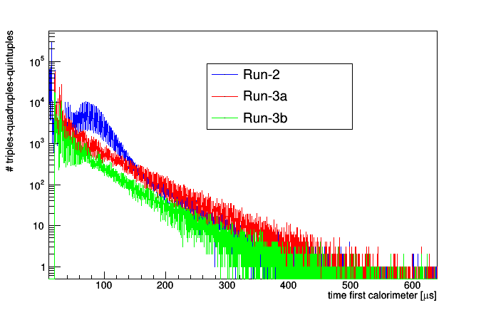
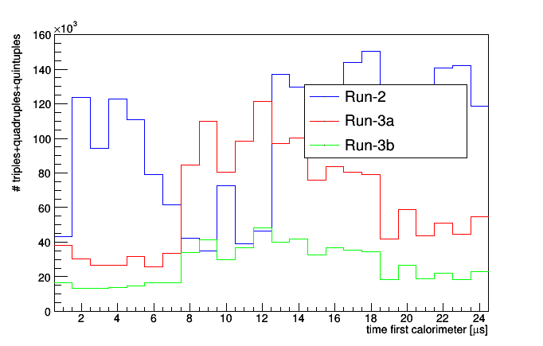
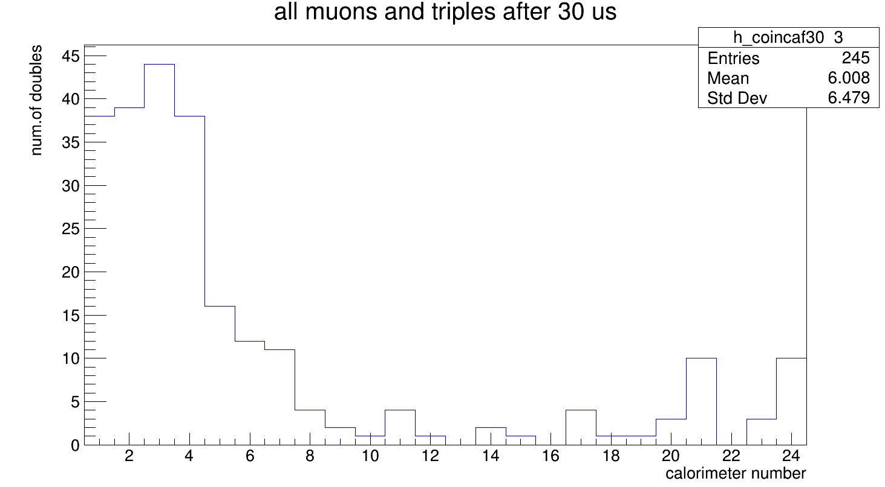
Comparison with the data
Very low statistics

Slide 18
Summary
During my internship at FermiLab:
Learned about the goal and the specifics of the g-2 experiment.
Extract the twiss parameters from a simulate test sample based on Run2
Used the Lost Muons Gun (tuned with this parameters) to simulate a sample of high statistics
Applied a selection criteria to select the muons which are lost
Analyzed this simulate sample using this Gun
Plotted the Momentum and Time distribution of the Lost Muons
Extract the the loss rate function and compare it with that coming from the data. ->requires more statistic in future.

Slide 19
Acknowledgements
I want to thank the FermiLab and the g-2 collaboration for the opportunity to work in this experiment. I want also to thank : Anna Driutti, Brendan Casey, Marco Incagli, Alberto Lusiani, Renee Fatemi and the entire simulation team for the constant support in my work. I also want to thank: David Tarazona ,Jason Crnkovic and Lorenzo Cotrozzi for the useful discussion and advice

Slide 20
Thank you for the attention

