Slide 1
Software and Hardware development for the Mu2e trigger and data acquisition system
Tommaso Baldi, Supervisor: Micol Rigatti
Italian Summer Students Final reports
28 September 2023
Notes:
Self presentation
background
what are you working on

Slide 2
Overview
Short Recap
Loopback Test
Discovery Mode
ROC test with Sequence of Macros
GUI updates
Notes:
Quick overview of the talk
Thx colleagues to skip the intro of the experiment

Slide 3
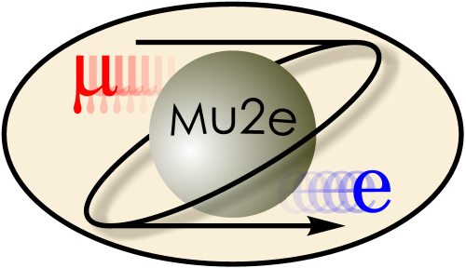
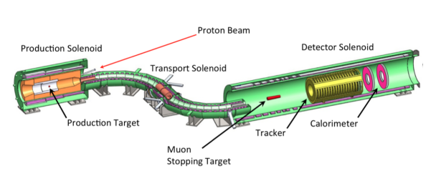
Mu2e
The purpose of the Mu2e experiment is to research the neutrino-less conversion of the muon into an electron in the field of an aluminum nucleus. Further, Mu2e aims to demonstrate the existence of physics beyond the Standard Model through this process due to the charged lepton flavor violation. The experimental technique employed by Mu2e experiment has been designed to improve the sensitivity by 10⁴, with respect to similar experiments
Notes:
I am not the best person to explain to you how it works

Slide 4
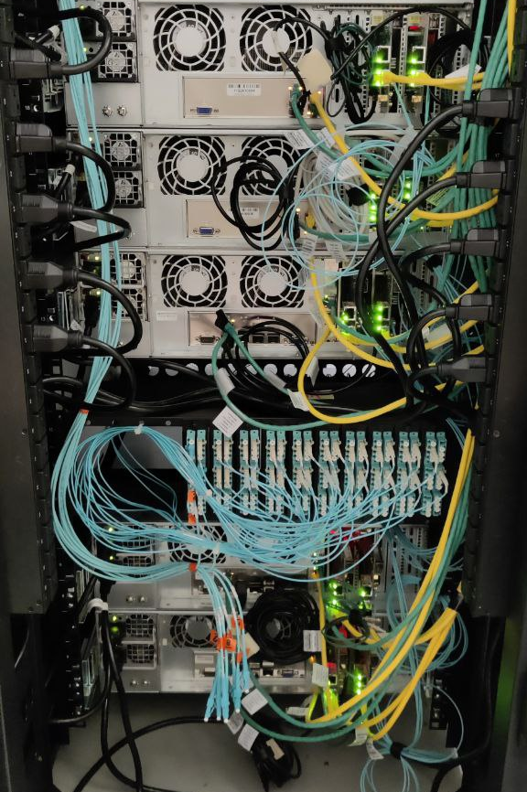
What is a TDAQ?
The TDAQ is a subsystem of the Mu2e experiment implemented for collecting digitized data and delivering that data to online and offline processing for analysis.
It is also responsible for:
detector synchronization
control interfaces
monitoring interfaces
timing and control network for precise synchronization
control of the data sources and readout
TDAQ server located in the DAQ room of the Mu2e building.

Slide 5
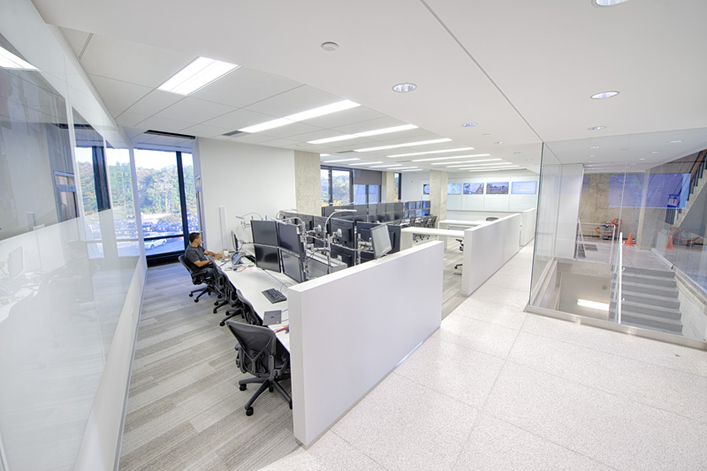
TDAQ Topology
Command Fan-Out card
Accelerator RF
0-Crossing Marker
Aggregator / Data Logger
Encoded System Clock
Run Control Packets
Control &
Data Storage
Network
WH Control Room
Extinction & Stopping Target Monitor ROCs
Run Control Host
Control Packets
dCache + ENSTORE [FIFE]
DCS / EPICS Host
Detector Hall
DCS & Management Network
(slow controls Ethernet)
Ethernet
Tracker and Calorimeter ROCs
DAQ Server
...
...
Offline Data Processing
Data Transfer Controller
Control and Data Packets
(2) 32-port 10G
Event Building
Switch
(For Tracker and Calorimeter Data)
Campus
Online Processing
...
Vacuum
...
CRV ROCs
Notes:
Many actors involved in the topology
One of the DTC is selected to act as CFO
CFO = Commad Fan Out (Give the clock to all the boards)
ROC = READ OUT CONTROLLER
DIRAC -> CALORIMETER
DRAC -> TARGET

Slide 6
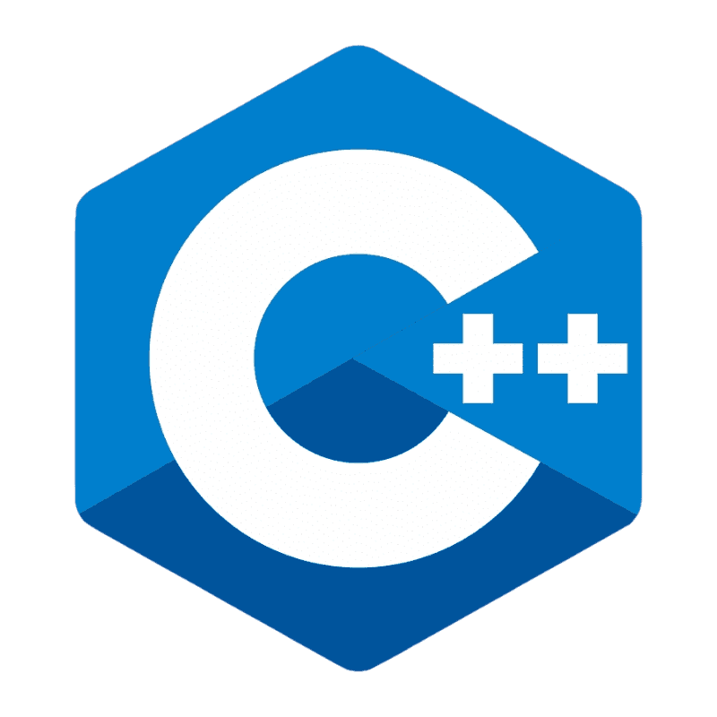
Online DAQ Software Development
otsdaq and artdaq are open source and developed by the Fermilab Scientific Computing Division.
Developments on otsdaq are in two directions:
User code is added through plugins (C++ classes inheriting from the appropriate class)
Server side
The user can design custom web-apps to introduce further functionalities
Web side

Slide 7
What is a vertical slice test?
A vertical slice is a top to bottom, fully implemented and tested piece of functionality. In this case, the vertical slice test consists of data transmission between the detector and the DAQ, which is composed by:
Data request, starting from the server;
Data reply, coming from the ROC;
Check if the response is the one expected.
Server
CFO
DTC1
ROC

Slide 8
Buffer test
The first task of the internship was the implementation of the OTS software responsible for requesting data transmission and acquiring the response.
The module of OTS used for the test is the FE Macros, which allows the user to interface with the electronic boards.
The macro implemented is called “buffer test”, which can send a request for a user-specified number of events and wait for the respective responses.
The test was successful, and we were able to send a request for up to 2300 events per time.
NOTE: since we are in a developing phase, the data retrieved from the ROC at the moment are simulated data (a counter).
Screenshot of the retrieved data.

Slide 9
Overview
Short Recap
Loopback Test
Discovery Mode
ROC test with Sequence of Macros
GUI updates

Slide 10
Timing Synchronization
The CFO spreads the clock first to the Data Transfer Controller (DTC) boards. The DTCs are configured in a chain: the first one extracts the 200 MHz clock and passes it to the next one. To prevent jitter accumulation, all the DTCs are also receiving a 200 MHz Reference Clock from the RTF module.
We must guarantee Event Window synchronization!
CFO
Command Fan Out
DTC10
200 MHz
Trk-01
DTC0
Calo-01
DTC11
DTC1
DTC12
DTC2
Trk-02
Calo-02
DTC13
DTC3
Event Builder
RTF
DTC14
DTC4
Trk-03
Calo-03
DTC15
200 MHz
DTC5
DTC16
DTC6
Trk-04
Calo-04
DTC17
DTC7
DTC8
Calo-05
Trk-05
DTC18
DTC9
DTC19

Slide 11
What does Event Window synchronization mean?
CFO
ROC0
DTC0
DTC0
ROC0
ROC5
ROC5
ROC0
DTC1
DTC1
ROC0
Δt
ROC5
ROC5
ROC0
DTC7
DTC7
ROC0
ROC5
ROC5
Signals travel to different boards and through fibers/cables of different lengths.

Slide 12
Event Window Synchronization
To line up Event Windows the approach is to delay each front-end to match front-end with longest latency.
How do we determine delay? Calculate from Signal Loopback
We can determine the round-trip time (RTT) by sending a marker and returning it many times and taking the average time.
Once we know the timing path latency for each front-end, we can calculate each front-end’s delay offset:
delay offset = “longest timing path latency” – “individual timing path latency”

Slide 13
FCC test stand – let’s make it simple
The loopback test is performed during the “start” phase of the state machine, and it is divided in steps. At each step.
DTCs prepare the path which will be follow by the marker to reach the target ROC of the current step.
CFO sends the markers on its links.
We assume to have a full topology, so:
# steps = # DTCs per chain x #ROCs per DTC
In this way we have an easier configuration, and we can use the same test also to discover the actual topology of the TDAQ.
CFO
DTC0
ROC
DTC1
ROC
DTC2
ROC

Slide 14
Overview
Short Recap
Loopback Test
Discovery Mode
ROC test with Sequence of Macros
GUI updates

Slide 15
Topology Discovery
CFO
The same mechanism can be used to discover the actual topology of the TDAQ.
By sending the marker across the topology, we can trace which ROCs are sending back the responses. At the end of the process the system gives a detailed report about which ROCs are reachable and which are not.
This report can be used to check if the actual topology is equal to the expected one. In this way, it’s easier to spot if OTS is properly configured or if some component is not working.
To understand if ROC is present or we send a marker to each link and we wait for an echo reply, if we wait for too long the CFO rise a timeout and we record the link as dead.
DTC0
ROC0
ROC5
DTC1
ROC0
ROC5
DTC7
ROC0
ROC5

Slide 16
Overview
Short Recap
Loopback Test
Discovery Mode
ROC test with Sequence of Macros
GUI updates

Slide 17
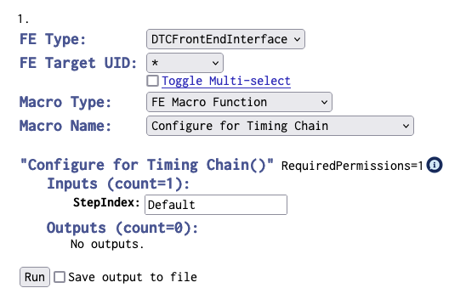
FEMacros – The TDAQ playground
OTS has a module used to test the Front-End of the boards involved in the TDAQ, it’s called FEMacros.
It is used to test the configuration, communication and the functionalities of all the boards, such as DTCs, CFO and ROCs.
This module is incredibly useful for the development, because it can speed up the testing phase of the hardware components.
The working-groups that are developing the subsystems use macros to understand how the ROCs behave with OTSDAQ.
Select the interface type
Select one or more targets boards
Select the macro that I want to perform
Input arguments
Save the results on file
Output arguments

Slide 18
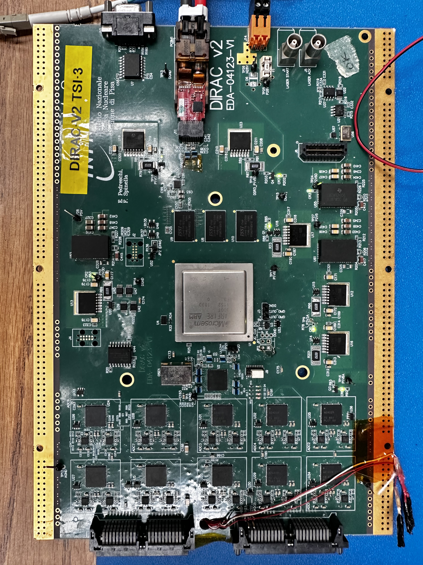
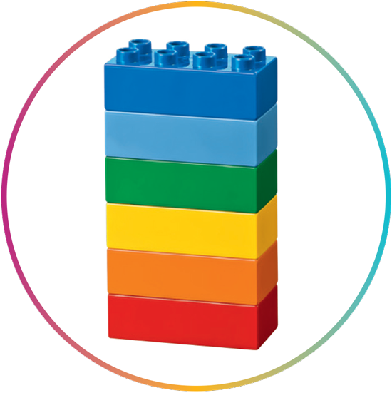
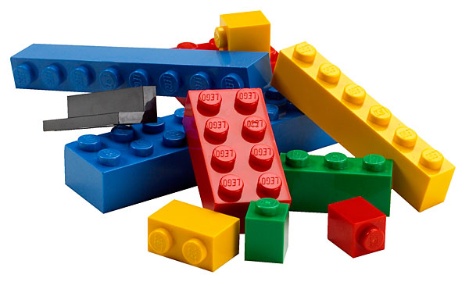
Macro sequences – Building software like LEGOs
Working-groups are focusing on the hardware development of the ROCs and they frequently update their boards by adding new registers or changing configuration procedure. Therefore, they need new macros every time they change the design of the boards. Writing new macros for each new change is not the best approach, so we decide to allow the user to build their own configuration sequences by chaining together simple macros. Once they find a sequence which is working fine it will be easily converted in an atomic macro.

Slide 19
Overview
Short Recap
Loopback Test
Discovery Mode
ROC test with Sequence of Macros
GUI updates

Slide 20
Keep things user friendly
During the summer program I have also work on the Web side of otsdaq to improve the user experience and speed up the development phase.
Command History of the FE Macros:
Search bar in the tree-view of the configuration menu:

Slide 21
Overview
Short Recap
Loopback Test
Discovery Mode
ROC test with Sequence of Macros
GUI updates

Slide 22
Thank you for your attention!
Contacts:
Email: tbaldi@fnal.gov
Phone: +1 224 457-8916
Office: IERC #1320

