Slide 1
Fast Ramping Accelerator Dipole Models for Fermilab’s Booster Upgrade and Muon Colliders
Stefano Mannucci
Final Presentation
28 September 2023
Supervisor: Alexander Zlobin, Emanuela Barzi

Slide 2
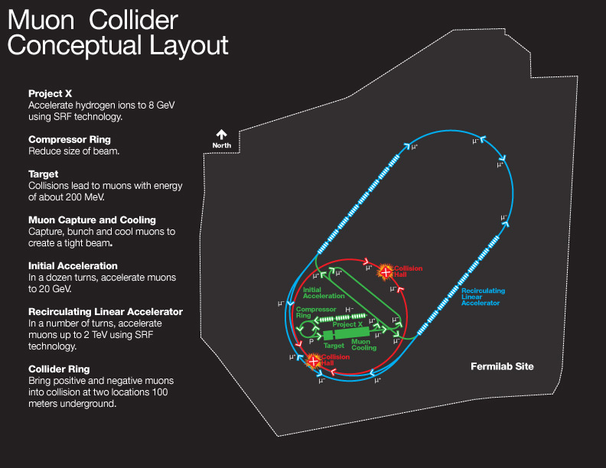
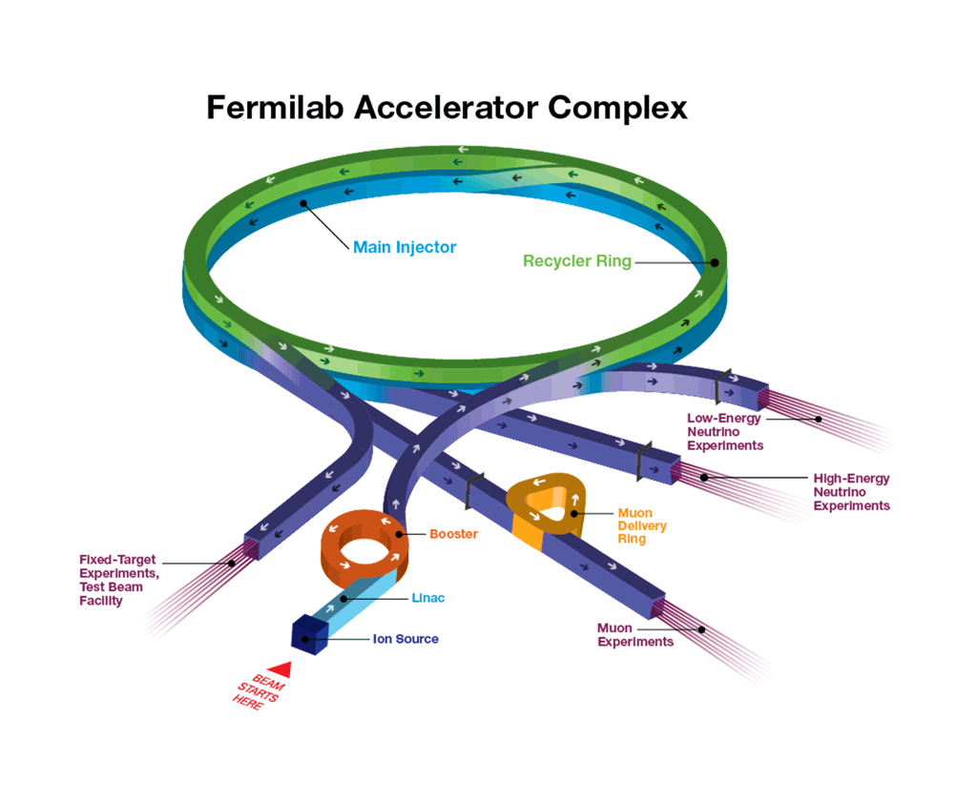

Why Fast Ramping Magnets?
Booster:
$B_{m}=0.4 T$: peak to peak amplitude;
$f=15−20 Hz$: frequency;
Muon collider:
$B_{m}=2 T$: peak to peak amplitude;
$f=400 Hz$.

Slide 3
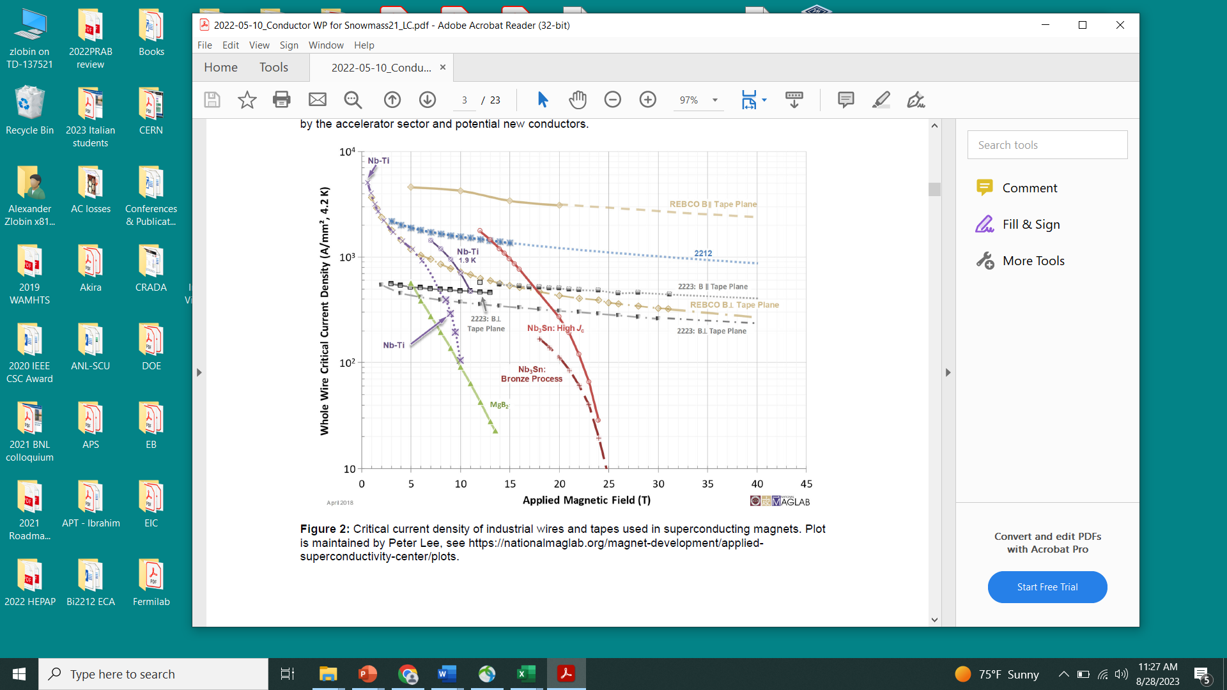
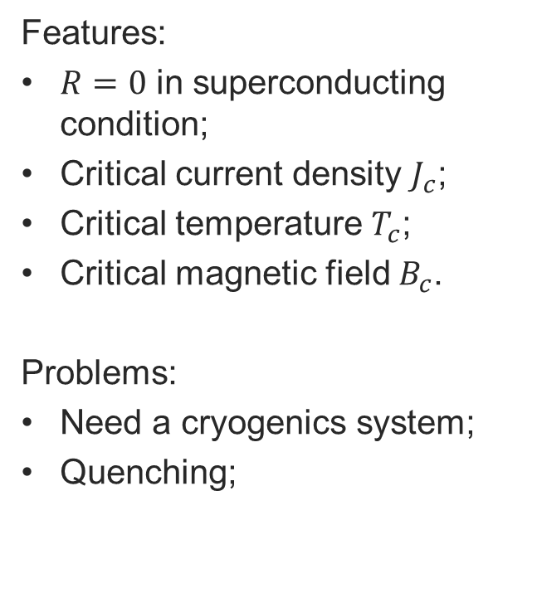
Superconductor: critical parameters
Features:
$R=0$ in superconducting condition;
Critical current density $J_{c}$;
Critical temperature $T_{c}$;
Critical magnetic field $B_{c}$.
Problems:
Need a cryogenics system;
Quenching;
IMPORTANCE OF TEMPERATURE

Slide 4
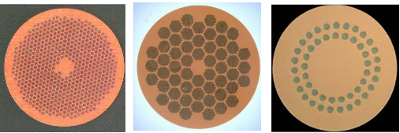
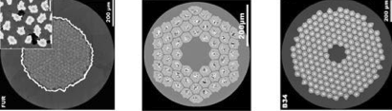
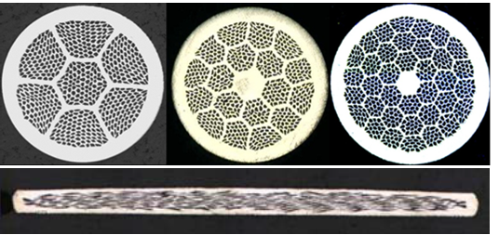
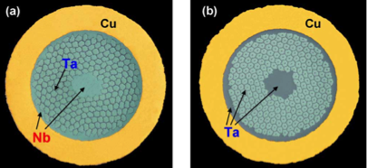
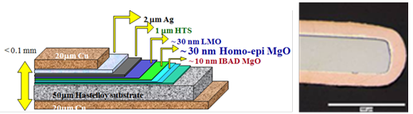
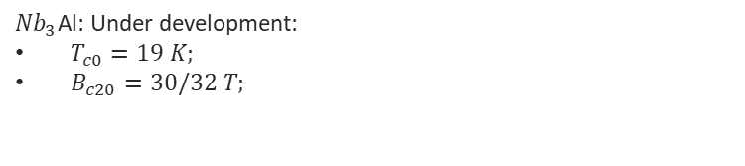
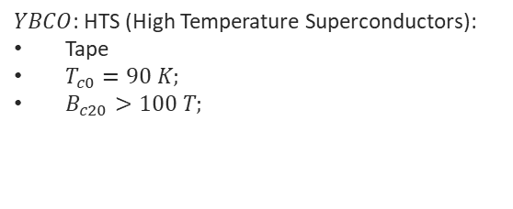
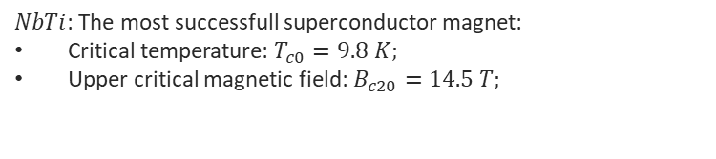
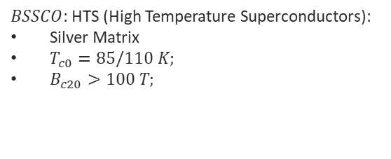
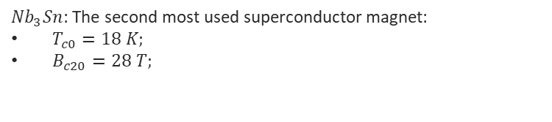
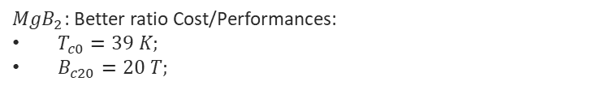
Practical composite superconductors
$NbTi$: The most successfull superconductor magnet:
Critical temperature: $T_{c0}=9.8 K;$
Upper critical magnetic field: $B_{c20}=14.5 T;$
${Nb}_{3}Sn$: The second most used superconductor magnet:
$T_{c0}=18 K;$
$B_{c20}=28 T;$
${Nb}_{3}$Al: Under development:
$T_{c0}=19 K;$
$B_{c20}=30/32 T;$
$BSSCO$: HTS (High Temperature Superconductors):
Silver Matrix
$T_{c0}=85/110 K;$
$B_{c20}>100 T;$
$YBCO$: HTS (High Temperature Superconductors):
Tape
$T_{c0}=90 K;$
$B_{c20}>100 T;$
${MgB}_{2}$: Better ratio Cost/Performances:
$T_{c0}=39 K;$
$B_{c20}=20 T;$

Slide 5
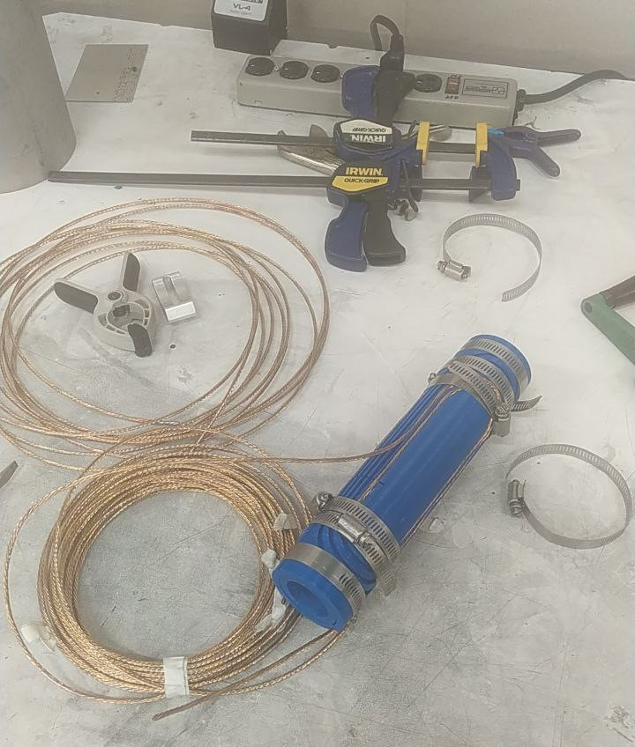
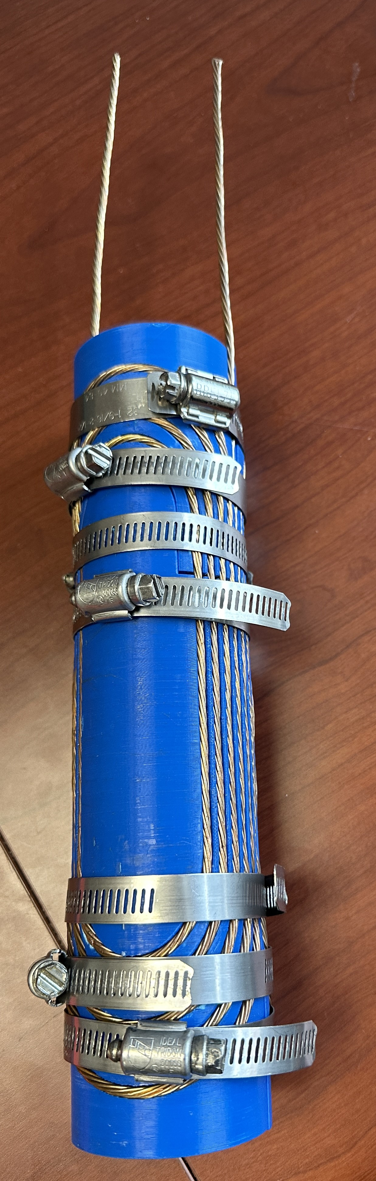
Winding a Real Magnet
One of the completed tasks was also to wind a real dipole composed of a six-around-one copper cable. This work has been really useful for understanding how is composed a dipole.

Slide 6
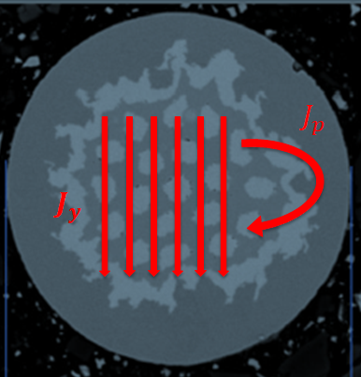

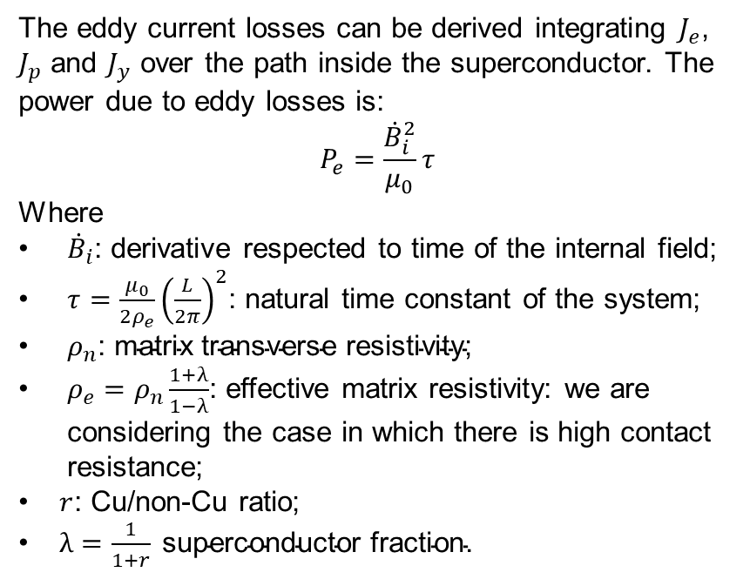
AC losses: Eddy Currents Power
The magnetization inside the superconductor creates the AC losses. It is possible to develope a model that considers two components: The hysteresis losses and the eddy current losses.
The eddy current losses can be derived integrating $J_{e}$, $J_{p}$ and $J_{y}$ over the path inside the superconductor. The power due to eddy losses is:
$$P_{e}=\frac{{\dot{B}}_{i}^{2}}{μ_{0}}τ$$
Where
${\dot{B}}_{i}$: derivative respected to time of the internal field;
$τ=\frac{μ_{0}}{2ρ_{e}}{\left(\frac{L}{2π}\right)}^{2}$: natural time constant of the system;
$ρ_{n}\text{: }\text{matrix} \text{transverse} \text{resistivity}\text{;}$
$ρ_{e}=ρ_{n}\frac{1+λ}{1−λ}$: effective matrix resistivity: we are considering the case in which there is high contact resistance;
$r$: Cu/non-Cu ratio;
$λ=\frac{1}{1+r} \text{superconductor} \text{fraction}\text{.}$

Slide 7
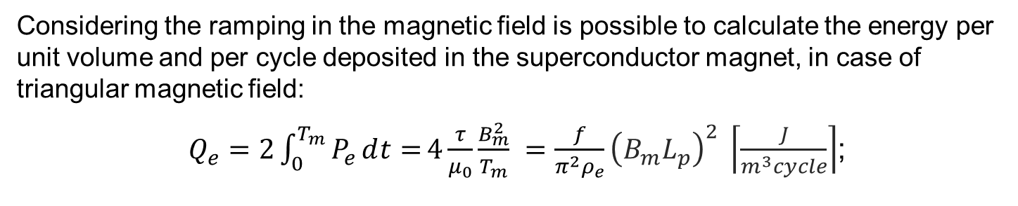
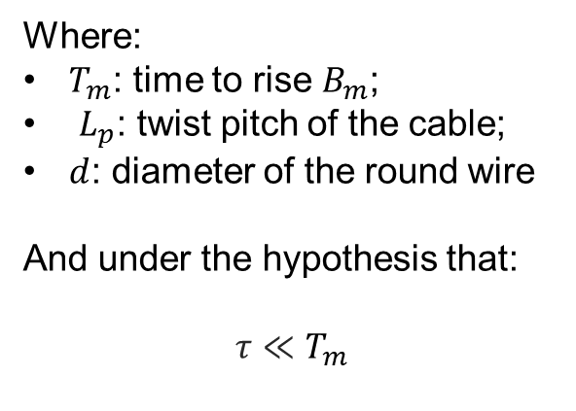
Eddy Current Energy Loss
Considering the ramping in the magnetic field is possible to calculate the energy per unit volume and per cycle deposited in the superconductor magnet, in case of triangular magnetic field:
$Q_{e}=2\int_{0}^{T_{m}}{P_{e}ⅆt=}4\frac{τ}{μ_{0}}\frac{B_{m}^{2}}{T_{m}} =\frac{f}{π^{2}ρ_{e}}{\left(B_{m}L_{p}\right)}^{2} \left\lceil \frac{J}{m^{3}cycle}\right\rceil$;
Where:
$T_{m}$: time to rise $B_{m}$;
$L_{p}$: twist pitch of the cable;
$d$: diameter of the round wire
And under the hypothesis that:
$$τ≪T_{m}$$

Slide 8
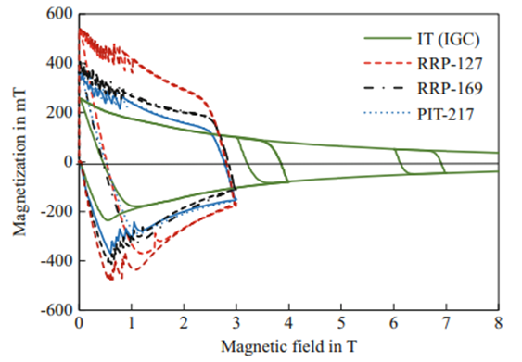

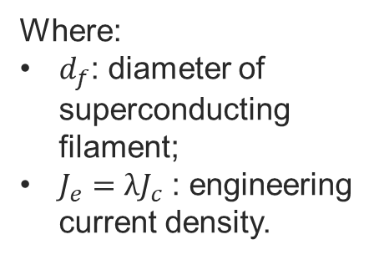
Hysteresis loss in the superconductor
The hysteresis losses are created from the magnetization of the superconductor in a magnetic field. This phenomenon creates the magnetization currents inside the wire. With approximation is possible to obtain that:
$P_{h}≅\frac{8}{3π}J_{e}d_{f}B_{m}f$;
And so:
$Q_{h}=2\int_{0}^{T_{m}}{P_{h}ⅆt}≅\frac{8}{3π}J_{e}d_{f}B_{m}$;
Where:
$d_{f}$: diameter of superconducting filament;
$J_{e}=λJ_{c}$ : engineering current density.

Slide 9
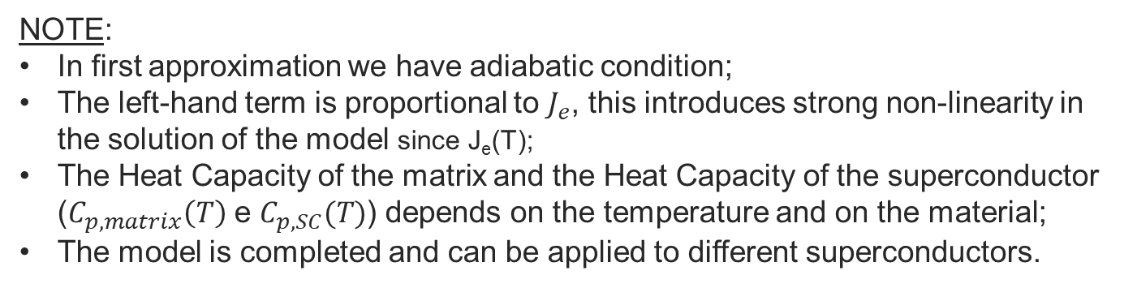
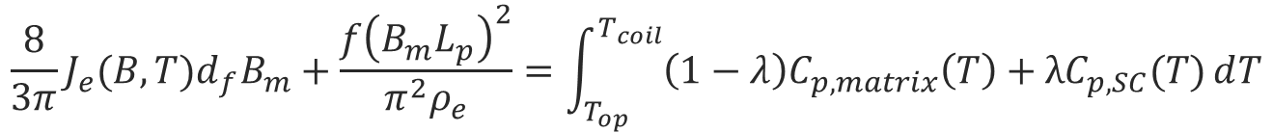
Thermal analysis
The superconductor must be designed to maintain the superconductive state during the normal operation. This work is done by the cryogenic system. The aim of this study, in particular, is to find the critical frequency at which the superconductor can reach the critical temperature. It is possible to do that considering:
$$\frac{8}{3π}J_{e}{(B,T)d}_{f}B_{m}+\frac{f{\left(B_{m}L_{p}\right)}^{2}}{π^{2}ρ_{e}}=\int_{T_{op}}^{T_{coil}}{{\left(1−λ\right)C}_{p,matrix}\left(T\right)+{λC}_{p,SC}(T)ⅆT}$$
NOTE:
In first approximation we have adiabatic condition;
The left-hand term is proportional to $J_{e}$, this introduces strong non-linearity in the solution of the model since J_{e}(T);
The Heat Capacity of the matrix and the Heat Capacity of the superconductor ($C_{p,matrix}\left(T\right)$ e $C_{p,SC}(T)$) depends on the temperature and on the material;
The model is completed and can be applied to different superconductors.

Slide 10
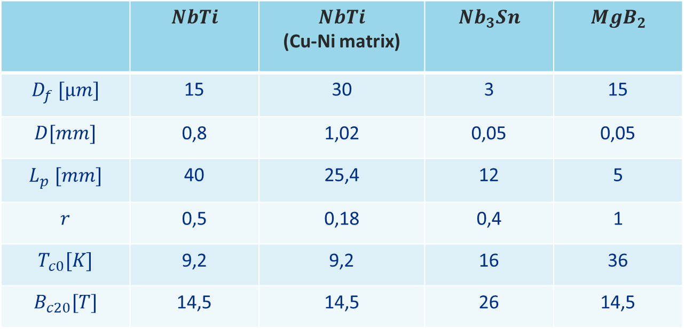
Geometrical parameters of the cables
The model that is developed has been applied to four different types of superconducting magnets, in particular is possible to see all the parameters in the list below:
 | $$NbTi$$ | $$NbTi$$ (Cu-Ni matrix) | $${Nb}_{3}Sn$$ | $${MgB}_{2}$$
$$D_{f} [μm]$$ | 15 | 30 | 3 | 15
$$D[mm]$$ | 0,8 | 1,02 | 0,05 | 0,05
$$L_{p} [mm]$$ | 40 | 25,4 | 12 | 5
$$r$$ | 0,5 | 0,18 | 0,4 | 1
$$T_{c0}[K]$$ | 9,2 | 9,2 | 16 | 36
$$B_{c20}[T]$$ | 14,5 | 14,5 | 26 | 14,5

Slide 11
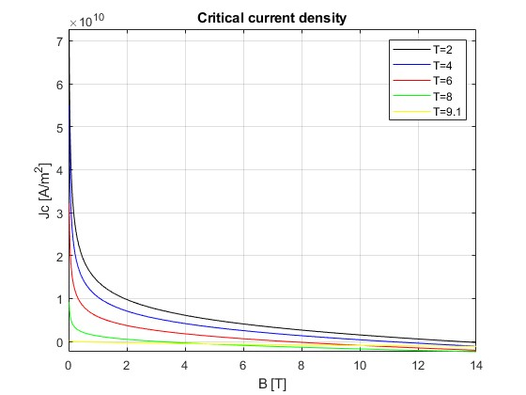
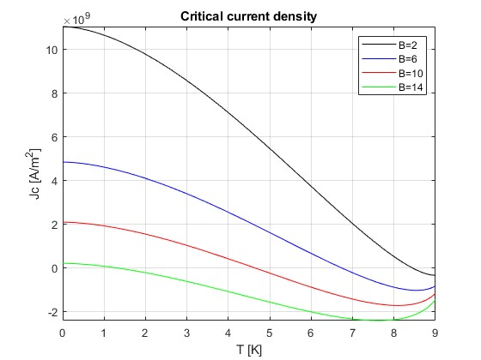

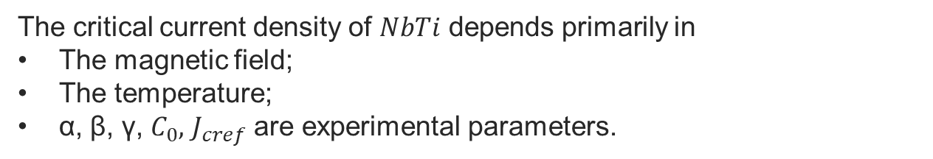

Solution $NbTi$: the critical current density
$$\frac{J_{c}\left(B , T\right)}{J_{cref}}=\frac{C_{0}}{B}{\left[\frac{B}{B_{c2}\left(T\right)}\right]}^{α}{\left[1−\frac{B}{B_{c2}\left(T\right)}\right]}^{β}{\left[1−{\left(\frac{T}{T_{c0}}\right)}^{1.7}\right]}^{γ}$$
$$B_{c2}\left(T\right)=B_{c20}\left[1−{\left(\frac{T}{T_{c0}}\right)}^{1.7}\right]$$
The critical current density of $NbTi$ depends primarily in
The magnetic field;
The temperature;
α, β, γ, $C_{0},$ $J_{cref}$ are experimental parameters.

Slide 12
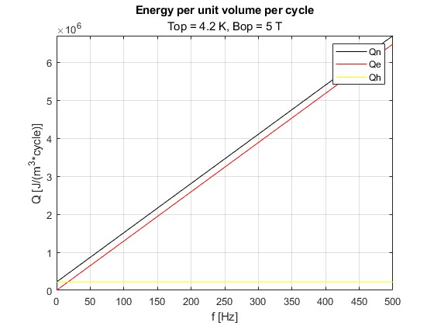
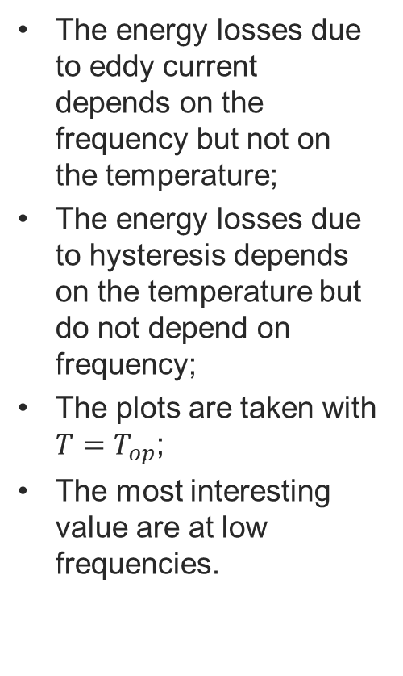
Solution $NbTi$: the energy per volume and per cycle
The energy losses due to eddy current depends on the frequency but not on the temperature;
The energy losses due to hysteresis depends on the temperature but do not depend on frequency;
The plots are taken with $T=T_{op}$;
The most interesting value are at low frequencies.

Slide 13
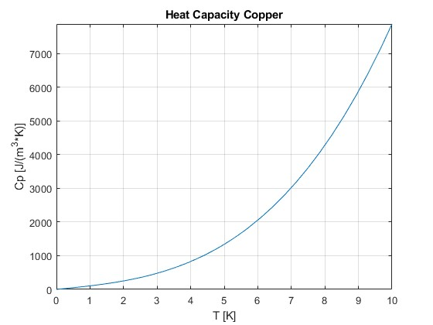
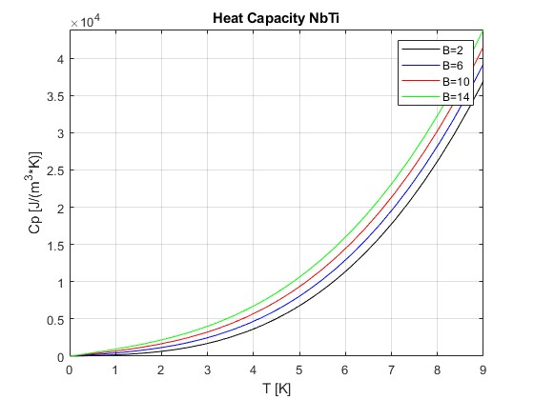
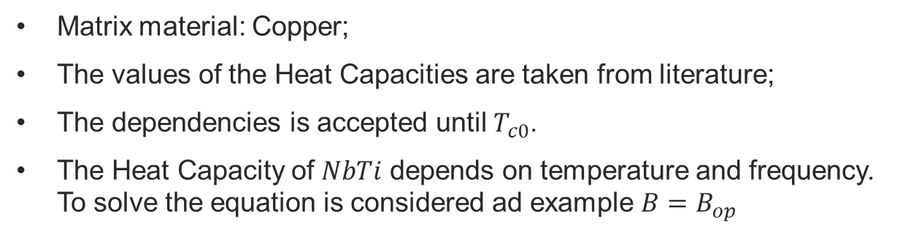
Solution $NbTi$: The Heat Capacity
Matrix material: Copper;
The values of the Heat Capacities are taken from literature;
The dependencies is accepted until $T_{c0}$.
The Heat Capacity of $NbTi$ depends on temperature and frequency. To solve the equation is considered ad example $B=B_{op}$

Slide 14
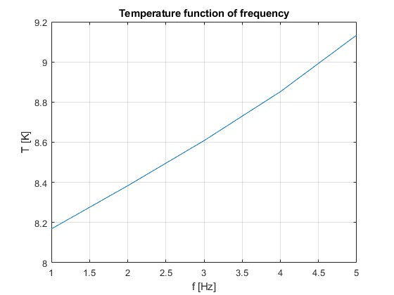
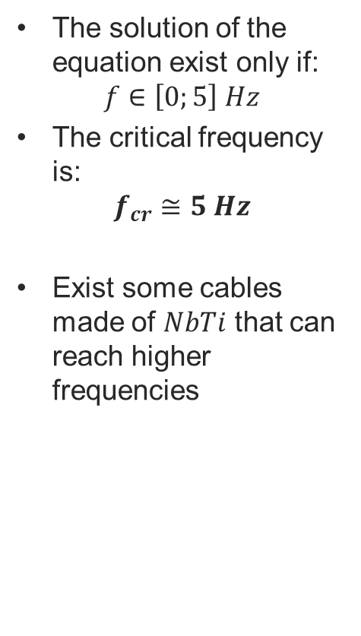
Solution $NbTi$: Temperature function of frequency
The solution of the equation exist only if:
$$f∈\left[0;5\right] Hz$$
The critical frequency is:
$$f_{cr}≅5 Hz$$
Exist some cables made of $NbTi$ that can reach higher frequencies

Slide 15
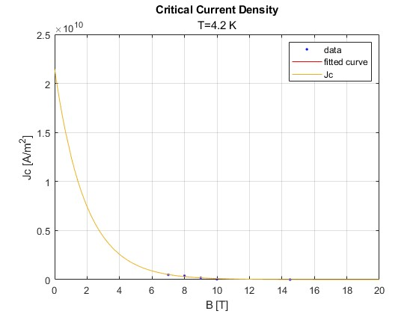
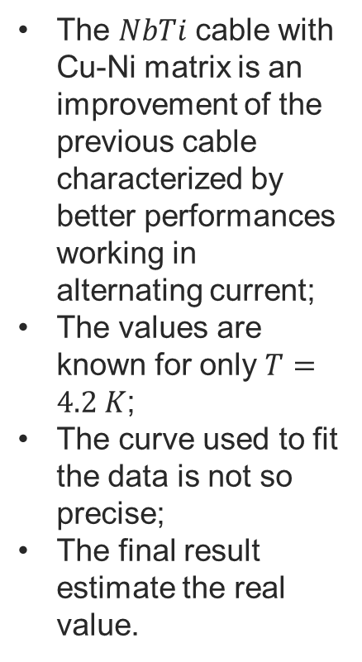
Solution $NbTi$(Cu-Ni matrix): the critical current density
The $NbTi$ cable with Cu-Ni matrix is an improvement of the previous cable characterized by better performances working in alternating current;
The values are known for only $T=4.2 K$;
The curve used to fit the data is not so precise;
The final result estimate the real value.

Slide 16
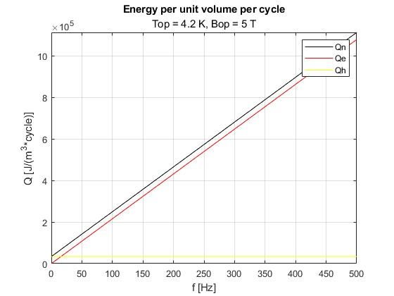
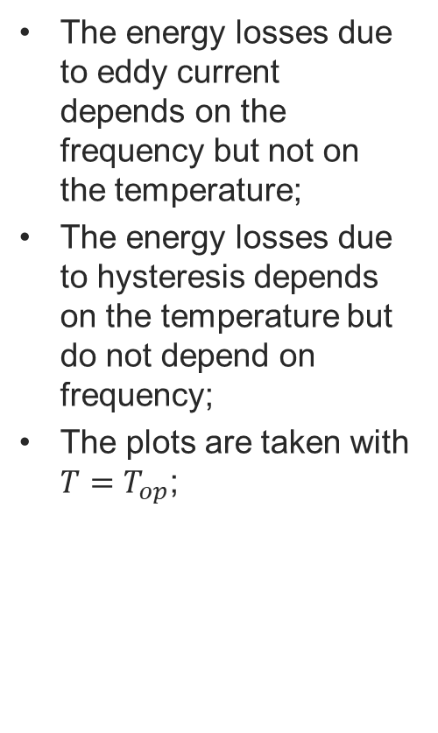
Solution $NbTi$ (Cu-Ni matrix): the energy per volume and per cycle
The energy losses due to eddy current depends on the frequency but not on the temperature;
The energy losses due to hysteresis depends on the temperature but do not depend on frequency;
The plots are taken with $T=T_{op}$;

Slide 17
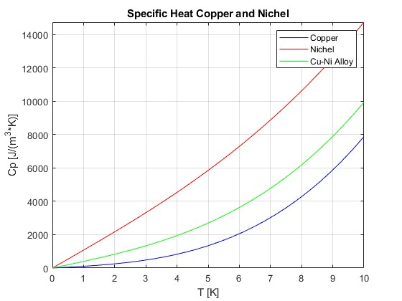
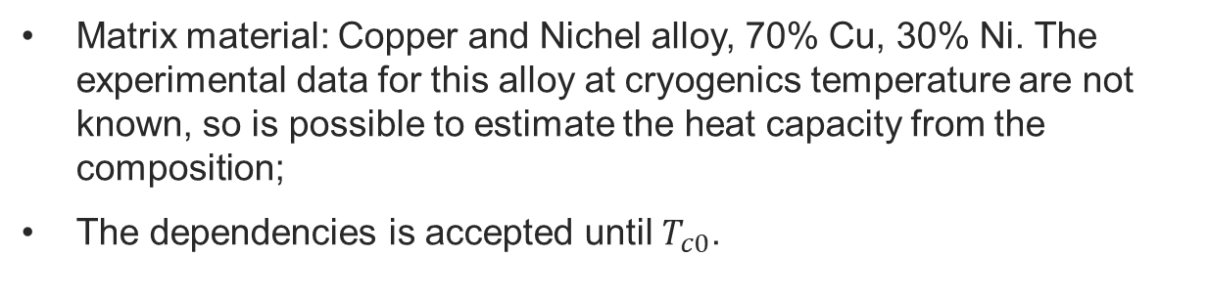
Solution $NbTi$(Cu-Ni matrix): The Heat Capacity
Matrix material: Copper and Nichel alloy, 70% Cu, 30% Ni. The experimental data for this alloy at cryogenics temperature are not known, so is possible to estimate the heat capacity from the composition;
The dependencies is accepted until $T_{c0}$.

Slide 18
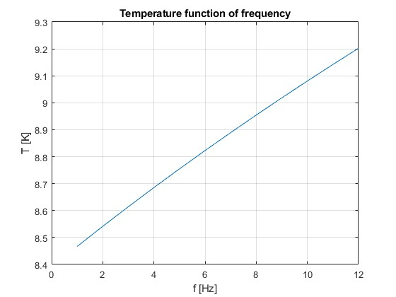
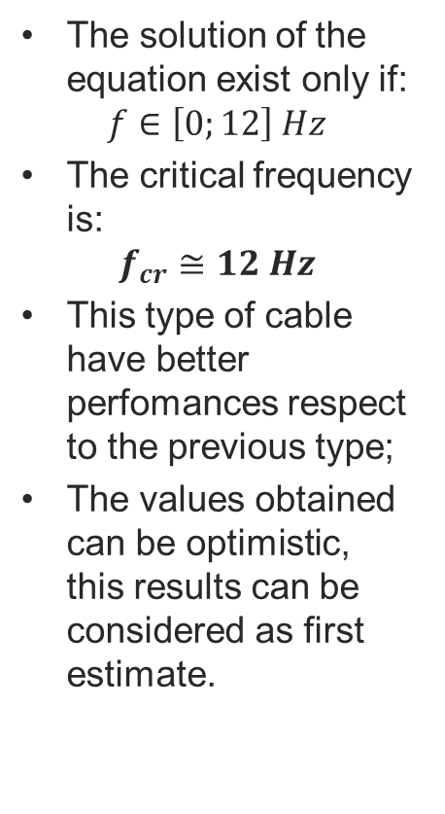
Solution $NbTi$ (Cu-Ni matrix): Temperature function of frequency
The solution of the equation exist only if:
$$f∈\left[0;12\right] Hz$$
The critical frequency is:
$$f_{cr}≅12 Hz$$
This type of cable have better perfomances respect to the previous type;
The values obtained can be optimistic, this results can be considered as first estimate.

Slide 19
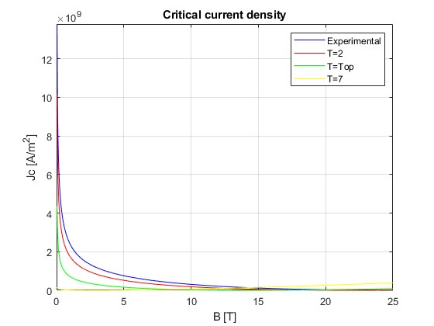
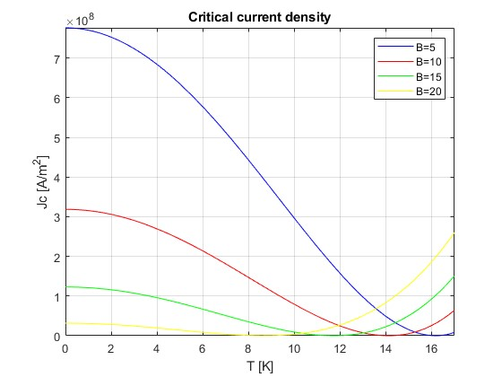

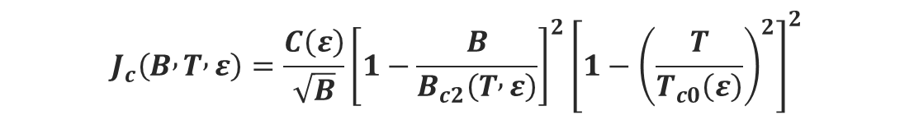
Solution ${Nb}_{3}Sn$: the critical current density
$$J_{c}\left(B , T , ε\right)=\frac{C\left(ε\right)}{\sqrt{B}}{\left[1−\frac{B}{B_{c2}\left(T , ε\right)}\right]}^{2}{\left[1−{\left(\frac{T}{T_{c0}\left(ε\right)}\right)}^{2}\right]}^{2}$$
$$\frac{B_{c2}\left(T , ε\right)}{B_{c20}\left(ε\right)}=\left[1−{\left(\frac{T}{T_{c0}\left(ε\right)}\right)}^{2}\right]$$
$$T_{c0}(ε)=T_{c0m}(1−a{\left|ε\right|}^{1.7})^{\frac{1}{3}}$$
The dependencies on the strain is dropped:
Is mantained the dependencies on the temperature and on the magnetic field

Slide 20
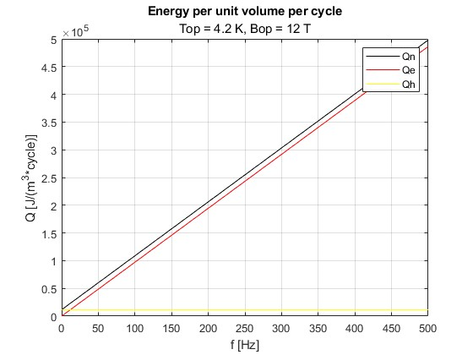

Solution ${Nb}_{3}Sn$: the energy per volume and per cycle
The energy losses due to eddy current depends on the frequency but not on the temperature;
The energy losses due to hysteresis depends on the temperature but do not depend on frequency;
The plots are taken with $T=T_{op}$ and $B=B_{op}$ ;
The values are interesting for all the range of the frequencies

Slide 21



Solution${ Nb}_{3}Sn$: Specific Heat and Heat Capacity
Matrix material: Bronze;
The value of the Heat Capacity is taken from literature;
The value of the Specific Heat of Bronze is taken from experimental data
The dependencies is accepted until $T_{c0}$.

Slide 22


Solution${ Nb}_{3}Sn$: Temperature function of frequency
The solution of the equation exist only if:
$$f∈\left[0, 350\right] Hz$$
The critical frequency is:
$$f_{cr}≅350 Hz$$
This type of superconducting magnets is really interesting from the point of view of fast ramping;

Slide 23

Solution ${MgB}_{2}$: the critical current density
The dependency on the temperature is dropped because the values for other temperatures are not known.
In the plot are visible the experimental data and the fitted curve.

Slide 24


Solution ${MgB}_{2}$: the energy per volume and per cycle
The energy losses due to eddy current depends on the frequency but not on the temperature;
The energy losses due to hysteresis are constant;
The plots are taken with $T=T_{op}$ and $B=B_{op}$ ;
The hysteresis losses are small, this is a consequence of the dimension of the cable.

Slide 25



Solution ${MgB}_{2}$: Heat Capacity
Matrix material: Monel: 35% Cu and 65% Ni. The experimental data for Monel at cryogenics temperature are not known, so is possible to estimate the heat capacity from the composition.
The dependencies is accepted until $T_{c0}$.

Slide 26


Solution${ MgB}_{2}$: Temperature function of frequency
The critical frequency of this cable is really high:
$$f_{cr}≅4500 Hz$$
Can be more interesting to consider higher values of $B_{m}$.
This type of superconducting magnet is really interesting from the point of view of fast ramping;

Slide 27



Application to dipole
Application of the model in a dipole with a not homogeneous magnetic field;
Divide the coil in small homogeneous parts, (as visible in the picture below) in which it is possible to consider a constant magnetic field;
In this work the dipole is divided in three ways, the third one is the most conservative and for that will be shown only the results from that;
The energy losses, useful for the cryogenics system design, and the temperature function of the frequency of the most suffering turn are plotted ;
$I=2000 A$.

Slide 28



Dipole $NbTi$
$D=0,8 mm,$
$l_{p}=40 mm;$
$d_{f}=15 μm;$
$L=173 m;$
$r=0,5;$
$N=7$ : number of strand.

Slide 29



Dipole ${Nb}_{3}Sn$
$D=0,05 mm,$
$l_{p}=12 mm;$
$d_{f}=3 μm;$
$r=0,4;$
$N_{1}=36$ : number of strand.
$N_{2}=7$ : number of strand.
$N_{3}=7$ : number of strand.

Slide 30



Dipole ${MgB}_{2}$
$D=0,05 mm,$
$l_{p}=5 mm;$
$d_{f}=30 μm;$
$r=1;$
$N_{1}=7$ : number of strand.

Slide 31


Results
 | $$NbTi$$ | $$NbTi$$ (Cu-Ni matrix) | $${Nb}_{3}Sn$$ | $${MgB}_{2}$$
$$f_{cr}:single cable$$ $$(B_{m}=2 T)$$ | 5 Hz | 12 Hz (*) | 350 Hz | 4500 Hz (*)
$$f_{cr}:dipole$$ $$(I=2000 A)$$ | 7 Hz | (*) | 550 Hz | 7500 Hz (*)
As visible from this conclusive list the ${MgB}_{2}$ cable seem to be the best cable for AC application thanks to his high $T_{c0}$. Nevertheless, we have to consider that the model for this type is the least reliable and has to be checked and improved. The values of this type of cable are really optimistic, in fact, if the dependency on the temperature is dropped, the Q values is constant with respect to T and do not follow the law of the critical current density (that decrease as the temperature increase). All the results obtained that present this problem are underlined with the symbol «*». The next step could be to upload $J_{c}\left(T\right).$ For the $NbTi$ dipole the result is not show, in this case the model cannot predict a physical solution.

Slide 32

Conclusion and new development
This project has some interesting theoretical results, in particular in finding the values of the critical frequency;
The project could be improved, by developing a more accurate model for some materials as seen before (sometimes we loose some dependencies taking some values from experimental data);
The model has to be verified with some experiment;
At this point is really interesting to analyze the ${Nb}_{3}Sn$ or the ${MgB}_{2}$ dipoles for the fast ramping magnets;
Other types of studies (mechanical, thermal…) can be applied now to analize if the cable are able to withstand this type of ramping.
THANK YOU FOR THE ATTENTION

Slide 33

Bibliography
«${Nb}_{3}Sn$ Accelerator Magnets», A. Zlobin, D. Schoerling;
«Superconducting Magnets», M. Wilson;
«Performance metrics of electrical conductors for aerospace cryogenic motors, generators, and transmission cables», M.D. Sumption, J. Murphy, M. Susner, T. Haugan;
“Research and Development of ${Nb}_{3}Sn$ Wires and Cables for High-Field Accelerator Magnets”, E. Barzi, A. Zlobin;
“High heat capacity and radiation-resistant organic resins for impregnation of high field superconducting magnets”, E. Barzi, A. Kikuchi;
«Conductors for Fast Ramping Accelerator Magnets», E. Barzi, C. Johnstone, M. Majoros, M. Palmer, M. Sumption, D. Zhang;
“AC losses calculation of Bi-2212 Cable-in-Conduit Conductor used in CFETR”, Jian Rong, Xiongyi Huang, Yuntao Song, Haojun Yang, Kun Lu;
“AC loss and contact resistance of different CICC cable patterns: Experiments and numerical modeling”, Anvar V.A,*, J. Qin, Y. Wu, T. Bagni, A. Devred, T.J. Haugan, M.S.A. Hossain,C. Zhou, A. Nijhuis;

Slide 34
«Heat Capacity of Reference Material: Cu and W» G. K. White, J. Collocot;
“The Specific Heat of NbTi from 0 to 7 T Between 4.2 and 20 K”, S.A. Elrod, J.R. Miller, L. Dresner;
“EUCAS 2023”, Akihiro Kikuchi;
“The Heat Capacity of Nickel from 15 to 300°K. Entropy and Free Energy Functions”, R. H. Busy, W. F. Glauque;
“Specific Heat of the 38K superconductor MgB2 in the normal and superconducting state: bulk evidence for a double gap” A. Junod, Y. Wang, F. Bouquet, P. Toulemonde;
“Review of superconducting properties of MgB2”, C.Buzea, T. Yamashita.
«Material properties data for heat transfer modeling in Nb3Sn magnets», A. Davies
“Nb3Sn Specic Heat Fit Function for Quench Simulation”, G. Manfreda;
“Properties of Copper and Copper Alloys at Cryogenic Temperatures”, N. J. Simon, £. S. Drexler, and R. P. Reed
“ERROR ANALYSIS OF SHORT SAMPLE Jc MEASUREMENTS AT THE SHORT SAMPLE TEST FACILITY”, E. Barzi

Slide 35

Acknowledgment
Fermi National Accelerator Laboratory;
Supervisors:
  Alexander Zlobin;
  Emanuela Barzi;
Summer Students at Fermilab:
  Simone Donati;
  Marco Mambelli;
  Giorgio Bellettini;
  Emanuela Barzi;
Applied Physics and Superconducting Technology Directorate
  Daniele Turrioni;
  Allen Rusy;
University of Pisa.

