Slide 1
Bridging the gap between cosmological simulations with Graph Neural Networks and Domain Adaptation
Andrea Roncoli
Final Presentation 2023
28th September 2023
Supervisor: Aleksandra Ćiprijanović

Slide 2
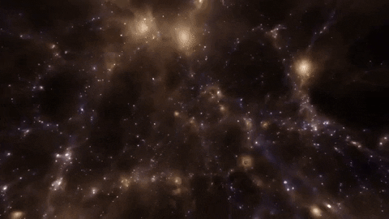
Inferring Cosmology from Simulations
Current approaches for inference of cosmology are mainly based on summary statistics (e.g. power spectrum).
Neural Networks and other Deep Learning approaches may be able to extract more (non-linear) information from complex datasets and outperform current methods.
Dataset: CAMELS

Slide 3
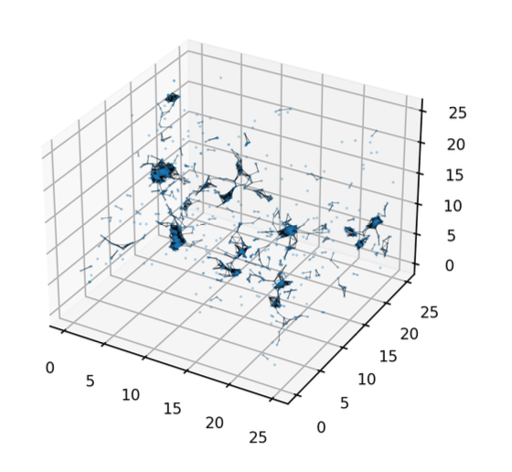
Constraining Cosmology with Graphs
Visualization of graph constructed by the data loading routine
Graphs are a very informative way of representing universes and galaxy clusters as datapoints.
In our project we use the CAMELS dataset galaxy catalogues.
Edges encode topological information of the simulated universe
Nodes encode galaxy properties
For these reasons, we are using Graph Neural Networks (GNNs) which can deal with such graphs as input.

Slide 4
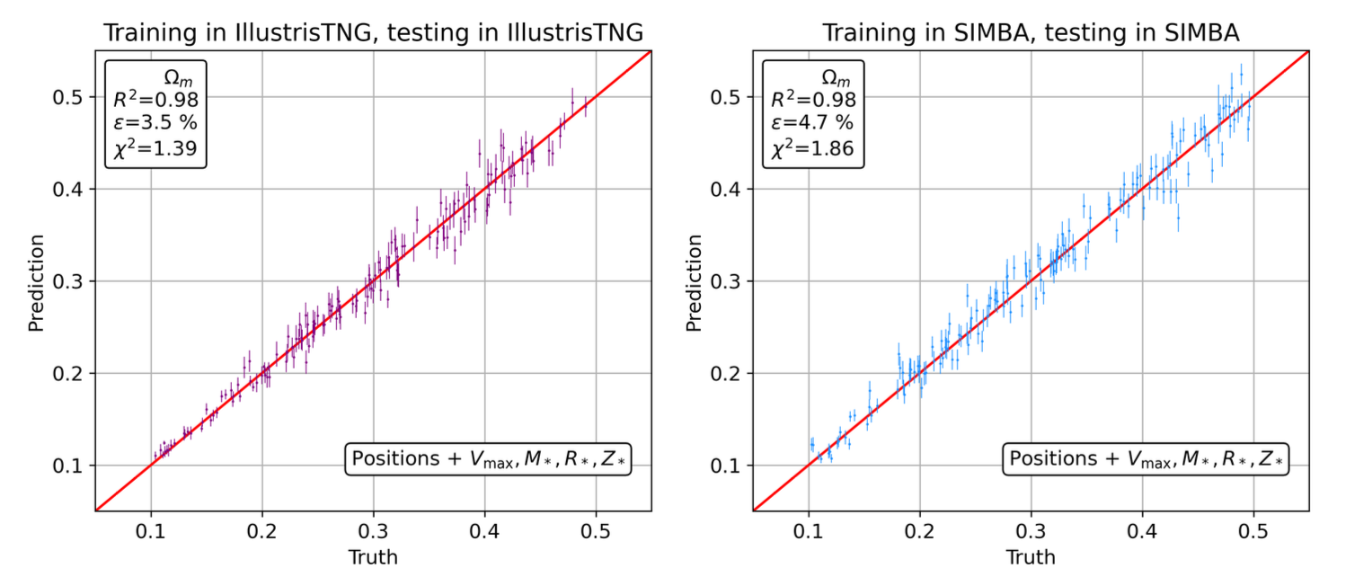
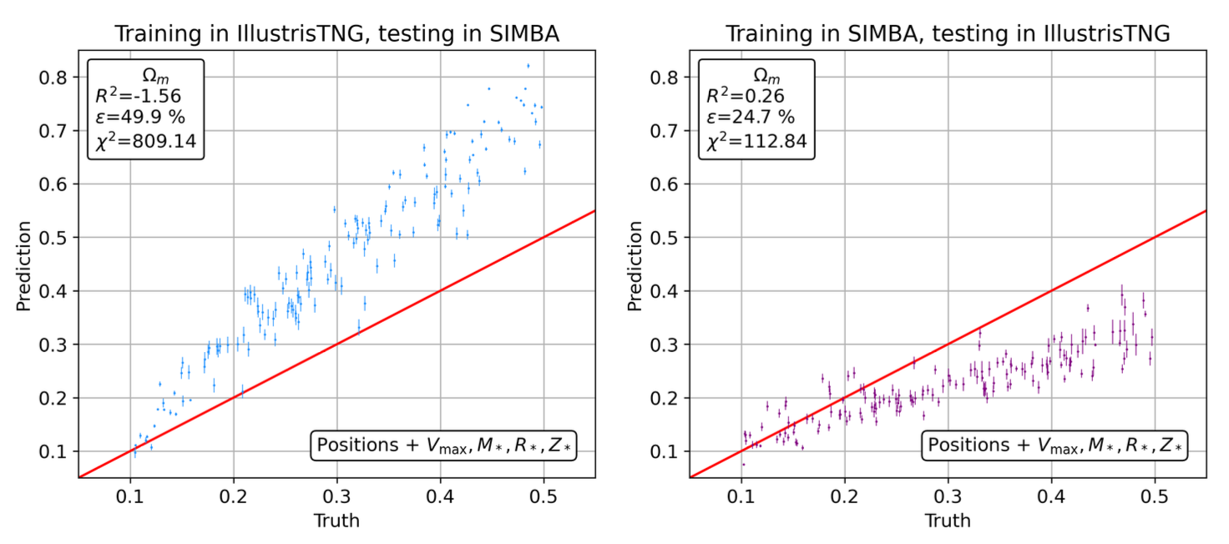
The Domain Generalization Problem
Domain generalization struggle by CosmoGraphNet (Villanueva et al 2023)

Slide 5
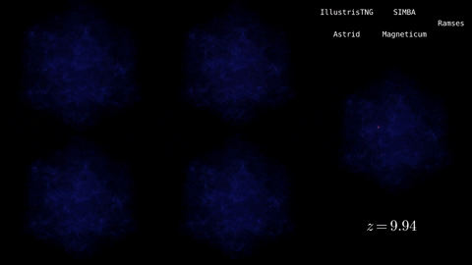
The Domain Generalization Problem
The problems with models trained with no domain adaptation is they are unable to generalize beyond the simulation they are trained in.
Models tend to ”learn the simulation”, and are fragile to a change in the simulation because of:
Different subgrid physics
Different numerical approximations, code for hydrodynamic equations resolution
Simulations evolved from same initial conditions in different suites (indicated on the top right)

Slide 6
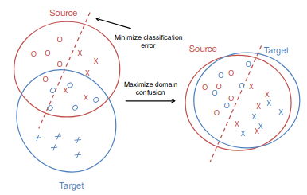
Domain Adaptation
Domain Adaptation is a technique to improve the performance of a model on a target domain containing insufficient annotated data by using the knowledge learned by the model from another related domain with adequate labeled data.
Many ways to align different domain distributions:
Distance-based methods
Adversarial methods
…

Slide 7
Maximum Mean Discrepancy
Smola et al. (2007)
Gretton et al. (2012)

Slide 8
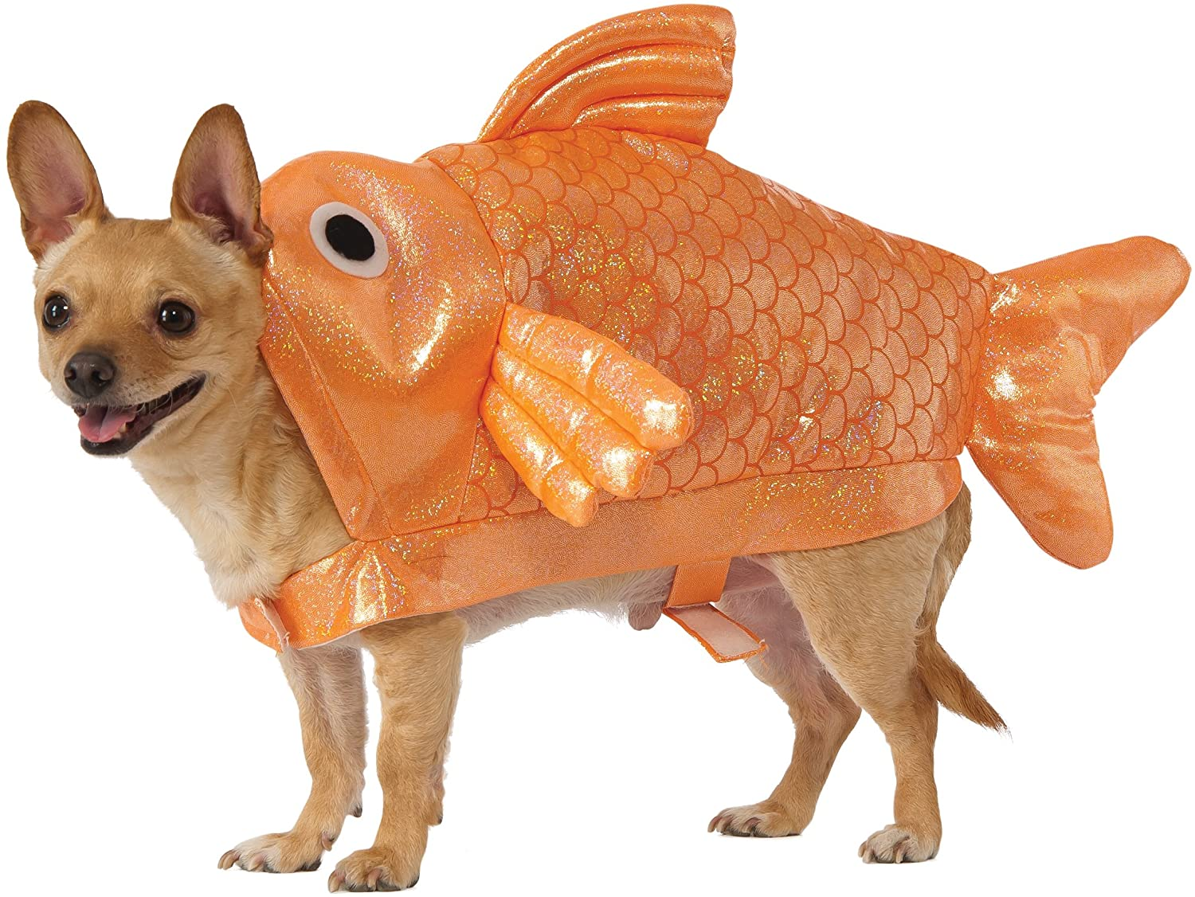
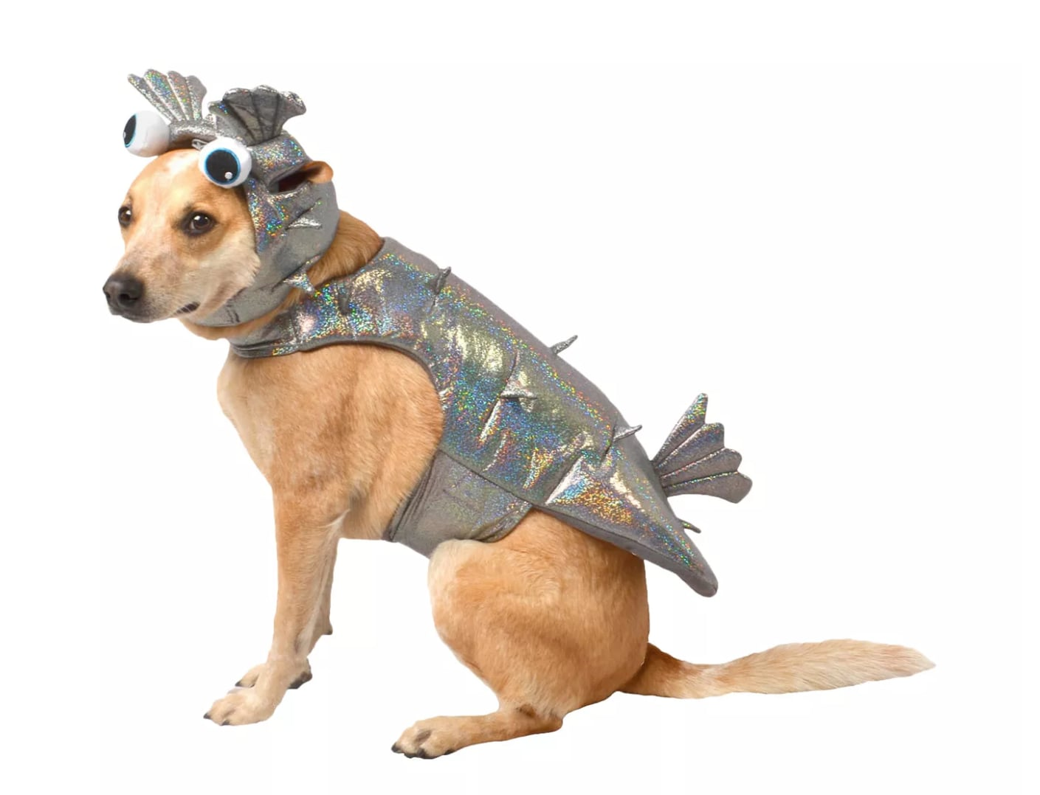
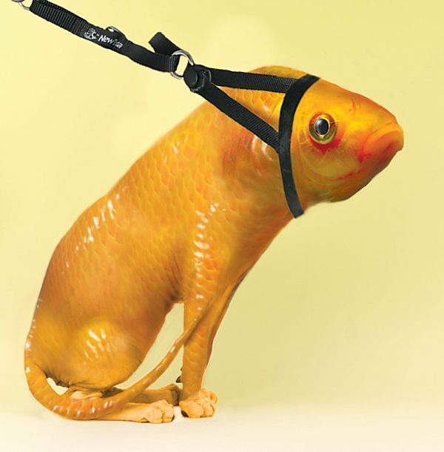
Maximum Mean Discrepancy
Smola et al. (2007)
Gretton et al. (2012)

Slide 9
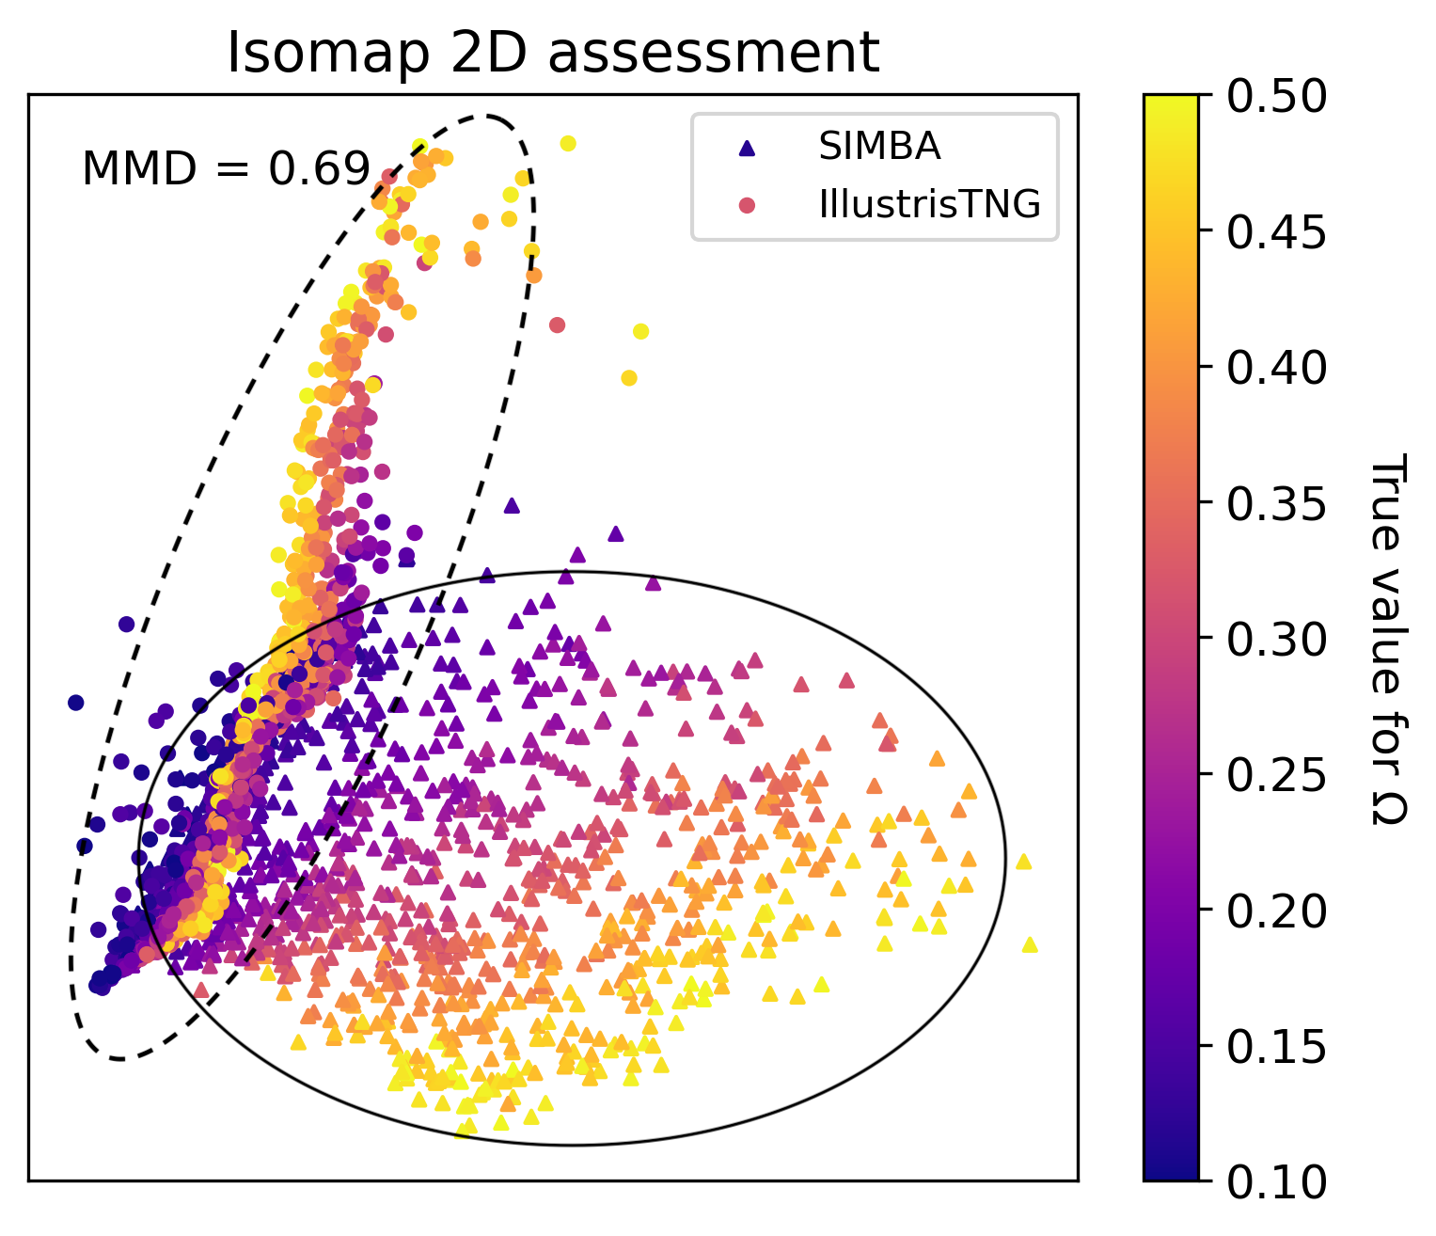
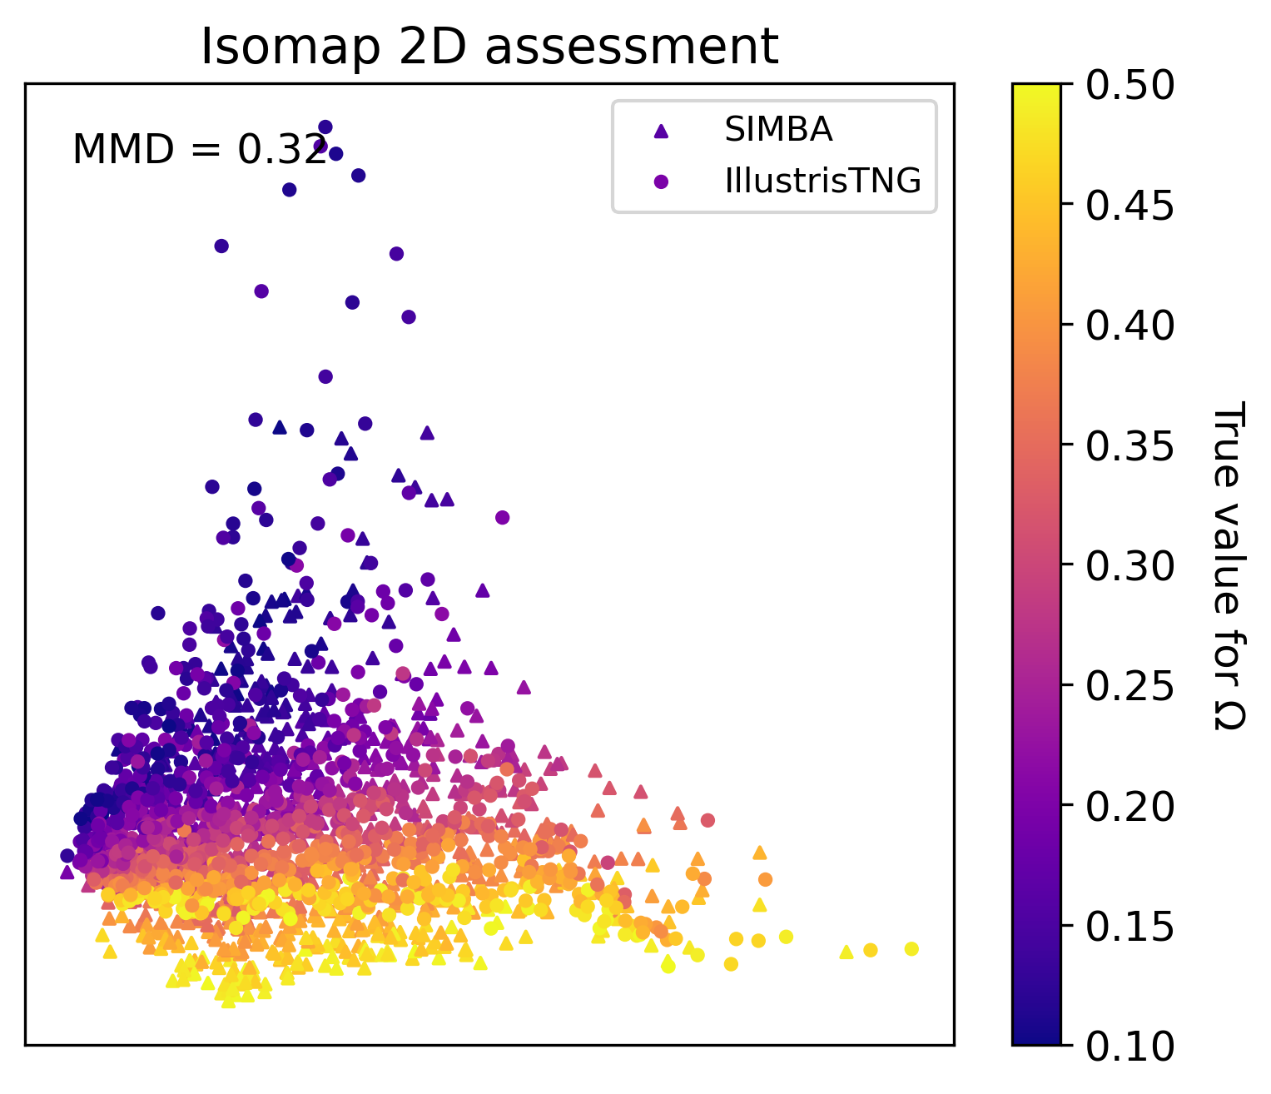
MMD Effect on Latent Space (SIMBA)
Organization of latent space with MMD loss

Slide 10
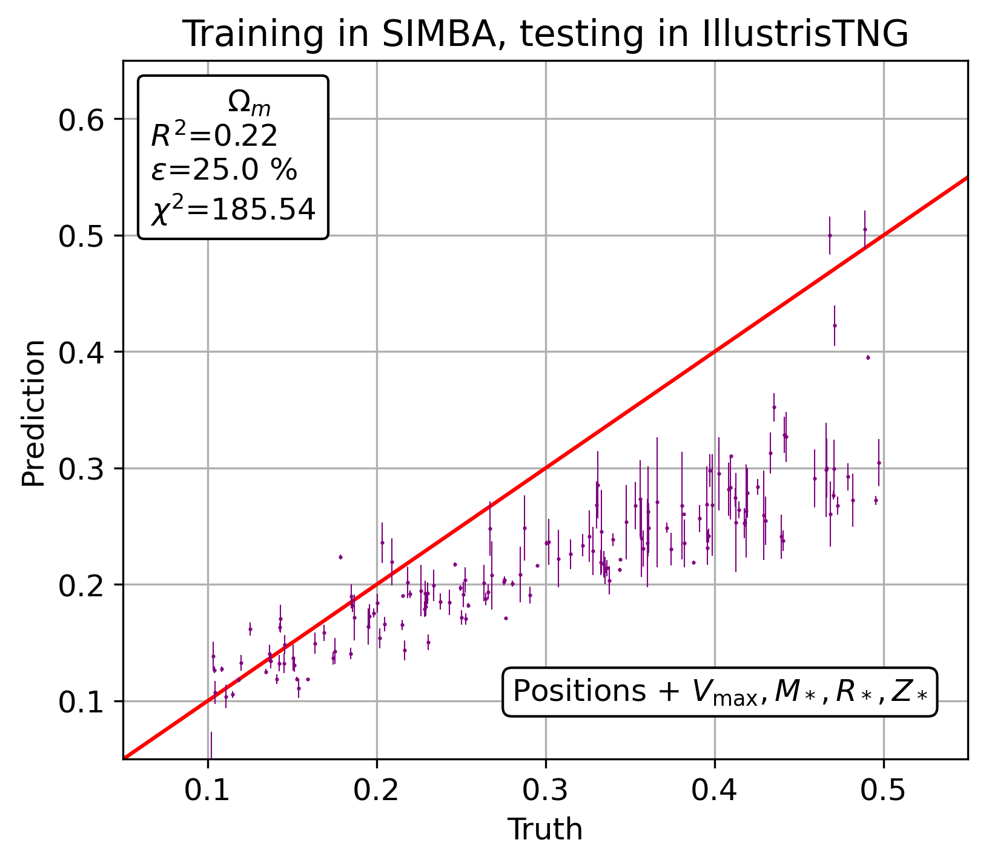
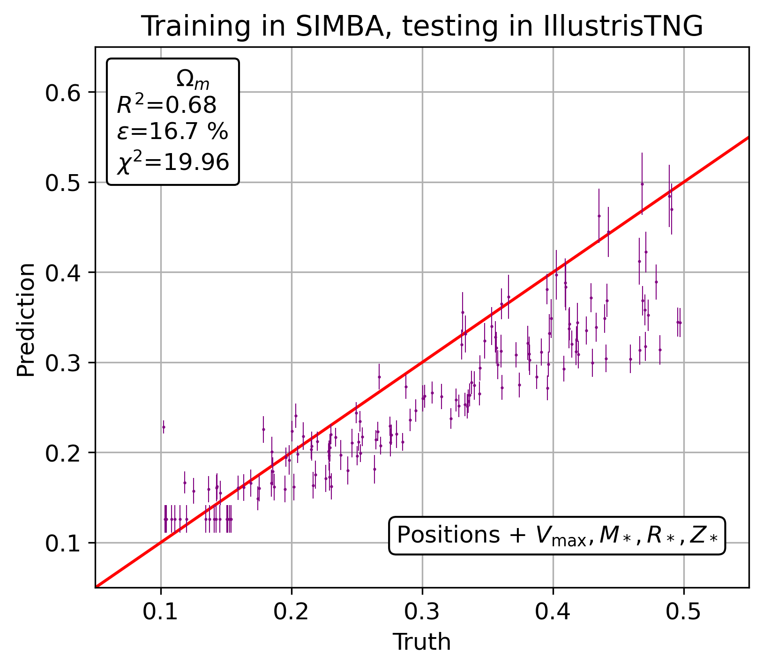
Predictions With a Better Organized Latent Space (SIMBA)
Difference in cross-domain accuracy for non domain adapted vs domain adapted models

Slide 11
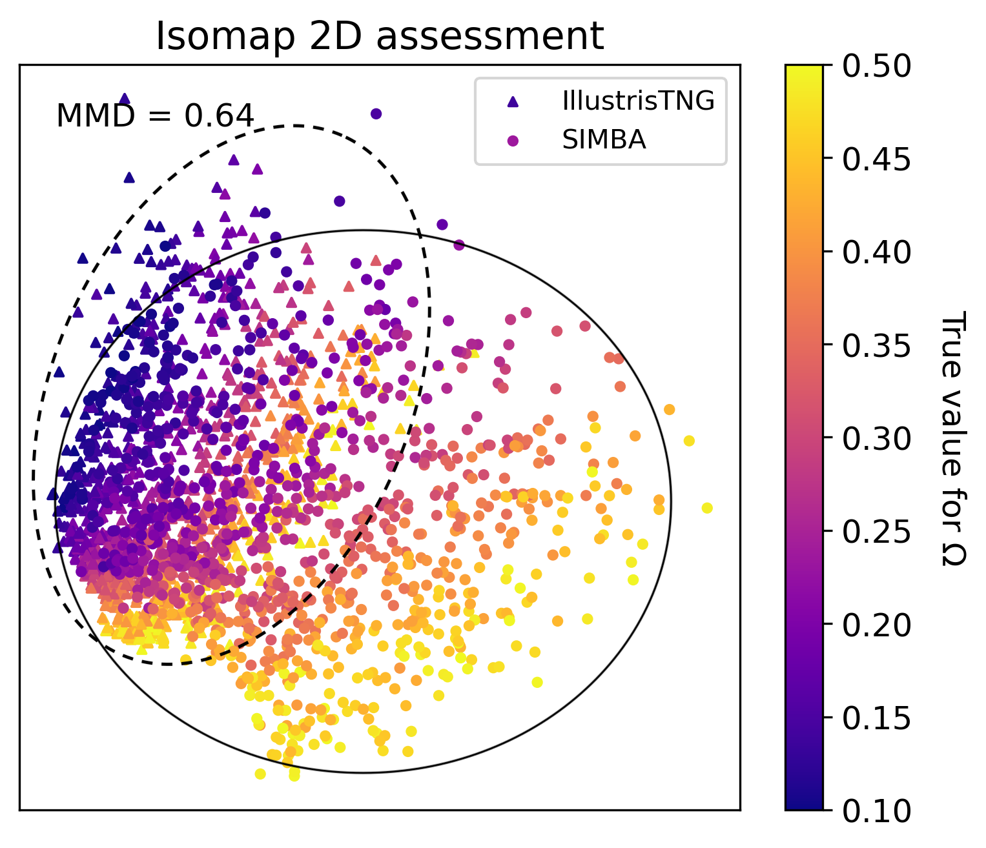
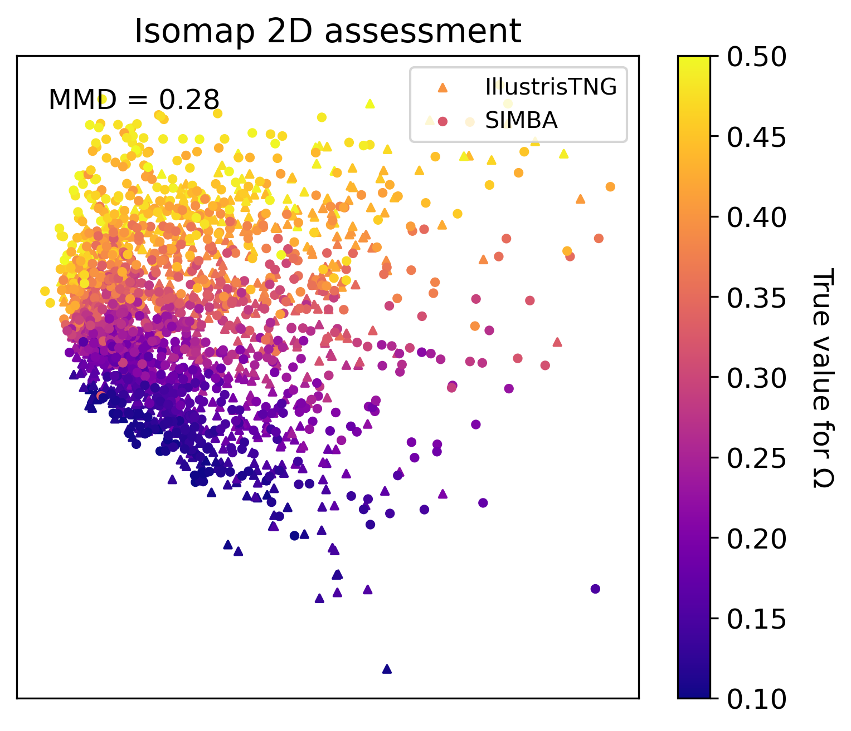
MMD Effect on Latent Space (IllustrisTNG)
Organization of latent space with MMD loss

Slide 12
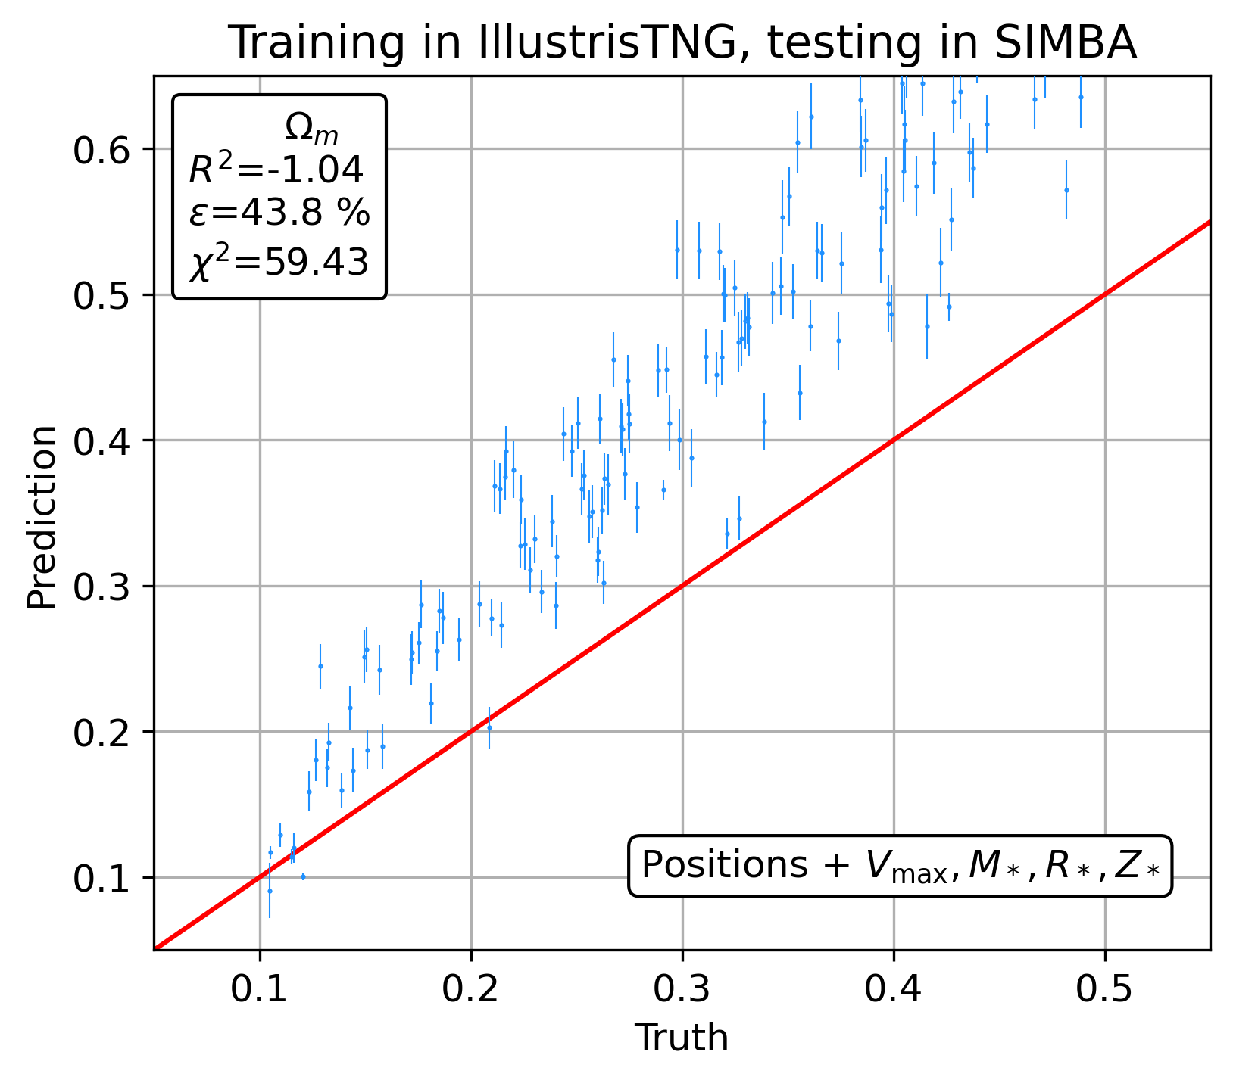
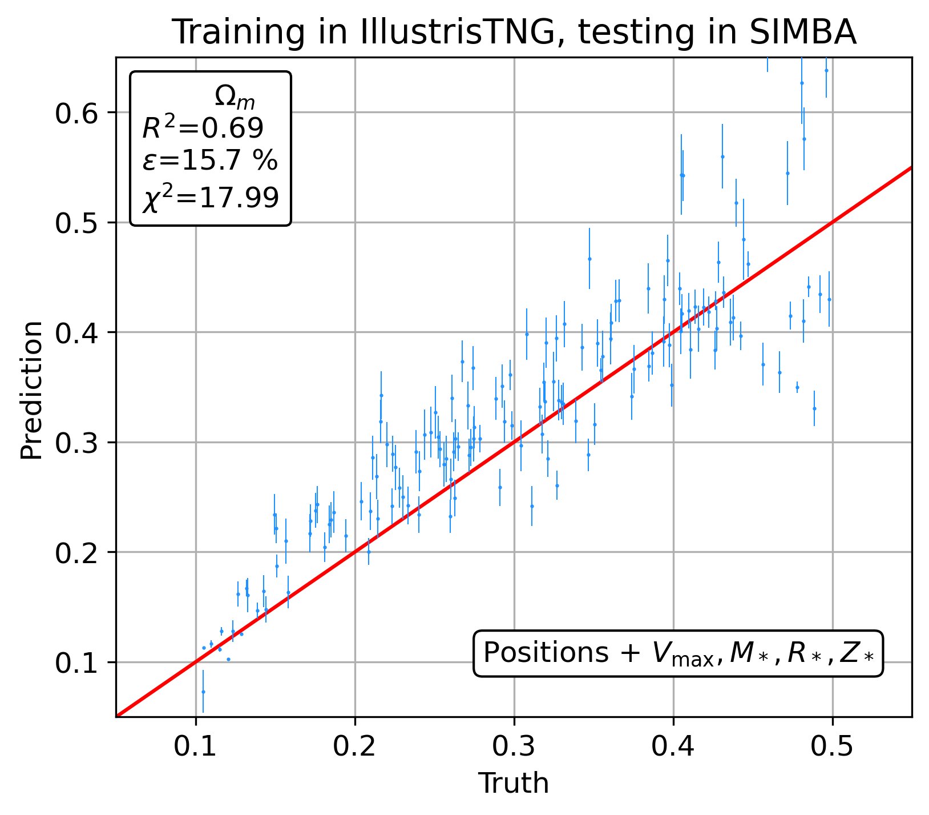
Predictions With a Better Organized Latent Space (IllustrisTNG)
Difference in cross-domain accuracy for non domain adapted vs domain adapted models

Slide 13
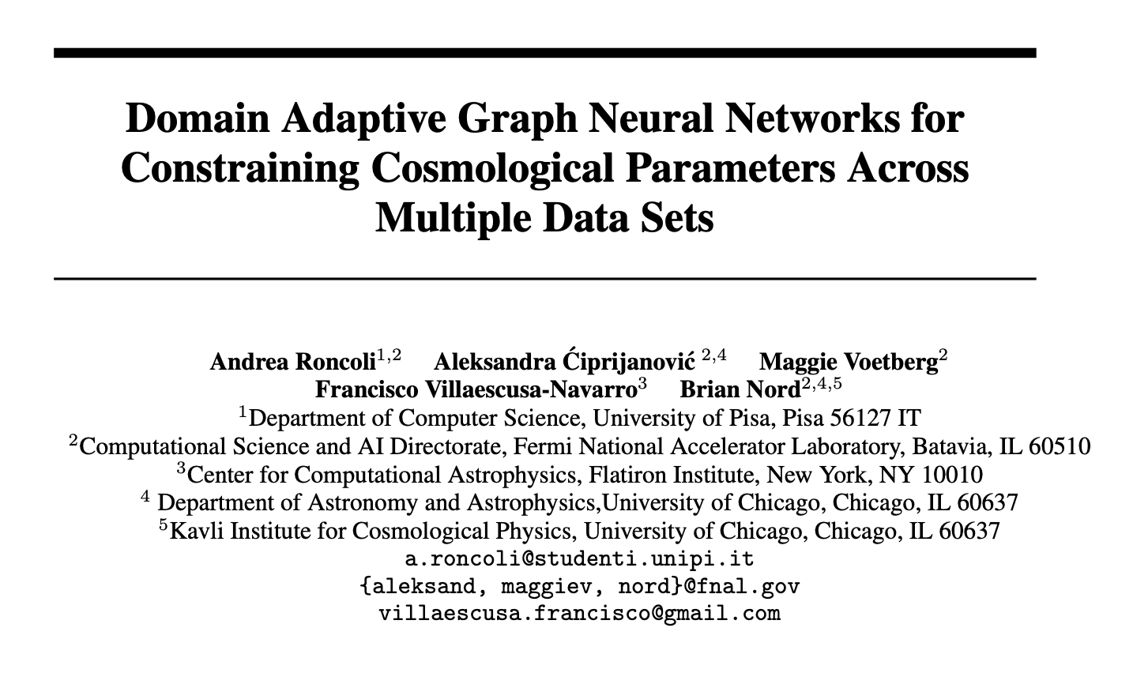
Submission to NeurIPS: ML for Physics Workshop

Slide 14
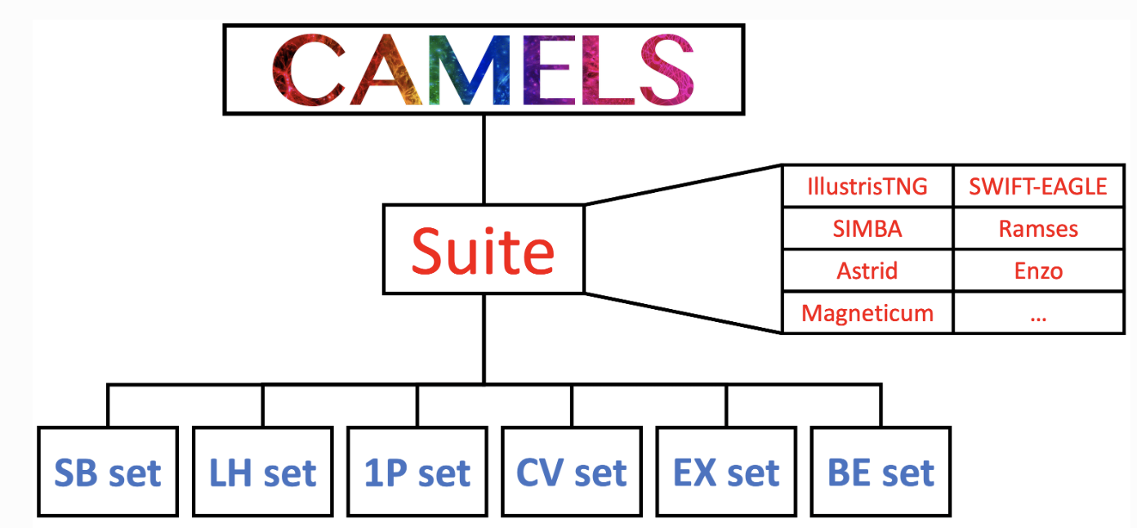
Limitations
More flexible adversarial-based approaches may be more effective than distance-based approaches such as MMD
Using data augmentation and simulation from all CAMELS suites may yield more cross-domain generalization
Structure of the CAMELS dataset; simulation sets/suites we used are highlighted in yellow

Slide 15
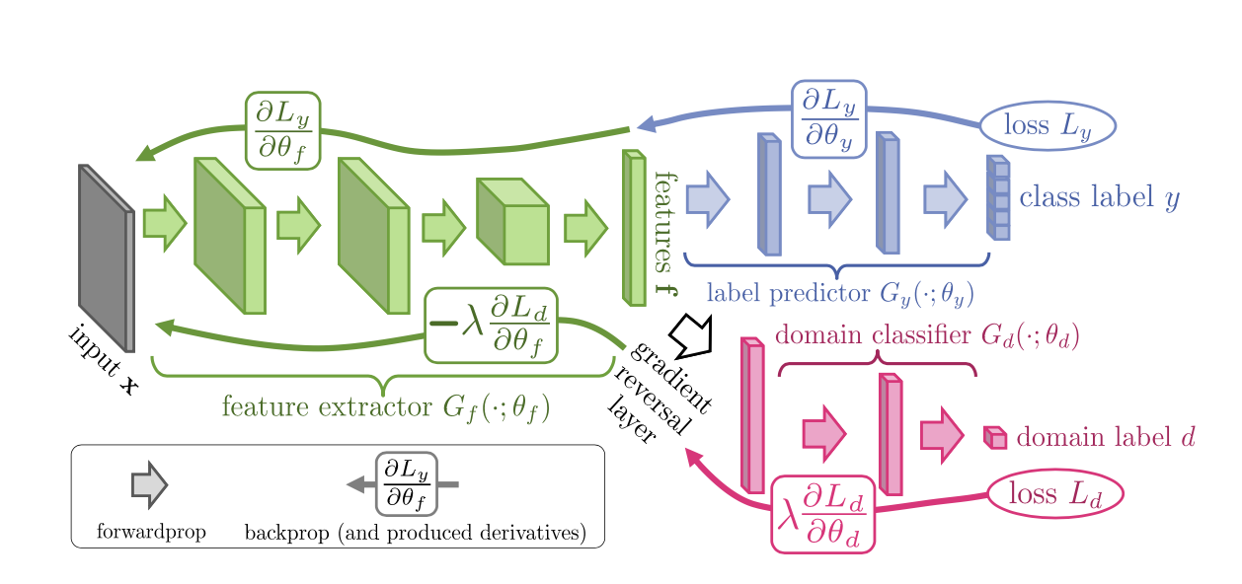
Future Work: Domain Adversarial Neural Networks
Architecture of the minmax adversarial objective function for domain adaptation

Slide 16
Future Work: Adversarial Discriminative Domain Adaptation
Phases of training for GAN-based adversarial domain adaptation

Slide 17
Thank you!
Andrea Roncoli
Midterm Report 2023
29th August 2023
Supervisor: Aleksandra Ćiprijanović

