Slide 1
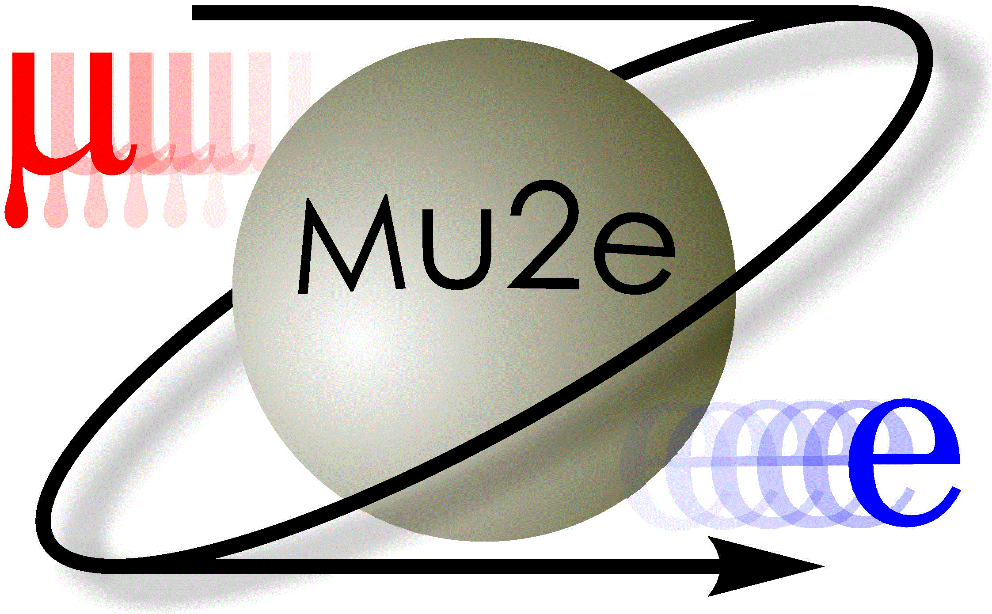
Developing a Photon Conversion Reconstruction Algorithm for Background measurements in Mu2e
Francesco Mattia Carone
09/27/2023

Slide 2
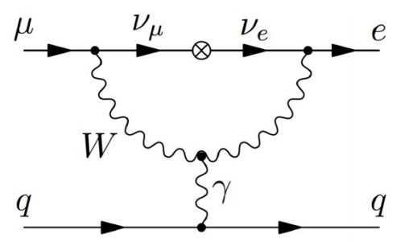
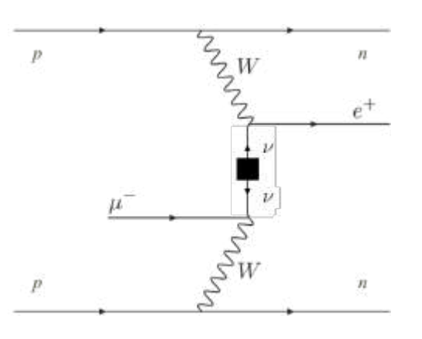
Mu2e Experiment purpose
The main goal of Mu2e is to look for the CLFV process${: μ}^{−}+N\left(A,Z\right)→e^{−}+N\left(A,Z\right)$.
If no process is observed, Mu2e would improve the the current measure of the upper limit of the process’s BR by 4 orders of magnitude and reach a Single Event Sensitivity (SES) of $3×{10}^{−17}$with a $90\%$ Confidence Level (CL) of $8×{10}^{−17}$.
A secondary goal is the search for the CLFV and LNV process: $μ^{−}+N\left(A,Z\right)→e^{+}+N\left(A,Z−2\right).$
The conversion can be mediated through either Giant Dipole Resonance or Ground State transition; in the latter case, the process is monoenergetic: $E_{e^{+}}\sim 92.3$ Mev. In the former case, the search is overwhelmed by background processes, RMC (Radiative Muon Captures).
The process is monoenergetic: $E_{e^{−}}\sim 104.97$ Mev
Complementary process to the double beta decay.

Slide 3
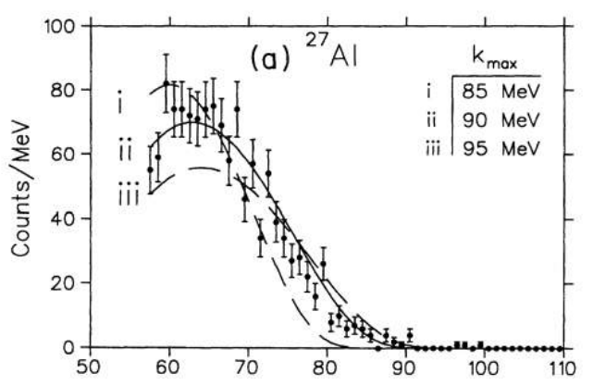
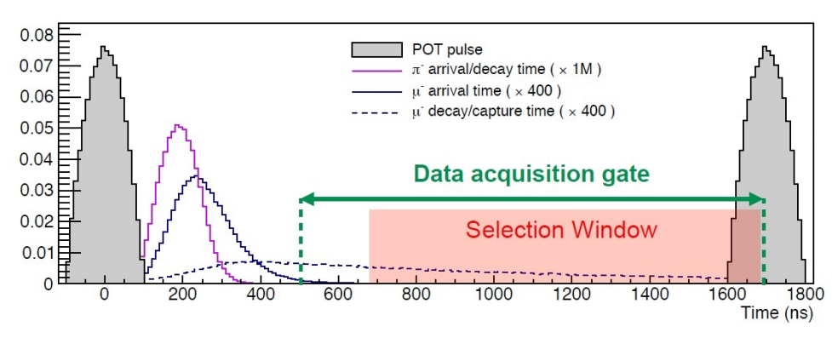
Backgrounds to the $μ^{−}−e^{+}$ process
As for the $μ^{−}−e^{+}$ process, the background processes are:
Radiative Muon Capture (RMC)
The photon produced can convert yielding a positron. The kinematic limit of the photon is $E_{γ}^{lim}\sim 101.85$ MeV.
Positrons and Muons from Cosmic Rays
Antiprotons
Radiative Pion Capture (RPC)
Pions that survive the delayed live gate can reach the stopping target and produce a photon with spectrum endpoint at $E_{γ}^{lim}\sim 135$ Mev. This background is suppressed.

Slide 4
Purpose of the Project
The goal is to develop an algorithm that is able to efficiently reconstruct double track events corresponding to conversions of primary photons into electron/positron couples.
A photon is said to be primary if it has not been produced starting by other photons. The efficiency of the algorithm should be higher for positrons in the CP momentum range, so that the algorithm can be adopted to reconstruct conversion events that are background to the $μ^{−}−e^{+}$ process.

Slide 5
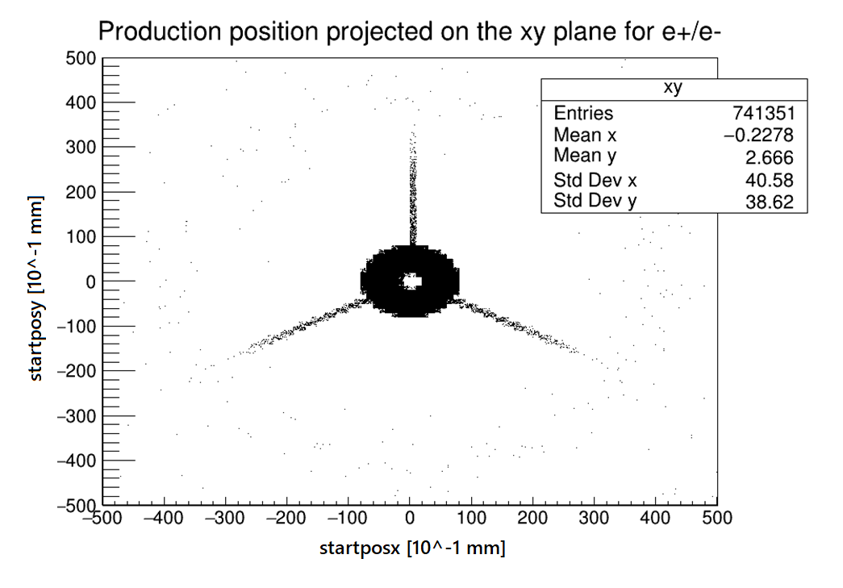
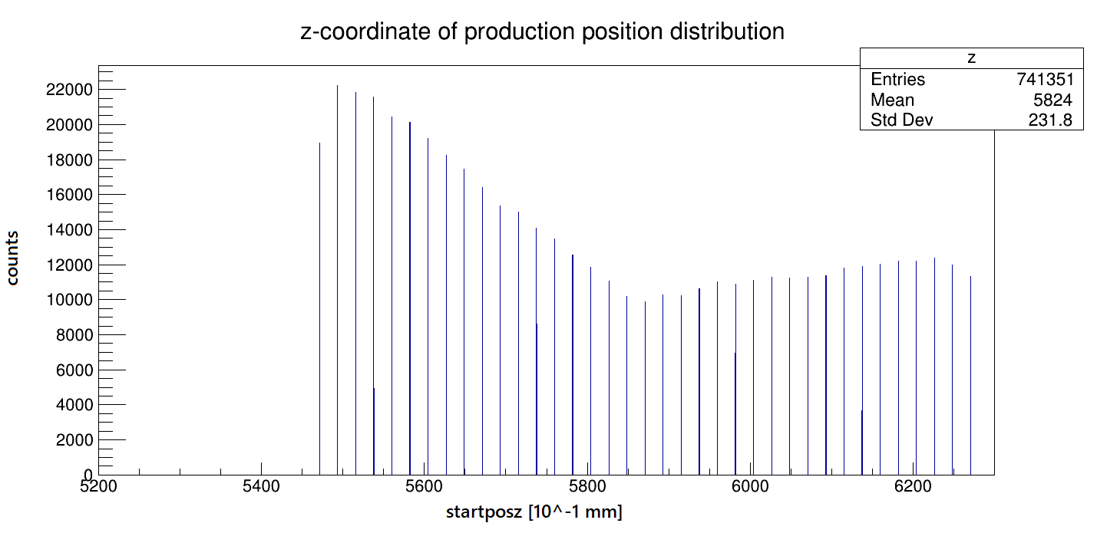
Software and Monte Carlo simulations
Monte Carlo simulated events are used in order to measure and optimize the efficiency of a developed track reconstruction algorithm.
Most of the code and of the scripts that are currently used for analysis of both simulation and reconstruction are kept in the Mu2e Offline GitHub repository at the link:
https://github.com/Mu2e/Offline.
Example: Monte Carlo sample of ${\sim 10}^{8}$ simulated photon conversion events, with photon energy randomly extracted from a flat distribution in the $70/102$ Mev interval (close to CP momentum). Such sample is typically called a «flat photons» sample.
We can plot and visualize the most interesting physical properties of the photons from the sample, such as starting position (plots above).

Slide 6
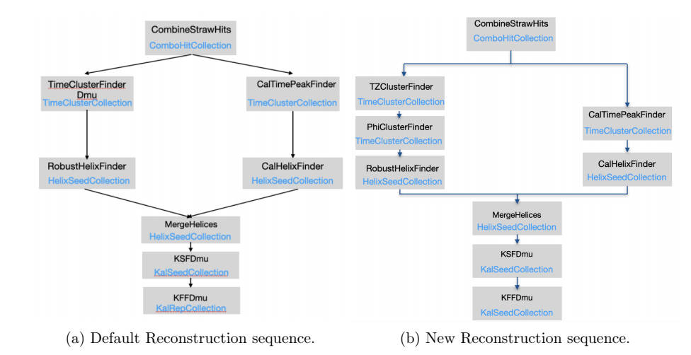
Track reconstruction sequences
Reconstruction algorithms that have been already developed and tested were mostly written in order to reconstruct single track events for electrons with an energy range close to CE. Instead, we need a new algorithm that can efficiently reconstruct primary photon conversion double-track events.
We can start from already existing double track events reconstruction algorithms, not specialized in photon conversion events, to develop a new one that is useful for our purpose. Below, a double track reconstruction algorithm sequence, specialized in $p\overline{p}$, is compared with the default sequence.

Slide 7
Analysis (part 1)
The double track reconstruction sequence showed in the previous slide was re-adapted to reconstruct double track electron/positron conversion events.
The efficiency of the sequence can be evaluated through the following analysis. First construct 6 separate sets of Monte Carlo truth conversion events, distinguished on the basis of the type of their final particles. Respectively, they are requested to exhibit, as final particles:
an electron/positron pair from same primary photon
an electron/positron pair from same photon
an electron/positron pair
at least an electron and a positron
a pair of any conversion particles
at least one conversion particle
Then, for each set, compute the ratio of the number of correspondencies between the set’s events and the reconstructed events (numerator) and the number of events in the set (denominator).
As for «conversion particle», we refer either to an electron or a positron that converted from a photon.
Starting from a sample of $\sim {10}^{9}$ Monte Carlo flat photons events, the new reconstruction sequence was applied to the data gathered from the simulated detector. Then, the reconstruction results were compared to the known properties of the Monte Carlo events (Monte Carlo truth).

Slide 8
Analysis (parte 2)
The ratio corresponding to the first set can be interpreted as the actual efficiency of the sequence. The other ratios provide information about the false positives appearing in the reconstructed events set.
Set | Number of reconstructed events | Number of Monte Carlo truth events | Number of correspondecies | Ratio
$e^{−}/e^{+}$ from same primary photon | 55 | 2844 | 2 | $$7.0 ×{10}^{−4}$$
$e^{−}/e^{+}$ from same photon | 55 | 5773 | 2 | $$3.5×{10}^{−4}$$
$e^{−}/e^{+}$ pair | 55 | 102822 | 5 | $$4.9×{10}^{−5}$$
At least $e^{−}/e^{+}$ | 55 | 172862 | 12 | $$6.9×{10}^{−5}$$
Just 2 conversion particles | 55 | 186808 | 9 | $$4.8×{10}^{−5}$$
At least 1 conversion particle | 55 | 680687 | 49 | $$7.2×{10}^{−5}$$
It was therefore measured an efficiency of $\sim 0.07\%$ and a false positive ratio of $\sim 96\%$.

Slide 9
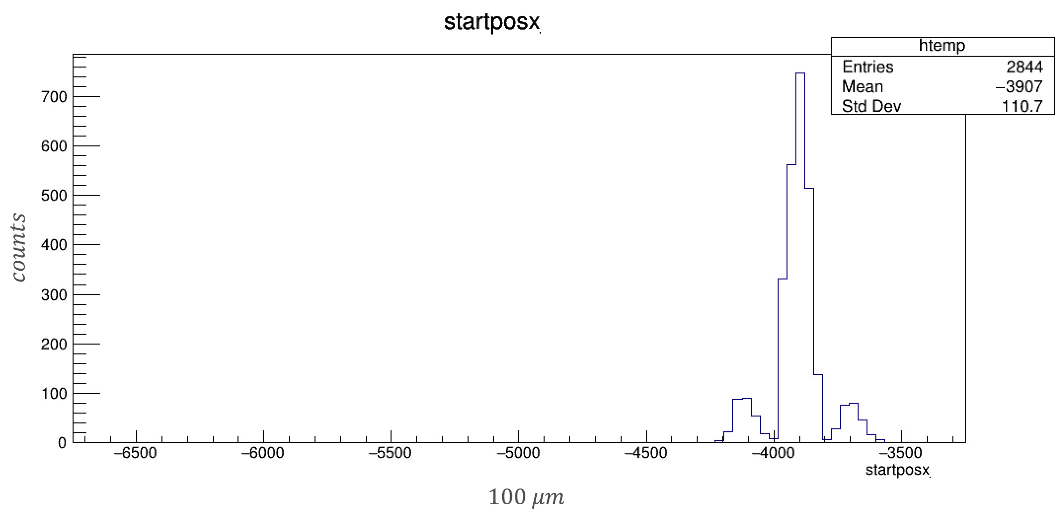
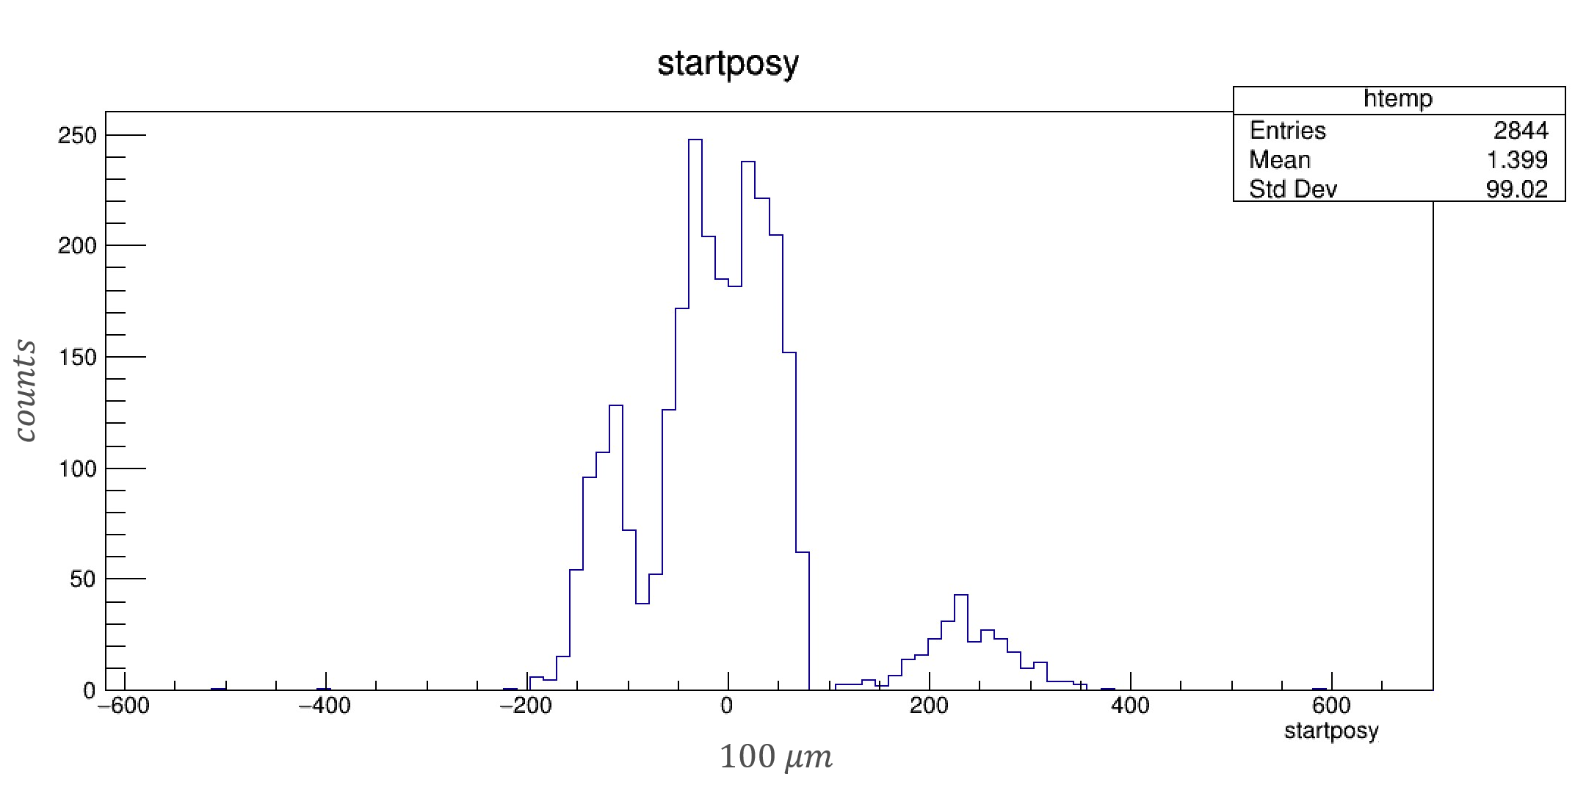
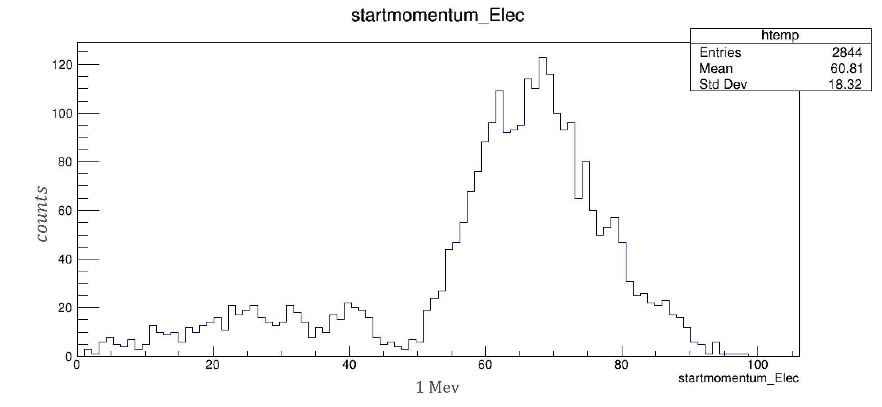
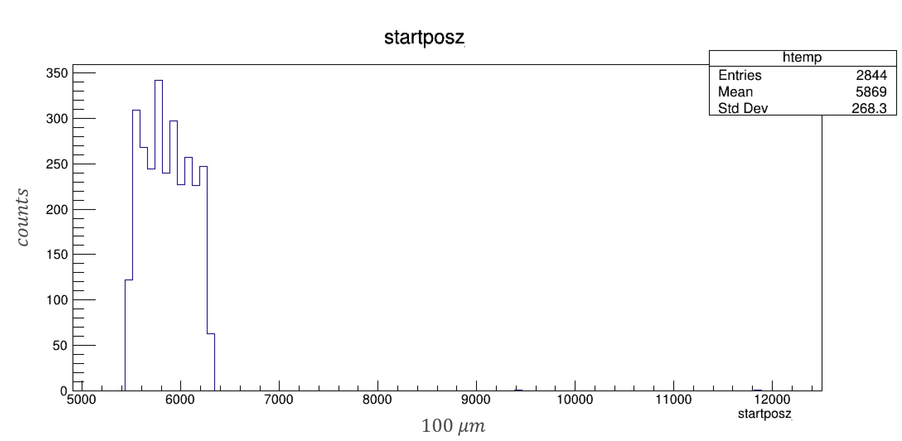
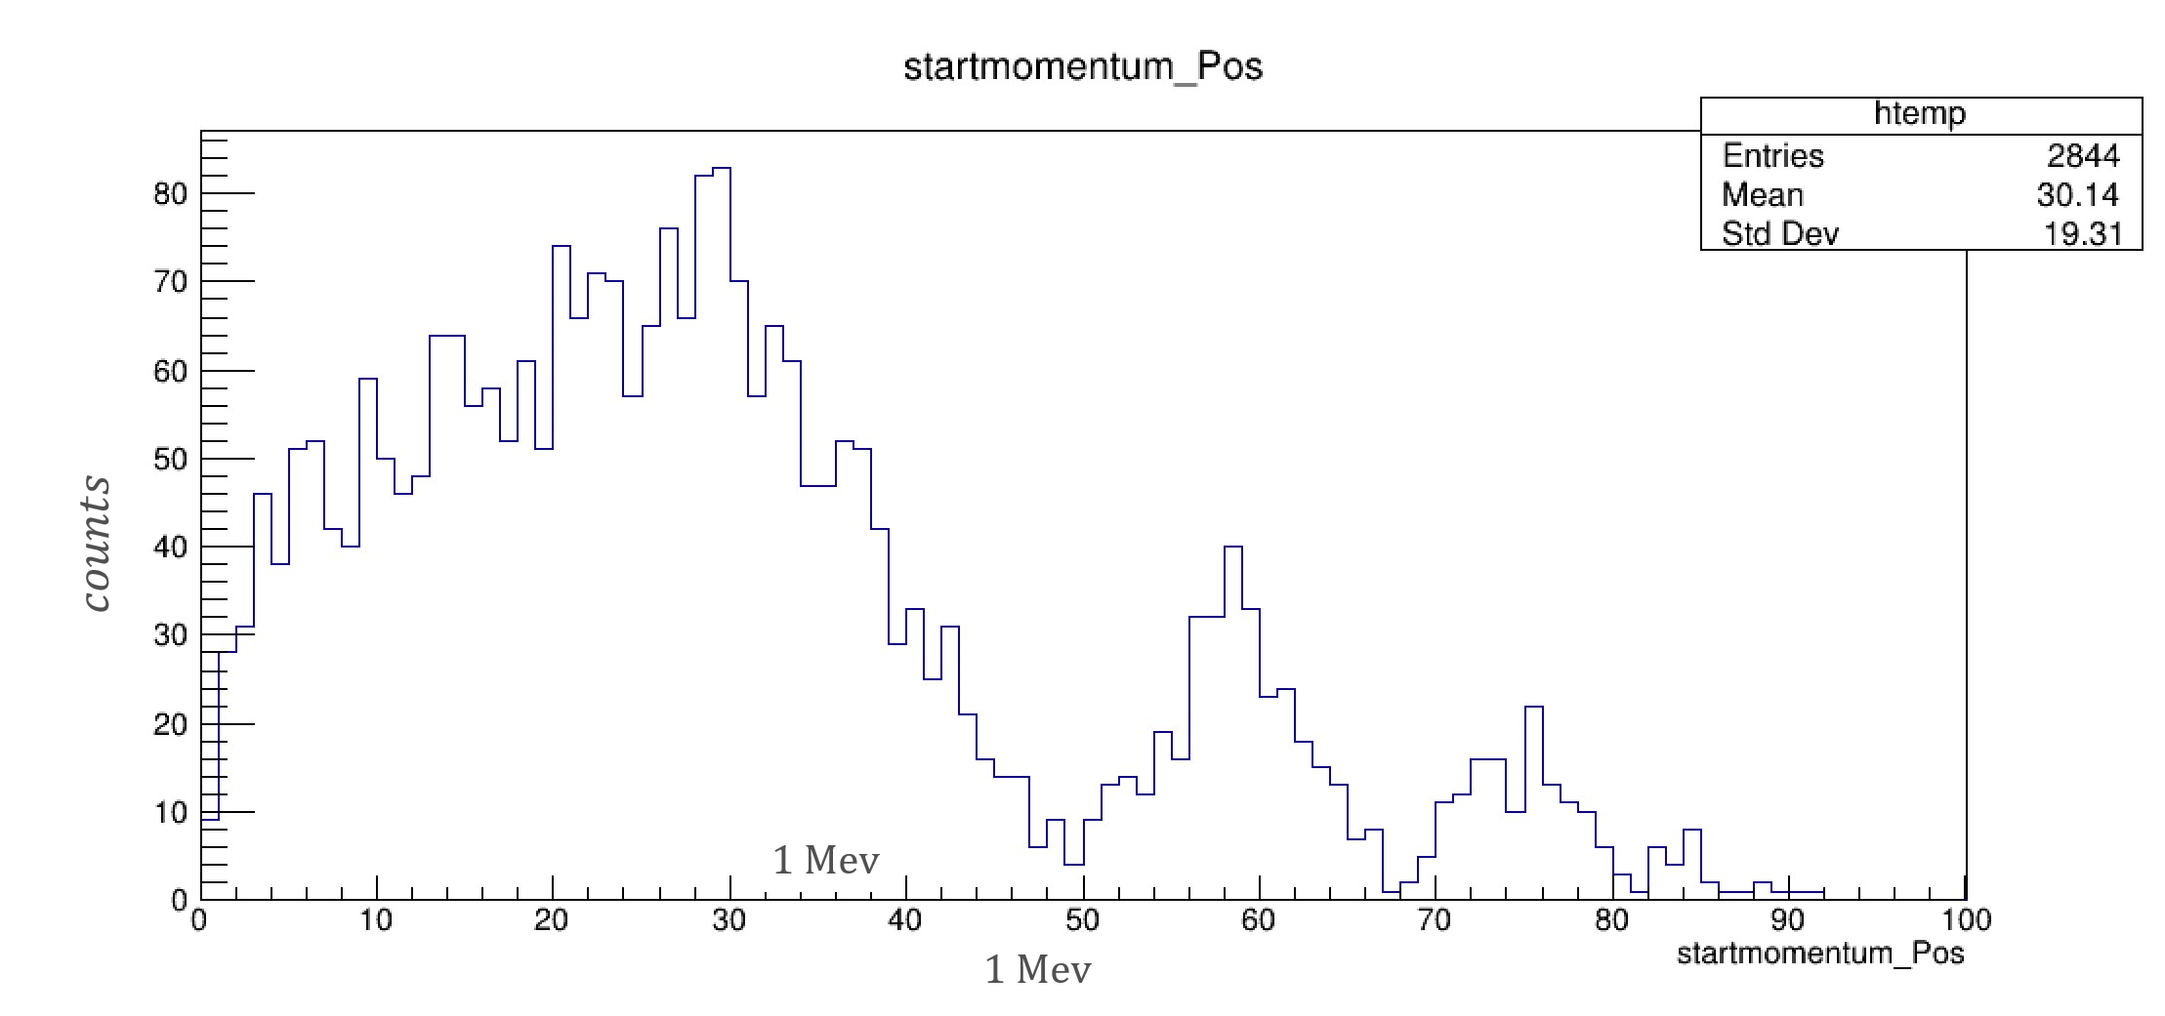
Analysis (part 3)
As for the Monte Carlo Truth conversion events corresponding to a primary photon converting into an electron/positron pair, it is interesting to observe the conversion position distribution, the electron and positron starting momentum distributions and starting momentum along photon direction distributions.

Slide 10
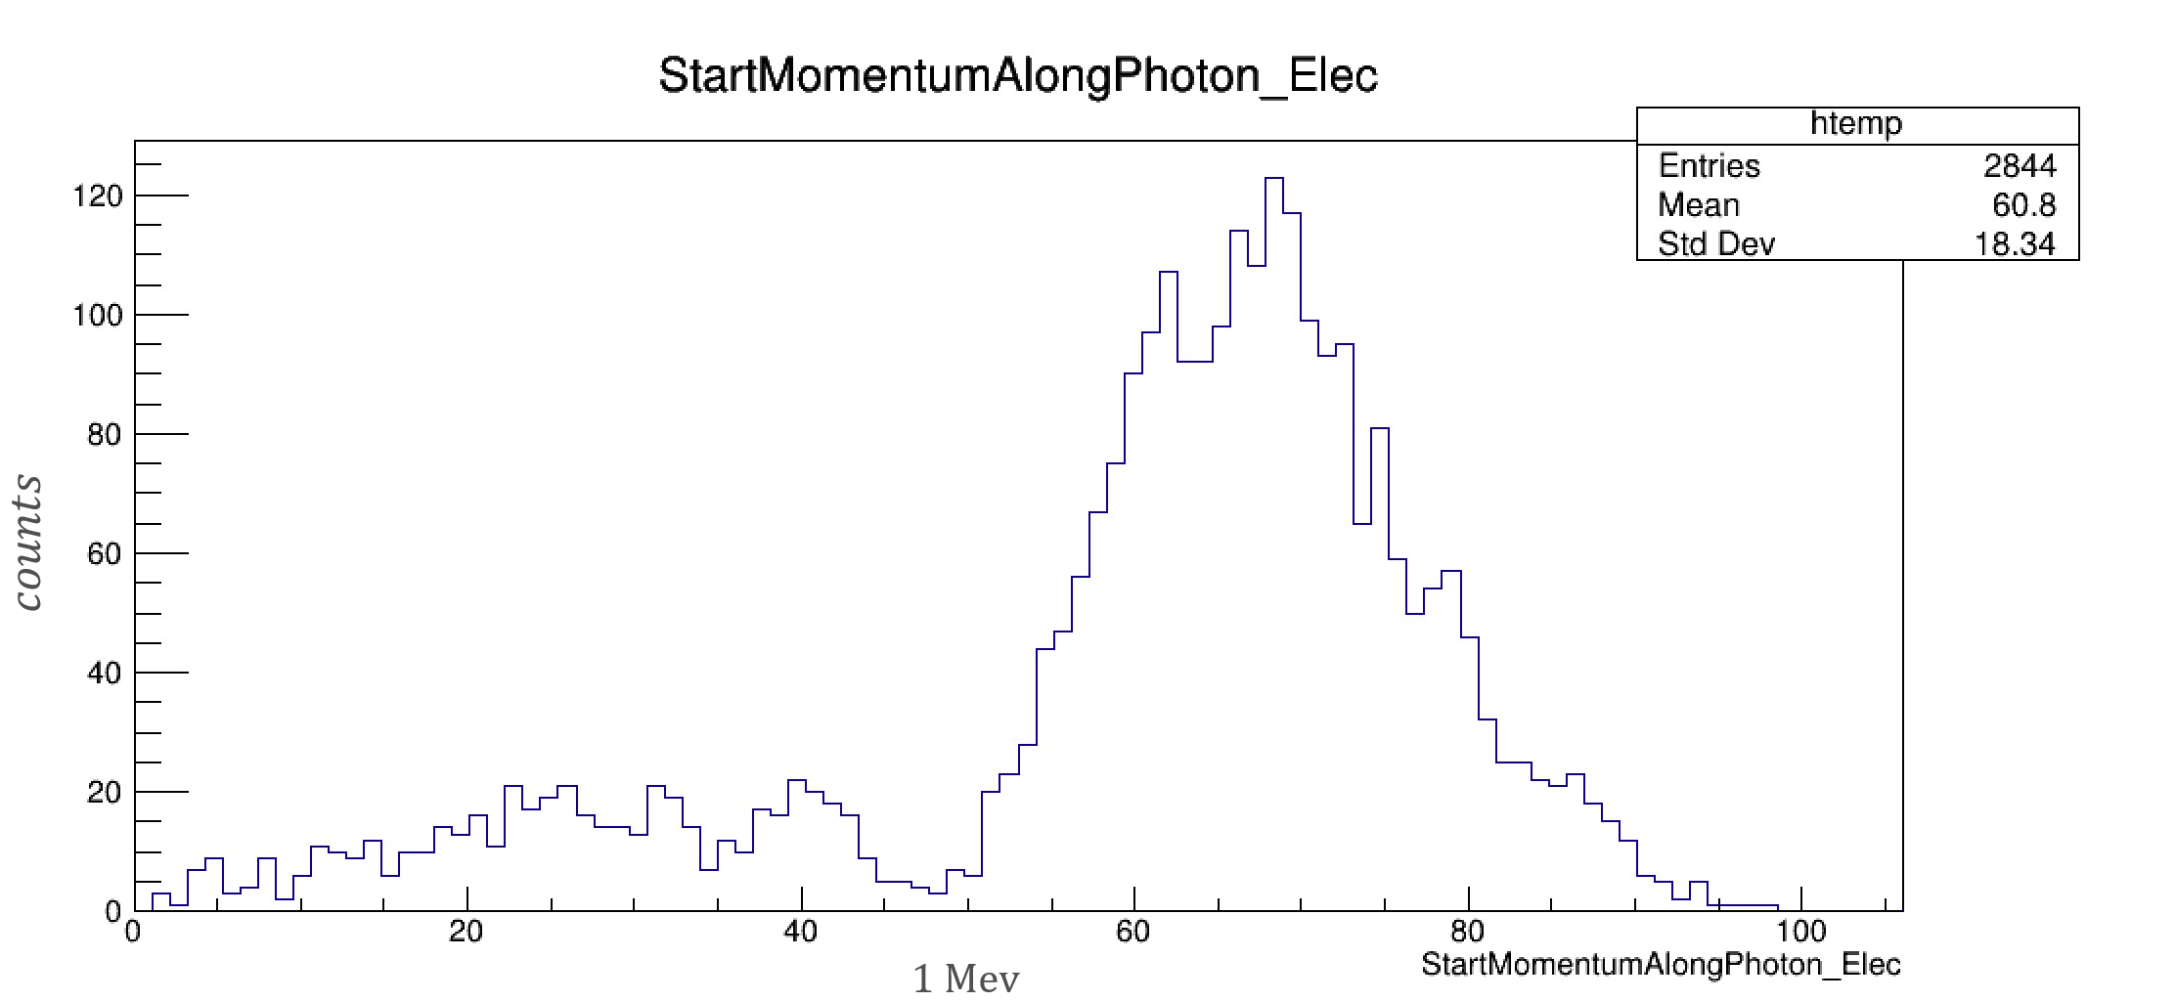
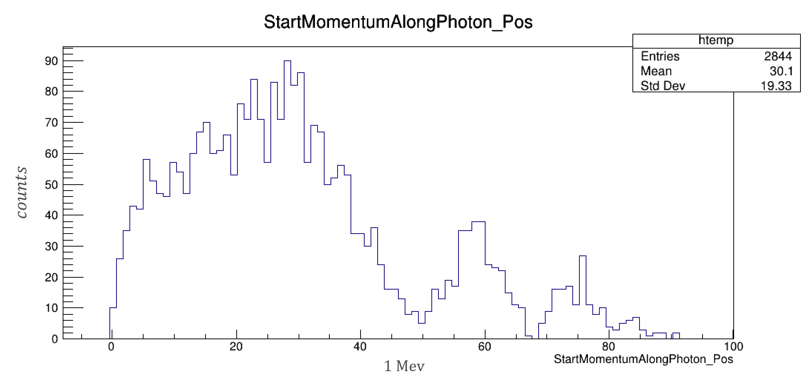
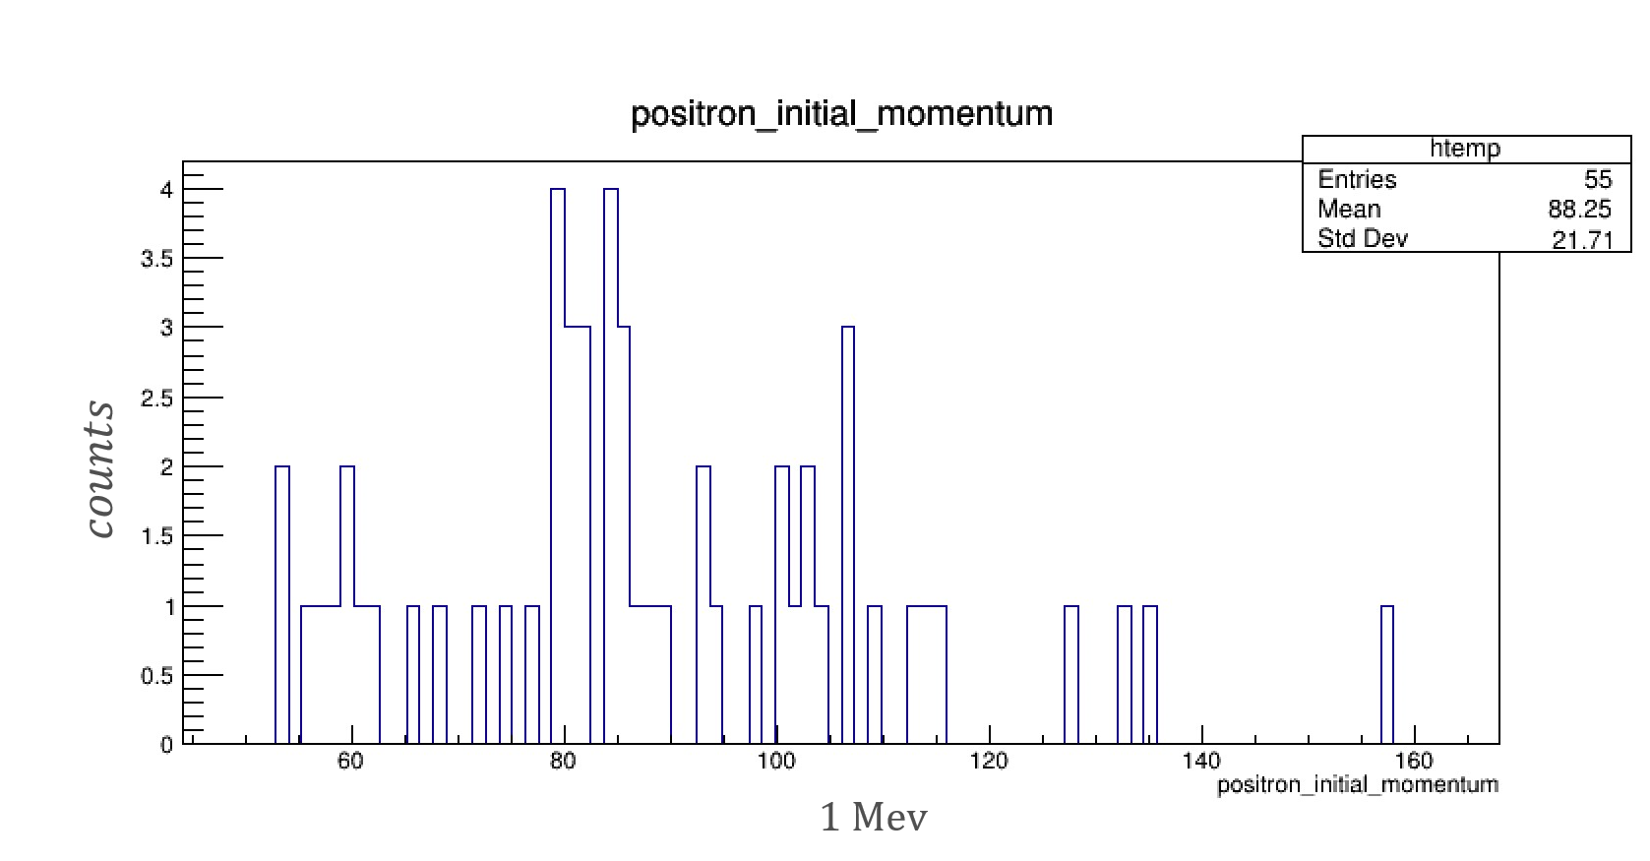
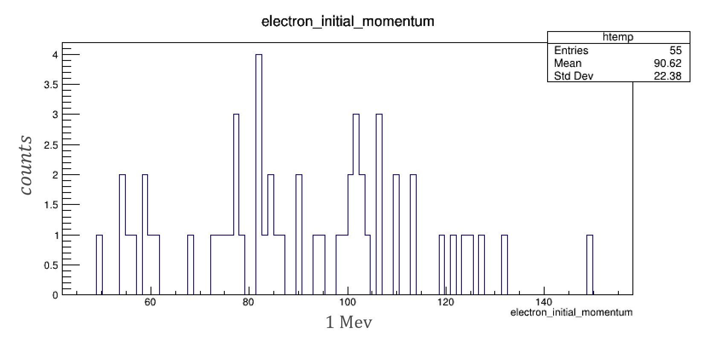
Analysis (part 4)
Analogously, for the reconstructed events set, the starting momentum distributions of the electron and the positron can be observed.

Slide 11
Future developments for the reconstruction algorithm
Despite the low reconstruction efficiency reached with the current version of the algorithm, it is auspicable that the algorithm itself will be made more efficient in the future. The analysis conducted nevertheless proves that reconstruction for the class of events of interest is possibile.

Slide 12
Side Projects
Together with the main project regarding the development of a photon conversion reconstruction algorithm for background measurements, I have also participated, during my stay at Fermilab, in:
Setup of the Mu2e DAQ system
Out-gassing of the Mu2e Calorimeter Redout Units

Slide 13
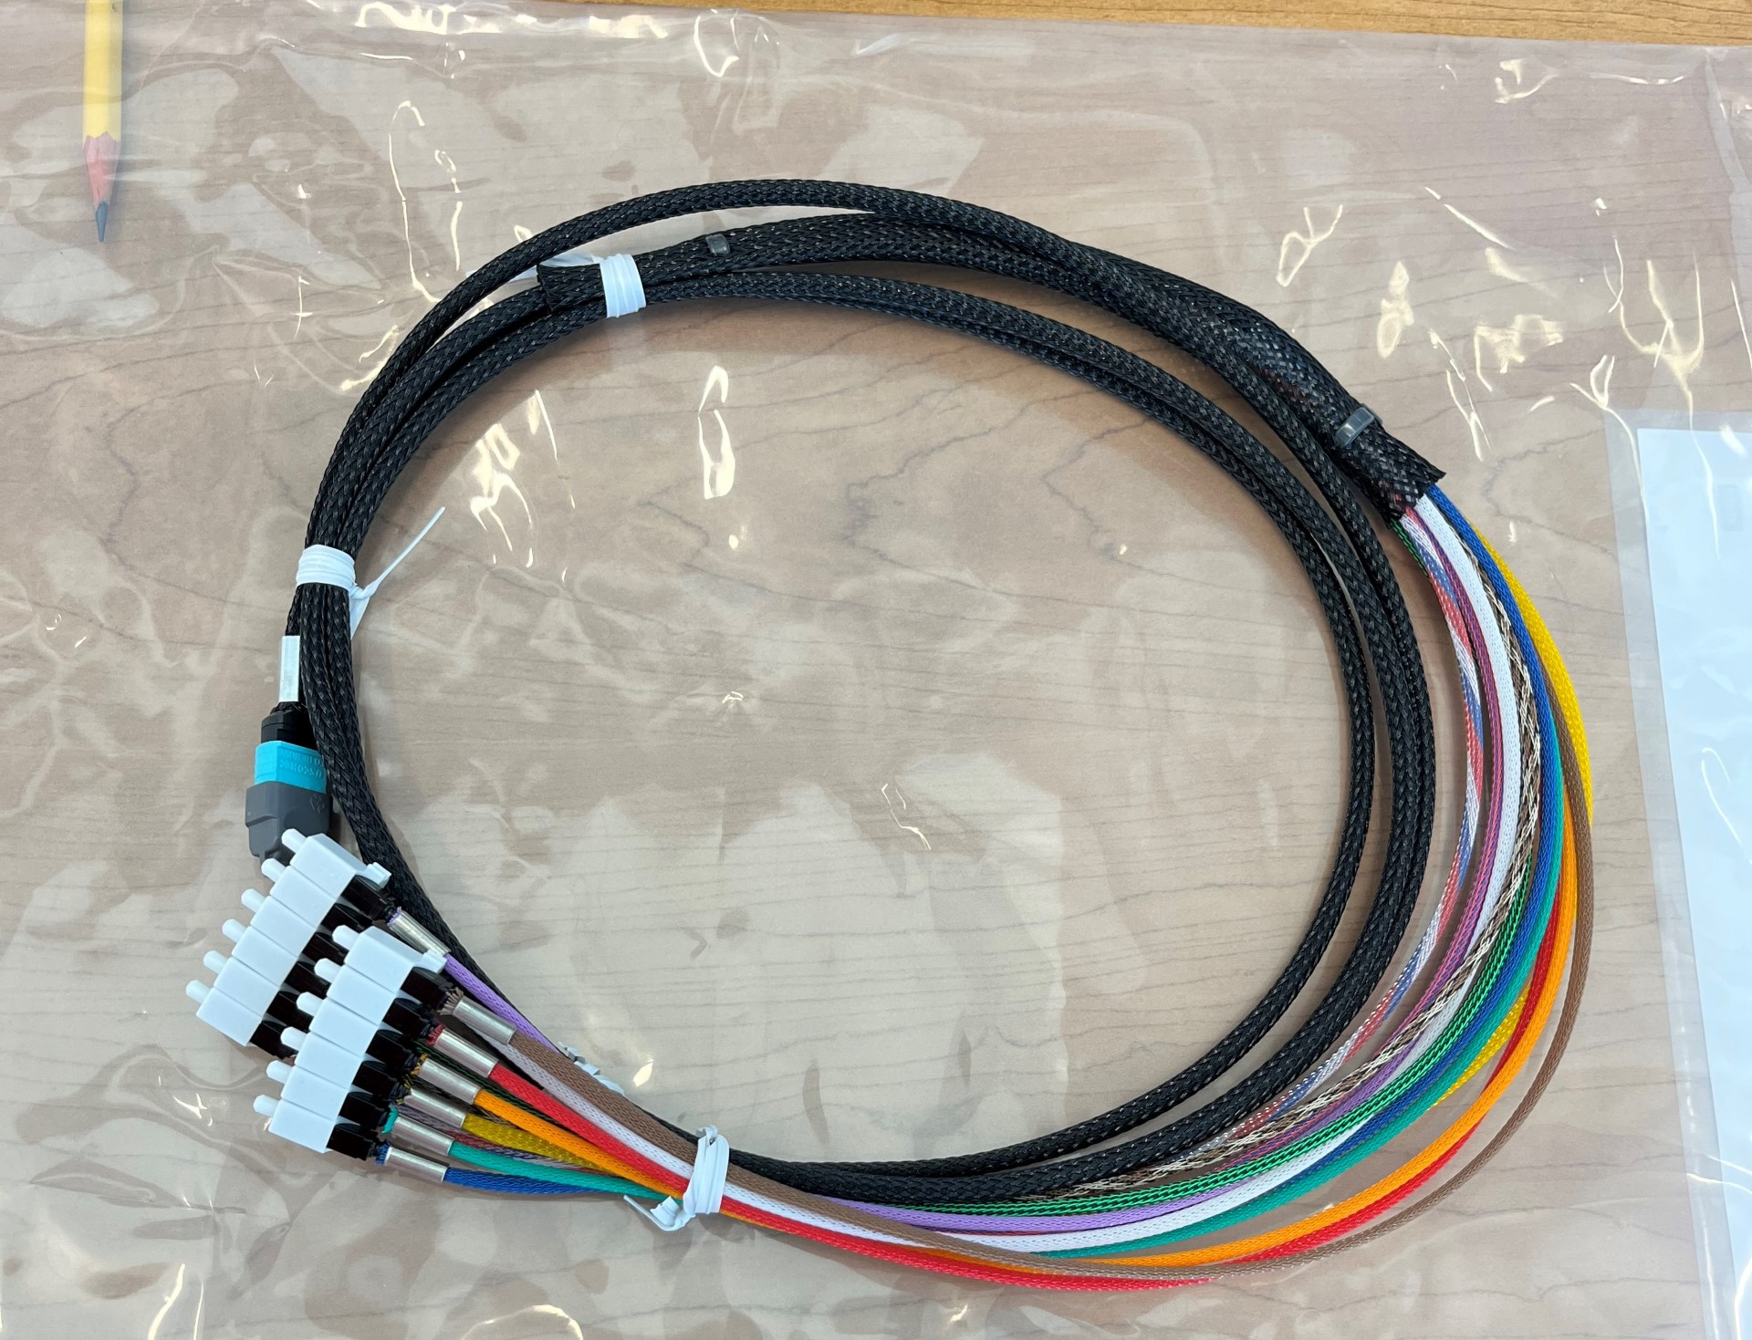
DAQ setup
Components of the DAQ set-up are now being chosen and tested. In particular, the insertion loss of the whole system is requested to be low enough to assure efficient data distribution. By now, the long run cables and the vacuum cables have been tested and have given the positive expected results. It is now needed to test the whole system together at once.

Slide 14
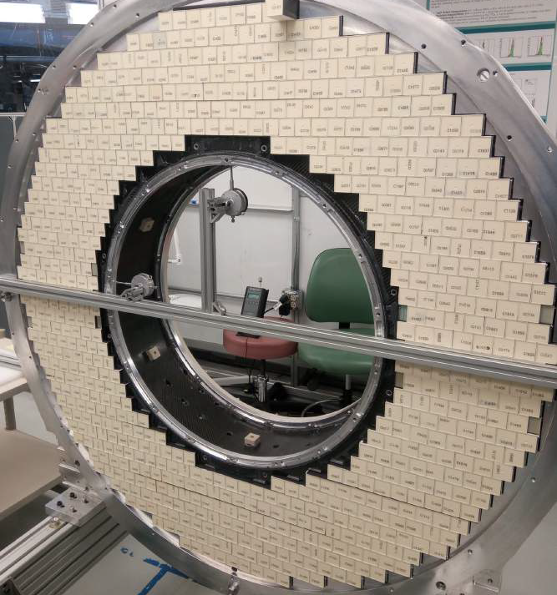
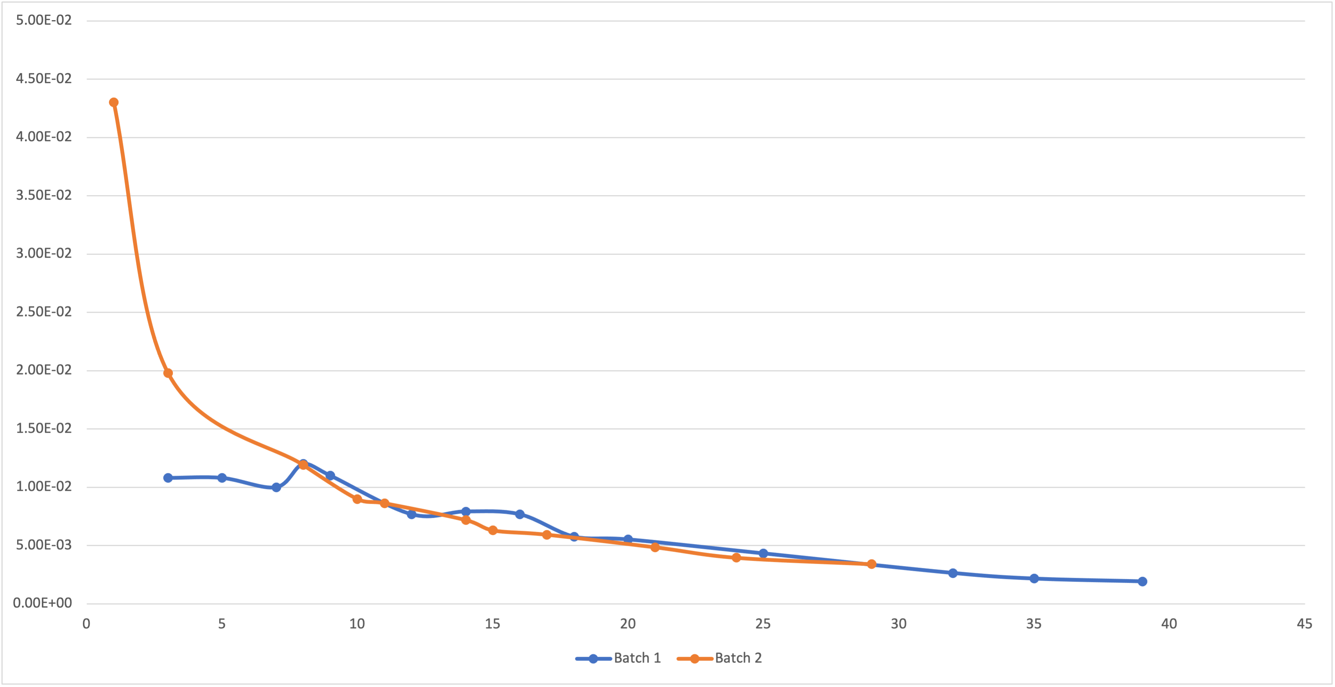
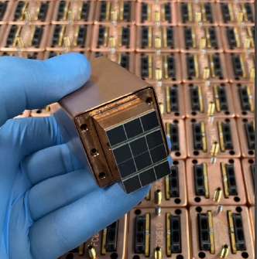
Outgassing of the calorimeter Readout units
Some of the readout units of the calorimeter have still to be put in place on the second calorimeter wheel. Before doing that, in order to assure their well functioning in the vacuum, it is needed to outgas them. The calorimeter will be completed by the end of the year.
Torr L/s
days

Slide 15
Thank you for your attention!

