Slide 1
Single Spoke Resonator (SSR) cryomodules assembly tooling and procedure for PIP-II
Matteo Giusti
Italian Summer Students Final Presentation
September 27, 2023
Supervisor: Jacopo Bernardini

Slide 2
INTRODUCTION

Slide 3
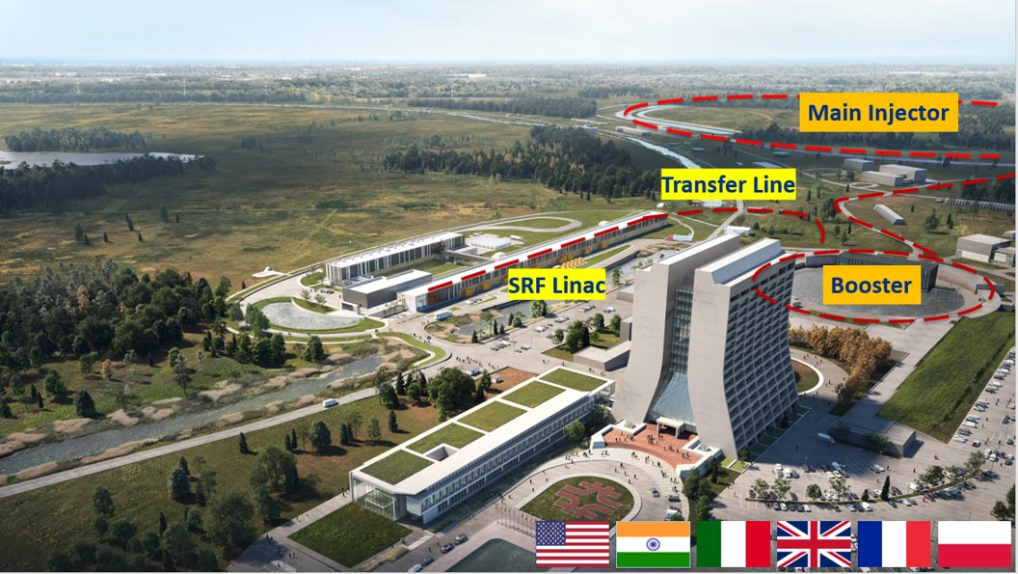
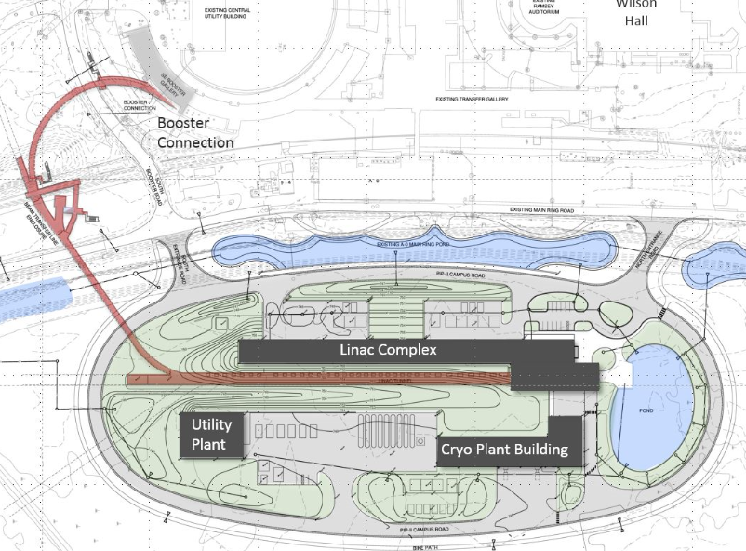
The PIP-II project
This project consists in upgrading the existing linear accelerator (LINAC)
at Fermilab to higher energies (800 MeV)
800 MeV H− SRF linac - PIP-II Introduction

Slide 4
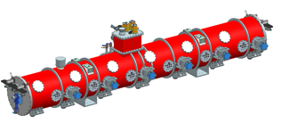
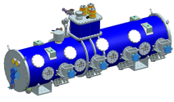
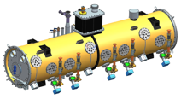
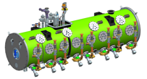
PIP-II 800 MeV SRF Linac
SSR1 and SSR2 are two of the 5 types of cryomodules that will constitute the new linac.
Elliptical
HB650 X 4
650 MHz
Elliptical
LB650 X 9
650 MHz
Single Spoke 2
SSR2 X 7
325 MHz
Single Spoke 1
pSSR1 X 2
325 MHz
HWR
162.5 MHz
833 MeV
Cryoplant
2.5kW @ 2K
516 MeV
177 MeV
Superconducting
CDS
32 MeV
10 MeV

Slide 5
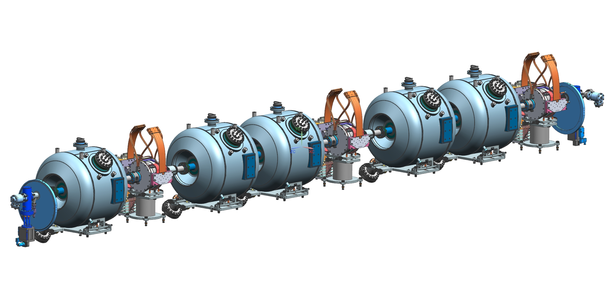
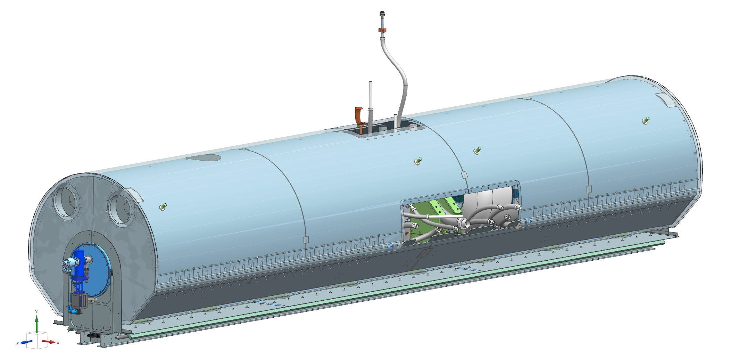
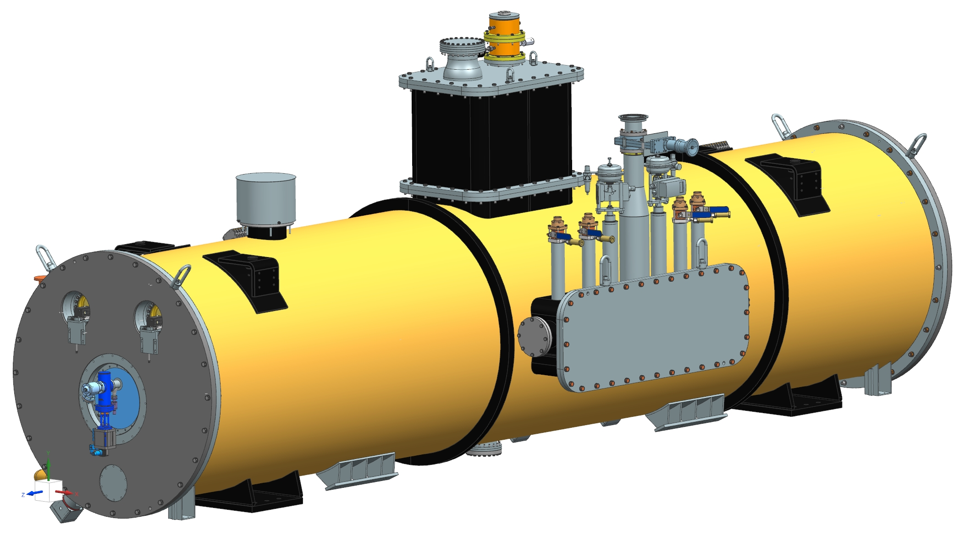
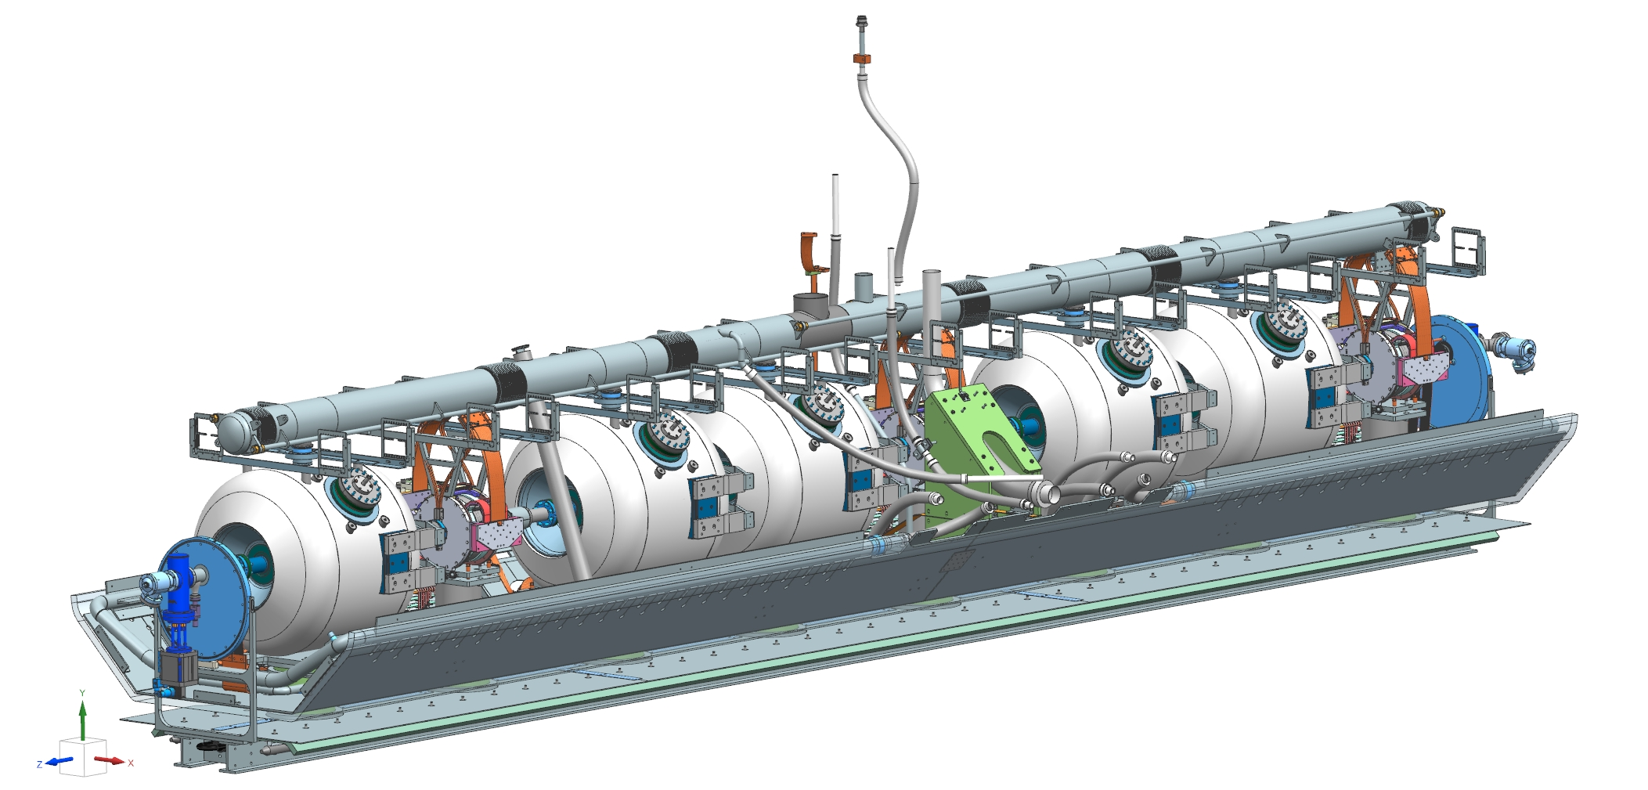
Description of the Cryomodule
1
4
Beam line assembly in the clean room
2
Coldmass assembly
Strong-back assembly
5
3
Top CM assembly
Beam line & Strong-back assembly

Slide 6
INTRODUCTION TO
ASSEMBLING PROCEDURE

Slide 7
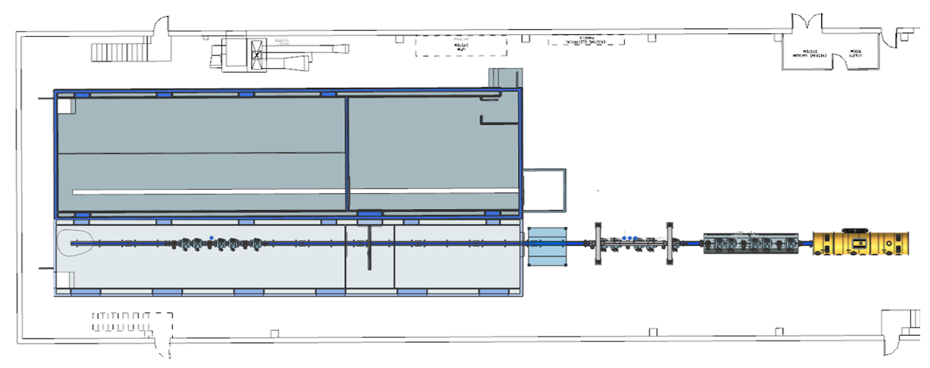
Assembling Procedure for SSR2
The SSR2 string will be assembled in the MP9 cleanroom (workstation 1) at Fermilab.
1
2
3
The vessel will arrive in MP9 with the strongback inside, the support posts will be already mounted on the strongback.

Slide 8
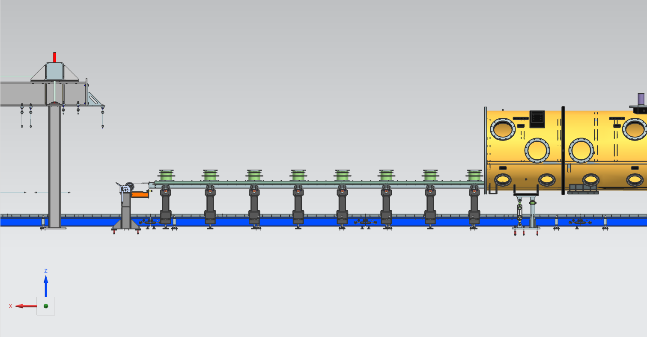
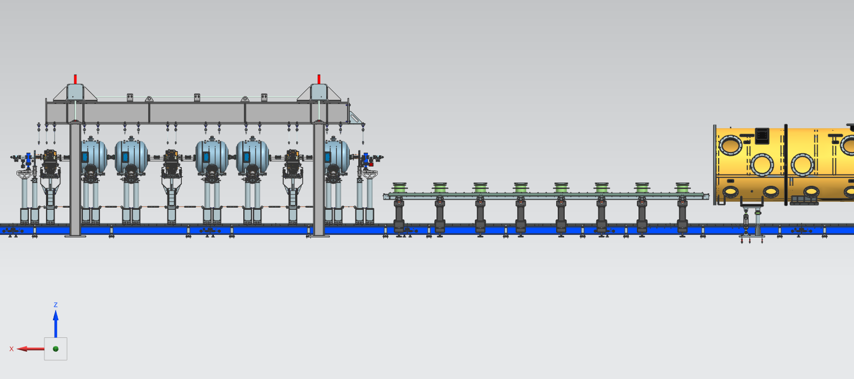
Assembling Procedure for SSR2
The strongback will be pulled out of the vessel onto the strongback support posts (workstation 3).
The cavity string will be moved out of the clean room on the support posts and fixed to the lifting tooling (workstation 2).

Slide 9
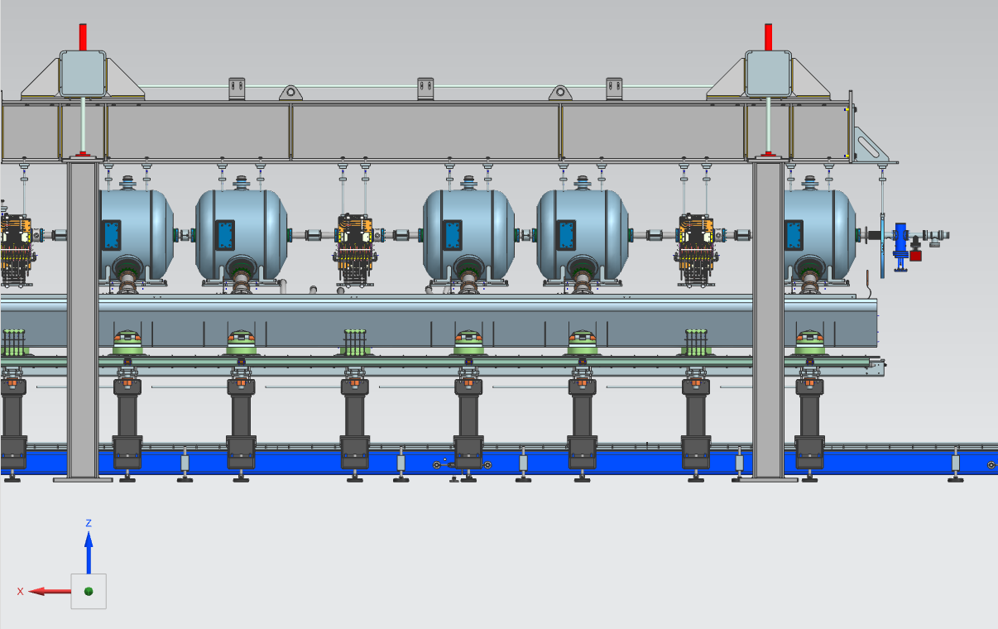
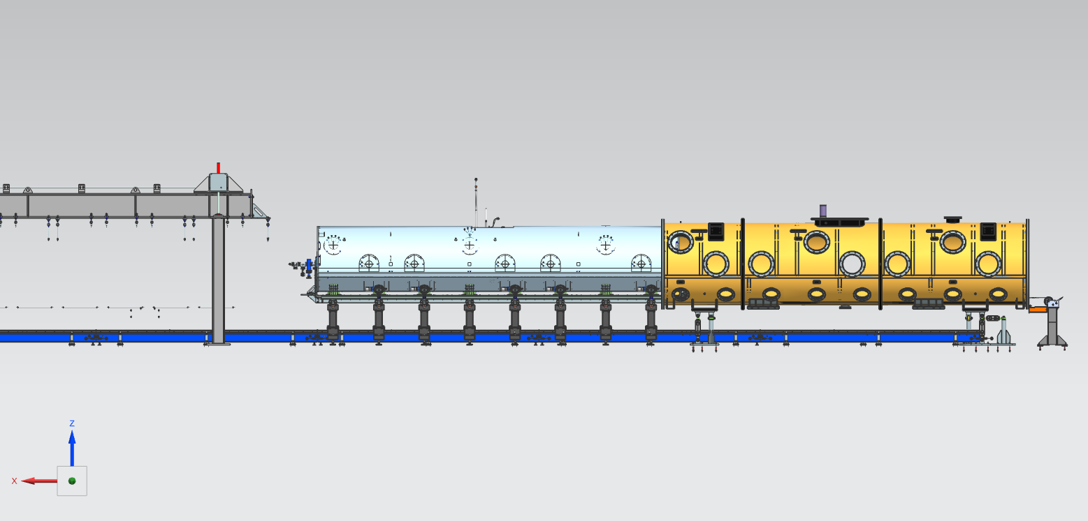
Assembling Procedure for SSR2
The string will be placed on the strongback (workstation 2).
The coldmass assembly will be firstly set up and placed inside the vacuum vessel (workstation 3), accomplishing the Cryomodule assembling.

Slide 10
LIFTING HOLDERS

Slide 11
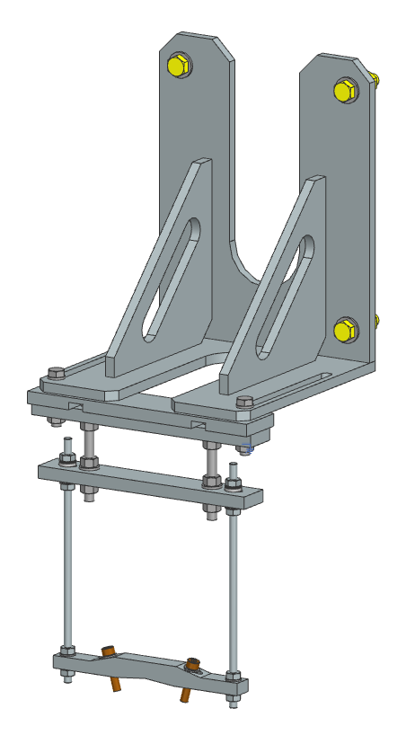
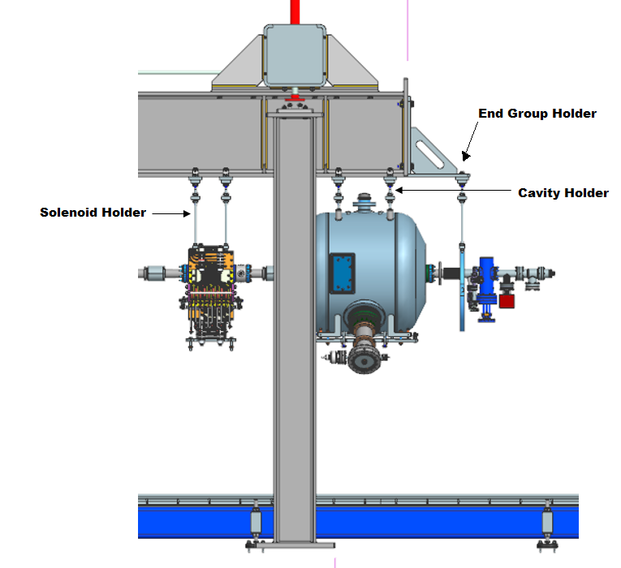
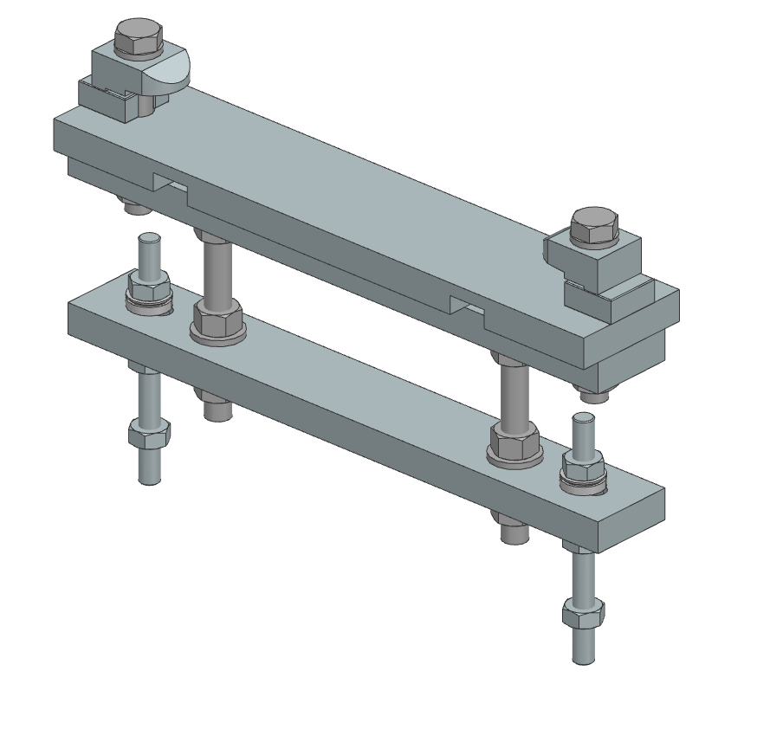
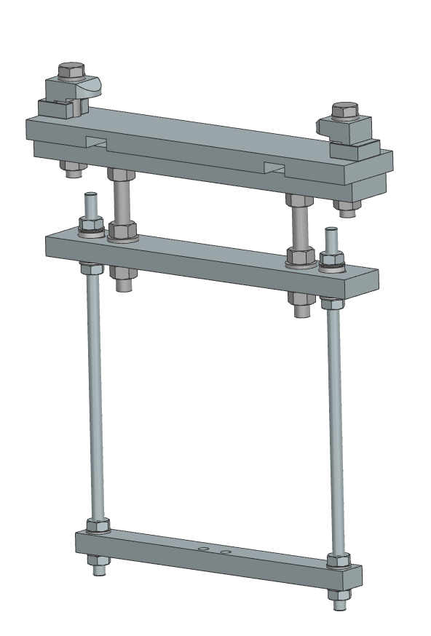
Goal
End Flange Holder
Write an Engineering Note on the lifting holders for SSR2 and SSR1.
The components:
Cavity Holder
The string assembly has to be fixed to the lifting tooling in order to be raised and placed into the cryomodule.
SSR2
Solenoid Holder

Slide 12
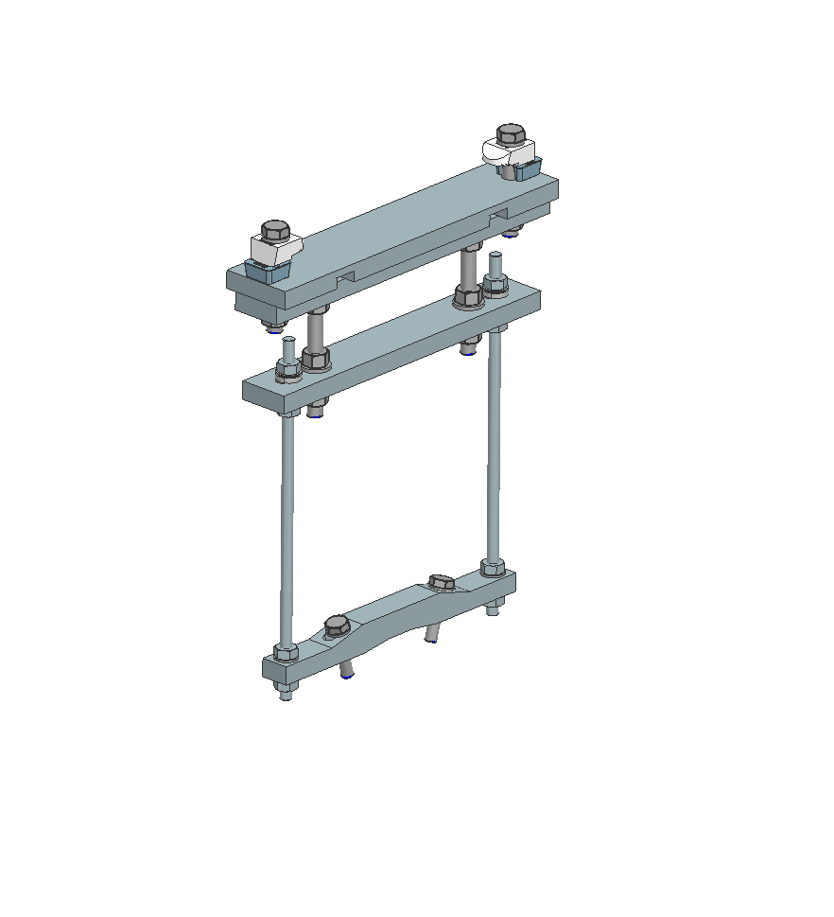
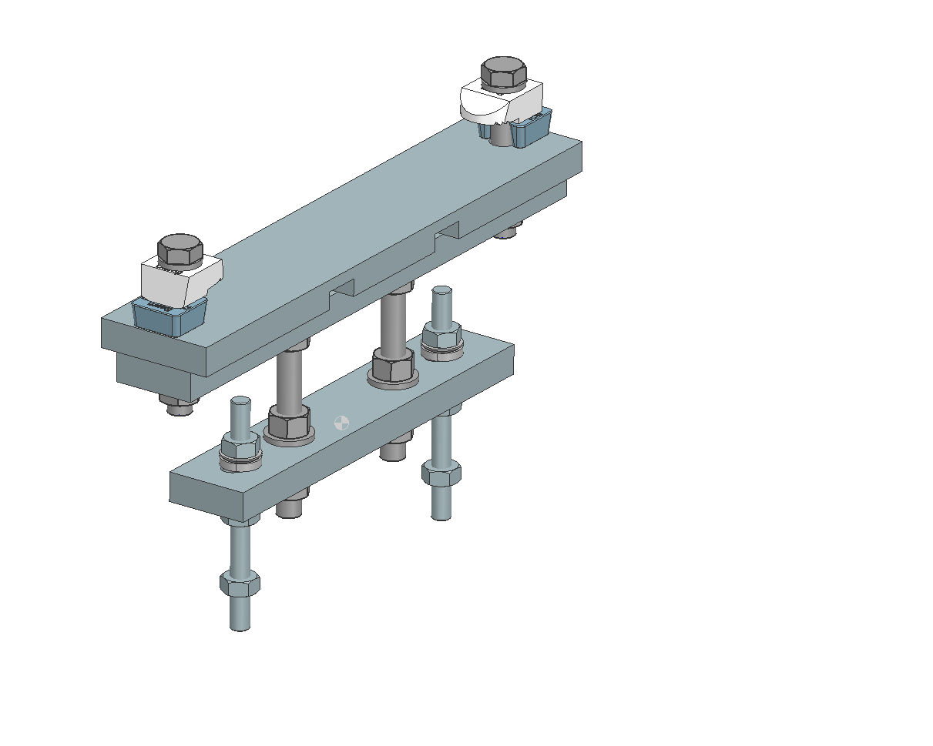
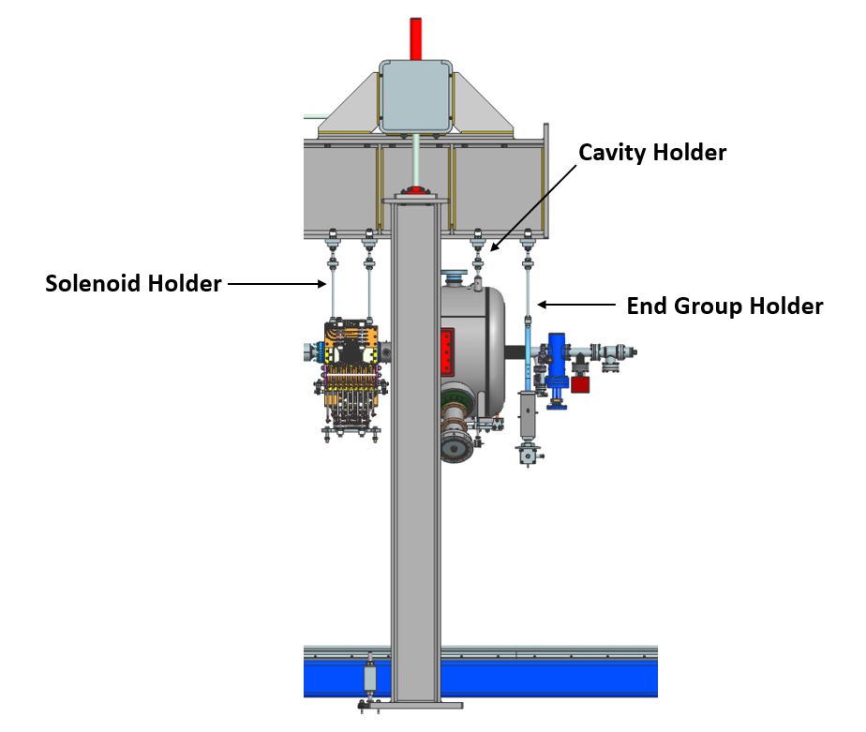
Goal
End Flange Holder
Write an Engineering Note on the lifting holders for SSR2 and SSR1.
The components:
Cavity Holder
The string assembly has to be fixed to the lifting tooling in order to be raised and placed into the cryomodule.
SSR1
Solenoid Holder

Slide 13
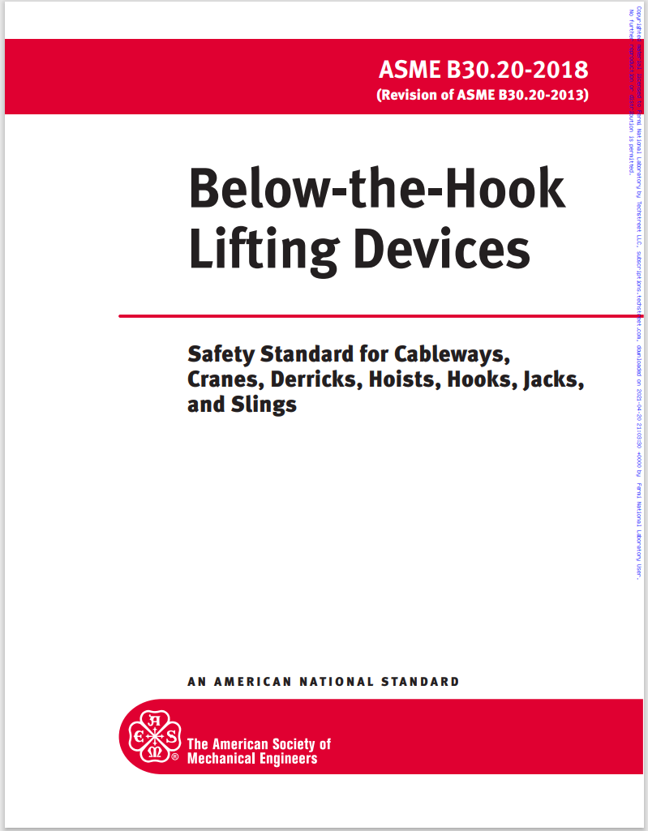
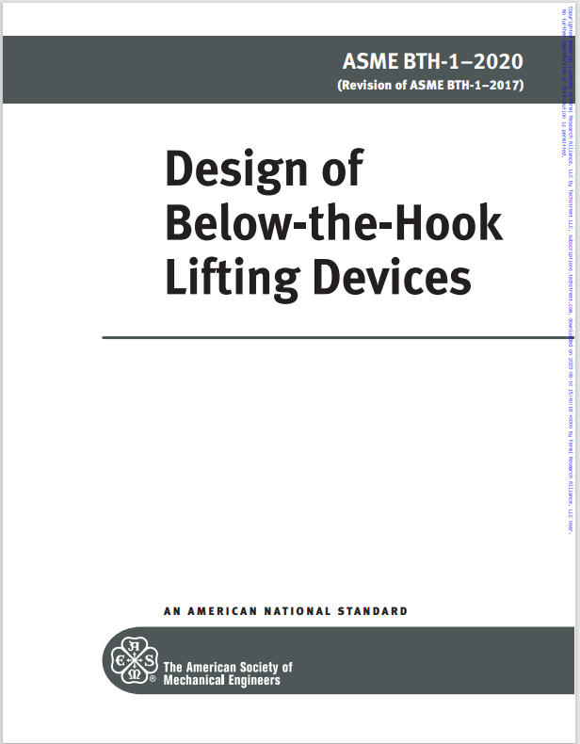
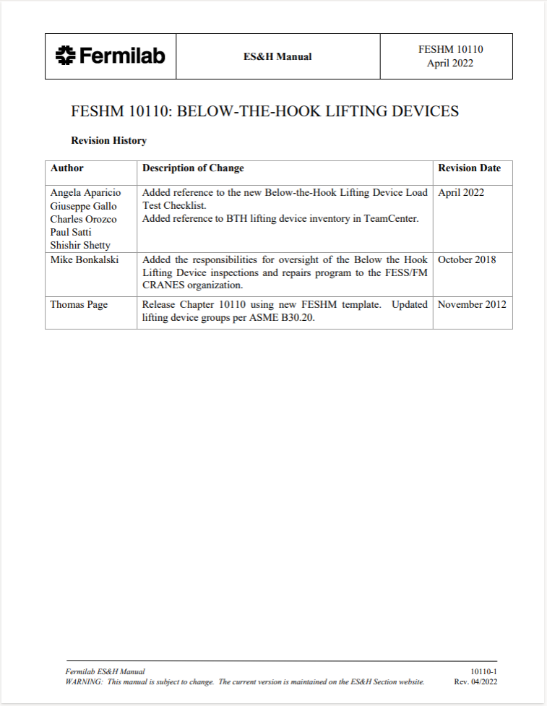
Description of the problem
Examine whether the design was able to withstand the weight of the string assembly.
This process is carried on following rules depicted in ASME and ASCE manuals (American Society of Mechanical and Civil Engineers).
A requirement was to consider an earthquake accident during the lifting.

Slide 14
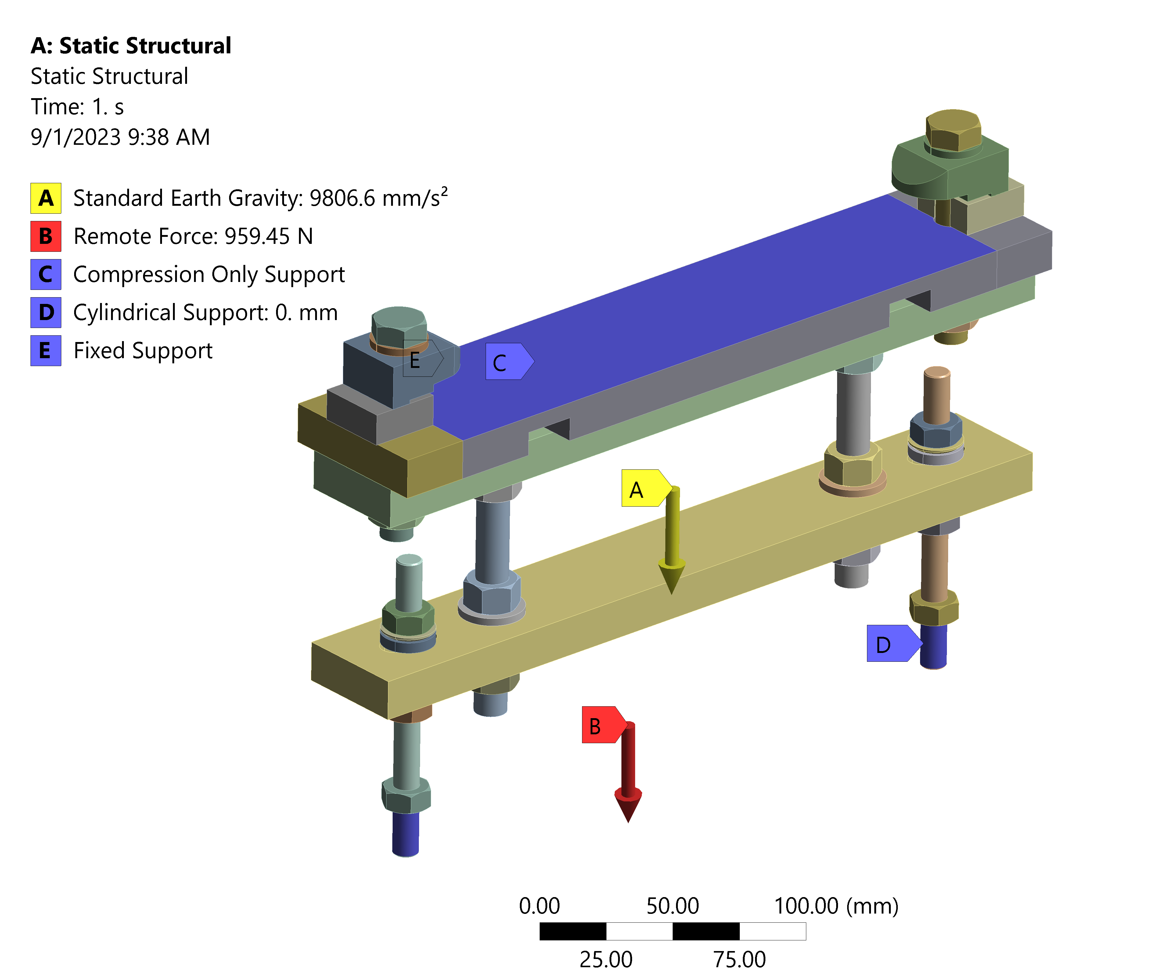
Description of the problem
To investigate the forces that arises in the material due to the loading a Finite Element simulation is conducted via the software ANSYS.
Interaction between the component and the environment (boundary conditions) needs to be modelled accurately, as also the type of contacts between different parts of the tool.

Slide 15
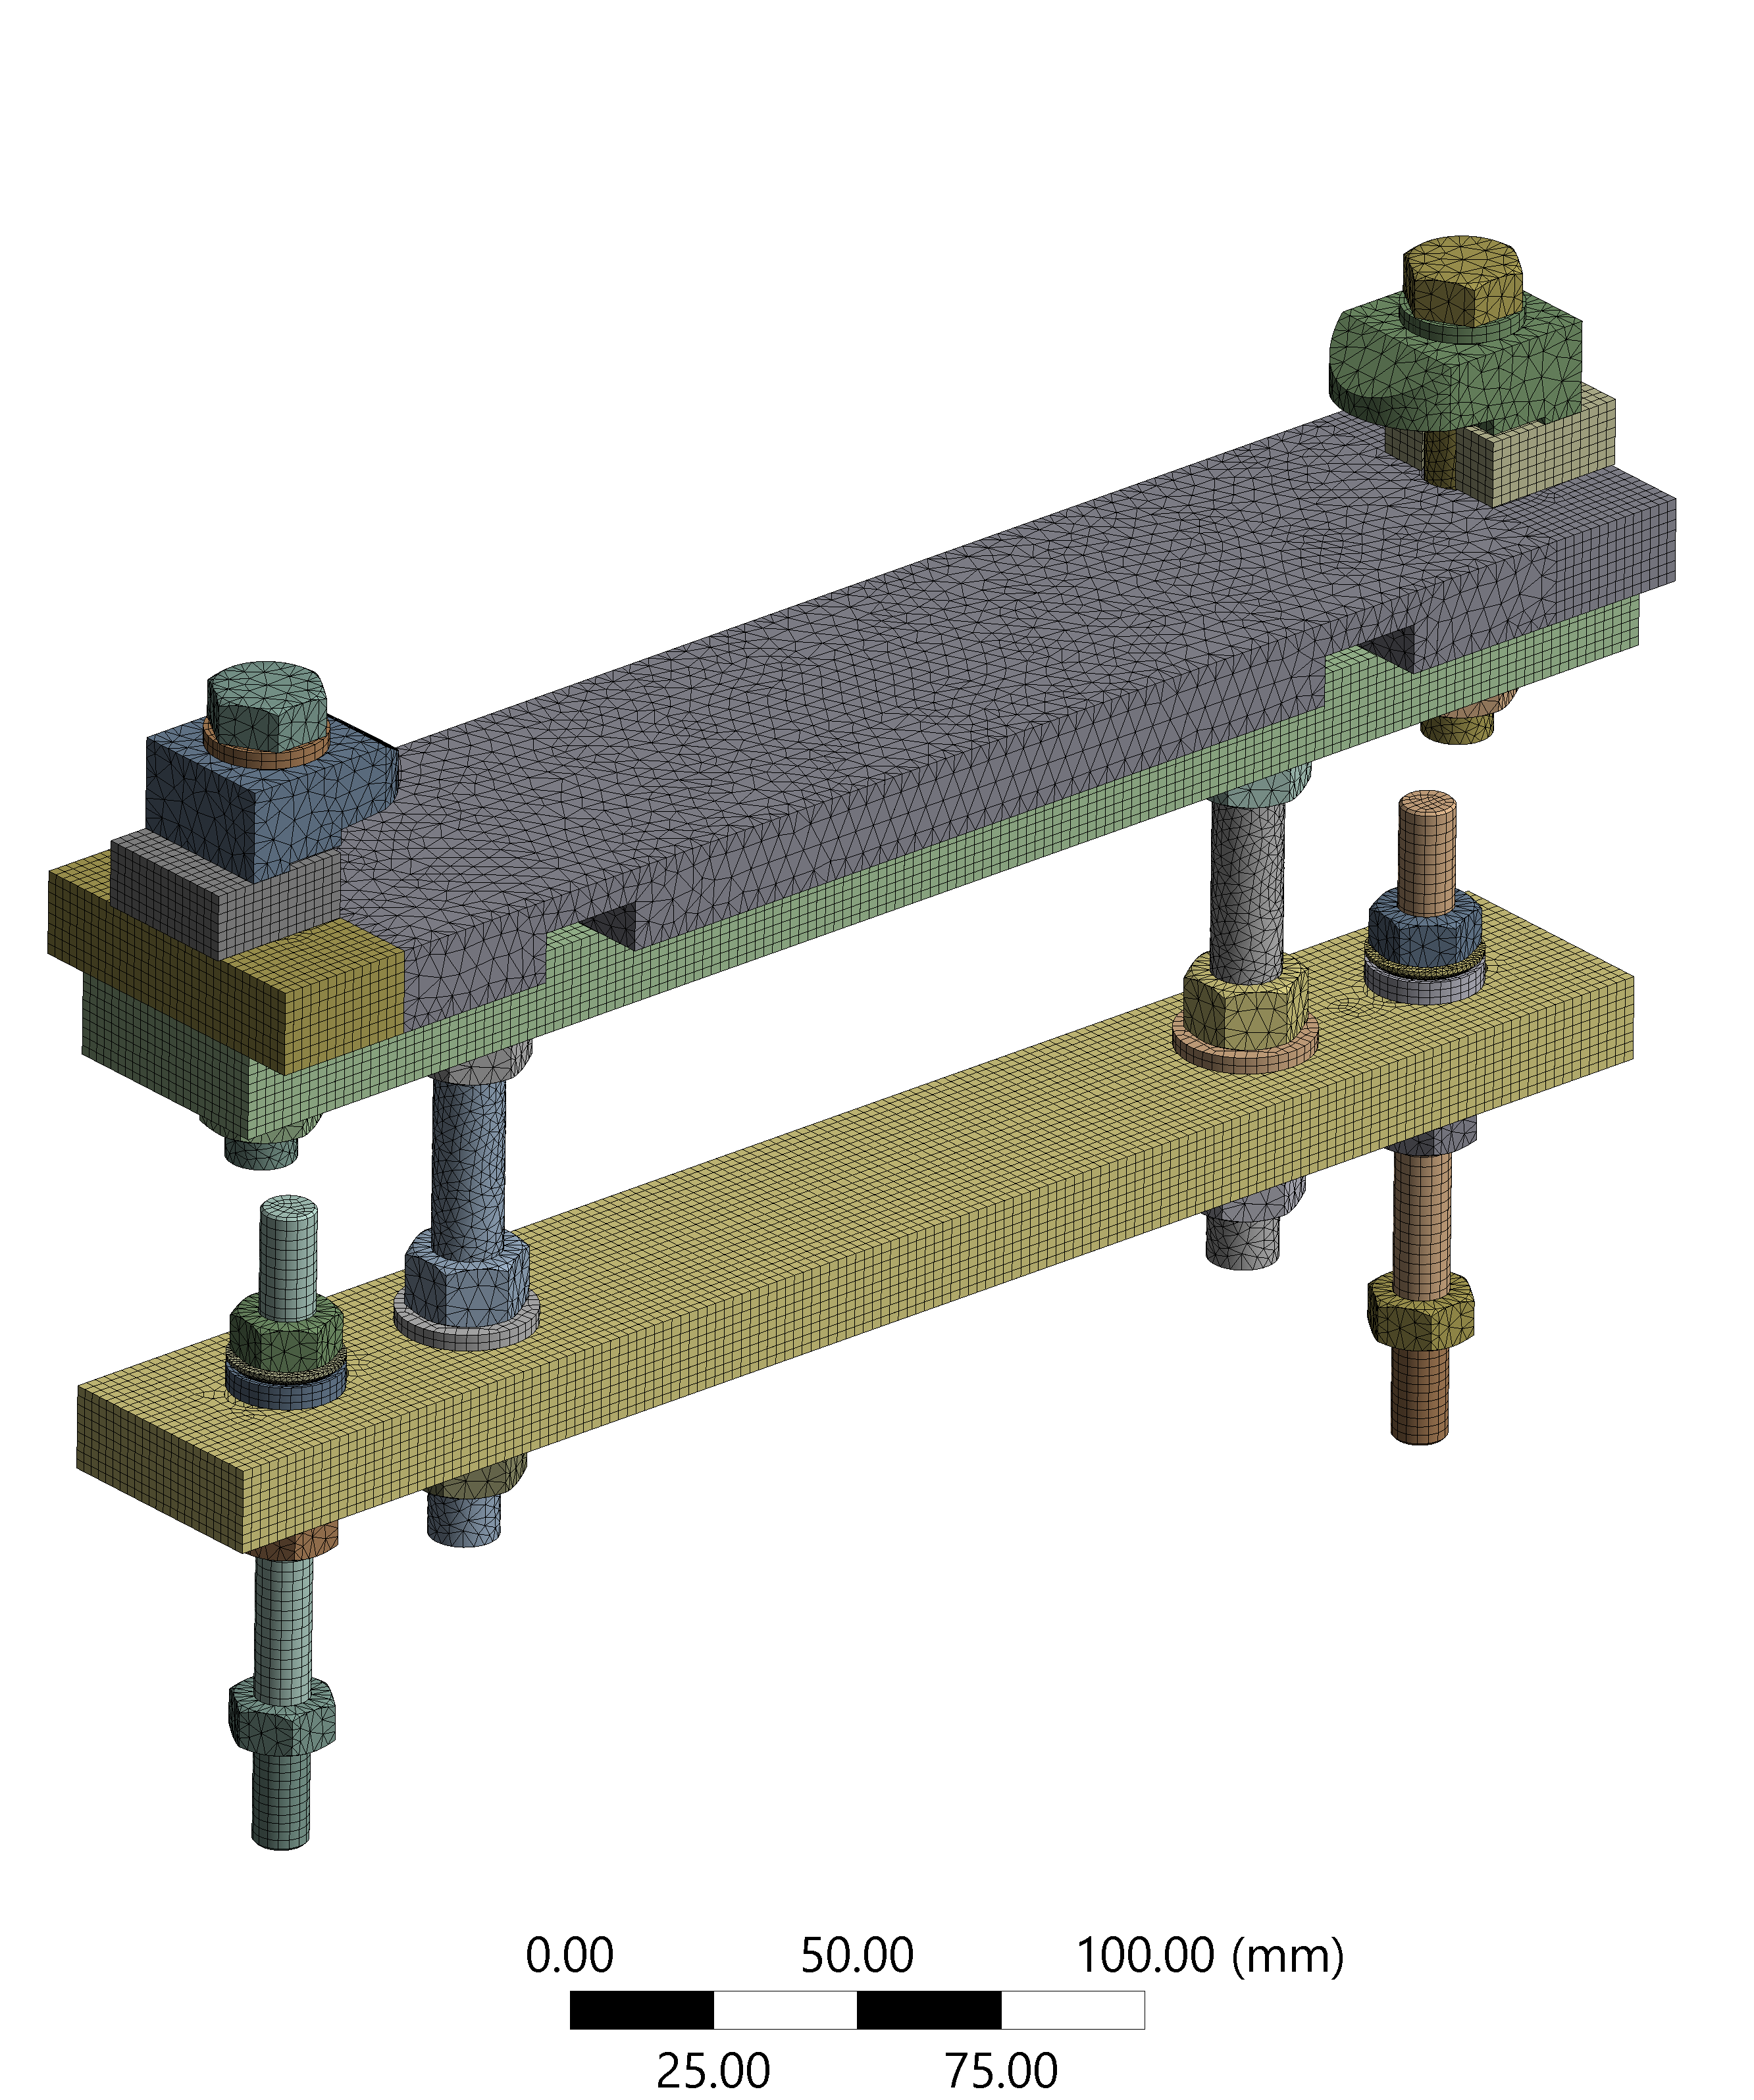
Difficulties faced
The computational cost of a more accurate modelling needs to be taken into consideration:
Finer mesh
Non-linear contacts (frictional contacts)
A simpler model is more likely to converge to a solution, so a good compromise need to be found.

Slide 16
Some results
Solenoid Holder
Maximum displacement: 0.065 mm
Maximum stress: 60 MPa
Safety Factor: 3.4
(Acceptable values)
Cavity Holder
Maximum displacement: 0.03 mm
Maximum stress: 52 MPa
Safety Factor: 3.7
(Acceptable values)

Slide 17
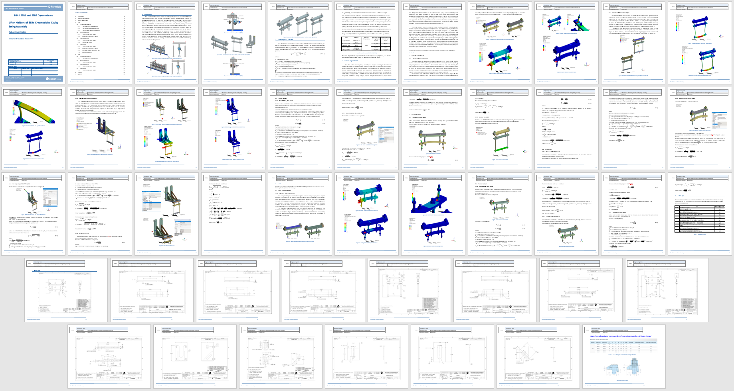
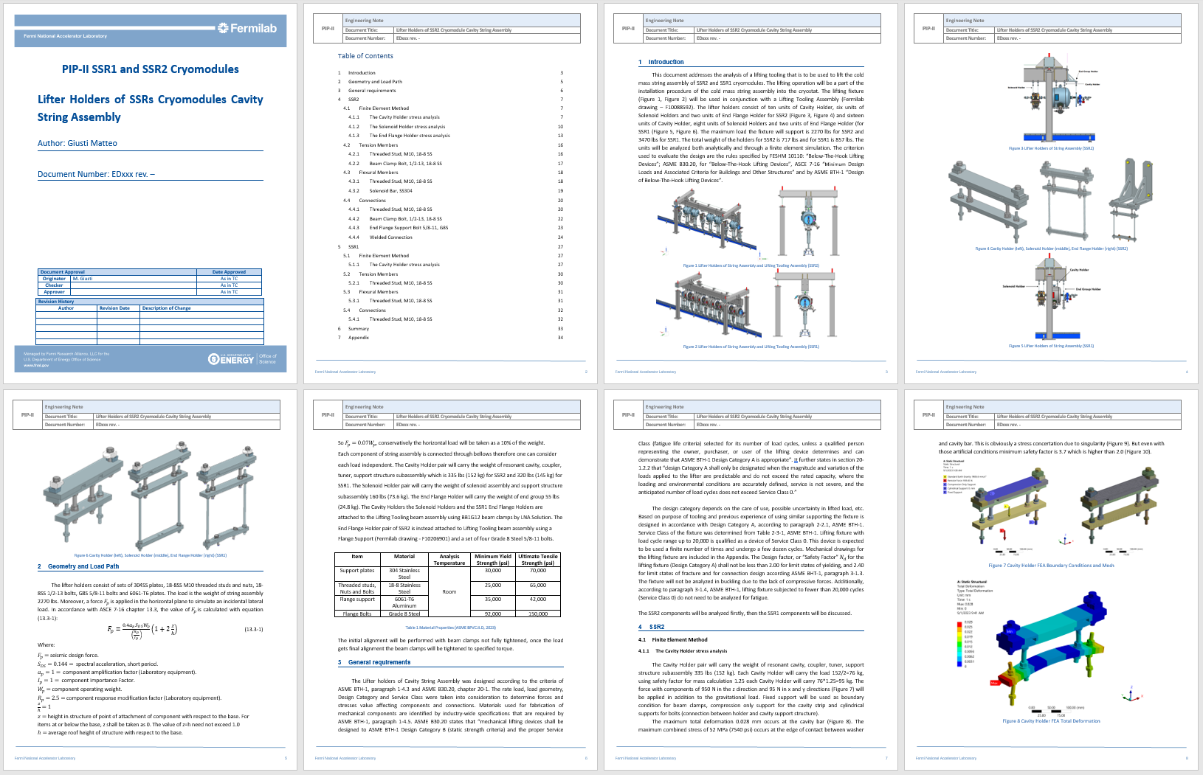
Engineering Note
Verify that the design meets the standards through:
FEA simulations
Analytical calculations of bending and tension members
Calculations on bolted and welded connections.
Write everything in an organized manner.

Slide 18
Summary
 | Part | MIN Safety Factor
SSR2 | Cavity Holder (FEA) | 3.7
 | Solenoid Holder (FEA) | 3.4
 | End Flange Holder (FEA) | 10
 | Threaded Stud, M10, 18-8 SS (tension) | 13
 | Beam Clamp Bolt, 1/2-13, 18-8 SS (tension) | 28
 | Threaded Stud, M10, 18-8 SS (flexion) | 2.8
 | Solenoid Bar, SS304 (flexion) | 5.7
 | Threaded Stud, M10, 18-8 SS (connection) | 16.7
 | Beam Clamp Bolt, 1/2-13, 18-8 SS (connection) | 37
 | End Flange Support Bolt 5/8-11, G8S (tensile) | 170
 | End Flange Support Bolt 5/8-11, G8S (shear) | 355
 | Welds | 38
SSR1 | Cavity Holder (FEA) | 2.7
 | Threaded Stud, M10, 18-8 SS (tension) | 7.5
 | Threaded Stud, M10, 18-8 SS (flexion) | 1.9
 | Threaded Stud, M10, 18-8 SS (connection) | 9.6
All components are stressed within the range of acceptability so the design is verified.

Slide 19
ADDITIONAL TASKS

Slide 20
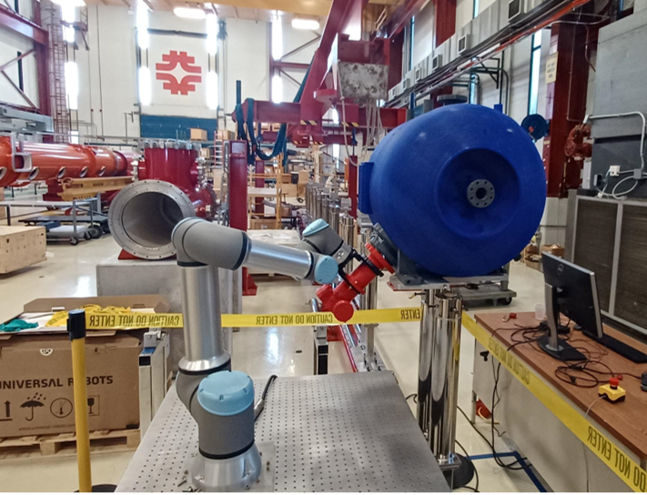
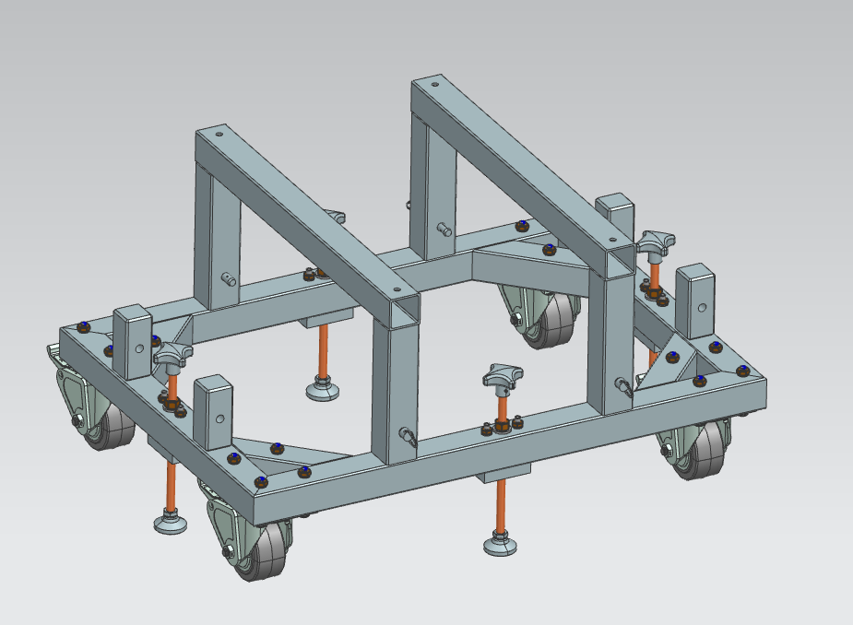
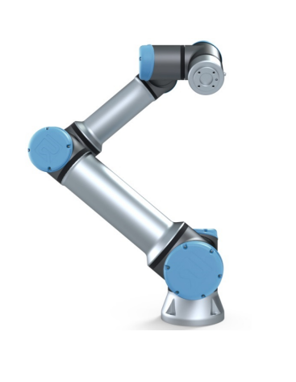
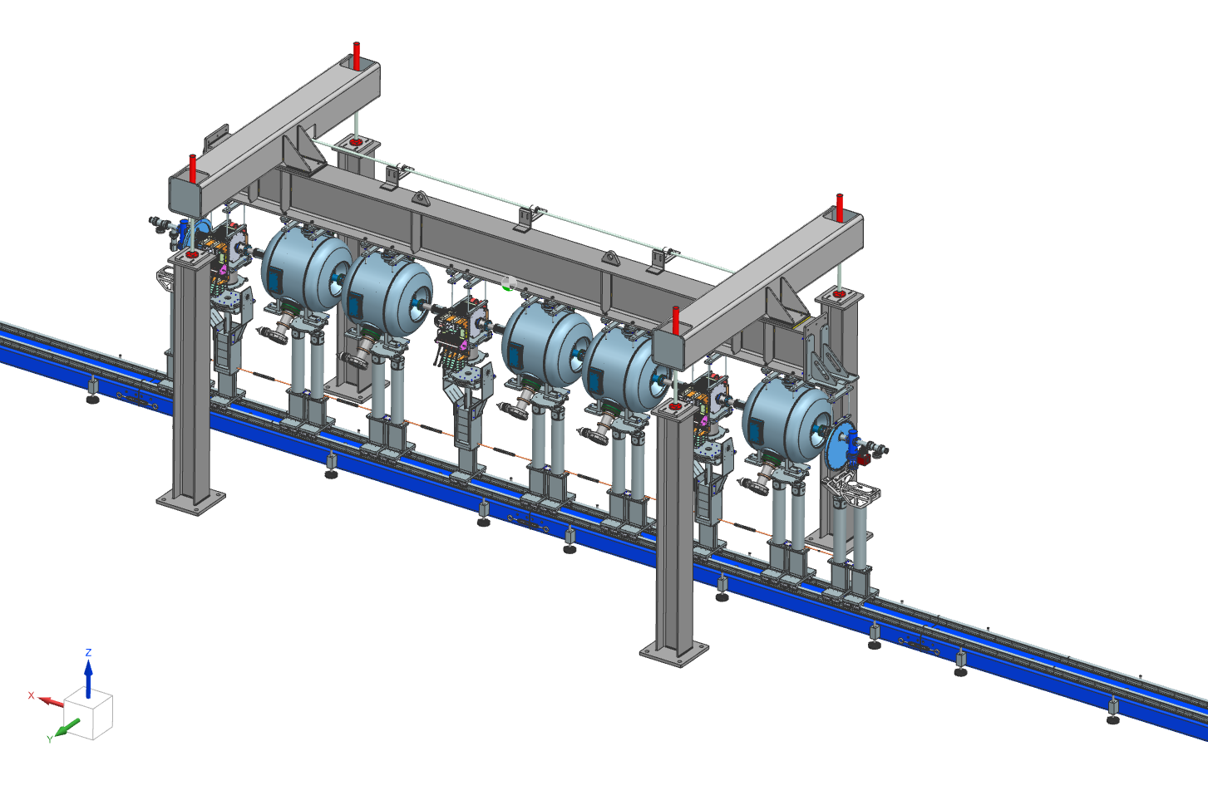
Positioning Cart Accessories
Locking system
Objective:
Design a locking system for the robot positioning cart.
Requirements:
At least 2 fixing points.
Grant enough stiffness.
Dimensions constraints due to cavity stands.

Slide 21
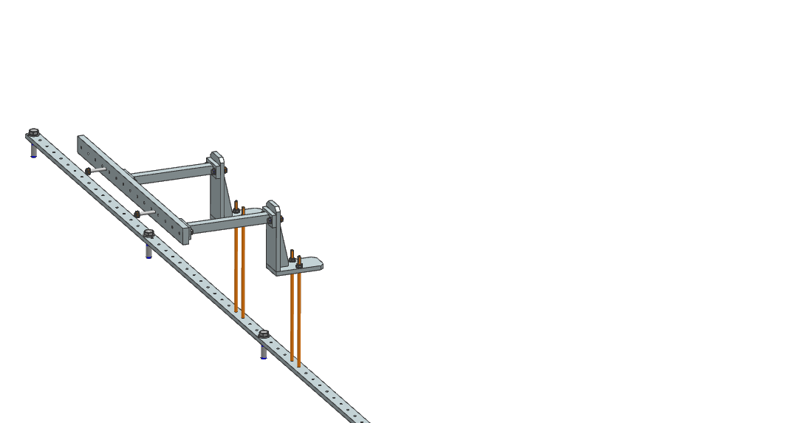
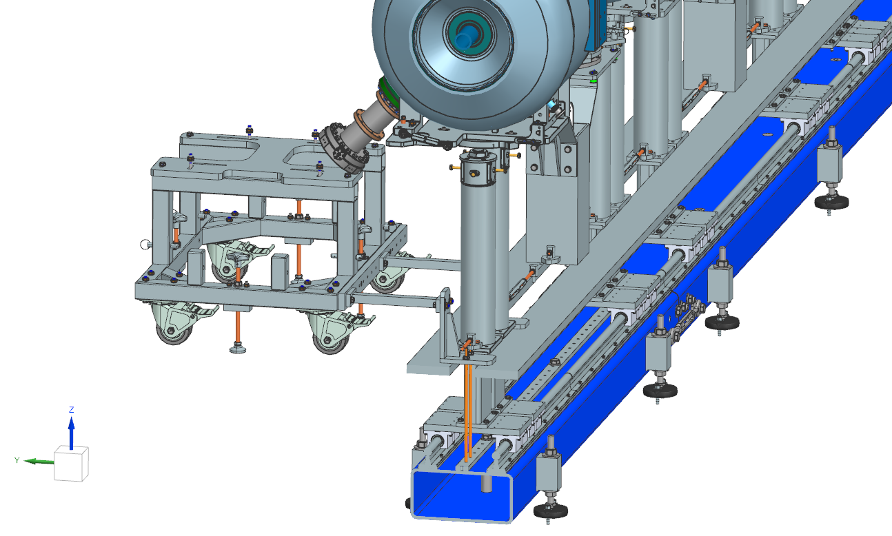
Positioning Cart Accessories

Slide 22
New solutions
Quick-Release One-Touch Fasteners
Pros:
Fast assembling components
Fastening tools not required in cleanroom
Cons:
Low clamping force (less than a bolted connection)

Slide 23
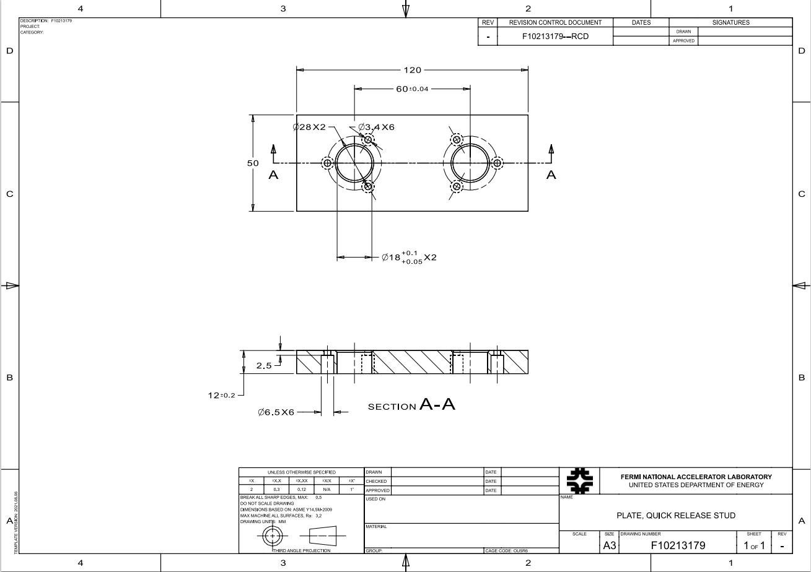
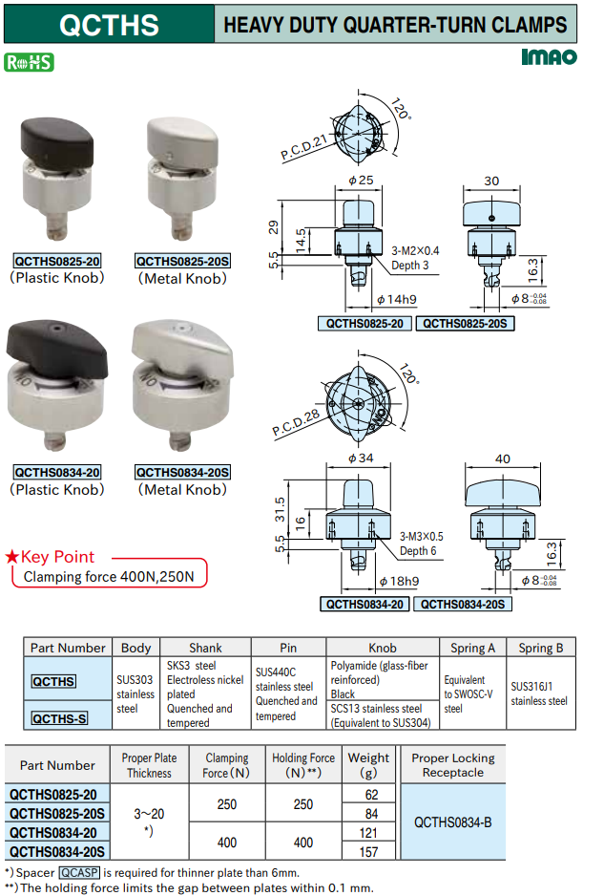
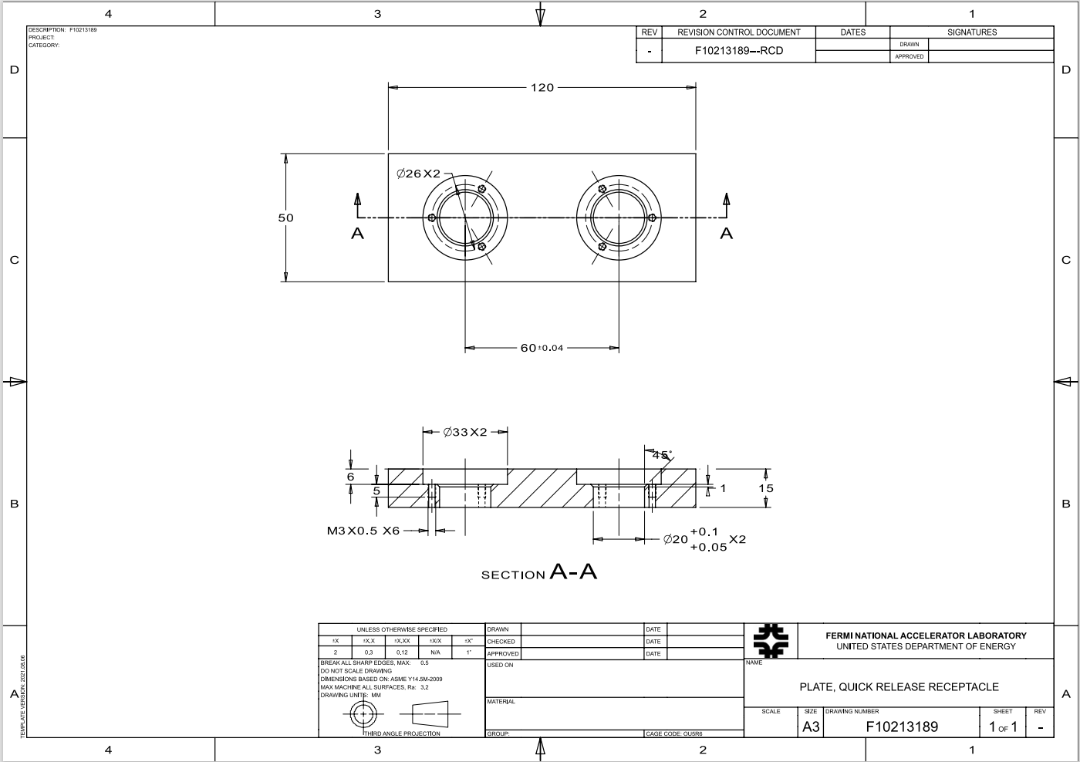
New solutions
Design of trial plate for testing

Slide 24
Probe Stage
Objective:
Design a stage for the magnetic field probe in order to measure the magnetic field outside of the test stand vessel in a repeatable way.
Requirements:
90° angle span.
15 cm of radial span.
Vertical adjustment to align the probe with the solenoid axis.

Slide 25
Probe Stage
90°
15 cm
15 cm
Standardized components are preferred to have a quick and not so expensive realization of the stage.

Slide 26
To-do in the future:
Release the EN.
Finalize the design of the locking system.
Investigate the cleanroom compatibility of the quick-release fasteners.
Finalize the design of the probe stage.

Slide 27
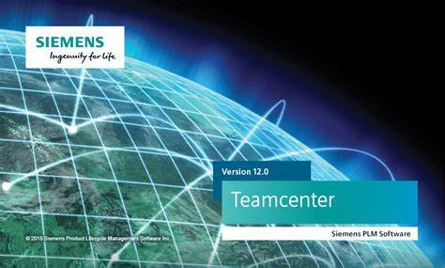
Conclusions
What I learned:
How to write an Engineering Note
Use of softwares:
ANSYS Workbench
Siemens NX
Teamcenter
Gain experience in design solutions
Understand the assembling procedure of a cryomodule

Slide 28
THANK YOU FOR THE ATTENTION!

