Slide 1
Cryogenic high-speed transmitter and receiver circuits in advanced CMOS technology for quantum computing and technology
Diego Pacini
Final presentation
09/27/2023

Slide 2
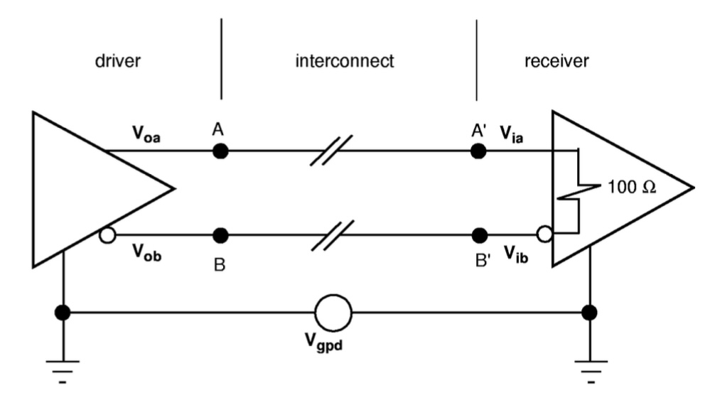
Low Voltage Differential Signaling (LVDS)
Design strategies:
Low-voltage swing
  Reduced power dissipation
  High speed
Differential signals
  Adequate noise margins
Self-terminated
  Minimize board costs
  Maximize clock rates
Uniform ground

Slide 3
Low Voltage Differential Signaling (LVDS)
Design benefits:
Constant driver and link currents
  Simplified design
Induced noise and ground-bounce as common mode signals
  Lower signal current
Low EMI
Low sensitivity to external noise

Slide 4
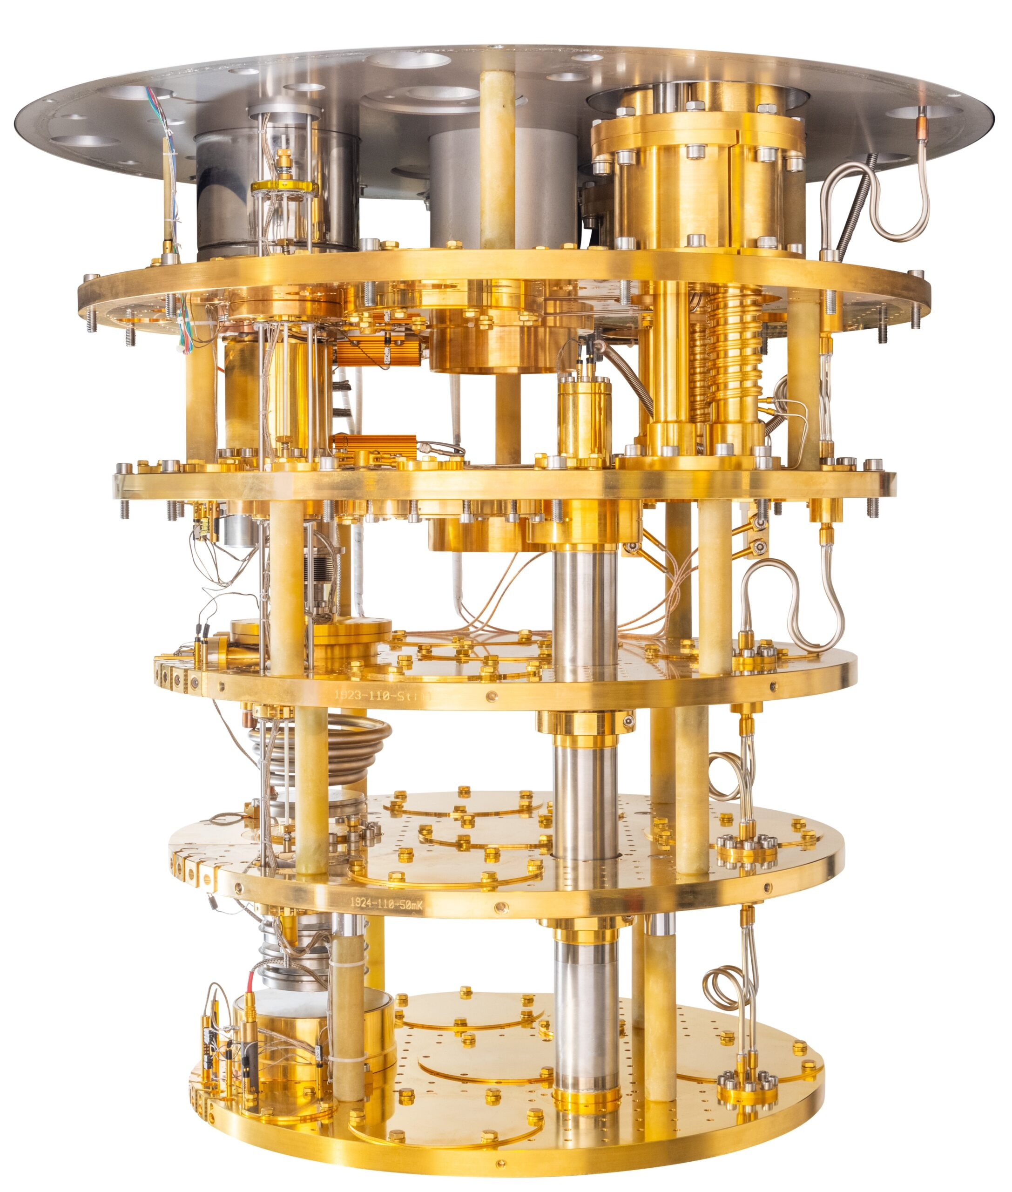
Why LVDS?
To transmit a large amount of data from one stage to another
Using a big number of cables, carrying data in parallel, would cause a too high thermal loading
Increasing data bandwidth allows to reduce the number of cables and interconnections

Slide 5
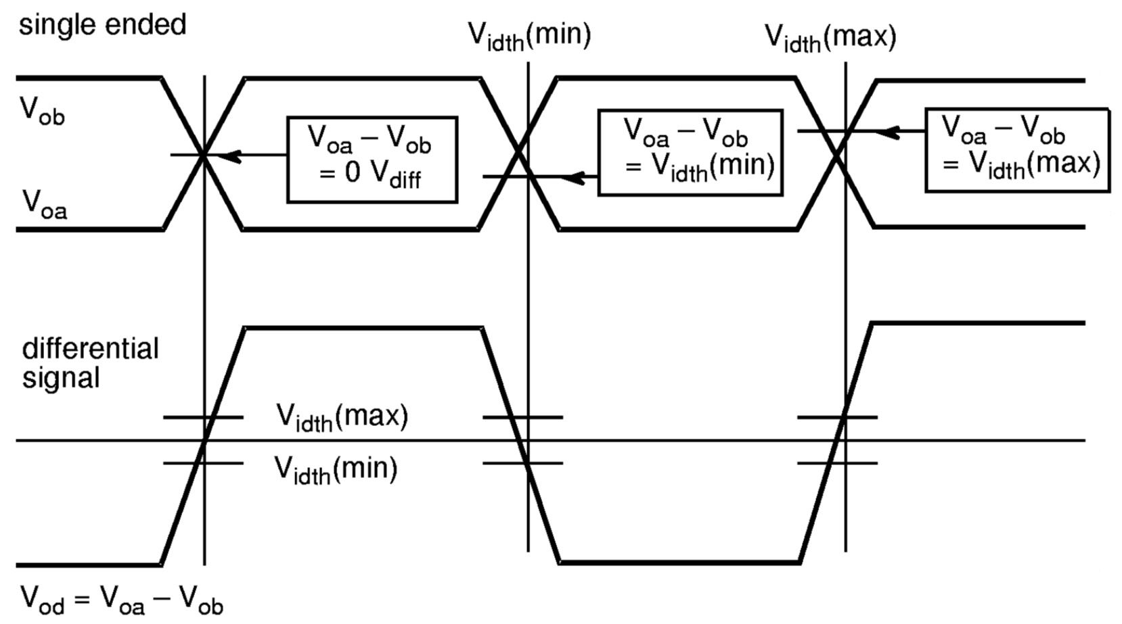
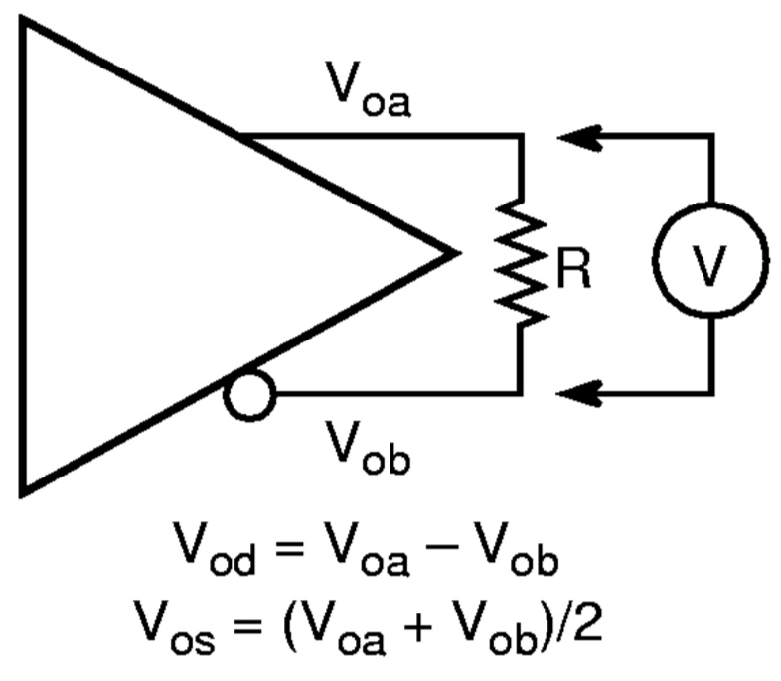




Transmitter

Slide 6






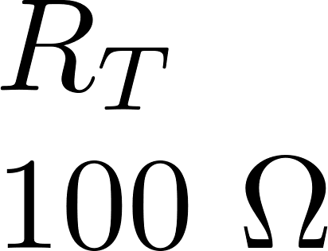
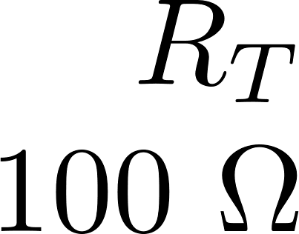

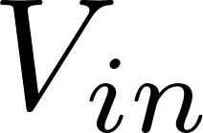



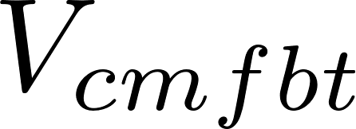

Transmitter block diagram

Slide 7



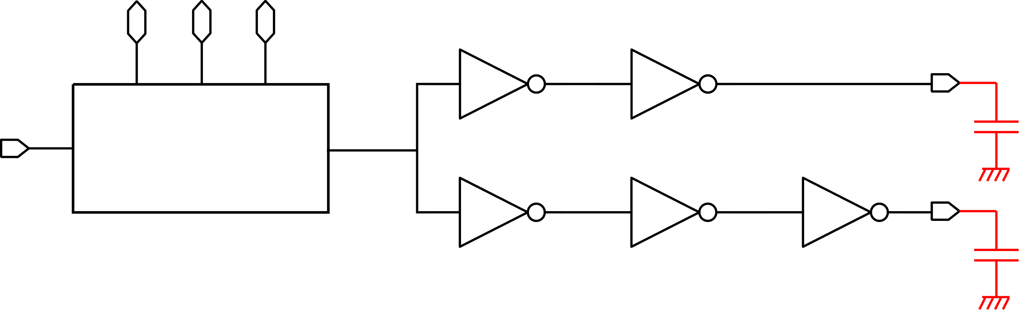
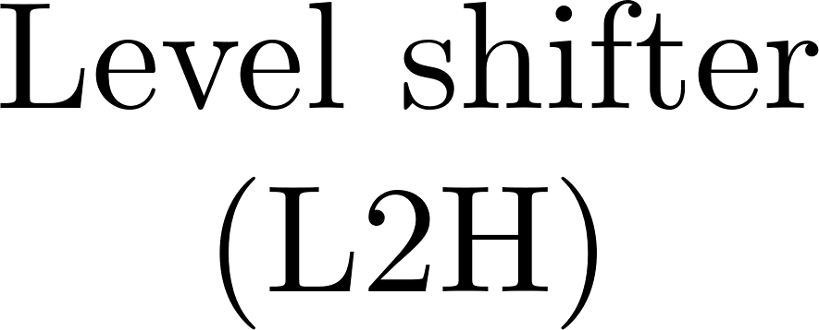


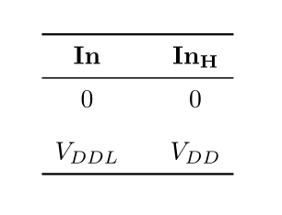
Transmitter – Pre-driver

Slide 8
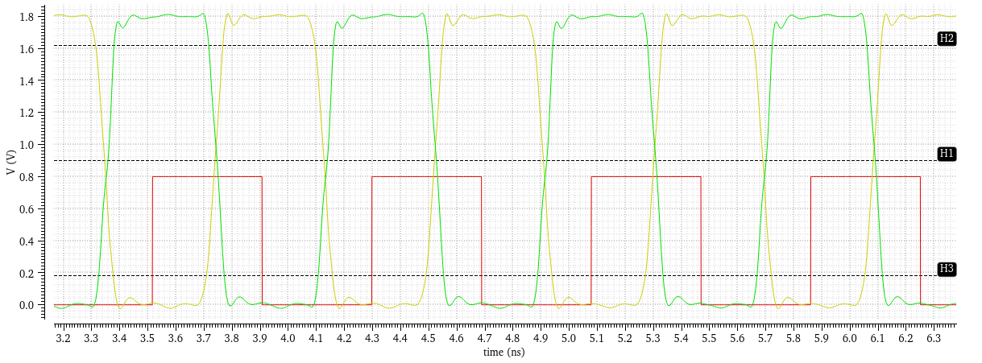

Transmitter – Pre-driver – Simulation results

Slide 9
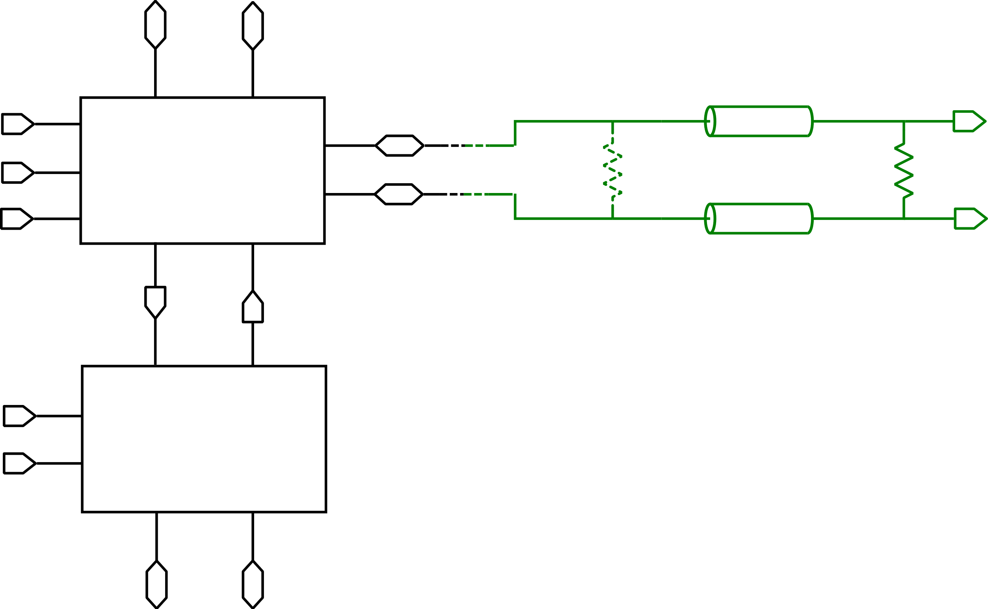









Transmitter – Core

Slide 10
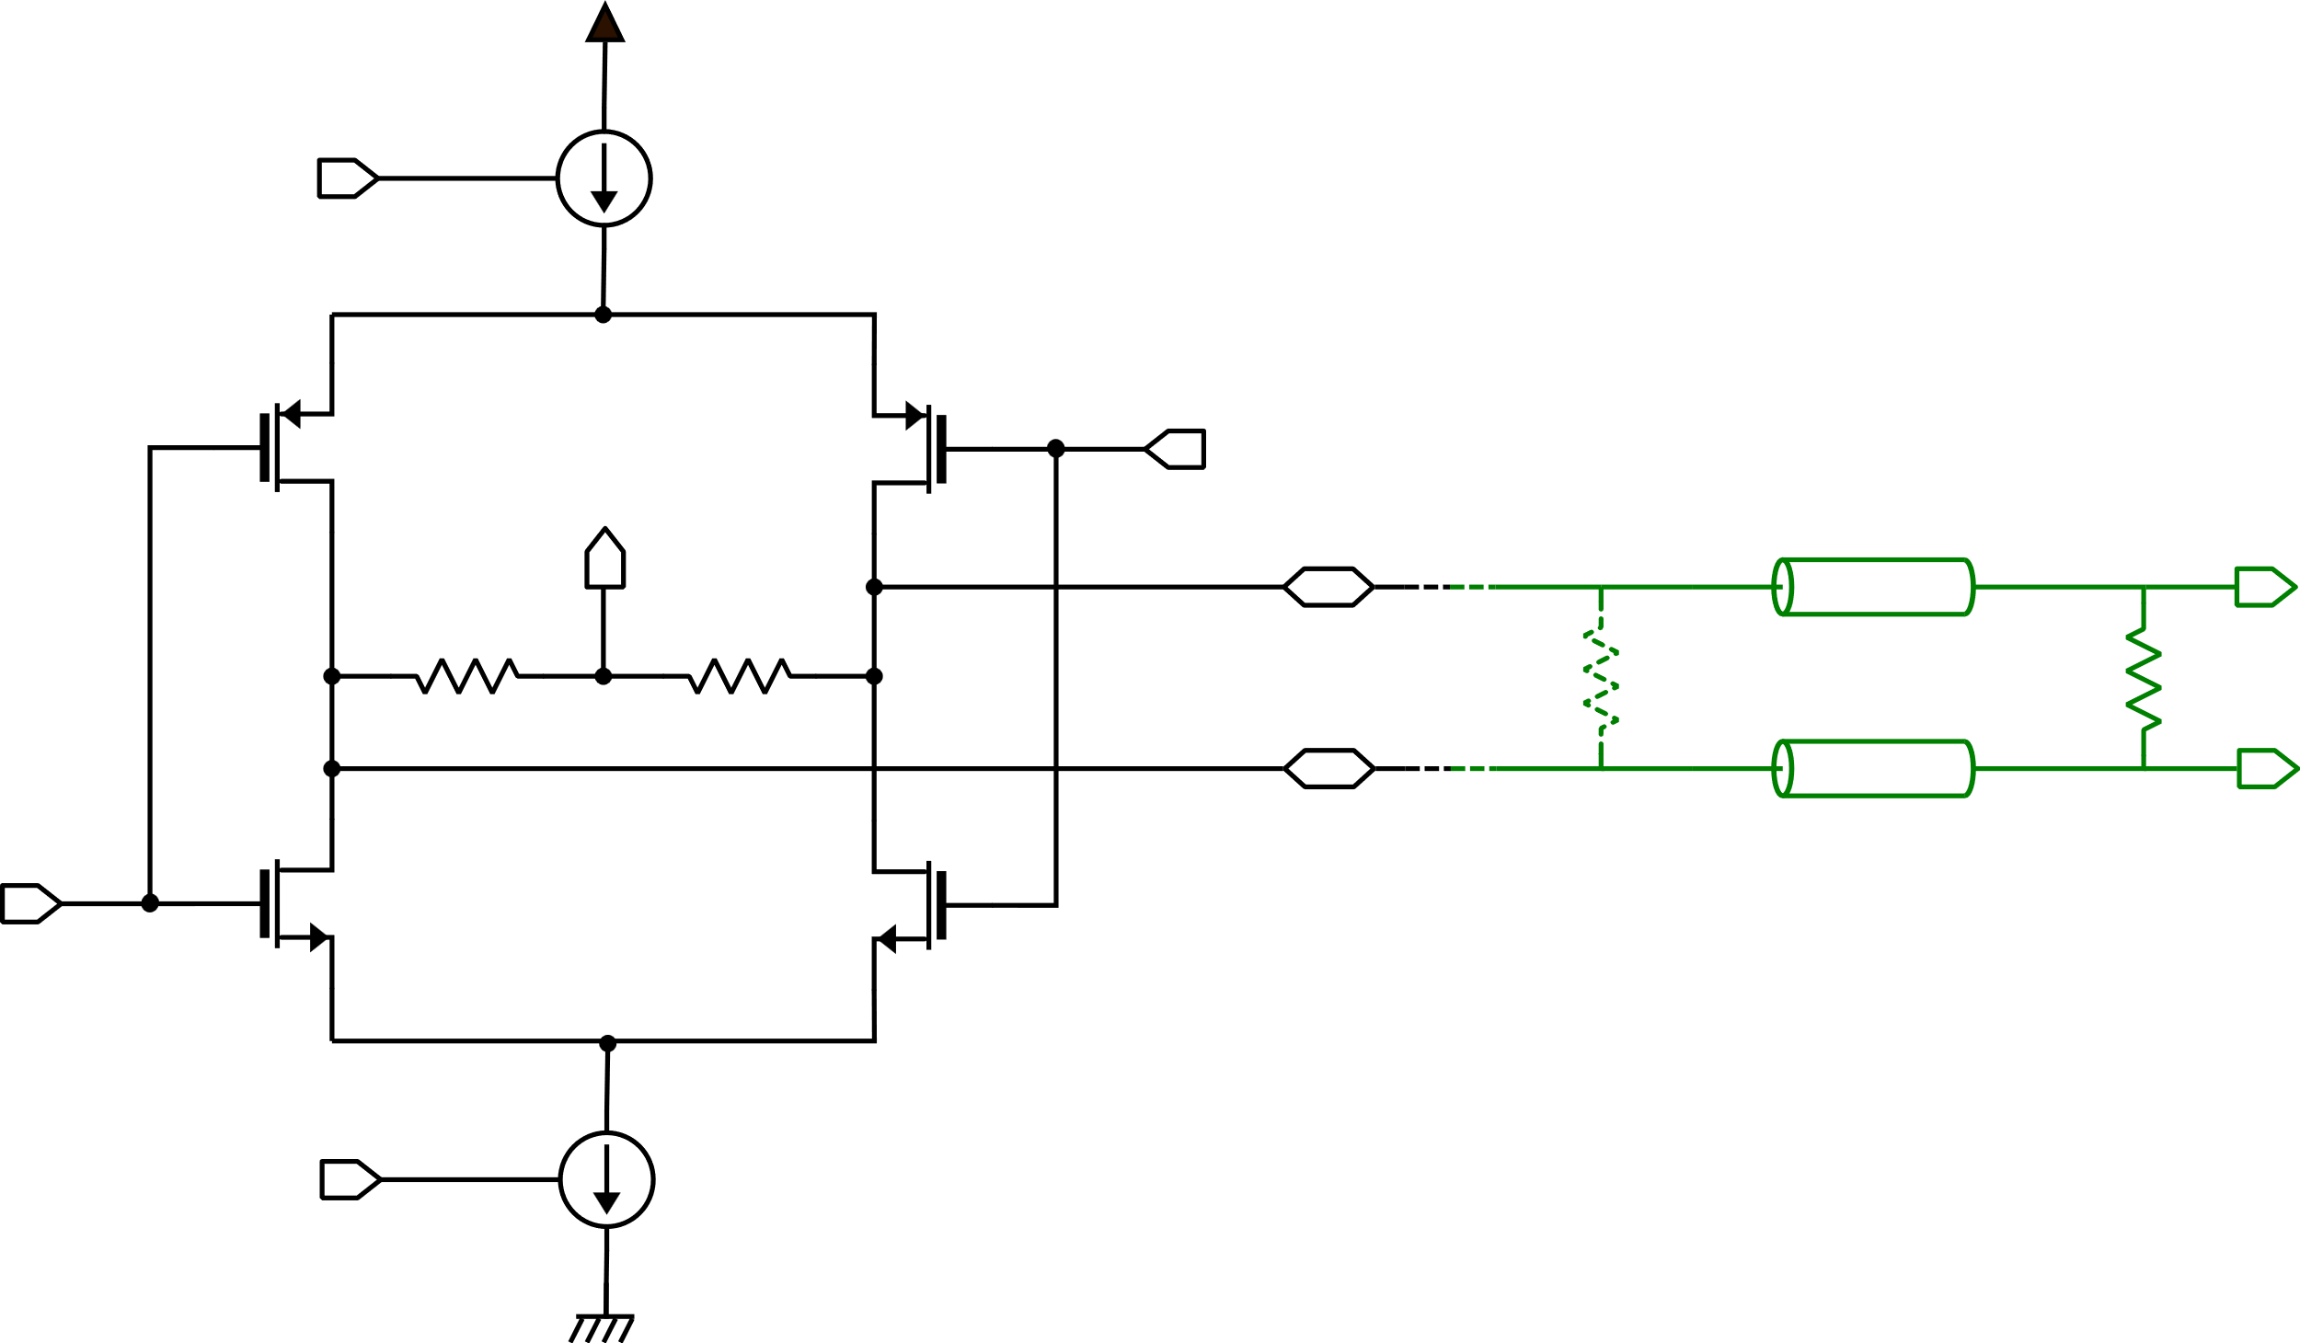






Transmitter – Core – Bridge

Slide 11
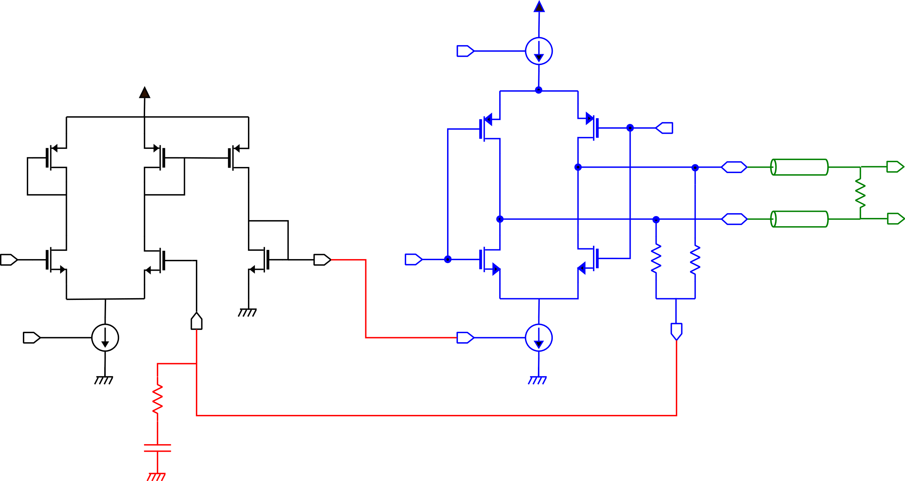



Transmitter – Core – CMFB

Slide 12
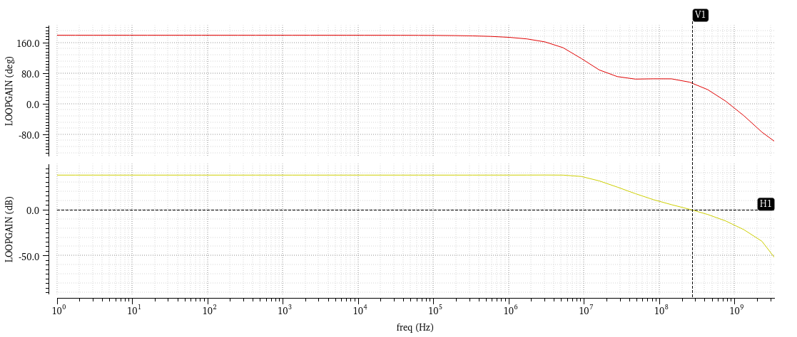
Transmitter – Core – CMFB – Simulation results

Slide 13
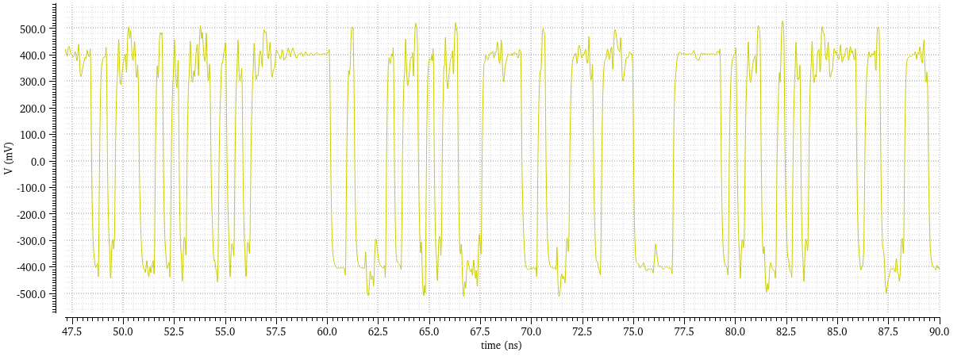

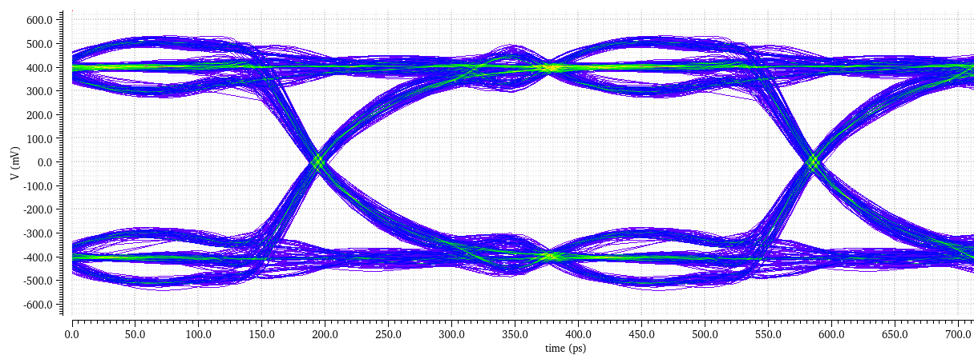

Transmitter – Simulation results

Slide 14
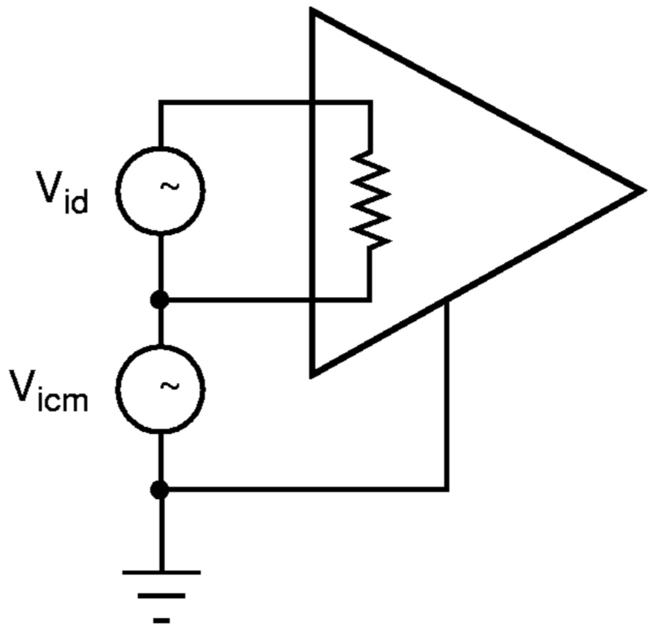
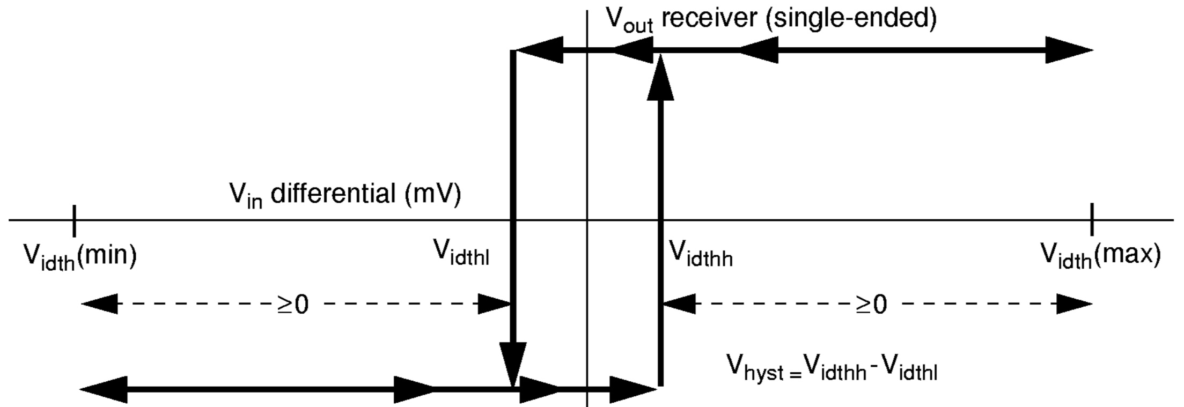
Receiver

Slide 15
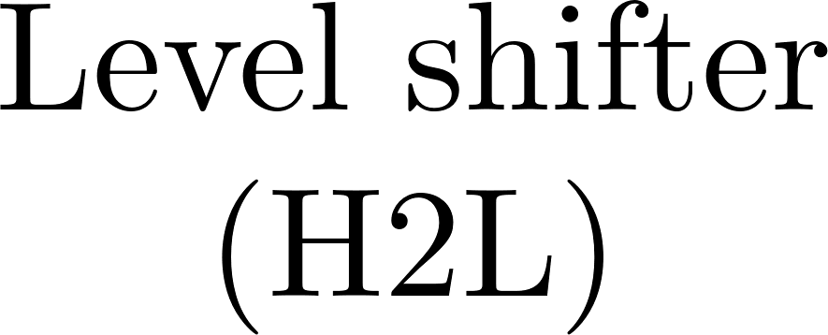

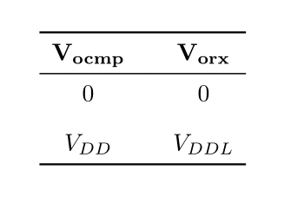
Receiver block diagram

Slide 16
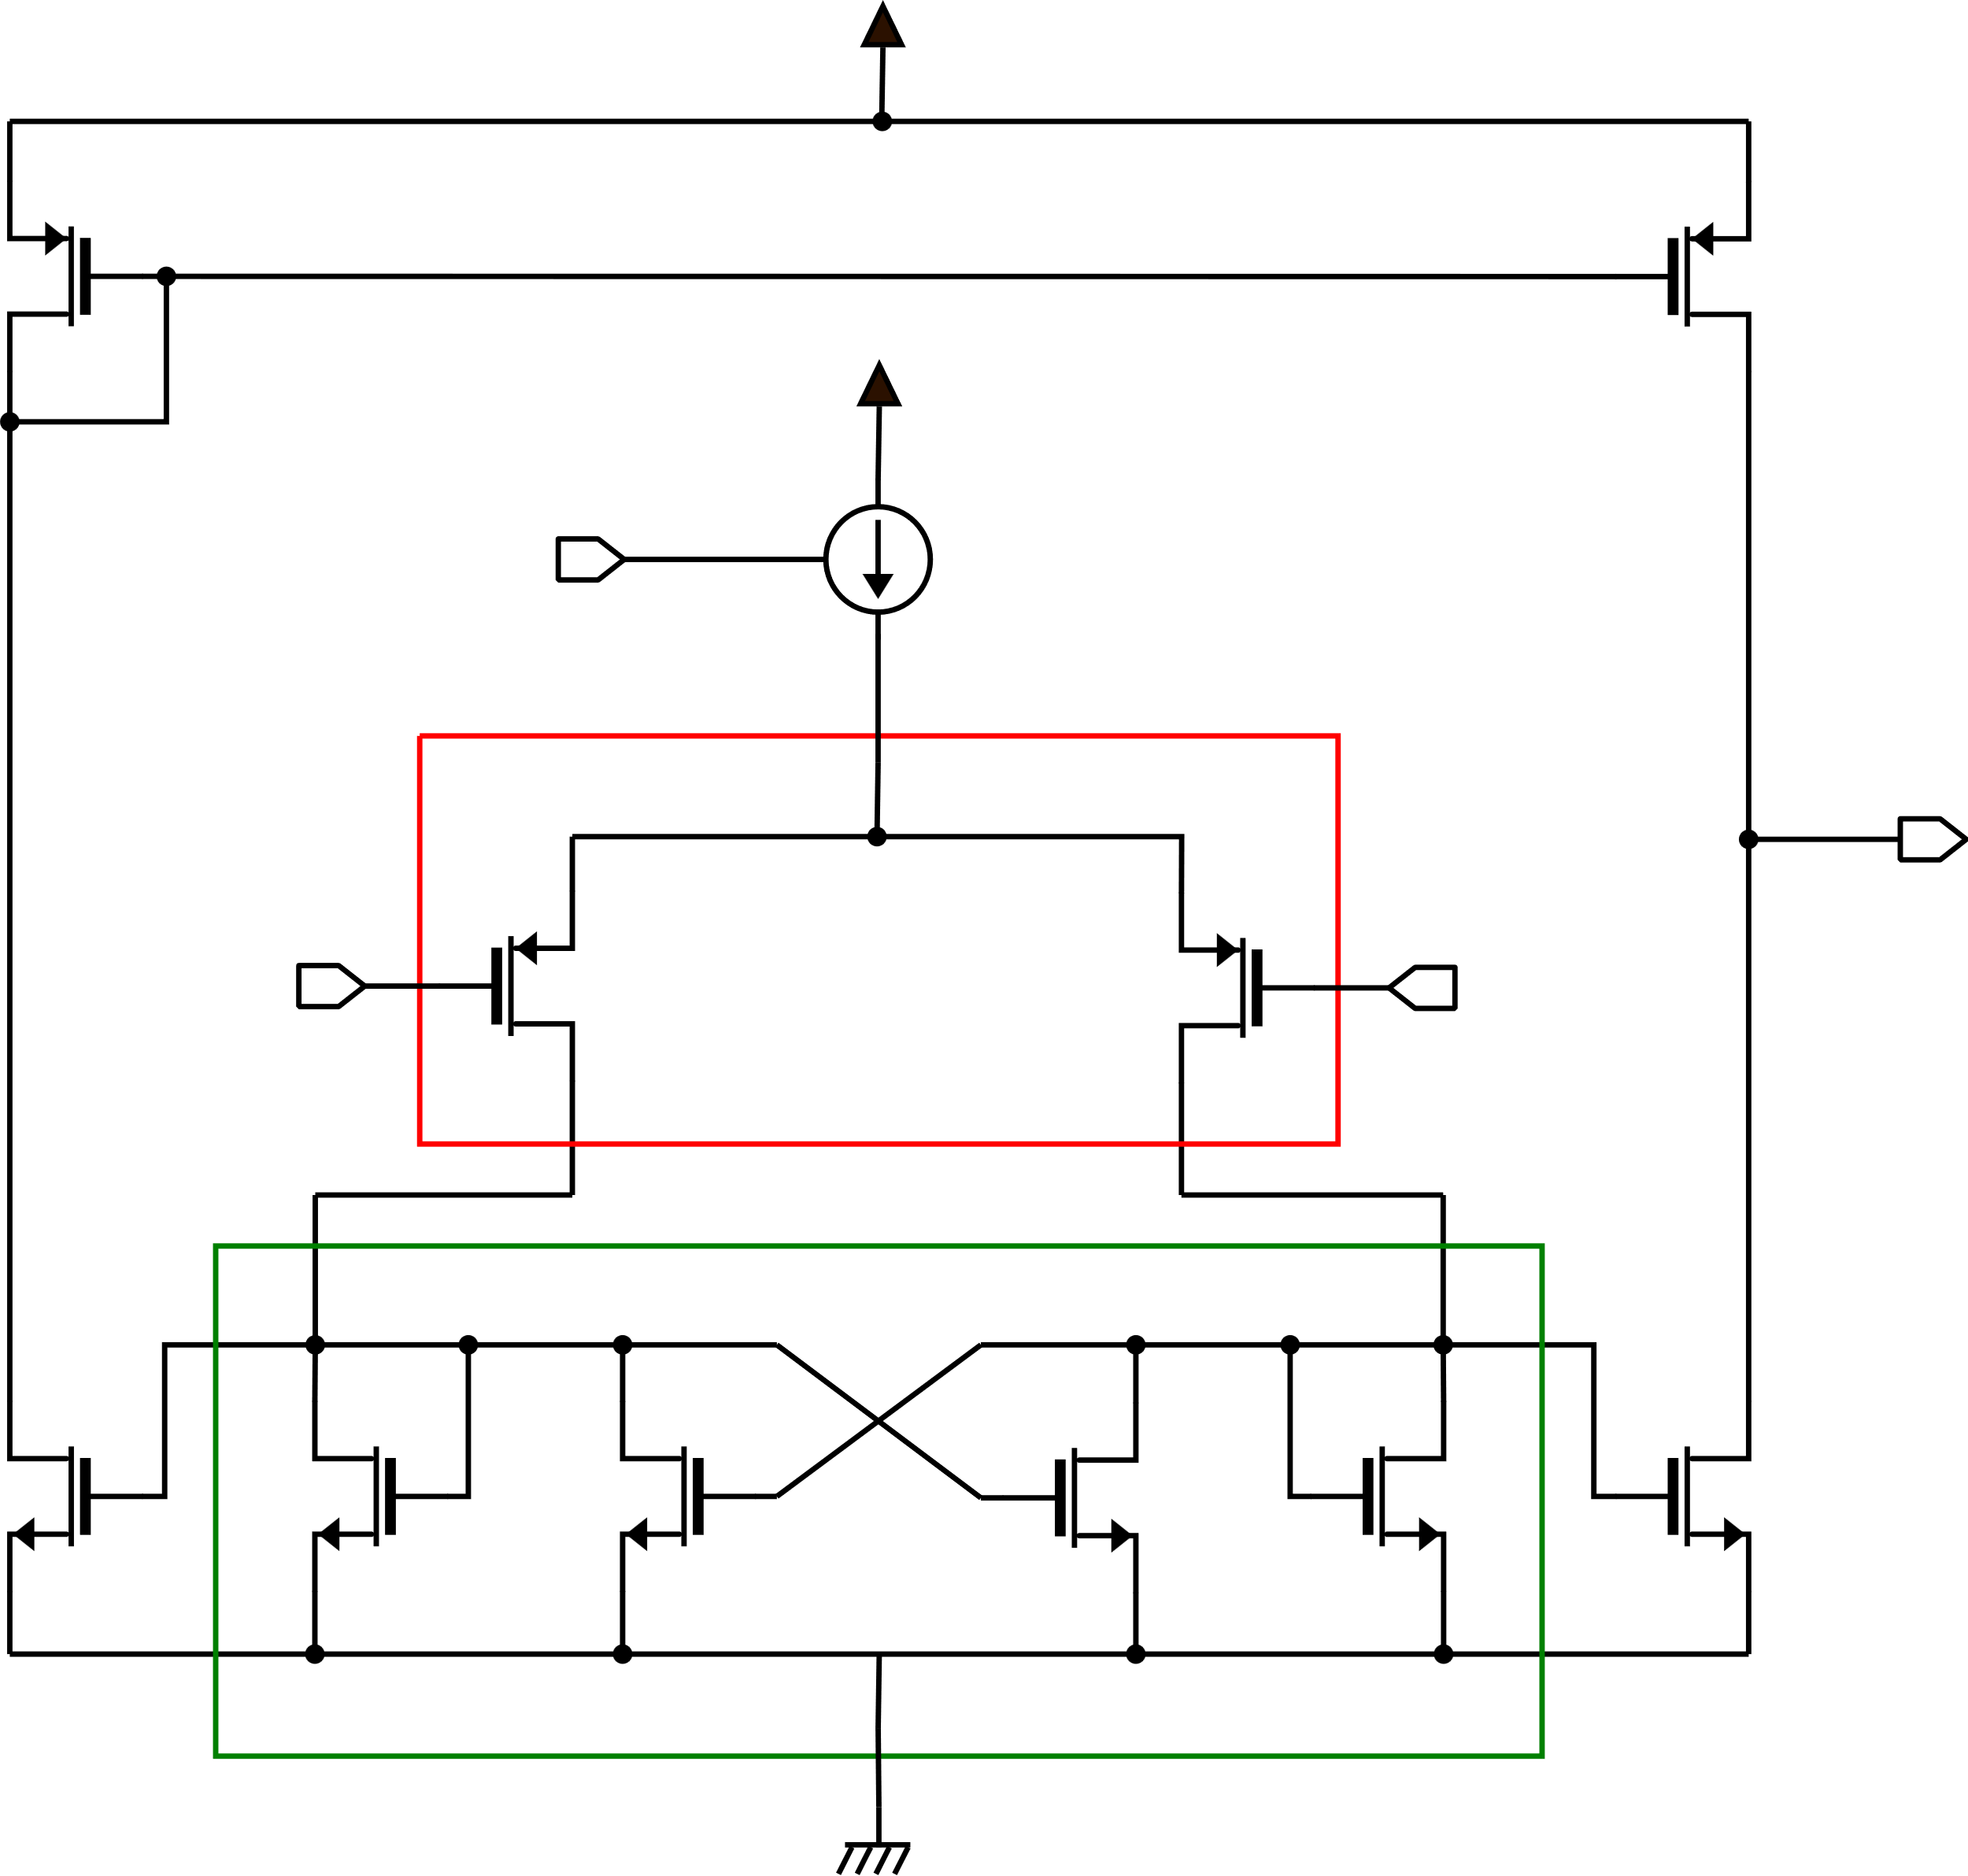
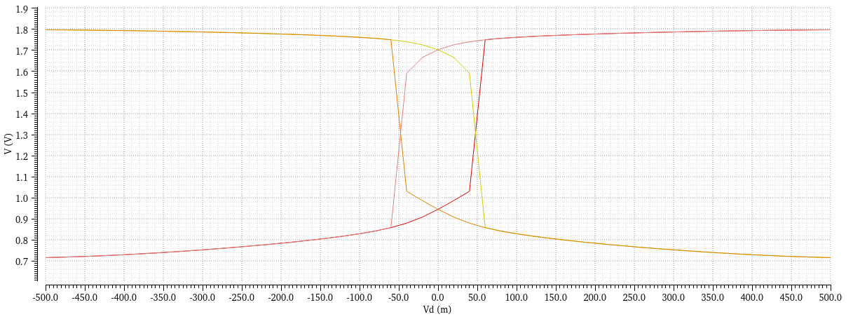
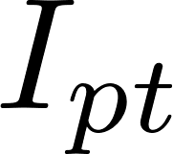


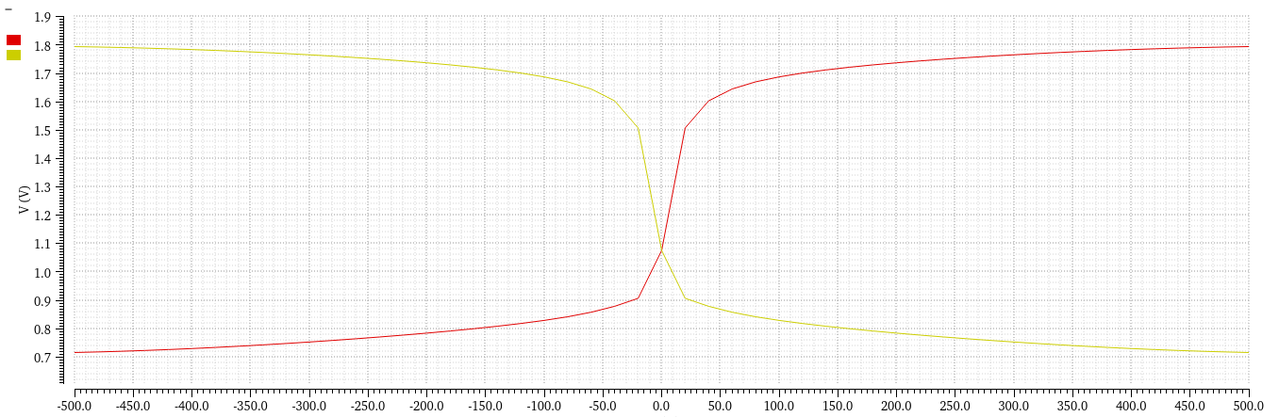





Receiver – Comparator

Slide 17
Thank you for your attention
References
1596.3-1996 - IEEE Standard for Low-Voltage Differential Signals (LVDS) for Scalable Coherent Interface (SCI)
D. Severin – Final Report – Characterization of CMOS transistors and testing of LVDS circuit at room and cryogenic temperatures
P. Bruschi – Mixed signals design – Lecture notes
R. J. Baker - CMOS Circuit Design, Layout, and Simulation

