Slide 1
Measurement of the gas gain and understanding the gas flow in the Mu2e Tracker
Student: Giovanni Celotto
Supervisor: Vadim Rusu
Final term presentation
19 September 2022

Slide 2
Overview
Mu2e experiment and tracker
Aim of the project
Experimental setup
Measurement of the current
Results:
Effect of water
Effect of humidity, temperature, pressure
Conclusions and Perspectives

Slide 3
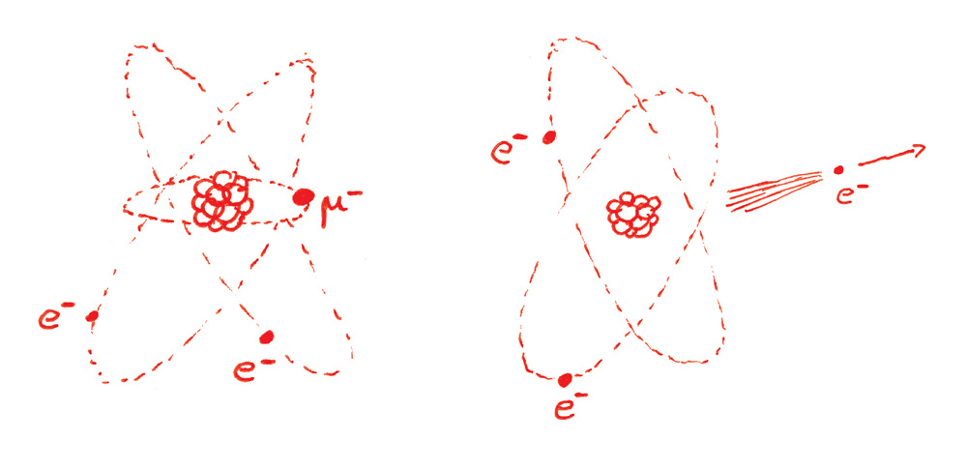
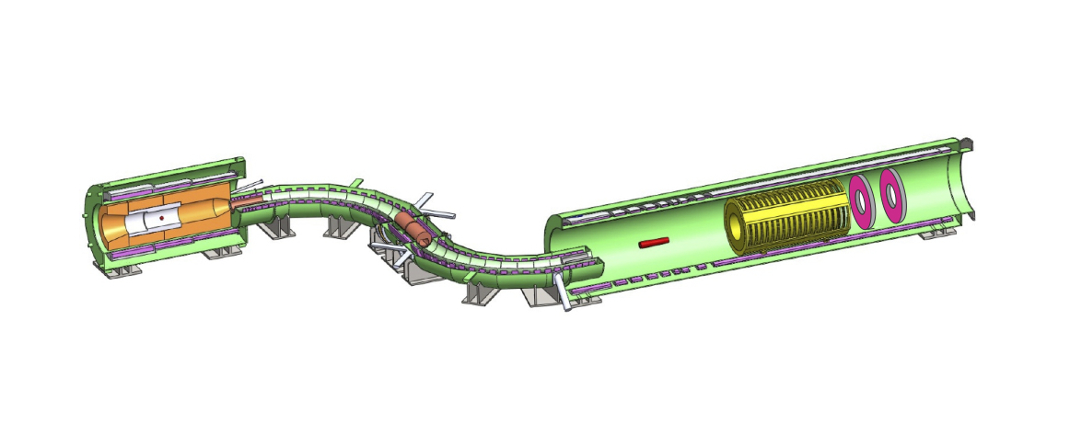
Mu2e Experiment
Neutrino-less conversion of muons into electrons in the Coulomb field of an Al nucleus
PS
DS
TS

Slide 4
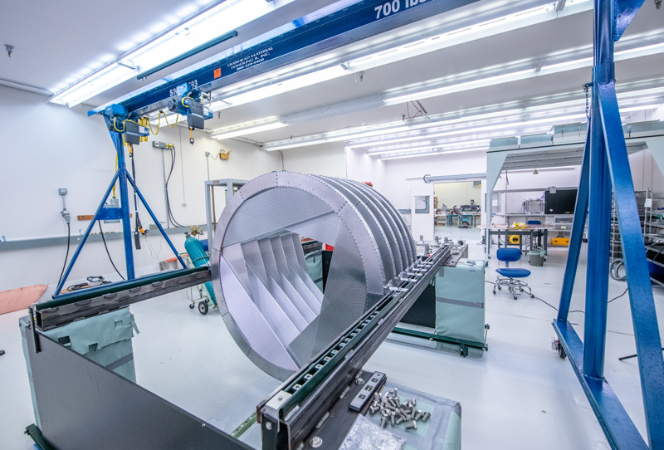
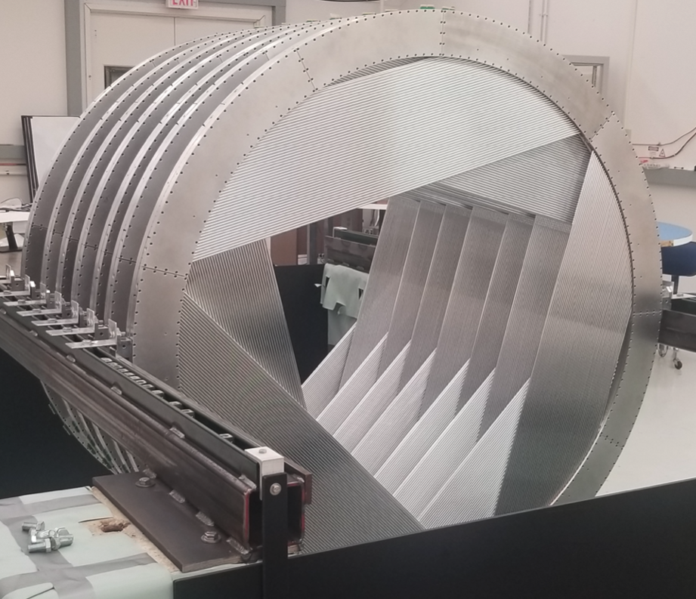
Mu2e Tracker
Low mass straw tube detector
Position and the momentum of the electron
Still under construction

Slide 5
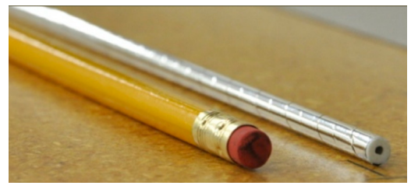
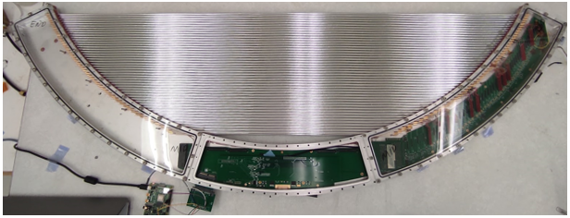
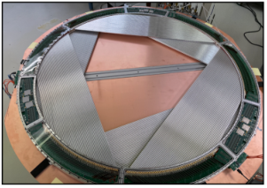
Mu2e Tracker’s panel
96 Mylar straws
5 mm diameter and 15 µm walls
25 µm gold plated tungsten sense wire

Slide 6
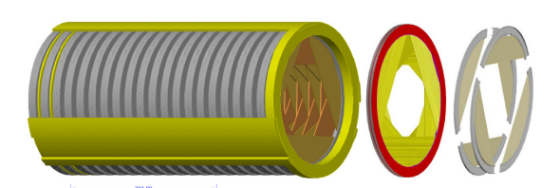
Mu2e Tracker’s panel
96 Mylar straws
5 mm diameter and 15 µm walls
25 µm gold plated tungsten sense wire

Slide 7
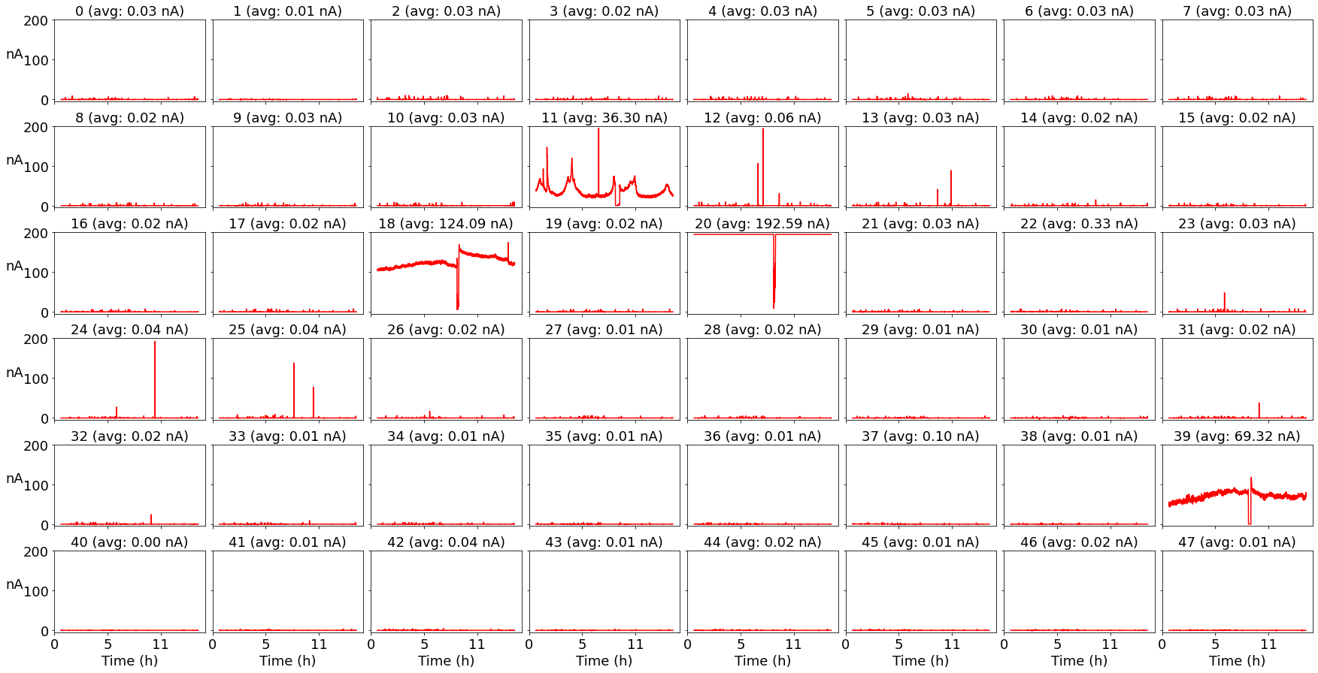
What’s the problem?
Higher Voltage
Higher gain
Measurement with no sources
No ionization products
Small currents

Slide 8
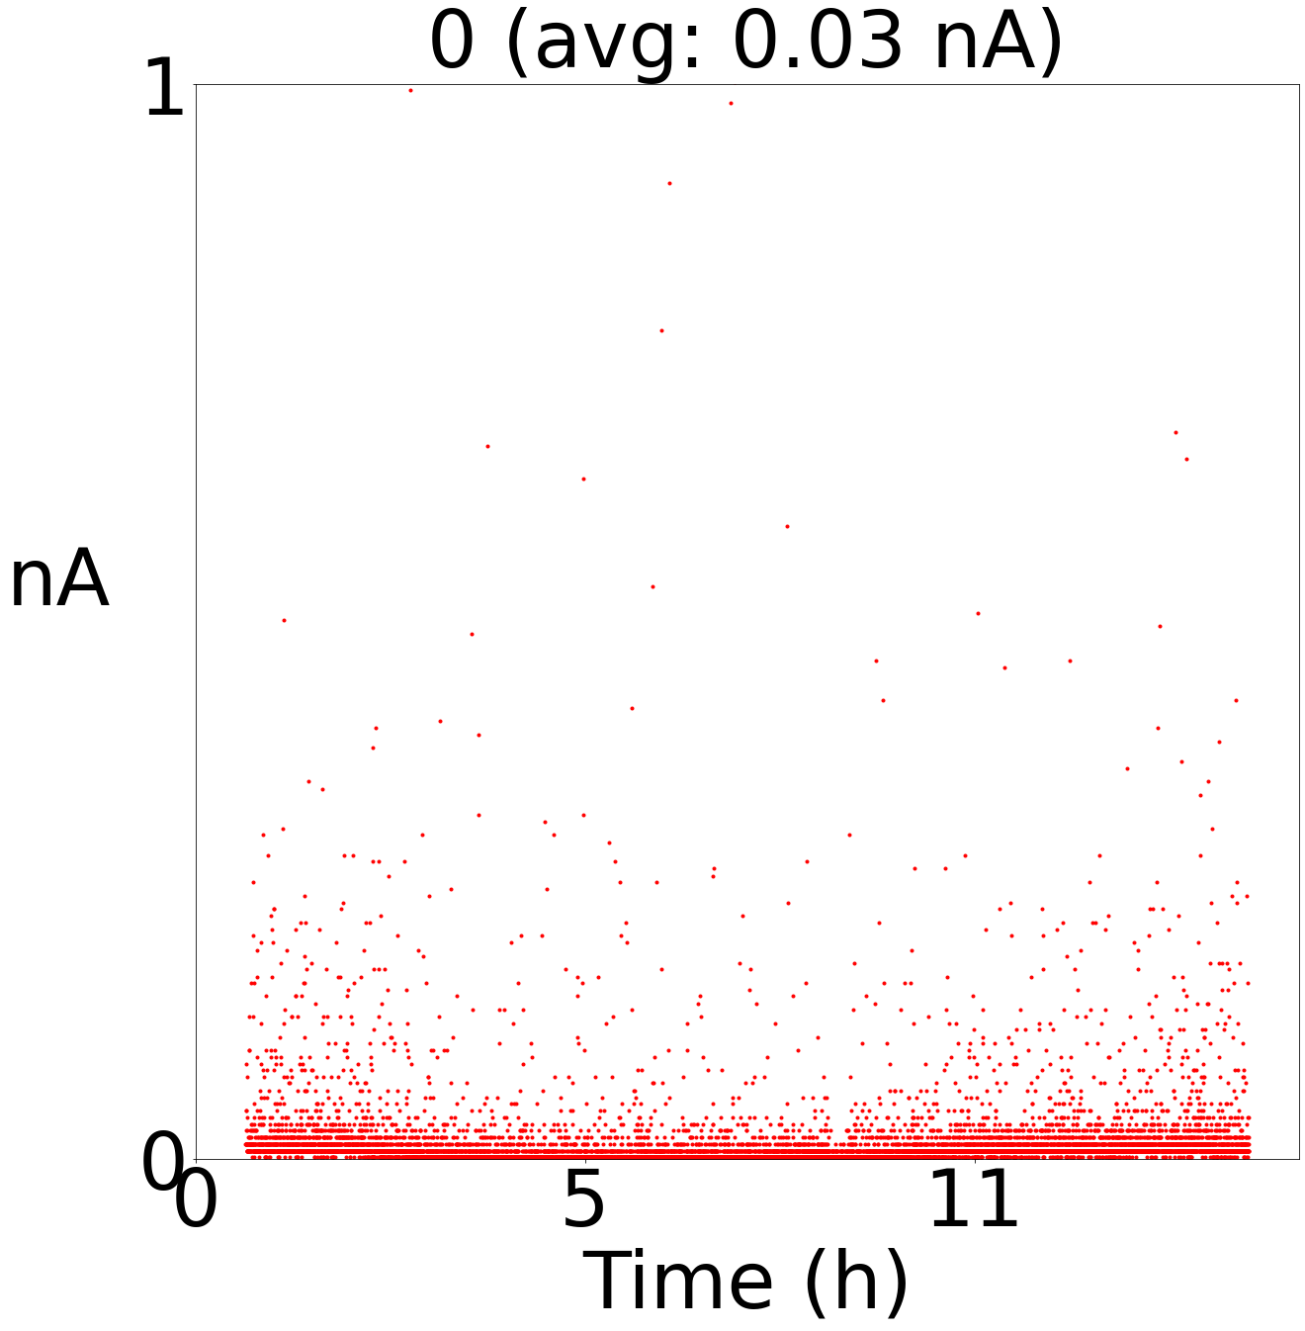
What’s the problem?
Higher Voltage
Higher gain
Measurement with no sources
No ionization products
Small currents

Slide 9
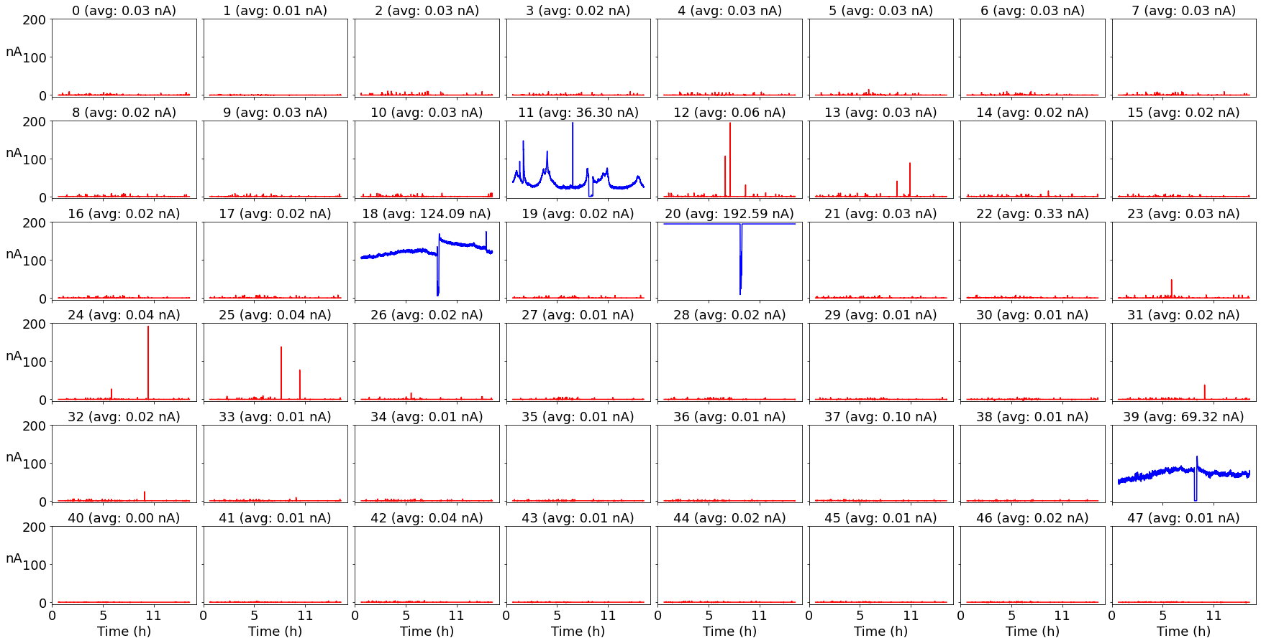
What’s the problem?
Higher Voltage
Higher gain
Measurement with no sources
No ionization products
Small currents

Slide 10
The Experimental Apparatus
Panel MN084
Gas Flowmeter
HV supplier
Slow Amplifiers
Raspberry Pi
Gas Flowmeter
HV supplier
Ar-$\text{C}{\text{O}}_{\text{2}}$ 0.14 SCFH
H20 0.1 SCFH
1450 V
Slow Amplifiers
24 (2 circuits each)

Slide 11
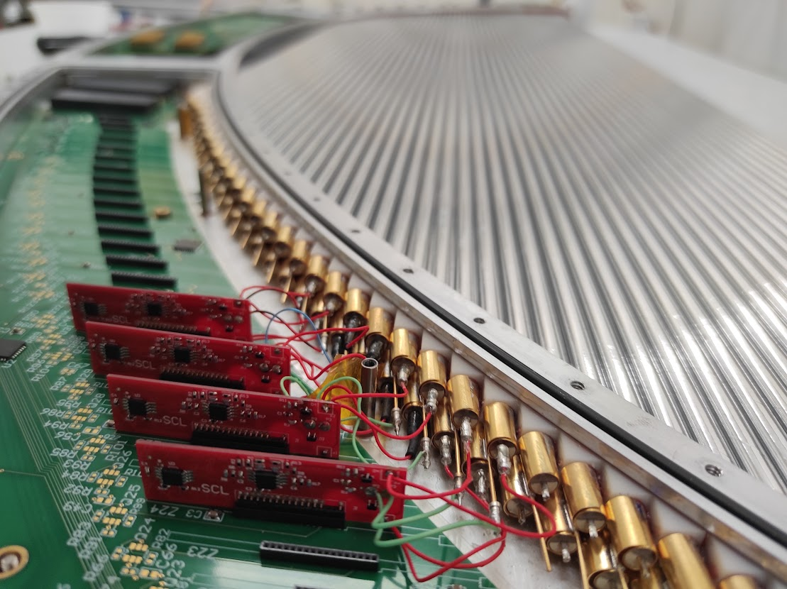
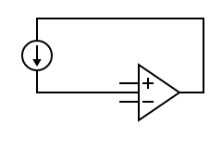
Measuring the current
ANODE
A
Two rows of straws
Measurement is performed on the cathode at low potential
CATHODE
C
ANODE
A
ANODE
CATHODE

Slide 12
Measuring the current
ANODE
Two rows of straws
Measurement is performed on the cathode at low potential
CATHODE
ANODE
ANODE
CATHODE

Slide 13
New data
Conditioning effect
The first time HV is applied high currents are measured

Slide 14
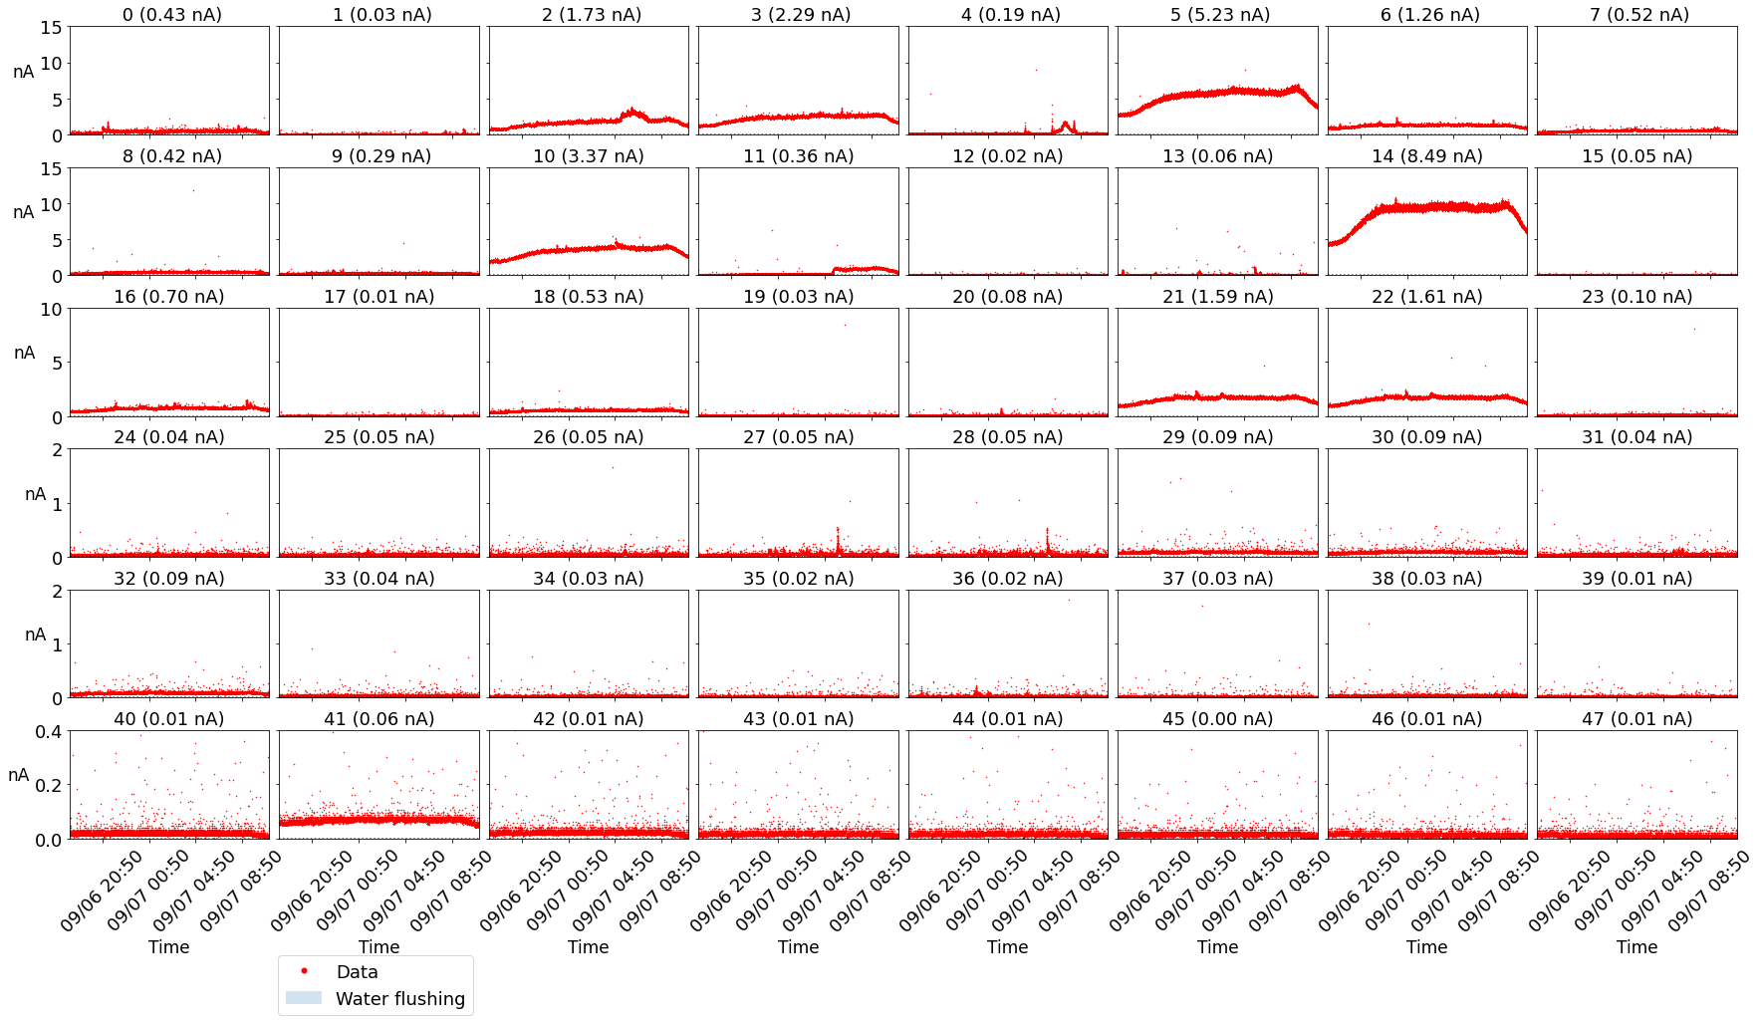
Currents before the water

Slide 15
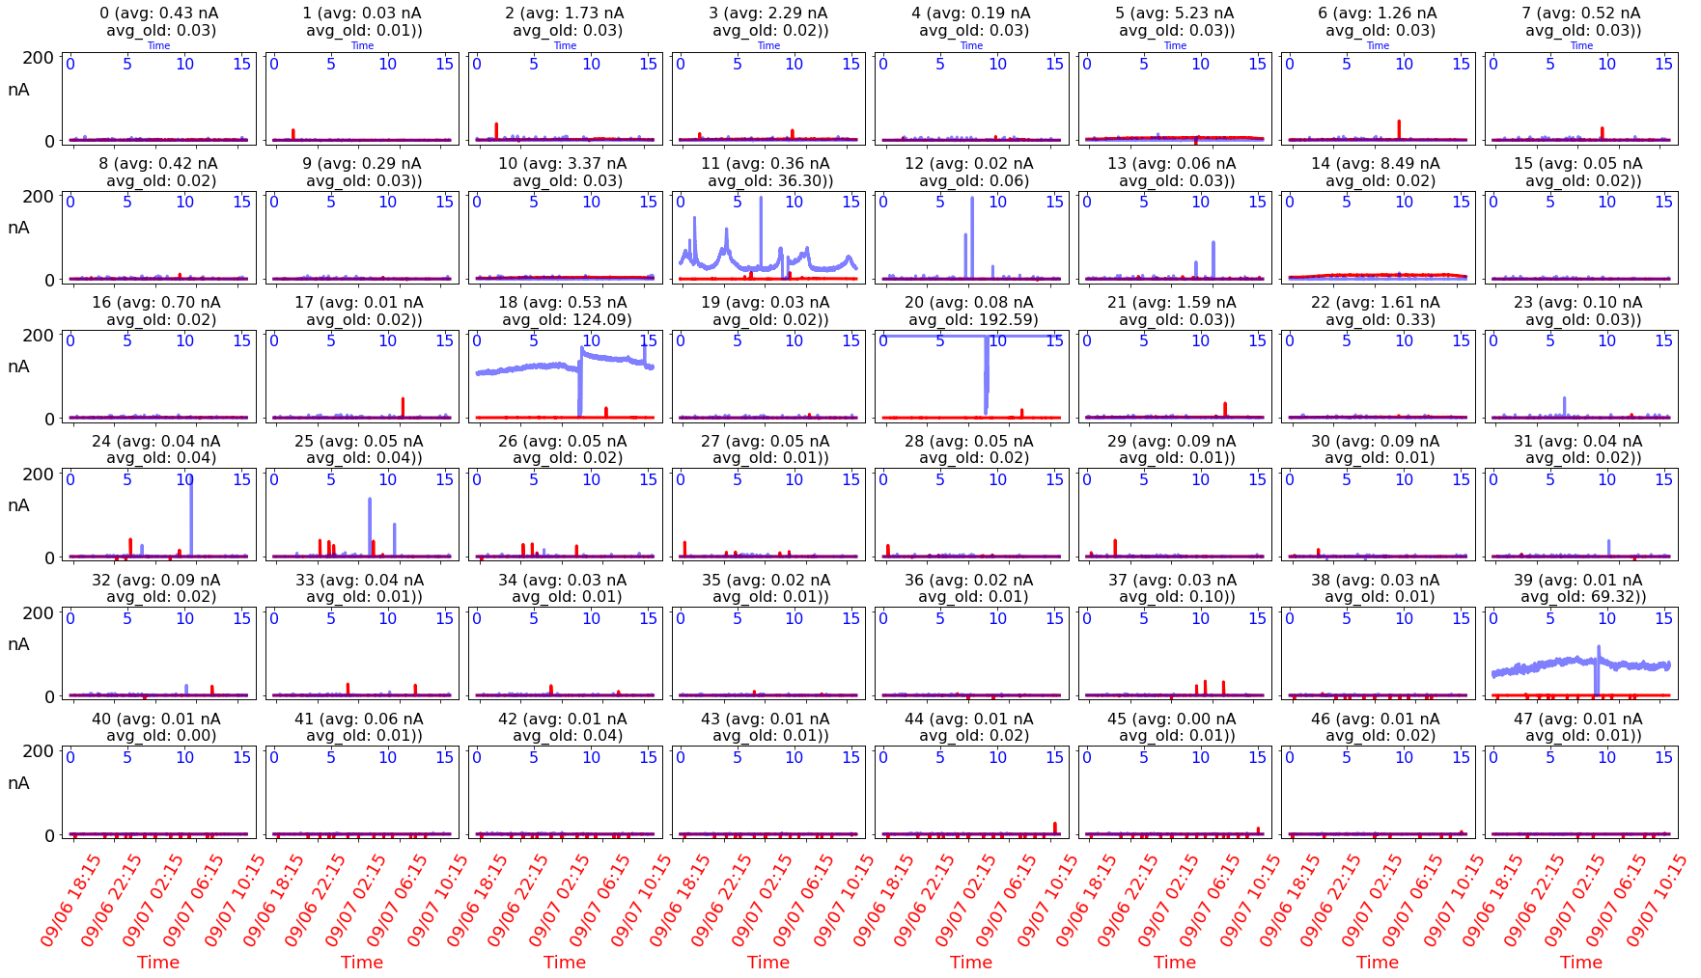
Old Data vs New Data before flushing water

Slide 16
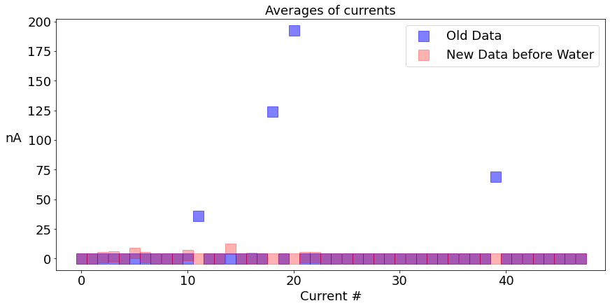
Old Data vs New Data before flushing water
After 1 month
Reduction in currents occurred before the water vapour was introduced
Some currents increased of few nA

Slide 17
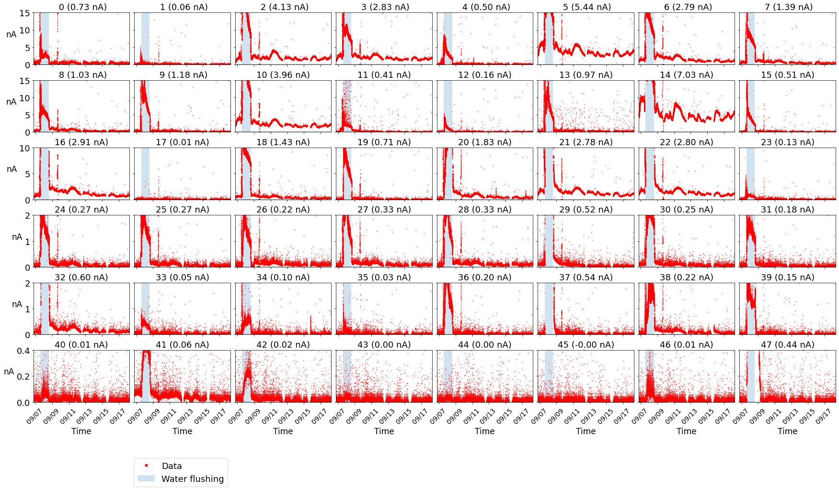
Effect of the water

Slide 18
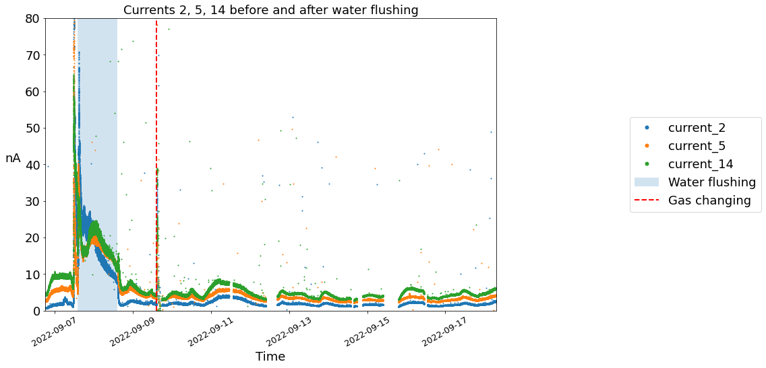
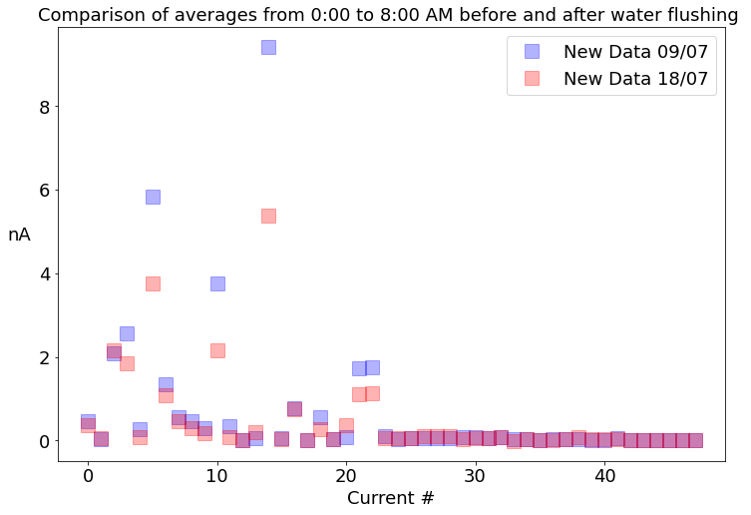
Effect of the water
After flushing water vapour
Further decrease in the highest currents without going to zero
Daily periodic oscillations
Secondary oscillation with 15 min-period

Slide 19
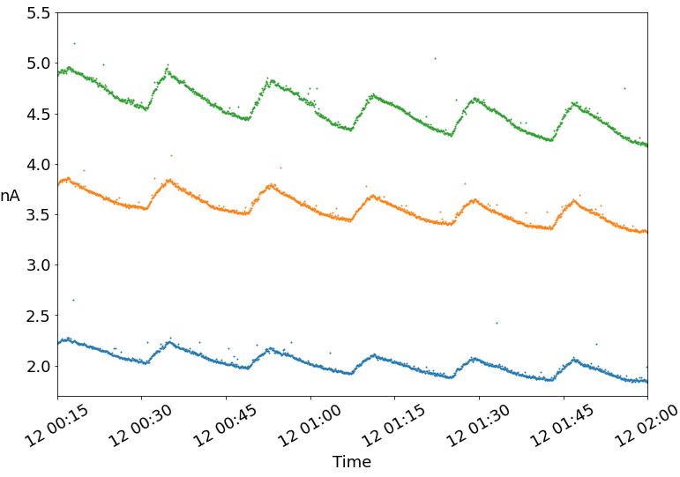
Effect of the water
After flushing water vapour
Further decrease in the highest currents without going to zero
Daily periodic oscillations
Secondary oscillation with 15 min-period

Slide 20
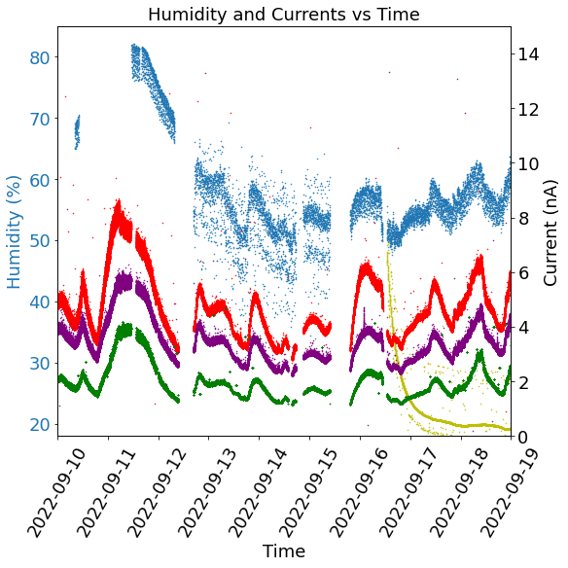
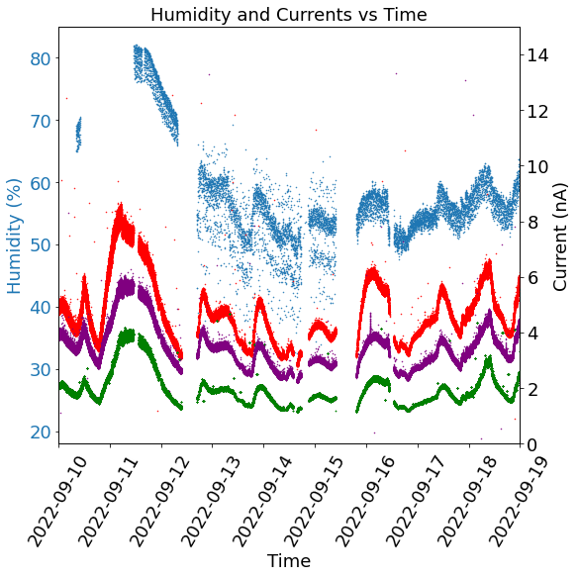
Daily oscillations
$$H\left(t\right)=B + A ⋅e^{−\frac{t}{τ}}$$
B (%) | A (%) | τ (hours)
20.05 ± 0.03 | 26.606 ± 0.001 | 5.541 ± 0.003
B (%) | A (%) | τ (hours)
20.05 ± 0.03 | 26.606 ± 0.001 | 5.541 ± 0.003

Slide 21
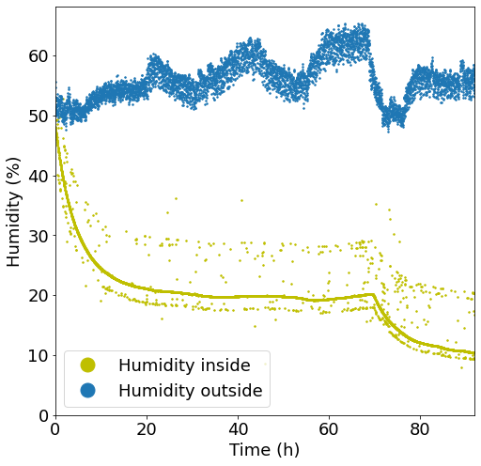
Why 20% of humidity in the panel?
We have 4 possibilities
The sensor does not go lower than 20%
The sensor is working. There is a leak
The sensor is broken. The humidity is actually 0%
The humidity is actually 20%

Slide 22
Why 20% of humidity in the panel?
We have 4 possibilities
The sensor does not go lower than 20%
The sensor is working. There is a leak in the panel
The sensor is broken. The humidity is actually 0%
The humidity is actually 20%

Slide 23
Why 20% of humidity in the panel?
We have 4 possibilities
The sensor does not go lower than 20%
The sensor is working. There is a leak in the panel
The sensor is broken. The humidity is actually 0%
The humidity is actually 20%

Slide 24
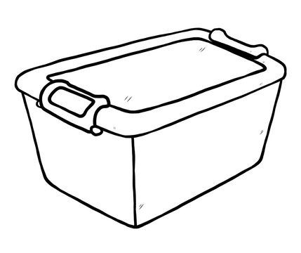
Why 20% of humidity in the panel?
We have 4 possibilities
The sensor does not go lower than 20%
The sensor is working. There is a leak
The sensor is broken. The humidity is actually 0%
The humidity is actually 20%

Slide 25
Why 20% of humidity in the panel?
We have 4 possibilities
The sensor does not go lower than 20%
The sensor is working. There is a leak
The sensor is broken. The humidity is actually 0%
The humidity is actually 20%

Slide 26
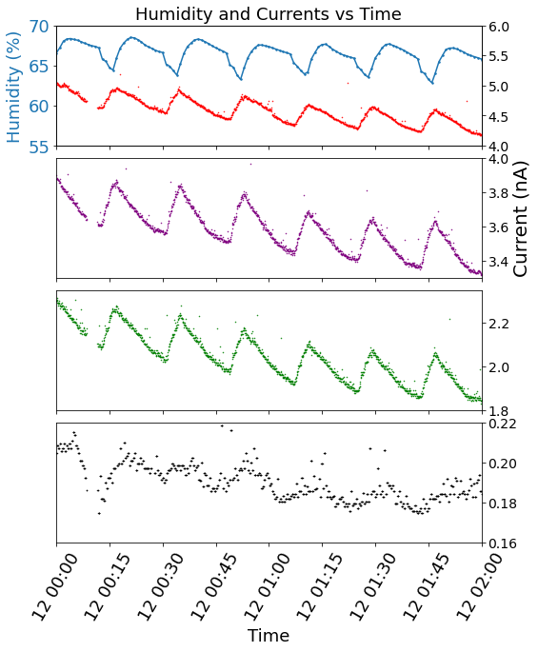
15-min period oscillations

Slide 27
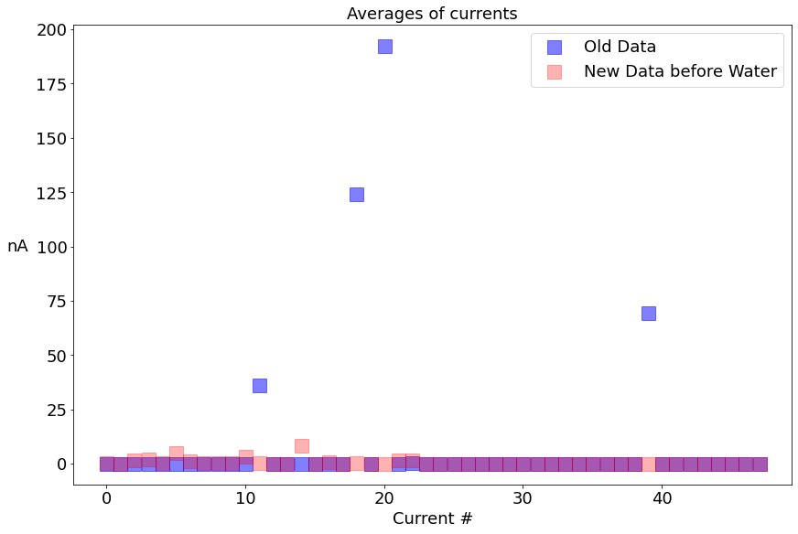
Conclusions
Conditioning effect has played by far the most dominant role on the reduction of the currents
Water has had a little effect on reducing small currents. More measurements are needed
Environmental conditions strongly affect the currents of the panel

Slide 28
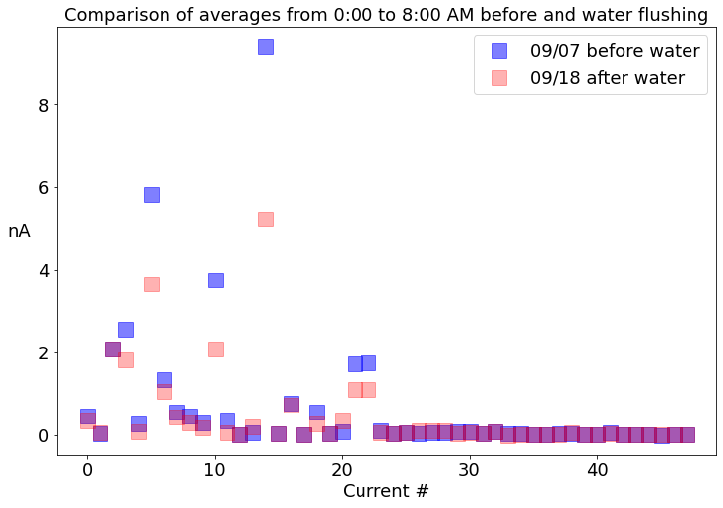
Conclusions
Conditioning effect has played by far the most dominant role on the reduction of the currents
Water has had a little effect on reducing small currents. More measurements are needed
Environmental conditions strongly affect the currents of the panel

Slide 29
Conclusions
Conditioning effect has played by far the most dominant role on the reduction of the currents
Water has had a little effect on reducing small currents. More measurements are needed
Environmental conditions strongly affect the currents of the panel

Slide 30
Thank you for your attention

Slide 31
Calibration of the humidity sensor
Humidity of the cleanroom is 60 %
 | Humidity 1 (%) | Humidity 2 (%)
Outside | 55 | 52
Inside | 58 | 100

Slide 32
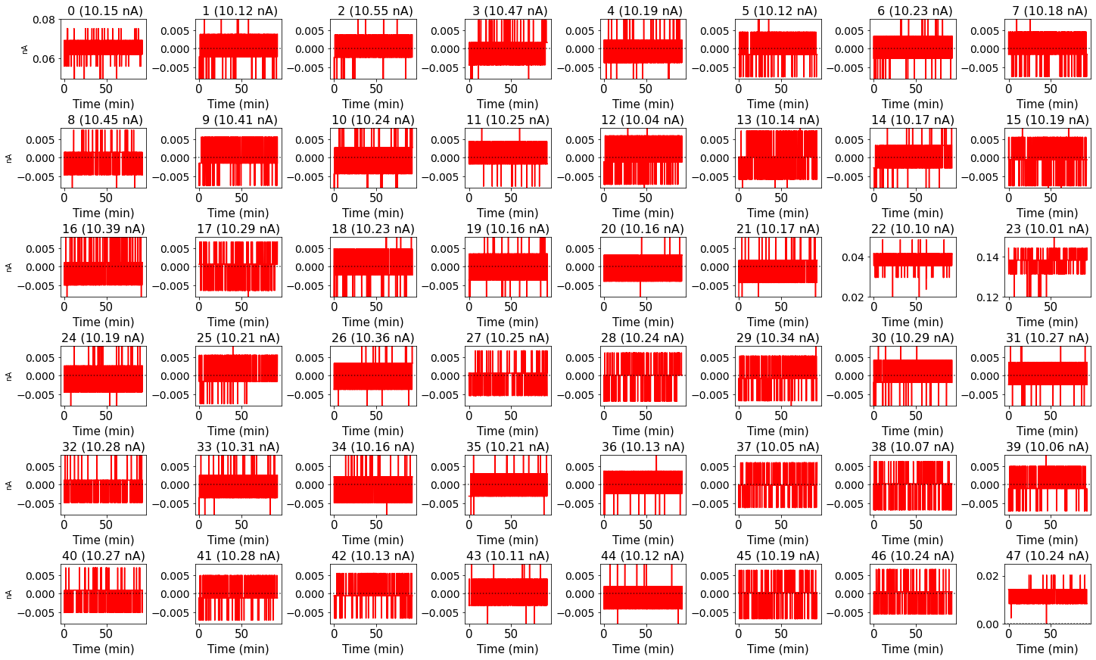
Pedestal Measurement

Slide 33
Environmental conditions

Slide 34
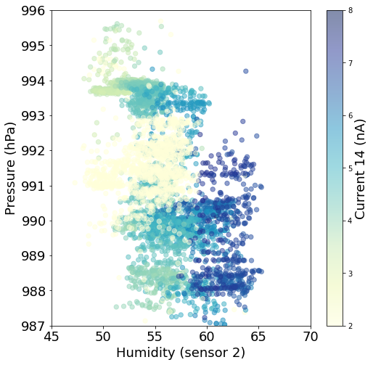
Environmental conditions
Pressure seems to have no clear effects on the currents

