Slide 1
Ion Beam Test 2022
IT SCD Data Analysis Status Report
A. Oliva for the SCD Group
24/4/2022

Slide 2
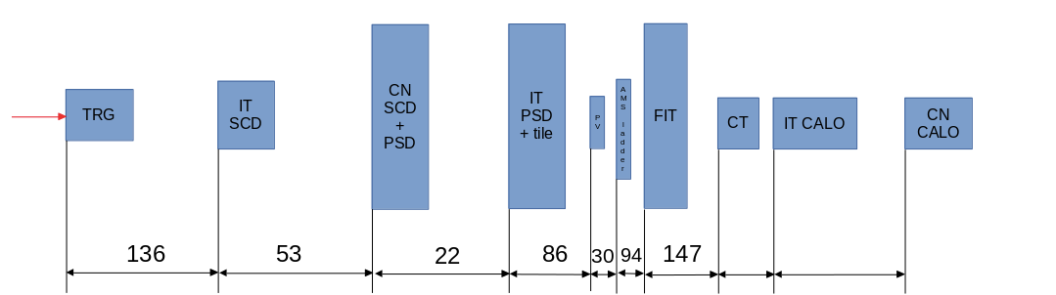
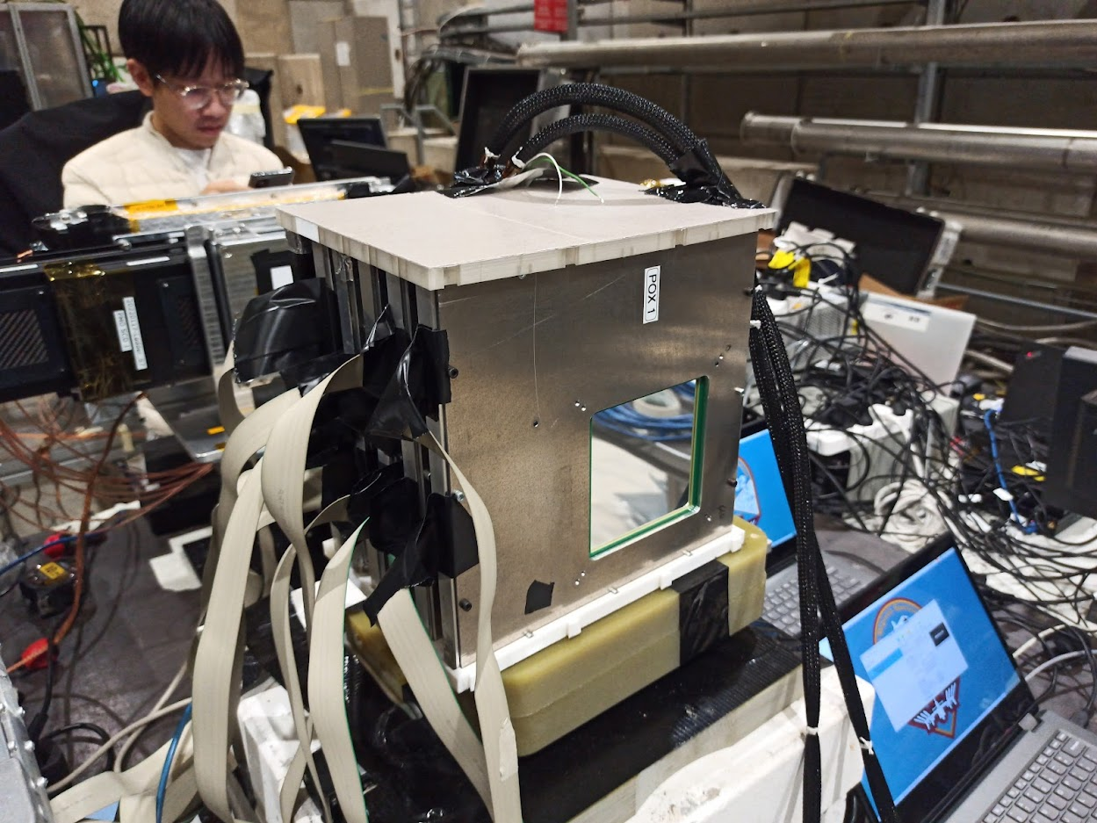
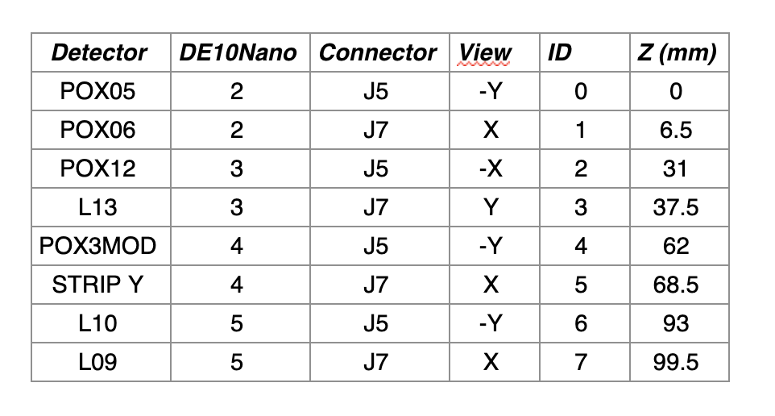
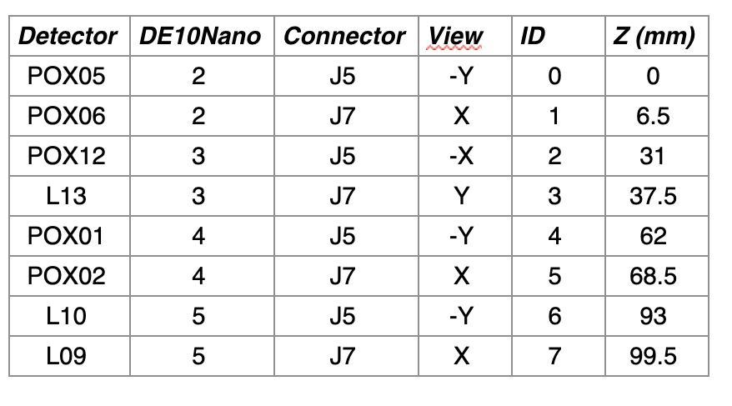
Extending the SCD Analysis to the full Period
8 similar sensors mounted in orthogonal pairs in frames, on a polymer base:
96×96 mm².
150 μm thickness.
12 μm strip width.
50 μm implantation pitch (2 floating).
150 μm readout pitch.
640 strips.
4X and 4Y independent position estimations.
2 different configurations have been tested.
Configuration 1 (runs < 184)
Configuration 2 (runs ≥ 184)
STRIPY has been excluded from reconstruction. For the first period only 7 sensors are used.

Slide 3
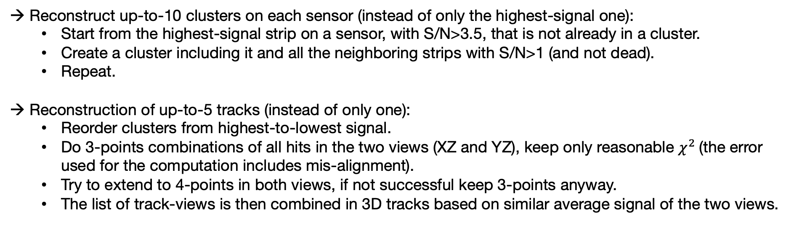
Event Reconstruction Update
Reconstruct up-to-10 clusters on each sensor (instead of only the highest-signal one):
  Start from the highest-signal strip on a sensor, with S/N>3.5, that is not already in a cluster.
  Create a cluster including it and all the neighboring strips with S/N>1 (and not dead).
  Repeat.
Reconstruction of up-to-5 tracks (instead of only one):
  Reorder clusters from highest-to-lowest signal.
  Do 3-points combinations of all hits in the two views (XZ and YZ), keep only reasonable $χ^{2}$(the error used for the computation includes mis-alignment).
  Try to extend to 4-points in both views, if not successful keep 3-points anyway.
  The list of track-views is then combined in 3D tracks based on similar average signal of the two views.

Slide 4
Alignment Update
The extended beam along the Y direction allows for sensitivity in two of the rotation angles.
Y-shift
Rotation along Z-axis
(we have a mix between X and Y)
Rotation along X-axis
(the beam looks squeezed)

Slide 5
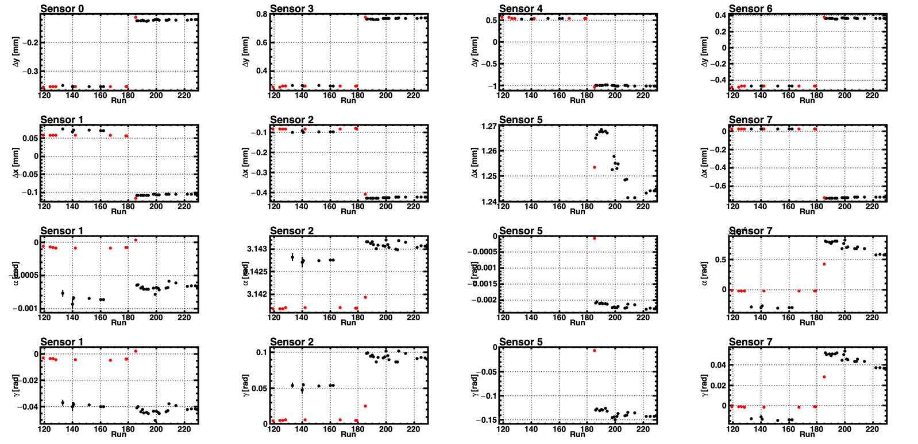
Alignment as Function of Time
When finger trigger is applied there is almost no sensitivity for rotations along Z (𝛼) and Y (𝛾).
Some sizeable time dependence is present and should be considered.
Conf. 1
Conf. 2
STRIPY
STRIPY
STRIPY

Slide 6
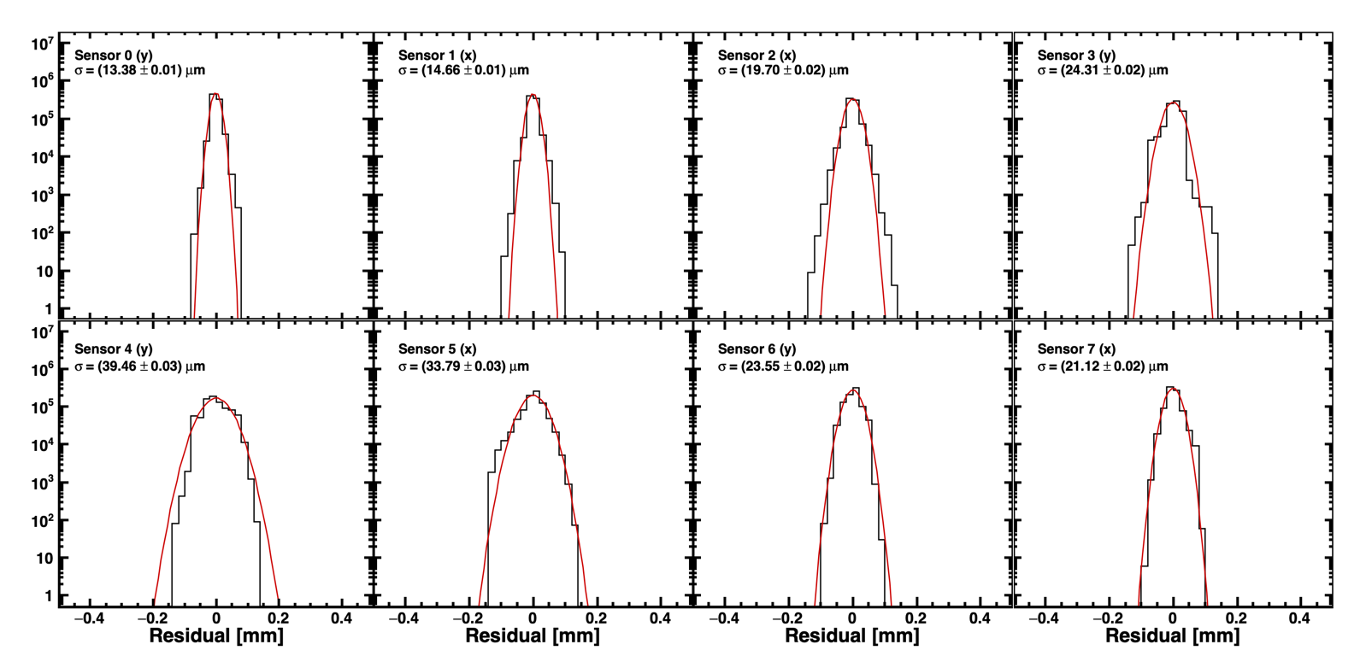
Residuals with Updated Alignment
Residuals with point for for configuration 2 (runs≥184).

Slide 7
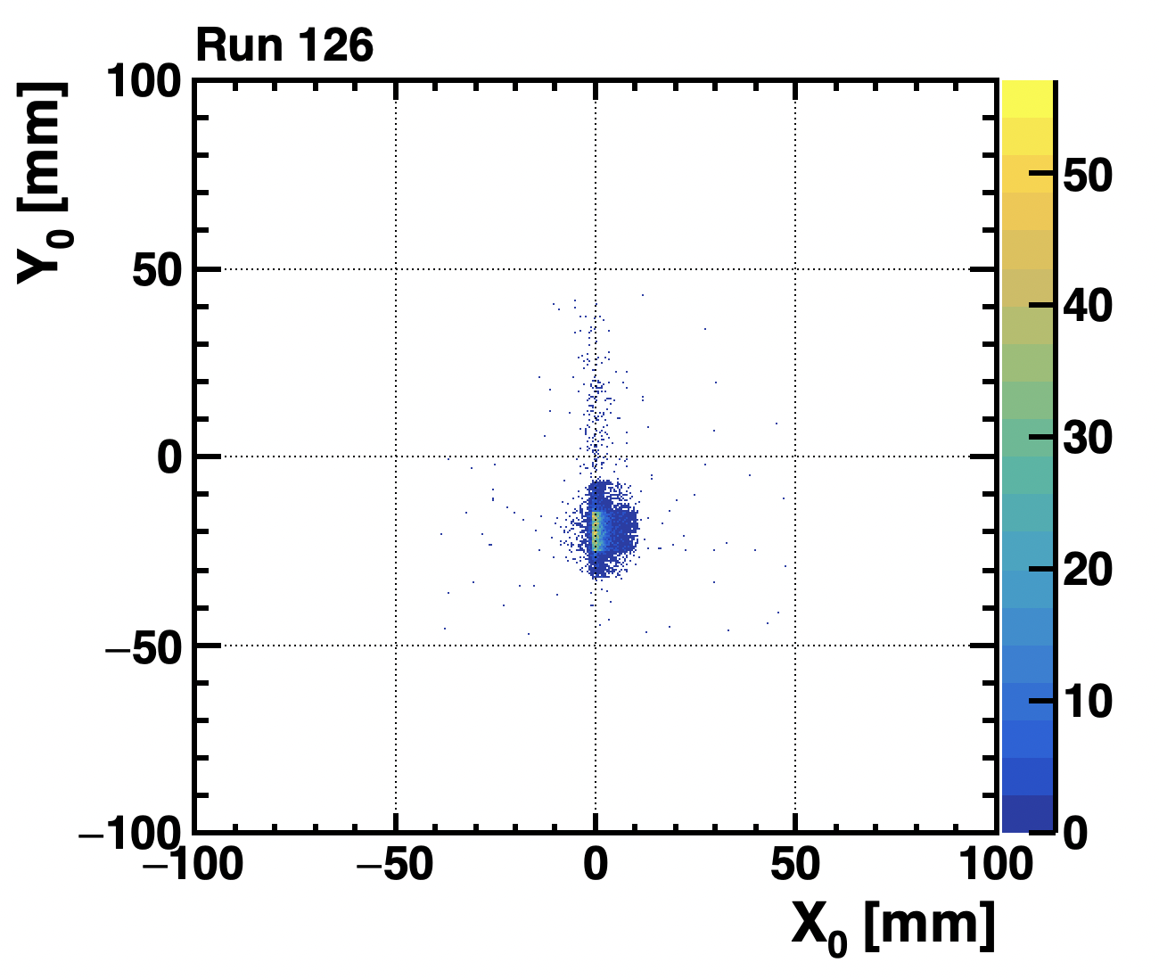
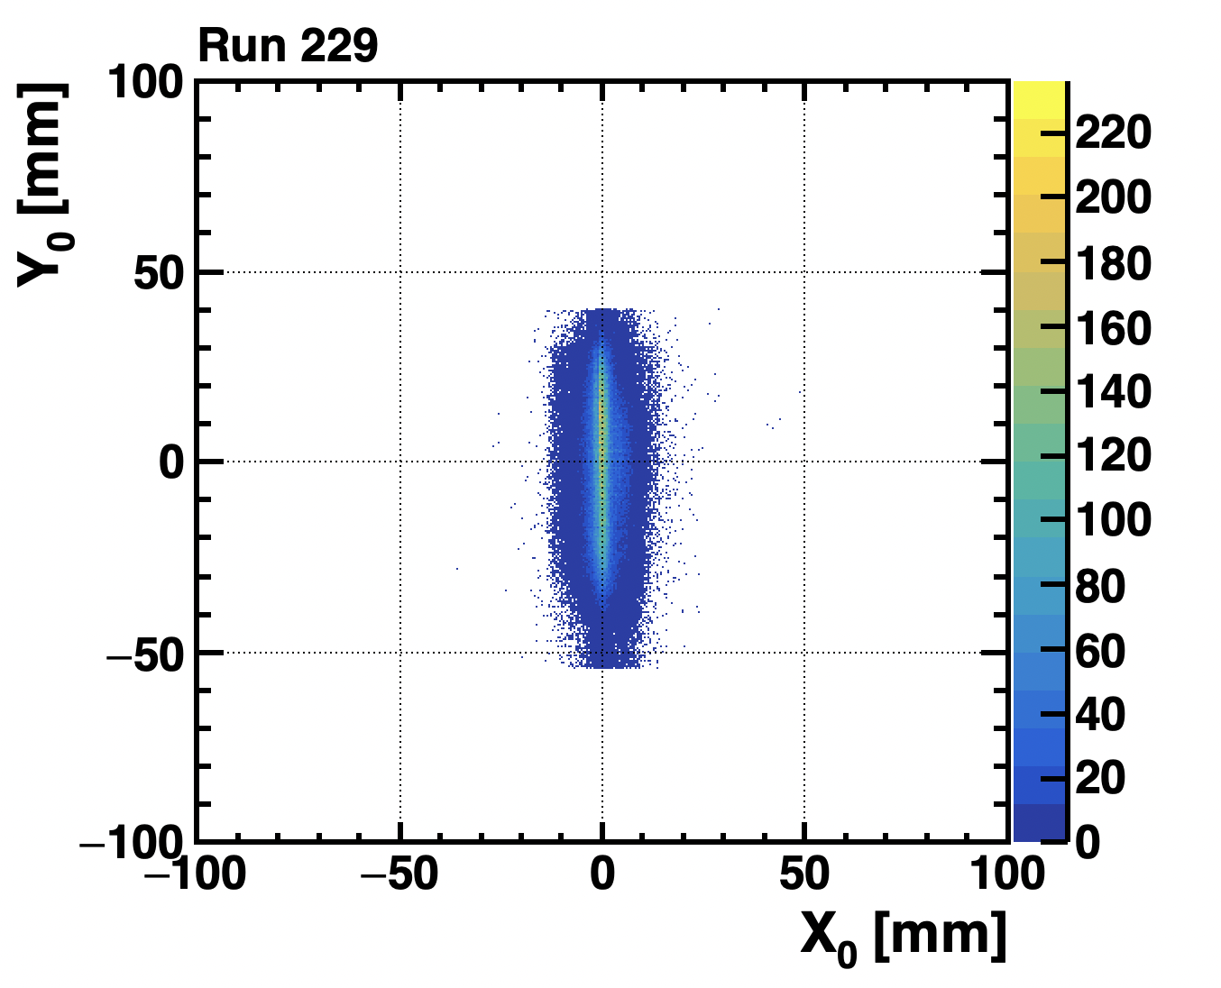
Alignment to Beam
We use as reference the average beam position and inclination (in runs without finger trigger).
Some corrections due to movements of the SCD box has been applied.
The fitted tracks have the same reference system in all processed runs.

Slide 8
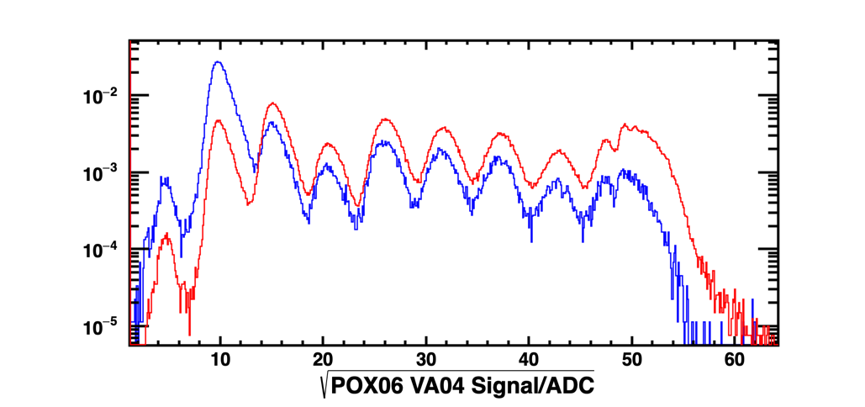
Gain Estimation
Gain is a value for each VAs factor to have similar signal signal.
The previous procedure based on the template fits is not applicable due to differences in relative abundances in on different VAs due to:
→ Changes in beam composition with time.
→ Changes in the SCD position with respect to the beam.
Configuration 1
Configuration 2
Readout: 0<η<0.04 or 0.96<η<1

Slide 9
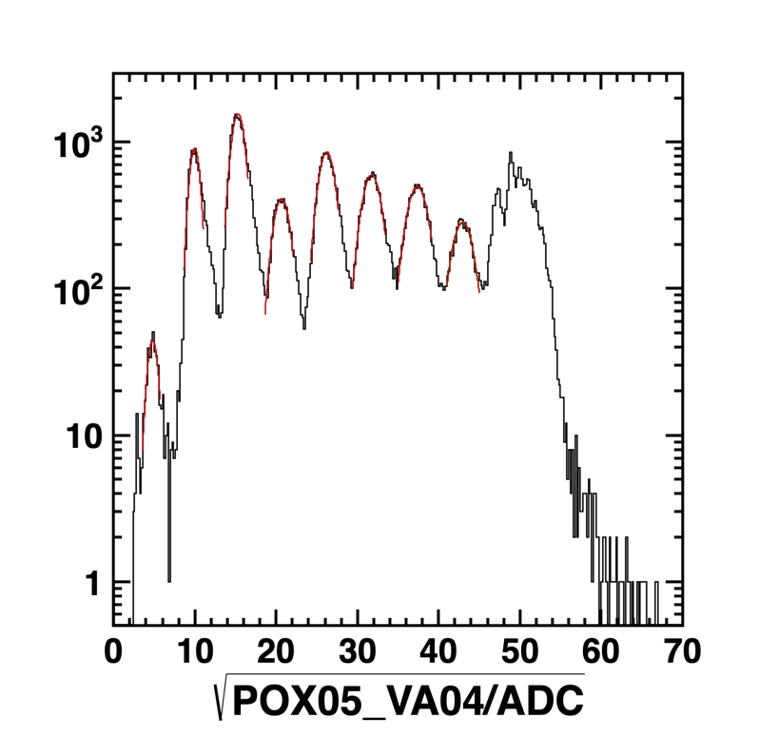
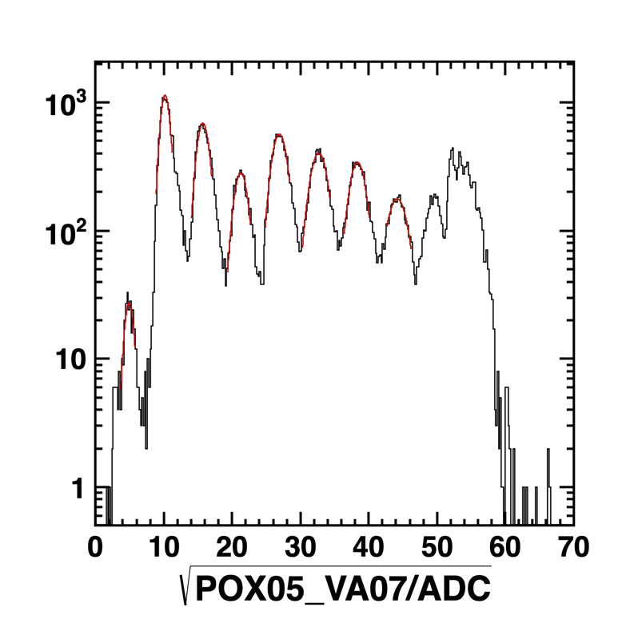
New Procedure for Gain Estimation
Evaluate the peak position for each Z (from 1 to 8) and for each VA of every sensor selecting the readout region.
Compare the results with a chosen reference (POX06-VA04), and evaluate gain factors.
Readout: 0<η<0.04 or 0.96<η<1
Readout: 0<η<0.04 or 0.96<η<1

Slide 10
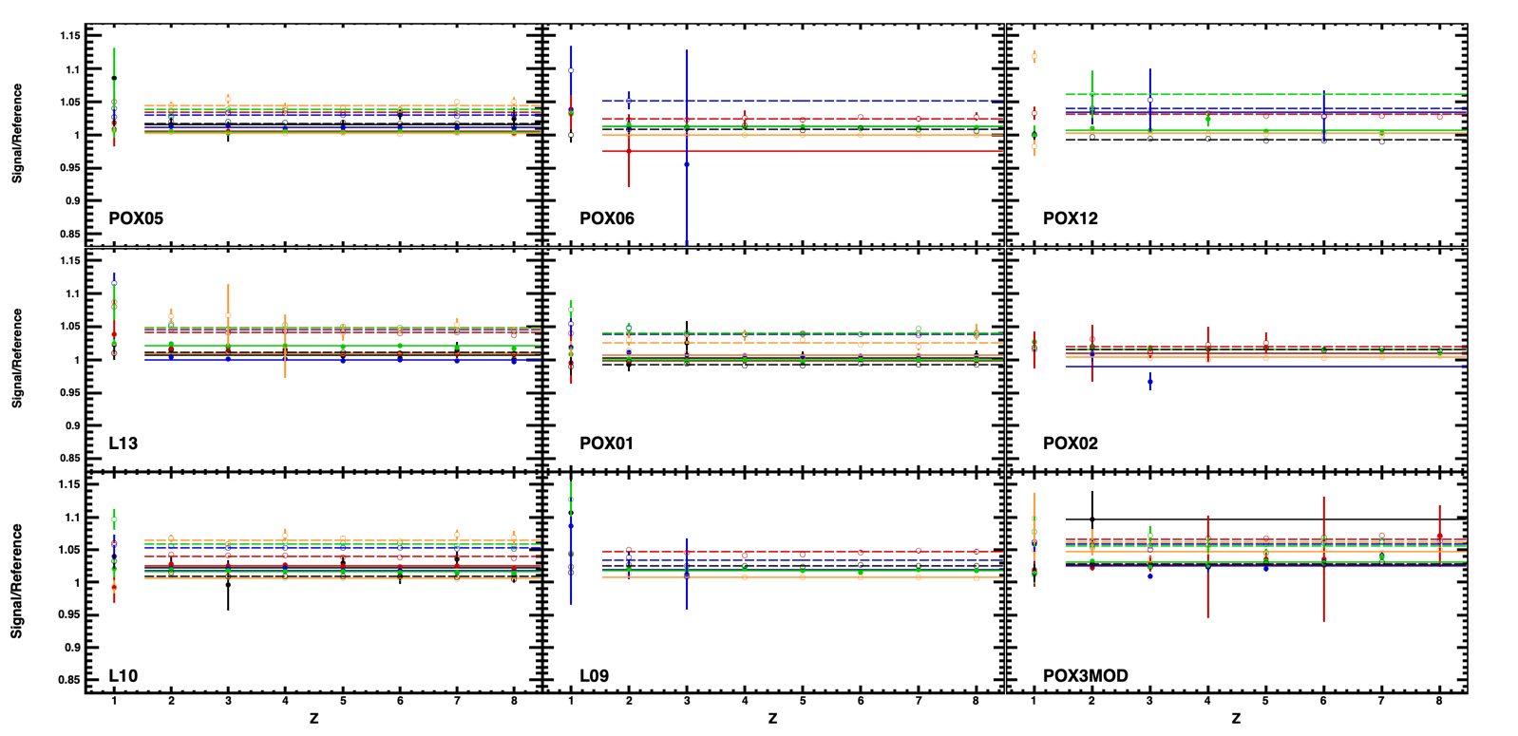
New Procedure for Gain Estimation
Evaluate the peak position for each Z (from 1 to 8) and for each VA of every sensor selecting the readout region.
Compare the results with a chosen reference (POX06-VA04), and evaluate gain factors.

Slide 11
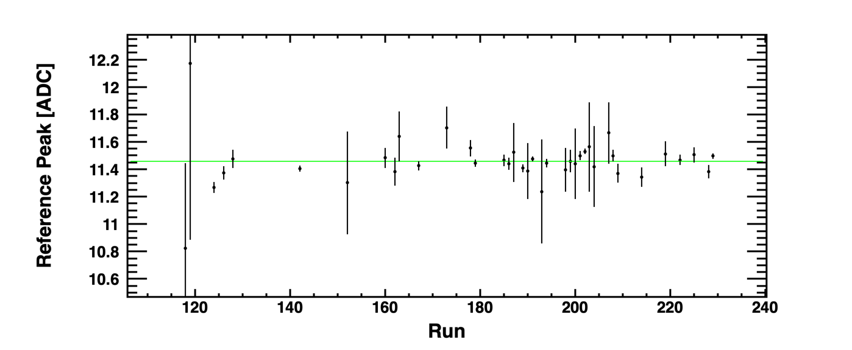
Gain Time Variation
I assume that there is no time variation of gain factors.
I did not go through everything, but it seems a reasonable assumption.
This can also be proven a posteriori (charge peak position asf function of time).
Readout: 0<η<0.04 or 0.96<η<1

Slide 12
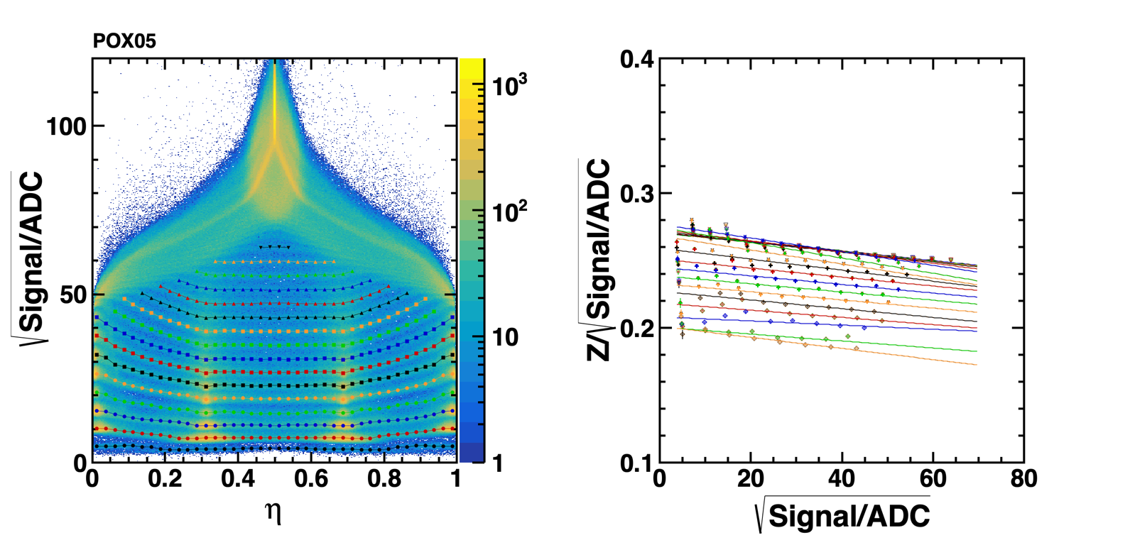
Update of Characterization of Total Signal vs 𝝶
VAs of the same sensor are put together (after gain correction). For fitting a “η-folding” is applied.
Apply a handwritten peak finding procedure to characterize the signal variation with η (charge loss).
Each line is an η-range.
Conversion function from signal to Z.

Slide 13
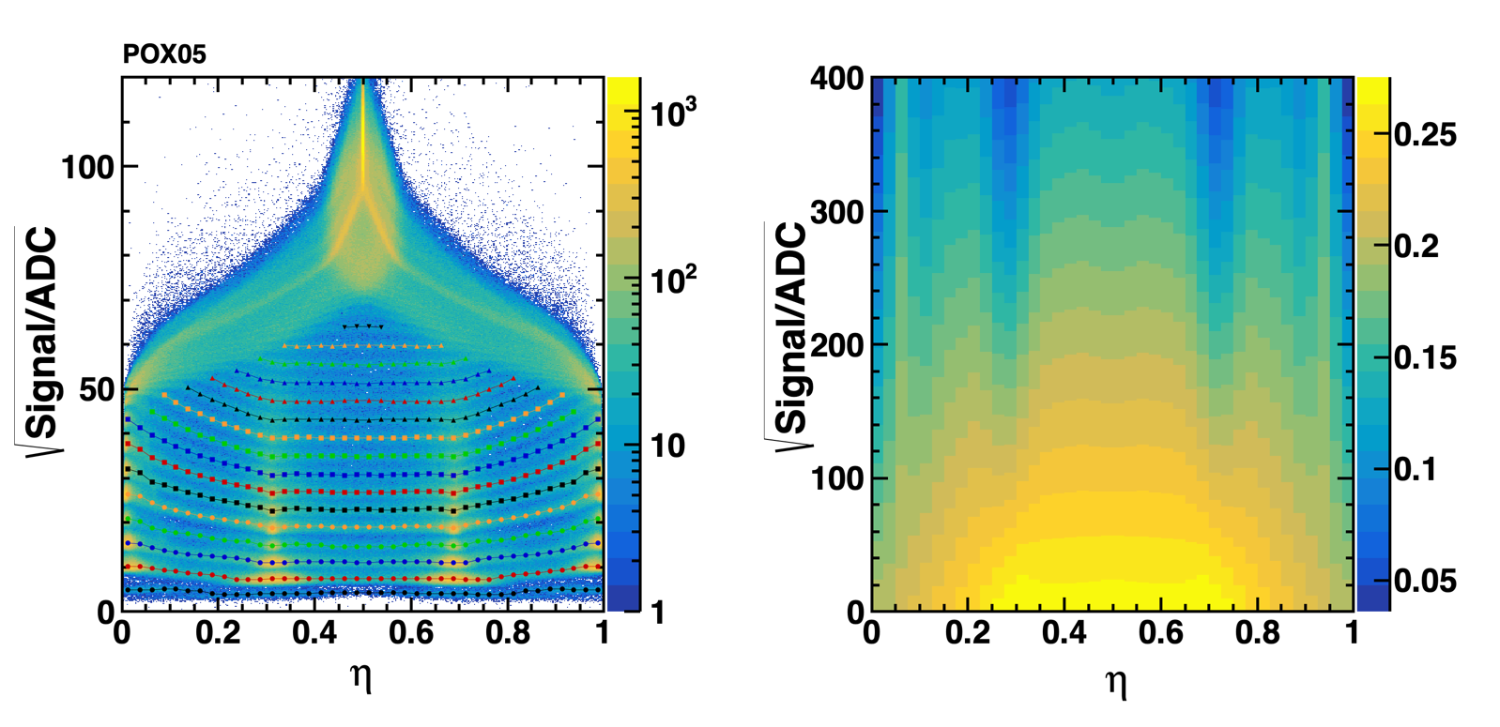
Update of Characterization of Total Signal vs 𝝶
VAs of the same sensor are put together (after gain correction). For fitting a “η-folding” is applied.
Apply a handwritten peak finding procedure to characterize the signal variation with η (charge loss).
Conversion function.

Slide 14
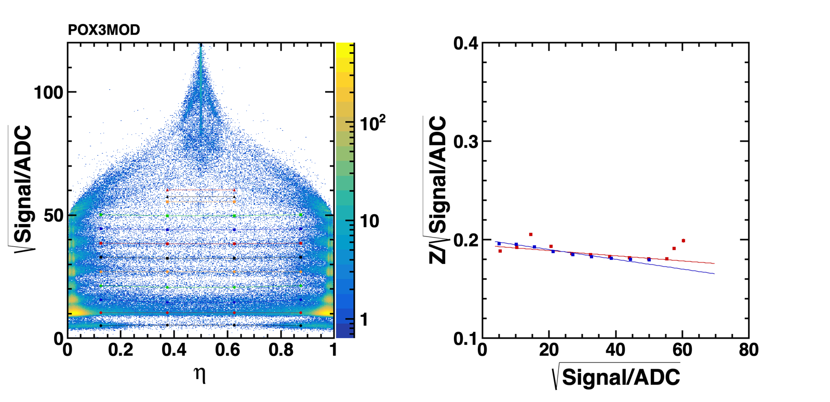
Characterization of Total Signal vs 𝝶: POXMOD
VAs of the same sensor are put together (after gain correction). For fitting a “η-folding” is applied.
Apply a handwritten peak finding procedure to characterize the signal variation with η (charge loss).
Each line is an η-range.
Conversion function from signal to Z.

Slide 15
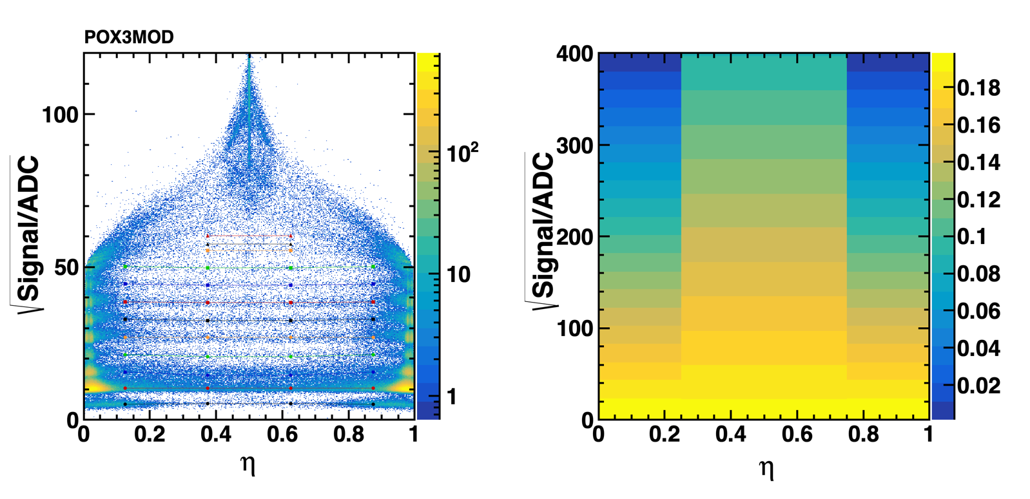
Characterization of Total Signal vs 𝝶: POXMOD
VAs of the same sensor are put together (after gain correction). For fitting a “η-folding” is applied.
Apply a handwritten peak finding procedure to characterize the signal variation with η (charge loss).
Conversion function.

Slide 16
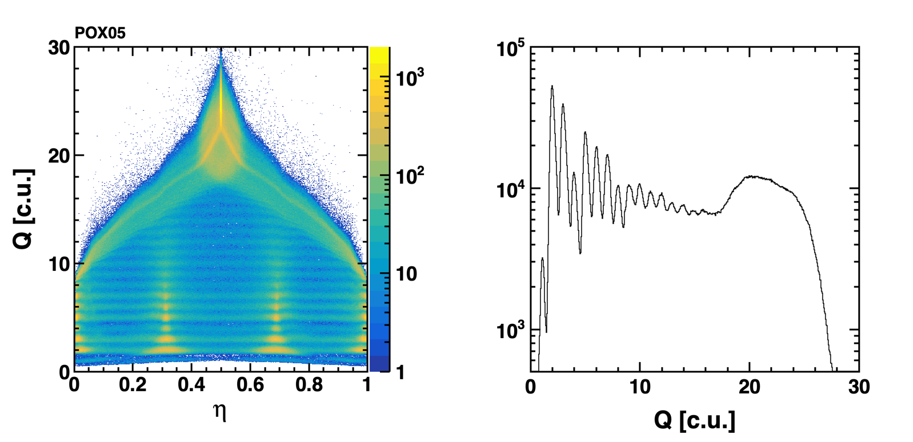
Single Sensor Charge from Cluster Total Signal
After applying the conversion function.

Slide 17
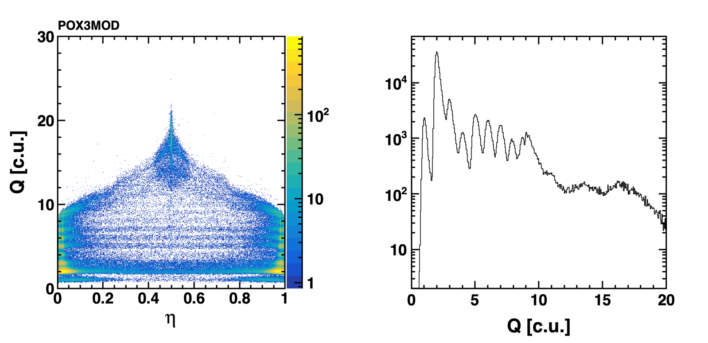
Single Sensor Charge from Cluster Total Signal
After applying the conversion function.

Slide 18
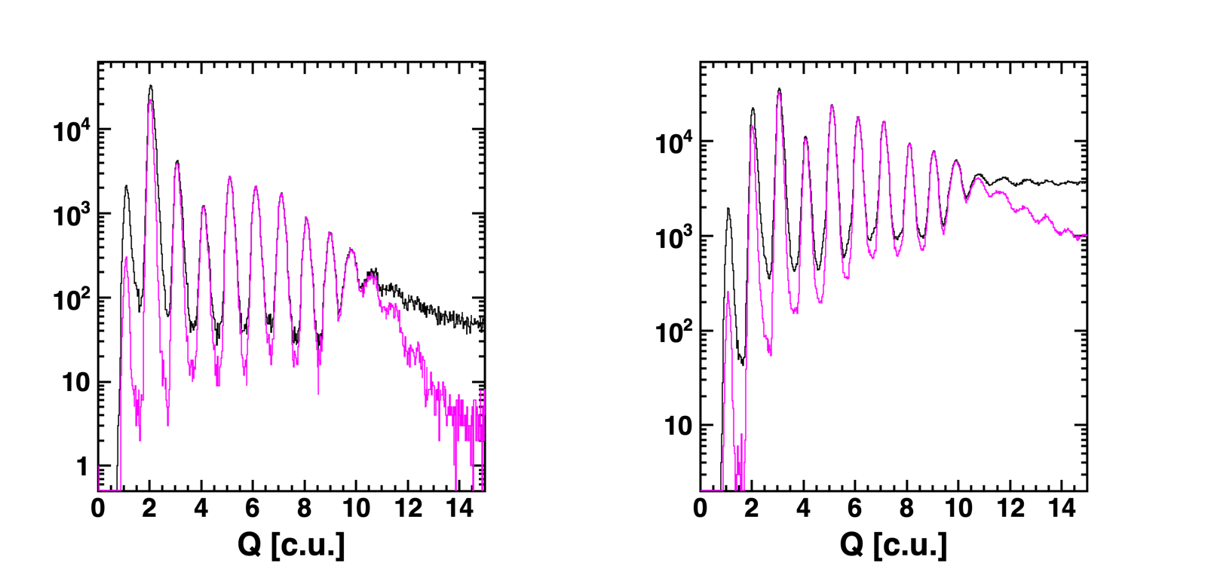
Track Charge Measurement
Average of all sensors.
Configuration 1
Configuration 2
RMS/Q < 10%

Slide 19
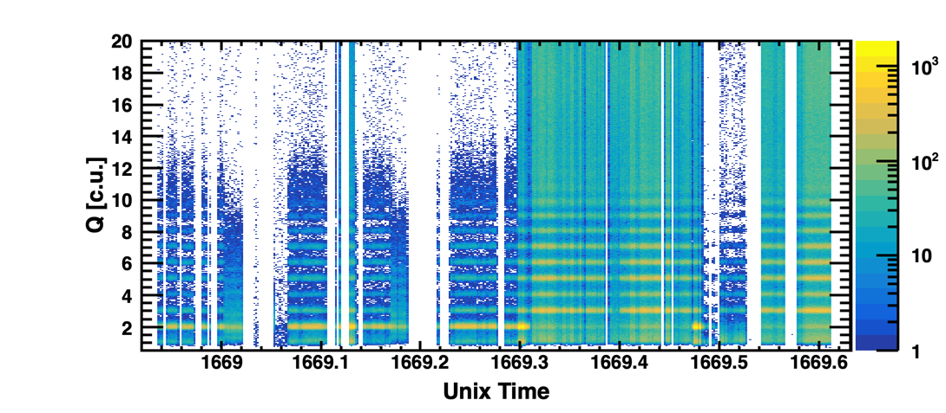
Track Charge Measurement
No time dependence in the peak position.

Slide 20
Track Charge Measurement
Update of a slide on SCD presented in Dec. 2019.
AMS-02 Inner Tracker (7 ⨉ 300 μm)
7 ⨉ 300 μm, straggling only
8 ⨉ 150 μm, straggling only
SCD TB 2022

Slide 21
Conclusions
Data analysis of Ion TB2022 for SCD system (8 micro-strip, 150 μm thick, silicon sensors) done for all runs with enough statistics (/storage/gpfs_data/herd/aolivaherd/tb2022/ntuples/v1).
Analysis code and details of data reduction in https://baltig.infn.it/oliva/tb2022
Basic properties of spatial and charge resolution have been derived through several procedures that account for silicon sensor calibration, alignment and signal dependence on impact position.
Derived performances are reasonable and focus on the low-Z range.
This data will be distributed for the use of other groups.
Next steps: include in the analysis stream PSD and start to look to Z>8.

