Slide 1
IHEP SCD Charge reconstruction

Slide 2
Previous data processing
The charge resolution is relatively large in section0, section1 and section2 of 60um, with the rest of the area being relatively uniform.（The different sections represent the different capacitors connected）
0ohm
0ohm
68 pf
47 pf
20 pf
100 pf
60um
25um

Slide 3
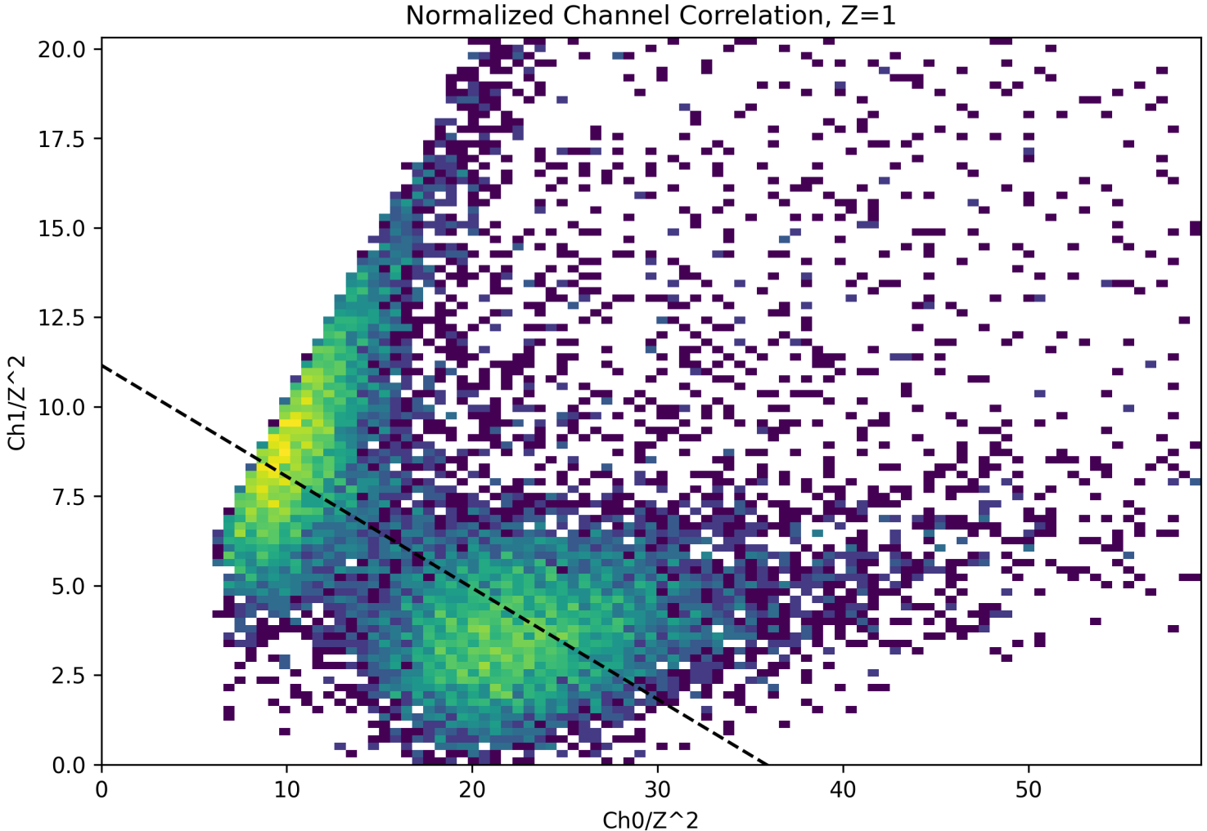
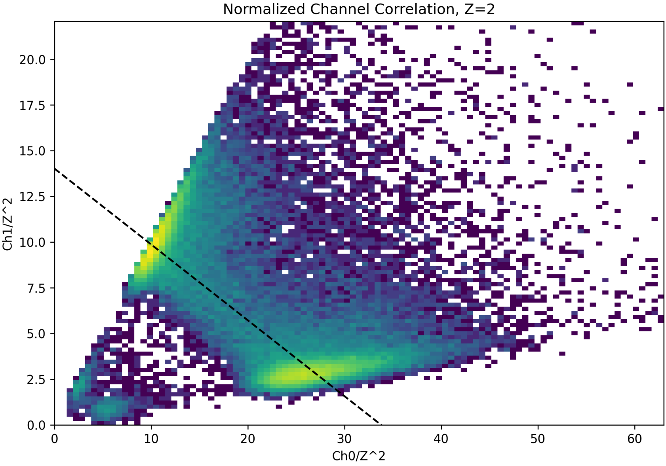
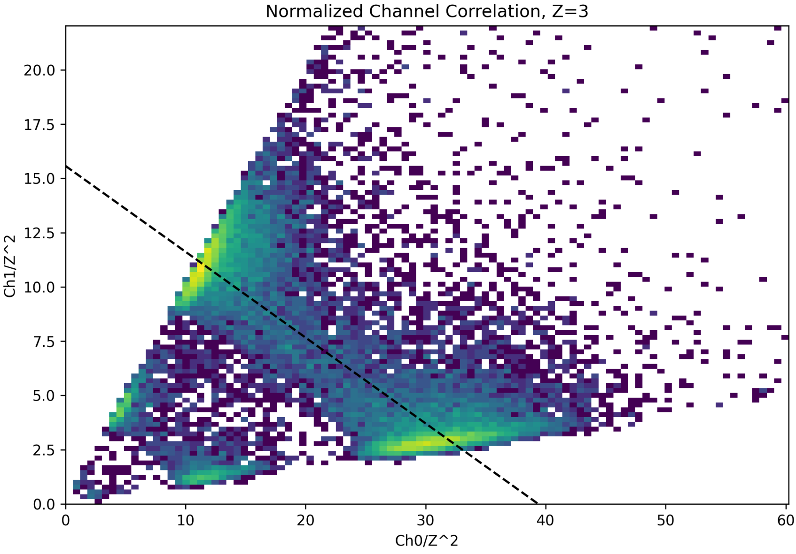
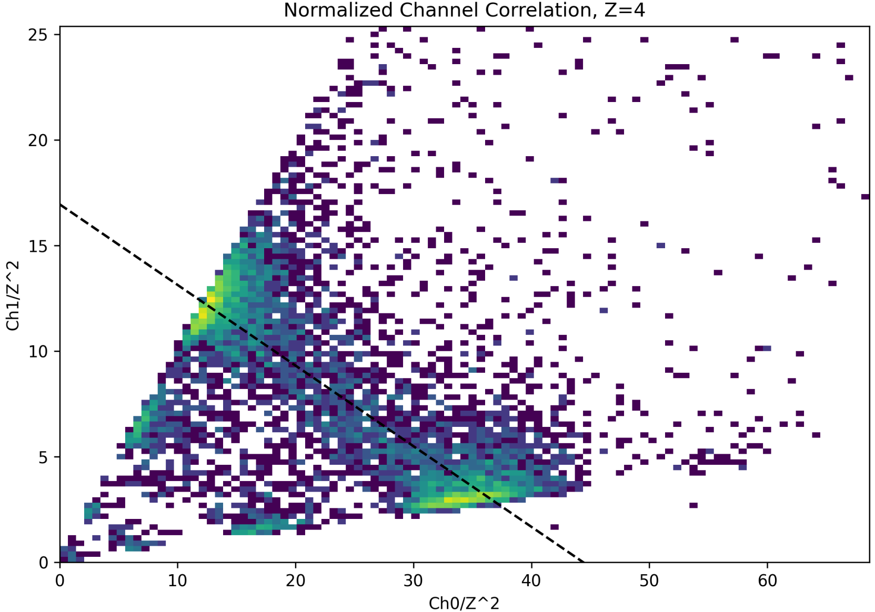
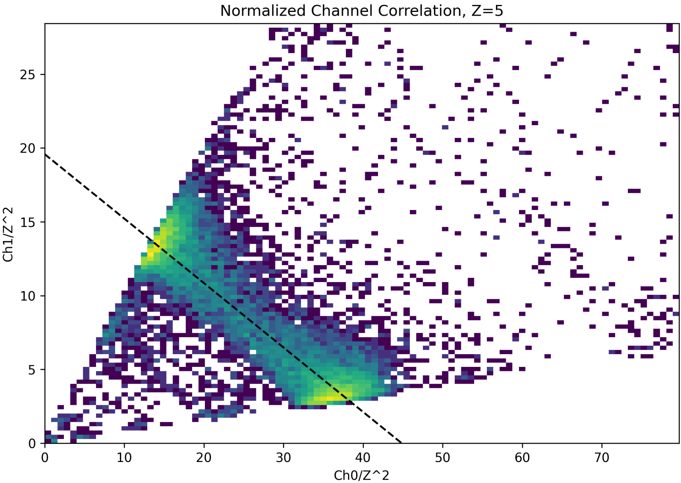
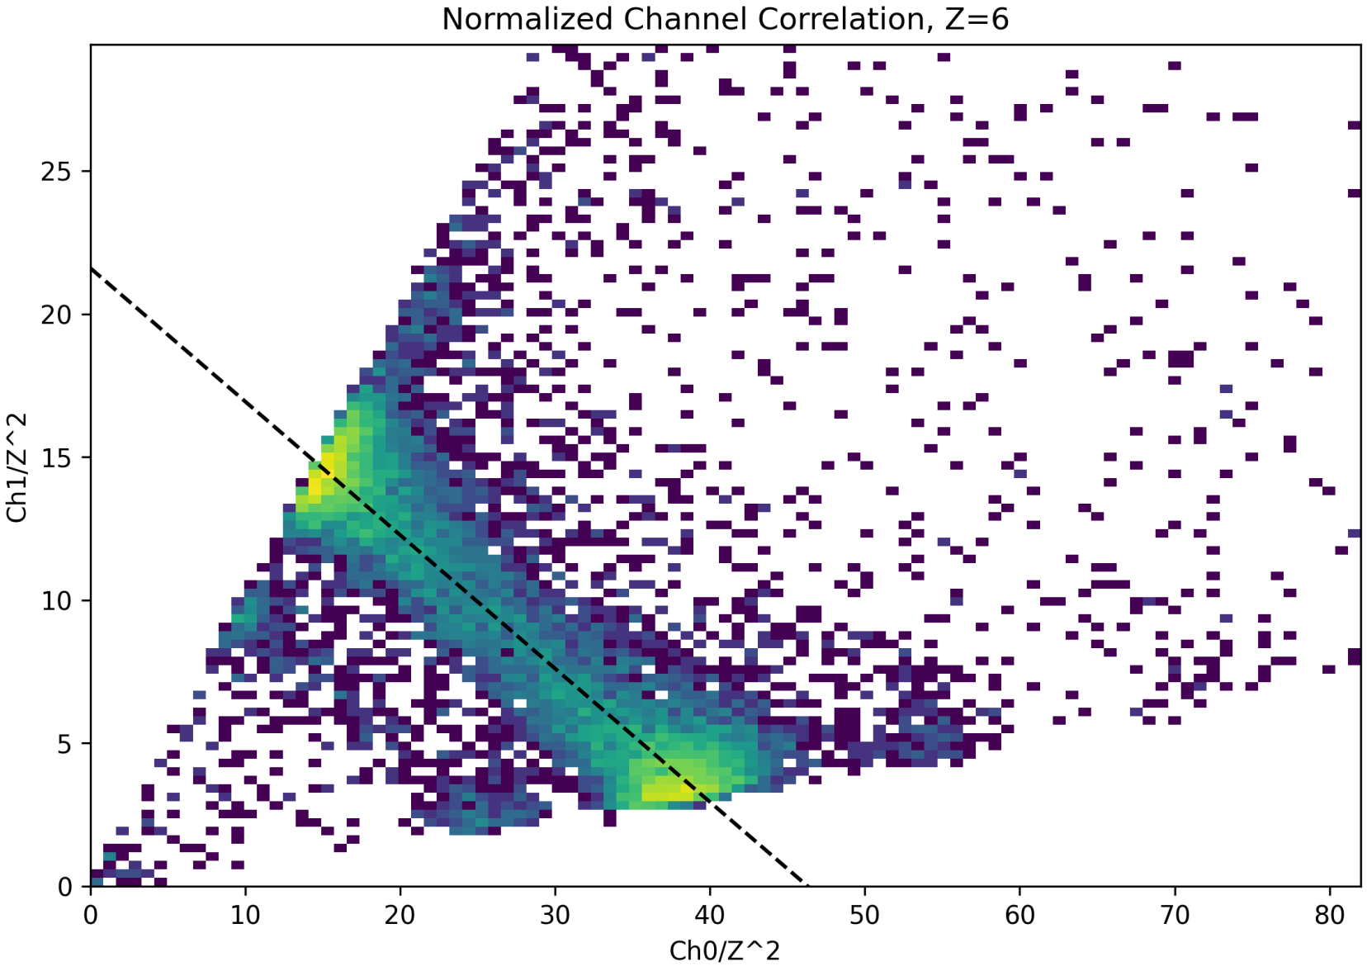
Charge reconstruction
Association of the two largest channels
floating strips
reading strips
Z=2
Z=3
Z=1
Z=4
Z=5
Z=6

Slide 4
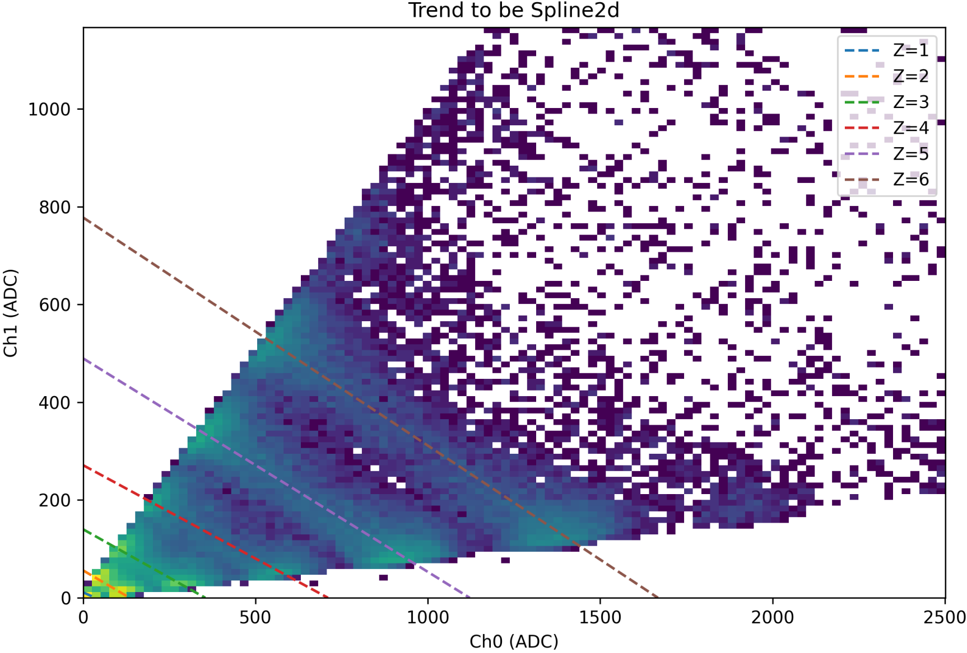
Charge reconstruction

Slide 5
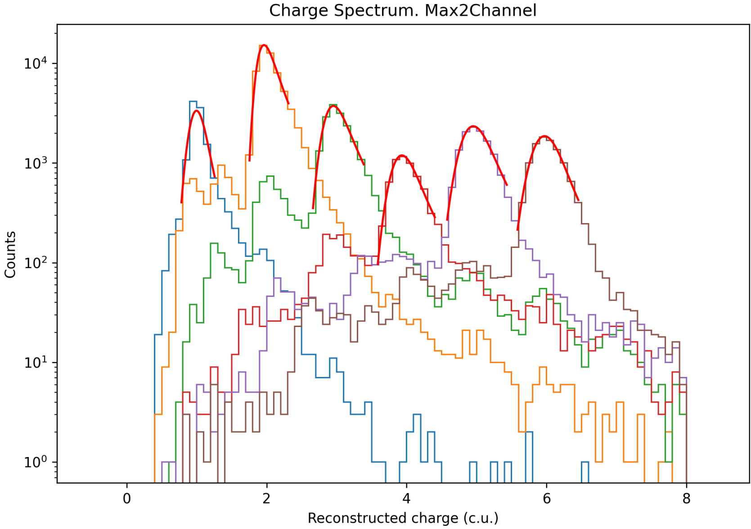
Charge reconstruction

Slide 6
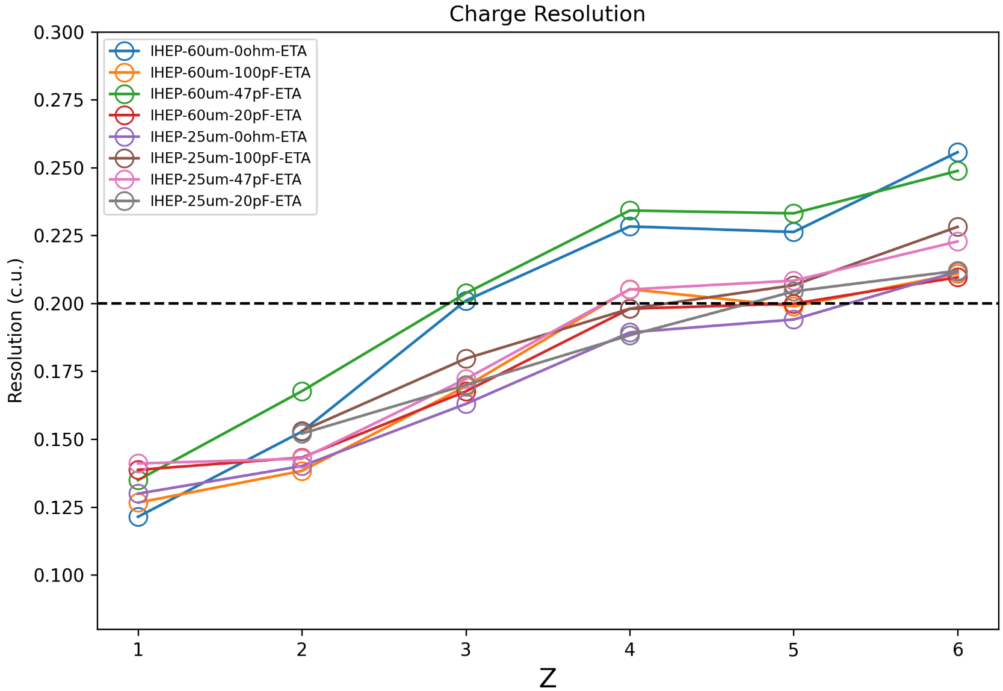
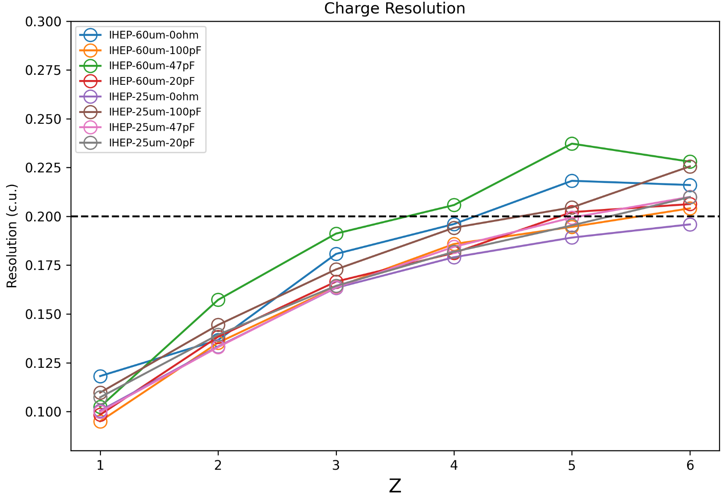
Charge reconstruction
Results of charge reconstruction in different sections
ETA method
new method
Conclusion：New method provides better charge resolution than ETA method.

