Slide 1
Preliminary HighZ Performance
Rui Qiao; Ke Gong; Wen-Xi Peng;

Slide 2
Background
We have 10 detector parameters in test beam (strip width=25/60um, ext-cap=20pF/47pF/68pF/100pF/0ohm).
We exclude the 68pF, becasue it cross two ASICs and has different gains.
The 47pF/20pF are preferred because of larger charge sharing
We use the amplitude correlation of the two maximum channels without saturation (<3000ADC) for charge identification

Slide 3
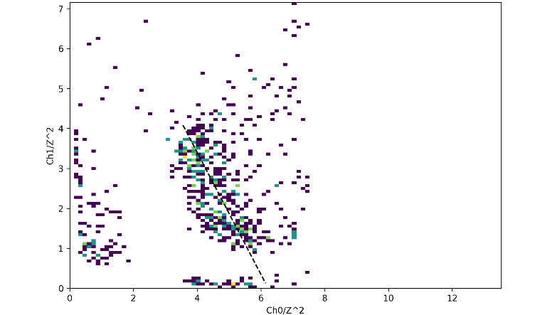
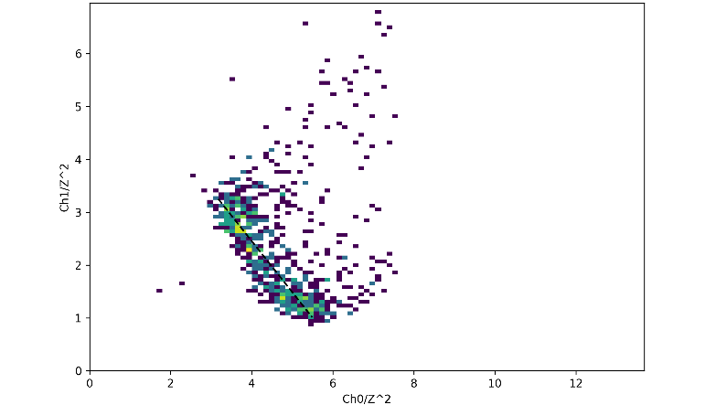
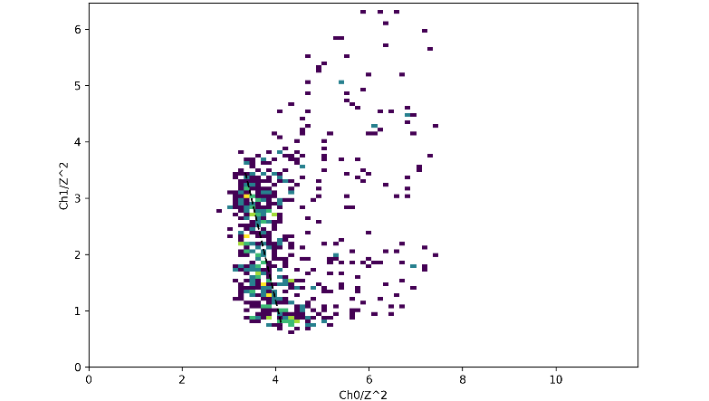
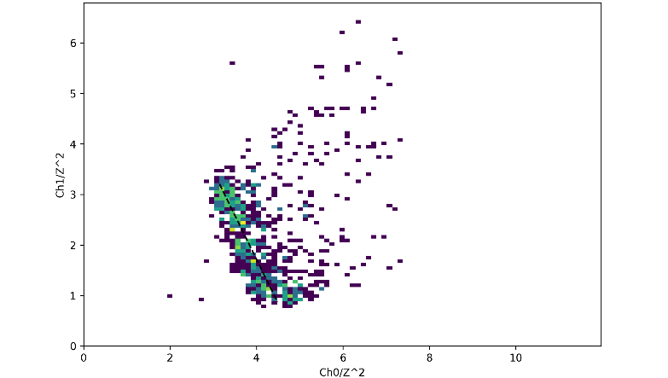
Z=20, 2 channel saturated (>3000 ADC)
60um-47pF
60um-20pF
25um-47pF
25um-20pF
20pF seems has better PID than 47pF.
60um-20pF seems has larger signal than 25um-20pF.
Notes:
G:\keyan\科研任务\221114_HERD束流测试\png\电荷重建_最大俩通道\IHEP_SCD1_section_2\饱和通道数_2\归一化通道关联_Z20.png
G:\keyan\科研任务\221114_HERD束流测试\png\电荷重建_最大俩通道\IHEP_SCD1_section_3\饱和通道数_2\归一化通道关联_Z20.png
G:\keyan\科研任务\221114_HERD束流测试\png\电荷重建_最大俩通道\IHEP_SCD2_section_6\饱和通道数_2\归一化通道关联_Z20.png
G:\keyan\科研任务\221114_HERD束流测试\png\电荷重建_最大俩通道\IHEP_SCD2_section_7\饱和通道数_2\归一化通道关联_Z20.png

Slide 4
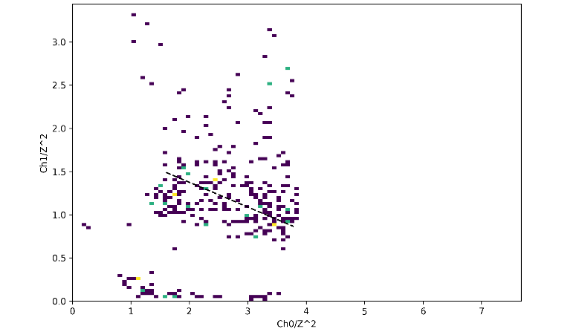
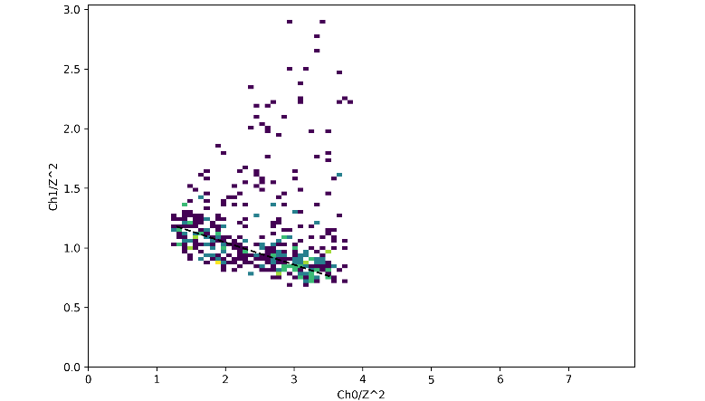
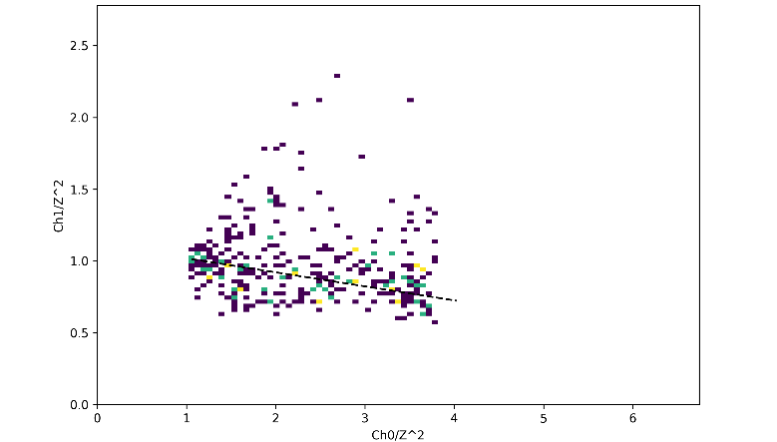
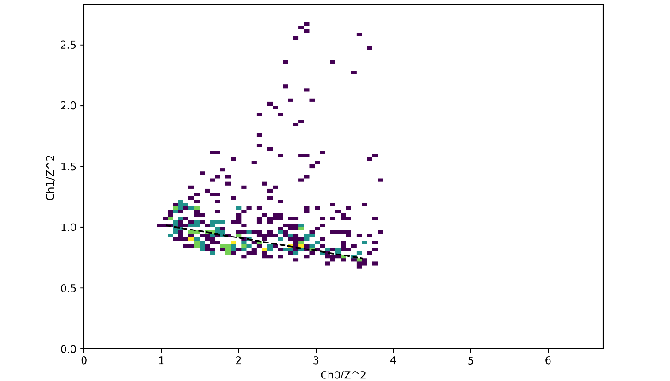
Z=28, 3 channel saturated (>3000 ADC)
60um-47pF
60um-20pF
25um-47pF
25um-20pF
20pF has better PID than 47pF.
60um-20pF seems has larger signal than 25um-20pF.
Notes:
G:\keyan\科研任务\221114_HERD束流测试\png\电荷重建_最大俩通道\IHEP_SCD1_section_2\饱和通道数_3\归一化通道关联_Z28.png
G:\keyan\科研任务\221114_HERD束流测试\png\电荷重建_最大俩通道\IHEP_SCD1_section_3\饱和通道数_3\归一化通道关联_Z28.png
G:\keyan\科研任务\221114_HERD束流测试\png\电荷重建_最大俩通道\IHEP_SCD2_section_6\饱和通道数_3\归一化通道关联_Z28.png
G:\keyan\科研任务\221114_HERD束流测试\png\电荷重建_最大俩通道\IHEP_SCD2_section_7\饱和通道数_3\归一化通道关联_Z28.png

Slide 5
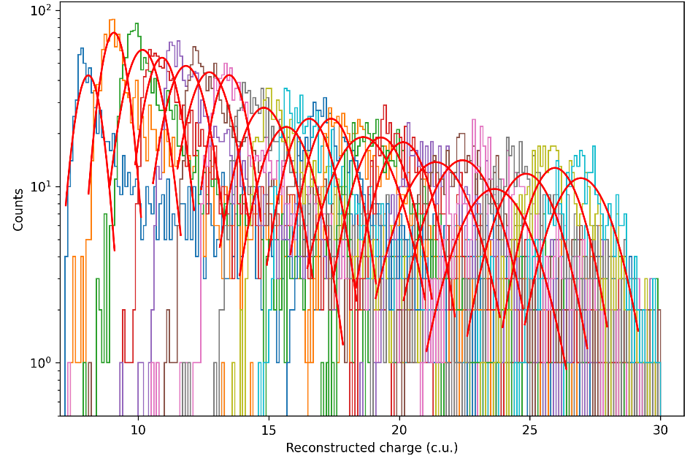
Preliminary charge reconstruction of 60um-20pF
Charge spectrum of Z=9~28 with 3 channels saturation.
Notes:
G:\keyan\科研任务\221114_HERD束流测试\png\电荷重建_最大俩通道\IHEP_SCD1_section_3\饱和通道数_3\重建电荷谱.png
G:\keyan\科研任务\221114_HERD束流测试\png\电荷重建_最大俩通道\IHEP_SCD2_section_6\饱和通道数_3\重建电荷谱.png

Slide 6
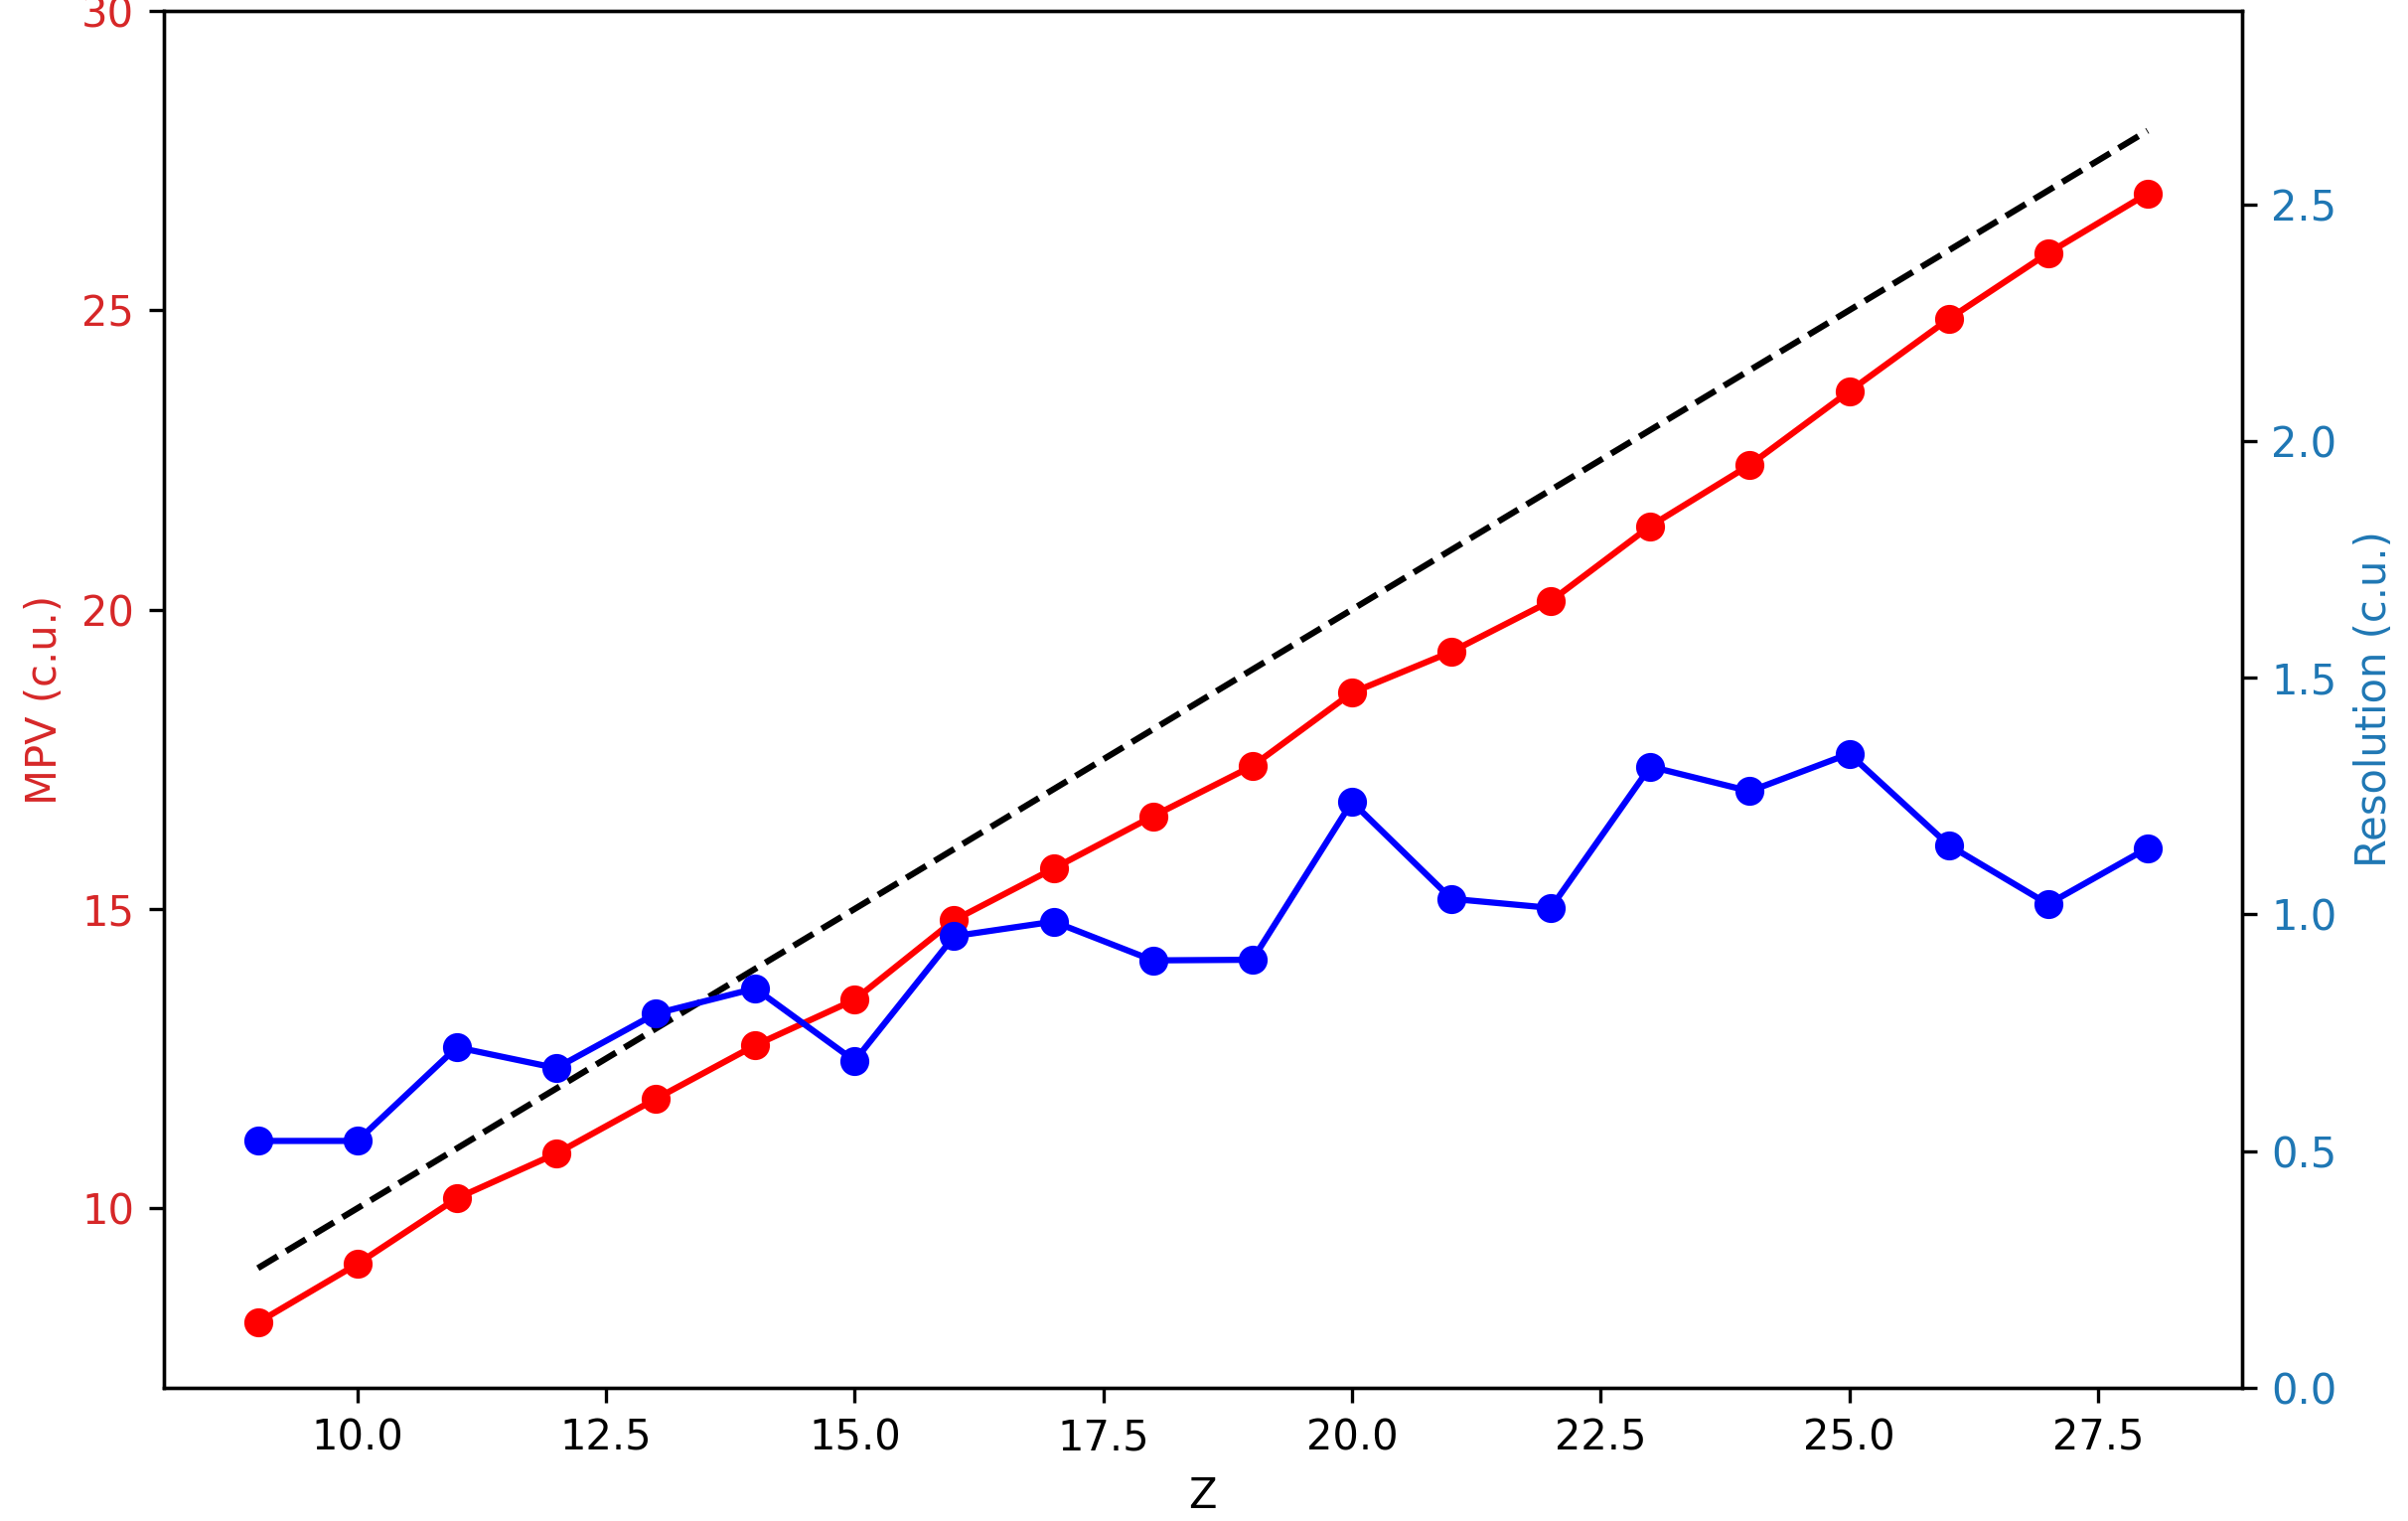
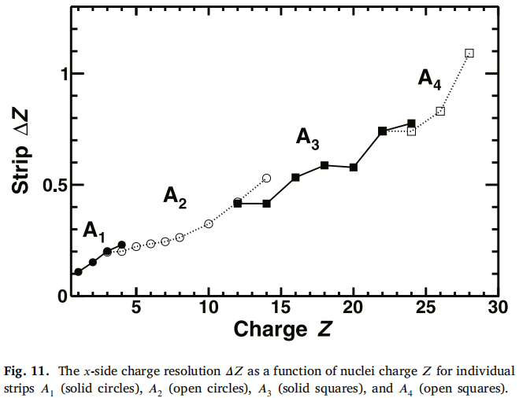
Preliminary charge resolution of 60um-20pF
Charge resolution of 60um-20pF with 3 channels saturation (Z=9~28 )
Channel charge resolution of AMS-02
The preliminary charge resolution of HERD SCD 60um-20pF is around 1.1 c.u. for Z=28. This is comparable to AMS-02.
Notes:
G:\keyan\科研任务\221114_HERD束流测试\png\电荷重建_最大俩通道\IHEP_SCD1_section_3\饱和通道数_3\电荷分辨.png
G:\keyan\科研任务\221114_HERD束流测试\png\电荷重建_最大俩通道\IHEP_SCD2_section_6\饱和通道数_3\电荷分辨.png

Slide 7
Conclusion
We investigate four detector parameters (strip width=25/60um, ext-cap=20/47 pF)
20pF seems has better PID than 47pF.
60um-20pF seems has larger signal than 25um-20pF.
Preliminary charge reconstruction of 60um-20pF. Charge resolution is around 1.1 c.u. , which is comparable to the AMS-02 single channel resolution.

Slide 8
Plan for 2023 test beam
 | Old SCD |  | New SCD
 | sect.1 | sect.2 | sect.1 | sect.2
Thickness (um) | 300 |  | 320
Size (cm) | 6*3.6 |  | 9.6*9.6
Impalnt Pitch (um) | 80 |  | 75 | 150
Readout Pitch (um) | 160 |  | 150
Width (um) | 60 | 25 | 55 | 90
Ext. Cap (pF) | 20 | 20 | TBD
2022
test beam
SCD
newly
design
SCD

Slide 9
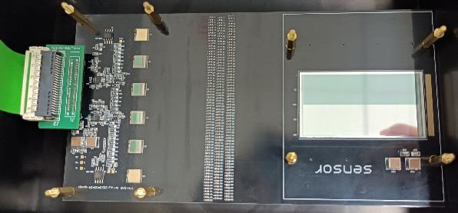
Plan for the new designed SCD
2022 test beam SCD
Replace by several larger SCDs with new specifications.
Replace by AMS02-like silicon capacitor. Can Giovanni provide some references on how to design?
Although the readout strips increase from 200 to 640 (10 VA), but readout only 384 (6 VA) to compatible with old DAQ.

