Slide 1


INMAPS 0.18 um CMOS technology:
front-end design status report
Stefano Zucca, Lodovico Ratti
Università di Pavia
Dipartimento di Elettronica
INFN
Sezione di Pavia
11th March 2010 – Pavia

Slide 2
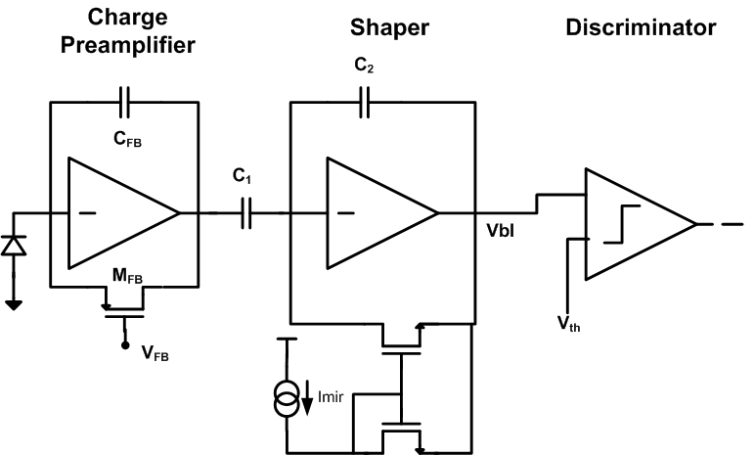

CHANNEL READOUT CHAIN
Vbl=750 mV
Imir=20 nA
Cfb=5 fF
C1=160 fF
C2=25 fF
A preliminary design and layout of each block in the figure above has been carried out.
All the simulations have been performed keeping C_{D}=40 fF.
Use of a mirror feedback configuration for C2 discharge instead of the transconductor in order to reduce the overall noise and threshold dispersion.
Notes:
2

Slide 3
PERFORMANCE
P=18 uW per pixel
T_{p}=235 ns
ENC=29 electrons (C_{D}=40 fF)
Threshold dispersion=13e (at the shaper output)
Threshold dispersion=23e (including discriminator contribution)
15um
NLI=1%
Charge sensitivity = 900 mV/fC

Slide 4
TEMPERATURE VARIATION
The channel readout has been simulated in the temperature range between 0°C and 80°C.
Gain temperature coefficient = 70 uV/(°C fC)

Slide 5
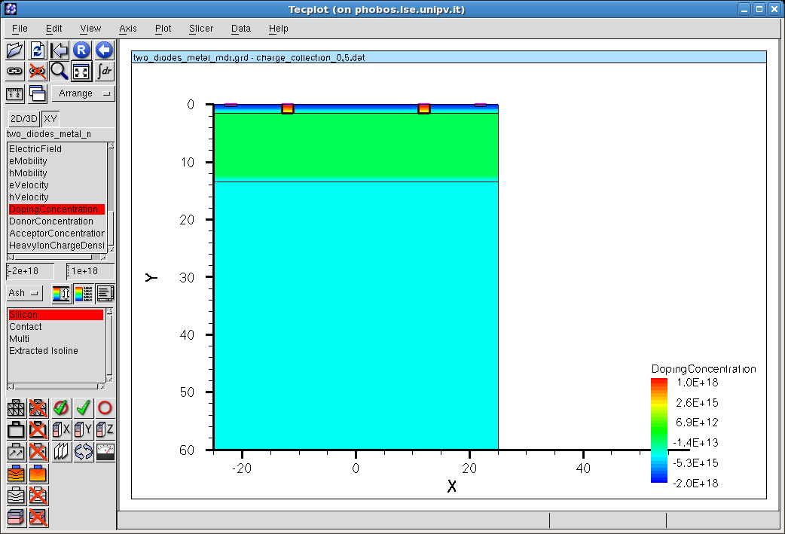
DEPLETION REGION WIDTH (ISE)
ISETCAD simulations have been performed in order to find out the depletion region width W as a function of the applied voltage.

Slide 6
DEPLETION REGION WIDTH (ISE)
As expected, the depletion region width W is weakly dependent on the nwell diode voltage biasing (7 um @ Vnwell=0.5 V)

Slide 7
OPEN ISSUES AND FUTURE ACTIVITIES
PSRR simulations.
Pixel structure (shielding between analog and digital part?).
Parallel run with standard resistivity epitaxial layer (strongly recommended by Renato Turchetta): useful to compare the two solutions.
Almost ready for the analog channel layout (some preliminary block layout have been already performed).
Further ISE TCAD simulations.

Slide 8
BACKUP SLIDES

Slide 9
35
Collecting
electrodes
35
Analog
50
Digital
50

Slide 10
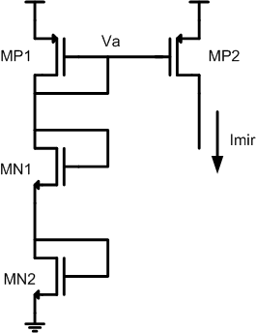
TEMPERATURE VARIATION
This good result has been obtained by exploiting the change in the temperature coefficient in both p and nMOS Id-Vgs characteristics.
MP1 operates in Vgs<0.65 V, while MN1 and MN2 in Vgs>0.65 V. The reduction of MP1 │Vth│ is compensated by Va increasing (in case of increasing temperature, and vice versa), keeping Imir almost constant.

