Slide 1
Power status
PPM: Description of the KM3NeT network by WP H

Slide 2
DU power

Slide 3
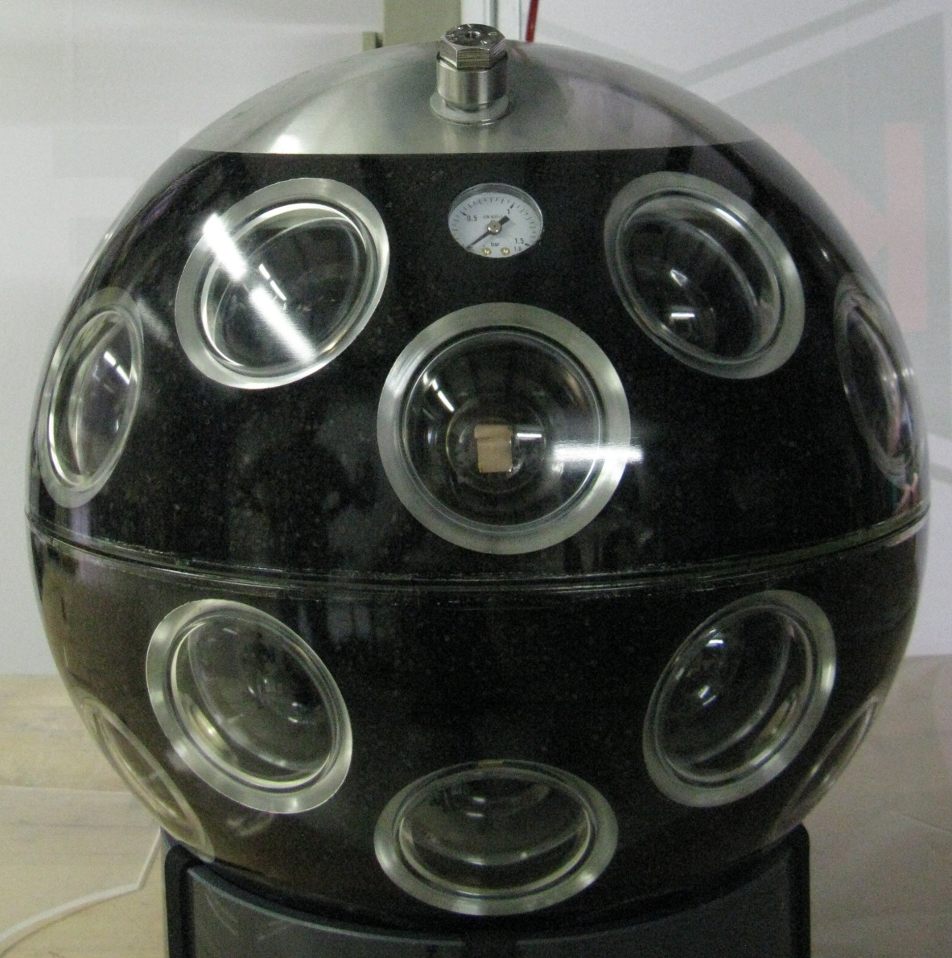
DOM power
Inventory
statusPPM expect. KM3NeT
Power conversion 1.6 W 1.4 W
DOM logic 7 .0 W 4.8 W
Signal collection, compass 0.18 W 0.18 W
Signal collection, piezo 0.12 W 0.12 W
Bases 1.1 W 1.1 W
Instruments 1 W 0.3 W
Total 11.0 W 7.9 W -> 8.7 W
!
WP F/L Electronic group

Slide 4
400 V / 12 V
Dimensions 70 mm Ø
V_{in} ≥ 350 V switch on
V_{in} ≤ 315 V switch off
V_{in} nom. 350 V< V_{in} < 400 V
Input polarity ; not sensitive
I_{in} fuse current 500 mA @ 10 ms
I_{in} nom. 24 mA @ 360 V-8.5 W
Spike suppres. input 15 nF
Max. start up load 1000 µF + 26 W
V_{out} nom. 11 V < Vout < 12 V
V_{ripple} < 100 mV
I_{out} switch off < 3 A peak reset @ Vin=0
T_{trafo} switch off 50 °C @ 1.5 A reset @ Vin=0
V_{isol}. In-out 4 kV
f_{res} @ start 200 kHz
f_{res} @ nom. values 65 kHz< f_{res} <140 kHz
Storage temperature -10°C < Ta < 60°C
Active temperature 10°C < Ta < 40°C
P_{load} 0 W < P_{load} < 18 W
η > 90%
Calculated reliability 98.56% for mission time of 15 y and ambient temp. of 15°C.
Nikhef - ET

Slide 5
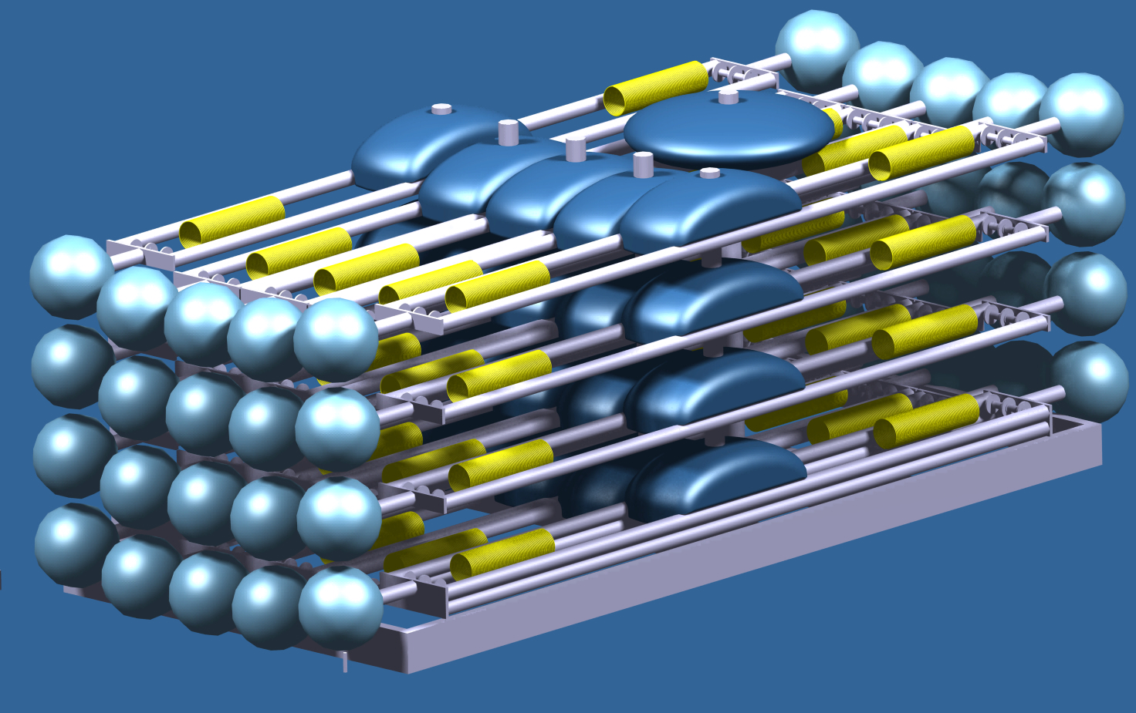
DOMBAR package
DU
number of floors
20
Floor interval length
40
m
TDR p.22
Leader length
100.00
m
TDR p.65?
with 2 spokes (Bar without DOMs)
Floor length
6.00
m
total height
900.06
m
at a current flow of 0 m/s
total height
891.93
m
at a current flow of 0.3 m/s
Top drift (drag)
116.96
m
at a current flow of 0.3 m/s,
critical drag <
180
m (TDR p. xx)
Top buoyancy
-1000
N
Syntactic foam of ca. 0.19 m³
Anchor
4338
kg
Concrete in air
transport weight
7202
kg
without deployment tools
transport volume
ISO container high cube type
release from bottom
14.37851
min
WP F/L DU-group

Slide 6
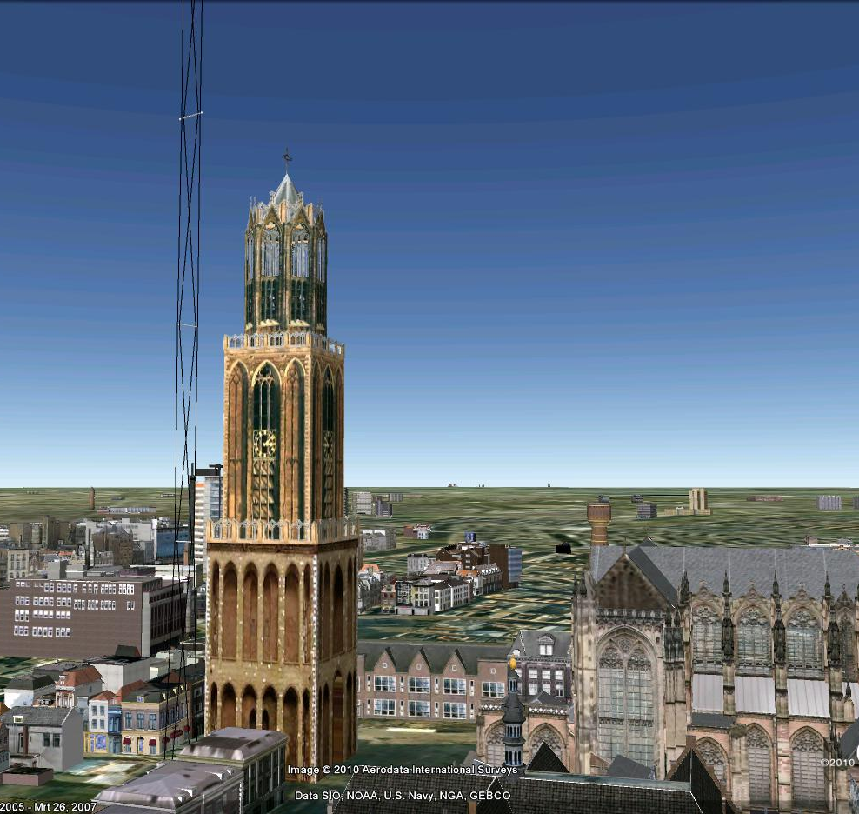
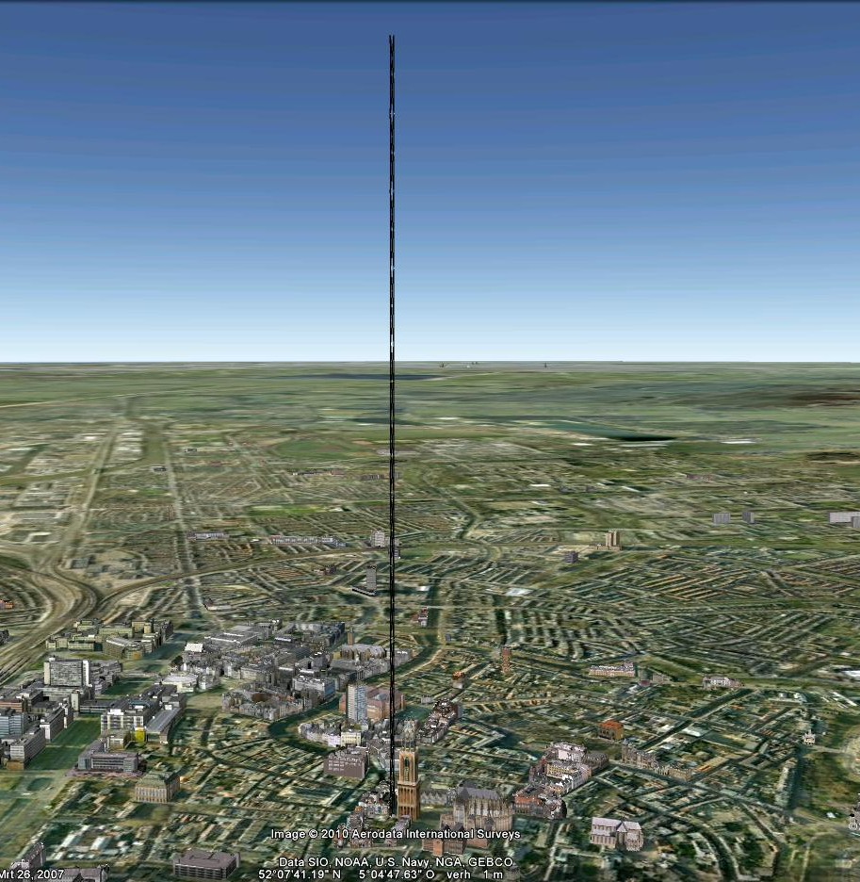
Nikhef PaulK

Slide 7
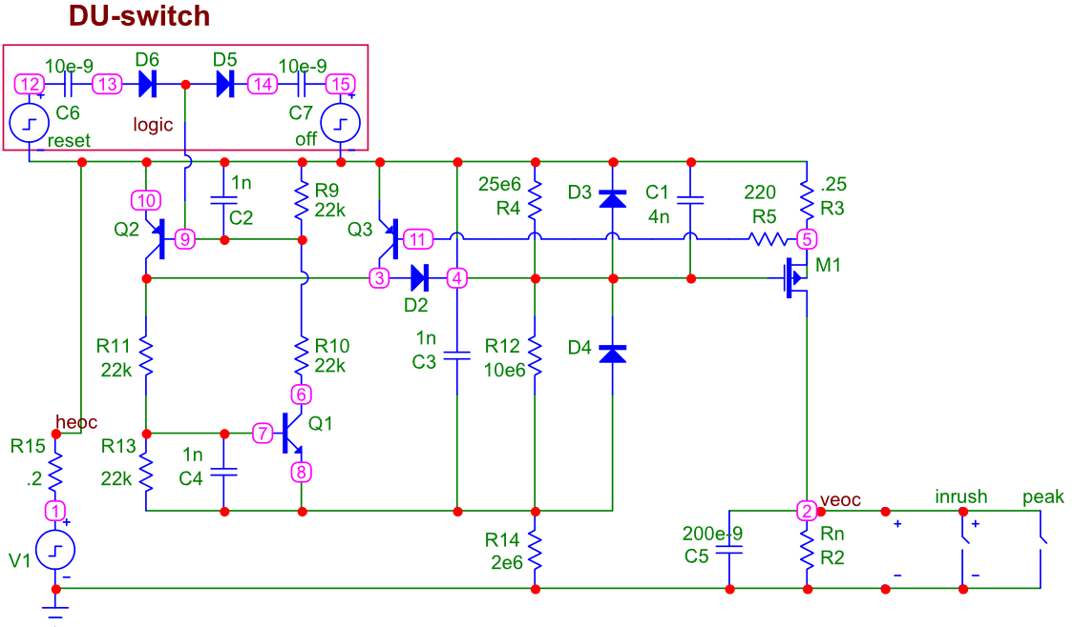
Nikhef - ET

Slide 8
Implications
DU
Power
Cu
Cross section
VEOC
Drag
Buoyancy
Dead-
weight
Rope
cross
section
Network
Power
Cu
Cross section
Cable
Transport
Deployment
Converters
Mechanics
Connectors
Nikhef

Slide 9
VEOC constrains
2 VEOCs, left and right – redundancy, stability
Top part , low part, separated by OFM
Electrical;
400 V 180 W, daisy chain
Optical;
OFM on floor 9
Shore RX, TX to OFM
OFM-DOM
Mechanical;
60 MPa environment
no stress in cable
small as possible to minimize drag
Floor interval 40 m? (= 40.06 m rope, 44 m VEOC)
DW – F1 120 m? ( = 40±2 + 40 +40 m rope, 134 m VEOC)
F20
F19
F18
F1
S2
S1
B
Ref. TDR fig. 3.14

Slide 10
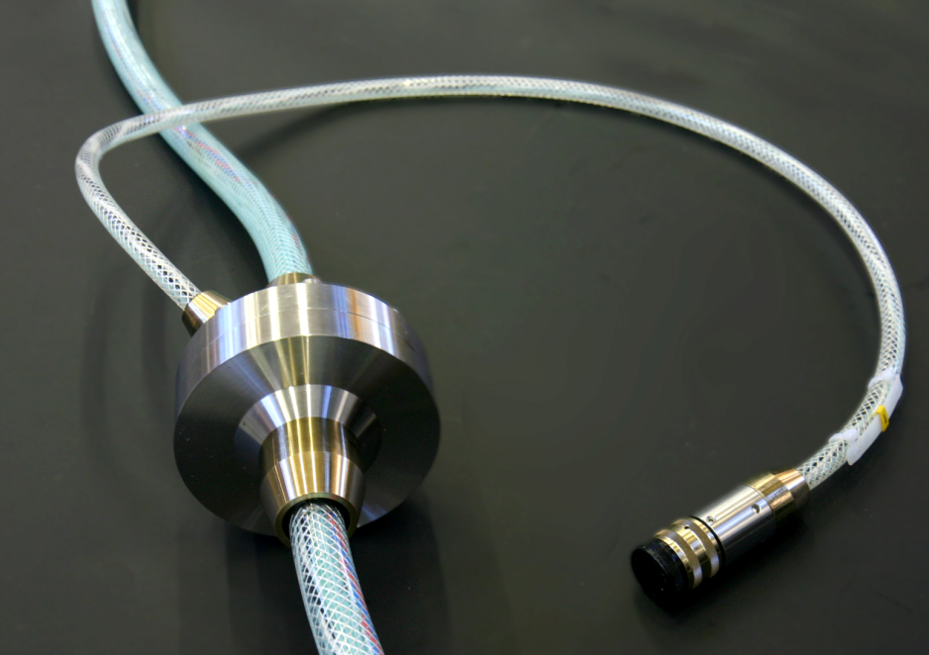
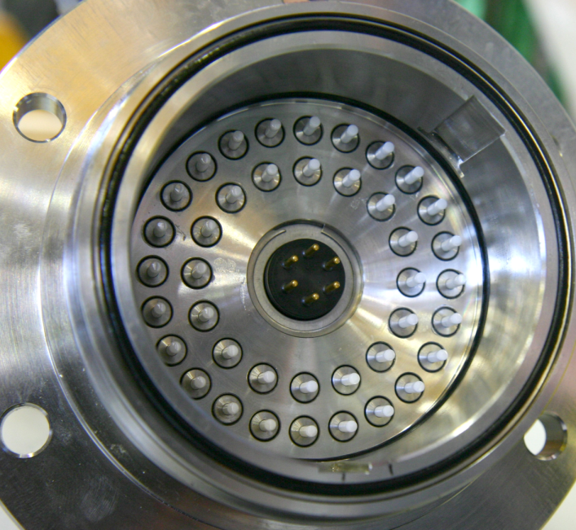
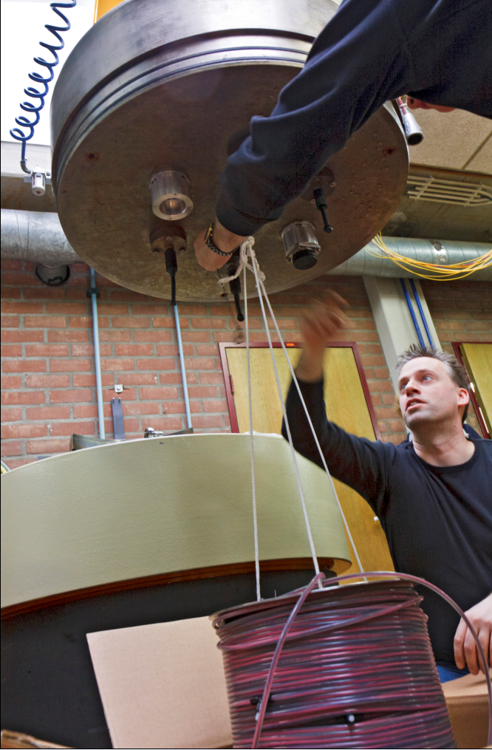
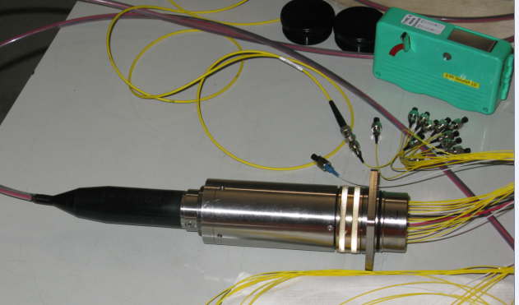
VEOC tests
Prototype (100 m) delivered by Seacon,
  cable tested with good results on 400 Bar
  Connector needed to test, fails
2. Prototype (200 m),
  cable tested with good results on 600 Bar
  Connector needed to test, fails (4 positions out of 13)
Nikhef

Slide 11
Floorplan
Instrumentation
Diagram block numbering
Diagram SJB distribution
Risk analisis
Justify the star/single PJB approach
Chance on failure MEOC very low:
only in shallow water by anchoring and fishing
repair within 48 hours
1/3 KM3NeT / failure
QA/QC
HEOC: low, loss 1 SJB
IL: low . Loss 1 DU
VEOC: high during deployment, low during operation
Switch/DU or switch/VEOC
10kV RWM not available yet
Plan to contact ODI (Antonio, Giorgio).
Alcatel don’t extend the production of the MVC.
Only parallel with 25km cable in between.
Future: different device from other partner, with latest constrains.
Alternatif:
PBF
Mario: 2 candidates (Breuker, Heinzinger) about 150000 Euro.
MEUST:
30km-coast
AC 5kV, 2 cable to shore, to same shore station
Ringstructure D=2km DC
48 smf / cable
230 0m depth
Nodes connect by penetrators
KM3NeT by RWMs
All information 2 wk of March to prepare for Amsterdam.

Slide 12
Main plan
One block:
13 SJB + EMSO
Inter distances 180 m
Floor area 2.3 km²
EMSO
Instrumentation
lines ???

Slide 13

Fiber routing
104 DU, 13 SJB + EMSO
8 DU / SJB
1 SMF- 1 λ
DOM
1..20
1 SMF- 1 λ
1 SMF- 41 λ
1 SMF- 1 λ
1 SMF- 41 λ
1 SMF- 1 λ
1 SMF- 1 λ
DOM
1..20
DU
1 SMF- 1 λ
PJB
4 SMF- 83 λ
local
8 DU / SJB
1
2
3
4
5
6
7
8
9
10
11
12
13
14
1 SMF- 1 λ
1 SMF- 1 λ
DOM
1..20
1 SMF- 41 λ
1 SMF- 1 λ
SJB
CTA
56 SMF- 84 λ
1 SMF- 41 λ
1 SMF- 1 λ
1 SMF- 84λ
1 SMF- 1 λ
DOM
1..20
DU
1 SMF- 1 λ
local
1 SMF- 83 λ
13 SJB + 1 EMSO / PJB
Based on 44 output multiplexer
  DWDM-F-100G-1-44-C-A-B01
  RWM with 8 positions

Slide 14
Power routing
104 DU, 13 SJB + EMSO
8 DU / SJB
DOM
1..20
2 Cu
DOM
1..20
2 Cu
DU
PJB
local
8 DU / SJB
1
2
3
4
5
6
7
8
9
10
11
12
13
14
DOM
1..20
CTA
2 Cu
SJB
DOM
1..20
2 Cu
DU
local
13 SJB + 1 EMSO / PJB
Based on 44 output multiplexer
  DWDM-F-100G-1-44-C-A-B01
  RWM with 8 positions

Slide 15
Network numbers
Without instrumentation load

Slide 16
SJB ?
Layout
  8 DU
  Spare connector ?
  Instrumentation ?
  Local control ?
    Switches
    Monitoring
  Mechanics
    Form factor
    Weight
    connectors

Slide 17
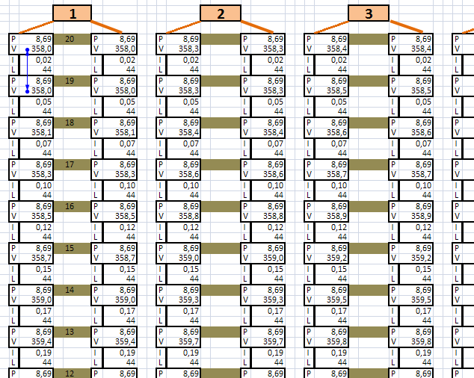
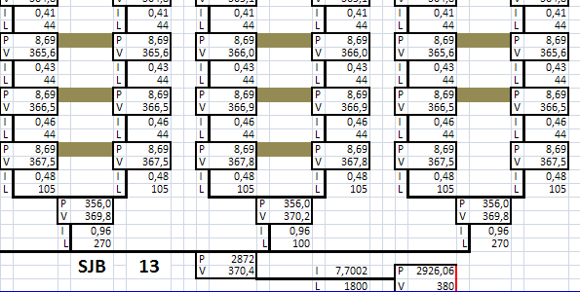
SJB distribution
DOM : 8.69W
Local temperature:
-functionality
-lifetime
DOM inventory (only PPM):
Power conversion 1.6 W
DOM logic 7 W
Signal collection, compass 0.18 W
Signal collection, piezo 0.12 W
Bases 1.09 W
Instruments 1 W
Total 11 W
!

Slide 18

PJB configuration
MVC 1
104 DU - 13 SJB
8 DU per SJB
1 SJB for EMSO
switch MV
10 kV
MVC 2
switch LV
400 V
MVC n
2
power monitor
MEOC
10 kV
PENETRATOR
CTA
FO
PENETRATORS
1
2
n
To be confirmed
1
2
n
57 optical fibers
+ extra (up to 64)
MCDU
1
8
optical splitter
LEGENDA:
1
/
1
electro optical
coupler
2
/
n
optical fibers
2
/
8
2
electrical conductors
to SJB
ODI 10kV ROV Wet Mateable (RWM)
Electrical connector
13
8
/
8
8
ODI RWM Optical connector , 8 pos
14
to EMSO
ODI RWM Electro-Optical connector
ODI RWM Electrical connector
INFN/LNS RosannaC

Slide 19
PJB configuration
MVC 1
104 DU - 13 SJB
8 DU per SJB
1 SJB for EMSO
switch MV
10 kV
MVC 2
switch LV
400 V
MVC n
2
power monitor
MEOC
10 kV
PENETRATOR
CTA
FO
PENETRATORS
1
2
n
To be confirmed
1
2
n
57 optical fibers
+ spare (up to 64)
MCDU
1
1
1
optical splitter
All the elements located inside red dotted boxes must be mounted on the same frame and deployed together
because up to now
the ODI 10 kV RWM connector is not safe for wet meatability
/
8
electro optical
coupler
2
/
n
2
/
8
2
to SJB
13
8
/
8
8
14
to EMSO
INFN/LNS RosannaC

Slide 20
PJB discussion
MVC 1
104 DU - 13 SJB
8 DU per SJB
1 SJB for EMSO
switch MV
10 kV
MVC 2
switch LV
400 V
MVC n
2
power monitor / control
MEOC
10 kV
PENETRATOR
CTA
FO
PENETRATORS
1
2
n
To be confirmed
1
2
n
57 optical fibers
+ spare (up to 64)
MCDU
1
1
1
optical splitter
All the elements located inside red dotted boxes must be mounted on the same frame and deployed together
because up to now
the ODI 10 kV RWM connector is not safe for wet meatability
/
8
electro optical
coupler
2
/
n
2
/
8
2
to SJB
13
8
/
8
8
14
to EMSO

Slide 21
Discussion
Connectors:
  Apparatus to apparatus
  Connection cables
Start up power:
  To start the control part first
  Chargable battery driven
100 – 10000 V
Low power
400 V
12 V battery
Control

Slide 22
Main characteristics

Slide 23
Remarks
MVC Alcatel don’t extend the production
Other interested parties: Heinzinger (G), Bruker (G), PBF (NL)
10 kV ROV Wetmateable not validated (yet)
Antonio & Giorgio contact ODI
How many instrumentation strings
Couldbe build on a SJB?
Power of the instrumentation?
Possibility to timesharing?
Adjusting power of the DOM
KM3NeT and PPM phase are different!
For WP F/L
Item
U ..V= , ±
I ..mA
Ip ..mA
Fp ..Hz
Tp ..ms
To Rosanna or Eric

