Slide 1
First European School on the Physics of the Electron-Ion Collider
M. Capua and E. Tassi on behalf of OC
EIC_NET Meeting - March,10 2023
Outline
Motivation
General Information
Scientific program

Slide 2
Motivation
Important to introduce and train a new generation of physicists to EIC physics programme.
An EIC summer school is organized by the CFNS (since 2019) but we believed it is useful to have a companion European school.
The school is intended for advanced graduate students and postdocs in nuclear and particle physics.
School will take place 18-22 Jun 2023 at the BV Airone Resort of Corigliano-Rossano.
School site and agenda available at:
https://agenda.infn.it/event/33450/
Registrations opened on February, 10th with the circulation of Bulletin nr. 1

Slide 3
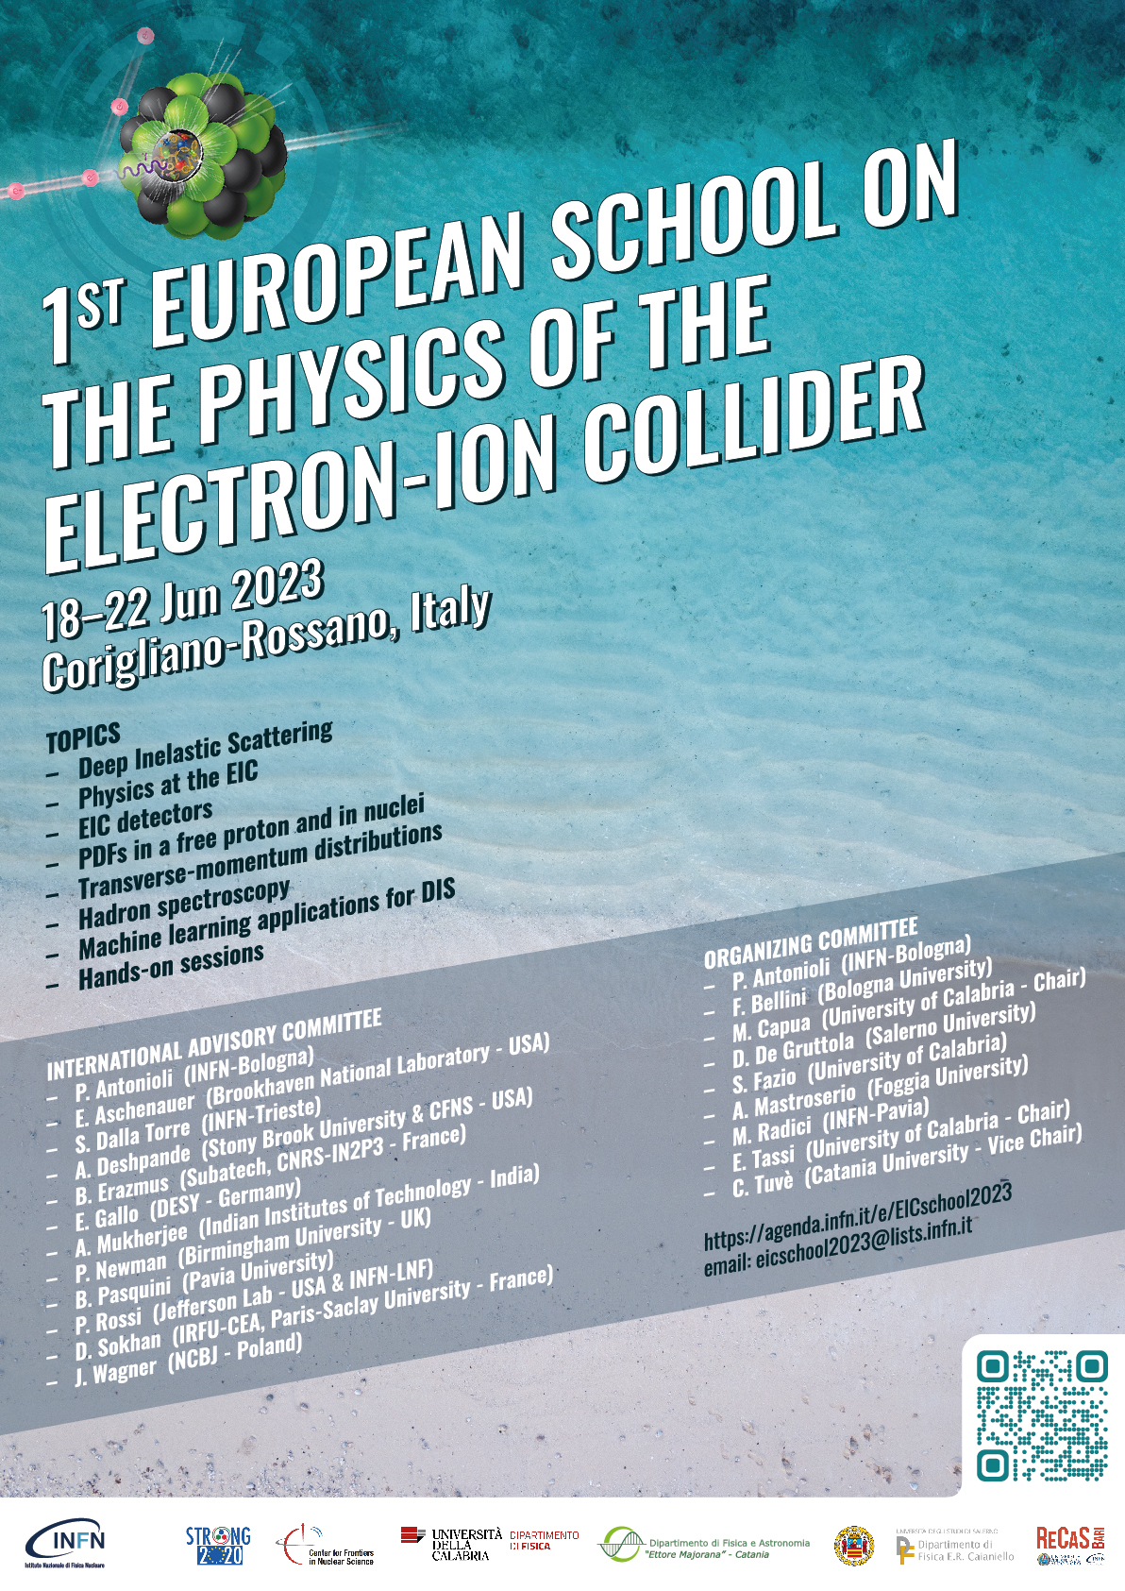
Motivation
Important to introduce and train a new
generation of physicists to EIC physics programme.
An EIC summer school is organized by the CFNS (since 2019) but we believed it is useful to have a companion European school.
The school is intended for advanced graduate students and postdocs in nuclear and particle physics.
School will take place 18-22 Jun 2023 at the BV Airone Resort of Corigliano-Rossano.
School site and agenda available at:
https://agenda.infn.it/event/33450/
Registrations opened on February, 10th with the circulation of Bulletin nr. 1

Slide 4
Committes
Organizing Committee
Pietro Antonioli (INFN-Bologna)
Francesca Bellini (U. di Bologna and INFN-Bologna)
Marcella Capua (U. della Calabria and INFN-Cosenza)
Daniele De Gruttola (U. di Salerno and INFN-Salerno)
Salvatore Fazio (U. della Calabria and INFN-Cosenza)
Annalisa Mastroserio (U. di Foggia and INFN-Bari)
Marco Radici (INFN-Pavia)
Enrico Tassi (U. della Calabria and INFN-Cosenza)
Cristina Tuvè (U. di Catania and INFN-Catania)
International Advisory Committee
Pietro Antonioli (INFN-Bologna)
Elke Aschenauer (BNL - USA)
Silvia Dalla Torre (INFN-Trieste)
Abhay Deshpande (Stony Brook Univ. and CFNS - USA)
Barbara Erazmus ( Subatech, CNRS-IN2P3 - France )
Elisabetta Gallo (DESY - Germany)
Asmita Mukherjee (IIT Mumbay - India)
Paul Newman (Univ. Birmingham - UK)
Barbara Pasquini (Univ. Pavia and INFN-Pavia)
Patrizia Rossi (JLab - USA and INFN-LNF)
Daria Sokhan (IRFU-CEA, Univ. Paris-Saclay - France)
Jakub Wagner (NCBJ - Poland)

Slide 5
Sponsoring Institutions
School sponsored by
Istituto Nazionale di Fisica Nucleare, Italy
Center for Frontiers in Nuclear Sciences, USA
STRONG2020: a European Union's Horizon 2020 Research and Innovation programme
on hadron physics (grant agreement No 824093)
Physics Department of University of Calabria, Italy
Salerno University and Physics Department "E. R. Caianello" of Salerno University, Italy
Physics and Astronomy Department "E. Majorana" of Catania University, Italy
RECAS Bari, Italy
Financial Support
A budget has been made available by CFNS to provide financial support (waive of registration fee) for deserving early career scientists (fully advertised in the School page).

Slide 6
1st Meeting with IAC
It took place online February, 20th
The IAC expressed appreciation and full support for the initiative
It was emphasized how the school could be a unique training opportunity
for European students as well as students coming from Asian countries
We got useful suggestions on possible improvements of the scientific program
(greater balance between theory vs experimental lectures) that we’re trying to implement
Broad discussion on the future of European School
We will approach again the IAC before the start of the School

Slide 7
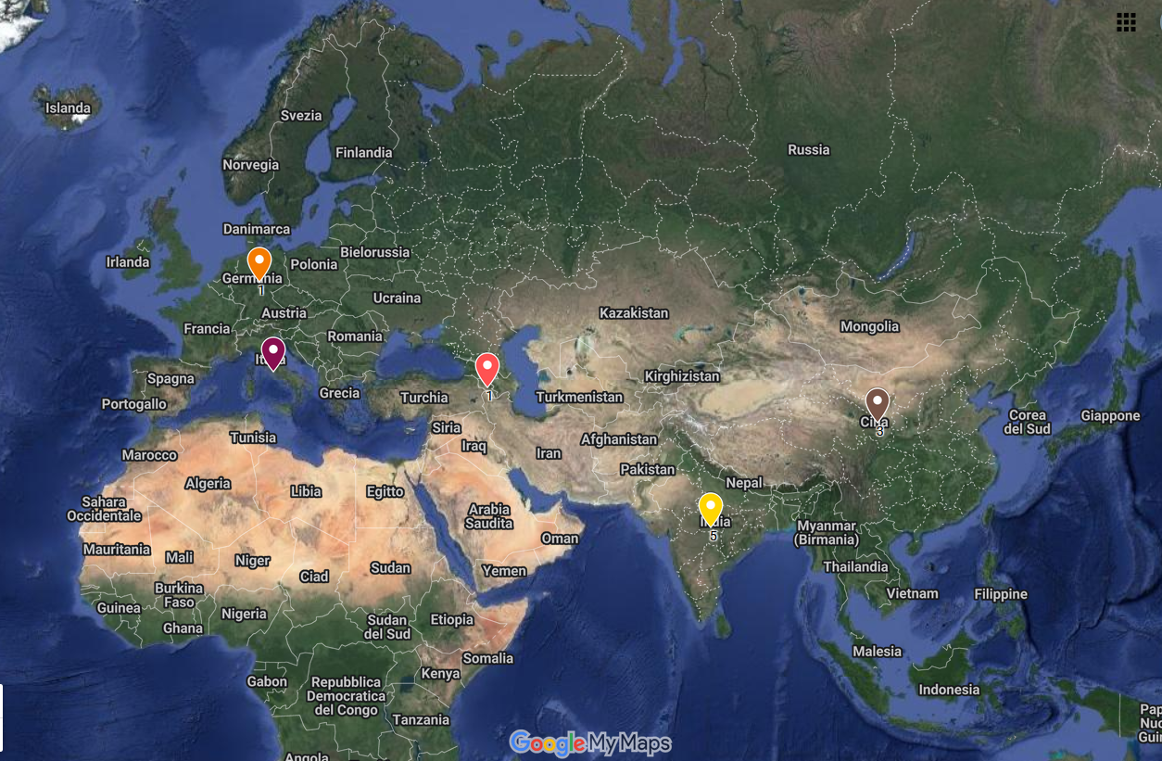
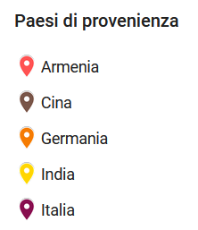
Registrations so far…
The registrations’ trend is, up to now, very good:
- 20 registered students (6 girls) from Italy (8), India (7), China (3), Germany (1) and Armenia(1)
- We expect additional (7) italian students
- Keep advertising the school (in particular in Europen countries) ⇾ 2nd bullettin

Slide 8
Scientific Program
A detailed (although still preliminary) scientific program already available on the School site.
A broad coverage of most the relevant EIC physics topic (with a special emphasis on TMDs)
Decided to add a Poster Session (Call of abstracts)
Very import to harmonize the content of the various lectures
Scientific Topics
The Electron-Ion Collider: From an idea to reality
Introduction to Deep Inelatic scattering
Collinear Proton PDFs from past, present and future data
Theory of Transverse-momentum dependent distributions (TMDs) and gluon TMDs
Experimental results on TMDs
Cooking show: how to extract TMDs froma global fit
The case for Ions: the Physics of nuclear PDFs and hadronization studies
Overview of the Physics case for the EIC
Overview on Spectroscopy
Introduction to Machine Learning Techniques
Hands-on session on Machine Learning Techniques (coll. PDFs and/or EIC Physics)
Monte Carlo Event Generators for EIC
The ePIC Detector
The Italian contribution to EIC

Slide 9
Scientific Program
A detailed (although still preliminary) scientific program already available on the School site.
A broad coverage of most the relevant EIC physics topic (with a special emphasis on TMDs)
Decided to add a Poster Session (Call of abstracts)
Very import to harmonize the content of the various lectures
Announced Lecturers
Pietro Antonioli (INFN)
Alessandro Bacchetta (U. Pavia and INFN)
Andrea Bressan (U. Trieste and INFN)
Francesco G. Celiberto (FBK - Trento)
Matteo Cerutti (U. Pavia and INFN)
Silvia Dalla Torre (INFN)
Annalisa D’angelo (U. Tor Vergata and INFN)
Abhay Deshpande (Stony Brook University and CNFS - USA)
Enrico Tassi (U. Calabria and INFN)
Gioacchino Vino (INFN)
Pia Zurita (U. Regensburg - Germany)

Slide 10
Concluding Remarks
Organization of the School is progressing well
School Site is now complete
Registration trend is very good
Working on finalizing the scientific program
Will soon circulate a second bulletin
Will keep you updated…

