Slide 1
Turbulence: an informal introduction
Niccolò Cocciaglia
PhD Seminar
22/03/2023
Notes:
Clouds on Jupiter, (May 2018, taken from NASA’s Juno spacecraft)

Slide 2
Summary
What and where is Turbulence?
Introduction: history and maths
Ideal vs. real flows: viscosity in action
«One parameter to rule them all»: the Reynolds number
2D vs. 3D Turbulence
Why study Turbulence
What I do
Take-home messages

Slide 3
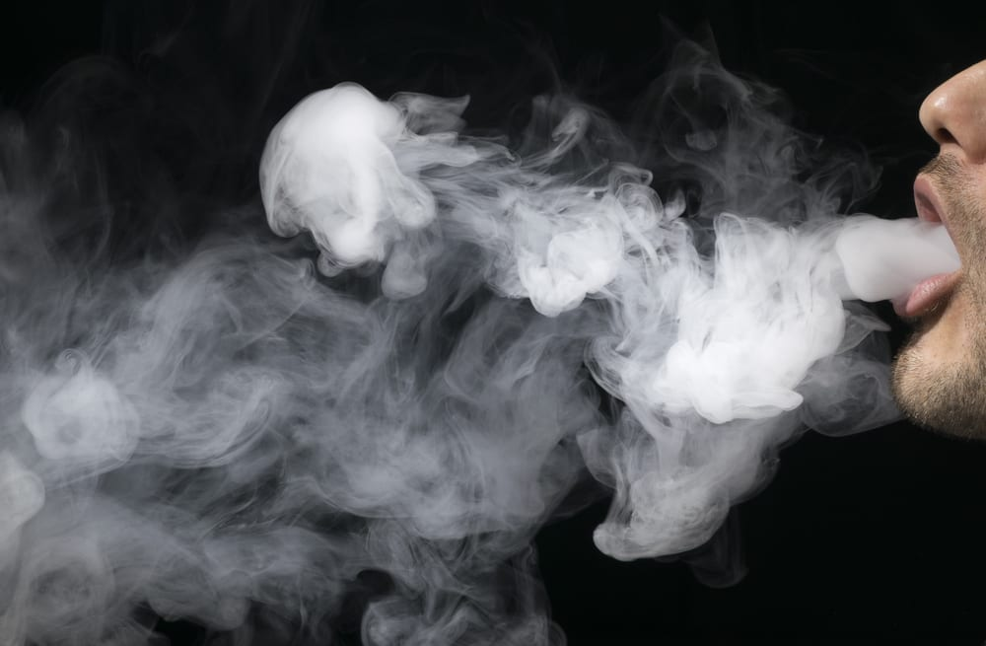
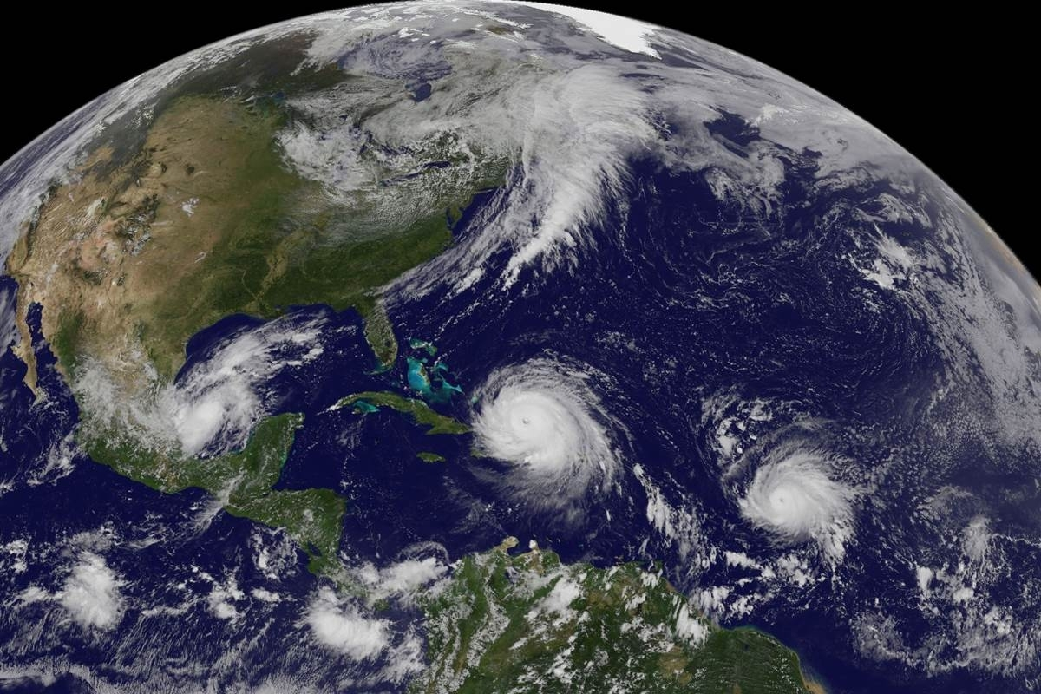
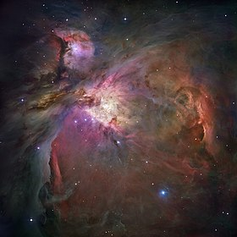
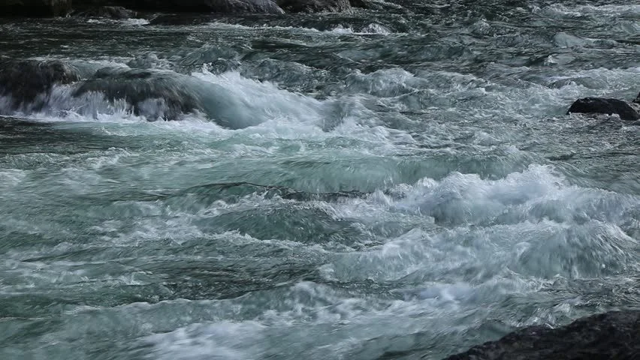
What is Turbulence? Where to find it?
Chaotic and disordered motion in fluid matter
Turbulence is everywhere!
Notes:
3° image: hurricanes Irma, Katia and José (2017)
4° image: Orion Nebula (Hubble, fake colours)

Slide 4
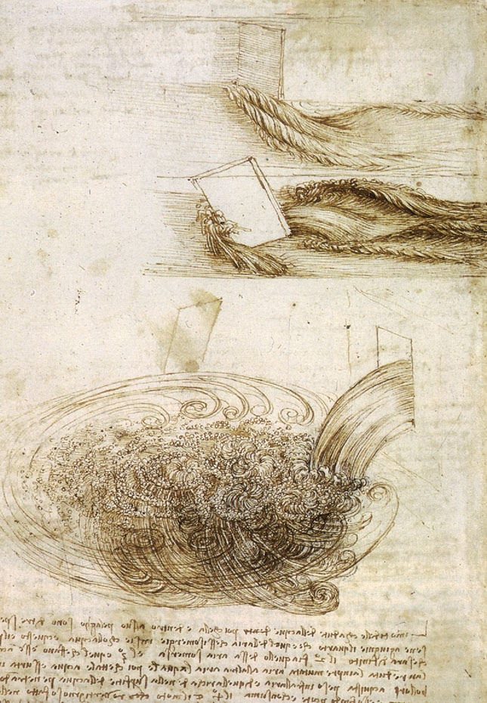
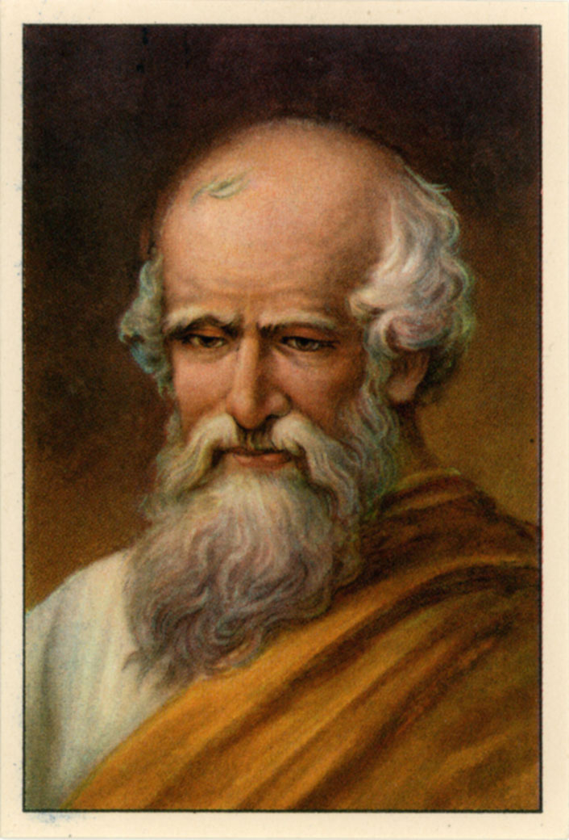
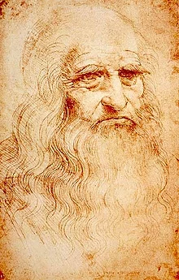
A bit of history...
Leonardo Da Vinci (1452-1519)
First scientific observations of turbulent flows
Archimedes (250 B.C.)
First studies on hydrostatics

Slide 5
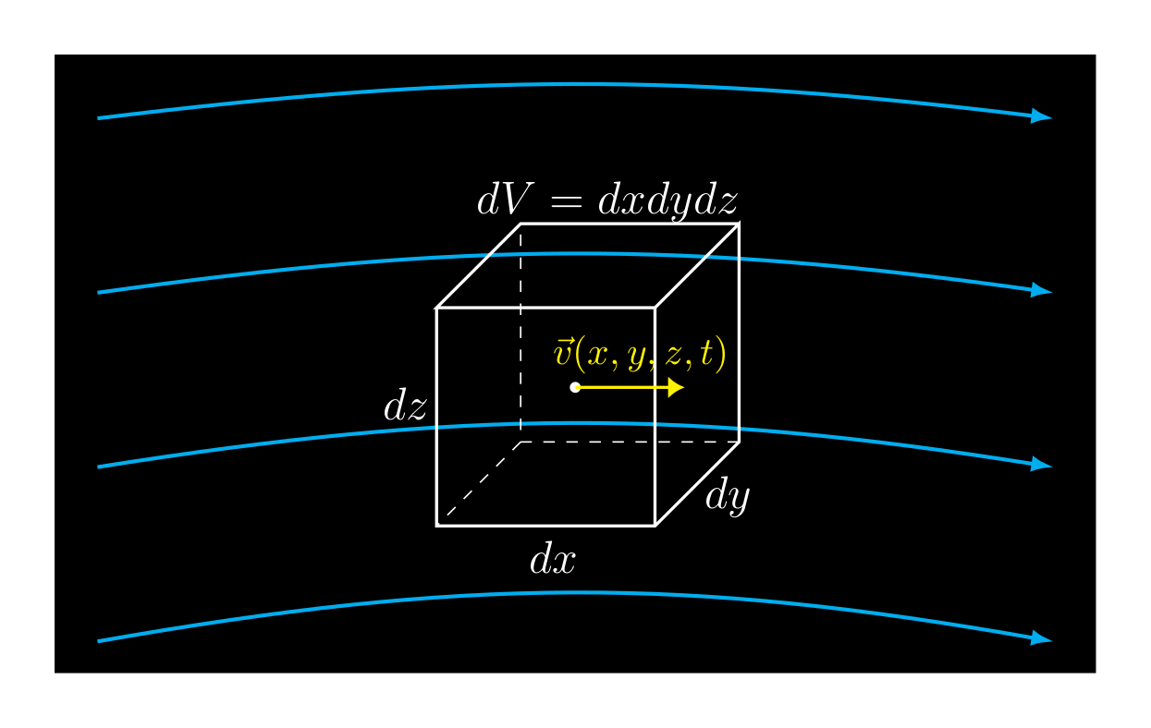
...and a bit of mathematics
Further credits to:
Newton, Euler, Lagrange, Laplace, Bernoulli, Navier, Stokes
Navier-Stokes equation
Kinematic viscosity
(incompressible flow)
Fluid element

Slide 6
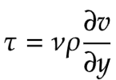
What is viscosity?
SHEAR MOTION:
Fluid elements (layers) move with different velocities
VISCOUS FORCES
try to oppose this motion
COUETTE FLOW
Newton’s law of viscosity
General formulation:
Shear stress
Notes:
Rules the thermodynamic irreversibility of the motion -> quantifies dissipation of energy
Causes an irreversible exchange of momentum among fluid elements
Effect visible when fluid elements move with different velocities
Stress: force per unit area (F/A)
Practical example: sliding something on the surface of the water (calm sea / pool) creates a shear flow: the object stops after a while because of viscous friction

Slide 7
Ideal vs. real fluids
IDEAL :
REAL :
Non-dissipative, adiabatic flow
Dissipative, adiabatic flow
needs external forcing to be sustained

Slide 8
The similarity law
Set of scaling relations:
Non-dimensional
N-S equation
: Mean fluid velocity
: Characteristic length
Reynolds number:

Slide 9
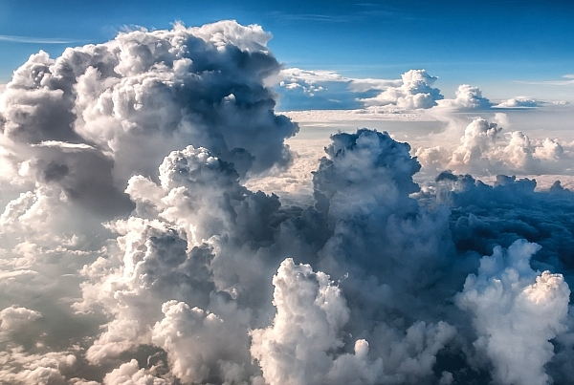
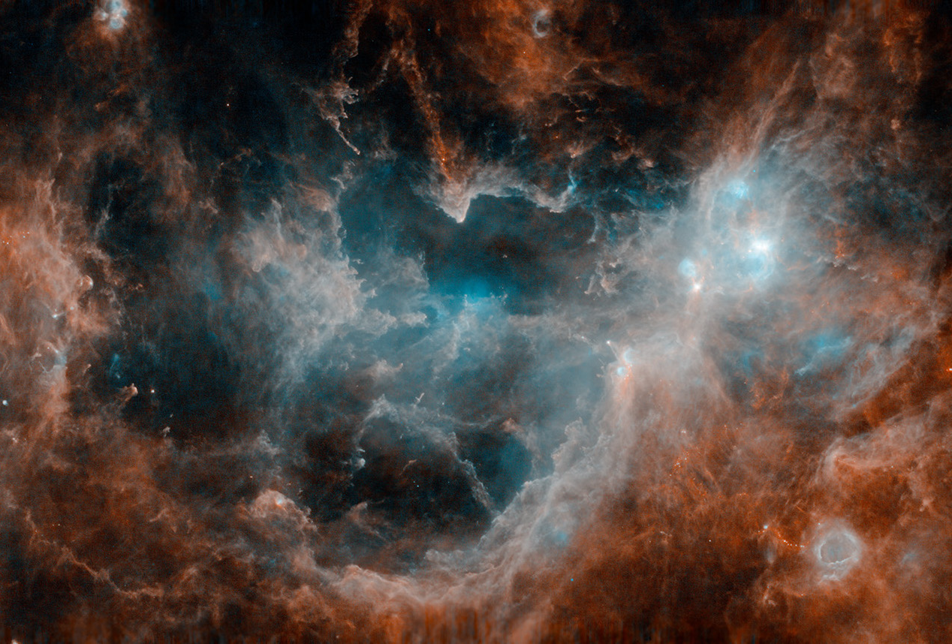
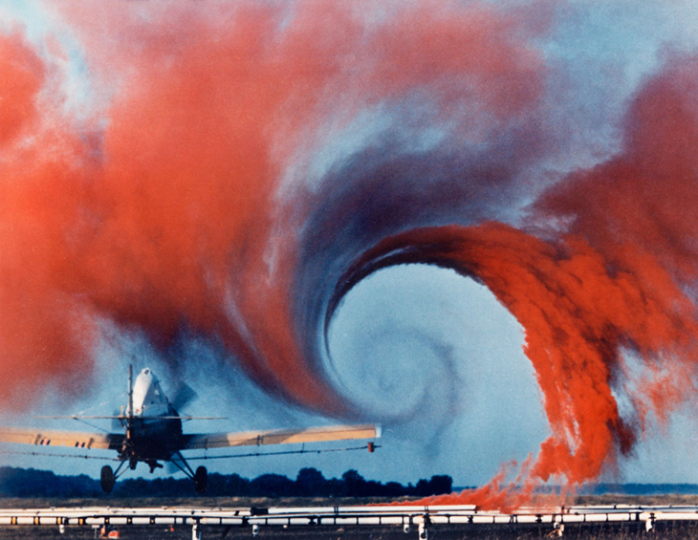
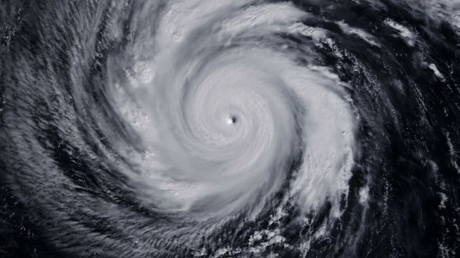
Similarity

Slide 10
Flows at increasing $Re$: the Reynolds experiment
$$Re∼\frac{inertial forces}{viscous forces}$$
Laminar regime
Transition regime
Turbulent regime
Video credits: YouTube, «Fluid Dynamics» channel

Slide 11
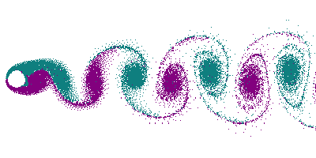
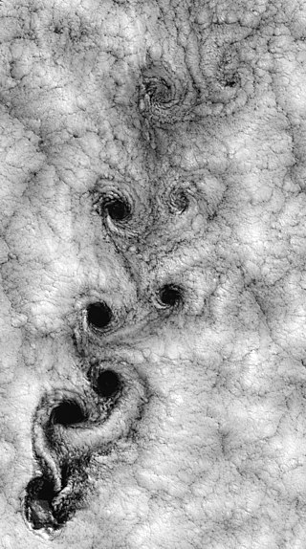
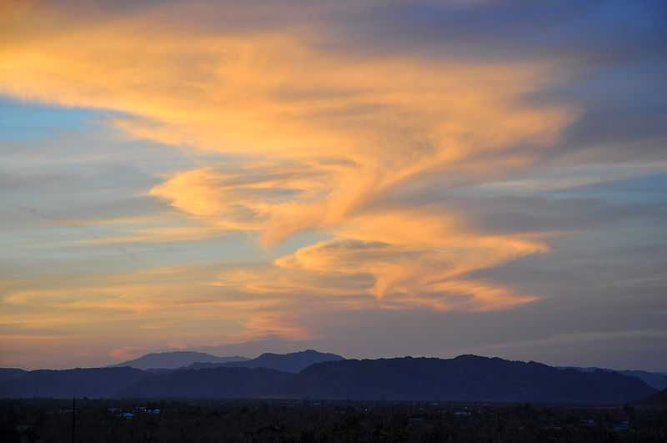
Von-Kármán vortex street
Juan Fernández Islands

Slide 12
2D vs. 3D turbulence
Vorticity:
2D
3D
«Inverse energy cascade»
«Direct energy cascade»
Video credits: YouTube, «turbulenceteam» and «brgirgis» channels

Slide 13
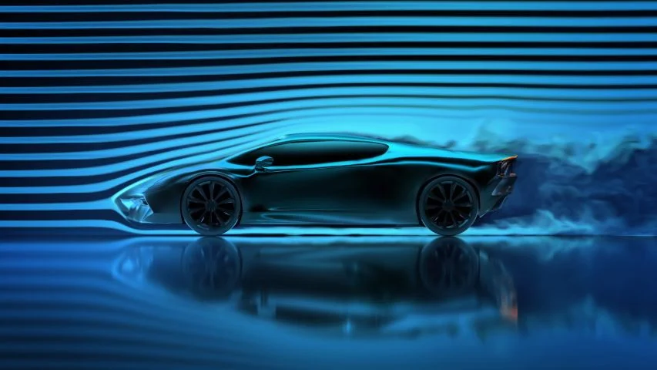
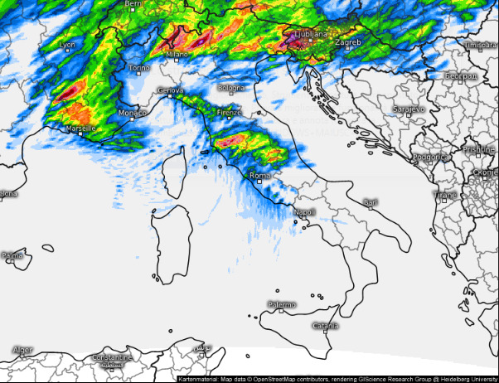
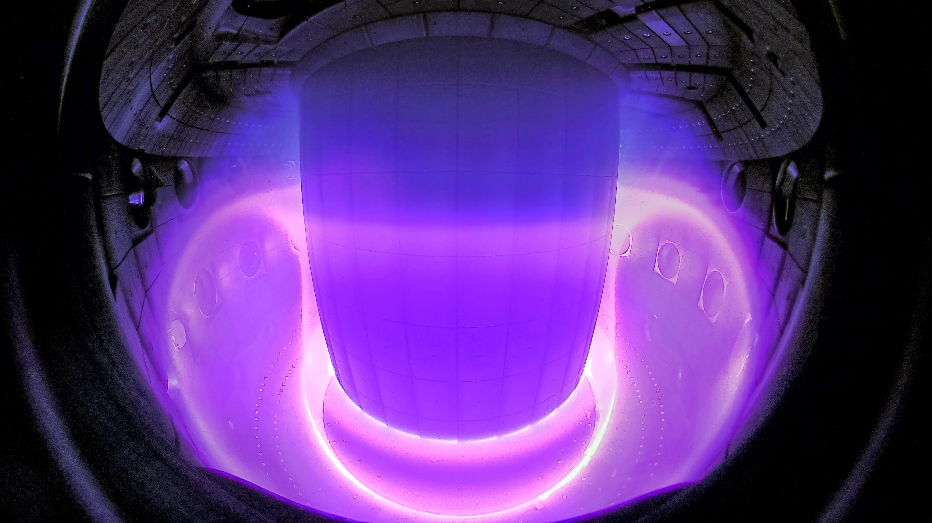
Why study turbulence?
Aerodynamics
Weather forecasts
Nuclear fusion

Slide 14
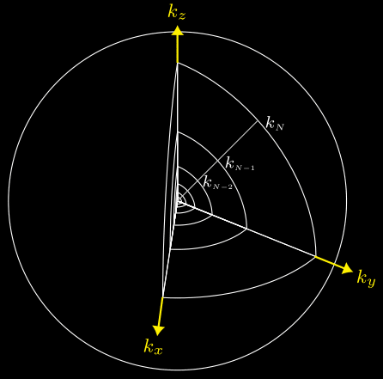
What do I do?
Shell model
Turbulent fluids as
non-equilibrium systems in statistical mechanics
Time correlation functions
Response to perturbations
Irreversibility
Transport phenomena
Entropy / Information
SABRA equations

Slide 15
Take home messages
(Almost) every liquid/gas in nature is in a turbulent state
Despite the extreme variety of turbulent phenomena, some universal laws exist
Applications affecting our everyday life
(aerodynamics, weather forecasts, nuclear fusion)

Slide 16
Thank you for your attention!

