Slide 1



Non Standard Interactions and Lorentz Invariance Violation in Solar Neutrino physics @ JUNO
Juno Itala meeting - March 28th-29th 2023 -
Roma 3 University and INFN
V. Antonelli, M. Magoni, L.Miramonti, M. D. C. Torri
(Physics Department Milano University and INFN Milano)

Slide 2
Plan of the talk
N.S.I. AND SOLAR NEUTRINOS: INTRODUCTION AND MOTIVATIONS
NSI and solar neutrino physics: spectrum and asymmetries.
JUNO potentialities for NSI searches with solar neutrinos
OTHER EXOTIC PHYSICS EFFECTS: LORENTZ INVARIANCE VIOLATION (LIV) AND HMSR (isotropic LIV ) and connection with NSI
LIV in neutrino physics: an example of isotropic LIV.
Connection LIV – NSI and JUNO potentialities and role
MATTER INTERACTION DESCRIPTION: A 3 FLAVOR MODEL FOR NSI AND LIV … AND NOT ONLY
  Models and analysis (oscillation probability, interaction in presence of matter, spectra and asymmetries, etc.)
  First results
NUMERICAL ASPECTS OF THE ANALYSIS
WHAT NEXT: inputs for discussion

Slide 3
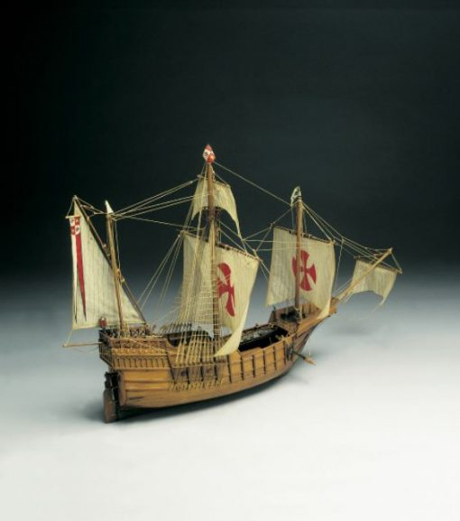
Meaning of the analysis
Why we still study solar neutrinos and why at JUNO ?
Status and open problems:
Metallicity (not only CNO, but also ⁷Be and/or ⁸B)
Oscillation pattern: verification of MSW-LMA solution in transition region between vacuum and matter oscillation
JUNO potentialities
Multipurpose experiment (sinergy reactor-solar)
High statistics and energy resolution
Improvement for background and E threshold (the ⁸B case)
Search for NSI and exotic effects with solar neutrinos @ JUNO?
Near future experiments (Neutrino Telescopes, LBL accelerator, JUNO, HyperKamiokande) built for CP violation, hierarchy, etc. can search for exotic effects
Searching for new lands we can improve the knowledge
of ‘’terra cognita’’ : Opportunity and sinergy between search
for NSI and traditional solar neutrino studies at JUNO.

Slide 4
Non Standard neutrino Interactions (NSI)
Search for deviations from ‘‘standard oscillation pattern” induced by additional interaction terms in L. Impact on neutrino (production), propagation and matter interaction in the detector.
Tests: accelerator LBL, atmospheric, reactor and mainly solar neutrinos.
  Connections with theories Beyond the Standard Model e Dark Matter searches
Solar neutrinos
MSW LMA consistency tests. Analyses of oscill. spectrum and day/night asimmetry:
⁷Be (recently Borexino) and
⁸B, vacuum to matter transition region (results from SNO and mainly SuperK).
JUNO promising: high statistics, low E threshold (2 MeV for ⁸B), excellent resolution.
Constraints on “Flavor-Diagonal Non-Standard Neutrino Interactions”
(mainly ε_{ee} ed ε_{ττ}).
Possible extension also to non diagonal interaction terms.

Slide 8
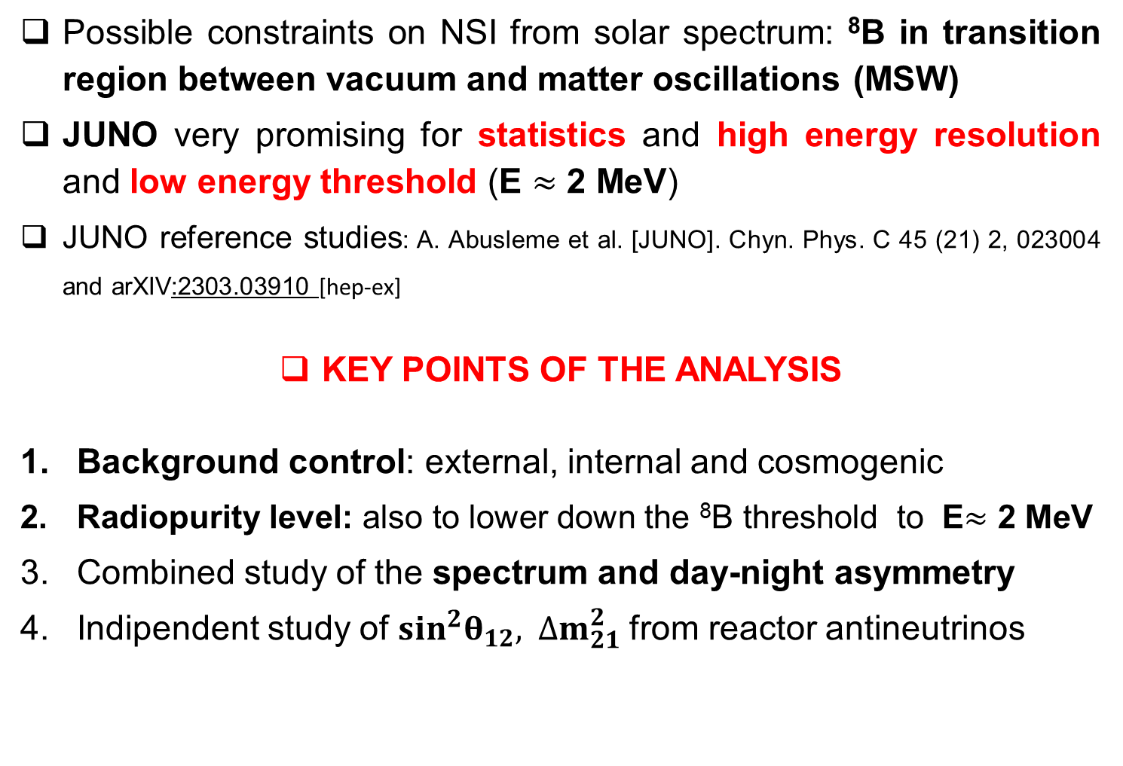
NSI @JUNO: POTENTIALITIES
Possible constraints on NSI from solar spectrum: ⁸B in transition region between vacuum and matter oscillations (MSW)
JUNO very promising for statistics and high energy resolution and low energy threshold (E $≈$ 2 MeV)
JUNO reference studies: A. Abusleme et al. [JUNO]. Chyn. Phys. C 45 (21) 2, 023004 and arXIV:2303.03910 [hep-ex]
KEY POINTS OF THE ANALYSIS
Background control: external, internal and cosmogenic
Radiopurity level: also to lower down the ⁸B threshold to E$≈$ 2 MeV
Combined study of the spectrum and day-night asymmetry
Indipendent study of $\sin^{2}θ_{12}, { ∆m}_{21}^{2}$from reactor antineutrinos

Slide 10
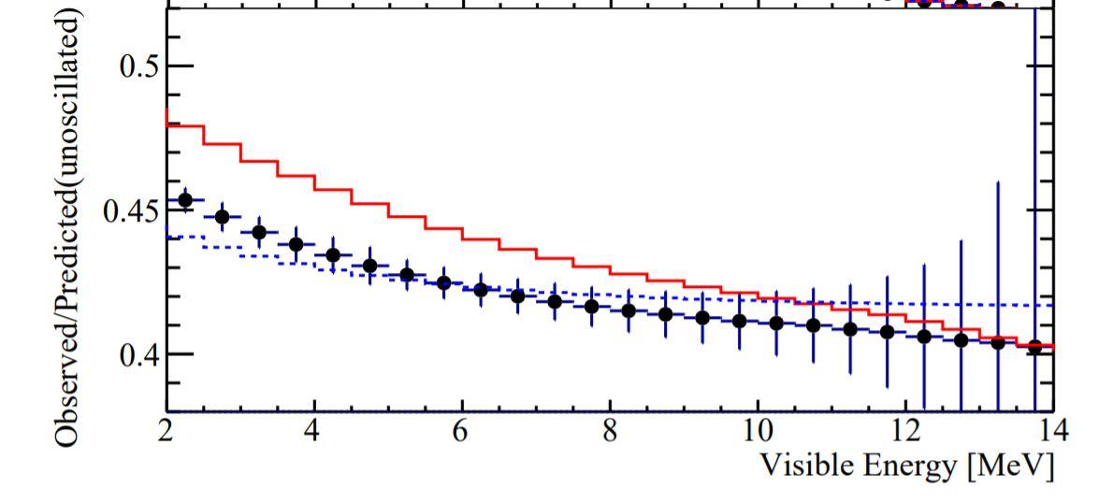
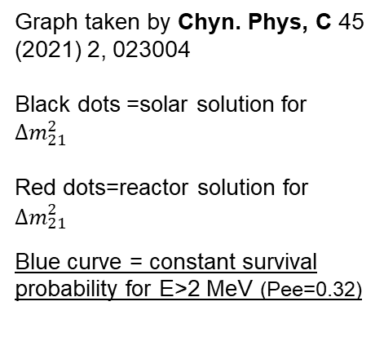
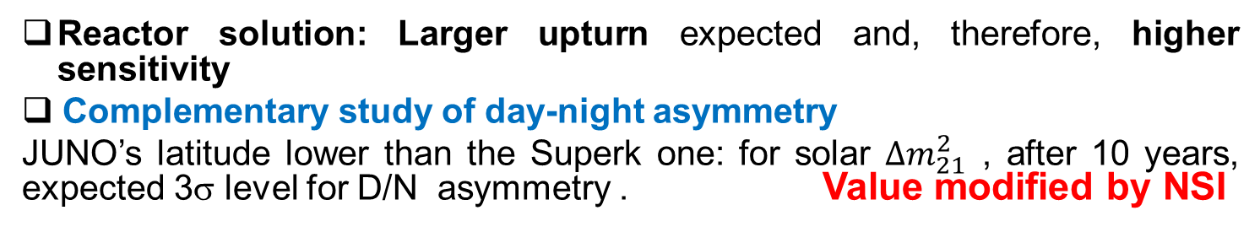
NSI study perspectives in JUNO (3)
Spectrum distorsions and day-night asymmetry
NSI effects: spectrum distorsions and modification of oscillation probability upturn
Detailed χ² analysis: advantage from high E resolution and low threshold.
Graph taken by Chyn. Phys, C 45 (2021) 2, 023004
Black dots =solar solution for ${∆m}_{21}^{2}$
Red dots=reactor solution for ${∆m}_{\begin{aligned}21 \\ \end{aligned}}^{2}$
Blue curve = constant survival probability for E>2 MeV (Pee=0.32)
Reactor solution: Larger upturn expected and, therefore, higher sensitivity
Complementary study of day-night asymmetry
JUNO’s latitude lower than the Superk one: for solar ${∆m}_{21}^{2}$ , after 10 years, expected 3σ level for D/N asymmetry . Value modified by NSI

Slide 11
LIV and neutrino oscillations
Dipersion relations modifications of kinematic origin
Standard oscillation phase
LIV induced modifications of the oscillation phase
LIV
Perturbation
This kind of BSM corrections can be only tiny perturbations.
Aim of the analysis constraints on LIV induced perturbations
* Neutrino oscillations and Lorentz Invariance Violation in a Finslerian Geometrical model
V. Antonelli, L. Miramonti, M.D.C.Torri Eur.Phys.J. C78 (2018) n.8, 667
* Neutrino Oscillations and Lorentz Invariance Violation M.D.C.Torri Universe 2020, 6(3), 37
* Present and future contributions of reactor experiments to mass ordening and neutrino oscillations studies
V. Antonelli, L. Miramonti, G. Ranucci Universe 2020, 6(4), 52

Slide 12
Exotic Physics @JUNO: LIV versus NSI
NSI induced corrections to neutrino:
Propagation: modification of the oscillation probability (correction to the MSW effect due matter interaction, mainly in the Sun)
Detection: modification of the interaction cross-sections in the detector (due to additional terms in ν-e matter interaction Lagrangian)
Spectrum deformation and modifications of D/N aymmetry
LIV induced corrections to neutrino propagation
Isotropic LIV: model HMSR (Homogenously Modified Special Relativity) (M. T, V. A., L. M. Eur.Phys.J. C79 (2019) no.9, 808)
Homogeneous modification of dispersion relations due to pure kinematic effects; minimal extension of S.M. preserving gauge symmetries and particle content
Modifications of the oscillation probability phases with terms proportial to L x E
(V. A., L. M., M.T. , Eur.Phys.J. C78 (2018) n.8, 667 ; M. T. ,Universe 2020, 6(3), 37)
Potential Corrections for experiments with high LxE: atmospheric neutrinos at JUNO (see also: V. Antonelli, L. Miramonti, G. Ranucci, Universe 2020, 6(4), 52)
LIV effects can simulate other NSI corrections: importance of sinergy between atmospheric and solar data at JUNO

Slide 13
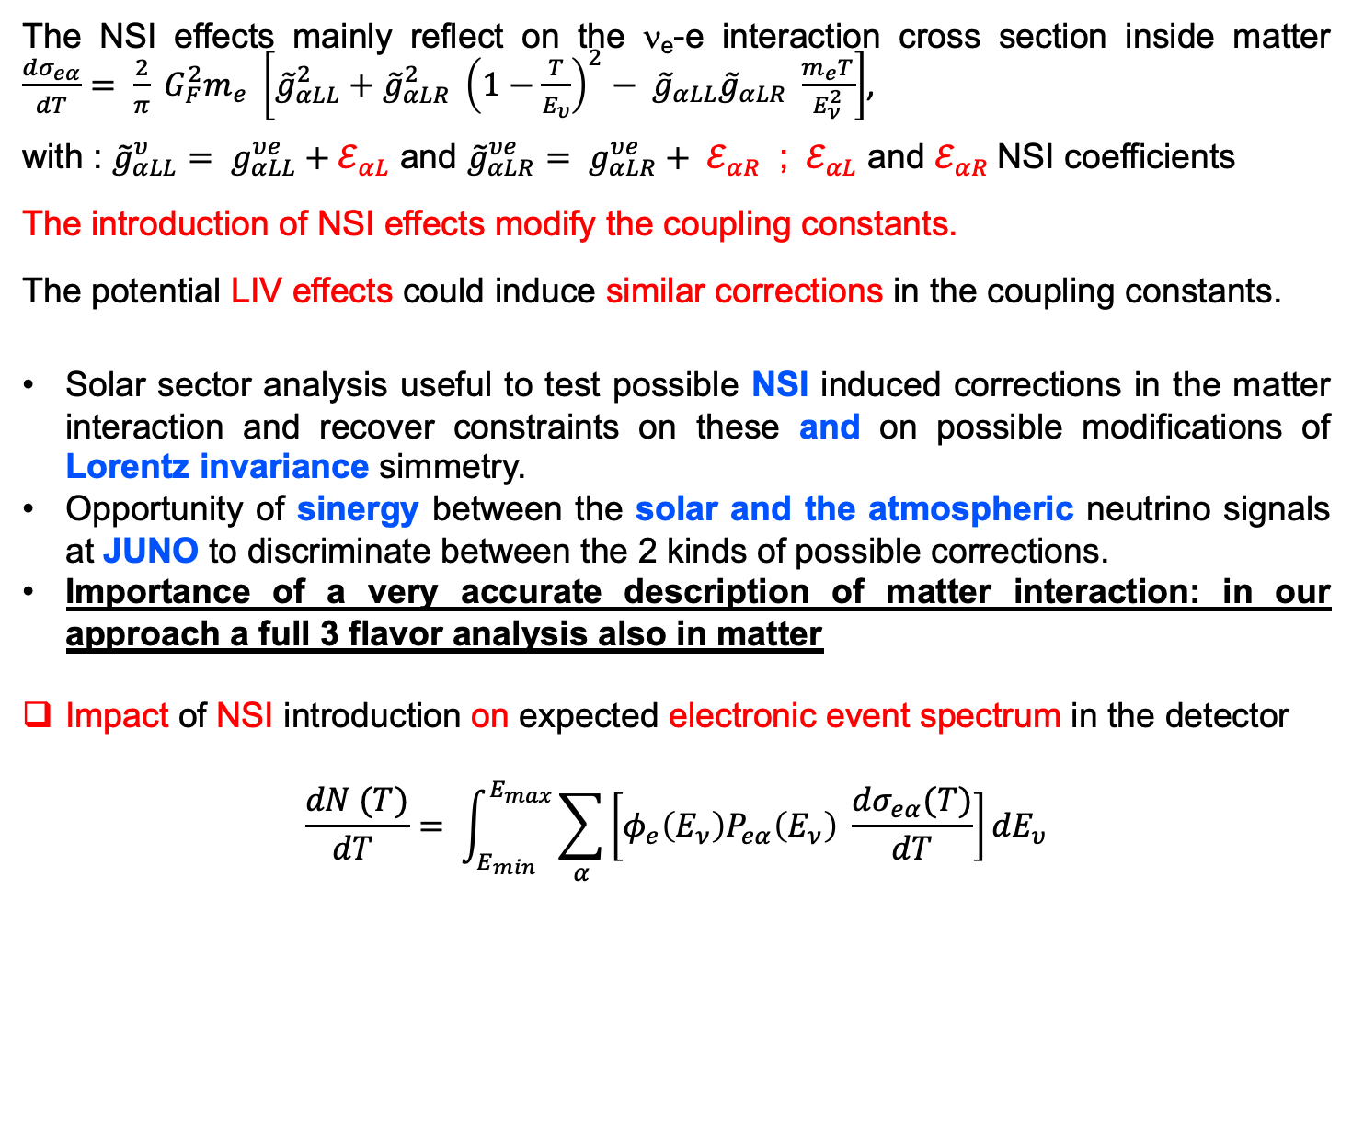
NSI modified cross sections in a 3 flavor analysis
The NSI effects mainly reflect on the ν_{e}-e interaction cross section inside matter $\frac{{dσ}_{eα}}{dT}= \frac{2}{π} G_{F}^{2}m_{e} \left[{\tilde{g}}_{αLL}^{2}+{\tilde{g}}_{αLR}^{2} {\left(1−\frac{T}{E_{υ}}\right)}^{2}− {\tilde{g}}_{αLL}{\tilde{g}}_{αLR} \frac{m_{e}T}{E_{ν}^{2}}\right]$,
with : ${\tilde{g}}_{αLL}^{υ}= g_{αLL}^{υe}+ℰ_{αL}$ and ${\tilde{g}}_{αLR}^{υe}= g_{αLR}^{υe}+ ℰ_{αR}$ ; ${ ℰ}_{αL}$ and $ℰ_{αR}$NSI coefficients
The introduction of NSI effects modify the coupling constants.
The potential LIV effects could induce similar corrections in the coupling constants.
Solar sector analysis useful to test possible NSI induced corrections in the matter interaction and recover constraints on these and on possible modifications of Lorentz invariance simmetry.
Opportunity of sinergy between the solar and the atmospheric neutrino signals at JUNO to discriminate between the 2 kinds of possible corrections.
Importance of a very accurate description of matter interaction: in our approach a full 3 flavor analysis also in matter
Impact of NSI introduction on expected electronic event spectrum in the detector
$$\frac{dN (T)}{dT }= \int_{E_{min}}^{E_{max}}{\sum_{α}{\left[φ_{e}\left(E_{ν}\right)P_{eα}\left(E_{ν}\right) \frac{dσ_{eα}(T)}{dT}\right]}}{dE}_{υ}$$

Slide 14
Our analysis: examples of numerical results

Slide 15
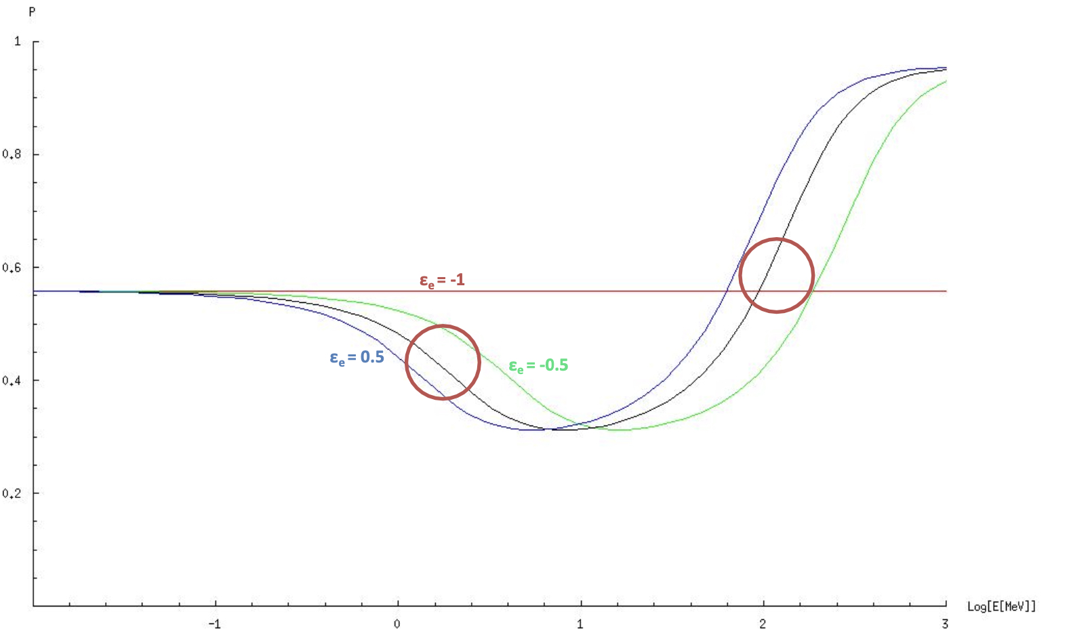
Overall survival probability (Pee) with NSI in the ’’2 flavor’’ semi-approximation
h

Slide 16
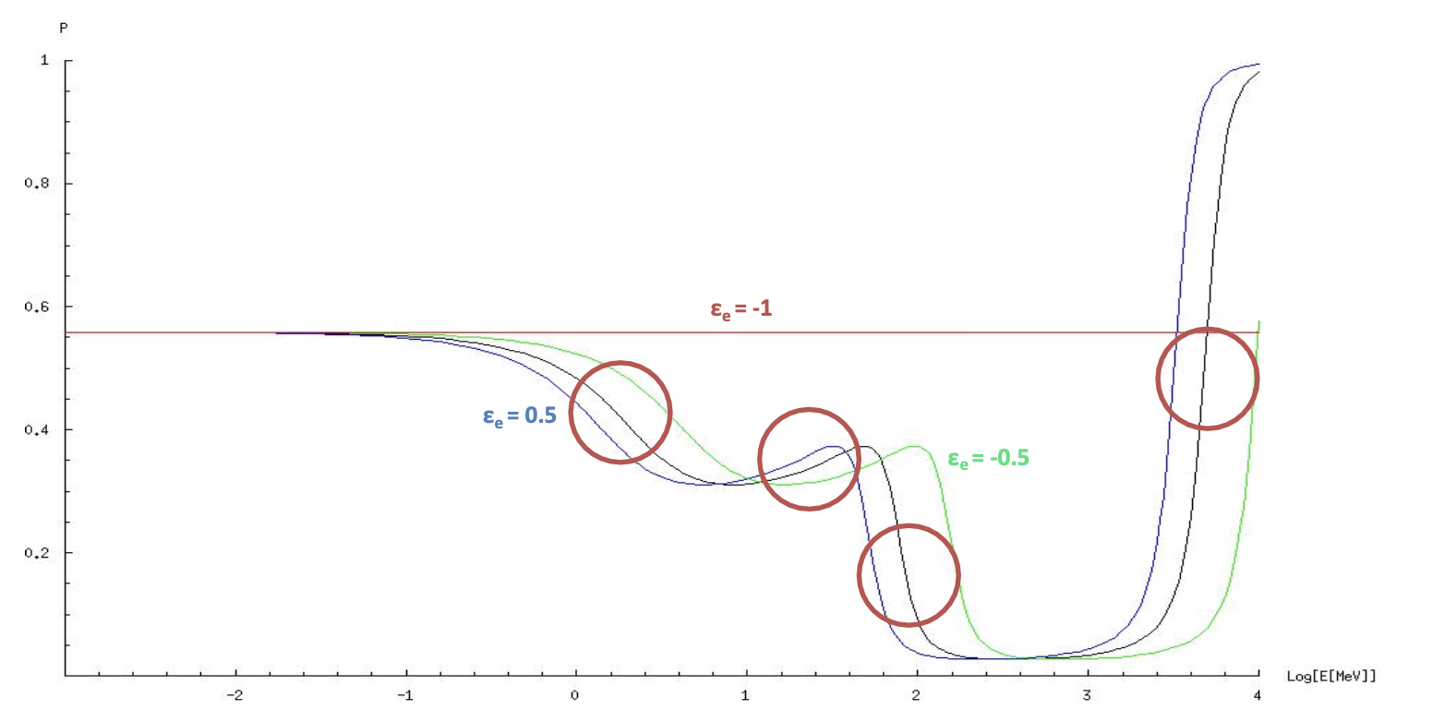
Overall Survival probability (Pee) in a full 3 flavor analysis
- Adoption of adiabatic hypothesis
- Presence of 4 resonances (2 additional due to 3rd flavor effect on transition and regeneration)

Slide 17
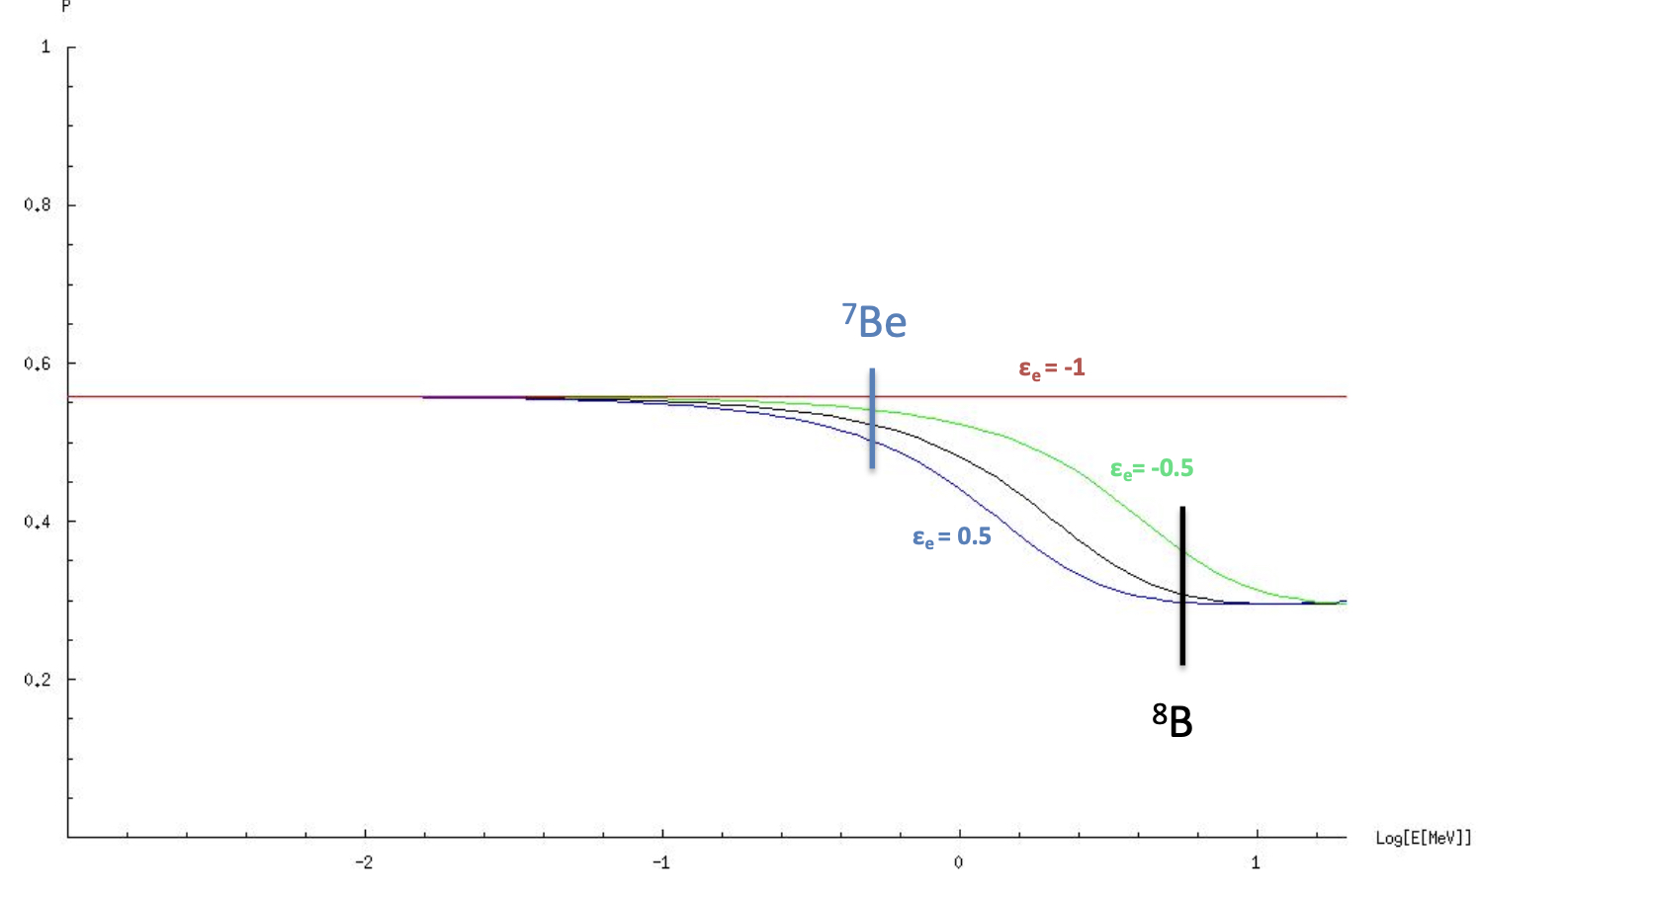
Full 3 flavor solution for solar neutrinos
Agreement with the approximated 2-flavor solution available in literature

Slide 18
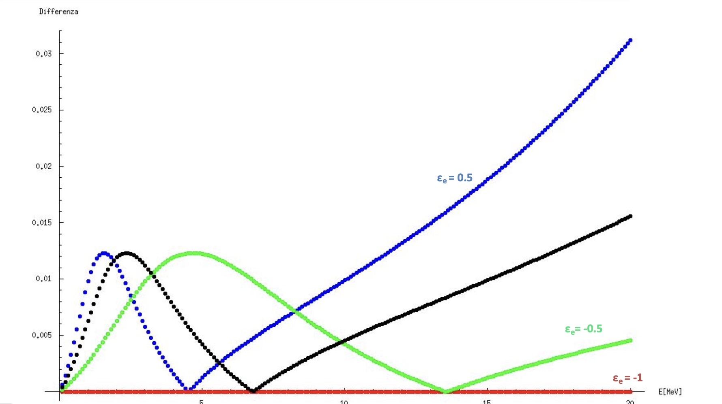
Comparison 2-3 flavor solutions
Absolute value of the percentage difference between our complete result, fully 3 flavor, and the approximated (2 flavor + corrections) solutions
Differences of the order of 1% most in the region of interest

Slide 19
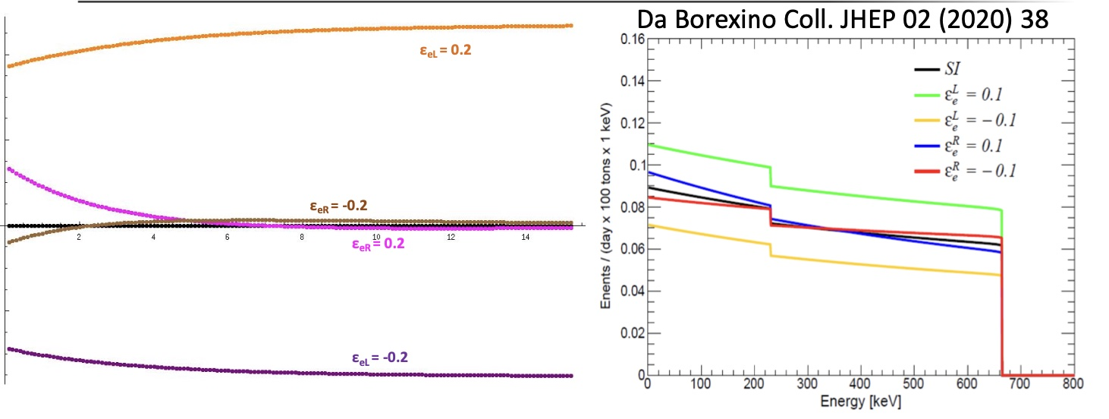
NSI effect on the spectrum: comparison with the Borexino case
Left: Our spectra with NSI normalized w.r.t. to the standard interaction case (black line) over all the solar energy range. Different colors represent different values of the NSI parameters
Right: Borexino Collaboration results for the ⁷Be interesting energy region
Agreement of our results with the Borexino ones: the LL NSI parameter mainly normalizes the spectrum; the LR one introduces also a shape deformation .
Interesting opportunity for JUNO measurements with low E threshold amd high resolution

Slide 23
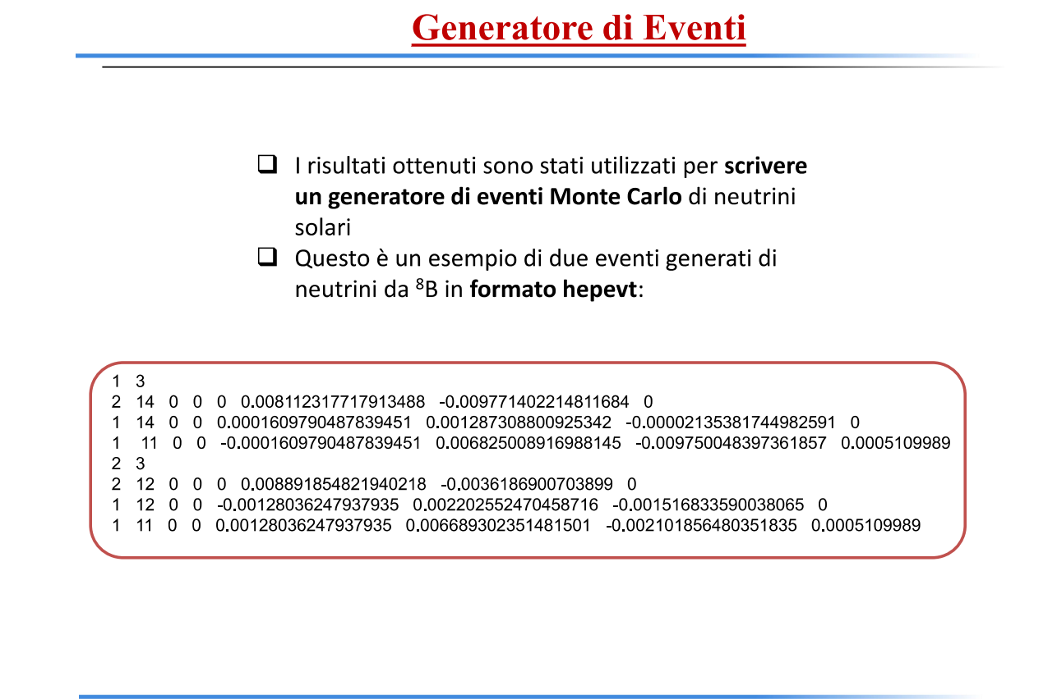
Output di analisi numerica

Slide 24
Back up slide

Slide 25
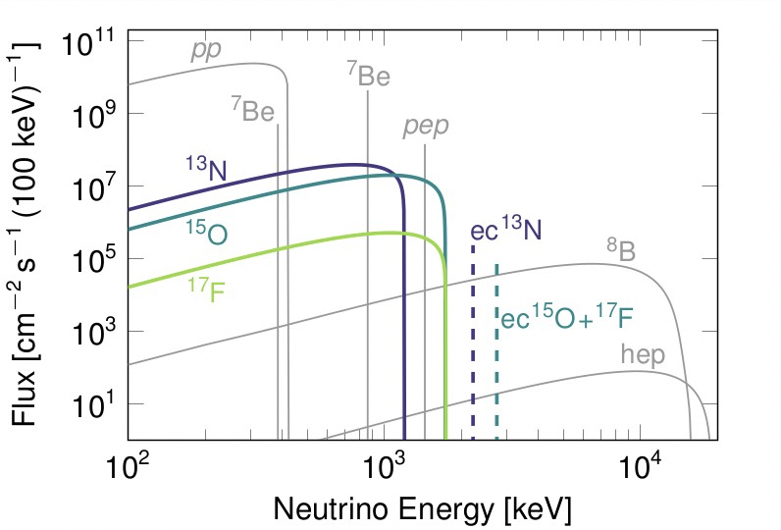
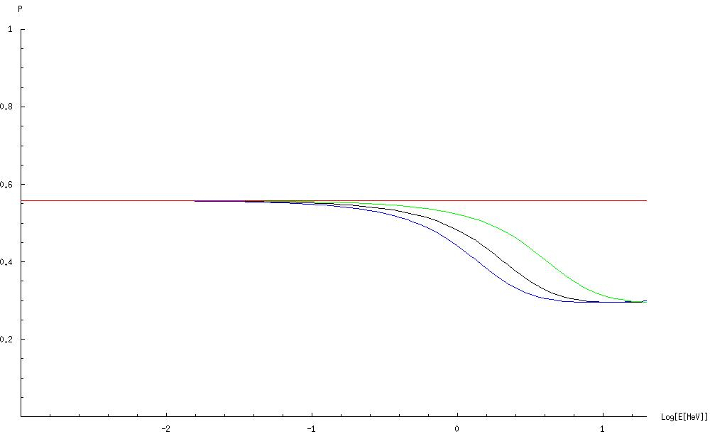
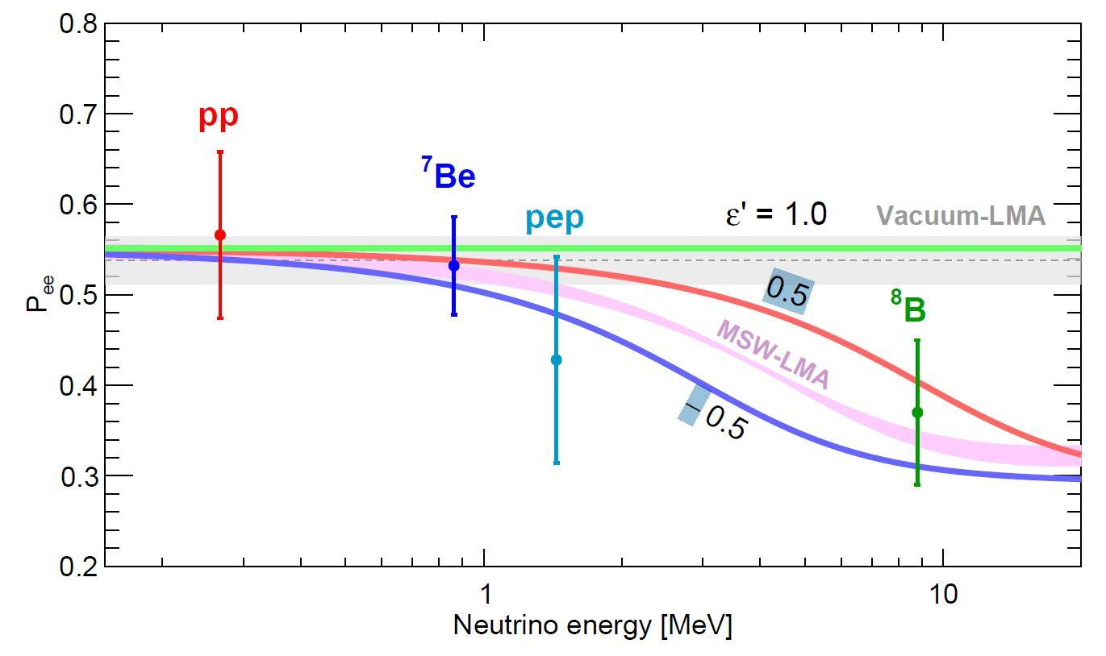
Status and open problems of solar neutrino physics
Solar ν spectrum (p-p chain and CNO cicle) 1-2 sector: mixing parameters
(from M. Agostini et al. [Borexino Coll.] Nature 587 (2020) 577 )
from: de Salas et al. JHEP02(2021)071
Oscillation probability
Our 3 flavor analysis
From Borexino Coll. JHEP 02 (2020) 38

