Slide 1
Readout Electronic Update
Andrea Fabbri on behalf of Electronic Group

Slide 2
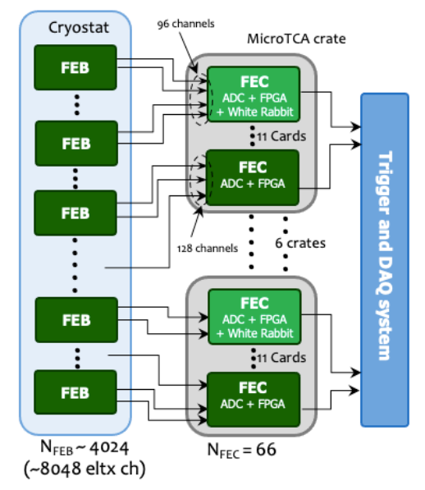
Electronic Readout Scheme
We had two electronic readout proposal until the FDR (end of April 2021).
The review committee suggestd to merge the two proposal:
  FEB (Front End Board - inside the cryostat) from the discrete solution.
  FEC (Front End Controller – outside the cryostat) based on the prototype coming from the ASIC solution.
FEB
  2 channel 1 tiles
  4024 tiles
  Total 8048 channels
  Analog signals from FEB will be transferred to FEC via differential pairs, 3-4 m inside the SS tank, ~10 m outside the tank
FEC
  ADC is on FEC, used to digitize analog signals from FEB
  FPGA & Power boards in MicroTCA.4 crate
  Q/T information is extracted with FPGA (waveform analysis)

Slide 3
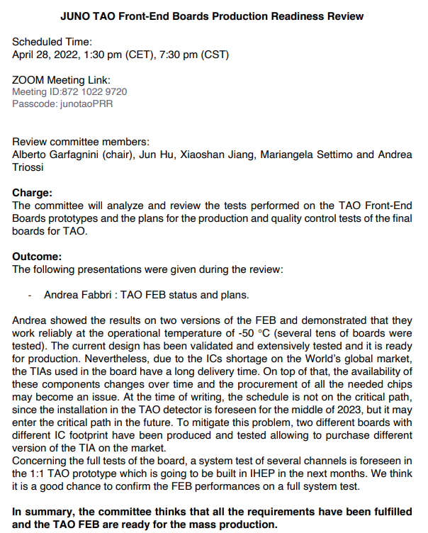
FEB PRR Results

Slide 4
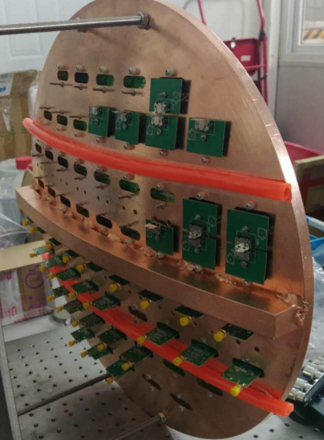
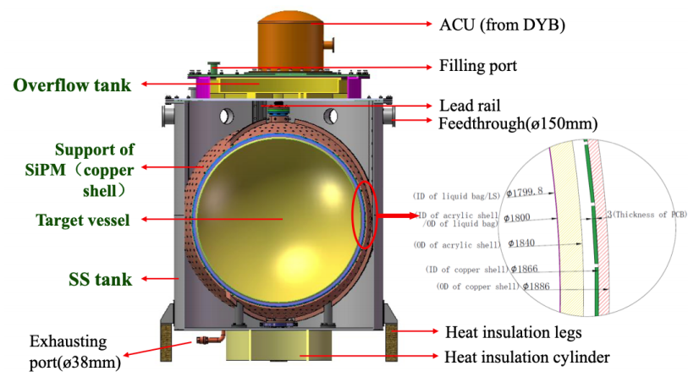
TAO Experiment
FEBs mock-up

Slide 5
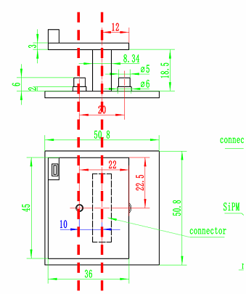
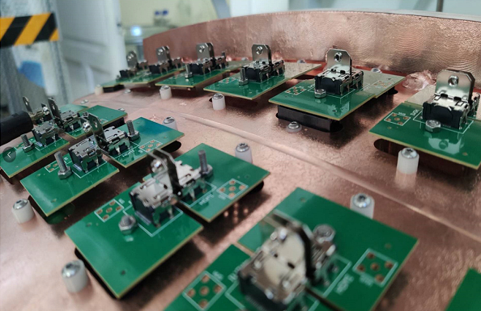
FEB – planar version

Slide 6
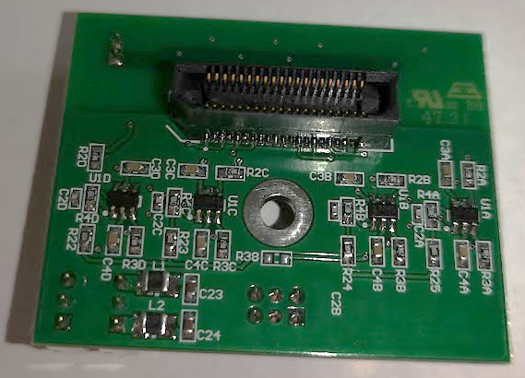
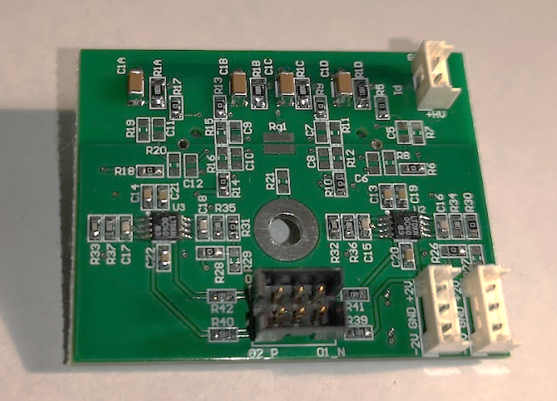
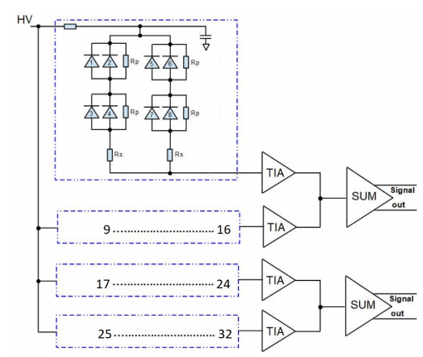
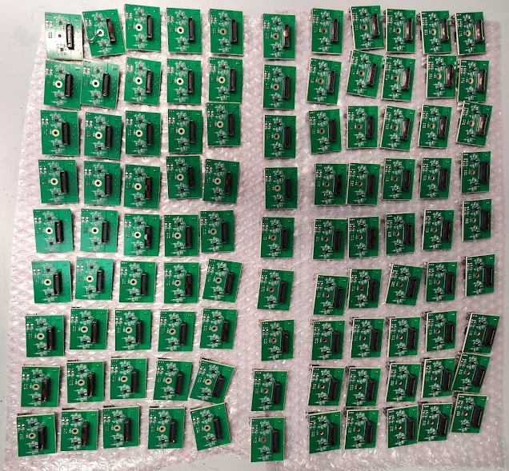
FEB – planar version
FR4 FEB prototype
Aramid (low background) FEB PCBs
100 pre-production batch

Slide 7
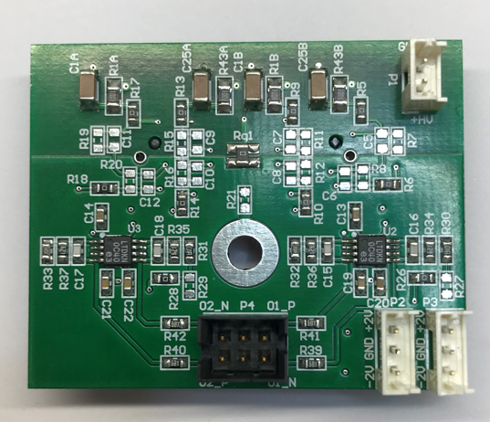
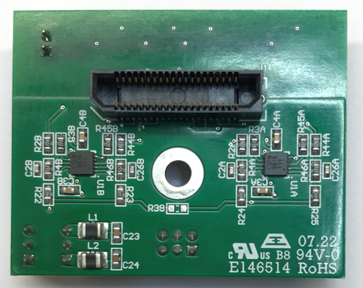
FEB Interfaces
HV supply
3 mt cable inside cryostat
+ 10-12 mt outside
0R resistor
LV supply
3 mt cable inside cryostat
+ 10-12 mt outside
Signal output
Differential pairs,
2-3 mt cable inside crysostat
+10-12 mt outside
LV supply
10 cm cable for the next FEB
(see next slide)
All the cable jackets will be made in PTFE to resolve the LAB compatibility issues
Tile
Board-to-board mating

Slide 8
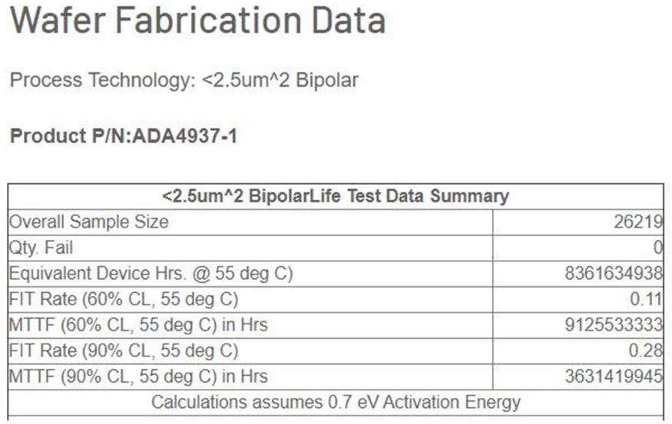
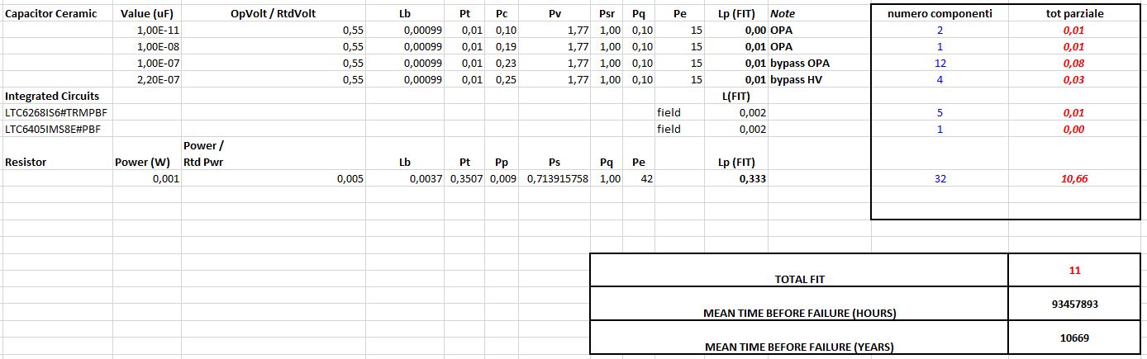


FEB reliability
Longest run @ -50° : 8 days
Integrated days @ -50° : 65 days
Number of cycles +20°/ -50° : ~100
Number of FEB prototypes : ~20
Number of failures : 0
from
Analog Design
FEB MTBF (Mean Time Between Failure)
N.B. ~4000 FEB with 10k years MTBF ➔ 1 failure every 2,5 years

Slide 9
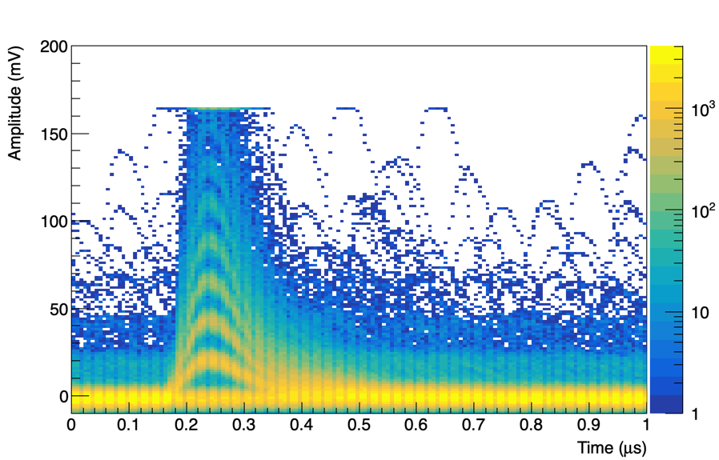
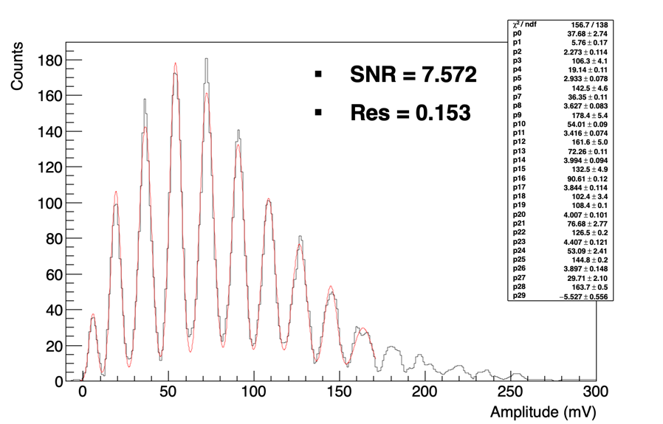
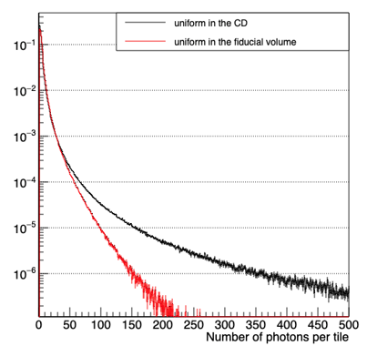
FEB Dynamic Range
Single P.E. maximum amplitude ~ 20 mV
0V-2V output linearity range (compatible with ADC input range)
P.E. Channel dynamic range 1 – 100 p.e. (1-200 p.e. on the whole tile)
IBD occupancy from MC simulations (75 cm radius)

Slide 10
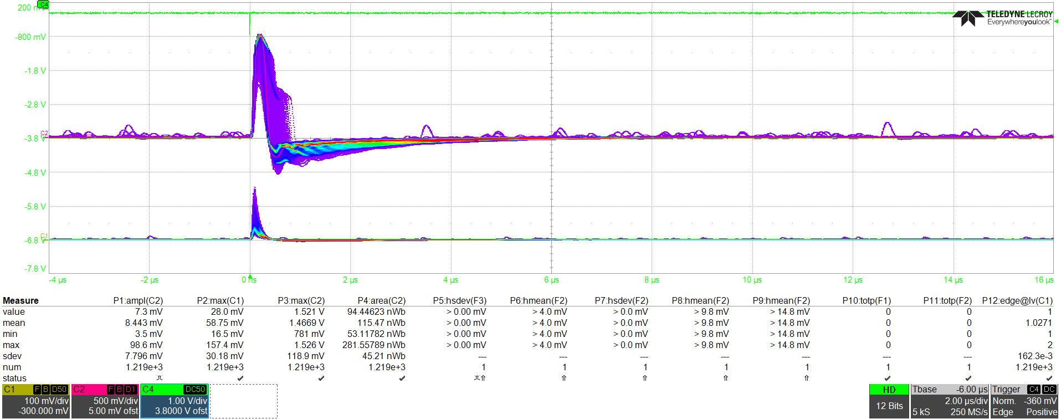
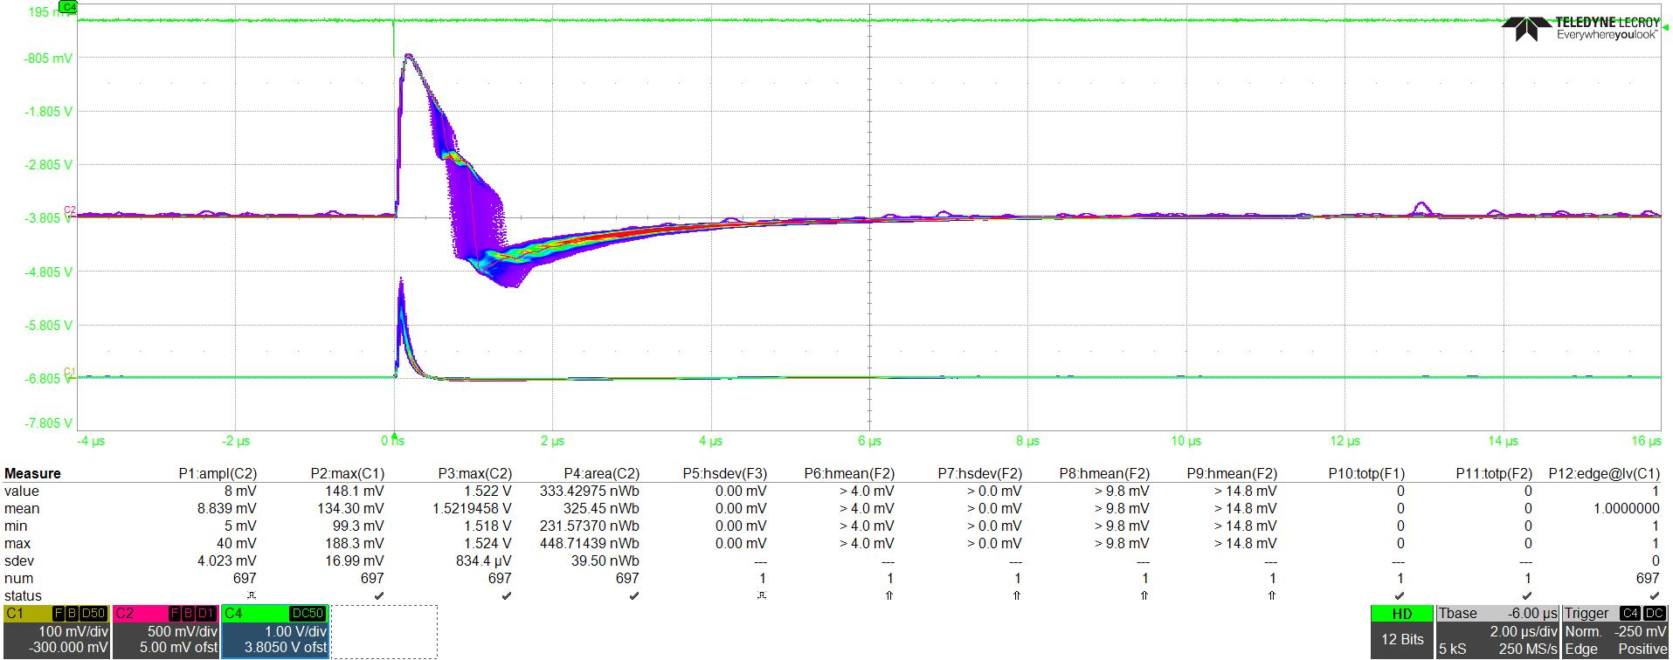
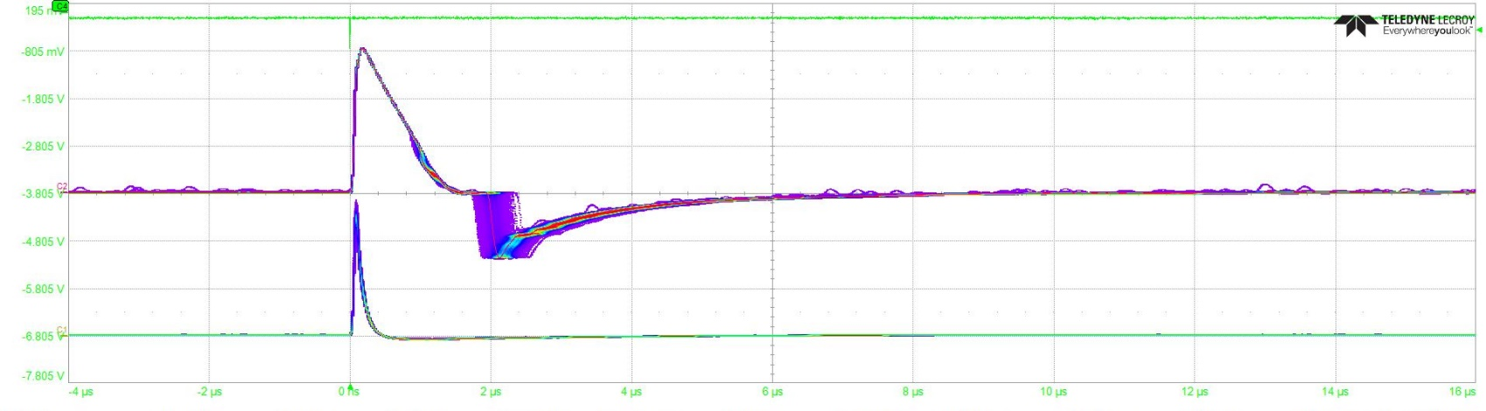
Test result – recovery time after muon scintillation
2u 4u 6u
Standard
gain
500 p.e.
Low
gain
We reduced the gain (1/20) of 1 FEB channel to have a «self calibration» of the light pulse.
The «rebounce» happens after the TIA saturation.
In the circled area the photon counting can be executed but it needs a careful evaluation of the baseline.
Standard
gain
1000 p.e.
Low
gain
Standard
gain
2000 p.e.
Low
gain

Slide 11
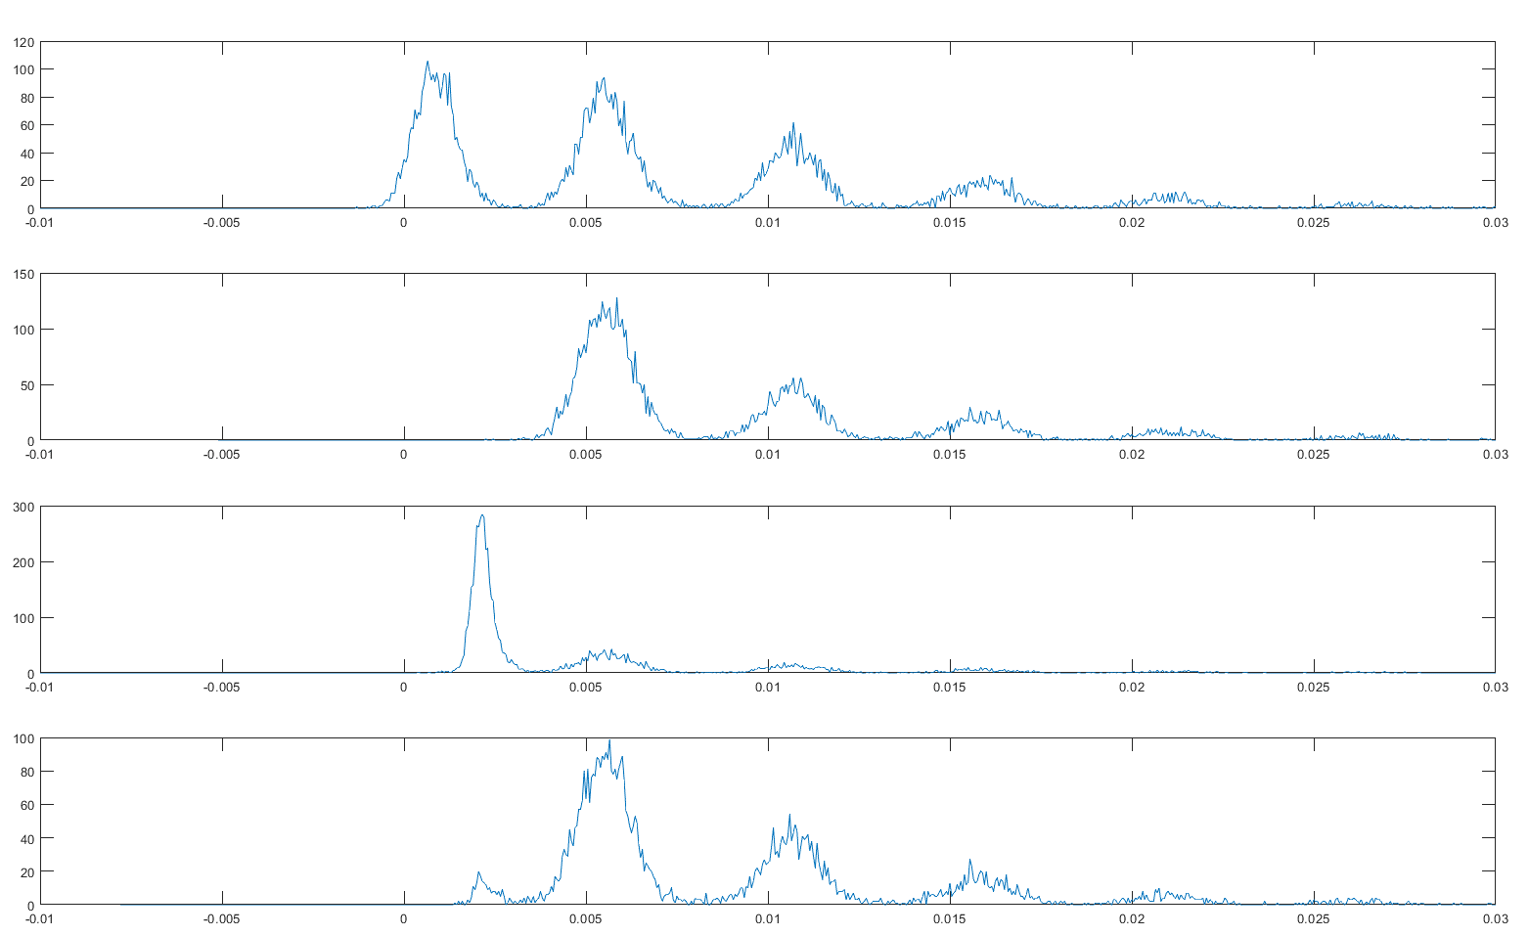
Test result – improving trigger performance
Laser trigger
All the plots are taken with the same laser configuration.
In the first plot the trigger comes from the laser itself.
On the others the trigger is setted on the FEB signal («self-trigger»).
The self trigger performance can be enhanched by adding a simple «time over threshold» constrain
Counts [au]
Counts [au]
½ p.e. threshold
¼ p.e. threshold
Counts [au]
¼ p.e. threshold +
150 ns time over threshold
Counts [au]
Peak maximum [mV]

Slide 12
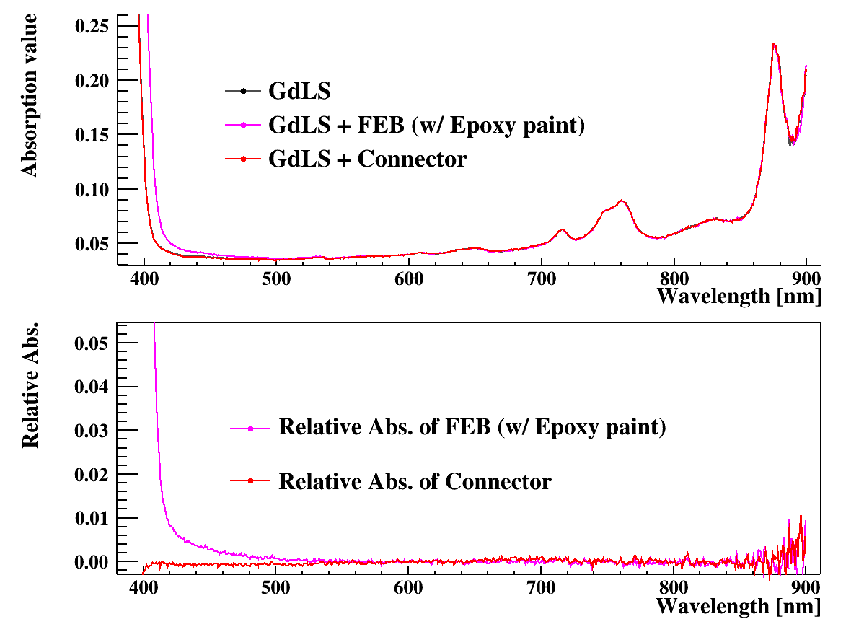
Compatibility issue
Connector alone is ok
A first test with Expoxy paint improves the performance of the whole board
Better results with sprayng methods may be achieved, test in progress.
From Zhangquan compatibility test results

Slide 13
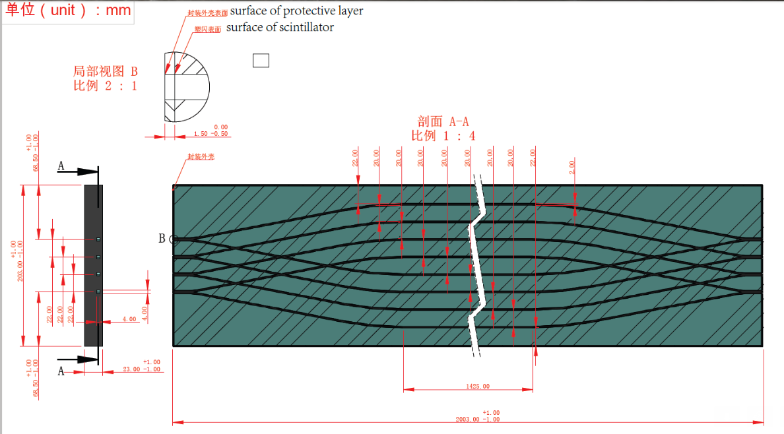
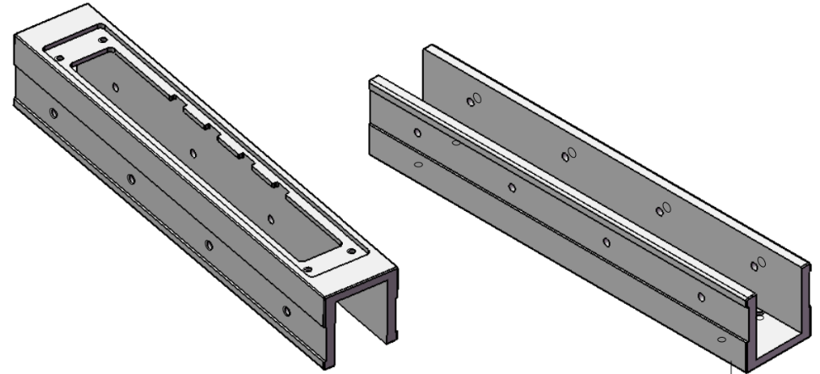
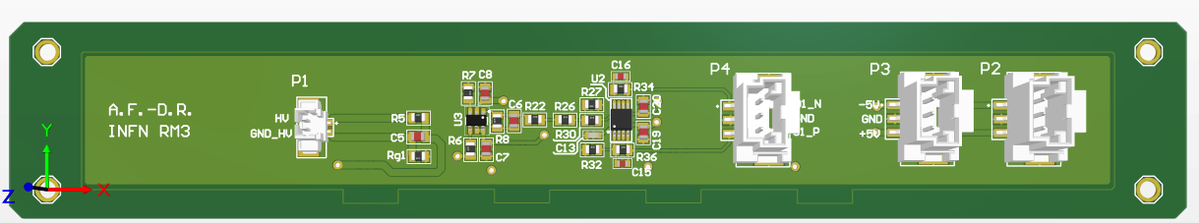
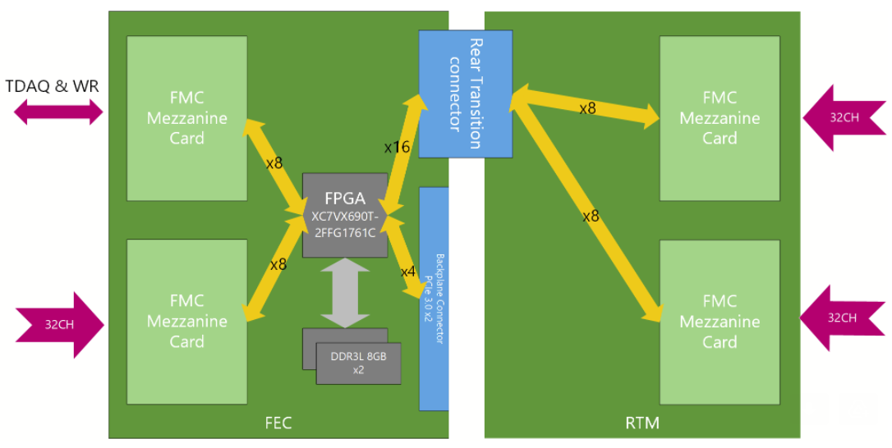
Veto Electronic Readout Architecture
Crystal – FEB adapter
VETO dedicated FEB
(4 SiPM on the bottom
side, directly coupled
to the optical fiber output)
FEB shape and mechanics
discussed with the VETO group
Each FEC can manage 96 channel ➔ 4 FEC can manage all Veto channels

Slide 14
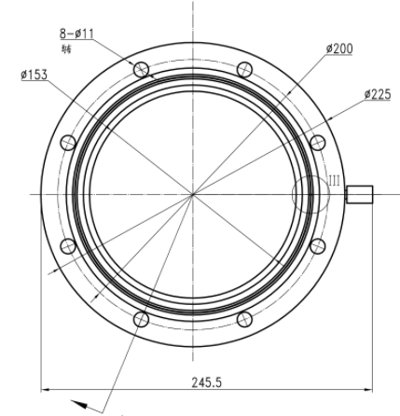
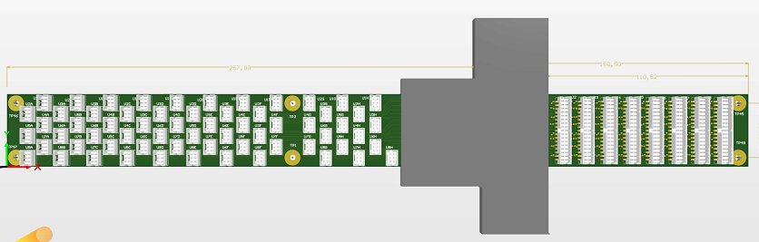
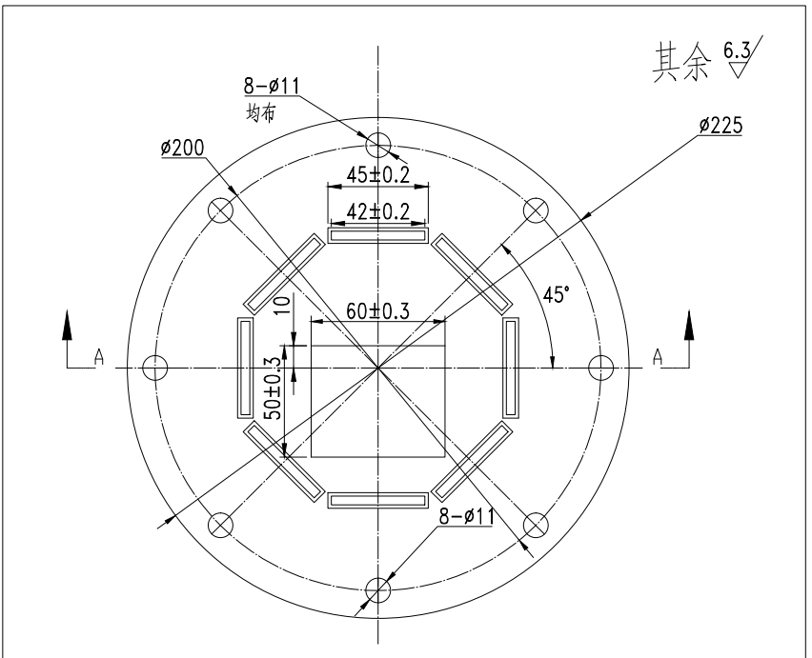

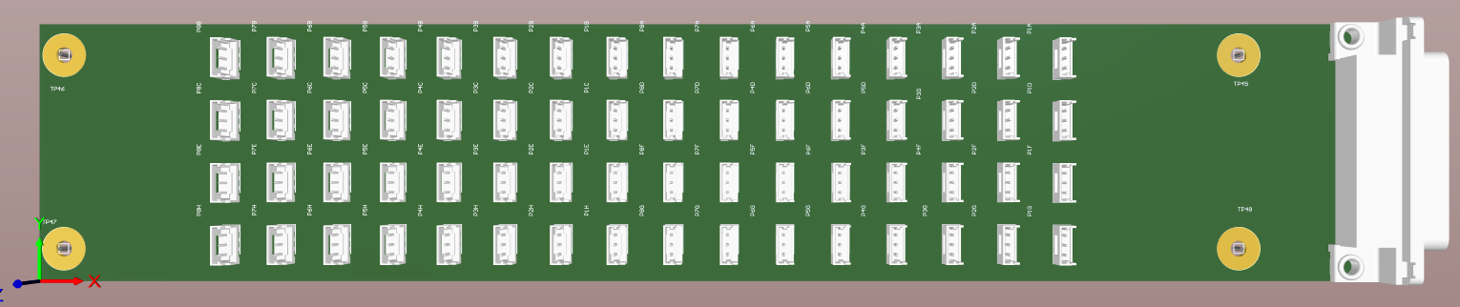

Flange design
153 mm
8048 differential pair for signal readout
8 flanges, 1006 differential pairs each
6 «signal feedthrough» PCB on each flange (84 pairs each)
2 «power feedthrough» PCB on each flange (50 A + 50 A each)
Power
Signal PCB
Power
10 simplified Signal PCB delivered last year (8 in IHEP, 2 in Roma)
Internal side
External side
Power PCB

Slide 15
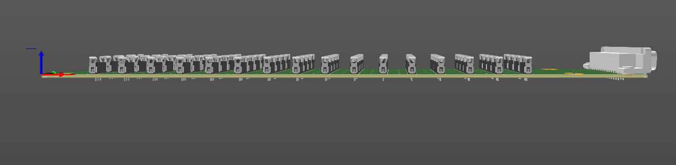
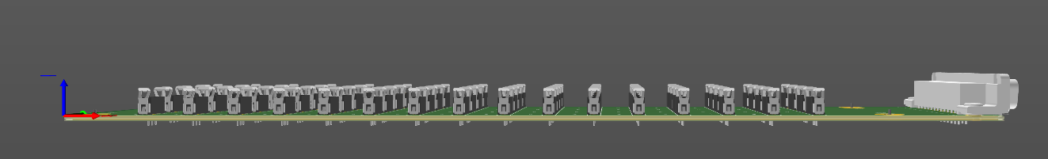
FEB Power Supply – Inside Tank
Signal cabling (1 cable/FEBs)
To FEC/ADC boards
9 pin DSUB connector
for V/I monitoring
Signal cabling (1 cable/ 6 FEBs)
25 pin
DSUB
connectors
Power cables from
LV power supplies
(standard DSUB connectors)
Signal cabling (1 cable/FEBs)
To FEC/ADC boards
Flange

Slide 16
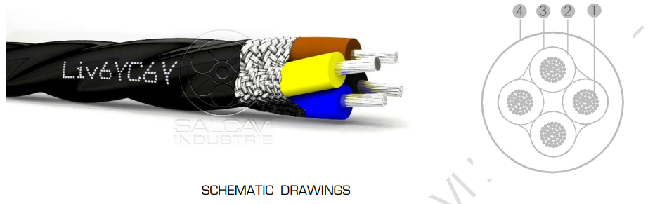
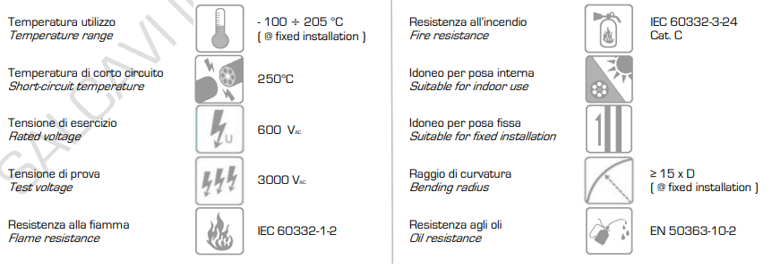
Cabling
Cable FEP/FEP (600V) Liv6YC6Y 3x0,25 mm2 – Ø 3,40 mm
Cond. 19x0,127 mm solered copper – isol. d. 1,05 mm
Shield: soldered copper twist
Cable FEP/FEP (600V) Liv6YC6Y-TP 2x2x0,25 mm2 – Ø 5,00 mm
Cond. 19x0,127 mm solered copper – isol. d. 1,05 mm
Shield: soldered copper twist
Shippment time: 25 weeks, imported from China.
Asked for a sample (few meters) to do compatibility test in IHEP.

Slide 17
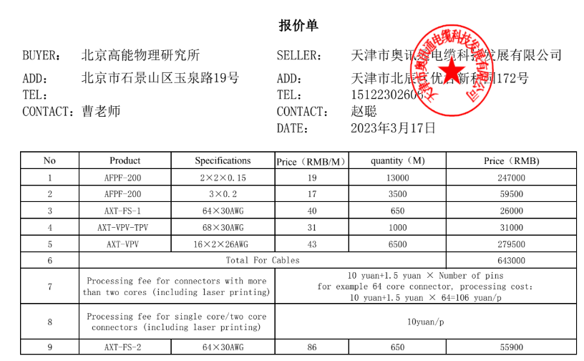
Cabling
Cavi interni
Cavi esterni

Slide 18
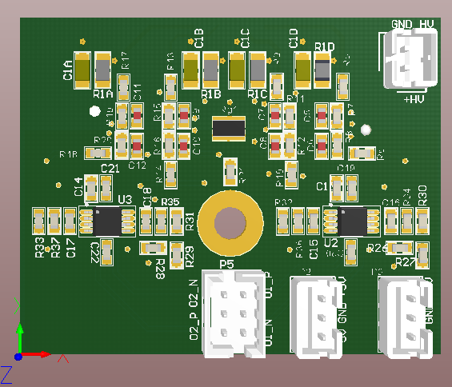


FEB Power Supply – Inside Tank
Each FEB needs 80 mA at +2V and 80 mA at -2V
Each flange have to supplies ~500 FEBs.
FEBs can be suddivided in ~86 rows with 6 FEBs each.
86 long pairs come from the flange to the first FEB of each FEB rows
Shorter cables can be used to bring supply to the other FEBs on the row
LV Supply
Connectors
Flange
FEB
FEB
FEB
FEB
FEB
FEB
FEB
FEB
FEB
FEB
FEB
FEB
FEB
FEB
FEB
FEB
FEB
FEB
FEB
FEB
FEB
FEB
FEB
FEB
FEB
FEB
FEB
FEB
Inside cryostat

Slide 19
Power Distribution
FEB Supply Modules
+12V
from uTCA connector
Isolated +2V
+2V
FEB
SiPM
GND
Isolated +2V
-2V
+70V / +110V
GND
FEC
SiPM
Supply
FEC Supply
ADC
+12V
from uTCA connector
+1.8V ADC
Differential Output
GND
FPGA
ADC
2.5V, 1.8V, 1,2V, 1V FPGA
ADC

Slide 20
Grounding
Flange PCB
(analog signal)
FEC
GND
Different grounding schematics are feasible with the current hardware.
We are going to setup lab to study the different grounding connection.
The results of this study will be tested in the 1-to-1 prototype setup in IHEP.
FEB
+2
GND
-2
Flange PCB
(low Voltages)
LV Supply
SiPM
+2V
GND
-2V
+2.2V
GND
-2.2V
shielding
GND
0R / NM
NM / 0R
Clean
Ground
Flange PCB
(SiPM bias)
HV Supply
+Vbias
GND
+Vbias
GND
+Vbias
GND
GND
Copper
Inside Outside
Grounded

Slide 21
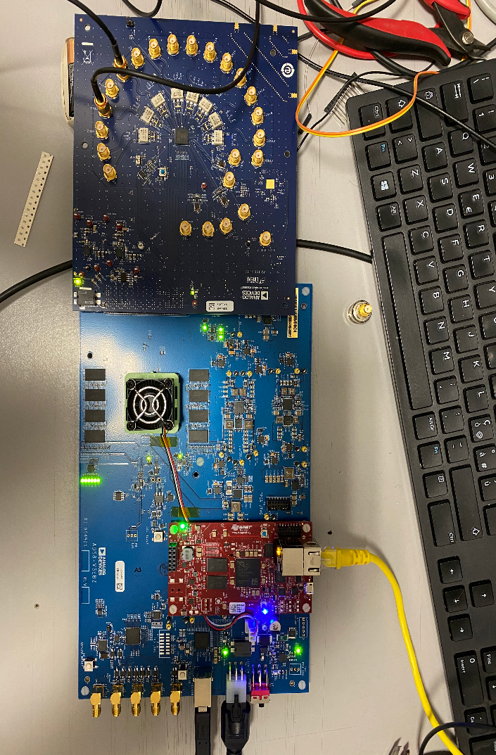
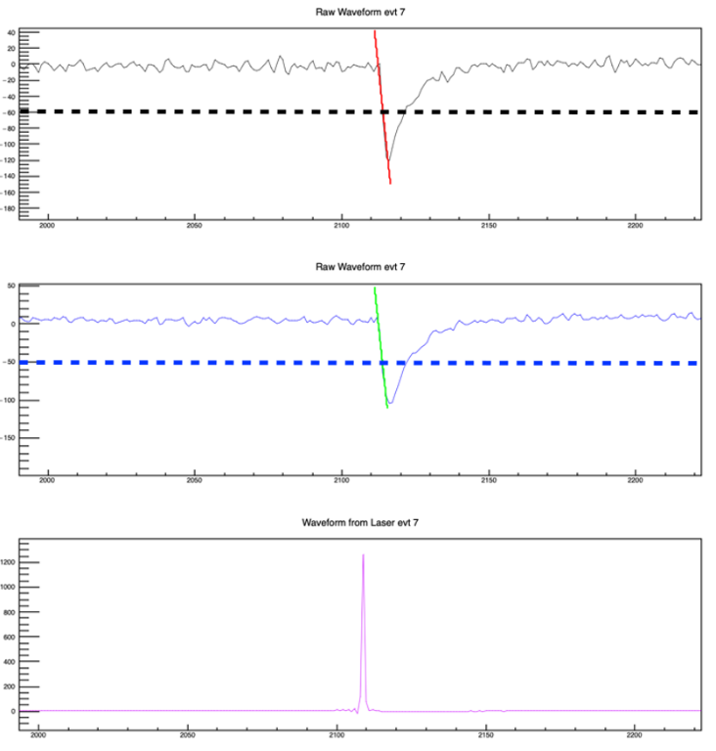
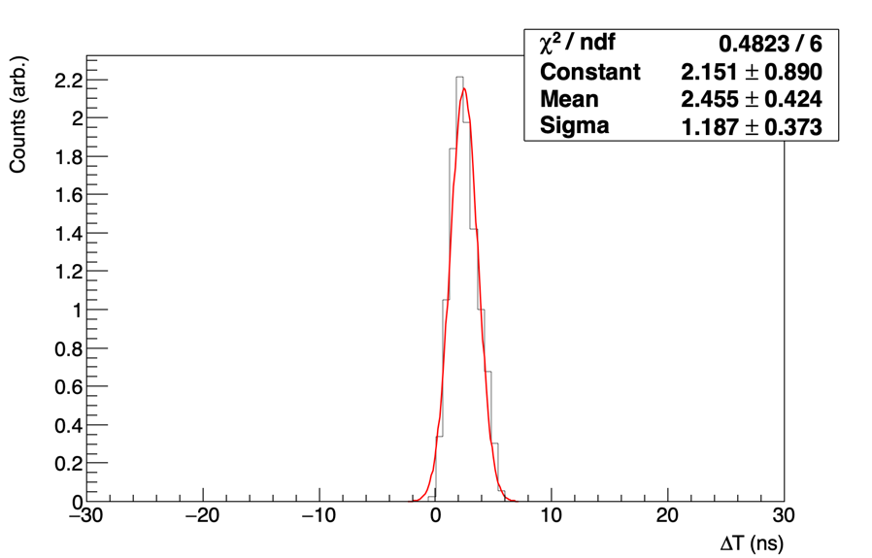

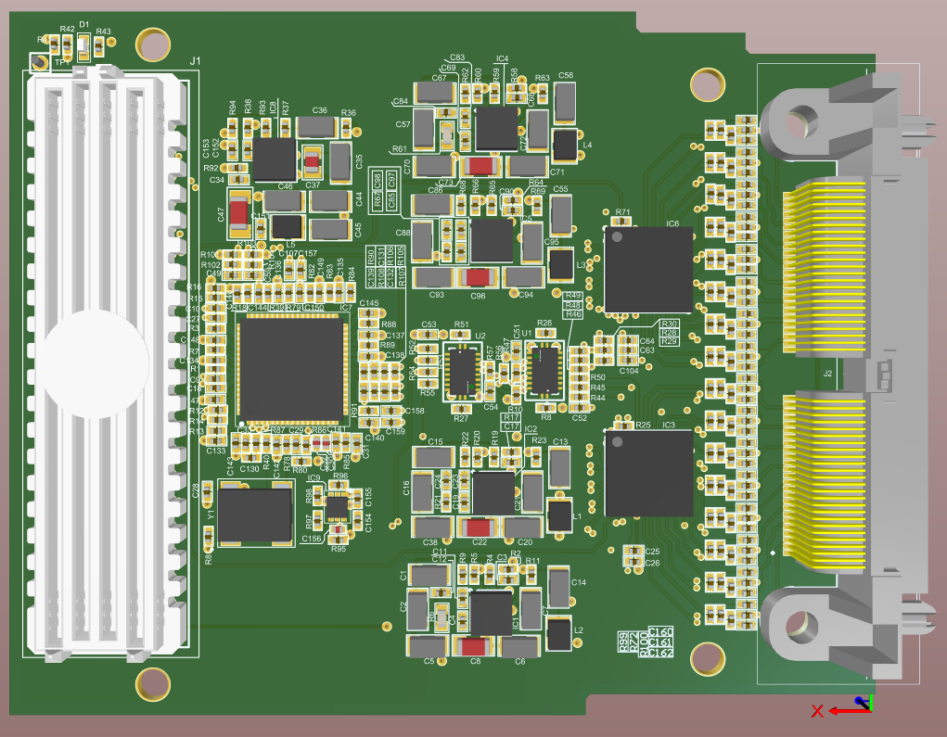
ADC Prototype
100 kHz laser
FPGA
Prototype system:
ADC board with AD9083
FPGA controller (Kintex7)
Ethernet connection with PC
ADC Board:
Two AD9083 – 16 Channels
Dedicated PLL
Working on the prototype,
still managing the external
connector.
250 Msample/sec ADC,125 MHz bandwidth
16 channels
Differential input
2 Vpp input
Dedicated Input for shared clock between different board

Slide 22
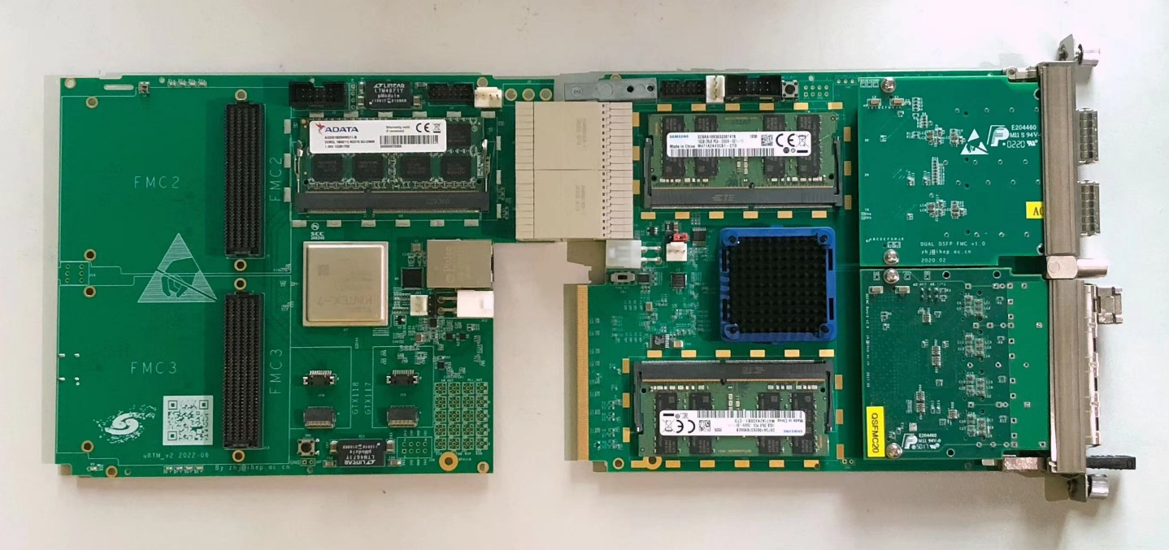
FEC and ADC Board
ADC Board - Roma3
FEC Board - IHEP
RTM-v2
u4FCP-v1

Slide 23
Production schedule
100 FEB pre-production received and tested. 50 of them shipped to China.
Components for the full production
Part Number | Board | Lead Time
LTC6269 (8400 pcs) | FEB | Scheduled for May
LTC6405 (8400 pcs) | FEB | Received
AD9083 (550 pcs) | ADC | Included in the bid
LTM8078 (290 pcs) | ADC | Included in the bid
AD9528 (290 pcs) | ADC | Received
4200 FEBs
should be ready
during the summer
275 ADC boards
should be ready
for September
Board | PCB status | Lead Time
Signal Flange | Received | 2° week of April
Power Flange | Received | 2° week of April
Test system for FEB | 1° week of April | 3° week of April
VETO FEB | Received | 1° week of April
The full production probably
will be done in China

