Slide 1
DESY interests
S. Antipov
1st WP9 Meeting, March 15th 2023

Slide 2
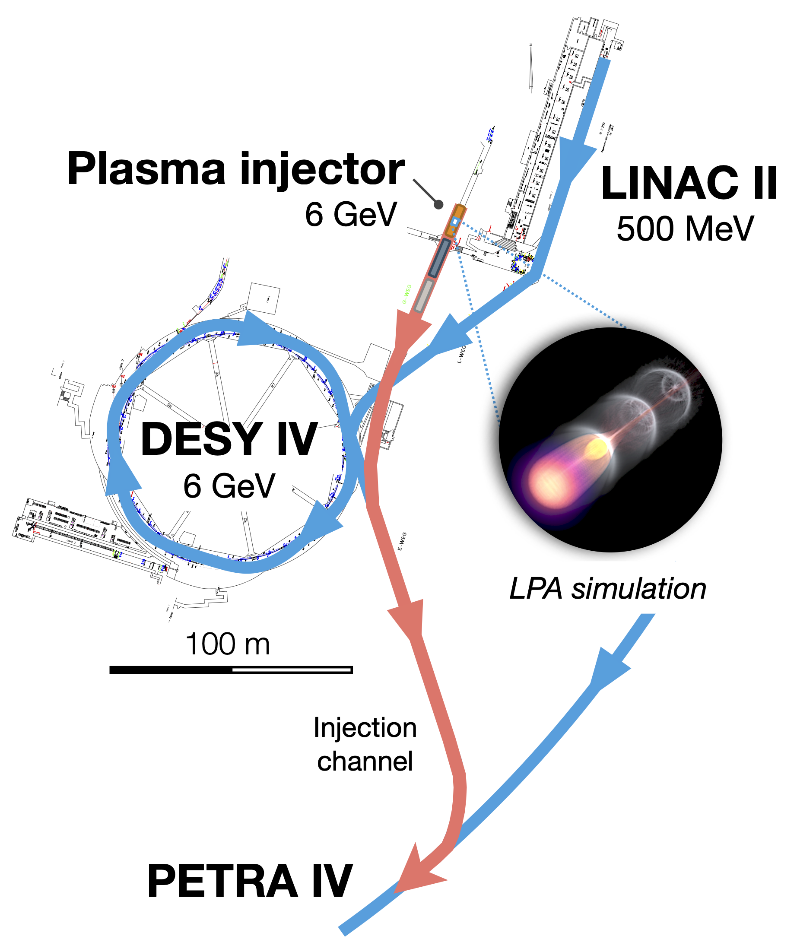
LPA injector for PETRA IV light source
Combining working, proven solutions to manipulate LPA beams
Energy | 6 GeV
Bunch charge | 100 pC
Energy spread | 0.1 %
Norm. emit. | 1 um
Rep. rate | 2.5 (30) Hz
Laser pulse energy | 20 J
CDR to be realeased in 2023
Included in the PETRA IV project proposal
R&D on laser, plasma cells starting now
| EuPRAXIA PP WP9 | Sergey Antipov, 14.03.2023

Slide 3
Proof-of-principle prototype at LUX
Building up on the existing LPA FEL infrastructure to demonstrate permille level energy spread in two years
new
existing
undulator
Courtesy P. Winkler
Existing LUX beamline
500 MeV range LPA FEL demostrator
chicane
x-band
spec
new
Collaborating w CERN on X-band
existing
Re-using HERA-era magnets
| EuPRAXIA PP WP9 | Sergey Antipov, 14.03.2023

Slide 4
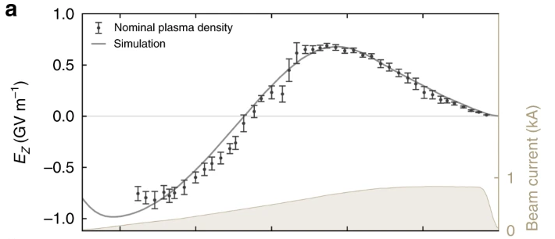
FLASHForward
Beam-driven plasma accelerator experiment at DESY
Goal: high-quality plasma booster
Research towards energy-spread preservation and high efficiency
X-Band TDS for beam characterisation
| EuPRAXIA PP WP9 | Sergey Antipov, 14.03.2023

