Slide 1




CERN interest in WP9
Andrea Latina, Edda Gschwendtner (CERN)
WP9 Kick-Off meeting, 15 Mar 2023

Slide 2
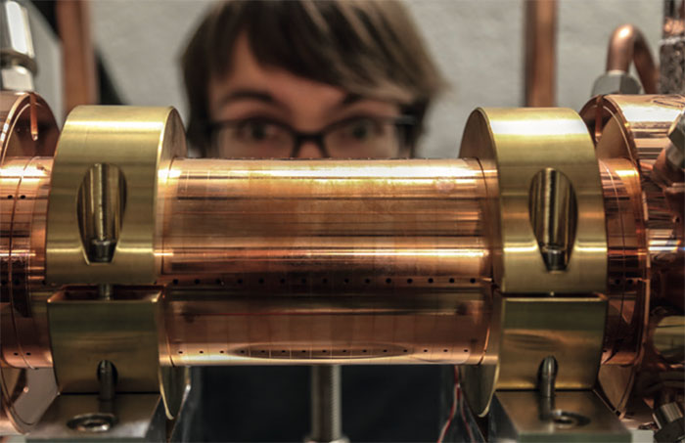
High-gradient acceleration, example: the CompactLight Design Study
The CompactLight Design Study (www.compactlight.eu ) was funded by the European Union under the Horizon 2020 research and innovation funding programme, grant agreement No. 777431, and was carried out by an International Collaboration of 23 international laboratories and academic institutions, three private companies, and five third parties.
The project aimed to design an innovative, compact, and cost-effective hard X-ray FEL facility complemented by a soft X-ray source, to pave the road for future compact accelerator-based facilities.
The result is an accelerator that can be operated at up to 1 kHz repetition rate, using the latest concepts for high brightness electron photoinjectors, high gradient accelerating structures in X-band, and novel short-period undulators.
Main deliverable: a (360-page) Conceptual Design Report
Two prototypes of the CompactLight RF structure are being built within i-FAST
The upgrade of the EuSPARC Linac for EuPRAXIA, at INFN-LNF, will use the CompactLight structure

Slide 3
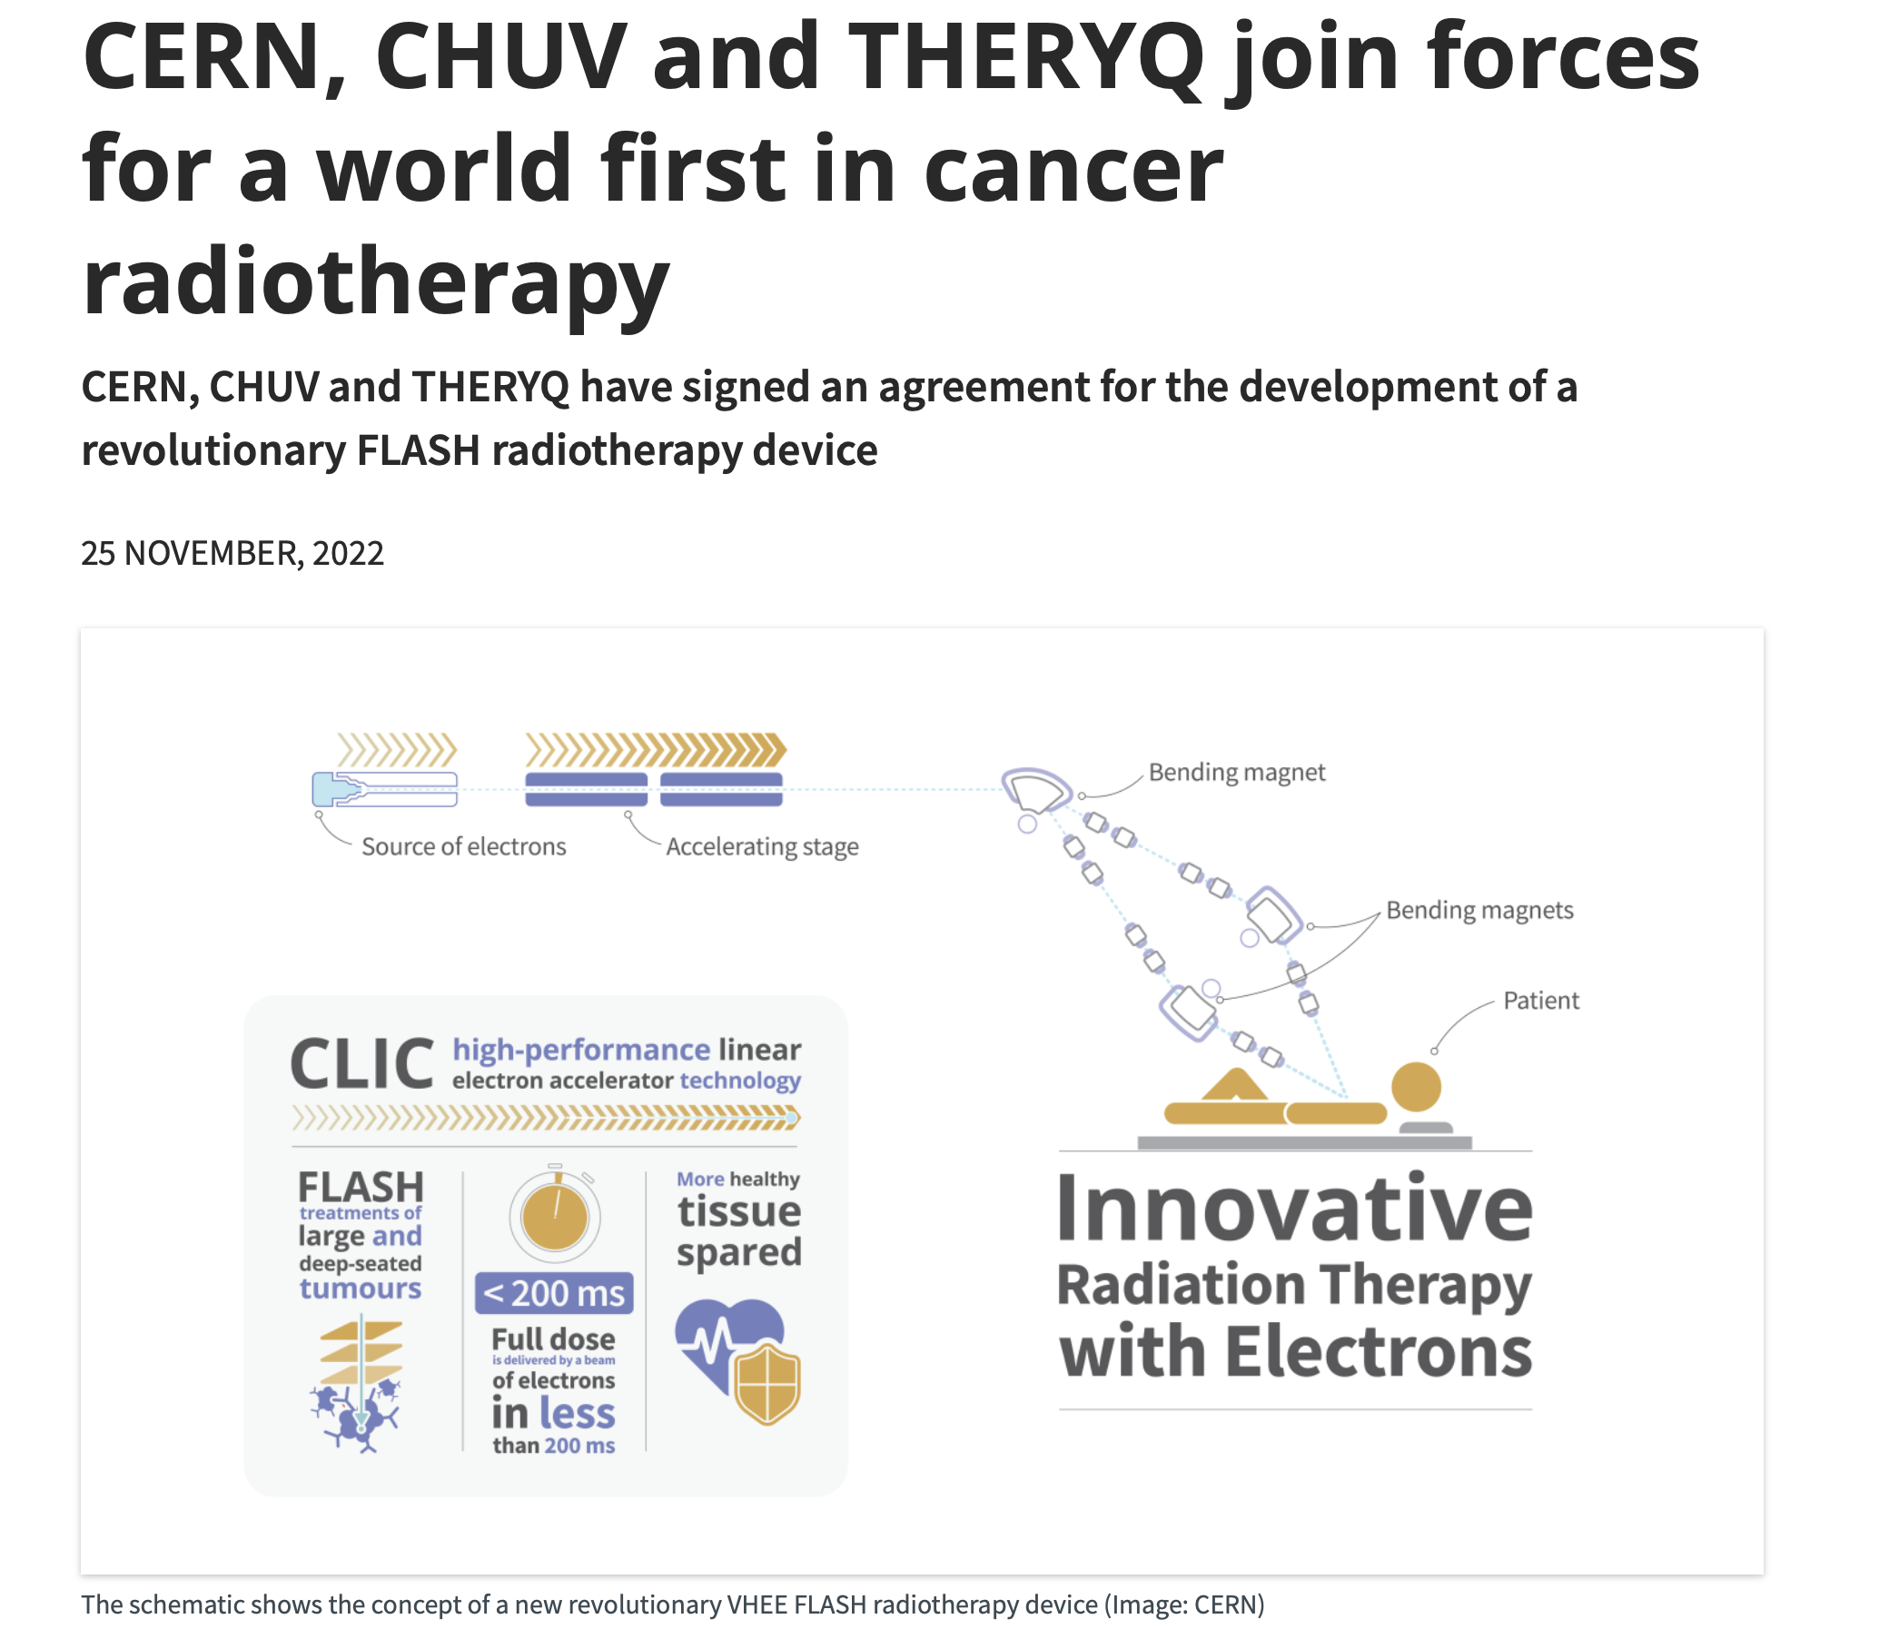
Compact linacs - The CREATE Proposal
The CREATE Proposal:
A consortium of 24 International Institutes, aiming to develop highly important and ground-breaking electron accelerator technologies for Europe`s future Research Infrastructures (RI). The project objective of CREATE is to develop innovative breakthrough technologies for electron accelerators while taking energy consumption, resource efficiency, costs, and environmental impact into due account
The consortium implements a European Partnership between Research Centers, National Laboratories, ESFRI projects, Universities and European Industry. The developed technologies will be used for future resource-efficient upgrades of existing RI at INFN, Elettra, CERN, DESY, UKRI, CNRS and ELI Beamlines.
In addition, the future realization of highly innovative European RI like the new ESFRI project EuPRAXIA and the CompactLight project, that is preparing its next phase toward ESFRI, are supported. Last not least, the development of compact and efficient accelerator products together with the involved European industry is envisaged→ E.g., a compact Inverse Compton Scattering (ICS) source, Compact linacs for medical applications.
CREATE aims at producing key prototypes to be installed on future RIs, consolidating and further strengthening the global leadership of European accelerator technology → Hi-rep rate X-band RF module (modulator + klystron)
1) X-band linac for medical applications (FLASH)
2) Compact ICS source

Slide 4


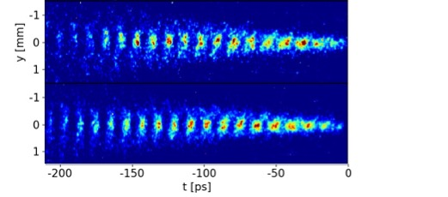
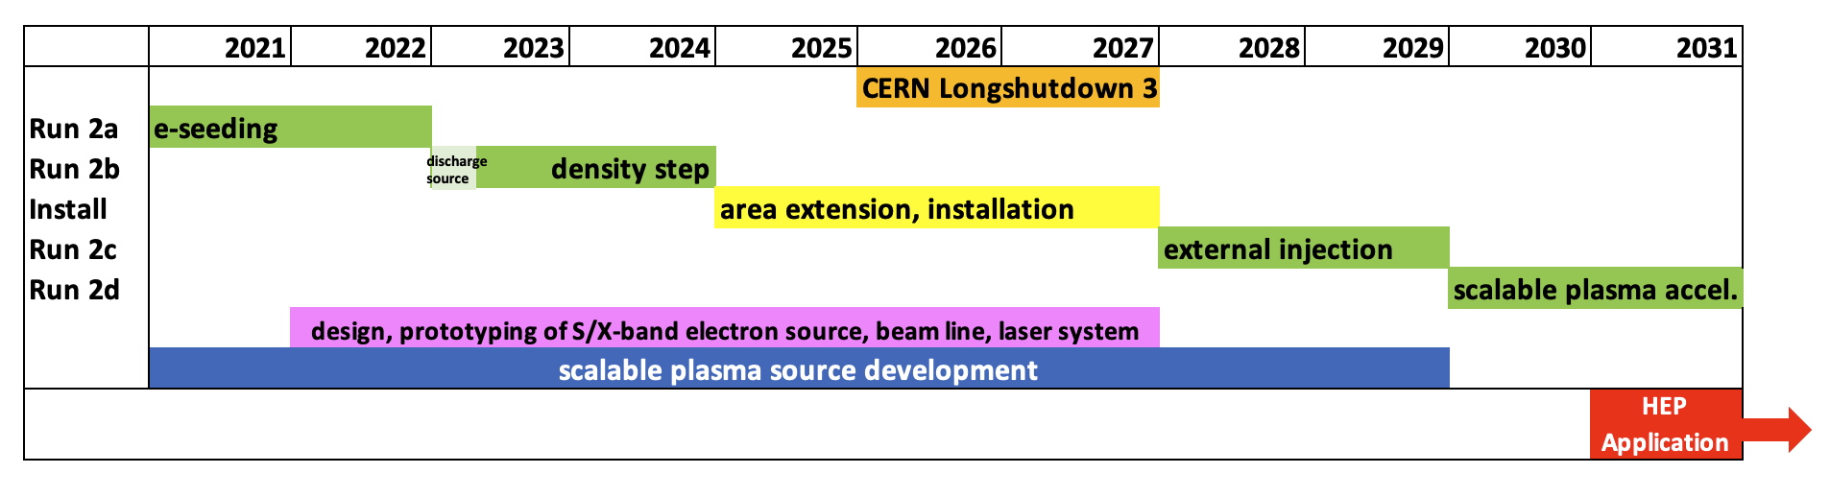
AWAKE Run 2: Towards first Particle Physics Experiments
Demonstrate possibility to use AWAKE scheme for particle physics applications in mid-term future!
  Accelerate electrons to high energy (gradient of 0.5-1GV/m), control beam quality, demonstrate scalablity.
Started 2021, program goes beyond CERN Long Shutdown 3 (2027+)!
y [mm]
Scalable plasma source
L. Verra et al. (AWAKE Collaboration), Phys. Rev. Lett. 129, 024802 (2022)
Particle physics experiment
Slide courtesy of E. Gschwendtner

Slide 5
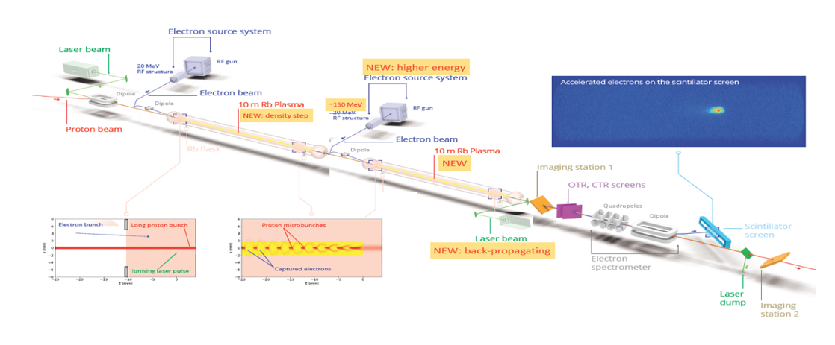

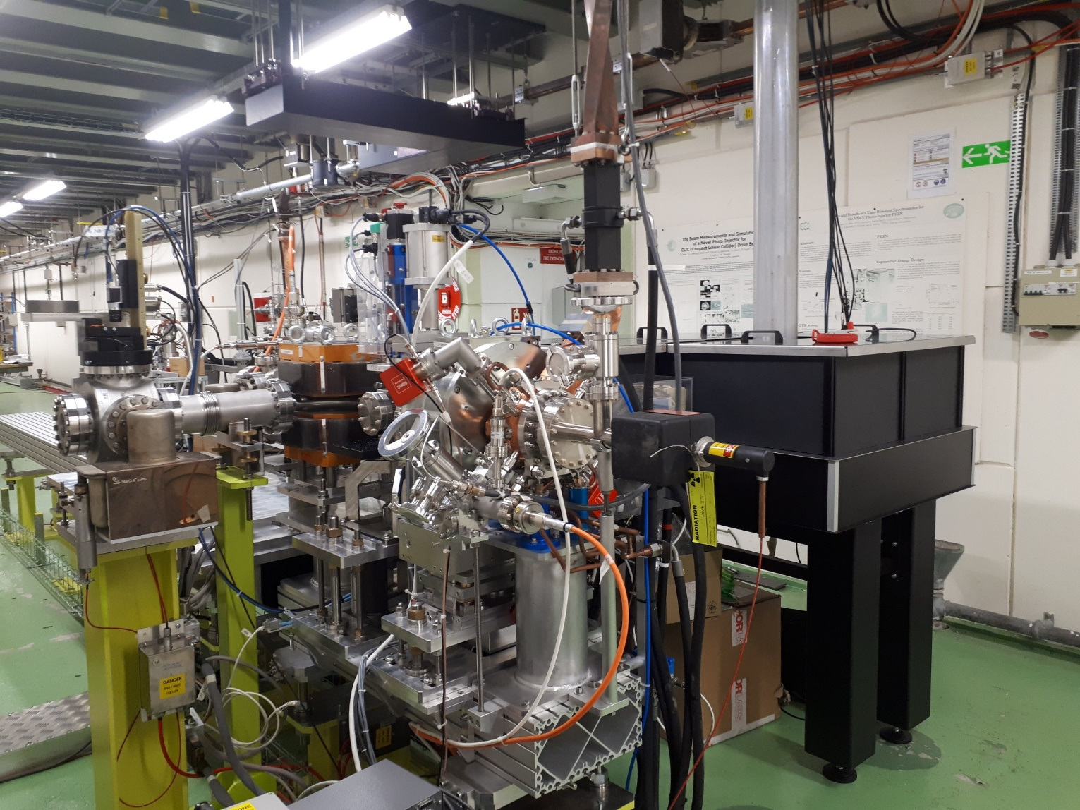


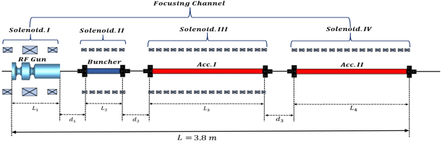
AWAKE Run 2c
AWAKE Run 2c and Run 2d after LS3 (2027+) :
Optimize acceleration of electrons in p-driven plasma wakefield
Accelerate an electron beam to high energy (gradient of 0.5-1GV/m)
Control electron beam quality as well as possible (emittance preservation at 10 mm mrad level)
New electron beam:
Based on X-band
Prototyping together with CLIC/CLEAR
150 MeV, 200 fs, 100 pC, σ = 5.75 µm
Blow-out regime: Beam loading: reach small ∂E/E , Match electron beam transverse properties to the plasma
Electron source prototype at CERN
1st plasma cell: self-modulator
2nd plasma cell: accelerator
CNGS target area during installation
Prototype in CTF2
Beam commissioning has started!
Slide courtesy of E. Gschwendtner

Slide 6
Summary
Four areas of interest:
X-band high-gradient acceleration and applications
Hi-rep rate injectors
Beam dynamics
Compact magnets

