Slide 1

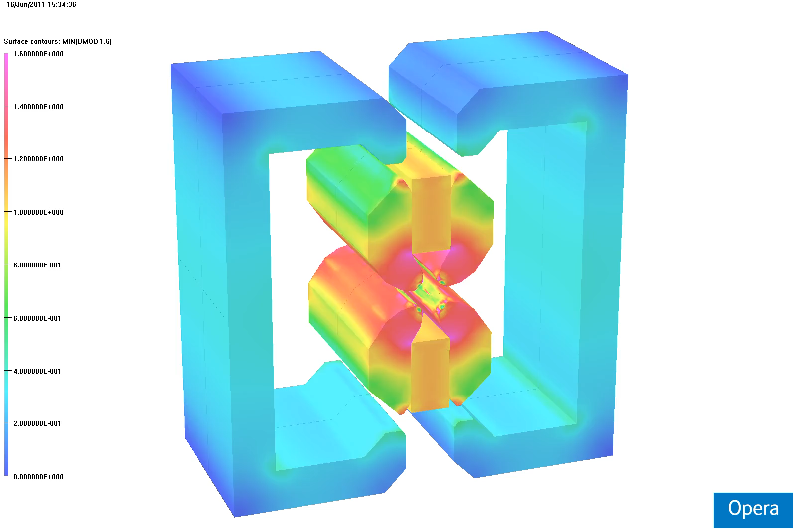
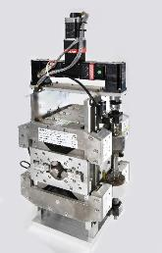
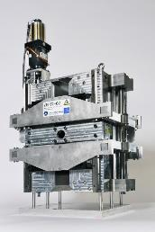
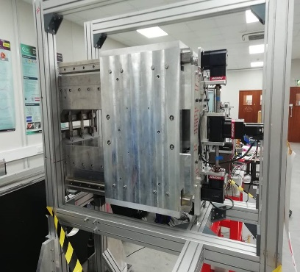
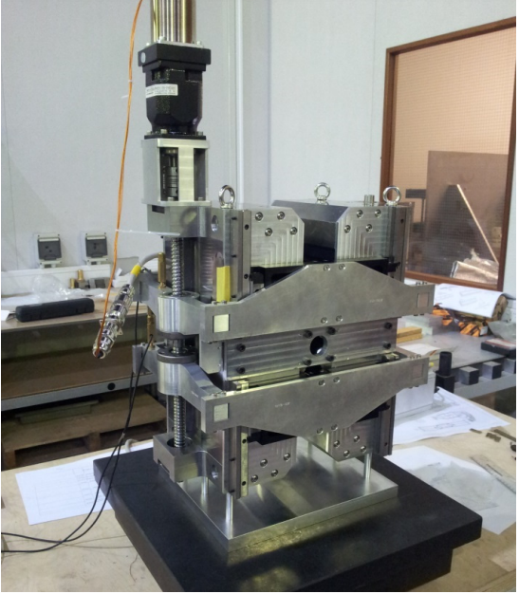
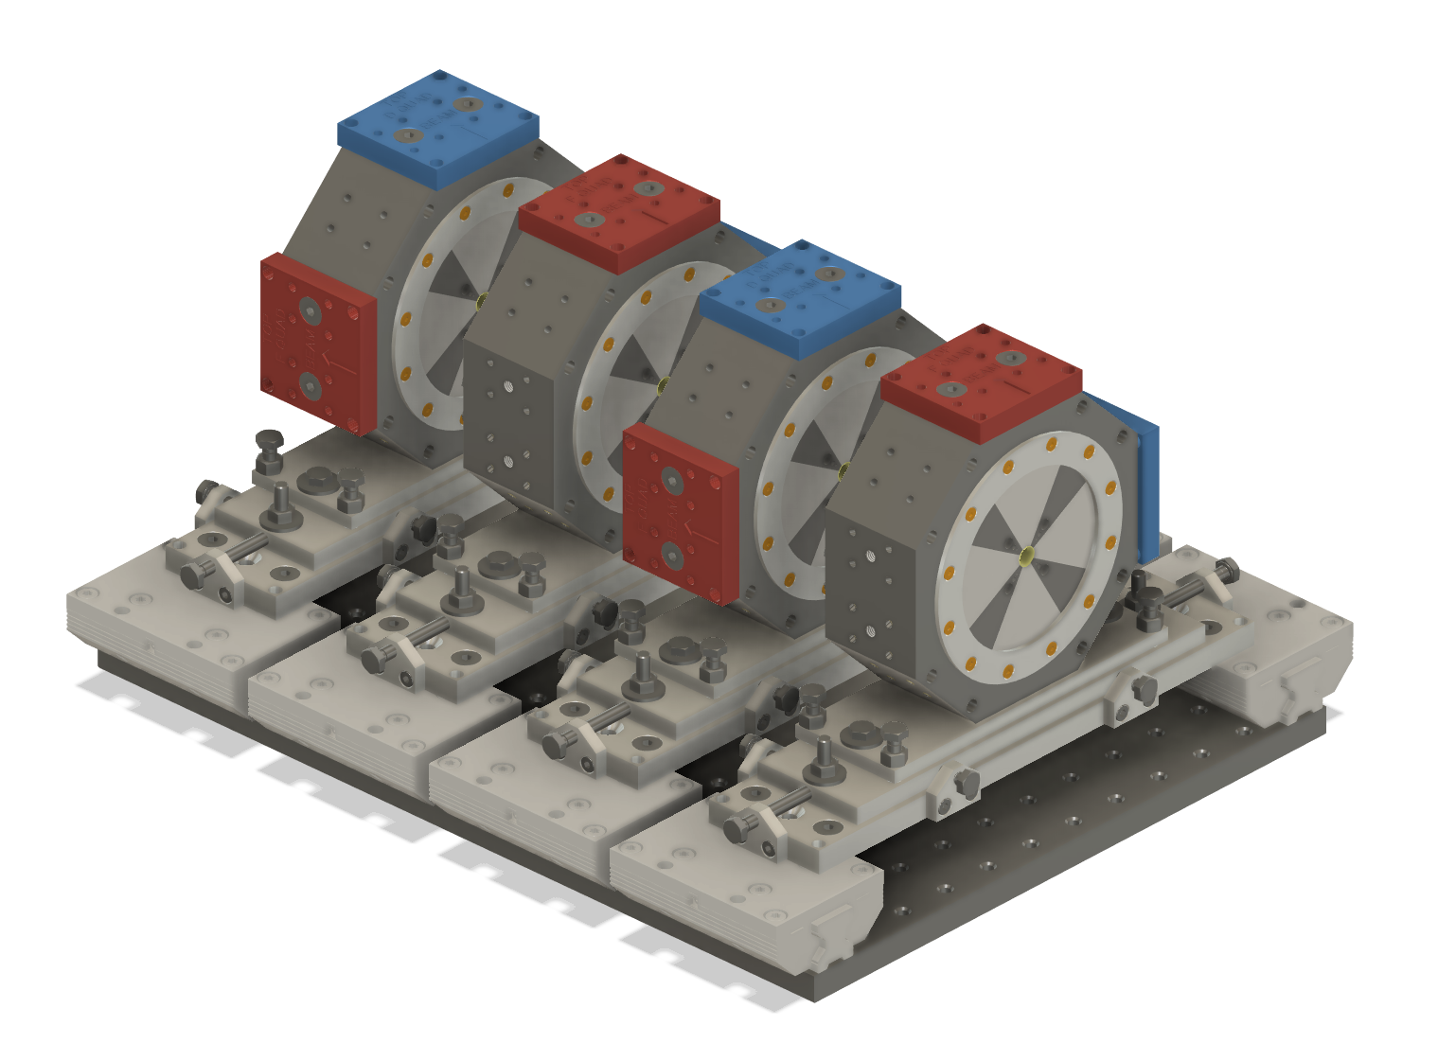
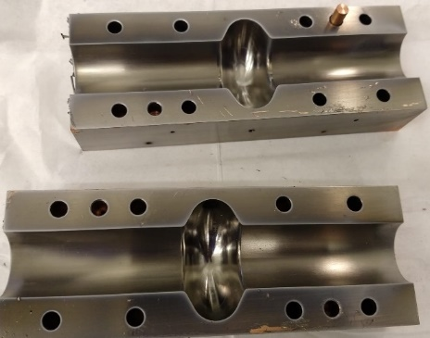
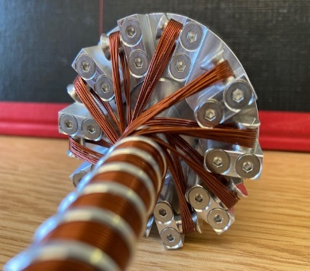
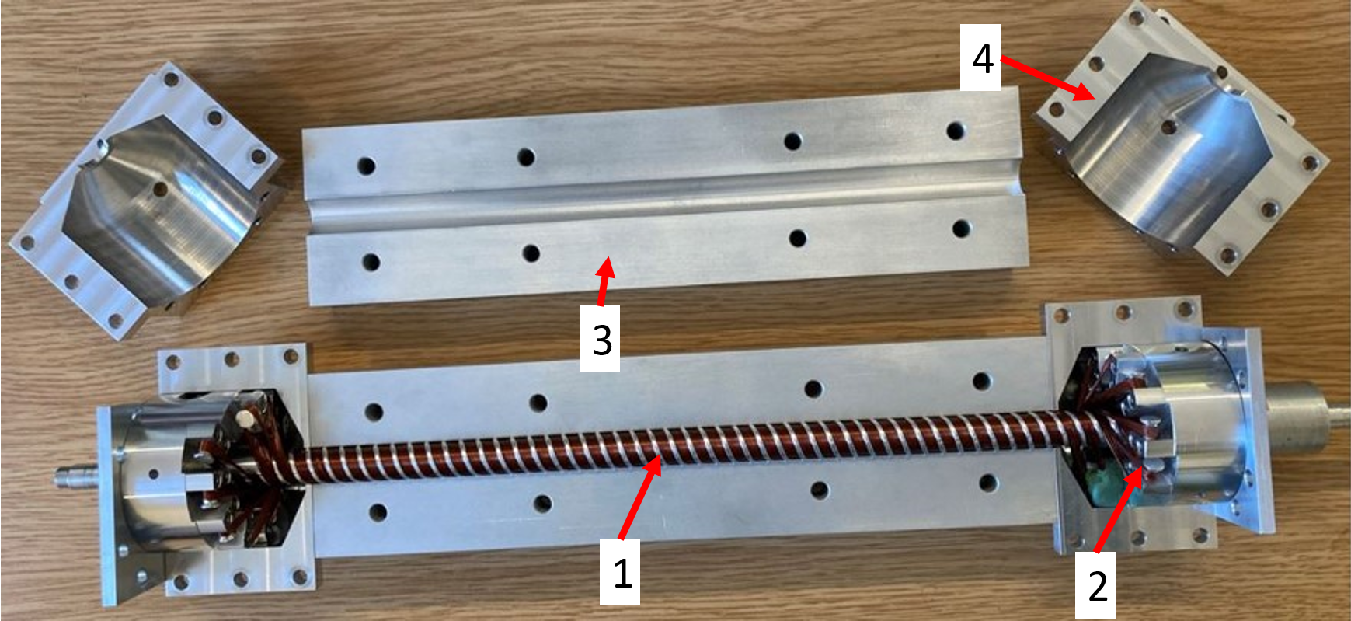
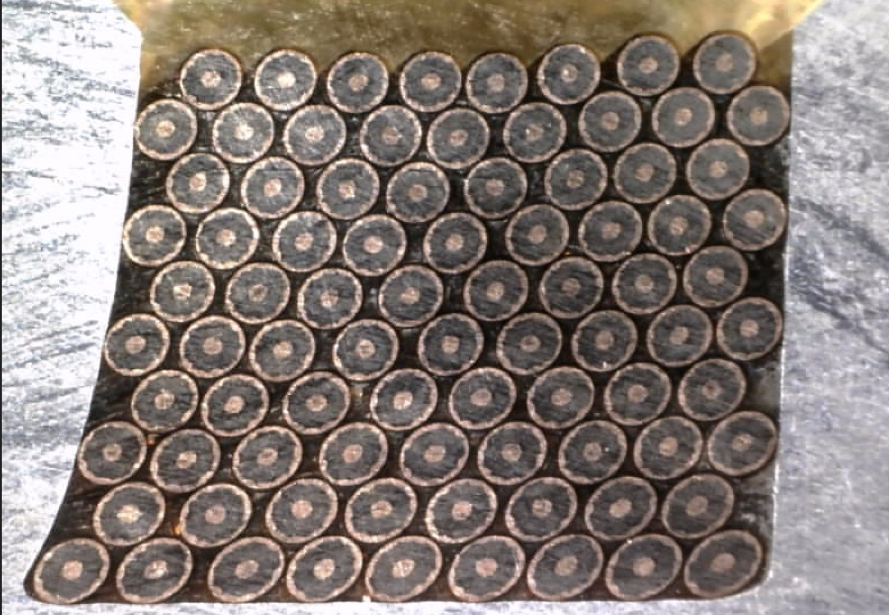
UKRI/STFC interests in EuPRAXIA WP9
Sustainable technologies
  Sustainable Accelerator Task Force
  Impact Review report in preparation
Permanent magnets
  ZEPTO: 2 tuneable PM quad prototypes,
  one dipole prototype, one quad installed on Diamond
  HEPTO: PM combined-function DQ magnet with coils
  ECRIS: tuneable PM dipole for ion sources
  Shimmable Halbach quad for beam capture
  from laser-plasma @ EPAC
Thin film SRF
  Development of coating technology
  Cavity deposition
  SRF testing
High-efficiency klystrons
  Collaboration with Lancaster University
  Concept for PM solenoids in klystrons
Superconducting undulators
  Machining and winding of 325mm prototype
  Soon to be tested at 4K
  Next step: 1m prototype
  Final goal: 2m module for deployment on XFEL facilities
Magnetic measurements
  Lab at Daresbury with Hall probe + stretched wire benches
  Development of pulsed-wire technique

