Slide 1
Study of the cuts on X(3872), at CMS
Alberto Vesentini
Università di Pisa & INFN
Pisa, 10 March 2011

Slide 2
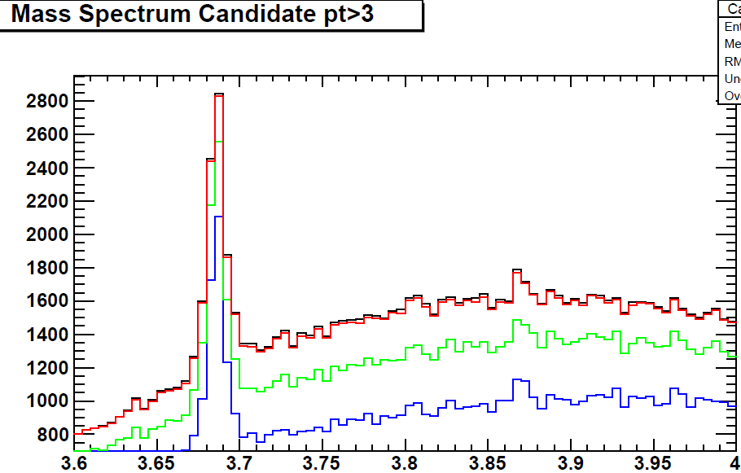
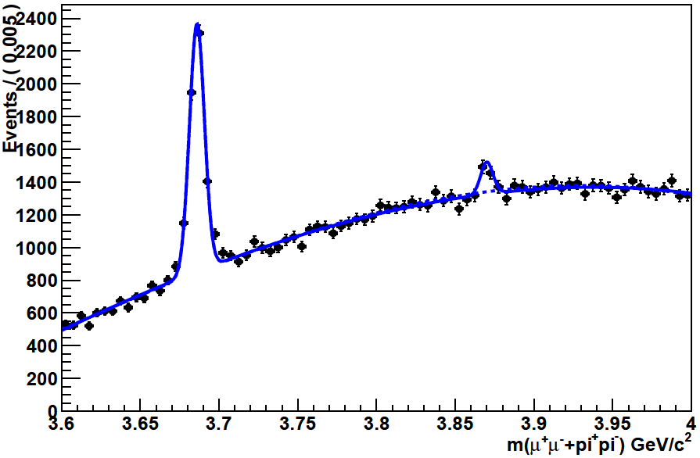
Previuos at QWG…
Marina Giunta slides’
X_{cand} p_{t} >3
X_{cand} p_{t} >5
X_{cand} p_{t} >8
X_{cand} p_{t} >11
Study on efficiency, acceptance …
c1 = 0.406569 +/- 0.00620918
c2 = -0.137397 +/- 0.00605678
c3 = -0.00983933 +/- 0.00602596
X_mass = 3.87 +/- 0.000899106
X_ σ = 0.00389225 +/- 0.000663821
Ψ‘_ mass = 3592.39 +/- 99.7543
Ψ‘_ σ = 0.00473338 +/- 0.000150675
Number_ Ψ‘ = 3592.39 +/- 99.7543
Number_X3872 = 382.518 +/- 75.051
nbkg = 88438.1 +/- 313.375
Run2010A and B

Slide 3
σ_{X(3872)} /σ_{Ψ(2S)} measurement
R= =
(in the given kinematical range: X_{cand} p_{t} > 5GeV, |y| <2.4)
where: N_{corr} = N_{meas} * A * ε
N_{meas} = from signal yields in the invariant mass distribution
A = acceptance
ε = ε_{μμ} * ε_{X(or Ψ’)}
ε_{μμ} = efficiency to reconstruct and trigger on 2 μ
ε_{x(or Ψ’)}= efficiency to reconstruct the X(or Ψ’) given 2 reconstructed and triggered μ (related to different π tracking efficiency)
Ratio of efficiency corrected event yields preliminary result:
R = 0.14 ± 0.027 (stat)
^{corr}
N_{X(3872)}
σ(pp→X(3872)+anything) × BR(X(3872)→ J/Ψππ)
^{corr}
N_{Ψ(2S)}
σ(pp→ Ψ(2S)+anything) × BR(Ψ(2S)→ J/Ψππ)

Slide 4
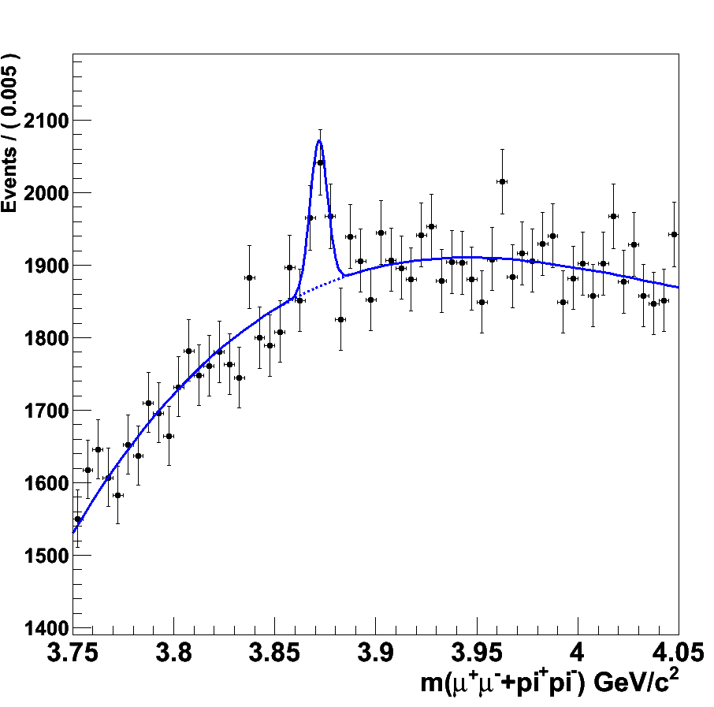
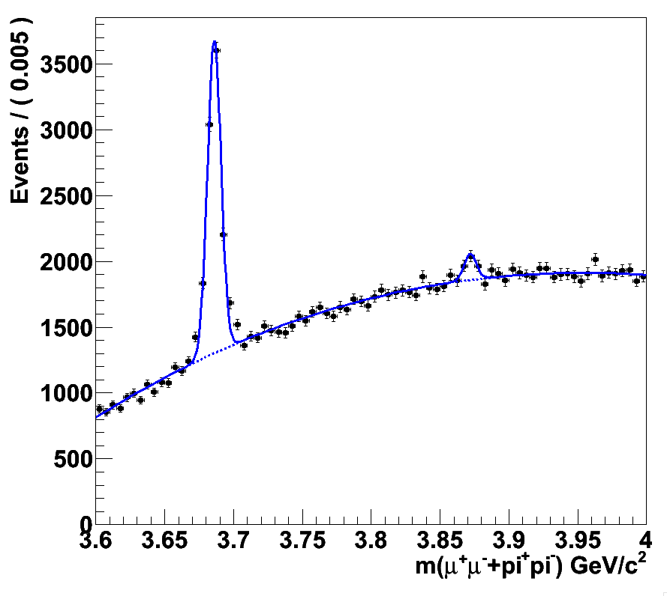
Preparing the slides for DBS for Moriond
Daniele Fasanella slides’
Fit:
Extended maximum likelihood fit with a single Gaussian plus a Chebychev polynomial, all parameters free to float.
Fit results:
μ_{gauss} = 3.871± 0.001 GeV/c²
σ_{gauss} = 0.004±0.001 GeV/c²
N_{signal} = 432 ± 102
N_{BG} = 110295 ±332

Slide 5
Dataset used: MC signal
New version of CMSSW: 3_9_7
Update the PATAnalyzer
/X3872_Direct_Feb2011/tzie-X3872_Direct_Feb2011-e30c6095aded777cd6de11b821cf9290/USER
/X3872_NoRho_Direct_Feb2011/tzie-X3872_NoRho_Direct_Feb2011-5cf9136d06ebe2130852c83adc6fb173/USER
/X3872_NoRho_FromB_Feb2011/tzie-X3872_NoRho_FromB_Feb2011-a6f3148a409805a69bc38058a9a68e20/USER
/X3872_WithRho_FromB_Feb2011/tzie-X3872_WithRho_FromB_Feb2011-a6f3148a409805a69bc38058a9a68e20/USER

Slide 6
Dataset used: MC background
Ψ (2S):
Prompt:/Psi2S2JPsiPiPi_Prompt/marinag-Psi2S2JPsiPiPi_Prompt-a3715896a069d0a80b1cabba92abdef5/USER
From B: /Psi2S_From_B/marinag-Psi2S_From_B-e494ff956b10a5c8748349412daeb757/USER
Background J/Ψ:
/JPsiToMuMu_2MuPEtaFilter_7TeV-pythia6-evtgen/Winter10-E7TeV_ProbDist_2010Data_BX156_START39_V8-v1/GEN-SIM-RECO

Slide 7
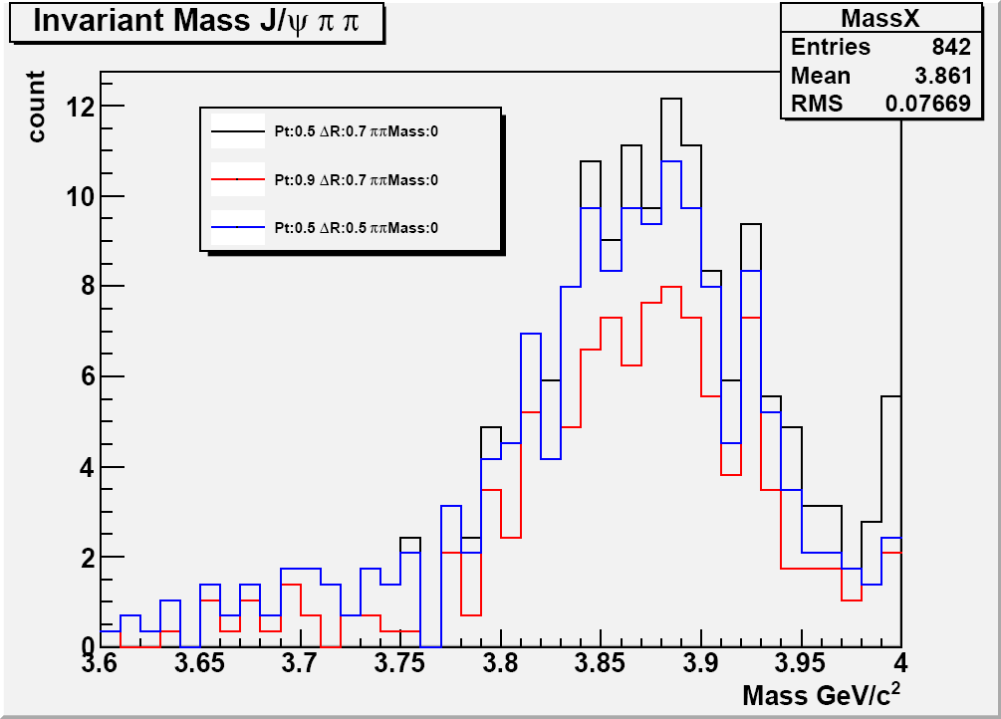
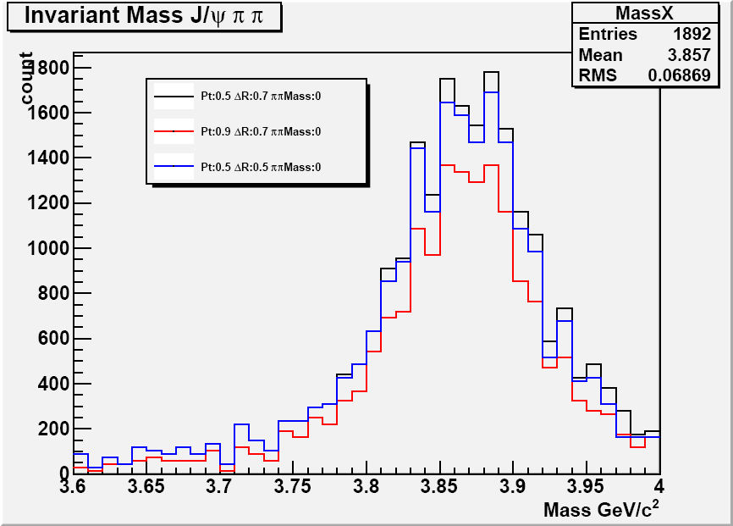
Invariant Mass
XdirectNoRho
Weight:
σε / #evt
Cuts:
- Vertex Prob (>0.01)
Pt J/Ψ
Mass J/Ψ
J/Ψ TrkTrk = false
Pt π min
ΔR(J/Ψ,π)
Mass ππ (on study)
XfromBWithRho

Slide 8
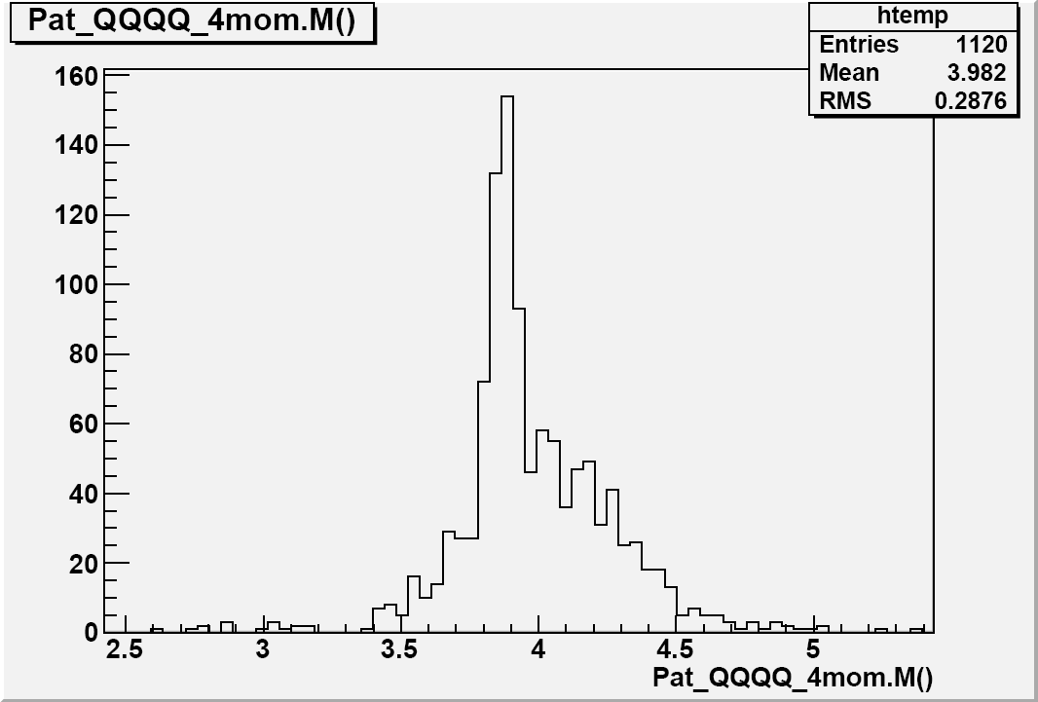
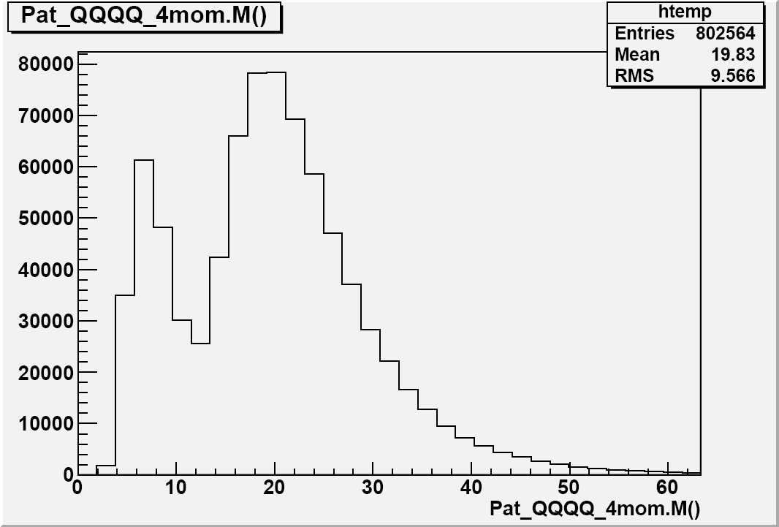
Invariant Mass II
NEW Analyzer
XdirectNoRho
OLD Analyzer
XdirectNoRho

Slide 9
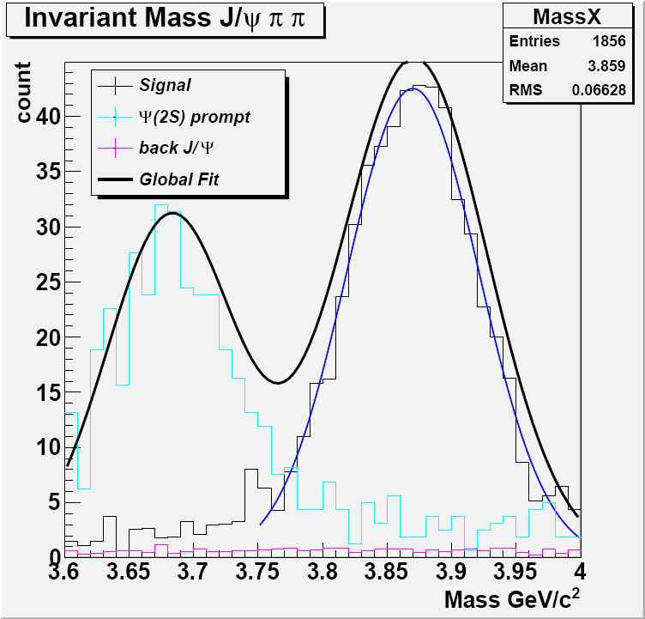
Efficiency
Signal, Back: Integral(μ±σ)
Few π with lowPt
ΔR really small
Pt π | ΔR(J/Ψ,π) | Signal | Back | S/√B | S/B
0 | 5 | 467.4 | 69.01 | 56.22 | 6.76
0.4 | 0.7 | 441.9 | 58.6 | 57.70 | 7.54
0.5 | 0.5 | 419.0 | 44.6 | 62.7 | 9.40
0.7 | 0.7 | 433.1 | 57.5 | 57.1 | 7.53
0.9 | 0.7 | 293.4 | 28.46 | 55.0 | 10.39

Slide 10
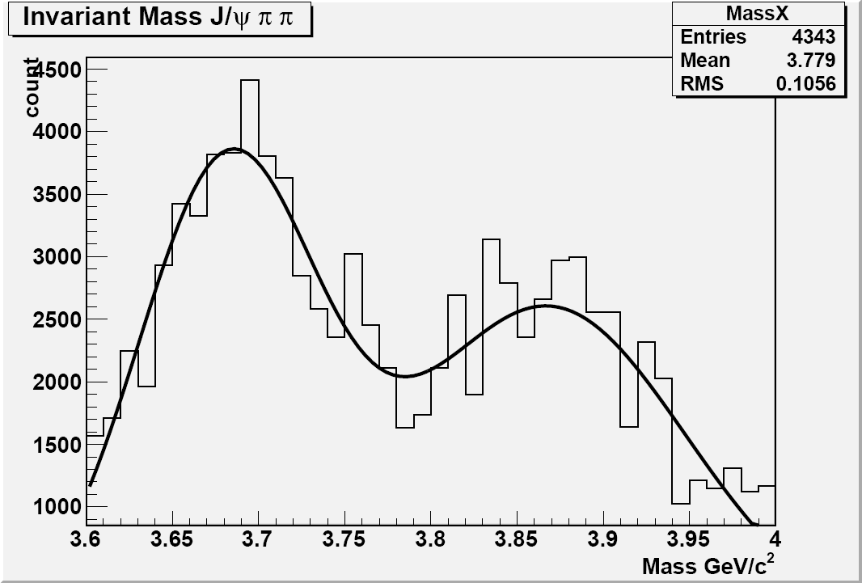
Efficiency II
XfromB(With/No)Rho

Slide 11
Prospective on future
Working on data, cuts looking/optimization:
Minimum number of Pixel/Silicon hits
Using the group analyzer (Fasanella et. al.)
Understand as well as possible the weigths…
Study other decay, similar to that one: Ψ->J/Ψππ …

Slide 12
Back up slides

Slide 13
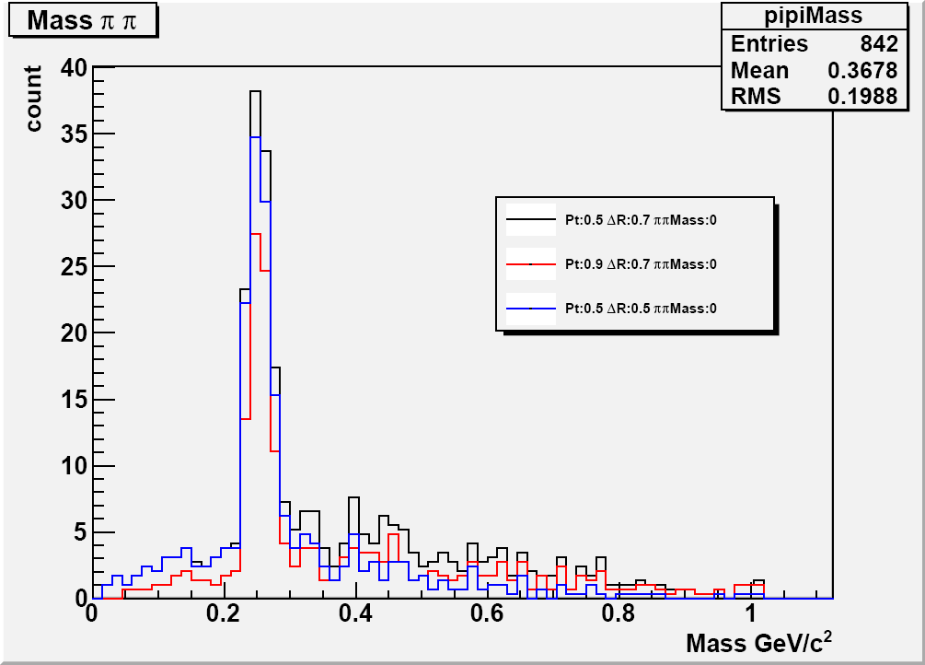
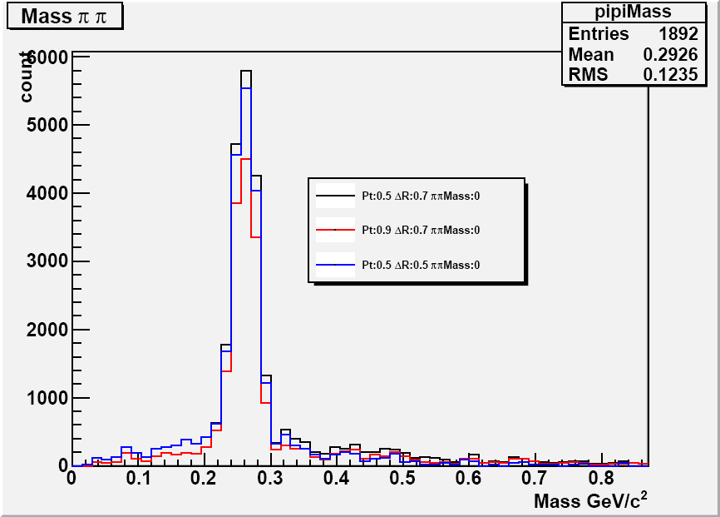
π π mass
XdirectNoRho
XfromBWithRho

Slide 14
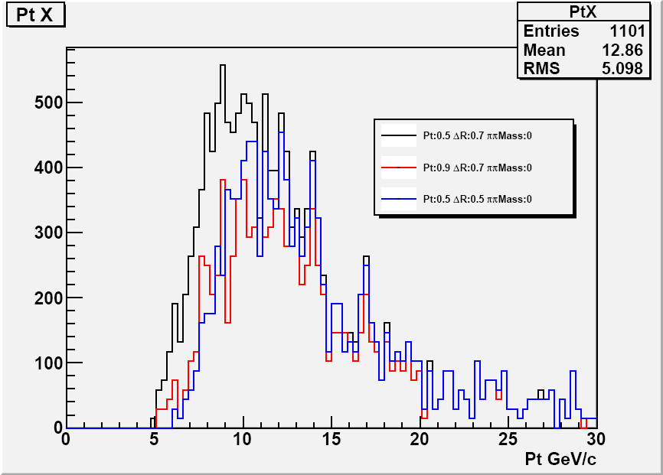
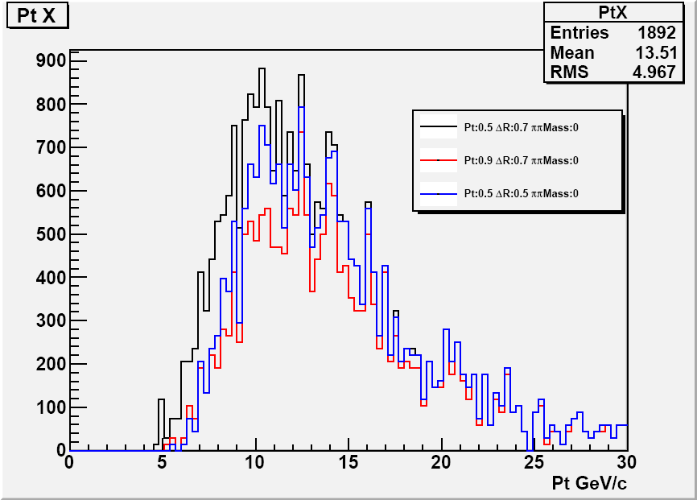
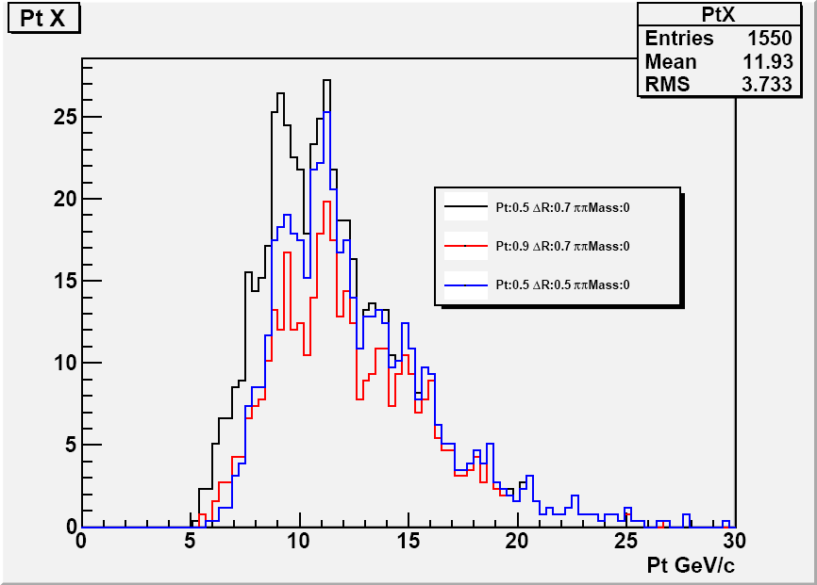
Pt X
XfromBNoRho
XfromBWithRho
XdirectWithRho

