Slide 1
Lincoln Project INFN Gruppo IV
Research Activities
Statistical and dynamical properties of artificial and real networks (T1)
Dynamics of topologically entangled polymer networks (T2)
Contact networks in epigenetics and protein folding dynamics (T3)
Resilience and control of neural and ecological networks (T4)
Interplay between social and information networks (T5)
Statistics and dynamics of quantum networks (T6)
Bologna section: Armando Bazzani (Local coordinator), Mirko Degli Esposti, Daniel Remondini.
Phd and Postodc: Giulio Colombini, Federico Capoani, Alessandra Merlotti

Slide 2
INFN Sections involved
INFN Section: Padova [PD] (National coordination)
INFN Section: Firenze [FI]
INFN Section: Bologna [BO]
INFN Section: Rende-Cosenza [RC]
INFN Section: Perugia-Camerino [PgCa]

Slide 3
Research Activity 2022
Synchronization problem of neural network using Fitzhugh-Nagumo delayed model has been considered proving the existence of global and local synchronized state and pointing out the role of delay time on the limit cycle for the neuron activity.
Failure detection on a transport network when a link capacity is reduced, by studying the sensitivity of the stationary state using the spectral properties of the Laplacian matrix.
Data driven compartmental model based on delay differential equations to forecast the Covid-19 epidemic evolution to forecast the hospitalization data in Bologna.
Nonlinear Beam dynamics: dynamics aperture and beams manipulaton (Activity in Bologna)

Slide 4
Some References
A Bazzani, F Capoani, M Giovannozzi Analysis of adiabatic trapping phenomena for quasi-integrable area-preserving maps in the presence of time-dependent exciters Physical Review E 106 (3), 034204 (2022)
C Mizzi, A Fabbri, G Colombini, F Bertini, A Bazzani A survival model to explain the statistical properties of multimodal mobility Journal of Statistical Mechanics: Theory and Experiment 2022 (2), 023404
S Polizzi, T Marzi, T Matteuzzi, G Castellani, A Bazzani Random Walk Approximation for Stochastic Processes on Graphs Entropy 25 (3), 394 (2023)
L. Squadrani, N. Curti, E. Giampieri, D. Remondini, B. Blais, G. Castellani Effectiveness of Biologically Inspired Neural Network Models in Learning and Patterns Memorization, Entropy 2022, 24(5), 682
Collaborations: Telecom, Bologna Municipality, Regione Emilia Romagna, AUSL of Bologna

Slide 5
Main Scientific Goals
1) The development of a Non-equilibrium Statistical Physics joining the Stochastic Dynamical Systems Theory with the Statistical Mechanics approach.
2) Providing relevant applications of Theoretical Physics methods and Non linear Dynamical Systems to biological and social systems

Slide 6
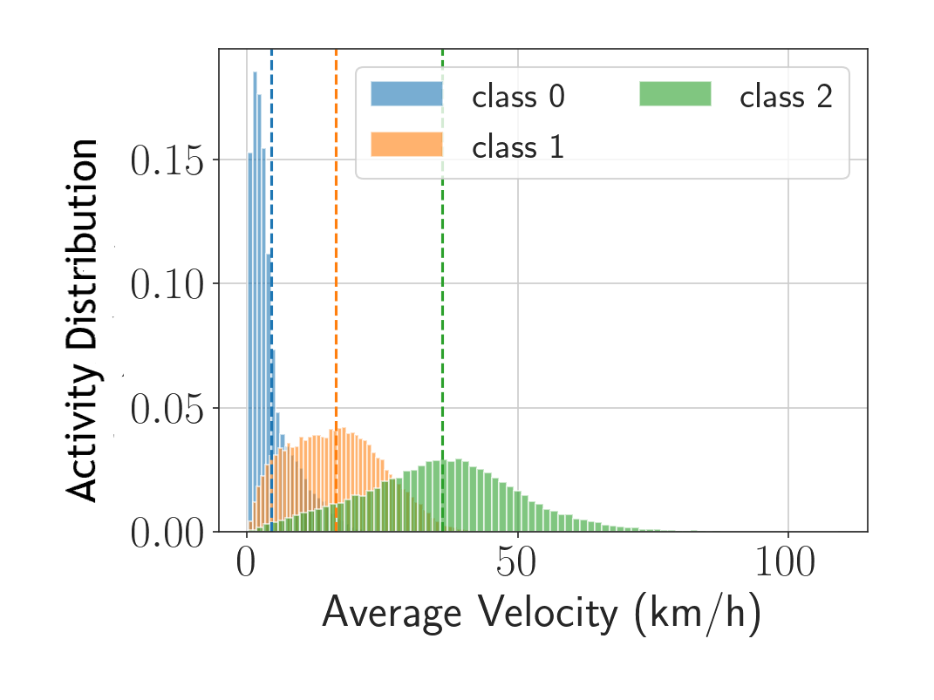
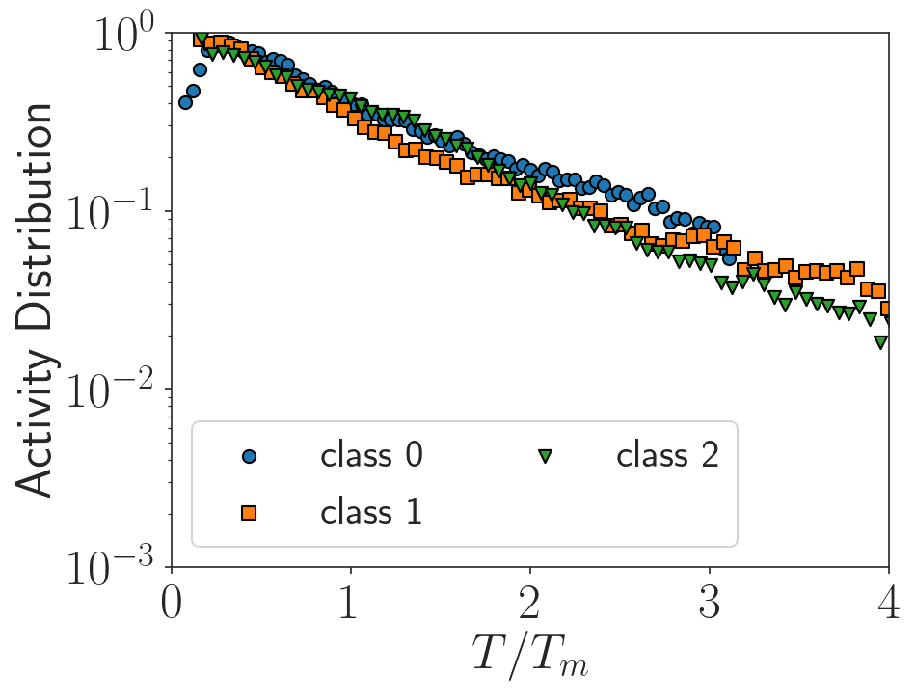
Universal properties of Complex Systems
Studying Human Mobility
Durations distribution of multimodal mobility: MDT Telecom dataset in Rimini

Slide 7
Future Activities
Applying Dynamical Systems Theory to Complex Systems towards a Non-equilibrium Statistical Physics: mesoscopic point of view
Developing dynamical models on graphs for transport systems: congestion dynamics and optimization strategies
Extending the Entropy concept to explain biological and social systems
Connection with PNRR projects and third mission activities of Theoretical Physics

Slide 8
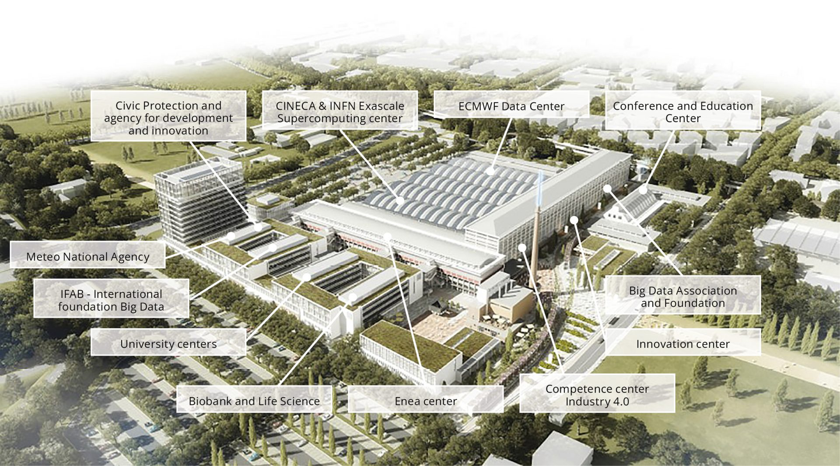
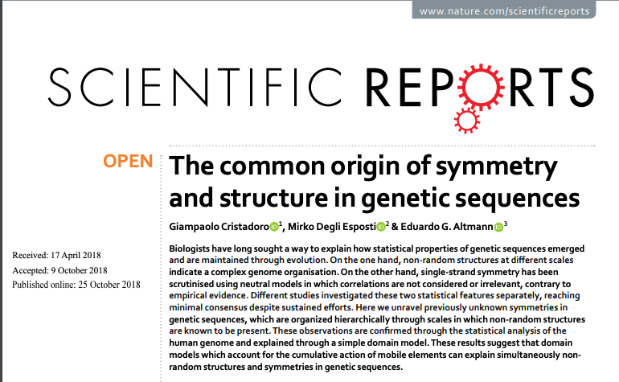
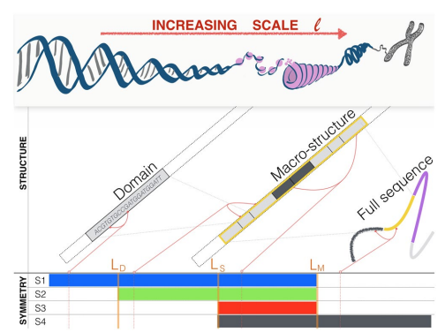
mirko degli esposti@INFN: entropy, information, irreversibility and applications (research and third mission)

