Slide 1

NAnoMAgnets
for quantum Sensing
and data SToragE
NAMASSTE
Samuele Sanna
Bologna Quantum Materials Lab
(DIFA-UNIBO, Bologna INFN Unit)
CSN5
Assemblea INFN-Bologna 20 marzo 2023

Slide 2
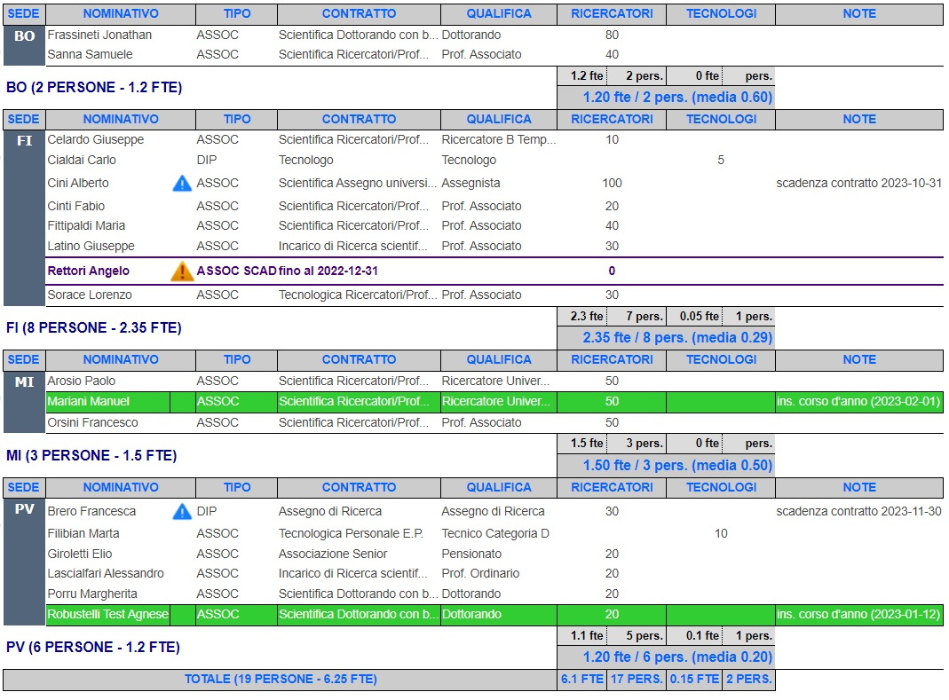
NAMASSTE - Participants
CSN5
Units:
PAVIA (Unit 1)
FIRENZE (Unit 2)
MILANO (Unit 3)
BOLOGNA (Unit 4)
External Participant: PARMA
P. Santini –Department of Mathematical, Physical and Computer Sciences, University of Parma

Slide 3
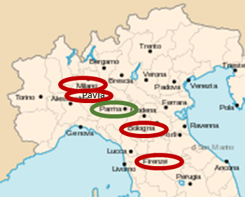
NAMASSTE - Participants
CSN5
Units:
PAVIA (Unit 1)
FIRENZE (Unit 2)
MILANO (Unit 3)
BOLOGNA (Unit 4)
External Participant: PARMA
P. Santini –Department of Mathematical, Physical and Computer Sciences, University of Parma
Synergical collaboration among Chemists and Experimental and Theoretical Physicists (Solid State Physics, Particle Physics)

Slide 4
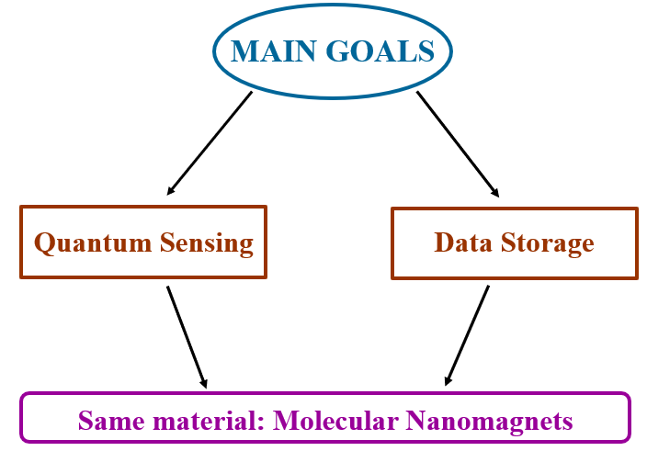
Goals of NAMASSTE
CSN5
A novel combination of experimental techniques:
Broad–Band NMR + EPR + μSR + Magnetometry

Slide 5
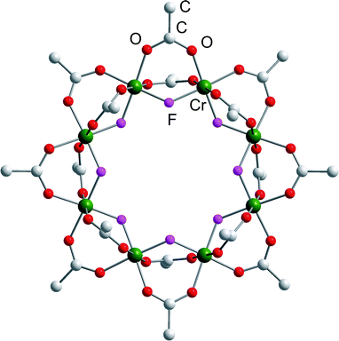
Molecular Nano Magnets (MNM)
magnetic core of a finite number (n ≥ 1) of paramagnetic ions (strong J_{intra})
shielded by organic ligands (weak J_{inter})
strong uniaxial anisotropy: magnetic bistability (double-well energy levels)
Scheme energy levels tractable with (almost) exact Hamiltonian
Notes:
Accoppiamento coerente tra le eccitazioni di spin e i fotoni alle microonde in cavità, che si pensa di sfruttare nel campo della computazione quantistica, perchè l’informazione quantica (QUBIT) viene immagazzinata nei gradi di libertà di spin del sistema magnetico.

Slide 6
Molecular Nano Magnets (MNM)
A large number (∼ 1 mol) of almost independent quantum objects
J_{inter} << J_{intra}
Quantum macroscopic system
  Ground state of 0D magnets
  Decoherence time – quantum tunnelling process
  Quantum coupling of cavity modes and spin
Notes:
Accoppiamento coerente tra le eccitazioni di spin e i fotoni alle microonde in cavità, che si pensa di sfruttare nel campo della computazione quantistica, perchè l’informazione quantica (QUBIT) viene immagazzinata nei gradi di libertà di spin del sistema magnetico.

Slide 7
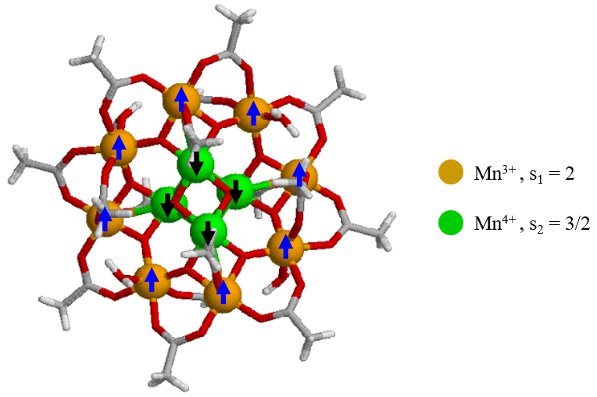
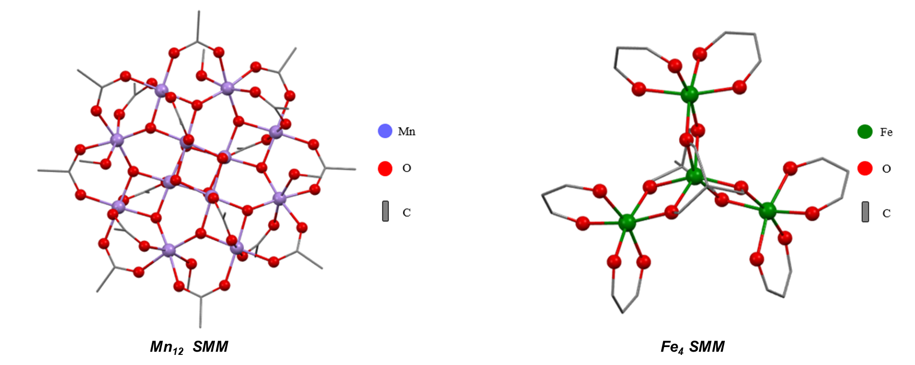
NAMASSTE - Samples
CSN5
Two families of Molecular Nanomagnets (MNMs)
3d Single - Molecule Magnets (SMMs) (Mn₁₂, Fe₄)
4f Single - Ion Magnets (SIMs)
(pentagonal bipyramidal Ln complexes; Ln – Zn and Ln – trop systems)
Easy
Axis

Slide 8
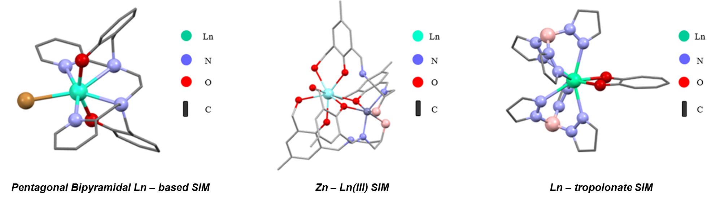
NAMASSTE - Samples
CSN5
Two families of Molecular Nanomagnets (MNMs)
3d Single - Molecule Magnets (SMMs) (Mn₁₂, Fe₄)
4f Single - Ion Magnets (SIMs)
(pentagonal bipyramidal Ln complexes; Ln – Zn and Ln – trop systems)

Slide 9
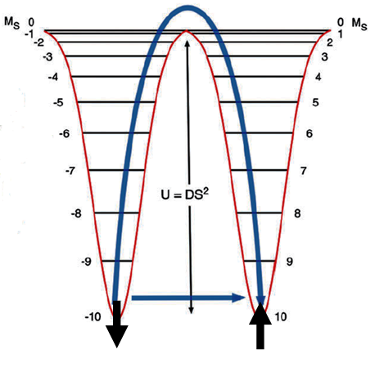
MNMs as Memory Storage Systems
CSN5
Strong uniaxial anisotropy → double – well energy levels
Our aims to improve the MNMs performance:
increase U and T_{B}
minimize the relaxation time at low T (QTM and Ramann relaxation)
energy barriers U for magnetization (M) reversal
slowing down of M on macroscopic timescales
below T_{B} MNMs are “blocked”
candidates for molecular bits for memory storage

Slide 10
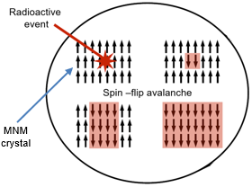
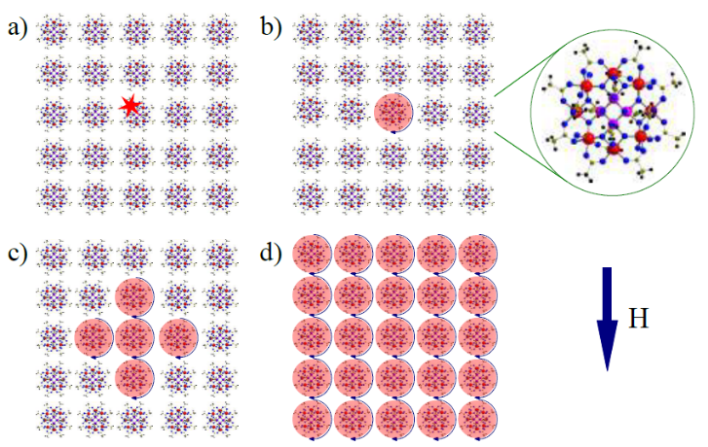
Experiments on MNMs as Sensors
CSN5
Starting from:
the detection of a spin - flip avalanche in a crystal of MNMs after energy deposition (∼ meV) due to impinging particle#
recent experiments* validating MNMs as sensors for α particles (low activity sources, ∼ 0.1kBq)
Sketch of the spin-flip avalanche mechanism#*
# P. C. Bunting, G. Gratta, T. Melia, S. Rajendran, Phys. Rev. D 95, 095001 (2017);
* H. Chen, R. Mahapatra, G. Agnolet, M. Nippe, M. Lu, P. C. Bunting, T. Melia, S. Rajendran, G. Gratta and J. R. Long, arXiv:2002.09409v2 (2020)

Slide 11
Experiments of MNMs as Sensors
CSN5
WHAT’S NEW IN NAMASSTE?
Comparison of:
Results on MNMs in normal conditions vs exposure to α and β particles to:
NMR and μSR (Relaxation times T₁ and T₂, spectra)
EPR (spectra)
SQUID Magnetometry (susceptibility measurements and hysteresis loop)
increase the overall detection sensitivity (more sensitive techniques)
increase the temperature of use of MNMs as sensors (higher energy barriers)

Slide 12

The role of Bologna Unit: muon spin spectroscopy (μ⁺SR) experiments
CSN5
Most relevant properties which make μ⁺ powerful to study magnetism in matter:
M_{μ} ≈ 200 M_{e} ≈ 1/9 M_{p} & Positively charged particle → interstitial position → local magnetic probe
s = ½ m_{μ} ≈ 3 μ_{p} ≈ 10 μ_{N} → big magnetic moment → very sensitive magnetic probe 10⁻³-10⁻⁴ μ_{B} (no quadrupolar effects)
Produced by π⁺ decay at rest → 100% spin-polarized beam & Stop range ≈ 140 mg/cm²
τ_{μ} ≈ 2.2 μs → “long” decay time
γ_{μ} /2π ≈ 135 MHz/T → asymmetry oscillations easy to detect – 100 kHz-100 GHz fluctuation range
Belonging to the lepton family → asymmetric decay → e⁺ preferentially along the μ-spin direction
Momentum: P_{µ}=29.8 MeV/c.
Kinetic energy: E_{µ}=4.1 MeV.

Slide 13
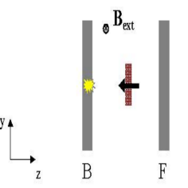
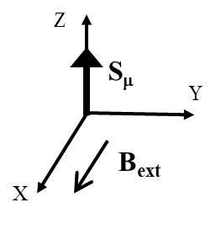
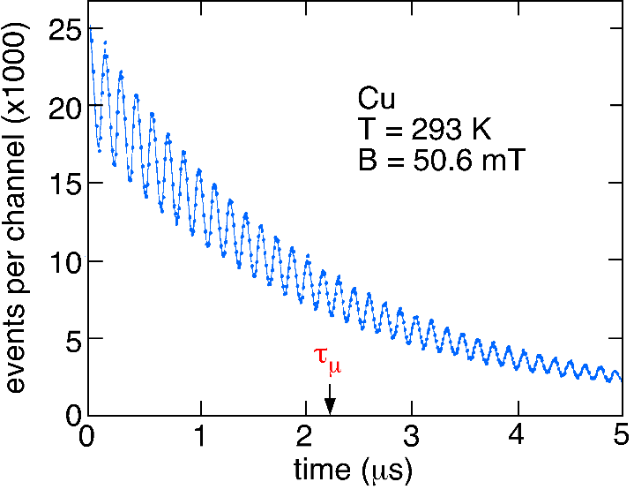
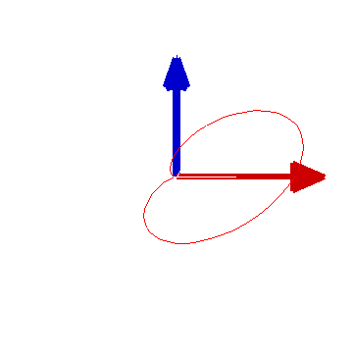
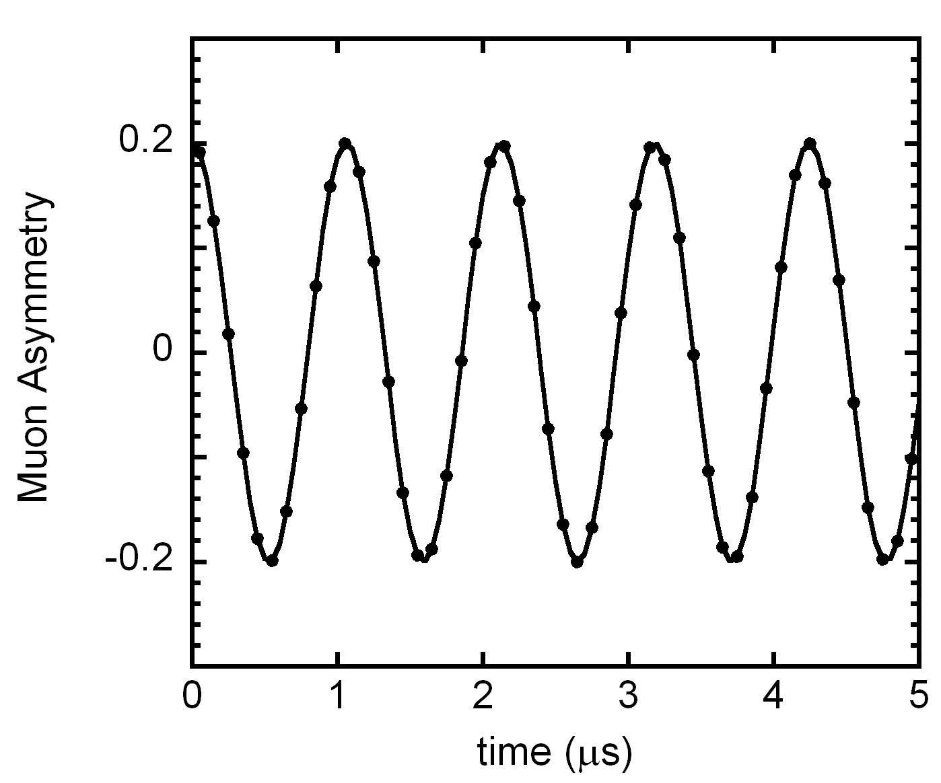
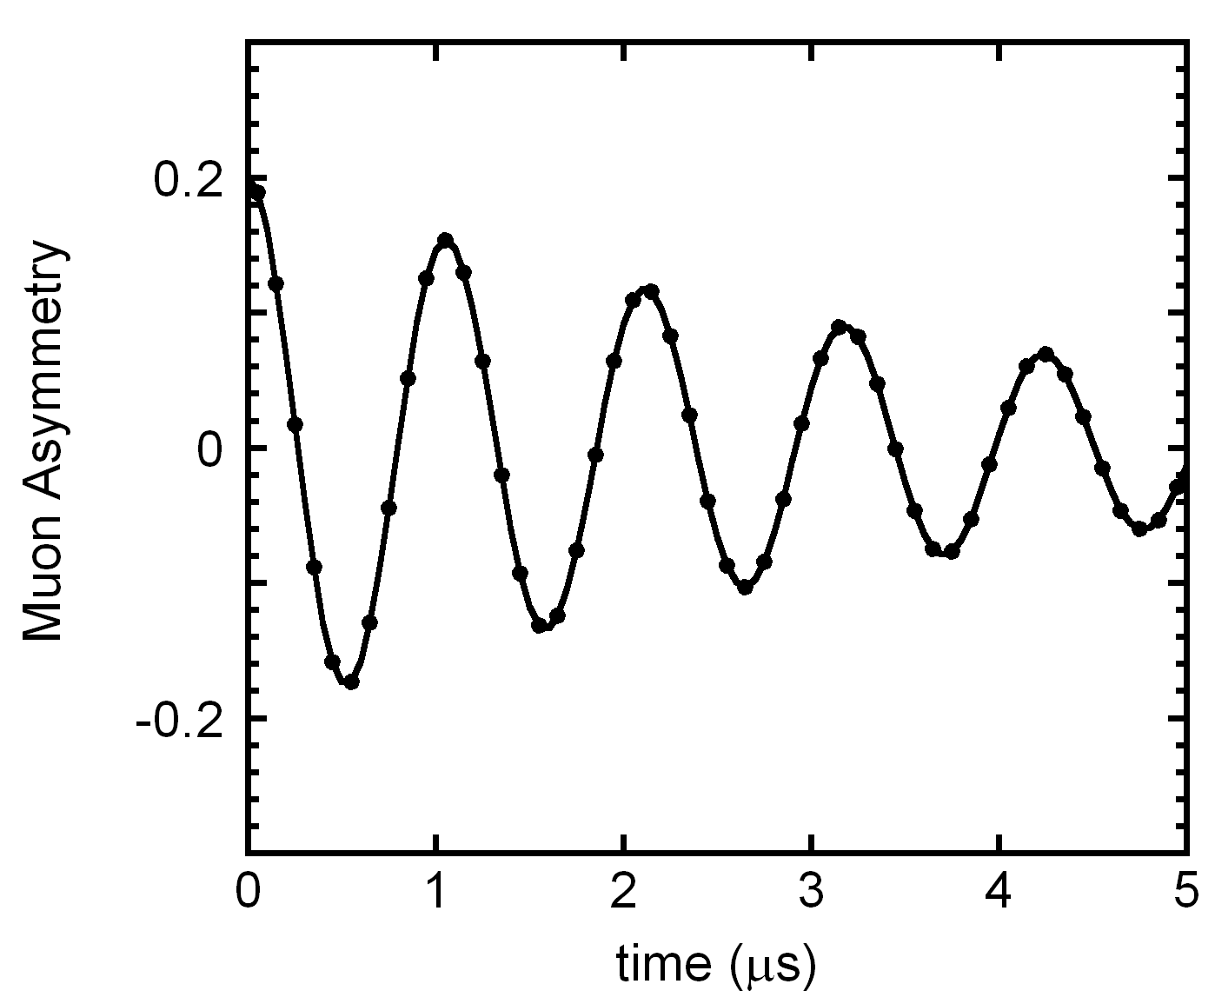
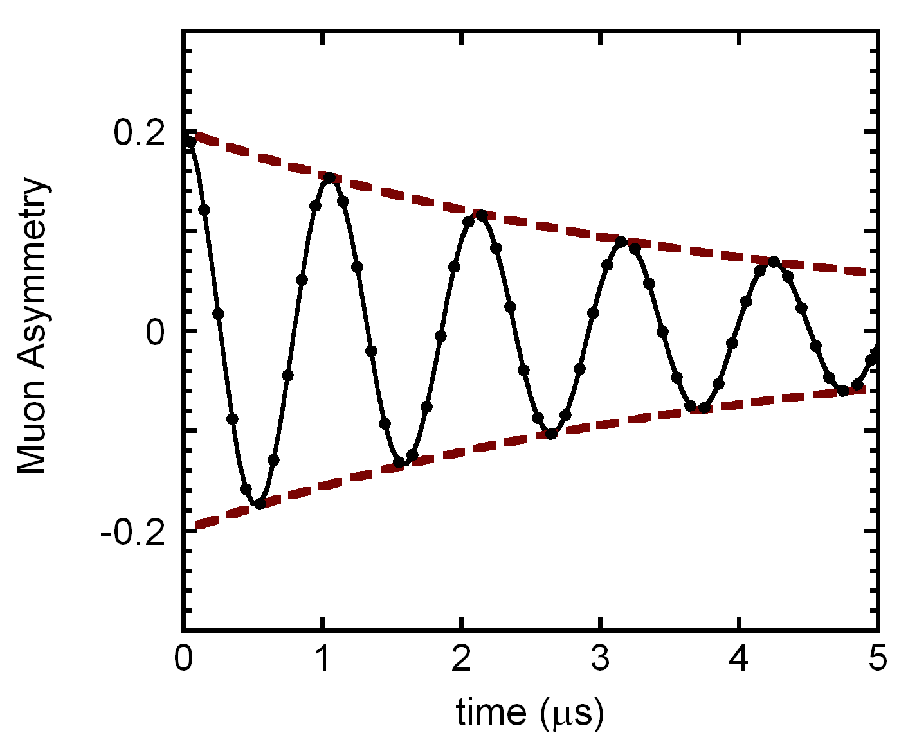


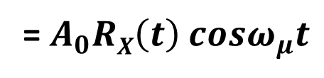
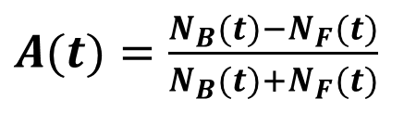
The μSR signal: the muon asymmetry vs time in Transverse Field (TF)
in Transverse Field
(TF ≡ B_{ext} ⊥ S_{μ}(0))
Single detector
Transverse relaxation function
$$P\left(t\right)=RX\left(t\right)cosω_{μ}t$$
B
$A(t)=\frac{N_{B}(t)−N_{F}(t)}{N_{B}(t)+N_{F}(t)}$
= $A_{0}RX\left(t\right)$ $cosω_{μ}t$
$RX\left(t\right)$
S_{μ}
Muon Larmor precession:
ω_{μ}= γ_{μ} B_{ext}
(γ_{μ} /2π = 136 MHz/T)
Relaxation rates depend upon static and dynamic conditions

Slide 14
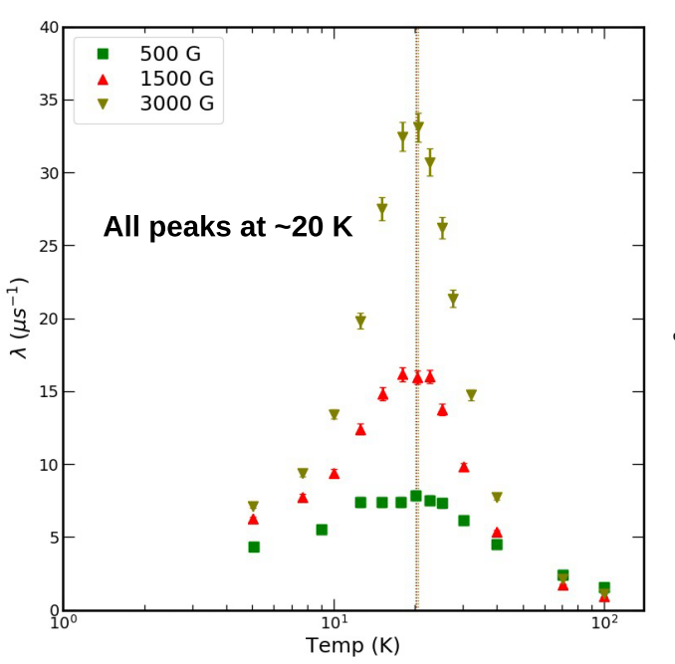
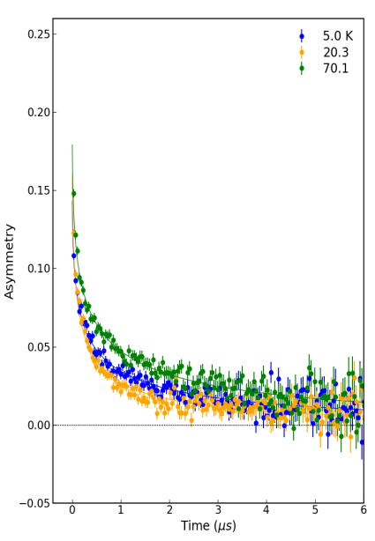
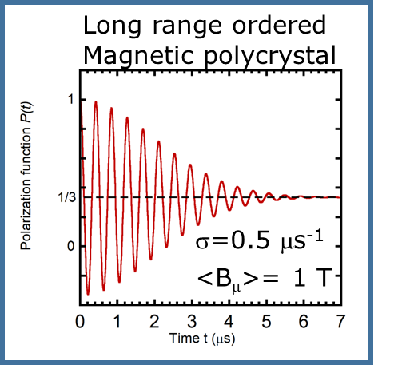
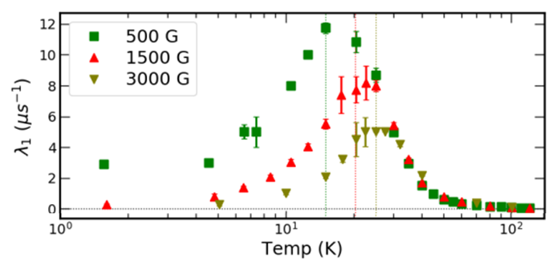
Muons as probe for magnetic sensing
Tb-tropolonate (DIAMAG ligand)
Tb-tropolonate MNM
Relaxation rate related to spin dynamics
Tb-semiquinonato (PARAM ligand)
(coherent oscillations)
(incoherent oscillations for T<T_{B})
Main ingredients at play: spin-orbit, crystal-field, hyperfine, coupling of the spins with optical phonons

Slide 15
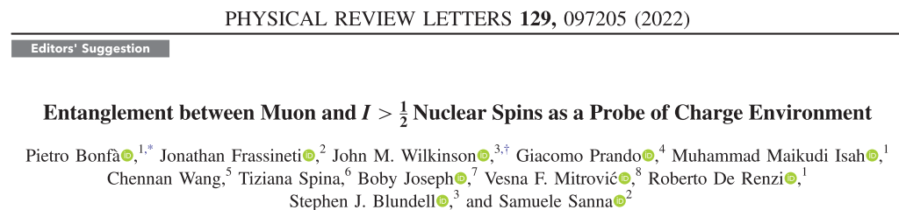
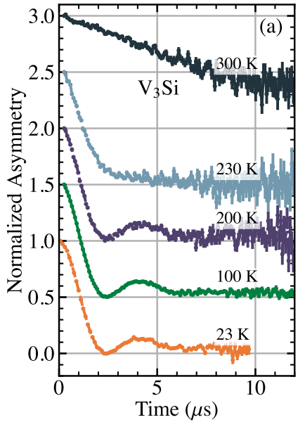
Not directly linked to NAMASSTE but…
μ⁺SR: quantum sensing for charge-related phenomena
QUANTUM COHERENT OSCILLATIONS

Slide 16
NAMASSTE – in brief
CSN5
Use of Molecular Nanomagnets for two purposes:
Use as molecular bits for memory storage
Use as high – sensitivity particles detectors
Improving their performance through:
Increasing T_{B} for increasing the operation temperature (memory storage and particles detectors)
Increase the sensitivity of the particles detection with more sensitive techniques (particles detectors)
Role of BOLOGNA UNIT: mainly μSR experiments and data analisys

Slide 18
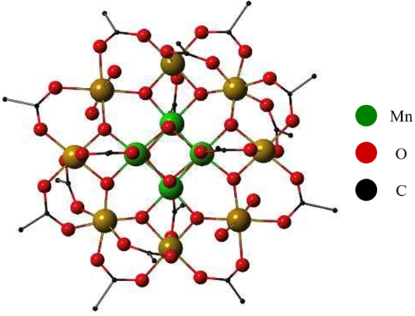
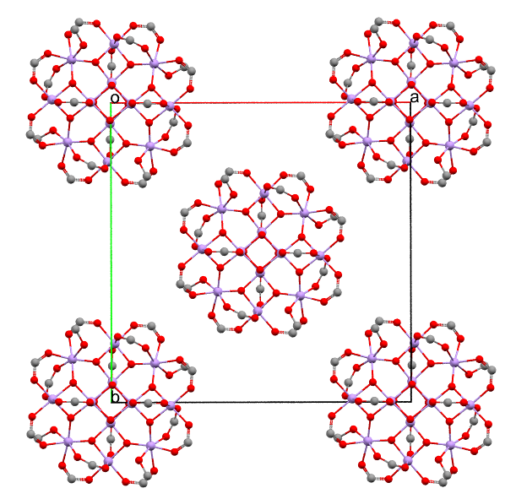
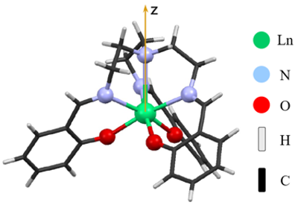
NAMASSTE - Samples
CSN5
Two families of Molecular Nanomagnets (MNMs)
3d Single - Molecule Magnets (SMMs) (Mn₁₂, Fe₄)
4f Single - Ion Magnets (SIMs)
(pentagonal bipyramidal Ln complexes; Ln – Zn and Ln – trop systems)
Mn₁₂ SMM Ln-based SIM Crystal of Mn₁₂

Slide 19
Goals of NAMASSTE
CSN5
Goals for the project:
Synergical collaboration among Chemists and Experimental and Theoretical Physicists (Solid State Physics, Particle Physics)
experimental and theoretical investigation, of the spin dynamics and the magnetic relaxation mechanisms of metal ions-based Molecular Nanomagnets (MNMs)
conceiving of new design principles for breaking record performances of MNMs to be used as magnetic memories for data storage
selection of the best MNM and the best read-out techniques to develop highly-sensitive quantum sensor for the detection of tiny perturbations due to small interactions, with impinging particles (e.g. α, β, Dark Matter (?), etc)

Slide 20
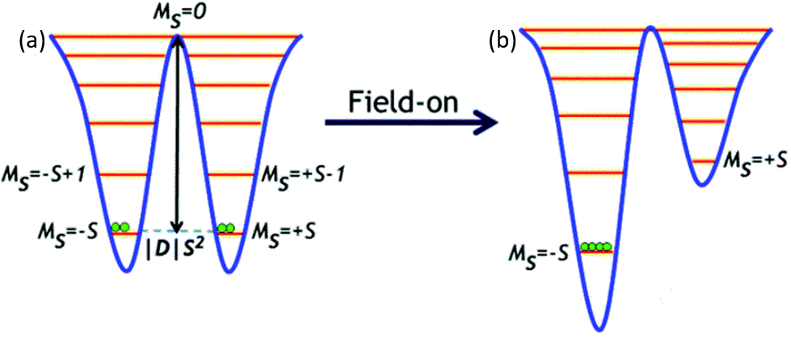

NAMASSTE - Samples
CSN5
Ground State Spin Configuration
Mn₁₂ → S = (8 ⋅ 2) – (4 ⋅ 3/2) = 10 (giant spin)
Easy
Axis
*Magnetic Bistability in MNMs
Progressive slowing down of Magnetization on decreasing T starting at intermediate T:
Quantum Tunneling of Magnetization at very low temperature: the energy of these transitions is lower than U = |D| S².
*S. Goswami, et al., Inorg. Chem. Front. 2, 687 (2015)

Slide 21
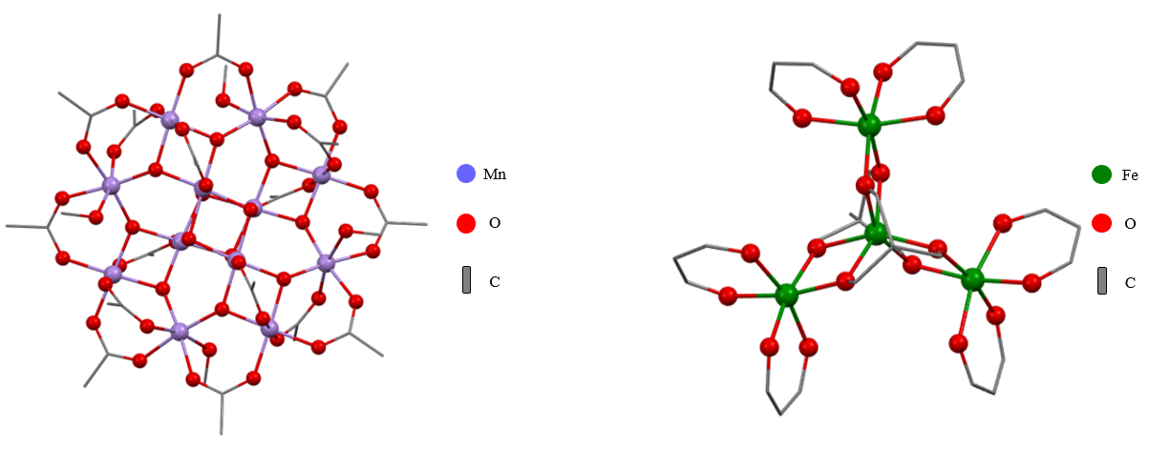
NAMASSTE - 3d SMM Samples
CSN5
Mn₁₂ SMM Fe₄ SMM
A. L. Barra, A. Caneschi, A. Cornia, D. Gatteschi, L. Gorin, L.-H. Heiniger, R. Sessoli, L. Sorace, J. Am. Chem. Soc. 129, 35, 10754–10762 (2007)
A. L. Barra, A. Caneschi, A. Cornia, F. Fabrizi de Biani, D. Gatteschi, C. Sangregorio, L. Sorace, J. Am. Chem. Soc. 121, 22, 5302–5310 (1999)

Slide 22
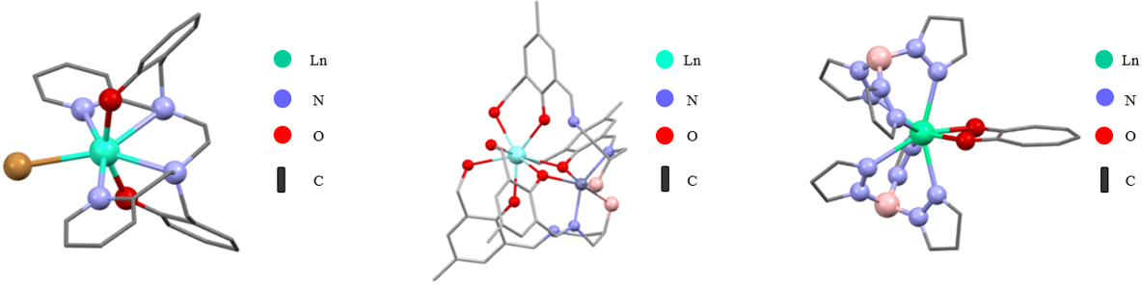
NAMASSTE - 4f SIM Samples
CSN5
Pentagonal Bipyramidal Ln – based SIM Zn – Ln(III) SIM Ln – tropolonate SIM
Z. Jiang, L. Sun, Q. Yang, B. Yin H. Ke, J. Han, Q. Wei, G. Xie, S. Chen, J. Mater. Chem. C 6, 4273−4280 (2018)
A. Amjad, A. M. Madalan, M. Andruh, A. Caneschi and L. Sorace, Chem. Eur. J. 22, 12849 (2016)
A. Caneschi , A. Dei , D. Gatteschi *, S. Poussereau, L. Sorace, Dalton Trans. 1048 -1055 (2004)

Slide 23
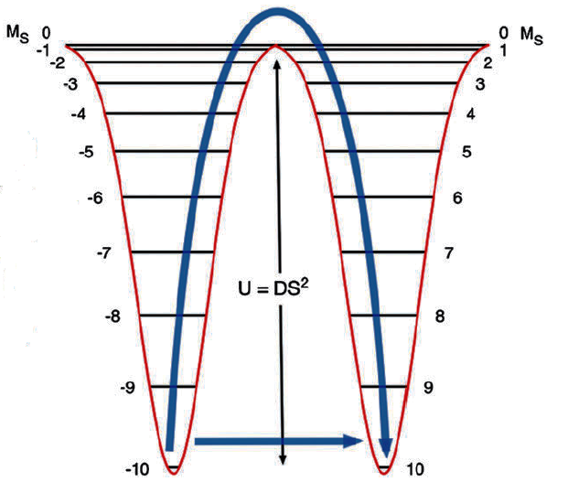
MNMs as Memory Storage Systems
CSN5
MNMs are characterized by:
Weak intermolecular interactions (no long - range order)
Strong uniaxial anisotropy (double – well energy levels)
Our aims to improve the MNMs performance:
increase the height of U and the T_{B}
minimize the relaxation mechanisms at low T (QTM and Raman relaxation)
energy barriers U for magnetization (M) reversal
slowing down of M on macroscopic timescales
below T_{B} MNMs are “blocked”
candidates for molecular bits for memory storage

Slide 24
NAMASSTE – Techniques
CSN5
Non - magnetic preliminary characterization measurements: IR, Uv-Vis, X-ray, NMR for ligands Unit 2
ac and dc magnetometry measurements vs temperature (T) and magnetic field (μ₀H) (2K < T < 300K, 0 < μ₀H < 5T) - Unit 1 and Unit 2
Zero and high magnetic field wide-band NQR/NMR on ¹H and transition-metal nuclei as a function of T and μ₀H applied (1.5K < T < 300K; 0.1T < μ₀H < 9T) respectively - Unit 1 and Unit 3
Low-field and FFC (Fast Field Cycling) wide-band ¹H NMR vs T and μ₀H (150K < T < 300K; 0.0025T < μ₀H < 0.25T) - Unit 3
EPR measurements at variable frequency, as a function of temperature and magnetic field (range: 4.2K - 300K and 0.1T - 4T) - Unit 2
MuSR measurements in longitudinal and transverse configurations vs temperature and magnetic field applied (1.8K - 300K, 0 – 0.6T) at PSI facility - Unit 1 and Unit 3 Unit 4

Slide 25
NAMASSTE – Theoretical Approaches
CSN5
Model of the MNMs: Spin Hamiltonian fitted on the experimental data (magnetometry)
First Principle Calculation: calculation of the parameters of an Hubbard model via Density Functional Theory (DFT) and subsequent extraction of the Spin Hamiltonian through perturbation theory.
NMR relaxation data: calculation of the relaxation and of the dynamic susceptibility (spin dynamics) through master equations fitted on the experimental data.
Avalanche effect (sensors application): use of same theoretical approaches taking into account the effect of the magnetic field and the role of the QTM among excited states for the determination of the best condition for the avalanche.

Slide 26
NAMASSTE - WorkPackages
CSN5
WP1 – Synthesis and first characterization of 3d SMM and 4f SIMs (participants: Unit 2 with feedbacks from Unit 1, Unit 3 and Paolo Santini) – Responsible: Unit 2
WP2 – Data storage and quantum sensing: experimental studies of intrinsic spin dynamics and relaxation of 3d SMM and 4f SIMs (Participants: Units 1, 2, 3, 4) Responsible Unit 1
WP3 – Theory of the 3d SMMs and 4f SIMs relaxation (participant: Unit 2 and Paolo Santini) – Responsible Unit 2
WP4 – Experimental and theoretical study for the characterization of MNMs as particle quantum detectors (participants: Unit1, Unit 2, Unit 3 and Paolo Santini) – Responsible Unit 1

Slide 27
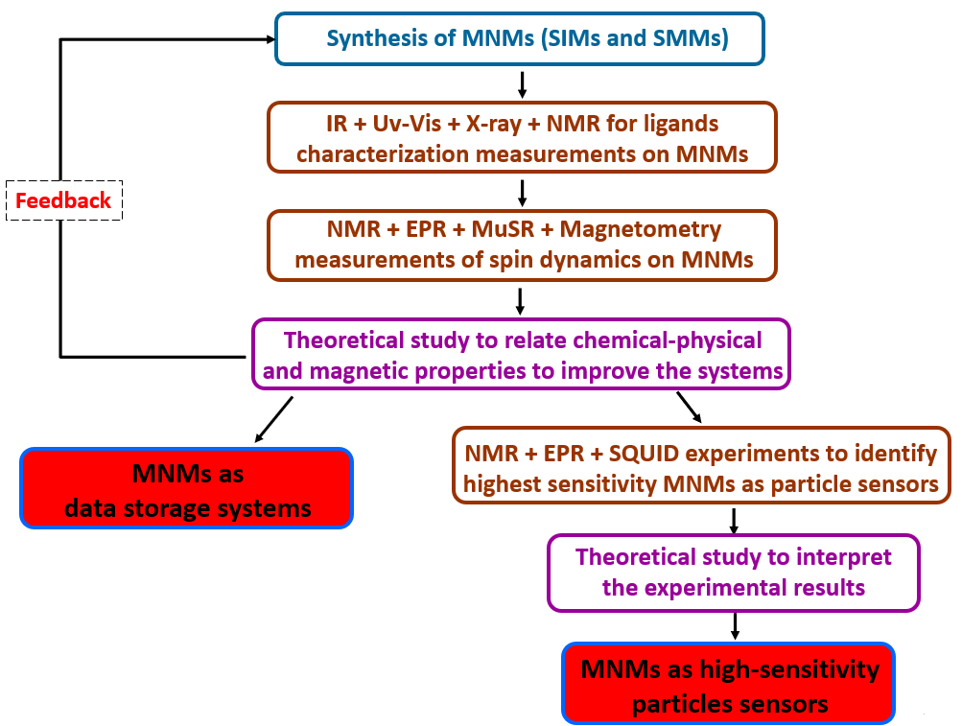
NAMASSTE – Methodology
CSN5

Slide 28
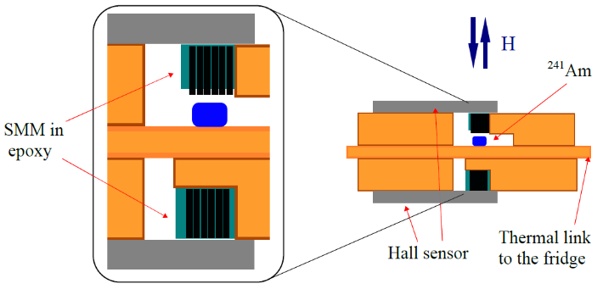
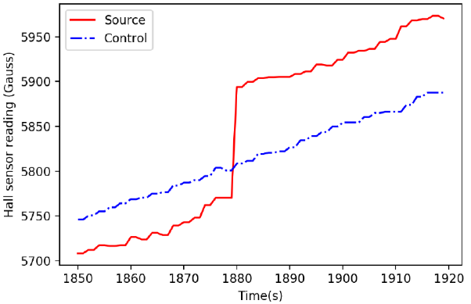
Experiments on MNMs as Sensors
CSN5
Starting from:
the detection of a spin - flip avalanche in a crystal of MNMs after energy deposition (∼ meV) due to impinging particle#
recent experiments* validating MNMs as sensors for α particles (low activity sources, ∼ 0.1kBq)
Sketch of the spin-flip avalanche mechanism#*
Experimental Set-up as conceived by Chen et al.* Detection of spin-flip avalanche*
# P. C. Bunting, G. Gratta, T. Melia, S. Rajendran, Phys. Rev. D 95, 095001 (2017);
* H. Chen, R. Mahapatra, G. Agnolet, M. Nippe, M. Lu, P. C. Bunting, T. Melia, S. Rajendran, G. Gratta and J. R. Long, arXiv:2002.09409v2 (2020)

Slide 29

Pavia

