Slide 1
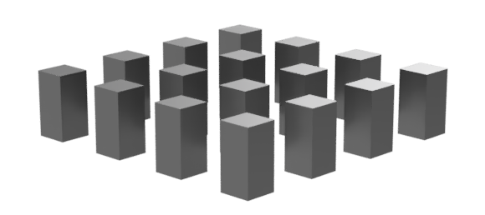
– flexiBlE hYbrid neutrON Detectors –
INFN - Grant Giovani Ricercatori e Ricercatrici
BEYOND
phD Ilaria Fratelli – associata INFN Bologna
20 Marzo 2023

Slide 2

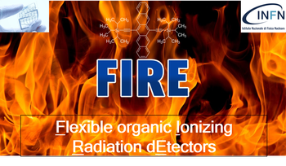
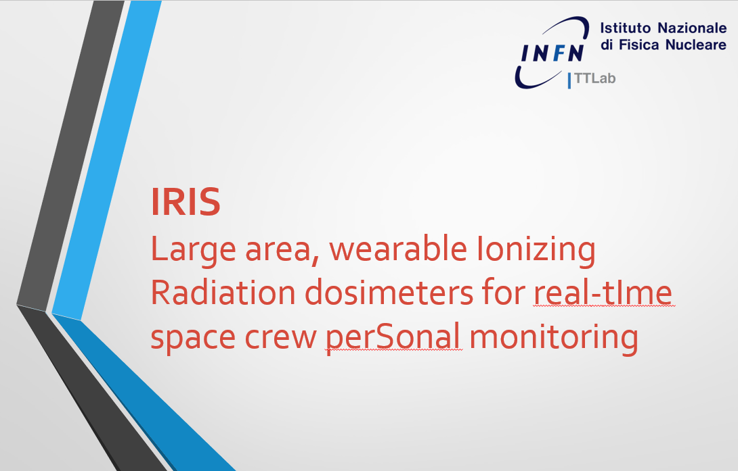
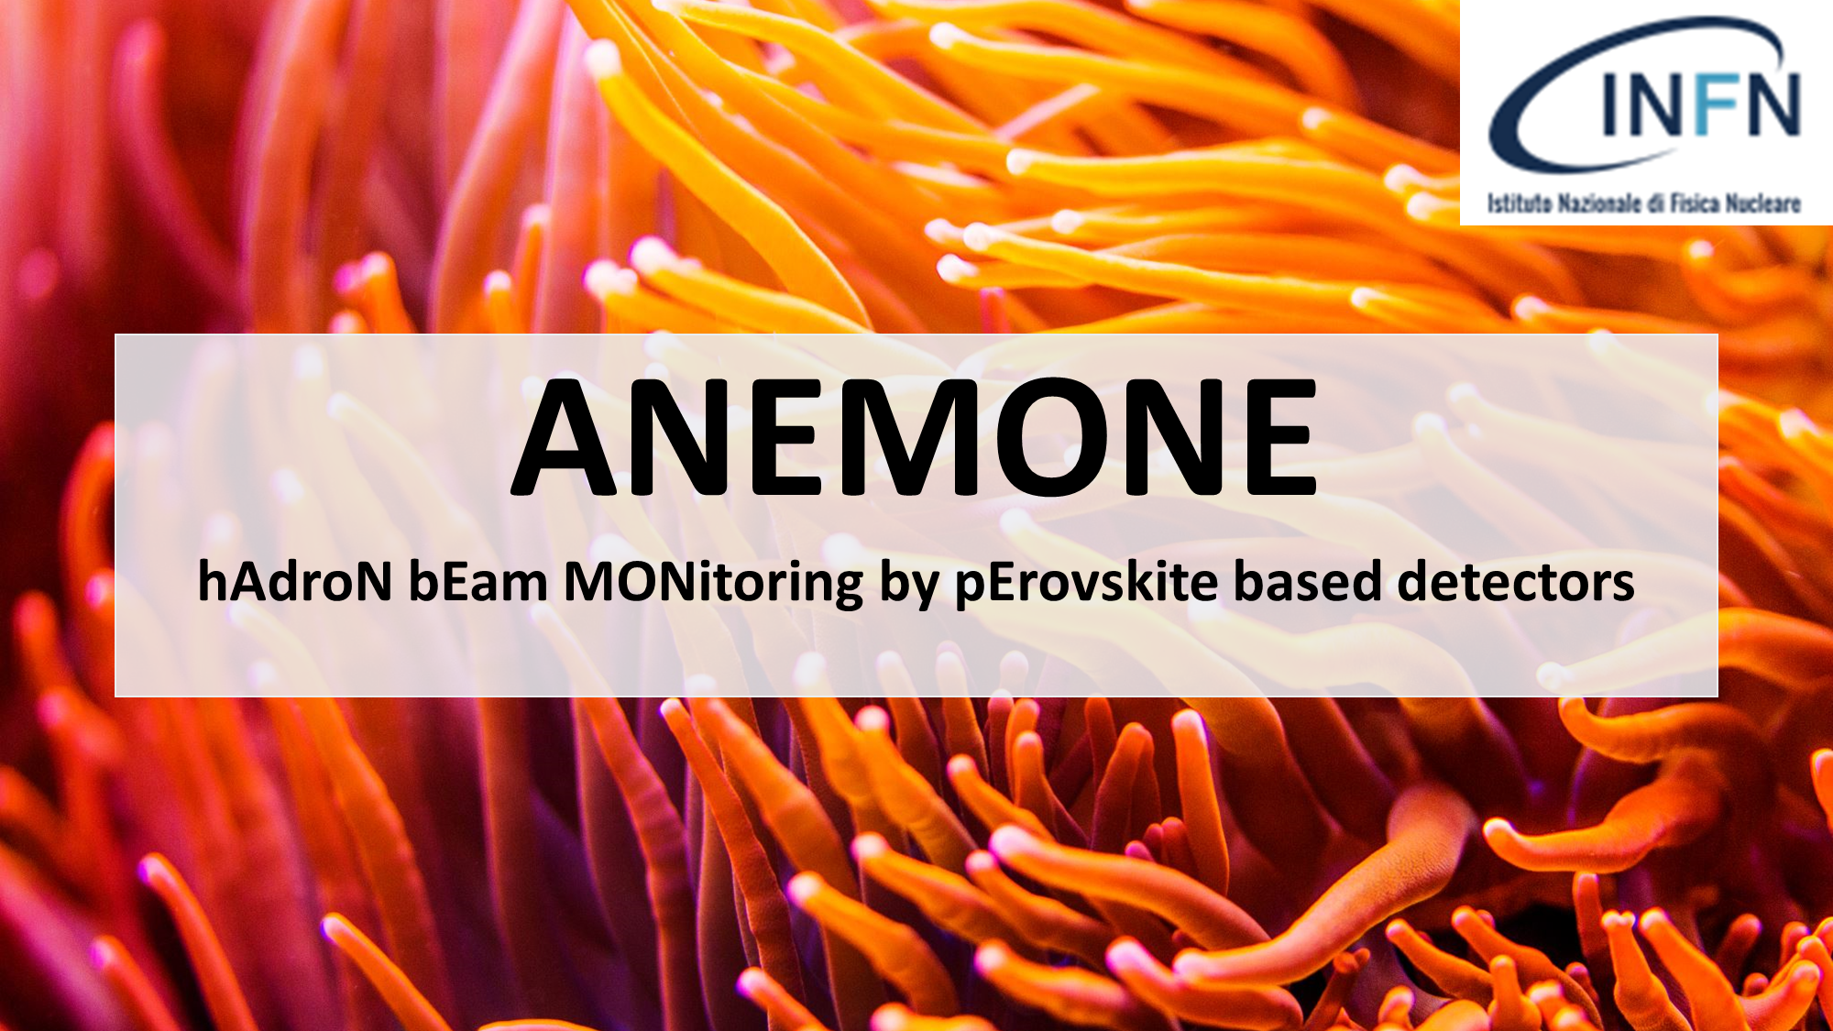
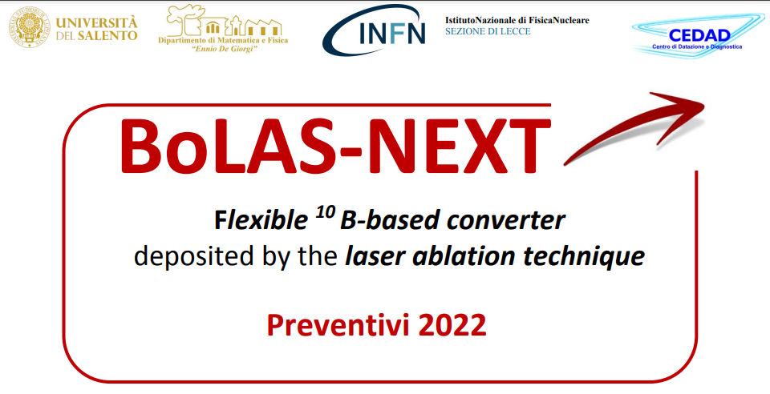
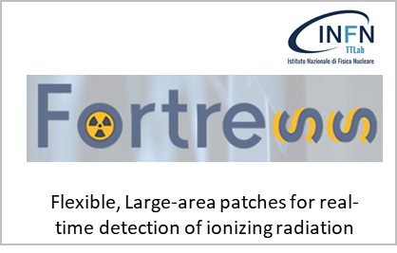
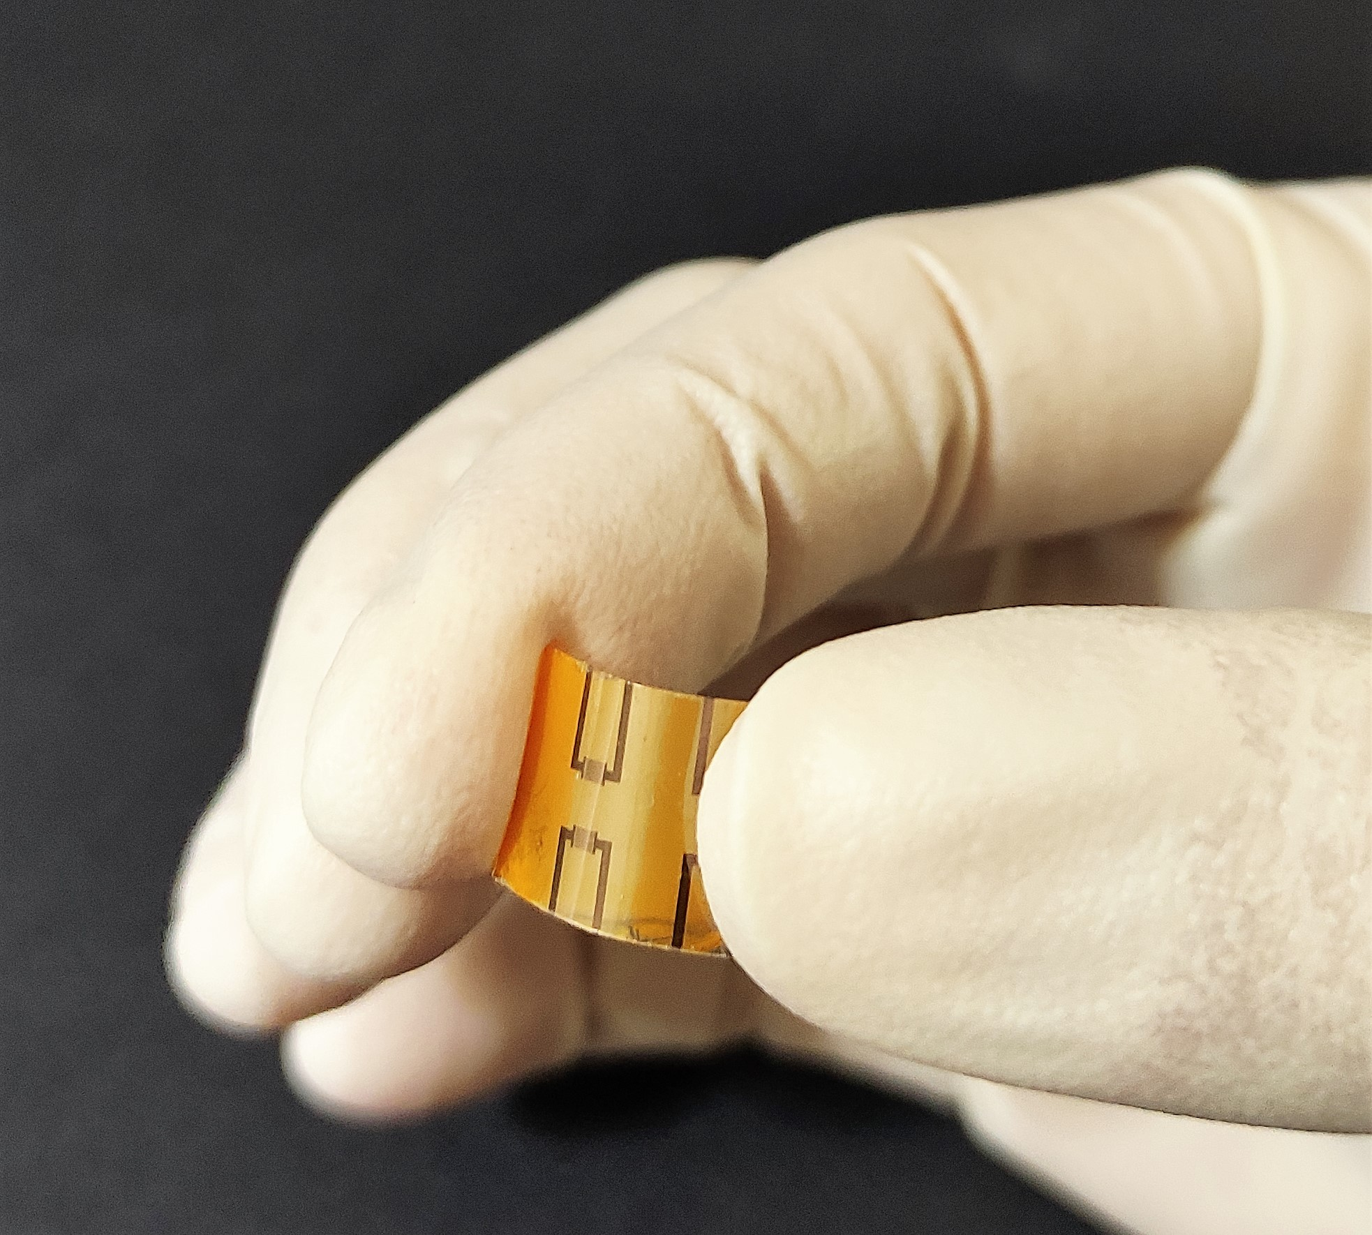
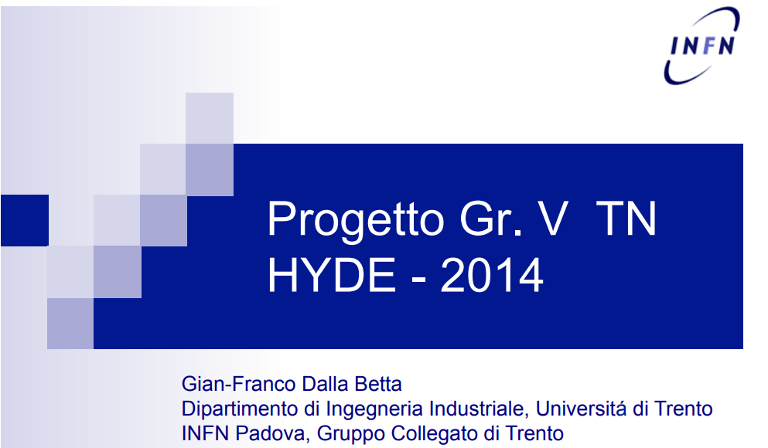
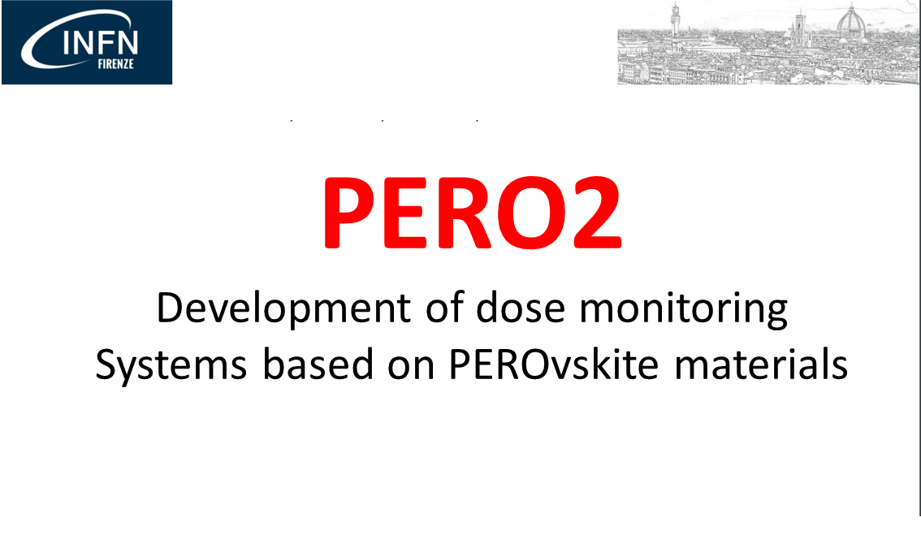
Sinergie e Background
CSN5
ASI – VUS3
CSN5
BEYOND
POR-FESR- Emilia Romagna
CSN5
CSN5
CSN5
Dispositivi FLESSIBILI, scalabili su LARGHE AREE, a BASSO COSTO per la RIVELAZIONE DIRETTA di neutroni termici e veloci in applicazioni mediche (BNCT) e monitoring ambientale
New hybrid detectors for neutrons
Ilaria Fratelli – 20 Marzo 2023
1 / 10

Slide 3
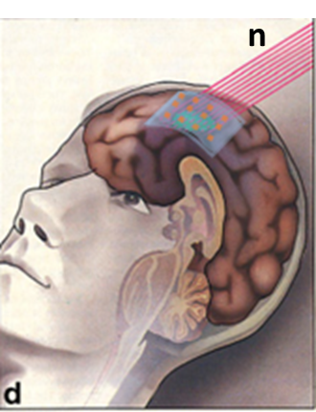

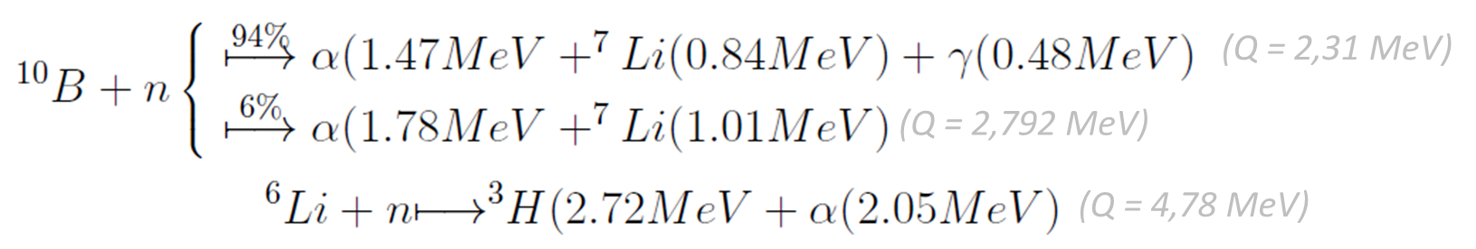
Boron Neutron Capture Therapy e dosimetria
Incident Beam Quality
1) Epithermal neutron flux > 10⁹ n cm⁻² s⁻¹
2) Neutron energy range [0,5 eV – 10 keV]
3) Fast neutrons and gamma rays as low as possible
WEARABLE DOSIMETER
LOW-COST
RAD-HARD
LOW POWER CONSUMPTION
Dymova MA, et al. Boron neutron capture therapy: Current status and future perspectives. Cancer Commun 2020;40(9):406–21.
Ilaria Fratelli – 20 Marzo 2023
2 / 10

Slide 4
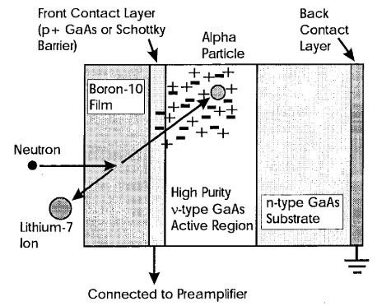
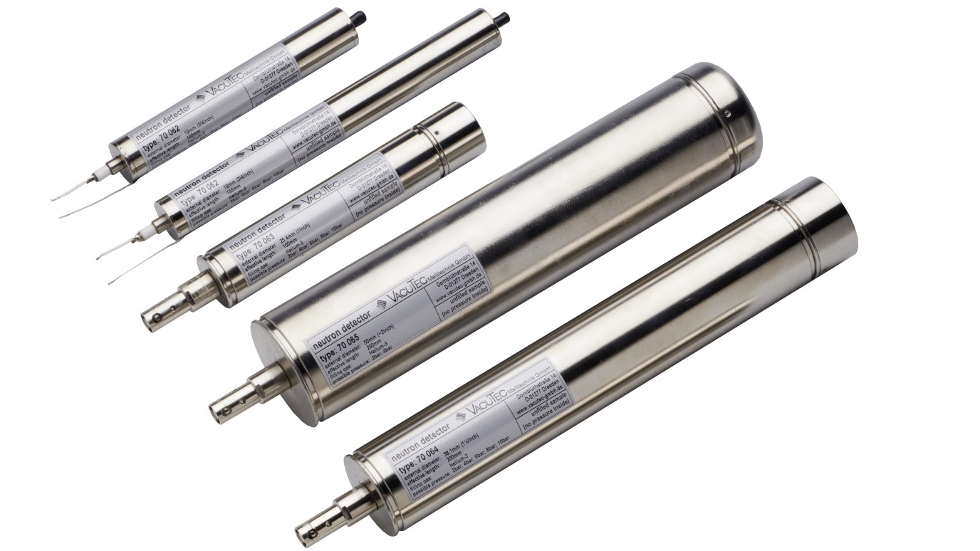
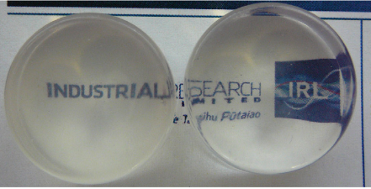

Stato dell’Arte per la rivelazione di neutroni
Contatori Proporzionali a Gas
Scintillatori
Rivelatori allo Stato Solido
VACUTEC
Bassa emissione di luce
Carenza di ³He
Alti costi di produzione
Impatto ambientale
Alto consumo energetico
Tempi di risposta
Trasferimento alpha inefficiente
Accoppiamento → < SNR
Fares M, et al. 3He proportional counter development for thermal neutron detection. Radiat Detect Technol Methods, 2021;5(2):264–72.
Amaro FD, et al. Novel concept for neutron detection: Proportional counter filled with 10 B nanoparticle aerosol. Sci Rep. 2017;7(1):1–7.
Carturan SM, et al. Flexible scintillation sensors for the detection of thermal neutrons based on siloxane 6 LiF containing composites: Role of 6 LiF crystals size and dispersion. Nucl Instruments Methods Phys Res Sect A Accel Spectrometers, Detect Assoc Equip. 2019 May 1;925:109–15.
Xie A, et al. Lithium-doped two-dimensional perovskite scintillator for wide-range radiation detection. Commun Mater 2020 11; 1(1):1–10.
McGregor DS et al. Self-biased boron-10 coated high-purity epitaxial GaAs thermal neutron detectors. IEEE Trans Nucl Sci. 2000;47(4 PART 1):1364–70.
Lai CC, Boyd R, et al. Effect of substrate roughness and material selection on the microstructure of sputtering deposited boron carbide thin films. Surf Coatings Technol. 2022;433
Ilaria Fratelli – 20 Marzo 2023
3 / 10

Slide 5
Stato dell’Arte per la rivelazione di neutroni
Contatori Proporzionali a Gas
Scintillatori
Rivelatori allo Stato Solido
VACUTEC
Bassa emissione di luce
Carenza di ³He
Alti costi di produzione
Impatto ambientale
Alto consumo energetico
Tempi di risposta
Trasferimento alpha inefficiente
Accoppiamento → < SNR
Fares M, et al. 3He proportional counter development for thermal neutron detection. Radiat Detect Technol Methods, 2021;5(2):264–72.
Amaro FD, et al. Novel concept for neutron detection: Proportional counter filled with 10 B nanoparticle aerosol. Sci Rep. 2017;7(1):1–7.
Carturan SM, et al. Flexible scintillation sensors for the detection of thermal neutrons based on siloxane 6 LiF containing composites: Role of 6 LiF crystals size and dispersion. Nucl Instruments Methods Phys Res Sect A Accel Spectrometers, Detect Assoc Equip. 2019 May 1;925:109–15.
Xie A, et al. Lithium-doped two-dimensional perovskite scintillator for wide-range radiation detection. Commun Mater 2020 11; 1(1):1–10.
McGregor DS et al. Self-biased boron-10 coated high-purity epitaxial GaAs thermal neutron detectors. IEEE Trans Nucl Sci. 2000;47(4 PART 1):1364–70.
Lai CC, Boyd R, et al. Effect of substrate roughness and material selection on the microstructure of sputtering deposited boron carbide thin films. Surf Coatings Technol. 2022;433
Ilaria Fratelli – 20 Marzo 2023
3 / 10

Slide 6
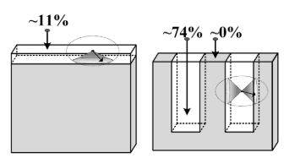
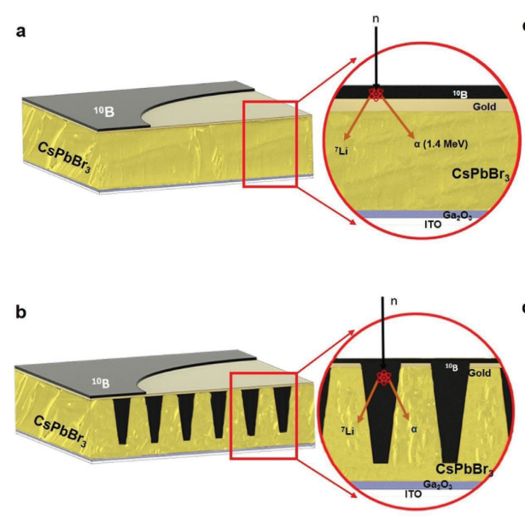
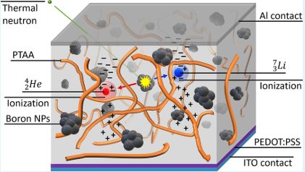
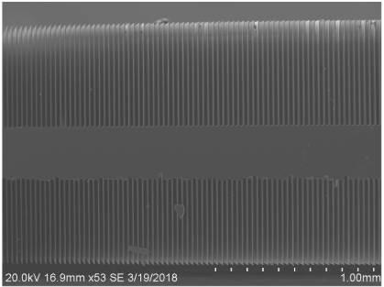
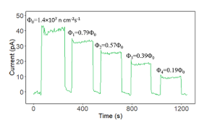
Background – BEYOND
3D MICROSTRUCTURED SEMICONDUCTOR NEUTRON DETECTORS based on Silicon
3D MICROSTRUCTURED
INORGANIC PEROVSKITE for NEUTRON DETECTION
¹⁰B NANOPARTICLES-loaded POLYMER for THERMAL NEUTRON DETECTION
¹⁰B
Si
McGregor DS. Improved manufacturing and performance of the dual-sided microstructured semiconductor neutron detector (DS-MSND). Nucl Instruments Methods Phys Res Sect A Accel Spectrometers, 2020;954(November 2018):161696
Quevedo-Lopez M., et al. Adv Mater Technol. 2020;5(12):3–9.
Quevedo-Lopez M., et al. ACS Appl Mater Interfaces. 2021;13(24):28049–56.
Quevedo-Lopez M., et al. Adv Mater Technol. 2022;2100956:1–7.
Sellin P., et al. Boron-Loaded Polymeric Sensor for the Direct Detection of Thermal Neutrons. ACS Appl Mater Interfaces. 2020;12(29):33050–7.
Ilaria Fratelli – 20 Marzo 2023
4 / 10

Slide 7
Background – BEYOND
3D MICROSTRUCTURED SEMICONDUCTOR NEUTRON DETECTORS based on Silicon
3D MICROSTRUCTURED
INORGANIC PEROVSKITE for NEUTRON DETECTION
¹⁰B NANOPARTICLES-loaded POLYMER for THERMAL NEUTRON DETECTION
¹⁰B
LIMITI:
L’ottimizzazione della deposizione del Boro per un completo riempimento delle 3D microstructured trenches.
Clustering delle nanostrutture di alpha convertitore e conseguente degrado delle proprietà di trasporto del polimero.
Si
McGregor DS. Improved manufacturing and performance of the dual-sided microstructured semiconductor neutron detector (DS-MSND). Nucl Instruments Methods Phys Res Sect A Accel Spectrometers, 2020;954(November 2018):161696
Quevedo-Lopez M., et al. Adv Mater Technol. 2020;5(12):3–9.
Quevedo-Lopez M., et al. ACS Appl Mater Interfaces. 2021;13(24):28049–56.
Quevedo-Lopez M., et al. Adv Mater Technol. 2022;2100956:1–7.
Sellin P., et al. Boron-Loaded Polymeric Sensor for the Direct Detection of Thermal Neutrons. ACS Appl Mater Interfaces. 2020;12(29):33050–7.
Ilaria Fratelli – 20 Marzo 2023
4 / 10

Slide 8


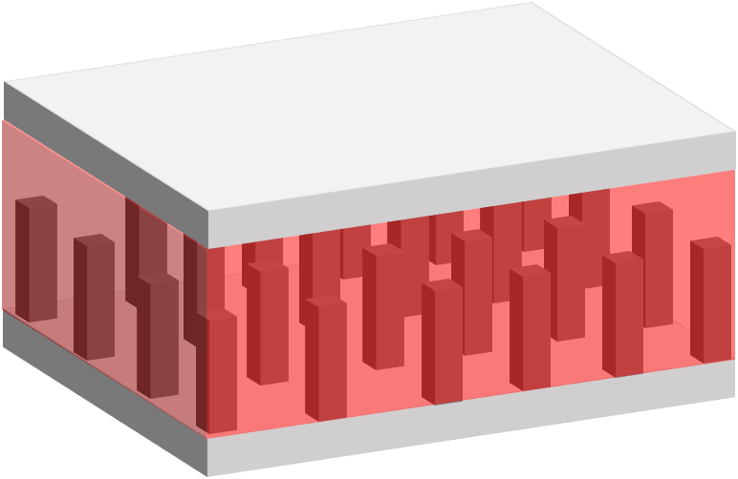
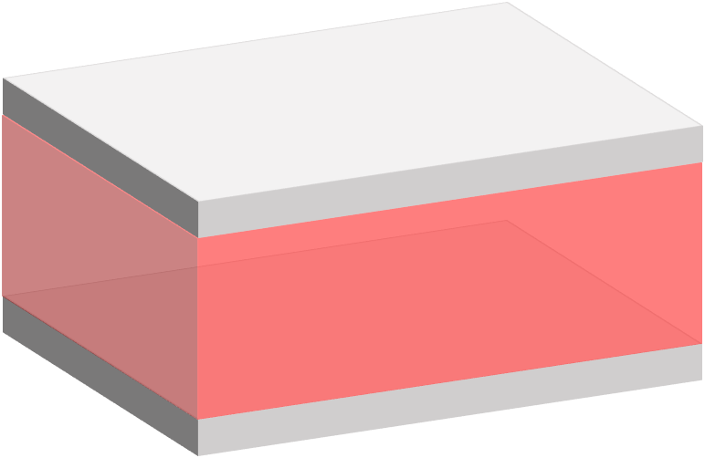
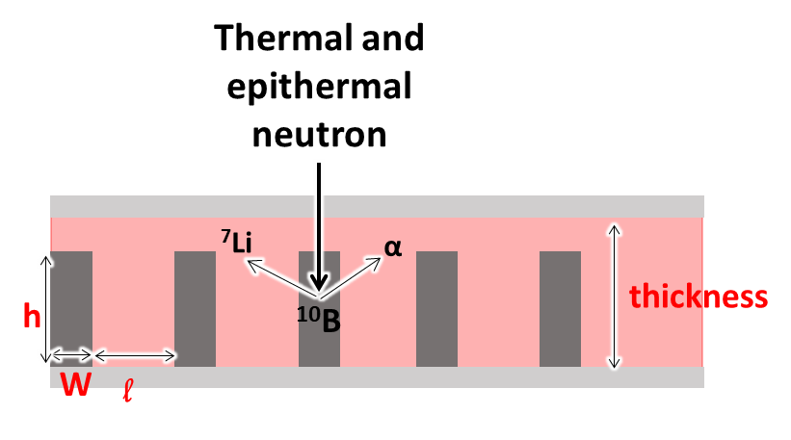
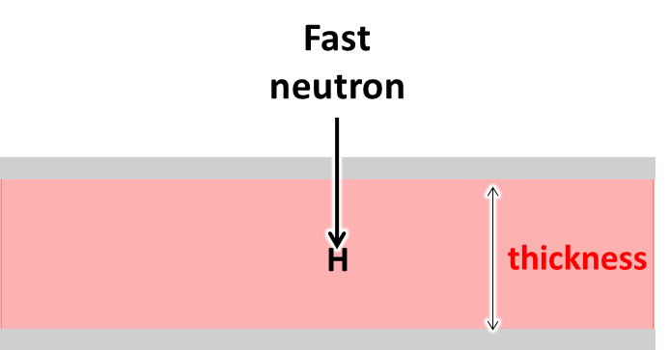
BEYOND – obiettivi
Contatto elettrico
Semiconduttore
α convertitore
(¹⁰B)
5-20 µm
Lo scopo di BEYOND è la realizzazione e caratterizzazione di dispositivi flessibili e scalabili su larghe aree basati su perovskite (PVK) e materiali organici (OP) per la rivelazione di neutroni termici e veloci.
0,5-3 µm
Contatto Elettrico
MECCANISMI di RIVELAZIONE
Neutrone
Termico/Epitermico
Neutrone
Veloce
[5-10] µm
[10-100] µm
Studio di W, h e thickness per:
Ottimizzare il trasferimento di carica α
Massimizzare l’assorbimento di neutroni
Mantenere buone proprietà di trasporto
Ilaria Fratelli – 20 Marzo 2023
5 / 10

Slide 9
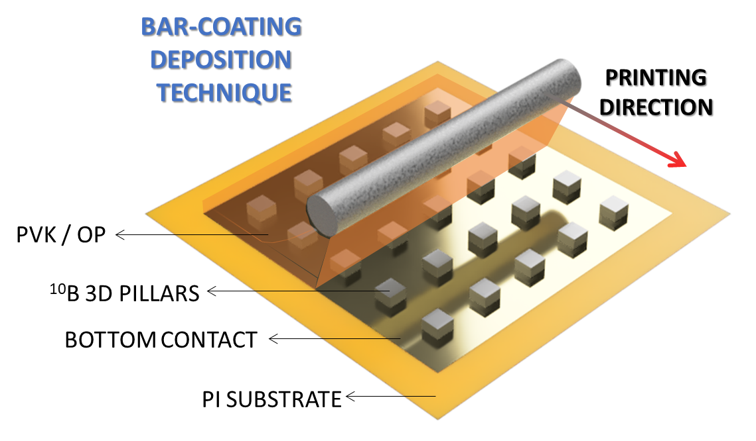
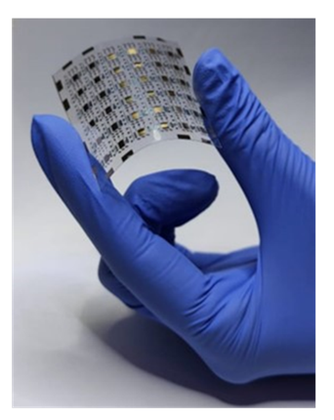
BEYOND – vantaggi
Contatto elettrico
Semiconduttore
α convertitore
(¹⁰B)
5-20 µm
0,5-3 µm
Contatto Elettrico
VANTAGGI
La scelta di patternare il ¹⁰B e non il semiconduttore (McGregor e Lopez) permette di adottare tecniche di deposizione da soluzione (low-cost, dispositivi flessibili e scalabili su larghe aree, completo riempimento delle microstrutture 3D)
Le microstrutture di ¹⁰B massimizzano il trasferimento α allo strato di semiconduttore rispetto ad un layer α convertitore planare.
Rivelatori a FILM SOTTILE → Ottima selettività neutroni/gamma
Alta concentrazione intrinseca di atomi H nelle PVK e OP
Fabbricazione in-house con mask-less lithography
Ilaria Fratelli – 20 Marzo 2023
5 / 10

Slide 10
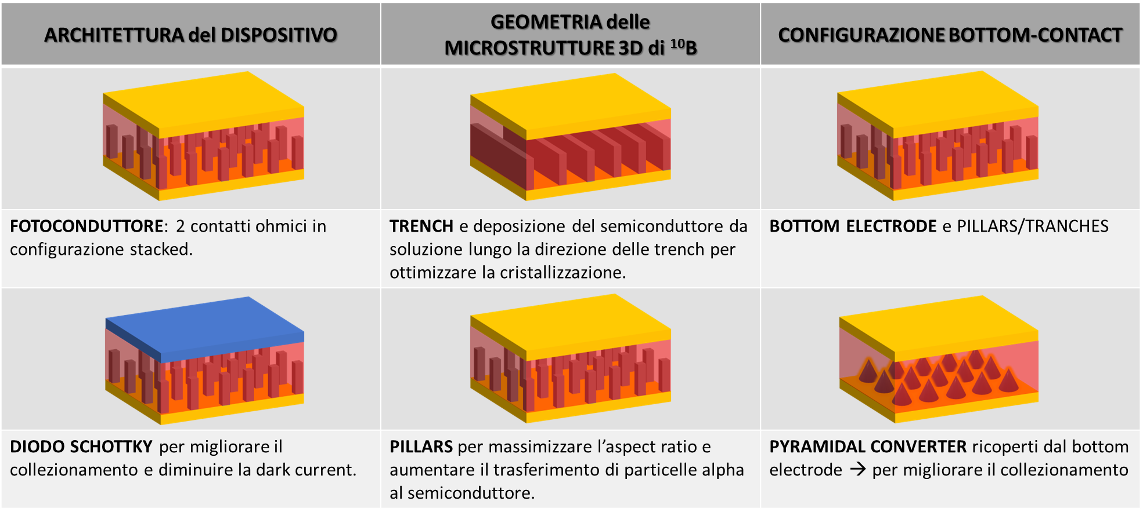
BEYOND – vantaggi
Ilaria Fratelli – 20 Marzo 2023
6 / 10

Slide 11
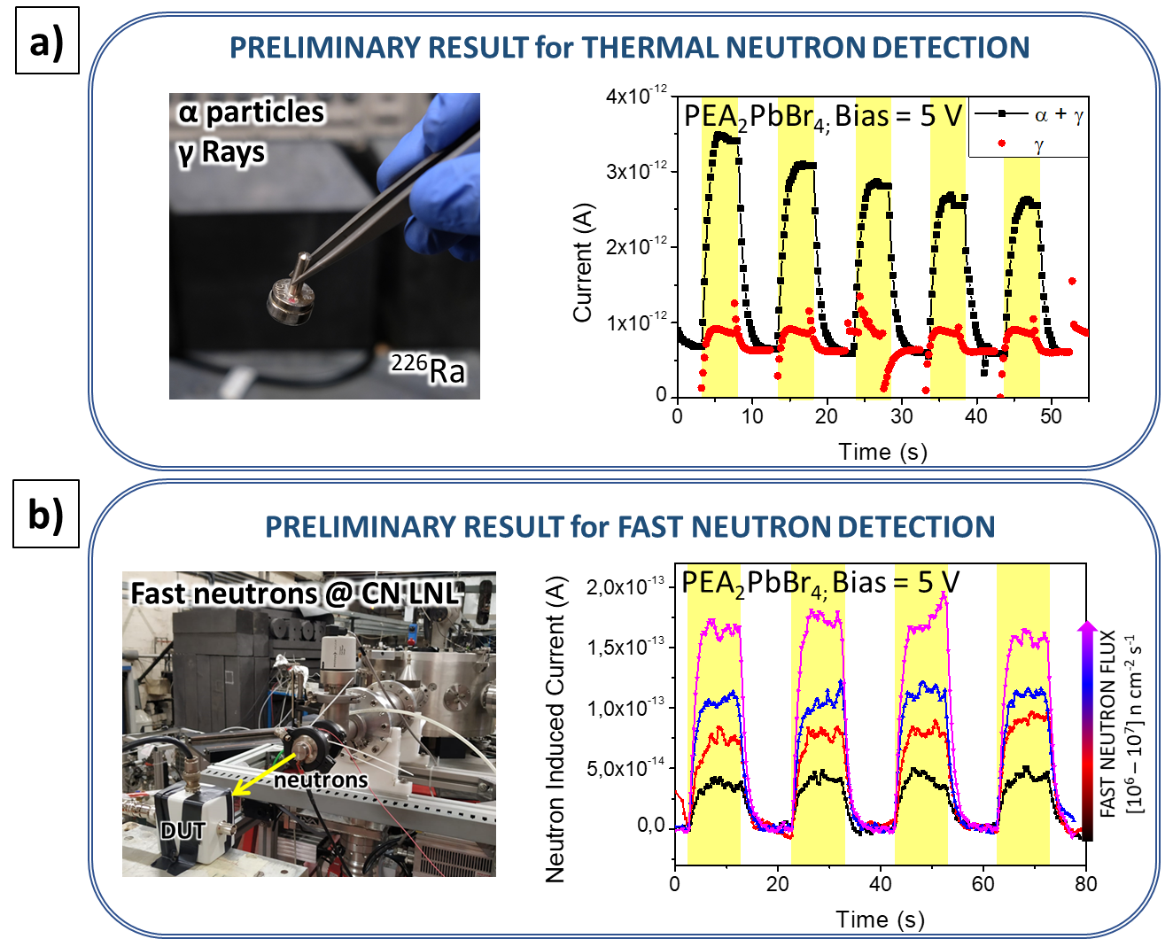
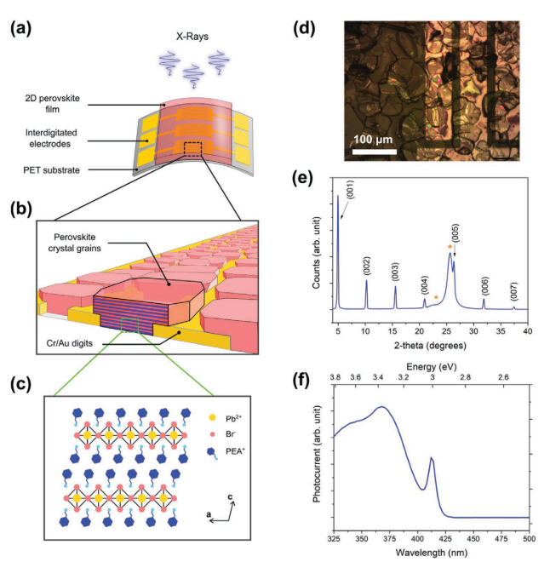
BEYOND – risultati preliminari
2D HYBRID PEROVSKITE
RIVELAZIONE α
SELETTIVITA’
RIVELAZIONE NEUTRONI VELOCI
PEA₂PbBr₄ (PEA = C₆H₅C₂H₄NH₃⁺)
Ciavatti A, Verdi M, Basiricò L, Fraboni B, Lédée F, et al.. Adv Opt Mater. 2022;10(1):2101145.
Ilaria Fratelli – 20 Marzo 2023
7 / 10

Slide 12
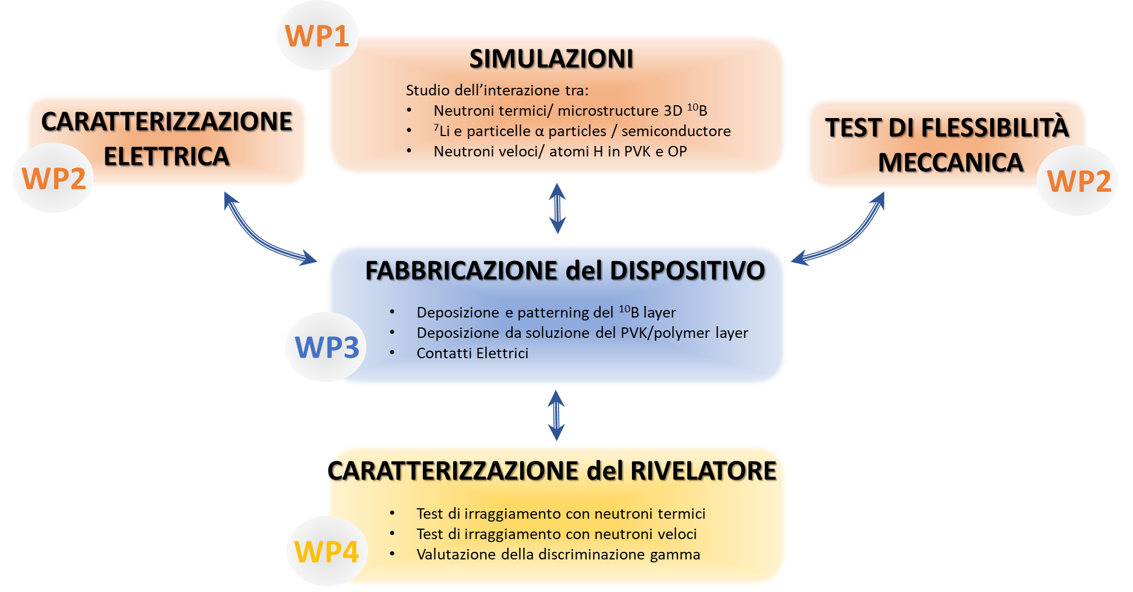
BEYOND – work packages
Ilaria Fratelli – 20 Marzo 2023
8 / 10

Slide 13
BEYOND – partecipanti
Name | Home Institution | Role | Age | FTE | Note
Ilaria Fratelli | INFN – BO | PI | 29 | 1 | OS and PVK deposition, photolithography processes, direct XR and Proton detection
Beatrice Fraboni | INFN – BO | Participant | 56 | 0.2 | FIRE project coordinator
Laura Basiricò | INFN – BO | Participant | 38 | 0.2 | ANEMONE experiment coordinator
Andrea Ciavatti | INFN – BO | Team Leader WP2 | 36 | 0.3 | Direct detection of ionizing radiation
Sara Maria Carturan | INFN – LNL | Participant | 53 | 0.1 | Fabrication and characterization of Polysiloxane-Based Scintillators
Gianluigi Maggioni | INFN – LNL | Participant | 54 | 0.1 | Physical deposition techniques (i.e. RF magnetron sputtering)
Marco Cinausero | INFN – LNL | Participant | 57 | 0.1 | Neutrons detectors, data acquisition and processing, discrimination in mixed radiation fields
Sandra Moretto | INFN – PD | Team Leader WP1 | 48 | 0.1 | Neutrons detectors, data acquisition and processing, discrimination in mixed radiation fields
TOTAL |  |  |  | 2.1
Ilaria Fratelli – 20 Marzo 2023
9 / 10

Slide 14
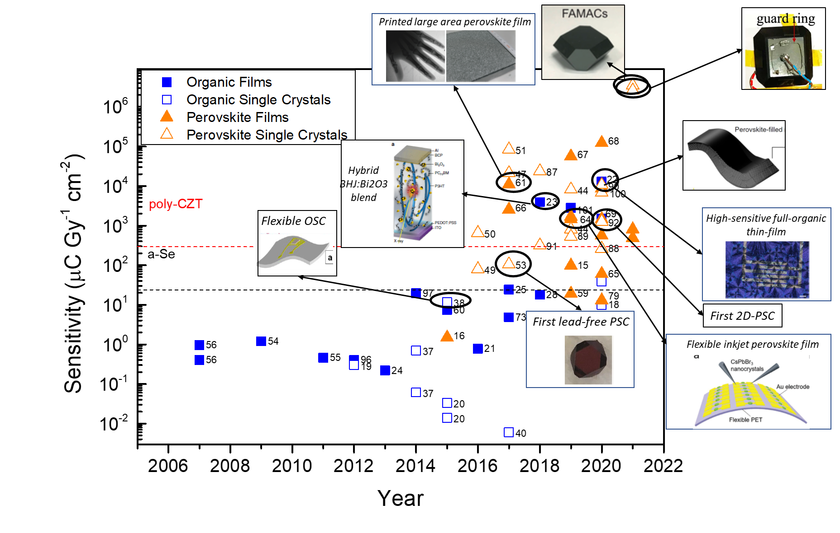
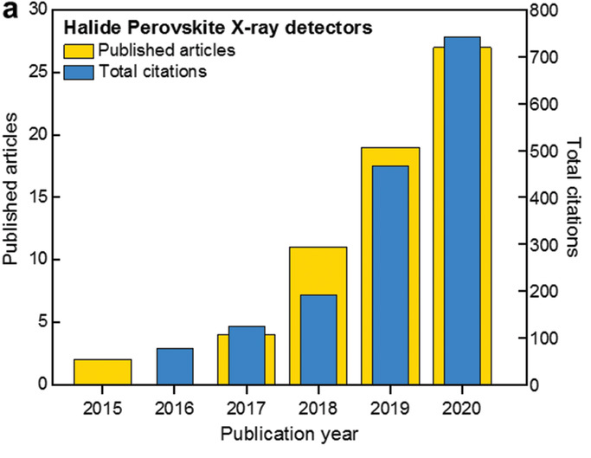
BEYOND – impatto scientifico
Basiricò L, Ciavatti A, Fraboni B. Solution‐Grown Organic and Perovskite X‐Ray Detectors: A New Paradigm for the Direct Detection of Ionizing Radiation. Adv Mater Technol. 2020 Aug; 2000475
Thomas D. Anthopoulos,Konstantinos Petridis et al., Metal Halide Perovskites for High-Energy Radiation Detection, Advanced Science, Volume: 7, Issue: 22; October 2020, DOI: (10.1002/advs.202002098)
Ilaria Fratelli – 20 Marzo 2023
10 / 10

Slide 15
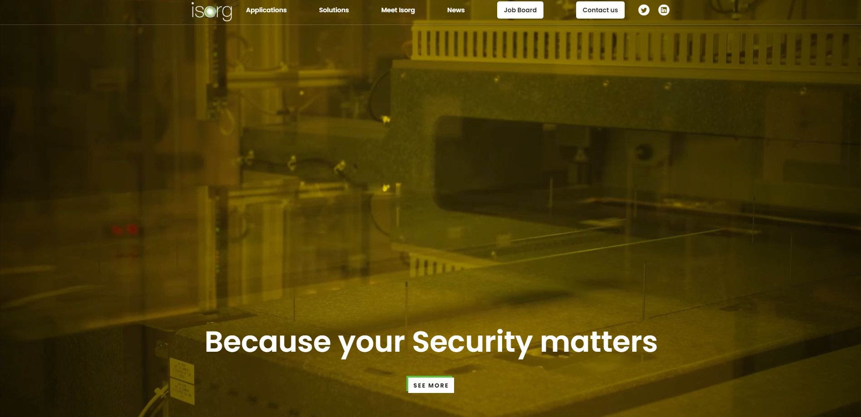
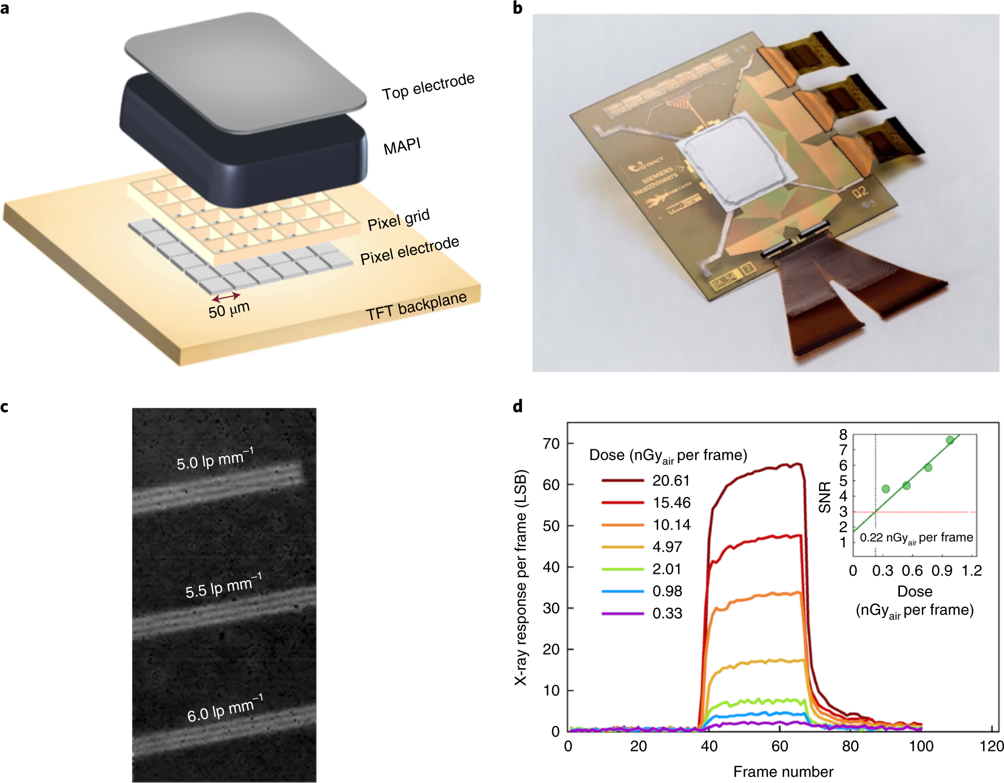
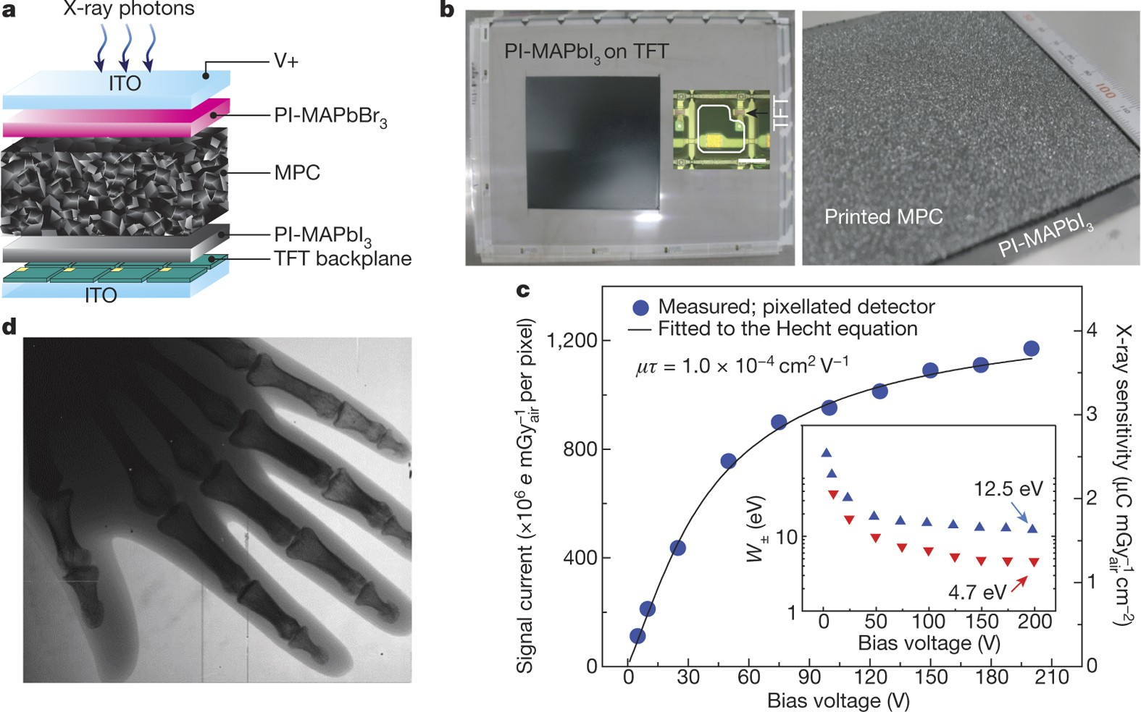
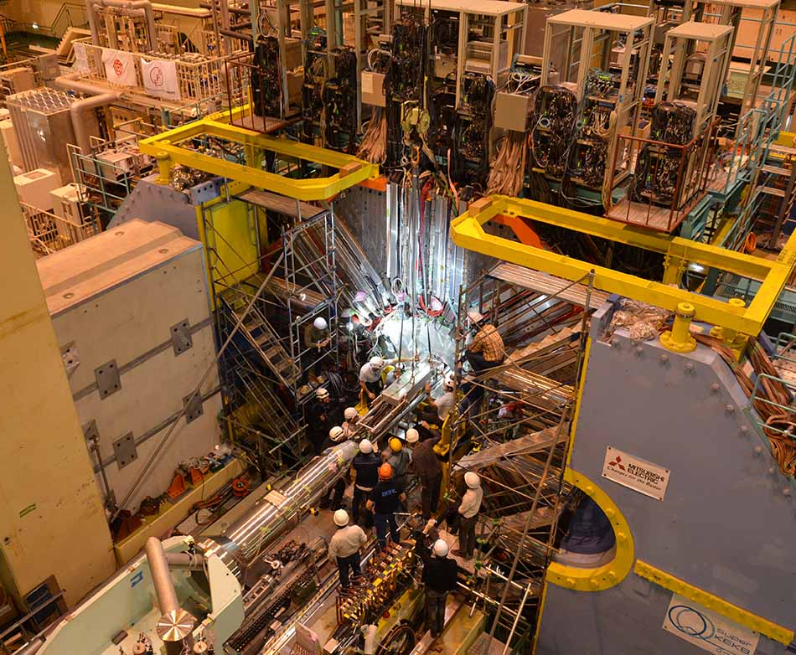
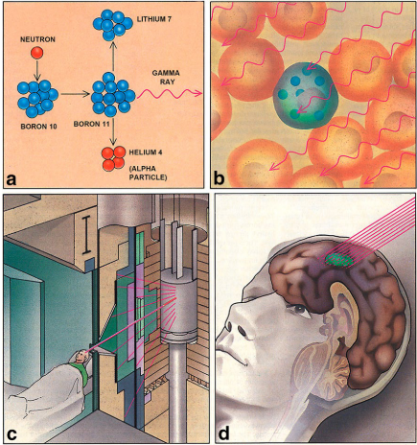
BEYOND – impatto tecnologico e sociale
SIEMENS – X-ray detectors – PEROVSKITES
ISORG – X-ray detectors – ORGANICS
Tedde S. et al. High-sensitivity high-resolution X-ray imaging with soft-sintered metal halide perovskites. Nat Electron 4, 681–688 (2021). https://doi.org/10.1038/s41928-021-00644-3
SAMSUNG – X-ray detectors – PEROVSKITES
… and NEUTRONS??
AMBIENT MONITOR
PERSONAL DOSIMETRY
Kim, Y., Kim, K., Son, DY. et al. Printable organometallic perovskite enables large-area, low-dose X-ray imaging. Nature 550, 87–91 (2017). https://doi.org/10.1038/nature24032
Ilaria Fratelli – 20 Marzo 2023
10 / 10

Slide 16
BEYOND
Grazie per l’attenzione!

Slide 18
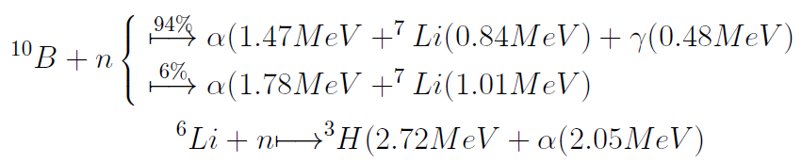
Interazione neutrone termico-materia
(Q = 2,31 MeV)
(Q = 2,792 MeV)
(Q = 4,78 MeV)
 | Cross Section (barn) @ 0.025 eV | Natural Abundance (%)
⁶Li | 942 | 7,6%
¹⁰B | 3842 | 19,9%
Ilaria Fratelli – 20 Marzo 2023

Slide 19
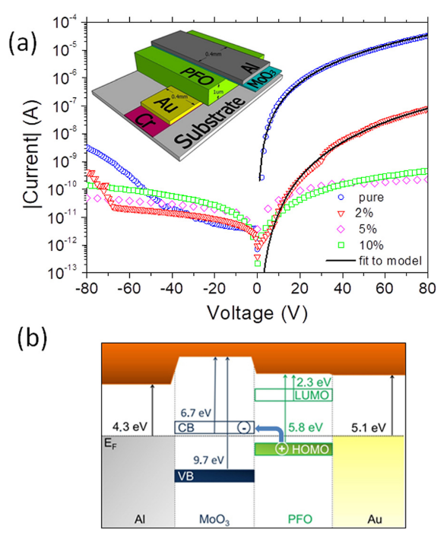
Materiali
PEA₂PbBr₄ (PEA = C₆H₅C₂H₄NH₃⁺)
PFO = poly(9,9-dioctyfluorene
L. F, Ciavatti A, Verdi M, Basiricò L, Fraboni B, Lédée F, et al. Ultra-Stable and Robust Response to X-Rays in 2D Layered Perovskite Micro-Crystalline Films Directly Deposited on Flexible Substrate. Adv Opt Mater. 2022;10(1):2101145.
Ciavatti A, Cramer T, Carroli M, Basiricò L, Fuhrer R, De Leeuw DM, et al. Dynamics of direct X-ray detection processes in high-Z Bi2O3 nanoparticles-loaded PFO polymer-based diodes. Appl Phys Lett ;2017 Oct 30;111(18):183301.
Ilaria Fratelli – 20 Marzo 2023

Slide 20
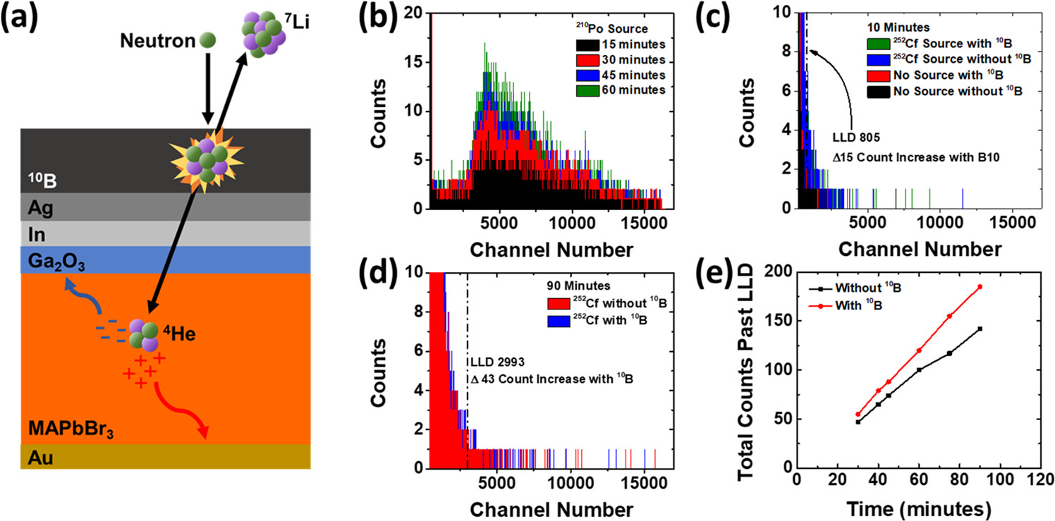
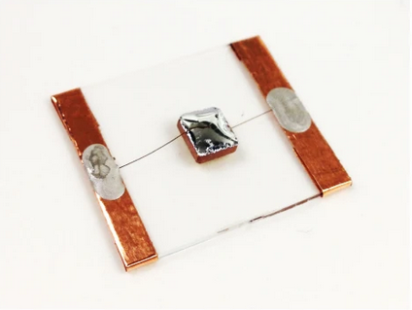
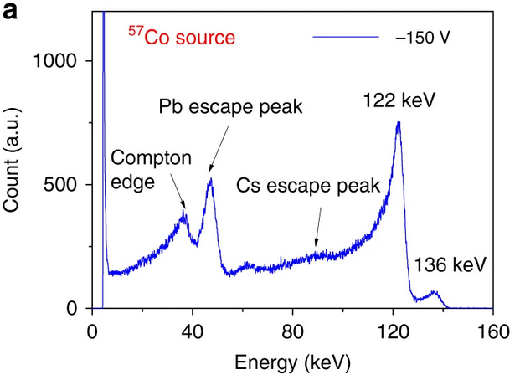
Spettrometria con PVK - letteratura
Gamma
Alpha
CsPbBr3
He, Y., Matei, L., Jung, H.J. et al. Nat Commun 9, 1609 (2018).
Quevedo-Lopez M., et al. Adv Mater Technol. 2020;5(12):3–9.
Ilaria Fratelli – 20 Marzo 2023

Slide 21
BEYOND – organizzazione e timeline
WP1 | Simulations and Calculations – leader: Dr. Sandra Moretto
WP2 | FND and TND detector fabrication – leader: Dr. Ilaria Fratelli
WP3 | Electrical and Mechanical Characterization – leader: Dr. Andrea Ciavatti
WP4 | Neutron detection tests @ CN-LNL – leader: Dr. Ilaria Fratelli
MILESTONE | MONTH | Description
M1 | 6 | Identification of the main geometrical parameters through Calculations and Monte Carlo Simulations
M2 | 12 | Identification of geometrical parameters and Semiconducting Materials properties under radioactive sources
M3 | 18 | Realization of TND and FND single pixel
M4 | 24 | Assessment of TND and FND detecting performances under relevant irradiation conditions
Ilaria Fratelli – 20 Marzo 2023

Slide 22
BEYOND – work packages
WP1: SIMULATIONS – leader: LNL
TASK 1.1 (INFN-LNL) → Geant4 Monte Carlo code for the calculation of the capture rate of thermal neutrons in converting layer and fast neutrons in semiconductors will be estimated.
TASK 1.2 (INFN-BO) → SRIM, calculation of the release of energy by alpha particles produced by 10B/n
WP2: HYBRID DEVICES FABRICATION – leader: Ilaria Fratelli
TASK 2.1 (INFN-LNL) → Deposition and patterning of the 10B converting layer.
TASK 2.2 (INFN-BO) → Deposition from solution by bar coating of the PVK and OP layer.
TASK 2.3 (INFN-BO) → Optimization of the device architecture.
WP3: ELECTRICAL and MECHANICAL CHARACTRIZATION – leader: Andrea Ciavatti
TASK 3.1 (INFN-BO) → Electrical characterization of the single pixel.
TASK 3.2 (INFN-BO) → Flexibility tests.
WP4: NEUTRON SENSING CHARACTERIZATION – leader: Ilaria Fratelli
TASK 4.1 (INFN-BO) → Preliminary tests under relevant α particle fluxes produced by radioactive sources. The irradiation conditions will be identified by the simulations provided by WP1.
TASK 4.2 (INFN-LNL/INFN-BO) → Characterization of the TND pixel under relevant irradiation condition at the MUNES beamline (CN-LNL)
TASK 4.3 (INFN-LNL/INFN-BO) → Characterization of the FND pixel under relevant irradiation condition at the 0° beamline (CN-LNL)
TASK 4.4 (INFN-LNL) → Spectroscopy measurements for the evaluation of neutron/gamma discrimination
Ilaria Fratelli – 20 Marzo 2023

Slide 23
BEYOND – Risk Assessment
N | Risk Description | Risk Level |  | CONTINGENCY MEASURES & MITIGATION PLAN
 |  | PROBABILITY | IMPACT
1 | Homogeneity and adhesion issues during the ¹⁰B sputtering deposition | LOW | HIGH | We will deposit ¹⁰B₄C (55–57) by e-beam/sputtering (Servizio bersaglio, LNL) or by PLD (INFN-Lecce) (21). We can evaporate Ti instead of Au for the bottom electrode to improve the adhesion of ¹⁰B₄C (58)
2 | Low resolution and low yield issues during the ¹⁰B patterning by lift-off process | LOW | LOW | We will pattern the converting layer by wet etching using nitric acid
3 | Poor absorption of thermal and epithermal neutrons | LOW | HIGH | Blending of LiBO nanoparticles in the PVK and OP solution. (59)
4 | Poor absorption of fast neutrons | HIGH | MEDIUM | Increasing the semiconductor thickness up to 50 µm
5 | Delay in the scheduling of neutron beamtimes at the designed facilities | LOW | MEDIUM | Test of the detectors response under neutron beams provided by other facilities (CNAO) and under intense radioactive sources (AmBe)
6 | High roughness of the semiconducting layer and leackage of the stacked architecture | LOW | MEDIUM | We will employ a post-processing method based on backfilling and subsequent etching. (60) We will employ an organic insulating material to fill the voids between the semiconducting microstructures and we planarized by etching the top of the layer.
7 | Delay in the profilometer purchase | LOW | LOW | We will characterize the morphology of the patterned ¹⁰B layer using AFM
Ilaria Fratelli – 20 Marzo 2023

Slide 24
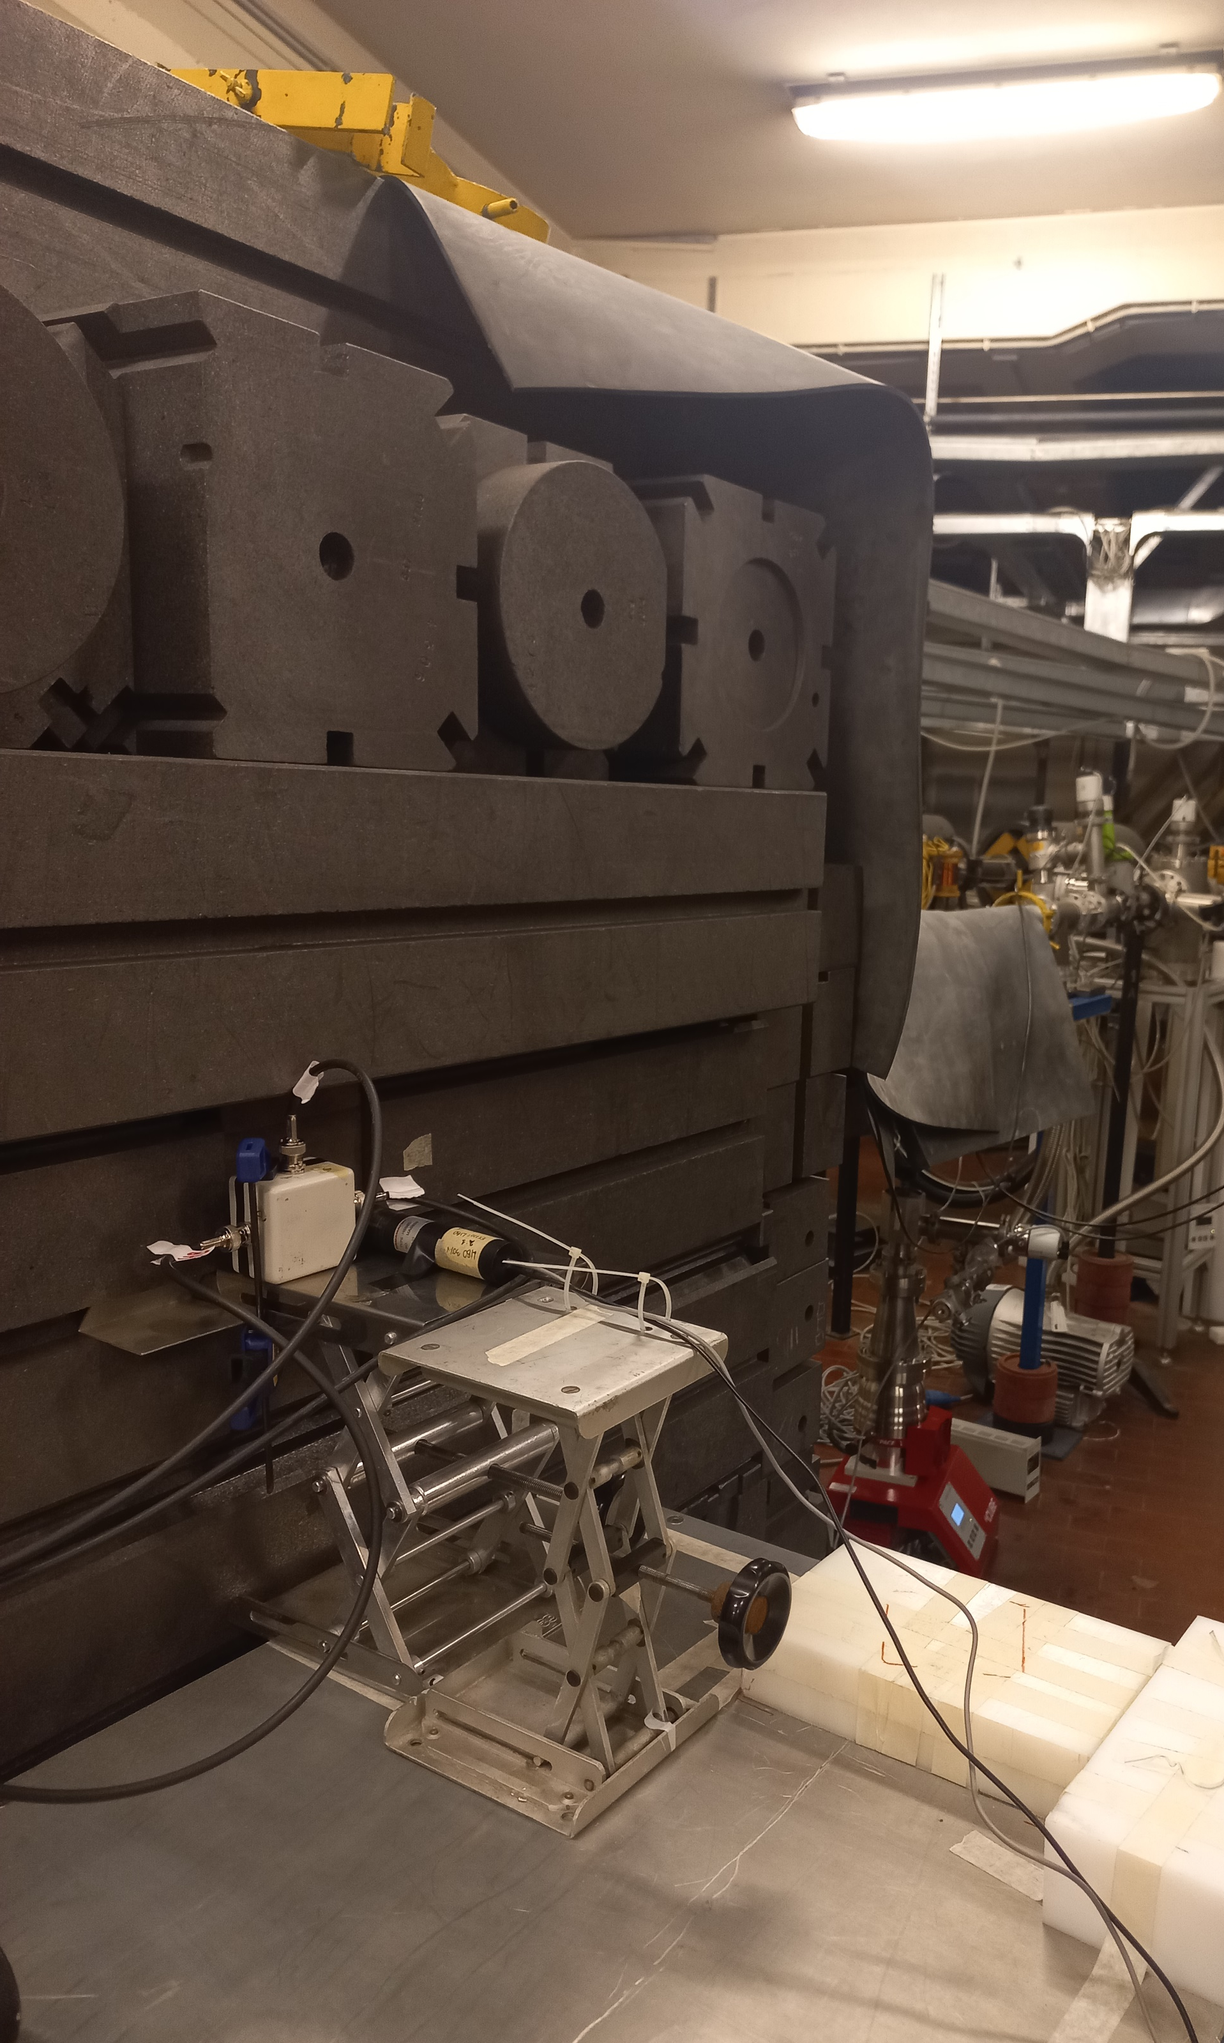
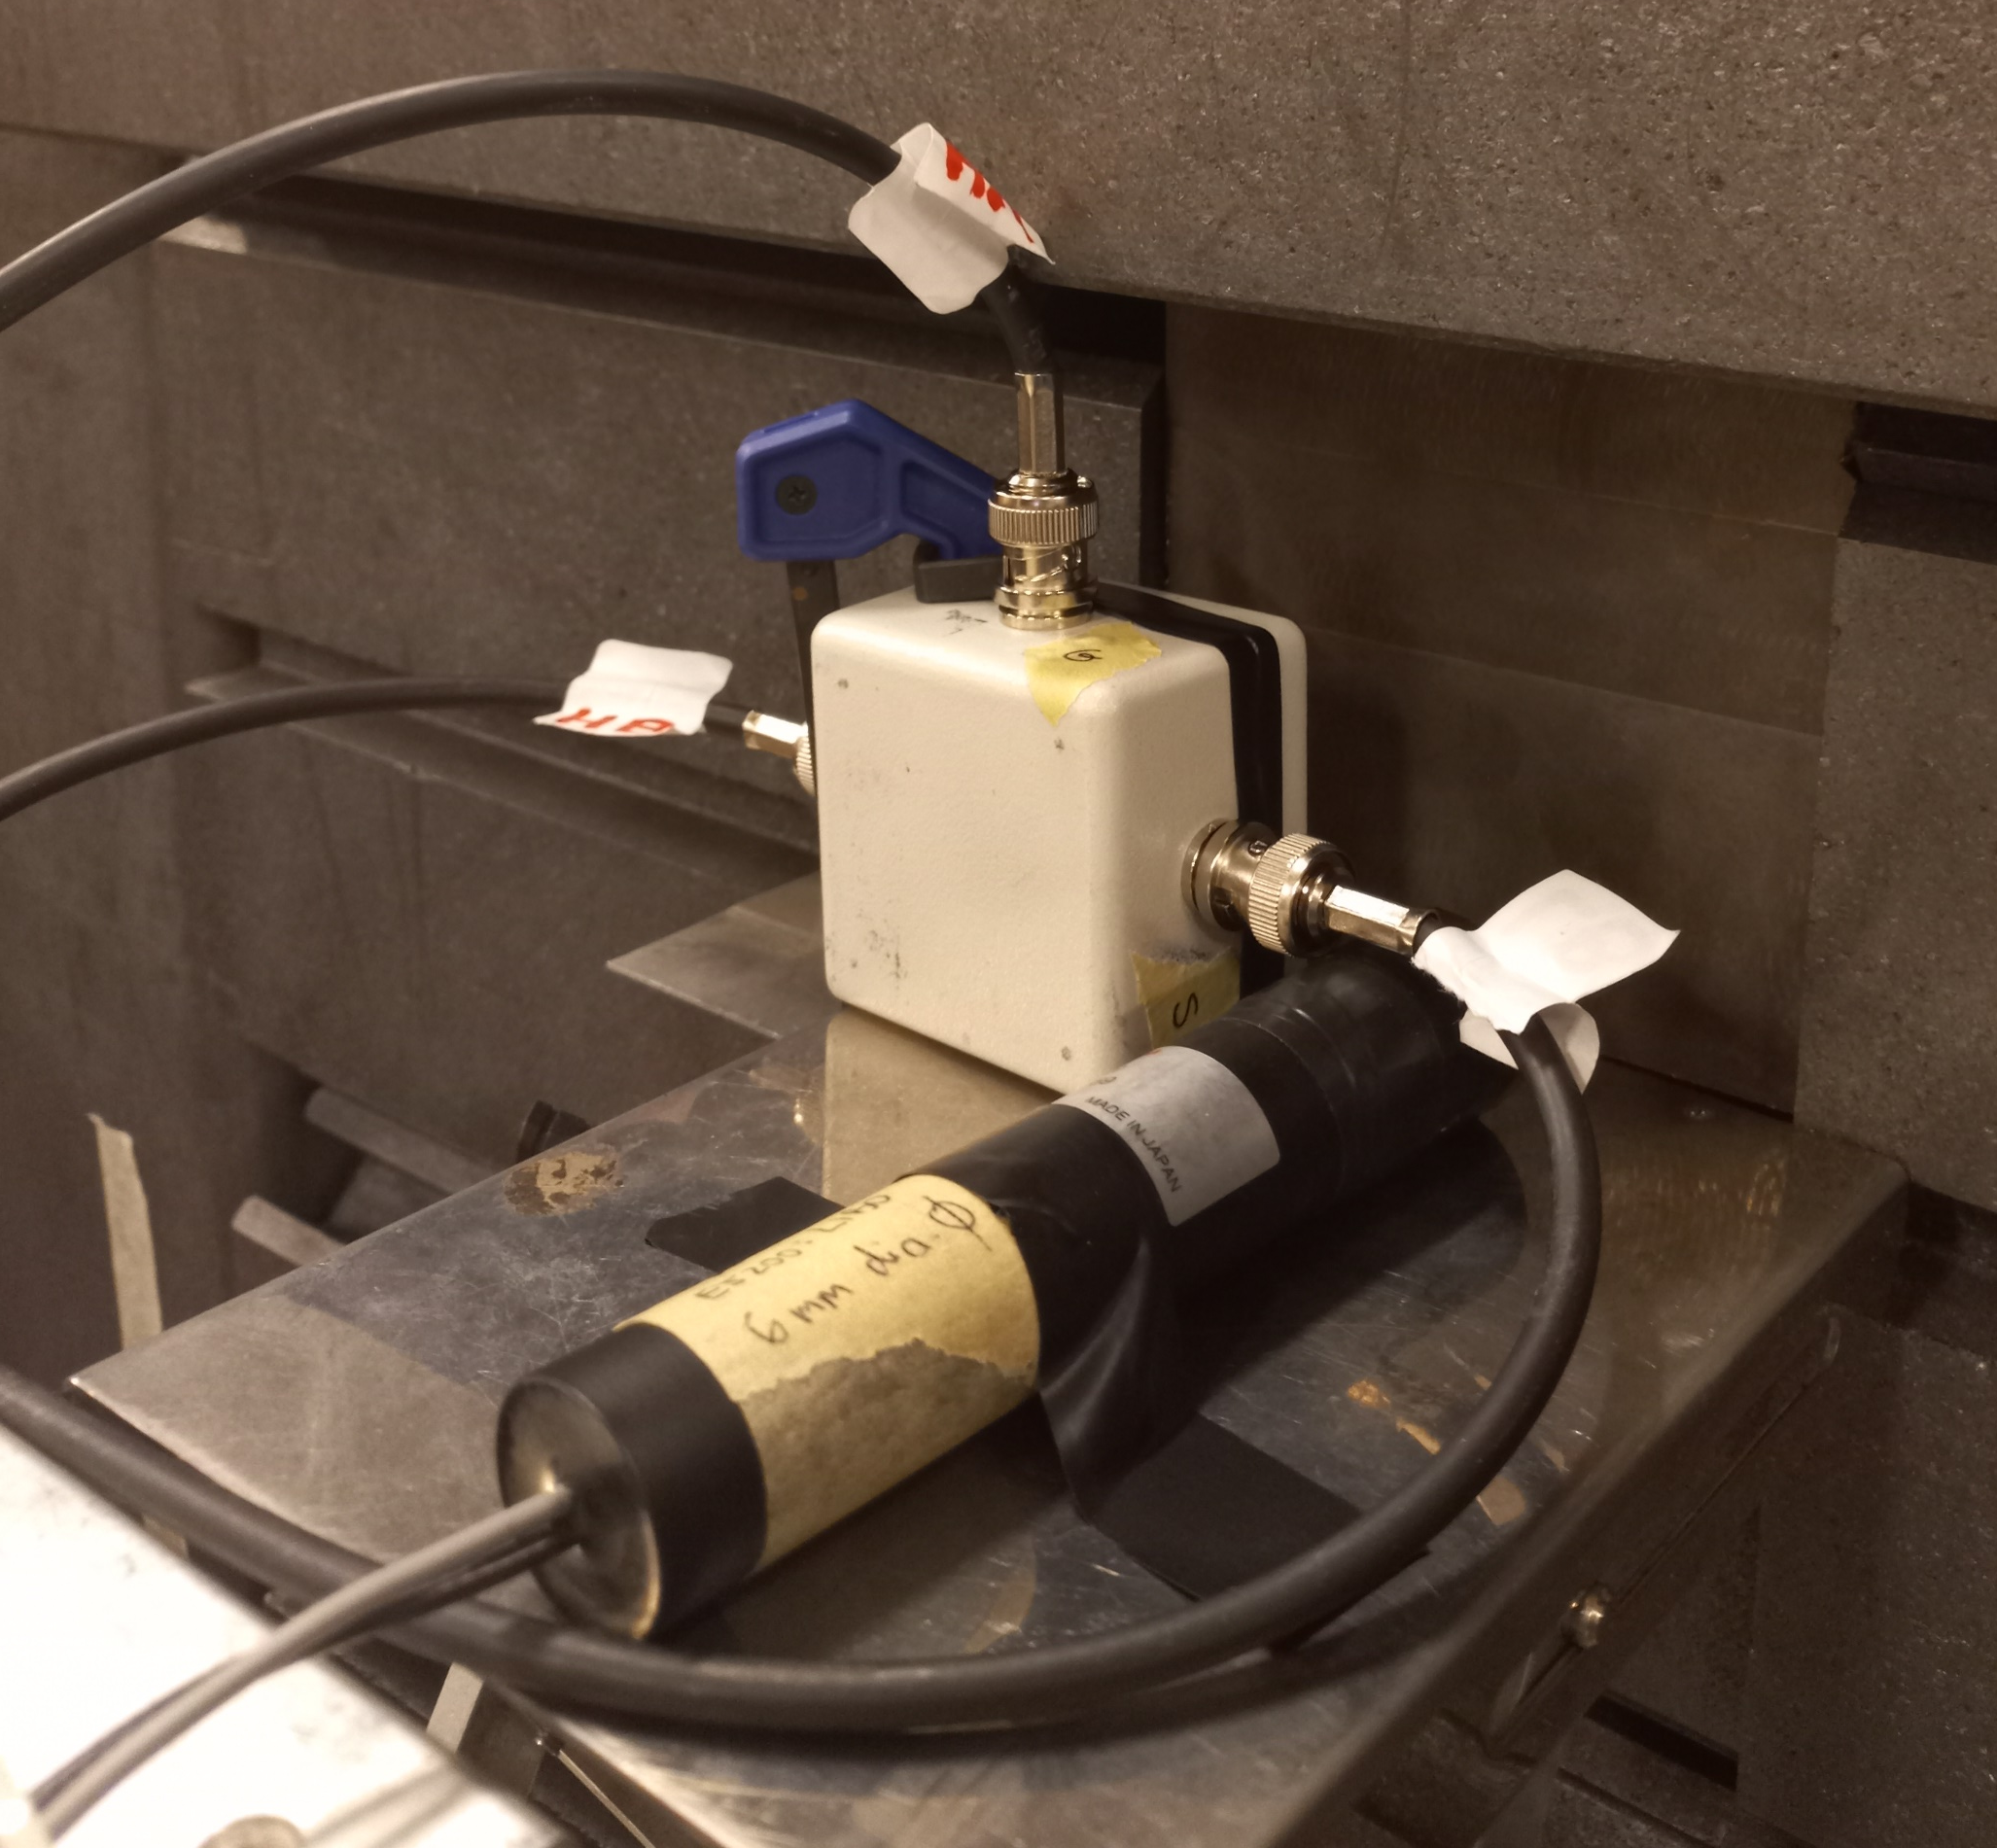
FIRE – rivelatori indiretti
MUNES @ LNL
Tubo fotomoltiplicatore + LiBO posizionato esattamente nella posizione del sensore per vedere la luce emessa dallo scintillatore a parità di condizioni di irraggiamento
(più lontano c’era anche un tubo accoppiato ad uno scintillatore commerciale per monitorare il fascio)
Organic PhotoTransistor
⁶Li¹⁰BO / ⁶LiF scintillator
+
Calvi S, et al. Org Electron 2022;102106452.
Carturan SM, et al. Nucl Inst Methods Phys Res Sect A,. 2019 1;925:109–15.
Schermino di Bismuto per attenuare i gamma
Cablaggio di 5 m per mantenere l’elettronica molto lontana
Fratelli I., et al. in preparation.
Ilaria Fratelli – 20 Marzo 2023
Selva A, et al., Appl Radiat Isot. 2022;182:110144.

