Slide 1
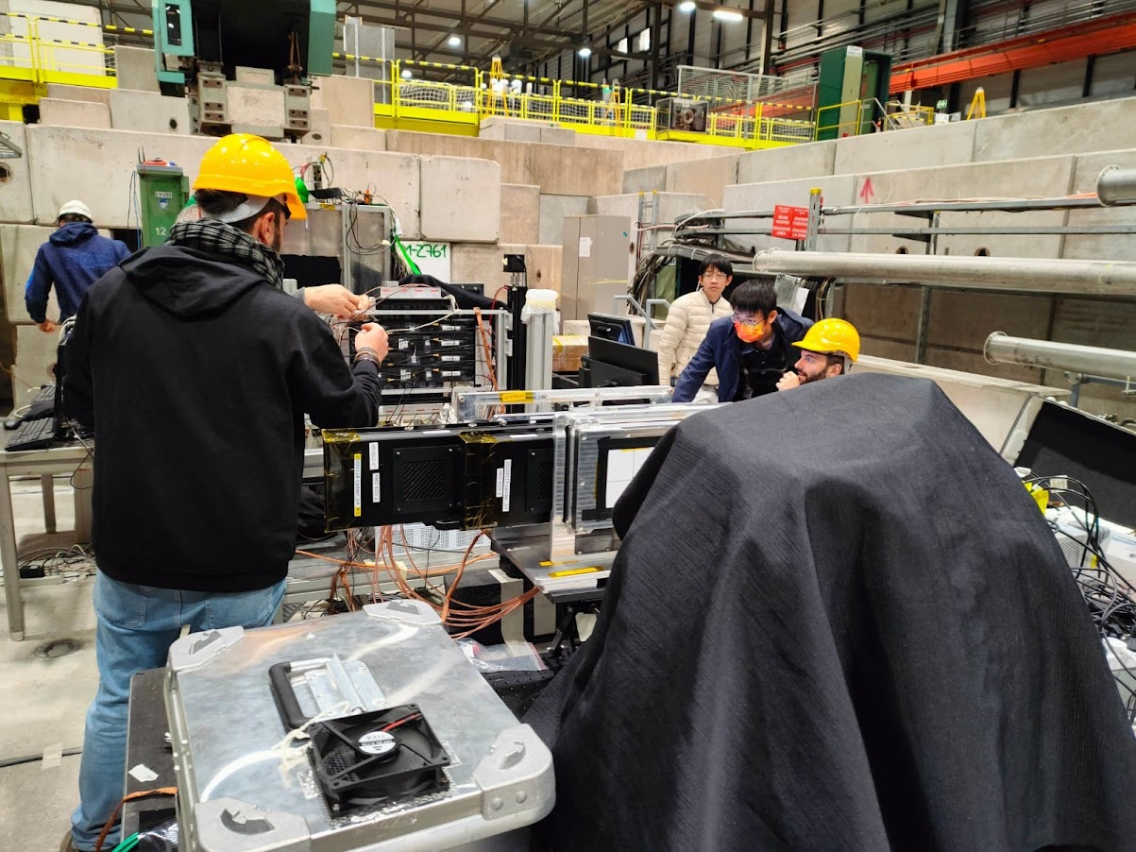
Preliminary analysis at SPS beam test: PSD report
C. Altomare, L. Di Venere, F. Gargano, M.N. Mazziotta, R. Pillera, D. Serini

Slide 2
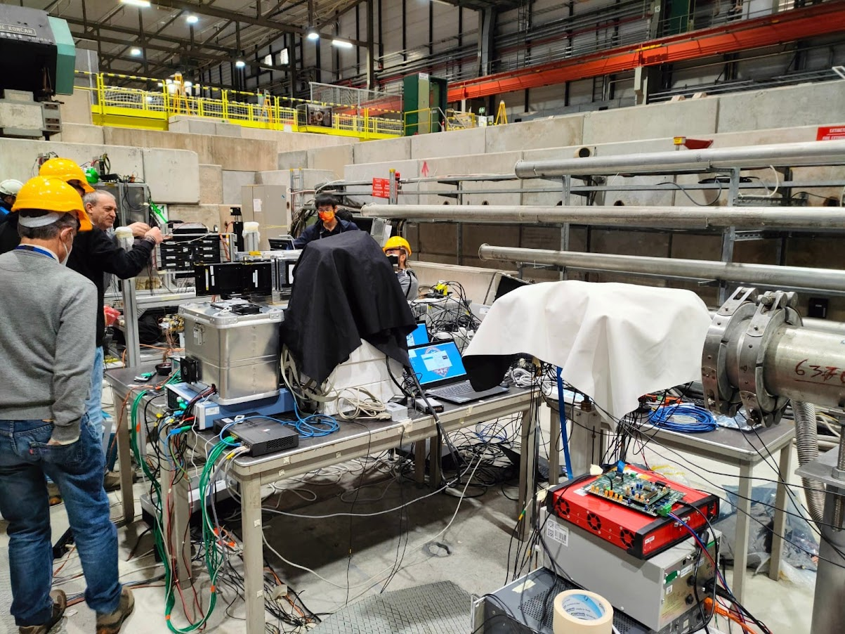
Set-up on the beamline
Main trigger (Plastic scintillator on beam axis):
TRIGGER: S0 10x10x0.5 cm tile.
Beam
Tile 1: Trigger Tile
Tile 2: PSD Tile
Tile S0
Beam

Slide 3
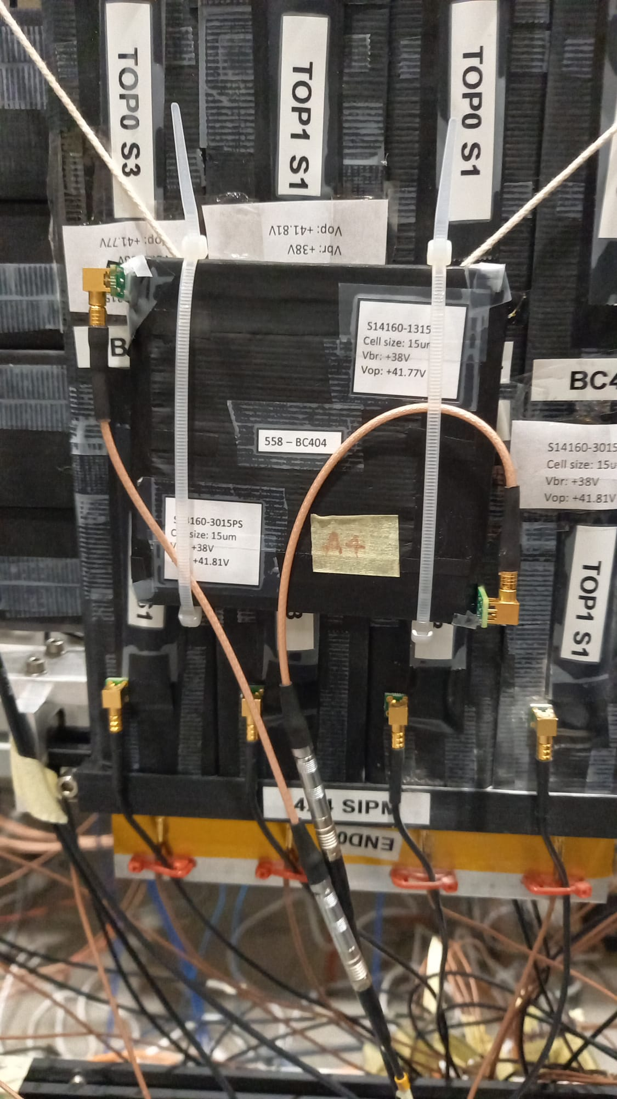
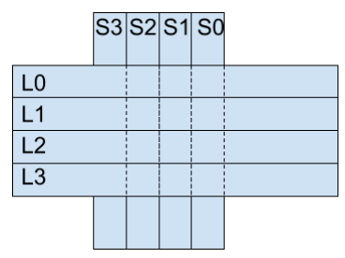
Readout configuration
Bar L2 (BC-404) 40 cm (BetaChip ASIC)
EndCap 1: 1 SiPM 3x3 mm
Top 1: PCB with 3 SiPM 3x3 mm
Top 2: PCB with 3 SiPM 1x1 mm
EndCap 2: 1 SiPM 3x3 mm
PSD
Tile
PSD
Tile 1 (bc-408): Trigger Tile
Tile2 (bc-404): PSD Tile
Small SiPM PCB with 3 1x1 Hamamatsu SiPM
Large SiPM PCB with 3 3x3 Hamamatsu SiPM
Tile 2
BetaCHIP configuration
HV = 42.5 V
trigger = 3EXT (TTL) «Syncronicity» with PSD in I2C
mux_path= 1 (low gain)
gain= 15 (lowest gain)
SiPM Model | S14160-3015 | S14160-1315
Size | 3x3 mm² | 1.3x1.3 mm²
Pixel pitch | 15 um | 15 um
Number of pixels | 39984 | 7284
Refractive index | 1.57 | 1.57
Peak sensitivity wavelength | 460 nm | 460 nm
PDE | 32% | 32%
Vbr | 38 V | 38 V
Data Sample
Trigger Threshold 600 mV -> He Cut
Trigger Threshold 100 mV -> proton Visible
PCB 3 SiPMs 1x1 mm
Beam
Particle fragments 150 GeV/n
A/Z 2.2
Beam size: ~4 cm
PCB 3 SiPMs 3x3 mm

Slide 4
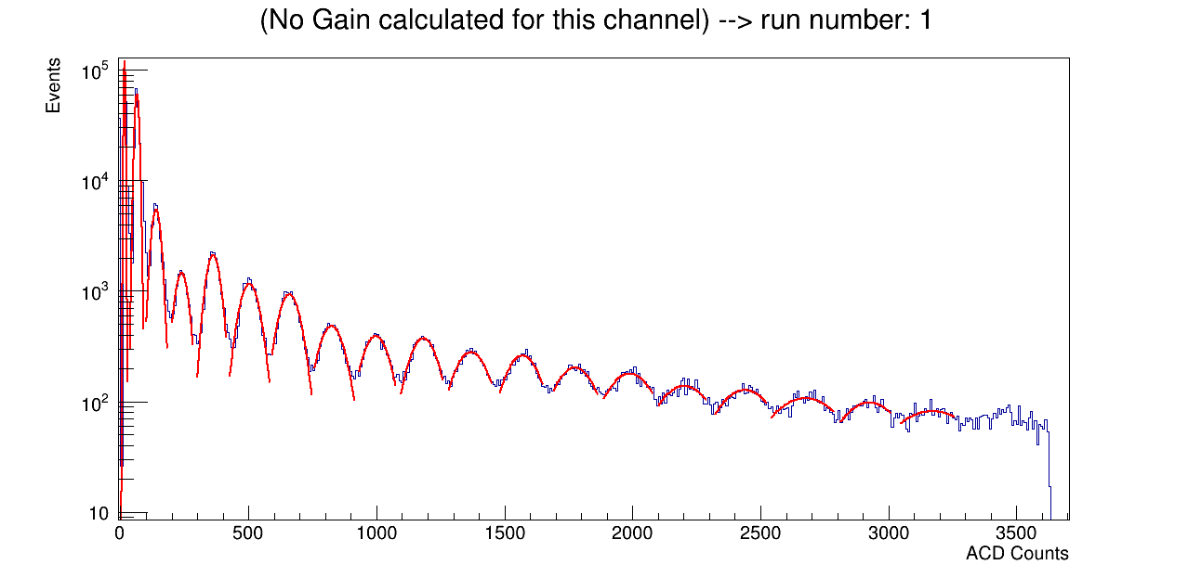
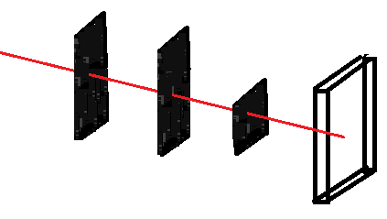
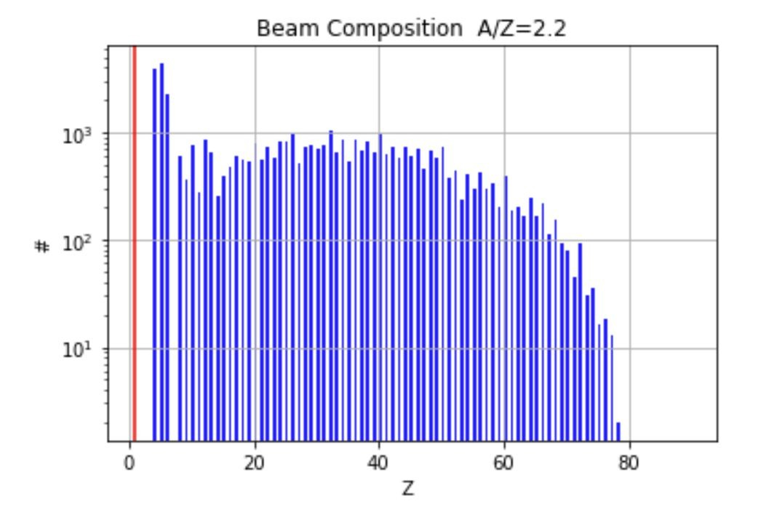
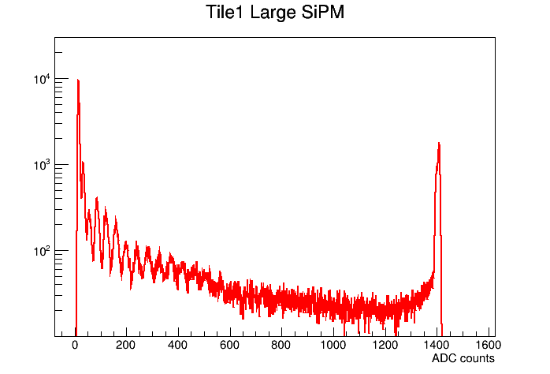
Beam composition expectation from Test Beam 2018
H
He
Trigger scintillator
PMT
Test Beam SPS 2018
Beam
Li
S0
B
Sh
S4
Be
C
N
O
F
Ne
PMT
Fragment simulation
Na
Mg
Al
Si
P
S
Cl
Ar
K
H-He
Auto Trigger
Tile 1
Low gain – 8
Test Beam SPS 2022
SiPM
Li
B
Be
C
N
F
Preliminary
O
Ne
Na
Mg
Si
Al
P
S
Cl

Slide 5
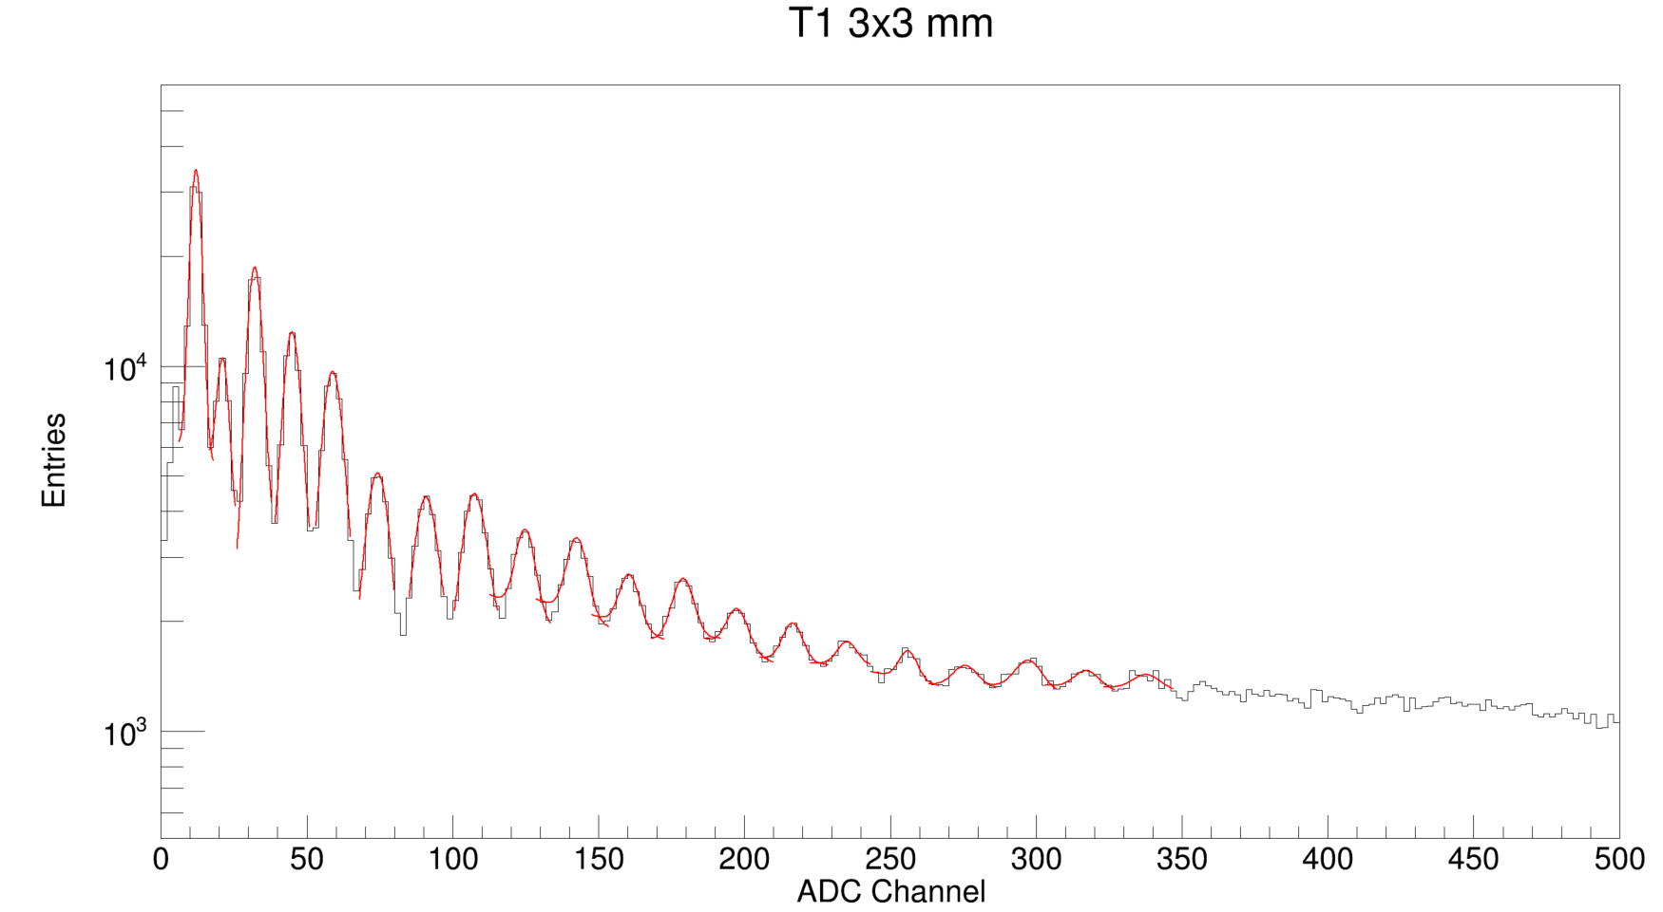
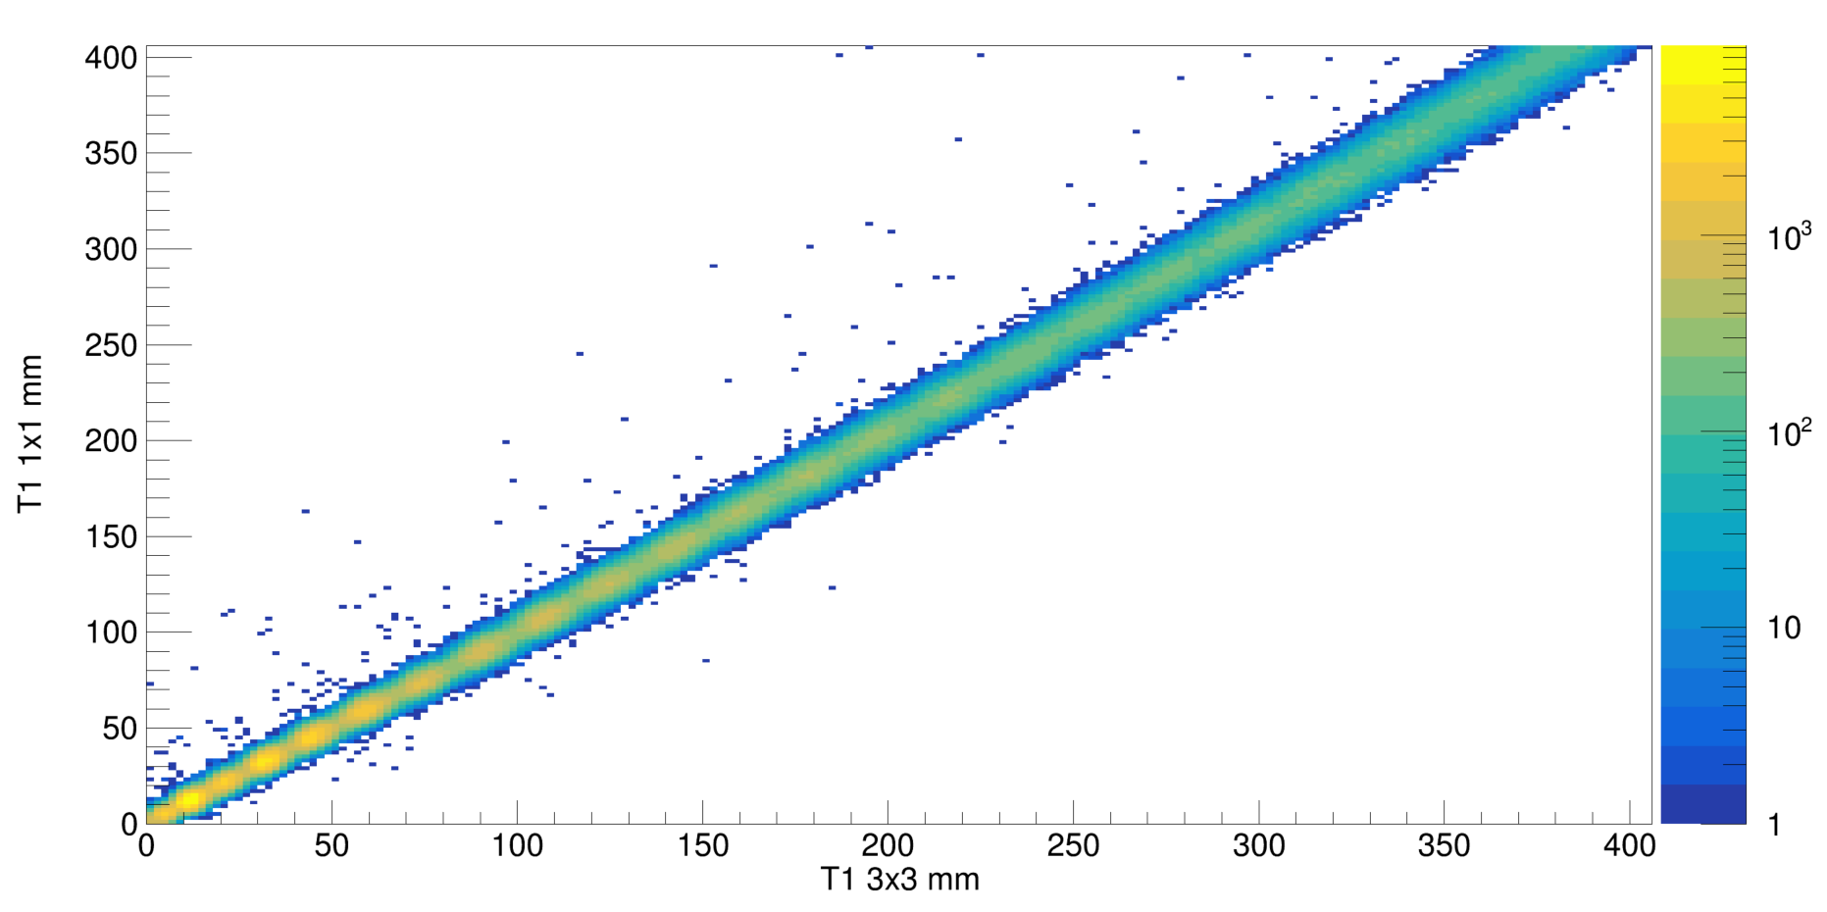
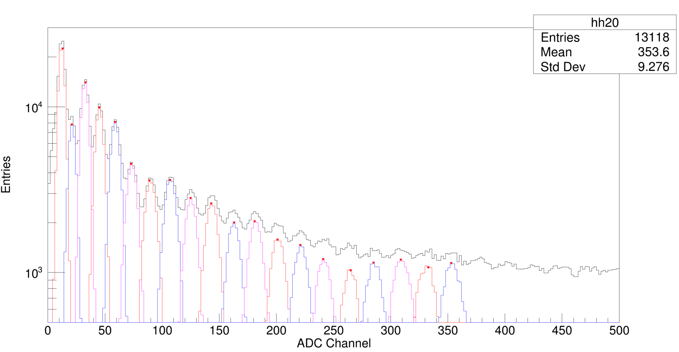
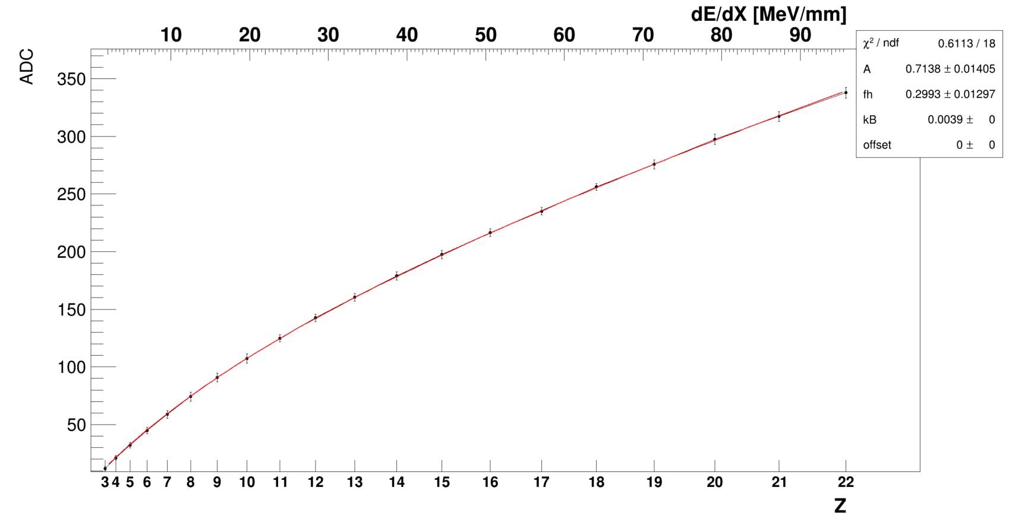
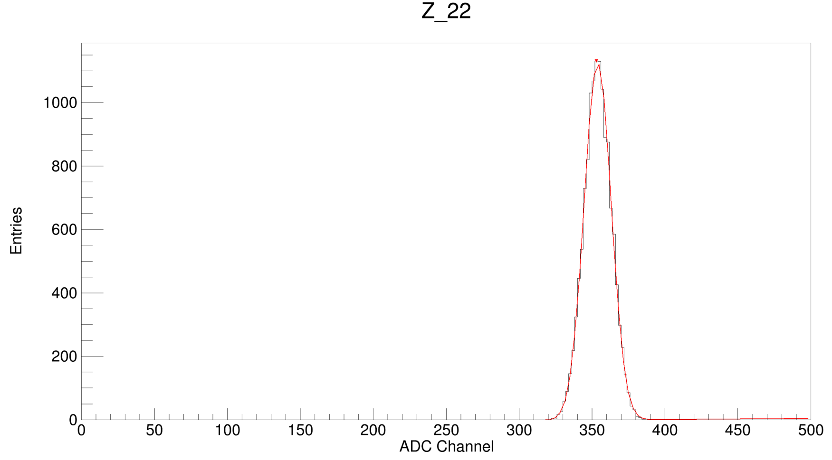
Tile 1 analysis (Front)
T1
TRG
PSD
T2
Run 201 -202
no veto no finger
Vthr: -600mV
LG15
3
SiPM 3x3 mm
5
4
6
7
8
9
10
11
12
13
14
15
16
17
18
20
19
21
22
Preliminary
Data Selection:
From T1 3x3 SiPM size
3
SiPM 1x1 mm
T 1
5
6
7
4
8
10
9
11
12
13
14
22
15
16
17
18
19
20
21
22

Slide 6
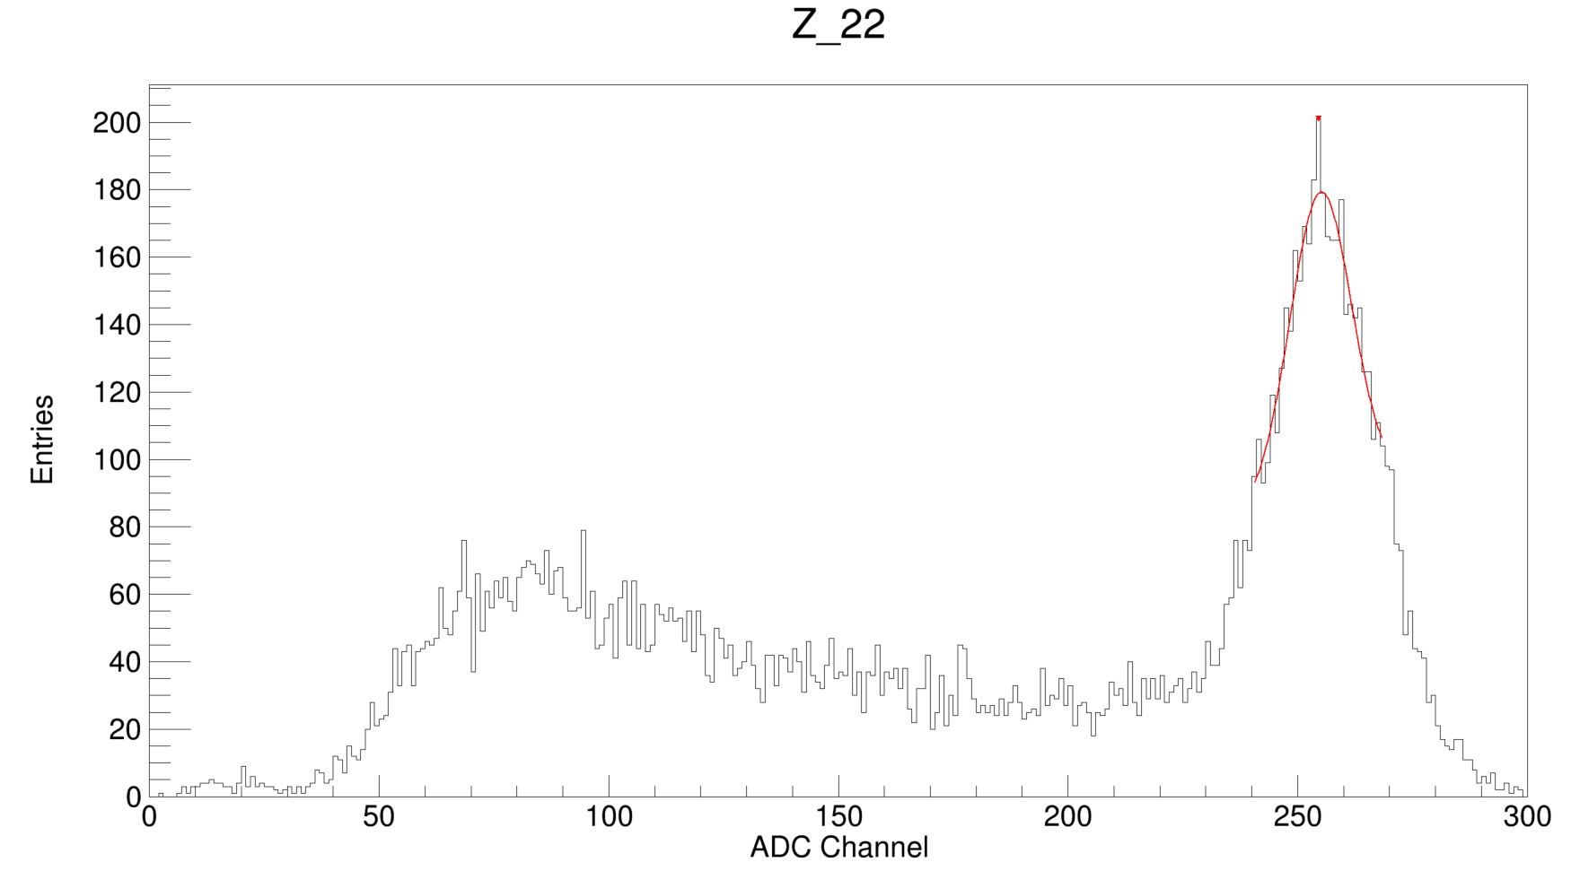
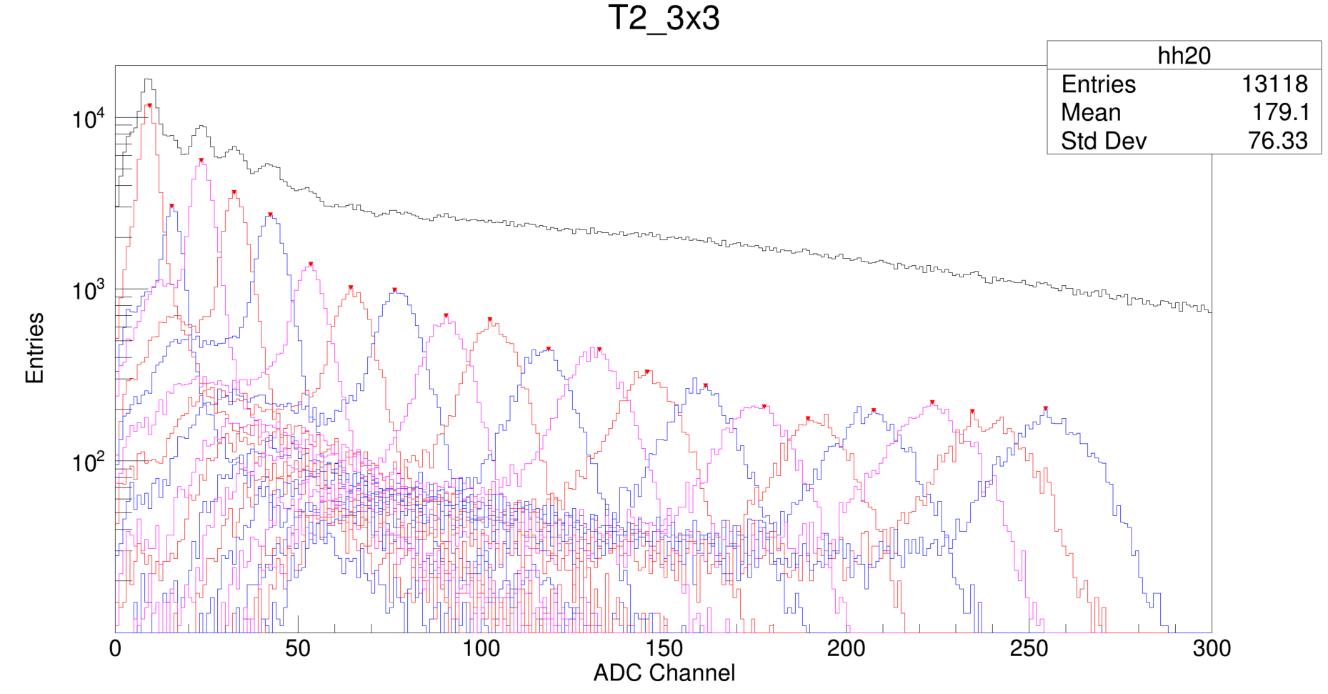
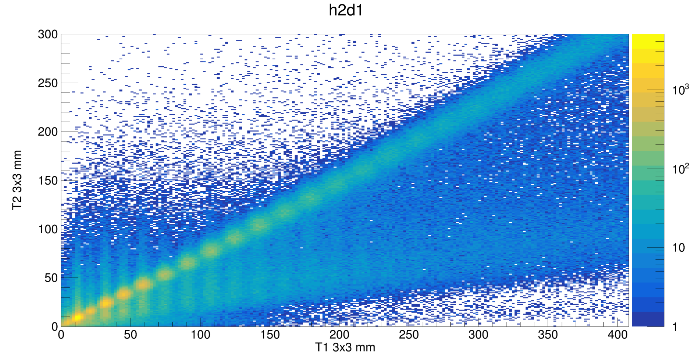
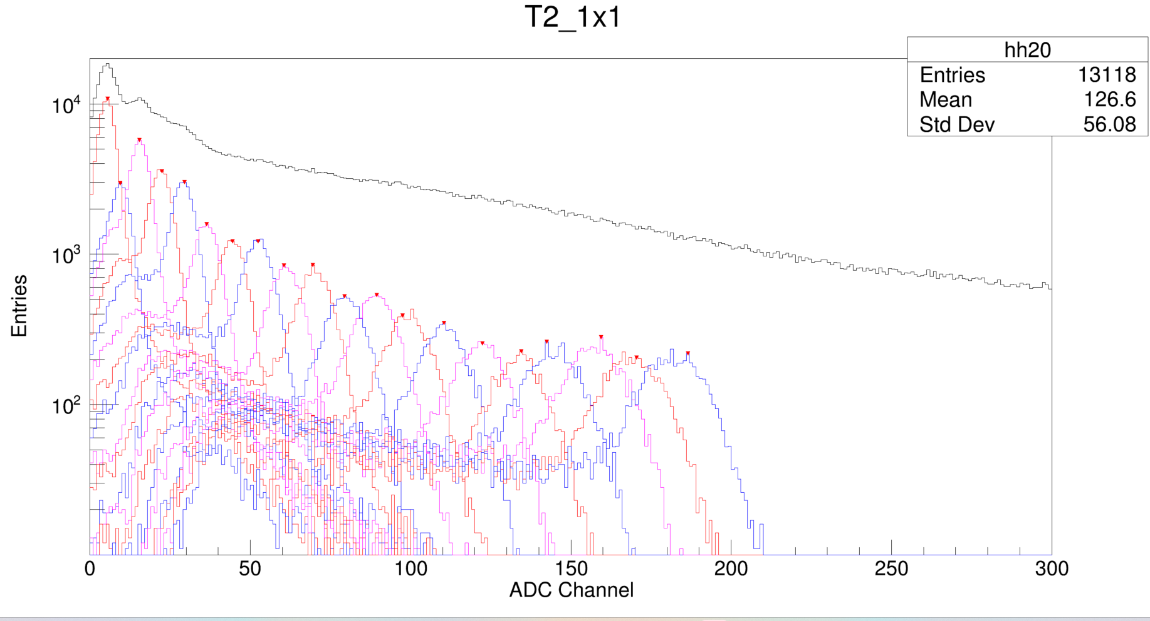
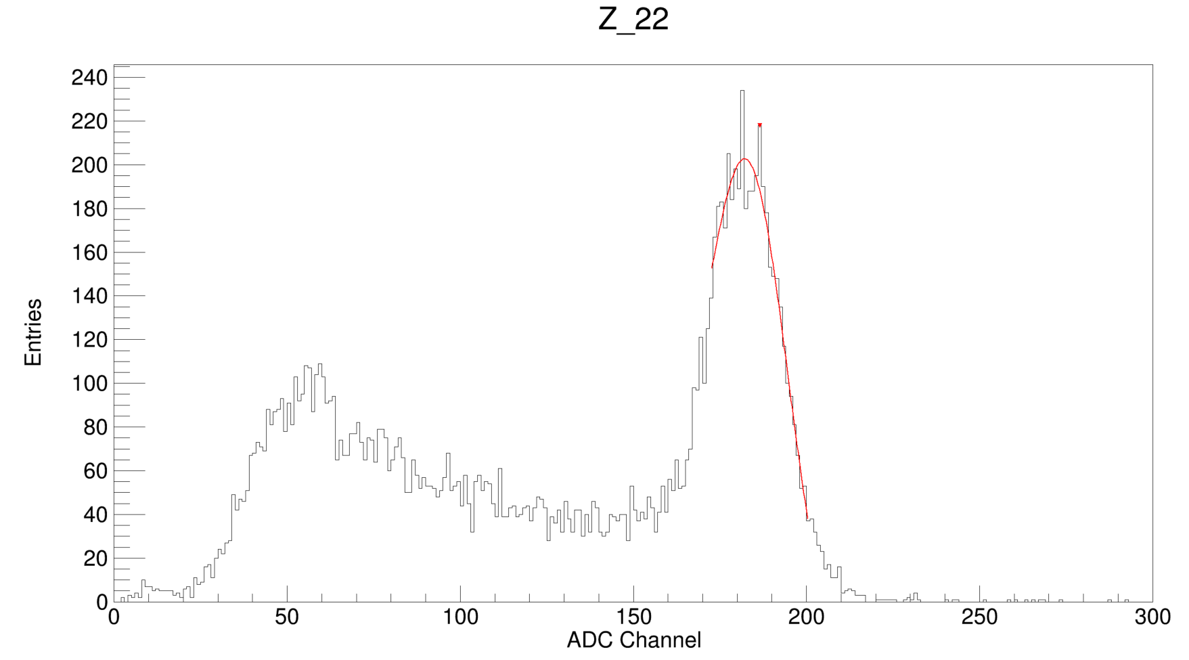
Tile 2 analysis (Back)
T1
TRG
PSD
T2
Run 201 -202
no veto no finger
Vthr: -600mV
LG15
3
22
5
6
SiPM 3x3 mm
Z:22 fragments
4
7
8
9
10
11
12
13
14
15
16
17
20
21
22
18
19
Data Selection:
From T1 3x3 SiPM size
Preliminary
3
SiPM 1x1 mm
T 2
5
4
6
7
8
9
10
11
12
13
14
15
22
16
17
19
20
22
Z:22 fragments
18
21

Slide 7
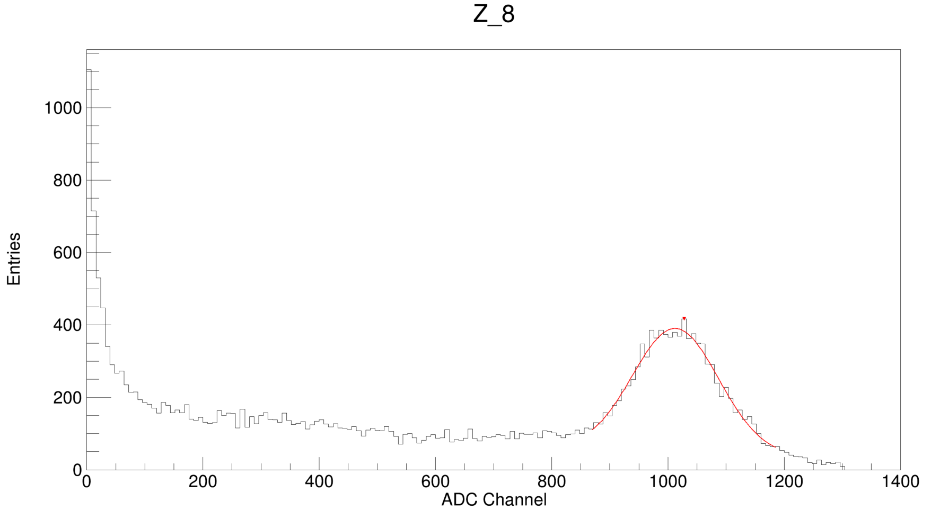
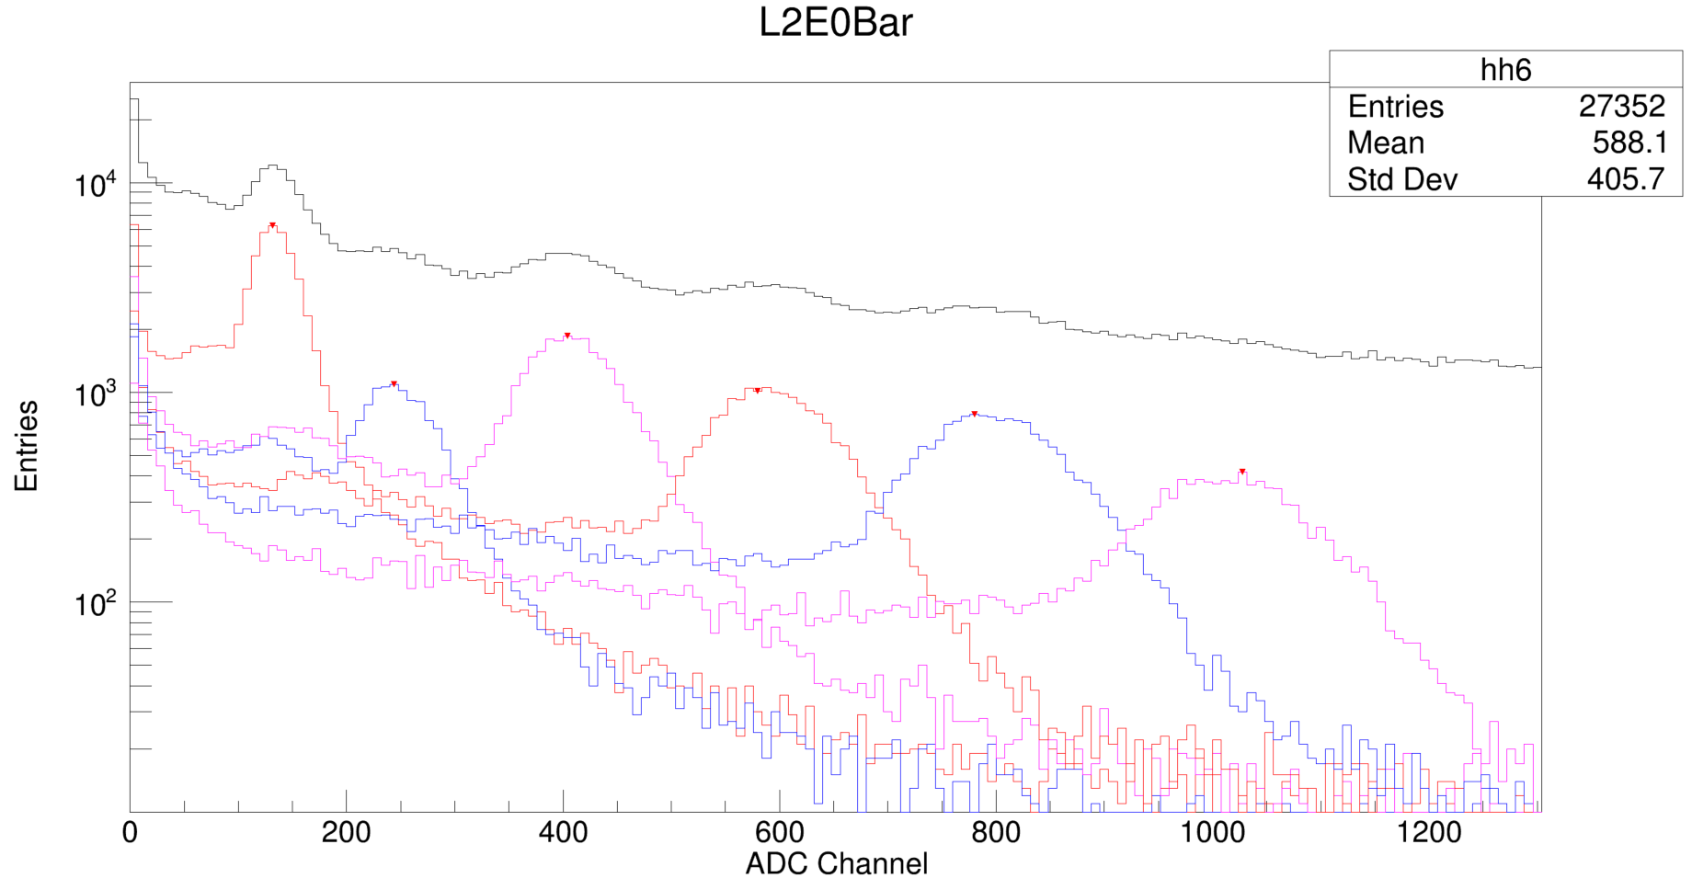
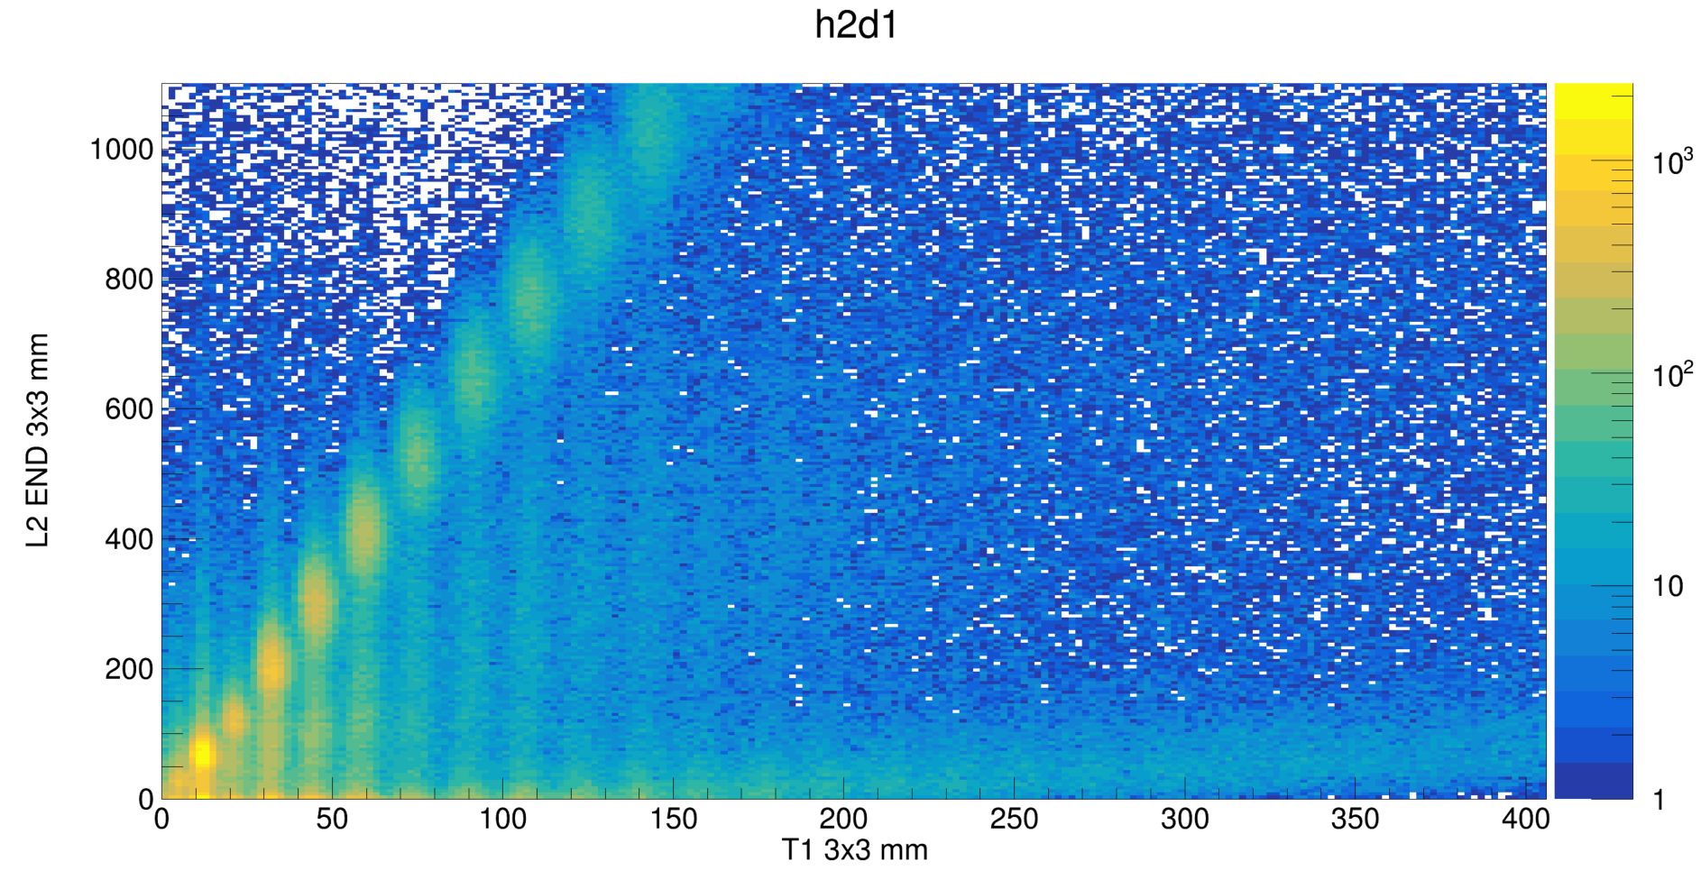
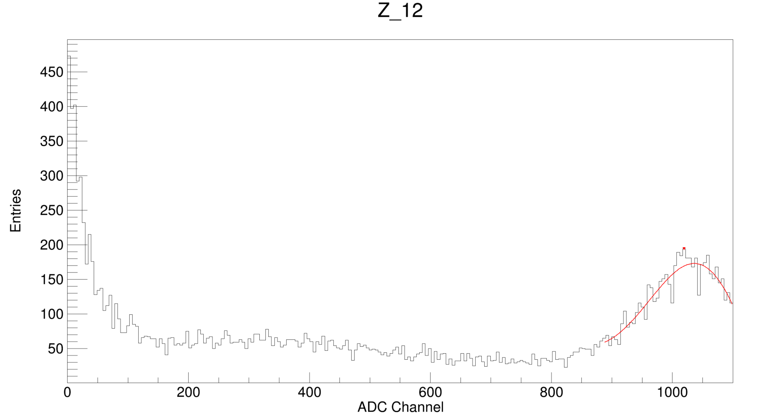
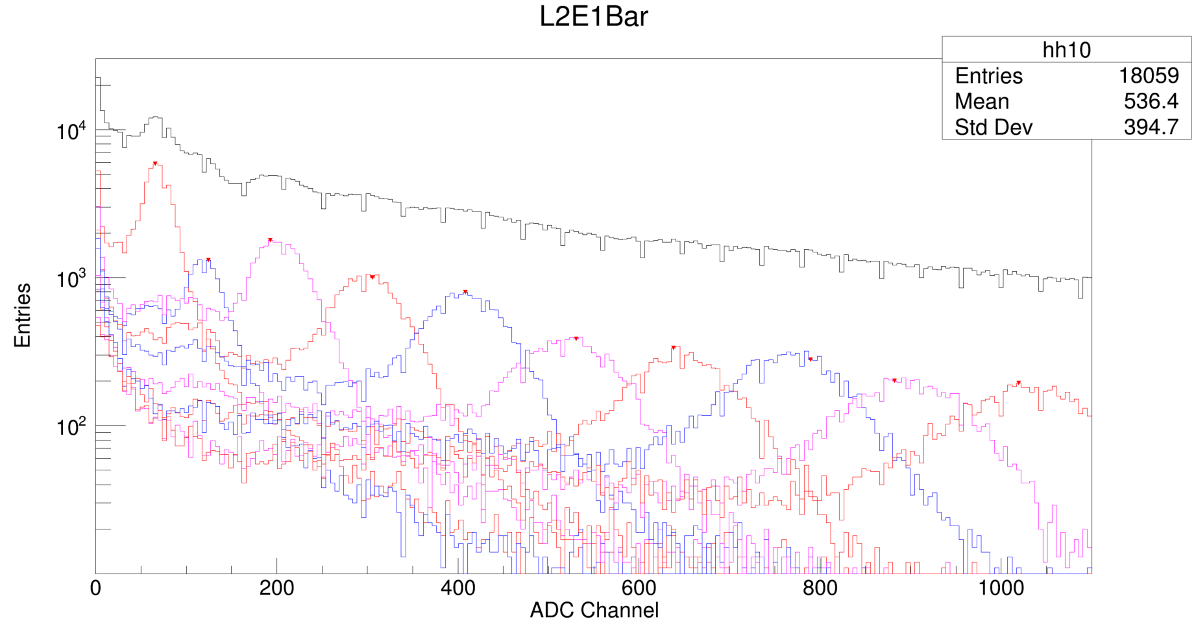
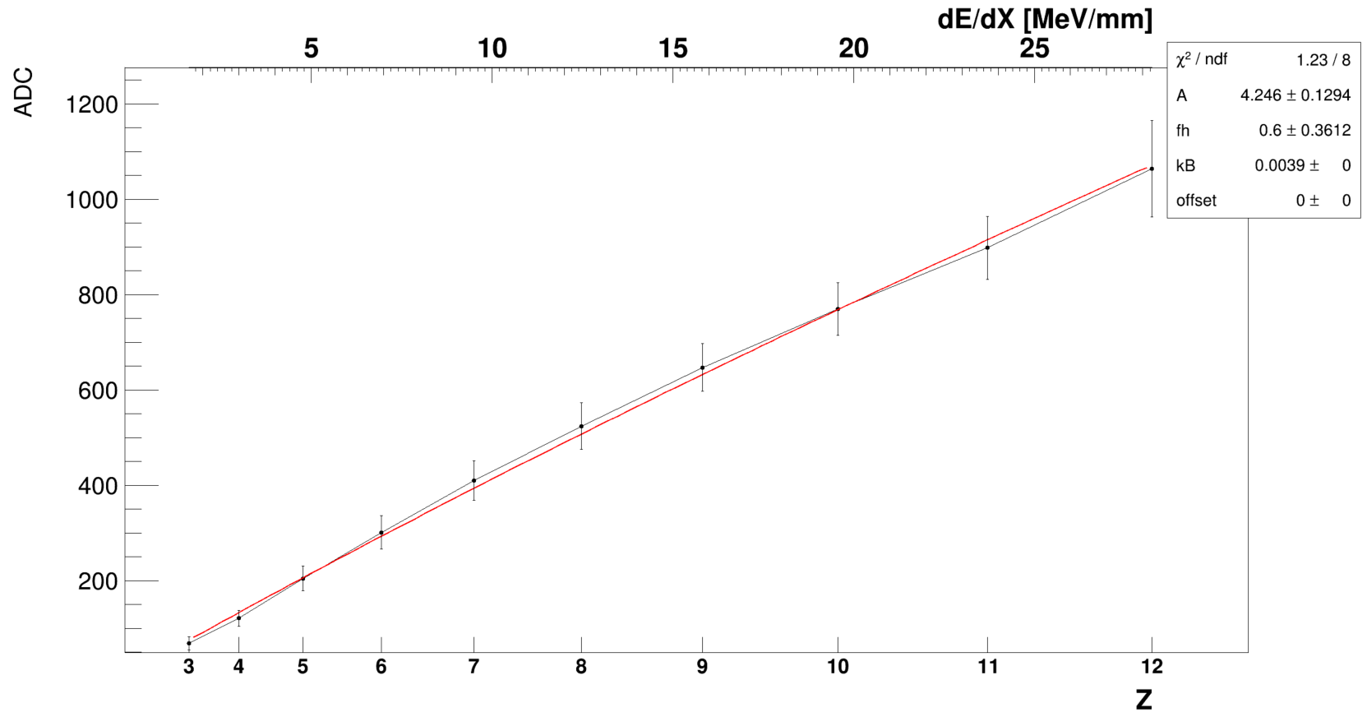
PSD L2 analysis (EndCup)
T1
TRG
PSD
T2
Run 201 -202
no veto no finger
Vthr: -600mV
LG0
L2
SiPM 3x3 mm
8
Z:8 fragments
3
5
6
4
7
8
Preliminary
L2
Data Selection:
From T1 3x3 SiPM size
Z:12 fragments
SiPM 3x3 mm
12
3
4
5
6
7
8
9
10
11
12

Slide 8
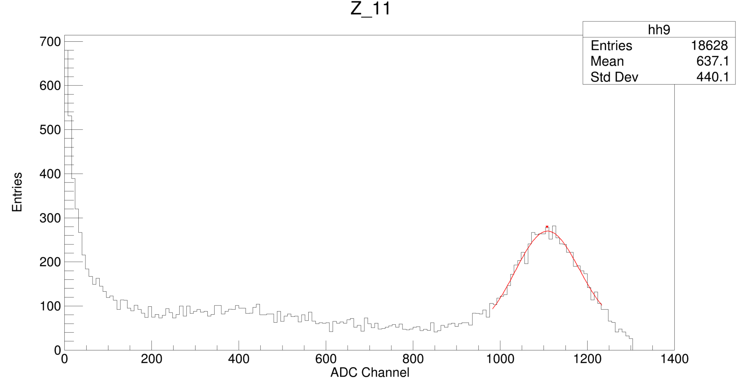
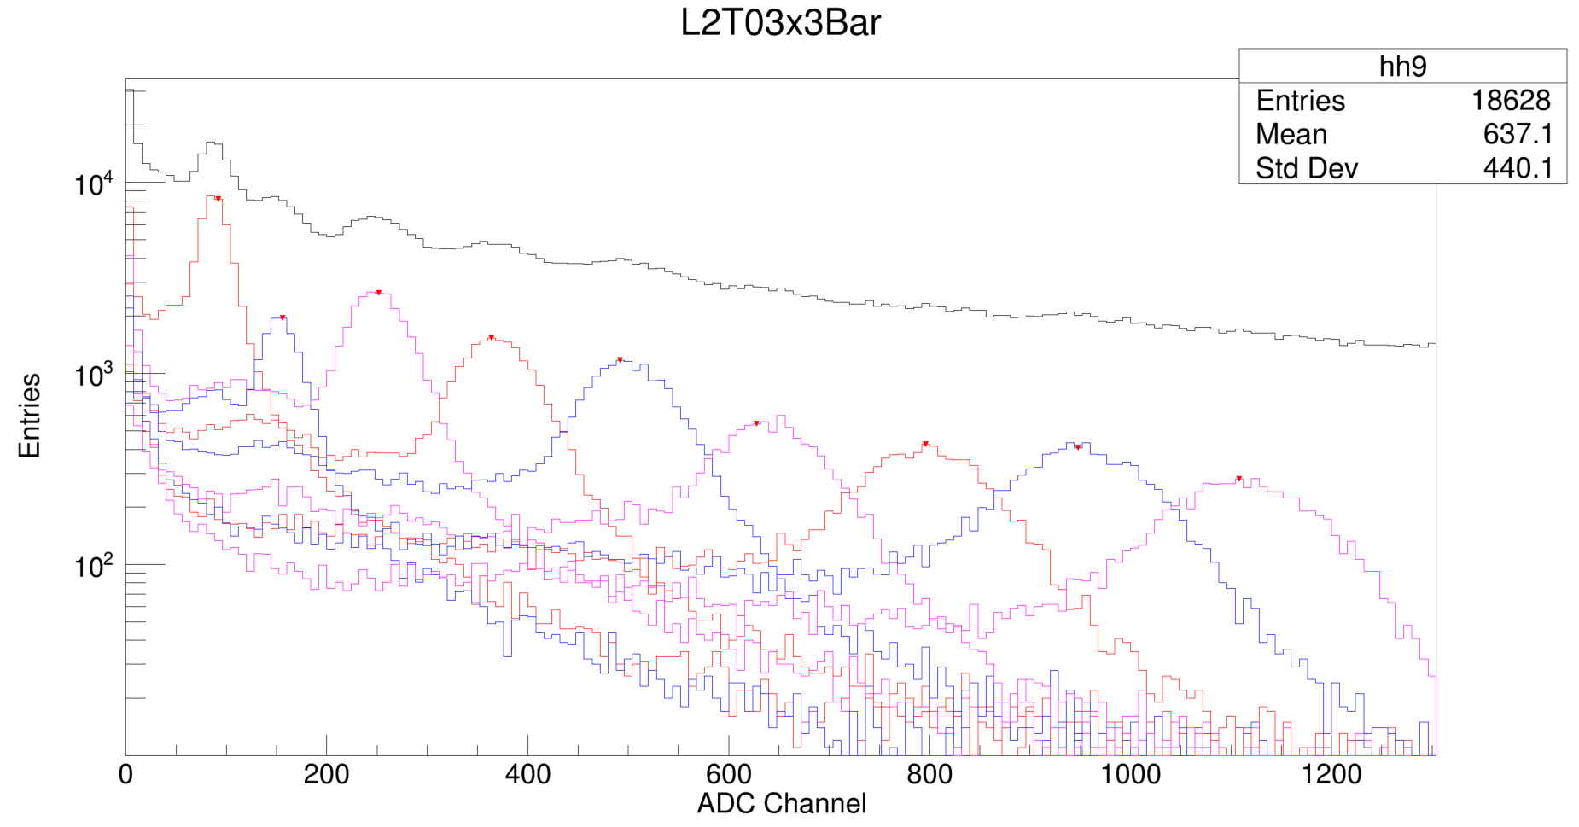
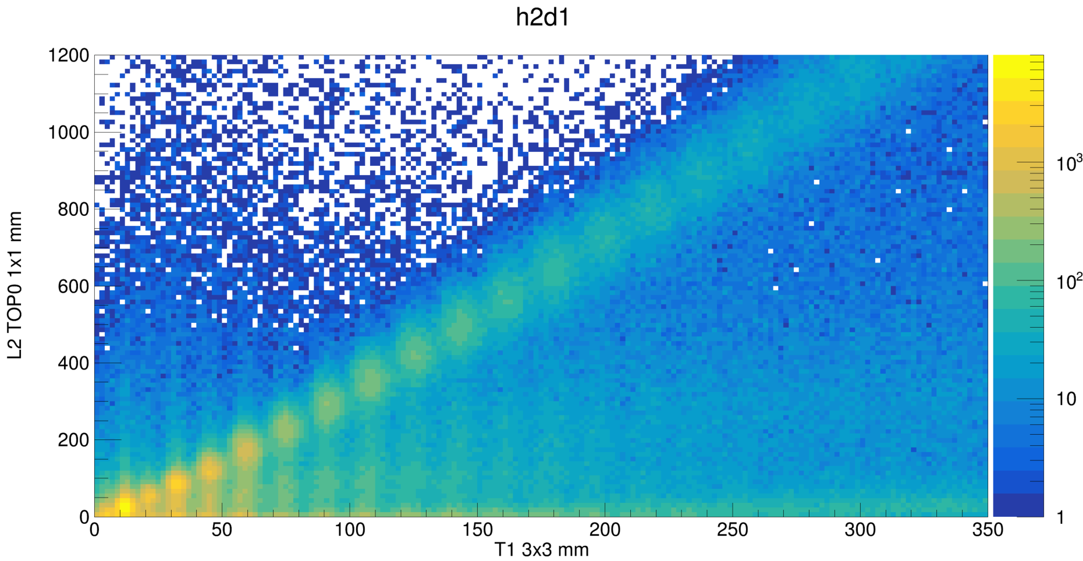
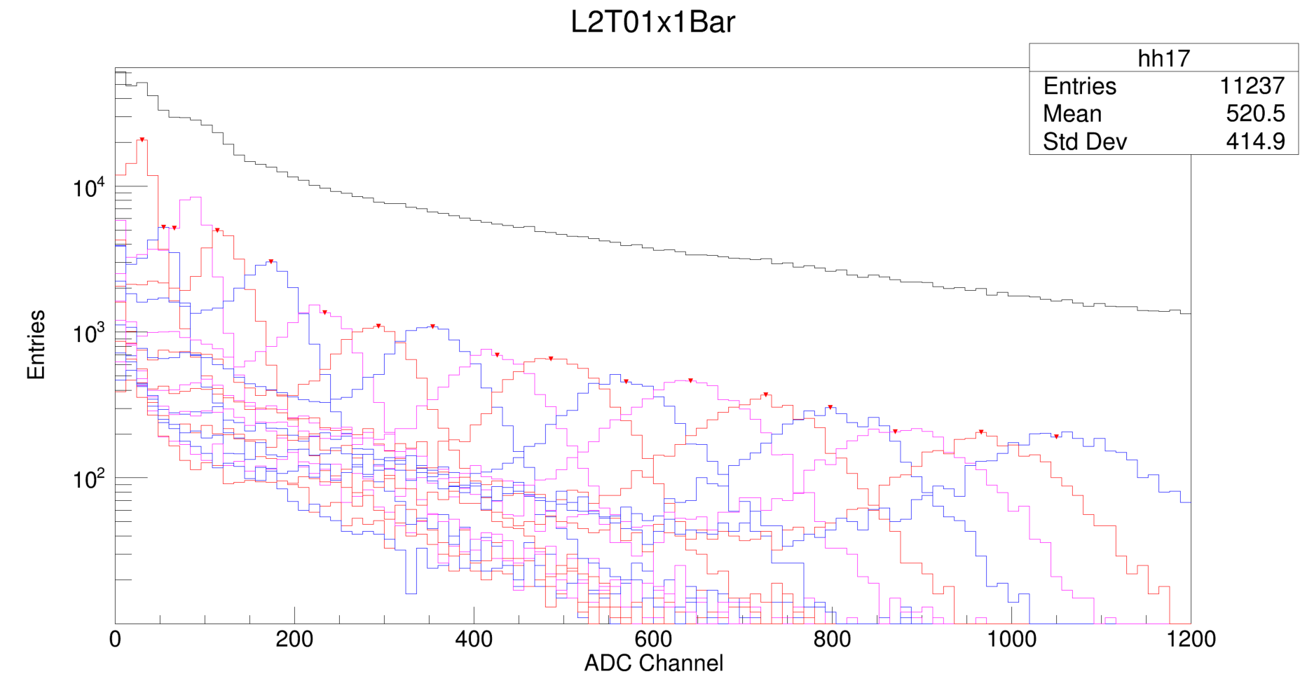
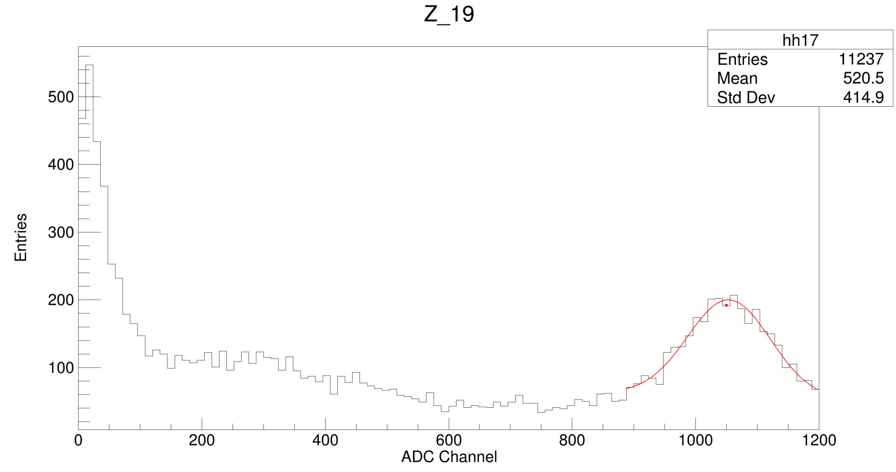
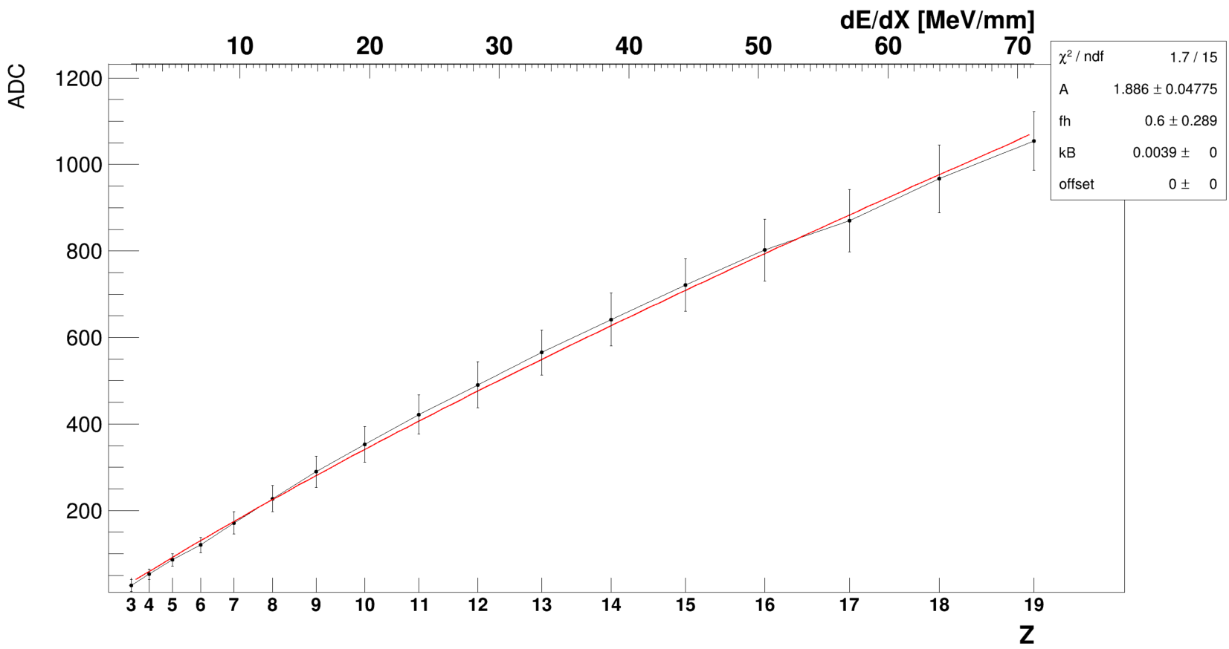
PSD L2 analysis (Top)
T1
TRG
PSD
T2
Run 201 -202
no veto no finger
Vthr: -600mV
LG0
L2
3
SiPM 3x3 mm
11
Z:11 fragments
4
5
Preliminary
6
7
8
9
10
11
L2
Data Selection:
From T1 3x3 SiPM size
3
Z:19 fragments
SiPM 1x1 mm
19
4
5
6
7
8
9
10
11
12
13
14
15
16
17
18
19

Slide 9
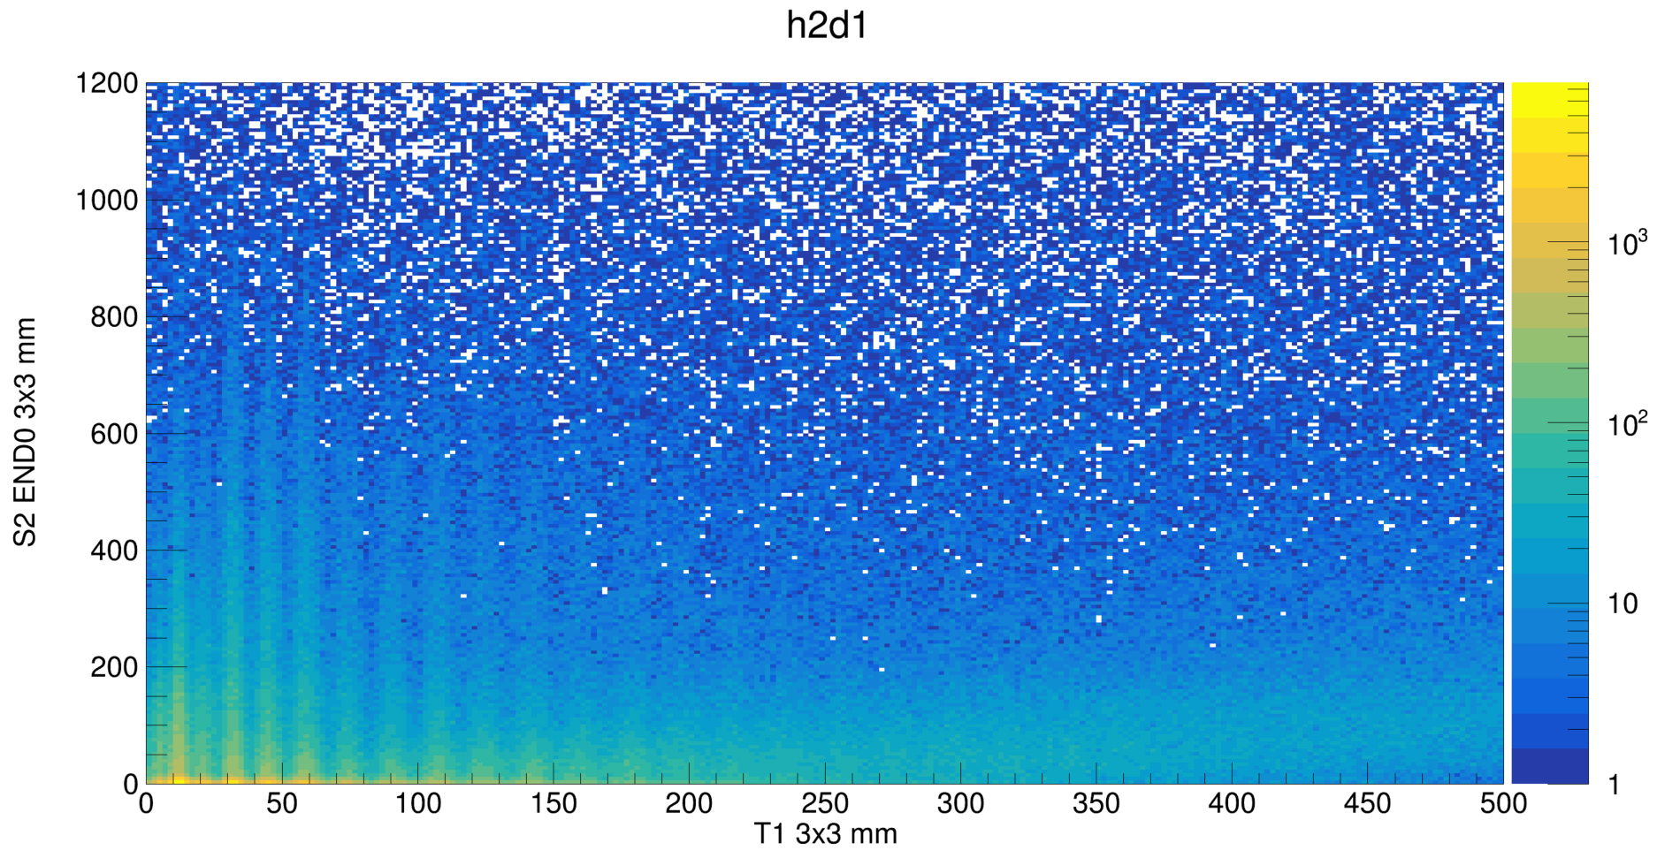
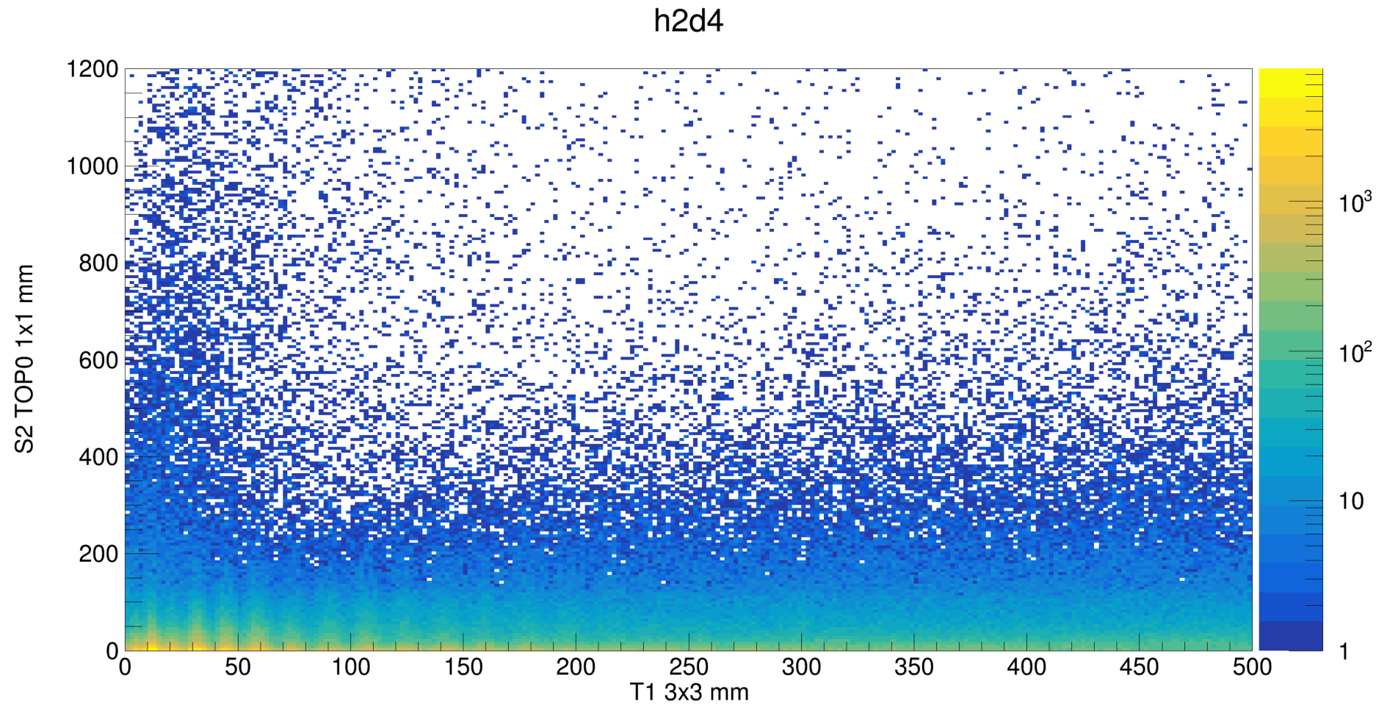
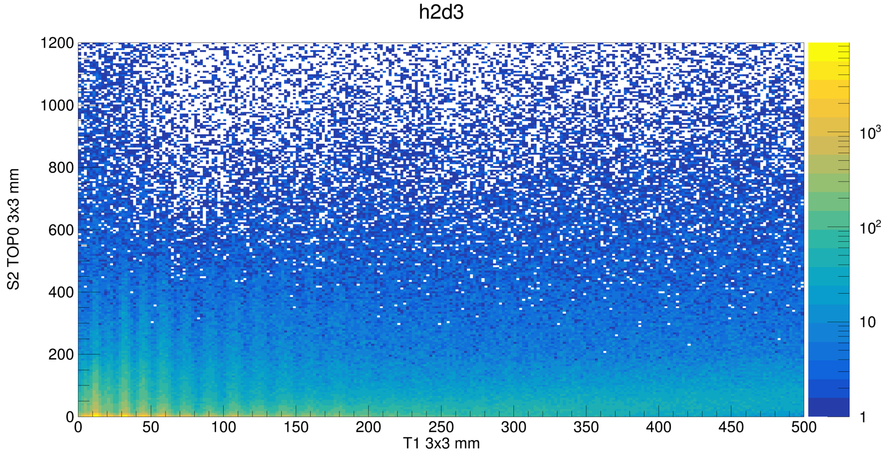
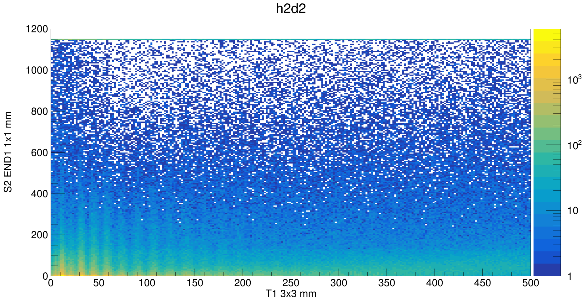
PSD S2 analysis
T1
TRG
PSD
T2
Run 201 -202
no veto no finger
Vthr: -600mV
LG0
S2
Preliminary
S2

Slide 10
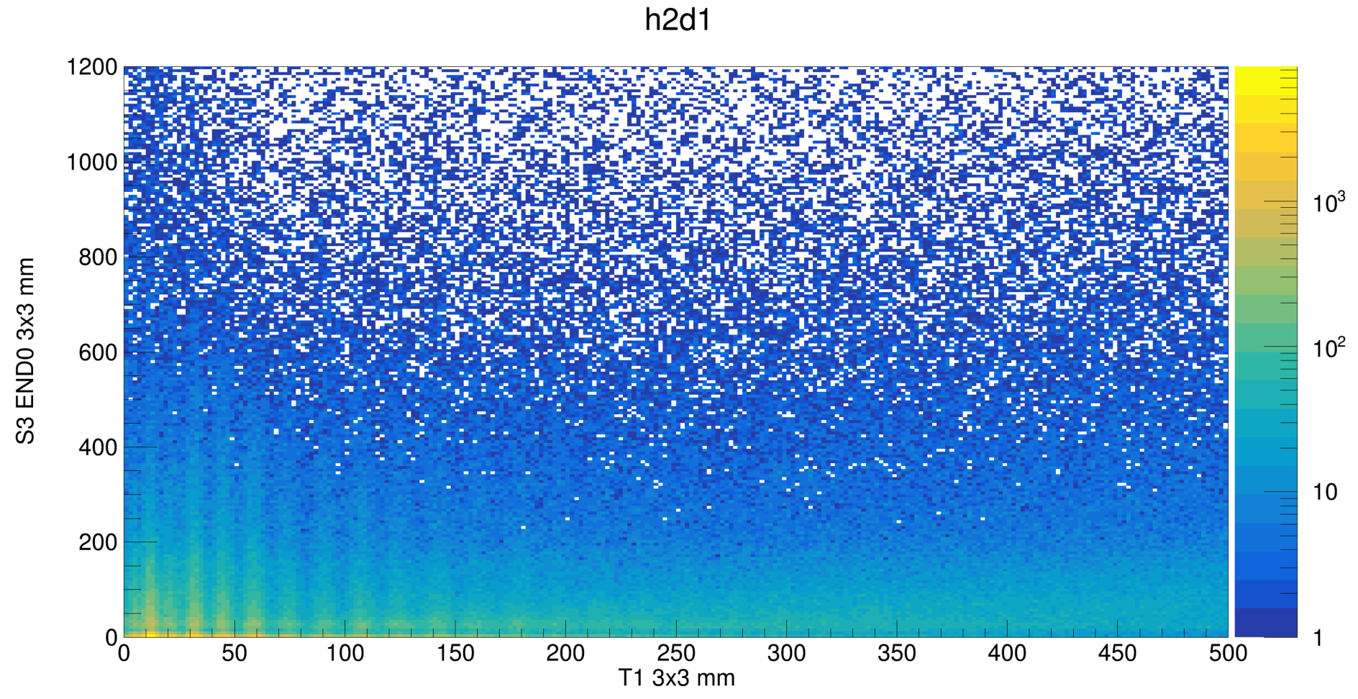
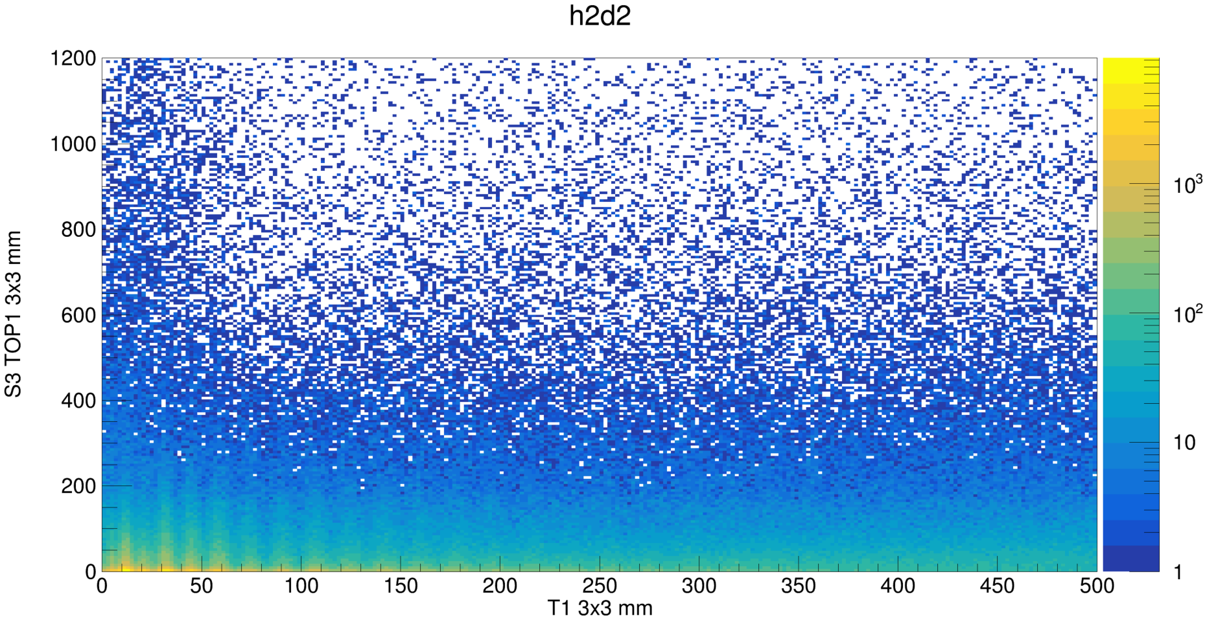
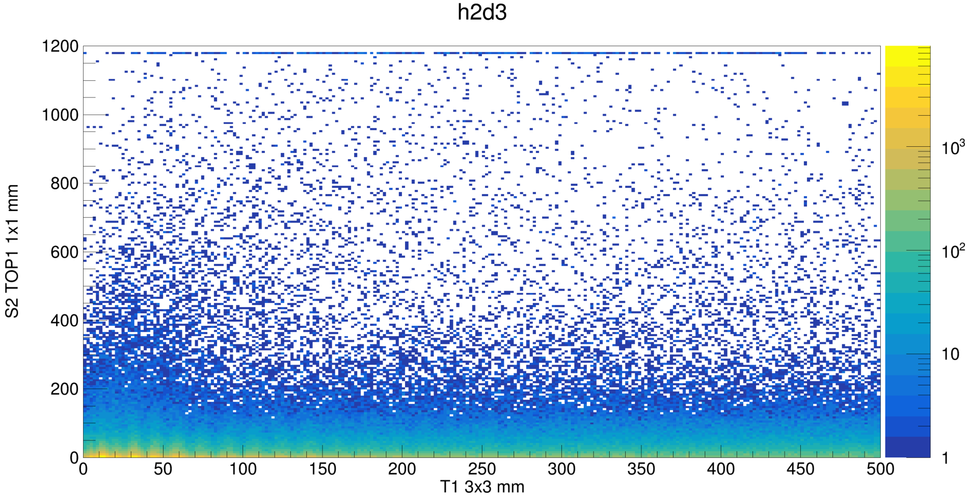
PSD S3 analysis
T1
TRG
PSD
T2
Run 201 -202
no veto no finger
Vthr: -600mV
LG0
S3
S3
Preliminary

Slide 11
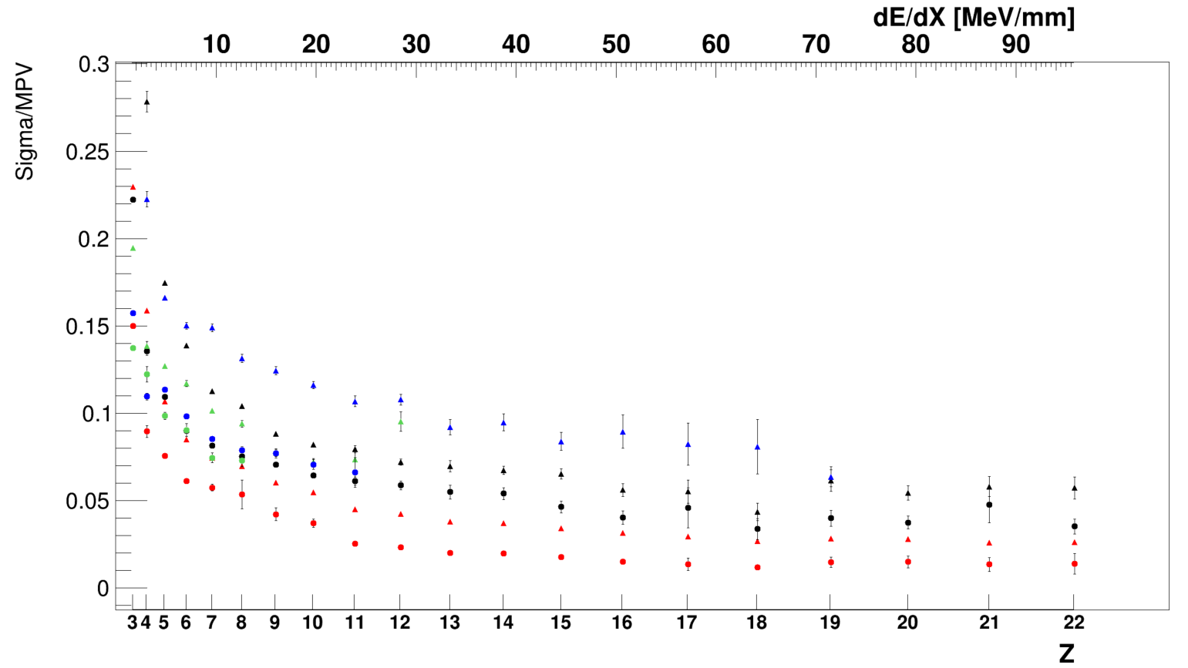
Peak resolution comparison
T1 3x3 mm
T1 1x1 mm
T2 3x3 mm
T2 1x1 mm
L2 END0 3x3 mm
L2 END1 3x3 mm
L2 TOP0 3x3 mm
L2 TOP0 1x1 mm
$$R=\frac{σ}{MPV}$$
Preliminary
High Z are better resolved
1x1 mm SiPMs have less resolution than 3x3 mm
Bars and back Tile have more or less the same resolution
3 Top SiPM have more or less the same resolution of 2 side SiPM
Back detectors have less resolution than front tile (probably due to the fragmentation)

Slide 12
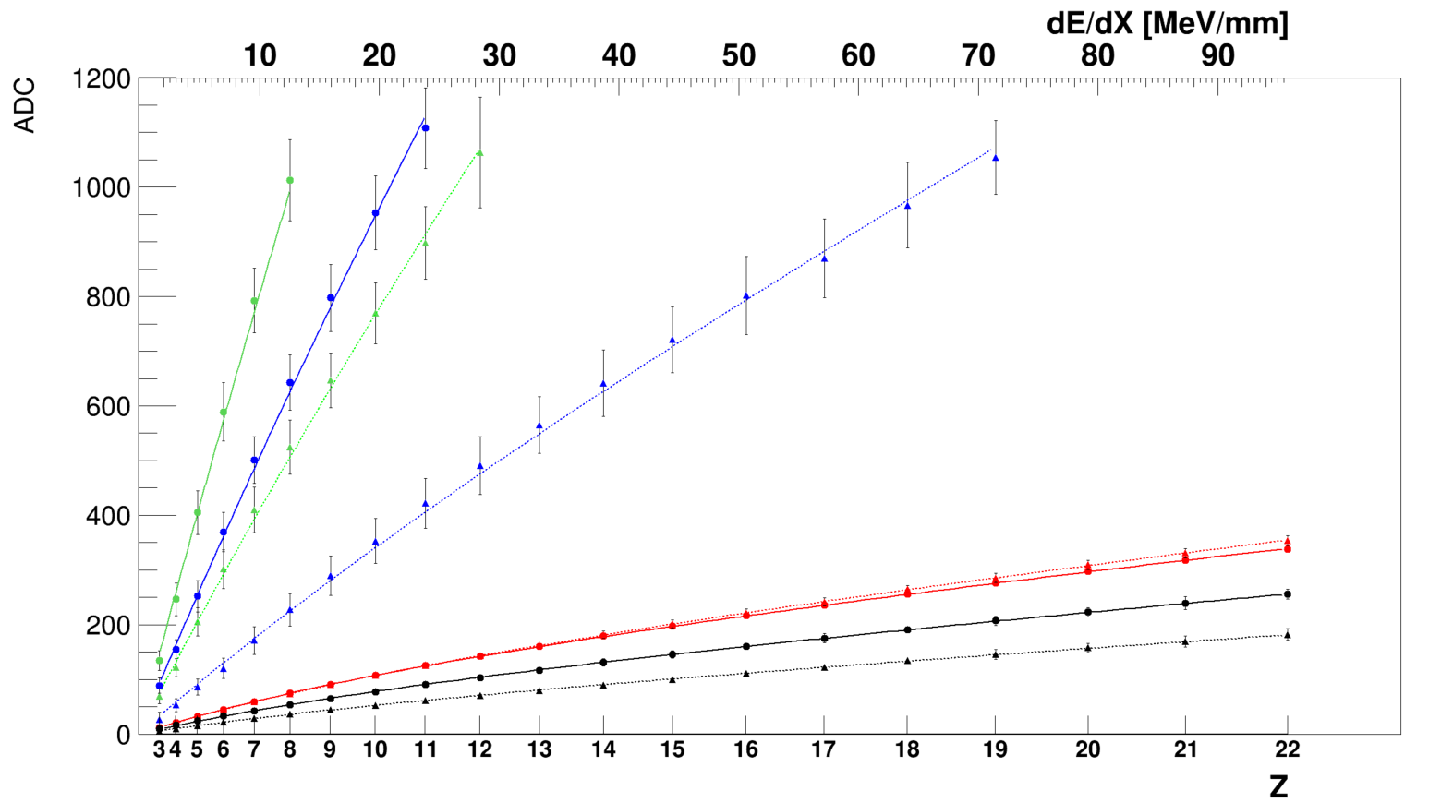
Quenching effect in plastic scintillator
BAR LG0
T1 3x3 mm
T1 1x1 mm
T2 3x3 mm
T2 1x1 mm
L2 END0 3x3 mm
L2 END1 3x3 mm
L2 TOP0 3x3 mm
L2 TOP0 1x1 mm
BAR LG0
Preliminary
Tile LG15

Slide 13
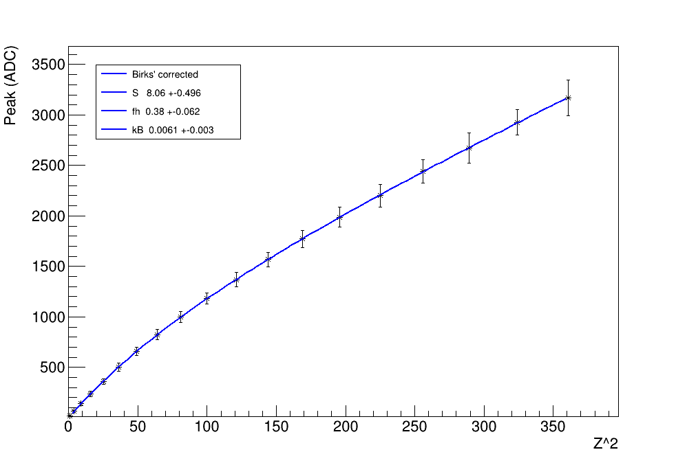
Quenching effect in plastic scintillator
Core scintillation
Halo scintillation
Beam test 2018
Preliminary
Preliminary
Ref | num | Fh | Err | Kb*
Dwyer [1] | 1 | 0,392 | 0,004
Marrocchesi [2] | 2 | 0,36 | 0,01
Beam Test 2018 [3] | 3 | 0,38 | 0,062
Simualtion [4] | 4 | 0,38 | 0,019
T1 3x3 | 5 | 0,2993 | 0,01297 | 0,0039
T1 1x1 | 6 | 0,3395 | 0,02363 | 0,0039
T2 3x3 | 7 | 0,3344 | 0,03051 | 0,0039
T2 1x1 | 8 | 0,3825 | 0,04701 | 0,0039
*Fixed for Tile fits
^{[1]}Robert DWYER and Dazhuang “ZHOU PLASTIC SCINTILLATOR RESPONSE TO RELATIVISTIC NUCLEI, Z< 28”
^{[2]} P.S. Marrocchesi at all “Beam test performance of a scintillator-based detector for the charge identification of relativistic ions”
^{[3]}De Benedictis et al “Characterization of plastic scintillator tiles equipped with SiPMs for the High Energy cosmic-Radiation Detection (HERD) experiment
^{[4]}Altomare , Serini et al “A full and customizable simulation of a scintillation tile equipped with SiPMs for Plastic Scintillator Detectors in the next generation of satellite experiments.”

Slide 14
To Do List
Sync analysis with other subsystems (e.g. IT SCD …): Ongoing
Gaussian/Multigaussian fit for Peak resolution: Done
Quenching effect studies with PSD scintillators and literature results : Done
Channel equalization with simulation : Ongoing
Comparison of runs with and without fingers: Ongoing
Comparison of runs with other beam position: Ongoing

Slide 15
BackUp Slides

Slide 16
Ref | num | Fh | Err | kb
Dwyer | 1 | 0,392 | 0,004
Marrocchesi | 2 | 0,36 | 0,01
Beam Test 2018 | 3 | 0,38 | 0,062
simualtion | 4 | 0,38 | 0,019
T1 3x3 | 5 | 0,2993 | 0,01297 | 0,0039
T1 1x1 | 6 | 0,3395 | 0,02363 | 0,0039
T2 3x3 | 7 | 0,3344 | 0,03051 | 0,0039
T2 1x1 | 8 | 0,3825 | 0,04701 | 0,0039
L2E03x3 | 9 | 0,6 | 0,3008 | 0,0039
L2E13x3 | 10 | 0,6 | 0,3612 | 0,0039
L2TOP03x3 | 11 | 0,6 | 0,3681 | 0,0039
L2TOP01x1 | 12 | 0,6 | 0,289 | 0,0039

Slide 17
PSD @ SPS Tile T1 1x1 mm
Run 201 -202
no veto
no finger
Vthr: -600mV
3
5
6
4
7
8
9
10
11
12
13
14
15
16
17
18
19
20
21
22

Slide 18
PSD @ SPS Tile T1
Run 201 -202
no veto
no finger
Vthr: -600mV

Slide 19
PSD @ SPS T1 Saturation 3x3 mm

Slide 20
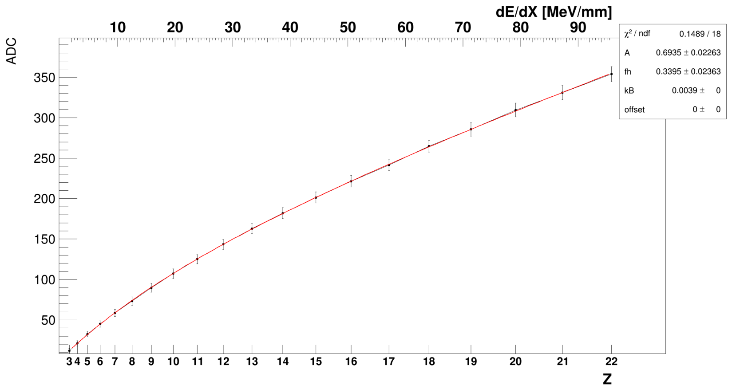
PSD @ SPS T1 Saturation 1x1 mm

Slide 21
PSD @ SPS T2 3x3

Slide 22
PSD @ SPS T2 1x1

Slide 23
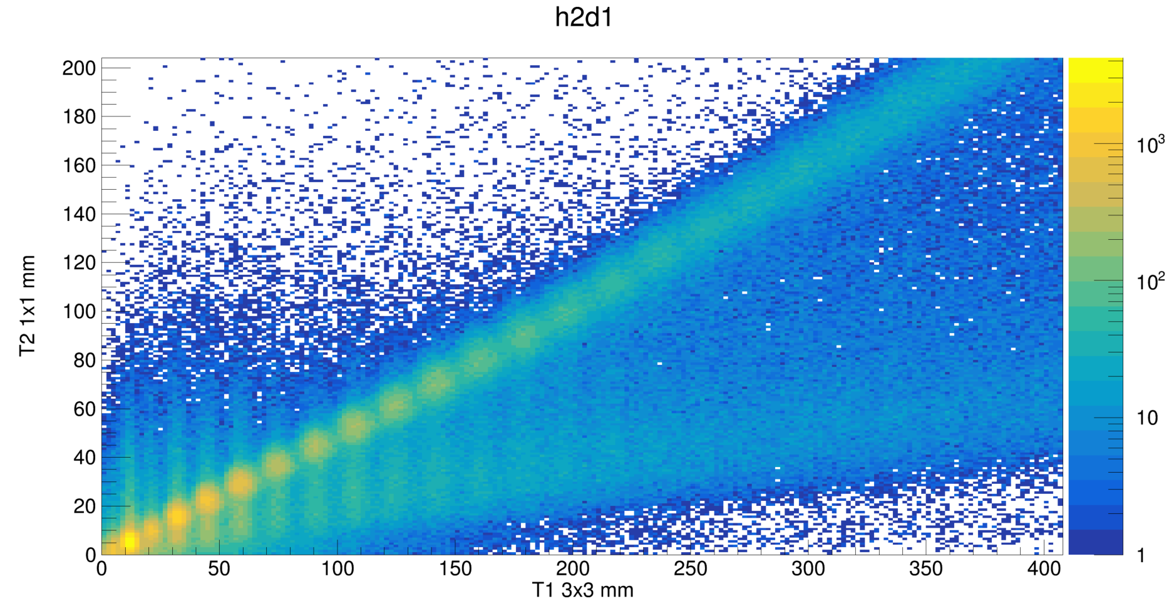
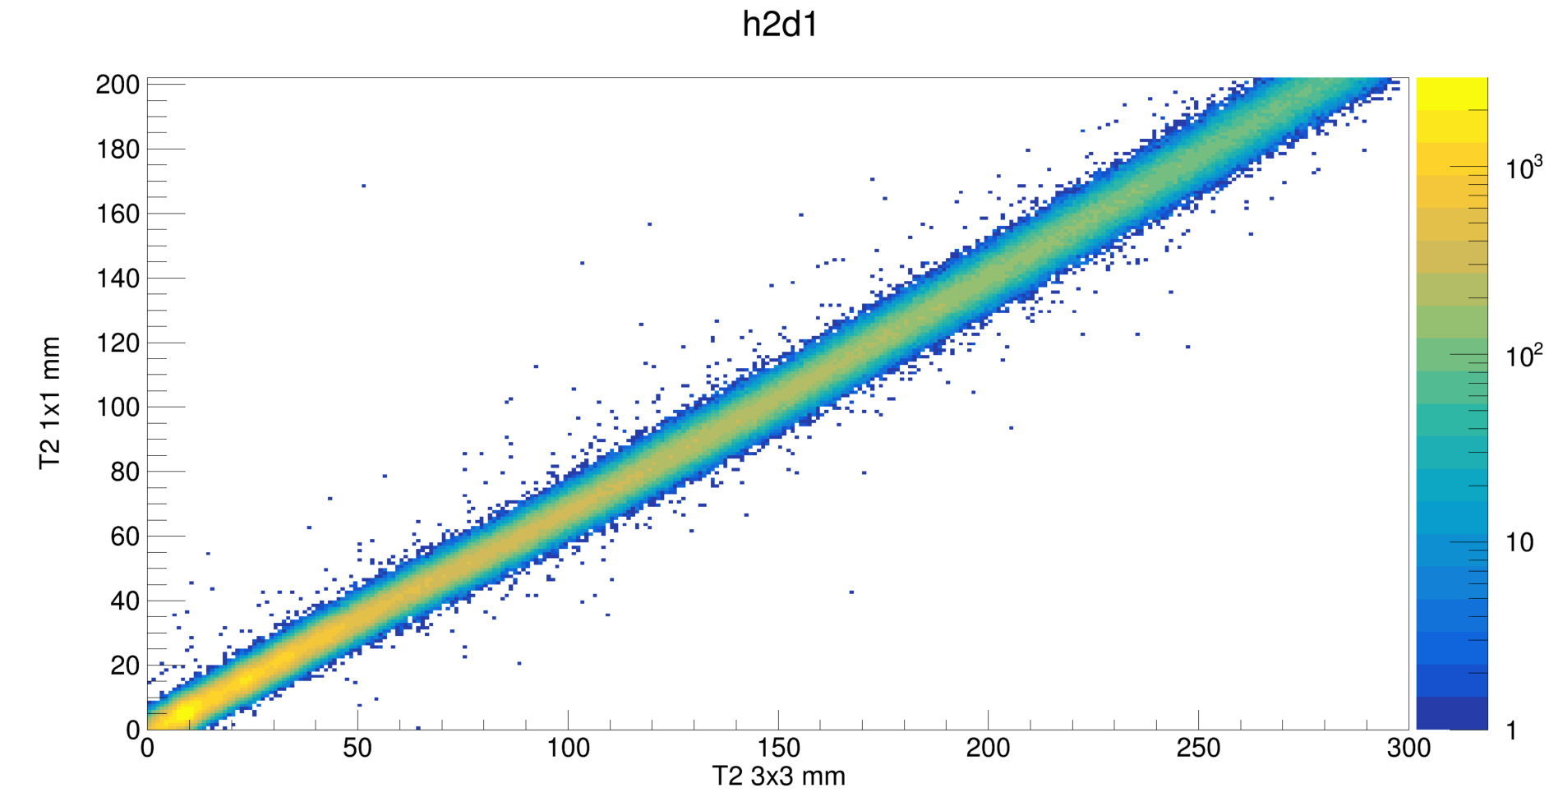
PSD @ SPS Scatter plots

Slide 24
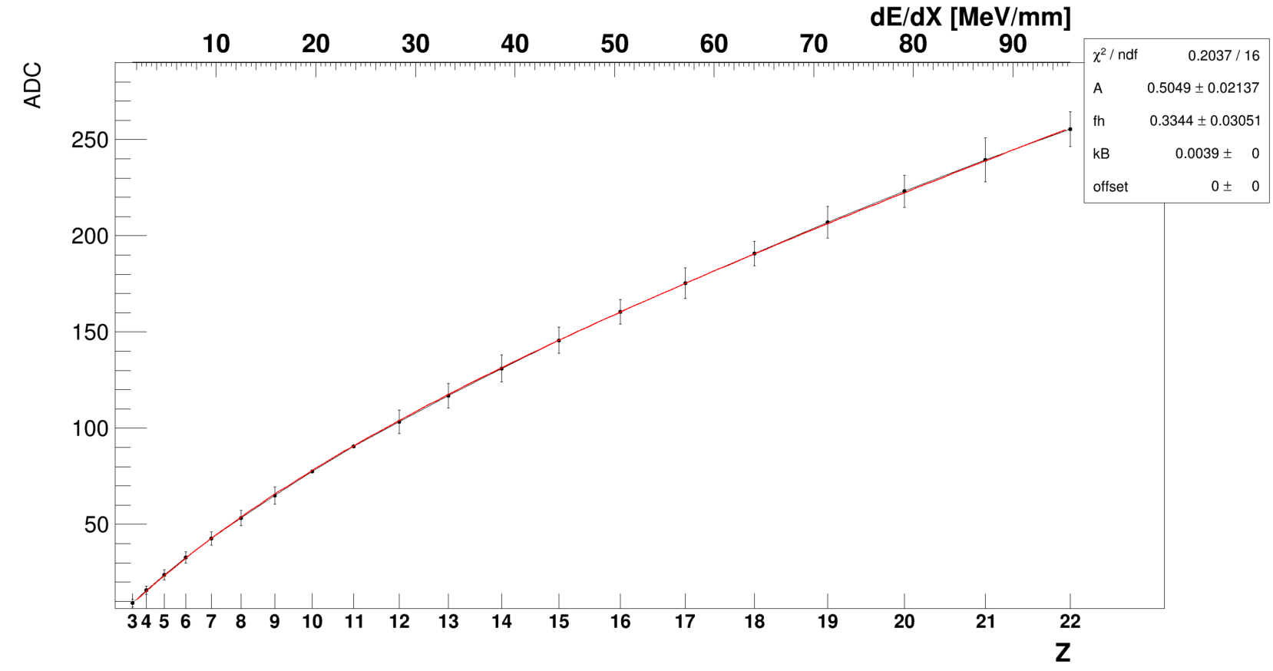
PSD @ SPS T2 3x3 Saturation

Slide 25
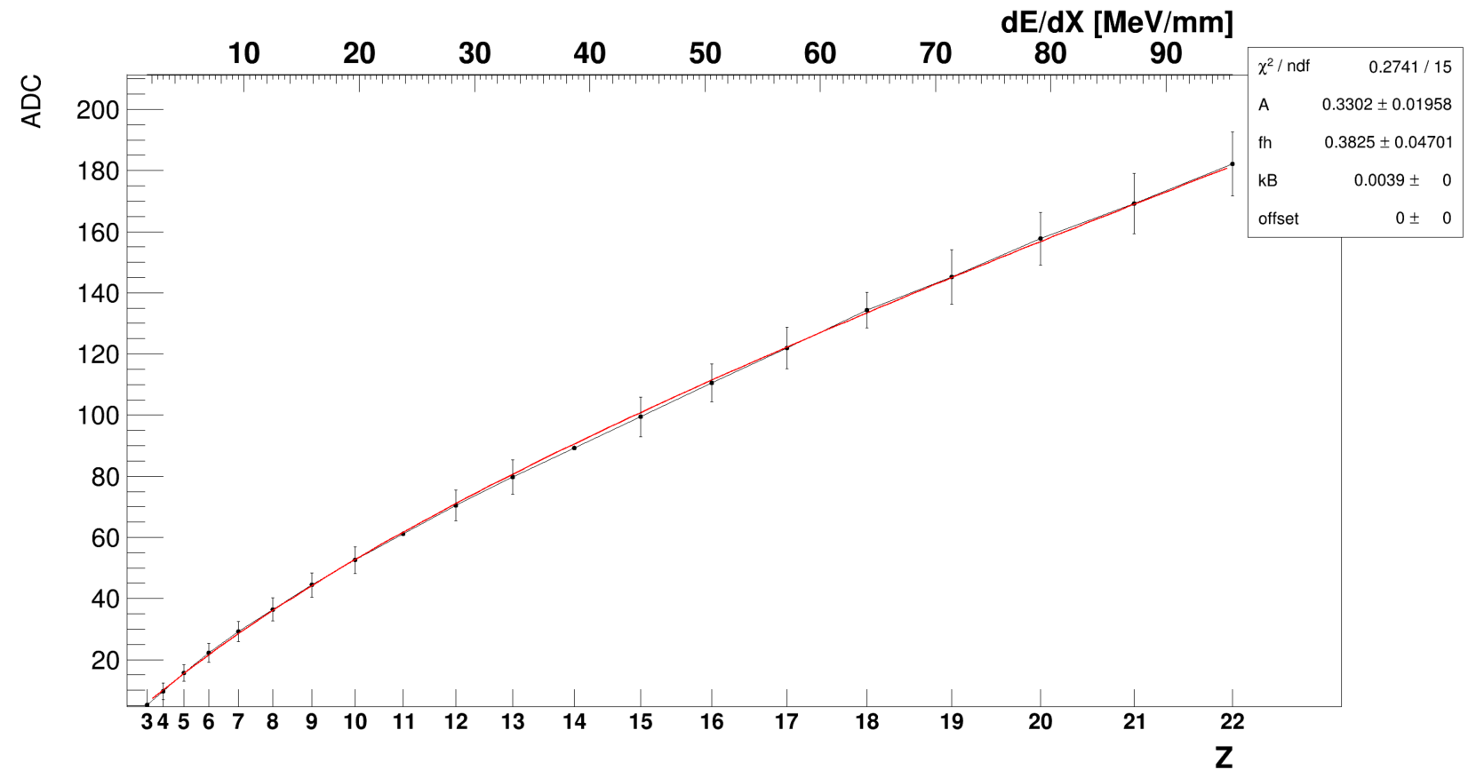
PSD @ SPS T2 1x1 Saturation

Slide 26
PSD @ L2 Bar EndCup0

Slide 27
PSD @ L2 Bar EndCup1

Slide 28
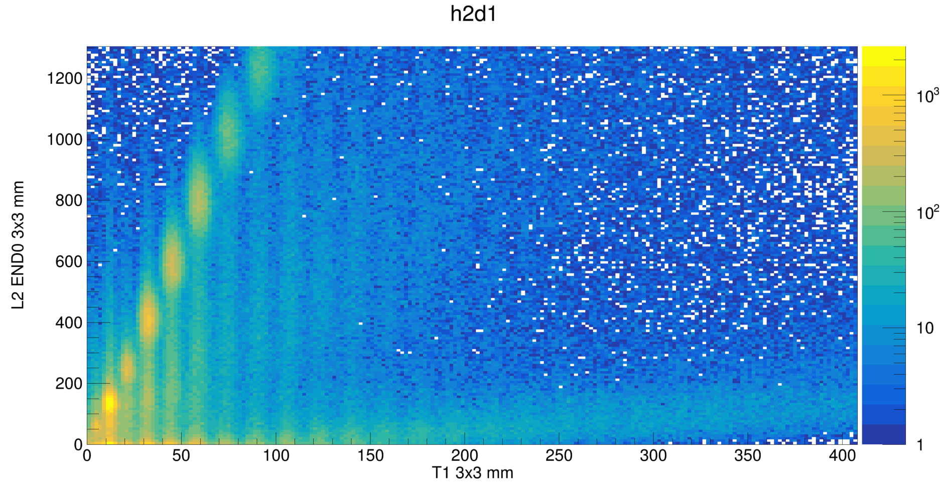
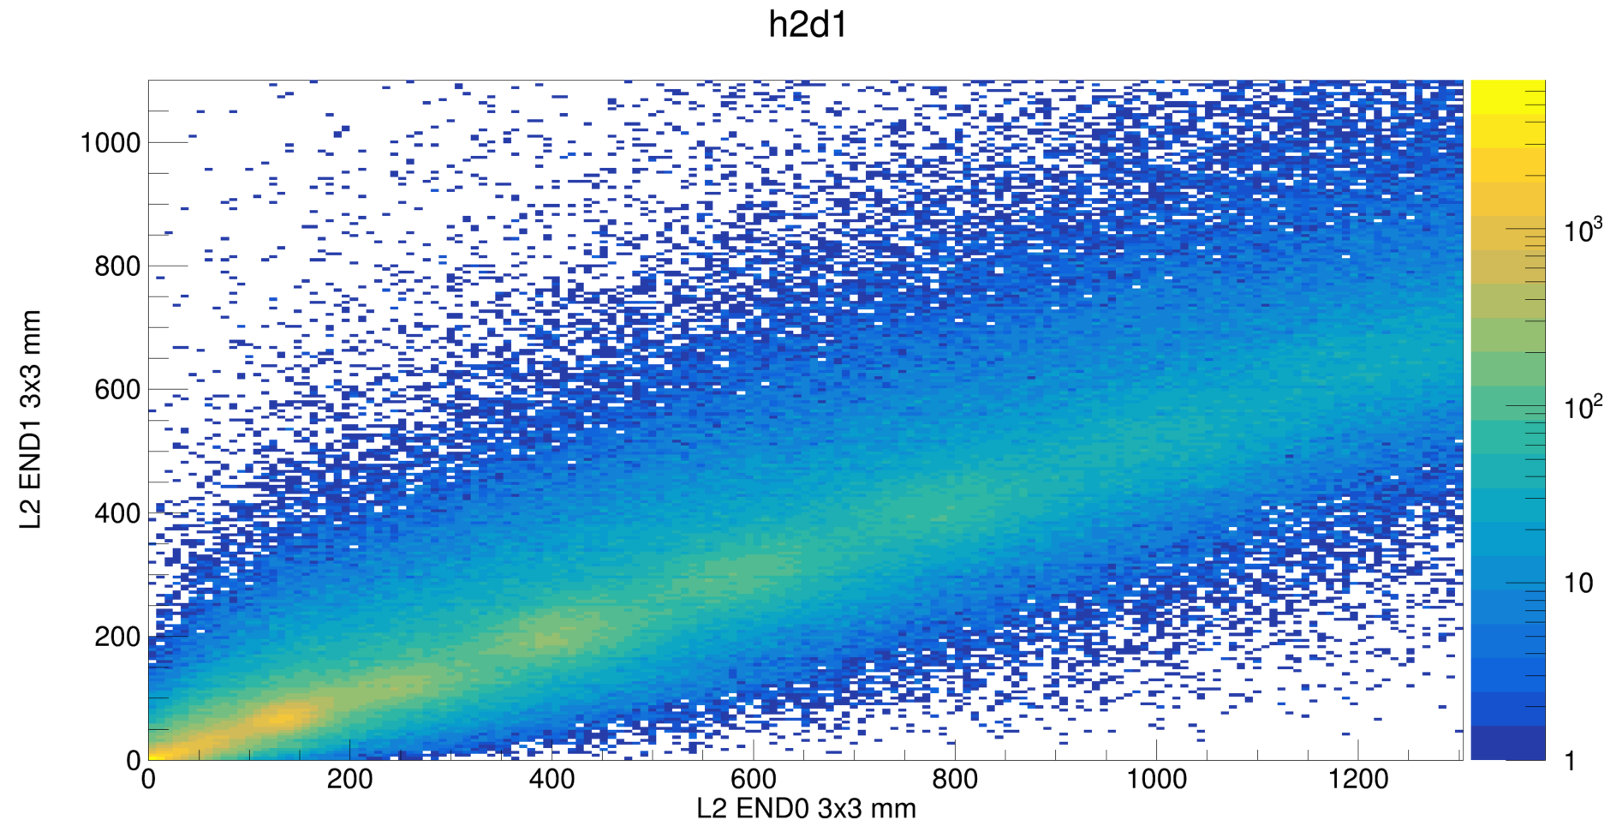
PSD @ SPS L2 Bar EndCup
Tile

Slide 29
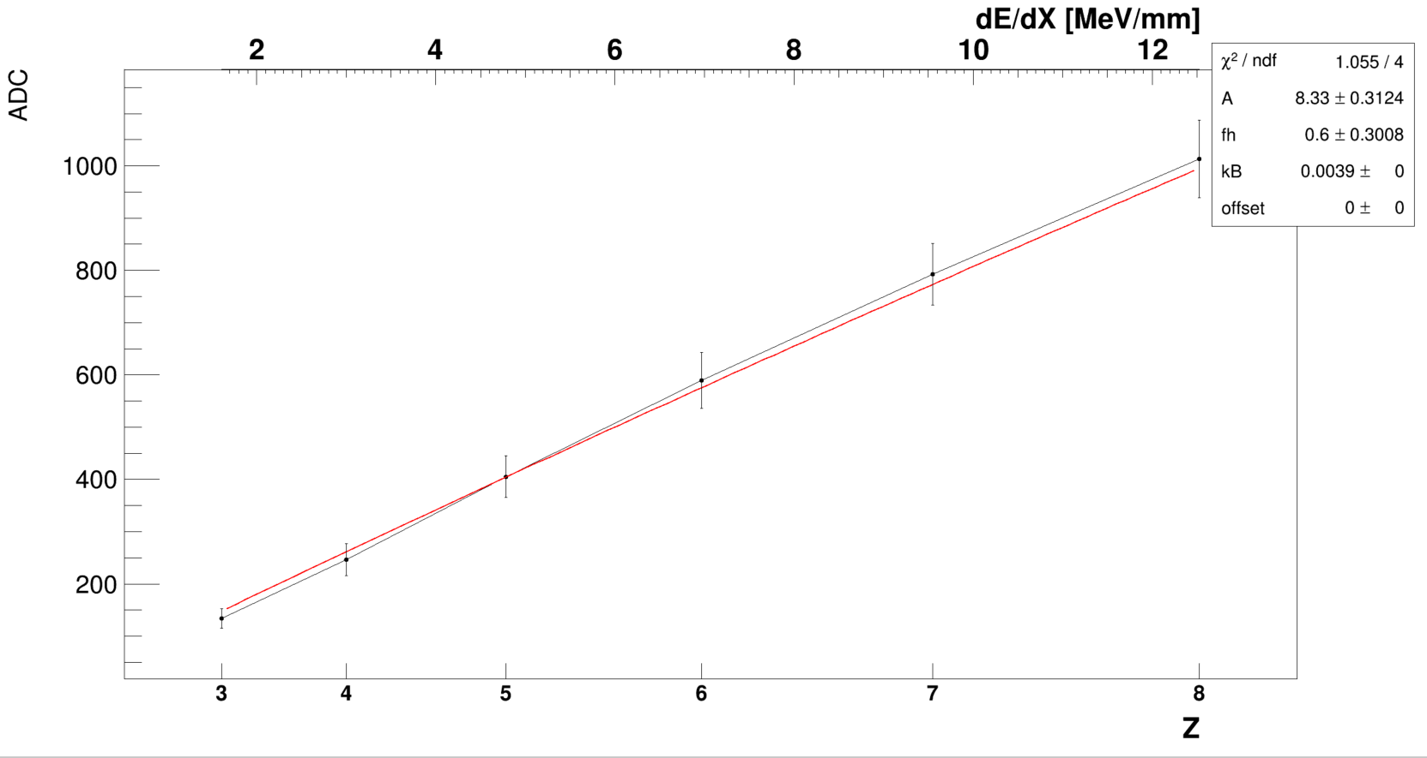
PSD @ SPS L2 Bar EndCup0 Saturation

Slide 30
PSD @ SPS L2 Bar EndCup1 Saturation

Slide 31
PSD @ SPS L2 Bar TOP0 3x3

Slide 32
PSD @ SPS L2 Bar TOP0 1x1

Slide 33
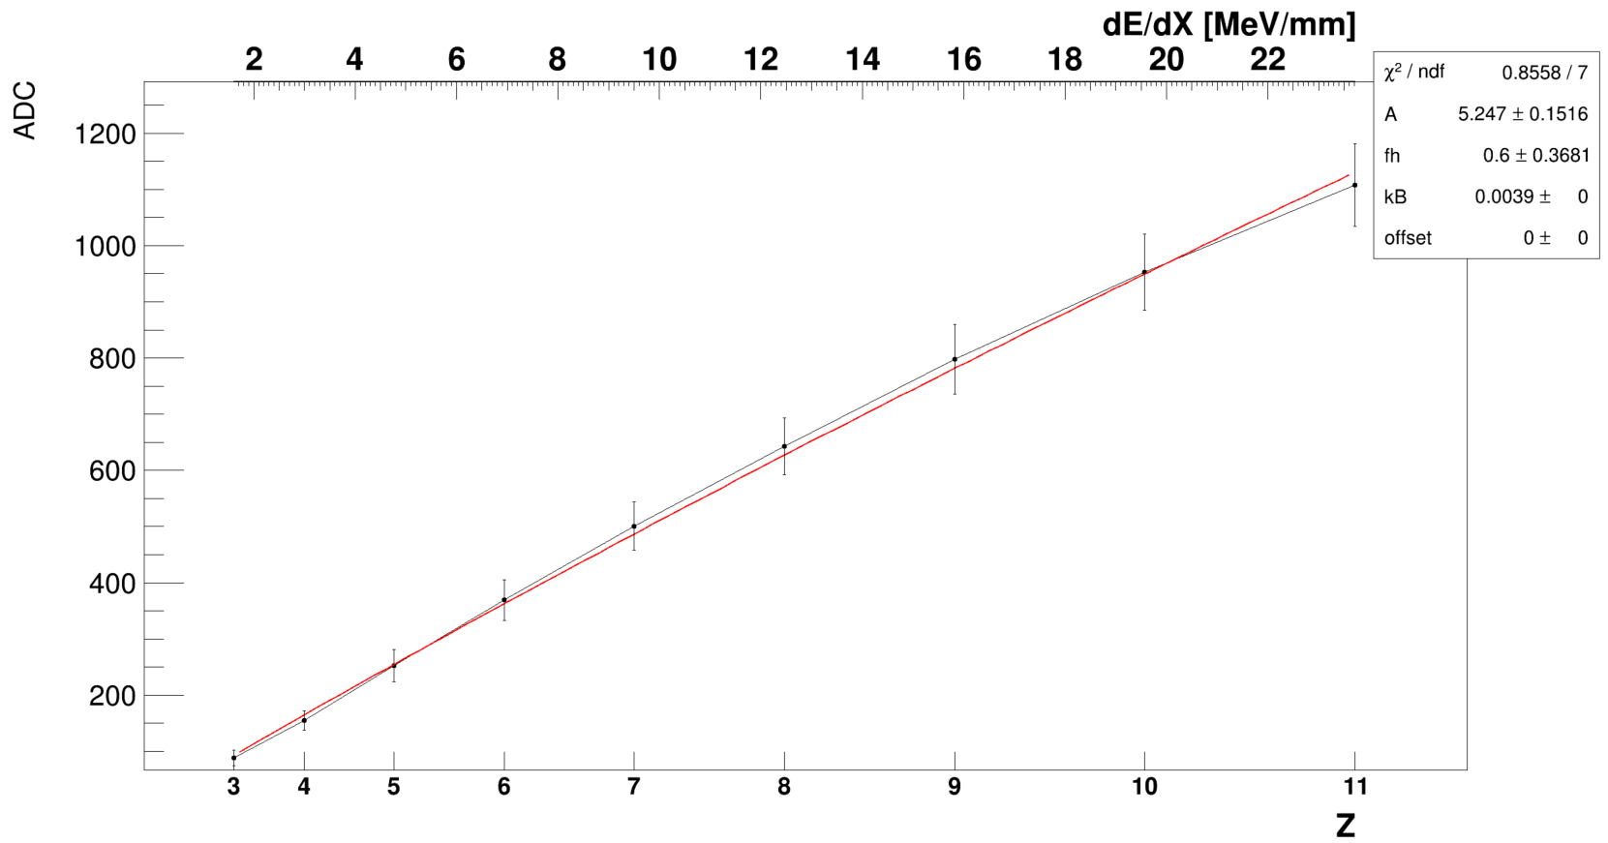
PSD @ SPS L2 Bar TOP0 3x3 Saturation

Slide 34
PSD @ SPS L2 Bar TOP0 1x1 Saturation

Slide 35
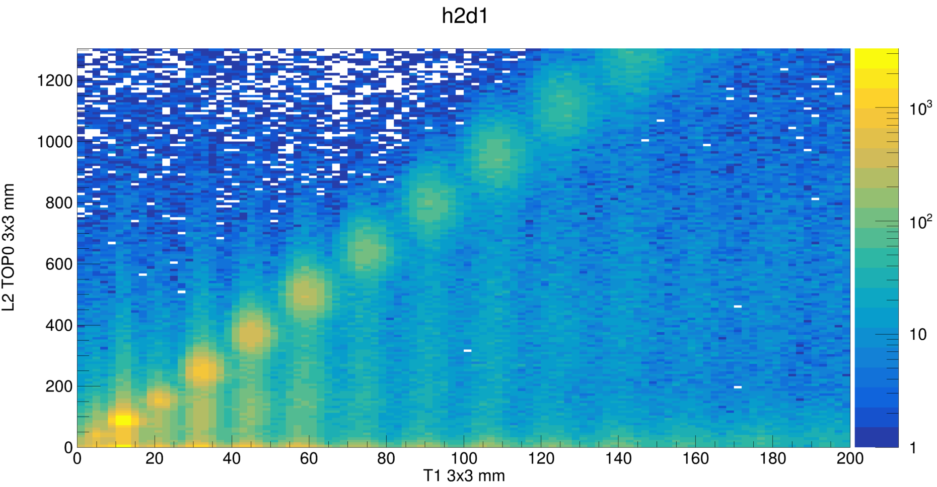
PSD @ SPS L2 Bar TOP0

