Slide 1
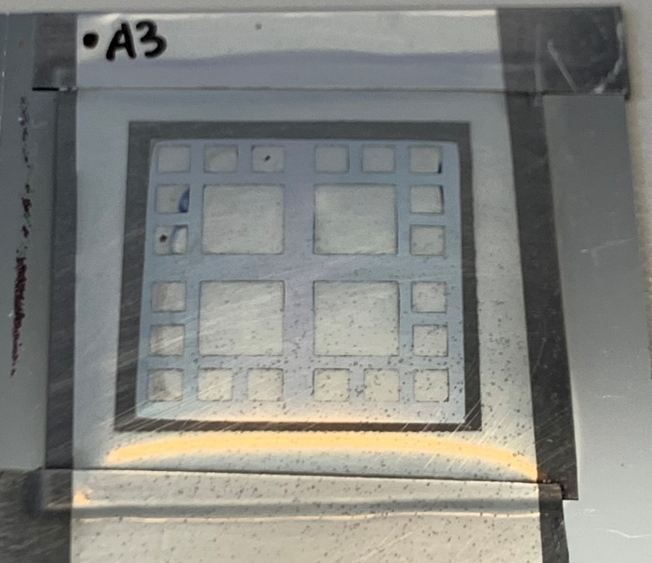



WP2: Evaluation of the response
Pixel/Device Designs:
  2x2 mm² around edges, 5x5 mm² pixels in middle

Slide 2
WP2: Evaluation of the response
Tested at MV Linac (6MV – reference conditions):
  Field size: 10x10 cm²
  Depth: 15mm in solid water

Slide 3
Linearity – 5um

Slide 4
Linearity – Bias 0V - 3V

Slide 5
Sensitivity so far…
Item | Bias: 0V | Bias: 3V
2.5um – 2x2mm² | 0.6 pC/cGy – 0.06 pC/mm/um/cGy | 2 pC/cGy
5um – 2x2mm² | 3 pC/cGy 0.15 pC/mm/um/cGy | 13.5 pC/cGy
5um – 5x5mm² | 20 pC/cGy 0.16 pC/mm/um/cGy | -

