Slide 1
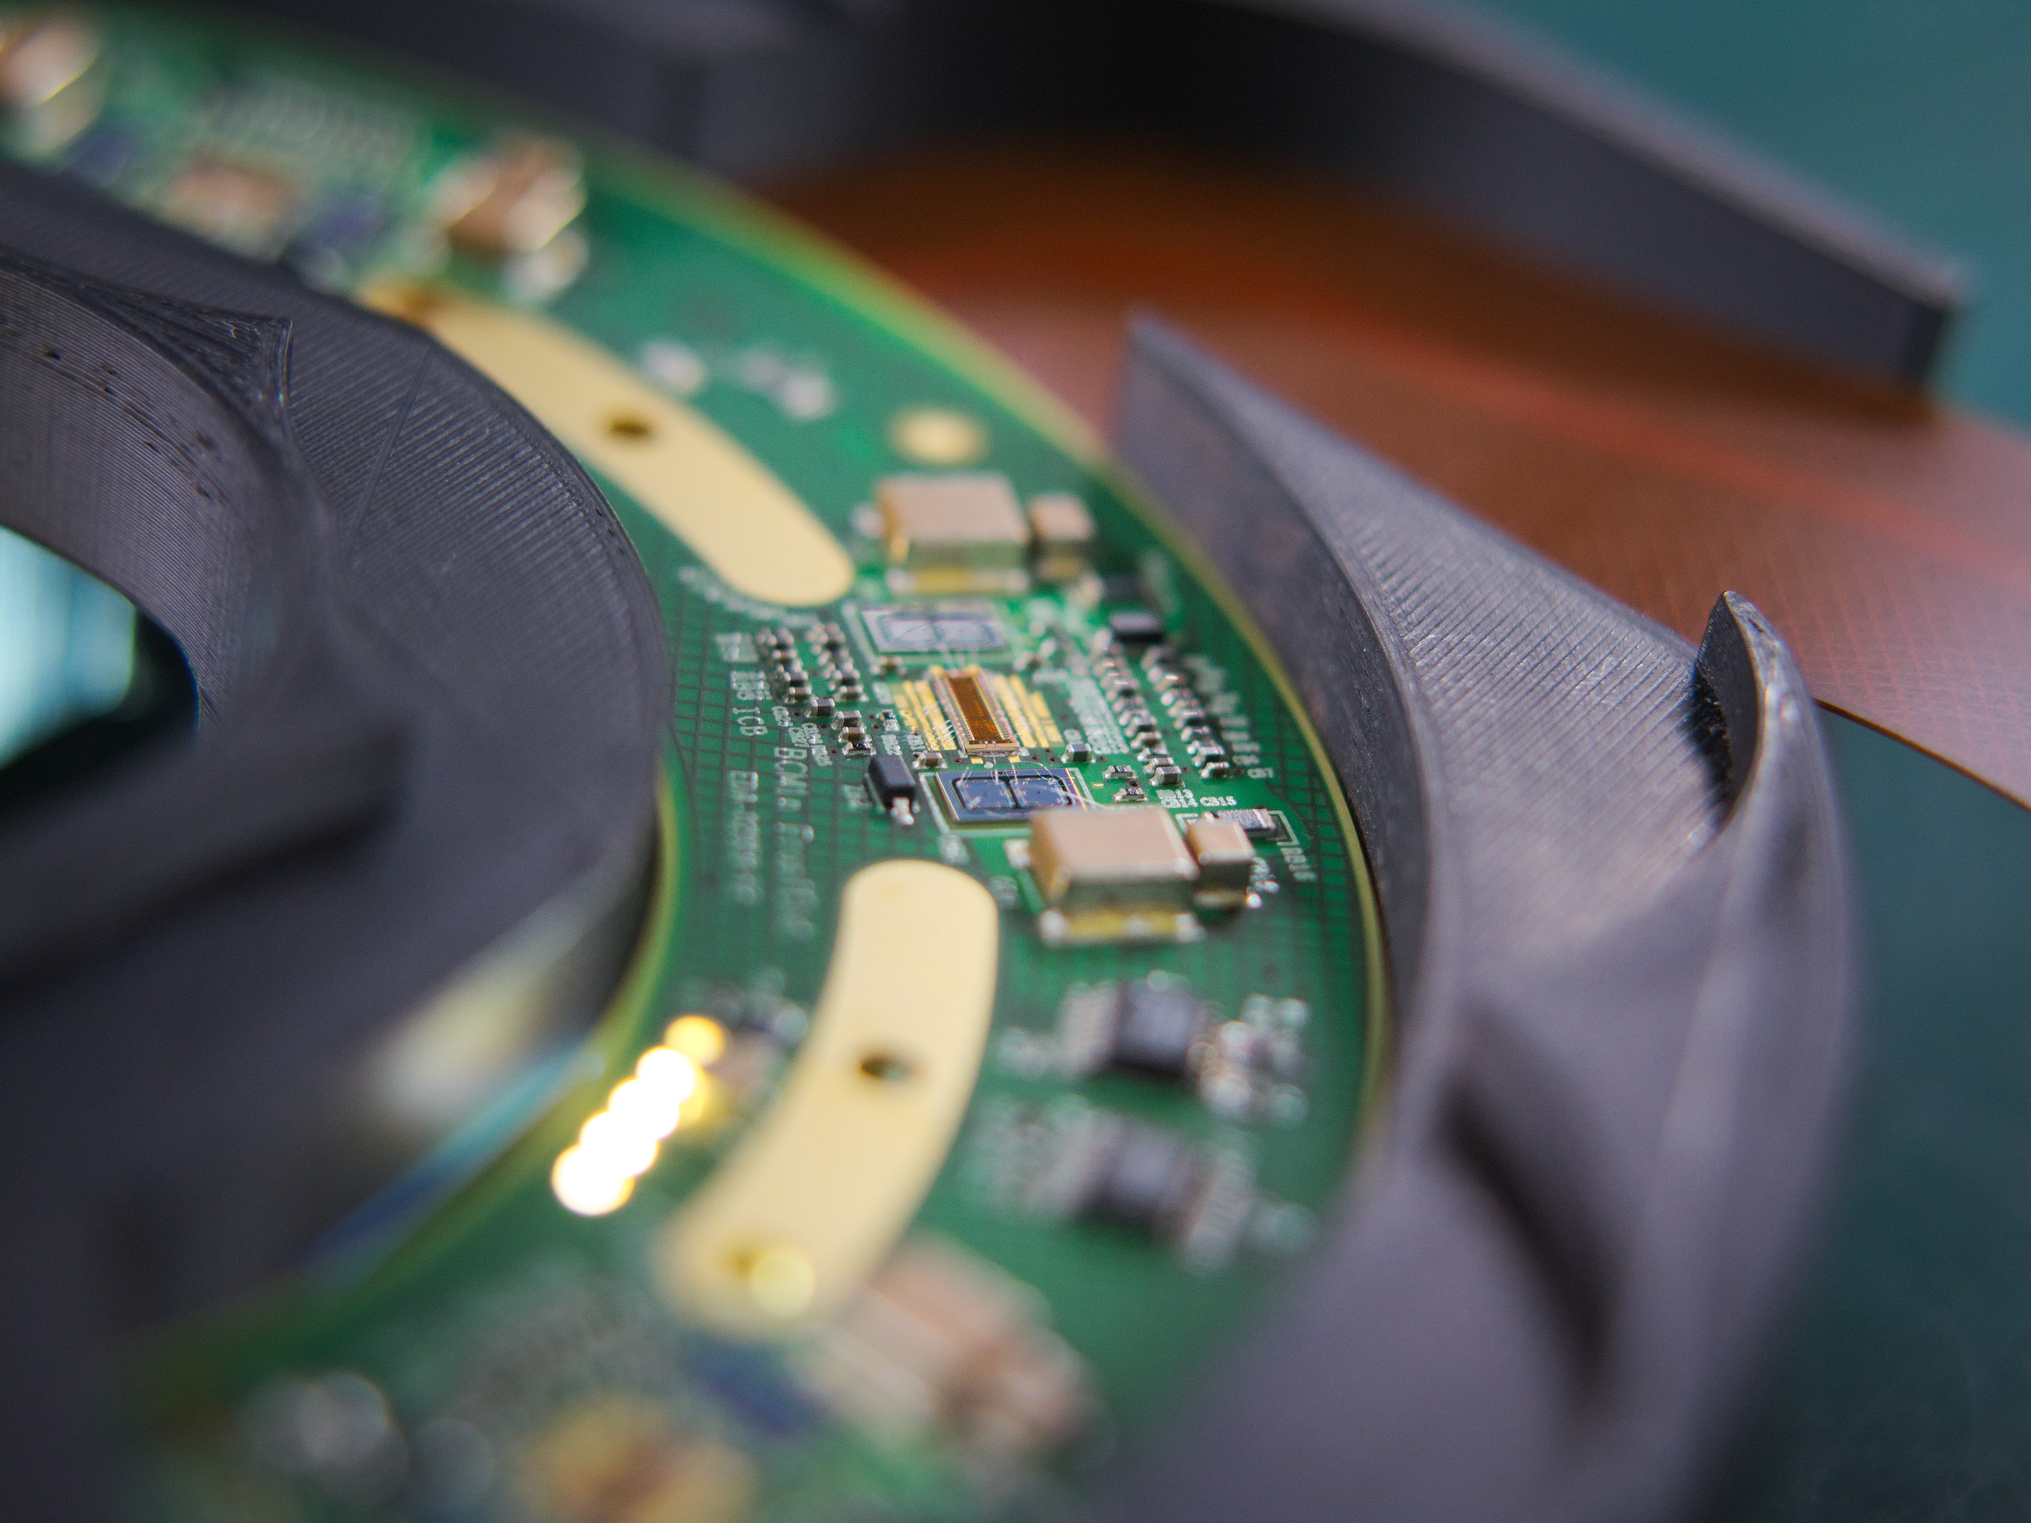
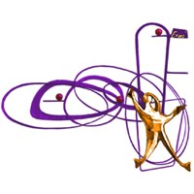
DESY Summer Student Program 2023
Afterglow calibration for BCM1F
INTERNATIONAL SCHOOL ’’FRANCESCO ROMANO’’
23/09/2023
STUDENT PRESENTATION
Lisa Generoso

Slide 2
BRIL Group
Beam Radiation, Instrumentation and Luminosity
Main focus:
To perform high precision measurements of the luminosity delivered by the LHC at CMS
INSTANTANEOUS LUMINOSITY
$ℒ =\frac{N_{1}N_{2}n_{b}f}{4{πσ}_{x}σ_{y}}$ [${cm}^{−2}s^{−1}$]
Gives information about the collision rate
Proportionality constant between the collision rate and the cross-section of a specific process
→ $R$ = $ℒ∙σ$

Slide 3
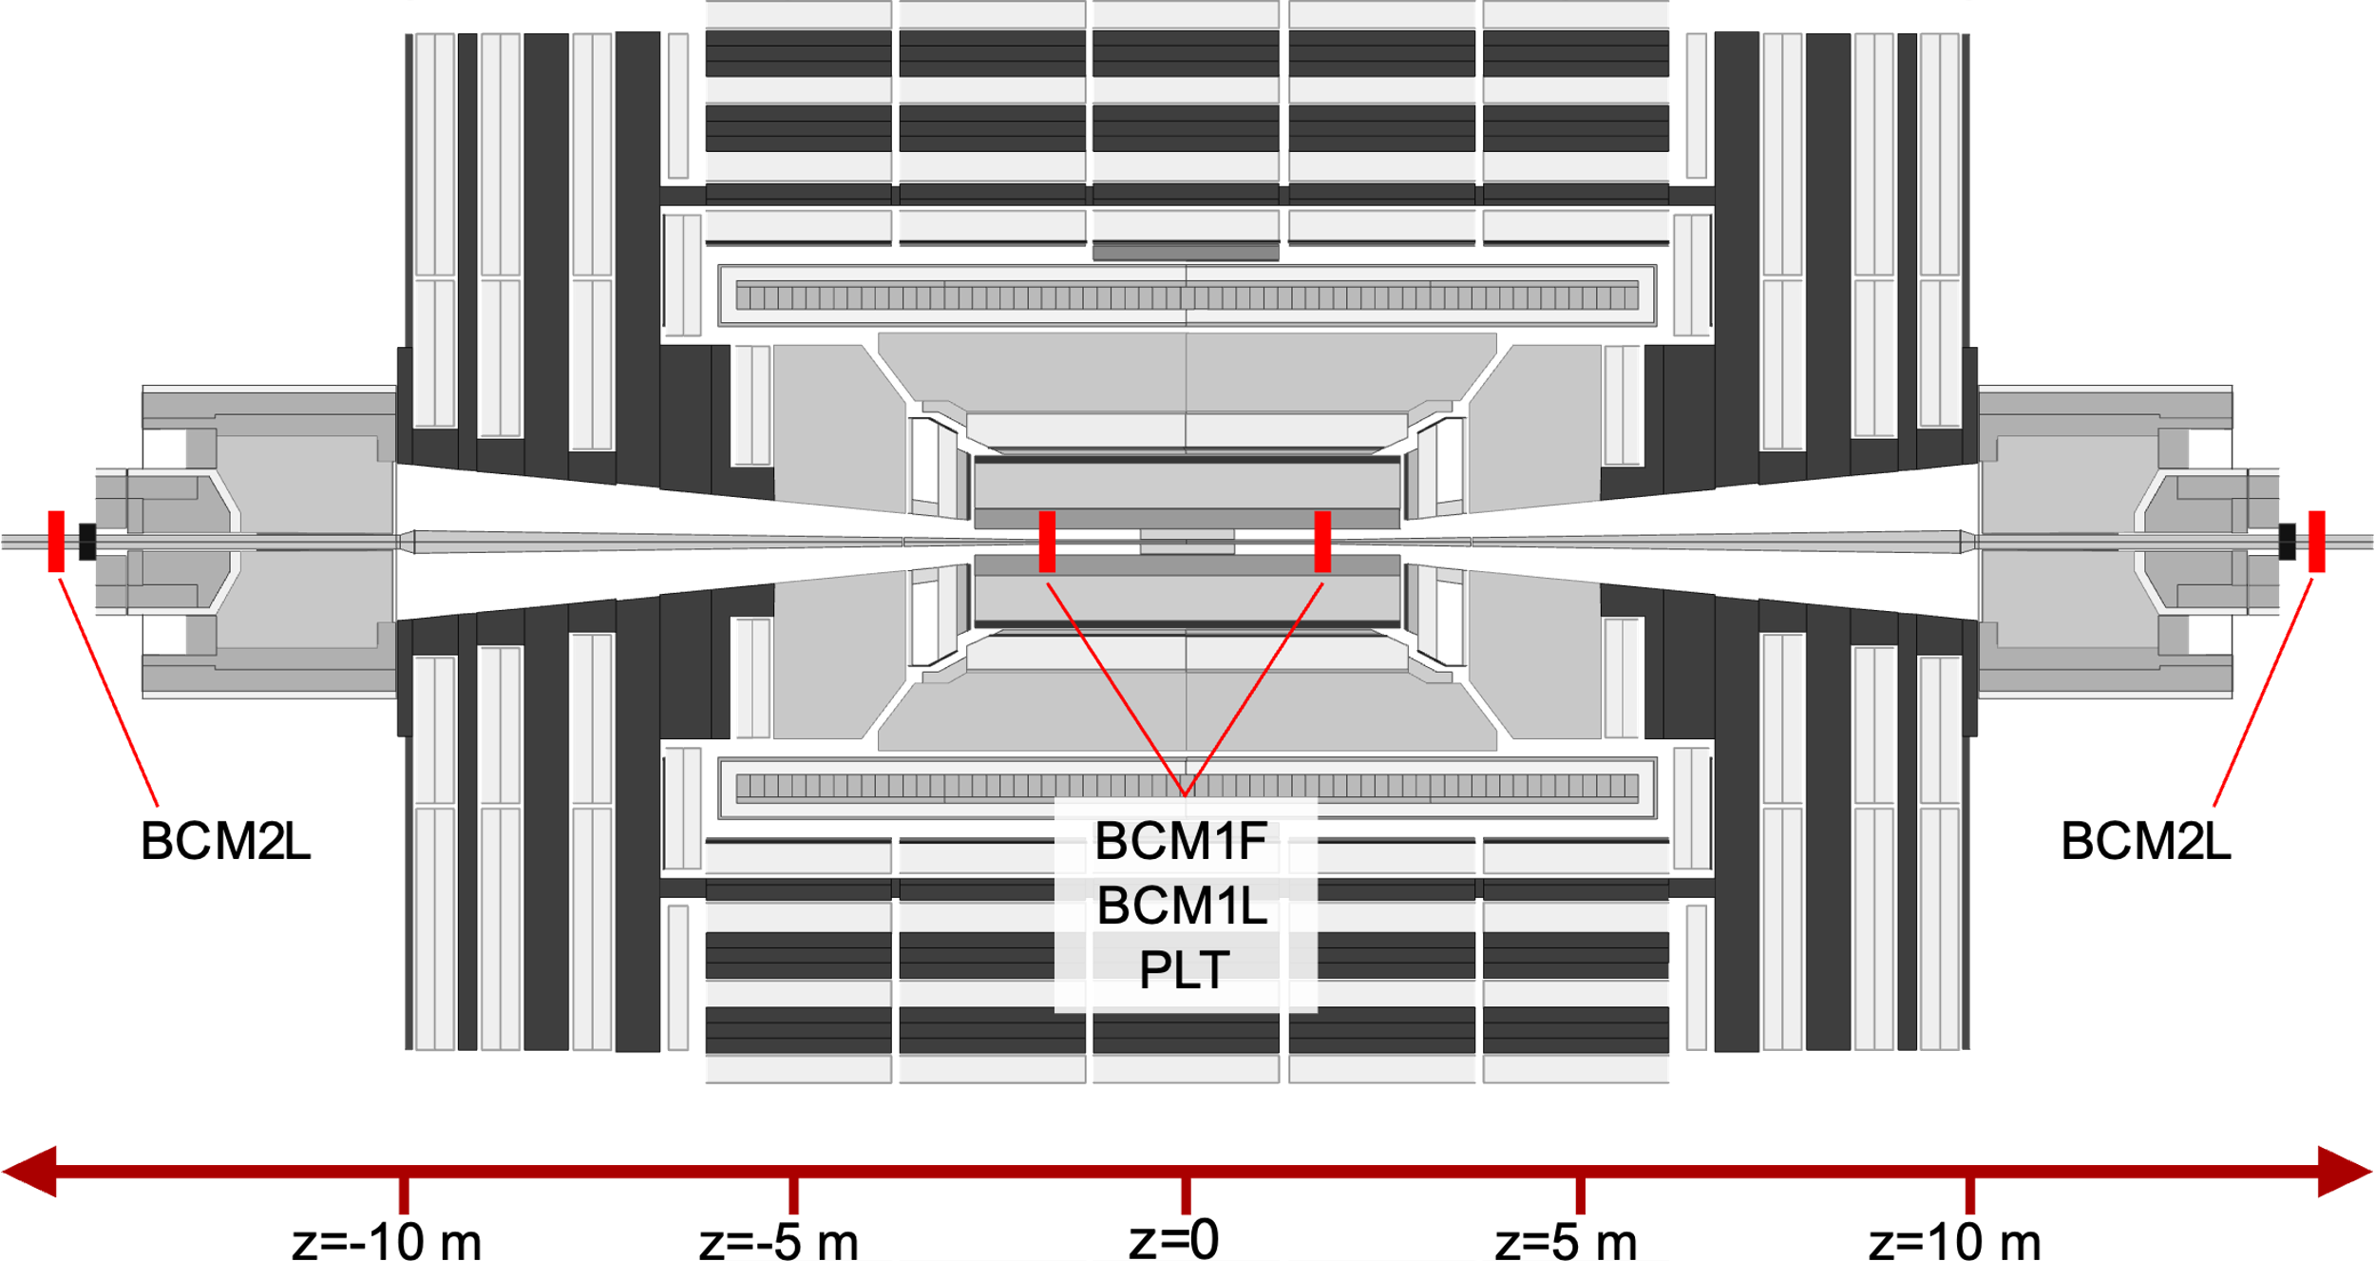
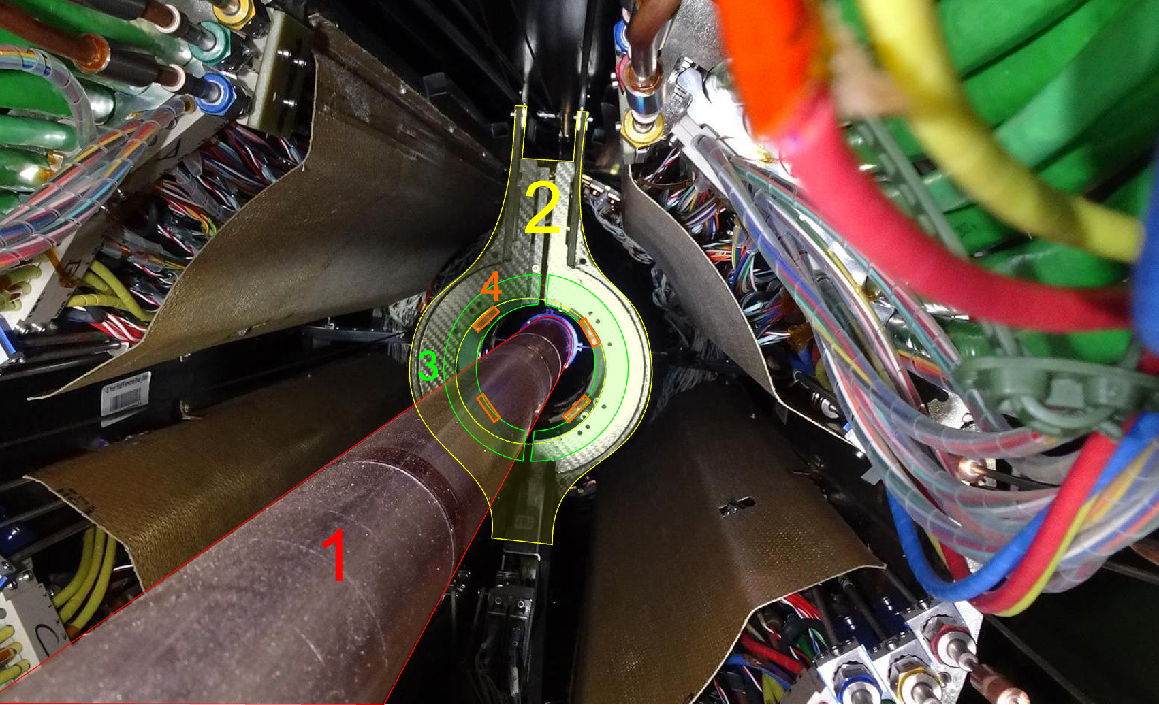
What is BCM1F?
The Fast Beam Condition Monitor
Luminometer: detector performing luminosity measurements and monitors at CMS

Slide 4
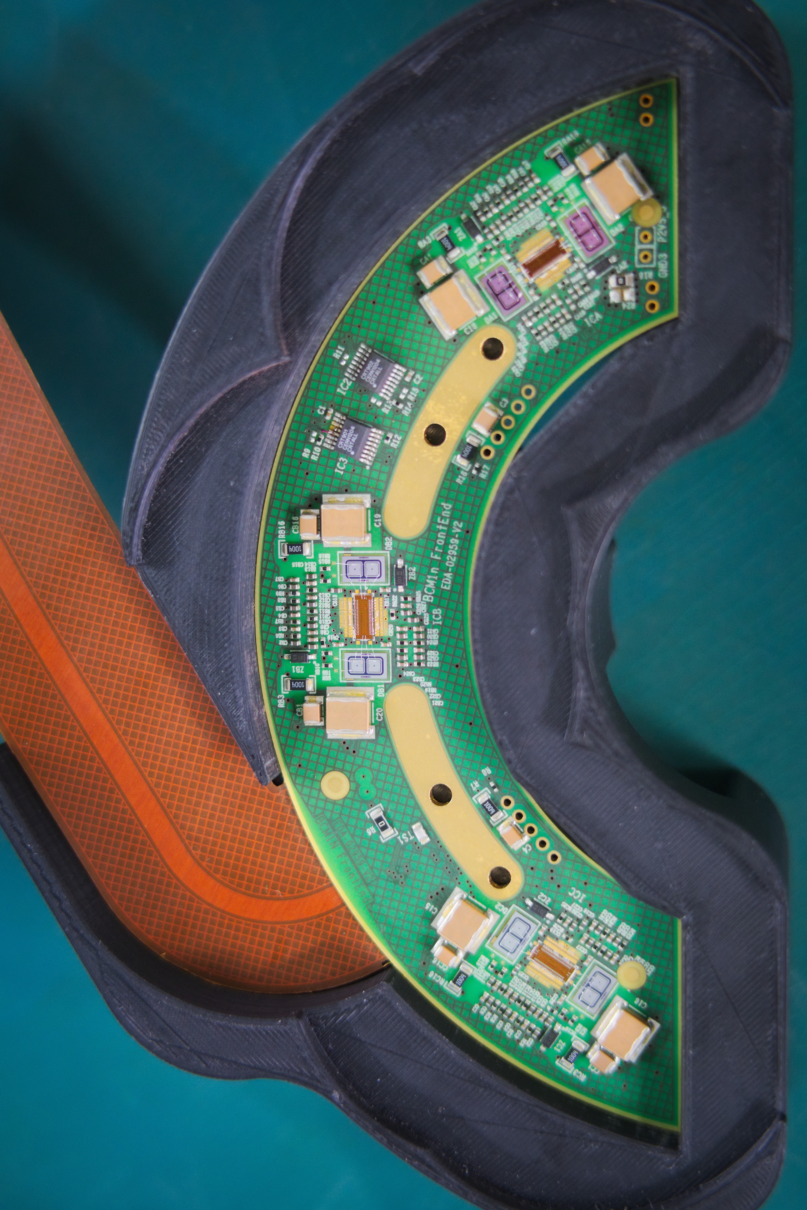
What is BCM1F?
The Fast Beam Condition Monitor
Consists of four C-shapes, two on each side.
Each C-shape has six double silicon diodes as sensors
→ 48 readout channels
Counts hits from pp collisions and from backgrounds
Instantaneous luminosity is determined bunch-by-bunch from the measured rate

Slide 5
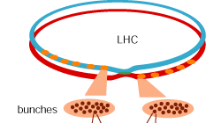
What is Afterglow aka Albedo ?
One of the most relevant sources of background and noise at the LHC
Late signals formed at a given BCID (bunch crossing index) measured in the subsequent collisions (25ns or multiples later)
Due to back-scattering or activation of the detector material

Slide 6
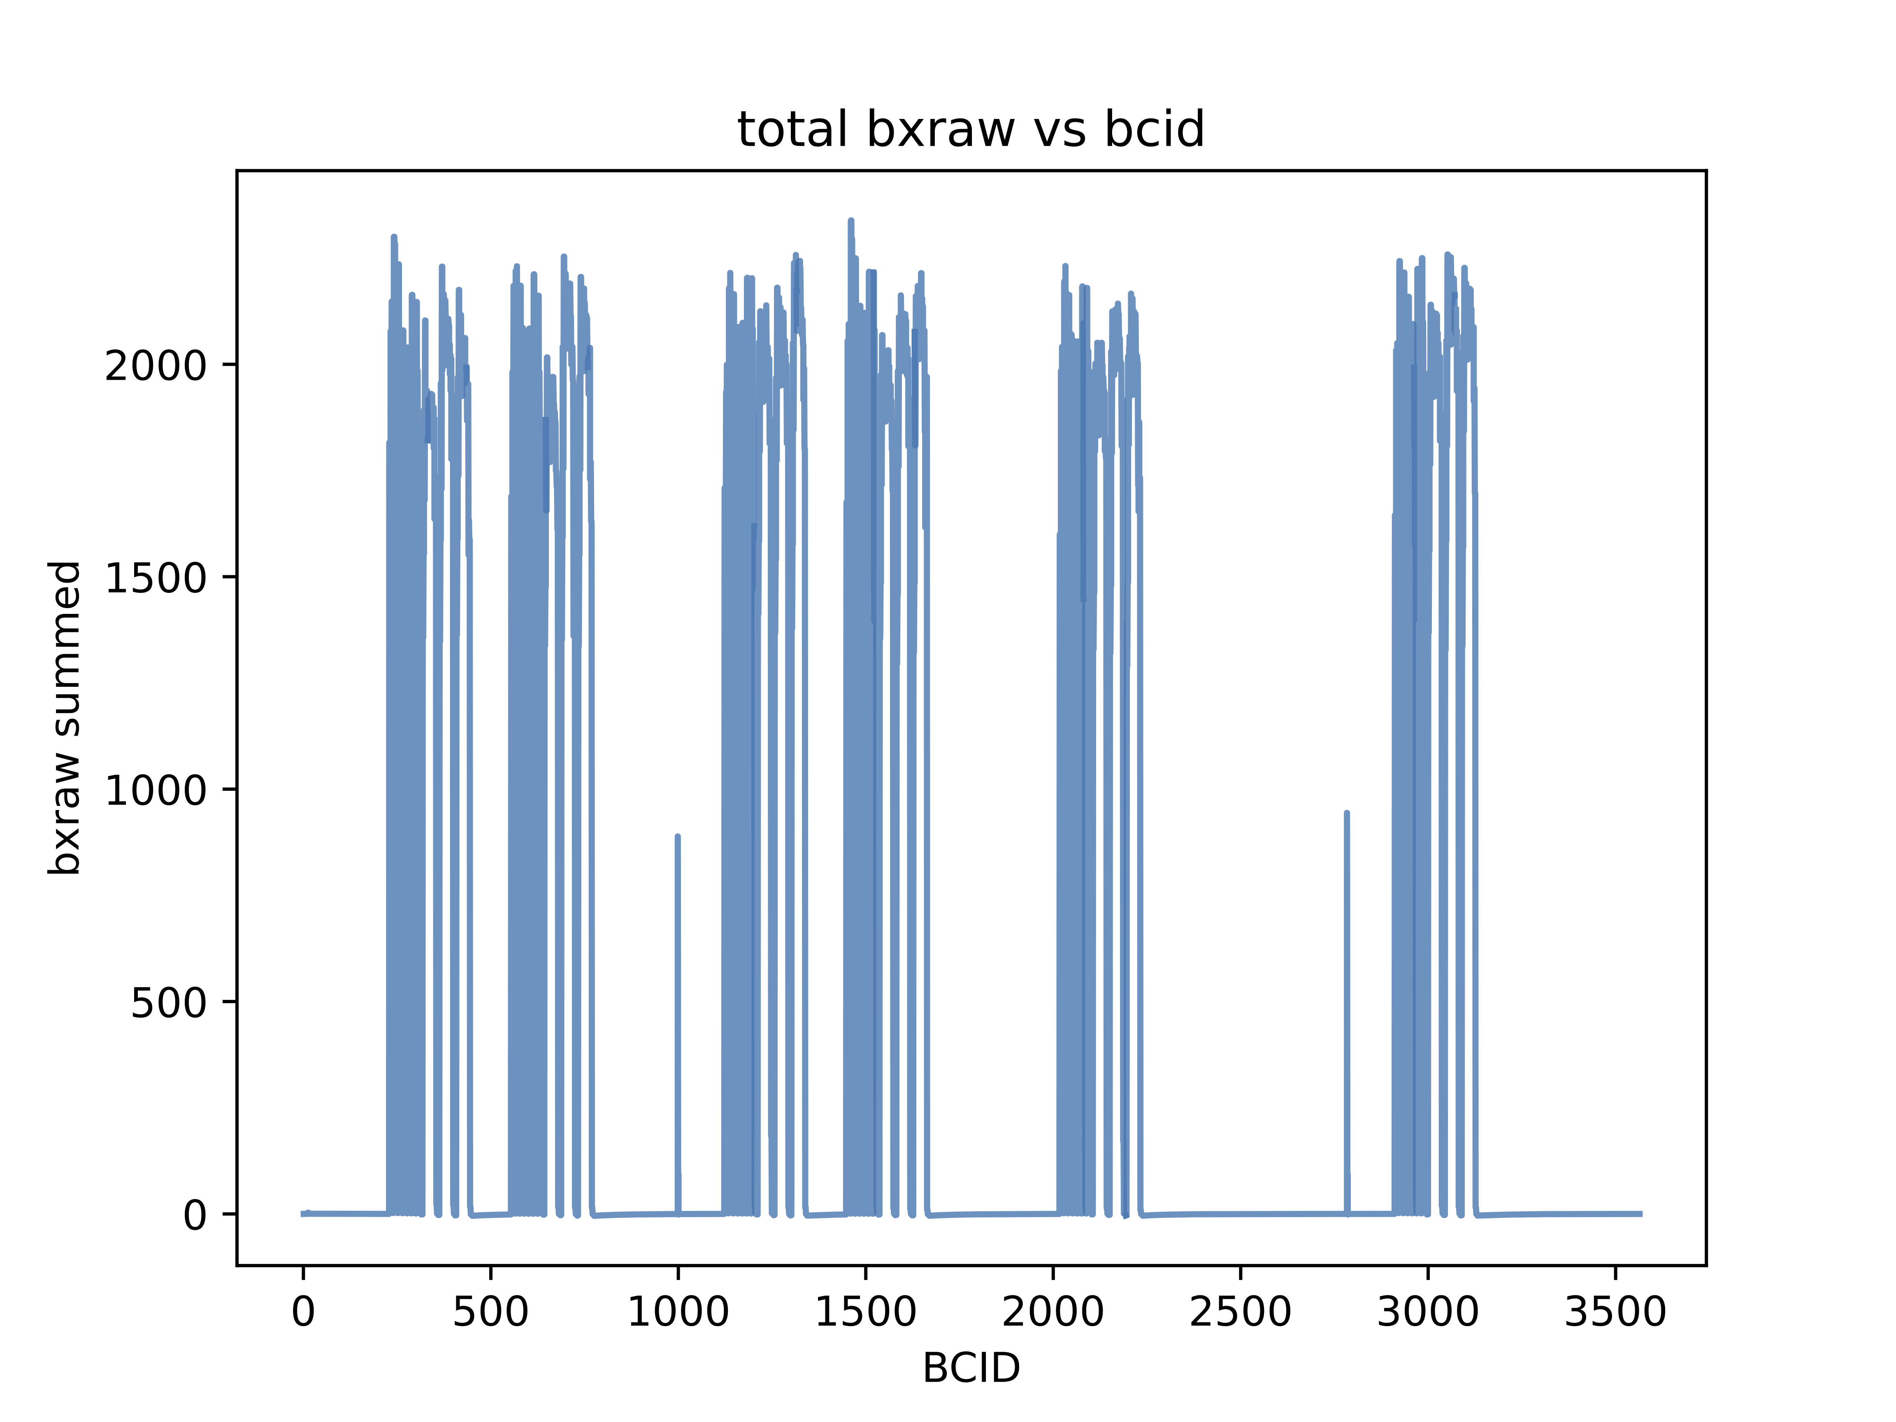
What is Afterglow aka Albedo ?
One of the most relevant sources of background and noise at the LHC
TRAIN
Additional hits in subsequent colliding bunches
→ Clearly visible at the end of each train in the rate of the first empty bunch
Overestimate of luminosity for each bunch crossing
Necessity to correct the afterglow background
→ higher precision measurements of luminosity

Slide 7
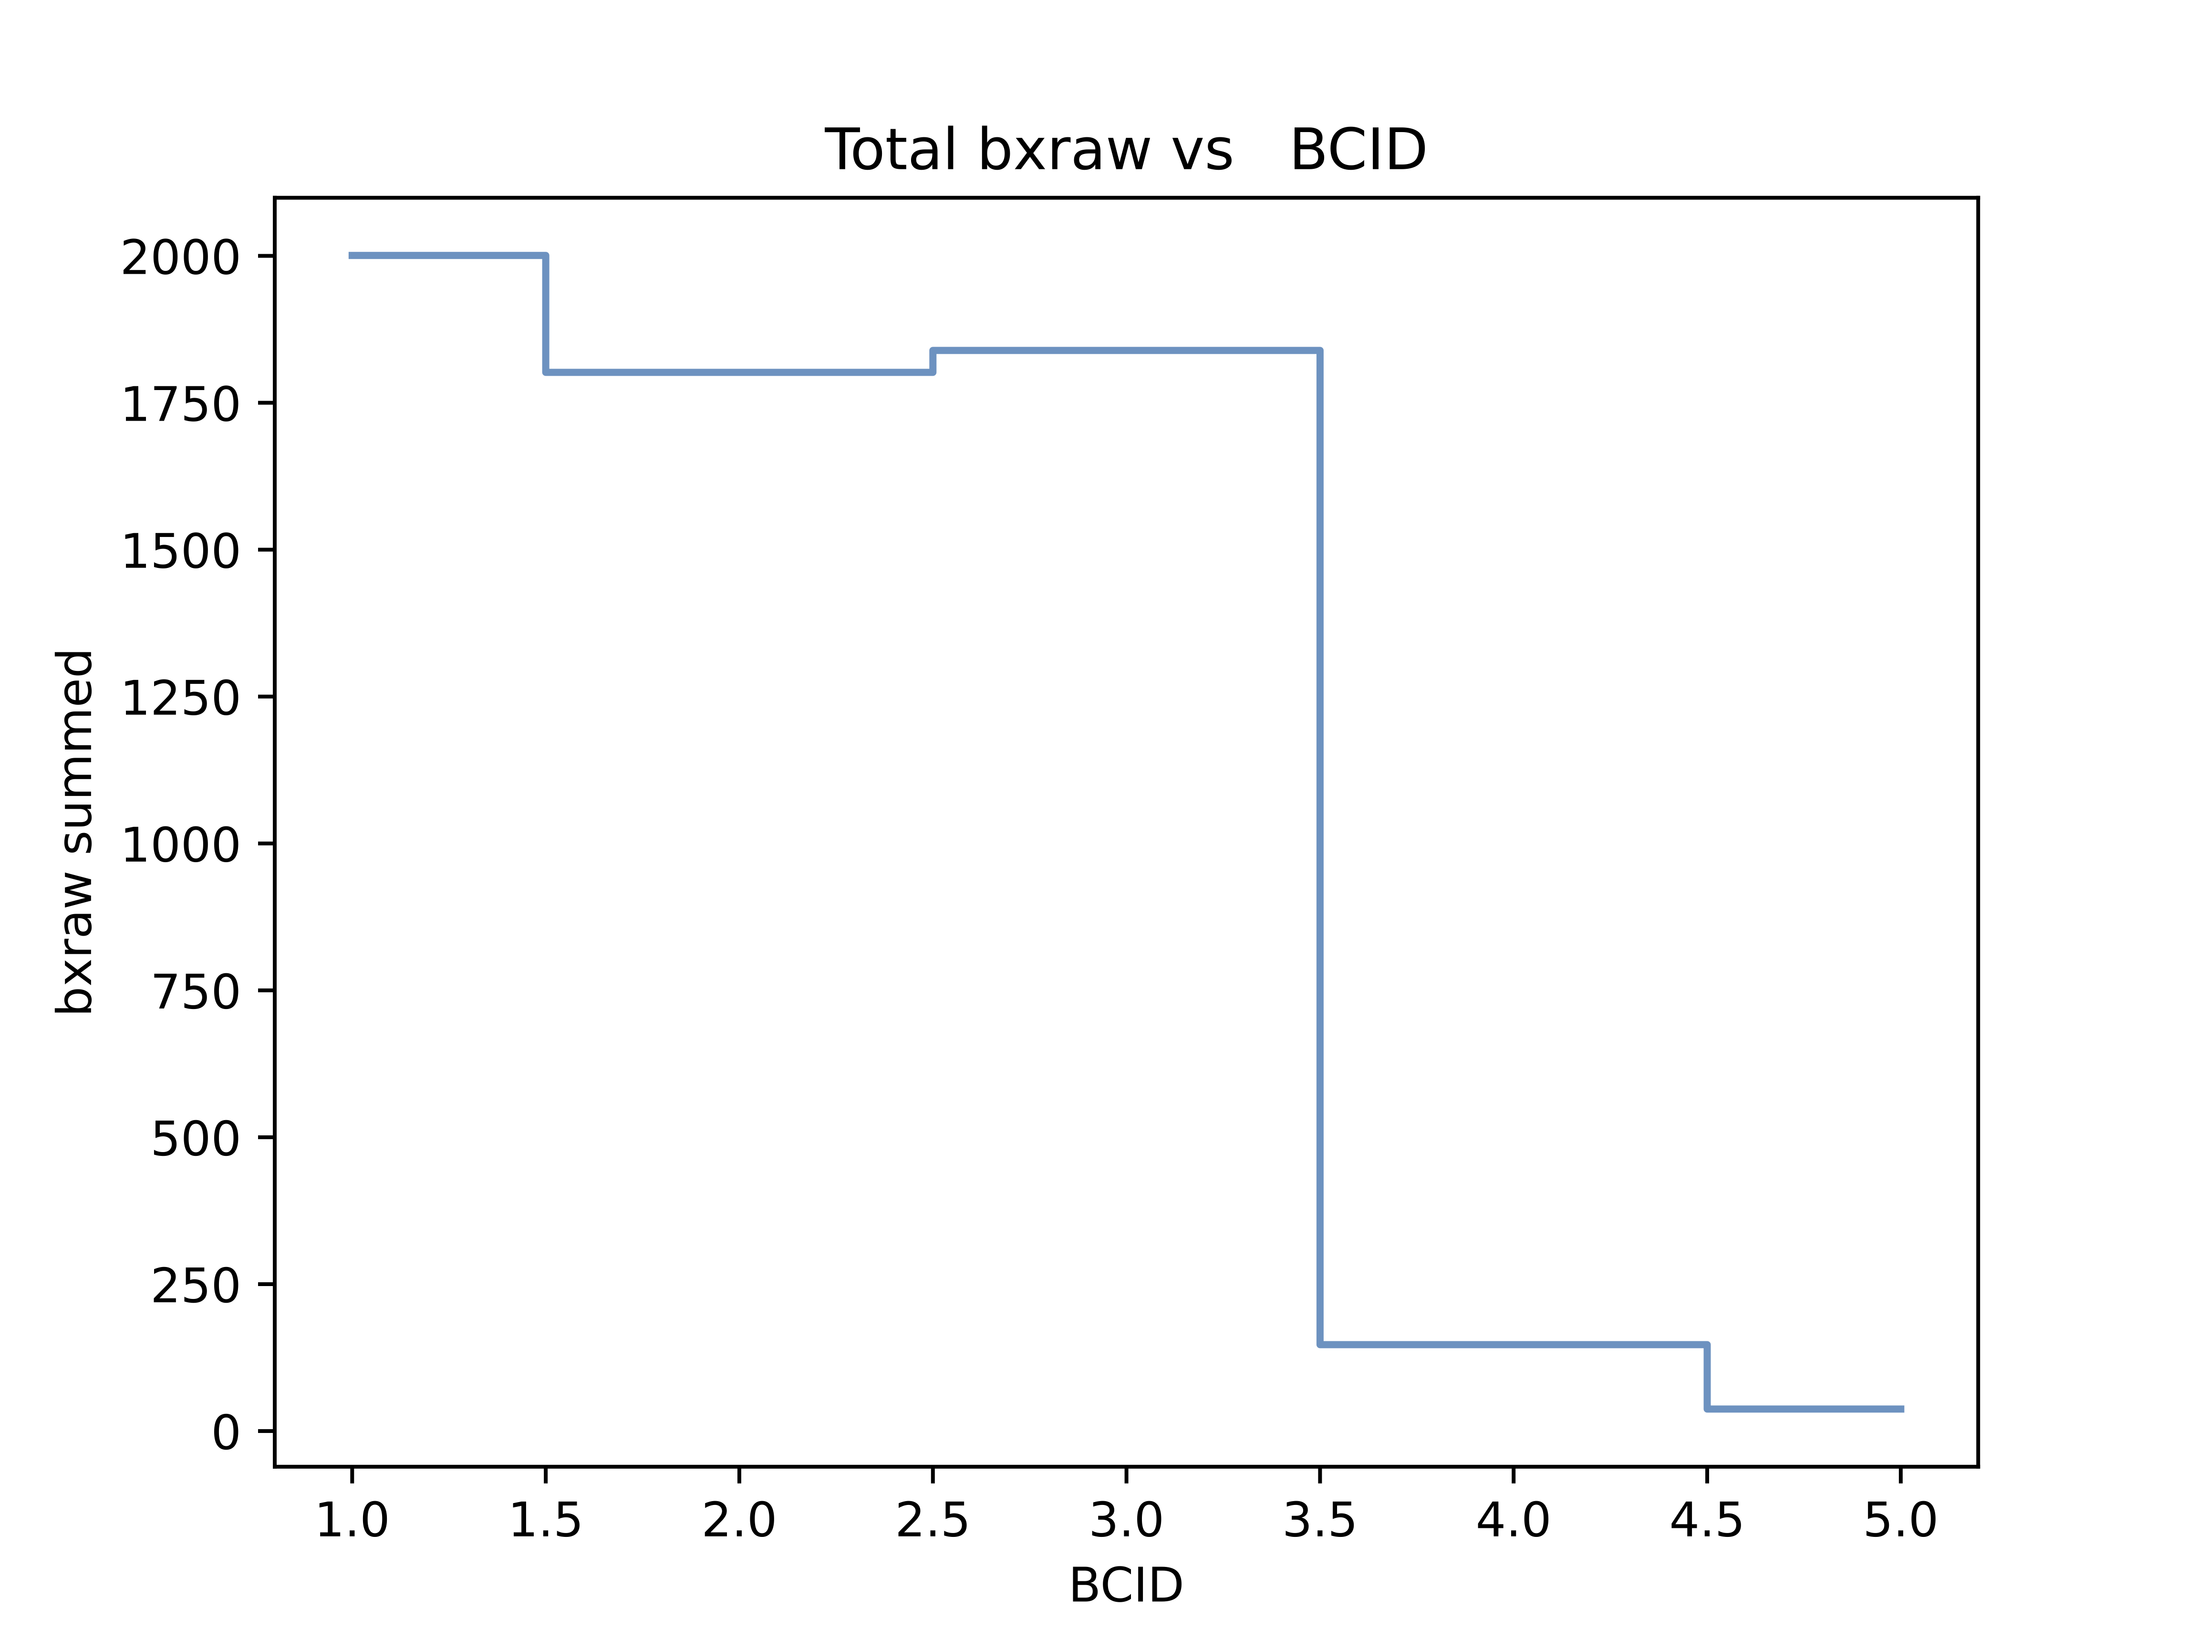
What is Afterglow aka Albedo ?
One of the most relevant sources of background and noise at the LHC
Additional hits in subsequent colliding bunches
→ Clearly visible at the end of each train in the rate of the first empty bunch
Overestimate of luminosity and background for each bunch crossing
Necessity to correct the afterglow background
→ higher precision measurements of luminosity
LAST FULL BUNCH
FIRST EMPTY BUNCH

Slide 8
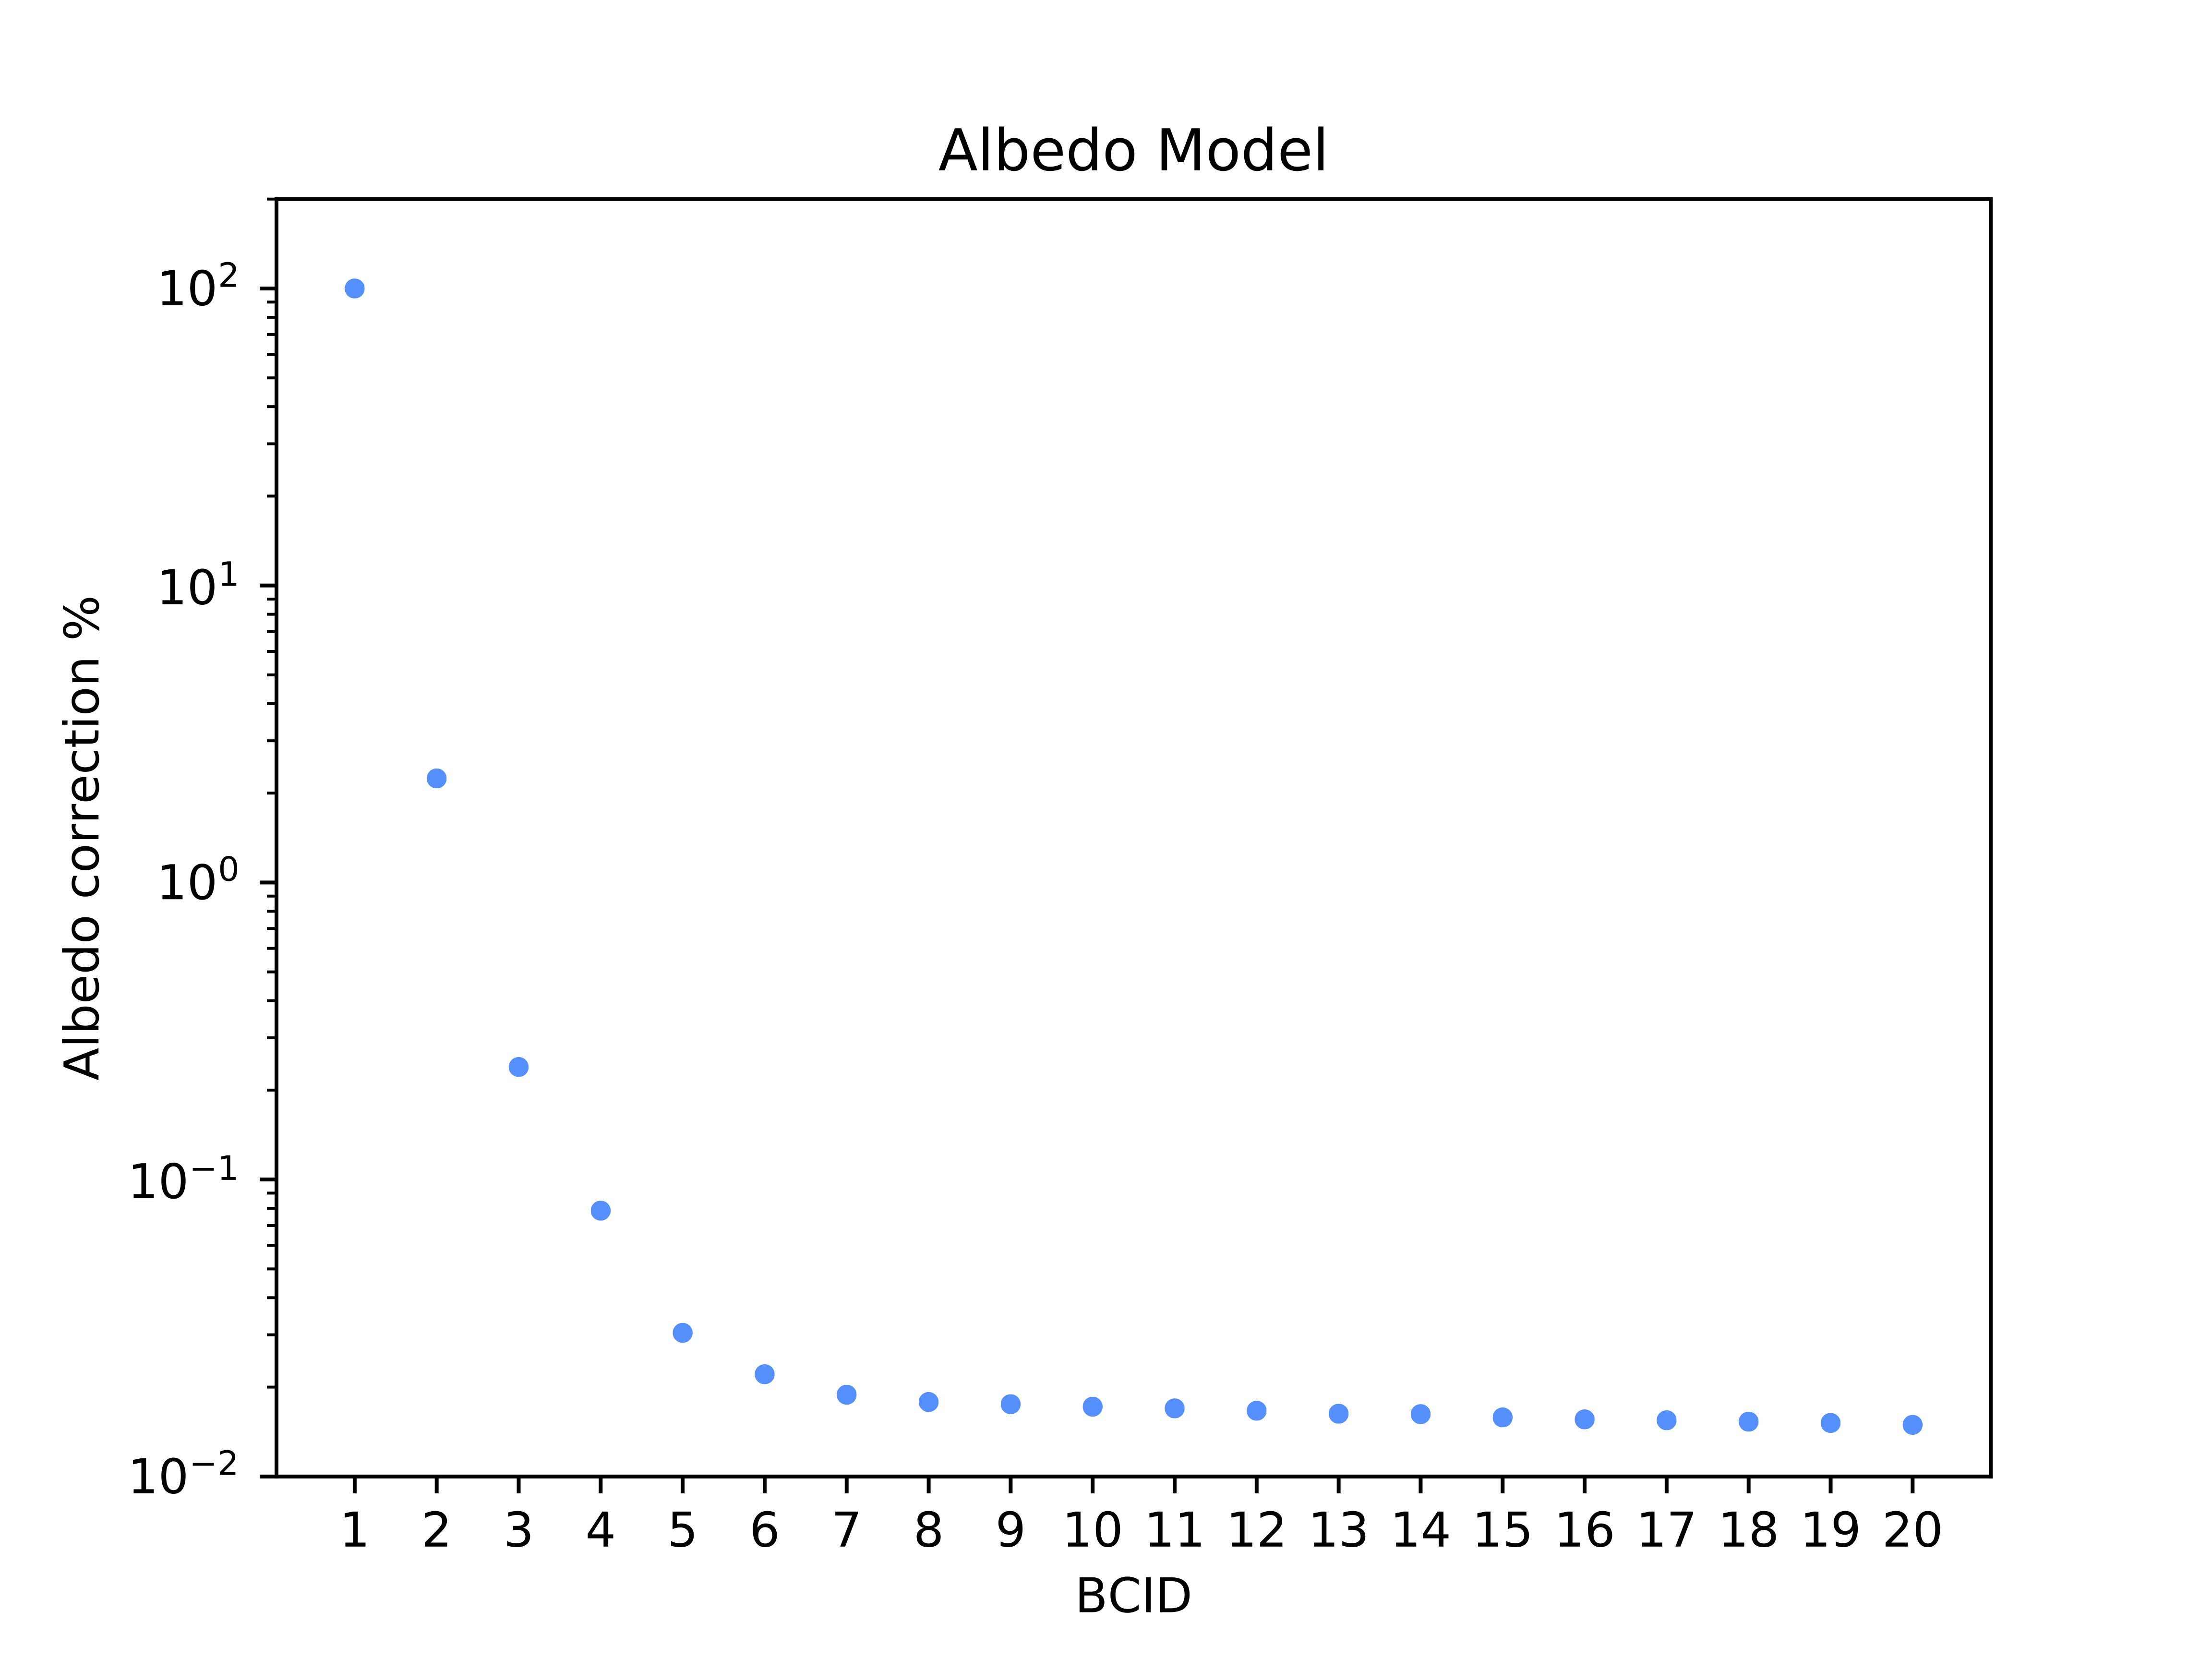
Albedo model
PREVIOUS BUNCH CORRECTION
NORMALIZED BUNCH
FURTHER BUNCHES CORRECTIONS
albedo_model = [1.0, 0.0224, 0.0023, 0.0007, 0.0003 …
One array, average over all channels
Obtained from the analysis of a single bunch fill in 2022
Correction terms: subtract relative rate from previous bunches
Exponential decrease
Errors expected to be negligible and not taken into account in the present study

Slide 9
Why is important to calibrate BCM1F?
Periodical monitoring of the performances of the current Albedo model on variable background conditions during data-taking
How to do it?
Channel-by-channel analysis going over all the 48 readout channels :
Test channel dependence
→ Exclusion of faulty channels
Measure rates as a function of time (fills)

Slide 10
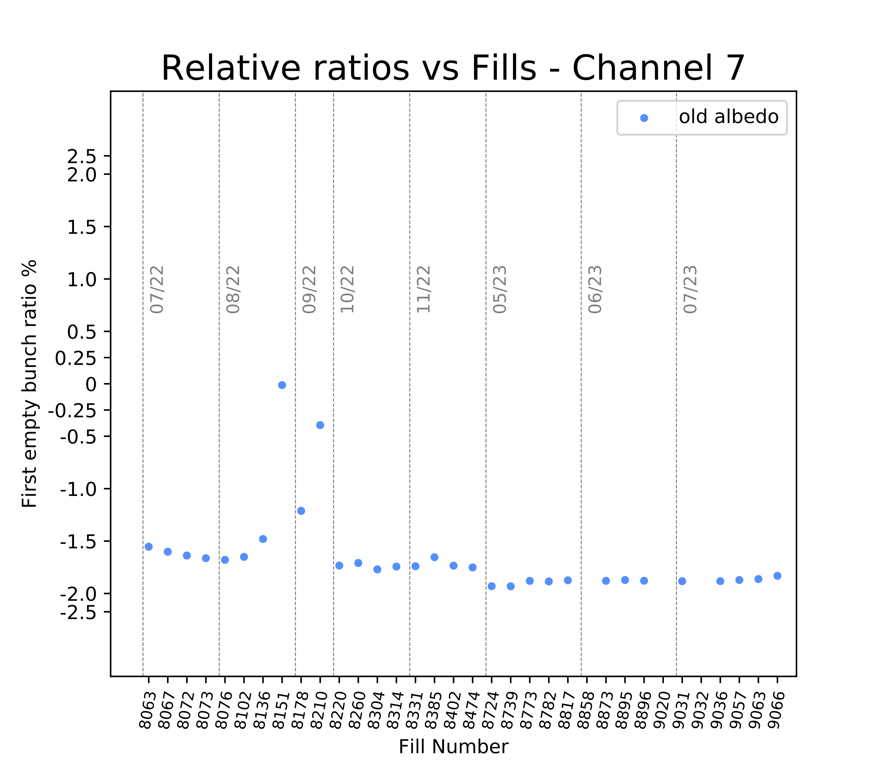
Channel by channel analysis
Time evolution of rates as a function of fills on a set of good channels
Anomalous albedo overcorrection for good channels
Why?
The Albedo model obtained on rates from all 48 channels
→ overestimate for good channels
→ underestimate for faulty channels

Slide 11
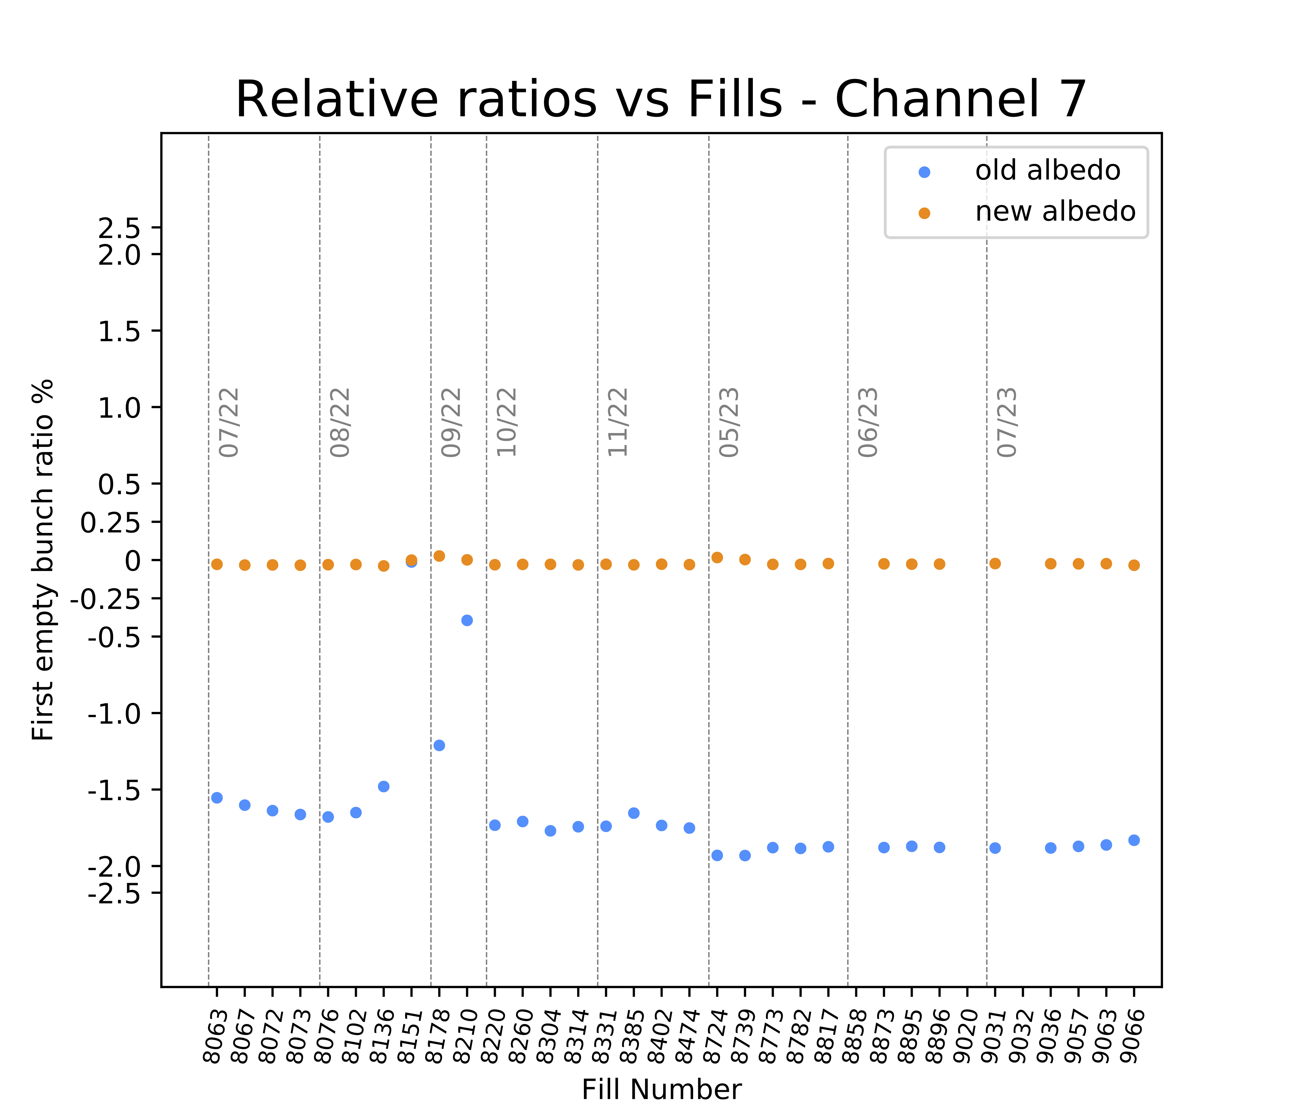
Channel by channel analysis
Channel customized Albedo correction for offline analysis
Anomalous albedo overcorrection for good channels
Consider the relative rate of the first empty bunch of the last train in each fill
Recalculate the first term individually for each channel : new_albedo = relative rate
Shifts the relative rates toward zero

Slide 12
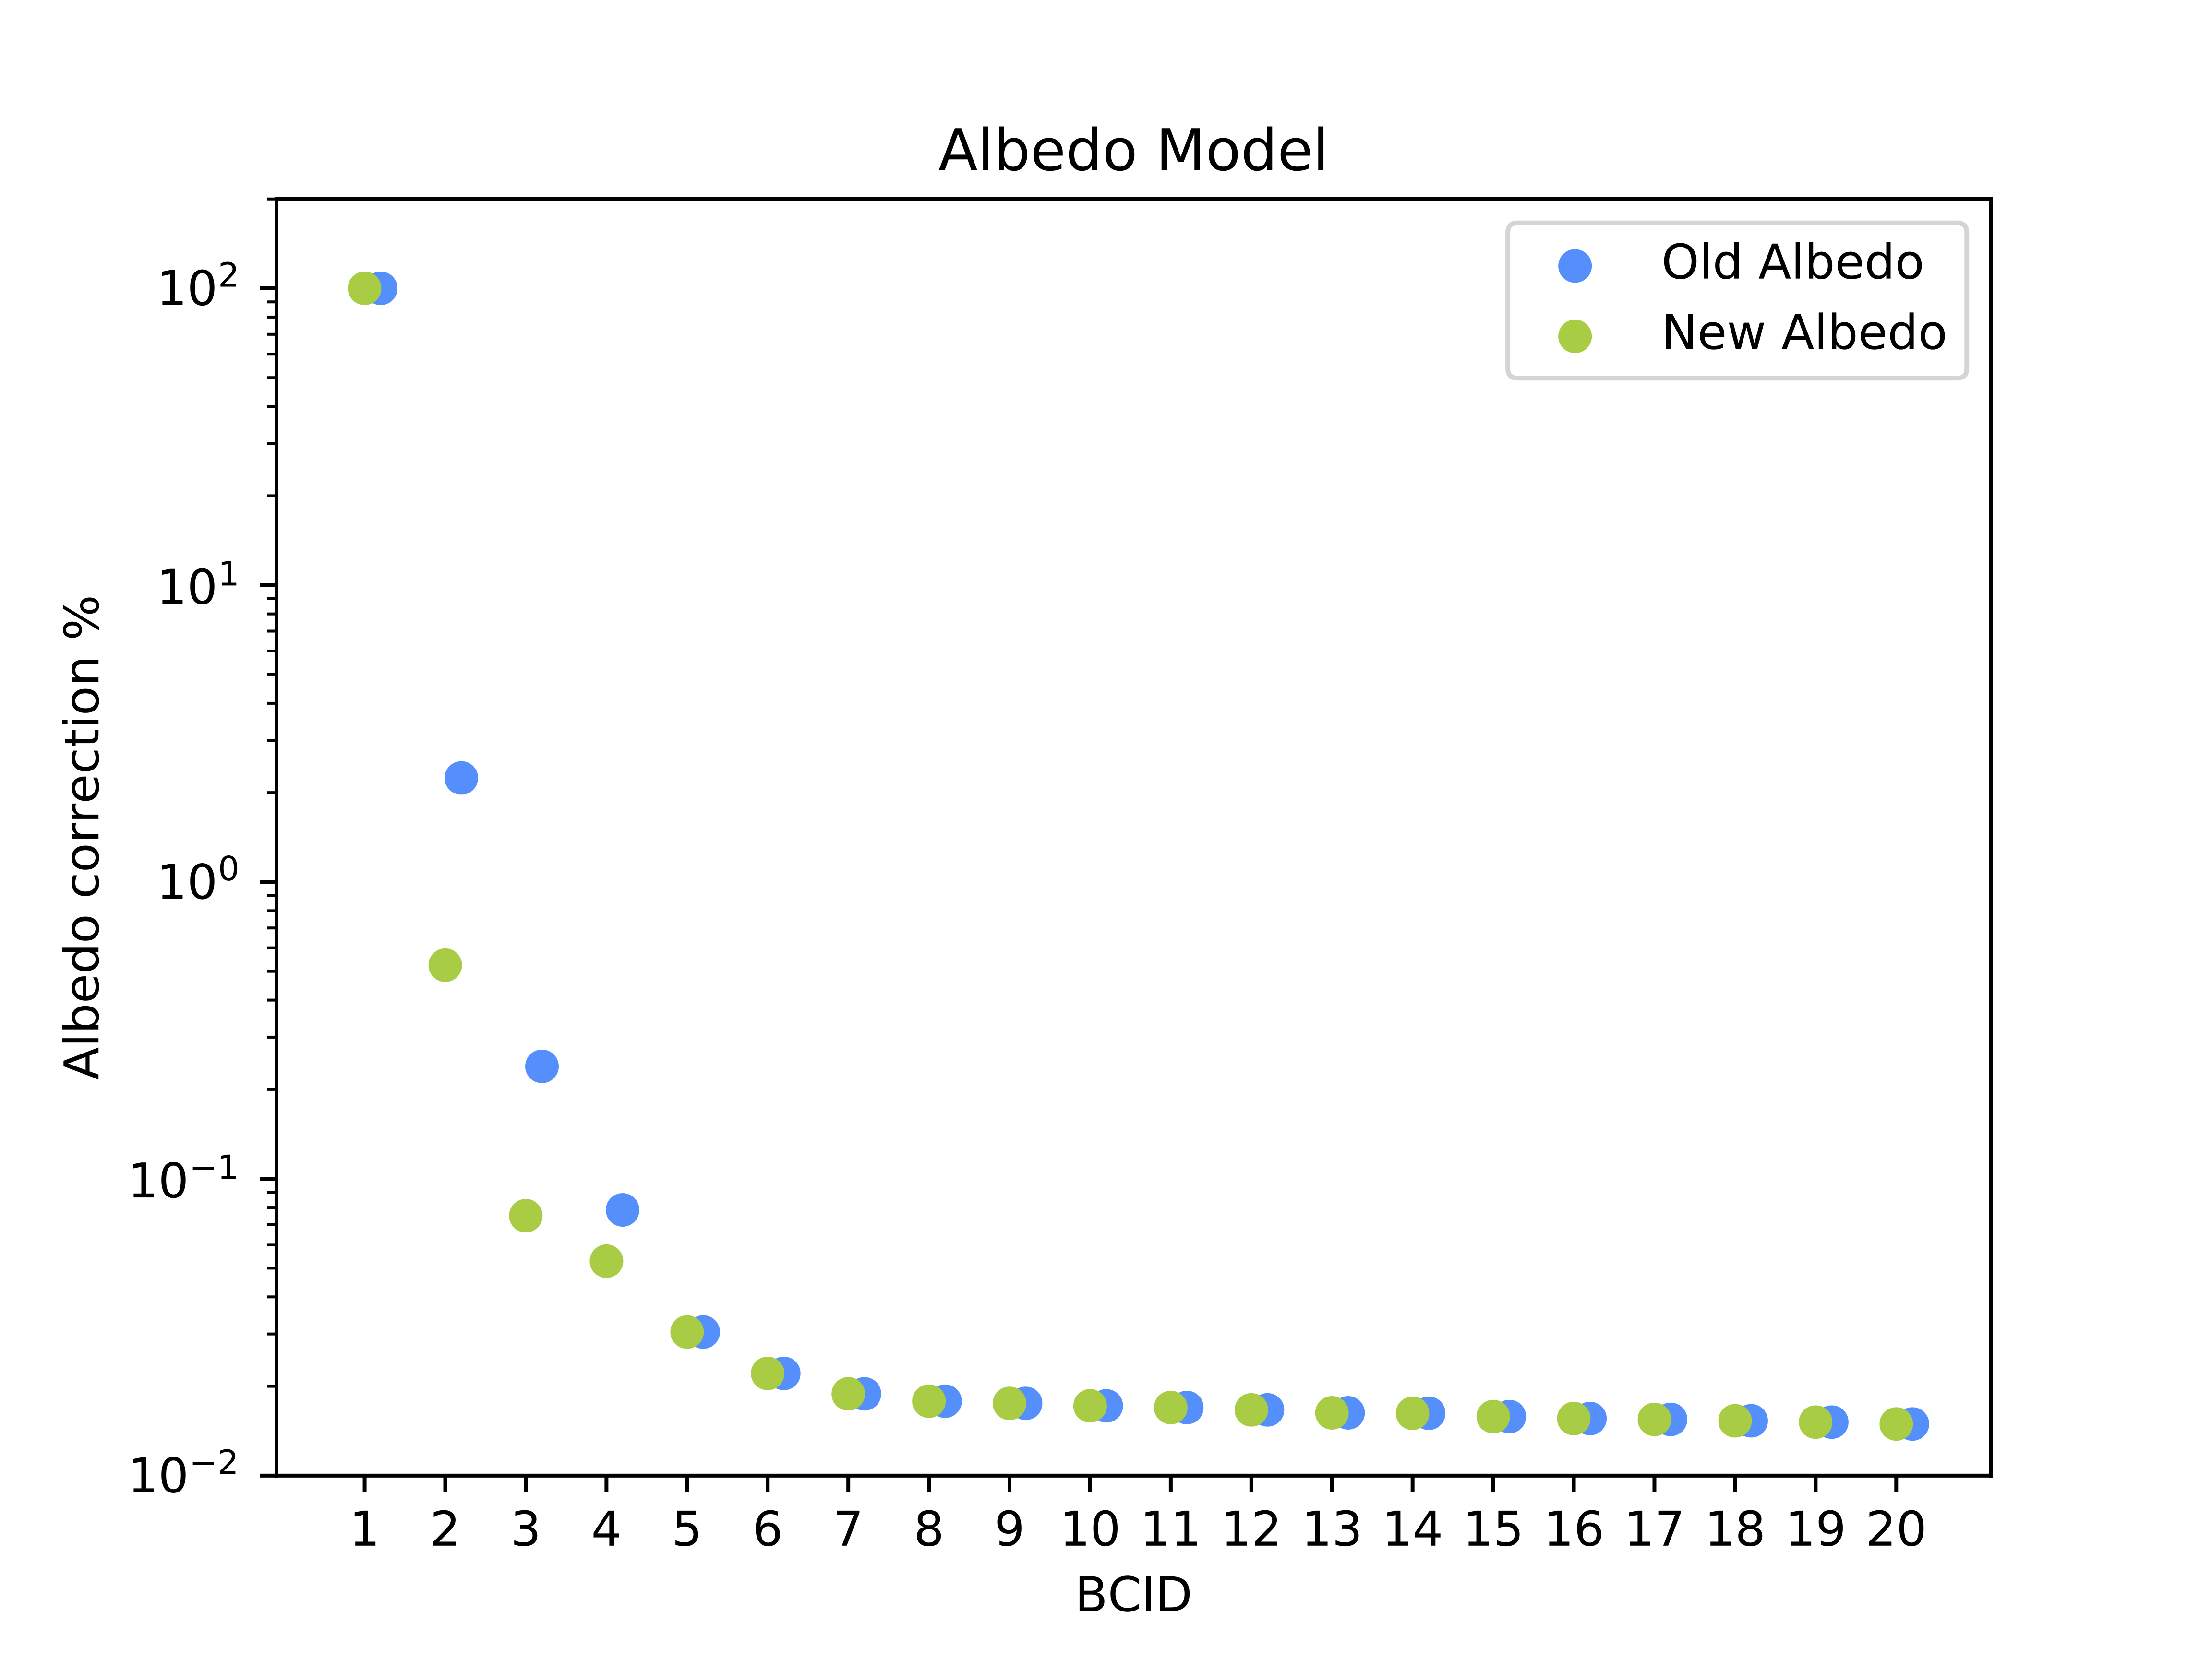
Albedo model update
New updated constant array for the online analysis
Model update:
Consider the first four correction terms
Estimate values from an average over many fills
Reproduce a physical (exponential) behaviour

Slide 13
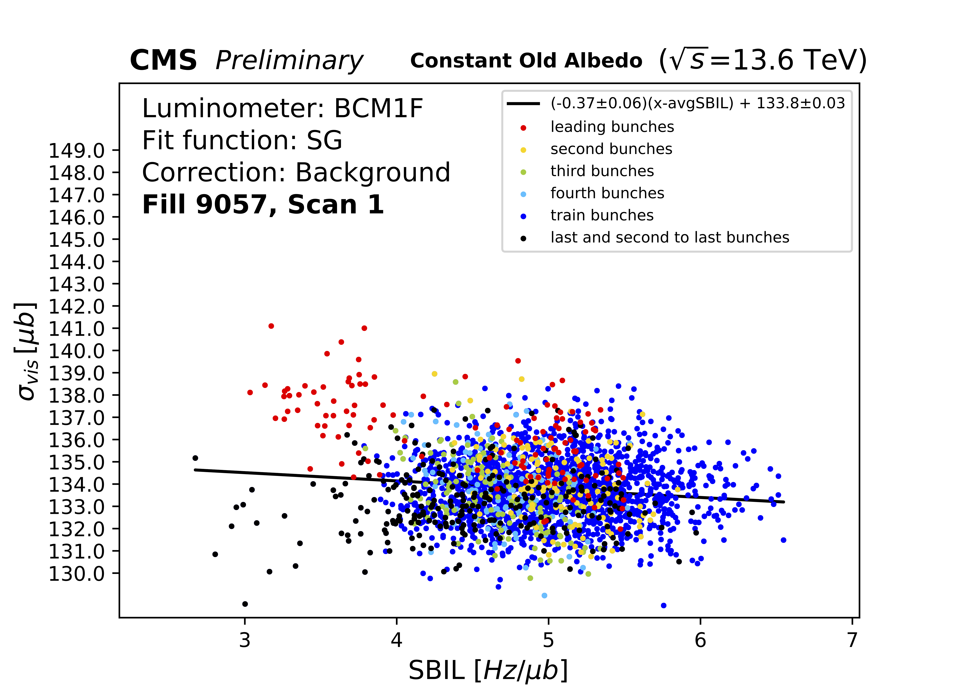
Emittance scan analysis
Comparison among the two Albedo models
The leading bunch is almost not affected by Albedo
Subsequent bunches differ significantly when the new model is applied
→ improved background correction

Slide 14
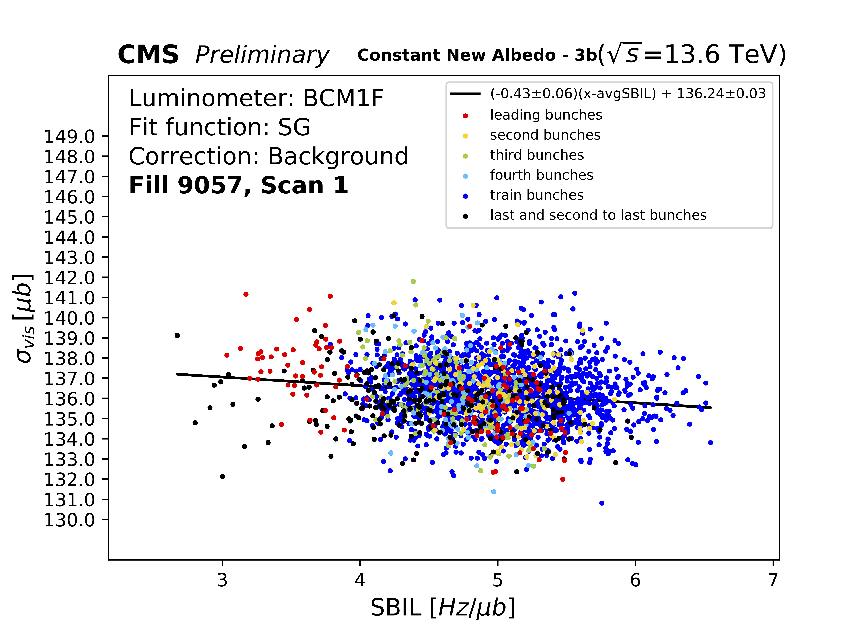
Emittance scan analysis
Comparison among the two Albedo models
The leading bunch is almost not affected by Albedo
Subsequent bunches differ significantly when the new model is applied
→ improved background correction

Slide 15
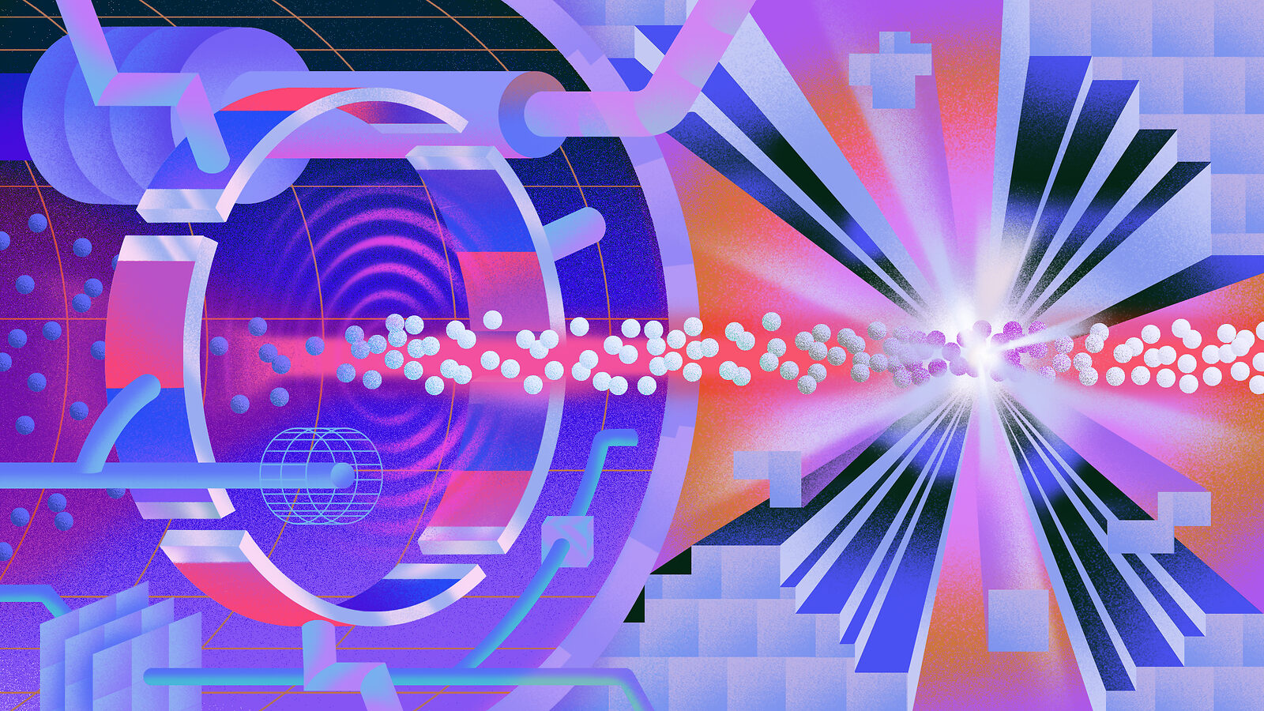
Conclusions and outlook
Goal: Calibrate the Albedo model on Run-3 data collected by BCM1F
Method: Channel-by-channel analysis and update of the Albedo model
Validation: Significant improvement in the afterglow correction shown by the emittance scans
→ the updated Albedo model was implemented in the CMS online system on August 31st
NEXT STEP …
Evaluate how the model update influences the precision of the luminosity measurements

Slide 16
THANK YOU FOR YOUR LUMINOUS ATTENTION.

