Slide 1
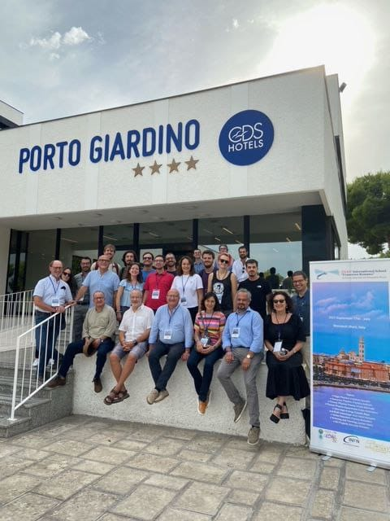
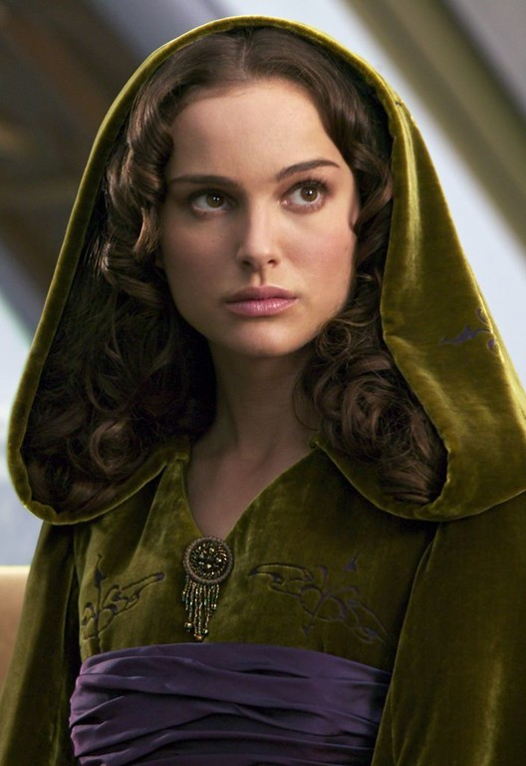
Hunting $X_{17}$ using resonant producion at
Marco Mancini – LNF INFN
Monopoli, 23/09/2023
marco.mancini@lnf.infn.it

Slide 2
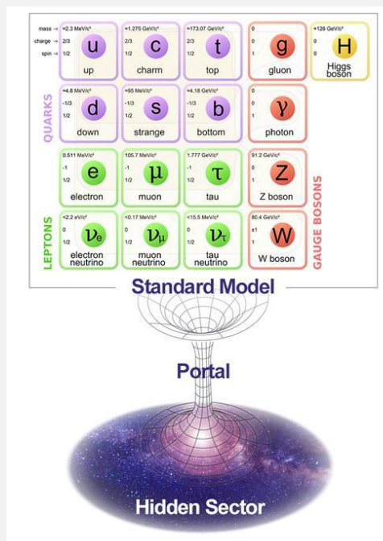
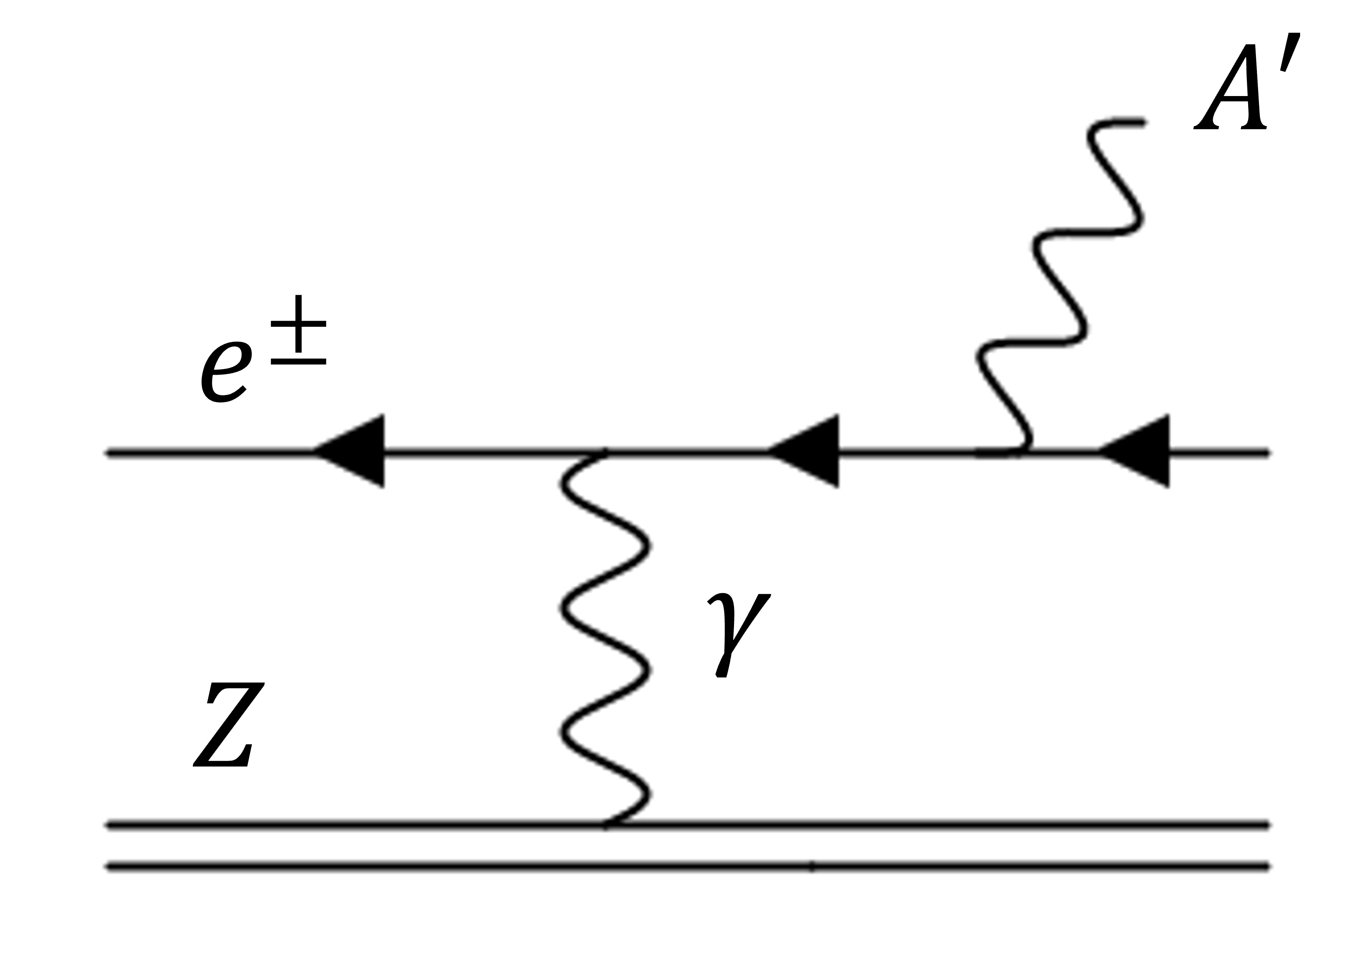
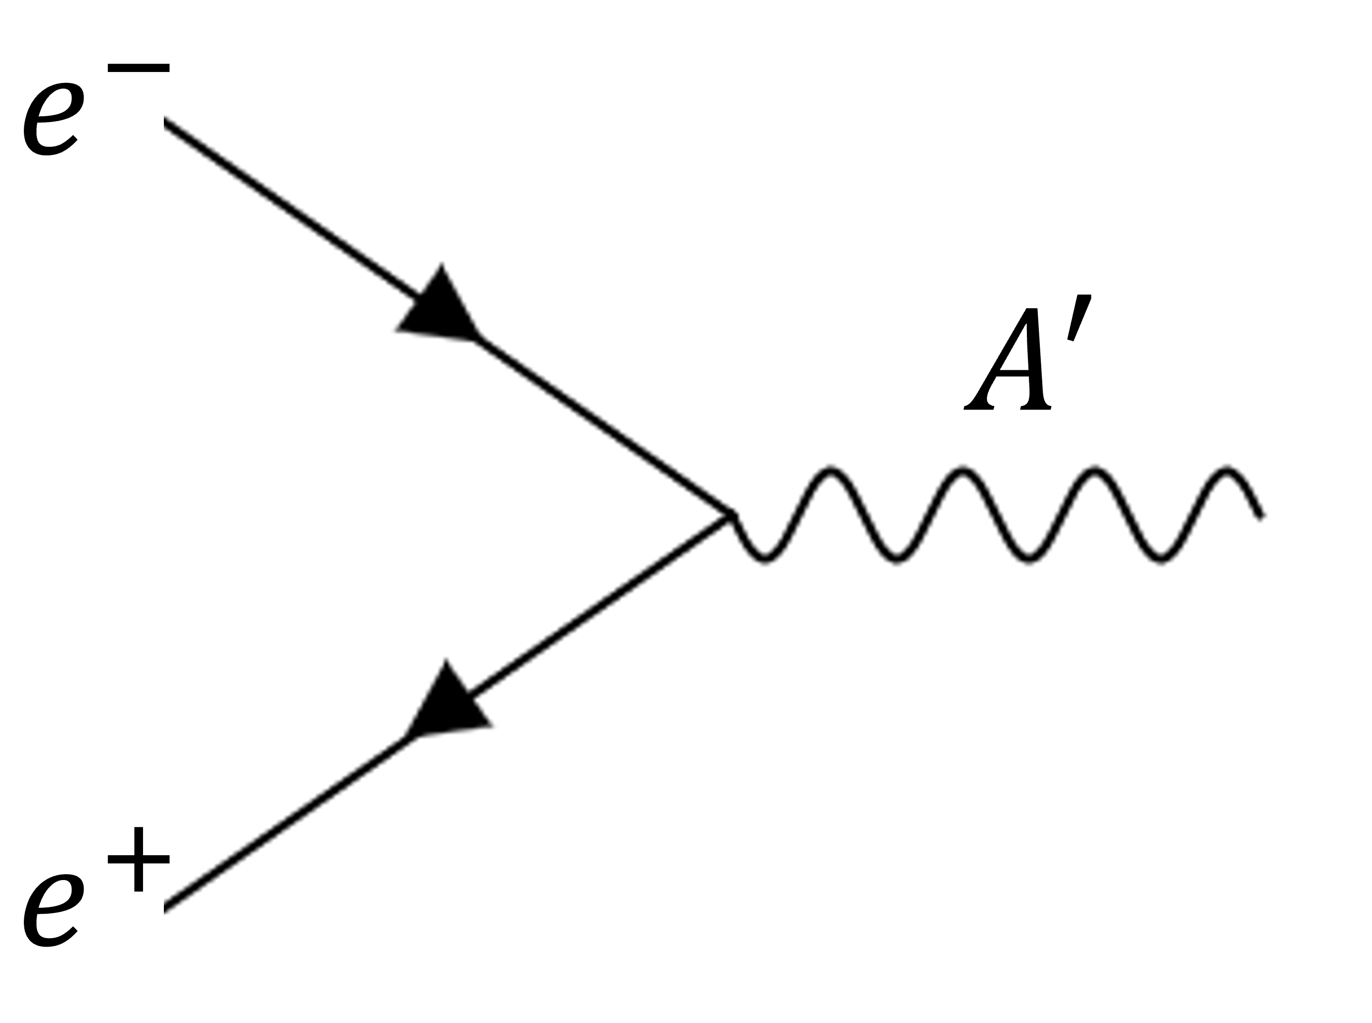
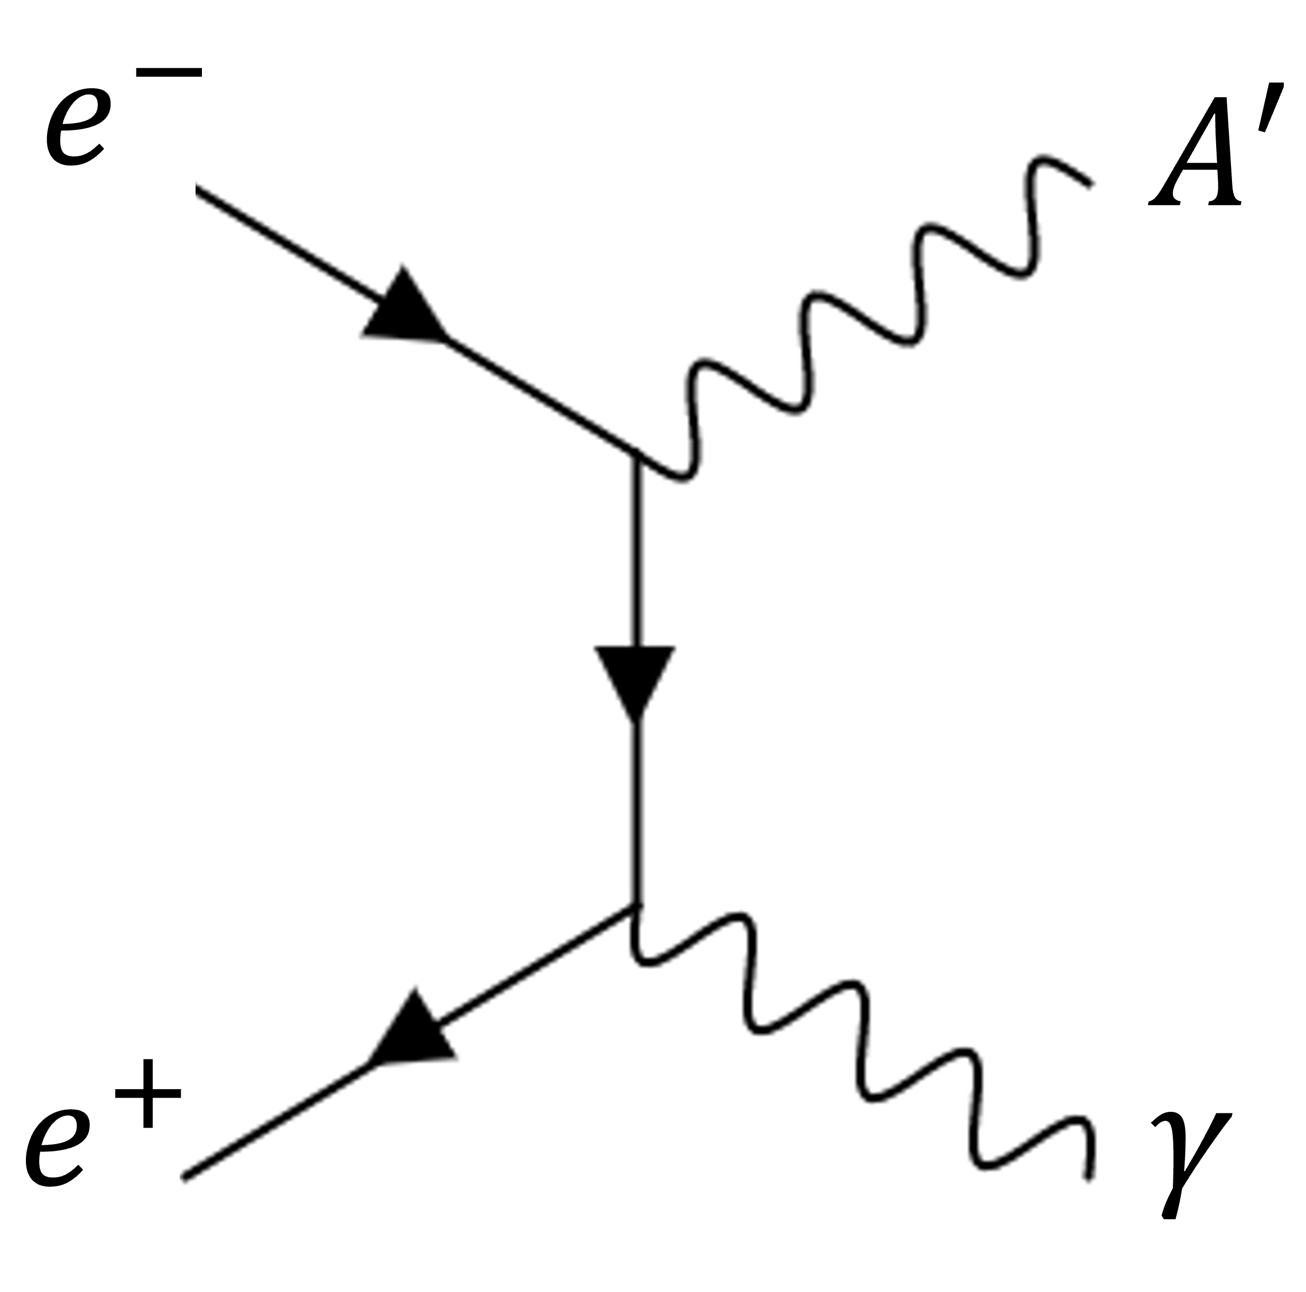
Search for $A^{′}$ with electron-positron reactions
The Dark Photon $A′$ is a massive neutral vector portal between SM and Dark Sector
$$ℒ∼g_{V}q_{f} {\overline{ψ}}_{f}γ^{μ}ψ_{f}A_{μ}^{′}$$
$g_{V}≪1$ → hidden/dark
Two different production mechanisms, annihilation and emission:
Resonant annihilation: $e^{+}e^{−}→A^{′}$ → $σ_{res}\left(E_{e^{+}}\right)=\frac{12π}{m_{A^{′}}^{2}} \frac{Γ_{A^{′}}^{2}/4}{{\left(\sqrt{s}−m_{A^{′}}\right)}^{2}+Γ_{A^{′}}^{2}/4}$
Associated production:$e^{+}e^{−}→γA^{′}$
$A′$-strahlung: $e^{±} Z→e^{±} Z A′$
The resonant annihilation is accessible only with a positron-beam facility
Nardi et al. Phys. Rev. D 97, 095004
$$𝓞(α^{2})$$
$$𝓞(α^{0})$$
$$𝓞(α)$$

Slide 3
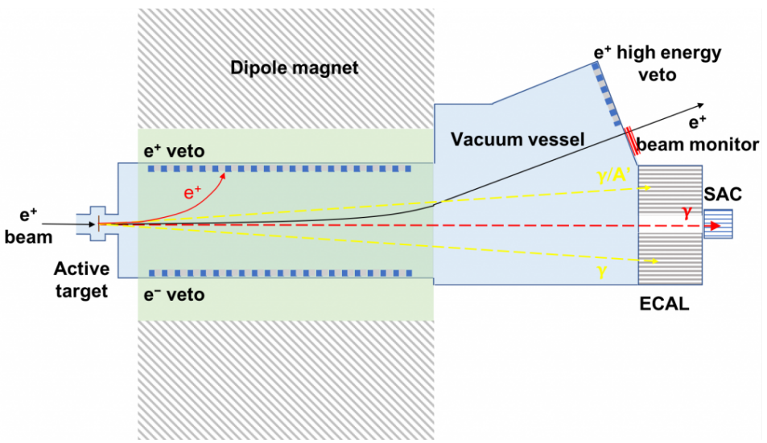
Positron Annihilation into DM Experiment
PADME is based @Laboratori Nazionali di Frascati (LNF) and it searches for $A′$ in the associated production $e^{+}e^{−}→γA^{′}$
$e^{+}$-beam ($E<550 MeV)$ on $100μm$ active diamond target
Dipole $B$-field bends out the un-interacted beam and charged particles
Signal→ $1γ$ in BGO Electromagnetic Calorimeter (ECal) & nothing elsewhere, measuring $ΔM_{miss}^{2}$ and giving us access to $m_{A^{′}}$
Bremsstrahlung rejected by ECal hole and the Small Angle Calorimeter (SAC) immediately behind
Plastic scintillator bars as charged particle vetoes
P. Albicocco et al 2022 JINST 17 P08032

Slide 4
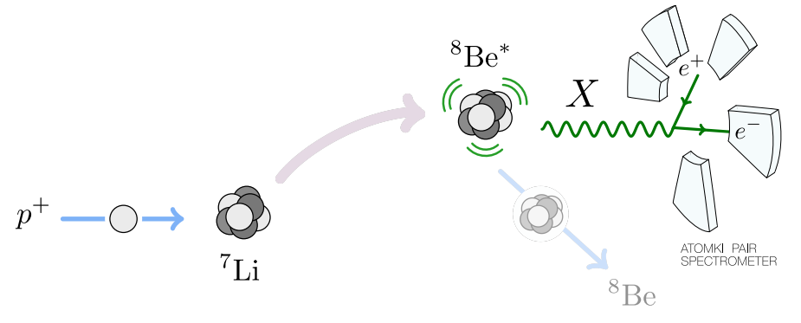
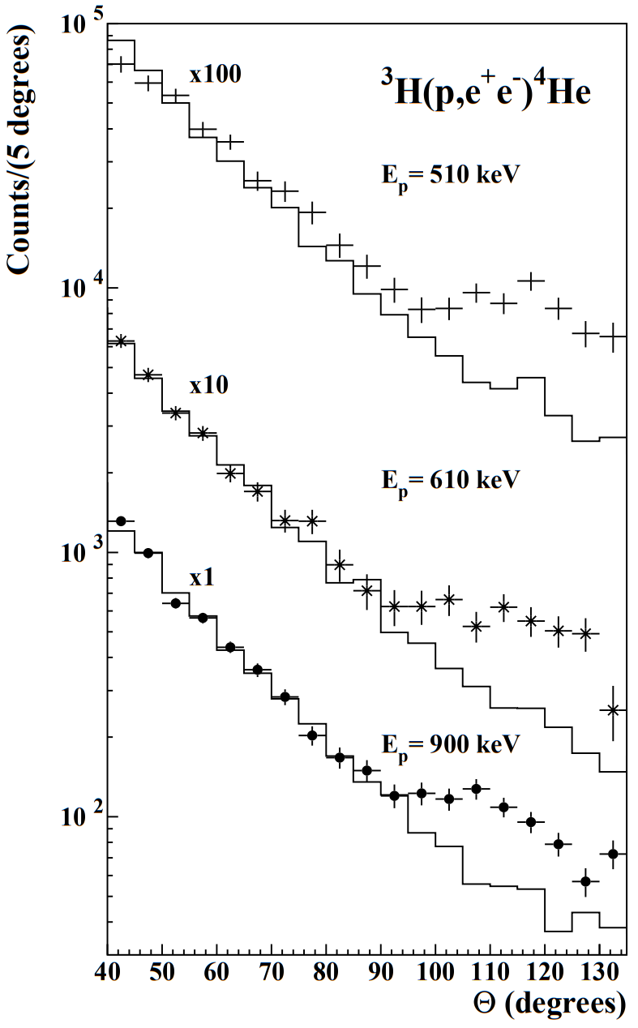
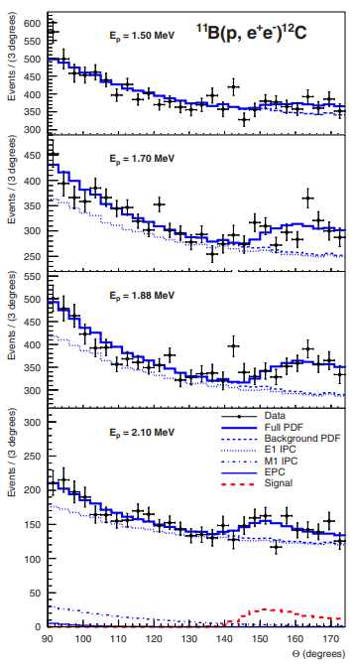
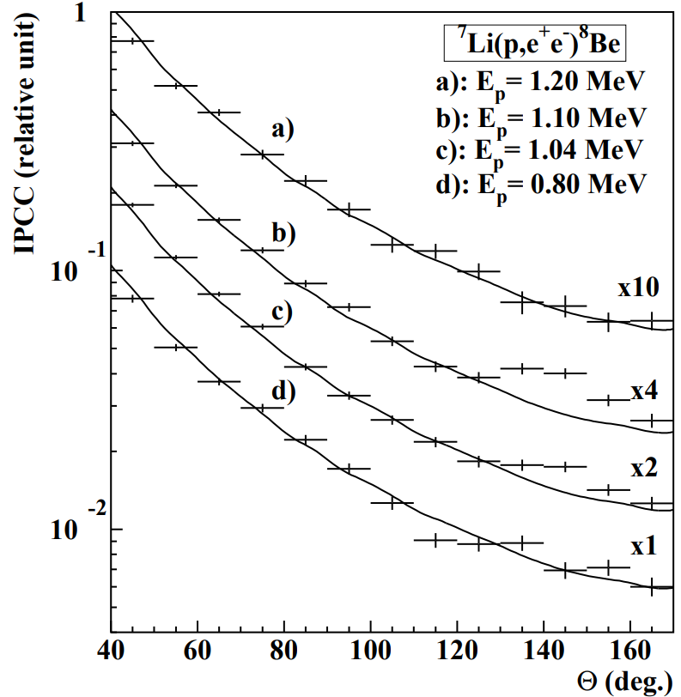
The ATOMKI $X_{17}$ anomaly
Recently, ATOMKI collaboration announced the observation of an anomaly in the angular correlation of $e^{+}e^{−}$ pairs produced via IPC in the ${}_{}^{8}{Be}$, ${}_{}^{4}{He}$ and ${}_{}^{12}C$ .
The anomaly seems to be compatible with the production and successive decay of a new $∼17 MeV$ mass mediator.
Phys.Rev.C, 104(4):044003
Phys. Rev. C 106, L061601
Phys.Rev.Lett. 116 (2016) 4, 042501

Slide 5
The $X_{17}$ particle
According to the ATOMKI observations, the main properties of the new $X_{17}$ particle are:
${m_{X}}_{17}∼17 MeV$
$Br\left(e^{+}e^{−}→X_{17}\right)≃5×{10}^{−6}Br\left(e^{+}e^{−}→γγ\right)$
$Γ_{V}=0.5 {\left(\frac{g_{V}}{0.001}\right)}^{2}eV$ for the vector case
The spin-parity selection rules $J_{∗}=L ⊕J_{0}⊕J_{X}$ and $P_{∗}={\left(−1\right)}^{L} P_{0}P_{X}$ are required to identify the nature of the new mediator
Feng et al. Phys. Rev. Lett., 117(7):071803, 2016
As proposed by J. Feng in Phys.Rev.D 102 (2020) 3, 036016
${}_{}^{12}C$ Last results
Phys. Rev. C 106, L061601

Slide 6
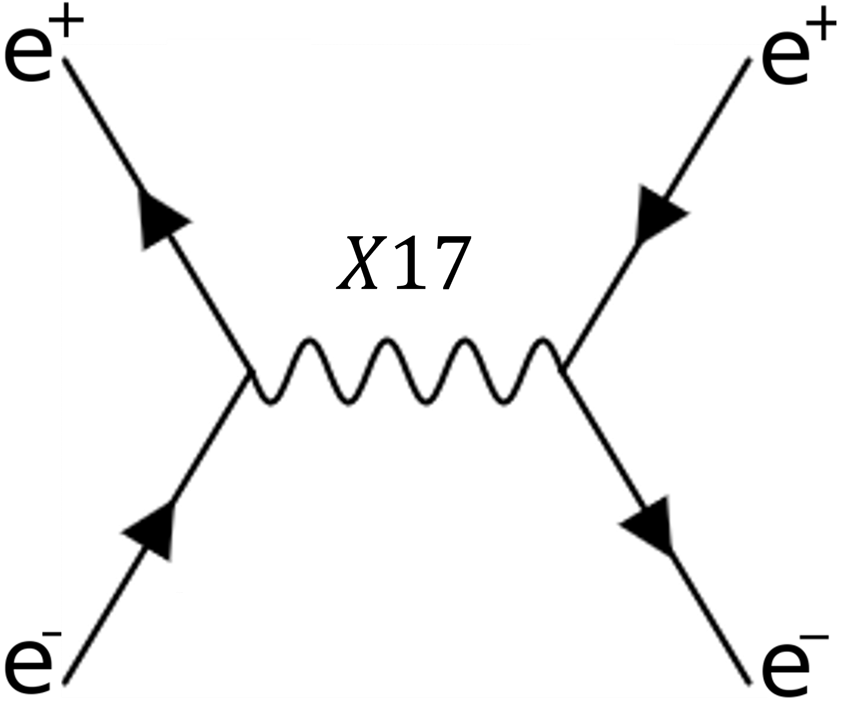
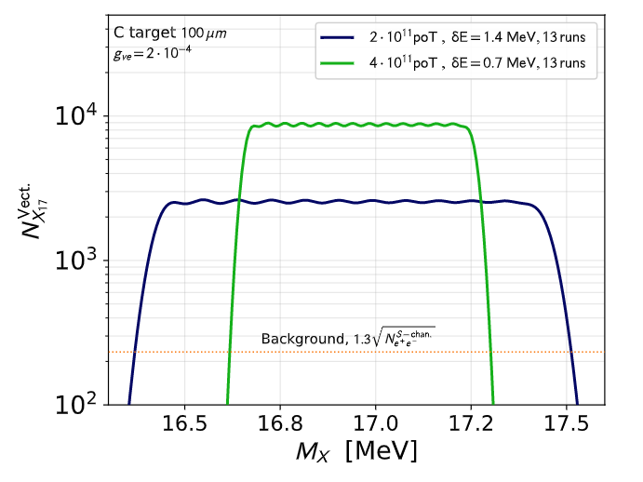
The $X_{17}$ resonant search on thin target
Use resonant production and search for visible $X_{17}$ decay in $e^{+}e^{−}$
$σ_{res}∝\frac{g_{V_{e}}^{2}}{2m_{e}} πZ δ\left(E_{res}−E_{beam}\right)$
The resonant production scales only with $Z$ and it is much larger than associated and radiative production
To exploit the resonant production, the $\sqrt{s}$ should be as close as possible to the expected mass:
$E_{res}=\frac{m_{X_{17}}^{2}}{2m_{e}}$ → A scanning procedure is required
$$X_{17}$$
Analysis strategy: vary the beam energy, fit the background, calibrate the luminosity and look for resonance
$$N_{X_{17}}^{perPoT }≃\frac{g_{V_{e}}^{2}}{2m_{e}}ℓ_{tar}\frac{N_{A}ρZ}{A}f\left(E_{res}, E_{beam}\right)$$
$f(E_{res},E_{beam})$ is the beam spread distribution→ gaussian with spread $δE$
Darmé et al. Phys. Rev. D 106, 115036

Slide 7
The Run III improvements
Main SM background is from Bhabha scattering and $γγ$-production. It will be fitted directly from the data
Improvements to the set-up are required!
Turned off the dipole B-Field to detect both final state particles with ECal
Added ETagger, a plastic scintillator detector in front of ECal in order to distinguish $e^{±}$ from $γ$.
Removed the SAC and installed a TimePix3 beam monitor and a LeadGlass luminometer
Some more on Etag Cosmic Rays tests in spares
TimePix3 + LeadGlass

Slide 8
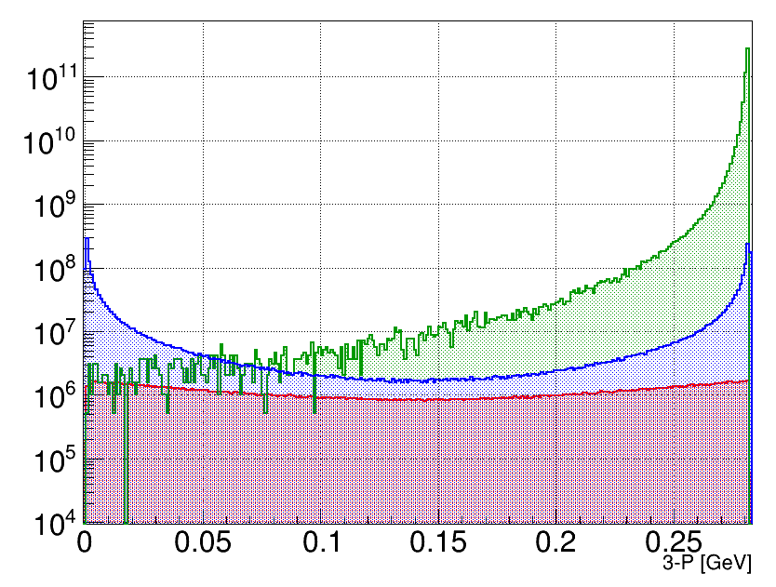
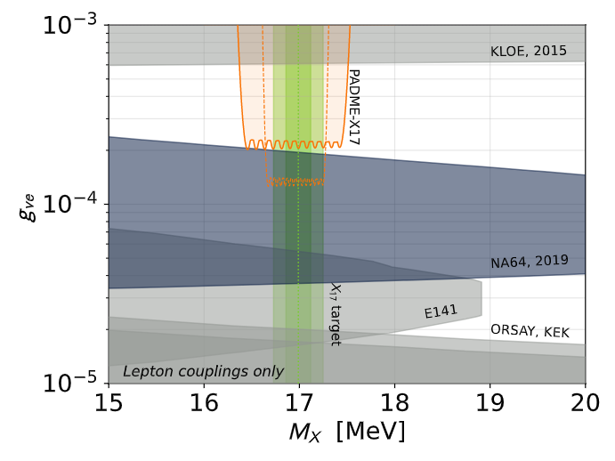
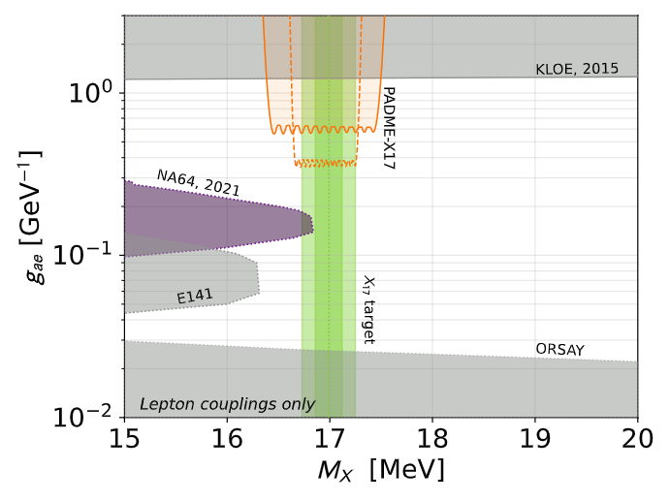
The expected SM BG and phenomenological limits
$σ_{Bhabha}=σ_{s−ch}+σ_{t−ch}$and processes simulated only at LO with CalcHEP
Beam condition: $N^{PoT}={2−4×10}^{11}$ and $E_{res}=282 MeV →\sqrt{s}=17 MeV$
$X_{17}$ production mechanism acceptance is assumed to be the same of Bhabha $s$-ch
Cuts on both final state particles on the azimuthal angle and energy
Expected limits both on:
Vector model, covering almost the entire free parameter space
Pseudoscalar model, in the case of an ALPs decaying into leptons only.
t-channel
s-channel
$e^{+}e^{−}→γγ$
$$\#\frac{events}{σ}$$
$\left|p\right|$ [GeV]
Phys. Rev. D 106, 115036

Slide 9
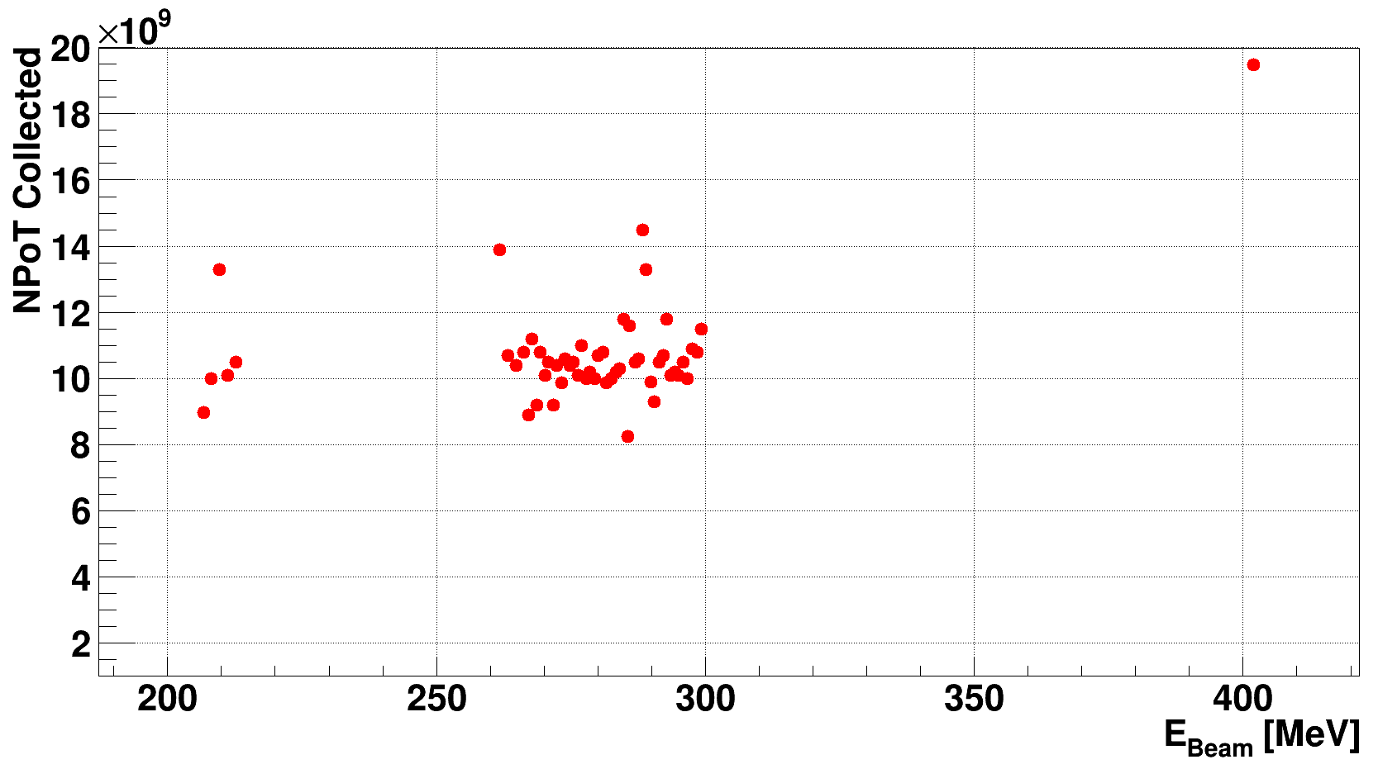
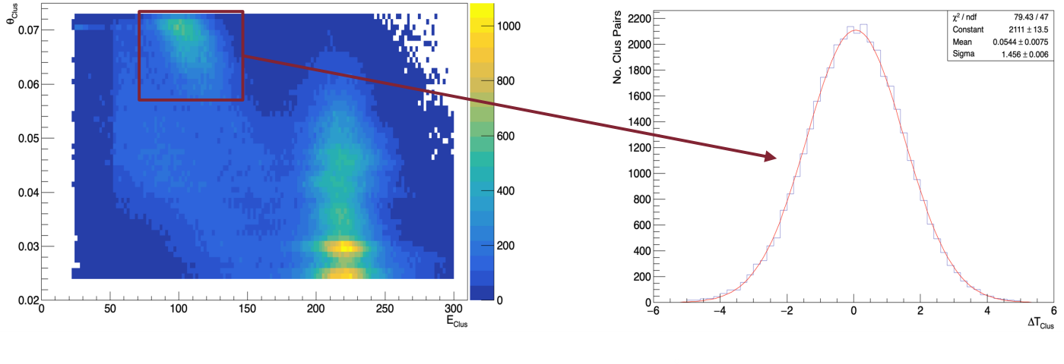
The Run III
Total amount of data collected $∼6×{10}^{11} PoT$, i.e. $∼{10}^{10} PoT$ per $\sqrt{s}$point:
47 invariant mass points in the beam energy range $260 MeV<E_{beam}<300 MeV$ and $δE_{beam}≃0.75 MeV$
6 points out-of-resonance: 5 points below and 1 above where $X_{17}$ is kinematically forbidden and suppressed.
5 punti con $N^{PoT}∼{10}^{10}$ ciascuno e$205 MeV≤E_{beam}≤212 MeV$
1 punto con $N^{PoT}∼2×{10}^{10}$ e $E_{beam}=402 MeV$
Can use this dataset to:
Compare data and MC predictions
Study the SM background and measure SM cross-sections with no eventual NP enhancement
Tune the search technique
$X_{17}$ expected mass
$$θ_{clus} [mRad]$$
$$\# pair$$
Data quality tests on kinematic variables $E_{γ}$ and $θ_{γ}$ → very good signal-BG separation and time correspondence
$$E_{clus} [MeV]$$
$$Δt_{clus}[ns]$$
9

Slide 10
Conclusions and future perspective
Run III completed at the of 2022 and the data analysis is in progress
Many experimental quantities available: $N (e^{+}e^{−})$, $N (γγ)$, $N (e^{+}e^{−}+γγ)$, $N^{PoT}$ → Different observables
$$\frac{N\left(e^{+}e^{−}+γγ\right)}{N^{PoT}} vs \sqrt{s}$$
No error from PID, but BG increases by $20\%$ → significance worsened by $8\%$
High control on systematic errors from acceptances and $N^{PoT}$ is needed
Studying the out-of-resonance points we aim to get low energy cross section measurements of the involved SM processes
Relying on the toy MC simulations, we expect to set strong limits on $X_{17}$ coupling to electrons
We aim to get some results both on Vector and Pseudoscalar model by the end of 2023, STAY TUNED!
10

Slide 11
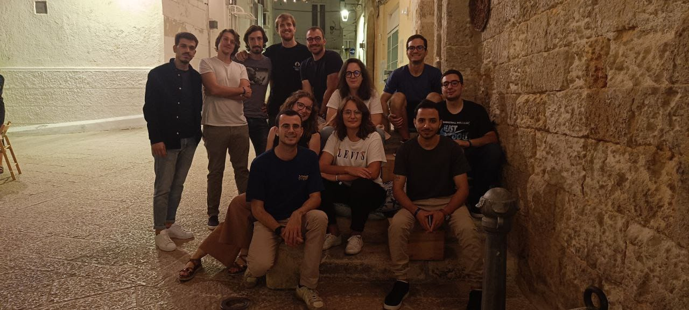
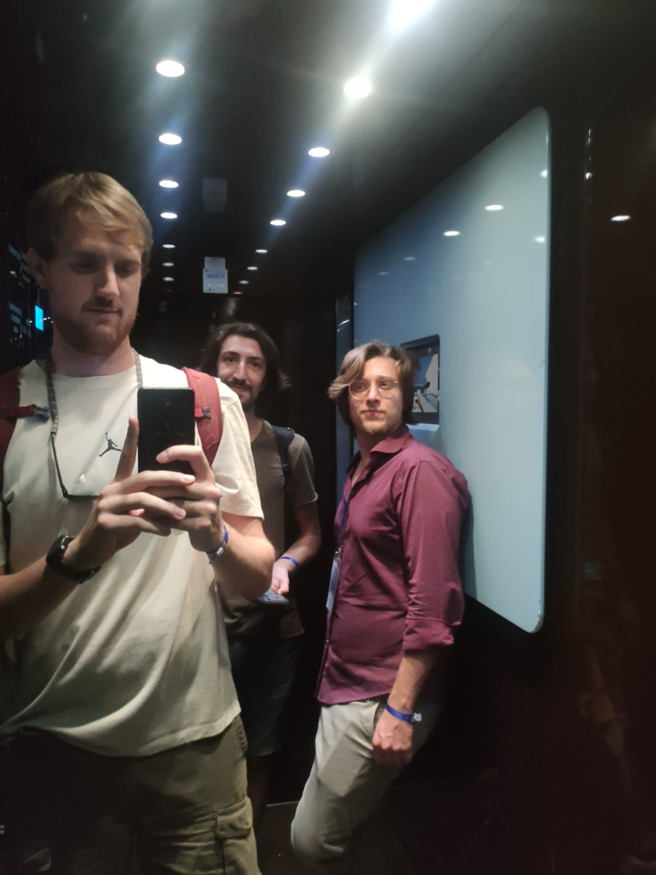
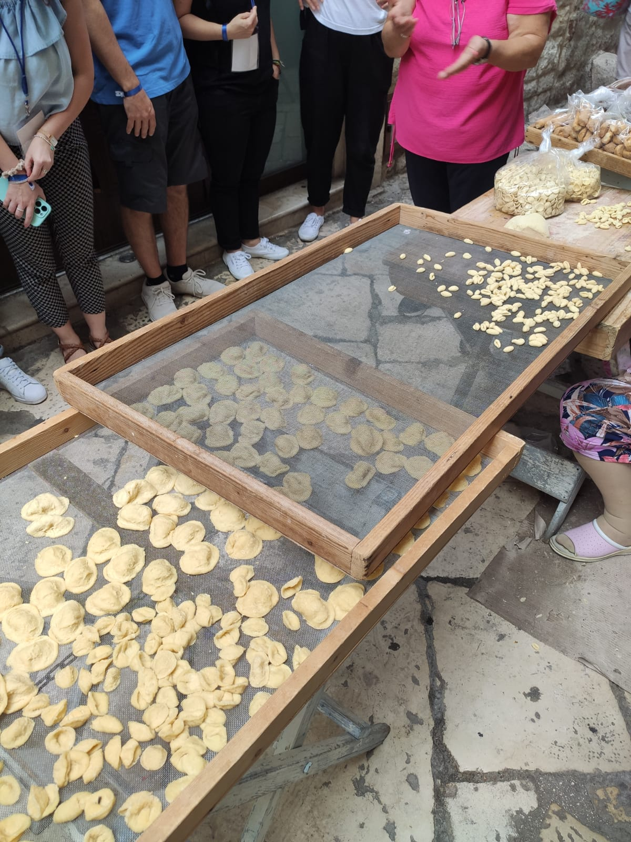
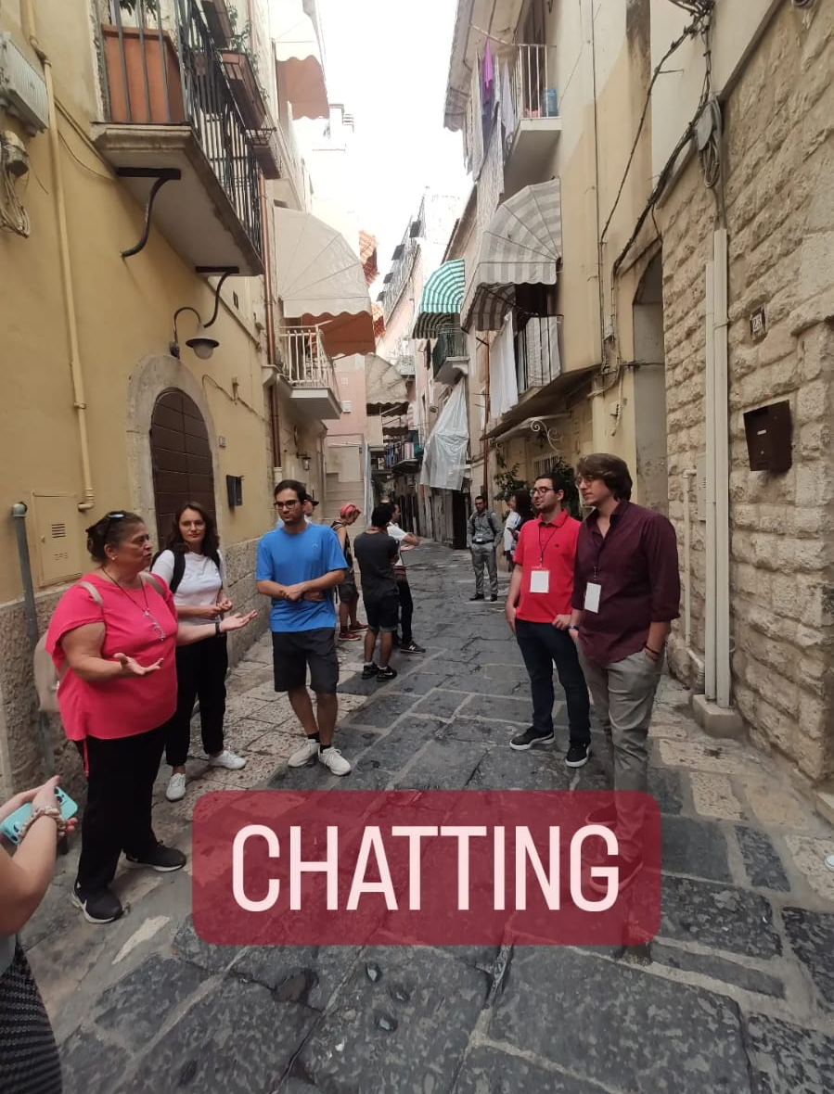
Grazie, Grazie a voi!
Thanks, thank you all!
Ruby

Slide 12
BACKUP SLIDES

Slide 13
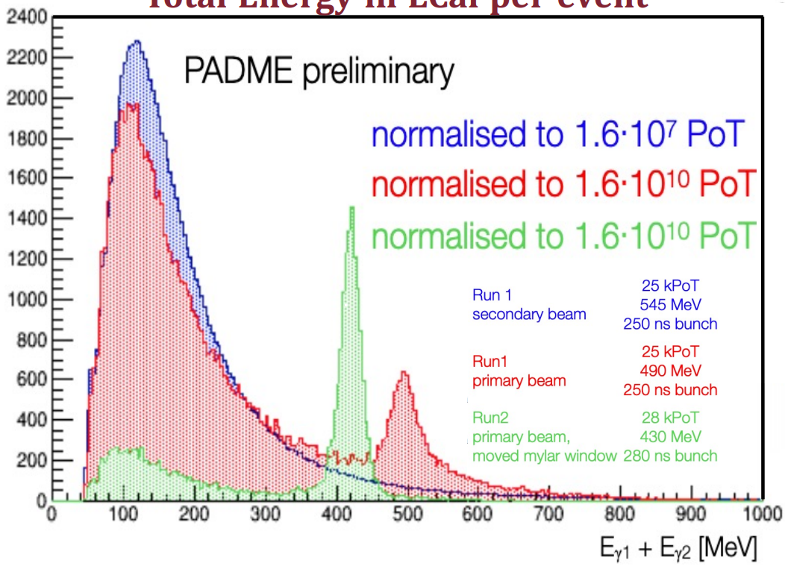
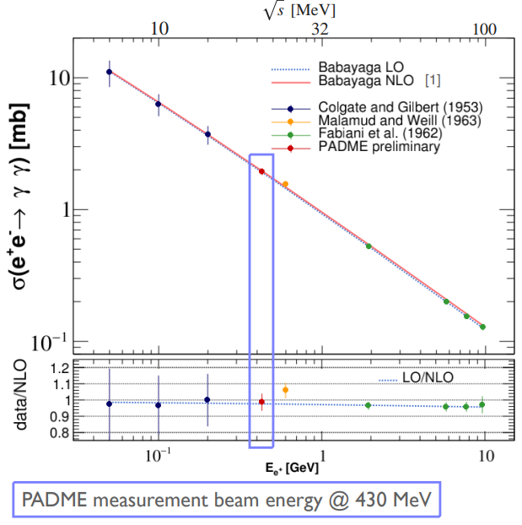
Run I-II and the Multi-photonannihilation measurement
Two Runs in three different configurations between 09/2018 and 12/2020:
Acquired Luminosity: $𝒪\left({10}^{12}\right)$ PoT per run
Modifications on vacuum window, bunch lenght and $e^{+}$ beam source
High Multiplicity
From a sample of acquired data of 2020 we derived the $σ\left(e^{+}e^{−}→γγ \left(γ\right)\right)$ :
$σ\left(e^{+}e^{−}→γA^{′}\right)∝g_{V}^{2}×σ\left(e^{+}e^{−}→γγ\right)×δ\left(M_{A^{′}}\right)$
Could be sentisitive to sub-$GeV$ new physics (e.g. ALPs)
First measurement below $500 MeV$ with $<20\%$ precision with only 10% of Run II dataset
$$\sqrt{s}[MeV]$$
$$E_{1}+E_{2}[MeV]$$
$$σ\left(e^{+}e^{−}→γγ\right) [mb]$$
$$σ{\left(e^{+}e^{−}→γγ \left(γ\right)\right)}_{PADME}=1.930±{0.029}_{stat}{± 0.156}_{syst}mb$$
QED@NLO$σ\left(e^{+}e^{−}→γγ \left(γ\right)\right)=1.9573±{0.0005}_{stat}±{0.0020}_{syst} mb$ Phys.Lett.B 663 (2008) 209-213
$$E_{beam}=430 MeV$$
$$\sqrt{s}[GeV]$$

Slide 14
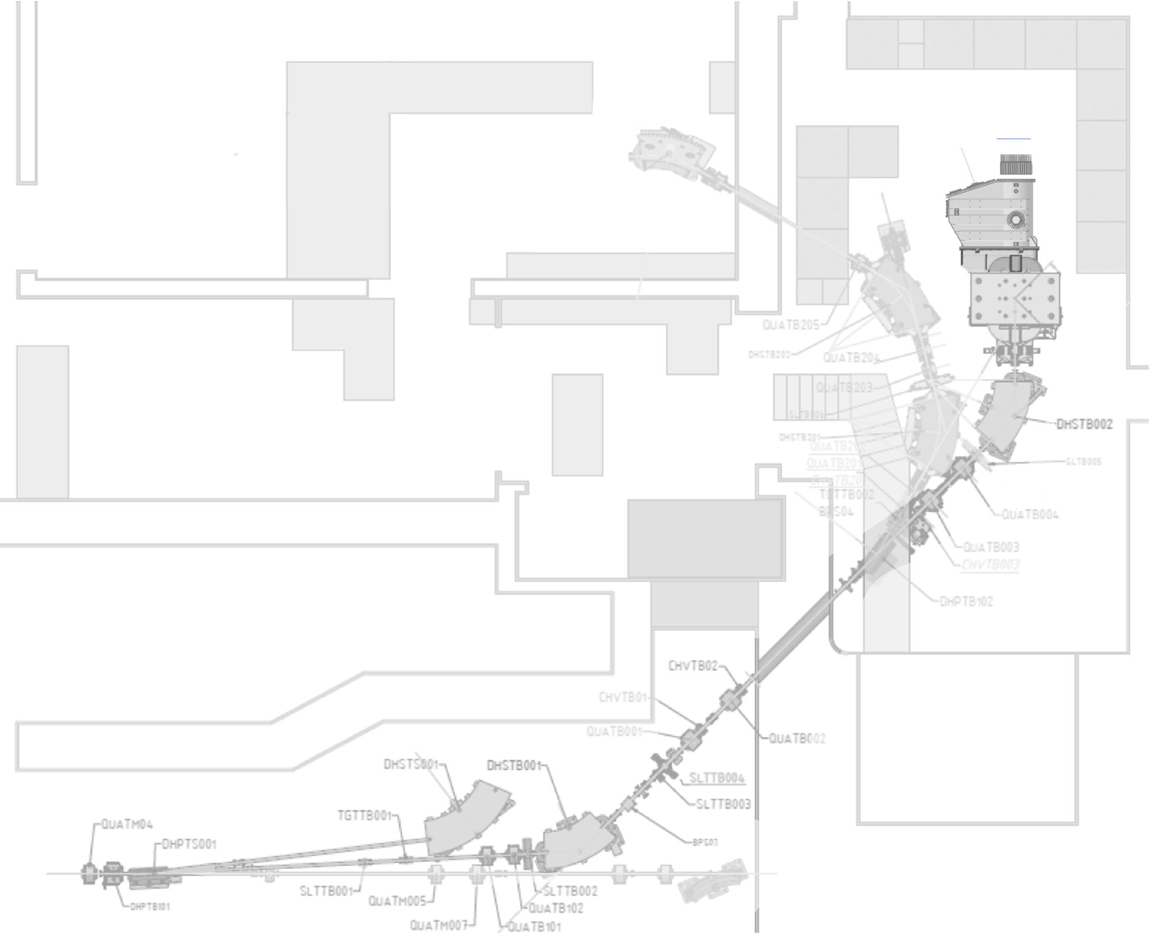
La linea di fascio della BTF e PADME
TimePix
ECal
Lead Glass
ETag
Rivelatori di PADME
Camera da vuoto
Dipolo di PADME (OFF)
Bersaglio
Diagnostica di BTF
Trasforto e focalizzazione del fascio
Selezione dell’impulso
Fascio dal LINAC
on + off, 49 pulses/s
on + on, 1 pulse/s

Slide 15
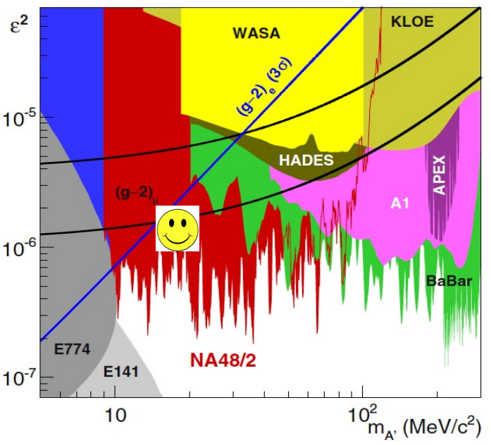
Il modello vettore protofobico
Feng et al. hanno proposto diversi modelli oltre il Modello Standard in grado di descrivere le anomalies del ${}_{}^{8}{Be}$, ${}_{}^{4}{He}$ e ${}_{}^{12}C$ sulla base della conservazione di spin-parità e momento angolare
J. Feng et al, Phys.Rev.D 102 (2020) 3, 036016
Bosone vettore protofobico con $J_{X17}^{P}=1^{−}$
La protofobia è necessaria per tenere in considerazione le limitazioni imposte dall’esperimento NA48/2 determinate dalle osservazione del processo $π^{0}→γe^{+}e^{−}$
FOCUS
La collaborazione NA48/2, Phys. Lett. B, 746:178–185
Protofobia: la costante di accoppiamento di $X_{17}$ con pioni e protoni deve essere soppressa per soddisfare tutti i vincoli sperimentali.

Slide 16
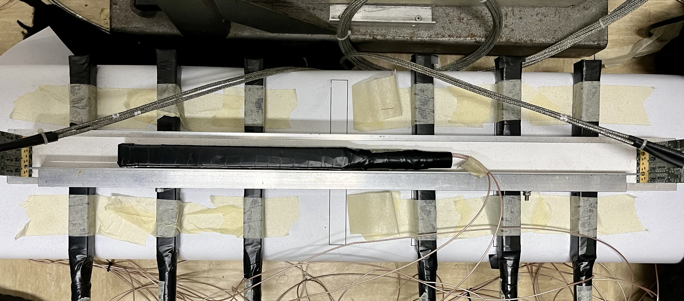
ETag test set-up
The aim was to evaluate the efficiency and the light output on different position of an ETag slab.
Single ETag slab (BC408 – 0.5x4x66 cm³) readout on each side by four 50 𝜇m SiPMs → 8 readout channels
Source: cosmic rays
Trigger: AND of two BGO fingers (ECal) placed over and under the DUT and crossed (discriminator thresholds 30 mV)
Acquisition: CAEN's V1742 sampling ADCs, signals digitized at 2.5 GS/s w/out zero suppression
7 different position scanned → 7 different runs
22/09/2023
PADME RunIII - ALPS2023
28

