Slide 1


CERN – 12-14 September 2022
THE SUPERCONDUCTING THIN SOLENOID FOR IDEA.
A TRADITIONAL DESIGN OR A STEP TORWARD NEW TECHNOLOGIES?
MICHELA BRACCO
On behalf of the Applied Superconductivity Group of INFN-Genova
Notes:
Good morning, I am Michela Bracco, and I am here today, on behalf of the applied superconductivity group of INFN Genova, to present to you the project we are developing for a new design for detector magnets.

Slide 2
SUPERCONDUCTING MAGNETS FOR PARTICLE DETECTORS
Main characteristics:
Large volume
Moderate magnetic field (0.5 to 2 T)
Transparency to particles is often required (thin magnets)
Generally, solenoidal configuration
Notes:
Let us start by saying that the main characteristics of superconducting magnets for detectors are their large size, the magnetic field they must generate is relatively low, between half a tesla and two Teslas with special cases, such as CMS, reaching 4T, transparency to particles is often required and they generally have a solenoidal configuration, with a few exceptions, such as the magnet for ATLAS, which is toroidal.

Slide 3
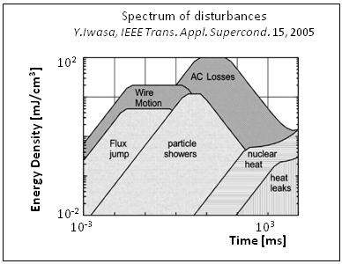
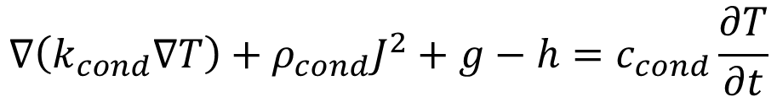
An important feature of superconducting magnets is stability
Stability is related to the release of energy that a magnet can withstand without quenching
$$∇\left(k_{cond}∇T\right)+ρ_{cond}J^{2}+g−h=c_{cond}\frac{∂T}{∂t}$$
Joule dissipation
cooling power
Notes:
All superconducting magnets, not just detector magnets, must be stable. The stability is the ability to withstand a release of energy, which may be prolonged in time or sudden, without quenching.

Slide 4
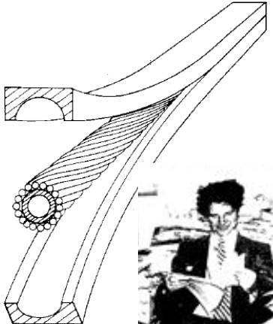
Cryogenic stability
$$ρ_{cond}J^{2}+g≤h$$
Low resistivity normal metal matrix (in parallel to superconductors) and good cooling
Magnets in liquid Helium pool
Forced flow magnets
OMEGA magnet (CERN)
Notes:
This stability is of two types, cryogenic and dynamic. Cryogenic stability is the one mainly related to the power of cooling. In this case, therefore, stability is ensured both by the use of low resistivity material in parallel with the conductor, and by the coolant that is able to remove the heat generated by a release of energy. Thus, good cooling, obtained for example by keeping the magnet in a helium bath or in forced flow magnets, guarantees good cryogenic stability.

Slide 5

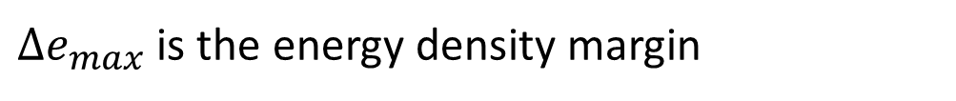
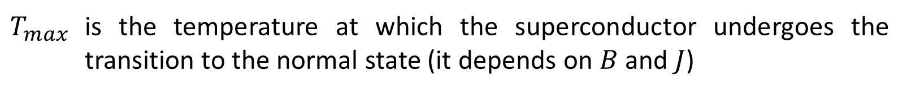
Adiabatic stability
The heat generation term must be limited to a maximum permissible level
$${∆e}_{max}=\int_{T_{op}}^{T_{max}}{c_{cond}dT}$$
${∆e}_{max}$ is the energy density margin
$T_{max}$ is the temperature at which the superconductor undergoes the transition to the normal state (it depends on $B$ and $J$)
Typical value of $T_{max}−T_{op}$ for NbTi is between $2 K$ and $3 K$
Notes:
A different concept is the adiabatic stability, also called dynamic stability. The sudden energy releases are absorbed by the thermal capacity of materials. Of course, cooling power is necessary to counterbalance the continuous heat flow. The heat that can be absorbed is, therefore, limited to a maximum level that depends on the thermal capacity of the conductor, and on the temperature margin. That is the difference between the operational temperature and the maximum temperature above which the cable is no more superconductive, typical value for NbTi is 2 or 3K.

Slide 6
Thin solenoids
Thin solenoids are based on adiabatic stability
Aluminium stabilised NbTi conductors
NbTi is ductile, relatively cheap and robust ($J_{\text{c}}$ is not affected by mechanical stress)
Aluminium: Low density, high radiation length, low resistivity at 4.2 K (RRR>2000)
Pure Aluminium in parallel to the superconducting composite:
increases the conductor thermal capacity per unit length
limits the dissipation in case of local transition to the normal state
limits the magnet weight
allowing positioning calorimeters outside the magnet
Notes:
Thin solenoids are based on adiabatic stability, are not in a helium bath, and are not forced flow magnets. They are indirectly cooled by pipes on the external structure of the magnet. They are made of NbTi cables stabilised by pure aluminium. The advantages of NbTi are ductility, relatively low cost and mechanical strength (transport properties are not affected by deformation). Aluminium used in parallel has low density, high radiation length, which ensures transparency to particles, low resistivity, and high heat capacity, important characteristics for magnet stability.

Slide 7
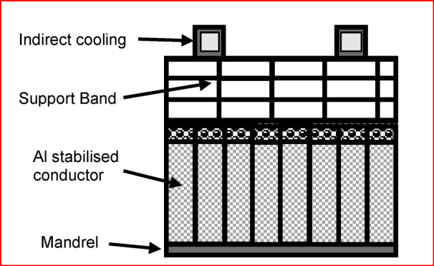
Thin solenoids
Superconducting cable
Soft soldering
Pure Aluminium
Schematic of the CELLO magnet
Notes:
The first solenoid constructed with this type of material was CELLO. In this magnet, the NbTi cables were soldered into an aluminium band.

Slide 8
Thin solenoids
Later, aluminium stabilised conductors have been manufactured by co-extrusion,
in such a way that the superconducting cable is embedded in pure aluminium matrix
The co-extrusion technology was applied for the first time in the CDF magnet (FERMILAB) in 1984
Superconducting cable
Pure Aluminium
Notes:
Later, to improve the bonding between NbTi and aluminium, co-extruded conductors were started to be produced. In this way, the NbTi cable is embedded within the aluminium matrix. The first conductor made with this technology was the cable for CDF at Fermilab. Since then, all the detector magnets were wound with this kind of conductors.

Slide 9
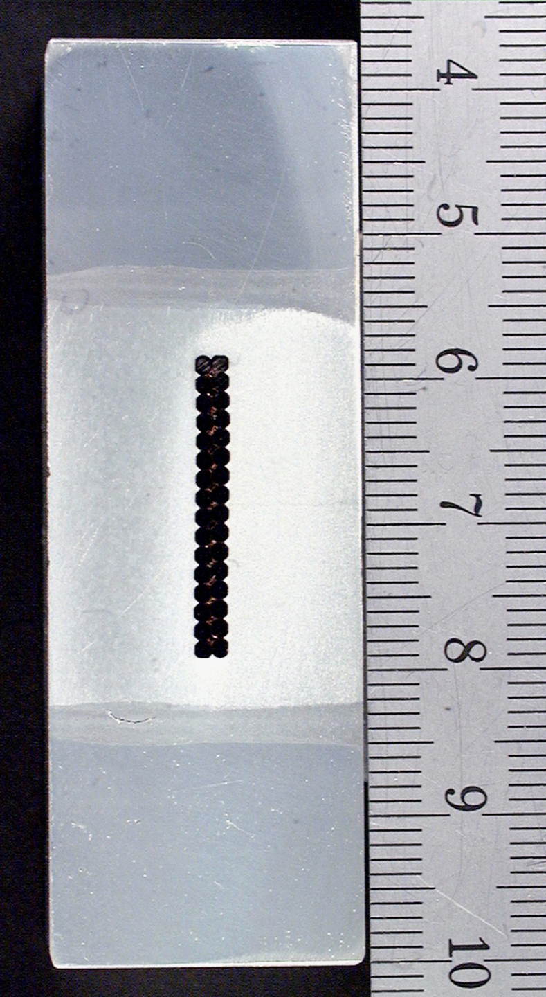
Thin solenoids
CMS conductor
Aluminium stabilised cable reinforced with EBW Aluminium alloy
Superconducting cable
Pure Aluminium
EB welding
Aluminium alloy
Notes:
The cable can be reinforced using aluminium alloys welded by electron beam technique to the pure aluminium matrix, as in the case of CMS's cable.

Slide 10
Thin solenoids
In some detector magnet, pure aluminium is replaced by high strength, low resistivity aluminium-nickel alloys.
ATLAS central solenoid [A.Yamamoto et al. NIM A 584, 2008, 53–74]
Notes:
Aluminium can also be substituted by low resistivity and high strength aluminium - nickel alloys.

Slide 11
Aluminium stabilisation is a terrific solution that has been applied to a large number of detector magnets.
However, fabrication of conductors requires cabling and co-extrusion.
Co-extrusion is an expensive and delicate industrial process.
Very few firms have the expertise to perform co-extrusion.
Notes:
Aluminium stabilization is a fantastic solution that has been used to make a large number of detector magnets. However, it requires the co-extrusion process, which is expensive and delicate, and only a few companies have good experience to be able to make them. At present the commercial availability of aluminium stabilised conductors is an issue.

Slide 12
Would it make sense to use other superconductors?
Notes:
Does it make sense then to use other types of superconductors instead of aluminium-stabilized NbTi?

Slide 13
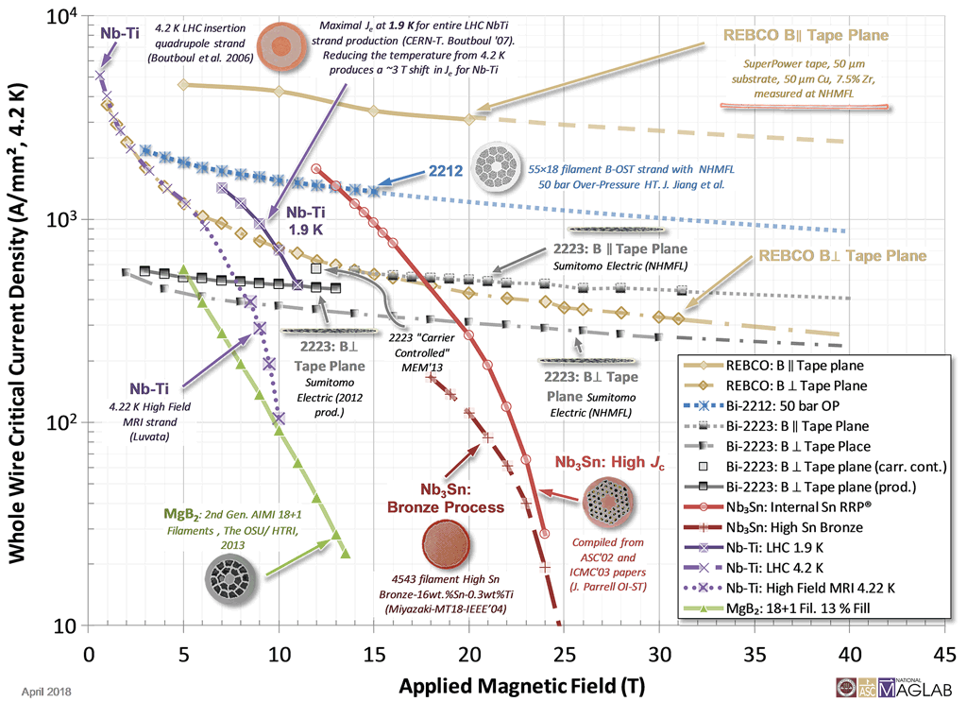
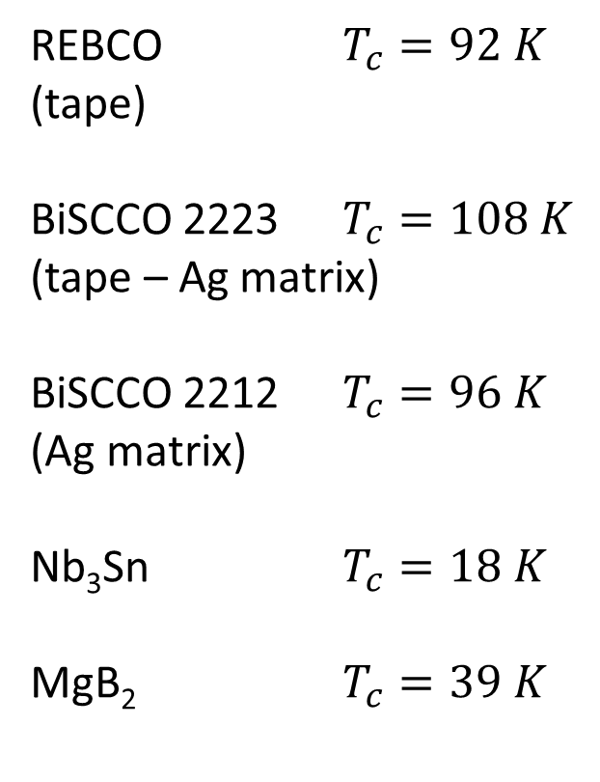
Technical superconductors
REBCO $T_{c}=92 K$
(tape)
BiSCCO 2223 $T_{c}=108 K$
(tape – Ag matrix)
BiSCCO 2212 $T_{c}=96 K$
(Ag matrix)
Nb₃Sn $T_{c}=18 K$
MgB₂ $T_{c}=39 K$
https://nationalmaglab.org/magnet-development/applied-superconductivity-center
Notes:
Among all technical superconductors, our focus has been on magnesium diboride or MgB2, that has a quite high critical temperature and

Slide 14
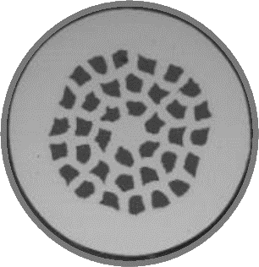
MgB₂ is more expensive than NbTi but much cheaper respect to REBCO and BiSCCO
It is produced by reacting the precursors powders at about 700°C for few minutes
MgB₂ filaments
Metallic matrix (Ni, Ni-Cu or Ti)
In situ: wires are prepared by powder-in-tube method using the precursors. MgB₂ is then obtained inside the wire by suitable heat treatment
Ex situ: wires are prepared by powder-in-tube method directly using MgB₂ powders.
Notes:
is much cheaper than high critical temperature superconductors. It is produced by reacting powders in a matrix by heat treatment at about 700°C for a few minutes. The resulting wires are then composed of a nickel, nickel-copper or titanium matrix with Mgb2 filaments inside.

Slide 15
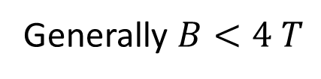
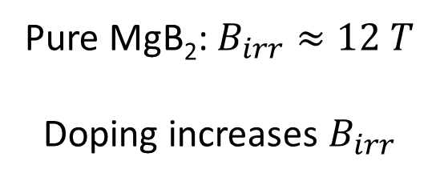
MgB₂ has low reversibility field $B_{irr}$ (if ${B≥B}_{irr}$ then $J_{c}=0$)
Pure MgB₂: $B_{irr}≈12 T$
Doping increases $B_{irr}$
But detector magnets must not generate high magnetic field
Generally $B<4 T$
Notes:
For mgb2, the reversibility field, that is to say the field beyond which the superconductor is still superconductive but no longer carries current, is relatively low, around 12T, which can be increased using doping. Detector magnets, however, should not generate such high fields, so magnesium diboride can be used.

Slide 16
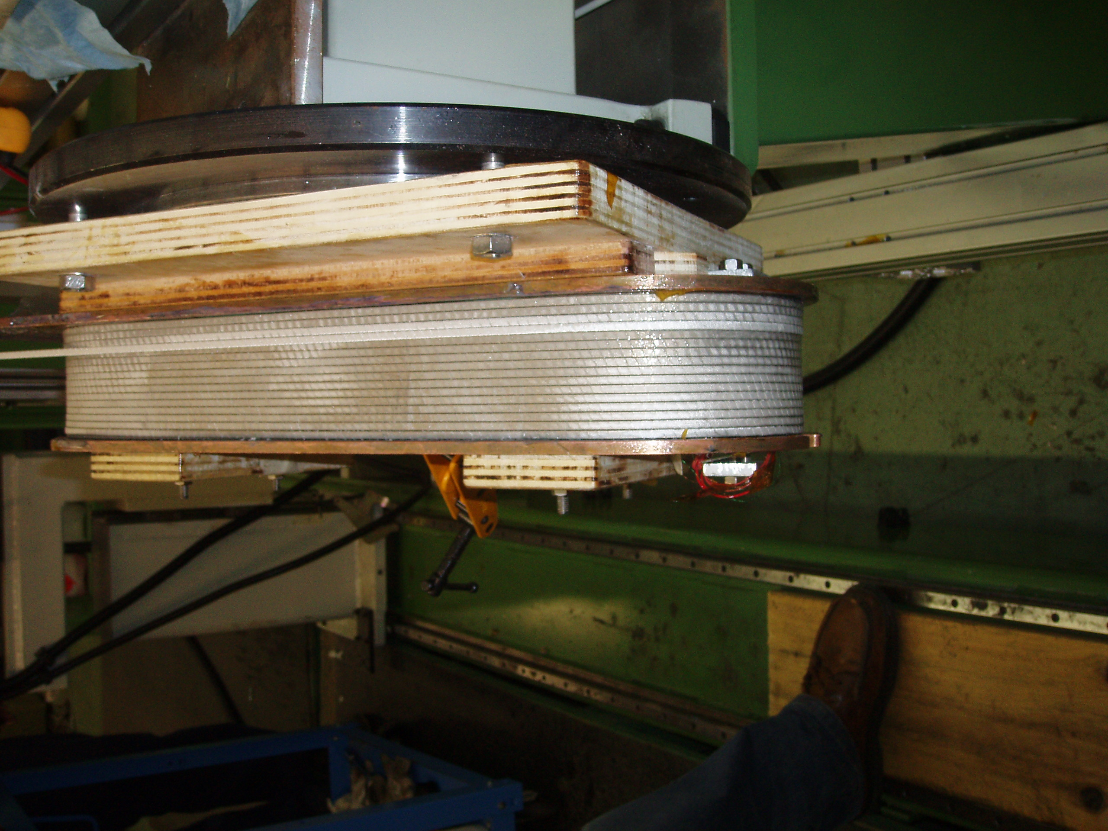
Like all technical superconductors except NbTi, MgB₂ is brittle:
for a given MgB₂ composite conductor, a critical bending radius does exist (order of 10 cm for a 1 mm wire).
Not an issue for large magnets!
Winding of a racetrack coil with ex-situ MgB₂ tape
Notes:
Like all technical superconductors except nbti, mgb2 is brittle, and its transport properties are affected by mechanical deformation. There is therefore a critical bending radius. However, this is not a major problem since detector magnets have large dimensions.

Slide 17
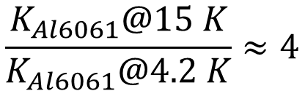
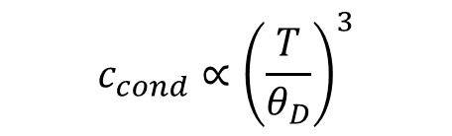

MgB₂ would allow operating the magnet at $T>10 K$ ($T_{c}=39 K$)
Higher energy density margin
$${∆e}_{max}=\int_{T_{op}}^{T_{max}}{c_{cond}dT}$$
More efficient cryogenics
Higher COP
$$c_{cond}∝{\left(\frac{T}{θ_{D}}\right)}^{3}$$
Better conduction cooling
$$\frac{K_{Al6061}@15 K}{K_{Al6061}@4.2 K}≈4$$
Aluminium matrix is not necessary for stabilization.
It can be necessary/useful for quench protection.
Notes:
What is very important is that mgb2 has a big advantage: it allows the magnet to be operated at temperatures above 10K, since it has a critical temperature of 39K. This allows for more efficient cryogenics, higher coefficient of performance and better conduction cooling, as you can see the thermal conductivity of al alloys at 15K is 4 times higher than the one at 4.2K. This results into lower electricity consumption and lower system cost. The main benefit is related to the increase of the energy margin because the heat capacity of the materials is higher, in fact in this range of temperature it increases with the third power of the temperature. Therefore, for a magnet operating above 10K, it is no longer necessary to use aluminium as a stabilizer. Putting aluminium in parallel can, however, be useful for quench protection.

Slide 18
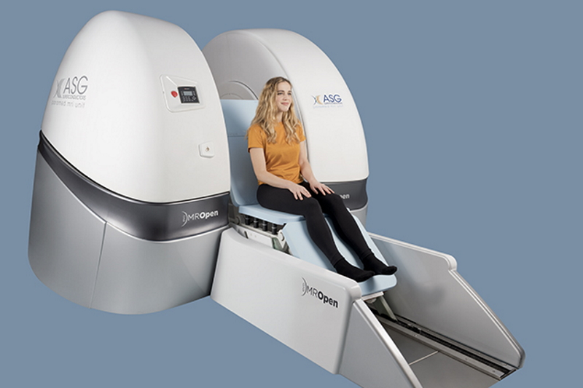
MgB₂ conductors are already used to wind magnets.
Open MRI based on cryogen free magnet wound with magnesium diboride tapes (ASG Superconductors)
Notes:
In addition, magnesium diboride is already used to wind magnets. One example is the Open MRI resonance magnets produced by ASG superconductors, magnets made from mgb2 tapes and cooled with cryocoolers.

Slide 19
First proposals about MgB₂ conductors coupled with aluminium were related to space applications due to low weight requirement
P. Spillantini,
Superconducting magnets and mission strategies for protection from ionizing radiation in interplanetary manned missions and interplanetary habitats
Acta Astronautica, 68 (9–10), 2011, 1430-1439
R. Battiston, W. J. Burger, V. Calvelli, V. I. Datskov, S. Farinon, and R. Musenich
Superconducting Magnets for Astroparticle Shielding in Interplanetary Manned Missions
IEEE Trans. on Appl. Supercond., 23 (3), 2013, 4101604
Notes:
Magnesium diboride coupled with aluminium was proposed for space applications due to its low density.

Slide 20

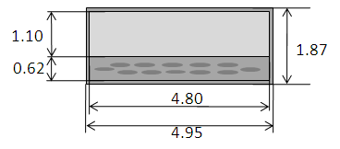
EU FP7 project to study superconducting shields to protect astronauts from space radiation
Conductor: Titanium clad MgB₂ tape + Aluminium strip
Ti/MgB₂ ratio 2.7/1
75 μm thick insulation
Total conductor cross section: 9.25 mm²
Average mass density : 3000 kg/m³
R. Musenich et al., “Ti–MgB2 Conductor for Superconducting Space Magnets”, IEEE Trans on Appl. Supercond26 (4), 2016
Notes:
For example, one of them was the SR2S conductor in mgb2 titanium clad with aluminium strips in parallel. The advantage of this conductor is the average mass density of about 3000 kg/m3.

Slide 21


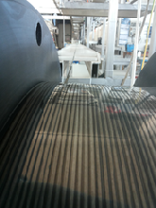
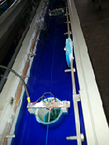
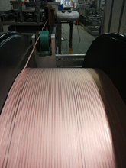
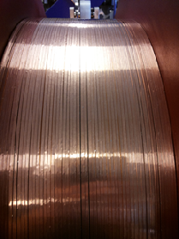
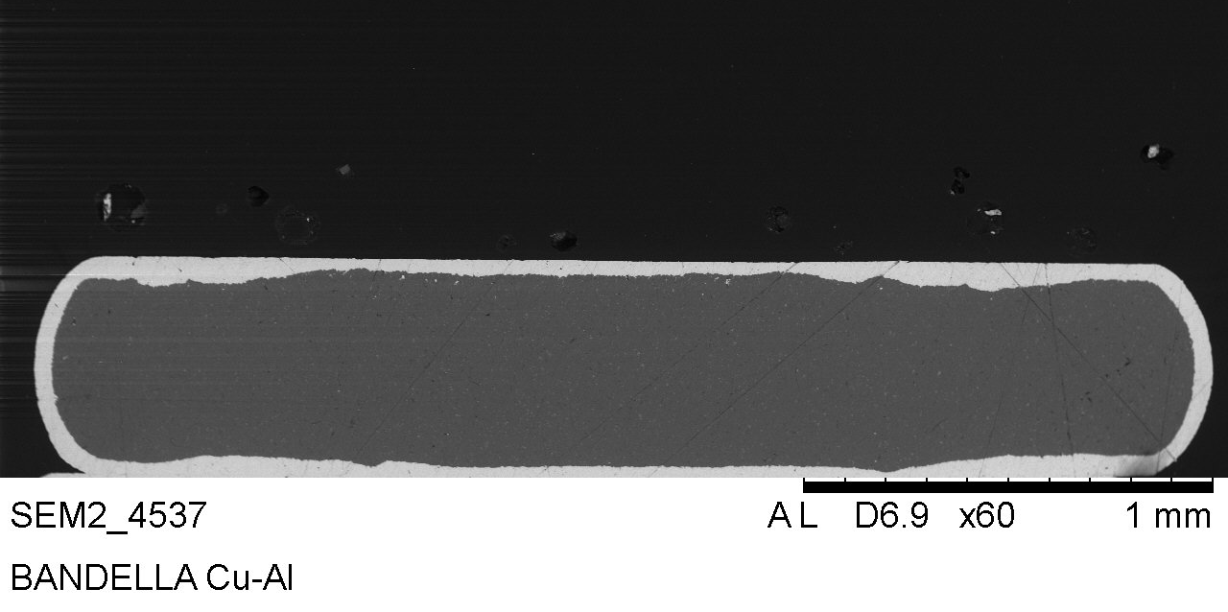
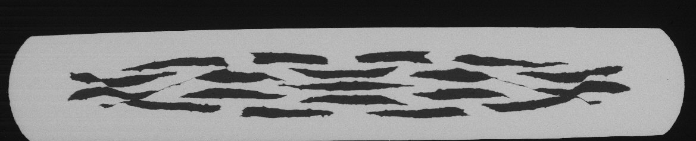
Development of the SR2S conductor prototype
now
360 m Ti-MgB₂
Ti-MgB₂ tape during copper plating
Copper plated
Ti-MgB₂ tape
3 mm
0.5 mm
Problems occurred during aluminium tape soldering due to different thermal contractions.
Solution was identified but, due to tight schedule and limited funds, no further attempts were made to solder the aluminum tape.
Cu-Ti-MgB₂ tape
Notes:
This conductor had been studied and proposed by INFN Genoa and Columbus superconductors, now ASG. A prototype of Ti-clad Mgb2 tape was constructed, as you can see in the images, and soldered to a copper strip. Problems occurred in the attempt of soldering an aluminium tape, solution was identified, but due to problems with a very tight timeline and limited resources, no further attempts were made to solder the aluminum tape.

Slide 22
INFN-Genova has started an R&D on application of Magnesium Diboride to future detector magnets
The idea of using MgB₂ for detector magnets arose during the preliminary design of the large solenoid for the DUNE (Deep Underground Neutrino Experiment) near detector, triggered by the current lack of availability of NbTi, aluminum stabilized conductors.
Notes:
INFN in Genoa has recently begun R&D on the application of magnesium diboride for detector magnets. The idea started during the preliminary design of the magnet for the DUNE near detector and was triggered by the current lack of aluminium-stabilized NbTi conductors.

Slide 23
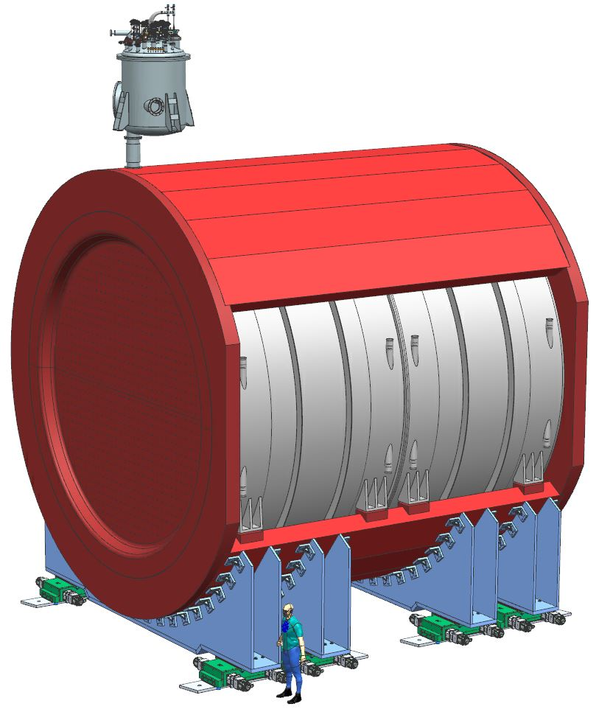
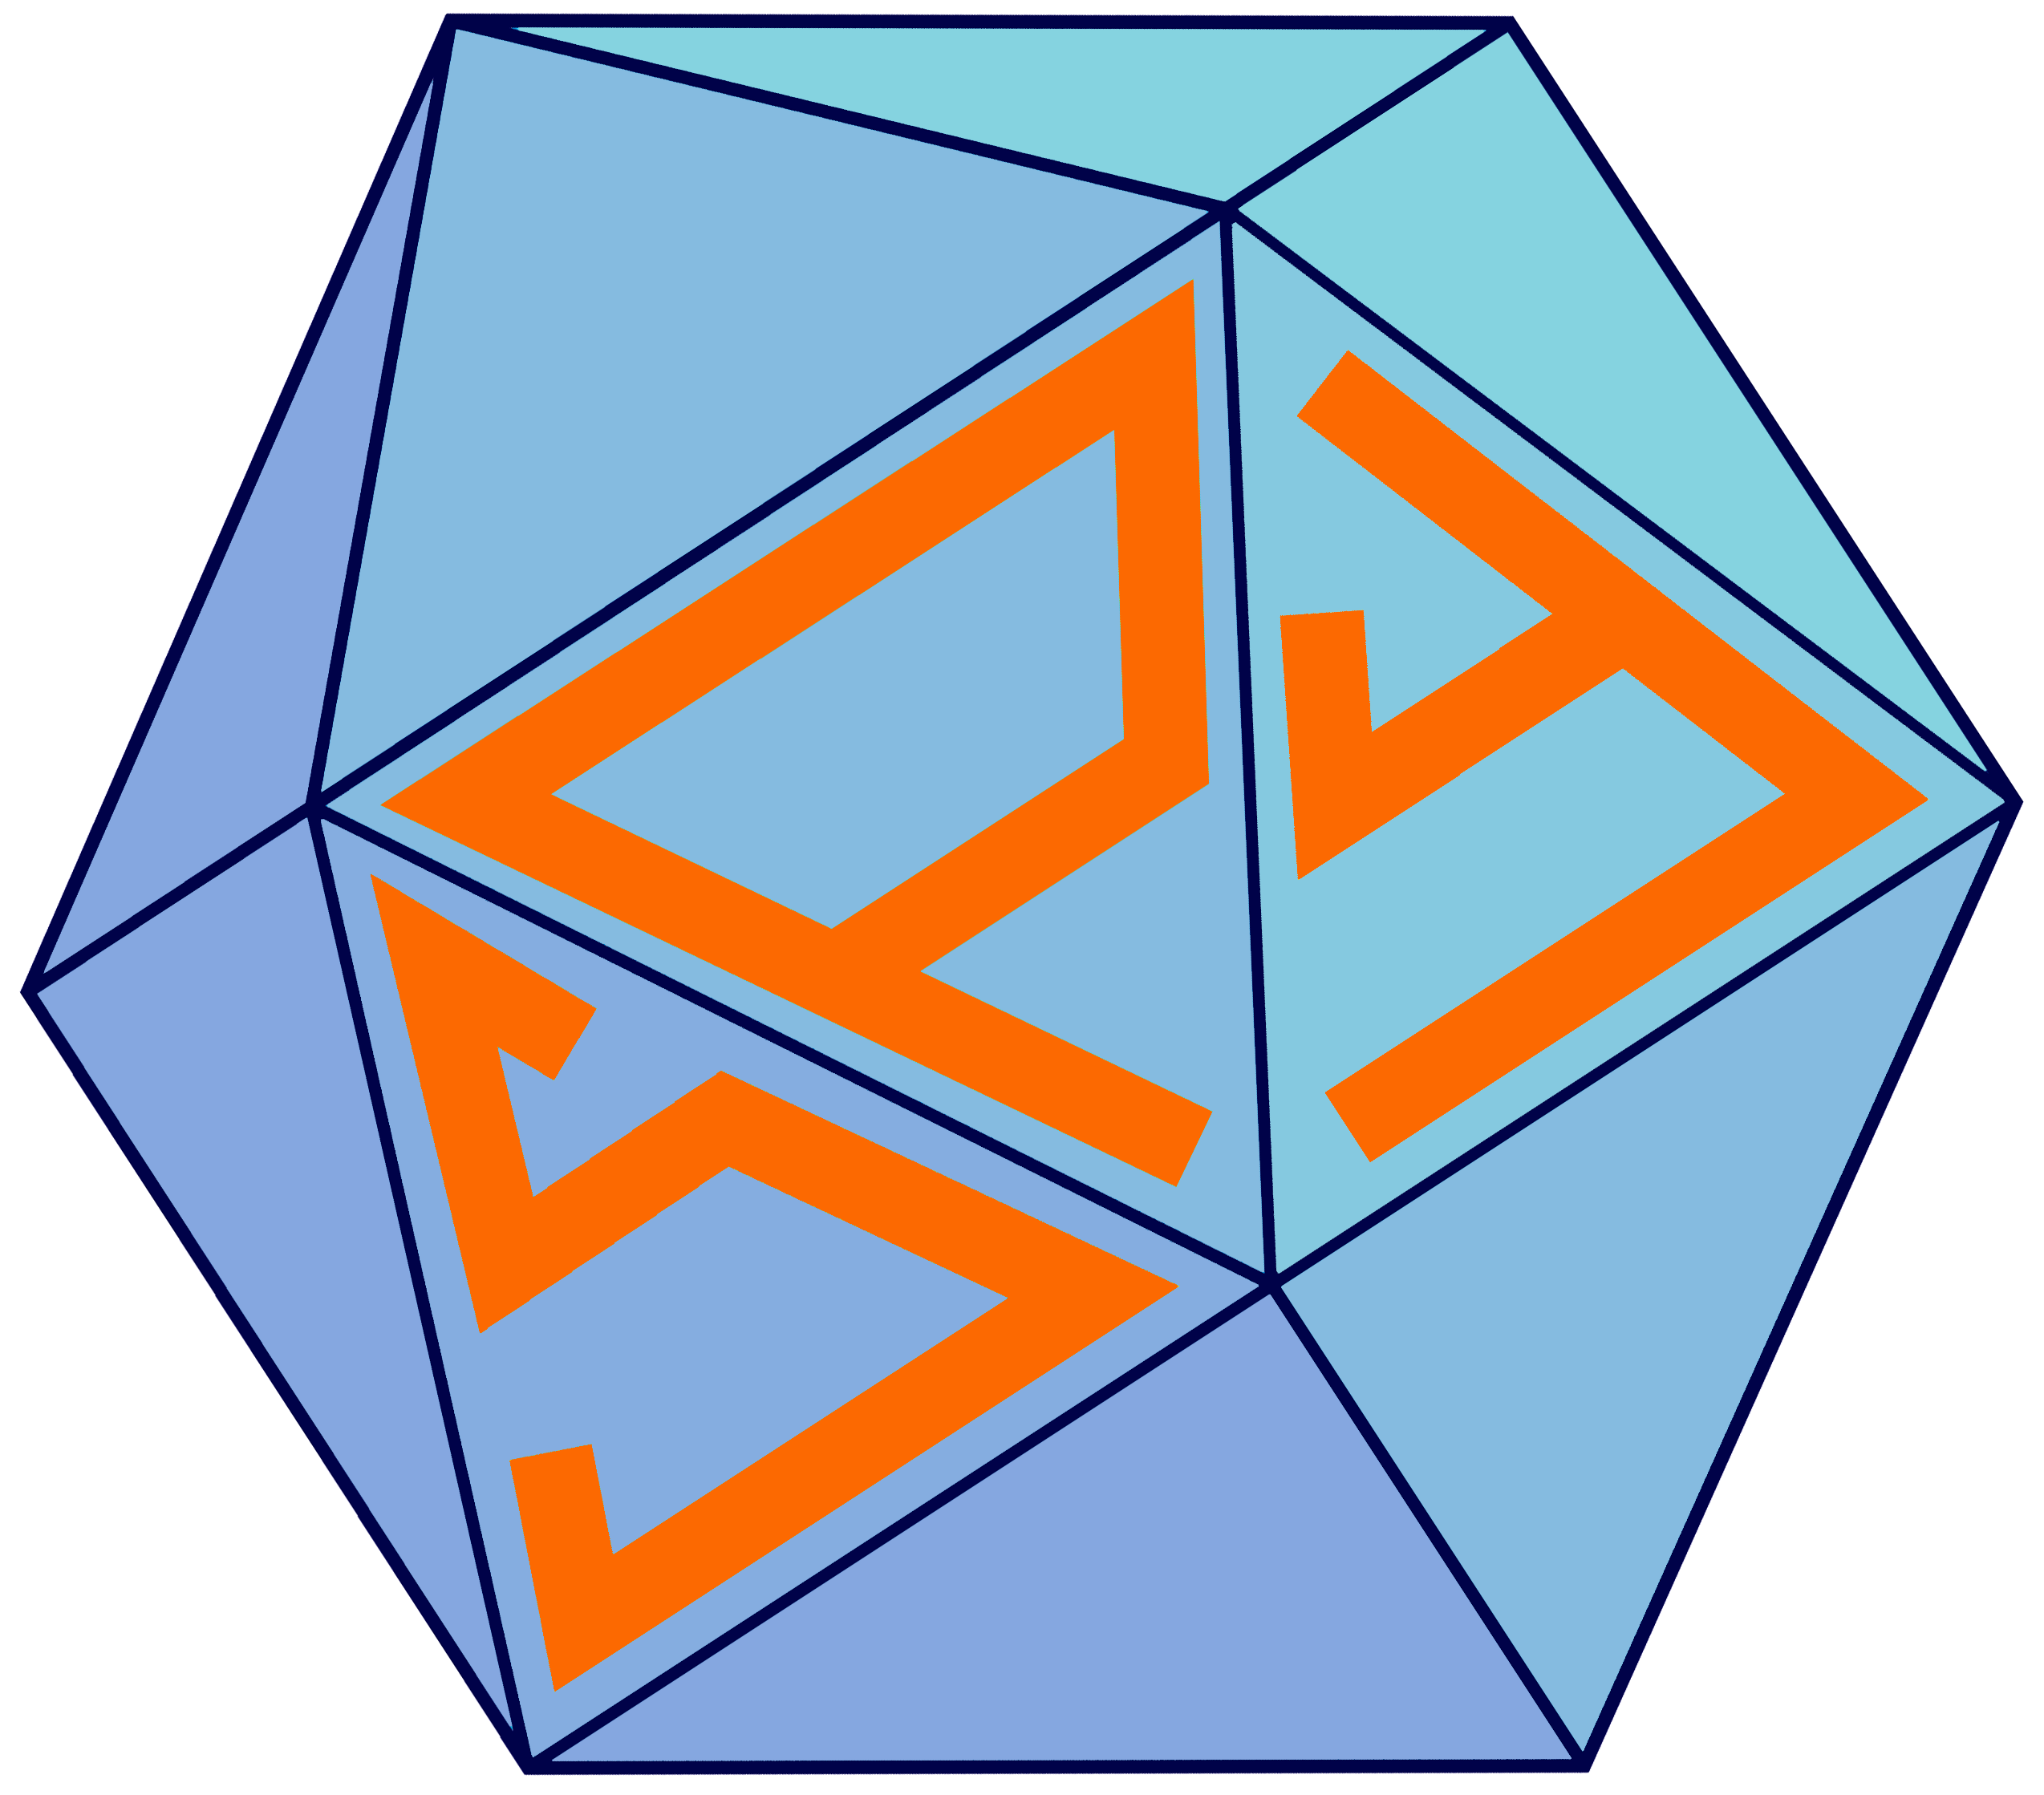
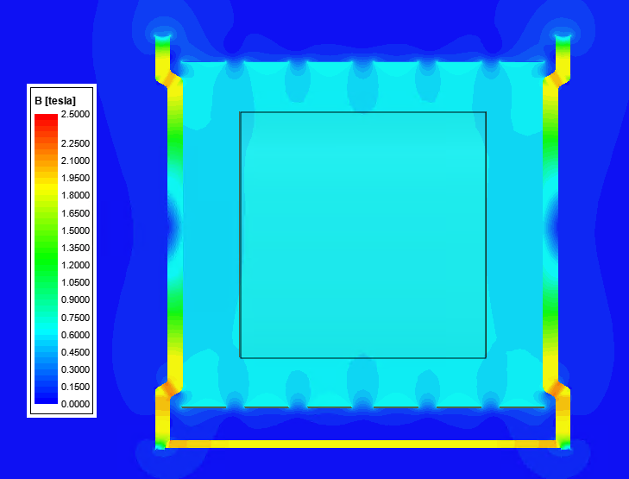



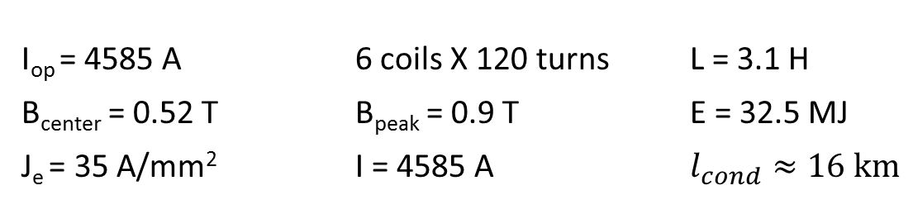


Large solenoid for the DUNE near detector
I_{op} = 4585 A 6 coils X 120 turns L = 3.1 H
B_{center} = 0.52 T B_{peak} = 0.9 T E = 32.5 MJ
J_{e} = 35 A/mm² I = 4585 A $l_{cond}≈16 km$
SPY@DND
y
x
z
$$\sim 7 m$$
x
z
667 A/mm
Notes:
DUNE's magnet is a large magnet, which needs to generate a low field (the maximum field on the conductors is 0.9T) and this makes mgb2 a possible candidate to replace NbTi. The required engineering current density is quite low, 35 A/mm2

Slide 24
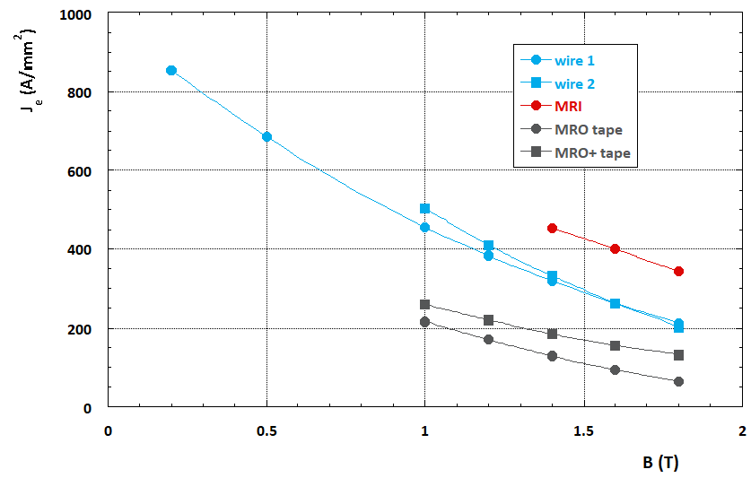
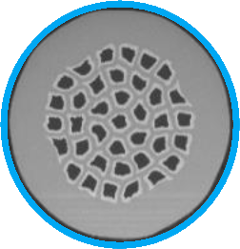
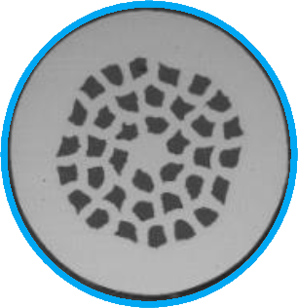

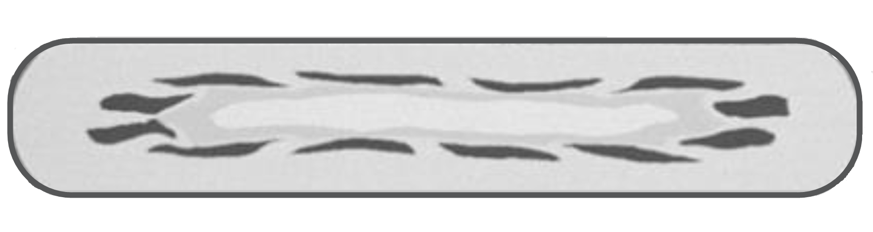
Ex-situ MgB₂ conductors (non-doped)
Wire 1
1 mm
Wire 2
1.33 mm
J_{e} @ 20 K (A/mm²)
MRI
1.53 mm
MRO/MRO+
3.67 X 0.65 mm
Courtesy of Tiziana Spina, ASG-Superconductors
B (T)
Notes:
As we can see on the plot, the critical current density of Mgb2 at 20K is an order of magnitude higher than the one required.

Slide 25
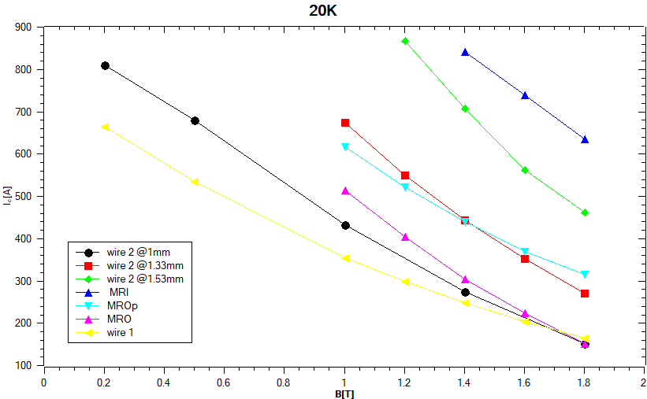
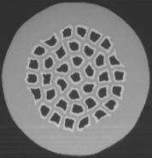
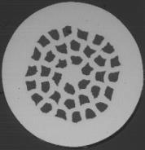

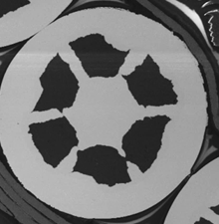
Ex-situ MgB₂ conductors (non doped)
900
800
700
600
500
400
300
200
100
Wire 1
Wire 2
I_{C} [A]
MRO/MRO+
MRI (1,53 mm)
0
1
2
Courtesy of Tiziana Spina, ASG-Superconductors
B [T]
Notes:
The critical current of the mgb2 wires, at 20K at 0.9T is lower than one thousand amperes, that means that if we want to operate the magnet at 4500 amperes it is necessary to braid several wires to make cables that meet the magnet requirements for DUNE. Of course, it is possible to lower the operating current, but this means to increase the inductance.

Slide 26
IDEA
Large dimensions
B_{center} up to 2 T → doped MgB₂ conductor
Notes:
Now let me analyse the IDEA magnet. It has large dimensions and must generate a higher field respect to the DUNE’S magnet, up to 2T. However, also in this case, it could be possible to use mgb2. But doping, for example with carbon, is necessary to increase the critical current at high field.

Slide 27
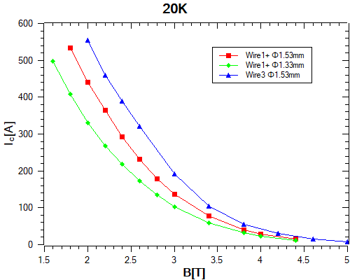
Ex-situ MgB₂ conductors (doped)
20K
Courtesy of Tiziana Spina, ASG-Superconductors
Notes:
As you can see in the plot, the critical current of doped magnesium diboride is higher than the one in non-doped material in the range of field of our interest. However, is still relatively low so it could be necessary to operate the magnet at lower temperatures than 20K. For example, working at 15K can achieve a gain in critical current by a factor of 1.7.

Slide 28
In MgB₂ magnets stability is due to the high specific heat
Aluminium in parallel is for protection:
Good bonding between cable and aluminium is not necessary (no co-extrusion)
High purity aluminium is not necessary
It is possible to use conductors obtained:
by cabling MgB₂ wires and aluminium wires
by soft soldering MgB₂ in aluminium channels
Soft soldering
Notes:
In MgB₂ magnets stability is due to the high specific heat as I already showed, so the use of aluminium in parallel can be useful for quench protection and not for stability. That means that good bonding between the superconductor and aluminium is not necessary, and consequently coextrusion is not needed. In addition, aluminium does not have to be highly pure. Cables can be made of mgb2 wires and aluminium wires twisted together or of mgb2 wires twisted around an aluminium core or with mgb2 cables soldered into aluminium strips.

Slide 29
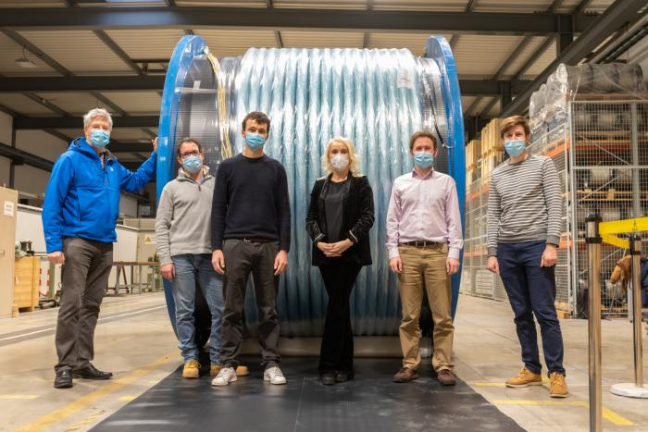
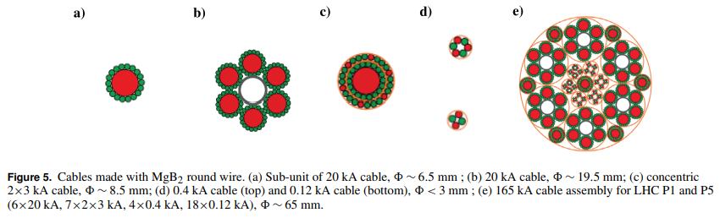
A remarkable example of MgB₂ wire cabling: LHC superconducting links
A. Ballarino, Supercond. Sci. Technol. 27 (2014) 044024
Notes:
A remarkable example of MgB₂ wire cabling are the cables made to transport current in the LHC. The wiring technology already exists and just needs to be adapted to our applications.

Slide 30
Summary
MgB₂ could be an excellent candidate to replace NbTi in detector magnets
Detector magnets wound with MgB₂ conductors can operate at $T>10K$, possibly up to $20 K$.
Consequences of higher operative temperature are:
higher stability (aluminium is required for protection, not as stabiliser)
higher thermal conductivity (better indirect cooling)
higher refrigerator COP
R&D is necessary to develop suitable conductors.
Detector magnet design should be rethought based on MgB₂ conductor features (as an example, the quench issue of MgB₂ detector magnets could be faced via controlled insulation technique)
Notes:
To summarize, magnesium diboride can be a good material for detector magnets because detector magnets wound with MgB2 conductors can operate above 10𝐾, possibly up to 20 𝐾, and therefore they have higher stability (aluminium is required for protection, not as stabiliser), higher thermal conductivity (better indirect cooling) and higher refrigerator COP, so, as said before, lower electricity consumption and lower system cost. For sure, R&D is necessary to develop suitable conductors and the detector magnet design should be rethought based on MgB2 conductor features.

Slide 31
THANK YOU FOR YOUR KIND ATTENTION

