Slide 1




^{A plea for H(650)}
WG1-SRCH
A. Kundu, A. Le Yaouanc, P. Mondal, G. Moultaka, F. Richard
Calcutta-Orsay-Montpellier collaboration

Slide 2
Introduction I
With RUN2 data there has been growing evidence for a wide resonance with M=650 GeV and Γtot=100 GeV
Note that the SM Higgs width would be 150 GeV at this mass
Historically this work started in 2018 1806.04529 with the mode ZZ, confirmed by 2103.01918, then came WW 2104.04762 and h(95)h(125) 2310.01643
Note in passing the connection between h(95) and H(650)
Putting them together, one reaches 6 s.d. global (Fisher method)
Question: how to interpret this resonance in the context of existing phenomenology ?
Caveat : one cannot exclude that this resonance is a tensor (under investigation)

Slide 3
Introduction II
To make a story short, an interpretation was not possible within present phenomenology
Hence the low popularity of this channel and our attempt to go beyond the usual 2HD+scalar models
Including triplets seems viable provided one goes beyond the Georgi Machacek model (one doublet + 2 triplets) by adding a second doublet to GM
In particular GM predicts ZZ/WW~2 while observation gives ~ten times less
Reminds us the story of going from SM to SUSY which required a second doublet
Such a SUSY extension has been developed by the Spanish groups (Quiros et al. 1308.4025)

Slide 4
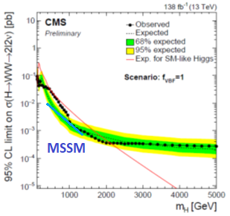
Model independent statement
Here I would like to emphasize a model independent aspect of this resonance: the fact that it couples to W+W- with ~ the same strength as h(125) which breaks down a unitarity sum rule (SR) due to Haber et al. Phys. Rev. D43, 904 (1991
There is no remedy for this in 2HD+singlets while models with triplets offer the possibility of a compensation through an H++ (u channel exchange of opposite sign)
One therefore predicts the appearance of H++->W+W+ with a coupling ~ H(600)W+W-
Major result which would kill the 2HD models

Slide 5

Sum Rule I
W+W- ->W+W- Haber et al. in P.R.D 43 (1991) 904-912
So-far we have been able to measure H(650)W+W- and (2302.07276) h(95)W+W-
There are other candidates like h(151) and H(330) where these measurements are unavailable, but we have ideas on how to deal with them (2308.12180 and https://indico.cern.ch/event/1253605/
H(650) alone forces to have a contribution of H++->W+W+ with a coupling ~ SM=gmW

Slide 6
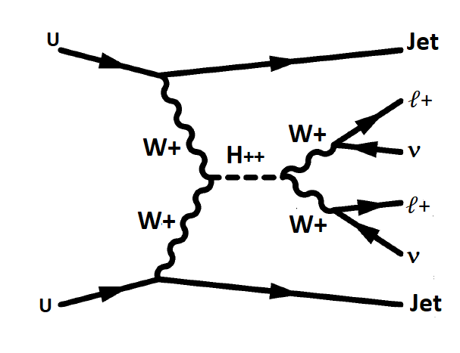
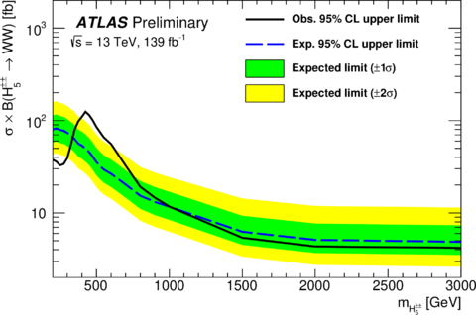
First hint from LHC
Recently at the Belgrade ATLAS meeting: H++(450)->W+W+
ATLAS-CONF-2023-023/
3.2 s.d. local, 2.5 s.d. global

Slide 7
Sum Rule II
W+W- -> ZZ allows a similar SR
This forces a strong coupling for H+->ZW+ which should be observed at LHC
Note that the result depends on the signs of the coupling constants which are not known from present measurements
h95ZZ is known from LEP2 (but not its sign !)

Slide 8
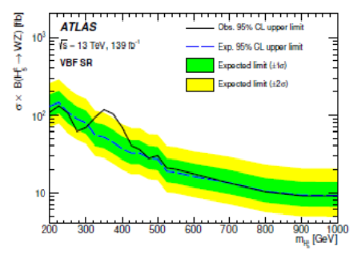
Evidence for H+ -> ZW+
2207.03925
Coincident excess at mH5+~375 GeV for ATLAS (2.8sd) & CMS 3.5 s.d. global
In GM H5++ and H5+ are mass degenerate which is almost true (see for e-GM 2111.14195)
Obviously H(650) does not have the same content as H5 in GM

Slide 9
Quantitative interpretations
Combining H++ and H+ gives 4.3 s.d. global.
Quantitatively, SR predicts Γ_{H++->W+W+} and the measured cross section allows to deduce the BR(W+W+) and the total width Γ_{H++->W+W+} /BR(W+W+)
u=70 GeV comes as a surprise: usual lore was BR(W+W+)=1 and u<25 GeV
BR(W+W+)~10% requires other modes like H’+W+ or even H’+H’+ (ZH’+ for H+)
A light (or several) light H’+ predicted

Slide 10
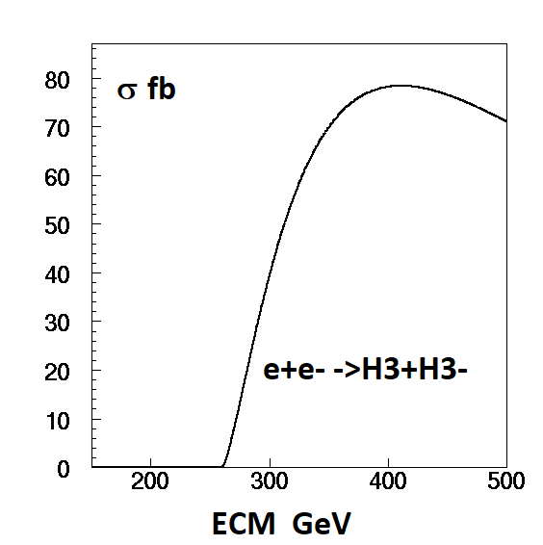
A light H’+ ?
There are few hints for this
B decays into Dτ and Λτ are reduced by 1.6 and 1.4 s.d. 2305.00614 suggesting mH+~200 GeV
ATLAS has searched for t->bH+->bbc and found a 3 s.d. local (2.5 global) excess around 130 GeV 2302.11739
Not allowed in 2HD models for type II 1702.04571 but allowed for tanβ>2 in type I
Good news for all Higgs factories !
e-GM predicts on top of H5+, H3+, an extra H2+ which could also be light (blind regions for searches ?)

Slide 11
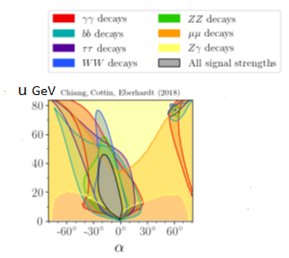
Precision Measurements
u=70 GeV deduced from the sum rules seems incompatible with PM
There is however a GM solution with large α=60° and u=v_{ξ}=v_{χ}=75 GeV which satisfies PM for h(125)
Implies that h can have a large triplet component, unnoticed, still passing PM
True for h->hh ? We need to understand V(h)
µ95γγ~0.3 does not seem to originate from the charged Higgs sector, given that µ125γγ∼1, meaning that H’+(130) does not seem to affect h125
1807.10660

Slide 12
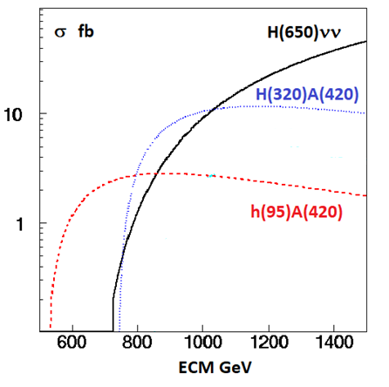
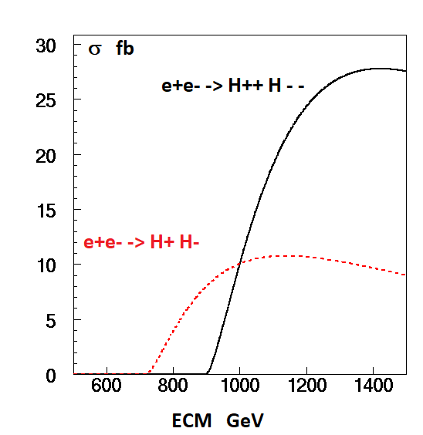
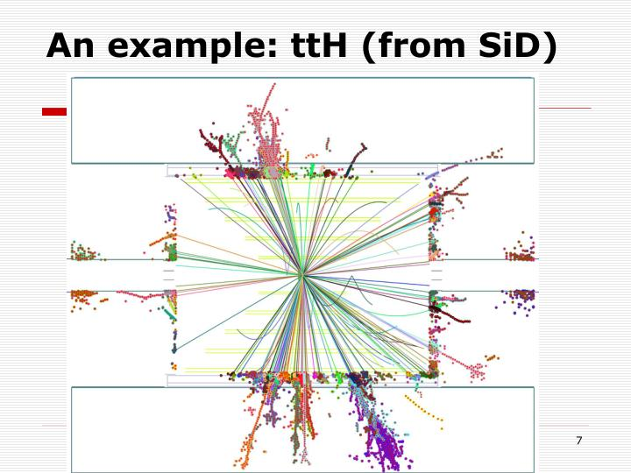
TeV collider reach
ILC would provide 8000 fb-1 at 1 TeV
The final states are complex modes (~ttH) requiring the highest L and an almost ideal detector
H(650) mainly produced through VBF (beam polarisation allows a factor ~2 gain, not included)
Using a e-e- collider one could also produce H ⁻ ⁻ through VBF with polarized beams ~100 fb at 1 TeV

Slide 13

Conclusions
Growing confidence that BSM physics is – at last ! – showing up with strong synergy between H(650), H++(450) and H+(375)->ZW and several neutral scalars including h(95)
This BSM physics does not fit in existing 2HD+S schemes
Needs an extended version of GM, e-GM or/and a Tensor scenario (in progress)
Final consolidation for 650 GeV resonance should come soon from CMS with ZZ
As expected from e-GM, several other signals are lying around, not discussed here
Very rich prospects for HEP !
Read our papers and a recent talk at ECFA WG1-SRCH:
2211.11723 , 2308.12180 and https://indico.cern.ch/event/1253605/
Stay tuned !

Slide 14
Additional slides

Slide 15
A tensor scenario ?
Seems viable despite several complexities (renormalizability, high energy behaviour, need for unitarization) which can perhaps be mastered as shown in 1511.00022
The large width can be interpreted as due to a 2J+1 factor instead of assuming a replica of the SM Higgs coupling
ZZ/WW=0.5 instead of 2 in GM ~agrees with observation within errors
Could be clearly distinguished from a scalar decay through its angular distribution which is forward peaked
Doubly charged candidates could be scalars or due to an isotensor giving T++, T+ and T0(650)
Haber et al sum rule still apply ? Uncertain but not excluded
Recently CMS has proposed an interpretation of X(650) as a bulk KK graviton 2310.01643
The large width seems to disfavour such an interpretation 9909255

Slide 16
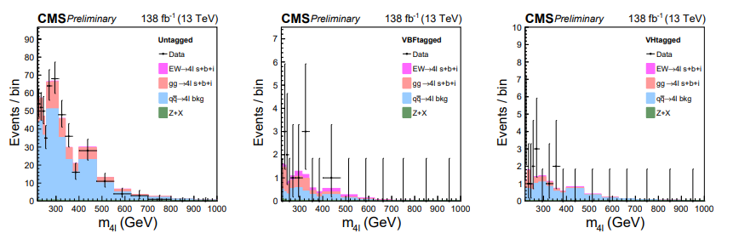
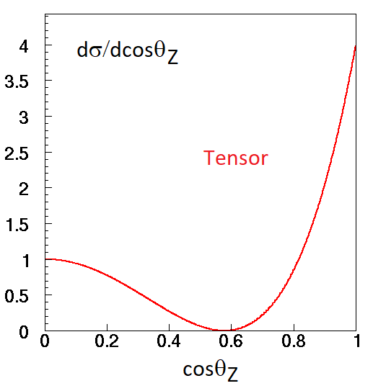
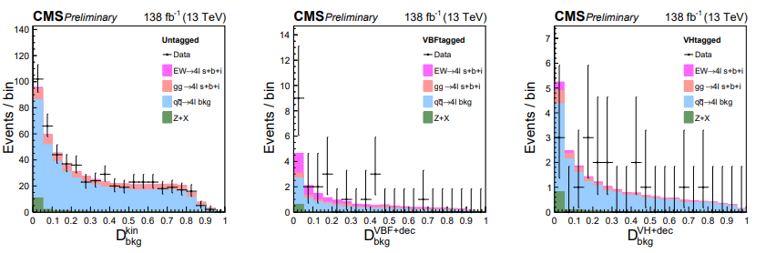
Results from CMS CMS-PAS-HIG-21-019
Selecting a scalar solution in ZZ->4l , D_{bkg}>0.6, CMS finds:
Tensor decay in ZZ
No sign of an excess at ~650 GeV in this subsample
A tensor resonance, fwd peaked, removed by this selection ?

Slide 17
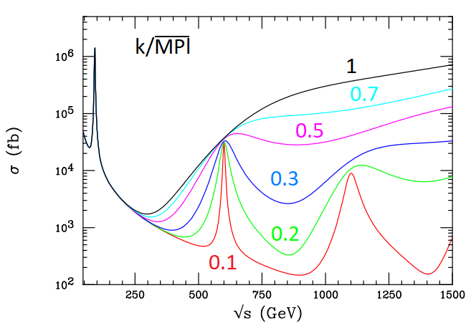
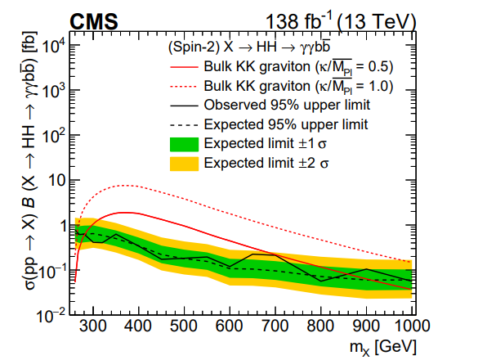
Bulk KK graviton ?
2310.01643 9909255 e+e- -> G_{KK}(600) -> µ+µ- versus k/Mplanck
(just for illustration since e+e- is unlikely to couple to G_{KK} )

Slide 18
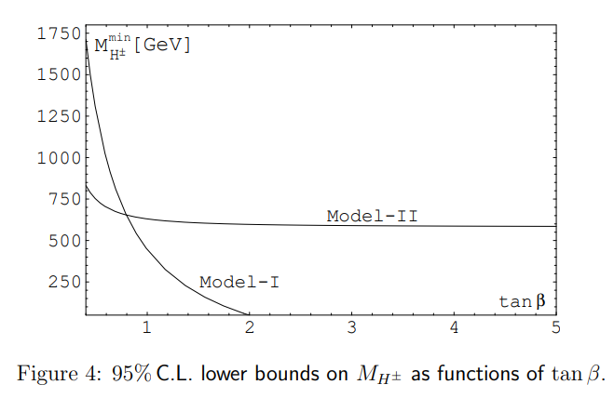
b->sγ constraint on mH+
Light H+ excluded for 2HDM II, not for 2HDM I with tanβ>2
1702.04571

Slide 19
How to derive the missing couplings ?
There are indications for several neutral scalars candidates on the market, with unknown couplings to WW/ZZ
Can one derive them taking into account the present measurements ?
The answer seems positive assuming there is no CP violation and using available measurements

Slide 20
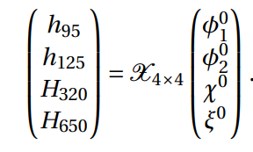
The neutral sector in e-GM
e-GM comprises two doublet fields φ1 , φ2 with vev v1 and v2 and two triplet fields χ, ξ with the same vev u
For the neutral sector one writes:
where the matrix is 4X4 unitary real (no CPV) with 16-4-6=6 free parameters requiring the unitary vectors to be orthogonal
In total there are 6+3 (v1, v2, u) free parameters and 14 observables from LHC measurements
One needs to choose between various Yukawa coupling patterns and we find that type I (all fermions having the same coupling) gives a reasonable agreement with the data

Slide 21
Example of a solution
v1=-30 v2=102 u=69.5 GeV Type I Yukawa
Coloured squares have unknown couplings except for h95WW which ~agrees with measurements
H125~cosαφ as predicted by PM of Chiang et al. 1807.10660
H650 dominated by doublets is produced mainly by ggF contrary to H5
Predicts µ95γγ~1 while ATLAS+ CMS measure µγγ=0.27+0.1-0.09 (2302.07276)
There exist another solution with μγγ∼0.3 w/o H+ contributions
H320->ZZ should be large: excluded unless H320->hh is very large

Slide 22
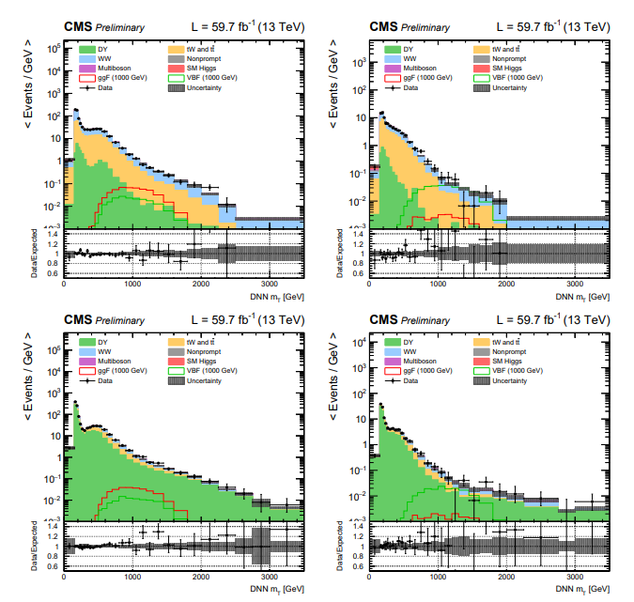
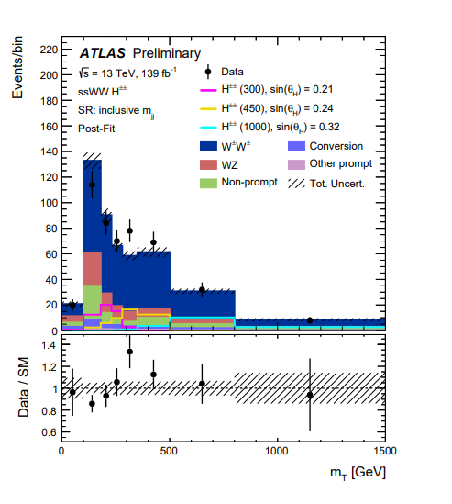
W+W- with b jet veto > 50 times larger W+W+ due to tt background
VBF W+W-
µe
µ+µ-
VBF W+W+

Slide 23
Scalars for sum rules

Slide 24
Historical progress of H(650)

Slide 25
1st indication : H->ZZ into 4 leptons
The cleanest channel for discoveries
From a combination of published histograms 1806.04529 with 113.5 fb⁻¹ from CMS (2/3) and ATLAS (1/3) one observes a peak with M_{H}~660 GeV Γ_{H}~100 GeV, σ~90±25 fb with s/b=46/20 ~3.8 s.d. local significance (5.8 Bayesian), 2.8 s.d. global
With 139 fb-1 ATLAS ~3.2 s.d. effect at the same mass 2103.01918
With 139 fb-1, with sequential cuts, an excess is observed at the same mass, s/b=9/2 ~2.1 s.d., for VBF->H(660)->ZZ ~30±10 fb (~2 times smaller with a MVA analysis) 2009.14791
The VBF cross section is well below the inclusive cross section ~90fb implying a dominant ggF contribution
CMS analyses into four leptons, ggF nor VBF, are not yet published
These results call for a combination of both analyses before one can draw a valid conclusion
Could stop here but…

Slide 26
Evidence for VBF->H(650)->W+W- ->ℓℓvv
Large top background even after b-jet vetoing
Wide signal with ±50% mass resolution
VBF->H(650)->ℓℓvv (µµ, ee and µe) favoured with 3.8 s.d. local (2.6 global) significance
The VBF cross section ~160±50 fb, close to SM, is >5 times larger than ZZ, inconsistent with GM which predicts for the scalar H5 WW/ZZ=0.5 !
Within 2HD, h(125)WW from CMS gives sin²(α−β)~0.97±0.09 meaning that H(650)WW~cos²(α−β)~(0.03± 0.09)SM
2HD 2 s.d. upper limit shown by the blue line
Both interpretations are inconsistent !
An attempt from ATLAS does not reach the same sensitivity (only µe) ATLAS-CONF-2022-066

Slide 27
W+W- with b jet veto > 50 times larger W+W+ due to tt background
VBF W+W-
µe
µ+µ-
VBF W+W+

Slide 28
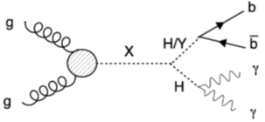
Evidence for gg+VBF->H(650)->Y(90)+h(125)->bb+γγ
3.8 s.d. for mH=650 GeV and mY=90 GeV shown at ICHEP22
Mass resolution on Y does not allow to distinguish between Z and h(95) which is by now a “good old friend”
CP says that bb cannot come from Z->bb but could be h(95) which is another strong candidate seen in 3 channels 2203.13180 +2302.07276
The cross section is dominant over all other indications ~200 fb but it includes ggF+VBF
HIG-21-011

Slide 29
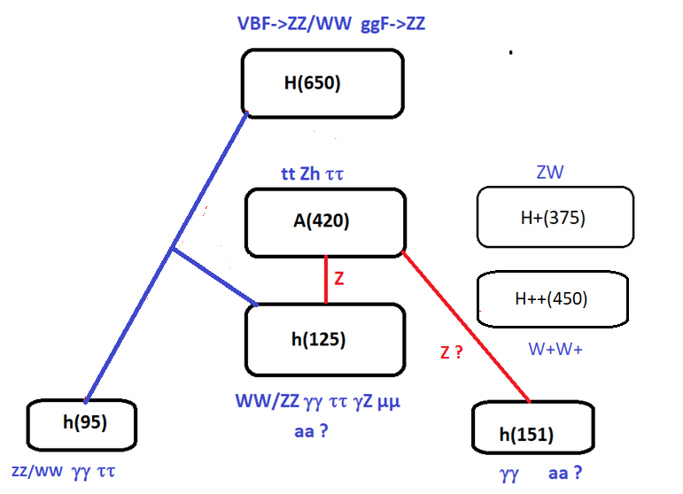
SUMMARY OF BSM CANDIDATES

Slide 30
Scalars for sum rules

Slide 31
LHC inputs for our work
We choose to select * combined searches with > 4 s.d. global significance with the exception of h151 which results from an unofficial combination of CMS & ATLAS data
This keeps 4 neutral scalars and one pseudo scalar
No change of significance after a CMS update of h(95)->2γ with RUN1 and RUN2 after some cleaning against Z->e+e-
ATLAS claims 1.7 s.d. on h95->2γ
Recent progress for H++ from ATLAS

Slide 32
Georgi-Machacek for pedestrians
Allows I=2, H++, without violating ρ=M²w/Mz²cos²θw=1 at tree level
Is achieved by combining 1 isospin doublet (v_{φ}) + 2 triplets, one real the other imaginary, with the same vacuum expectations :
=1 with v_{χ}=v_{ξ}=u
Predicts a 5-plet of physical states H5++ H5+ H50 H5- H5- - Fermiophobic only produced by VBF
+ 3-plet H3+ H30 (CP-odd) -> A(400)
Mass degeneracy inside multiplets usually assumed but unnecessary for ρ=1 see 2111.14195
+ Singlets h and h’ mixing angle α

Slide 33
The GM model for advanced
GM is constituted by one doublet φ and two triplets, one complex χ and one real ξ, with the same vacuum expectations to get ρ=1
Y=1/2 T=1/2 vφ Y=1 T=1 vχ Y=0 T=1 vξ=vχ ρ=1
Only φ couples to fermions
They form the following physical states, dominantly triplet r
s_{H}=2√2vχ/v
H1 and H1’ have following composition
The physical states are
Common wisdom: the mixing angle α has to be small to avoid altering the doublet properties of the SM h(125)
Also vξ=vχ small while SR says that vξ=vχ=70 GeV

Slide 34
SGM: a SUSY version of GM
1308.4025
GM does not necessarily mean compositeness
SGM provides all the “goodies” of SUSY:
Perturbativity, computability
EWSB naturally triggered
Mh predicted with less “tension” on stop masses with extra contributions to RC
Two doublets as needed to interpret H320 and the ZZ/WW decays of H(650)
DM candidate
Complex/rich world with ~20 Higgs scalars

Slide 35
TeV projects
 | CME [TeV] | Lumi per IP [10³⁴cm⁻²s⁻¹] | Years to physics | Cost range [B$] | Power [MW]
FCC-ee | 0.24 | 8.5 | 13-18 | 12-18 | 290
ILC | 0.25 | 2.7 | <12 | 7-12 | 140
CLIC | 0.38 | 2.3 | 13-18 | 7-12 | 110
ILC | 3 | 6.1 | 19-24 | 18-30 | 400
CLIC | 3 | 5.9 | 19-24 | 18-30 | 550
MC | 3 | 1.8 | 19-24 | 7-12 | 230
MC | 10 | 20 | >25 | 12-18 | 300
FCC-hh | 100 | 30 | >25 | 30-50 | 560
SNOWMASS
D. Schulte
Higgs Hunting 23
+ CEPC-ee 0.24 TeV
SPPC-pp 100 TeV

Slide 36
LUMINOSITY at 1 TeV
In reference 1903.01629 a running scenario of ILC at 1 TeV collecting 8000 fb-1 has been envisaged
Beneficial for Higgs self-coupling measurement
Discoveries at LHC would boost these studies at ILC and CLIC
Convert ILC into an ERL 2105.11015 and 2203.06476

