Slide 1
the idea vertex detector and its integration inthe fcc-ee interaction region
Fabrizio Palla
Fabrizio Palla¹
Manuela Boscolo ², Filippo Bosi ¹, Francesco Fransesini ², Stefano Lauciani ²
¹INFN Sezione di Pisa, Italy
²INFN Laboratori Nazionali di Frascati (RM), Italy
Second ECFA workshop on e+e- Higgs/EW/Top Factories,
Paestum (Italy)
12 October 2023

Slide 2
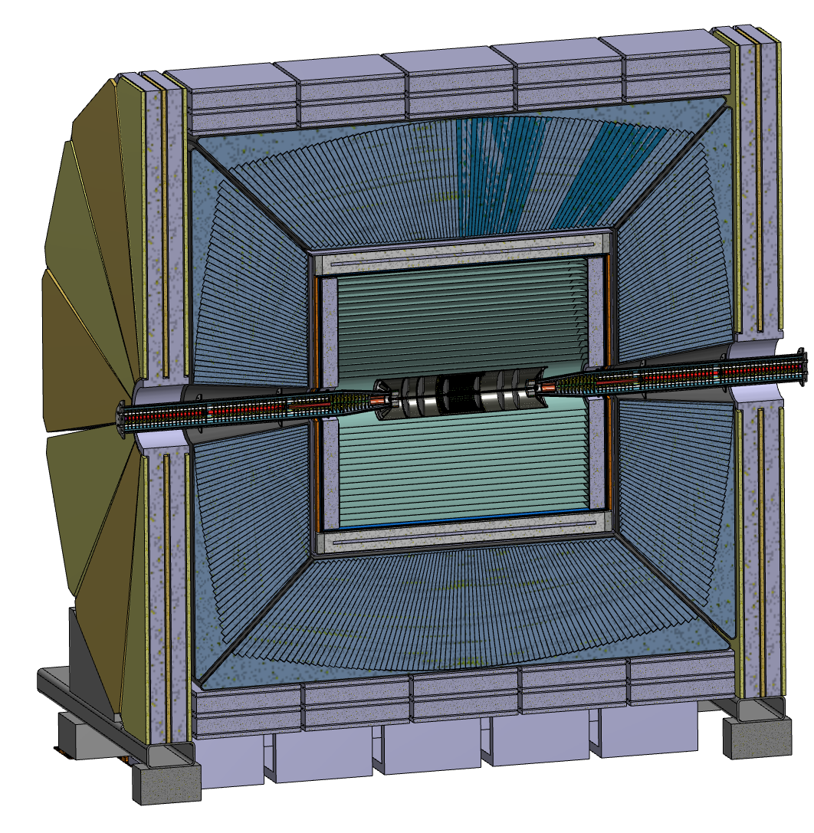
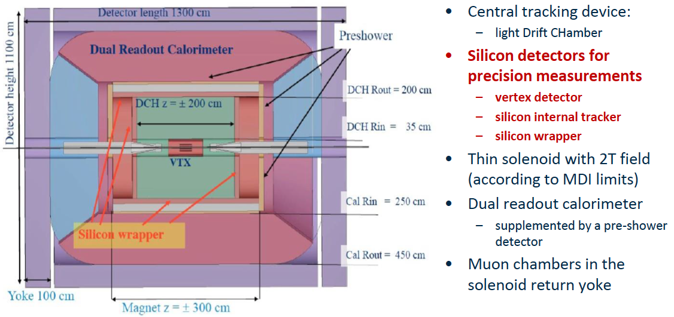
The IDEA Concept

Slide 3
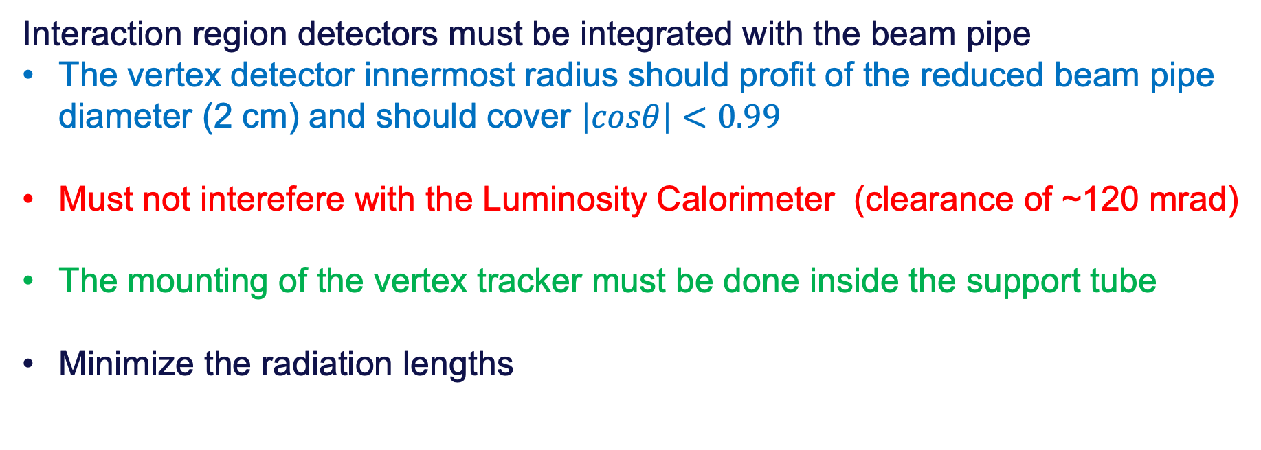
Requirements
Interaction region detectors must be integrated with the beam pipe
  The vertex detector innermost radius should profit of the reduced beam pipe diameter (2 cm) and should cover $\left|cosθ\right|<0.99$
  Must not interefere with the Luminosity Calorimeter (clearance of ~120 mrad)
  The mounting of the vertex tracker must be done inside the support tube
  Minimize the radiation lengths

Slide 4
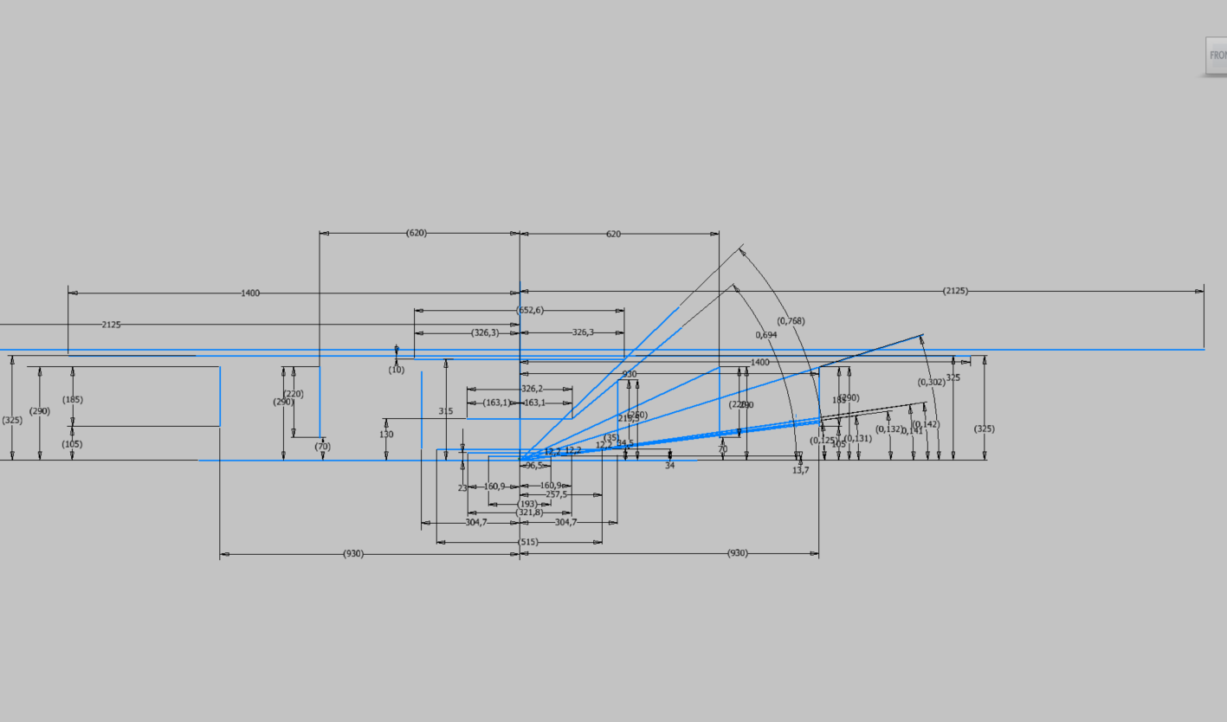
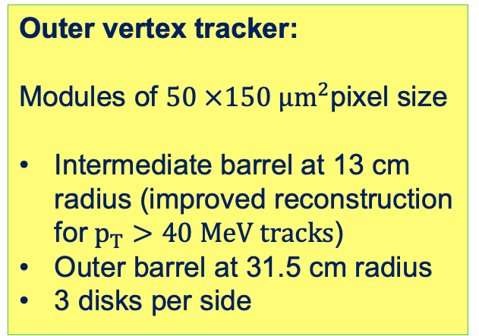
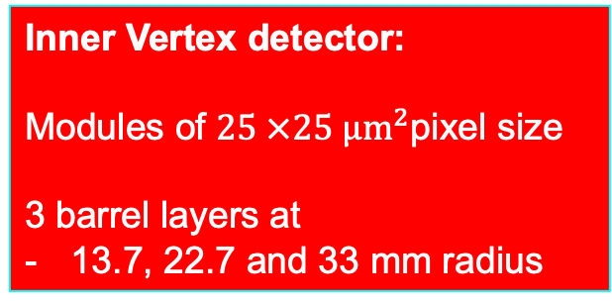
Outer vertex tracker:
Modules of $50 ×150 µm^{2}$pixel size
Intermediate barrel at 13 cm radius (improved reconstruction for$p_{T}>40 MeV tracks$)
Outer barrel at 31.5 cm radius
3 disks per side
EXSTERNAL CILINDER
OUTER TRACKER
MEDIUM TRACKER
DRIFT CHAMBER
DISK 3
DISK 1
DISK 3
Inner Vertex detector:
Modules of $25 ×25 µm^{2}$pixel size
3 barrel layers at
13.7, 22.7 and 33 mm radius
DISK 2
INNER TRACKER
DISK 2
DISK 1

Slide 5
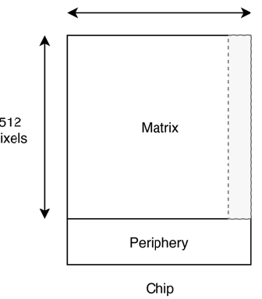
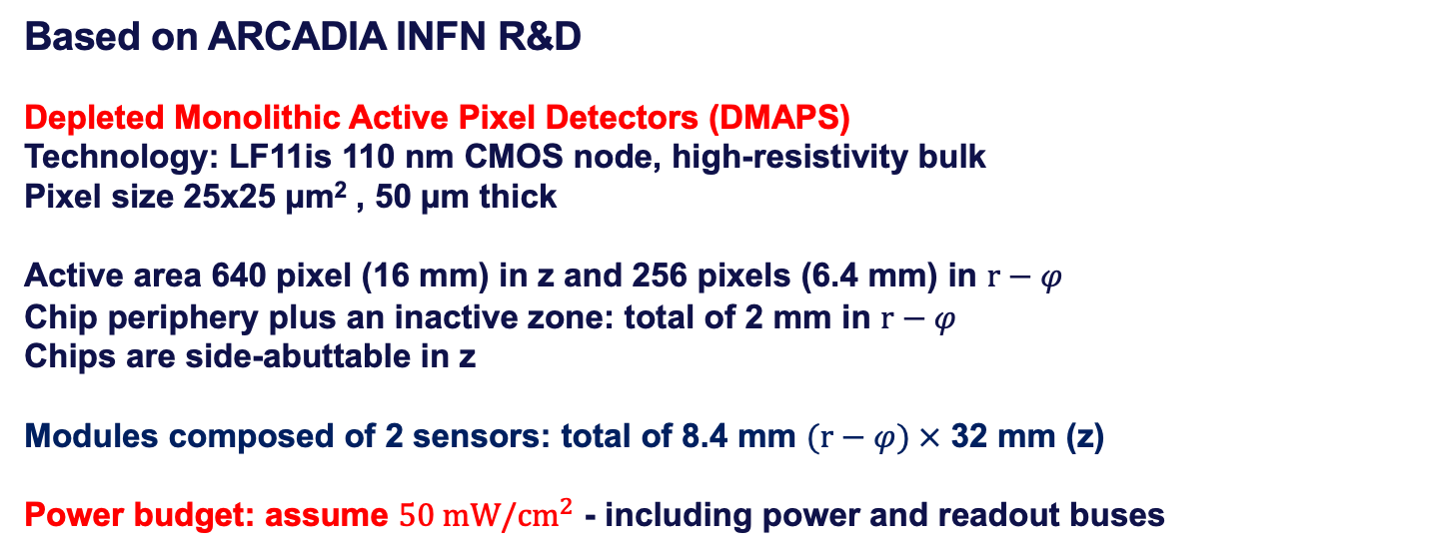
Inner vertex detector modules
"Fully Depleted MAPS in 110-nm CMOS Process With 100–300-μm Active Substrate," in IEEE Transactions on Electron Devices, June 2020, doi: 10.1109/TED.2020.2985639.
Based on ARCADIA INFN R&D
  Depleted Monolithic Active Pixel Detectors (DMAPS)
  Technology: LF11is 110 nm CMOS node, high-resistivity bulk
  Pixel size 25x25 µm² , 50 µm thick
  Active area 640 pixel (16 mm) in z and 256 pixels (6.4 mm) in $r−φ$
  Chip periphery plus an inactive zone: total of 2 mm in $r−φ$
  Chips are side-abuttable in z
Modules composed of 2 sensors: total of 8.4 mm $(r−φ) ×$ 32 mm (z)
  Power budget: assume $50 mW/{cm}^{2}$ - including power and readout buses
See talk by A. Andreazza
High rate capability (100 MHz/cm2) architecture on a scalable 512x512 pixel matrix (25µm pitch) MD3 Main Demonstrator chip: measured 30 mW/cm² at full-speed
z 640 pixel
32 mm
Chip 1
Chip 2
R-phi 256 pixel
8.4 mm
Readout

Slide 6
Layer 1
15 overlapping staves of 6 modules each
Overlap to allow alignment ~500 µm
Pinwheel geometry: all modules at the same (smallest) radius
Power budget ~12 W
Total weight ~22 grams
Total thickness 0.25% X₀
Silicon: 0.053% X₀
Power and readout bus: 0.056% X₀

Slide 7
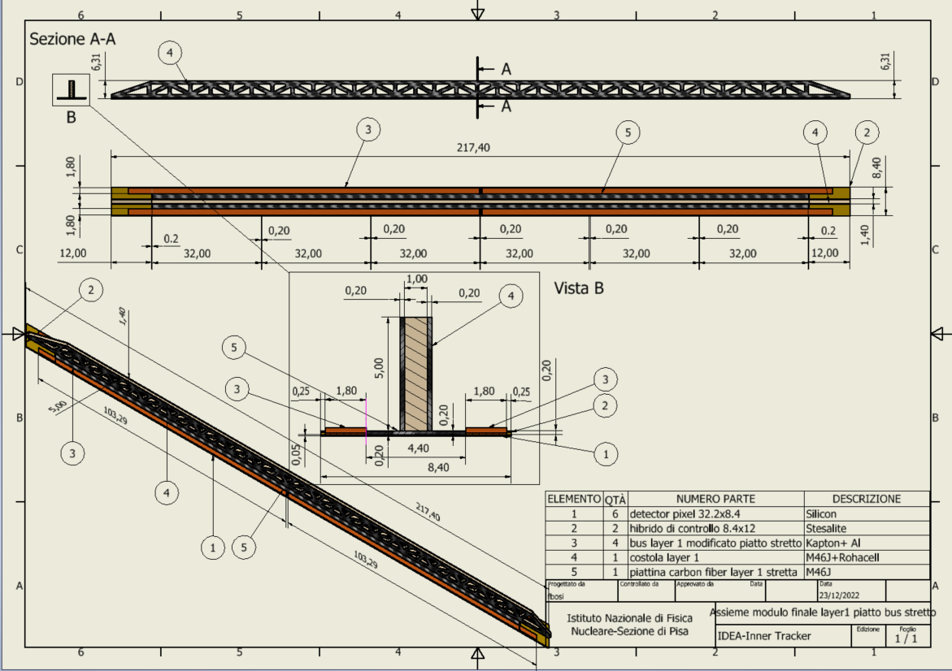
Layer 1 stave detail
Reticular lightweight support to provide stiffness
Thin carbon fiber walls interleaved with Rohacell
2 buses (data and power) 1.8 mm wide and 250 µm thick (50 µm Al, 200 µm kapton) per side
  Inspired to low mass hybrid R&D
Sensors facing interaction point w/o any other material in front
Readout chips either sides
Air cooled

Slide 8
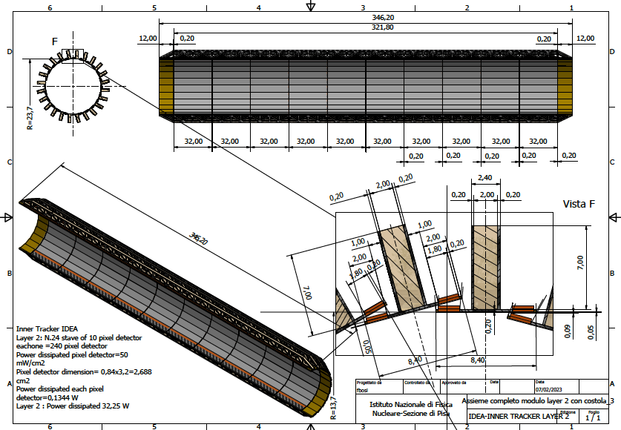
Layer 2
24 overlapping staves of 10 modules each
Pinwheel geometry
Counter-rotated wrt layer 1 to mitigate charge-asymmetry effects in track reconstruction
Power budget
~32 W
Total weight ~63 grams
Total thickness 0.25% X₀

Slide 9
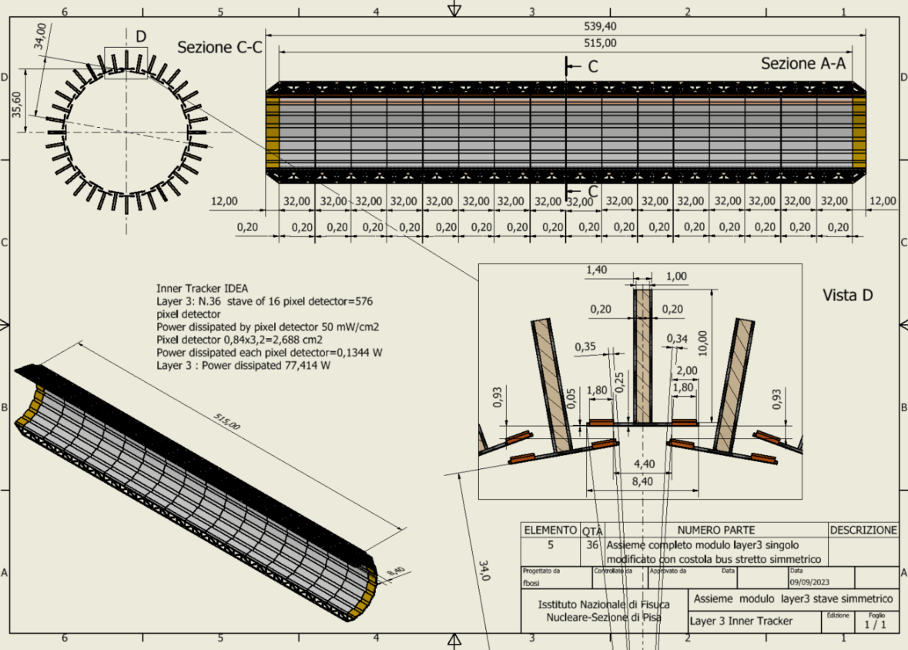
NEW
Layer 3
36 staves of 16 modules each
Lampshade geometry.
Charge symmetric track reconstruction
Total weight ~150 grams
Total thickness 0.25% X₀
Power budget
~77 W

Slide 10
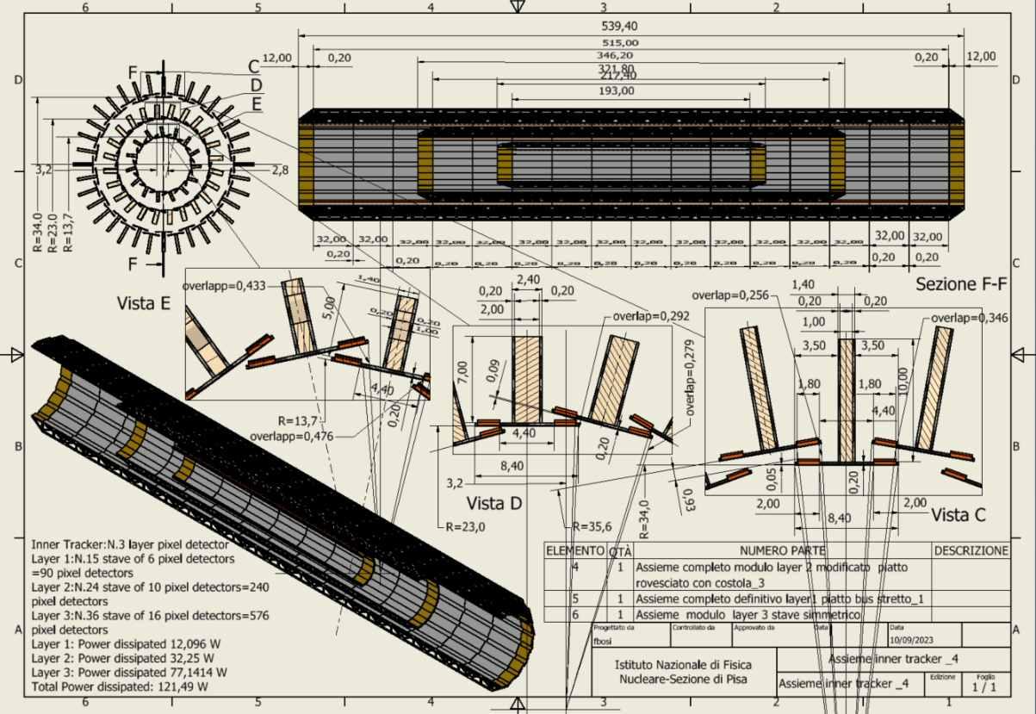
Overall Inner Vertex layout
NEW
Total power ~120 W
Total weight ~230 grams

Slide 11
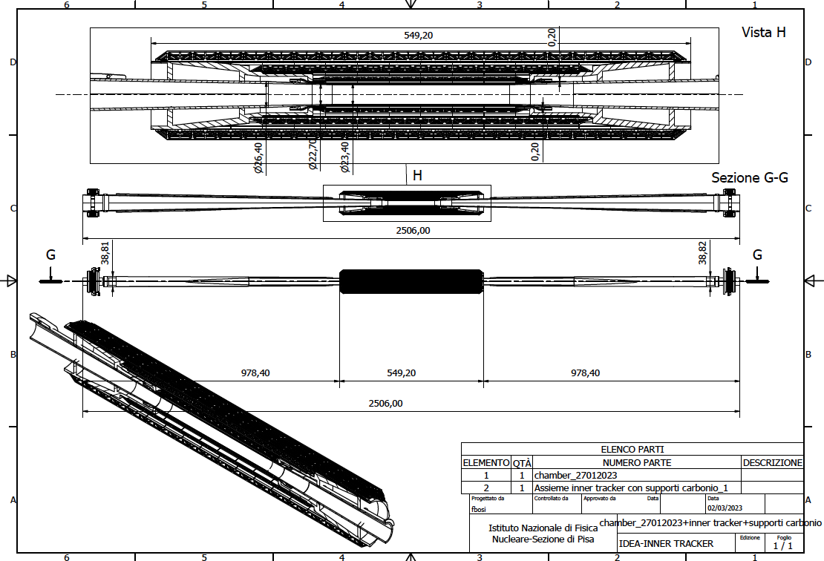
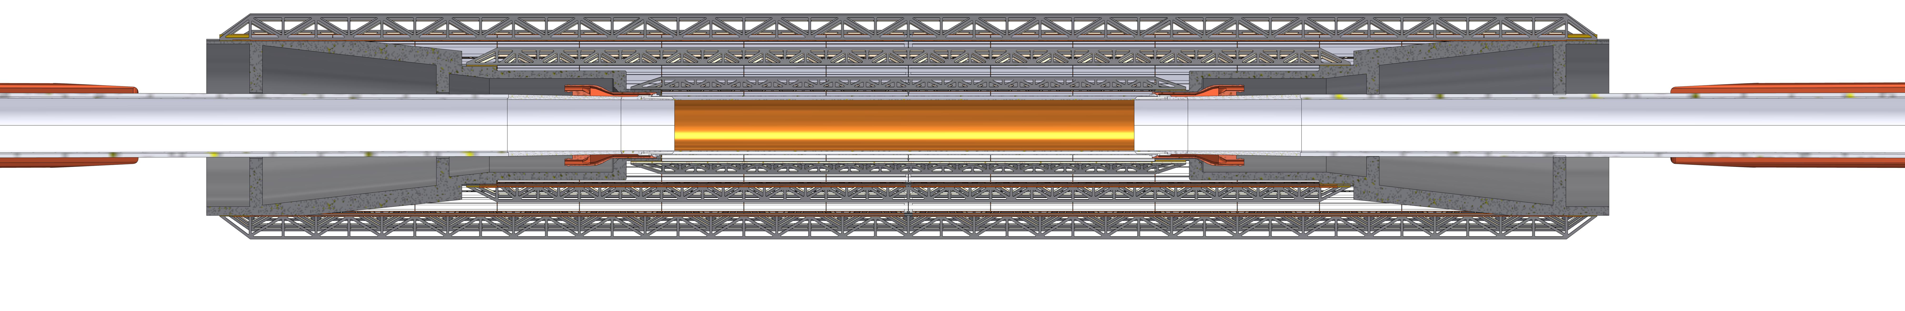
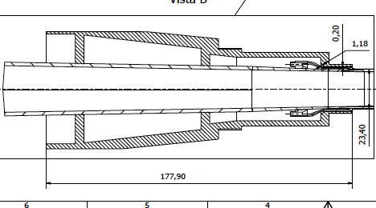
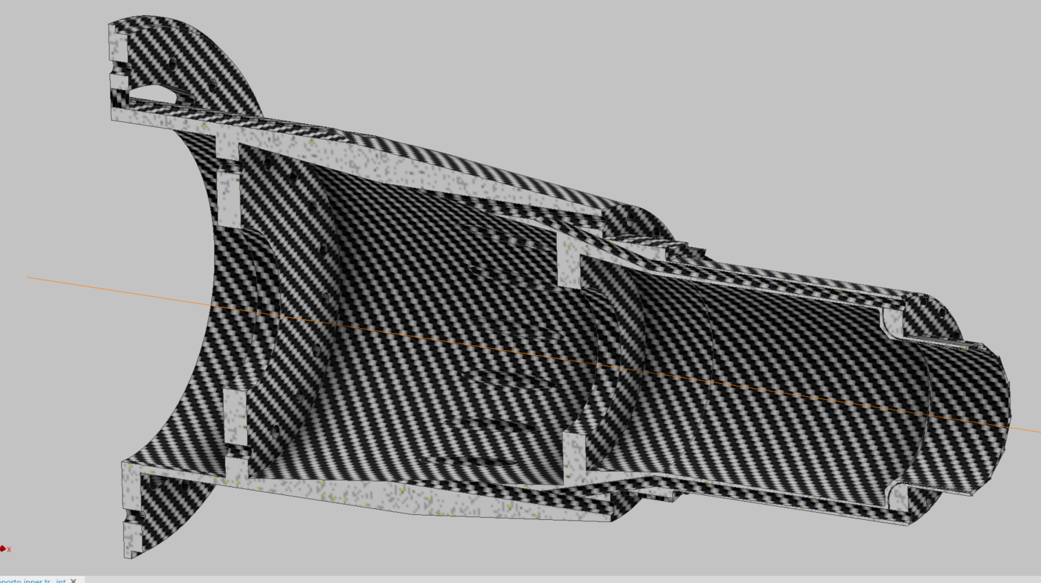
Inner vertex detector supporting conical structures on elliptical chamber
~450 grams
Engineered for air ducts and thermal isolation from the beam pipe during bakeout
Cooling Third layer
Cooling Second Layer
Cooling First Layer
Cooling Pipe

Slide 12
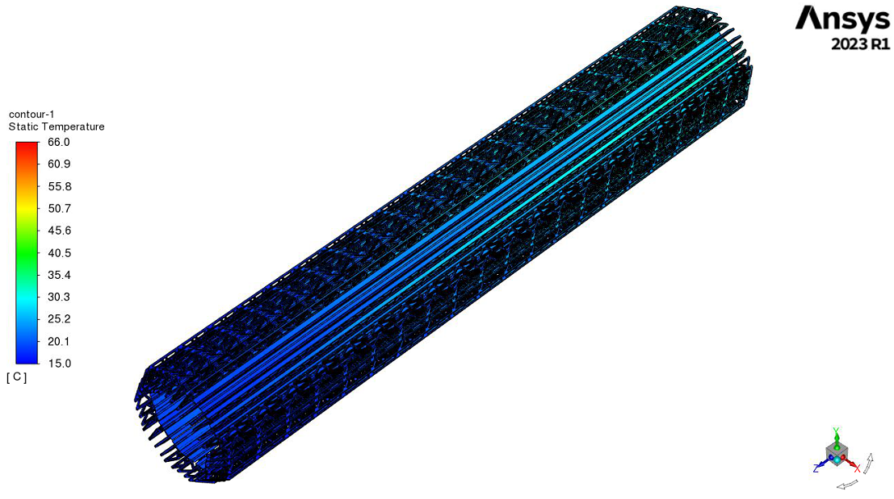
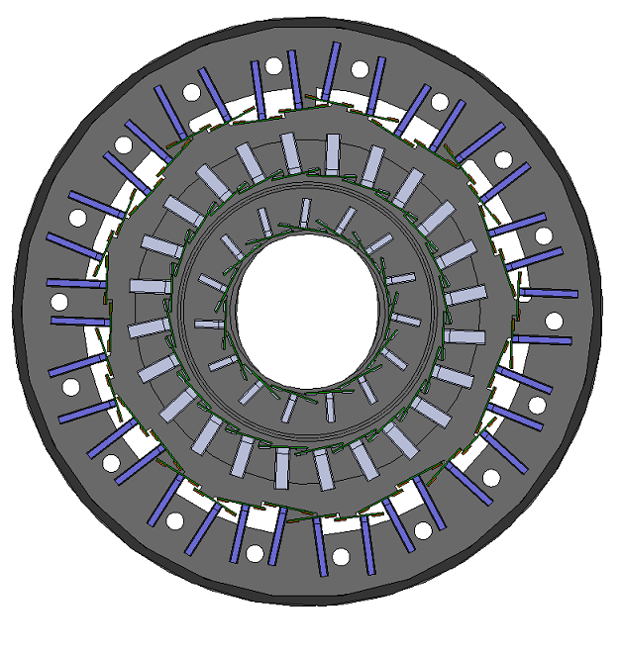
Thermal simulation in progress
INFN Perugia
G. Baldinelli, F. Bianchi, C. Turrioni
Start from a radial sector of layer 3 (relying on periodic symmetry) and import in ANSYS FEA. Then move to all other layers
Layer 3 is the toughest in power dissipation and length
Optimisation of the system ongoing: (speed and T of air, direction of the inlet flow, connection with the other layers, etc…)
A mechanical vibrational analysis will be performed
Experimental validation of the simulations foreseen
Full model
Extraction of a radial sector for layer 3

Slide 13
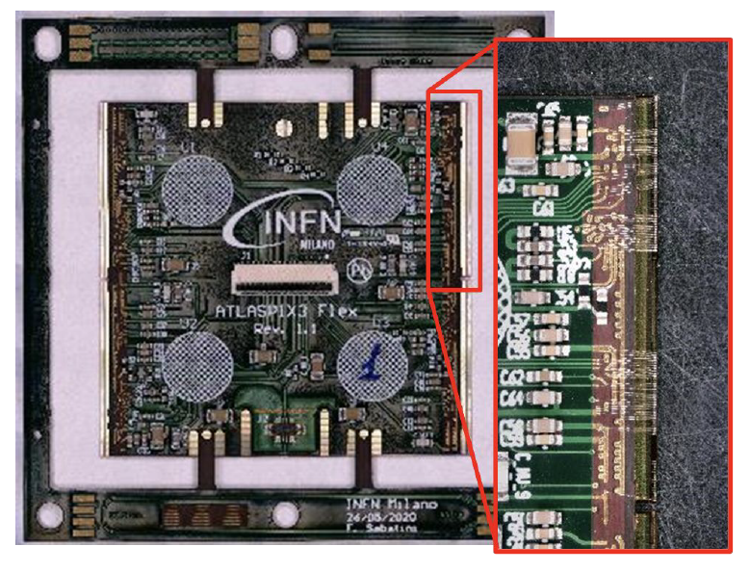
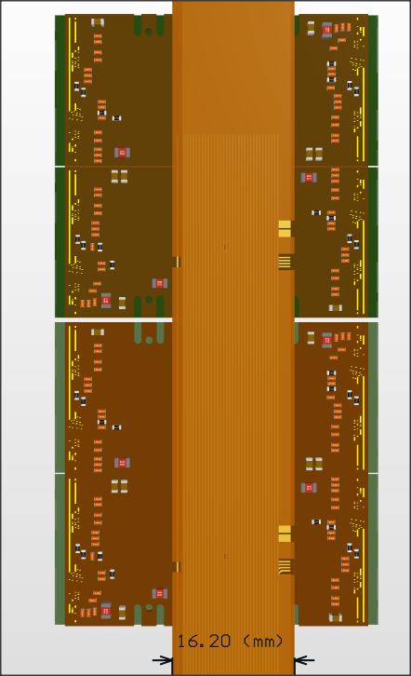

Outer vertex layers modules
Based on ATLASPIX3 R&D
  DMAPS
  50 x 150 µm²
  Up to 1.28 Gb/s downlink
  TSI 180 nm process
  132 columns of 372 pixels
  Active (total) length (r-phi x z)
    18.6 (21) mm x 19.8 (20.2) mm
  Module is made of 2x2 chips – total length:
    size 42.2 mm x 40.6 mm
  Power budget not established yet:
    assume $100 mW/{cm}^{2}$
Power
For details see A. Andreazza talk
HV
Data IN/OUT

Slide 14
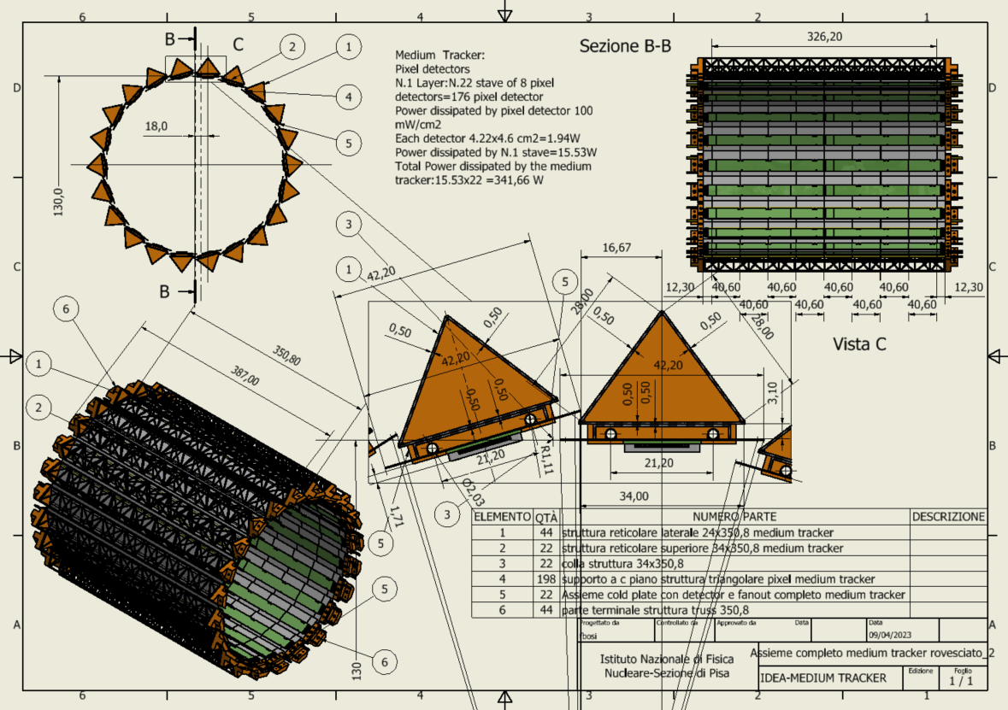
Middle Vertex Barrel
At 13 cm radius
22 staves of 8 modules each.
Lightweight reticular support structure (ALICE/Belle-II like)
Readout chips either side
Power budget
~342 W
Total weight ~1 kg
Water cooled (2 pipes of 2 mm diameter)

Slide 15
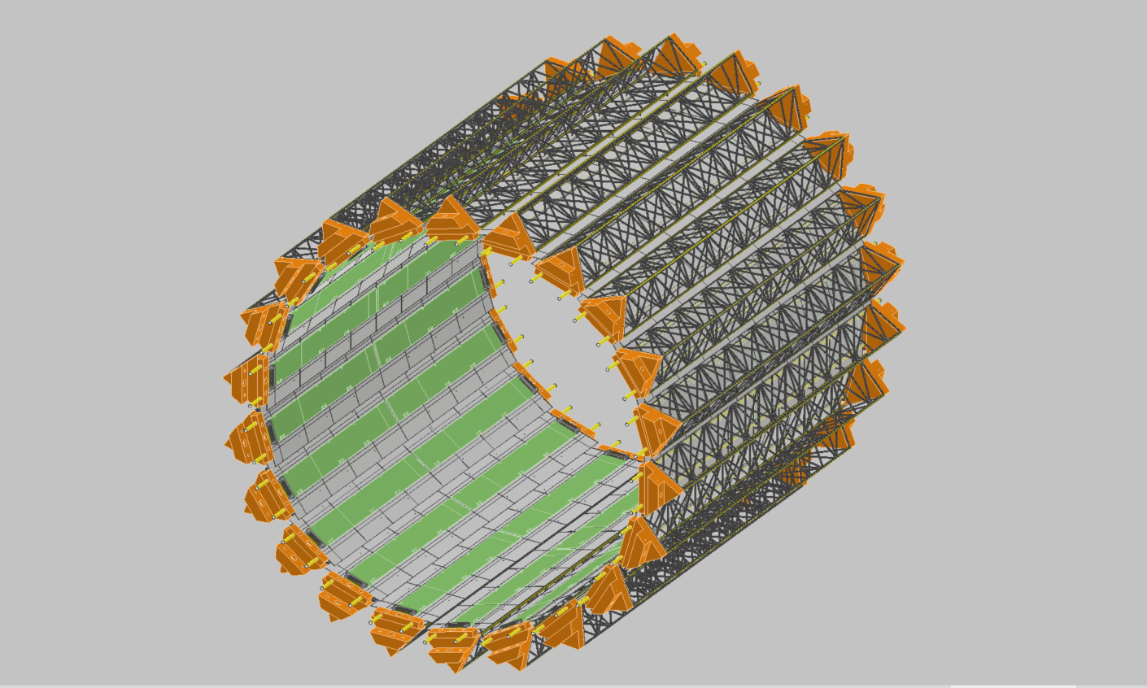
MIDDLE TRACKER

Slide 16
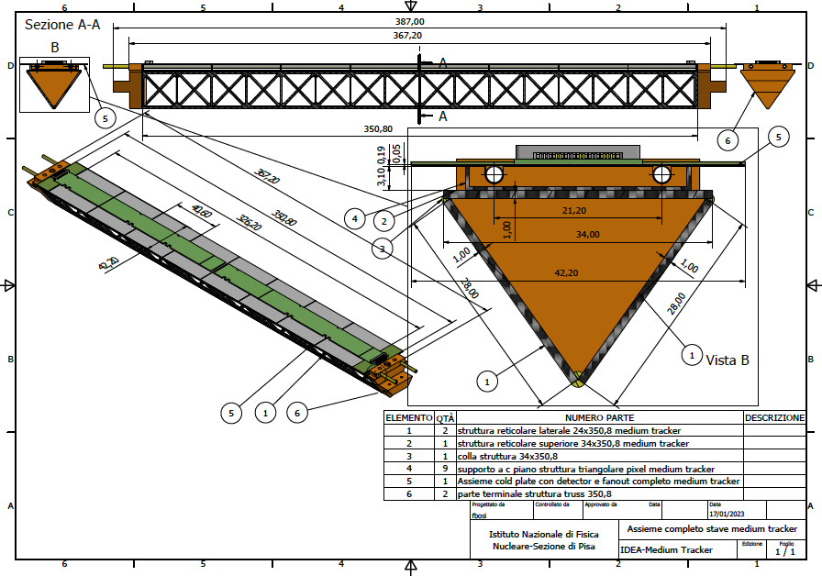
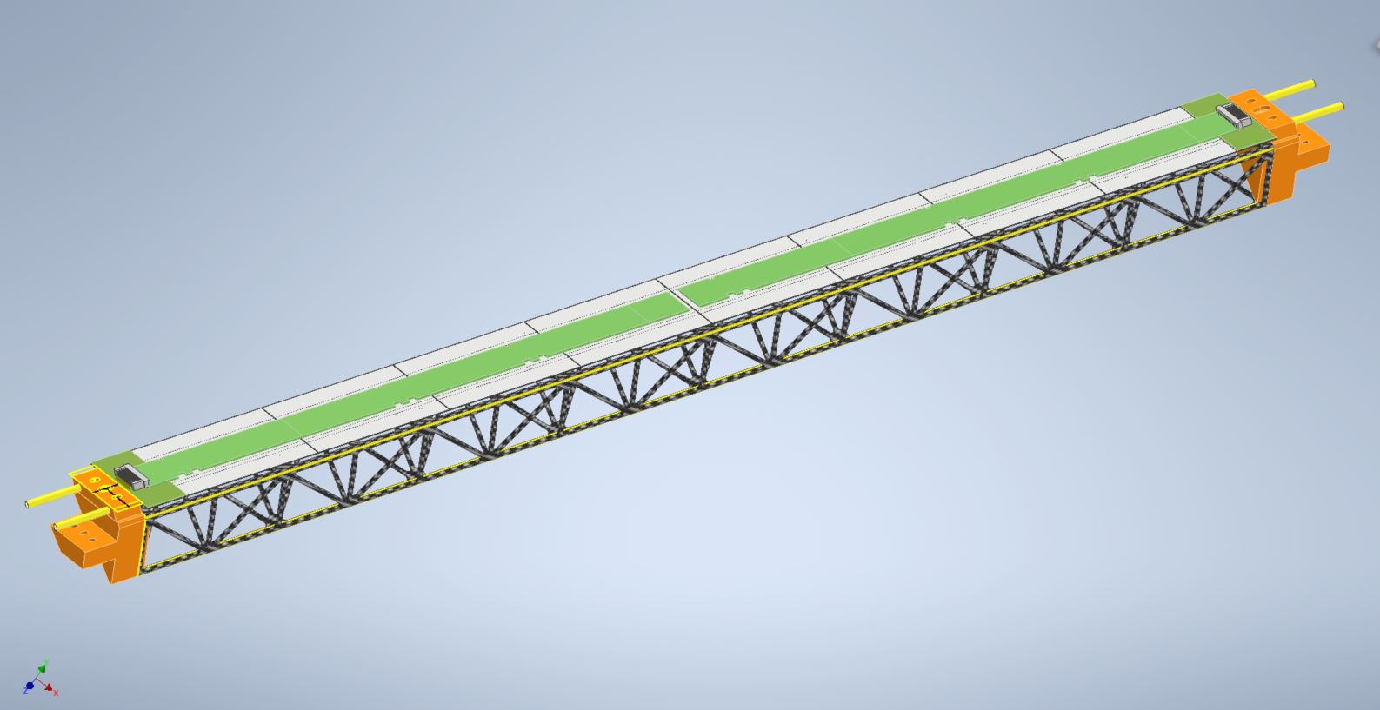
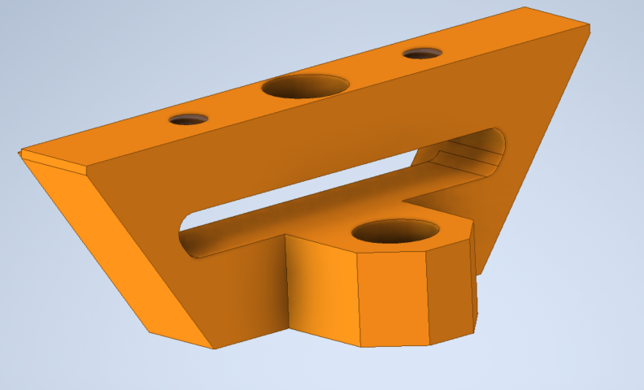
Stave detail

Slide 17
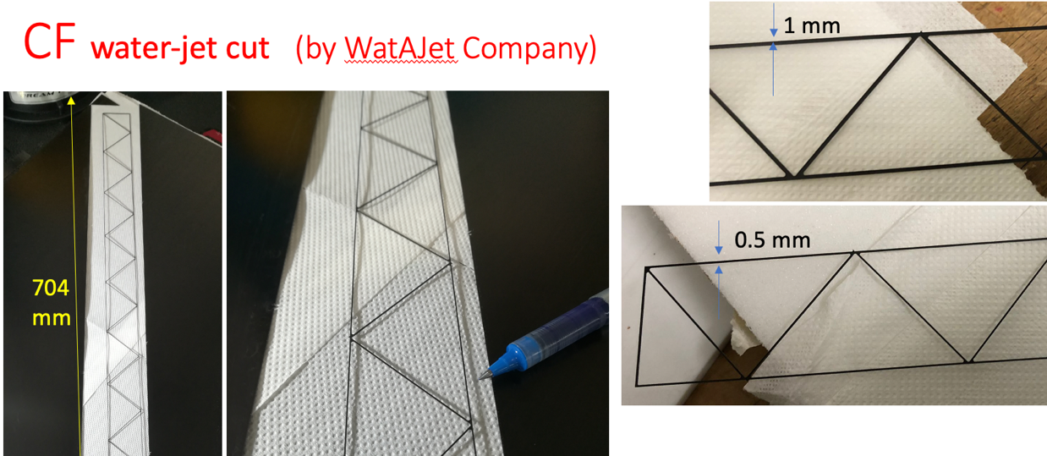
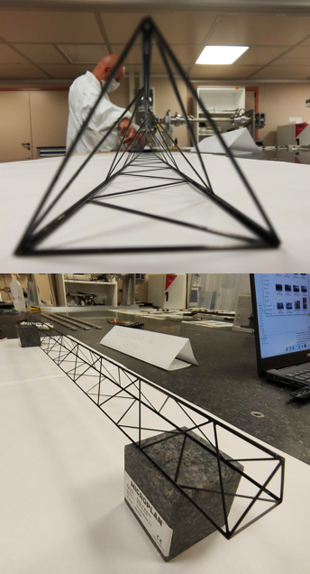
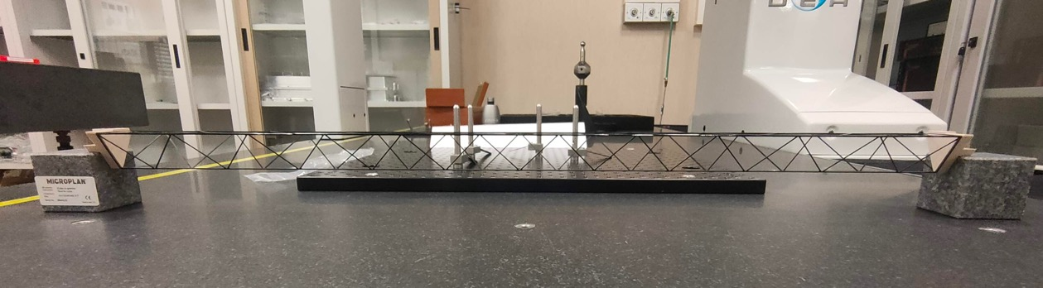
Prototypes built for Belle II upgrade in Pisa

Slide 18
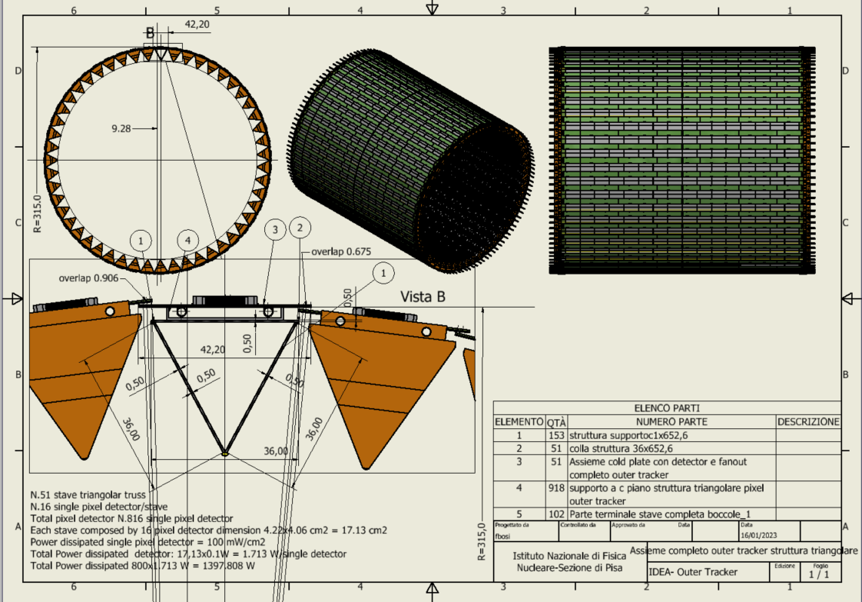
Outer Vertex Tracker Barrel
At 31.5 cm radius
51 staves of 16 modules each
Lightweight reticular support structure (ALICE/Belle-II like)
Total weight ~3.7 kg
Readout chips either side
Power budget
~1400 W
Water cooled (2 pipes of 2 mm diameter)
Notes:
NB. Qui la struttura reticolare deve stare giù perché sennò non si riesce ad ottenere il raggio esterno più grande e vicino alla DCH.

Slide 19
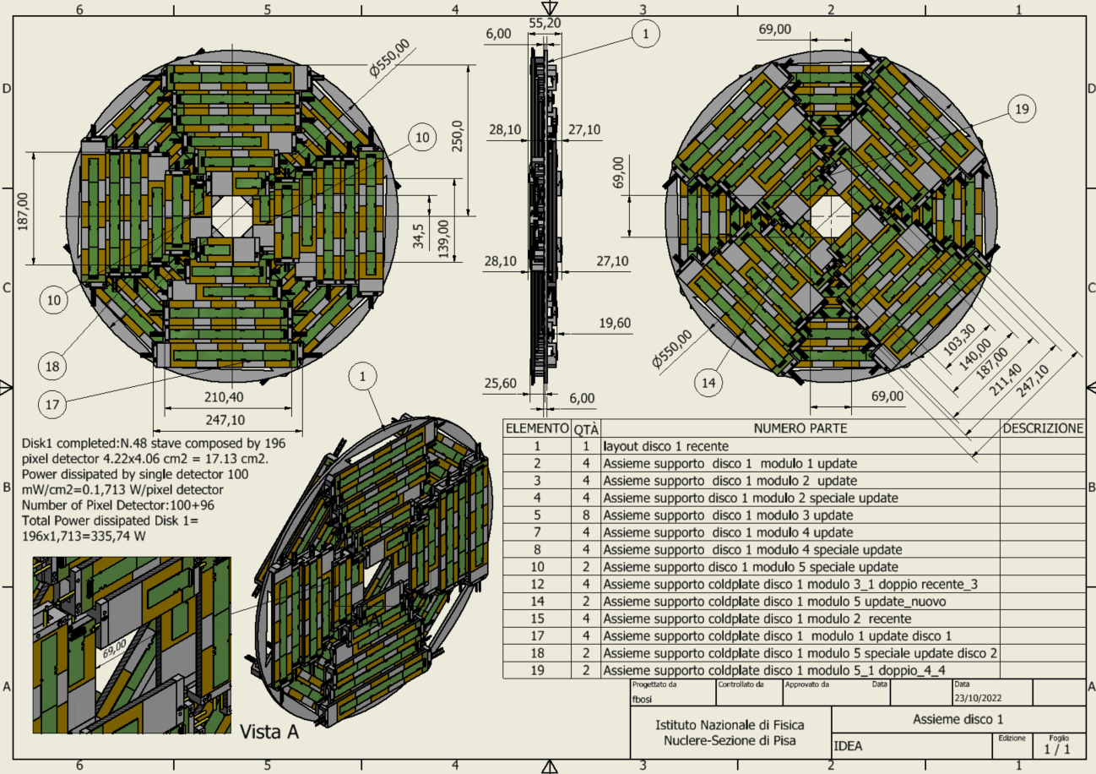
Outer Vertex Tracker Disk 1
2 sides (front and back) each with 4 petals.
One petal is made of different staves of overlapping modules
Total modules per disk: 196
Total weight ~850 grams
Power budget ~ 336 W
Cooling using 1 water pipe (2 mm diameter)
Similar geometry for the other two disks

Slide 20
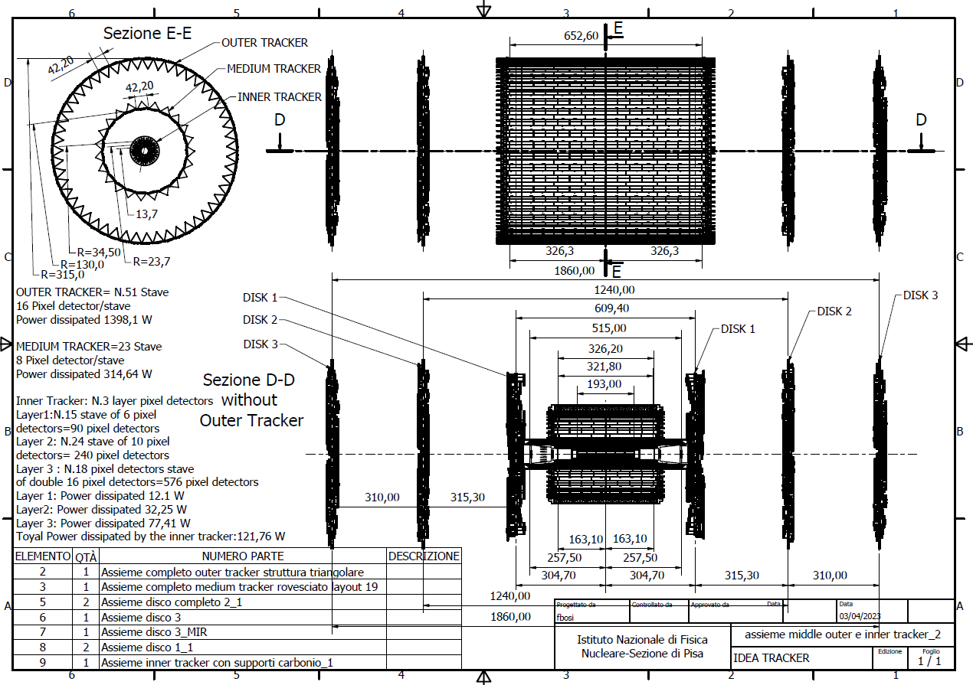
Overall layout and dimensions

Slide 21
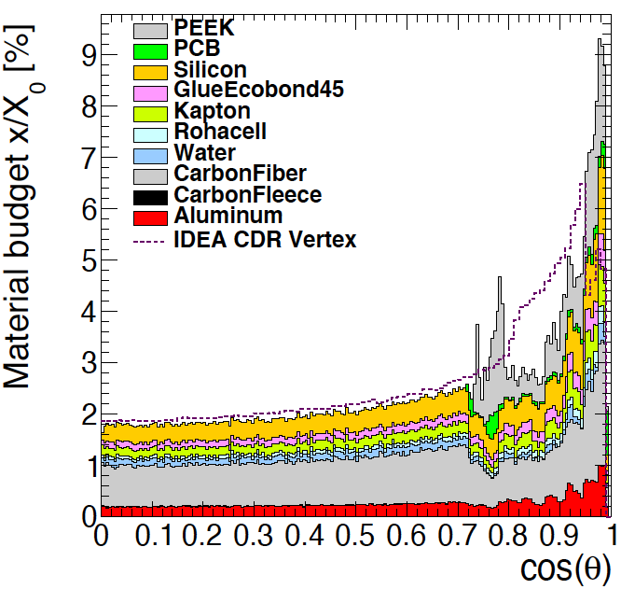
Simulated material budget
Armin Ilg
In agreement with CAD estimates
Smaller X/X₀ wrt IDEA CDR estimates
even including power and readout
cables in the sensitive region
Silicon only ~15% of the total

Slide 22
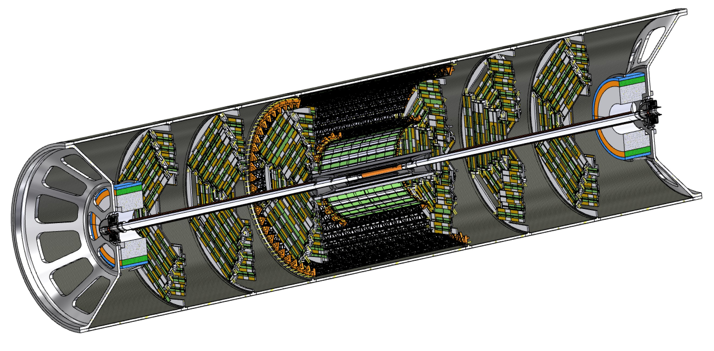
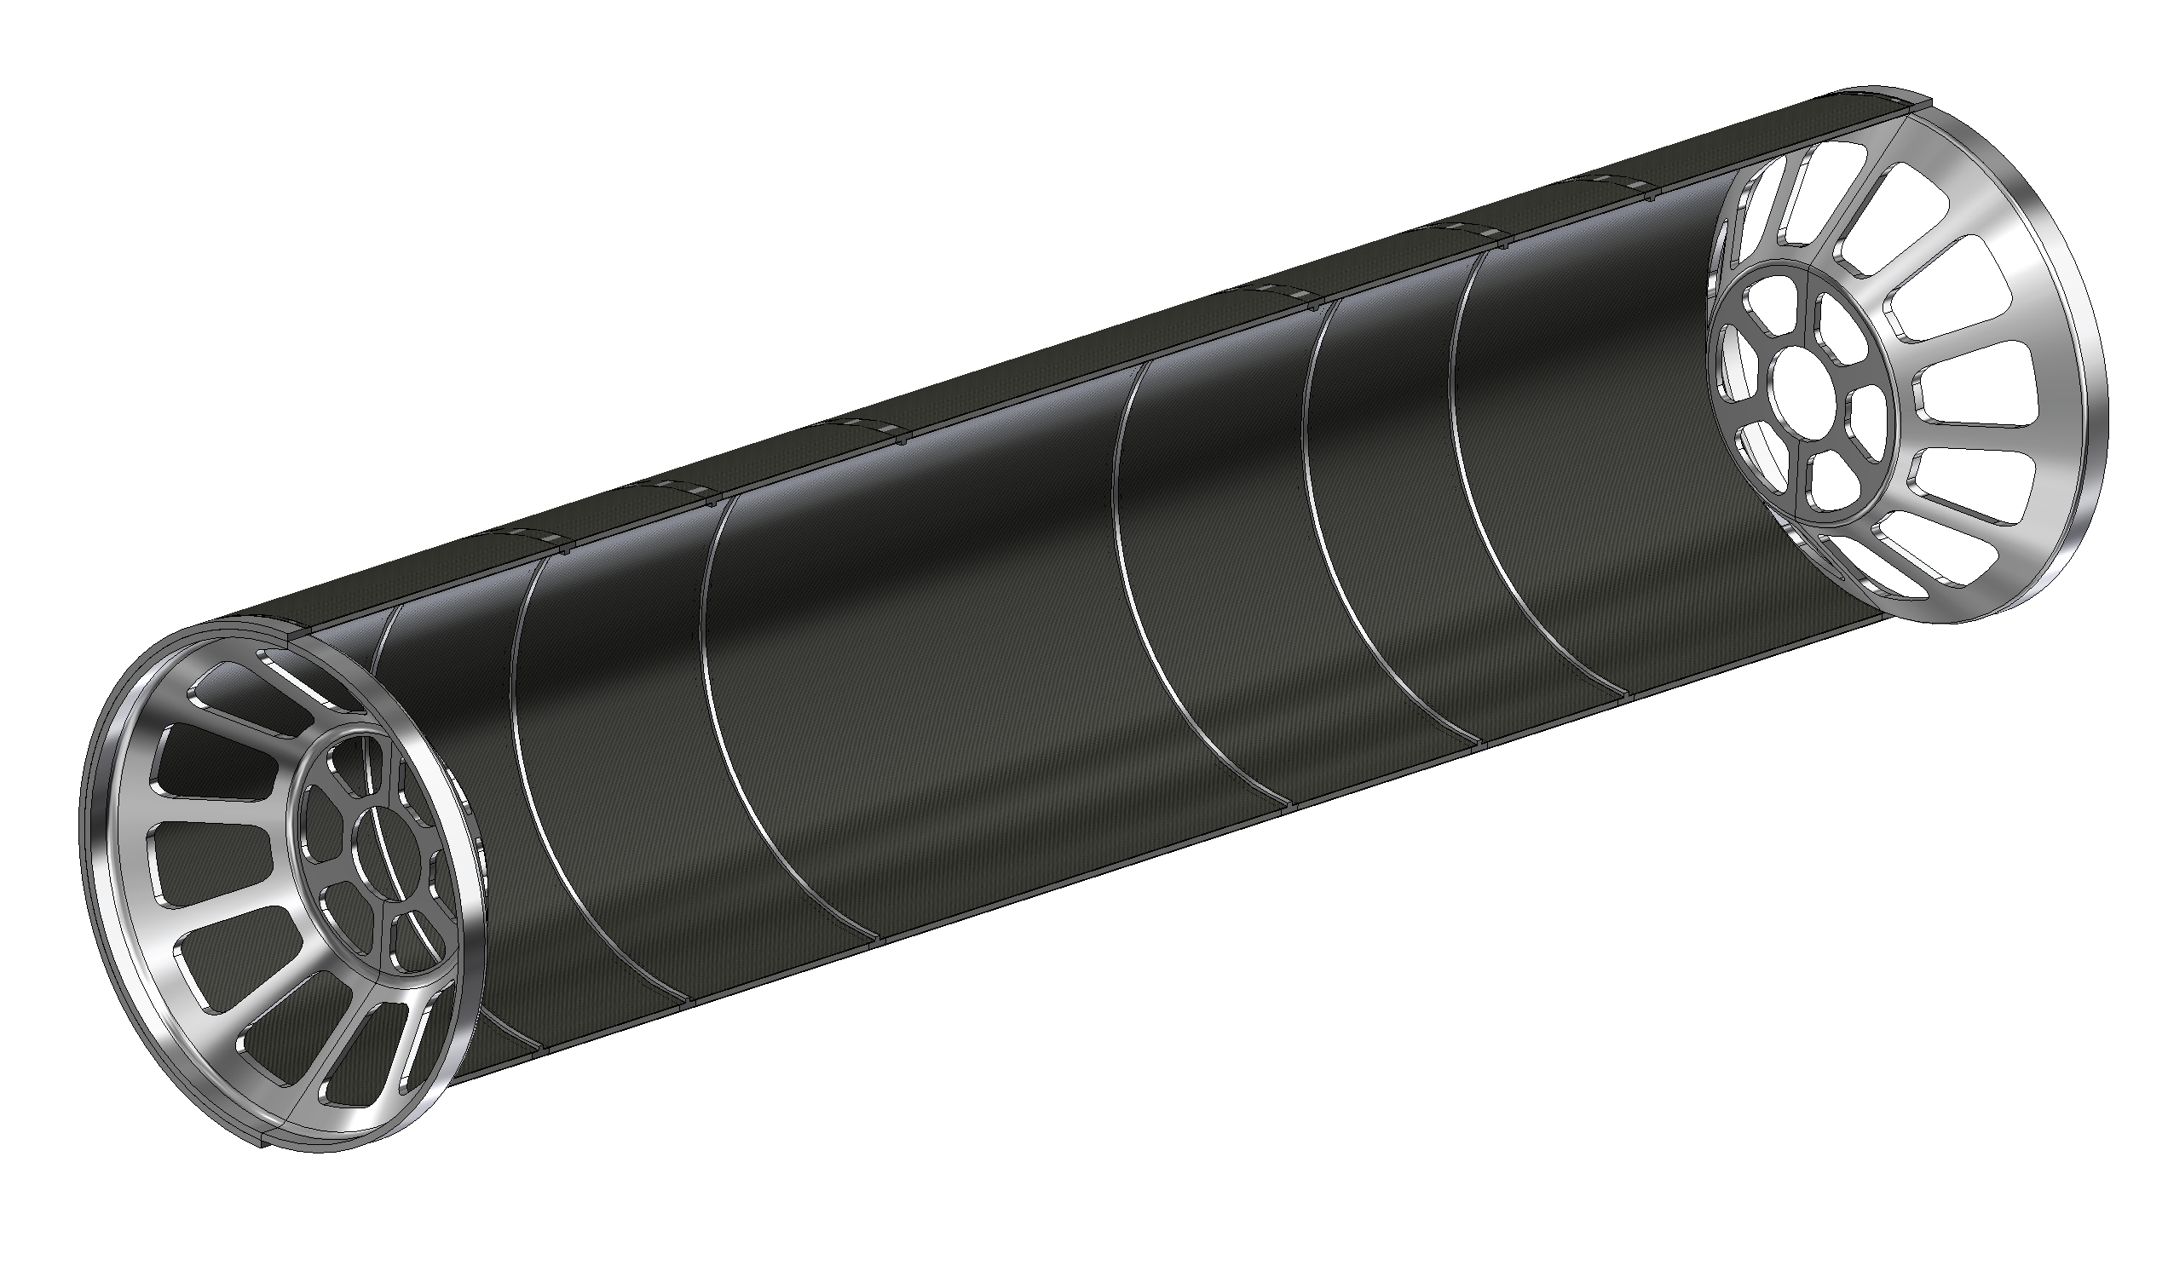
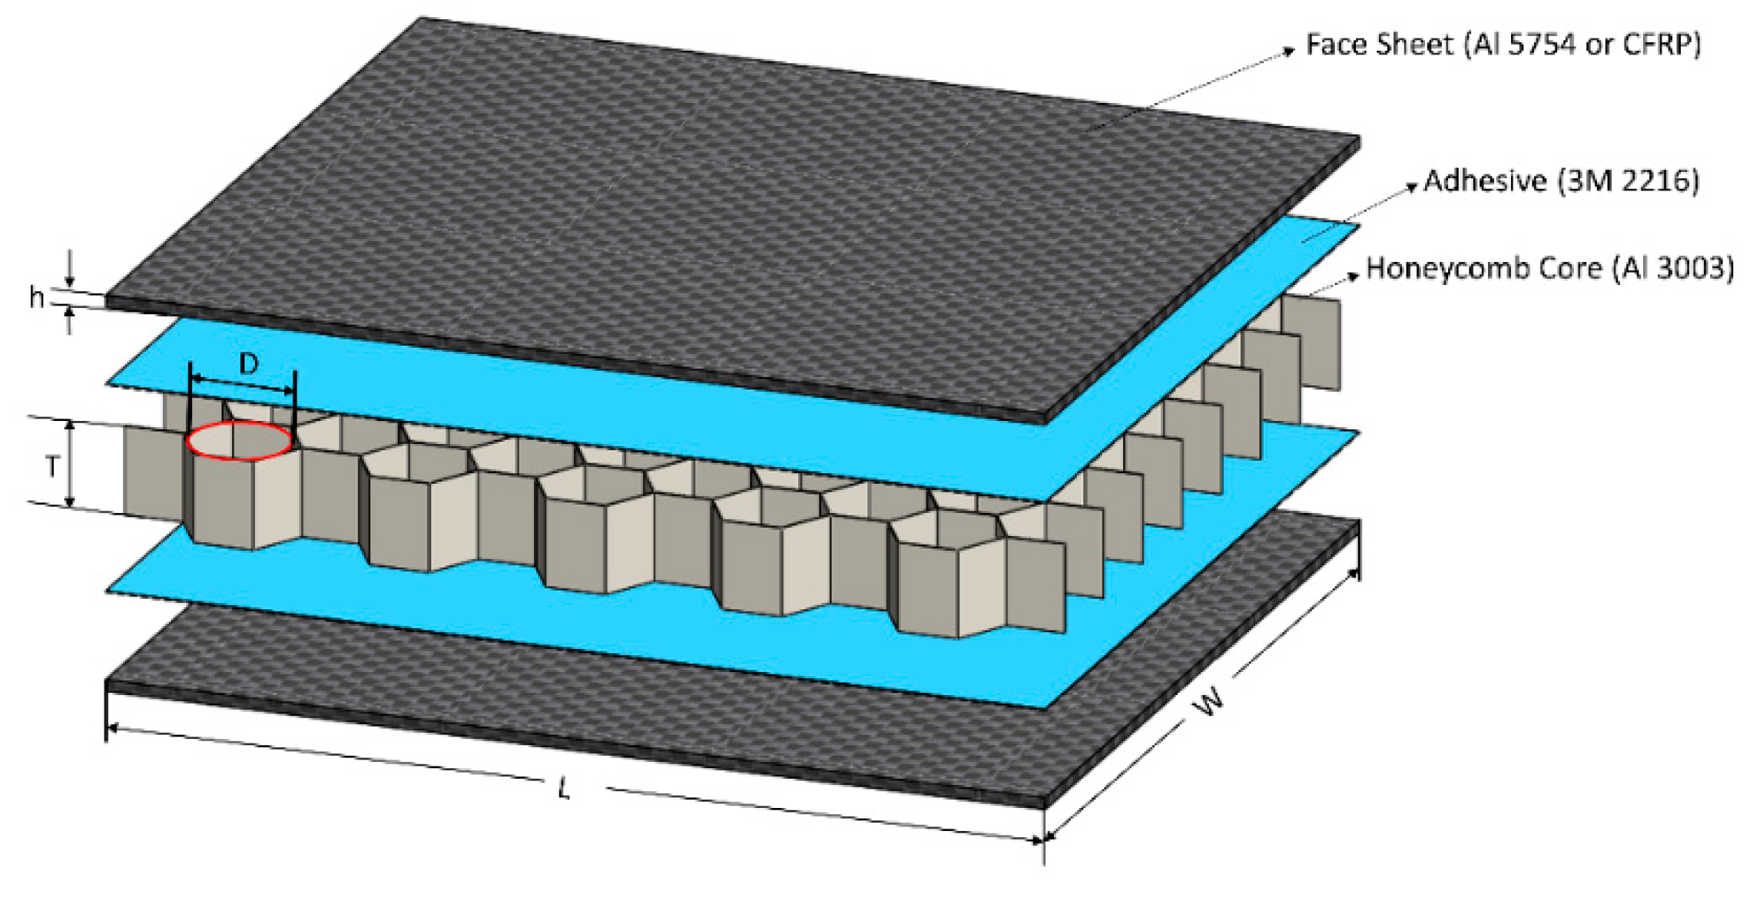
Support cylinder
All elements in the interaction region (Vertex and LumiCal) are mounted rigidly on a support cylinder that guarantees mechanical stability and alignment
  Once the structure is assembled it is slided inside the rest of the detector
  Studies on-going where to anchor it (most likely to the Calorimeter)
Aluminium endcaps
Aluminium ribs
1mm CF + 4mm HC + 1mm CF

Slide 23
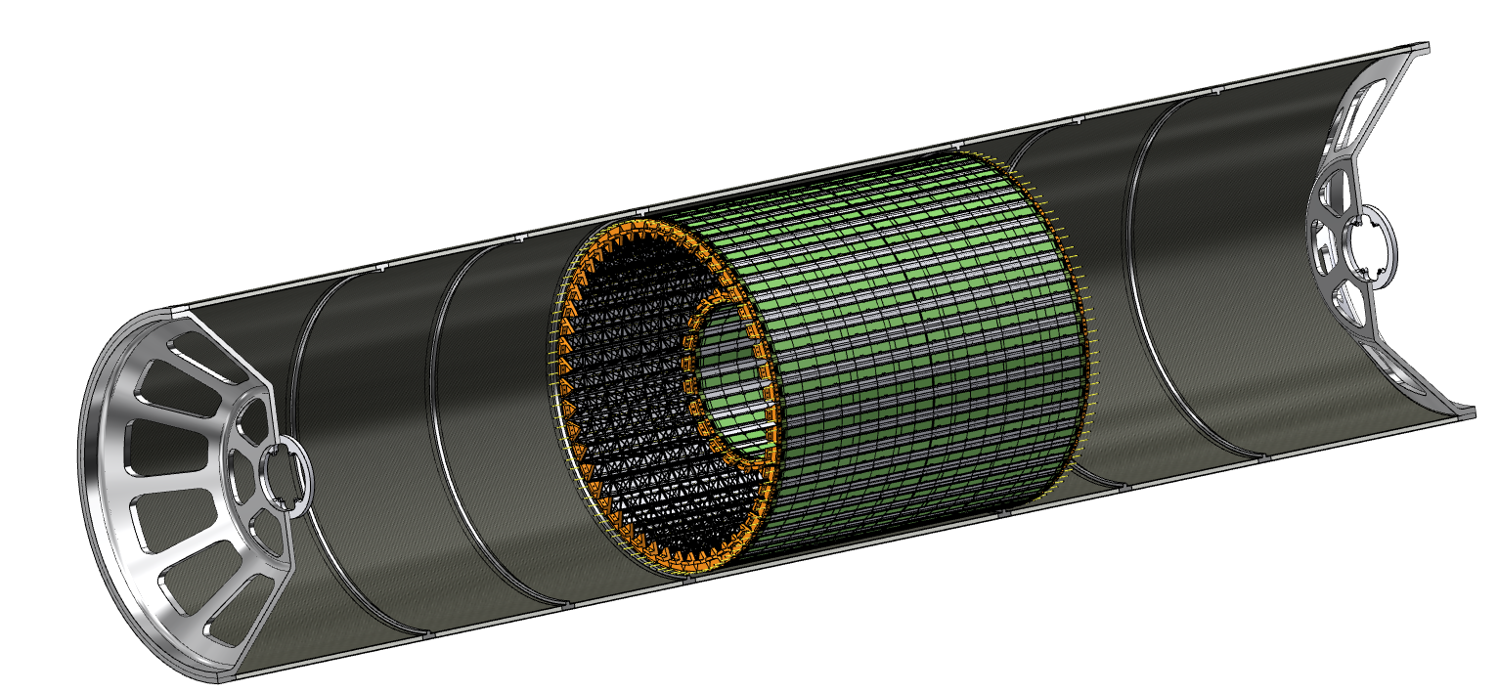
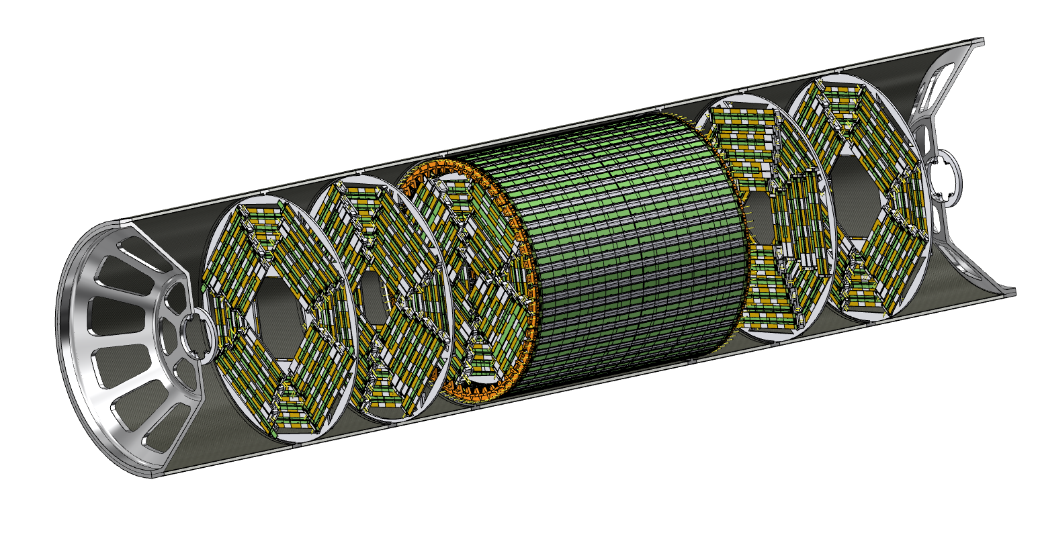
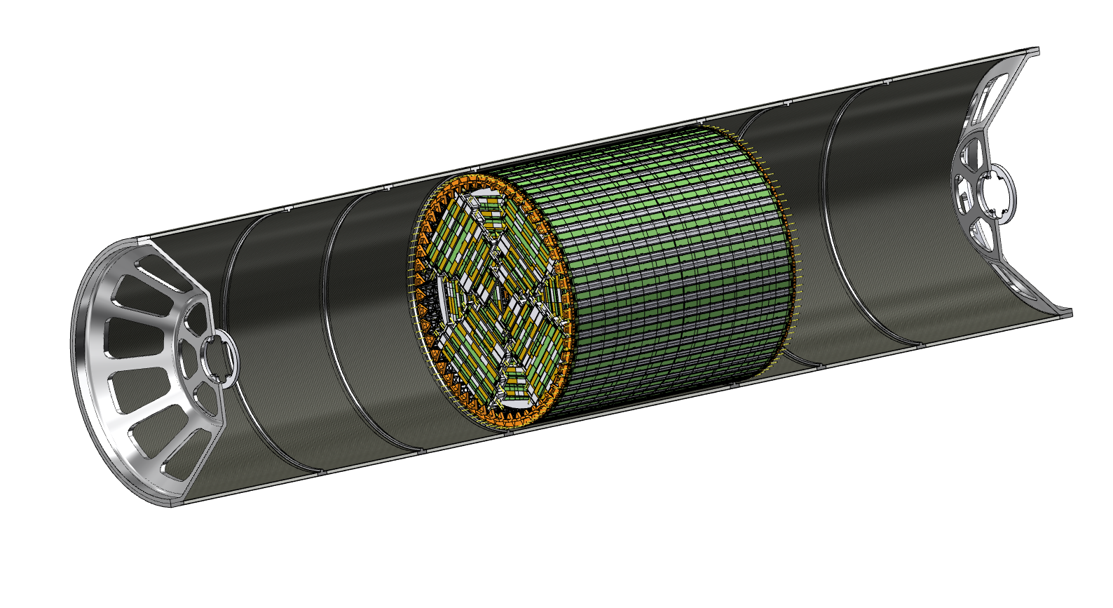
Assembly procedure – I
1) Outer vertx tracker, middle vertex tracker and disks 1 are installed as a rigid structure inside the support tube
2) Disks 2 and 3 are installed inside the support tube

Slide 24
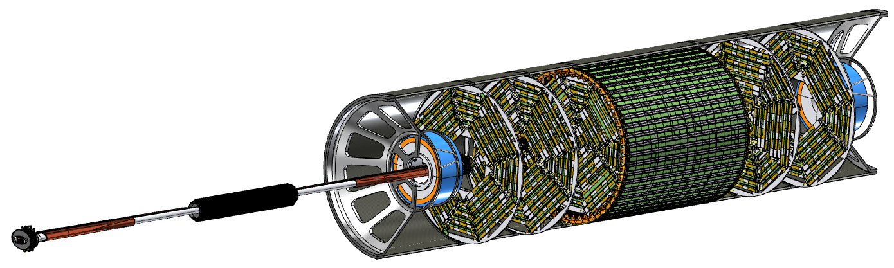
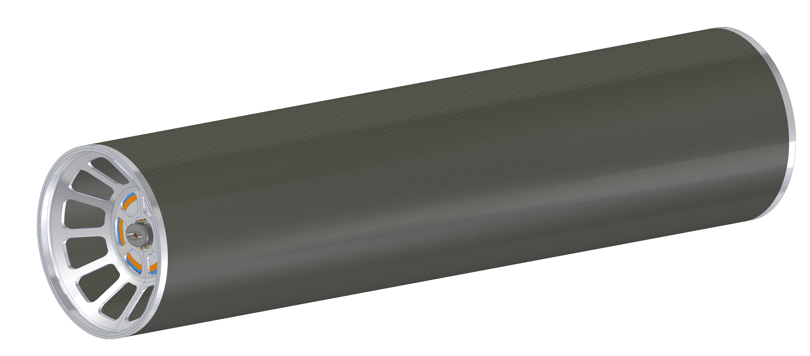
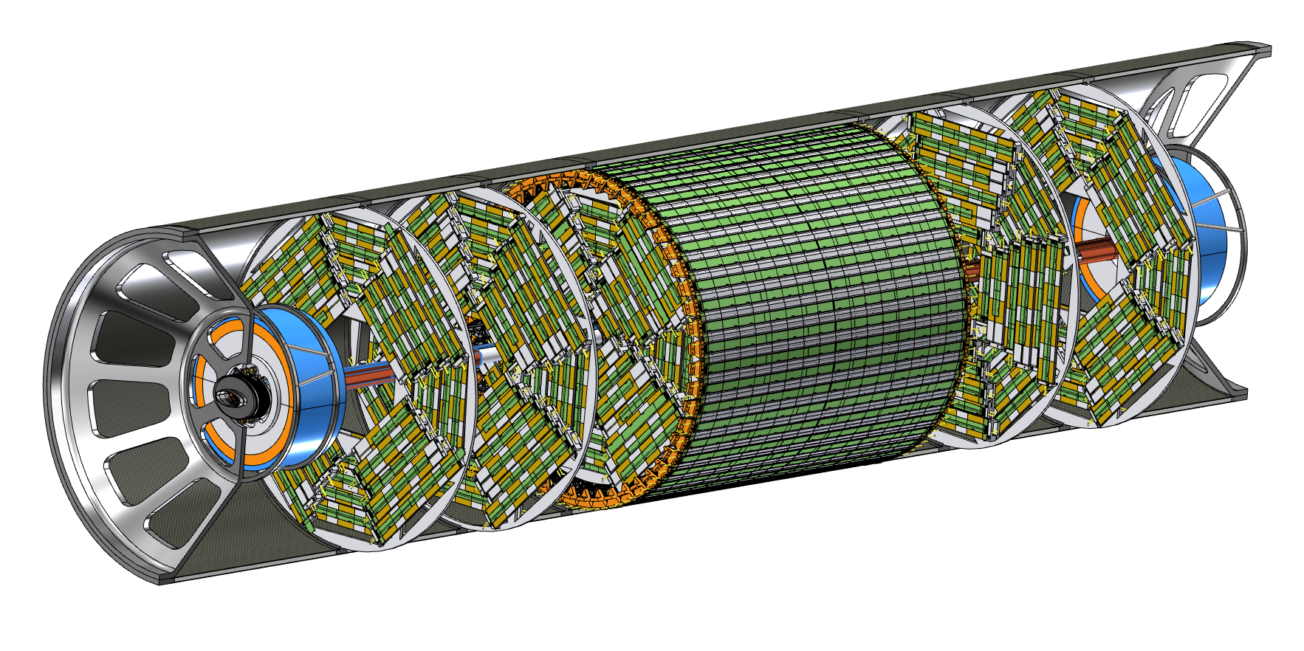
Assembly procedure – II
3) LumiCal is installed in centered position, then beam pipe with inner vertex detector is inserted with a dedicated tool inside disks and outer vertex tracker, then fixed to both endcaps
4) LumiCal can be aligned in the correct position on the outgoing beams
5) Support tube can be closed

Slide 25
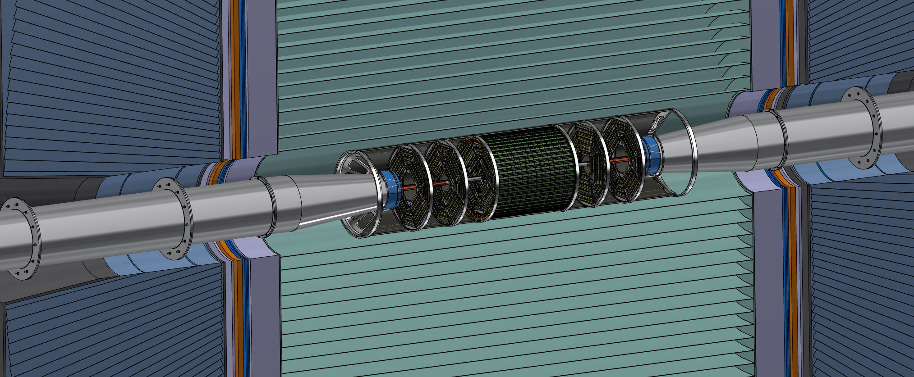
General integration
    M. Boscolo, F. Palla, F. Fransesini, F. Bosi and S. Lauciani, Mechanical model for the FCC-ee MDI, EPJ Techn Instrum 10, 16 (2023). https://doi.org/10.1140/epjti/s40485-023-00103-7

Slide 26
Conclusions
A layout of the interaction region with LumiCal and vertex trackers of the IDEA detector has been engineered
  Feasibility studies of integration successfully done including mounting sequence
  Documented in
    M. Boscolo, F. Palla, F. Fransesini, F. Bosi and S. Lauciani, Mechanical model for the FCC-ee MDI, EPJ Techn Instrum 10, 16 (2023). https://doi.org/10.1140/epjti/s40485-023-00103-7
Next/ongoing steps:
  Inner Vertex detector
    Study thermal isolation from the beampipe bakeout in progress
    Study the routing of the services (readout and power cables) in progress
  Outer Vertex Tracker
    Study the routing of the services (readout and power cables, cooling manifolds) in progress

Slide 27
Thank you for your attention.
Date / Name of the event
Name of the speaker/author
Space for additional logos
27

Slide 28
Backup

Slide 29
Half-ladder layout – layer 1
96.5 mm
Chip 1
Chip 2
Chip 1
Chip 2
Chip 1
Chip 2
8.4 mm
0.2 mm
0.1 mm
z=0
Layer 1 ladders are placed at 13.7 mm radius

Slide 30
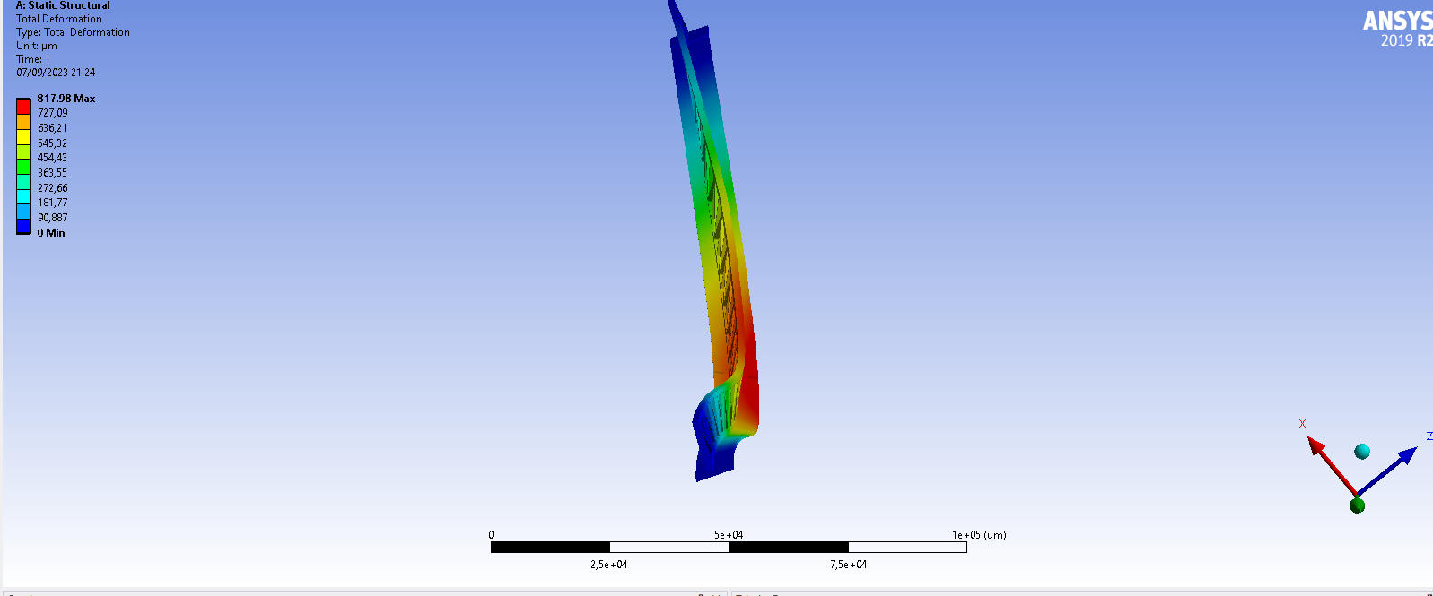
Static Simulation old Layer 3
Asimmetric structure
Torsion deformation

Slide 31
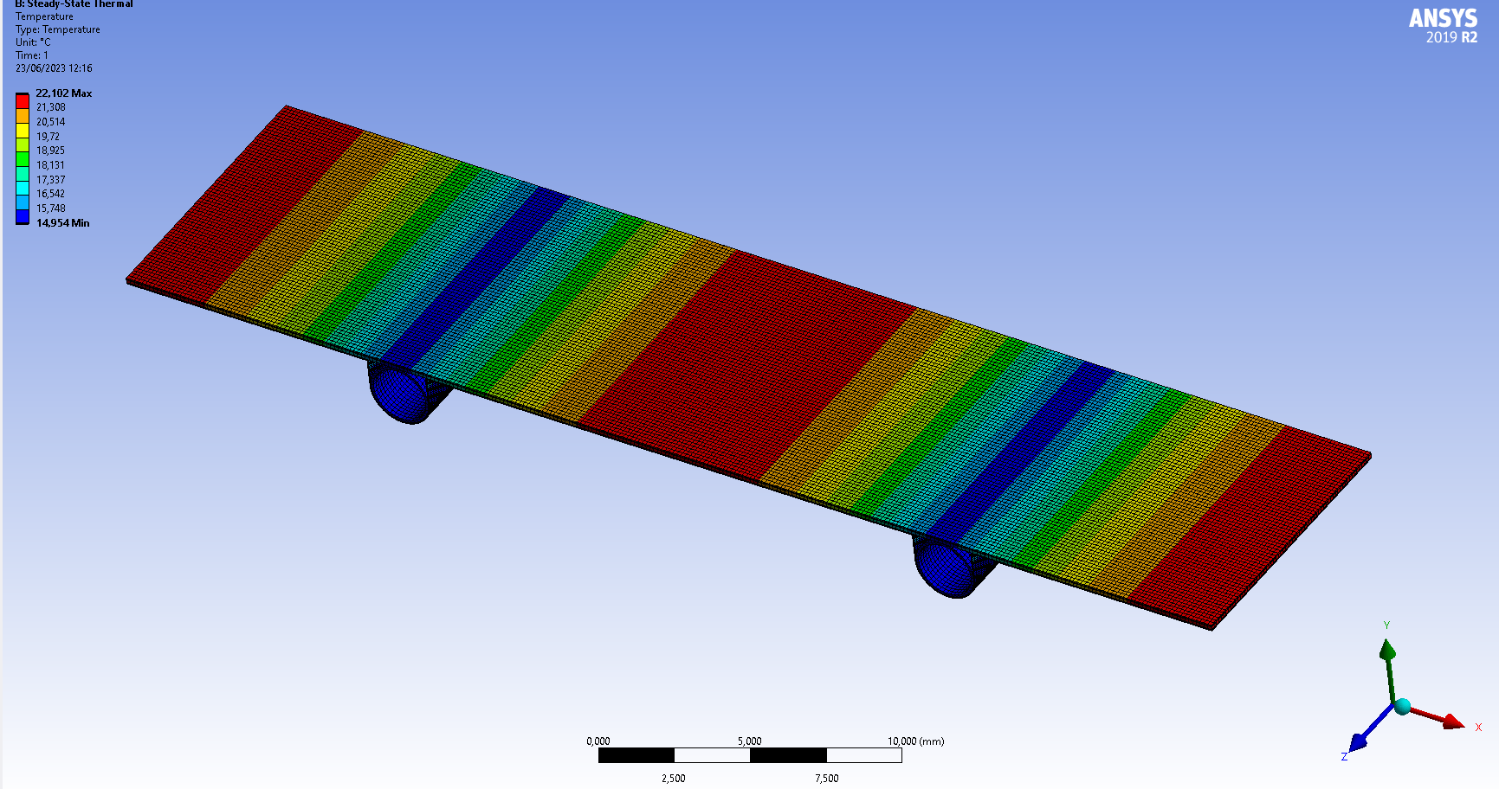
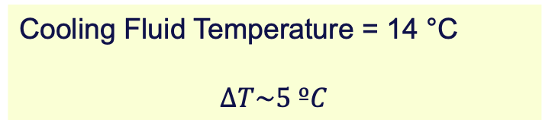
Cooling Fluid Temperature = 14 °C
$$ΔT\sim 5 ºC$$

Slide 32
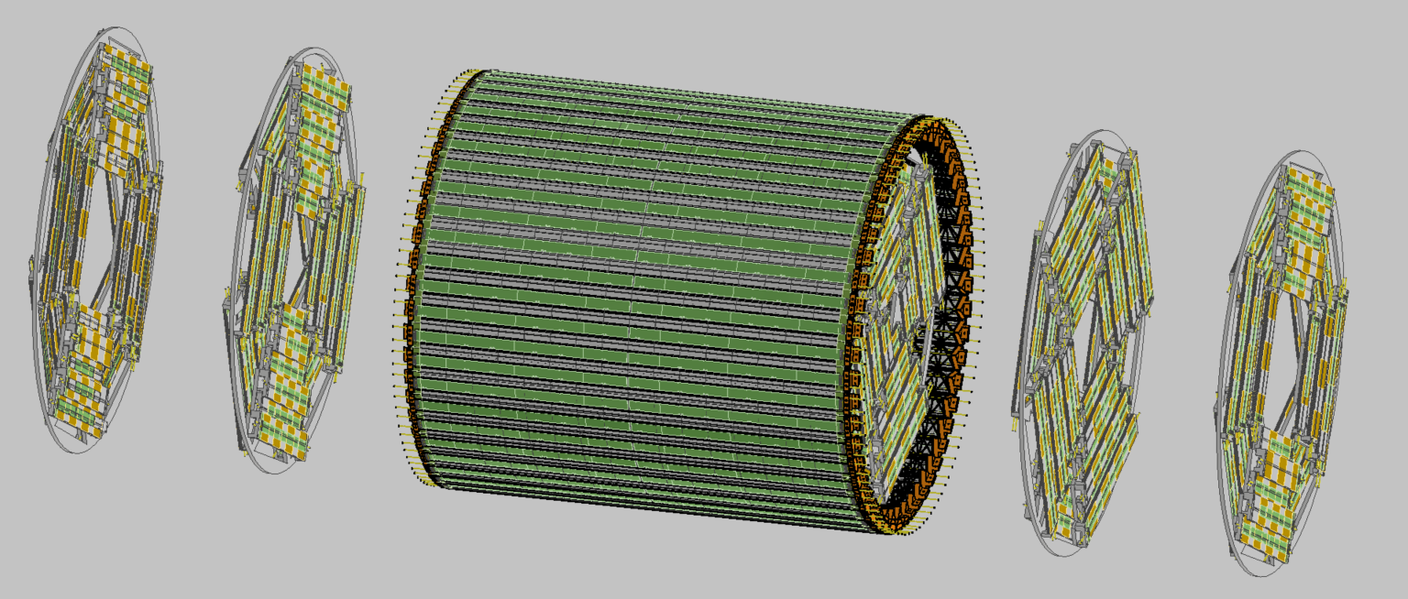

Slide 33
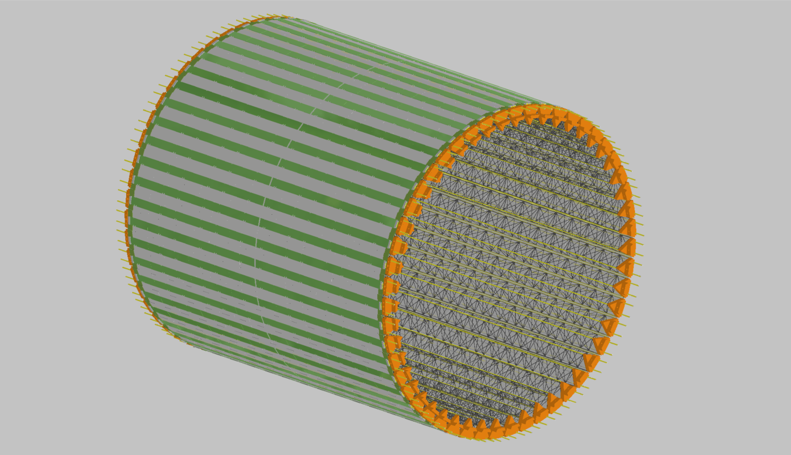
OUTER TRACKER

Slide 34
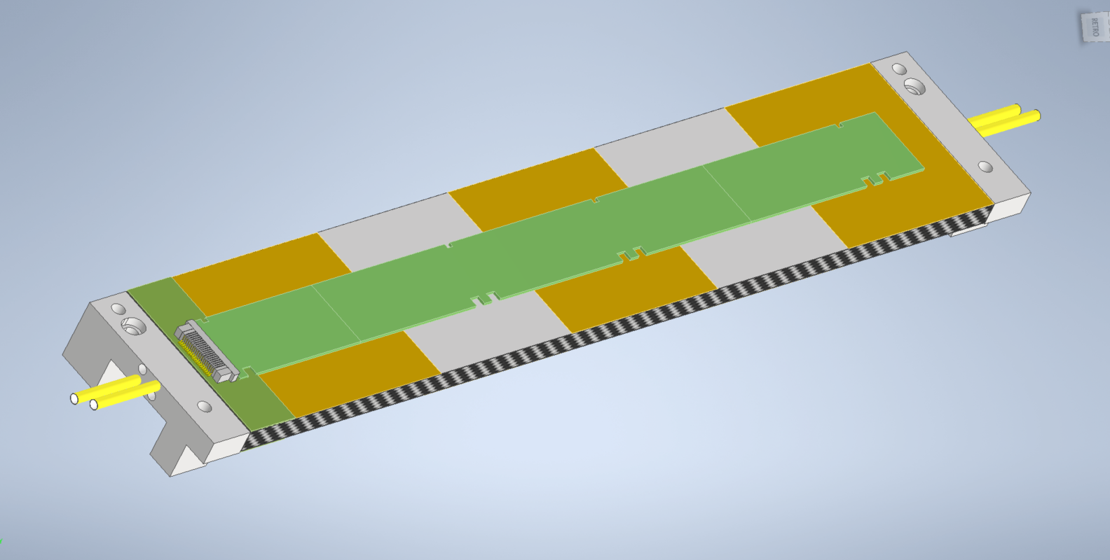
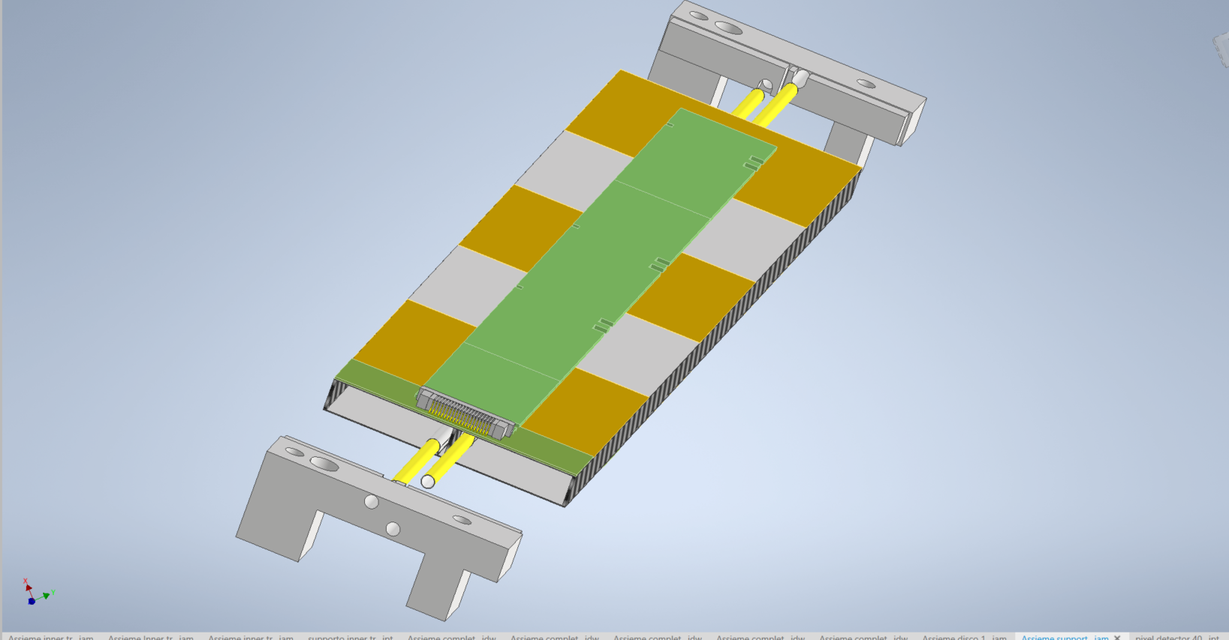

Typical disk module stave
Front
Upper modules
Electrical bus
Carbon fibre spacer
Cooling pipes
Lower modules
Carbon fibre pacers
Back

Slide 35

DISK 2

Slide 36

DISK 3

Slide 37
All Vertex

Slide 38
Inner vertex (all 3 layers)
A. Ilg

Slide 39
Middle and Outer vertex
Middle
Outer
A. Ilg

Slide 40



Inner Tracking System 3 (ALICE)
Detector Overview
  Wafer-scale sensor ASICs
  Fabricated with stitching
  All electrical signals and power
  routed on-chip
  Ultra-thin and bendable: 50 µm
  266 mm (Z) x variable width* (rφ)
  CMOS MAPS
    65 nm technology
  Open-cell carbon foam spacers
Key benefits
  Extremely lightweight
    Material budget: 0.35% X₀ => 0.05% X₀
  Uniformly distributed material
  Closer to interaction point
    Beam pipe radius: 18.2 mm => 16 mm
    Radial position: 24 mm => 18 mm
266 mm
rφ
5.6 cm
7.5 cm
9.4 cm
18 mm
open-cell carbon foam spacers
* The sensor width (rφ) varies with layer

