Slide 1
R&D on superconducting detector magnets for a future Higgs factory
Matthias Mentink on behalf of CERN EP Magnet Working Group
12/10/23

Slide 2
Introduction: CERN EP Magnet Working Group
Within CERN, EP Magnet working group comprises members from several groups within CERN EP Department
Main responsibility: Maintenance, operation, and troubleshooting of (superconducting) detector magnets, such as ATLAS, CMS, Morpurgo dipole, M1, Vertex magnets, etc.
In addition, since few years, participation in technology development for (superconducting) detector magnets through CERN EP R&D WP8
Support for superconducting detector magnet projects, such as BabyIAXO, Alice-3, AMS-100, FCC-hh, FCC-ee, Muon collider, NA60+, etc.

Slide 3
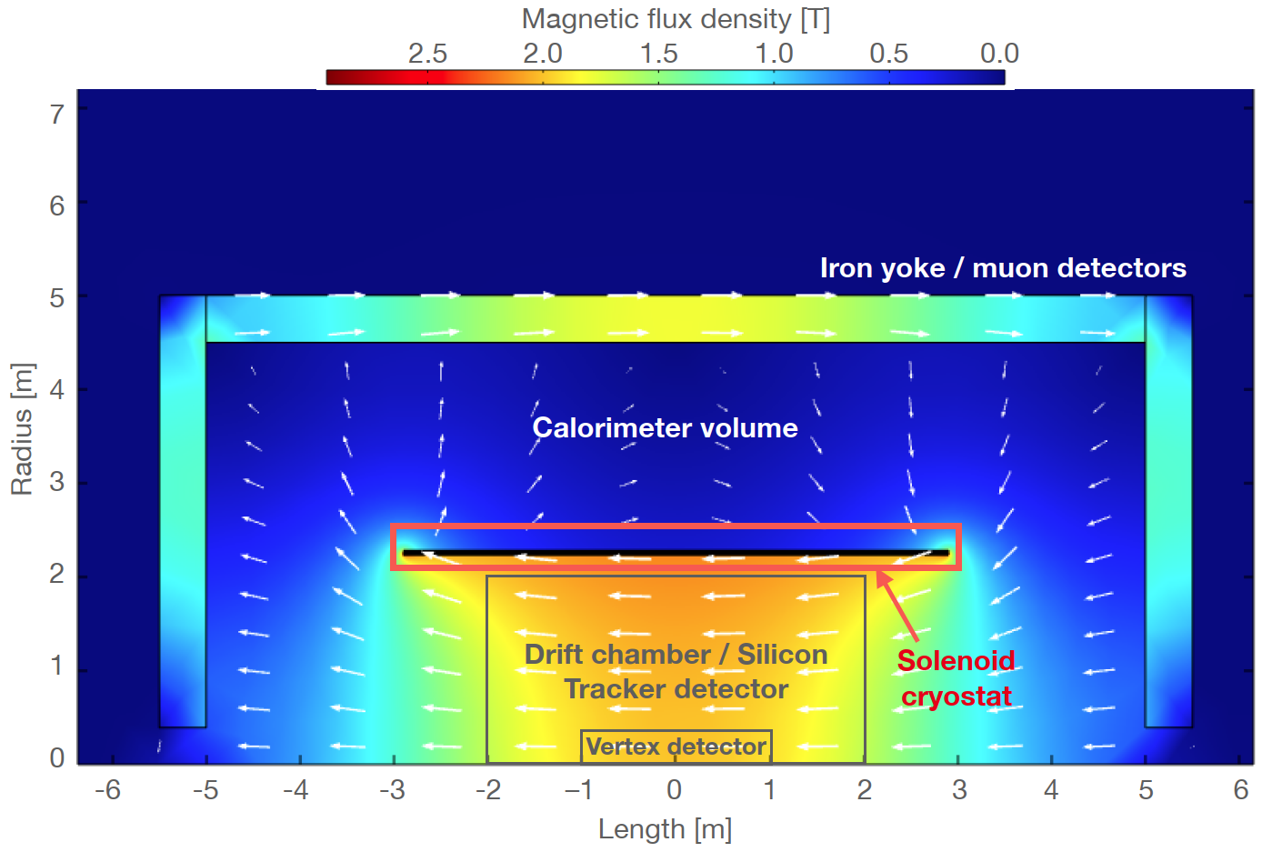
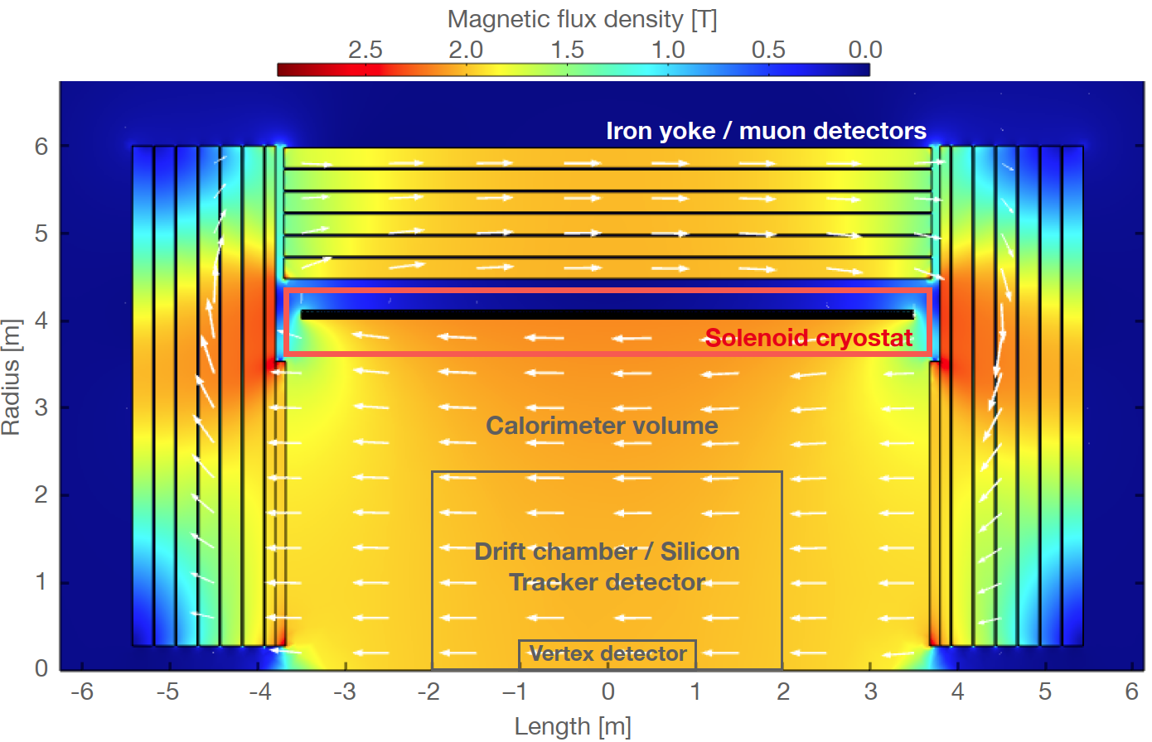
Introduction: Contributions to FCC-ee superconducting detector magnets
In recent years, conceptual design studies of superconducting detector magnets for the FCC-ee “IDEA” and “CLD” detector concepts [1-5] (not the main focus of this talk).
IDEA detector magnet: 2 T ultra-transparent solenoid, featuring full magnetic shielding through a return yoke, where particles must traverse the solenoid and vacuum vessel before reaching the calorimter
CLD detector magnet: 2 T larger solenoid inside yoke featuring partial magnetic shielding
FCC-ee IDEA concept
FCC-ee CLD concept

Slide 4
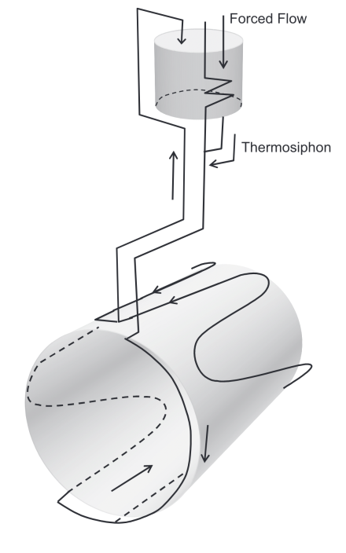
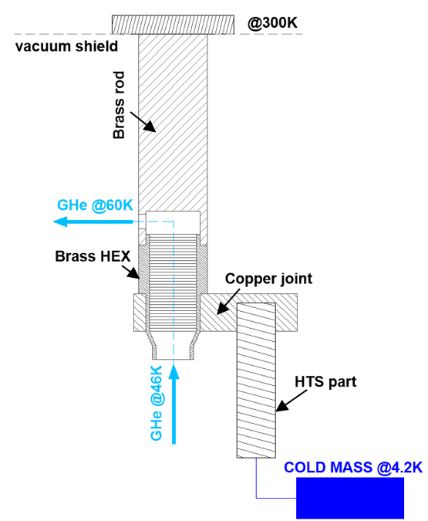
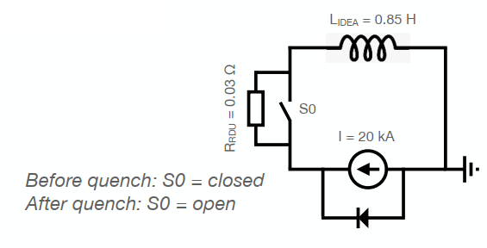
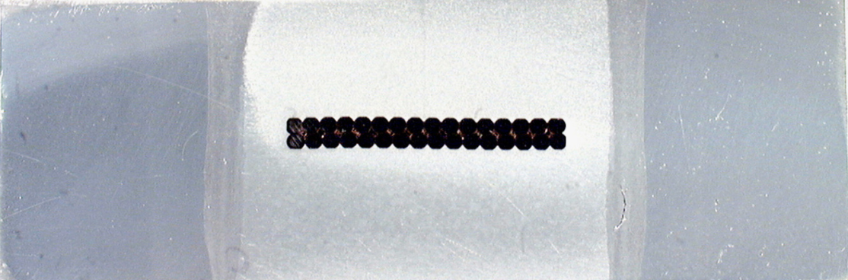
What technology developments are useful, needed, critical for future superconducting detector magnets?
Cryogenics
Quench detection and protection
Vacuum vessel technology
Conductor technology

Slide 5
“Standard” Cryogenic solution
“Standard” cryogenic solution for cooling superconducting detector magnets, including for FCC-ee
Liquid helium accumulated in control Dewar, located at elevated height, fed with liquid helium from external cryogenic plant
External cryogenic plant also provides forced-flow gaseous helium cooling at ~50 K to maintain thermal shield temperature.
Cooling lines between Control Dewar and cold mass, for circulation of mixture of liquid and gaseous helium
Gravity-powered thermosyphon circulation: Minimal losses, no pump needed, circulation keeps going even in case of power cut
Convenient, well-understood, reliable, and historically widely demonstrated solution for cooling superconducting detector magnets
Control Dewar, at elevated height
Cooling lines
Outer support cylinder of solenoid
Liquid-helium Thermosiphon of ATLAS Central Solenoid [6] (very similar to CMS)

Slide 6
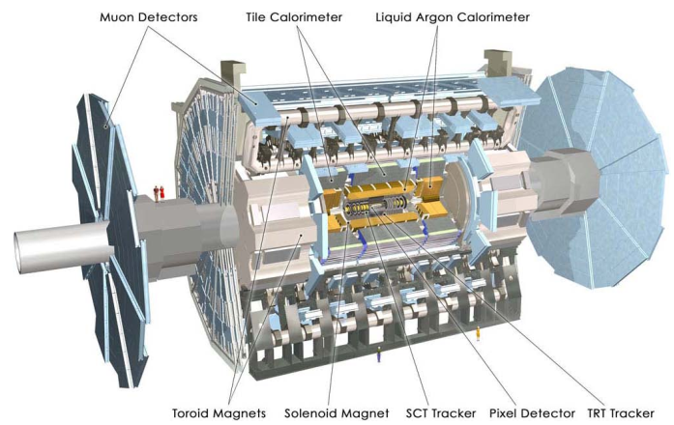
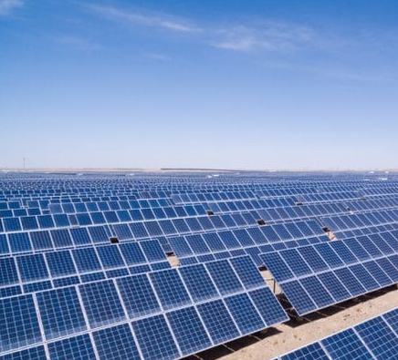
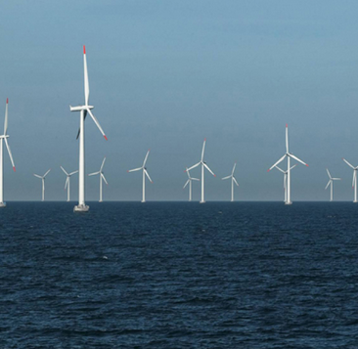
Magnet power consumption numbers (ATLAS example)
ATLAS Magnets (Comprising Central Solenoid, Barrel Toroid, 2x End-cap Toroid, cryogenic needs [7]:
2400 m² of cold mass area, 140 kA of current carried by current leads (connecting 4.5 K to room temperature)
20 kW cooling power at ~50 K for maintaining thermal shield temperature
3 kW cooling power at 4.5 K for maintaining cold mass temperature
3 kW cooling power at 4.5 K for maintaining bottom of current leads at 4.5 K
Cryogenics main power consumer at 2.9 MW (~90% of total for magnet system)
Nb-Ti-based superconducting detector magnets, energy-efficiency from a capital perspective:
Officially acknowledged ATLAS magnet cost in 2007: 159 MCHF
Typical cost of commercial solar/wind electricity production: ~1 CHF/Watt [8,9]
This implies: Capital investment to cover electricity consumption of cryogenics: ~3 MCHF, less than 2% of overall magnet cost
For large superconducting detector magnets: Expensive, despite being designed as-cheap-as-possible, and magnet power consumption looks reasonable given upfront cost.
Important to limit power consumption where possible, provided it does not substantially increase the overall cost of the magnet system
ATLAS Detector including superconducting magnets
Solar/wind power generation

Slide 7
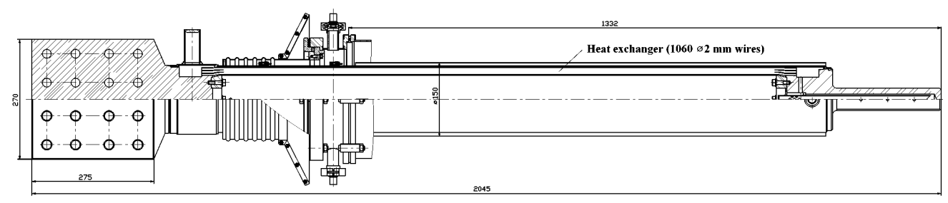
Novel cryogenic technology development: HTS-based current leads
Conventional current leads for superconducting detector magnets:
Current leads: Needed to connect magnets at 4.5 K to room-temperature power converters
Conventional solution [10]: Liquid helium evaporates inside cooling leads to provide cooling power → About third of total magnet power consumption dedicated to maintaining current lead temperature
Novel solution, similar to what was applied in LHC [11]:
  >99% of current lead heat load intercepted at ~50 K
  4.5 K to 50 K section comprises stainless steel shunted with high-temperature superconducting tapes
  Resulting in minimal heat load at 4.5 K
Expectation with novel solution: 10x reduction in power consumption needed for maintaining the current lead temperature → Currently under investigation, in context of CERN EP R&D WP8
ATLAS Toroid current leads [5]
Concept of an HTS-based current lead
(Courtesy W. Gluchowska)

Slide 8
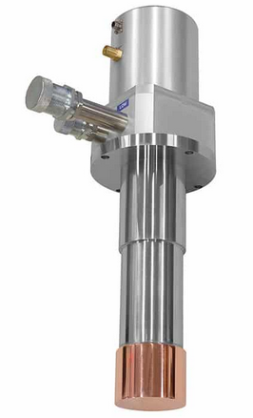
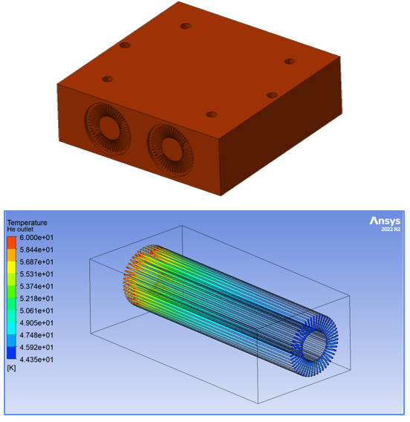
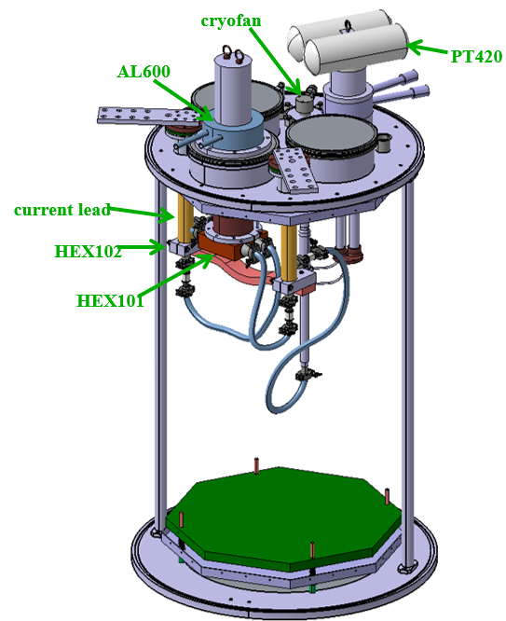
Novel cryogenic technology development: Cryocoolers for superconducting detector magnets
Conventional cryogenic plant:
Relatively high efficiency, in terms of cooling power at 4.5 K vs electricity consumption at 300 K
Large installation, featuring long transfer lines (adds to heat load and relatively large amount of helium needed)
Cryo-coolers:
Currently, modest cooling power and lower cryogenic efficiency compared to large plants, although higher-efficiency commercially available cryocoolers are expected this year and the next
Compact and modular, contributing to enhanced reliability and redundancy
Low-maintenance, closed-circuit without liquid helium → Only modest amount of helium needed, important given future helium availability constraints and rising price of helium
Allows for localized liquefaction (less overall heat load), and compatible with thermosiphon cooling
Localized helium gas circulation for thermal-shield cooling
Currently under development in context of CERN EP R&D:
Cryocooler-to-helium heat exchangers, local helium liquefaction + thermosyphon, HTS-based current leads, demonstrator setup
Part of the BabyIAXO magnet design
~500 mm
Example of a commercially-available cryo-cooler cold-head, to be connected to an external compressor [12,13]
Cryo-cooler-to-helium-gas heat exchanger, under development in context of CERN EP R&D WP8
(Courtesy W. Gluchowska)
Demonstrator setup, featuring cryo-coolers, cryofan, heat exchangers, HTS-based current leads (CERN EP WP8, Courtesy W. Gluchowska)

Slide 9
Quench detection and protection
Quench detection and protection of conventional aluminum-stabilized Nb-Ti superconducting detector magnets:
Quench detection through continuous redundant voltage measurements and inductive balancing
Quench protection through energy extraction (i.e. external dump resistor) or quench heaters
Well-understood and works well
Quench detection and protection of future High-Temperature-Superconductor-based superconducting detector magnets:
More challenging detection, as quench propagation velocity is very low
More challenging protection, given that inducing a large normal-zone throughout the cold mass is extremely difficult
Nevertheless, concepts do exist to tackle both quench detection and protection, suitable for both Low and High-Temperature Superconductor for example [14] → Under investigation in CERN EP R&D WP8 through demonstration with demonstrator coil
→ For conventional aluminum-stabilized Nb-Ti superconducting detector magnets, quench detection and protection is available and well-understood
Quench protection of superconducting detector magnet for FCC-ee IDEA concept [1]

Slide 10
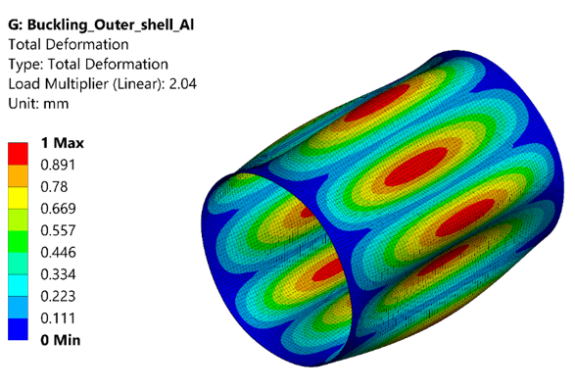
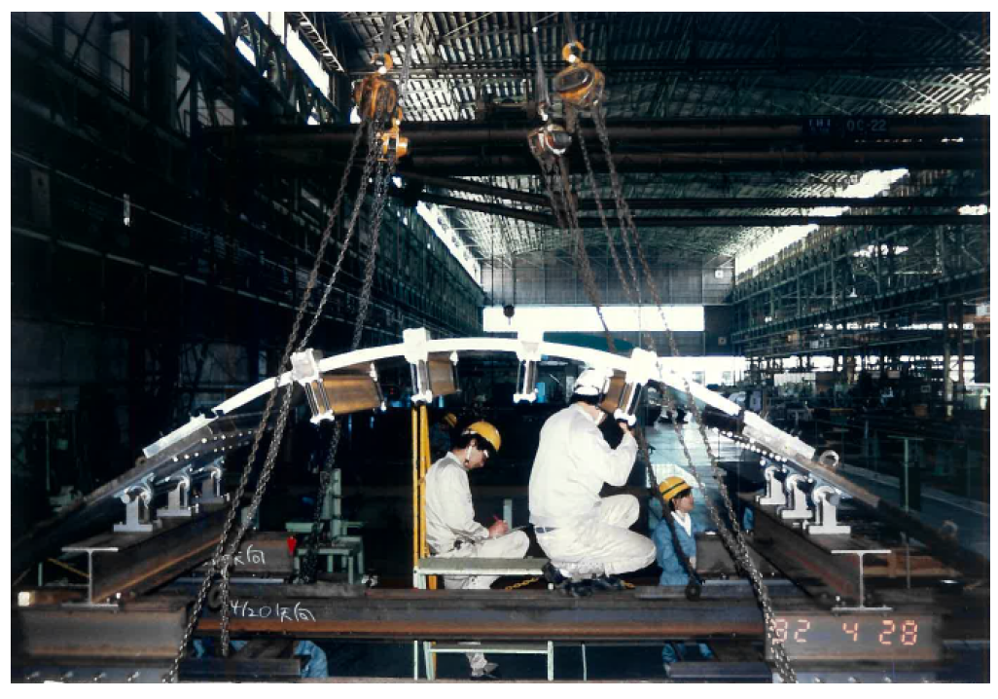
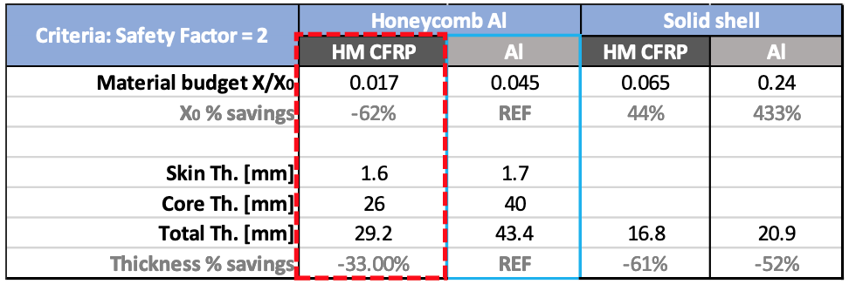
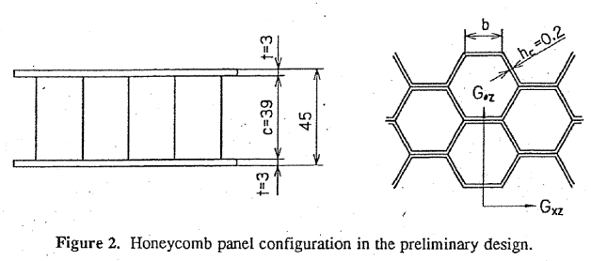
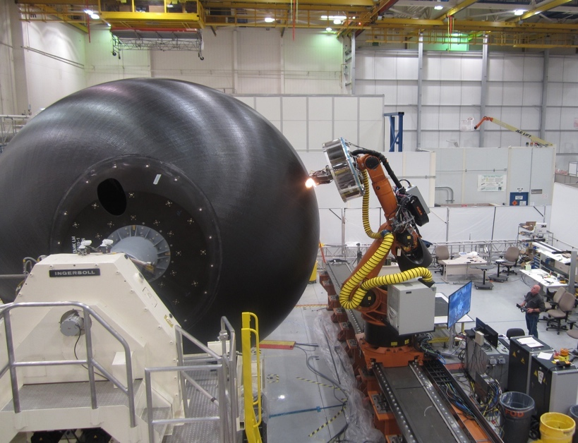
Ultra-transparent vacuum vessel technology
Of interest for ultra-transparent magnets (such as for FCC-ee IDEA detector): Ultra-transparent vacuum vessel
Solenoid for IDEA concept: Particles must traverse solenoid before reaching calorimeter → Transparent cold mass and vacuum vessel needed.
Major challenge: Outer vacuum vessel wall, exposed to bucking
For highest transparency:
  Smart structures such as honey-combs, to increase effective thickness and resilience against buckling
  Smart materials, such as carbon-based materials
Under investigation in context of CERN EP R&D Work-package 4
Transparency comparison of different materials for FCC-ee IDEA Solenoid (Courtesy M. Barba [15])
Aluminum-based honey-comb vacuum-vessel technology, as demonstrated previously at KEK (Courtesy A. Yamamoto)
Out-of-autoclave process (Courtesy M. Barba [15])

Slide 11
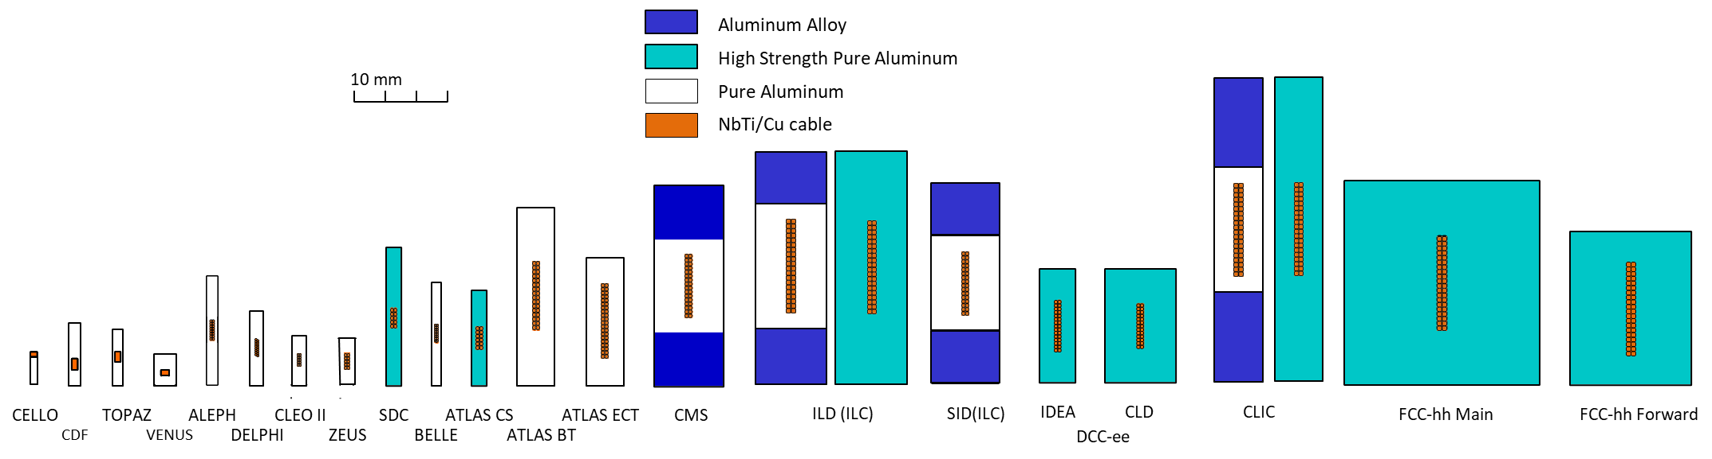
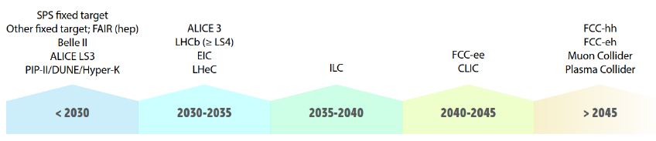
Critical need for future superconducting detector magnets: Conductor (1/3)
Superconducting detector magnets require unique conductor technology, owing to their very large stored magnetic energy
Historically proven solution: Aluminum-stabilized niobium-titanium conductor
  Superconducting Nb-Ti carries current during nominal operation, and aluminum provides stability and mechanical reinforcement and temporarily carries current in case of a quench
  Aluminum stabilization: Cost-effective, robust, well-understood and proven over 50 years, with excellent thermal, electrical, and (in case of aluminum-alloy) mechanical properties for a given weight
  Niobium-titanium superconductor: Most widely used superconductor, cheap, widely available, comfortably allows up to ~4-5 T (covers most detector needs), mechanically extremely resilient compared to other superconductors
Nb-Ti Rutherford cable
64 mm
High-purity aluminum
Aluminum-alloy reinforcement
21.6 mm
Cross-section of the CMS conductor
Courtesy: The CMS collaboration
Aluminum-stabilized Nb-Ti conductors over 100 years
(Courtesy A. Yamamoto [16])
Present
1978
2023
~2060
Future proposed particle physics experiments being studied: from LDG Accelerator R&D Report, CERN 2022-001

Slide 12
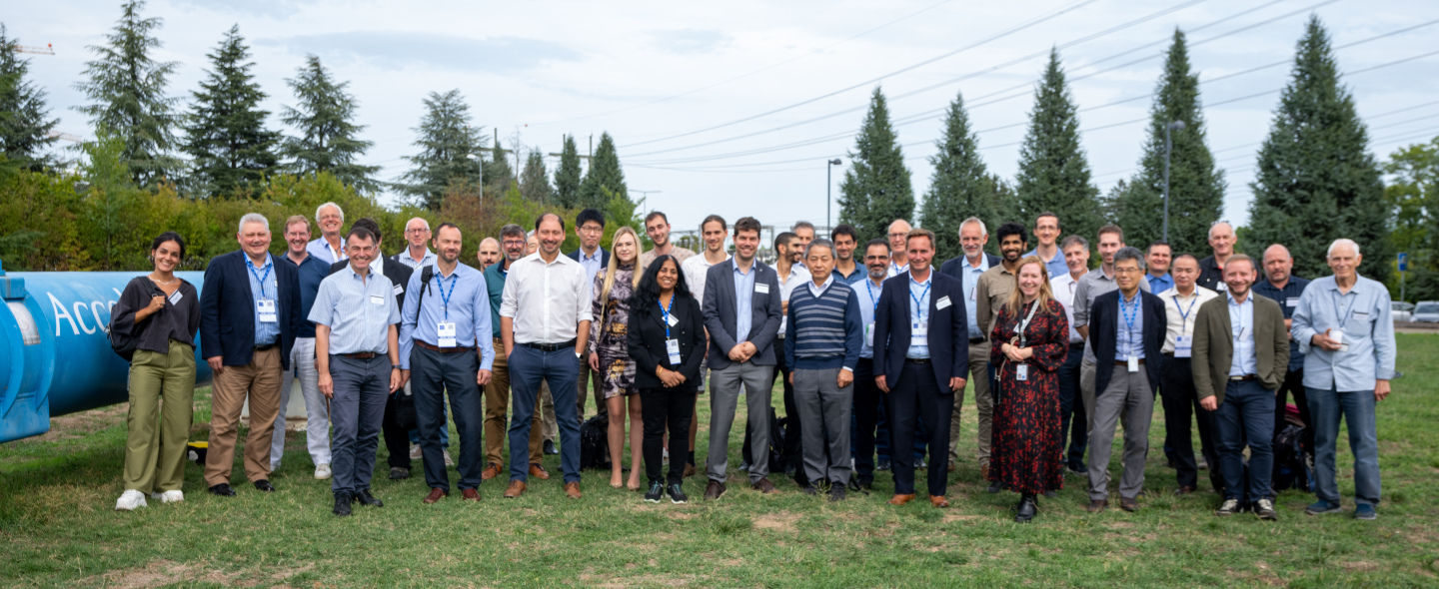
Critical need for future superconducting detector magnets: Conductor (2/3)
Superconducting Detector Magnet Workshop (2022, co-organized by CERN and KEK):
  Aluminum-stabilized conductor was a topic of key interest
  Workshop included world-wide representatives from institutes and industry
  Findings: On-going R&D effort at IHEP with Chinese industry, but no commercial availability since a few years
Following this: Since 2023, organization of inter-departmental working group and associated steering committee at CERN supported by KEK expertise, for the purpose of re-establishing availability in context of CERN EP R&D
Plans [17]:
  Currently on-going: Effort to collaborate with industry using existing facilities on re-establishing conductor technology, which includes co-extrusion process and cold-working facility
  Future options, depending on budget availability: Setup of a dedicated facility in industry or at institute
Superconducting Detector Magnet Workshop, held at CERN in 2022 (indico.cern.ch/event/sdmw)
Co-extrusion process needed for aluminum-stabilized Nb-Ti conductor production
(Courtesy B. Cure [17])

Slide 13
Critical need for future superconducting detector magnets: Conductor (3/3)
Some possible conductor long-term alternatives (not exhaustive):
Aluminum-stabilized niobium-titanium:
  Proven over 50 years, affordable, well-understood, with sufficient magnetic field range to cover typical superconducting detector magnets, mechanically extremely resilient
  Requires low temperature operation (5 K), and currently not commercially available
  On-going effort to re-establish availability through CERN EP R&D WP8
Aluminum-stabilized Magnesium-diboride:
  Of interest for superconducting busbars and magnets
  Demonstrated for superconducting busbars, through LHC Hi-lumi superconducting link project
  Would allow operation at elevated temperatures (10-20 K), albeit with limited magnetic field range
  Likely more expensive than niobium-titanium, and requires development
  On-going effort at INFN Genoa to investigate feasibility for proposed Alice-3 solenoid
Aluminum-stabilized high-temperature superconducting (HTS) conductor (ReBCO / Bi-2223)
  Of interest for superconducting busbars and magnets
  Would allow operation over wide temperature range (4-77 K) and wide magnetic field range, significantly beyond the limits of niobium-titanium
  Likely more expensive than niobium-titanium, and requires development
  On-going effort within CERN EP R&D WP8 to fabricate short-length prototype conductors

Slide 14
Summary: R&D of superconducting detector magnet technologies for future Higgs factory
Cryogenics
  Existing cryogenic solutions work well, although helium price and availability is a concern
  Investigations within context of CERN EP R&D WP8:
    Cryo-coolers and associated technologies
    HTS-based high-efficiency current-leads to reduce cryogenic power requirement for superconducting detector magnets
Quench detection and protection
  Existing technology works well for conventional superconducting detector magnets
  Within context of EP R&D WP8: Novel method for quench detection and protection for both low- and high-temperature superconducting magnets under investigation
Ultra-transparent vacuum vessel technology:
  Effort within EP R&D WP4 to optimize transparency through smart geometries (such as honey-comb structure) and novel materials (carbon-based vacuum-vessel wall)
Conductor technology for superconducting detector magnets
  Commercial availability of work-horse aluminum-stabilized Nb-Ti conductor has been an issue in recent years, therefore an inter-departmental effort at CERN with KEK support was organized to see how availability may be re-established
  Other conductor types may be of interest as well, although there are presently no obvious fully developed, just-as-good, and commercially-available candidates (that I know of)

Slide 15
References
[1] Deelen, Dudarev, Cure, Mentink, “Design and Quench Analysis of Superconducting Solenoids for the Lepton Future Circular Collider”, IEEE Transactions on Applied Superconductivity 32, 4100204 (2022)
[2] Mentink, Sasaki, Cure, Deelen, Dudarev, Abe, Iio, Makida, Okamura, Ogitsu, Sumi, Yamamoto, Yoshida, Iinuma, “Superconducting detector magnets for high energy physics”, Journal of Instrumentation 18, (2023)
[3] Deelen, Cure, Dudarev, Mentink, Vaskuri, “High Temperature Superconductor Magnets for Future Particle Physics Experiments”, presented at ASC2022 (2022)
[4] Deelen, Dudarev, Cure, Mentink, “Superconducting Solenoids for the IDEA and CLD Detector Concepts”, presented at the 5th FCC Physics Workshop (2022)
[5] Deelen, Cure, Dudarev, Mentink, “Designing Superconducting Solenoids for FCC-ee”, presented at the Lar Calorimeter workshop (2022)
[6] Yamamoto, Kondo, Doi, Makida, Tanaka, Haruyama, Yamaok,a “Design and Development of the ATLAS Central Solenoid Magnet”, IEEE Trans. On Appl. Supercond. 9, p. 852 (1999)
[7] Ten Kate, “ATLAS Superconducting Toroids, the Largest Ever Built”, Int. J. Mod. Phys. A, p. 2933 (2010)
[8]. https://coldwellsolar.com/commercial-solar-blog/how-much-investment-do-you-need-for-a-solar-farm/
[9]. https://www.energy.gov/eere/wind/articles/land-based-wind-market-report-2022-edition
[10]. Dudarev, Ten Kate, Boxman, Keilin, Kopeikin, Kovalev, Kuljamzin, Romanovskii, Shcherbakov, Shugaev, Stepanov, “20.5 kA Current Leads for ATLAS Barrel Toroid Superconducting Mangets”, IEEE Trans. On Appl. Supercond. 12, p. 1289 (2002)
[11]. Ballarino, “Current Leads for the LHC Magnet System”, IEEE Trans. On Appl. Supercond. 1275 (2002)
[12]. https://absolut-system.com/cryogenics/cryocooler/
[13]. https://www.shi.co.jp/english/products/machinery/cold/index.html
[14]. Mentink, Dudarev, Mulder, Nugteren, ten Kate, “Quench Protection of Very Large, 50-GJ-Class, and High-Temperature-Superconductor-Based Detector Magnets”, IEEE Transactions on Applied Superconductivity (2015)
[15]. Barba, Chalifour, Bremer, Soledad Molina, Gargiulo, Angeletti, Aleksa, “R&D on light-weight cryostats and on high-density signal feedthroughs”, 4th FCC Physics and Experiments Workshop (2020)
[16]. Yamamoto, “Superconducting Technology for Future Colliders and Detectors”, Muon Collider Workshop, October 2023
[17]. Cure, “Status and plans of aluminium stabilized conductor R&D at CERN for detector magnets”, Muon Collider Workshop, October 2023

