Slide 1
High-Z performance
Rui Qiao

Slide 2
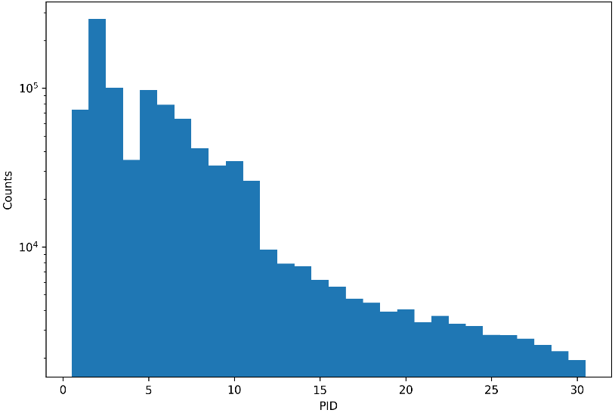
Background
Joint particle identification from the large PMO-SCD (~100cm², Z=1~6) & small PD (~0.8cm², Z>6)
The statistics of PID
Notes:
G:\keyan\科研任务\221114_HERD束流测试\png\符合PID\PMO+PD与IHEP_SCD1符合\与Joint符合后的PID统计性_IHEP_SCD1.png

Slide 3
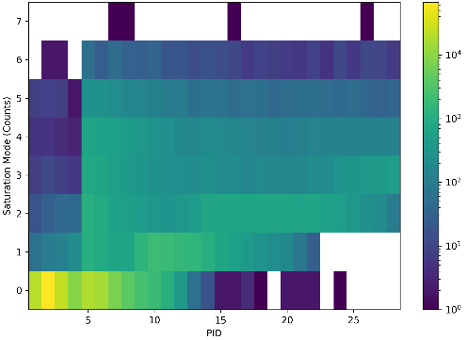
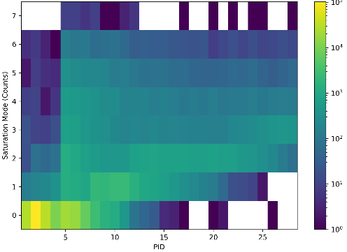
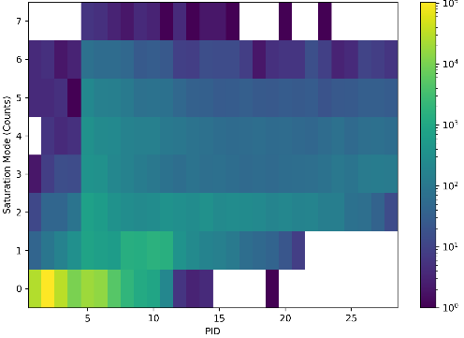
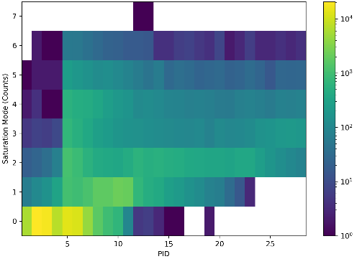
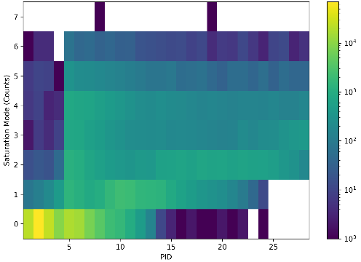
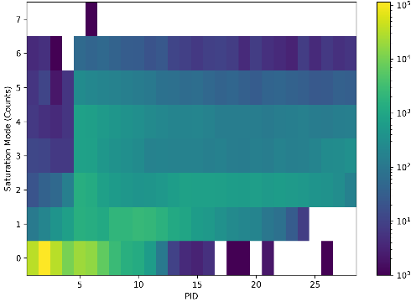
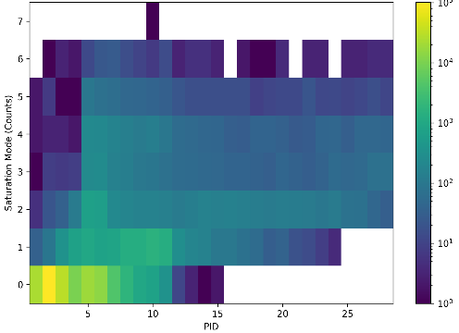
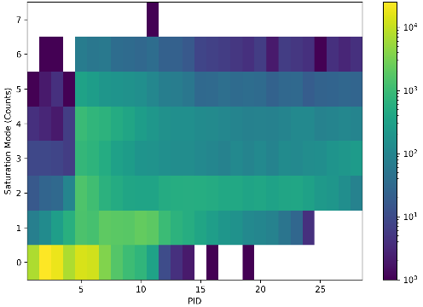
The counts of saturation channels (Y) vs PID(X)
60um-20pF
60um-47pF
60um-68pF
60um-100pF
25um-20pF
25um-47pF
25um-68pF
25um-100pF
Notes:
G:\keyan\科研任务\221114_HERD束流测试\ana_result\20230214_初探重核响应\饱和模式\

Slide 4
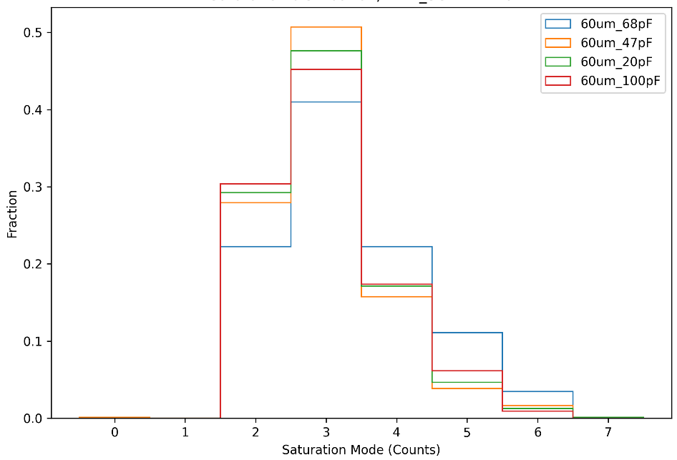
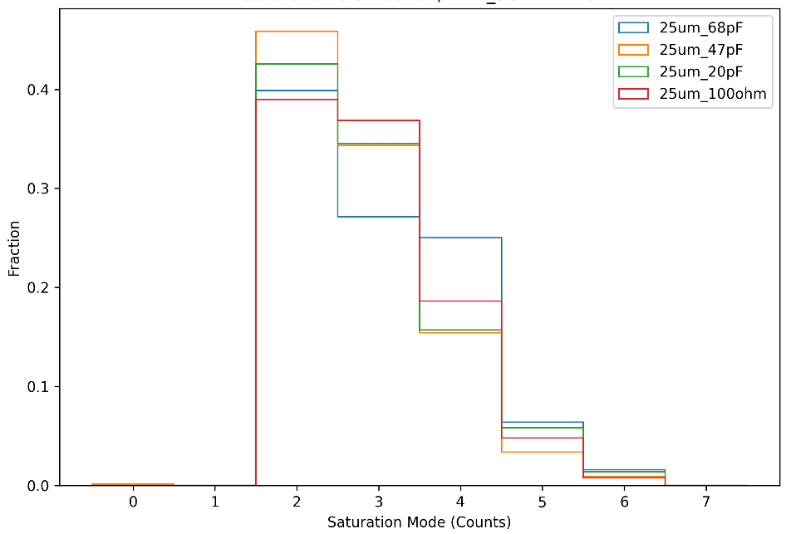
The distribution of counts of saturation channels, Z=26
60um width, with 4 different capacitances
25um width, with 4 different capacitances
The 25um width detector has less saturation channels.
No single channel saturation. This is not predicted!
Notes:
G:\keyan\科研任务\221114_HERD束流测试\ana_result\20230214_初探重核响应\饱和模式\

Slide 5
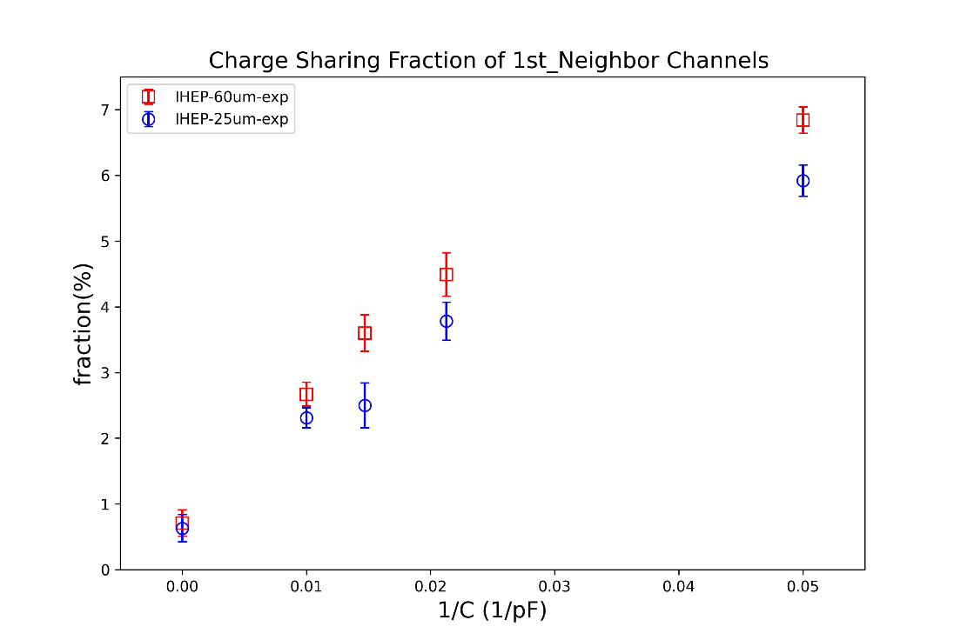
The charge sharing ratios
Z=28 generates 3600fC in 300um detector.
VA saturation thr=200fC。
The charge sharing ratio of 47/68/100pF is less than 5%.
3600fC*5%=200fC，single saturation
3600 fC
The charge sharing ratios of readout strip incidence
By Ruo-Si Lu
200 fC
200 fC
VA
saturation
thr

Slide 6
Conclusion
Higher-Z leads to more saturation
For Z=26, 25um detector is more likely to has 2 saturation channels, while 60um detector is more likely to has 3 saturation channels.
This saturation is un-expected from the charge sharing ratios calibrated with light ions.

