Slide 1
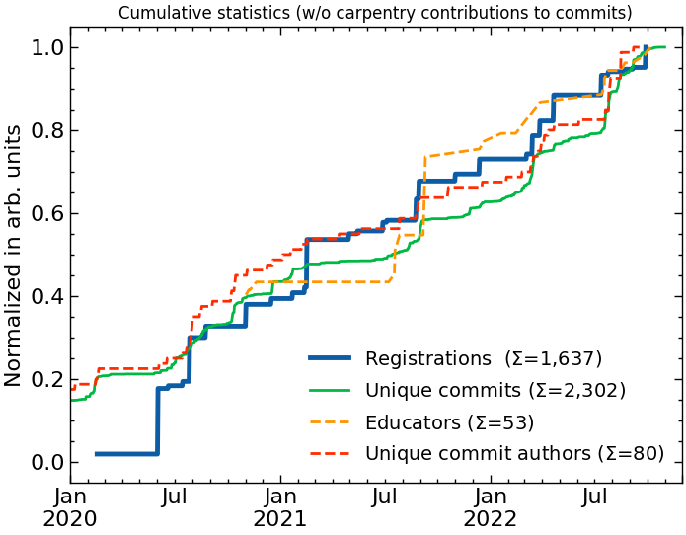
Training – Points for Discussion (learned from HEP: HSF IRIS-HEP training)
What skills to students have on arrival?
Python
What basic skills are needed?
C++, git, machine learning, containers $←$ shared
Experiment framework, preservation $←$ specific
More advanced topics (for who?)
Geant4, ROOT, etc.
GPUs (heterogeneous), efficient coding
Sustainable training
Reusable materials, also suitable for self study
In person training or remote?
Remote is cheap, but less effective
Schools are intense and effective, limited throughput
Evolution from students to mentors to trainers
Building a training community – across fields?
Rewarding efforts in training is critical

